Slide 1
Evaluating NOAA-20 and S-NPP VIIRS Radiometric Consistency
Sirish Uprety and Changyong Cao
With contributions from
Wenhui Wang, Slawomir Blonski and Xi Shao
GSICS Annual Meeting
March 06, 2019
Frascati, Italy

Slide 2
Background
After successful launch of NOAA-20 in Nov. 18, 2017, VIIRS has gone through extensive calibration and validation.
To ensure the calibration quality is well within specification, VIIRS radiometric performance needs to be continuously monitored and independently validated.
This study evaluates the radiometric consistency of operational NOAA-20 and S-NPP VIIRS by comparing nadir reflectance using:
SNO over polar region
SNPP bias relative to MODIS
N20 bias relative to MODIS
Bias between SNPP and N20: Double differencing
Extended SNO (SNOx) over desert and ocean
SNOx extended over African desert and tropical ocean
Bias between SNPP and N20: Double differencing (similar to SNO)
PICS (such as Libya 4)
NOAA-20 and SNPP VIIRS are compared with Landsat OLI
Deep Convective Cloud (DCC)

Slide 3
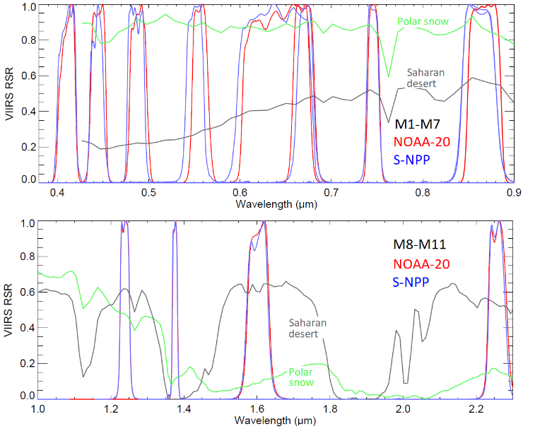
VIIRS Spectral Bands (RSB)
11 moderate bands (0.412-2.25 μm), 3 imagery bands, 1 Day/Night band (DNB)
VIIRS |  | MODIS
Band | Wavelength (µm) | Band | Wavelength (µm)
M1 | 0.402 - 0.422 | 8 | 0.405 - 0.420
M2 | 0.436 - 0.454 | 9 | 0.438 - 0.448
M3 | 0.478 - 0.498 | 10 | 0.483 - 0.493
M4 | 0.545 - 0.565 | 4 | 0.545 - 0.565
M5 I1 | 0.662 - 0.682 0.600 - 0.680 | 1 | 0.620 - 0.670
M7 I2 | 0.846 - 0.885 0.850 – 0.880 | 2 | 0.841 - 0.876
M8 | 1.230 - 1.250 | 5 | 1.230 - 1.250
M10 | 1.580 - 1.640 | 6 | 1.628 - 1.652
M11 | 2.225 - 2.275 | 7 | 2.105 - 2.155

Slide 4
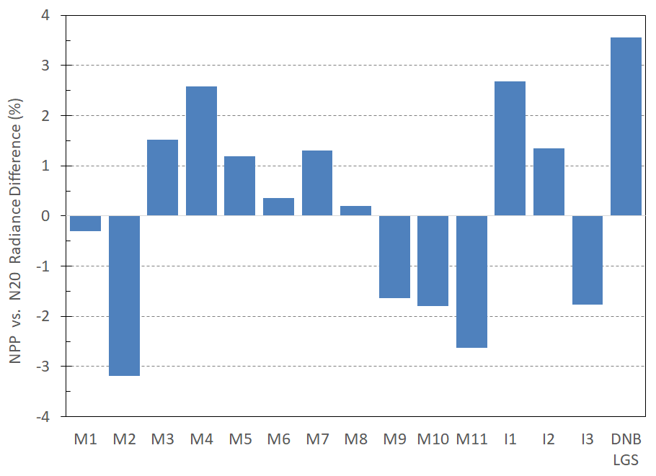
Radiance and Reflectance Comparison
NOAA-20 and S-NPP VIIRS uses different solar models
S-NPP uses Kurucz spectrum (MODTRAN 4.0)
NOAA-20 uses Thuillier solar model.
Comparing radiance can result in bias due to differences in solar irradiance model.
Figure indicates bias for most of the bands; M2 suggests large bias of more than 3%.
This study compares VIIIRS reflectance products which is independent of solar model.

Slide 5
NOAA-20 Spectral Bias Relative to S-NPP
SNPP and N20 RSRs are not identical and can have minor differences.
Results in spectral bias
Spectral Band Adjustment factors (SBAF) used based on Sciamachy
Ref: NASA Langley tool (https://www-pm.larc.nasa.gov/cgi-bin/site/showdoc?mnemonic=SBAF)
Spectral bias for all bands are on the order of 1% or less except M4 (desert: ~3.2%).
Spectral Bias= (N20 - SNPP)×100%/SNPP
Target | M1 | M2 | M3 | M4 | M5 | M7 | M8 | M10 | I1 | I2
South Pole | 0.3% | 0.1% | 0.1% | -0.8% | 0.2% | -0.4% | 0.0% | 0.5% | 0.3% | -0.4%
DCC | 0.0% | 0.7% | 0.2% | -0.4% | 0.0% | -0.4% | -0.1% | 0.7% | 0.2% | -0.4%
Libyan Desert | -1.1% | 0.0% | 0.1% | 3.2% | 0.3% | 1.0% | 0.1% | 0.2% | 1.5% | 0.8%

Slide 6
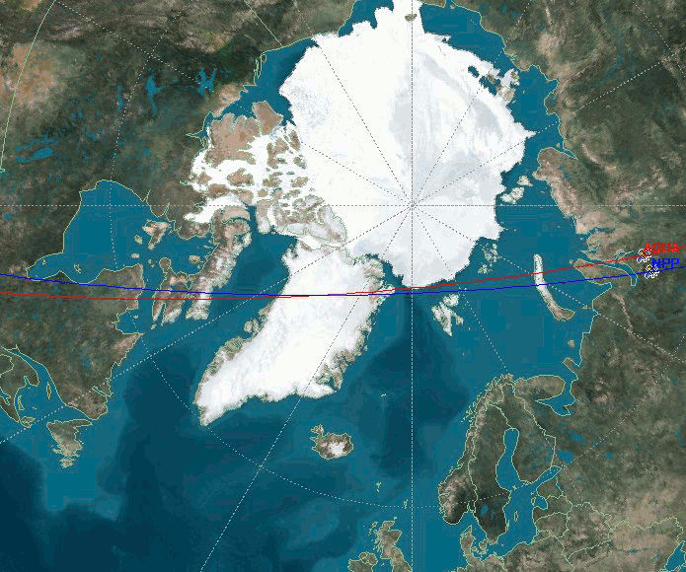
Evaluating NOAA-20 and S-NPP Consistency using Polar SNOs
Both NOAA-20 and SNPP have SNOs with AQUA.
Study uses SNOs from both SH and NH.
Near identical solar and sensor geometry for both sensors.
Double differencing shows the radiometric consistency between SNPP and NOAA-20 VIIRS.
VIIRS operational data and AQUA MODIS C6 is used in comparison.
SNO

Slide 7
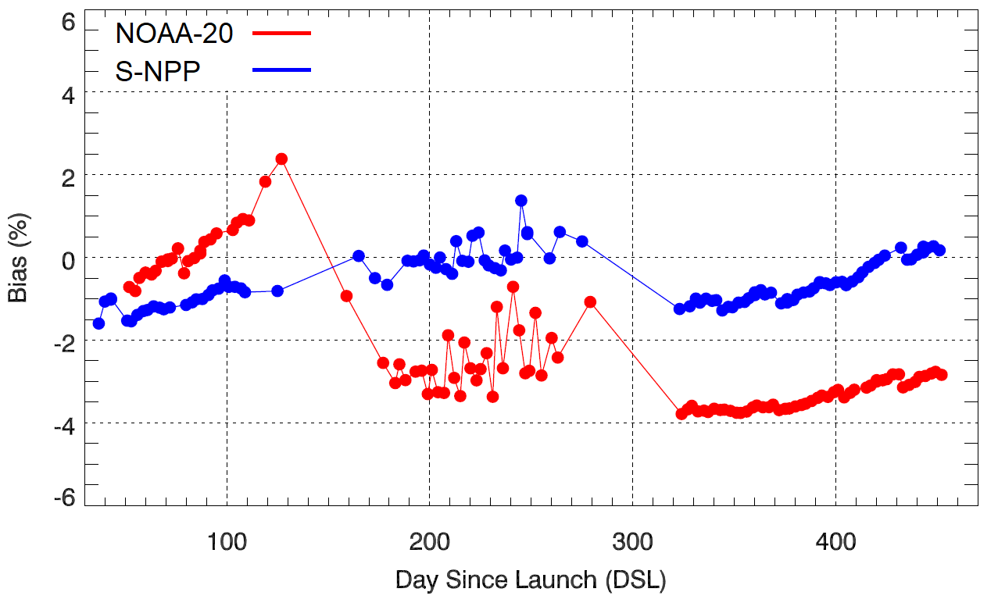
NOAA-20 VIIRS M1 Bias (Polar SNO)
M1
NOAA-20 Drop: H-factor update
Red: N20 Bias relative to MODIS
Bias= (V-M)*100%/M
Blue: SNPP Bias relative to MODIS
Radiometric consistency between N20 and SNPP
N20 Bias: ~-3%
Bias trends changing over time.
After H-factor update (March 23, 2018), NOAA-20 is lower than S-NPP by ~-2.7%

Slide 8
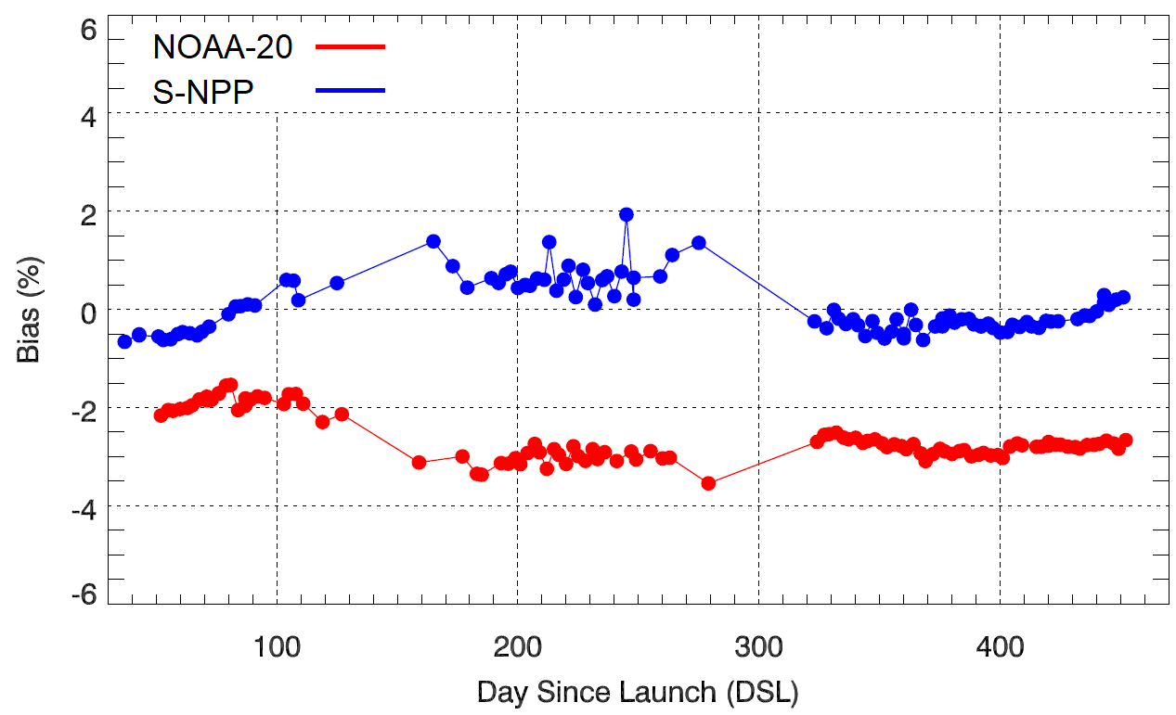
NOAA-20 VIIRS M4 Bias (Polar SNO)
M4
N20 Bias: ~-3%
NOAA-20 reflectance lower than S-NPP by ~3%

Slide 9
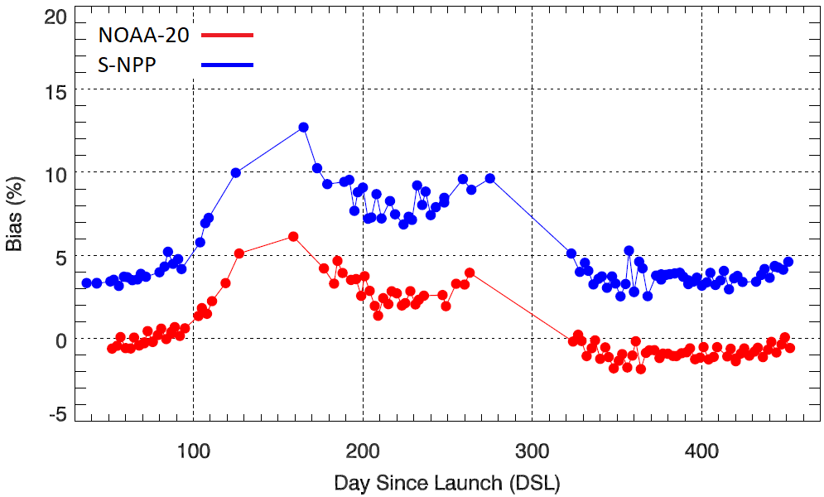
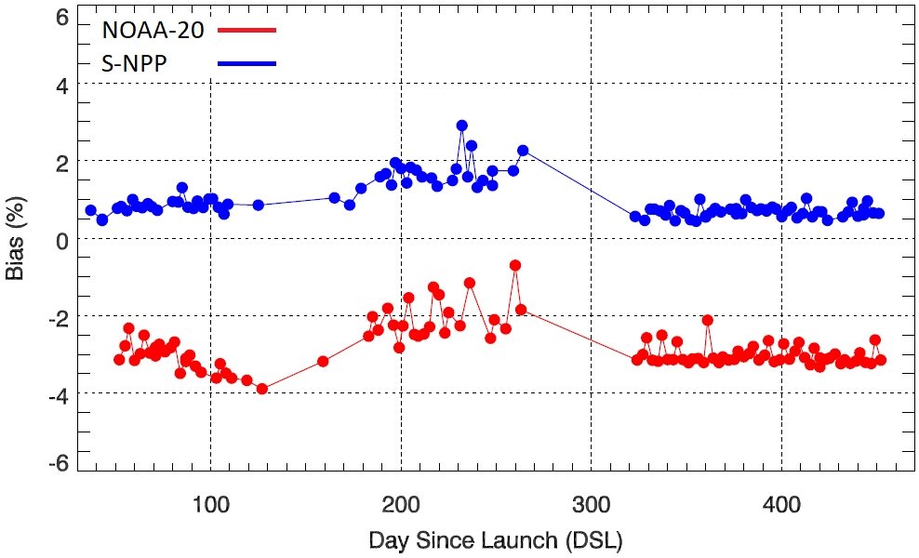
NOAA-20 VIIRS M5 and M7 Bias (Polar SNO)
M5
M7
N20 Bias: -5%
N20 Bias: -3.5%
Large bias exists for M5 (-5.5%) and M7 (-3.5%) because S-NPP VIIRS M5 and M7 calibration are biased high by ~2%.
9

Slide 10
NOAA-20 VIIRS I1 and I2 Bias (Polar SNO)
I1
I2
N20 Bias: ~-2.5%
N20 Bias: ~-3.7%
I1 bias is low (-2.5%) compared to I2 (-3.7%)
I2 and M7 have similar RSRs and their bias agree very well.

Slide 11
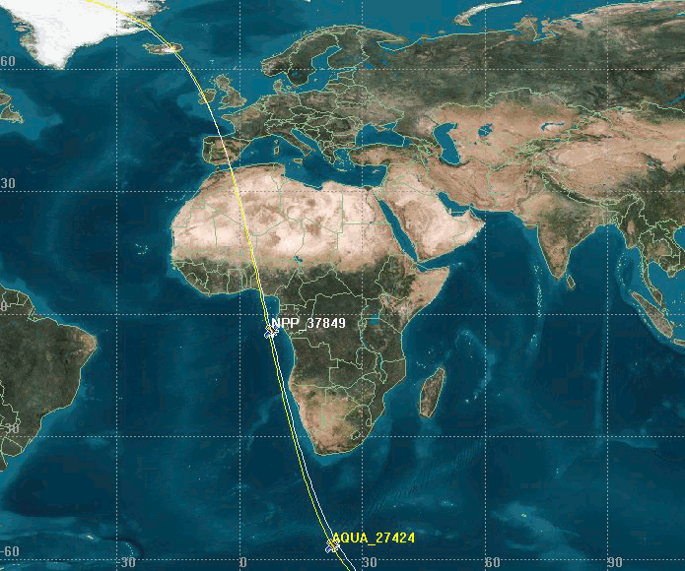
Evaluating NOAA-20 and S-NPP Consistency using Extended SNO (SNOx) over Saharan Desert
SNOs extended to low latitude Saharan desert and tropical ocean.
Allows instrument comparison over desert sites within few minutes of time difference.
Technique is regularly used to monitor S-NPP Bias relative to MODIS
https://ncc.nesdis.noaa.gov/VIIRS/VIIRS_MODIS_Intercomparison.php
NOAA-20 VIIRS and AQUA MODIS can be compared using SNO-x.
Double differencing needed to evaluate NOAA-20 and S-NPP consistency.
SNO
STK Image
SNO-x Ref: Uprety et al. 2013, Jtech

Slide 12
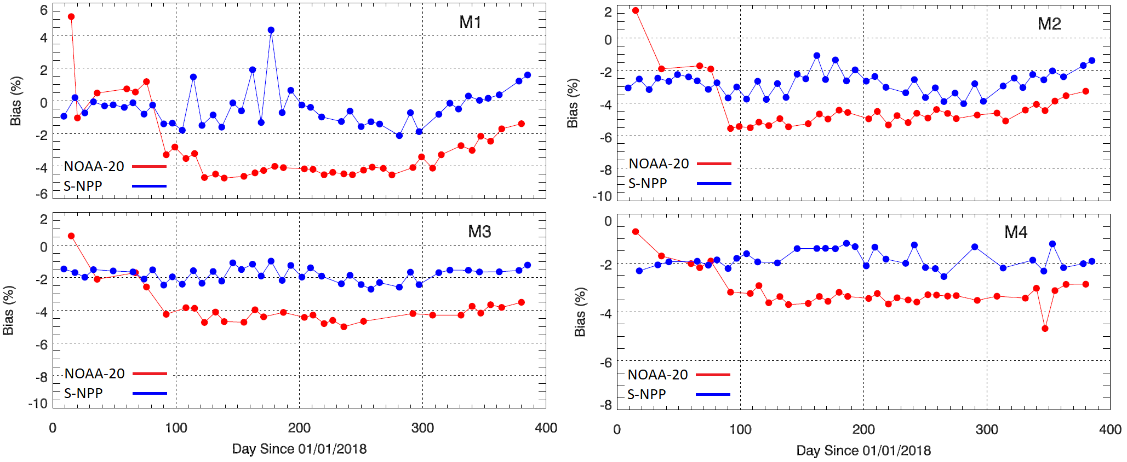
M1-4 Bias Trends (Desert SNOx)
N20 Bias: ~-2.5%
N20 Bias: ~-1.5%
N20 Bias: ~-2.5%
Large SBAF (~-3.2%) increases uncertainty in bias.
N20 Bias: ~-1.5%
M1-4 bias for NOAA-20 ranges from -1.5% to -3%.
SNOx bias over Saharan desert consistent with SNO bias over polar region.

Slide 13
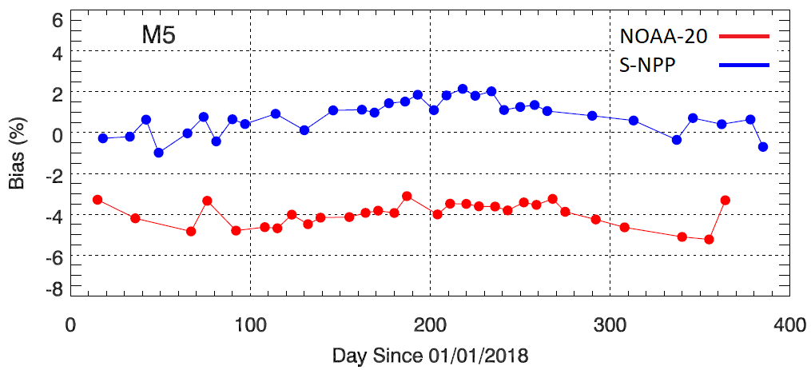
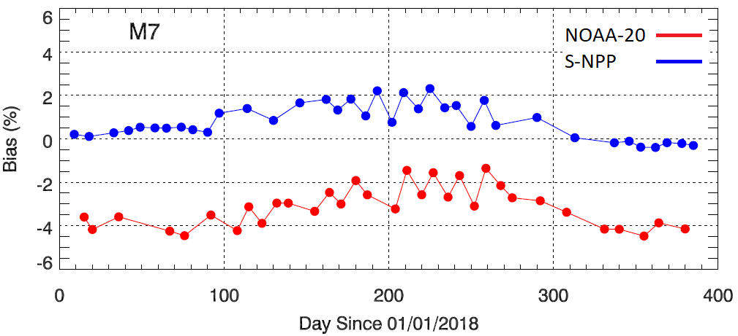
M5 and M7 Bias Trends (Desert SNOx)
Both M5 and M7 NOAA-20 VIIRS biases are lower than SNPP.
Bias agrees with polar SNO to within 0.5%
M5 and M7 suggest large bias because S-NPP VIIRS M5 and M7 are biased high by about 2%.
N20 Bias: ~-5%
N20 Bias: ~-4%

Slide 14
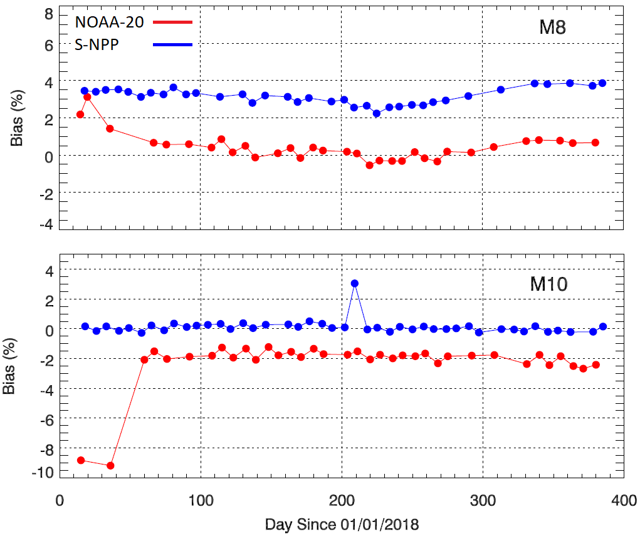
M8 and M10 Bias Trends (Desert SNOx)
N20 Bias: ~-3%
NOAA-20 VIIRS is lower than SNPP for both M8 (~-3%) and M10 (~-2%).
N20 Bias: ~-2%

Slide 15
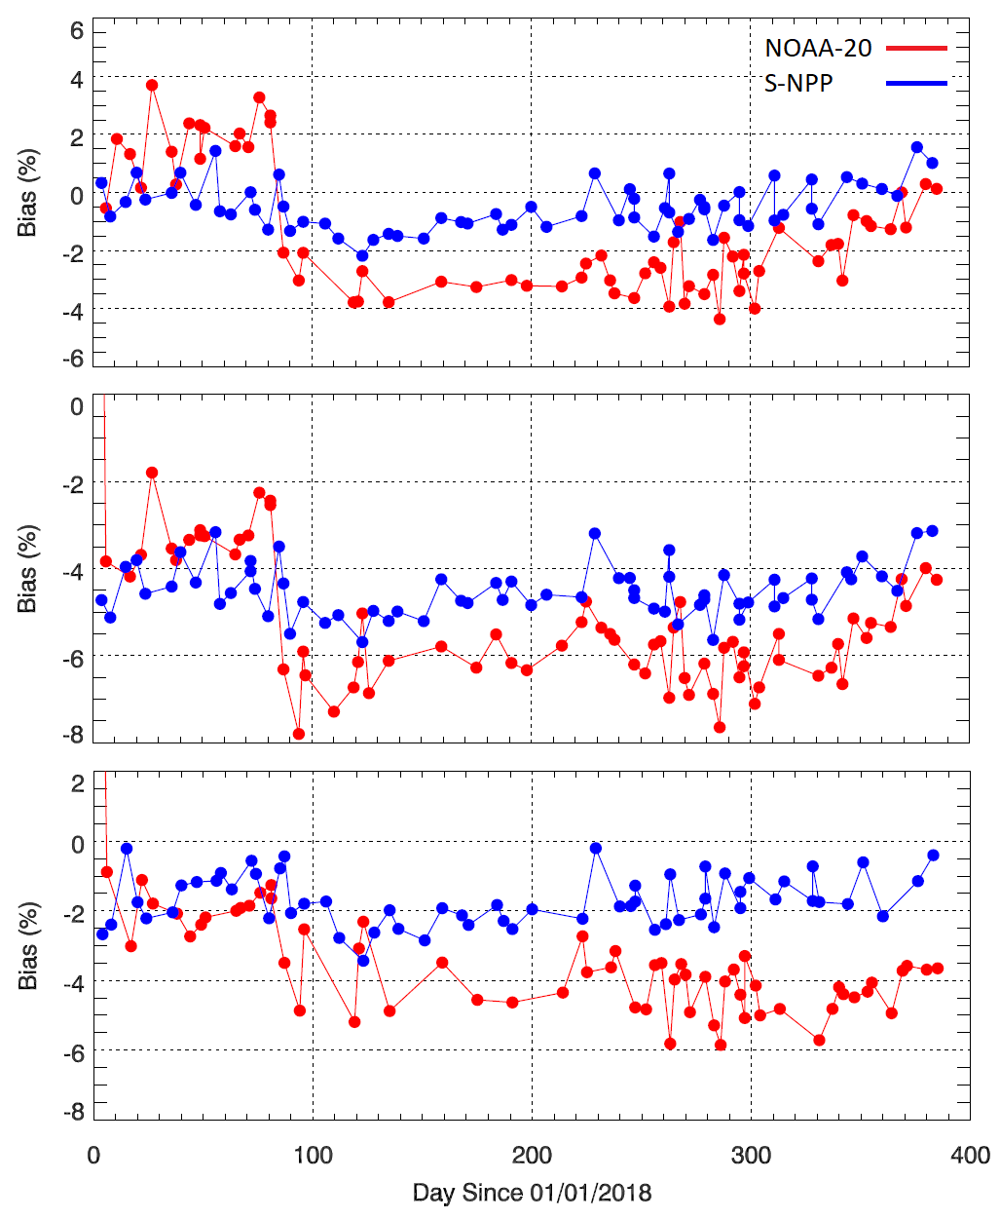
Ocean SNOx (M1-3 Bias Trends )
Ocean
Comparison performed over clear sky tropical ocean using SNOx.
Uses VIIRS high gain only
M1-3 suggest bias on the order of -2% more recently.
HG (over ocean) and LG (Polar SNO and Desert SNOx) Bias are consistent.
N20 Bias: ~-1.5%
M1
N20 Bias: ~-1.5%
M2
N20 Bias: ~-2.5%
M3

Slide 16
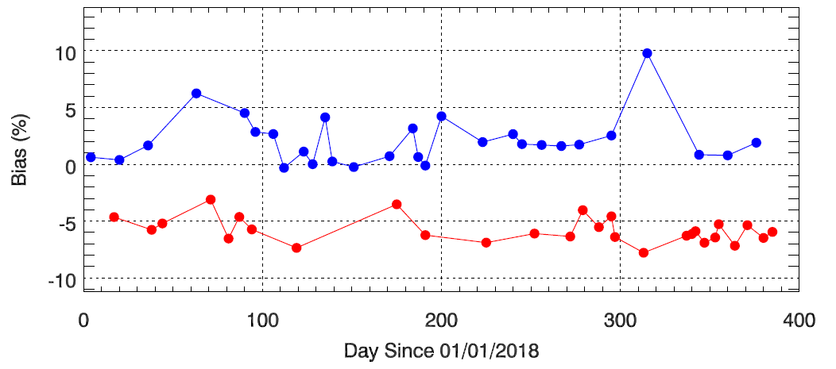
M6 Comparison over Ocean
M6
NOAA-20 agrees with S-NPP to 6-7%
M6 has with larger uncertainty.
Uses VIIRS high gain only over clear sky using SNOx

Slide 17
M5, M7 Bias using Pseudo-invariant Calibration Sites (PICS) Libya 4 Desert Site

Slide 18
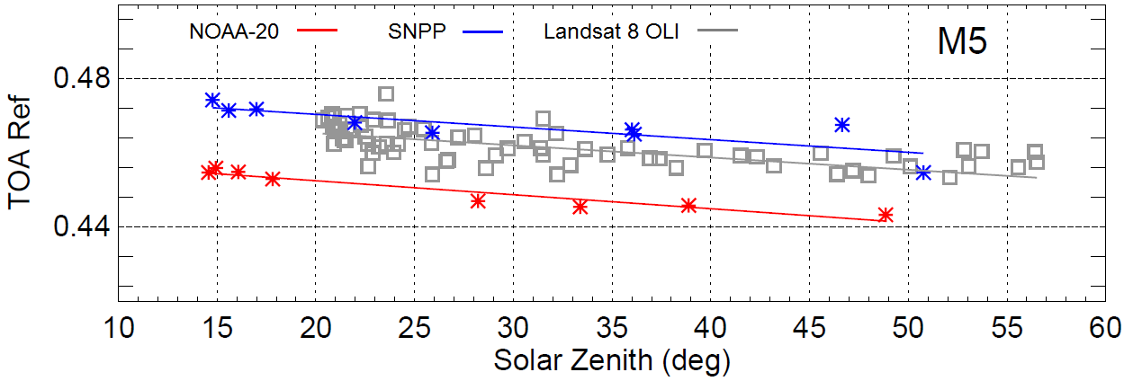
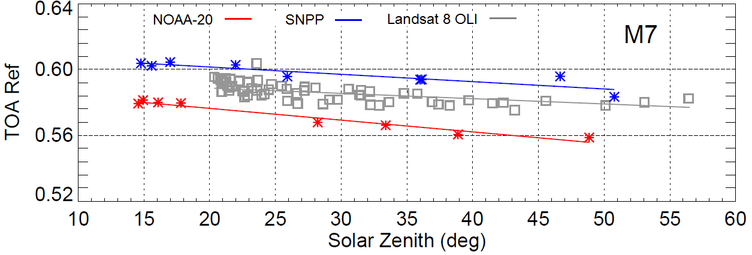
Bias over Libya 4 Relative to OLI
NOAA-20 Bias:-4.0% at 25° solar zenith
NOAA-20 Bias:-4.5% at 25° solar zenith
Note: Both NOAA-20 and SNPP VIIRS are scaled using SBAF to account spectral difference relative to OLI.

Slide 19
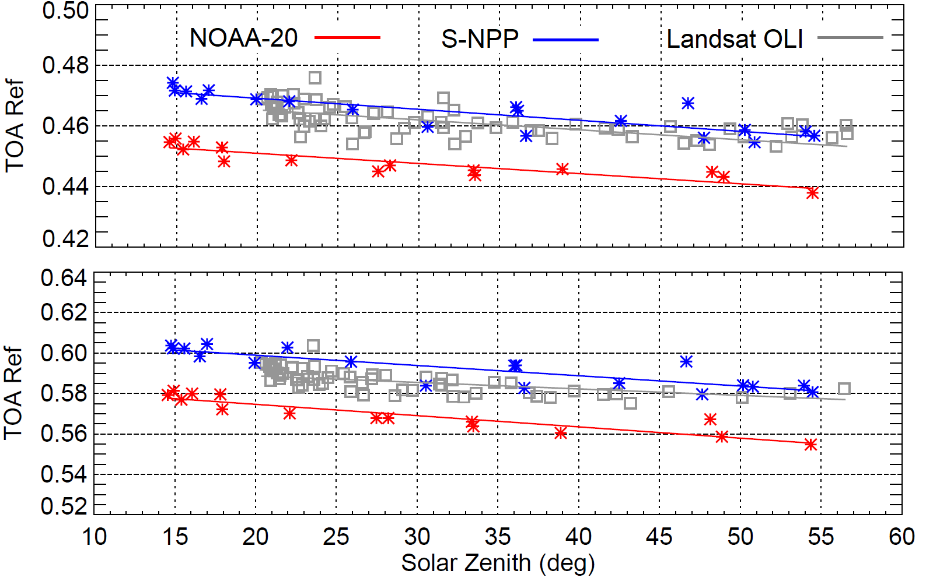
Bias over Libya 4 Relative to OLI
M5
NOAA-20 Bias:~-4.0% at 25° solar zenith
M7
NOAA-20 Bias:~-4.5% at 25° solar zenith
Note: Both NOAA-20 and SNPP VIIRS are scaled using SBAF to account spectral difference relative to OLI.

Slide 20
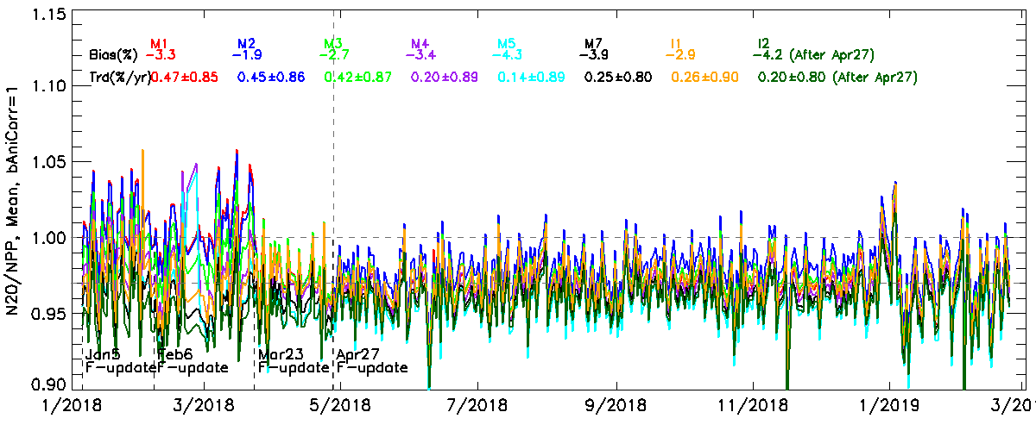
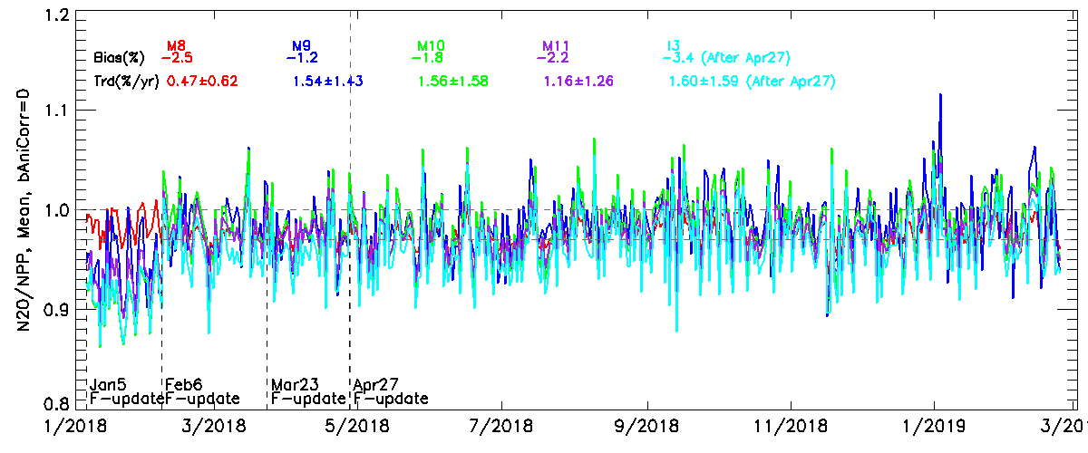
NOAA-20 and S-NPP DCC Ratio (VNIR and SWIR Bands)
All NOAA-20 bands are biased low, consistent with previous results.
Courtesy from Wenhui Wang, GST@ NOAA/STAR

Slide 21
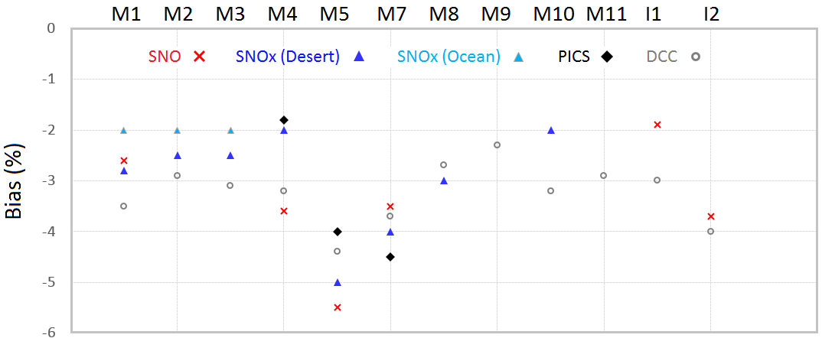
Summary
Study suggests that NOAA-20 VIIRS observed reflectance is consistently lower than S-NPP for all RSB.
Larger bias exists for M5 (~-4.5%) and M7 (~-4%) because S-NPP VIIRS M5 and M7 calibration are biased high by ~2%.
Results from multiple independent validation methods agree to within 1% for most bands.
Root cause is most possibly attributed to prelaunch calibration and investigation ongoing.
VIIRS bias will be regularly monitored and reported to the users.

Slide 22
Questions?

