Slide 1
Migration Trial from MODIS to VIIRS on AHI VIS/NIR RTM Simulation Approach
† Yusuke YOGO
Japan Meteorological Agency / Meteorological Satellite Center
† yogo@met.kishou.go.jp

Slide 2
JMA’s AHI VIS/NIR Cal. Approaches
RTM simulation approach vs Aqua, Terra/MODIS
  Need to migrate to VIIRS
  -> We made a trial to replace Aqua, Terra/MODIS with S-NPP/VIIRS
“Ray-Matching” method vs S-NPP/VIIRS
Comparison between Himawari-8 and 9/AHIs (or with adjacent GEOs)
Lunar calibration
DCC method

Slide 3
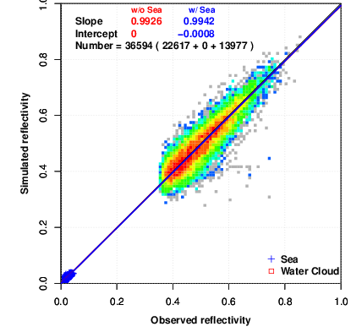
AHI VIS/NIR RTM Approach
Procedure
  Select liquid water cloud and clear-sky ocean areas
    Liquid water cloud part is inevitable
    because it covers wide dynamic range
  Retrieve parameters before main calculation
  from LEO radiance
  Calculate AHI-equivalent radiance
  by using RSTAR (Nakajima and Tanaka, 1986)
  Compare with AHI observations
MODIS L1B
or VIIRS SDR
“REAP”
“CAPCOM”
Retrieval
Softwares
Aerosol
& Cloud
Params
“RSTAR”
Radiative
Transfer
Model
RT Model
Simulated
Value
“JRA-55”
JMA Re-analysis
Calibration
Result
AHI L1B
Observed
Value
Aura/OMI
Ozone L3
Example:
AHI B04 vs MODIS (NIR=3.75 μm)
0 <- sim. reflectance -> 1
clouds
ocean
0 <- obs. reflectance -> 1

Slide 4
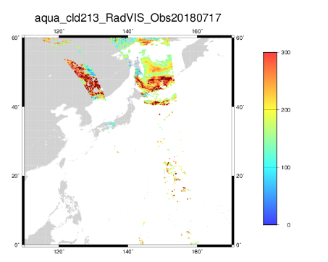
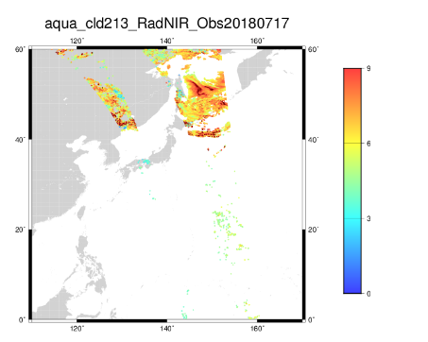
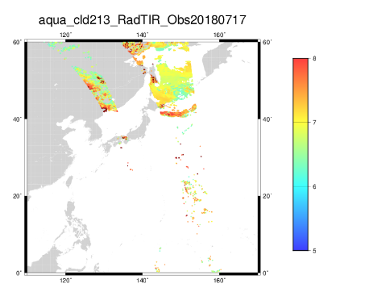
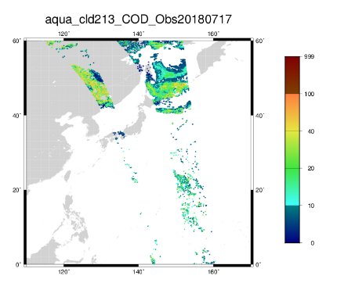
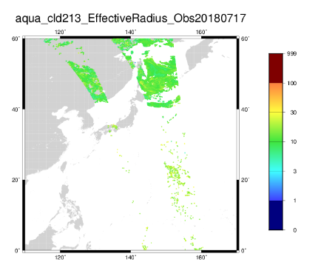
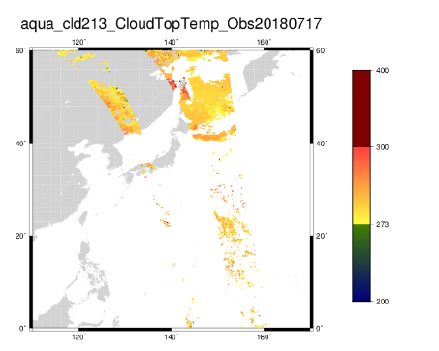
Cloud Retrieval on RTM Approach
Cloud Retrieval Software “CAPCOM” (Nakajima and Nakajima, 1995)
  3-channel method: input [VIS, NIR and TIR] and
  retrieve [optical thickness, effective radius and top temperature]
  Selectable from several channels for NIR
  Only for liquid water clouds (sphere)
  Current thresholds after cloud retrieval
 | mainly corresponds to | MODIS | VIIRS
VIS | optical thickness | Band 1 (0.64 μm) | M05 (0.67 μm)
NIR | effective radius | selectable from Band 6, 7 and 20 (1.64/2.13/3.75 μm) | selectable from M10, 11 and 12 (1.61/2.25/3.70 μm)
TIR | top temperature | Band 31 (11.0 μm) | M15 (10.8 μm)
VIS, NIR and TIR
Parameters | Thresholds
Optical Thickness | 10 to 100
Effective Radius | less than 100 μm
Top Temperature | more than 273 K
optical thickness, effective radius
and top temperature

Slide 5
S-NPP/VIIRS Experiment
Make a trial to replace MODIS with S-NPP/VIIRS
  Period: 2019-01-02 to 01-31
  VIS = M05 (0.67 μm)
  NIR = M10, 11 or 12 (1.61/2.25/3.70 μm)
  TIR = M15 (10.8 μm)
Compare to current implementation with Aqua/MODIS
  VIS = Band01 (0.64 μm)
  NIR = Band20 (3.75 μm) for AHI B01-04 / Band07 (2.13 μm) for AHI B05-06
  TIR = Band31 (11.0 μm)
Acknowledgement:
We deeply appreciate Prof. T. Y. Nakajima (Tokai Univ.)
for providing CAPCOM itself and CAPCOM ancillary files
adapted for S-NPP/VIIRS SRF.

Slide 6
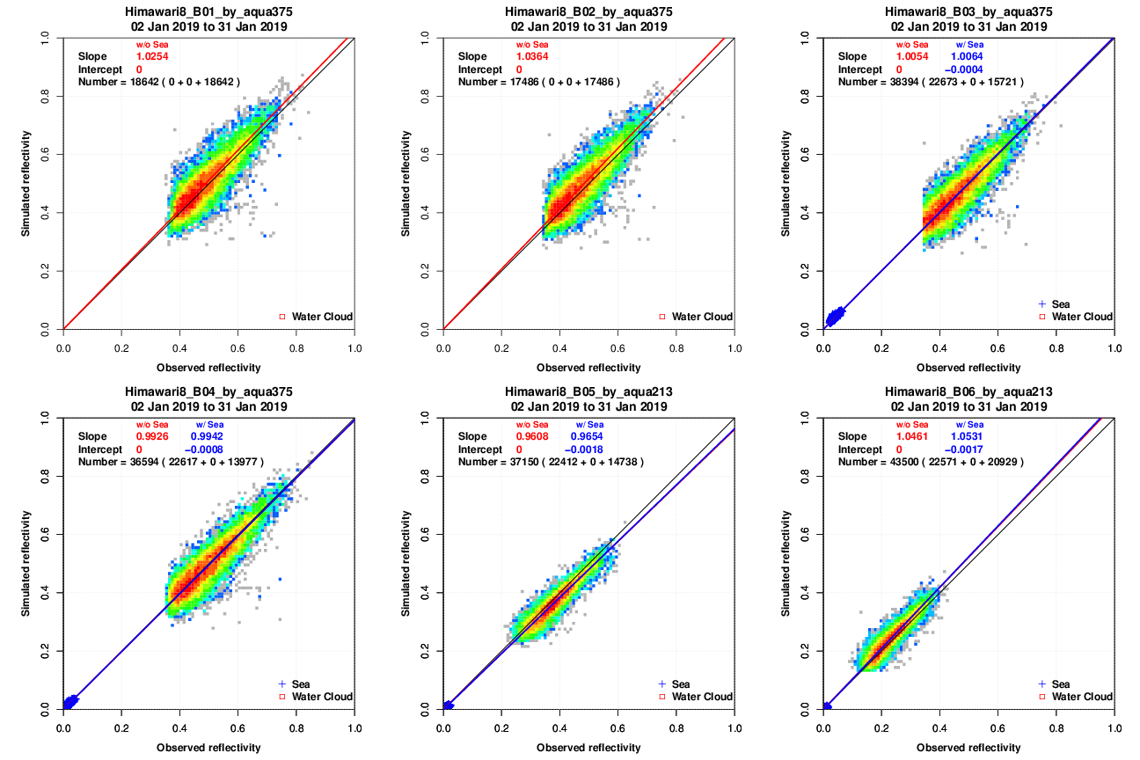
Preliminary Results
Aqua, Terra/MODIS (current implementation)
  Almost identical with AHI observation at any AHI bands
over-
estimation
under-
estimation
0 <- sim. reflectance -> 1
0 <- sim. reflectance -> 1
0 <- sim. reflectance -> 1
AHI B01 using
Aqua/MODIS
B01-B20-B31
AHI B02 using
Aqua/MODIS
B01-B20-B31
AHI B03 using
Aqua/MODIS
B01-B20-B31
0 <- obs. reflectance -> 1
0 <- obs. reflectance -> 1
0 <- obs. reflectance -> 1
0 <- sim. reflectance -> 1
0 <- sim. reflectance -> 1
0 <- sim. reflectance -> 1
AHI B04 using
Aqua/MODIS
B01-B20-B31
AHI B05 using
Aqua/MODIS
B01-B07-B31
AHI B06 using
Aqua/MODIS
B01-B07-B31
0 <- obs. reflectance -> 1
0 <- obs. reflectance -> 1
0 <- obs. reflectance -> 1

Slide 7
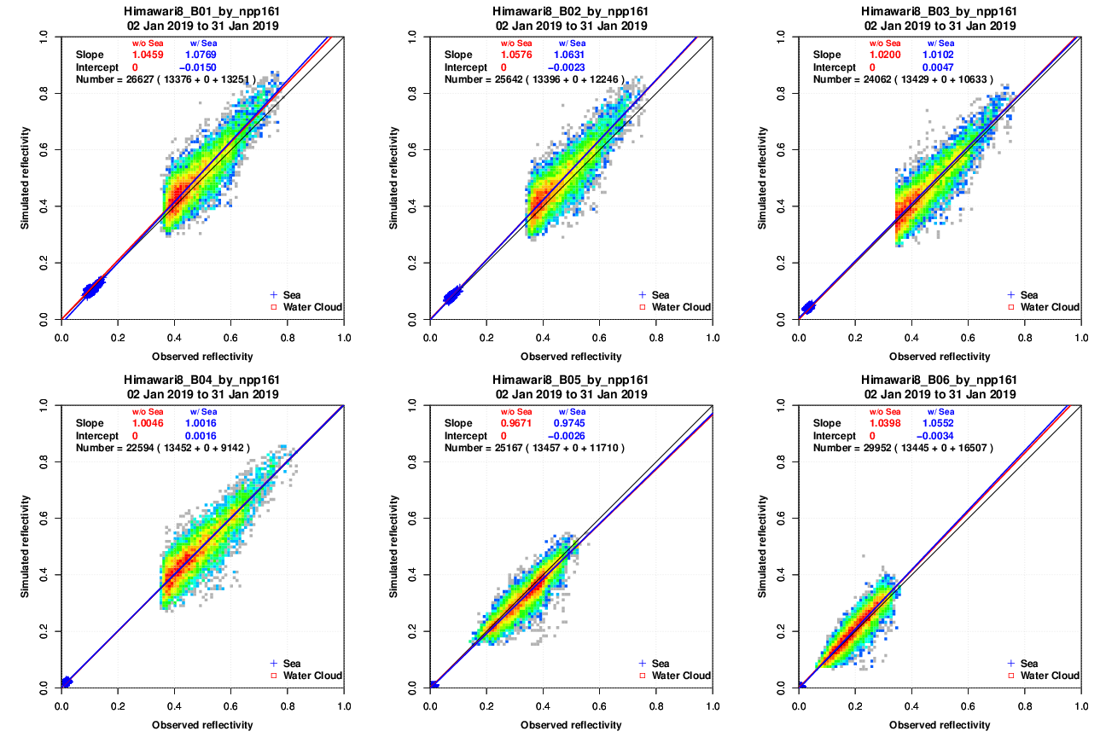
Preliminary Results
Adopted M10 (1.61 μm) as NIR: 👍
  Almost identical with AHI observation at any AHI bands
  Slightly overestimated at high reflectance?
over-
estimation
under-
estimation
0 <- sim. reflectance -> 1
0 <- sim. reflectance -> 1
0 <- sim. reflectance -> 1
AHI B01 using
S-NPP/VIIRS
M05-M10-M15
AHI B02 using
S-NPP/VIIRS
M05-M10-M15
AHI B03 using
S-NPP/VIIRS
M05-M10-M15
0 <- obs. reflectance -> 1
0 <- obs. reflectance -> 1
0 <- obs. reflectance -> 1
0 <- sim. reflectance -> 1
0 <- sim. reflectance -> 1
0 <- sim. reflectance -> 1
AHI B04 using
S-NPP/VIIRS
M05-M10-M15
AHI B05 using
S-NPP/VIIRS
M05-M10-M15
AHI B06 using
S-NPP/VIIRS
M05-M10-M15
0 <- obs. reflectance -> 1
0 <- obs. reflectance -> 1
0 <- obs. reflectance -> 1

Slide 8

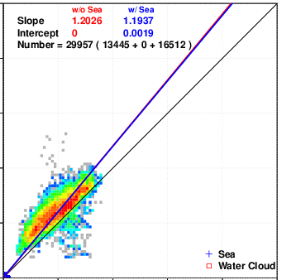

Preliminary Results
Adopted M11 or 12 (2.25/3.70 μm) as NIR:
Basically overestimated at AHI B05 and 06 (1.6/2.3 μm)
  shorter wavelength NIR radiance contains information of wider optical thickness range
  Also, some studies have pointed out “vertical non-uniformity”
  about cloud particle radius (Nakajima et al., 2010)
  -> effective radius and calculation results will differ among selected NIRs
NIR wavelength | 1.64 μm | 2.13 μm | 3.75 μm
COT range | 0 to 28 | 0 to 15 | 0 to 8
retrieved radius | large? | medium? | small?
revised from Nakajima et al., 2010
over-
estimation
under-
estimation
0 <- sim. reflectance -> 1
3.75 μm
2.13 μm
1.64 μm
AHI B06 using
S-NPP/VIIRS
M05-M12-M15
0 <- obs. reflectance -> 1

Slide 9
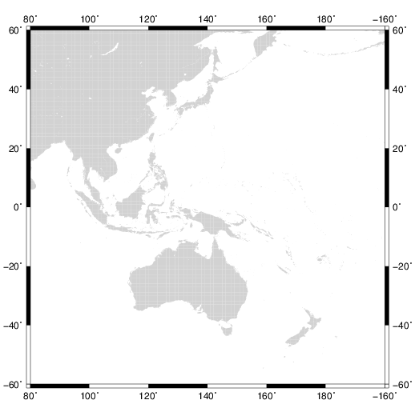
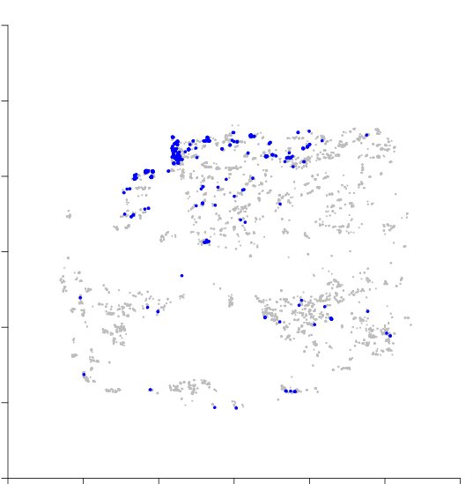
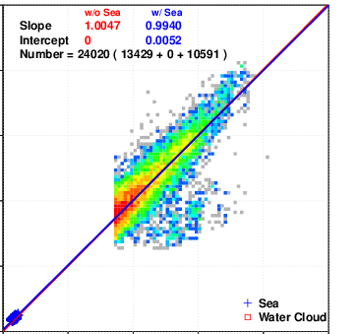
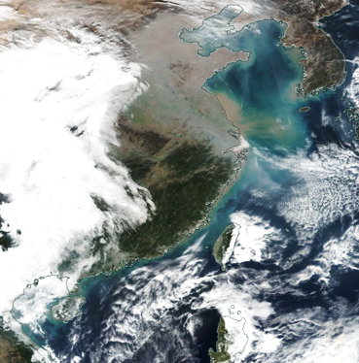
Preliminary Results
Adopted M11 or 12 (2.25/3.70 μm) as NIR:
Occasionally underestimated at all AHI VNIR bands (0.47-2.3 μm)
  Underestimation can be seen mainly around East/South China Sea
  Turbid ocean/dust were misdetected as clouds?
    But not sure why it couldn’t be seen when using S-NPP/VIIRS M10
    Sometimes MODIS shows the same situation at same region and season
  -> We can avoid this problem by choosing region and/or adjusting thresholds
over-
estimation
under-
estimation
underestimated (sim/obs < 0.75) = blue
turbid ocean
(particularly winter)
dust (yellow sand)
from the continent
(particularly spring)
0 <- sim. reflectance -> 1
AHI B03 using
S-NPP/VIIRS
M05-M12-M15
S-NPP/VIIRS True Color, 2019-01-24
credit: NASA Worldview
0 <- obs. reflectance -> 1

Slide 10
Summary
We made a trial to replace Aqua, Terra/MODIS with S-NPP/VIIRS
on AHI VIS/NIR RTM simulation approach
  This approach uses 3-channel (VIS, NIR and TIR) cloud retrieval software “CAPCOM”
Choosing S-NPP/VIIRS M10 (1.61 μm) as NIR worked well
But M11 and 12 (2.25/3.70 μm) showed over/underestimation against AHI obs
  Overestimation was probably caused by optical thickness range dependency by
  NIR selection and “vertical non-uniformity” inside cloud
  Underestimation was probably caused by wrong detection of turbid ocean/dust around East/South China Sea
Need to select a NIR channel properly
(Is shortwave NIR like 1.61 μm the best option? Any ideas?)
Need to choose region and/or adjust thresholds to avoid wrong detection

Slide 11
End
Thanks for your attention / Grazie!

Slide 12
References
Nakajima, T., and M. Tanaka, 1986: Matrix formulations for the transfer of solar radiation in a plane-parallel scattering atmosphere. J. Quant. Spectrosc. Radiat. Transf., 35, 13–21.
Nakajima, T. Y., and T. Nakajima, 1995: Wide-area determination of cloud microphysical properties from NOAA AVHRR measurements for FIRE and ASTEX regions. J. Atmos. Sci., 52, 4043–4059.
Nakajima, T. Y., K. Suzuki, and G. L. Stephens, 2010: Droplet growth in warm water clouds observed by the A-Train. Part I: Sensitivity analysis of the MODIS-derived cloud droplet sizes. J. Atmos. Sci., 67, 1884–1896.

Slide 13
Why we chose those MODIS bands as NIR
When we started the research (GMS-MTSAT era), we chose 3.7 μm as NIR
We thought it is reasonable to use MODIS NIR of 1.6 and 2.1 μm when we compute about AHI B05 (1.6 μm) and B06 (2.3 μm), respectively
However Terra/MODIS SD cover and Aqua/MODIS 1.6 μm band have some malfunction
Finally we chose Aqua 3.7 μm for B01-04 and Aqua 2.1 μm for B05-06

Slide 14
larger Opt. Thickness
smaller Eff. Radius
NIR Radiance
VIS Radiance

Slide 15
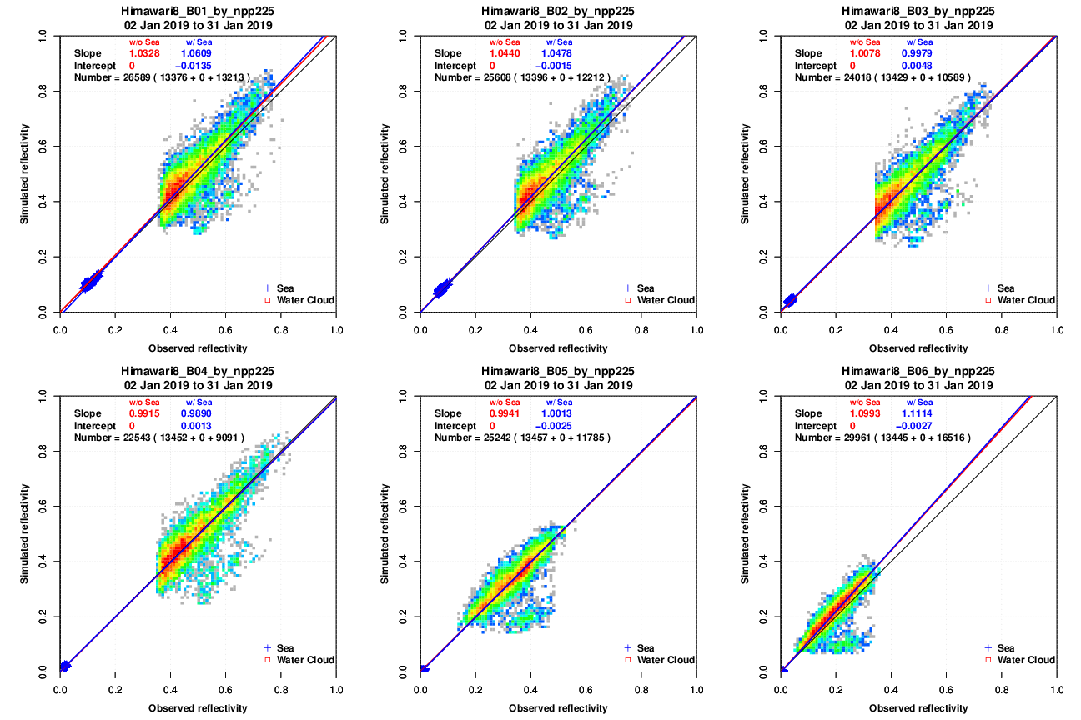
Adopted M11 (2.25 μm) as NIR
over-
estimation
under-
estimation
0 <- sim. reflectance -> 1
0 <- sim. reflectance -> 1
0 <- sim. reflectance -> 1
AHI B01 using
S-NPP/VIIRS
M05-M11-M15
AHI B02 using
S-NPP/VIIRS
M05-M11-M15
AHI B03 using
S-NPP/VIIRS
M05-M11-M15
0 <- obs. reflectance -> 1
0 <- obs. reflectance -> 1
0 <- obs. reflectance -> 1
0 <- sim. reflectance -> 1
0 <- sim. reflectance -> 1
0 <- sim. reflectance -> 1
AHI B04 using
S-NPP/VIIRS
M05-M11-M15
AHI B05 using
S-NPP/VIIRS
M05-M11-M15
AHI B06 using
S-NPP/VIIRS
M05-M11-M15
0 <- obs. reflectance -> 1
0 <- obs. reflectance -> 1
0 <- obs. reflectance -> 1

Slide 16
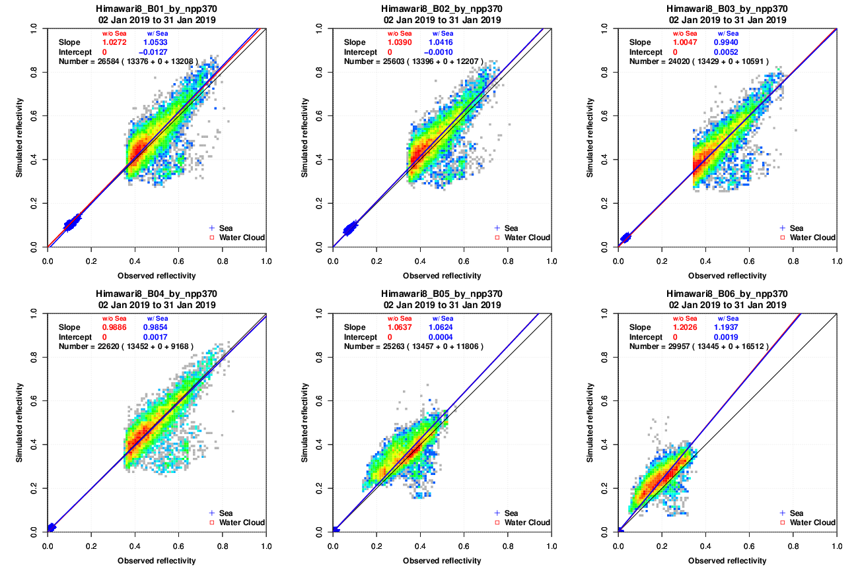
Adopted M12 (3.70 μm) as NIR
over-
estimation
under-
estimation
0 <- sim. reflectance -> 1
0 <- sim. reflectance -> 1
0 <- sim. reflectance -> 1
AHI B01 using
S-NPP/VIIRS
M05-M12-M15
AHI B02 using
S-NPP/VIIRS
M05-M12-M15
AHI B03 using
S-NPP/VIIRS
M05-M12-M15
0 <- obs. reflectance -> 1
0 <- obs. reflectance -> 1
0 <- obs. reflectance -> 1
0 <- sim. reflectance -> 1
0 <- sim. reflectance -> 1
0 <- sim. reflectance -> 1
AHI B04 using
S-NPP/VIIRS
M05-M12-M15
AHI B05 using
S-NPP/VIIRS
M05-M12-M15
AHI B06 using
S-NPP/VIIRS
M05-M12-M15
0 <- obs. reflectance -> 1
0 <- obs. reflectance -> 1
0 <- obs. reflectance -> 1

Slide 17
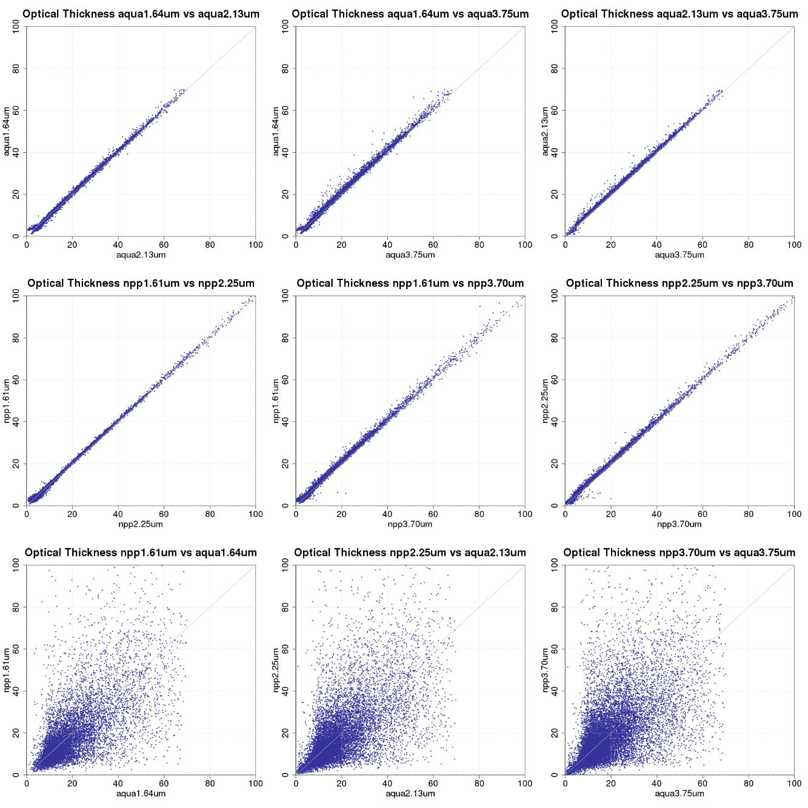
Optical Thickness
where NPP vs Aqua
collocated roughly:
Δlon < 0.01 deg
Δlat < 0.01 deg
Δt < 5 min

Slide 18
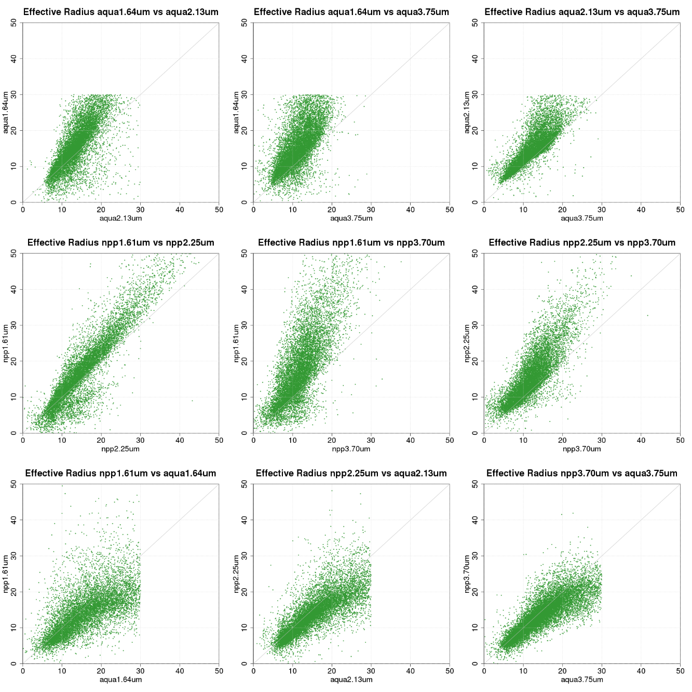
Effective Radius

Slide 19
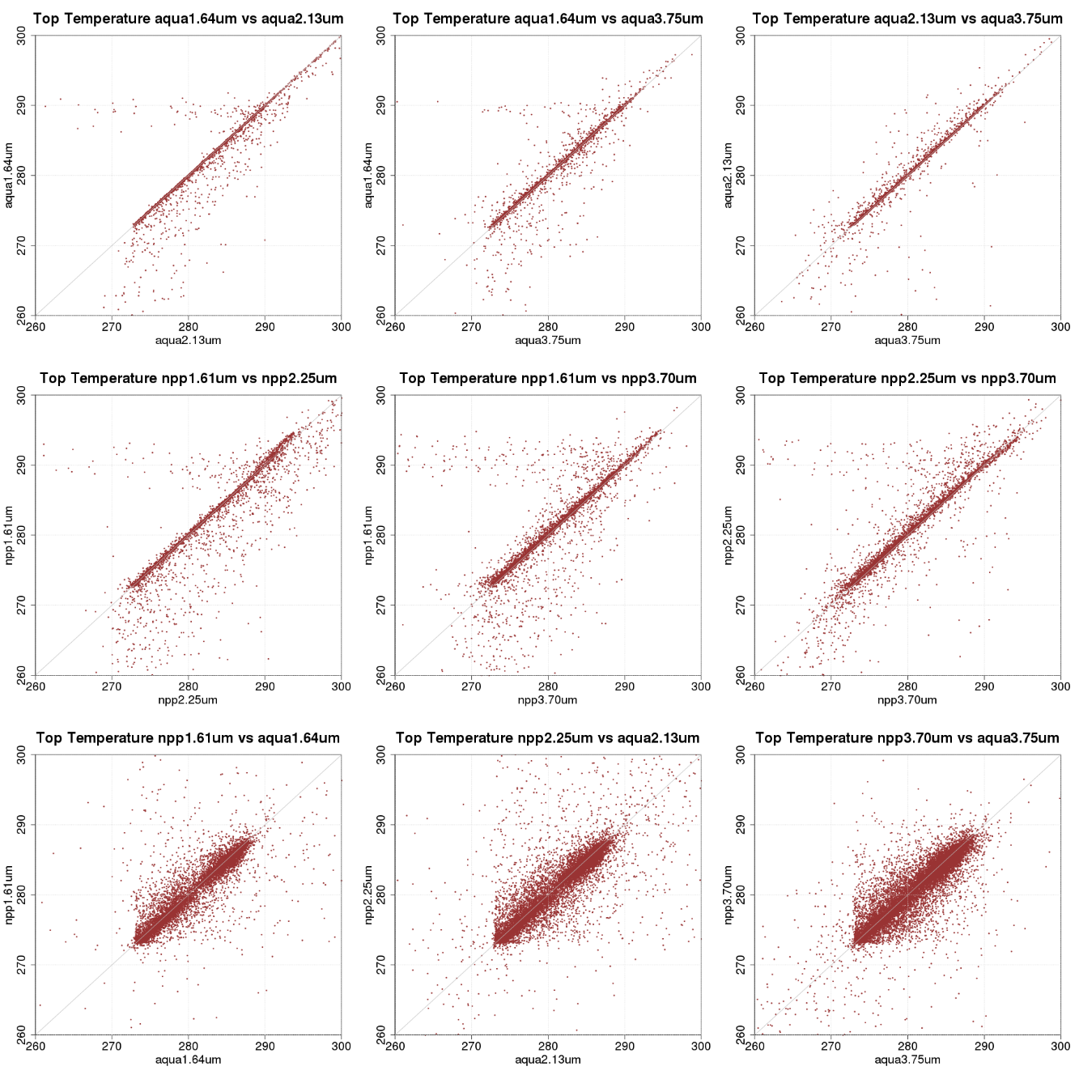
Top Temperature

