Slide 1
Impacts of I01 and M05 of S-NPP/VIIRS on AHI-VIIRS Ray-matching
Kazuki KODERA and Masaya TAKAHASHI
Meteorological Satellite Center
Japan Meteorological Agency

Slide 2
Table of Contents
Background
Current status and outline of AHI-VIIRS Ray-matching at JMA
Motivation
Problems and aim
Comparison of I01 with M05
Summary
Discussion
SBAF uncertainty and M05 calibration difference against I01

Slide 3
Background
Current status : AHI-VIIRS Ray-matching at JMA
Data
Inputs : Himawari-8/AHI L1 data (2 km resolution) and S-NPP/VIIRS SDR on NOAA CLASS
Using VIIRS I01 vs. AHI Band03
SBAFs: SBAF Tool by NASA LaRC (Band01-05) and radiative transfer calculation (Band06)
Method
1) GEO-LEO collocation based on Doelling et al. (2011)
2) Taking average of VIIRS obs. to agree with AHI’s footprint size
3) Applying SBAF to averaged VIIRS obs. and comparing with AHI obs.
4) Making regression of collocation data and calculating correction coefficients
Himawari-8 / AHI | Band01 (0.47 μm) | Band02 (0.51 μm) | Band03 (0.64 μm) |  | Band04 (0.86 μm) | Band05 (1.6 μm) | Band06 (2.3 μm)
S-NPP / VIIRS | M03 (0.49 μm) | M03 (0.49 μm) | I01 (0.64 μm) | M05 (0.67 μm) | M07 (0.87 μm) | M10 (1.6 μm) | M11 (2.3 μm)
SBAF (StdErrReg%) over all-sky tropical ocean force fit ( offset = 0 ) | for scaled radiance
 | I01 | M05
Himawari-8/AHI Band03 | 0.999 (0.20 %) | 0.978 (1.41 %)
AHI Band03
VIIRS I01
VIIRS M05

Slide 4
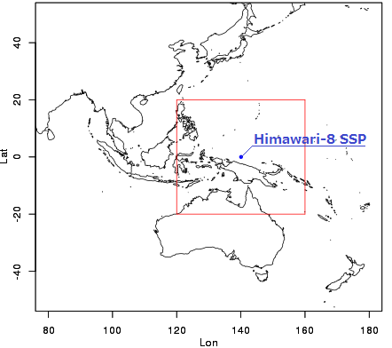
Motivation
GSICS community agreed with using I01 for 0.6 μm ch
We have used I01 for AHI-VIIRS Ray-matching
Problems for using I01 at JMA Long time is needed to get large size data !
I01 data are very large
Our internet connection is very slow
We have to restrict acquisition target region
Currently only Himawari-8 SSP (140E) ± 20 deg.
We can’t afford to get other satellites data (e.g. NOAA-20)
We expect that using M05 solves these problems.
M05 data size is smaller than I01
However, uncertainty could be bigger than using I01
Aim: investigate impacts of using M05
To check possibility if I01 can be replaced to M05 on AHI-VIIRS Ray-matching
Average of data size ( in Nov.2018 )
I01 ( / granule ) | 107 MB *
M05 ( / granule ) | 28 MB *
* include Geolocation files

Slide 5
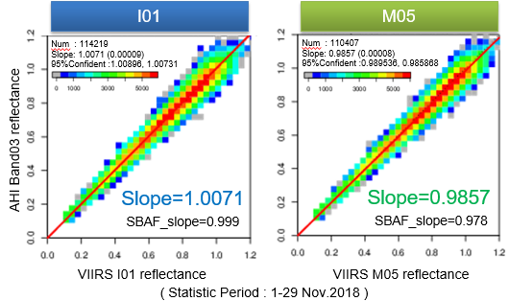
Comparison of I01 with M05
Result in this study
Linear regression in difference (force fit)
M05 has +2.1 % bias against I01.
2.1 %
difference
0.6 % difference
Preceding study
Dr. Cao reported M05 has +1.5 % calibration bias against I01
at GRWG Web Meeting in July 2018.

Slide 6
Summary
At GSICS web meeting in July 2018, the members agreed to use VIIRS I01 as reference for 0.6 μm channel rather than M05.
JMA has used I01 for AHI-VIIRS Ray-matching, but data size of VIIRS I-bands is large. It’s difficult for JMA to expand the acquisition target region and to download other satellites data. On this point, using M05 is better than using I01.
However, we have never checked how big uncertainty of using M05 is.
We investigated the validity of using M05 on AHI-VIIRS Ray-matching.
M05 has +2.1 % bias against I01 whereas Dr. Cao reported +1.5 % M05 calibration bias against I01.
Root cause(s) of 0.6 % difference is under investigation.
Discussion about this 0.6 % difference (Next slide=>)

Slide 7
Discussion
Result in this study : M05 is +2.1 % bias
Cao’s report : M05 is +1.5 % bias
What is root cause(s) for 0.6 % difference?
A) SBAF uncertainty available on NASA LaRC SBAF tool
Automatically calculate “StdErrReg%” and “StdErrSlp%”
Which SBAF uncertainty should be used in this study?
B) M05 bias vs. I01 isn’t equal to 1.5 % in this SDR
(on-going) We have to directly compare M05 with I01.
C) Coding bugs or other causes
Does anybody have other ideas about causes?
Uncertainty | I01 | M05
StdErrReg [%] | 0.2045 | 1.414
StdErrSlp [%] | 1.7684×10⁻³ | 1.2136×10⁻²

Slide 8
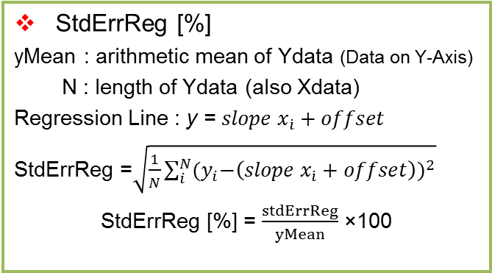
Discussion for SBAF uncertainties
Which SBAF uncertainty should be used in this study?
StdErrReg[%] and StdErrSlp[%] are
following equations, according to Dr. Scarino.
Uncertainty | I01 | M05
StdErrReg [%] | 0.2045 | 1.414
StdErrSlp [%] | 1.7684×10⁻³ | 1.2136×10⁻²
StdErrSlp [%]
xMean : arithmetic mean of Xdata (Data on Y-Axis)
1. Compute Standard Deviation (SD) of XData.
2. This gives the SD of XData = $\frac{\sqrt{\sum_{i}^{N}{{(x_{i}−xMean)}^{2}}}}{\sqrt{N−1}}$ 3. Thus from 2 we can write:
$\sqrt{\sum_{i}^{N}{{(x_{i}−xMean)}^{2}}}$ = (SD of XData) × $\sqrt{N−1}$ 4. Compute Ratio: $C=\frac{StdErrRegression}{((SD of Xdata) × \sqrt{N−1})}$ 5. Divide Ratio C by Slope (for Linear Case) and Multiply by 100 to get StdErrSlp [%] :
$StdErrSlp [\%]=\frac{C}{Slope} ×$ 100
StdErrReg [%]
yMean : arithmetic mean of Ydata (Data on Y-Axis)
N : length of Ydata (also Xdata)
Regression Line : y = $slope{ x}_{\dot{i}}+offset$
StdErrReg =$\sqrt{\frac{1}{N}\sum_{i}^{N}{{{(y}_{i}−\left(slope{ x}_{\dot{i}}+offset\right))}^{2}}}$
StdErrReg [%] = $\frac{stdErrReg}{yMean}$ ×100

Slide 9
Thank you for your attention

Slide 10
Back up

Slide 11
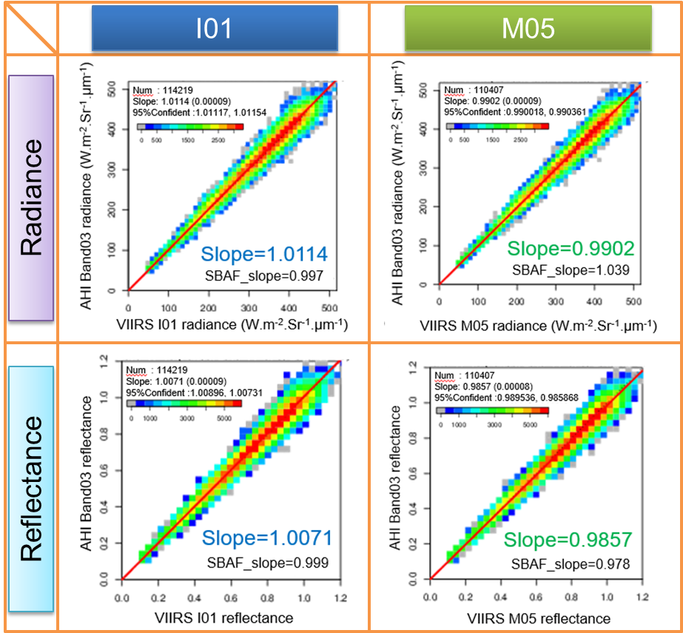
Comparison of I01 with M05
2.1 %
difference
2.1 %
difference

Slide 12
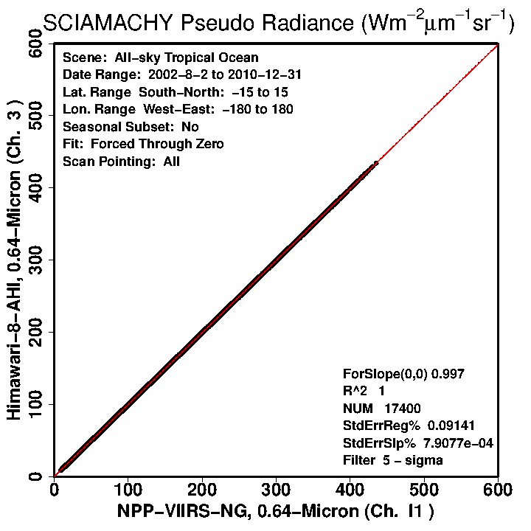
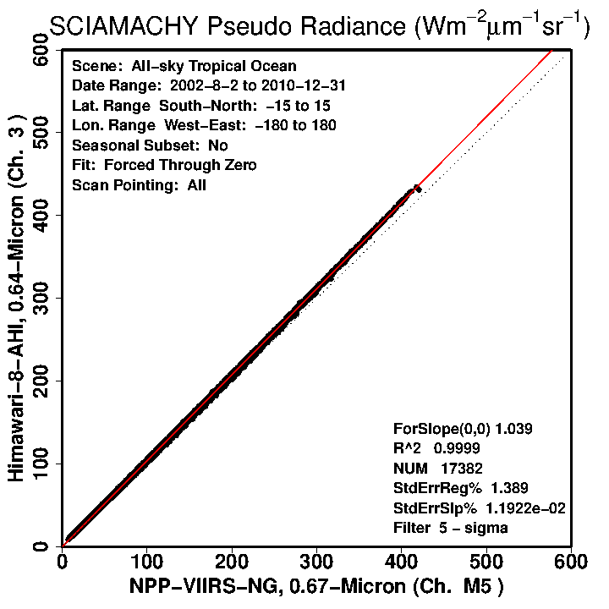
SBAF for Radiance
From : NASA LaRC website

Slide 13
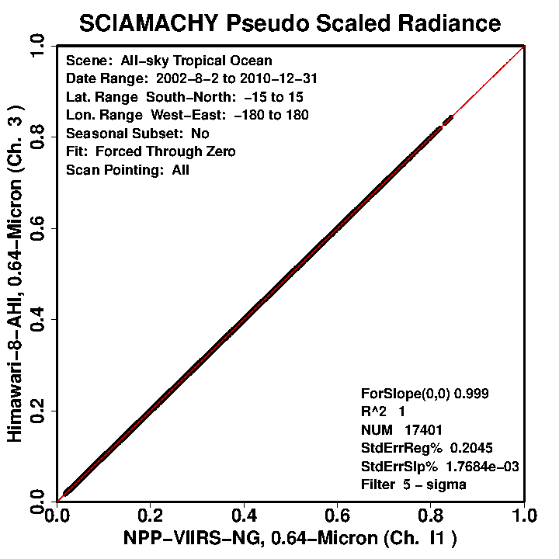
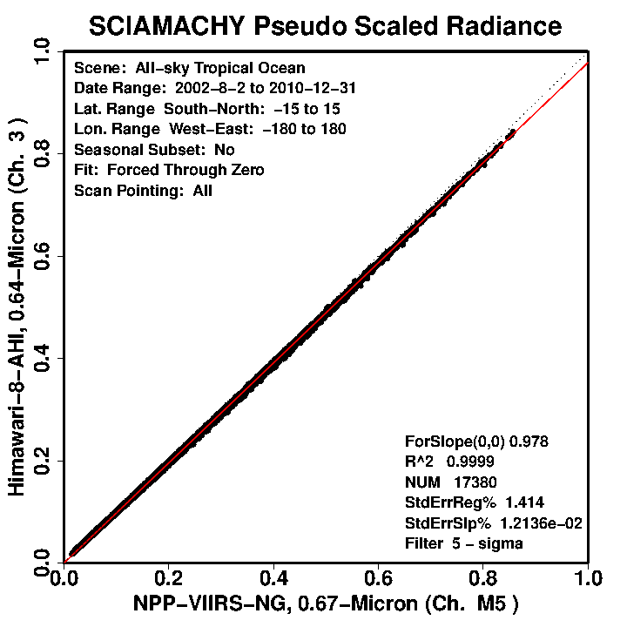
SBAF for Scaled Radiance
From : NASA LaRC website

