Slide 1
Sentinel-3 OLCI A/B Tandem, with a focus
on Deep Convective Clouds
An output of the Sentinel-3 Tandem for Climate project
https://s3tandem.eu/
https://twitter.com/S3Tandem
Nicolas Lamquin, ACRI-ST
Sébastien Clerc, Ludovic Bourg, ACRI-ST
Craig Donlon, ESA
GSICS Annual Meeting
ESA/ESRIN, Frascati, Italy
March 6th 2019

Slide 2
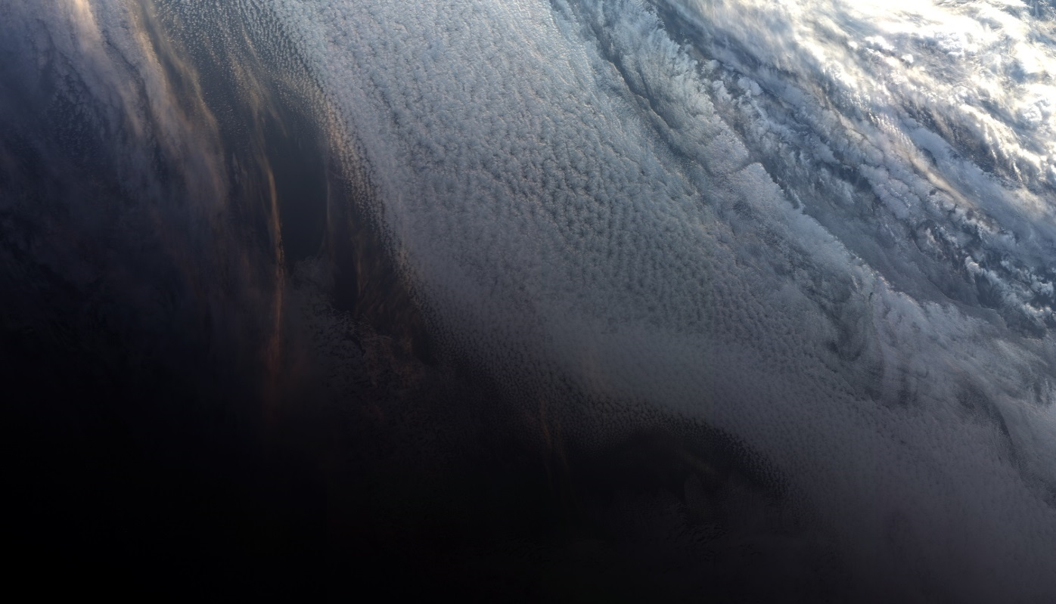
Sentinel-3 mission and OLCI
Sentinel-3: measures sea surface topography, sea and land surface temperature, and ocean and land surface colour with high accuracy and reliability to support ocean forecasting systems, environmental monitoring and climate monitoring
S3A: Feb 16th 2016
S3B: Apr 25th 2018
Revisit < 2 days
C and D in preparation
OLCI: Ocean and Land
Colour Instrument
VNIR: 21 bands
(400-1020 nm)
GSD: 300 m at nadir (FR)
Swath width: 1270 km
5 cameras, tilted to avoid glint
Antarctica - Sentinel-3B’s very first sight
https://www.eumetsat.int/website/home/News/DAT_3912999.html

Slide 3
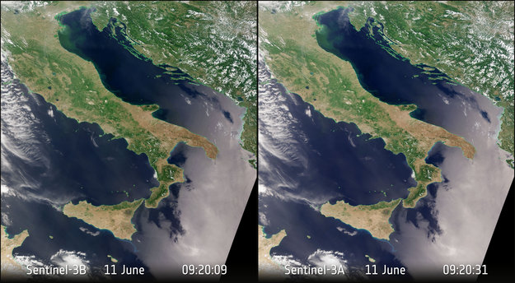
S3A/S3B tandem/drift phase
S3A/S3B tandem: S3B put on same track as S3A, 30s delay
Tandem period: early June to mid-October 2018
Following short drift period
→ ideal framework for sensor inter-comparison and inter-calibration
https://earth.esa.int/web/sentinel/missions/sentinel-3/news/-/article/sentinel-3-flies-tandem

Slide 4
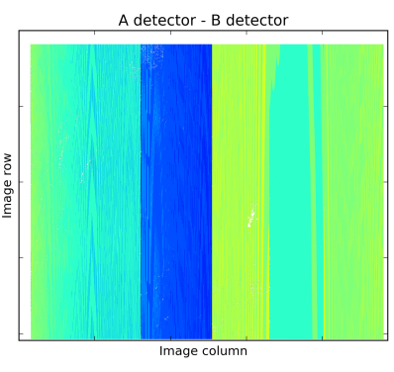
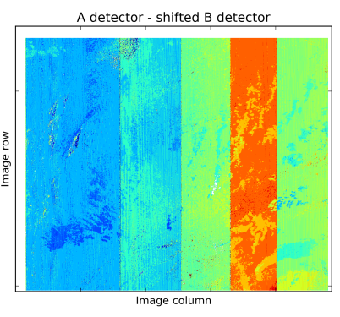
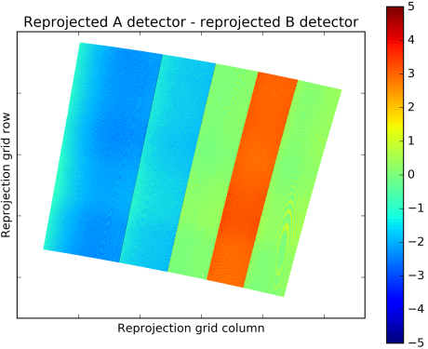
Geometrical coregistration and reprojection on L3 grid
Detectors footprints cannot match perfectly (raw differences in detector indices on the left)
Perform an image coregistration based on image 2D-shifts and radiometry best match (regression) per pixel (differences in detector indices in the middle)
Geometrical calibration performed at L1B used for reprojection on L3 grid, differences in reprojected products (right image) show same patterns per camera
→ reprojection used perferably to image coregistration technique for each image
Superimposed detector images difference
Detector images difference after coregistration from regression of radiometry
Detector images difference after reprojection on same L3 grid

Slide 5
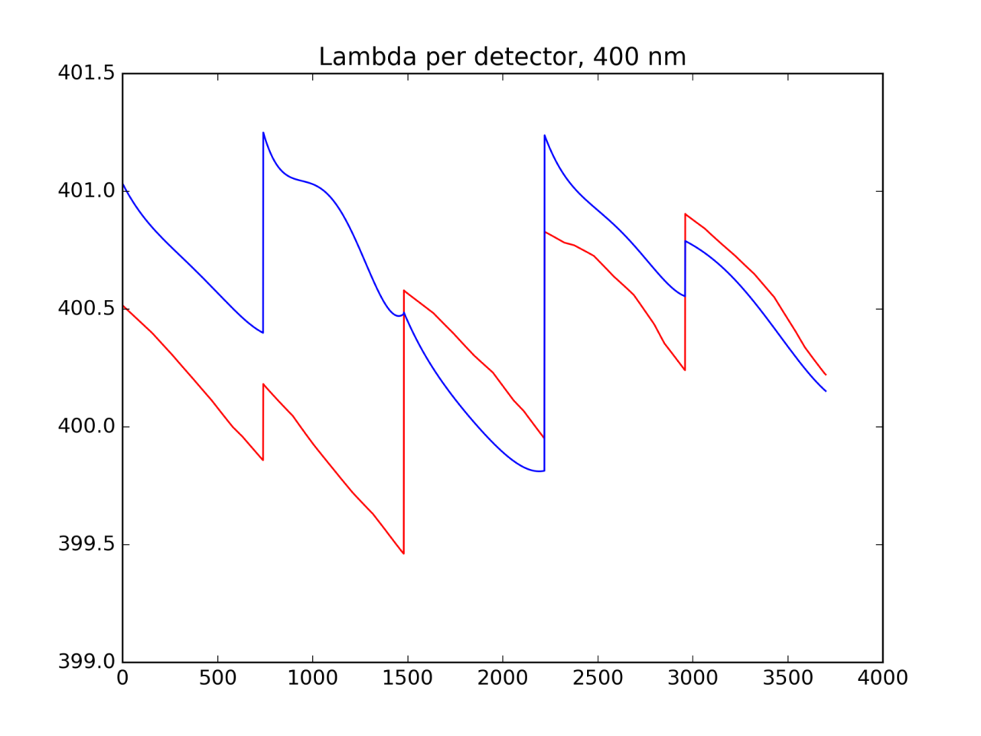
OLCI-A / OLCI-B spectral characterization and data homogenization
Spectral characterization shows up to 1 nm difference between OLCI-A and OLCI-B
B
A

Slide 6
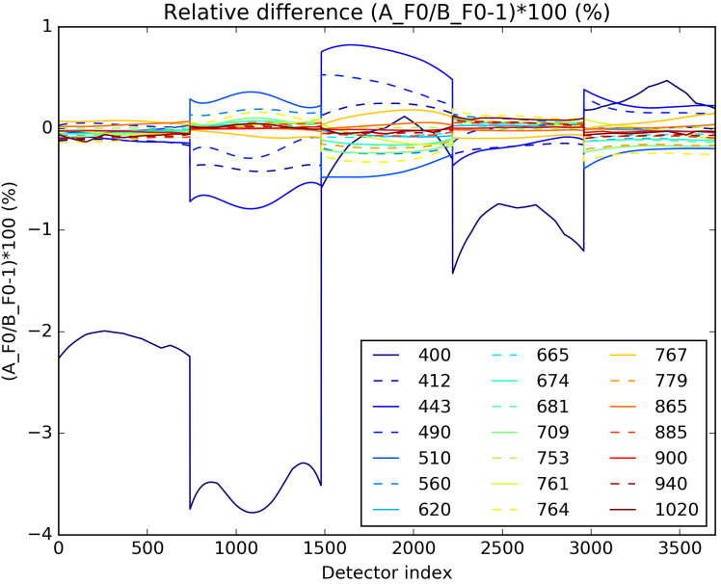
OLCI-A / OLCI-B spectral characterization and data homogenization
Spectral characterization shows up to 1 nm difference between OLCI-A and OLCI-B
It can appear small but differences in TOA radiance can come up to 4% at 400 nm firstly due to solar irradiance

Slide 7
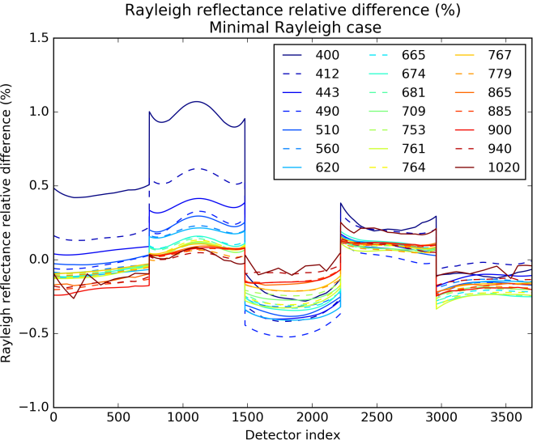
OLCI-A / OLCI-B spectral characterization and data homogenization
Spectral characterization shows up to 1 nm difference between OLCI-A and OLCI-B
It can appear small but differences in TOA radiance can come up to 4% at 400 nm firstly due to solar irradiance
Secondly due to Rayleigh scattering strong dependency with wavelength

Slide 8
OLCI-A / OLCI-B spectral characterization and data homogenization
Spectral characterization shows up to 1 nm difference between OLCI-A and OLCI-B
It can appear small but differences in TOA radiance can come up to 4% at 400 nm firstly due to solar irradiance
Secondly due to Rayleigh scattering strong dependency with wavelength
Finally due to BOA dependency with wavelength
Gaseous absorption differences (out of strong features) has a small effect
homogenization of OLCI-A and OLCI-B must be performed prior any comparison = “measurand adjustment”
corresponds to OLCI “smile-correction” performed in first L2 processing steps
depends on the target with assumptions on the target behaviour
OLCI L2 smile-correction breadboarded and used for the homogenization
adjust toward nominal wavelength both for A and for B (=operational process)

Slide 9
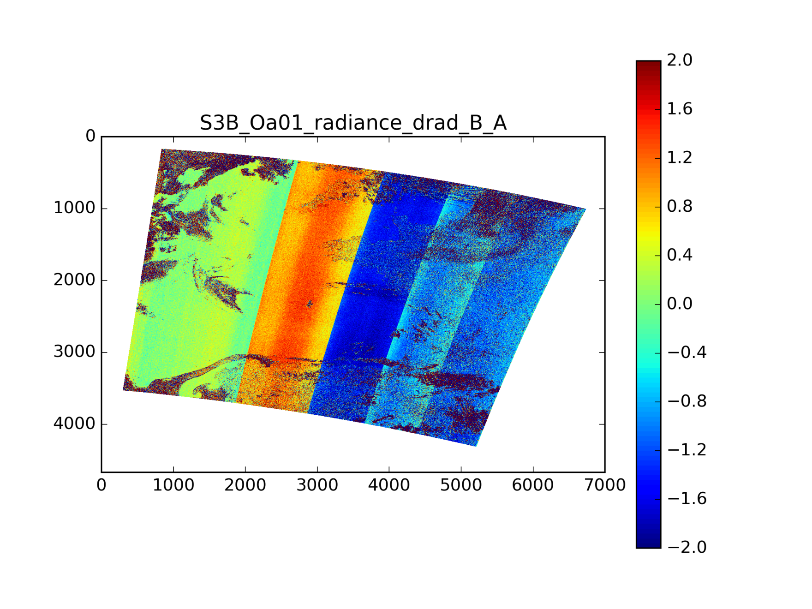
Homogenization benefits example: prior (i.e. comparisons at instrument wavelengths)
B radiance – A radiance, 400 nm
Strongest differences between cameras in TOA radiances at 400 nm…

Slide 10
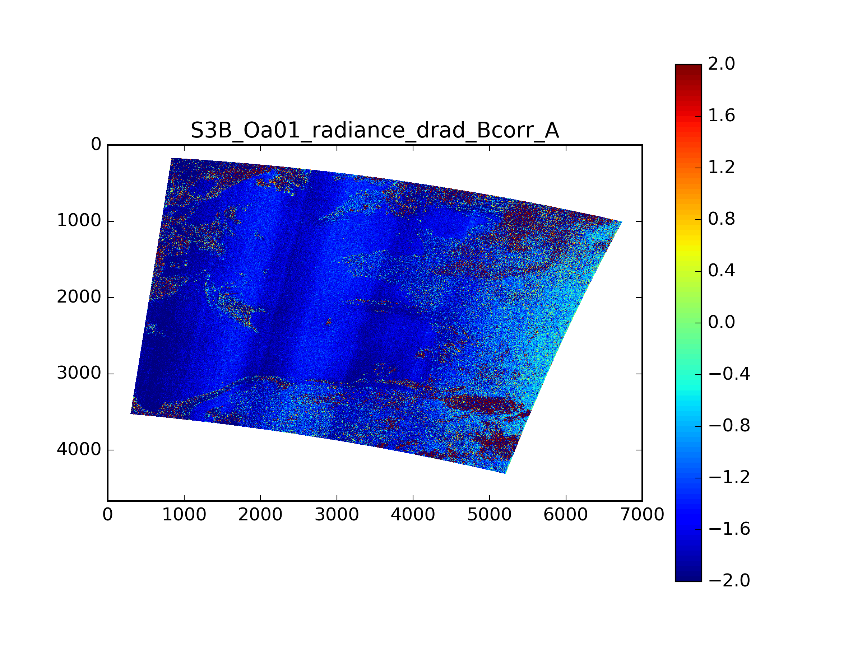
Homogenization benefits example: after (i.e. comparisons at nominal wavelengths)
B radiance – A radiance, 400 nm
…but due to the need of homogenizing the datasets
REMAINING DIFFERENCES TO INVESTIGATE !

Slide 11
Comparisons, one day statistics (20180702)
B / A -1 (%), 400 nm
histograms per bin of detectors (i.e. across the FOV, gathering data along-track)
differences are comparable for all targets Water/Land/Cloud
larger dispersion over clouds due to cloud motion and parallax effects, but mean is ok (in metrological language: less precision, same accuracy)
strong bias about 1-2% between A and B (seen at all bands, slightly decreasing with increasing wavelength)
intra-camera effects, though small in comparison (0.5 % roughly)

Slide 12
Comparisons, one day statistics (20180702)
B / A -1 (%), 412 nm and 510 nm

Slide 13
Comparisons, one day statistics (20180702)
B / A -1 (%), 940 nm
effect of strong gas absorption features not handled in the methodology → H₂O here, O₂ at dedicated bands… (even stronger)
clouds: higher altitude, less H₂O, less impact
needs a fine handling/modeling of absorption (not done here)

Slide 14
Comparisons, one day statistics (20180702)
B / A -1 (%), 1020 nm
at 1020 nm low signal over water → less precision
specific features detected here at 1020 nm, solves the issue “is that OLCI-A effect comes from the detector or the diffuser ?” → answer is detector as seen in the tandem comparison “bump”

Slide 15
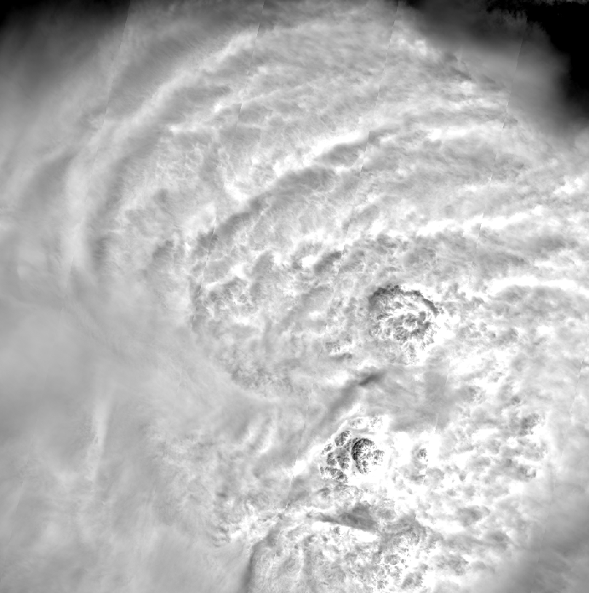
Why deep convective clouds ?
Benefits of DCCs: high reflectance, white target → smaller impact of wavelength shifts
Model: top-of-DCC reflectance x stratospheric gaseous absorption
whiteness →assume negligible variation with $λ_{A}$-$λ_{B}$
gas transmission can be modeled finely for strong absorption features
$ρ_{{TOA}_{A}}\left(θ_{s},θ_{v},∆φ,λ_{A}\right)=ρ_{DCC}^{}\left(θ_{s},θ_{v},∆φ,λ\right).T_{gas}\left(θ_{s},θ_{v},λ_{A}\right)$
$ρ_{{TOA}_{B}}\left(θ_{s},θ_{v},∆φ,λ_{B}\right)=ρ_{DCC}^{}\left(θ_{s},θ_{v},∆φ,λ\right).T_{gas}\left(θ_{s},θ_{v},λ_{B}\right)$
→ homogenization is much simpler,
only needs a model of Tgas
$ρ_{{TOA}_{B}}\left(θ_{s},θ_{v},∆φ,λ_{A}\right)=ρ_{{TOA}_{B}}\left(θ_{s},θ_{v},∆φ,λ_{B}\right)\frac{T_{gas}\left(θ_{s},θ_{v},λ_{A}\right)}{T_{gas}\left(θ_{s},θ_{v},λ_{B}\right)}$
or
$L_{{TOA}_{B}}\left(θ_{s},θ_{v},∆φ,λ_{A}\right)≅L_{TOA_{B}}\left(θ_{s},θ_{v},∆φ,λ_{B}\right).\frac{F_{0}\text{(}λ_{A}\text{). }T_{gas}\left(θ_{s},θ_{v},λ_{A}\right)}{F_{0}\text{(}λ_{B}\text{). }T_{gas}\left(θ_{s},θ_{v},λ_{B}\right)}$
DCC from MSI S2-A

Slide 16
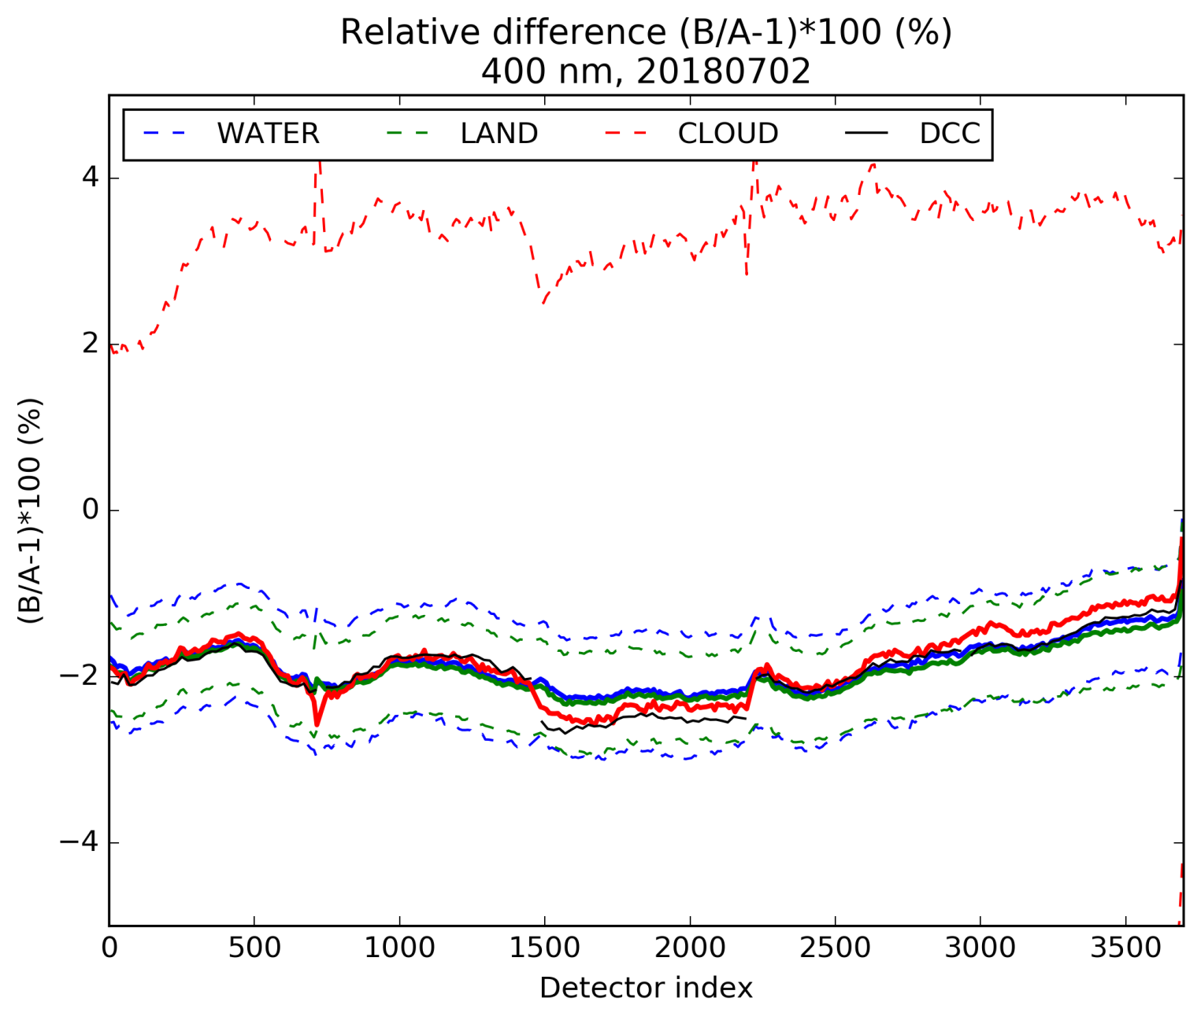
Deep convective clouds in tandem: comparisons to other targets (400 nm example…) 2018/07/02
perfect agreement
non-linearity ?

Slide 17
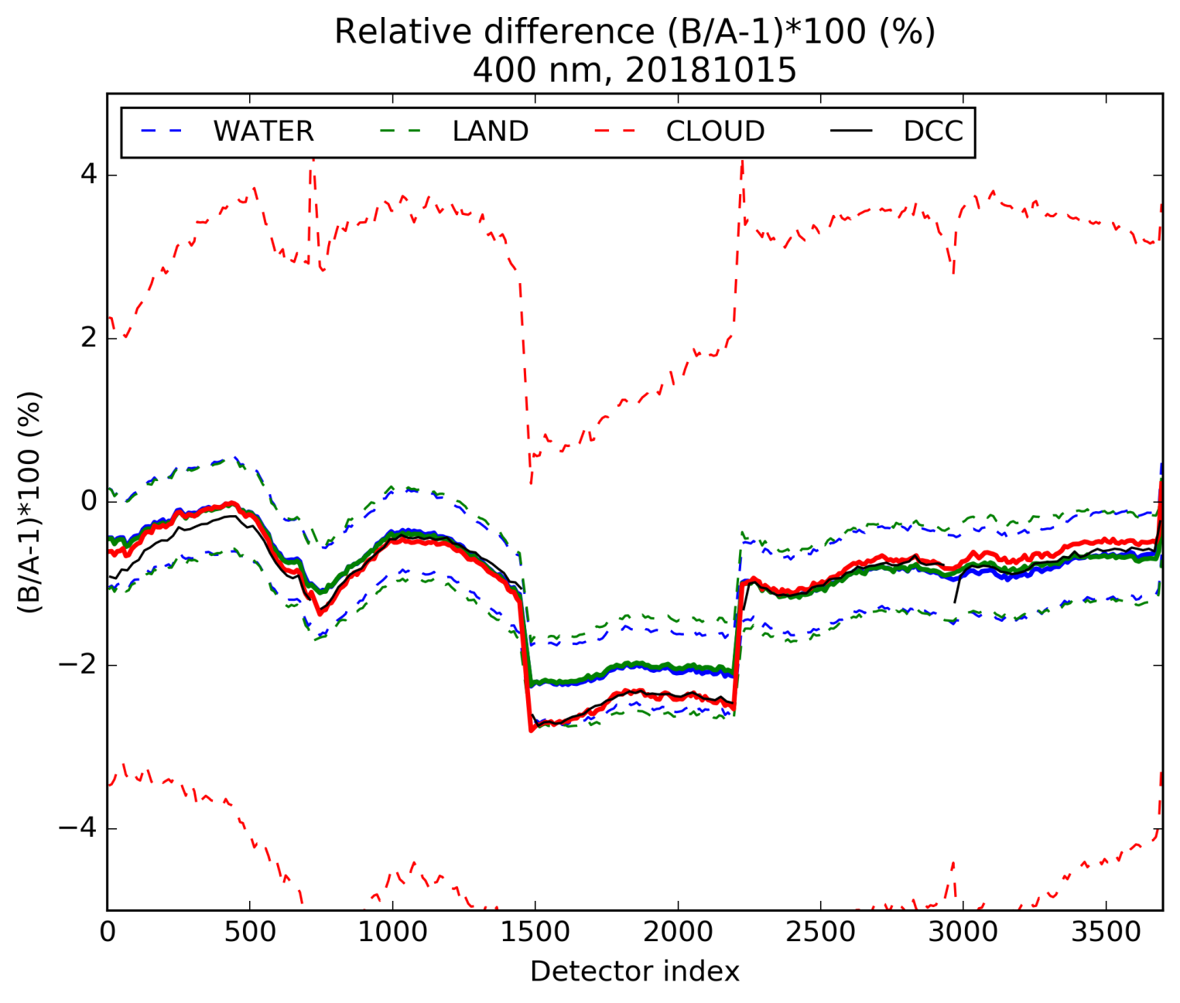
Deep convective clouds in tandem: comparisons to other targets (400 nm example…) 2018/10/15
Temporal effect on
all cameras except 3 at 400 nm

Slide 18
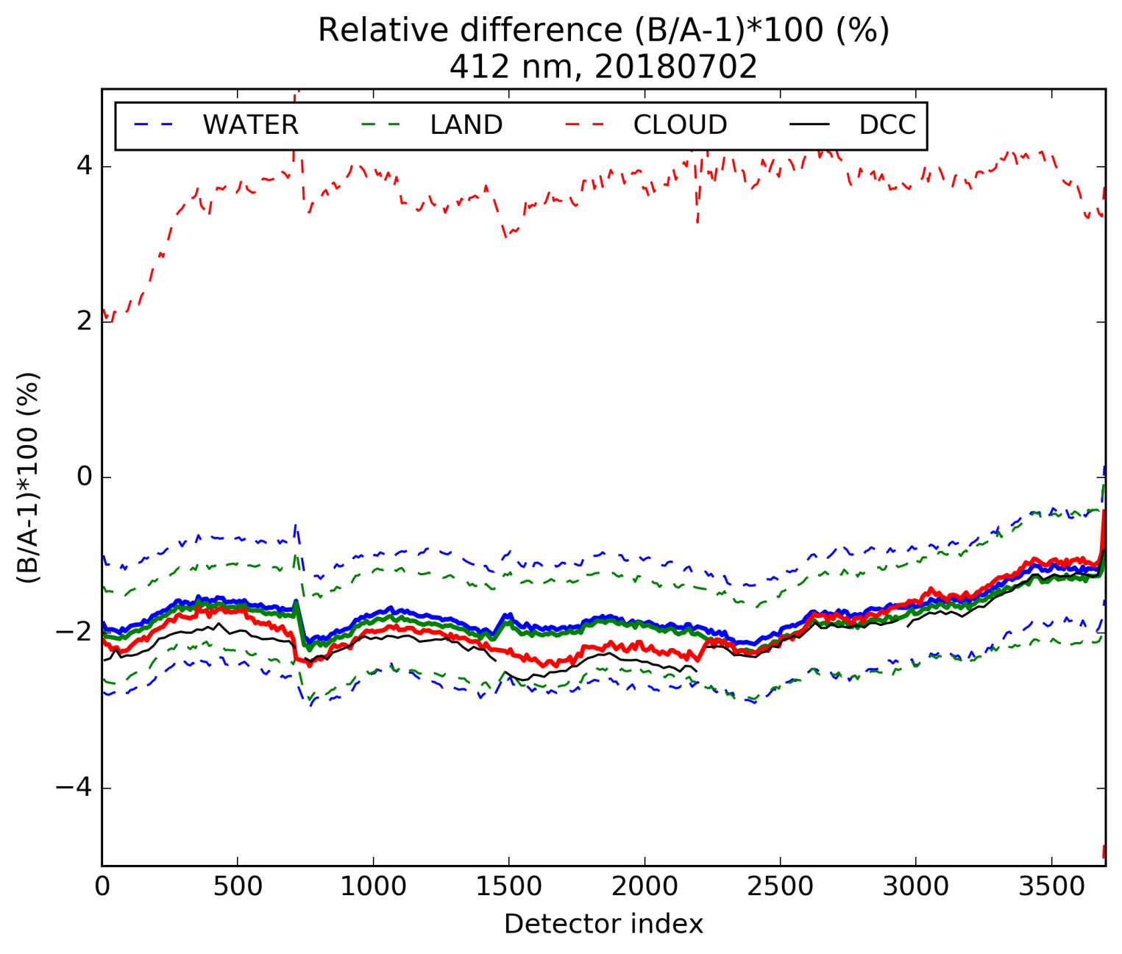
Deep convective clouds in tandem: comparisons to other targets (412 nm example…) 2018/07/02

Slide 19
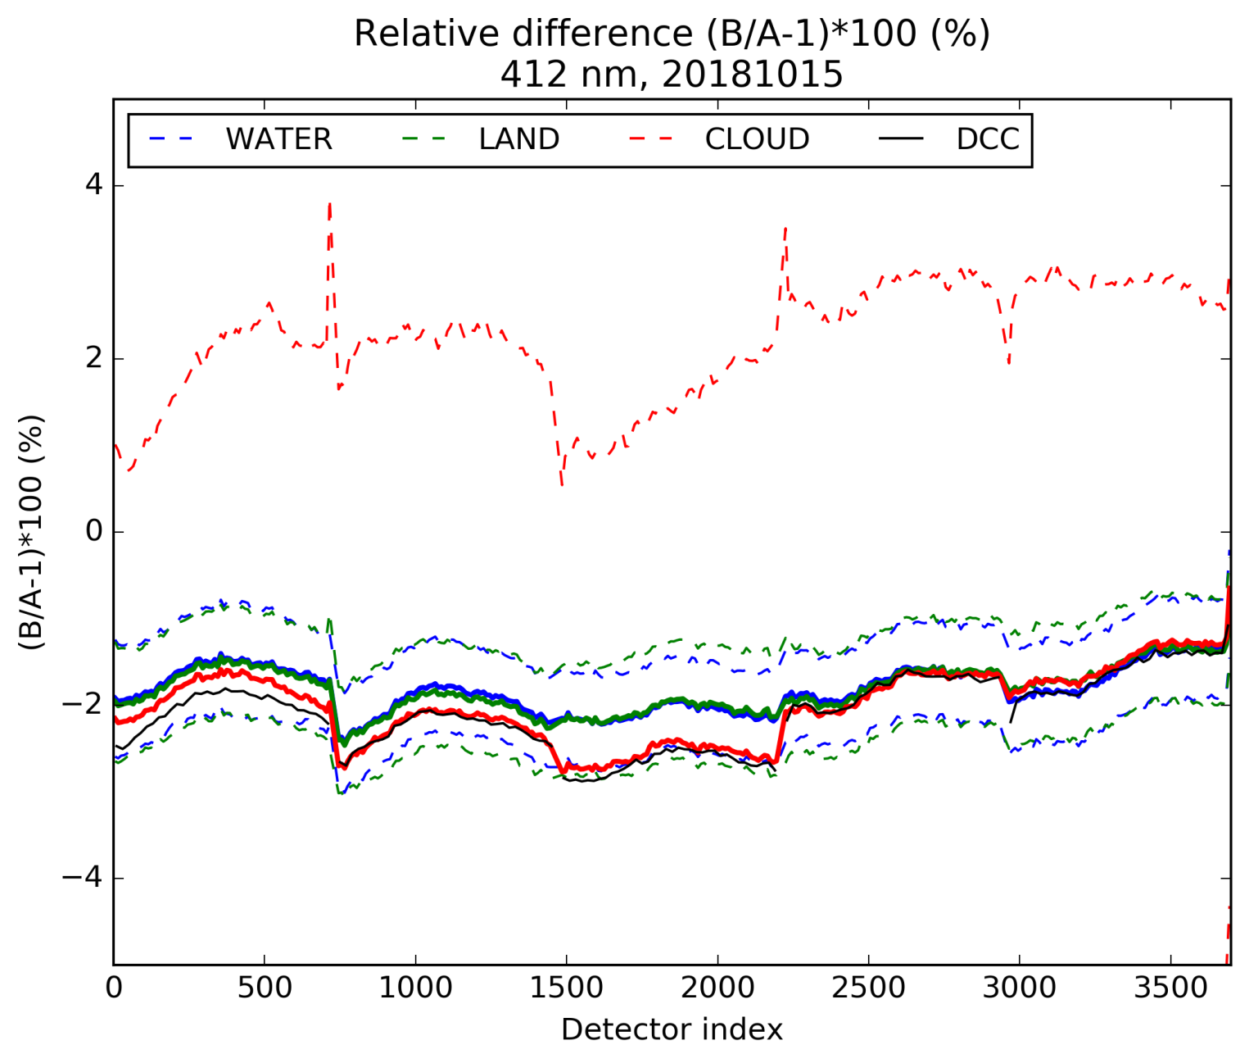
Deep convective clouds in tandem: comparisons to other targets (412 nm example…) 2018/10/15
Differences in time: S3B cal has no temporal degradation
applied in the dataset used

Slide 20
Deep convective clouds in tandem: comparisons to other targets (412 nm example…) 2018/10/15
Here we have « obtained » HOMOGENISATION coefficients. We could align one sensor on the other DETECTOR-PER-DETECTOR but we have NO ABSOLUTE REFERENCE.
Especially we have no consistency in the FOV / within the cameras though it seems like we have a constant bias + « something »…
Which sensor is producing these shapes (if any of the two) ? Both ?
We need to understand the origin per sensor → goal is HARMONISATION
→look at DCC statistics within the FOV

Slide 21
Deep convective clouds: interband methodology
Interband calibration validation methodology used for S2-MSI in
Lamquin, N., Bruniquel, V., and Gascon, F. (2017). Sentinel-2 L1C radiometric validation using deep convective clouds observations. European Journal of Remote Sensing, 51:1, 11-27, DOI: 10.1080/22797254.2017.1395713
Adapted to OLCI: compute LUTs of RTM at OLCI bands with instruments SRF
Proceed independently for OLCI-A and OLCI-B
Comparison to a model using a pivot at a reference band (you could use a purely white model if interested in the FOV dependencies only)
→ problem is: you take a reference band that also has FOV dependency (or is supposed to), best is to look at interband far from reference (e.g. 400 nm)

Slide 22
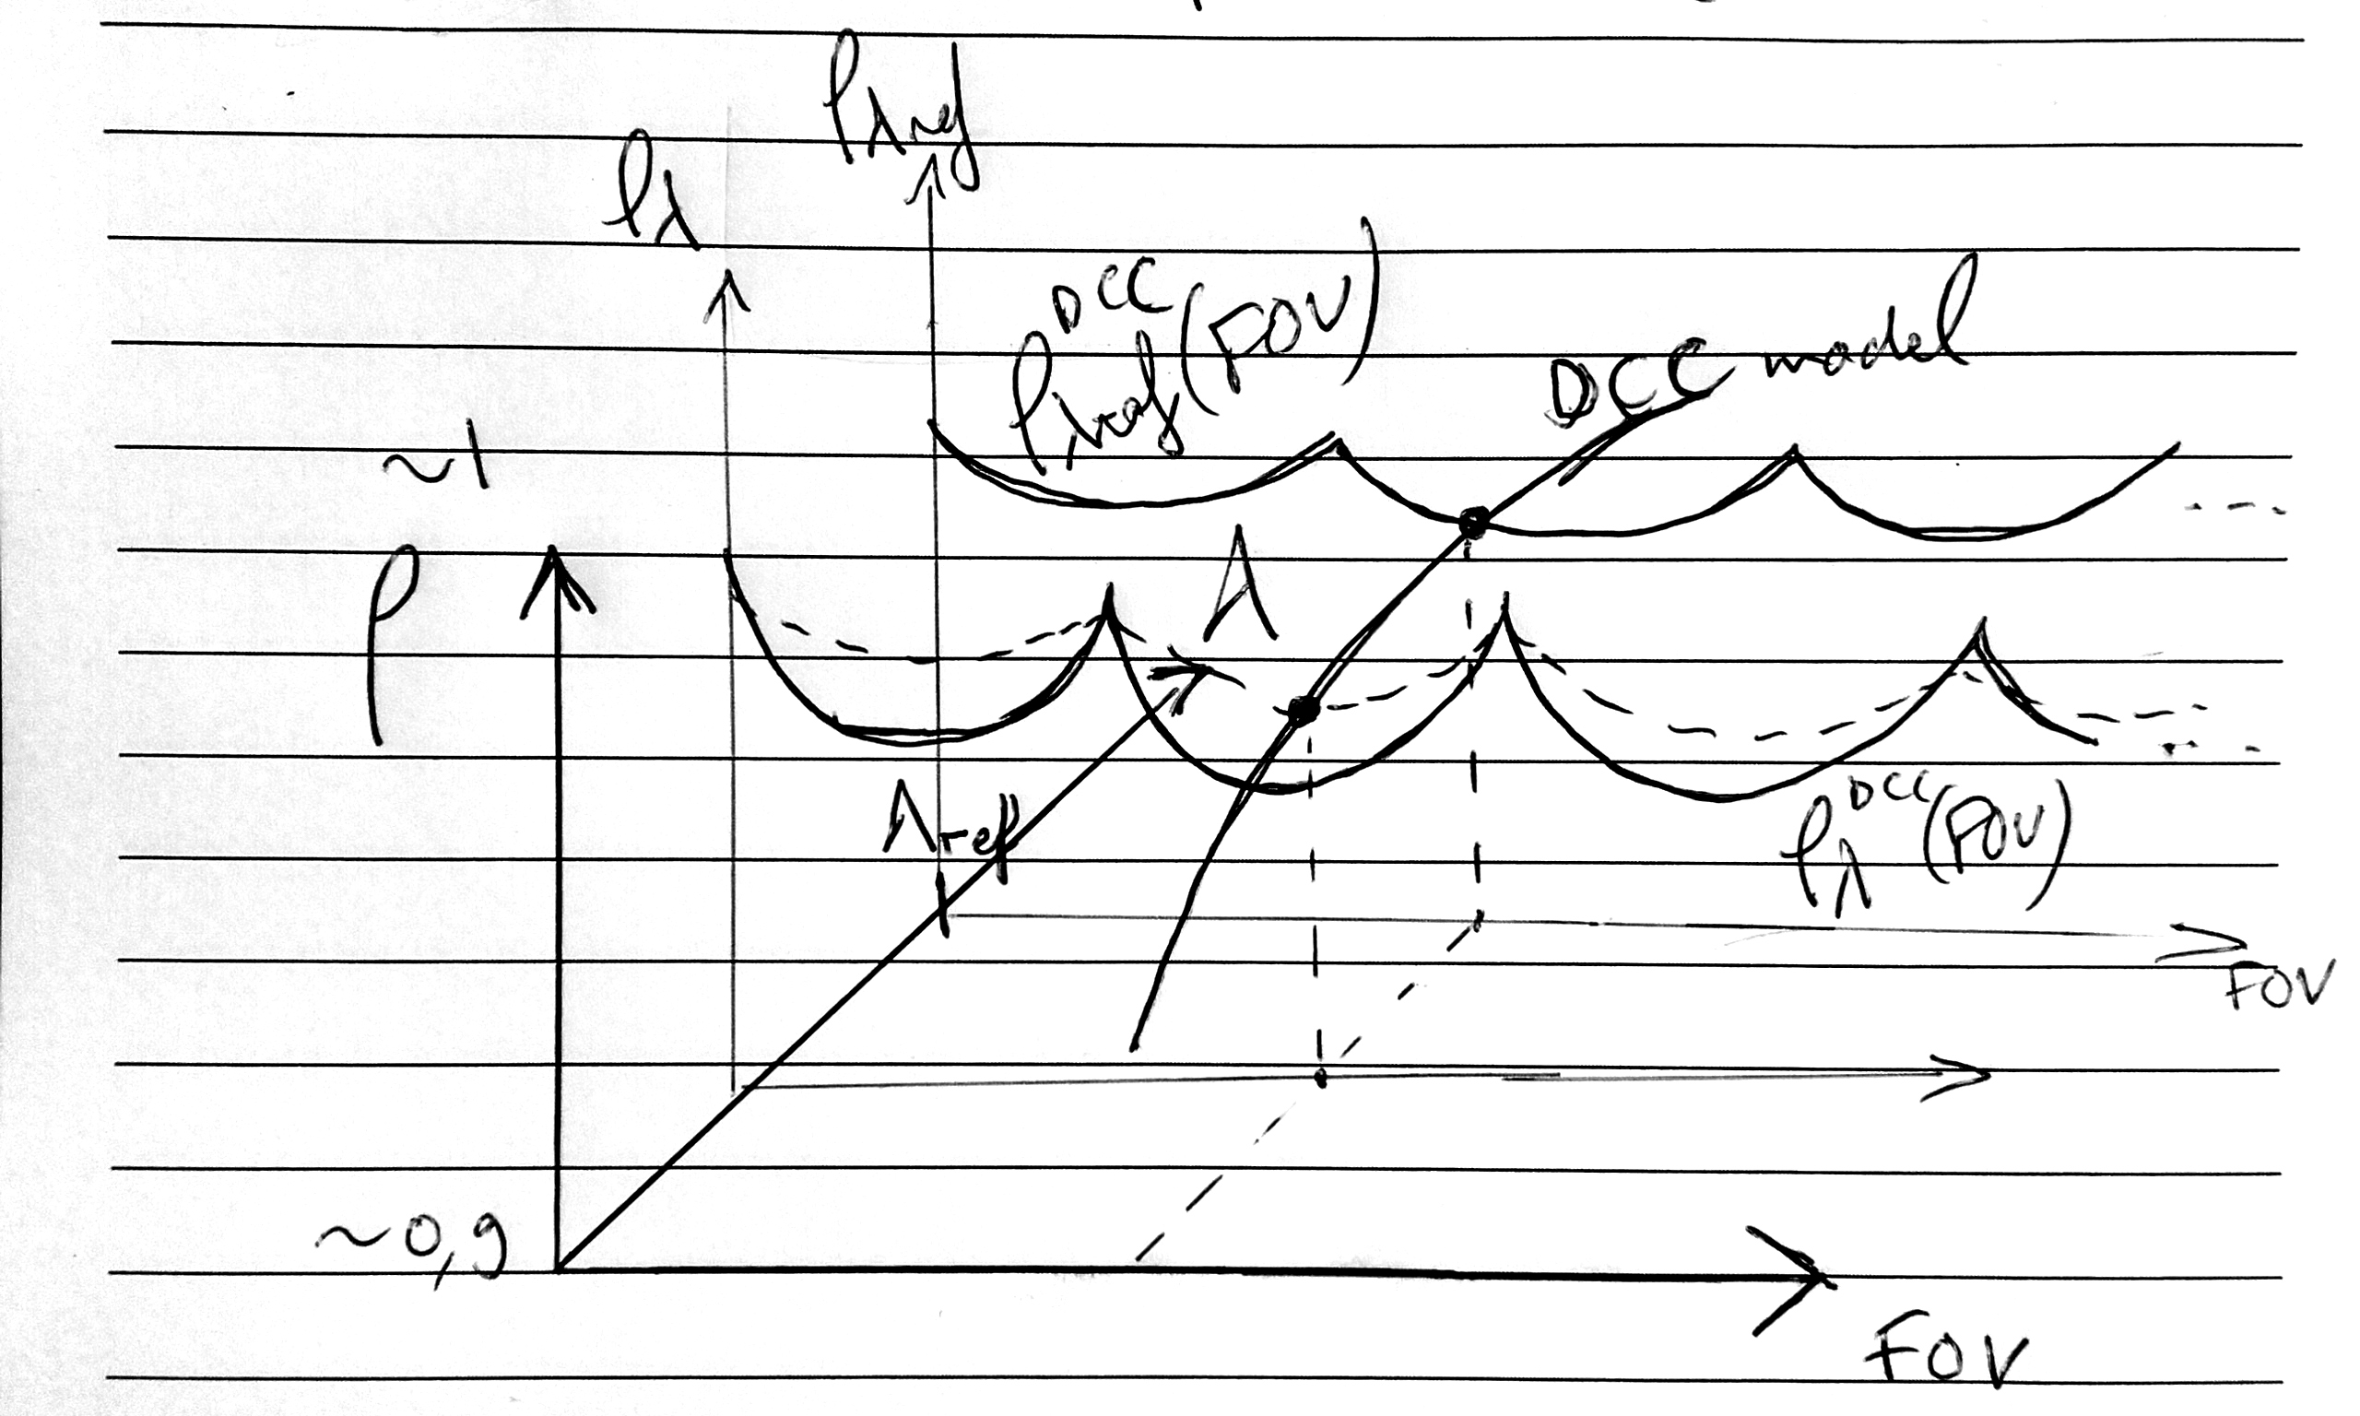
Deep convective clouds: interband methodology

Slide 23
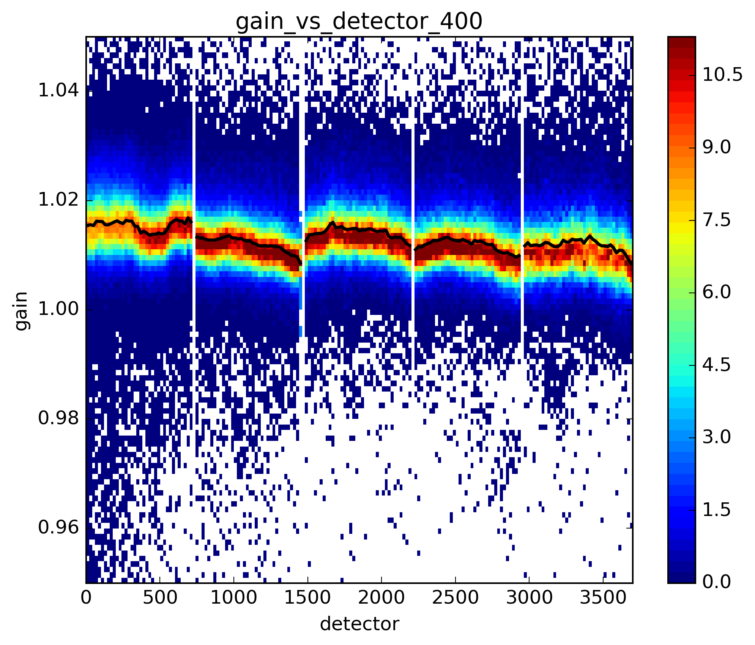
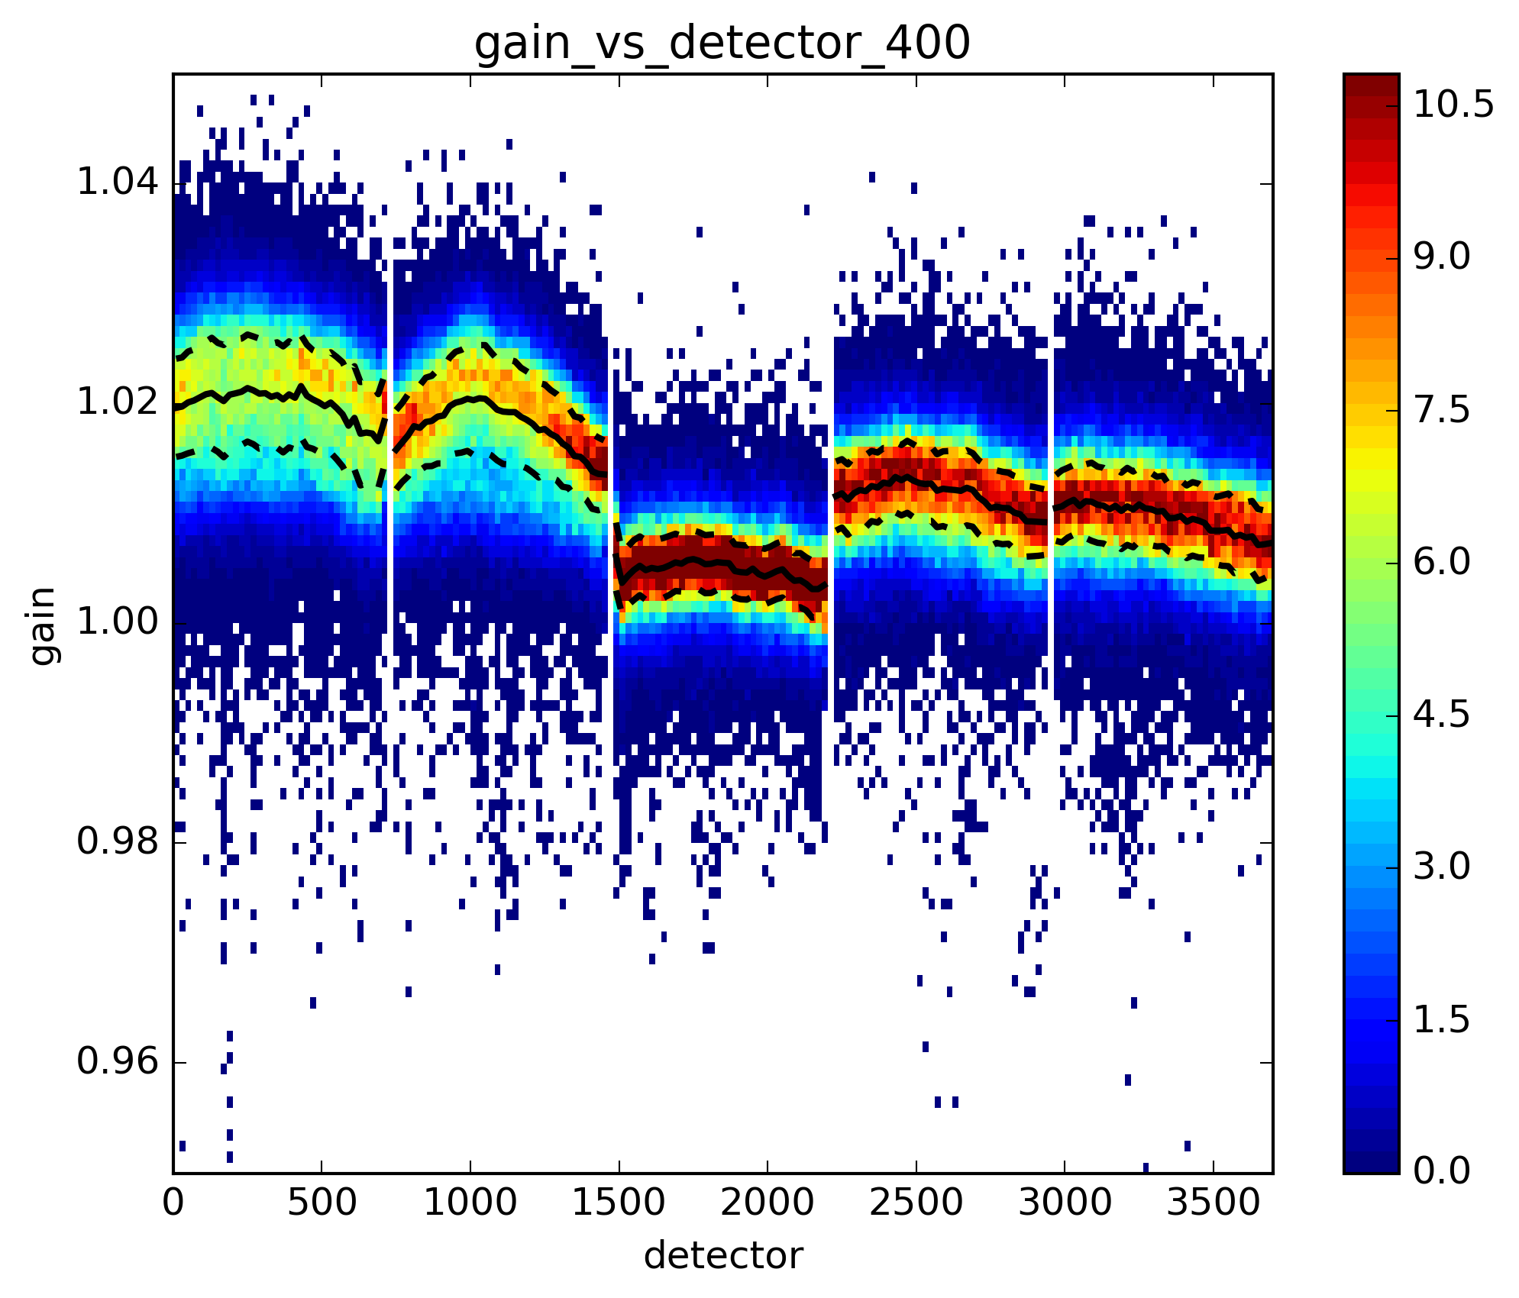
Deep convective clouds: interband 400 nm
(4 months macropixel statistics)
→400 nm more dispersion on B
$λref$=560 nm
OLCI A $ρ_{λ}/ρ_{λref}$
OLCI B $ρ_{λ}/ρ_{λref}$
Looking at intra-camera effects → same patterns in A and B
Inter-cameras effects are only indicative, not to be taken as absolute truth
Camera 3 in OLCI-B has an obvious different behaviour, needs more investigations

Slide 24
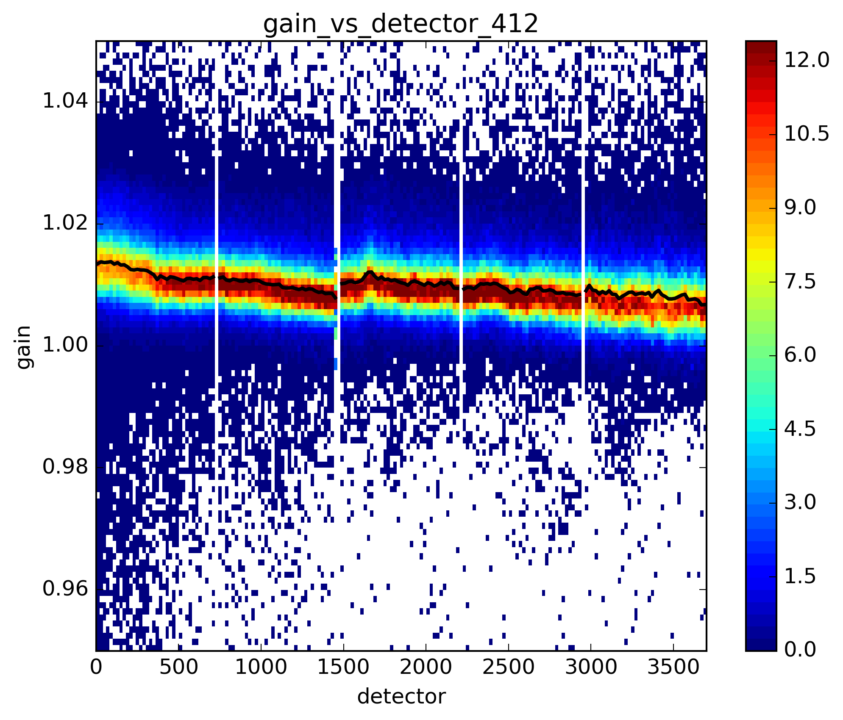
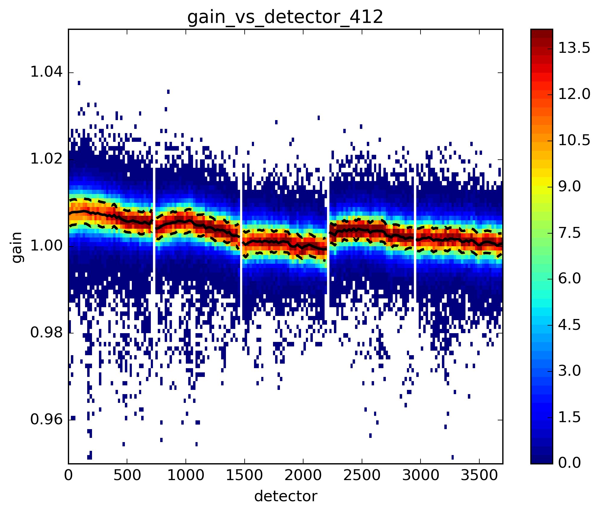
Deep convective clouds: interband 412 nm
OLCI A $ρ_{λ}/ρ_{λref}$
OLCI B $ρ_{λ}/ρ_{λref}$

Slide 25
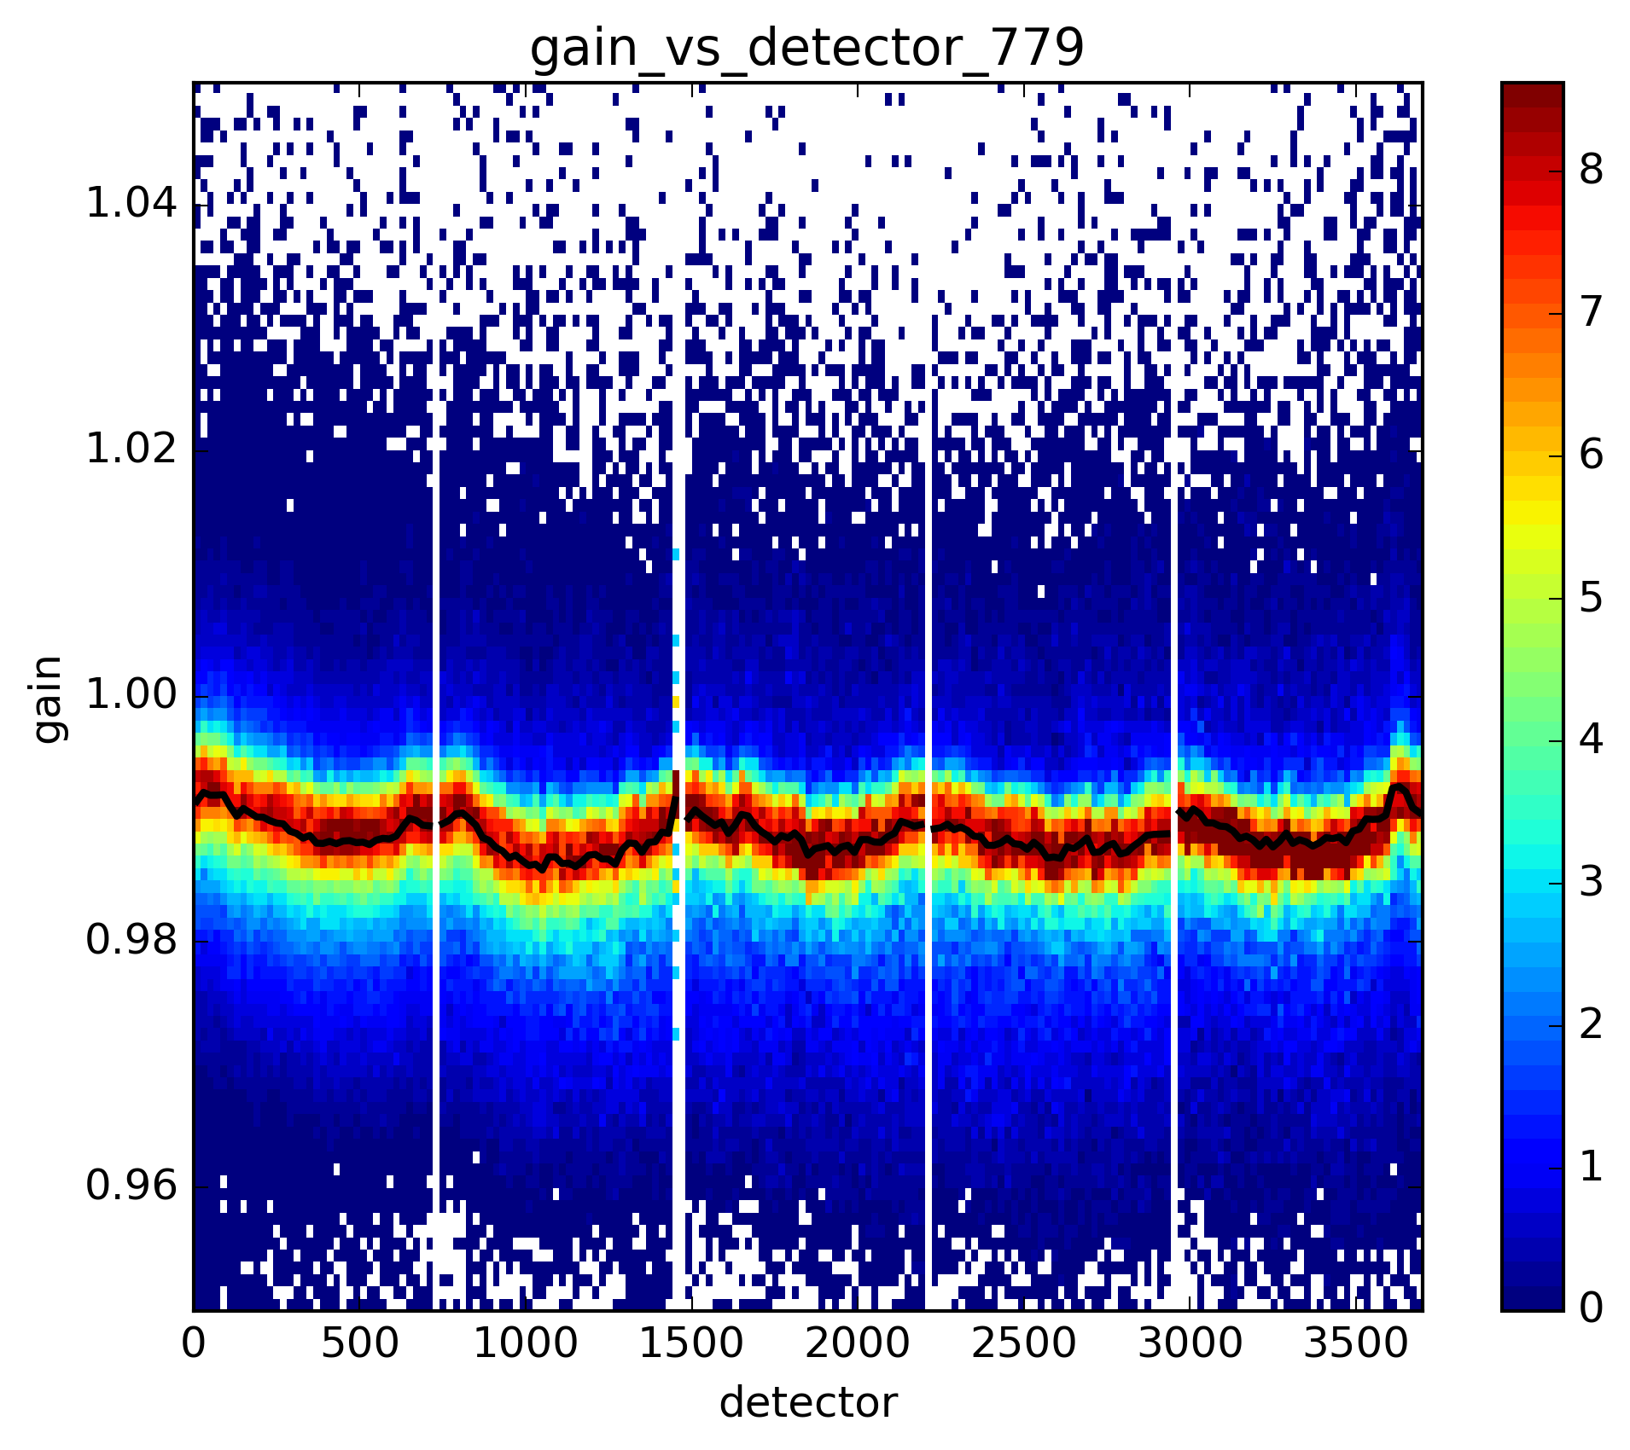
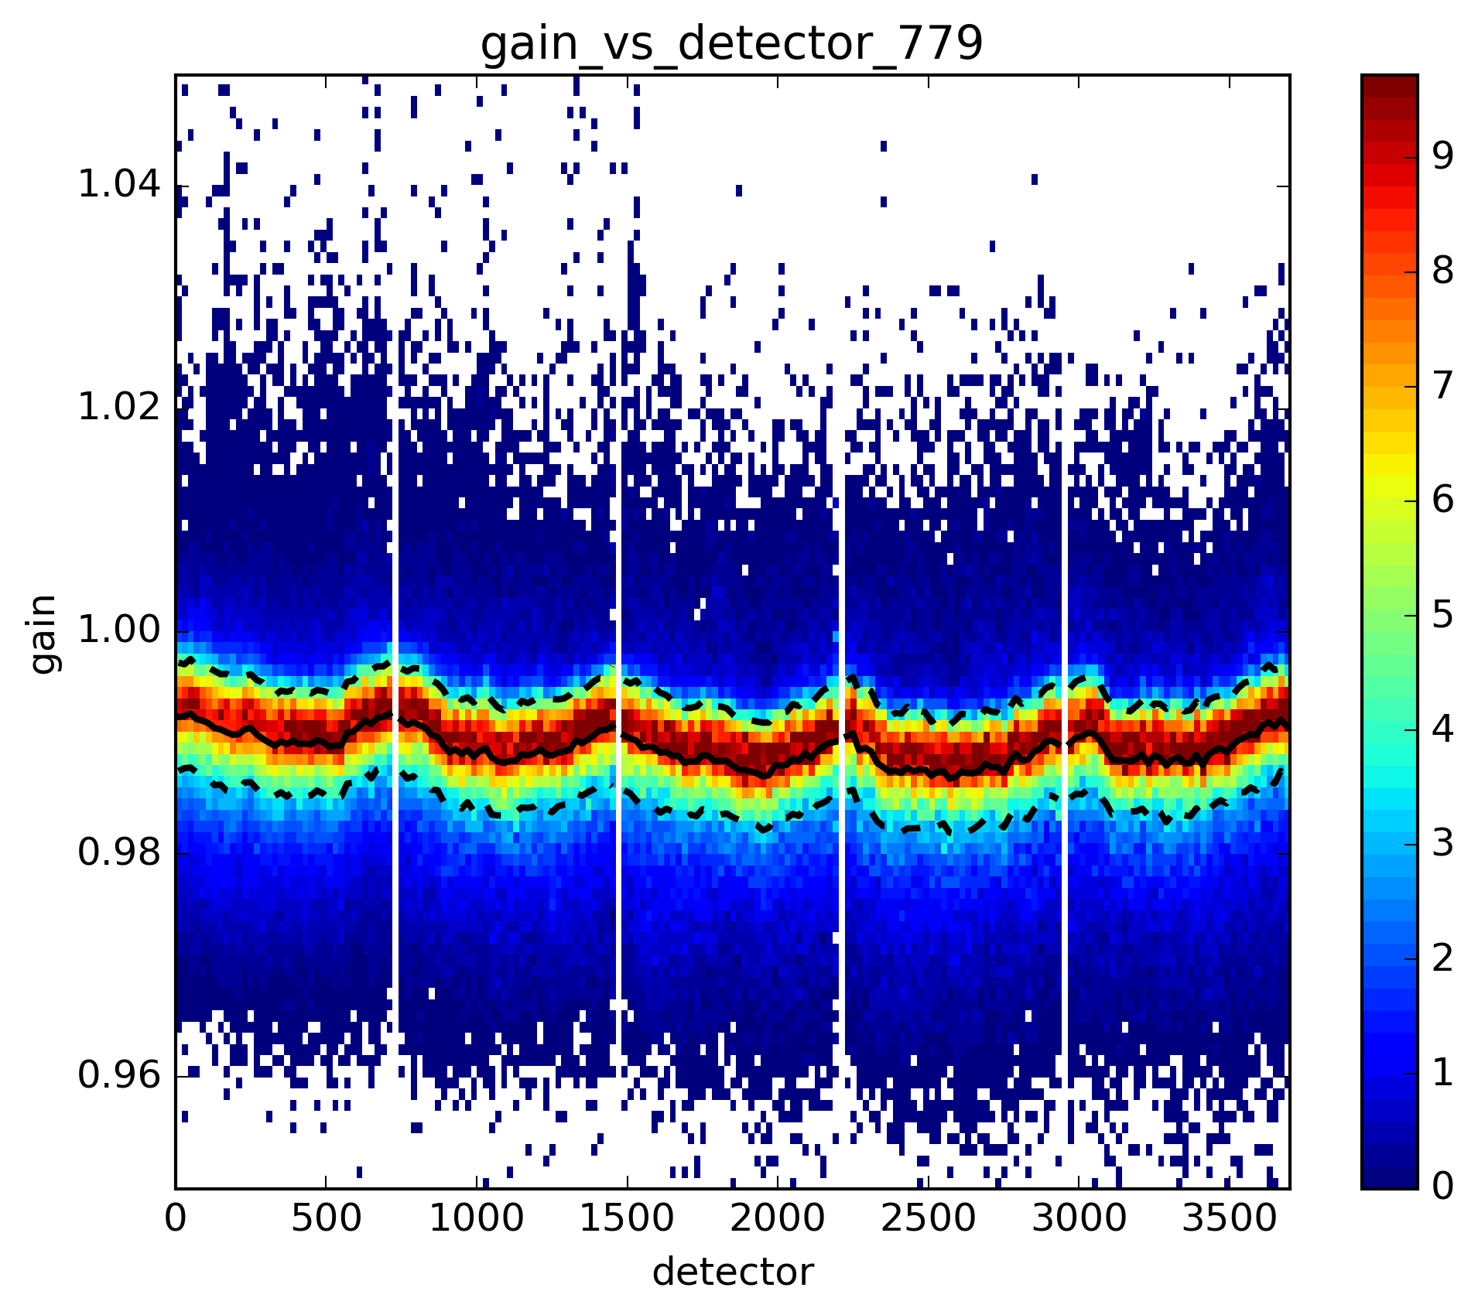
Deep convective clouds: interband 779 nm
OLCI A $ρ_{λ}/ρ_{λref}$
OLCI B $ρ_{λ}/ρ_{λref}$
Definitely intra-cameras effects both in A and B,
possibly related to absolute gains.

Slide 26
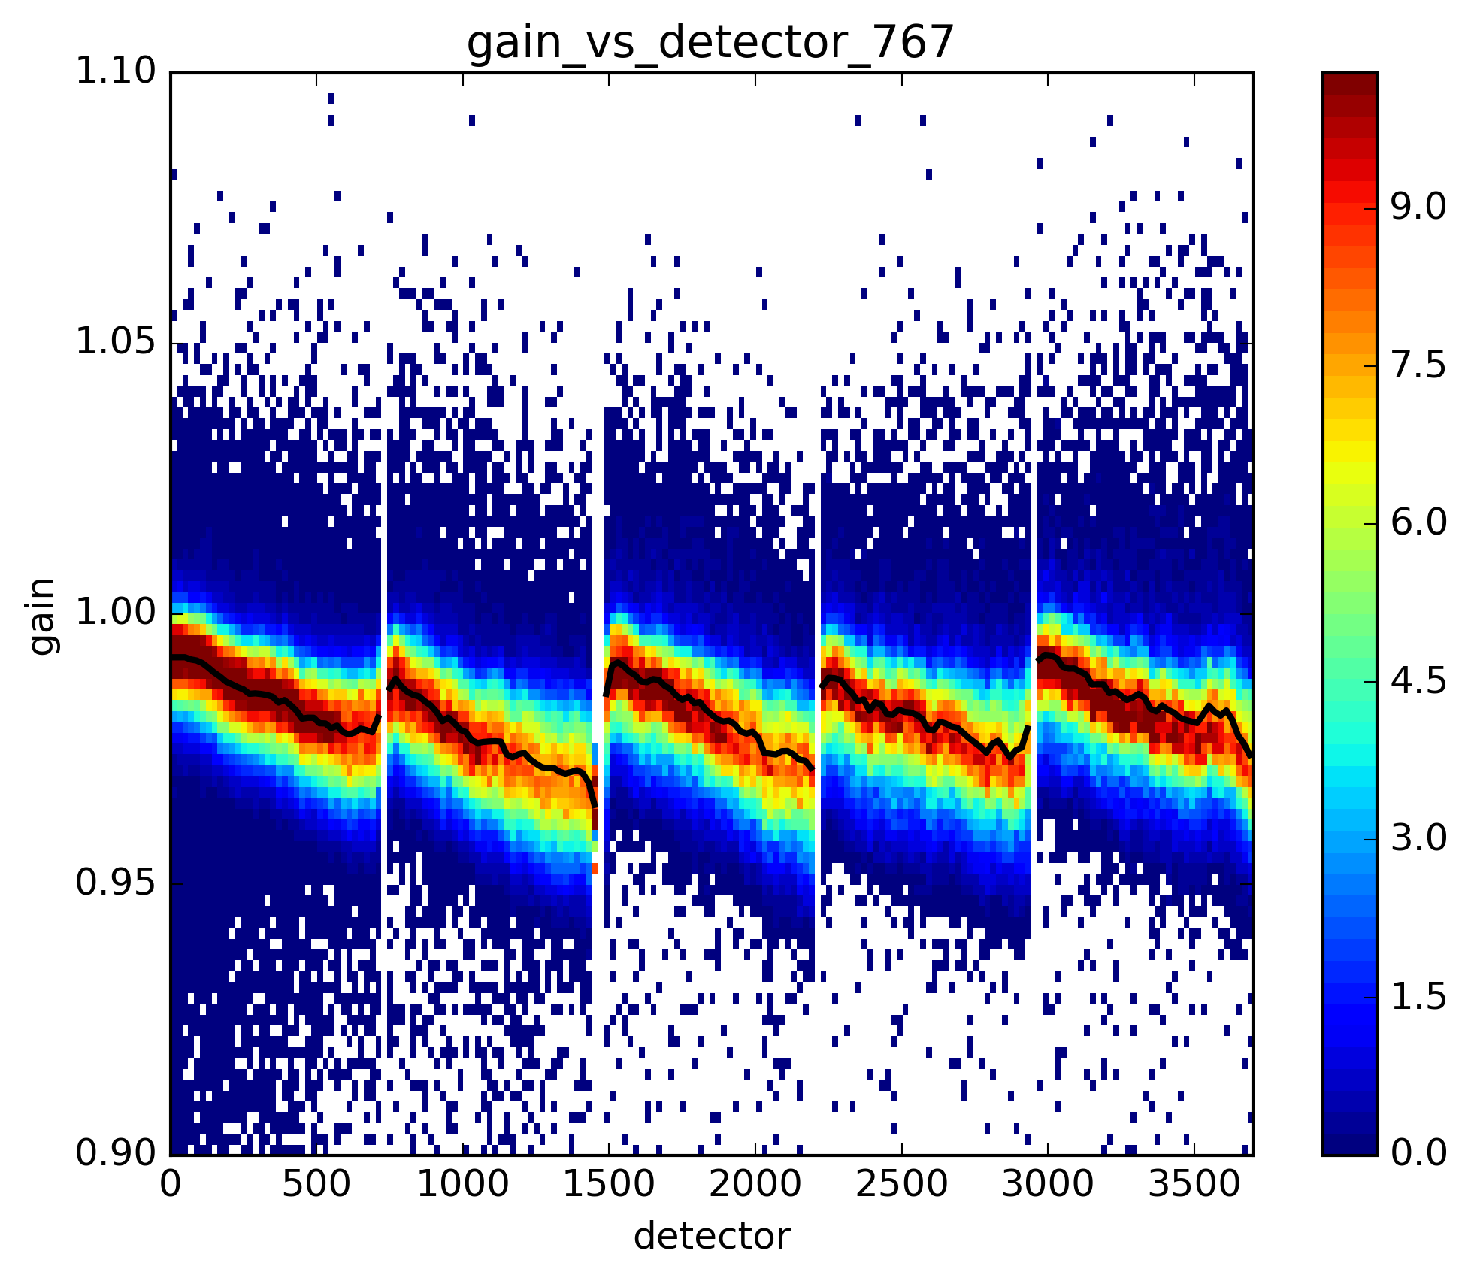
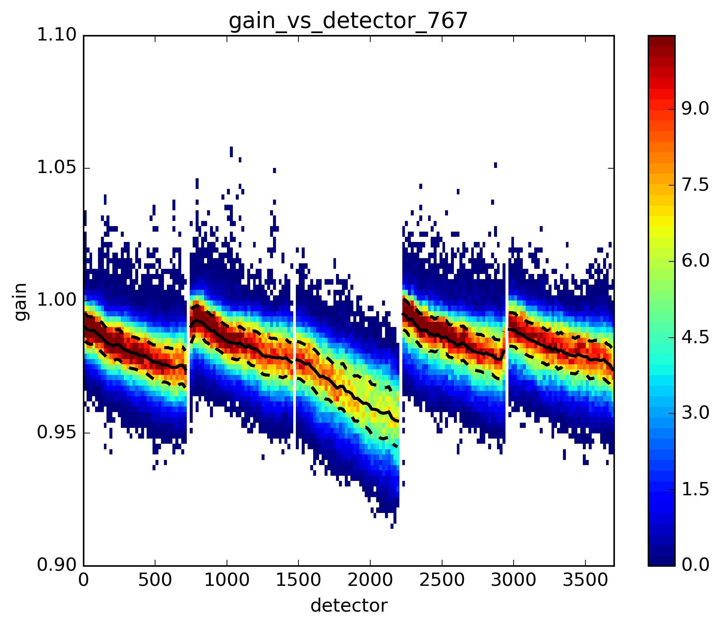
Deep convective clouds: interband 767 nm O₂ band
OLCI A $ρ_{λ}/ρ_{λref}$
OLCI B $ρ_{λ}/ρ_{λref}$
Strong absorption not well taken into account in Tgas model → remnant in DCC reflectance signal related to wavelength shift in the cameras

Slide 27
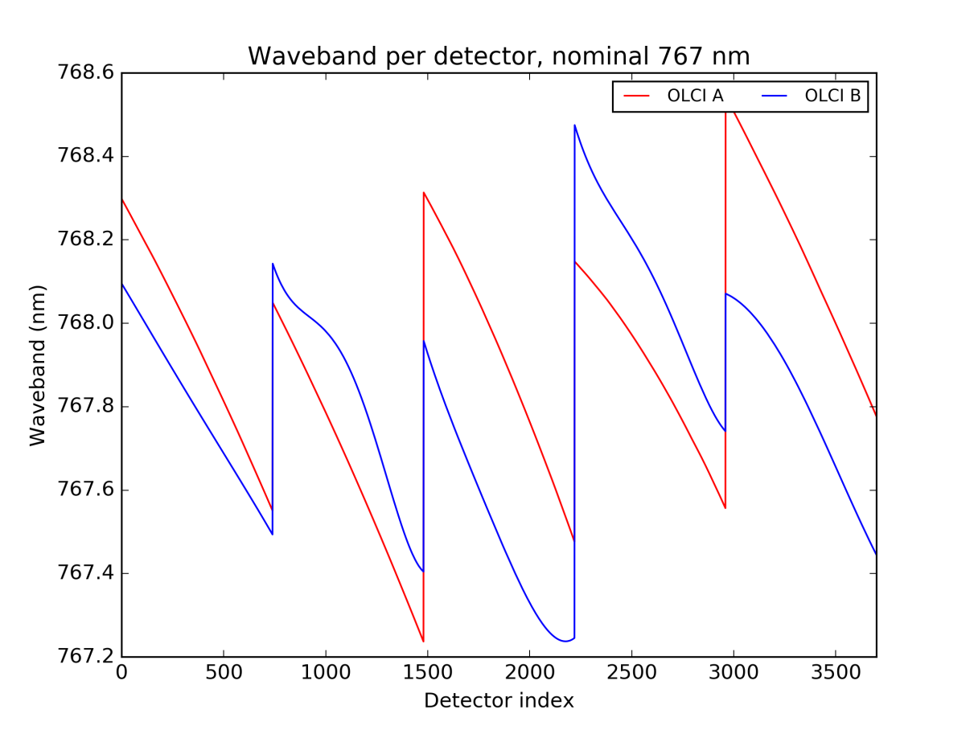
Deep convective clouds: interband 767 nm O₂ band
Spectral characterization 767 nm
Same « jumps » at camera interfaces in
OLCI-A and OLCI-B spectral characterizations

Slide 28
Deep convective clouds: interband 767 nm O₂ band
Same « jumps » in OLCI-A and OLCI-B but not same signature here
→ DCCs can bring information for spectral calibration

Slide 29
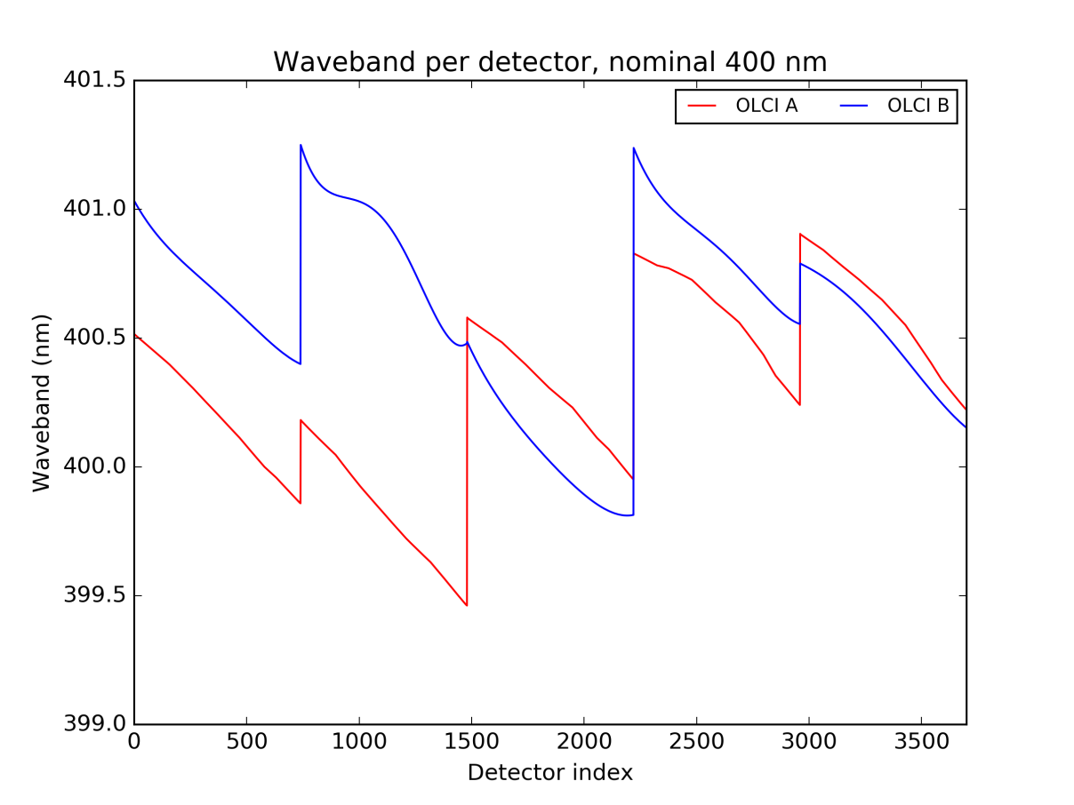
Deep convective clouds: interband 767 nm O₂ band
Spectral characterization at 400 nm
Same « jumps » in OLCI-A and OLCI-B but not same signature here
→ spectral characterization update needed ?
In the 400 nm spectral characterization, continuity found
Remember camera 3 BTW

Slide 30
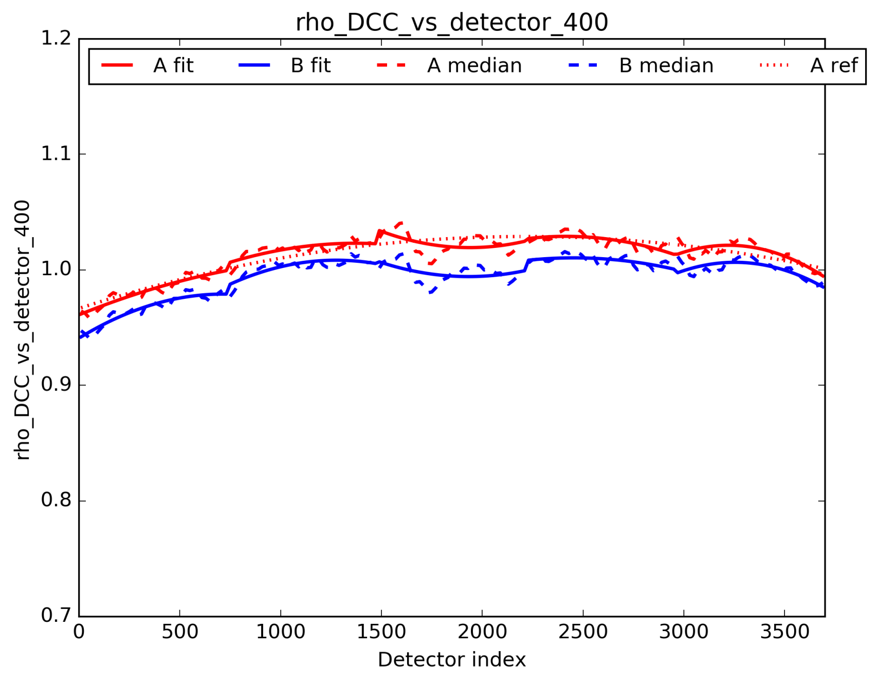
Deep convective clouds: absolute comparisons (tandem period, july 2018), example at 400 nm
DCC reflectance
empirical BRDF
supposing perfect FOV cal
Collocated tandem A/B observations
One month statistics (1 day/week = 4 days)
Fit per camera
Fit of average across the FOV =
intersection between OLCI geometry and BRDF

Slide 31
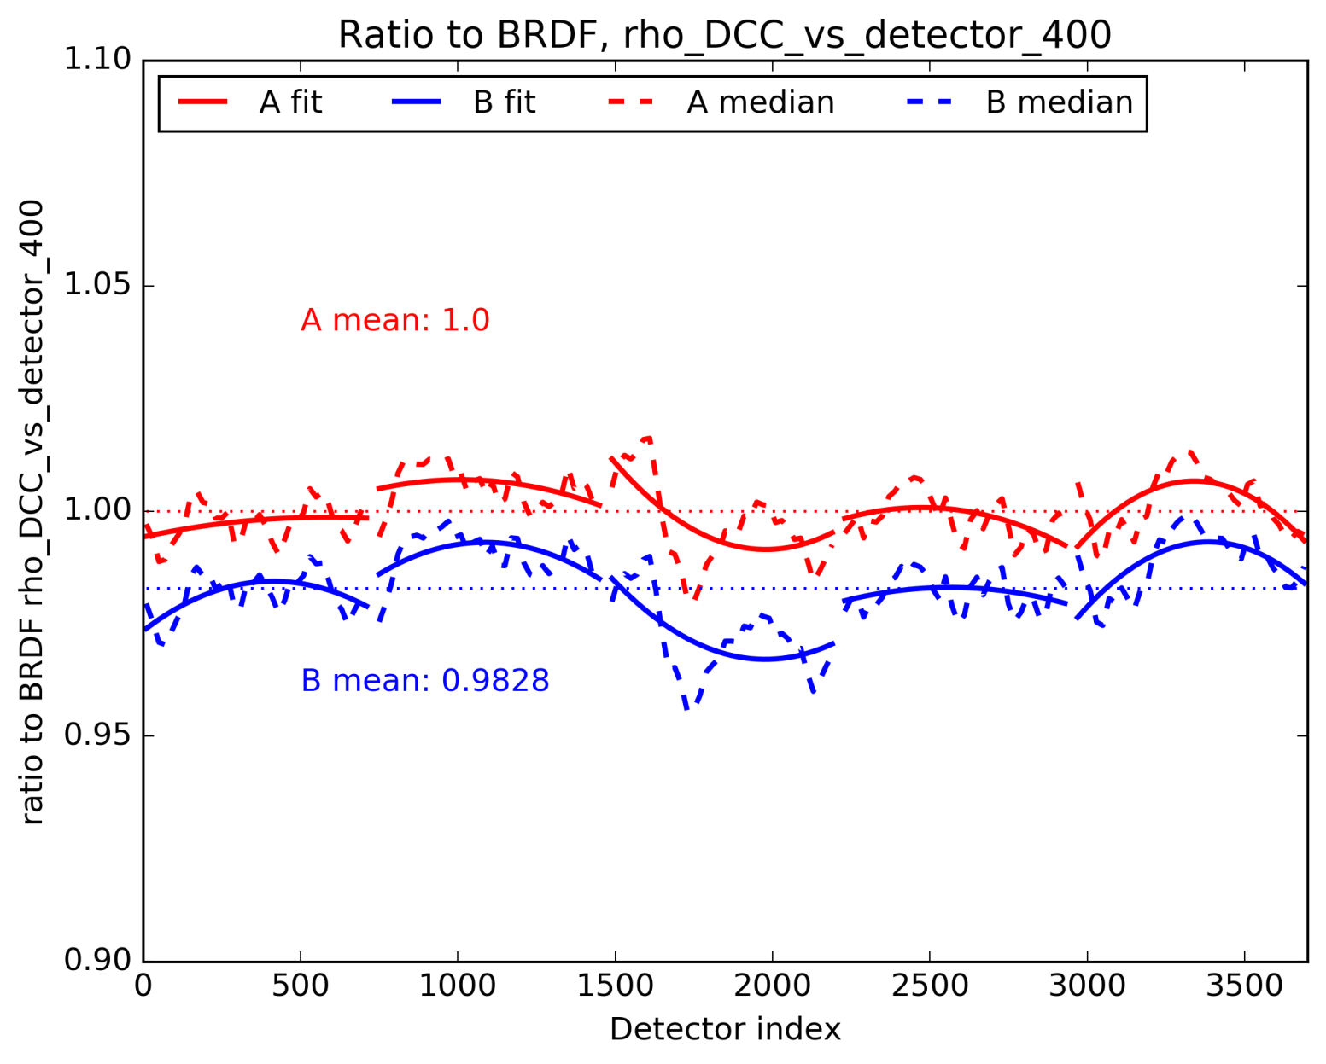
Deep convective clouds: absolute comparisons (tandem period, july 2018), example at 400 nm
DCC reflectance normalized by
OLCI-A BRDF across the FOV
Ratio to « average BRDF » gives absolute bias(es) + « something »
BUT: noise in DCC statistics → only indicative
Lucky dataset is same targets from tandem

Slide 32
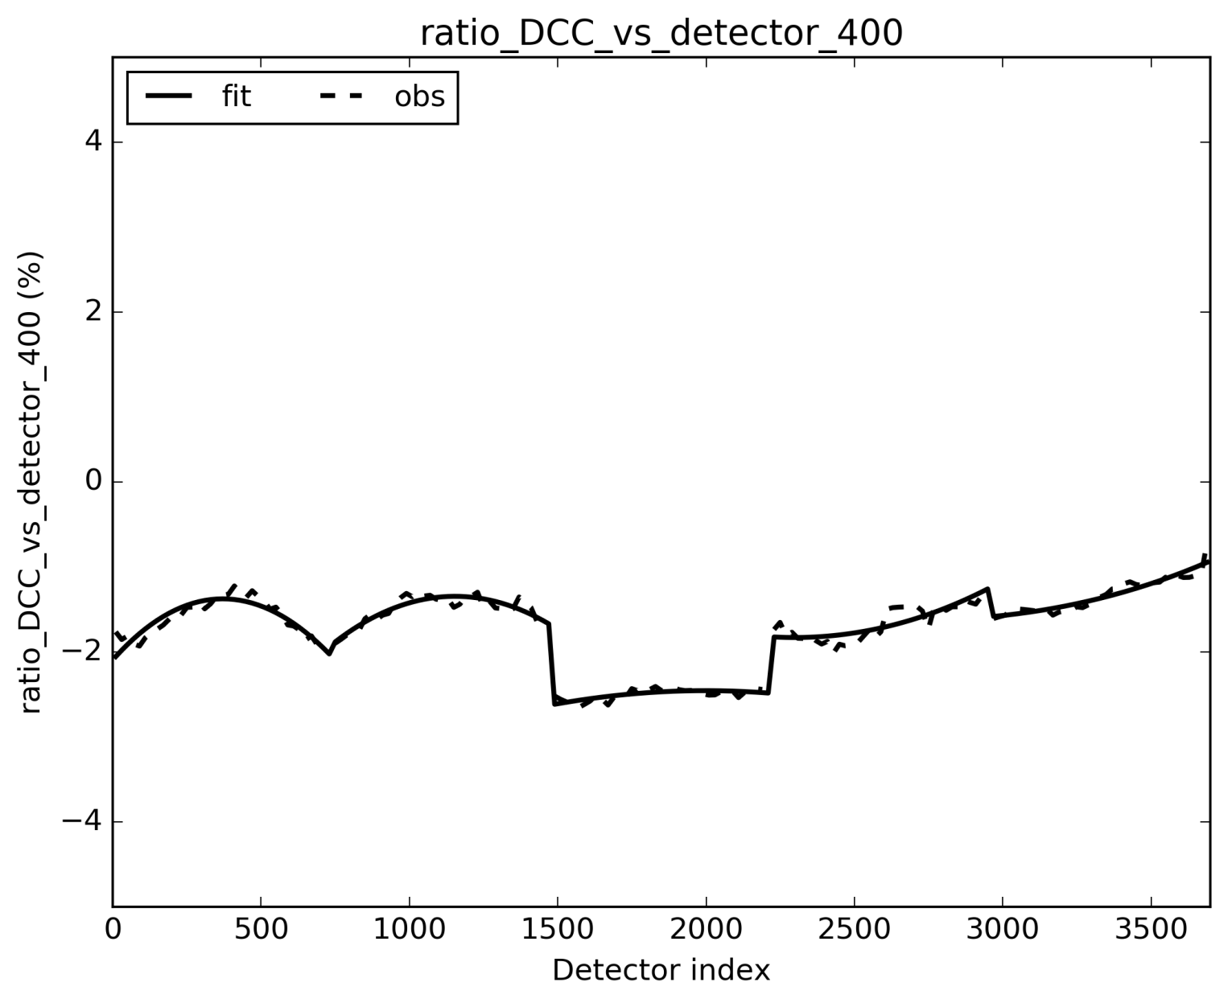
Deep convective clouds: absolute comparisons (tandem period, july 2018), example at 400 nm
Independent A/B assessment of DCC statistics fit the tandem results
BUT: not so independent since same targets over same period (tandem)
HOWEVER: shows that the statistics is consistent = absolute relative bias(es) hold
CAN WE OBTAIN THAT WITH INDEPENDENT
DATASETS ?
(B/A-1)%

Slide 33
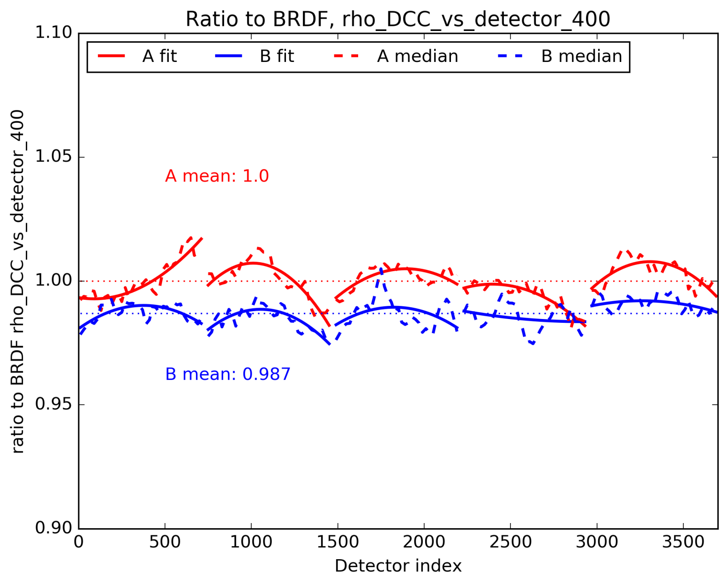
Deep convective clouds: test on January 2019
OLCI-A taken as absolute reference,
not necessarily true
Not far !
Same kind of effects, not full month covered, looks promising but needs more statistics to converge, maybe also better DCC pixels selection, hopefully !
Preliminary, to be consolidated

Slide 34
Conclusions and way forward
Tandem phase has a lot of benefits though it does not solve all problems
L1 comparisons requires homogenisation for proper comparisons, so do any sensor-to-sensor comparisons → requires some L2 tools/assumptions
Comparisons show calibration artefacts and bias between A and B OLCIs
DCCs offer the possibility to bypass homogenisation and perform very well for the comparisons
DCCs allow to check tiny calibration artefacts within the cameras → OLCI-A and OLCI-B behave similarly
DCC techniques can be used to some extent for A vs B absolute monitoring, out of the tandem
Final word: it is one step to see and understand differences, it is another to decide what to do next…
Future: inspect drift phase and L2 tandem

