Slide 1
S3 SLSTR VIS-SWIR Calibration
Dave Smith – SLSTR Calibration Scientist
Mireya Etxaluze, Ed Polehampton
RAL Space, Science and Technologies Facilities Council, United Kingdom

Slide 2
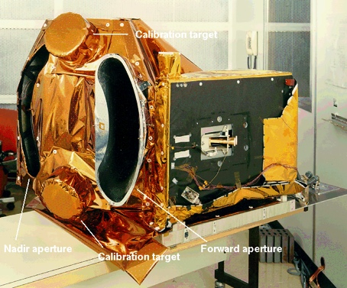
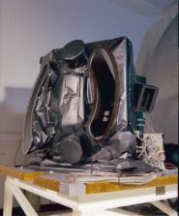
ATSR Series
1991-2000 ATSR-1
1995-2008 ATSR-2
2002-2012- AATSR

Slide 3
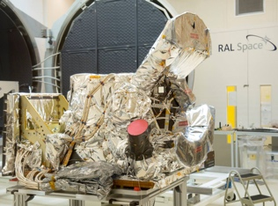
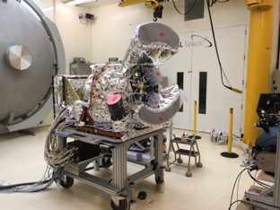
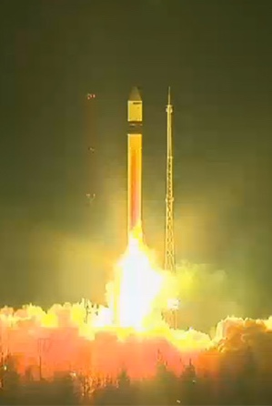
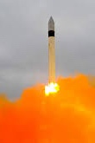
Sentinel-3 Series
2016 – Sentinel 3A
2018 – Sentinel 3B
2021 – Sentinel 3C
Spectral Calibration in progress
Instrument Calibration Spring 2019
2023 – Sentinel-3D
…
Launched 16-Feb-2016 ☺
Launched 25-Apr-2018 ☺

Slide 4
Sea and Land Surface Temperature Radiometer
Nadir swath >74° (1400km swath)
Dual view swath 49° (750 km)
Two telescopes Φ110 mm / 800mm focal length
Spectral bands TIR : 3.74µm, 10.85µm, 12µm
SWIR : 1.38µm, 1.61µm, 2.25 µm
VIS: 555nm, 659nm, 859nm
Spatial Resolution 1km at nadir for TIR, 0.5km for VIS/SWIR
Radiometric quality NEΔT 30 mK (LWIR) – 50mK (MWIR)
SNR 20 for VIS - SWIR
Radiometric accuracy 0.2K for IR channels
2% for Solar channels relative to Sun

Slide 5
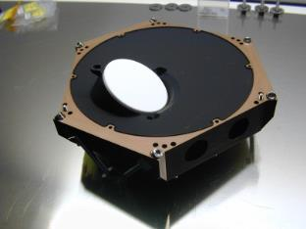
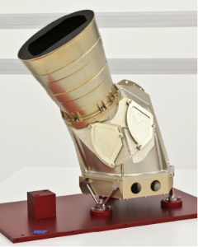
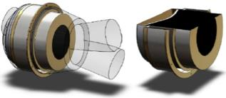
On-Board Calibration systems
Thermal InfraRed
Blackbodies
VIS-SWIR Channels
VISCAL
Effective e >0.998
T non-uniformity < 0.02 K
T Abs. Accuracy 0.07 K
T stability < 0.3 mK/s
8 PRT sensors + 32 Thermistors
Zenith diffuser + relay mirrors
Uncertainty <2%

Slide 6
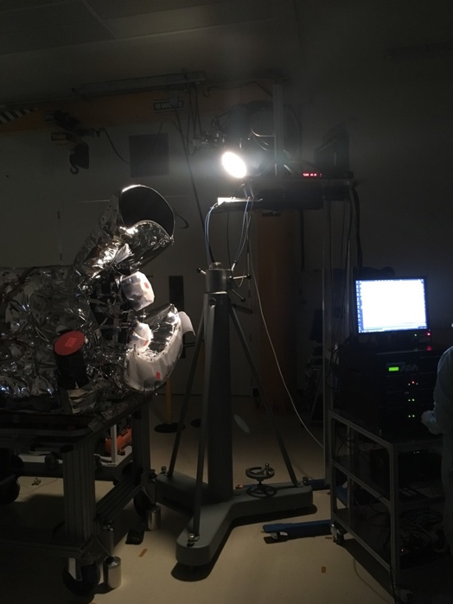
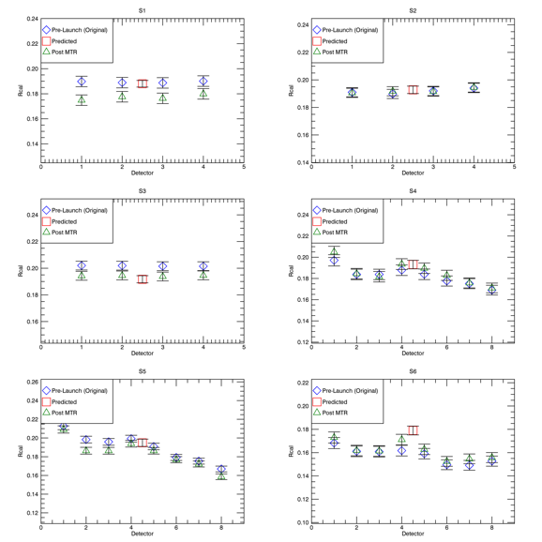
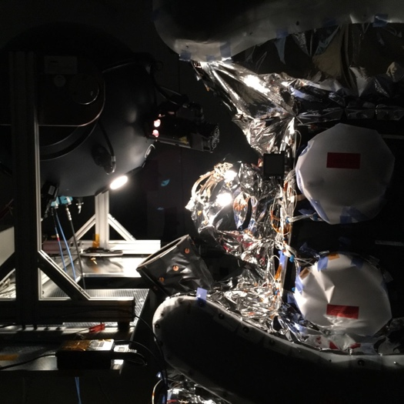
Pre-Launch Calibration
Pre-Launch Calibration was to characterise key instrument performance
Radiometric response of each detector
Signal-to-Noise performance of each detector
Reflectance factor of VISCAL system
Polarisation sensitivity
Reflectance factors for SLSTR-B

Slide 7
Vicarious Calibration Approach
Analysis using stable desert and ice targets as used for ATSR series, MERIS, MODIS etc…
To avoid having to download large volumes of data, L1 images over desert, ice, sunglint have been processed using S3ETRAC tool and TOA reflectances + ancillary information are saved to Netcdf files.
Approach was developed and used successfully for AATSR
Tool developed by ACRI-ST based on specifications from CNES and RAL
Extractions allow comparisons with other sensors
Directly as in the case of SLSTR and OLCI/AATSR and MERIS
Indirectly where satellites are not time coincident using matching geometry
E.g. AATSR/MERIS vs MODIS
E.g. AATSR vs ATSR-2 vs ATSR-1

Slide 8
Calibration Sites Extracted using S3ETRAC
Site name | North Latitude | South Latitude | East Longitude | West Longitude | Latitude size | Longitude size
CEOS_ALGERIA-3 | 30.82 | 29.82 | 8.16 | 7.16 | 1 | 1
CEOS_ALGERIA-5 | 31.52 | 30.52 | 2.73 | 1.73 | 1 | 1
CEOS_LIBYA-1 | 24.92 | 23.92 | 13.85 | 12.85 | 1 | 1
CEOS_LIBYA-4 | 29.05 | 28.05 | 23.89 | 22.89 | 1 | 1
CEOS_MAURITANIA-1 | 19.9 | 18.9 | -8.8 | -9.8 | 1 | 1
CEOS_MAURITANIA-2 | 21.35 | 20.35 | -8.28 | -9.28 | 1 | 1
Algeria 1 | 24.25 | 23.35 | 0.05 | -0.85 | 0.9 | 0.9
Algeria 2 | 26.54 | 25.64 | -0.93 | -1.83 | 0.9 | 0.9
Algeria 3 | 30.77 | 29.87 | 8.11 | 7.21 | 0.9 | 0.9
Algeria 4 | 30.49 | 29.59 | 6.04 | 5.14 | 0.9 | 0.9
Algeria 5 | 31.47 | 30.57 | 2.68 | 1.78 | 0.9 | 0.9
Arabia 1 | 19.33 | 18.43 | 47.21 | 46.31 | 0.9 | 0.9
Arabia 2 | 20.58 | 19.68 | 51.41 | 50.51 | 0.9 | 0.9
Arabia 3 | 29.37 | 28.47 | 44.18 | 43.28 | 0.9 | 0.9
Egypt 1 | 27.57 | 26.67 | 26.55 | 25.65 | 0.9 | 0.9
Libya 1 | 24.87 | 23.97 | 13.8 | 12.9 | 0.9 | 0.9
Libya 2 | 25.5 | 24.6 | 20.93 | 20.03 | 0.9 | 0.9
Libya 3 | 23.6 | 22.7 | 23.55 | 22.65 | 0.9 | 0.9
Libya 4 | 29 | 28.1 | 23.84 | 22.94 | 0.9 | 0.9
Mali 1 | 19.57 | 18.67 | -4.4 | -5.3 | 0.9 | 0.9
Mauritania 1 | 19.85 | 18.95 | -8.85 | -9.75 | 0.9 | 0.9
Mauritania 2 | 21.3 | 20.4 | -8.33 | -9.23 | 0.9 | 0.9
Niger 1 | 20.12 | 19.22 | 10.26 | 9.36 | 0.9 | 0.9
Niger 2 | 21.82 | 20.92 | 11.04 | 10.14 | 0.9 | 0.9
Niger 3 | 22.02 | 21.12 | 8.41 | 7.51 | 0.9 | 0.9
Sudan 1 | 22.19 | 21.29 | 28.67 | 27.77 | 0.9 | 0.9

Slide 9
Vicarious calibration model over sites
ρ_{scene} = L_{scene}/(I_{sun}cos(θ_{s})/π)
ρ_{scene} = (ρ_{surf}(ρ_{sol,0}+τ_{sol})(ρ_{view,0}+τ_{view,0}) + ρ_{sol,scatt} ) τ_{gas,sol}τ_{gas,view}
Sensor
Direct scattering
ρ_{sol,scatt}(λ,θ_{s} ,θ_{v},φ_{sol-view} ,P, …)
Scattering from surface
ρ_{v}(λ ,θ_{view},P, …)
Gaseous Absorption
τ_{sol}(λ,θ_{sol},P,…)
Gaseous Absorption
τ_{view}(λ,θ_{view},P…)
Scattering from Sun ρ_{sol,0}(λ,θ_{sol},P…)
Surface BRF
ρ_{surf}(λ,θ_{sol} ,θ_{view} ,φ_{sol-view},t)

Slide 10
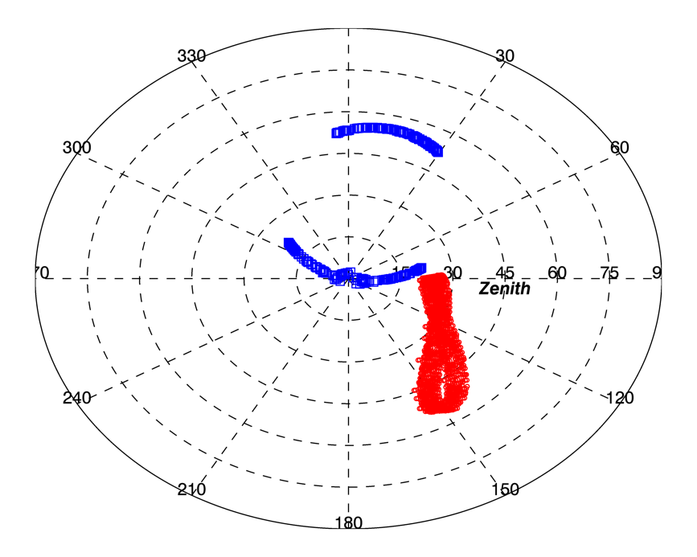
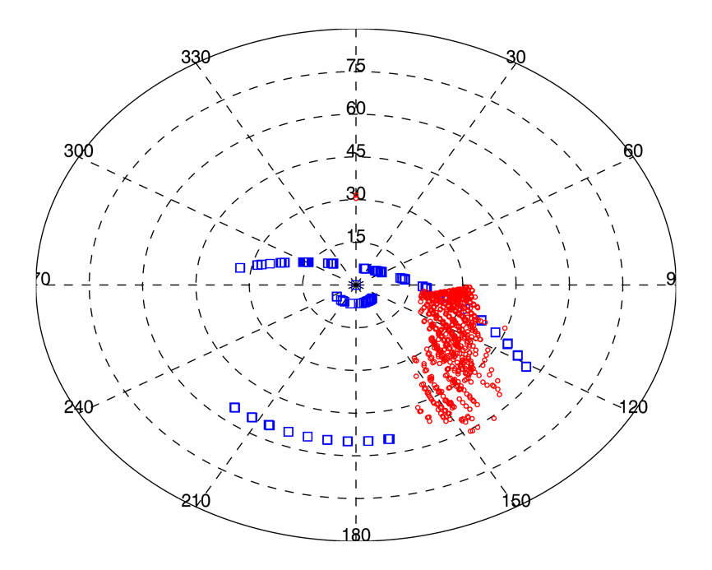
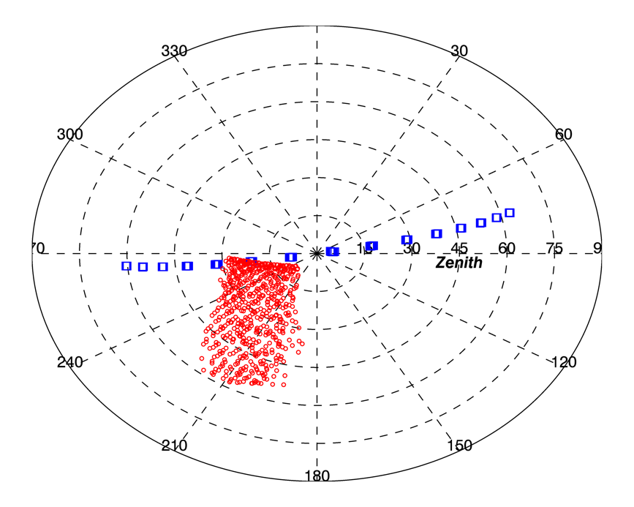
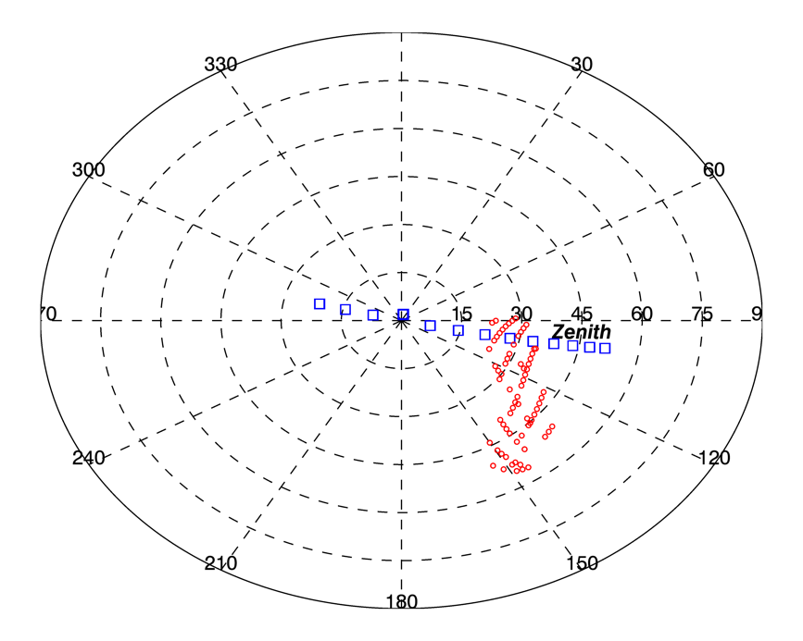
Geometric Comparisons
AATSR
SLSTR
MODIS-A
OLCI

Slide 11
Spectral Comparisons
Desert sites are The earth is not spectrally flat!
Affects band-band comparisons and inter-satellite comparisons
Spectral differences are due to surface BRDF + atmospheric conditions

Slide 12
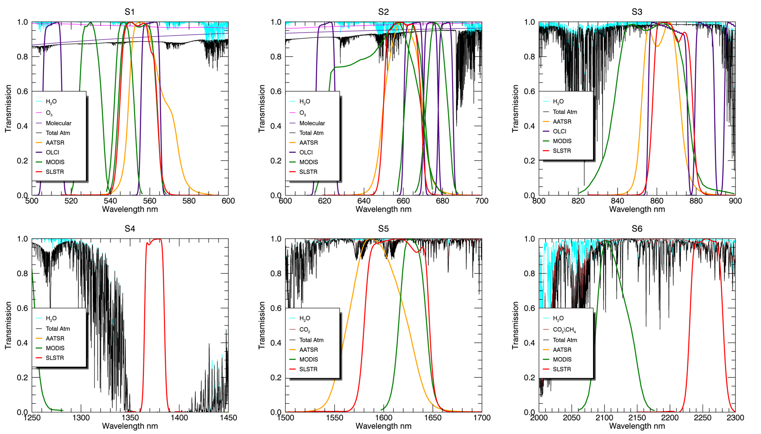
Spectral Band Comparisons
At 2.25um Methane is a significant absorber!

Slide 13
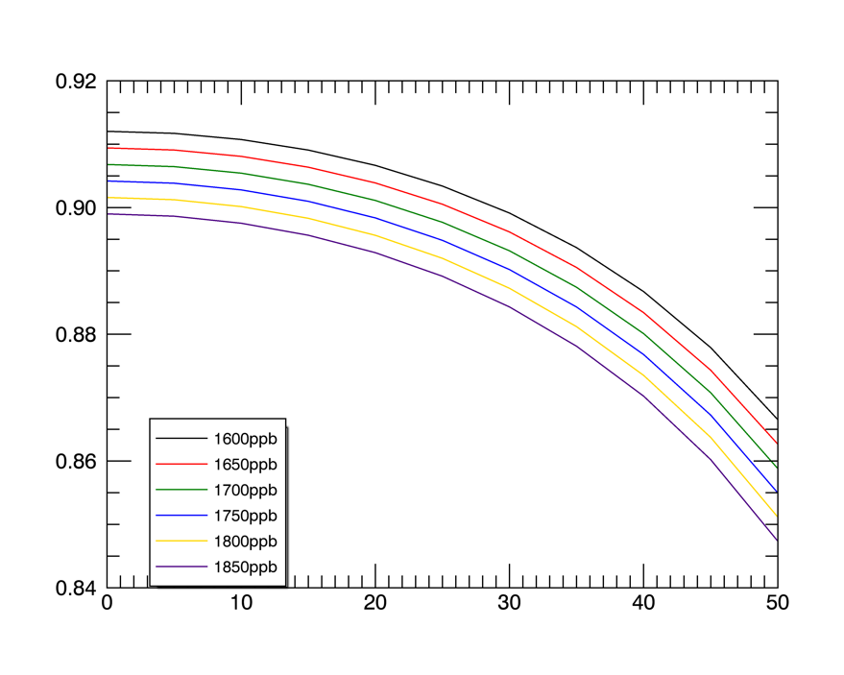
Impact of Methane on S6
SLSTR 2.25um comparisons vs. MODIS 2.13 comparisons
No CH4
SLSTR/MODIS = 0.78
With CH4 – Defualt values
SLSTR/MODIS = 0.86
With CH4 – 2018 values
SLSTR/MODIS ~ 0.88
RTM code – such as MODTRAN and 6S use hard coded values of CH4
MODTRAN = 1600ppb
Current values = 1860ppb and increasing

Slide 14
SLSTR vs AATSR – Geometric Matching
Atmospheric corrections are not performed in the first instance since it is assumed that AATSR and SLSTR spectral responses are well matched
Any short term variations in atmospheric conditions should average out with time

Slide 15
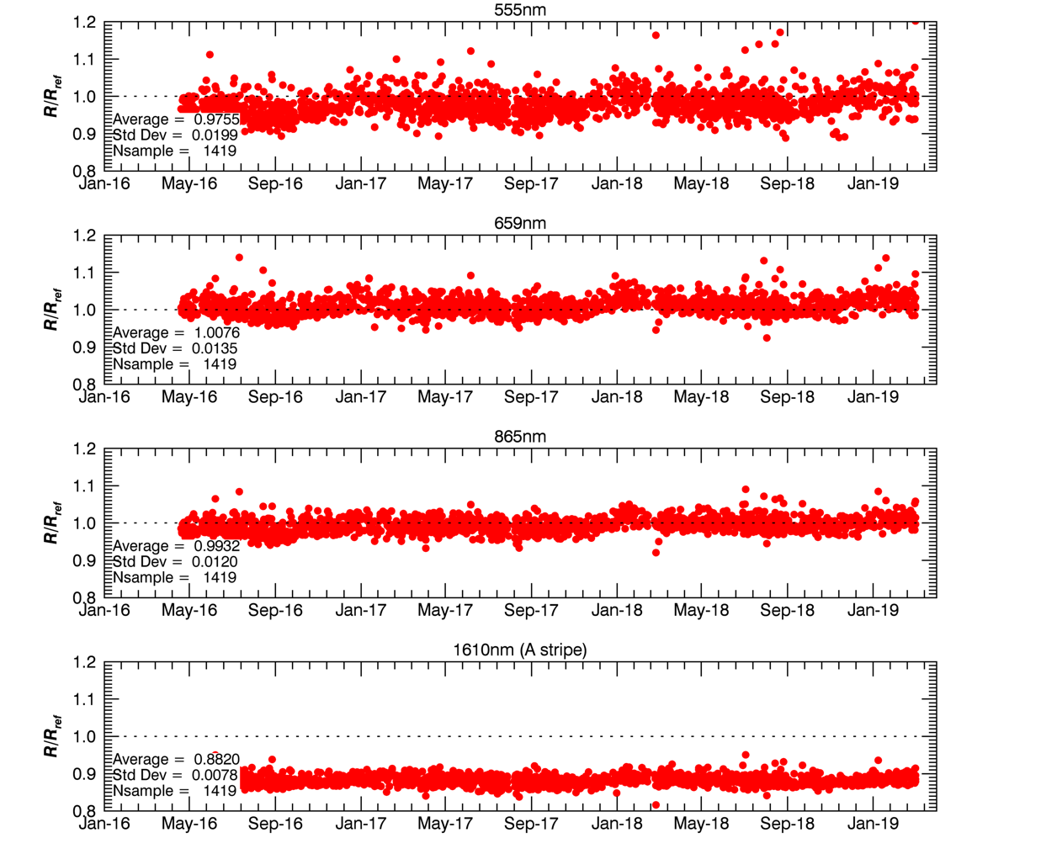
SLSTR-A vs AATSR (Nadir View)
Combined results for all desert sites processed to date
Match-ups constrained to VZA <25 degrees
SWIR A and B stripes show excellent agreement – mean difference < 0.1%
Geometric corrections are needed to account for different overpass times
 | Average R/R_{ref} | Stddev
S1 | 0.974 | 0.019
S2 | 1.006 | 0.013
S3 | 0.992 | 0.012
S5a | 0.882 | 0.008
S5b | 0.882 | 0.008

Slide 16
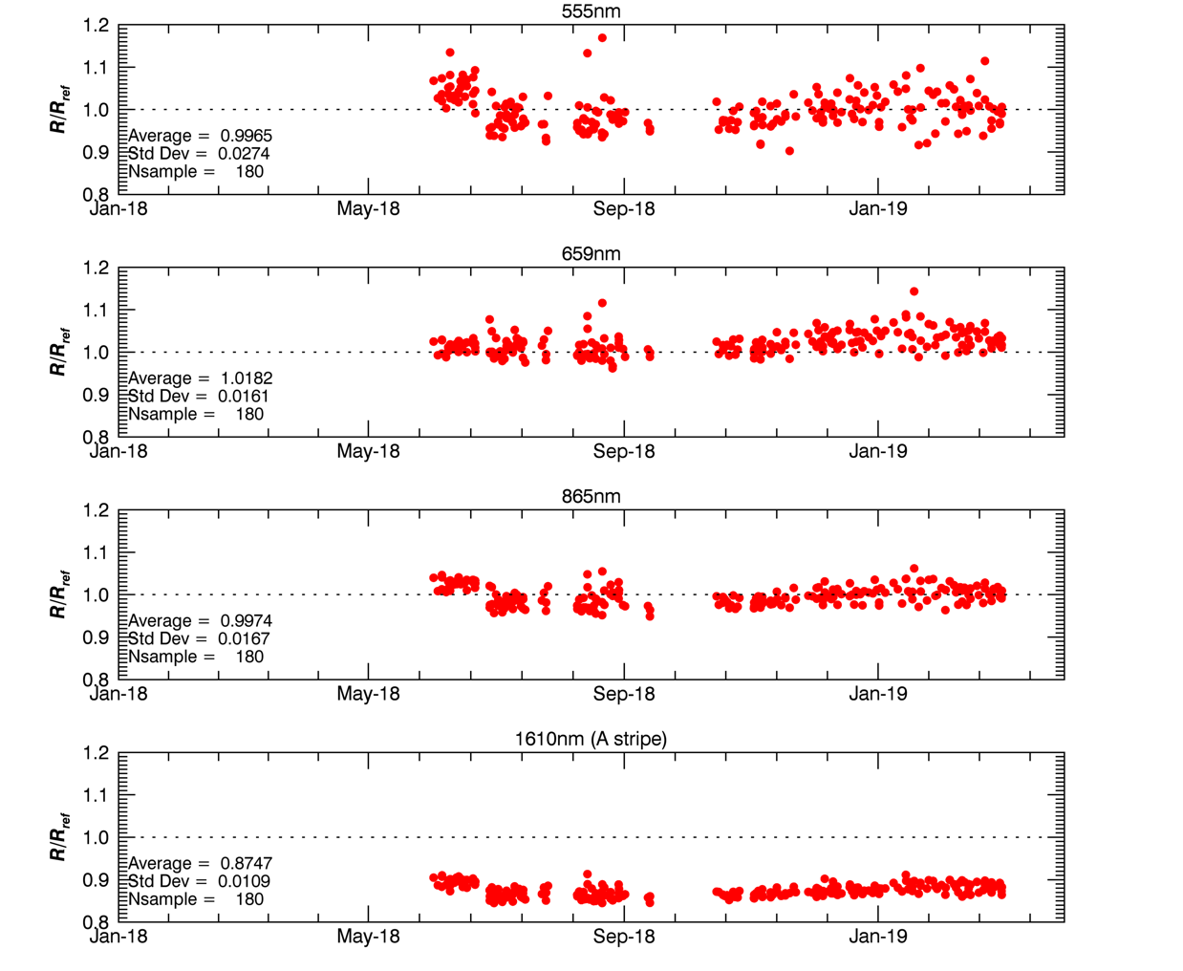
SLSTR-B vs AATSR (Nadir View)
Combined results for all desert sites processed to date
Match-ups constrained to VZA <25 degrees
SWIR A and B stripes show excellent agreement – mean difference < 0.4%
Geometric corrections are needed to account for different overpass times
 | Average R/R_{ref} | Stddev
S1 | 0.997 | 0.027
S2 | 1.018 | 0.016
S3 | 0.997 | 0.017
S5a | 0.875 | 0.011
S5b | 0.879 | 0.012

Slide 17
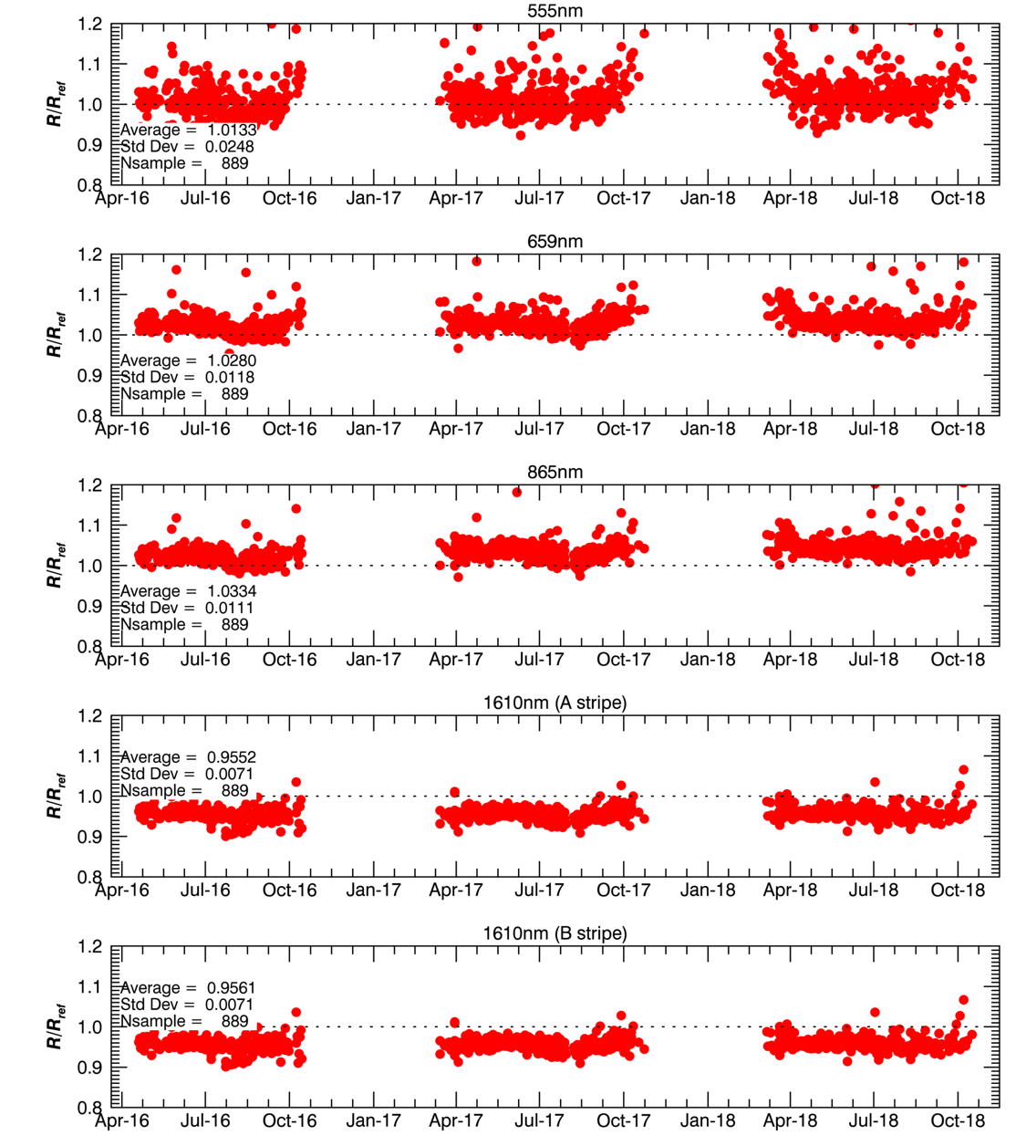
SLSTR-A vs AATSR (Oblique View)
Combined results for all desert sites processed to date
Match-ups constrained to VZA <25 degrees
SWIR A and B stripes show excellent agreement – mean difference < 0.1%
Geometric corrections are needed to account for different overpass times
 | Average R/R_{ref} | Stddev
S1 | 1.013 | 0.013
S2 | 1.028 | 0.012
S3 | 1.033 | 0.011
S5a | 0.955 | 0.007
S5b | 0.956 | 0.007

Slide 18
SLSTR vs OLCI – Spectral Correction
Geometric correction is not performed since measurements are time coincident and near matching geometry
Corrections for spectral variations, atmosphere + site spectral profile are needed

Slide 19
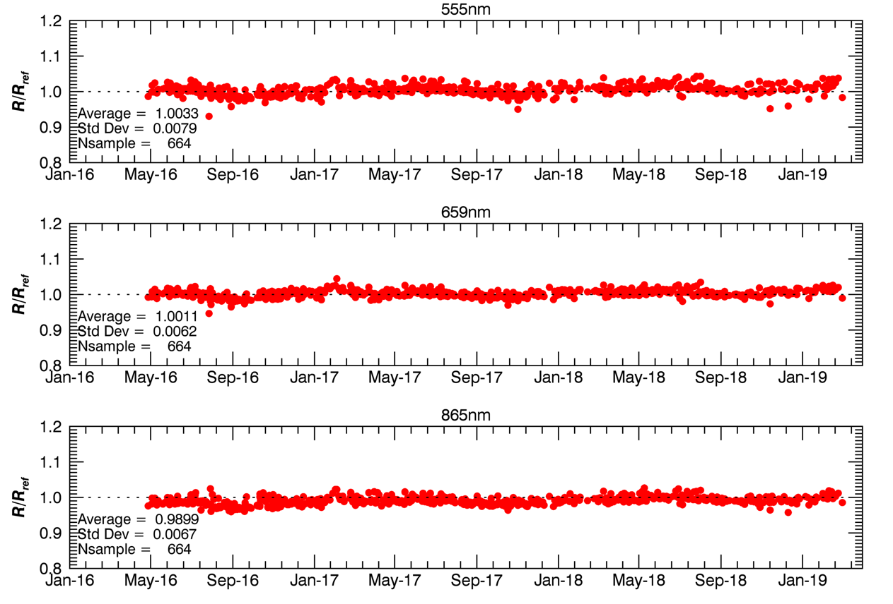
SLSTR-A vs OLCI-A
Combined results for all desert sites processed to date
Match-ups constrained to observations where nadir VZA <25 degrees
Corrections for spectral variations, atmosphere + site spectral profile are needed
 | Average R/R_{ref} | Stddev
S1 | 1.003 | 0.008
S2 | 1.001 | 0.006
S3 | 0.990 | 0.007

Slide 20
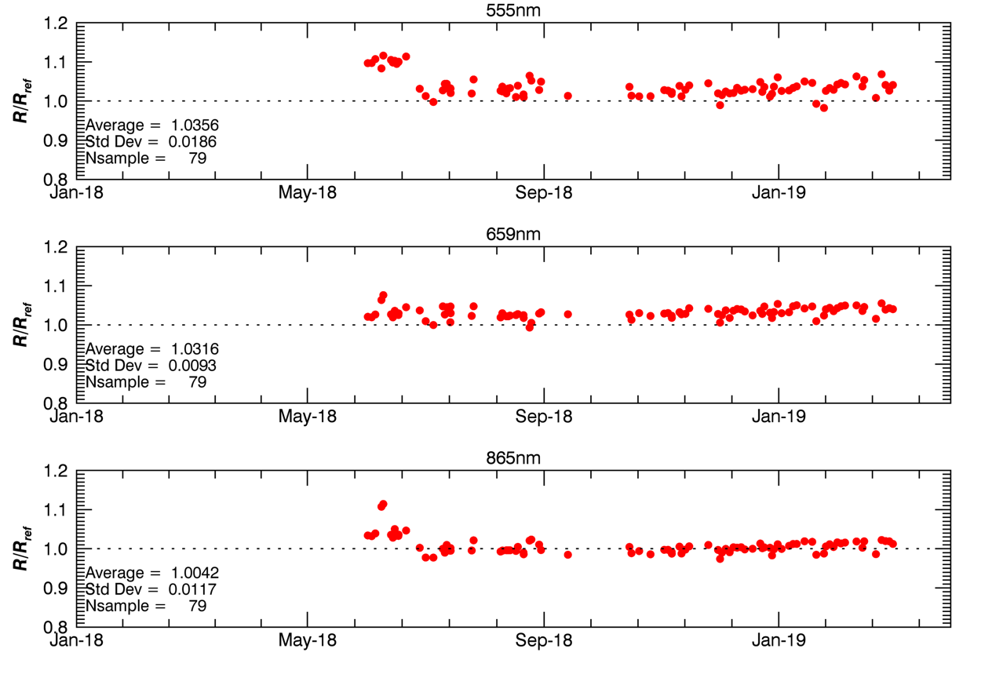
SLSTR-B vs OLCI-B
Combined results for all desert sites processed to date
Match-ups constrained to observations where nadir VZA <25 degrees
Corrections for spectral variations, atmosphere + site spectral profile are needed
 | Average R/R_{ref} | Stddev
S1 | 1.036 | 0.019
S2 | 1.032 | 0.009
S3 | 1.004 | 0.012

Slide 21
SLSTR vs MODIS Aqua – Spectral + Geometric Corrections
Geometric corrections are needed to account for different overpass times
Corrections for spectral variations, atmosphere + site spectral profile are needed

Slide 22
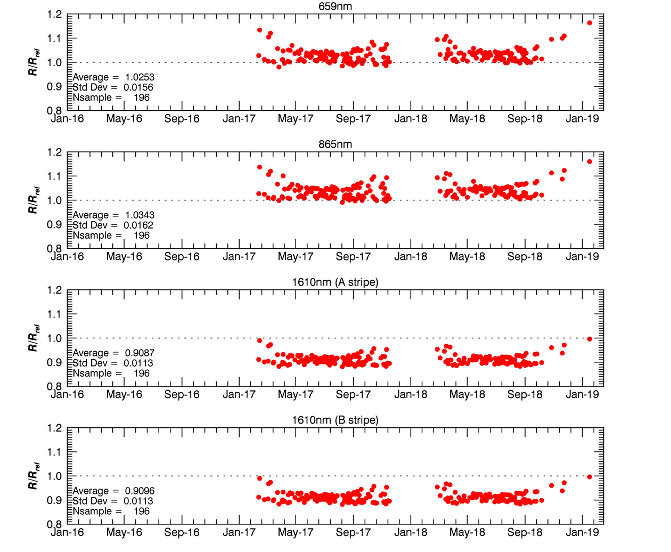
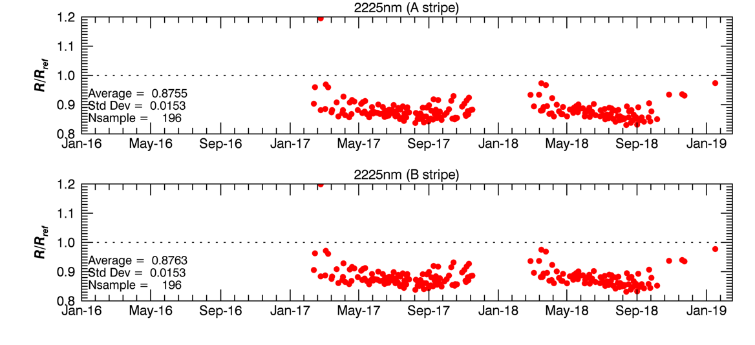
SLSTR-A vs MODIS-Aqua
Data for Libya-4 only
Match-ups constrained to observations where nadir VZA <25 degrees
Geometric corrections and
Corrections for spectral variations
 | Average R/R_{ref} | Stddev
S2 | 1.025 | 0.0156
S3 | 1.034 | 0.0162
S5a | 0.909 | 0.0113
S5b | 0.909 | 0.0113
S6a | 0.876 | 0.0153
S6b | 0.876 | 0.0153
Default CH4 values used

Slide 23
Sun-Glint Calibration Model
The Sun-glint model is based on Cox and Munk (1954) and accounts for:
Surface reflectance (white-cap, wind-roughened surface)
Rayleigh scattering
Atmosphere transmittance
For AATSR and MODIS we have used ECMWF data for wind speed and Aerosol values from Aeronet
All the inputs needed are in the SLSTR Level-1 data products, except aerosol optical depth!
So for SLSTR we need to determine the visibility, aerosol size distribution, and wind velocity by constraining the model to S1, S2 and S3
We assume that the relative calibration error is <3% (based on desert analysis)
This is done for each image!

Slide 24
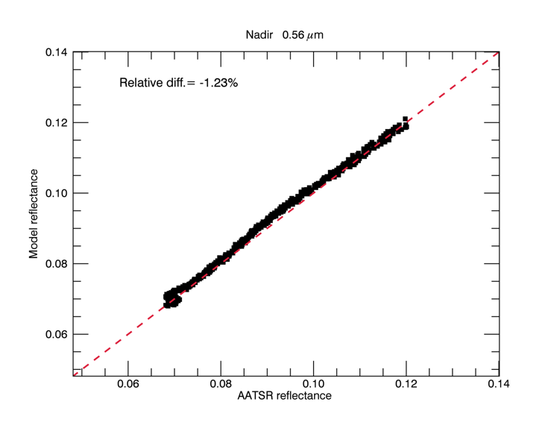
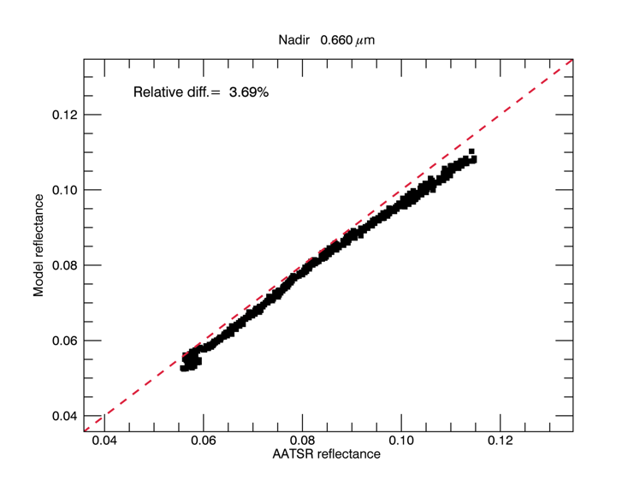
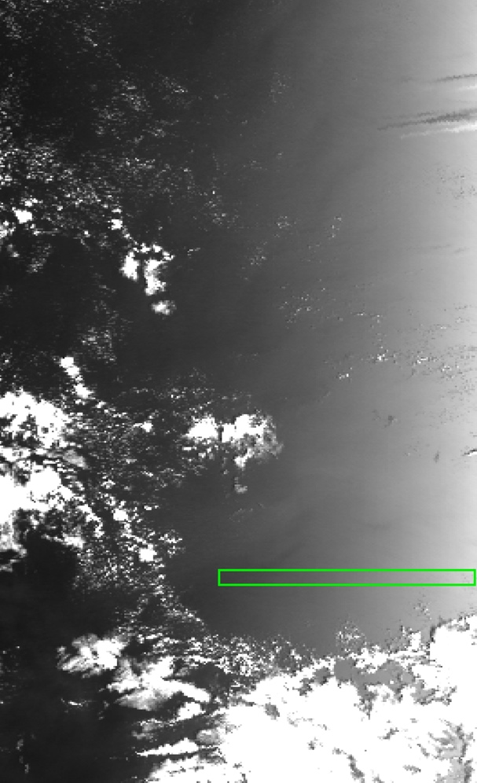
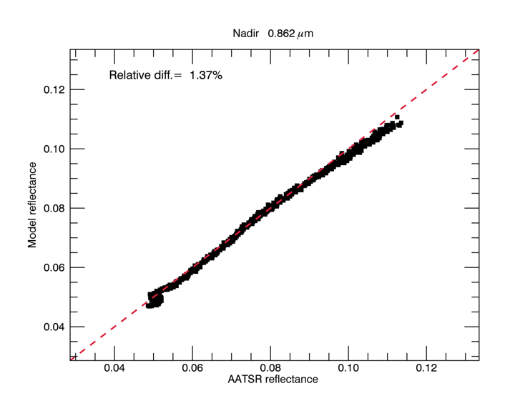
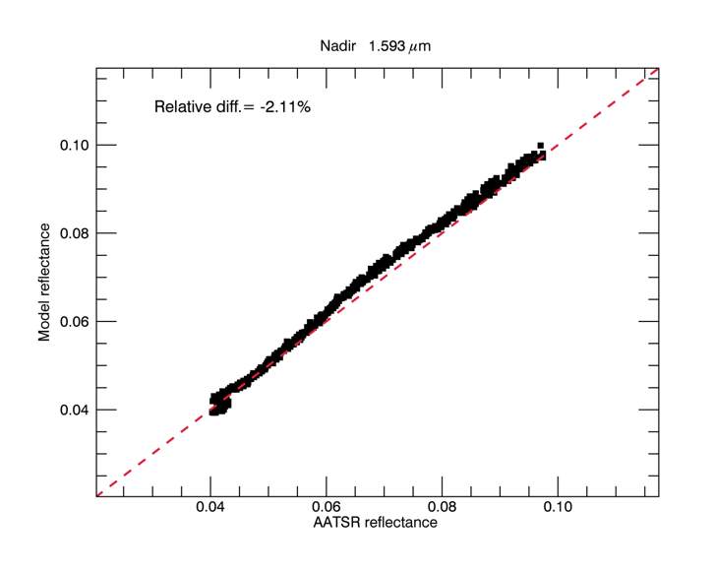
Sun-Glint Model vs. AATSR South Pacific 04/01/2010

Slide 25
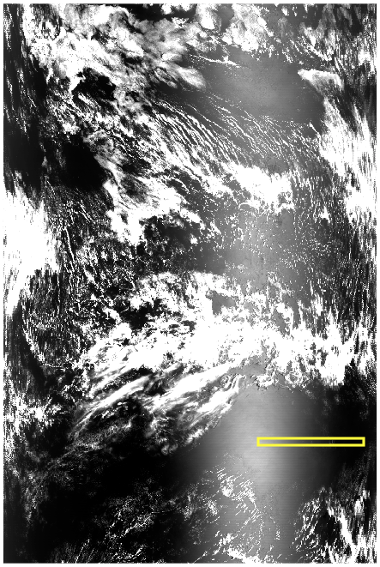
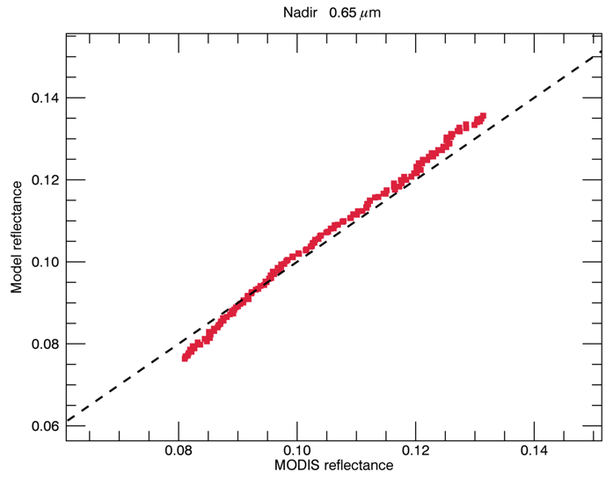
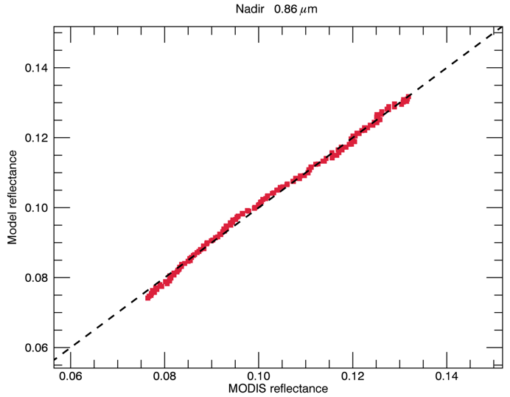
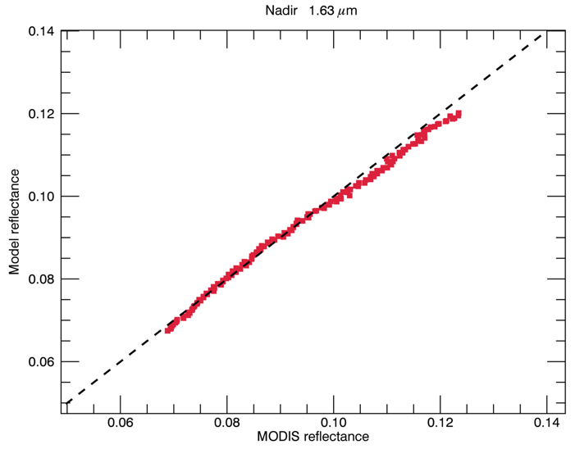
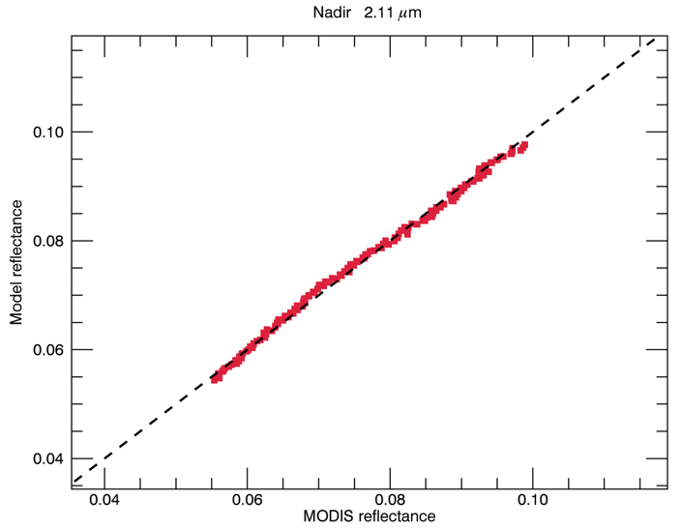
Sunglint Model vs. MODIS South Pacific 01/04/2017
Nadir 0.65 μm
Nadir 0.86 μm
Nadir 1.63 μm
Nadir 2.11 μm

Slide 26
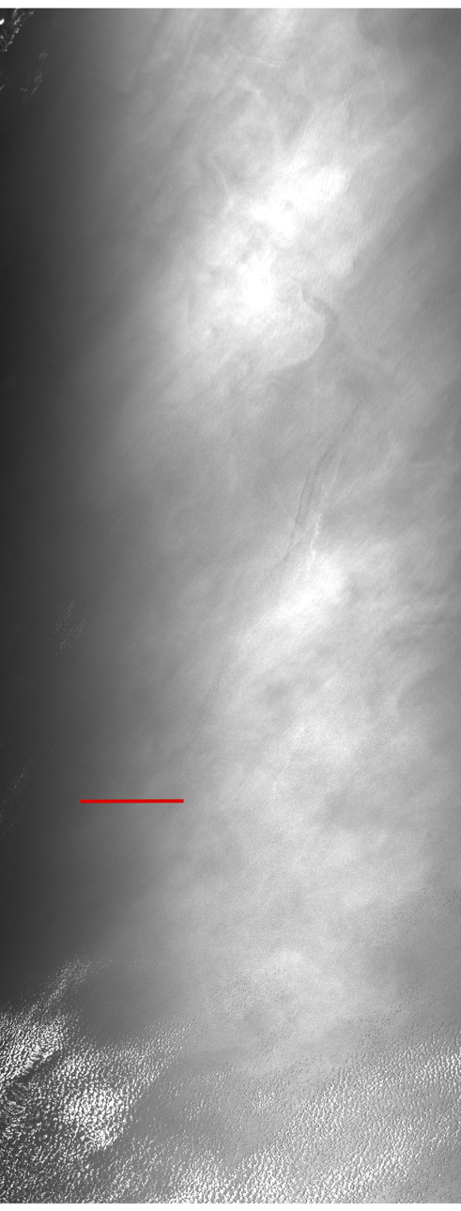
SLSTR vs Sunglint Model North Pacific 22/04/2017
Image from: https://coda.eumetsat.int/#/home
Product Name: S3A_SL_1_RBT____20170422T185118_20170422T185418_
20170422T205046_0179_017_013_2520_MAR_O_NR_002.SEN3
The best solution for this image is for the following conditions:
τ_{aer} (0.55 μm)= 0.099
wind_x= -2.5 m/s (30% lower than wind_x provided in Level-1)
wind_y= -6.6 m/s (as provided in the Level-1 image)
Sunglint coordinates: lat= 22.63 deg., long= -128.36 deg.

Slide 27
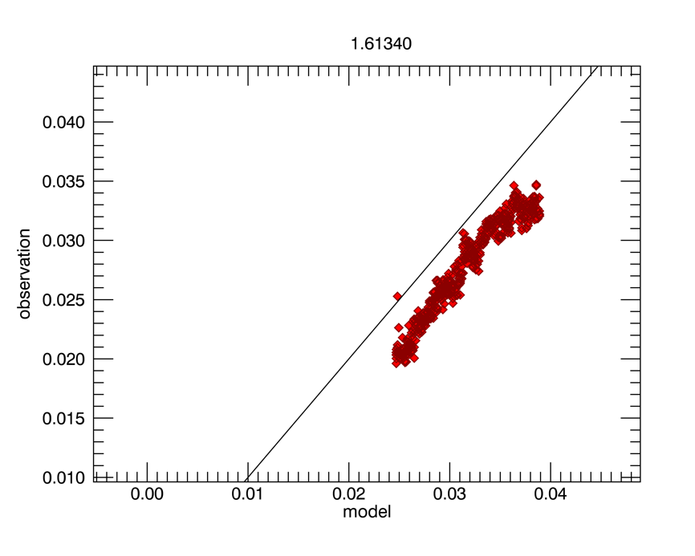
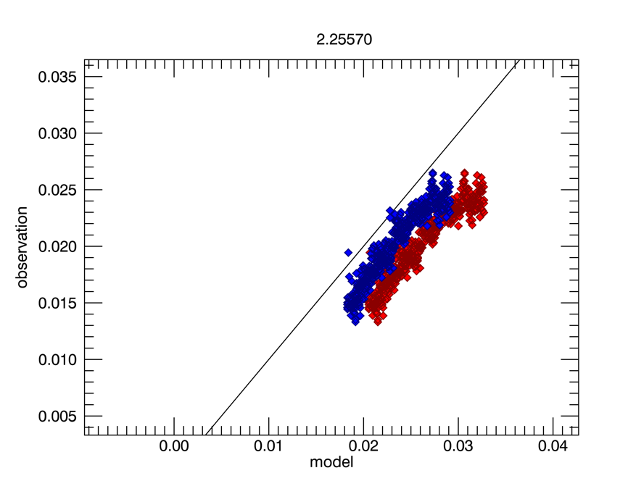
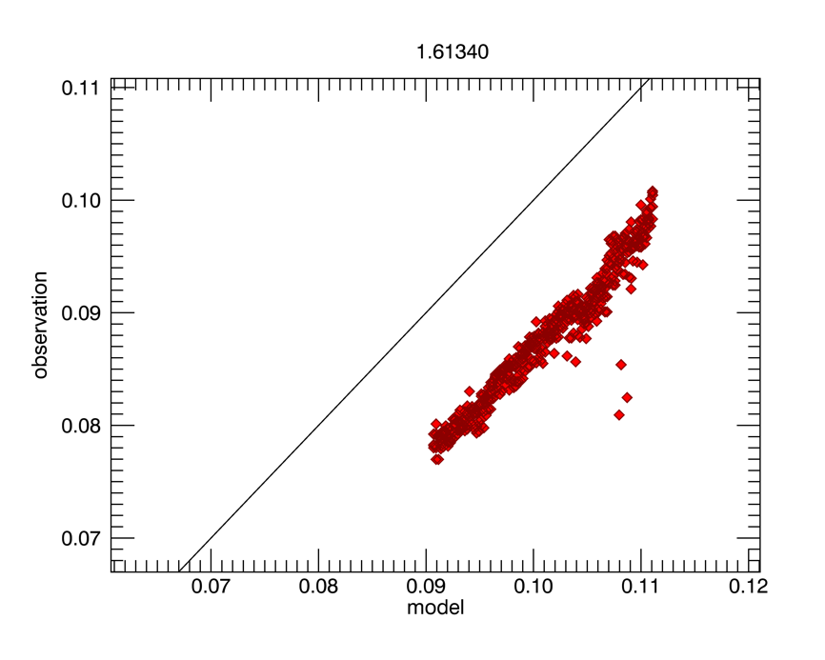
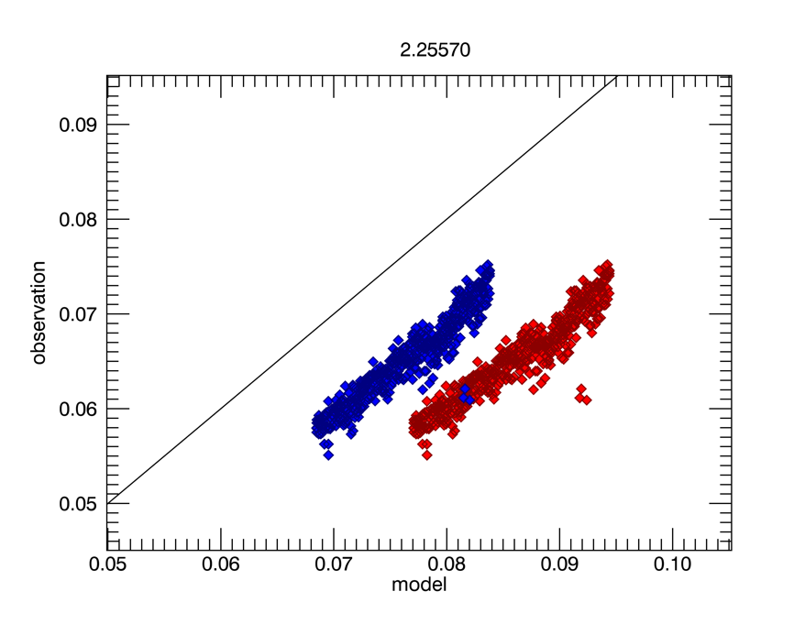
Comparisons against Sun-glint model
20180102T171405
S5: -12.3%
S6: -23.1% (without CH4)
S6: -13.3% (with CH4)
20180318T193911
S5: -12.3%
S6: -26.1% (without CH4)
S6: -13.8% (with CH4)

Slide 28
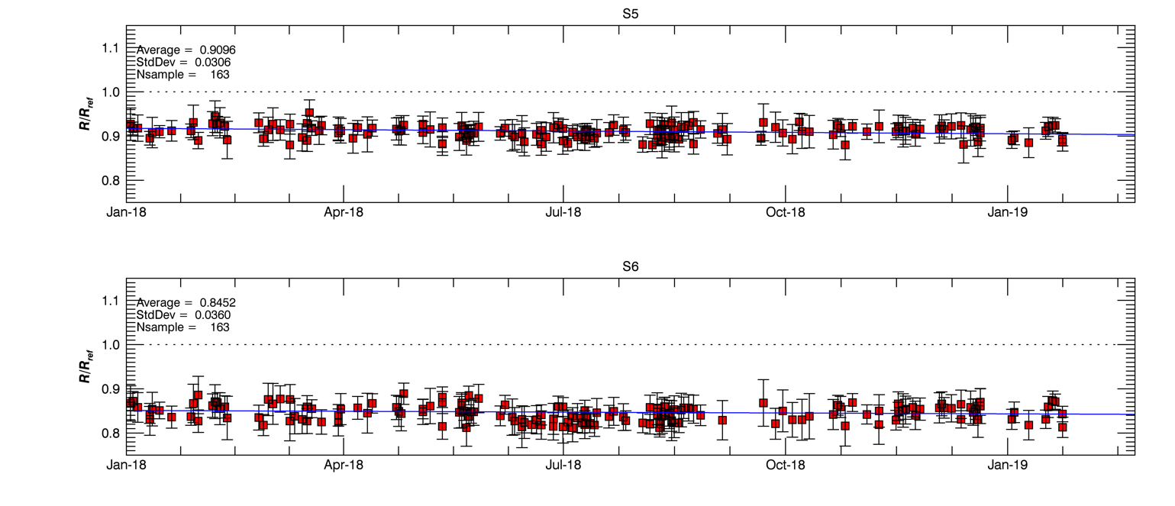
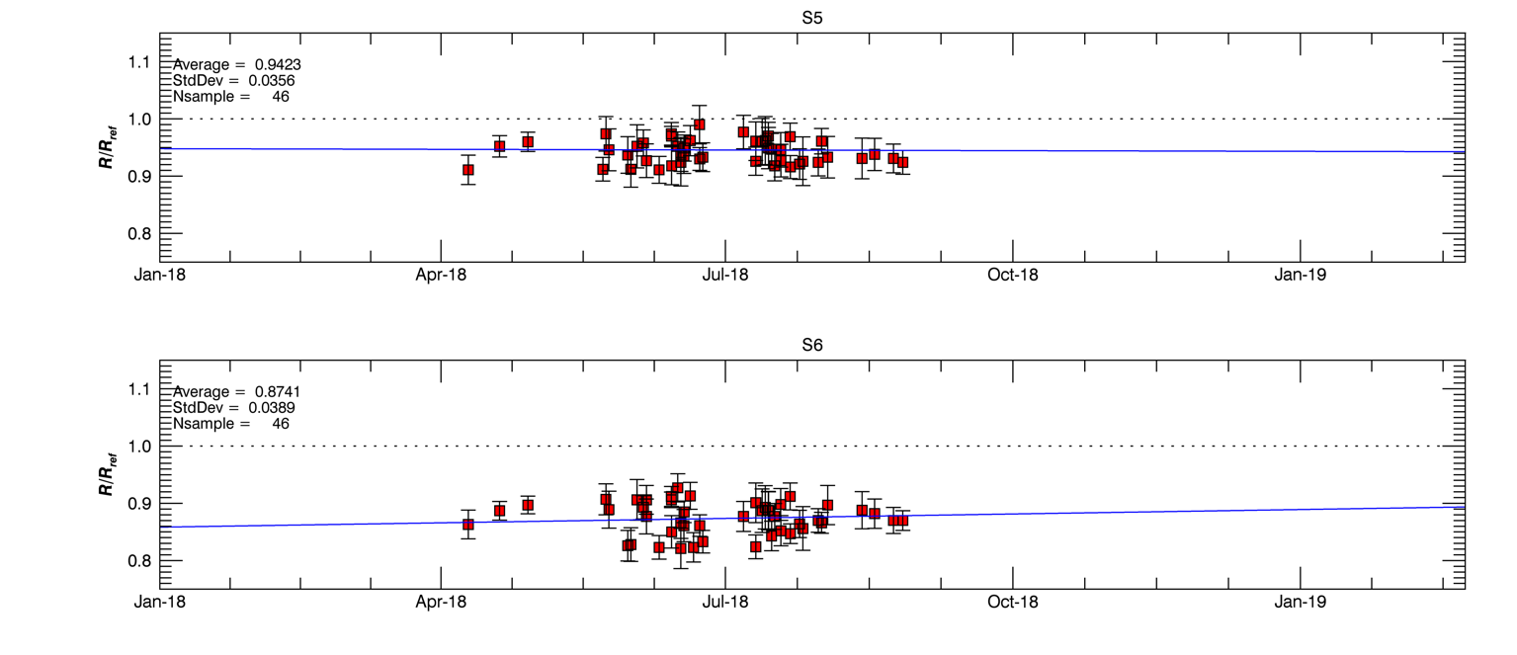
Sun-glint analysis trends
NADIR
 | Average Rel.Diff. (%) | Stddev
S5 | 0.909 | 0.031
S6 | 0.845 | 0.036
Note: S1-S3 are ‘fixed’ to determine wind speed and AOT
OBLIQUE
 | Average Rel.Diff. (%) | Stddev
S5 | 0.942 | 0.036
S6 | 0.874 | 0.039
Oblique view scenes with sun-glint not available during winter months

Slide 29
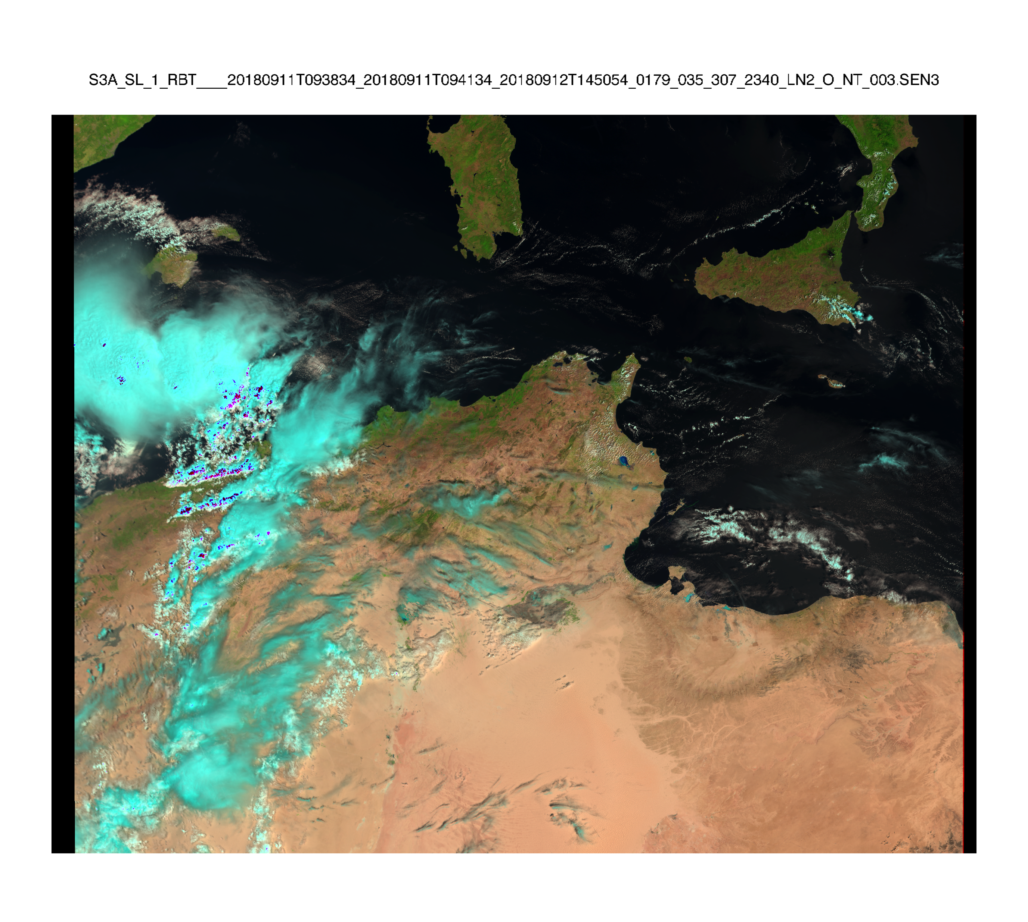
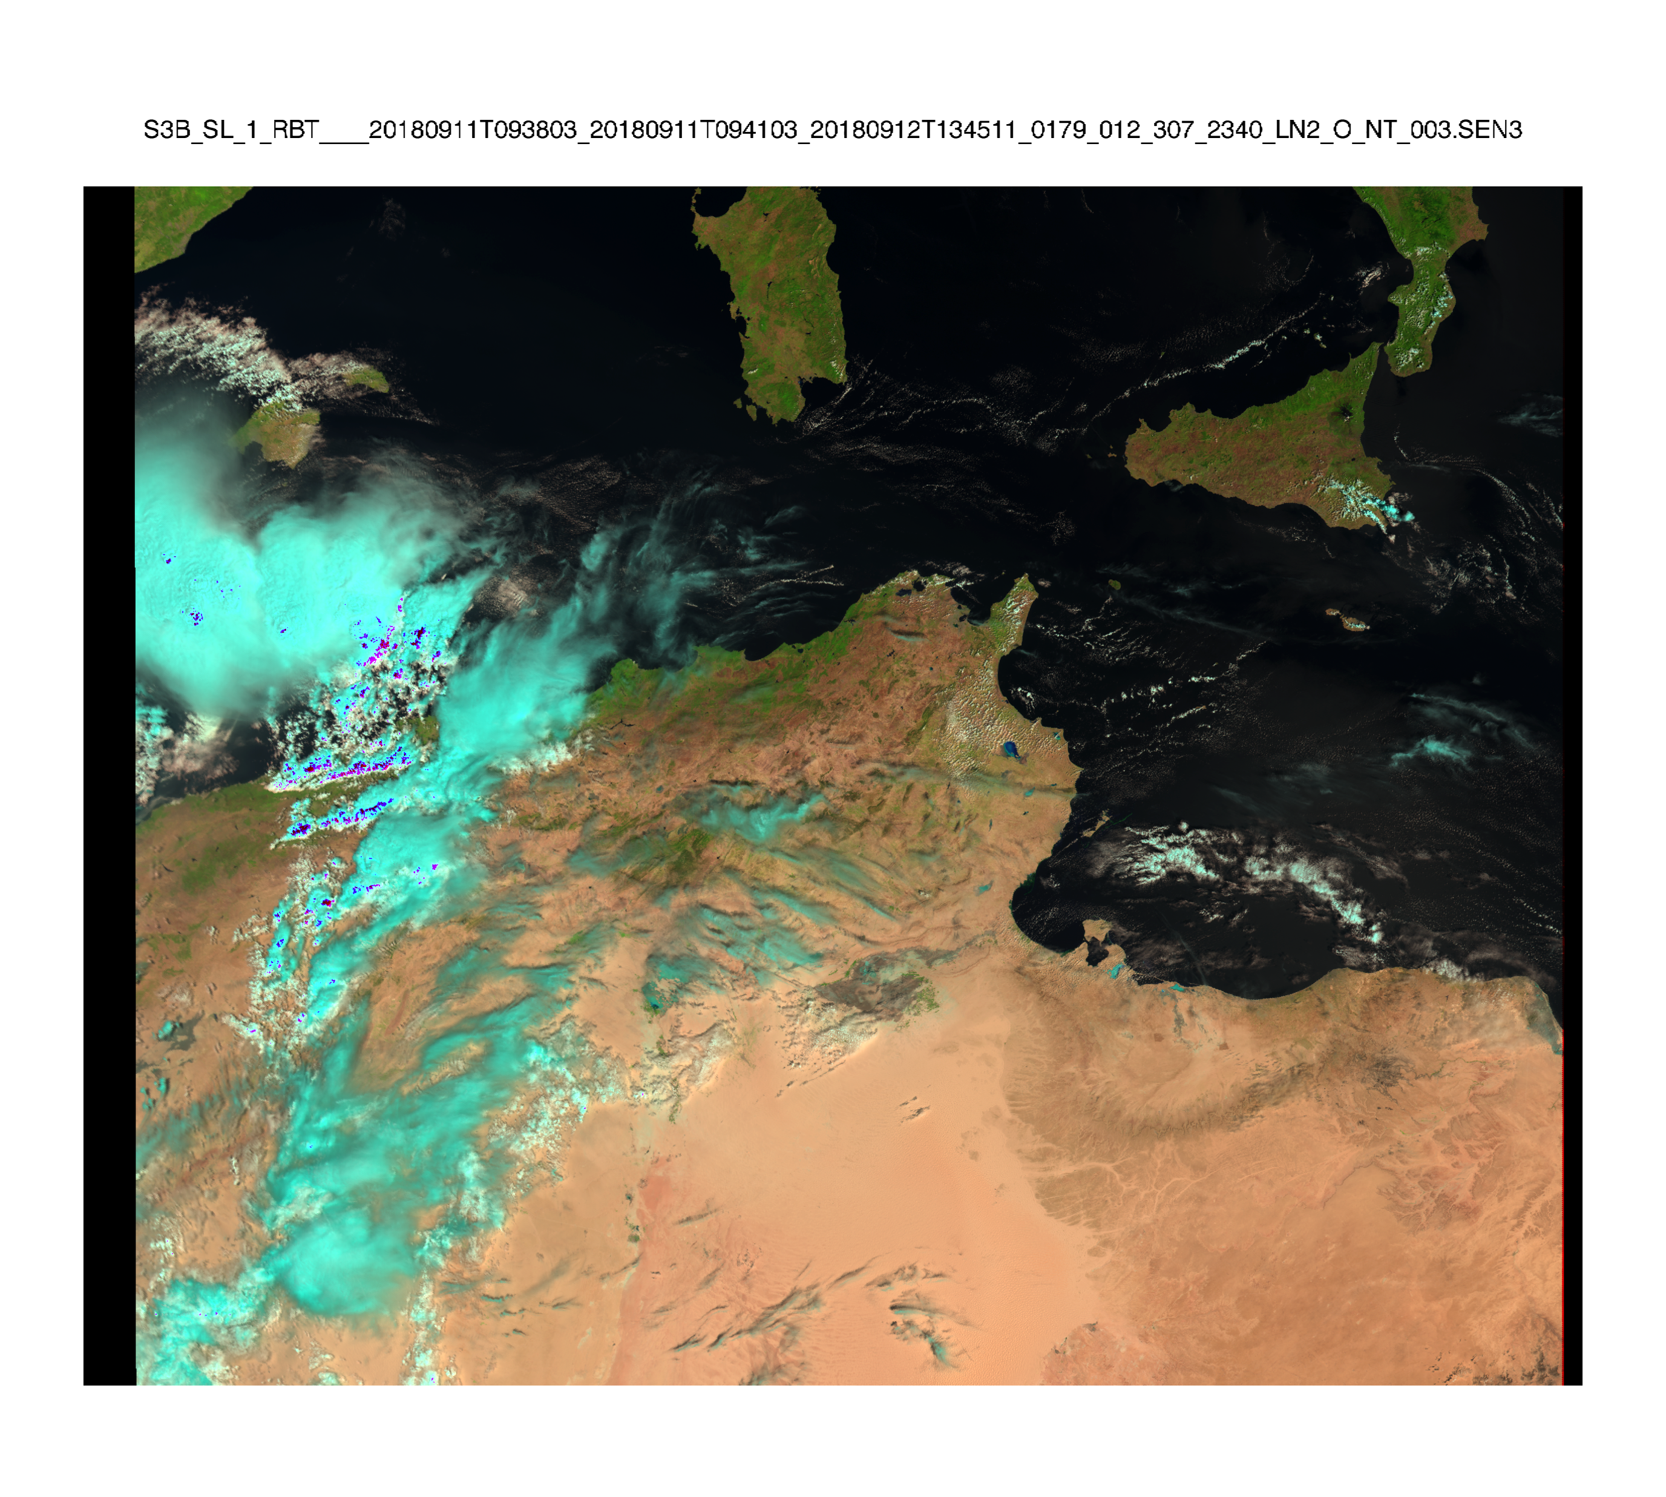
Tandem Phase Analysis
Sentinel-3A
Sentinel-3B
Sentinel-3A flying on Same Track 30s behind Sentinel-3B

Slide 30
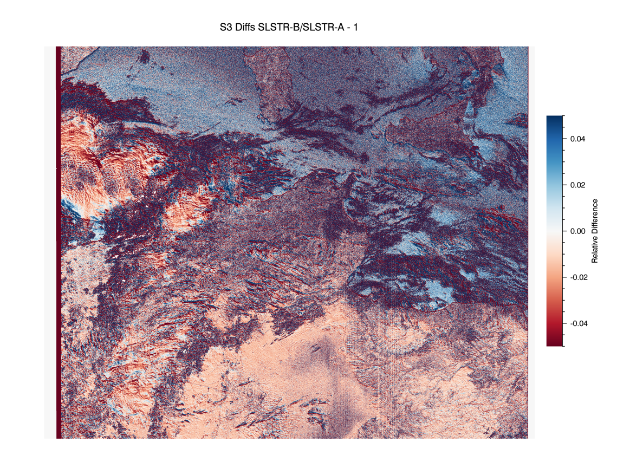
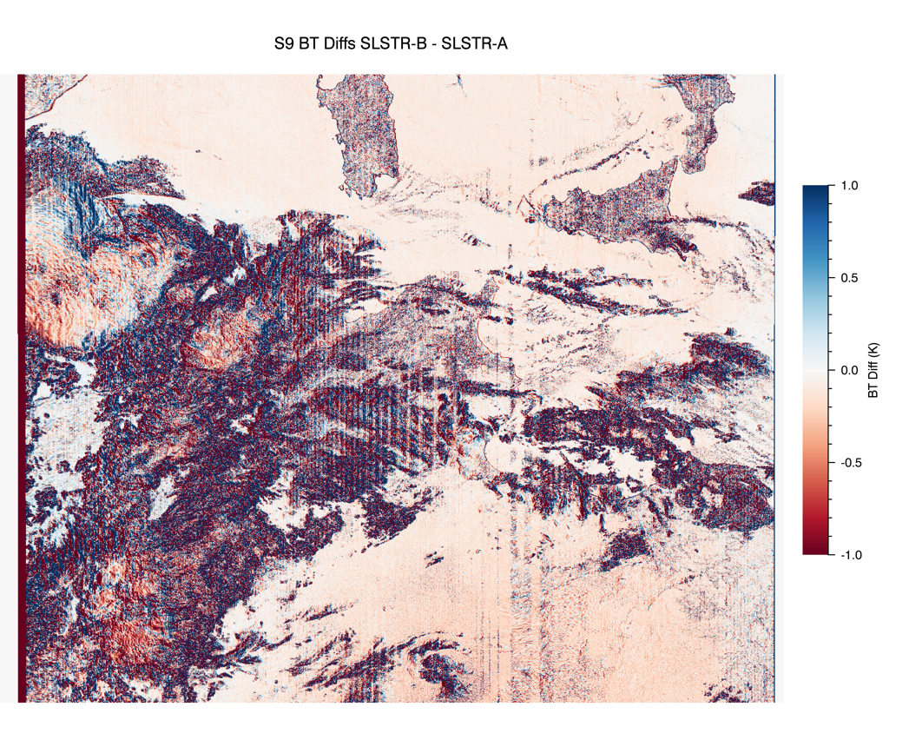
Tandem Phase Analysis
S3 (870nm) Differences
S9 (12um) Differences
Note comparisons are affected by spatial variations – e.g. clouds, surface features

Slide 31
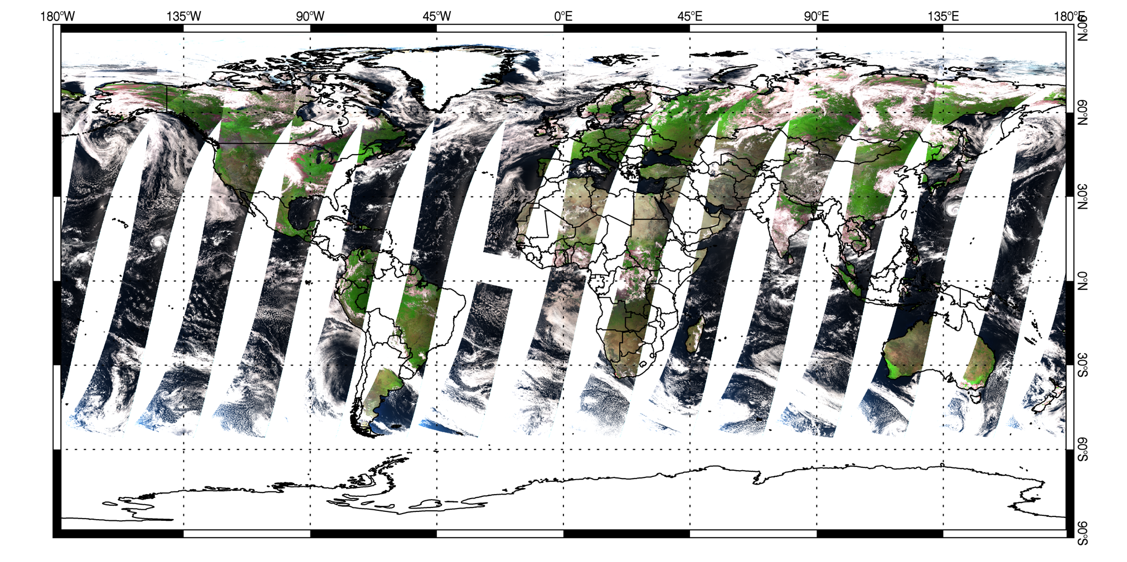
SLSTR-A L3 Solar Channels
Data for 19-August-2018
Notes:
False colour reflectance channels (r = S5, g=S3, b = S2 for land), (r=S3, g=S2, b = S1 for clouds and ocean).
L1 data are averaged in 0.05degree cells.

Slide 32
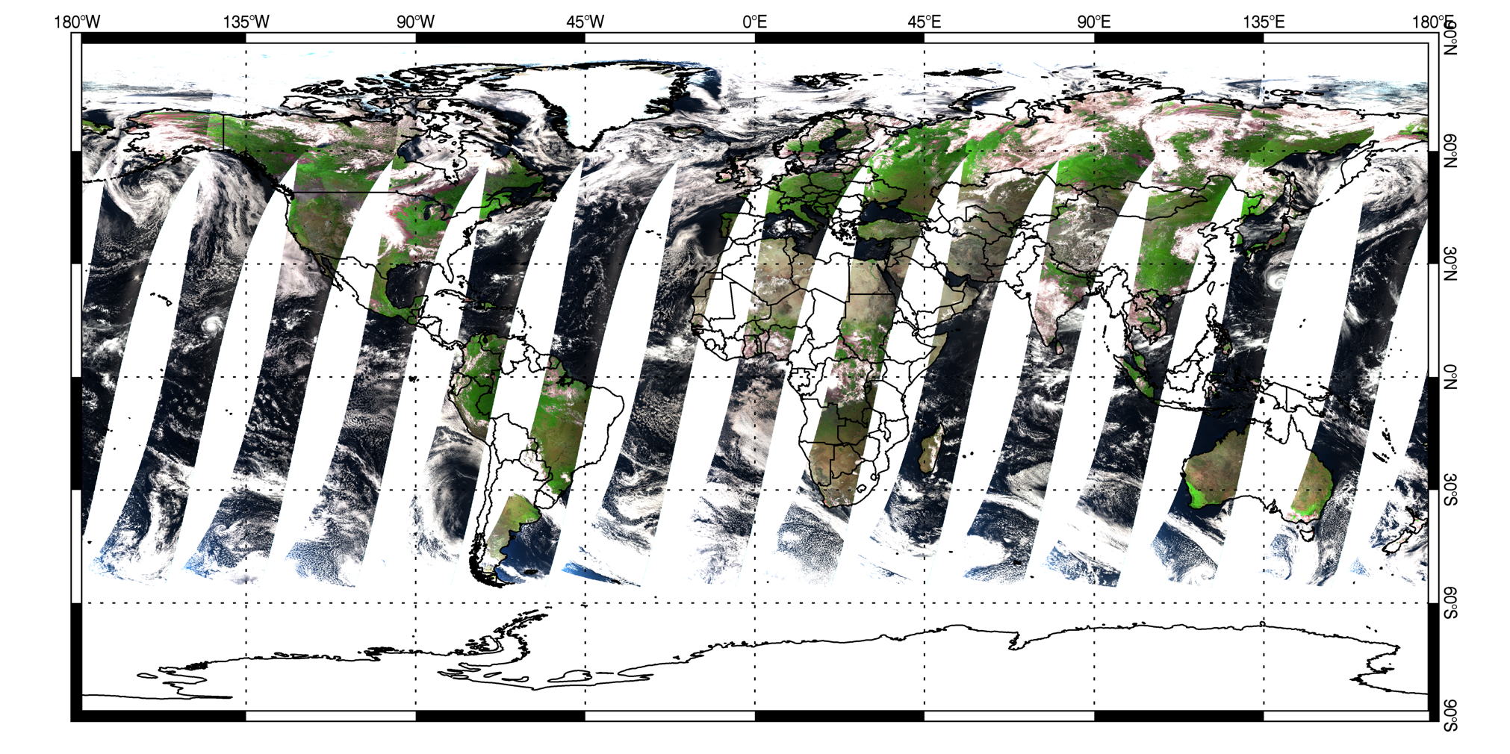
SLSTR-B L3 Solar Channels
Data for 19-August-2018
Notes:
False colour reflectance channels (r = S5, g=S3, b = S2 for land), (r=S3, g=S2, b = S1 for clouds and ocean).
L1 data are averaged in 0.05degree cells.

Slide 33
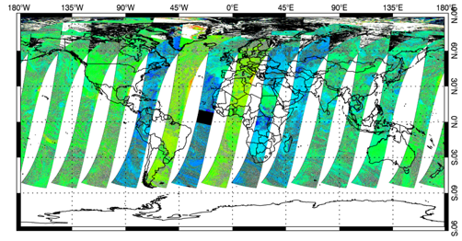
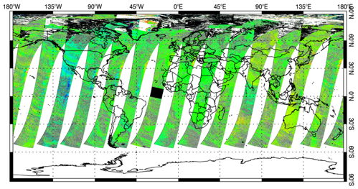
S3B-S3A Tandem Phase Comparisons
S1
S2
S3
Level-3 data for 19th August 2018
Relative Differences S3B/S3A - 1
S5
S6
S3B are aligned to first order with S3A based on comparisons over Desert sites
Residual differences most likely due to residual non-linearity errors
Note S1 and S2 affected by gain changes

Slide 34
S3B-S3A Comparisons Unfiltered
Match ups are for 0.05degree cells filtered radiances in valid range
Comparisons are binned in 1% intervals
Error bars show standard deviation of comparisons
S1
S2
S3
S4
S5
S6

Slide 35
S3B-S3A Comparisons ±10% Trimming Applied
Match ups are for 0.05degree cells filtered radiances in valid range
Comparisons are binned in 1% intervals
Error bars show standard deviation of comparisons
S1
S2
S3
S4
S5
S6

Slide 36
SLSTR VIS/SWIR Calibration Status – Mar-2019
 | Comparisons over Deserts |  |  |  |  |  | Sunglint |  | Libya4 (Goaverts)
Channel | SLSTR-A/OLCI-A (Nadir Only) | SLSTR-A/MODIS-A (Nadir Only) | SLSTR-A/AATSR |  | SLSTR-B/SLSTR-A* |  | SLSTR |  | SLSTR
 |  |  | (Nadir) | (Oblique) | (Nadir) | (Oblique) | (Nadir) | (Oblique)
S1 | 1.008 (0.014) | - | 0.974 (0.019) | 1.013 (0.025) | 1.022 (0.027) | 1.002 (0.008) |  |  | 1.042 (0.018)
S2 | 1.004 (0.011) | 1.011 (0.010) | 1.006 (0.013) | 1.028 (0.012) | 1.005 (0.005) | 1.000 (0.005) |  |  | 1.022 (0.014)
S3 | 0.991 (0.010) | 1.018 (0.010) | 0.992 (0.012) | 1.033 (0.011) | 1.000 (0.017) | 0.985 (0.005) |  |  | 1.013 (0.014)
S5a | --- | 0.899 (0.006) | 0.882 (0.012) | 0.955 (0.007) | 0.992 (0.017) | 0.982 (0.003) | 0.909 (0.031) | 0.942 (0.036) | 0.889 (0.012)
S5b | --- | 0.900 (0.006) | 0.883 (0.008) | 0.956 (0.007) | 0.995 (0.015) | 0.983 (0.003)
S6a | --- | 0.876 (0.015) | --- | --- | 0.995 (0.015) | 1.007 (0.003) | 0.845 (0.036) | 0.874 (0.039) | 0.889 (0.016)
S6b | --- | 0.876 (0.015) | --- | --- | 0.995 (0.009) | 1.016 (0.003)
SLSTR-B Data were generated from IPF-D where calibration files were not generated for all orbits – hence comparisons with SLSTR-A have more noise. Comparisons between SLSTR-A and B are for period after CMTR
Comparisons depend on the calibration of the reference sensor

Slide 37
SLSTR-B Known Issues
The following issues are under formal investigation by ESA supported by Industrial team and RAL
VIS/SWIR Calibration – significant differences in some bands between pre/post launch and SLSTR-A/B - NC-ESA-COM-00037
S1(555nm)/S2(669nm) noise in VISCAL signals leading to 2-3% apparent gain variation. NC-ESA-COM-00038
S7/S8 Co-Registration – apparent (130m shift) - NC-ESA-COM-00039
Similar to effect seen on S3A (250m shift)
Thought to be related to timing within detection chain

Slide 38
SLSTR-B Summary of CNES Vicarious Calibration Results
Results from Desert Sites
S1-S3 Nadir Are consistent with S2A-MSI, S3A-OLCI, S3A-SLSTR MERIS, AATSR
S5 and S6 Consistency with SLSTR-A but not AATSR, MODIS-A, L8-OLI or S2
Discrepancies in S6 between desert and sunglint methods.
NC-ESA-COM-00037

Slide 39
SLSTR Compliance/recommendations (1/3 from IOCR)
All SRD requirements related to SLSTR instrument and data products are confirmed to be compliant, except…
There are 3 NC currently in place :
On-ground to in-orbit radiometric calibration (VIS-SWIR) is inconsistent ; NC-ESA-COM-00037
Effect was discussed already at MTR leading to the following actions/results:
SLSTR-B was aligned to SLSTR-A using vicarious calibration results over the desert sites.
Tandem Phase analysis shows remaining residual differences. A refined analysis will be performed by S3T4C-project (long-term activity).
Remaining differences of Vicarious Calibration results (S4/S5/S6) are to be resolved within MPC activity.
The difference of on-ground calibration must be resolved before the SLSTR-C model calibration (Project activity).
“The absolute radiometric accuracy of TOA reflectance data acquired at beginning of life in the solar channels shall be less than 2% traceable to international standards, considering an unpolarised scene.” SL-IQ-050

Slide 40
Conclusions
Tandem Phase gives near perfect conditions for cross-calibration
Is being considered for Sentinel-3C
On-going analysis to harmonize SLSTR-B with SLSTR-A
CH4 seems to account for discrepancy between different methods in 2.25um channel (Desert, Sunglint etc..)
Also CO2, H20 for other spectral bands
More effort needed on uncertainty estimates on Desert site analysis
I.e. geometric, spectral differences of the surface reflectance – any corrections are derived from indirect observations. Differences between methodologies…
Sun-glint Analysis
Useful for SWIR channels
Uncertainty is dominated by knowledge of Aerosols and wind speed which is tied to calibration of VIS channels
Extend analysis to Ice targets

