Slide 1


Towards harmonization of multi-sensor high resolution time series: the Belharmony approach
Stefan Adriaensen¹ ,Sindy Sterckx¹, Erwin Wolters¹, Else Swinnen¹, Isabelle Piccard¹, Cristiana Bassani², Charlotte Wirion³,Boud Verbeiren³
GSICS Annual meeting in ESA/ESRIN at Frascati, Italy on 04-08 March 2019
¹, VITO
², CNR-IIA , Italy
³, VUB, Belgium

Slide 2
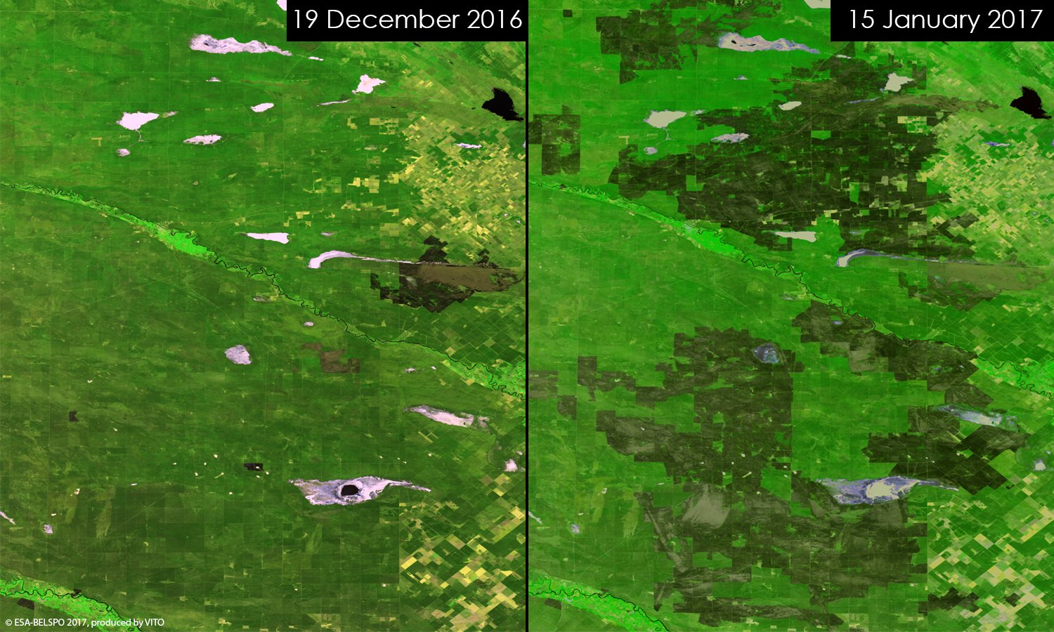
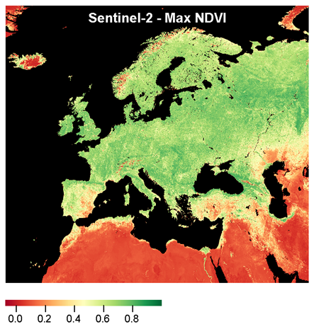
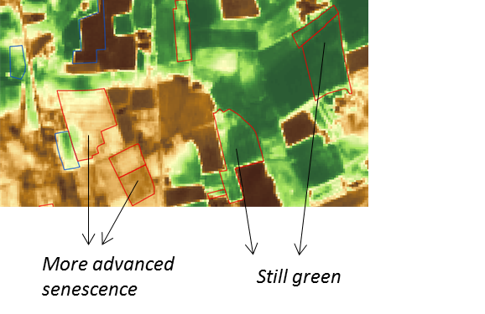
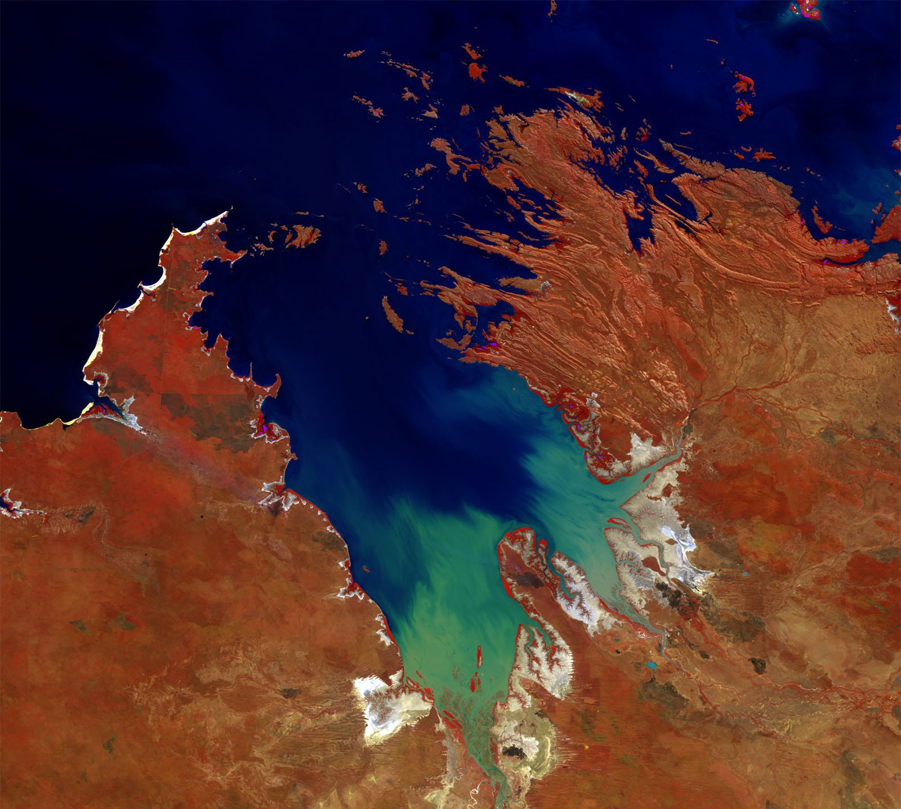
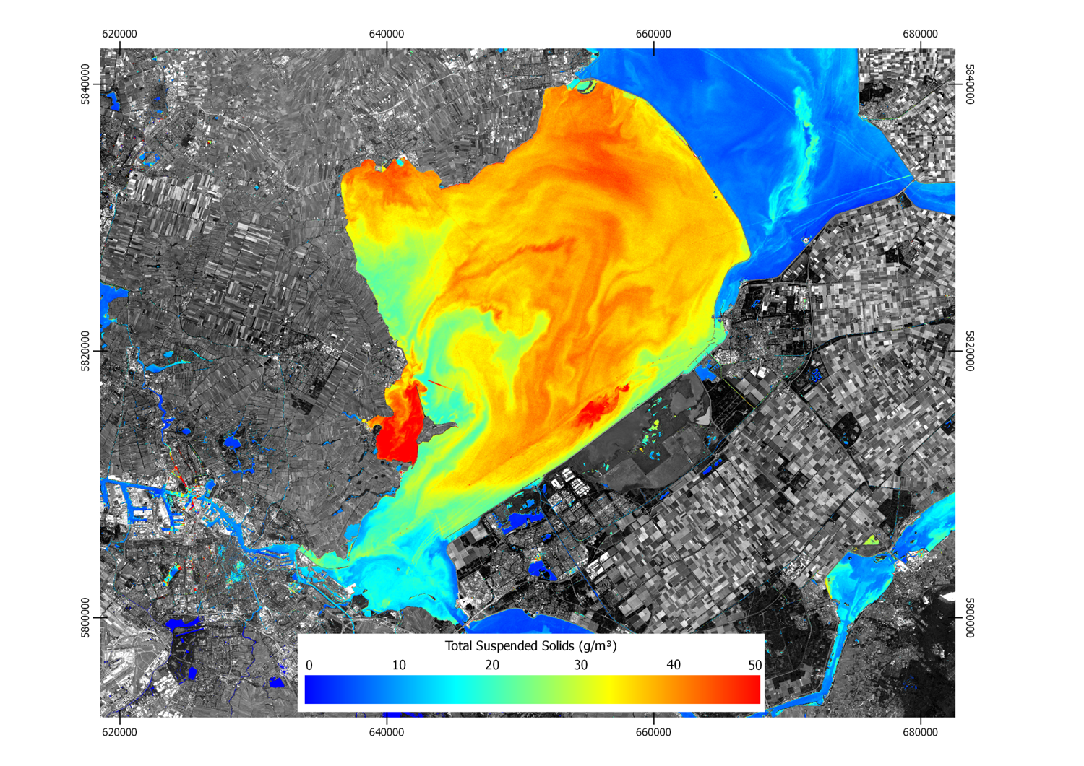
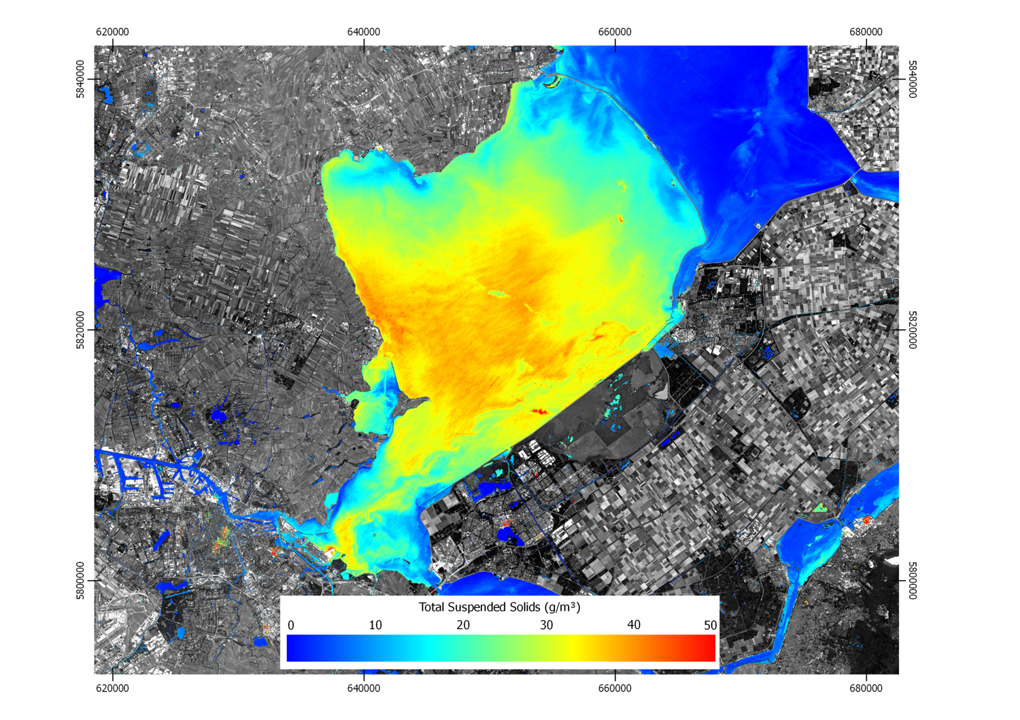

BELHARMONY CONTEXT
A clear tendency in the use of higher spatial and temporal resolution
Sentinel-2
PROBA-V
PROBA-V
Western-Australia_KingSound
Landsat-8
Markermeer
Sentinel-2 Markermeer

Slide 3
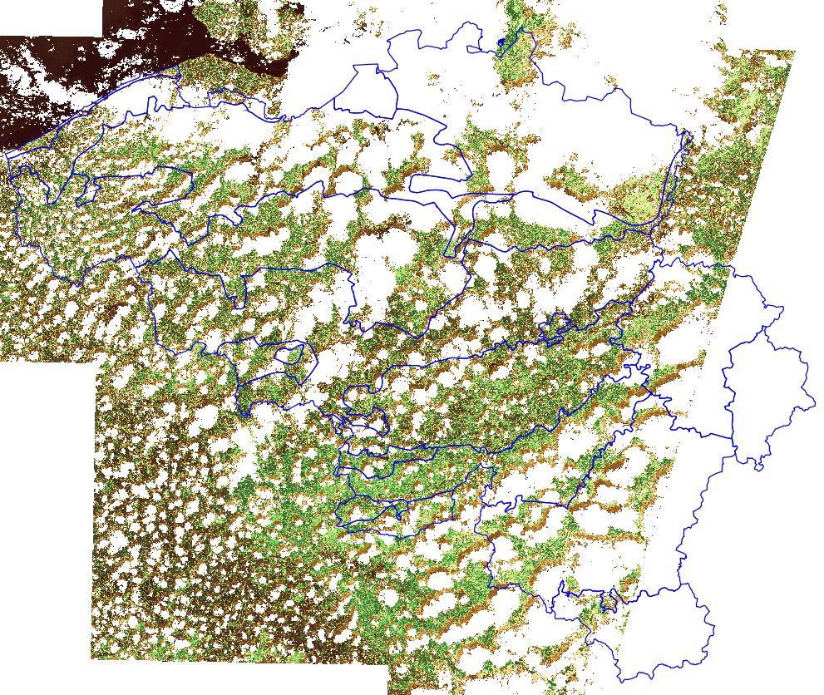
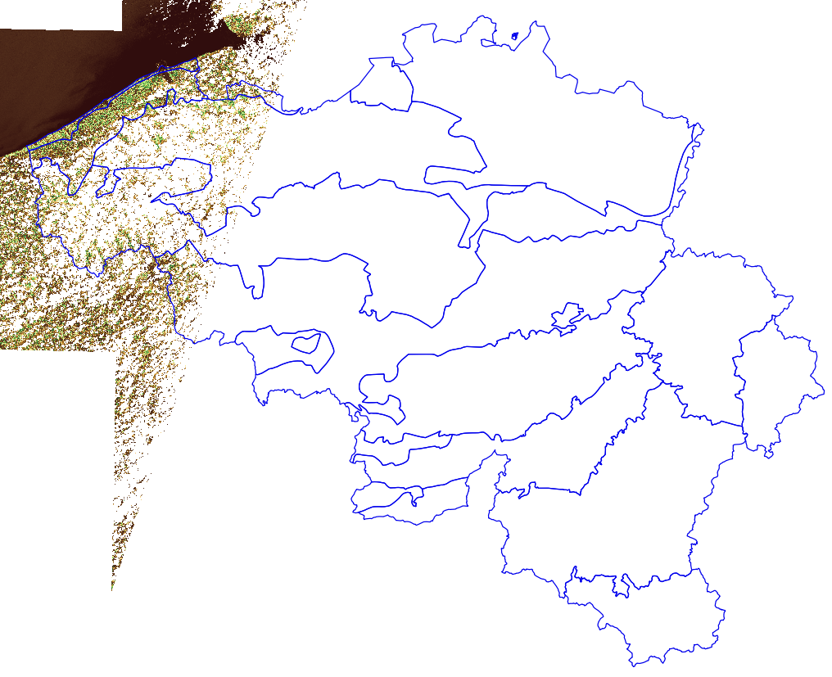
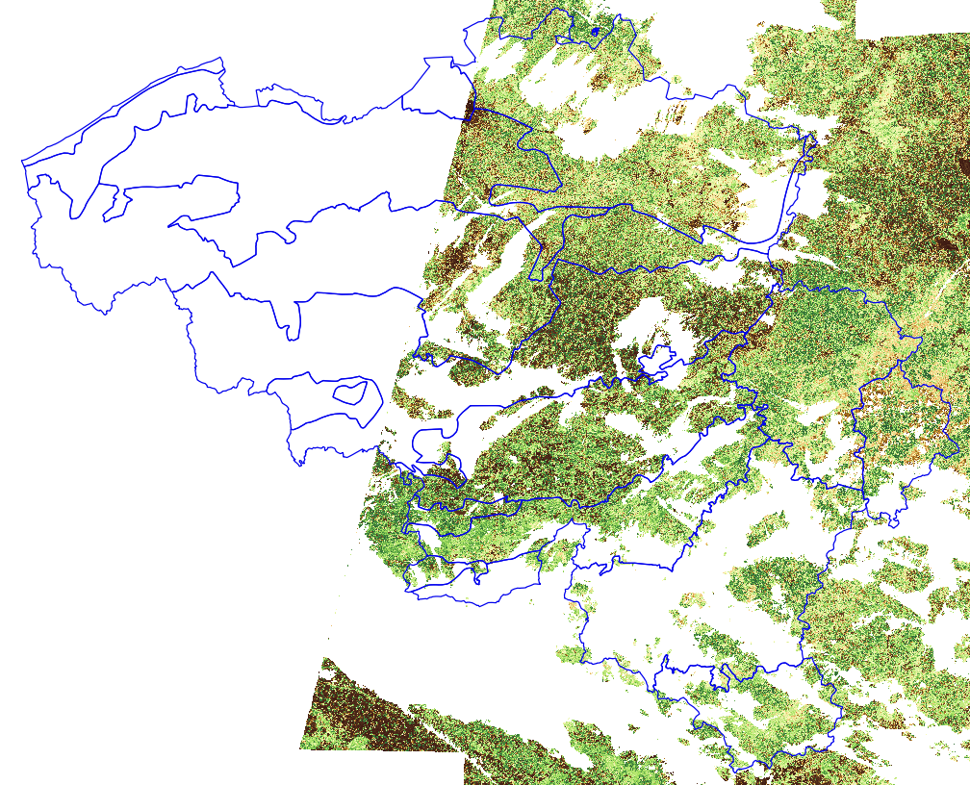
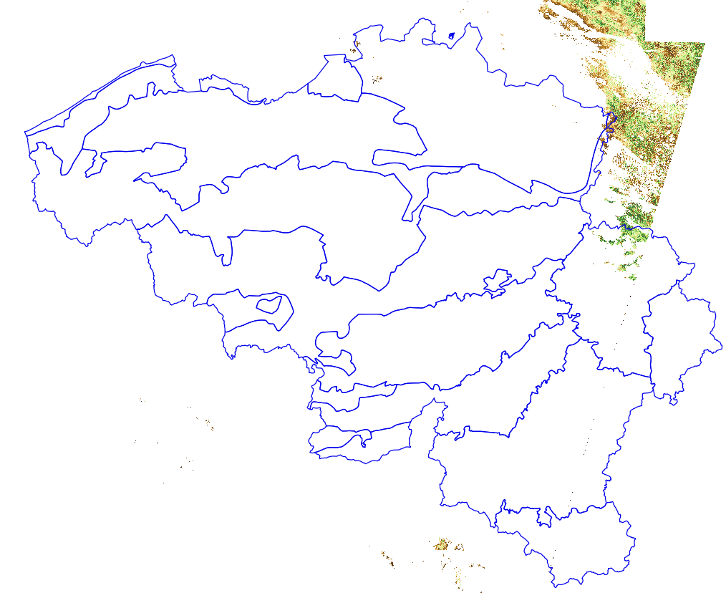
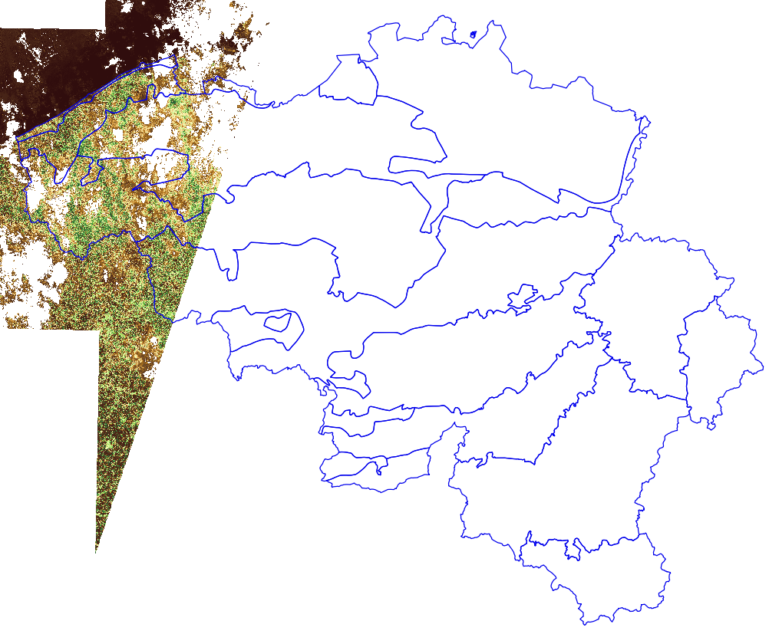
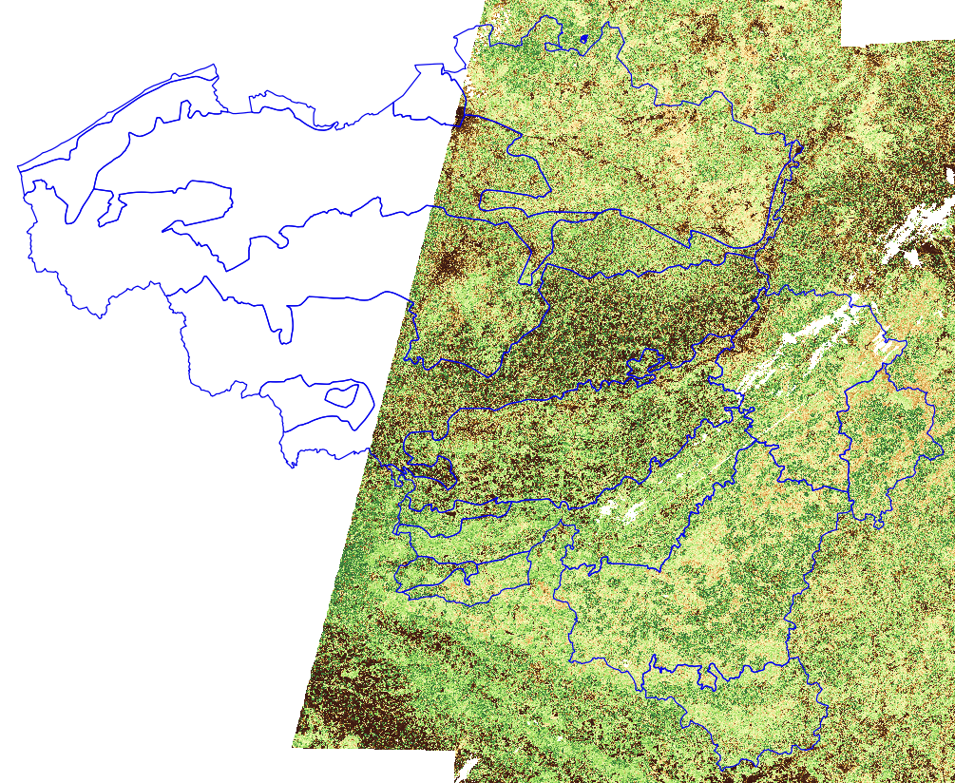
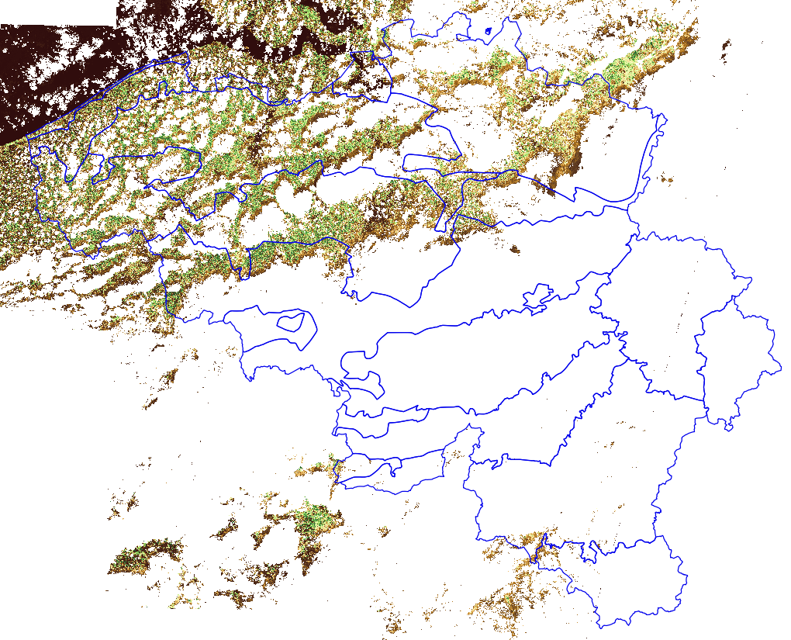
BELHARMONY CONTEXT: Sentinel-2 acquIsitions august 2016
 | 9/8 | 12/8
16/8 | 16/8 (DMC) | 19/8 | 22/8
 | 26/8 |  | 29/8

Slide 4
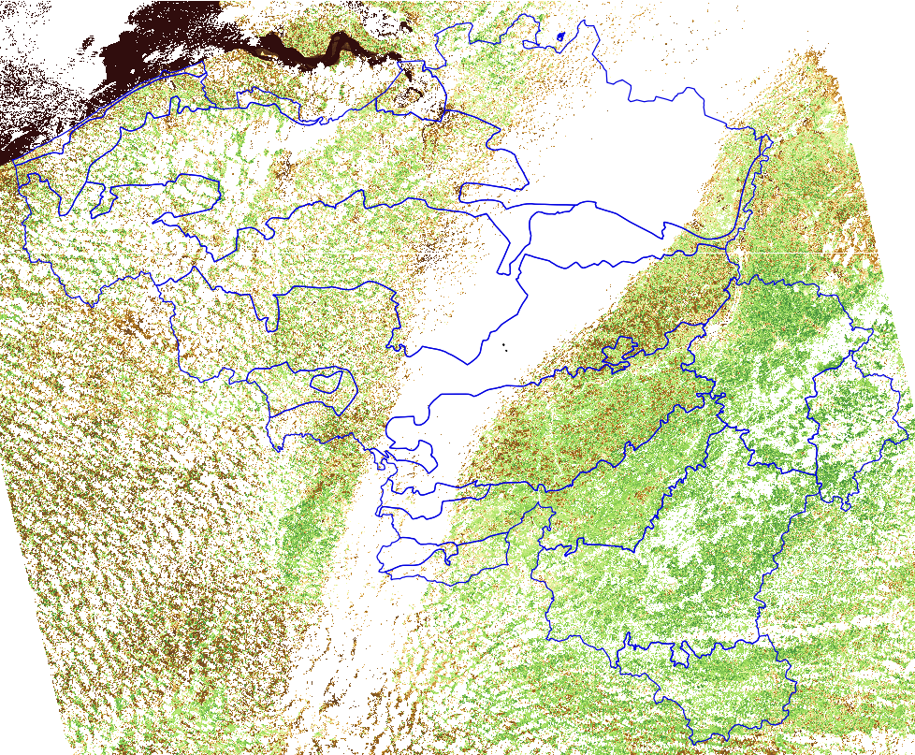
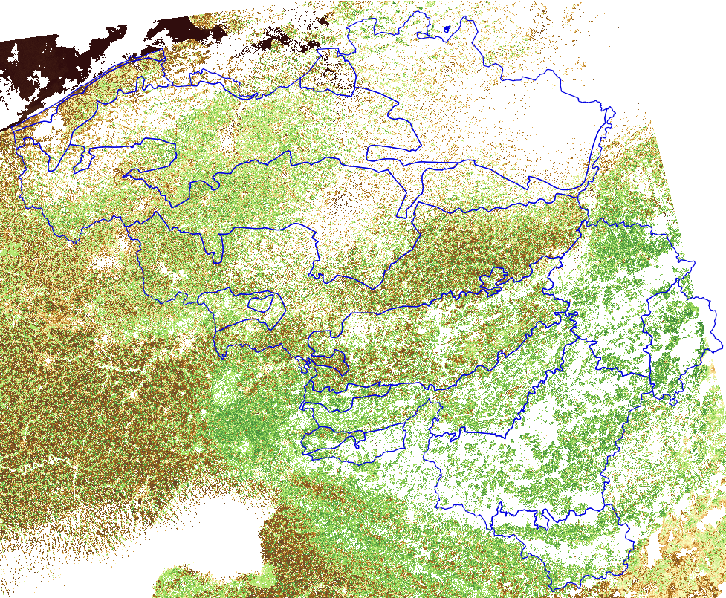
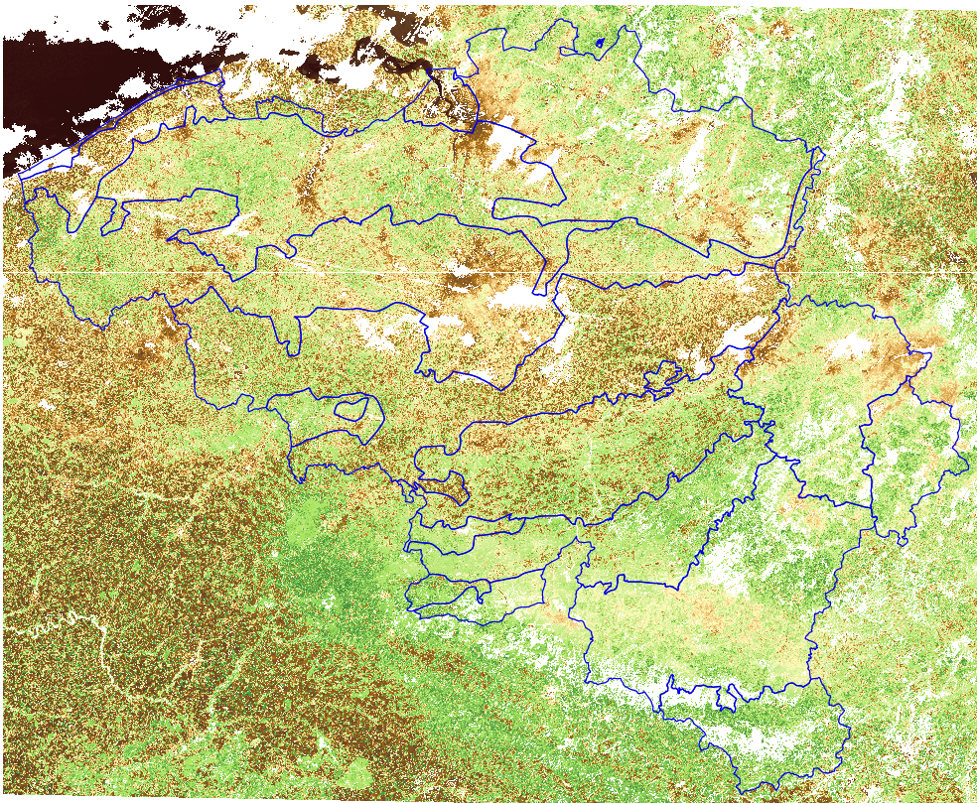
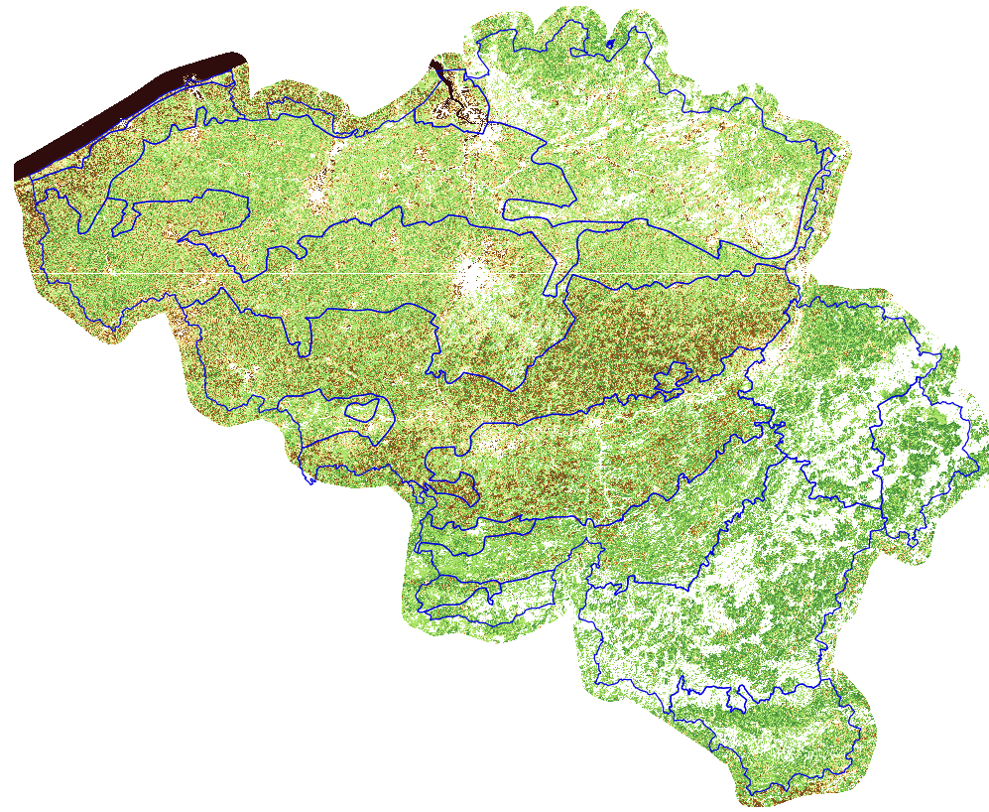
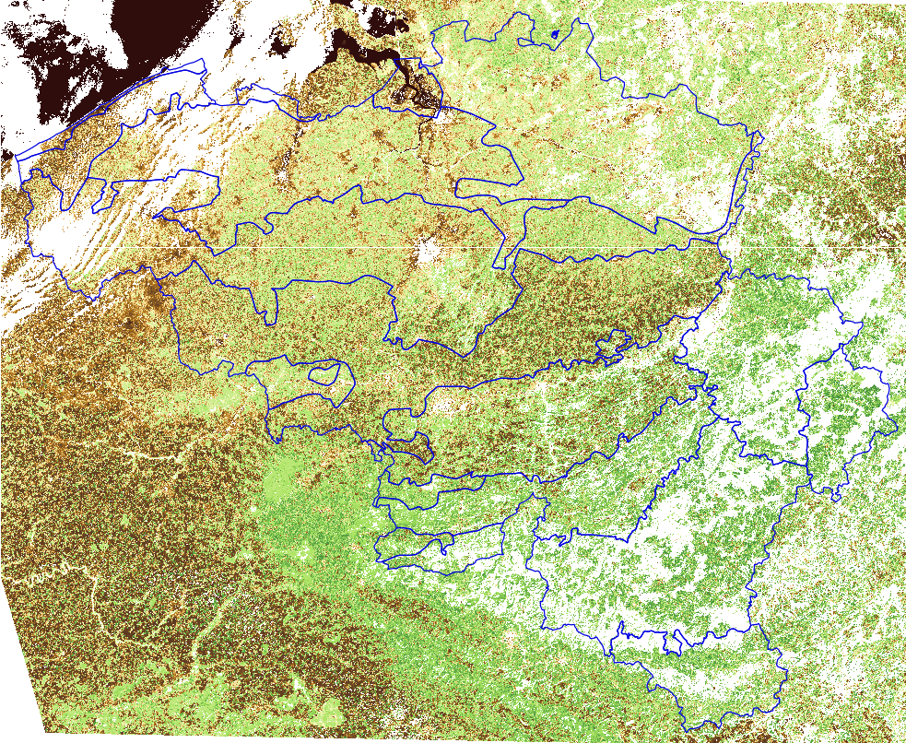
BELHARMONY CONTEXT: Sentinel-2 & DEIMOS-1(DMC) acquisitions aug. 2016
6/8 (DMC) | 9/8 | 12/8 | 13/8 (DMC)
16/8 | 16/8 (DMC) | 19/8 | 22/8
23/8 (DMC) | 26/8 | 26/8 (DMC) | 29/8

Slide 5
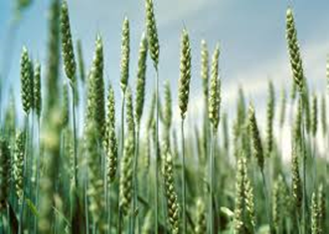
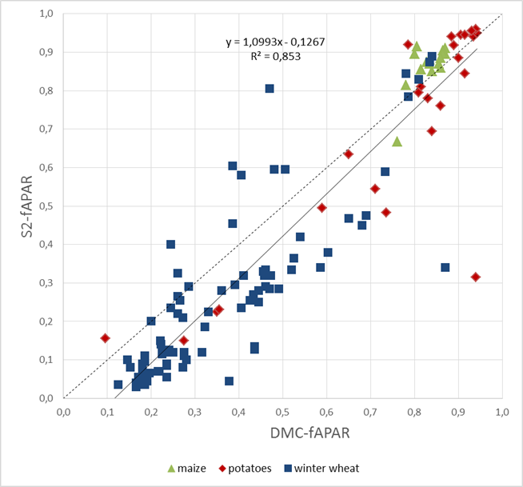
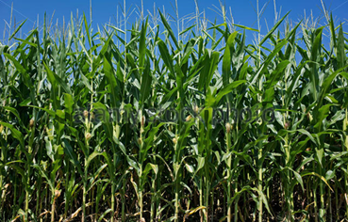
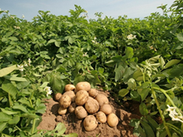
BELHARMONY CONTEXT
Data consistency concern !

Slide 6
BELHARMONY OVERALL OBJECTIVE
To assess and improve the consistency of multi-sensor high resolution time series. (HARMONY)
Focus on Landsat-8, Sentinel-2, PROBA-V (central camera) and Deimos-1/DMC
How ?
  Bottom-up approach (from L1 to L2 to L3)
Why ?
  Overall applicability
  To identify cause of biases
  Errors amplified from L1 (TOA refectance) to L2 (BOA reflectance)

Slide 7
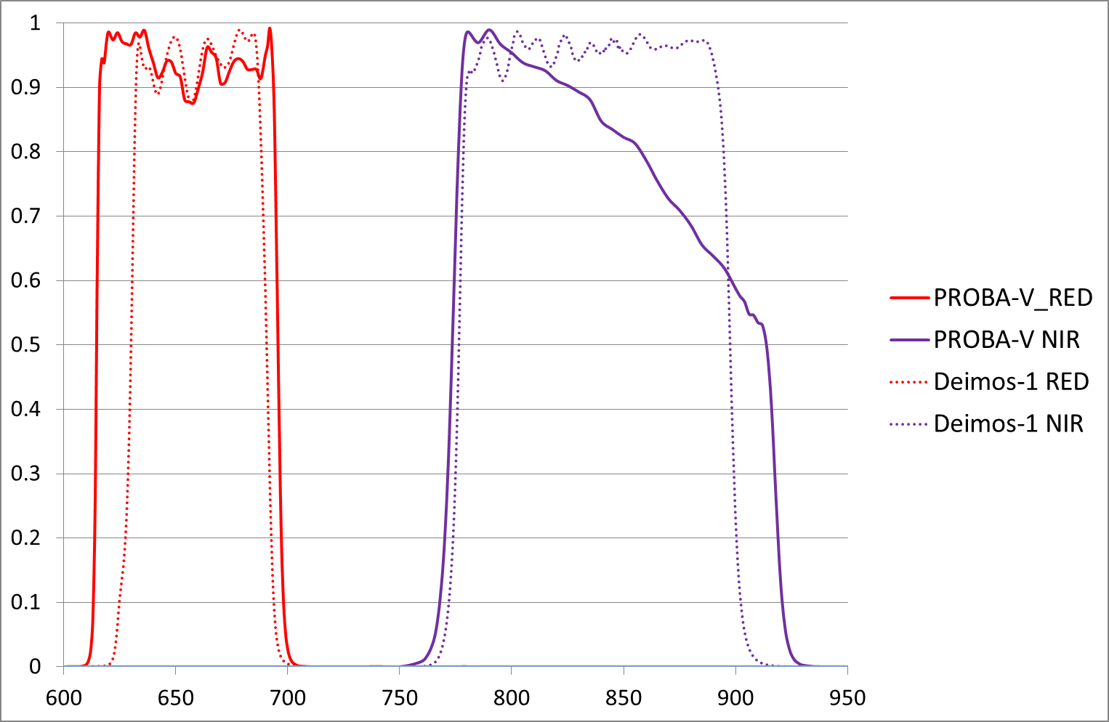
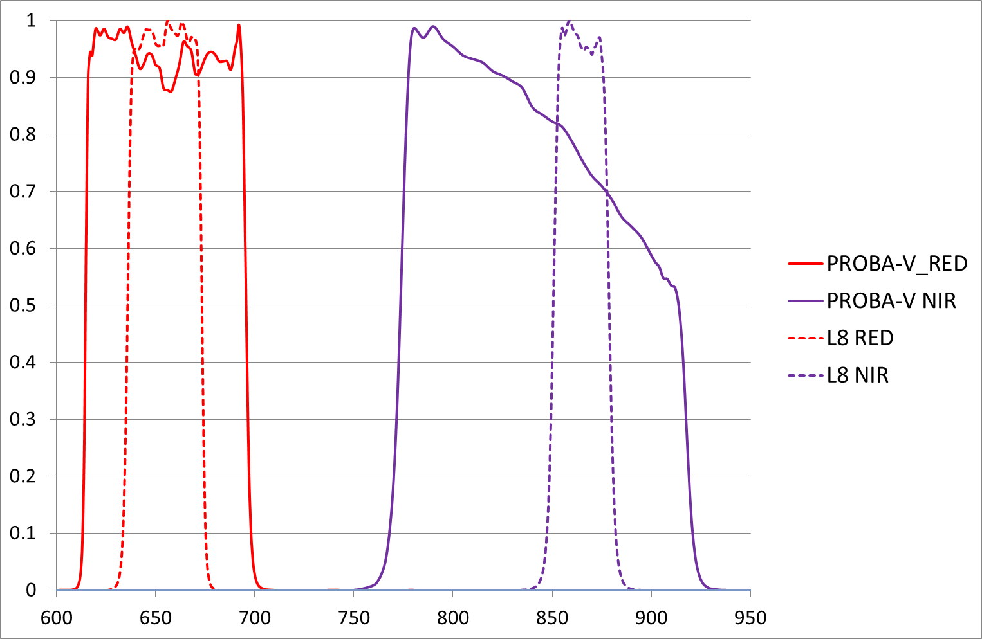
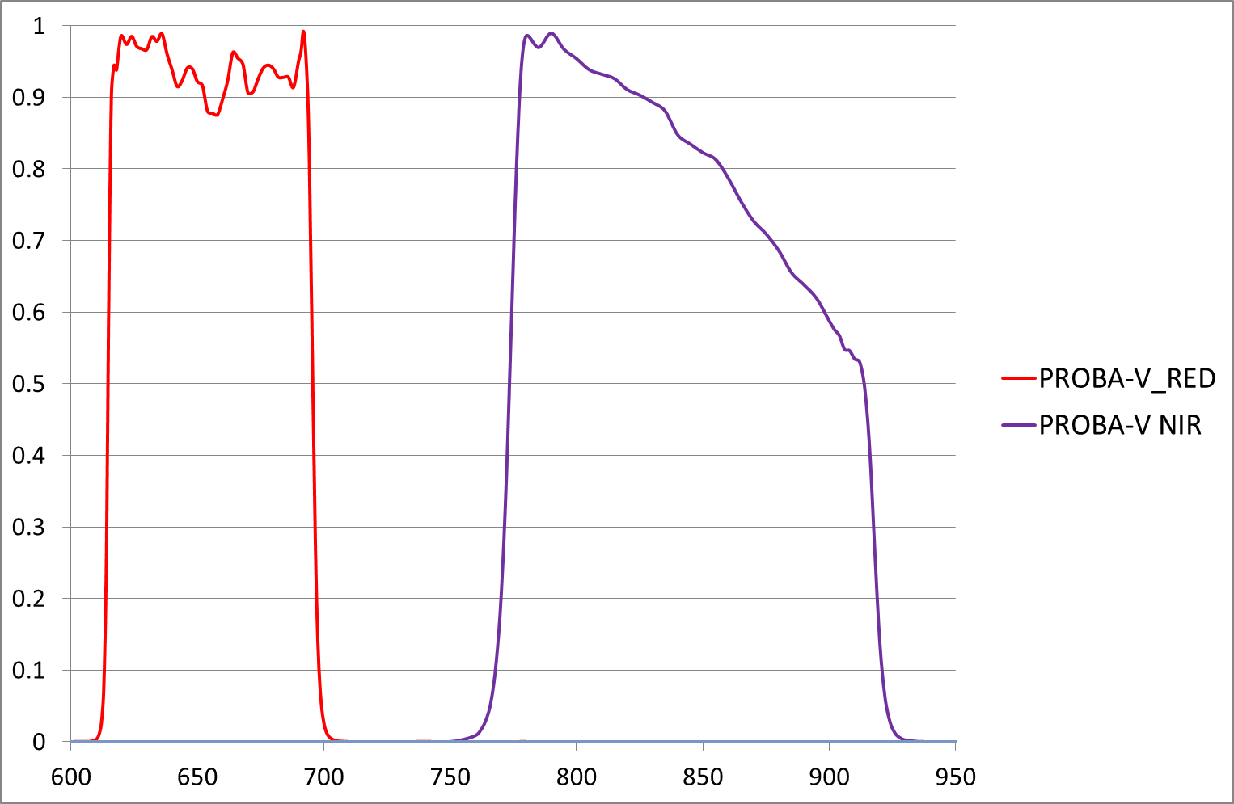
BELHARMONY scientific QUESTIONs
Does there exist a bias in the L1 data ?
  Is this bias scene brightness dependent ?
  Can we determine gains for inter-calibration of the L1 data ?
What is the impact of intrinsic differences in the RSRF of the different sensors ?
  Can BELHARMONY through the introduction of band or index dependent spectral adjustment functions correct for this ?

Slide 8
BELHARMONY scientific QUESTIONs
Does there exist a bias in the L1 data ?
  Is this bias scene brightness dependent ?
  Can we determine gains for inter-calibration of the L1 data ?
What is the impact of intrinsic differences in the RSRF of the different sensors ?
  Can BELHARMONY through the introduction of band or index dependent spectral adjustment functions correct for this ?
Can biases in L2 and L3 data be reduced through the use of a common processing chain ?

Slide 9

BELHARMONY scientific QUESTIONs
Does there exist a bias in the L1 data ?
What is the impact of intrinsic differences in the RSRF of the different sensors ?
Can biases in L2 and L3 data be reduced through the use of a common processing chain ?
PROBA-V
SMAC
Sentinel-2
Sen2COR
Landsat-8
LaSRC
De Keukelaere et al. (2018)
Deimos-1/DMC
No standard A/C available

Slide 10
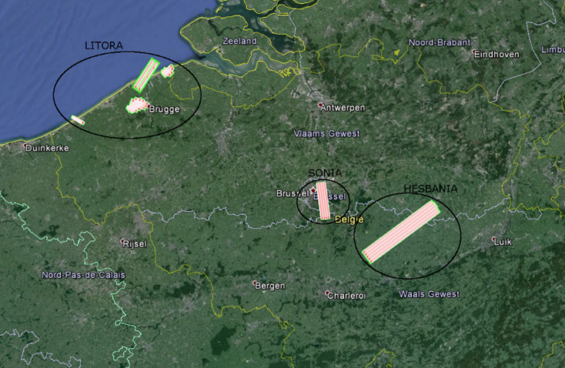
BELHARMONY scientific QUESTIONs
Does there exist a bias in the L1 data ?
What is the impact of intrinsic differences in the RSRF of the different sensors ?
Can biases in L2 and L3 data be reduced through the use of a common processing chain ?
What is impact of all these harmonization measures on the consistency of the multi-sensor L2/L3 time series?
  => BELHARMONY APPROACH:
  BELAIR CASE STUDIES

Slide 11

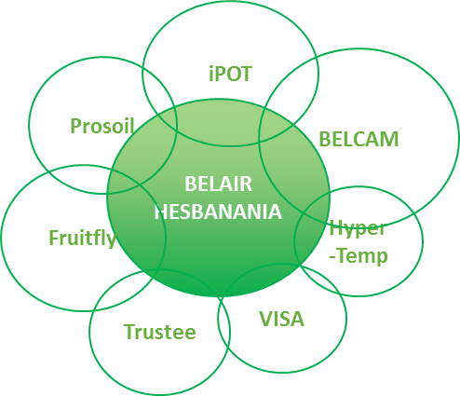
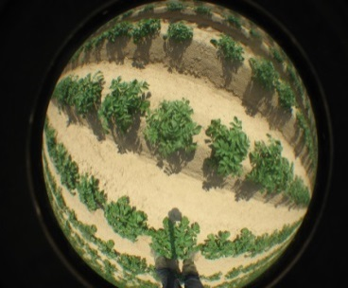
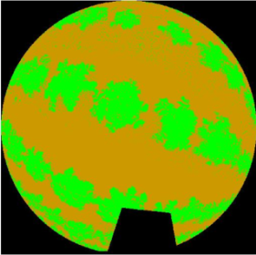
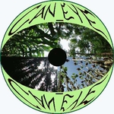
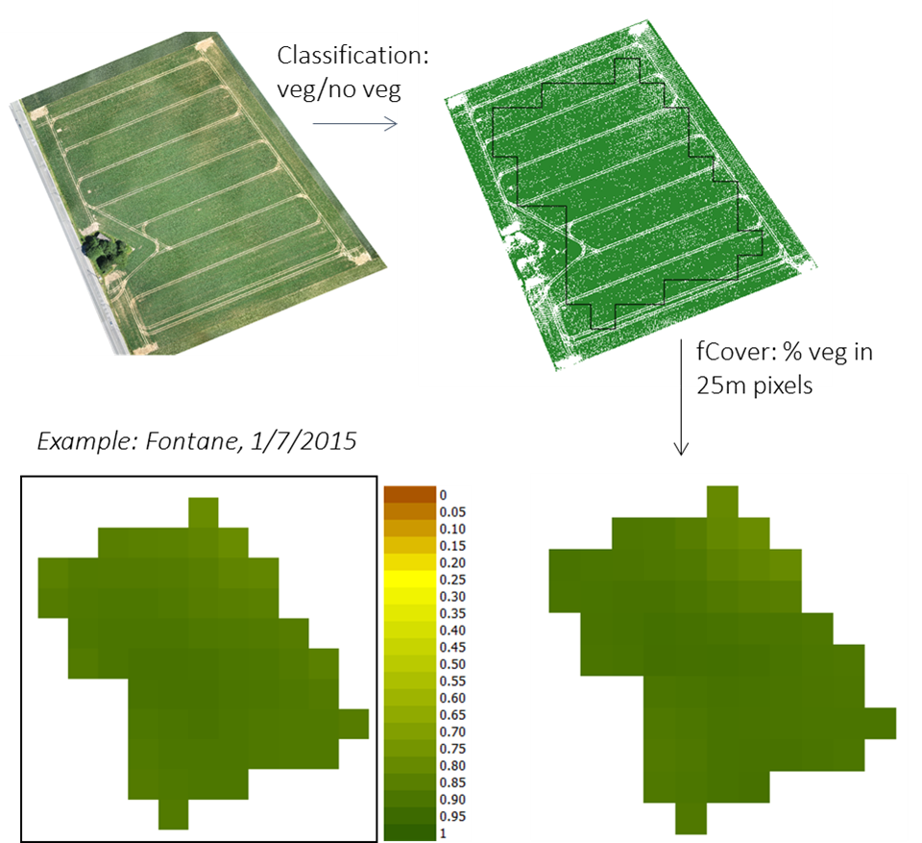
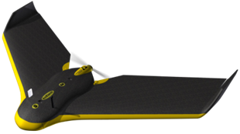
HESBANIA CASE STUDIE
Hemispherical photograps (LAI, fCover, fAPAR)
UAV images (fCover)

Slide 12
BELHARMONY scientific QUESTIONs
Does there exist a bias in the L1 data ?
What is the impact of intrinsic differences in the RSRF of the different sensors ?
Can biases in L2 and L3 data be reduced through the use of a common processing chain ?
What is impact of all these harmonization measures on the consistency of the multi-sensor L2/L3 time series?
  => BELHARMONY APPROACH:
  BELAIR CASE STUDIES

Slide 13
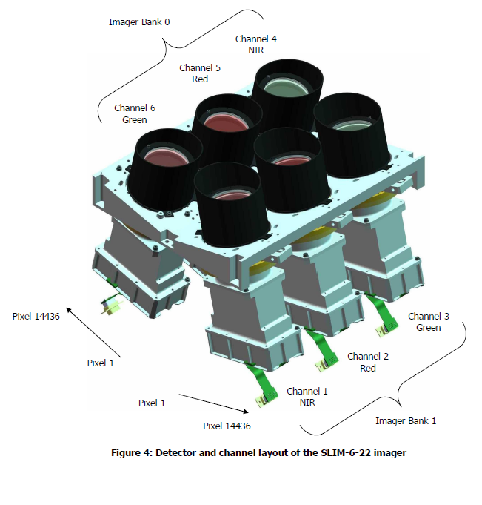
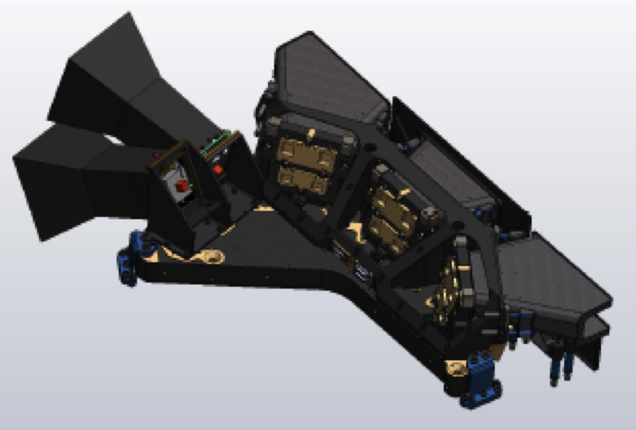
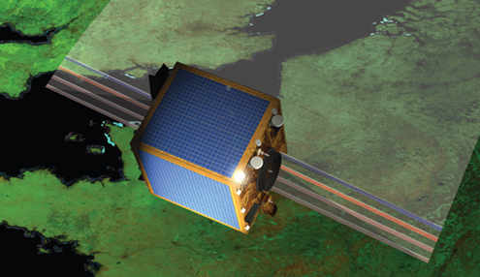

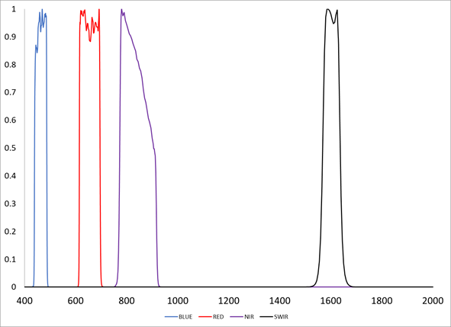
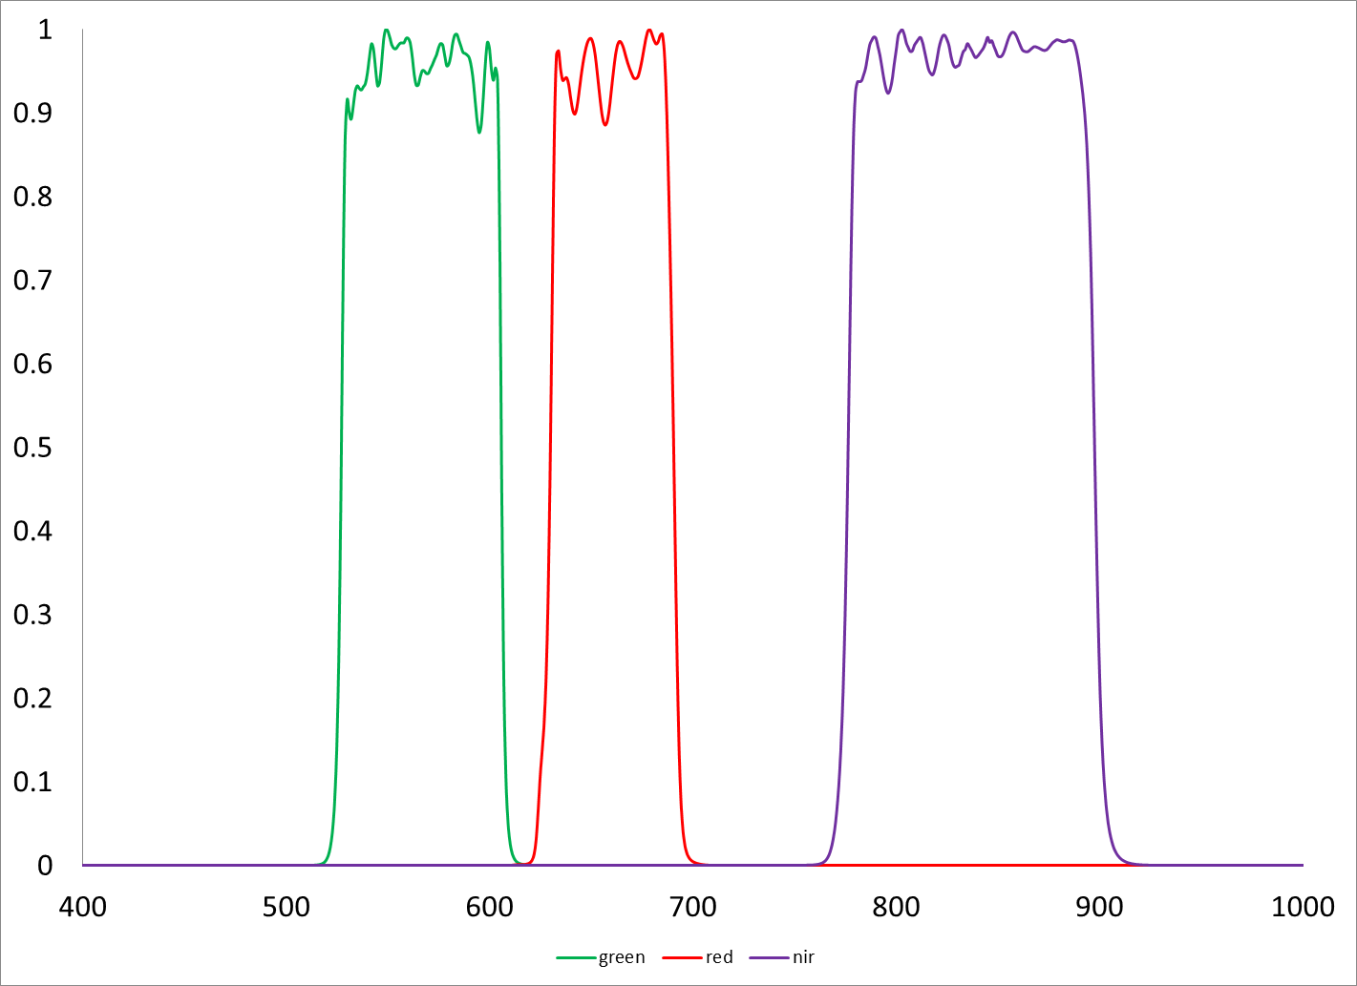
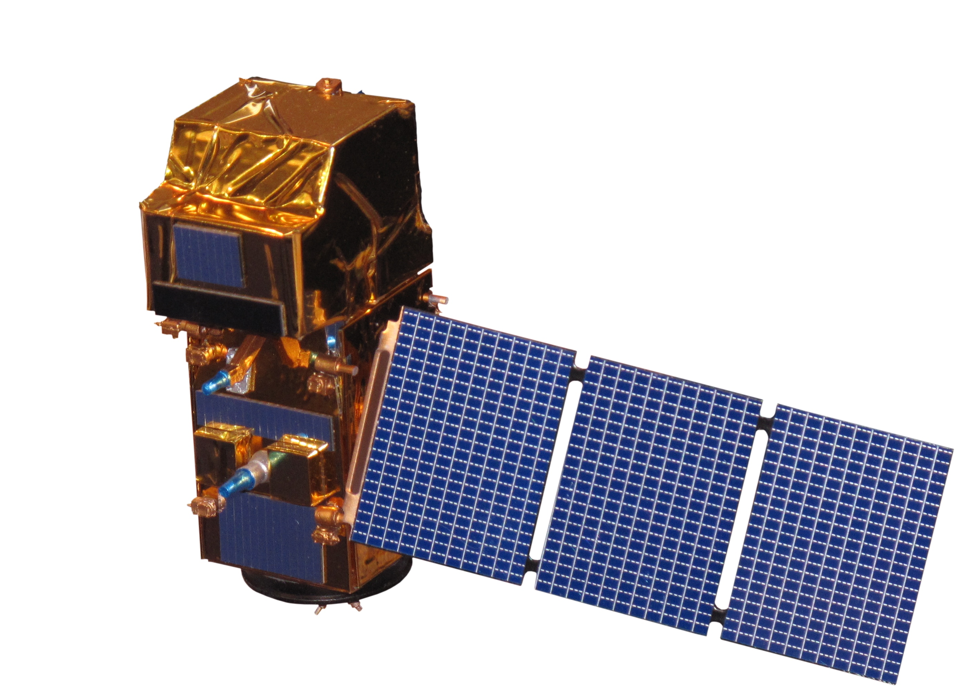
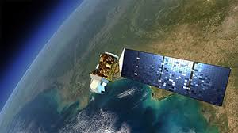
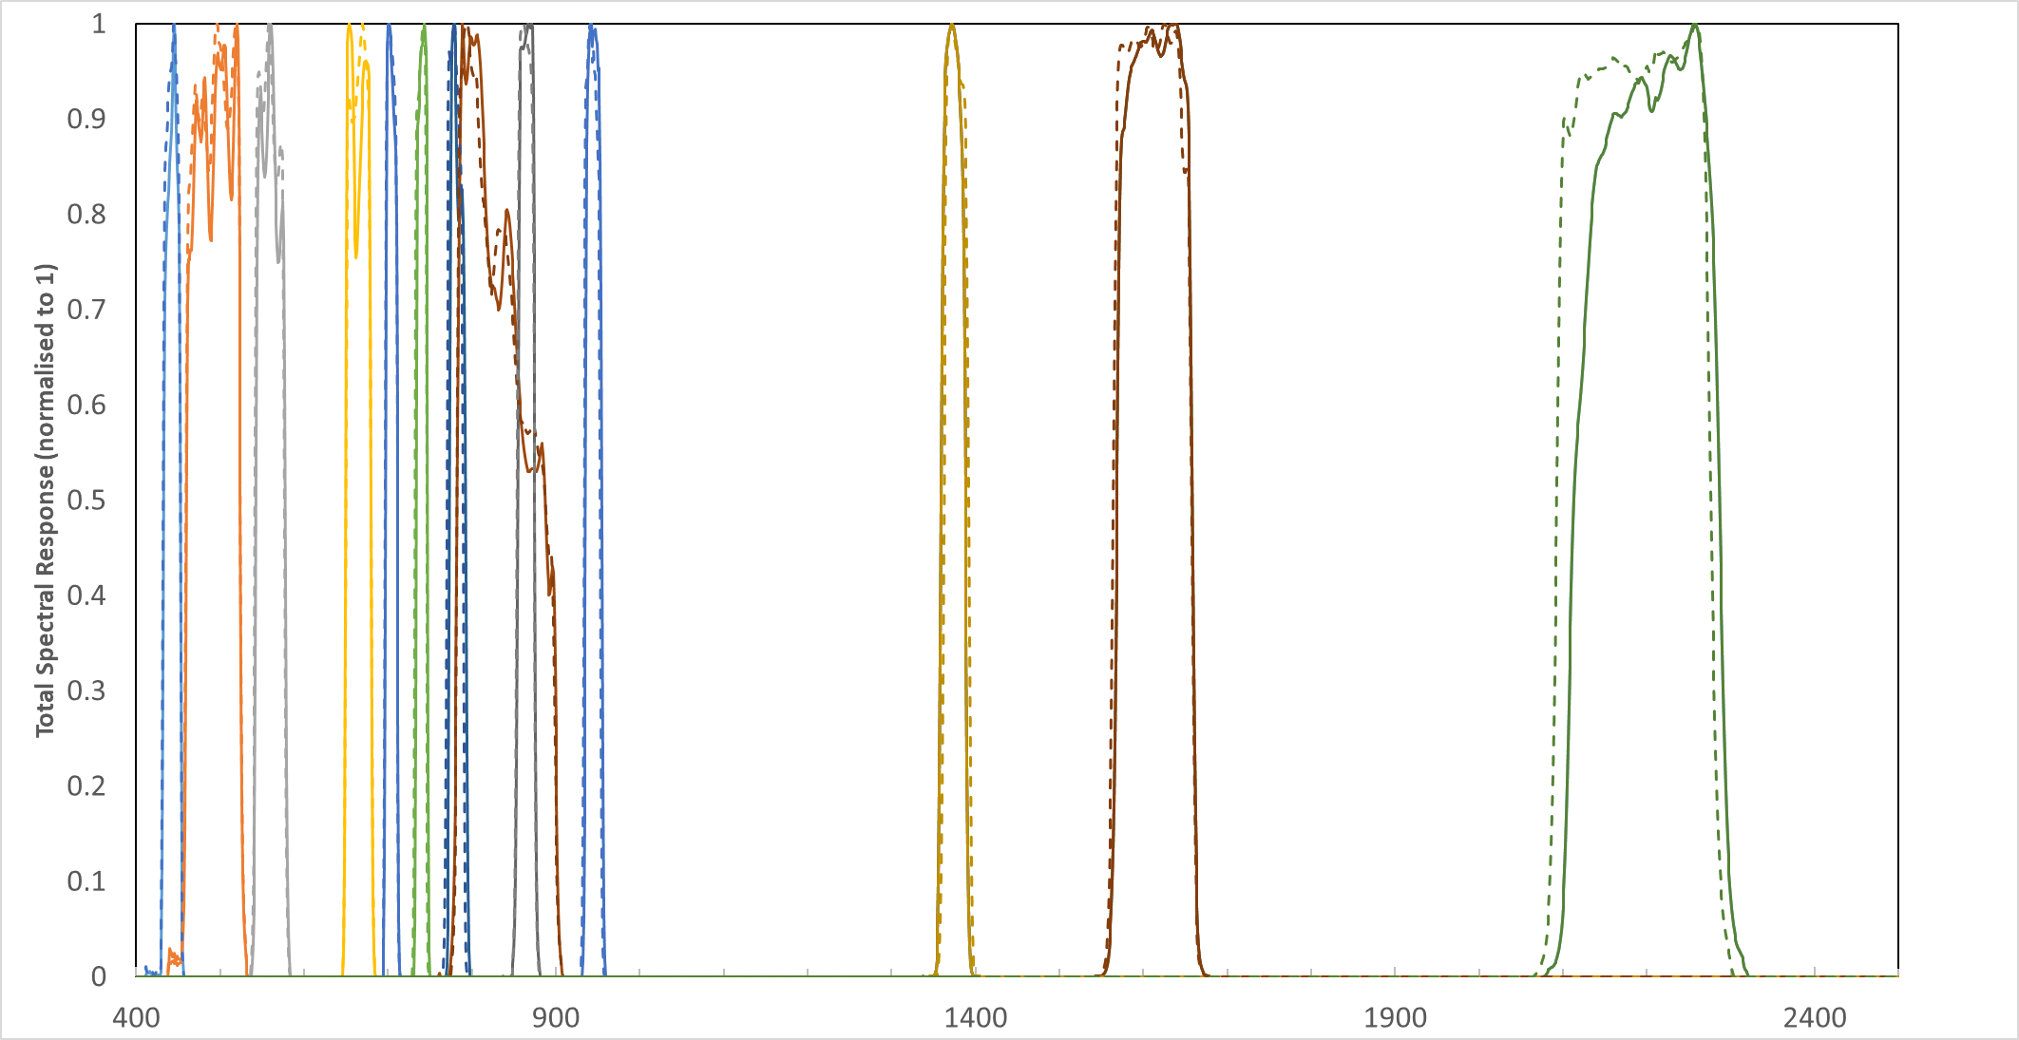
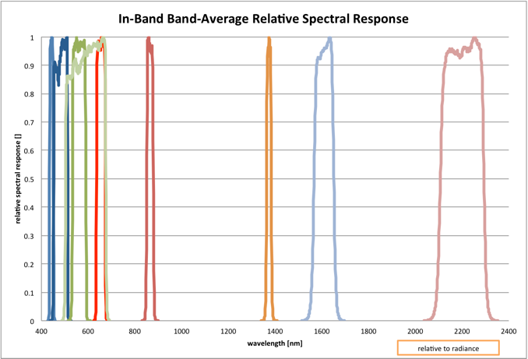
PROBA-V
DEIMOS-1 SLIM-S-22 Imager
No on-board calibration devices
3 cameras (focus on CENTER camera ~100 m res.)
3 VNIR bands (BLUE, RED, NIR)
1 SWIR band
2 Imager banks Cameras (P,S)
  3 Bands : GREEN, RED, NIR
  GSD 22 m at nadir
  600 km swath
No-onboard calibration devices
Sentinel-2A &-2B
Landsat-8

Slide 14
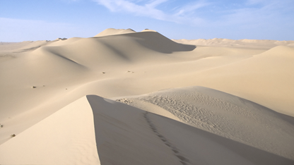
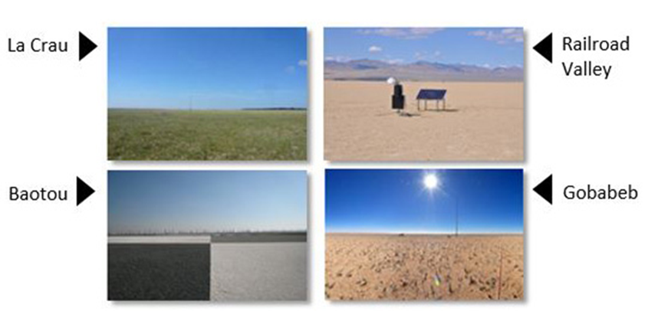
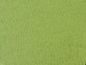
medium/high radiance APPROACH
Inter-comparison over the Libya-4 PICS desert site following the OSCAR* desert approach
Bias Assessment over instrument RadCalNet sites (Land Equipped Sites (LIS))
*OSCAR (Optical Sensor Calibration with simulated Radiances). Govaerts, Y., S. Sterckx, and S. Adriaensen (2013). Use of simulated reflectances over bright desert target as an absolute calibration reference. Remote Sensing Letters, , Vol. 4: 6, 523-531.

Slide 15
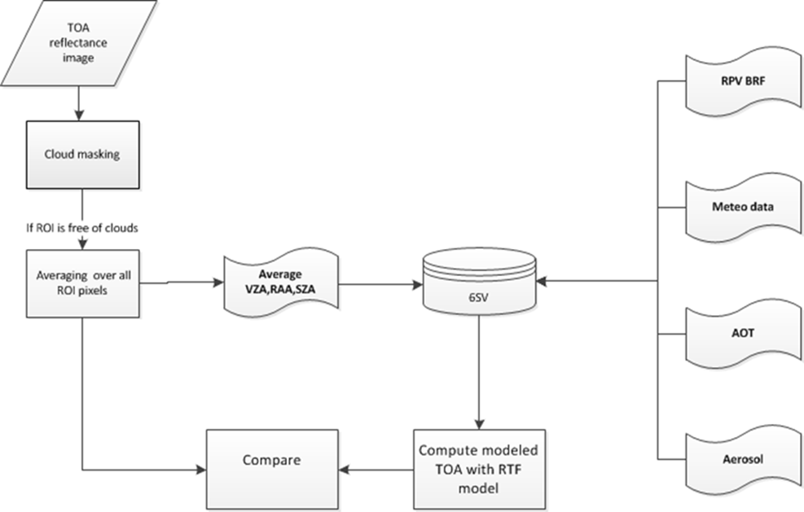
LibyA-4 OSCAR: implementation
  6SV simulations
  Surface RPV BRF
  ECMWF NPW data (P, O₃, H₂O)
  Desert aerosol
  AOT (monthly)

Slide 16
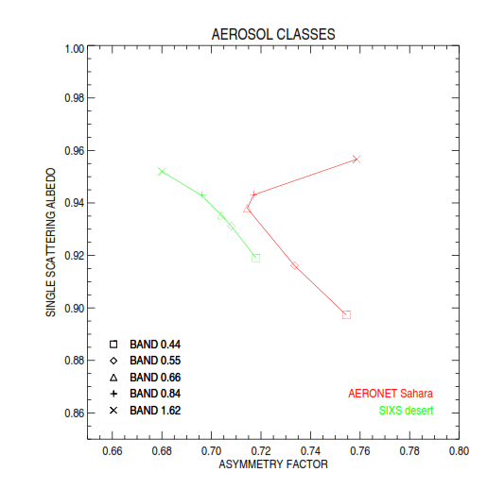
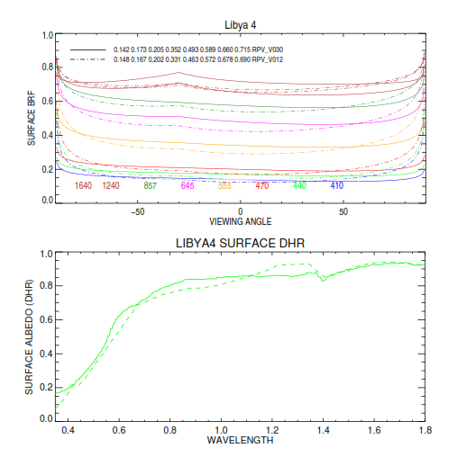
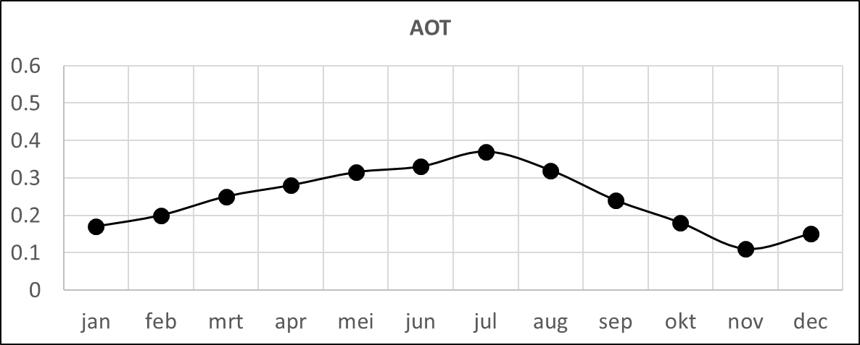
Improvements to DESERT approach*
Surface characterisation improvement (MISR/MODIS ** ⬄ ORIG*: POLDER/ATSR2)
Aerosol characterisation
*
*Govaerts and Clerici (2004)
** Govaerts, Y., Sterckx, S., Adriaensen, S. Remote Sensing Letters 2013

Slide 17
Number of observations for LIBYA-4
Mission | Number of observations
Sentinel-2A | 68
Sentinel-2B | 19
Landsat8 | 62
PROBA-V | 214
Deimos1 | 91

Slide 18
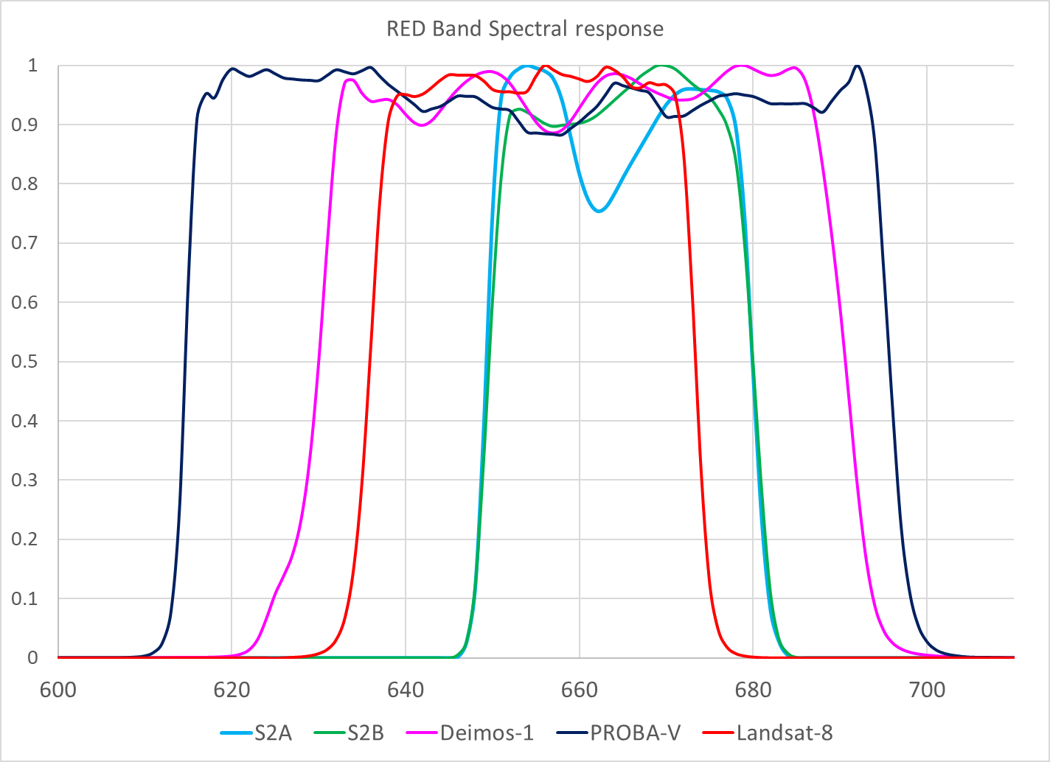
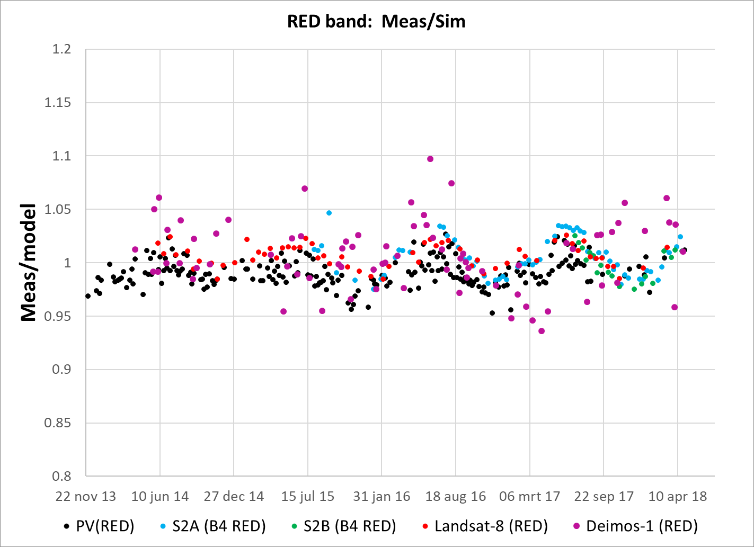
OSCAR LIBYA-4 Desert results RED banDs

Slide 19

Ratio observed / simulated TOA reflectances

Slide 20





Slide 21

Relative ratio difference with respect to sentinel-2A

Slide 22
CONCLUSIONS LiBYa-4
For comparable spectral bands Landsat-8, PROBA-V, Sentinal-2B and Deimos-1 agree to within 2% with Sentinel-2A, except for the green band on Deimos-1 where a difference of 3,5 % is observed
Differences between Sentinel-2A and Sentinel-2B of the same magnitude as differences observed between Sentinel-2A and the other sensors. Sentinel-2A is for most bands slightly brighter than Sentinel-2B.
The results confirm that all sensors investigated are well-calibrated and that inter-sensor differences are small at least over bright areas such as Libya-4.

Slide 23

Observations vs simulations over Radcalnet sites

Slide 24
methodology
S2A, S2B, L8, PV, and Deimos1 images downloaded
ROI TOA reflectance extractions
  ~1km, ~ 500 m, ~100 m
Generation of quicklooks for cloud check over sites + surroundings → exclude scattering from nearby clouds (< ~5 km)
Spectral resampling of RadCalNet TOA reflectances (at 10 nm) to the respective spectral bands
Selection of match-ups between sensor observations and Radcalnet simulations
  time constraint ±15 – 45 minutes

Slide 25
Number of cloud-free matchups
Sensor | LCFR | RVUS | GONA | Total
Sentinel-2A | 32 | 14 | 27 | 73
Sentinel-2B | 20 | 8 | 22 | 50
Landsat 8 | 24 | 6 | 14 | 44
PROBA-V | 103 | 28 | 42 | 173
Deimos1 | 4 | 7 | 0 | 11

Slide 26

Gobabeb (GONA), 23.500ºS, 15.033ºE

Slide 27

gobabeb (GONA)

Slide 28



No Deimos1 data available for GONA

Slide 30

RailROAD Valley PLAYA (RVUS), 38.504ºN, 115.692ºW
Representative area 100 x 100 m
1 PROBA-V pixel
(100 m resolution)
3 × 3 L8 pixels
(30 m resolution)
5 × 5 S2 pixels
(20 m resolution)
5 × 5 Deimos1 pixels
(22 m resolution)

Slide 31

RailROAD Valley PLAYA (RVUS)

Slide 32





Slide 33










Brdf effects RVUS, RED
L8
S2A
S2B
PV
D1
L8 B2
S2A B4
S2B B4
PV B2
D1 B3

Slide 34
RVUS : TOA reflectectance Sentinel-2A and SENTINEL-2B

Slide 35

LA CRAU (LCFR), 43.55ºN, 4.85ºE

Slide 36

LA CRAU (LCFR), 43.55ºN, 4.85ºW

Slide 37









Brdf effects LCFR, RED
L8
S2A
S2B
PV
D1
L8 B2
S2A B4
S2B B4
PV B2
D1 B3

Slide 38
Conclusions radcalnet
Current number of match-ups not sufficient to draw statistically robust conclusions
Due to non-nadir viewing, BRDF effects regularly occur over LCFR and RVUS
BRDF effects cause large intra-sensor variation, which exceeds the inter-sensor variation
Additional site BRDF information required in TOA simulations to reduce intra-sensor variation
Inter-sensor relative differences over GONA within ±2.5% → comparable to Libya-4 results

Slide 39
OVERALL conclusions
Relative differences between sensors small:
  Within ±1.5 % for Libya-4
  Within ±2.5 % and Gobabeb
Deimos-1 green band slightly larger differences : 3.5% difference
S2A possibly slightly brighter than S2B, but within uncertainty range of reference methods
No statistically robust conclusions possible for RVUS and LCFR

Slide 40


Thank you!

Slide 41

Different ratio spectral profile Libya-4 vs radcalnet

Slide 42








Brdf effects GONA, RED
L8
S2A
S2B
PV
D1
No data
L8 B2
S2A B4
S2B B4
PV B2
D1 B3
No data

Slide 43

Libya-4 DEIMOS-1 results > No significant difference in results due to VAA / imager bank

Slide 44



PROBA-V
No on-board calibration devices
3 Cameras (focus on CENTER camera ~100 m res.)
  2 focal planes
    VNIR with 3 bands
    SWIR with 1 band but staggered strips

Slide 45

DEIMOS-1
SLIM-S-22 Imager
2 Imager banks Cameras (P,S)
  3 Bands : GREEN, RED, NIR
  GSD 22 m at nadir
  600 km swath
No-onboard calibration devices

Slide 46




Sentinel-2A & 2B
VAA

Slide 47



Landsat-8
VAA
VZA

