Slide 1
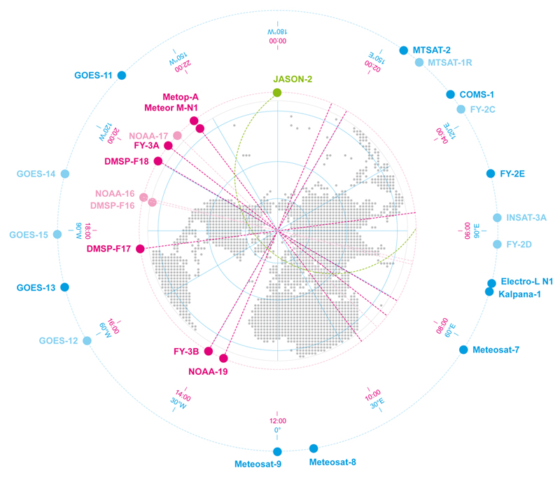
Importance of a healthy microwave imager constellation Adapted from CGMS-46 paper on importance of GCOM-W1 follow-on Presented to CGMS-46 Plenary session, agenda item O

Slide 2
Core Meteorological Mission
In support of the programmes coordinated or co-sponsored by WMO for weather and climate, CGMS Members plan to maintain the operational capabilities and services described below, that constitute the CGMS baseline for the operational contribution to the Global Observing System (GOS).
In LEO sun-synchronous orbit – 3 orbital Plans
Multispectral visible and infrared imagery
Infrared hyperspectral sounding (at least am and pm)
Microwave sounding
Microwave imagery
However shortfall in microwave imagery – depends on the variable of interest and spatial resolution
Notes:
Source: WMO http://library.wmo.int/pmb_ged/wmo_1157_en.pdf

Slide 3
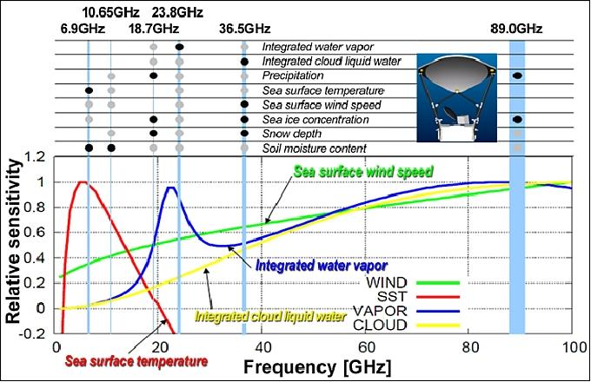
From JAXA

Slide 4
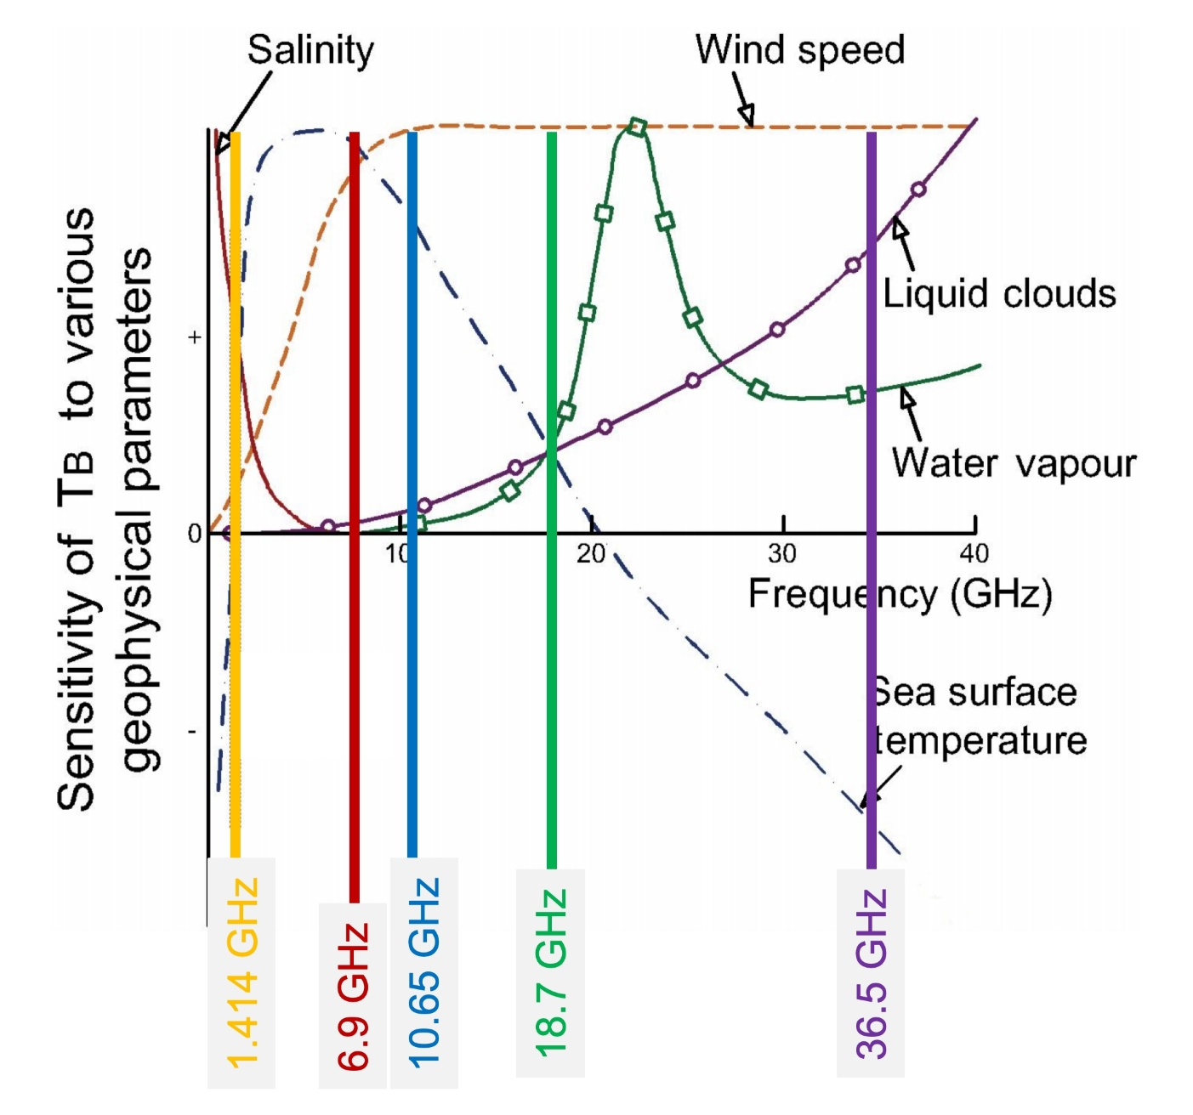
From ESA
Notes:
This figure justifies the combination of channels selected as baseline for the Copernicus Imaging Microwave Radiometer - candidate mission
Caption: Location of CIMR bands and sensitivity of brightness temperature for open seawater over a range of observing frequencies in the microwave band for a set of key geophysical parameters (From Gabarro et al, 2017).
This figure clearly highlights why CIMR channels are chosen to maximize the information available in the 1.4-37 GHz frequency range.

Slide 5
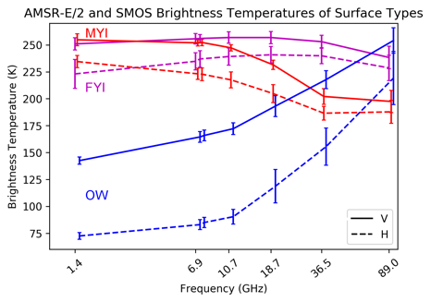
From ESA – Mark Drinkwater (after Pedersen et al, 2018)
Notes:
Caption: Spectral separation of sea ice signatures in the range 1 - 36 GHz (after Pedersen et al., 2018). See: https://figshare.com/articles/amsre2_SMOS_tie_points_png/7370261/2

Slide 6
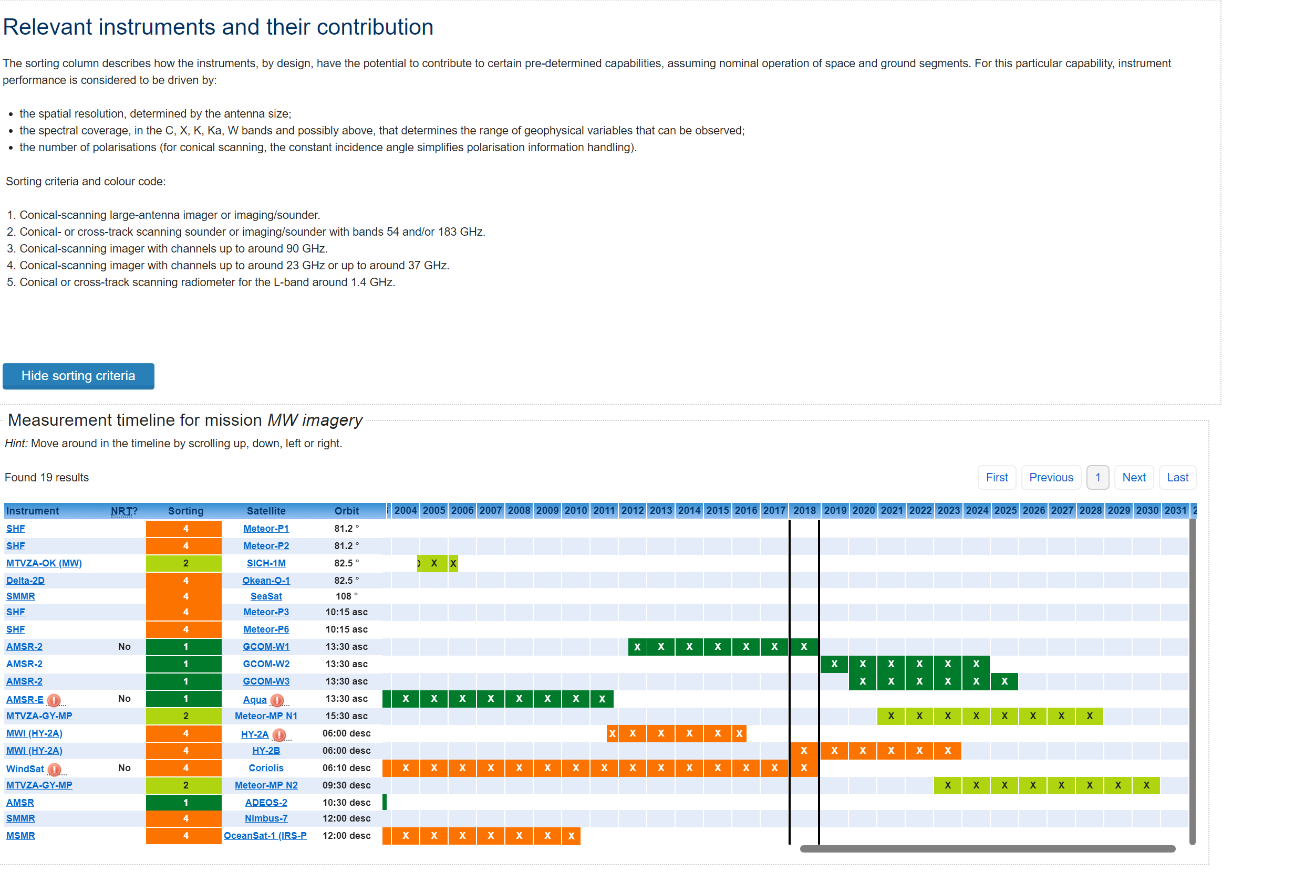
MWI for SST - unhealthy (from OSCAR)

Slide 7
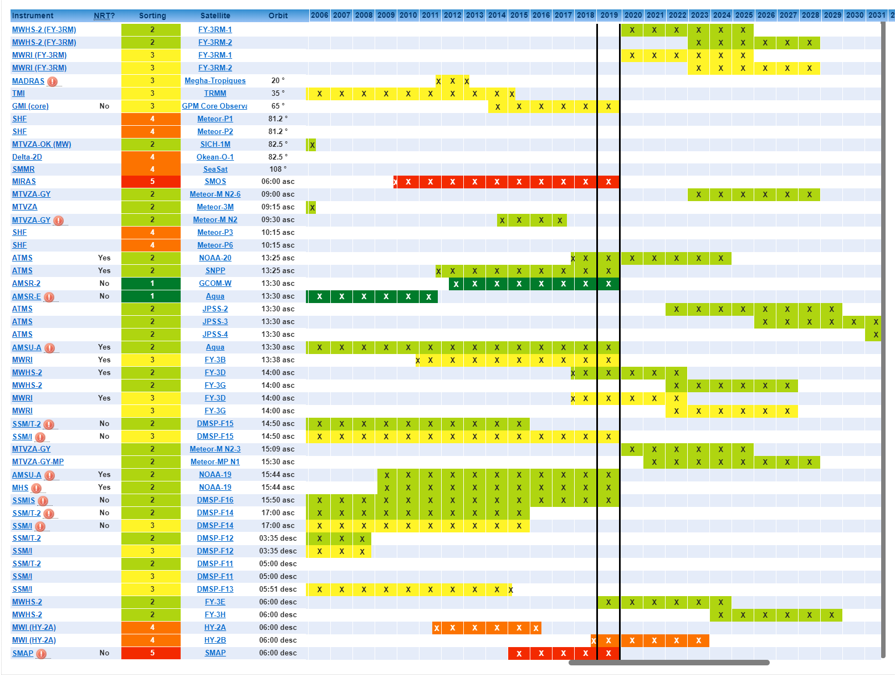
Precipitation and Sea Ice – Healthier

Slide 8
Salinity - UNHEALTHY

Slide 9
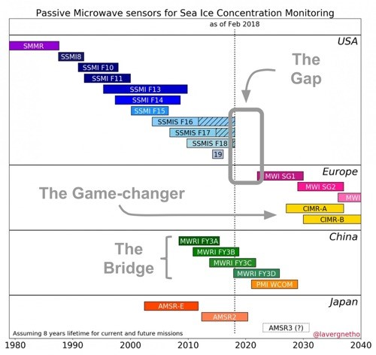
From ESA Constellation of Microwave Imagers
Notes:
Caption: Timeline of past, present and future microwave satellite radiometer missions relevant for sea ice concentration mapping for the period 1980s to 2030s highlighting a gap in capability and the use of Chinese missions to bridge the gap.
However, these missions do not include the low-frequency channels or high-spatial resolution offered by the proposed European CIMR mission concept. Directly responding to the Integrated European Policy for the Arctic, CIMR will be a unique
mission providing complementary low frequency and high-spatial resolution measurements: a game changer for Arctic monitoring (courtesy T. Laverne, Met.No)

Slide 10
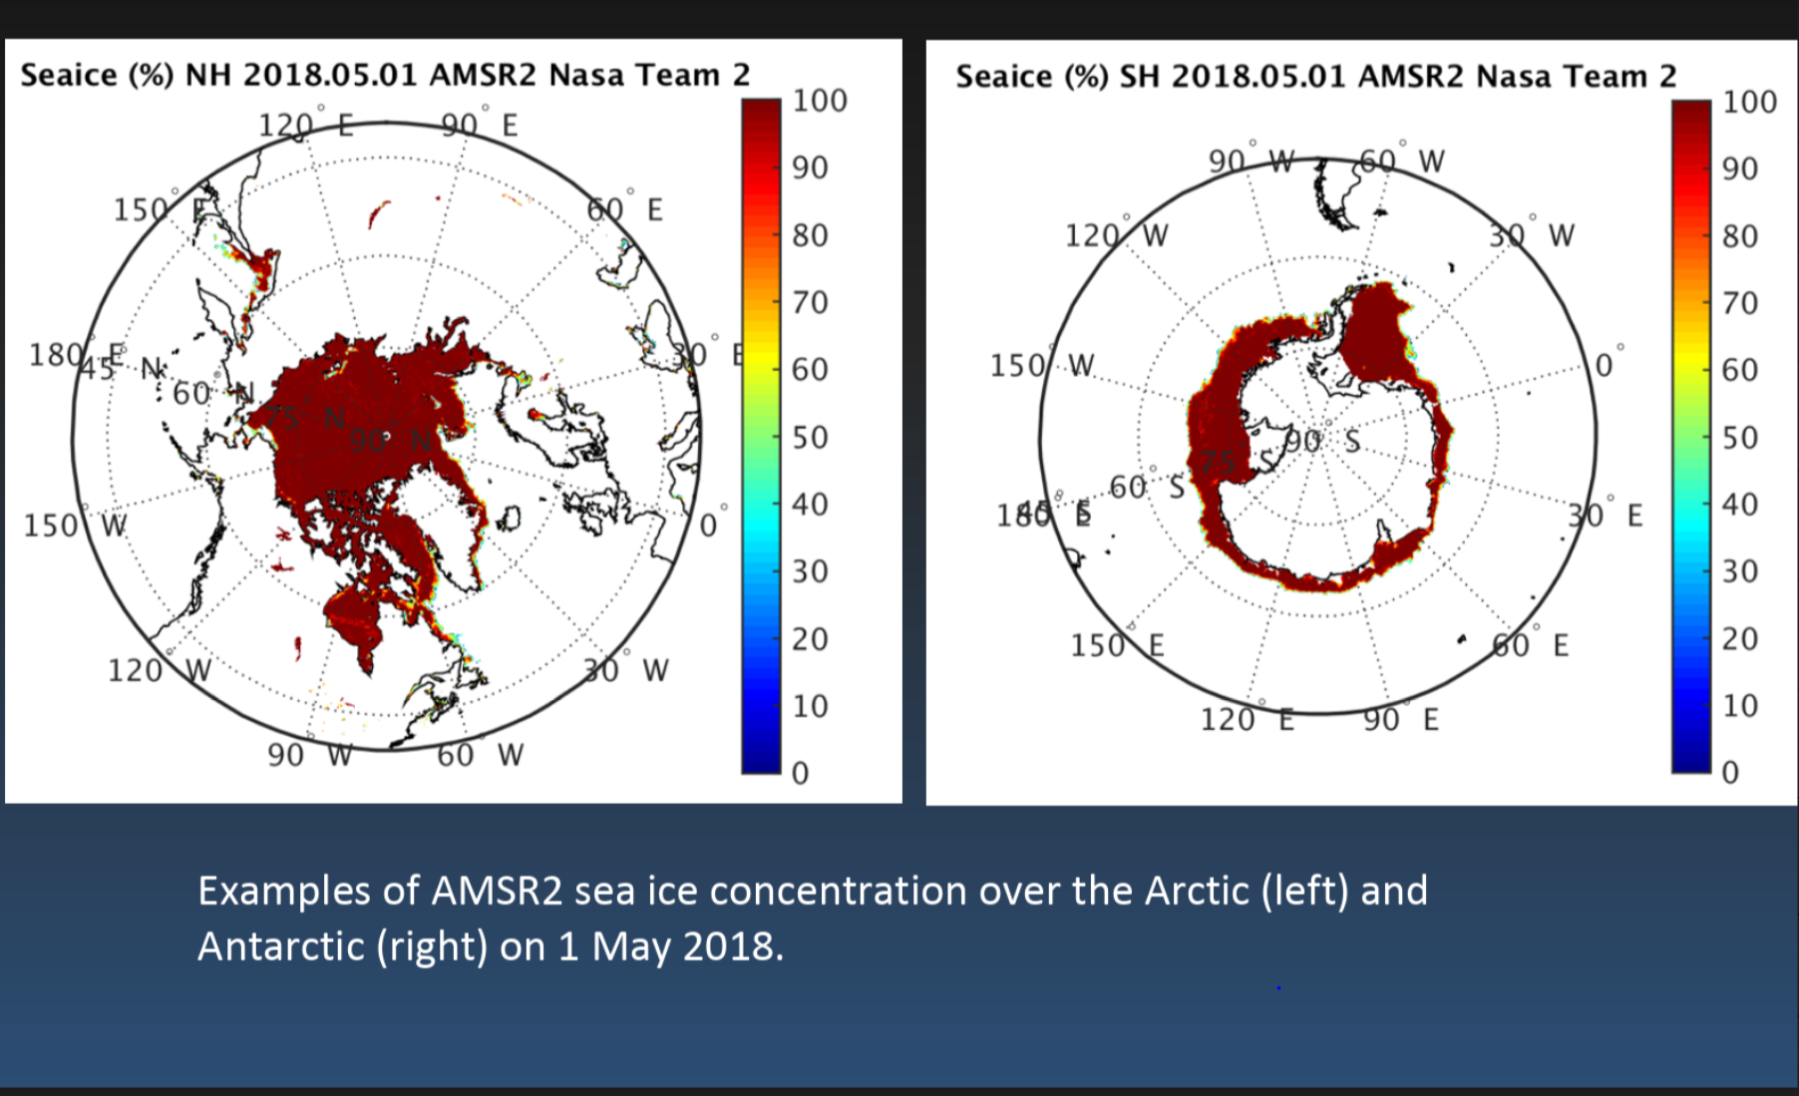
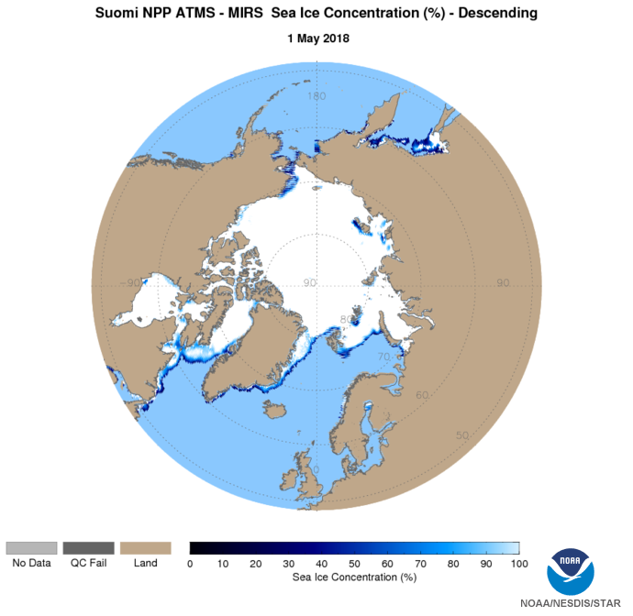
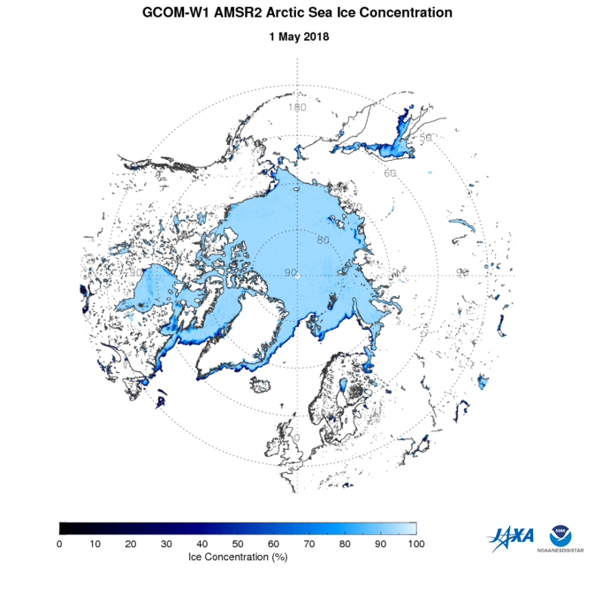
NOAA ATMS Operational Product
NOAA AMSR2 Operational Product

Slide 12
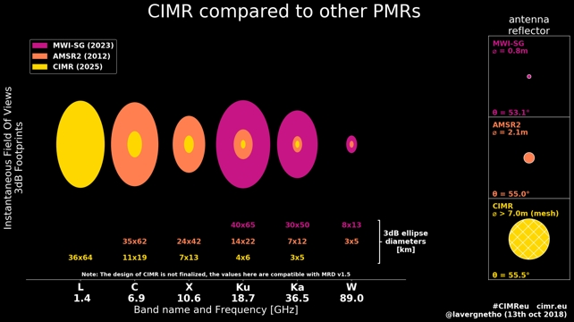
Copernicus Imaging Microwave Radiometer - candidate mission
Notes:
Caption: Illustration of the frequency channels of the CIMR mission, and their targeted spatial resolutions. CIMR is compared to two other similar Passive Microwave Radiometers (PMR): the Japanese AMSR2 in orbit since 2012, and the MWI to fly on-board the European EPS-SG satellites from ~2023 (MWI-SG).
(courtesy T. Lavergne, 2018). See: Figshare. https://doi.org/10.6084/m9.figshare.7177730.v1

Slide 13
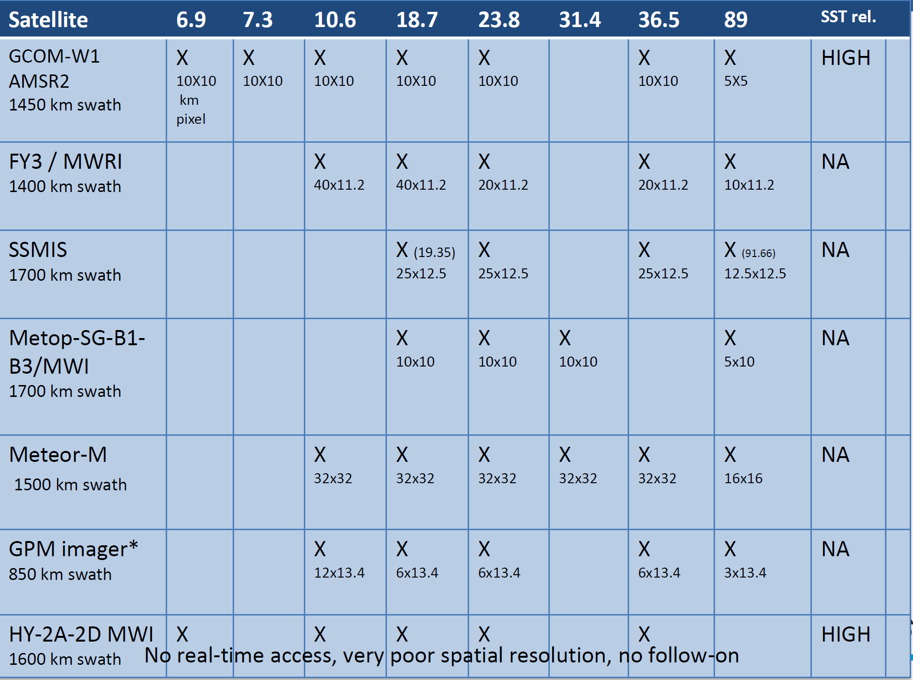

Slide 14
GCOM-W Operational Use Overview
Japan is a world leader for major advances in Polar Satellite Global Microwave Imagery for weather and climate through:
JAXA AMSR-E instrument on the U.S. Earth Observing System research satellite mission Aqua launched in 2002, providing ~9 years of observations
Follow-on JAXA AMSR-2/GCOM W1, launched in 2012
AMSR E/Aqua demonstrated the high value of these microwave imagery advances
Set the foundation for today’s expanding operational use of AMSR-2 on GCOM – W1
Led to multiple agencies planning to populate early morning and mid-morning orbits to enable GCOM-W type coverage from 3 orbits to enhance the value of GCOM through more frequent observations (US Department of Defense, EUMETSAT, China, Russia) However other missions do not have SST
Enabled critical partnership with U.S. – NOAA - JPSS to meet JPSS microwave imagery requirements, thus providing top priority observations to a top priority US program, anticipating a 3 - satellite GCOM-W series
GCOM-W AMSR-2 represents the gold standard in passive microwave satellite imagery
Coverage (swath width), spatial resolution
Unique all-weather observations of surface conditions including sea surface temperature and soil moisture
In routine use by all the world’s major operational meteorological agencies and the agencies focused on weather and climate research
Notes:
Source of AMSR-E information: NASA http://aqua.nasa.gov/sites/default/files/AquaStatus_October2015.pdf

Slide 15
GCOM-W Operational Use Overview
Most important weather and related unique capabilities/contributions from GCOM – W / AMSR 2 for public safety, infrastructure protection – land, sea, air
Tropical Cyclones - Helps accurately determine storm center location, structure, and track intensity - critical to accurate predictions to protect life and property
Heavy rain - High spatial resolution precipitation products important for predicting heavy rainfall events, floods, etc. – provides much improvement over soundings for very difficult to predict parameters
Sea ice – Sees through clouds to distinguish sea ice from ocean, available day and night in often data sparse regions (e.g., Arctic) – critical for navigation along with SAR and visible imagery
Marine wind forecasts – surface wind information where in situ data is sparse (e.g., over oceans).
Additional capabilities/contributions from GCOM-W / AMSR2
Global soil moisture information for numerical weather models – Beyond AMSR2, there is limited satellite coverage for this observational parameter today.
Contributes to sea surface temperature products – Provides ocean surface information through clouds, Important since the average cloud cover over oceans is 69%, and even more in eastern Pacific
Notes:
Source of AMSR-E information: NASA http://aqua.nasa.gov/sites/default/files/AquaStatus_October2015.pdf

Slide 16
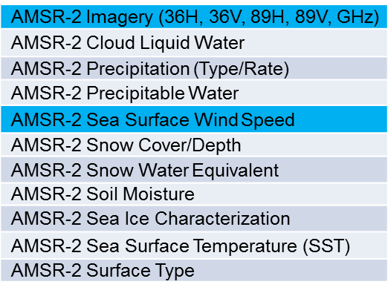
Current Users of Near Real-time GCOM – W Data
US NOAA National Weather Service
Tropical Cyclone Monitoring and Forecasting
Numerical Weather Prediction Model Assimilation
Marine Forecasting and Monitoring
Hydrological and Precipitation Forecasting and Monitoring
Seasonal and Climate Forecasting
US National Ice Center
US Department of Defense
AFWA
FNMOC
NAVO
Naval Research Laboratory
Joint Typhoon Warning Center
Oceanographer of Navy
Leading Numerical Weather Prediction Centers outside US including: Japan, ECMWF
US NWS GCOM Data Product Priorities (initial) for AWIPS2

Slide 17
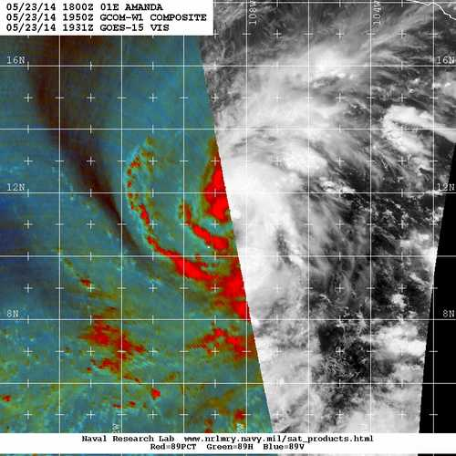
AMSR2 Data Products Tropical Cyclone Example
TROPICAL STORM AMANDA DISCUSSION NUMBER 6
NWS NATIONAL HURRICANE CENTER MIAMI FL EP012014
800 PM PDT FRI MAY 23 2014
Amanda has organized quickly over the past few hours. Deep convection now wraps more than halfway around the estimated center position, and an AMSR-2 microwave pass a few hours ago showed the development of a mid-level eye feature. Based on the latest ADT estimate from UW-CIMSS the initial intensity has been increased to 50 kt. Now that Amanda is developing inner-core structure, it seems likely that the cyclone will be able to take advantage of the favorable environment and intensify, possibly rapidly, during the next day or so.
24 h later Amanda was a 100-kt hurricane

Slide 18
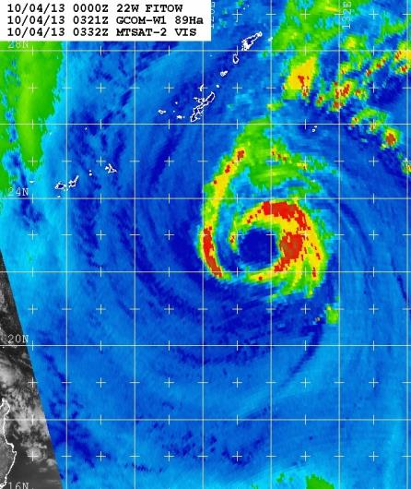
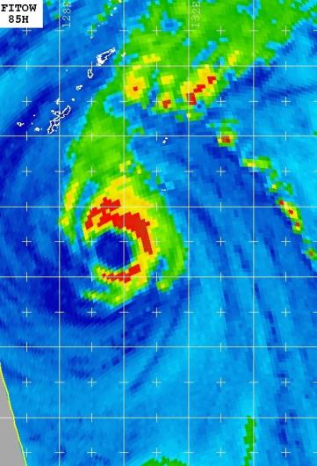
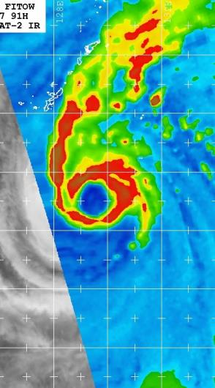
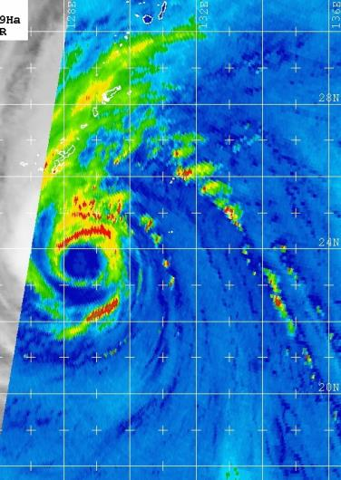
AMSR-2 Temporal Sampling Enhancement
AMSR2 03Z
F-15 06Z
F-17 08Z
AMSR2 16Z
New GCOM AMSR2’s large swath and excellent spatial resolution aids JTWC in monitoring Typhoon Fitow near Okinawa and Taiwan straits via 89 GHz brightness temperature imagery
1330 LTAN greatly augments existing constellation TEMPORAL sampling
Notes:
AMSR2 flies in the afternoon orbit (Local Time of Ascending Node, LTAN is 1:30pm or 1330) which augments the existing DMSP early morning orbits (0530 and 0730) well temporally, frequently filling the 10-12 gaps of available SSM/I and SSMIS data with excellent resolution imagery (examples here do NOT use the final remapping software, thus appear coarse).
Acknowledgments: Naval Research Laboratory, Marine Meteorology Division, Monterey, CA
Kim Richardson, Mindy Surratt, Song Yang, & Jeff Hawkins
Source: AMSR-2 Products for Operational Applications, Jelenak, Chang, Zhan, Brennan, Sienkiewicz, Kussenson, Boukabara, JAXA-NOAA Meeting Nov. 2014

Slide 19
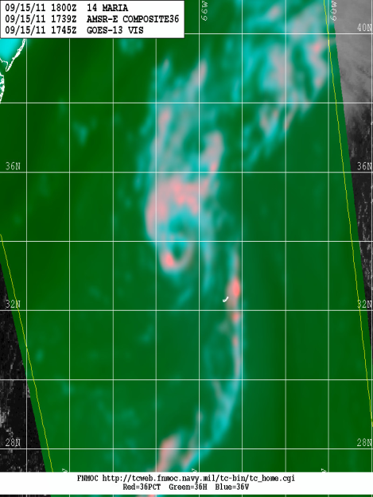
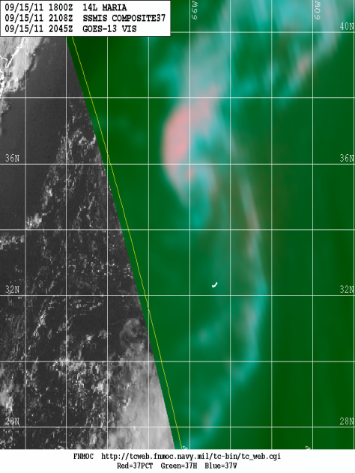
Impact of Resolution
Resolution differences affect the ability to resolve low to mid-level eyewall structure
Comparison of 36/37-GHz color composite imagery over Hurricane Maria from AMSR-R (left) and SSMIS (right) at 1739 UTC and 2018 UTC 15 September 2011, respectively – Images courtesy FNMOC TC webpage
Notes:
Source: AMSR-2 Products for Operational Applications, Jelenak, Chang, Zhan, Brennan, Sienkiewicz, Kussenson, Boukabara, JAXA-NOAA Meeting Nov. 2014

Slide 20
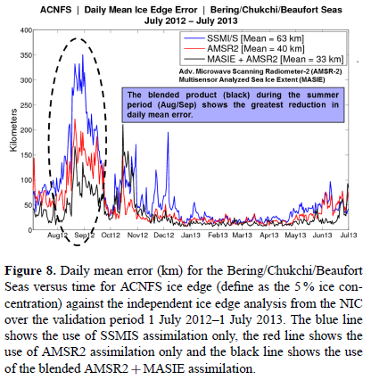
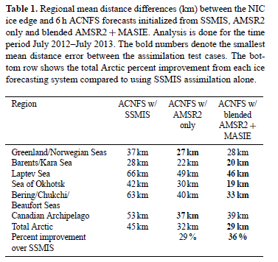
AMSR 2 Data Products – Sea Ice Example
Navy’s ice forecast system – Arctic Cap Nowcast/Forecast System (ACNFS) assimilates AMSR2 data
Noted improvements in forecasting the location of ice edges, especially during summer months
Notes:
Source: Posey et al. 2015 “Improving Arctic sea ice edge forecasts by assimilating high horizontal resolution sea ice concentration data into the US Navy’s ice forecast systems” http://www.the-cryosphere.net/9/1735/2015/tc-9-1735-2015.pdf

Slide 21
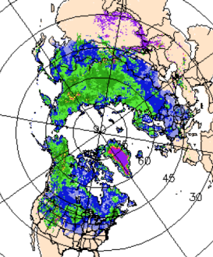
AMSR2 Cryospheric Integration into the National Ice Center
AMSR 2 products will be used in the snow and ice analysis like the Ice Charts and the IMS.
AMSR 2 Products
Brightness Temperatures
Snow Water Equivalent
Snow Depth
Sea Ice Concentrations
Ice Analysis Display
…and also blended with other products to generate improved estimates for NWP
Blended Ice Concentrations
(AMSR 2 + VIIRS + ATMS + Sentinel 1 + Ice Analysis)
Blended Snow Depth
(AMSR 2 + Surface obs + ATMS + Climatology down scaling)

Slide 24
Summary of AMSR2 Uses
AMSR2 | Environmental Parameters | Operational Forecasts/Assessments | Users
High spatial resolution microwave imagery Microwave remote sensing allows penetration through clouds for more frequent surface information Officially fulfills NOAA requirements for conical microwave imagery products Provides continuity for AMSRE and DoD SSMI/S instruments | Imagery | Tropical cyclone tracking and forecasting | NHC, TAF-B, CPHC Joint Typhoon Warning Center NWC, WPC, WFO’s, RFCs
 | Total Precipitable Water Cloud Liquid Water Precipitation Type/Rate | Hydrological forecasting for rain events, floods | NWS/WFOs, NWC, WPC, NHC, RFCs
 | Sea Ice Characterization Snow Cover/Depth Snow Water Equivalent | Used for monitoring and tracking sea ice. Critical for navigation, search and rescue. | NIC US Navy Alaska Region WFOs, snow-impacted WFOs and RFCs, and NWC / NOHRSC
 | Sea Surface Temperature | SST primary source of data for seasonal forecasts (El Nino, La Nina oscillations) and for predicting tropical storm intensification. Also important for Coral Reef Watch. Used directly by marine forecasters to adjust winds for atmospheric stability effects. | NWS Centers and WFOs with Marine Responsibilities CoastWatch, NOS, NMFS
 | Microwave Brightness Temperature | Assimilation in numerical weather prediction models to support 2-10 day weather forecasts. | NWS/NCEP, international NWP centers including Japan JCSDA, NIC
 | Sea Surface Wind Speed | Used in weather models and directly by forecasters for marine forecasts | NWS Centers and Forecast Offices with Marine Responsibilities
 | Soil Moisture Surface Type | Used in weather forecast models, agricultural, drought assessments. Critical for water resource and food security planners. | NWS/NCEP CPC and EMC USDA, US Drought Monitor

Slide 25
Conclusion
AMSR2 provides all-weather information critical for tropical cyclone forecasting, hydrological applications such as extreme precipitation, flash flood forecasting and drought forecasting, and marine environmental weather information (wind speed, which contributes to wave height forecasting, and sea surface temperature).
Microwave imager observations from AMSR2 are routinely used by NOAA, DoD, Japan, EUMETSAT, and other environmental agencies for weather forecasting and environmental monitoring applications.
Importance of AMSR2 data for tropical cyclone forecasting is evident in many forecast discussions from the National Hurricane Center and Joint Typhoon Warning Center
CONTINUITY OF AMSR2 TYPE OBSERVATIONS IS IMPORTANT
ESA’s proposal for a conical microwave imager (CIMR)with lower frequency channels for SST and Soil Moisture is absolutely critical.
Commitment for continuity is also critical. Must plan a follow-on for AMSR3 while AMSR3 is being developed.

Slide 26
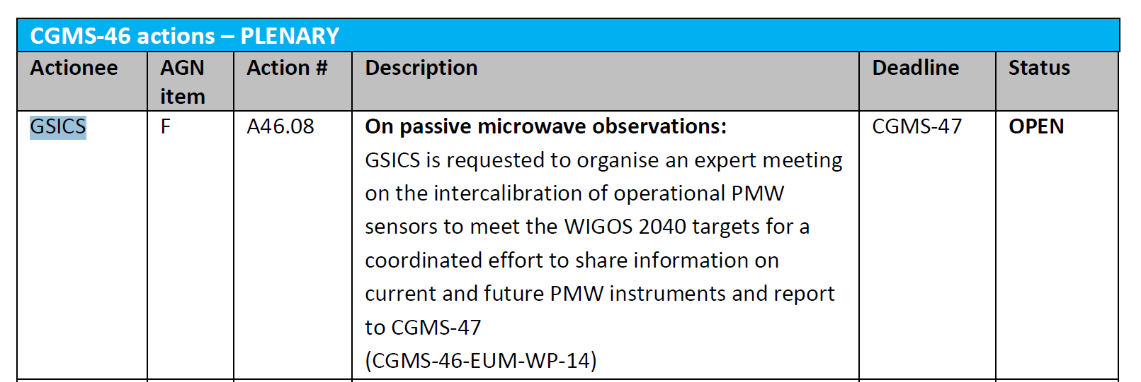

Slide 27
GCOM Operational Use in U.S. NOAA NWS
AMSR-2 directly supports the following operational service areas:
Tropical
Imagery to National Hurricane Center (NHC), Tropical Analysis and Forecast Branch (TAF-B), Central Pacific Hurricane Center (CPHC)
Marine
Winds and SST to NHC, Ocean Prediction Center (OPC), and all coastal Weather Forecast Offices (WFOs)
Precipitation / Hydrology
Precipitation products & imagery to National Water Center (NWC), Weather Prediction Center (WPC), NHC, WFO’s, River Forecast Centers (RFCs)
Numerical Weather Models
Data for model assimilation and development at Environmental Modeling Center (EMC), Joint Center for Satellite Data Assimilation (JCSDA)
Cryosphere
Ice characterization for Alaska Region WFOs, & for Alaska marine services. Snow characterization for all snow-impacted WFOs and RFCs, and National Water Center / National Operational Hydrologic Remote Sensing Center (NWC / NOHRSC)
Climate
Soil Moisture to Climate Prediction Center (CPC)
Notes:
Source: Mike Johnson, NWS

Slide 28
MWI – operational conical imagers (credit OSCAR)
Early morning
SSMIS until ~ 2020, likely DoD follow-on.
SSMIS include temperature and water vapor soundings.
DoD follow-on still pending
NSOAS,CAST – HY2A (2011-2014), HY2B(2016-2019)……
Mid morning
EUMETSAT (9:30) -Metop-SG-B1 (2021-2028) , B2(2028-2035), B3(2035-2042) INCLUDES water vapor sounding channels
Russia (9:30) – Meteor-M N2 (2014-2019), N2-2 (2016-2021), N2-4 (2020-2025) - INCLUDES temperature and water vapor sounding channels
CMA (10:00) – FY3C (2013-2018)
Afternoon
JAXA(13:30) – GCOM-W1-AMSR2 (2012 – 2017), GCOM-W2(2016-2021), GCOM-W3(2020-2025).
CMA (14:00) - FY3D (2015), FY3F (2020)
Russia (15:30) – Meteor-M N2-1 (2015-2020), N2-3 (2019-2024), N2-5 (2021-2026) INCLUDES temperature and water vapor sounding channels
GCOM-W series is unique - only microwave SST imager

Slide 29
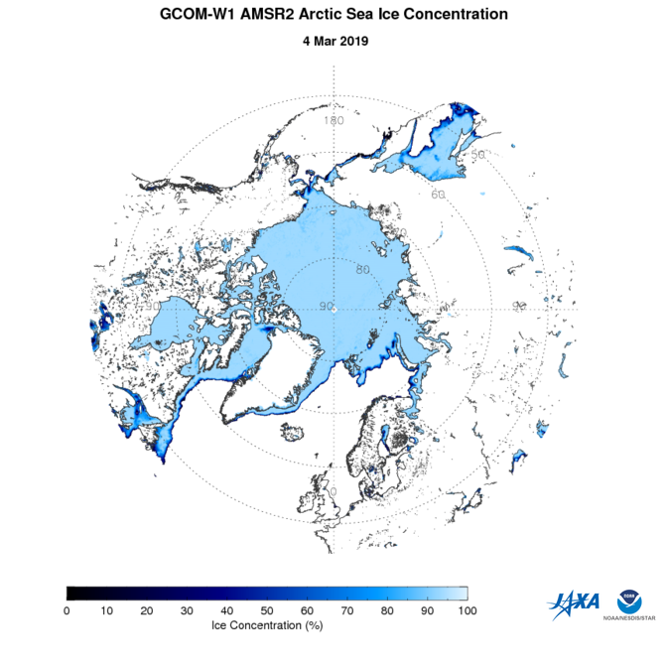
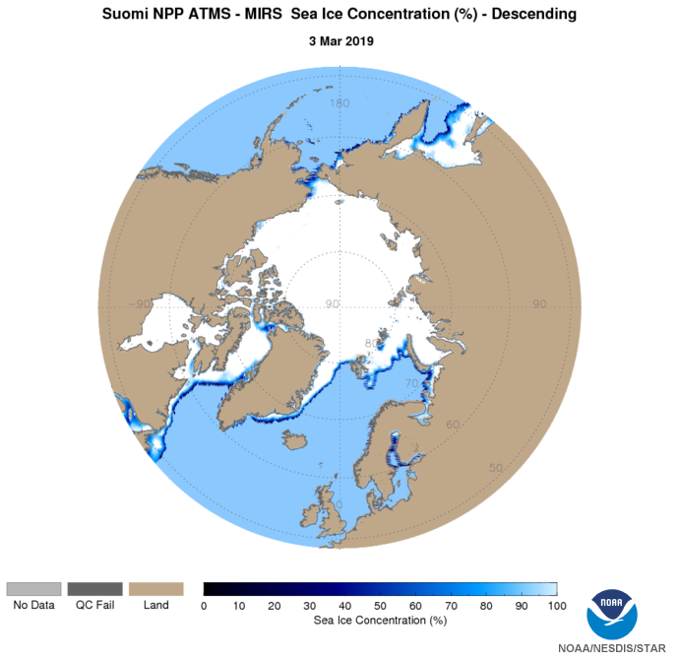
Remember sounders provide ice concentration
ATMS provide ice cover with poorer resolution ~ 70 Km. oversampled at 16 km sampling

Slide 30
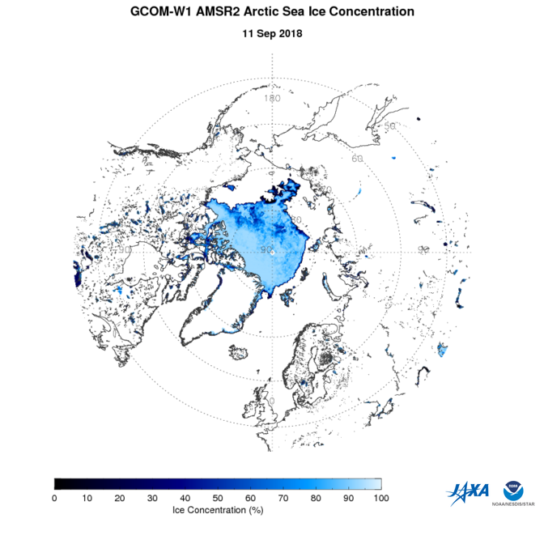
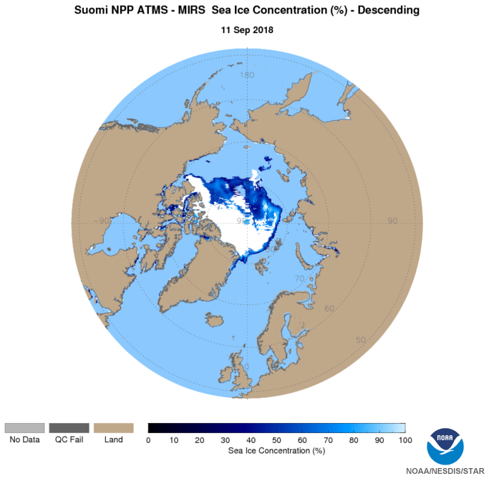

Slide 31
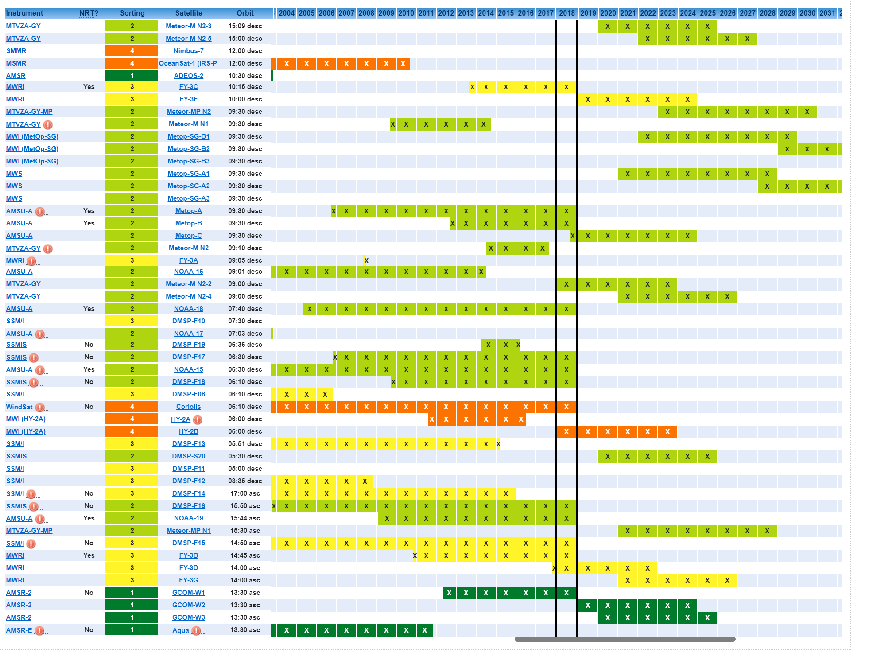
Precipitation and Sea Ice – Healthier

