Slide 1
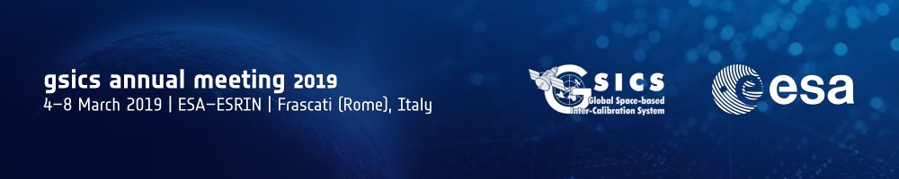
SMOS geophysical products
GSICS Annual Meeting 2019
GRWG – MW sub-group
March 6th, 2019 – ESRIN, Frascati, Italy
R. Sabia¹ and the SMOS Validation and Retrieval Team
1 Telespazio-Vega UK Ltd for European Space Agency (ESA), ESRIN, Frascati, Italy.

Slide 2

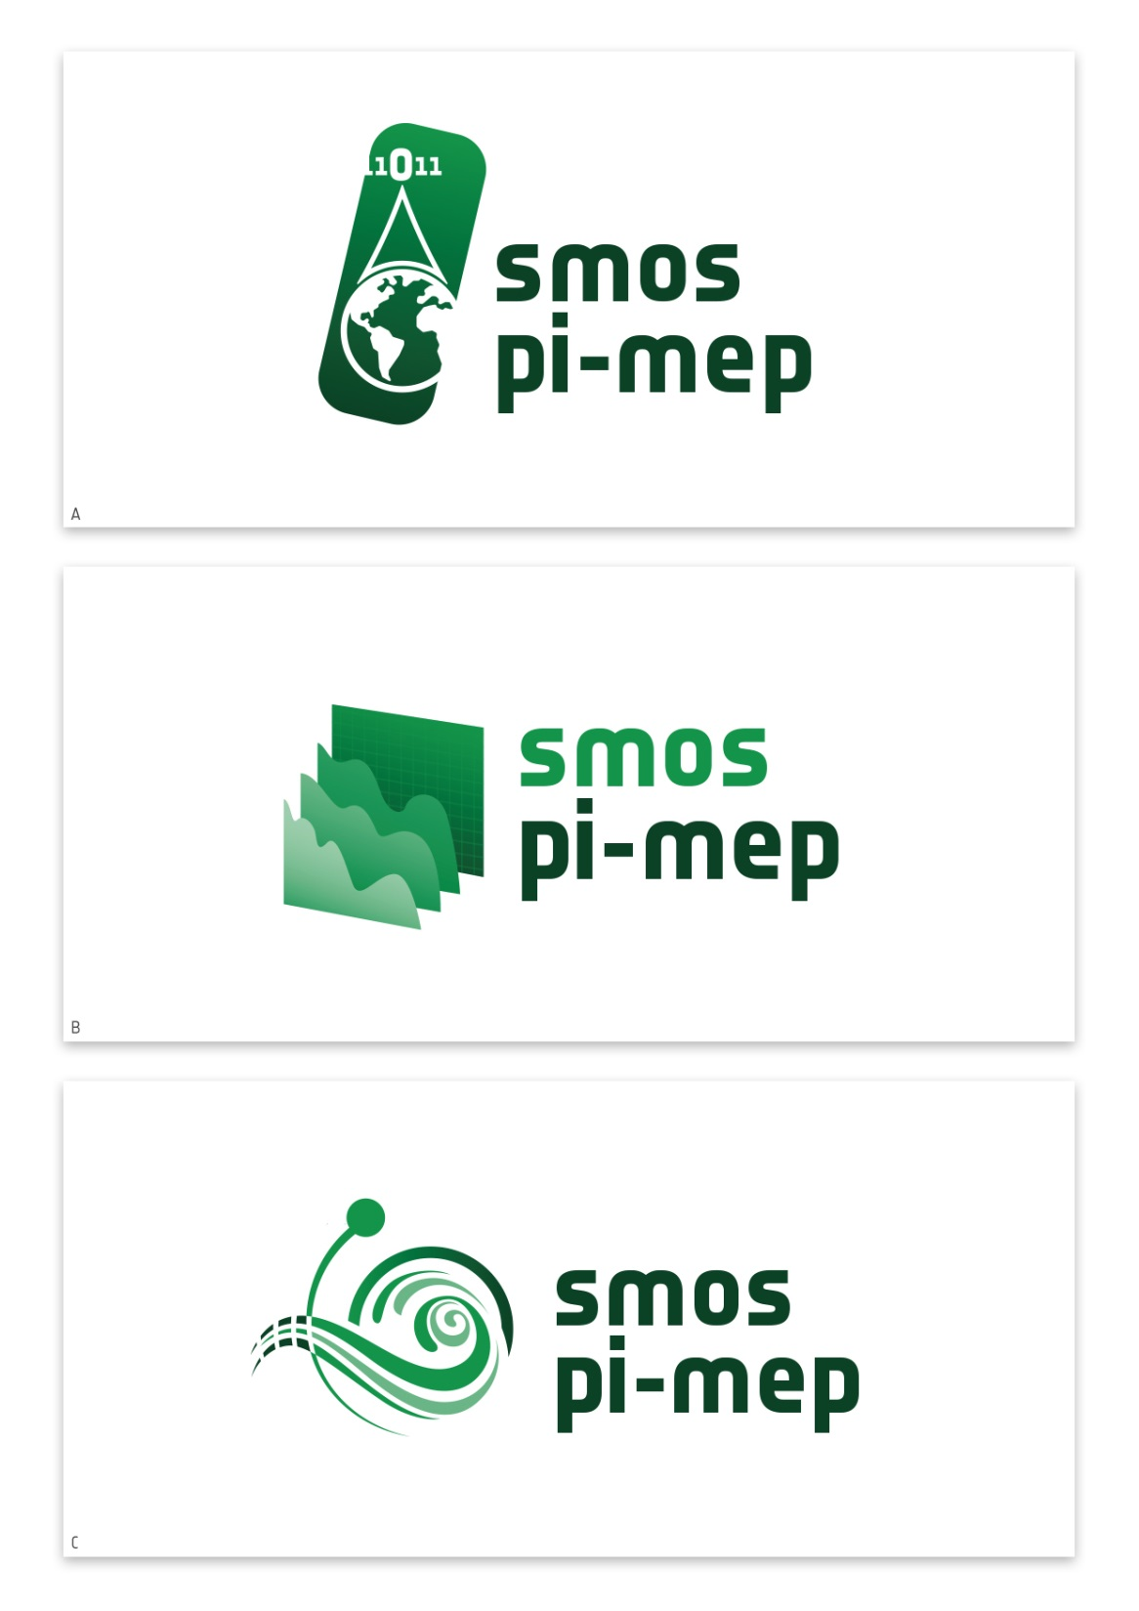
Outline
SMOS L2 SM and OS overview
SMOS L2 geophysical products – latest releases
SMOS L2 validation procedures
SMOS Pi-MEP Salinity
  Rationale, Objectives, Features
  SMOS Pi-MEP SAG board
  Platform website
  Platform Tools and Web Applications
  Oceanographic Process studies
  ESA/NASA potential partnership
Summary and Perspectives

Slide 3
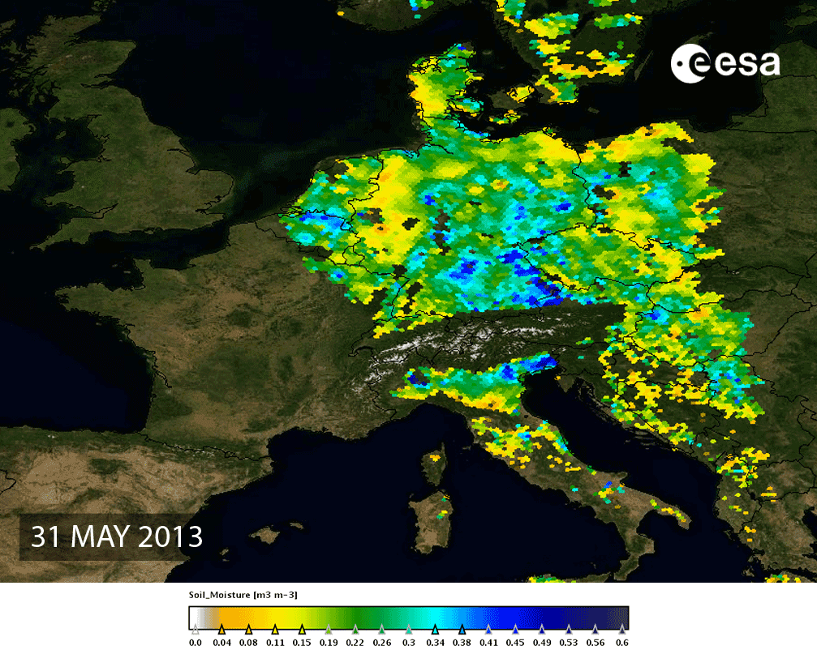
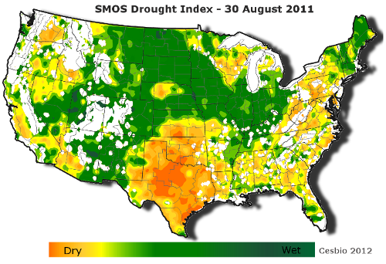
SMOS overview – L2SM
Level 2/Level 3 - Soil Moisture
Soil moisture is a key variable controlling the exchange of water and heat energy between the land the atmosphere. Precipitation, soil moisture, percolation, run-off, evaporation from the soil and plant transpiration are all components of the terrestrial part of the water cycle.
Estimating soil moisture in the root zone is paramount for improving short- and medium-term meteorological modelling, hydrological modelling, the monitoring of plant growth, as well as contributing to the forecasting of hazards (e.g., floods)
 | Accuracy | Spatial res. | Revisit time
Soil Moisture | 4% vol. soil moisture | 35-50 km | 1-3 days
SMOS RZSM can be used to retrieve a drought index. It will take into account the severity, magnitude, duration and spatial extents of the drought. Credit: CATDS/CESBIO/ESA
SMOS soil moisture on May 2013, when heavy rainfall led to disastrous flooding in central Europe (blue indicates wet soil, yellow/orange dry soil). Credit: CESBIO/ESA

Slide 4
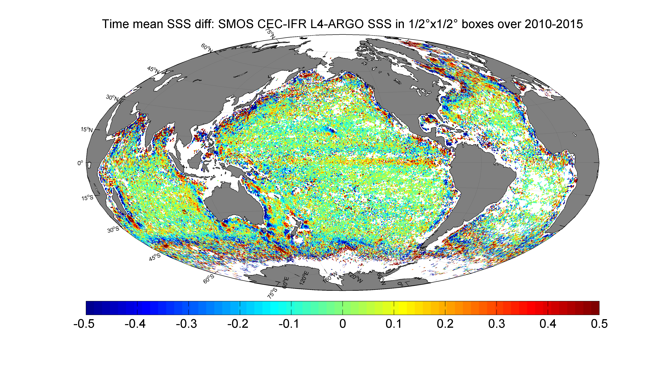
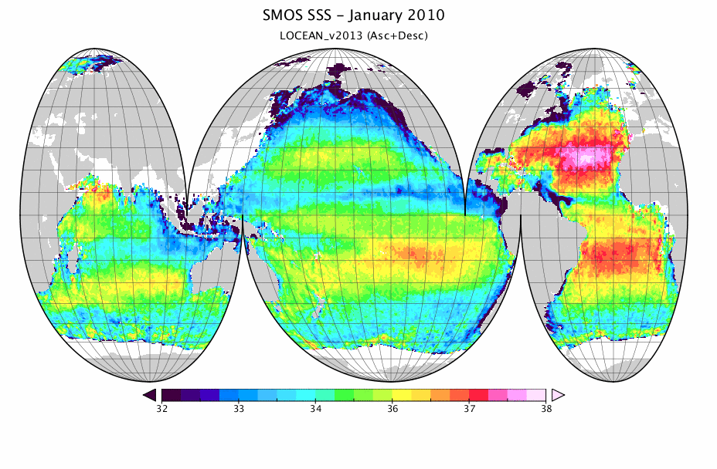
SMOS overview – L2OS
Level 2/Level 3 – Ocean Salinity
Sea Surface Salinity variations governed by: E-P balance, freezing/melting ice, freshwater run-off and horizontal/vertical advection
Key oceanographic parameter (density); triggers thermohaline circulation and heat redistribution
Data are available from SMOS data dissemination platform:
https://smos-diss.eo.esa.int/
 | Accuracy | Spatial avg | Time avg
Ocean salinity | 0.5-1.5 psu for single observation 0.1 psu for a 10/30 day average for an open ocean area of 200x200 km | 200 km | 10-30 days

Slide 5
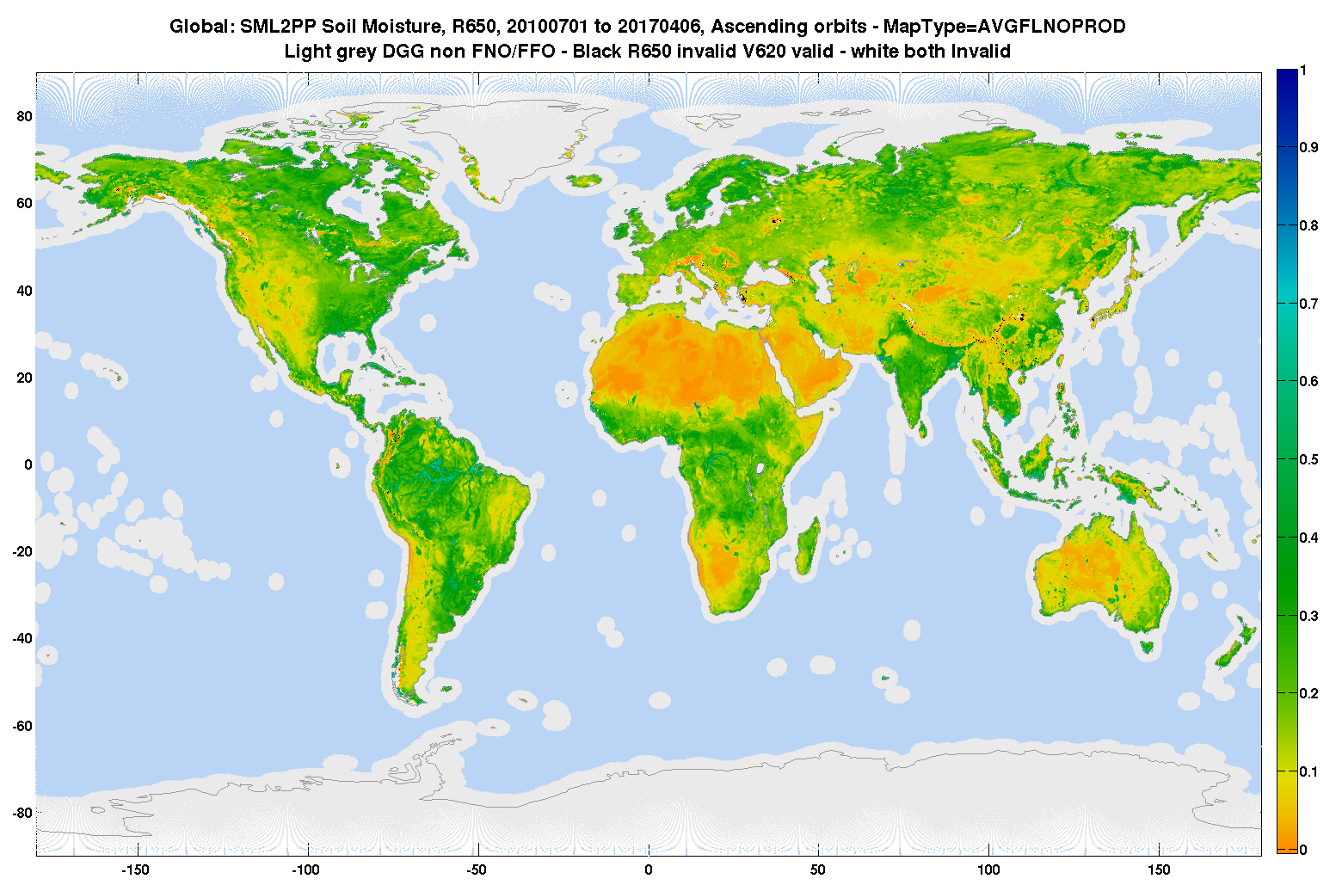
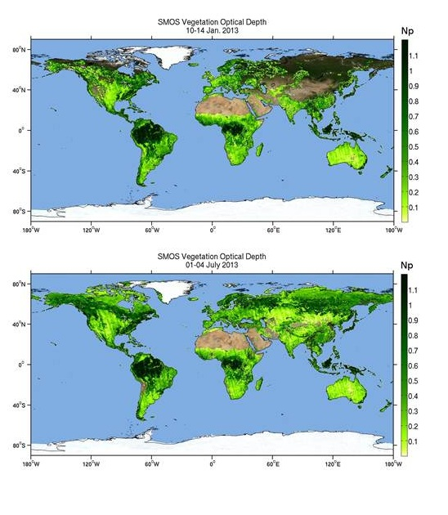
SMOS DATA QUALITY: LEVEL 2 SOIL MOISTURE
Expert Support Laboratory L2 Soil Moisture
L2 SM v650 (Disseminated November 2017)
Improved characterization of the goodness of fit in the retrieval scheme (Chi_2 rescaling)
Algorithm improvements (min. current DQX, flood rule, DQX enhancement)
Novel land surface classification (IGBP simplified (Broxton) - aligned with SMAP)
Rescaled ECMWF auxiliary data (CDF-matching)
NN NRT v200 (trained vs L2SM v650) disseminated since Aug 2018
Version 7 (2019+)
Implementation improved dielectric const. model for Organic Soil
Investigating the possible use of the 2-stream model (additional possible value in the cryosphere domain)
Improved characterization of the retrieved parameters uncertainties (DQX)
Refined parameterizations (Omega, HR, etc) for specific land classes
L2SM v650 global SM map obtained averaging 28 months spanning over 7 years (Credits: CESBIO-ESA).
SMOS-IC VOD map in July 2013 (Credits: CESBIO-INRA_ESA).
For overall performance assessment see: [Kerr et al., 2016] “Overview of SMOS performance in terms of global soil moisture monitoring after six years in operations” (RSE SMOS special issue)
Notes:
V6XX
Better characterization of the auxiliary data files generated by the post-processor by splitting the values of Tau, roughness and RFI probability for ascending and descending orbit, usage of a new soil type and snow map and improved utilization of this data in the Level 2 soil moisture processor.
Improved soil moisture retrieval in forest areas.
Improved computation of the RFI probability, used to adjust radiometric uncertainty in the retrieval of the soil moisture by using most recent observations instead of historical data.
Further investigations during the reporting period focussed on:
Improved flagging of snow.
Testing of improved dielectric constant model for soil.
Reduce the complexity of the Level 2 soil moisture user product. Studying the production of a “fool proof” user product for the future.
Harmonising ancillary data for SMOS and SMAP data processing.

Slide 6
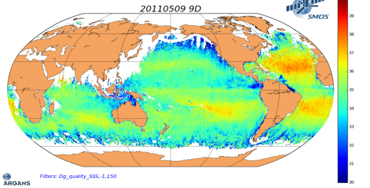
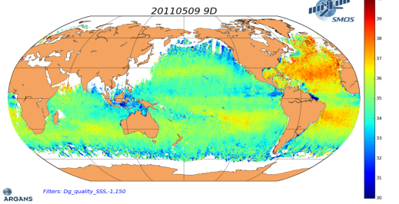
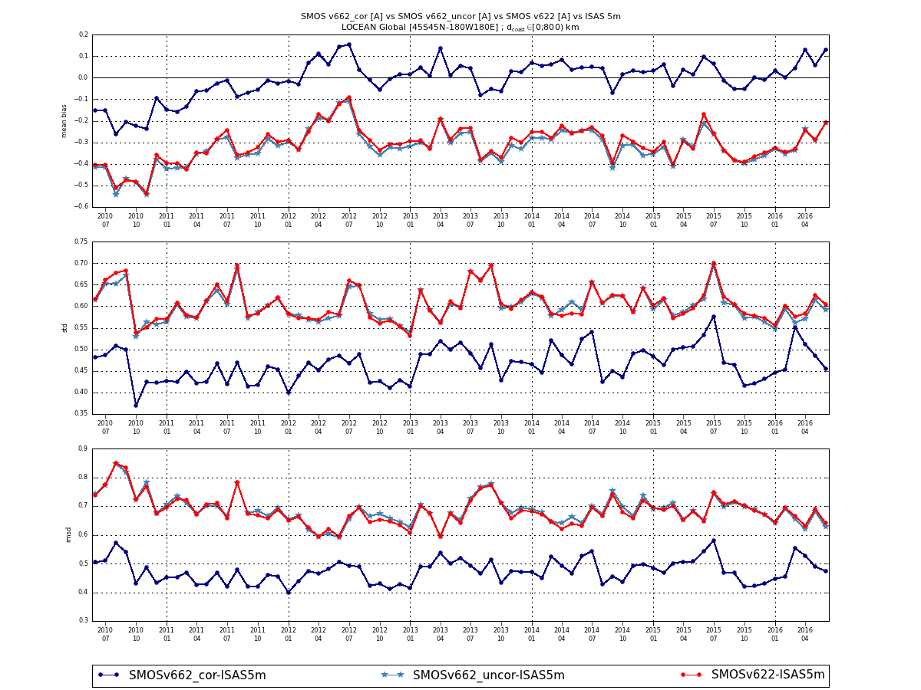
SMOS DATA QUALITY: LEVEL 2 SEA SURFACE SALINITY
Expert Support Laboratory L2 ocean salinity
L2 OS v662 (Disseminated May 2017)
Land-Sea Contamination correction implemented
Single roughness model selected and upgraded (SSS1)
SSS anomaly generation (currently wrt WOA-09 climatology)
Improved data filtering (RFI and Sun)
Upgrade internal module to enable faster L1 metrics (L1 toolbox and L2 v670)
Land-Sea Contamination effect, before and after correction (Credits: Argans)
Version 7 (2019+)
Implementation of a SMOS-based climatology to estimate a de-biased SSS anomaly
Upgrade dielectric constant model to better characterize cold waters
Improved characterization L2 SSS uncertainty
Improved wind speed characterization (source and uncertainties) in the retrieval scheme
L2SSS validation statistics for global oceans near the coast (<800 km). (Credits: LOCEAN)
Notes:
Global validation at 0.29
V6XX
Estimation of the Vertical Total Electron Content (VTEC) through Level 1C Stokes 3 measurements for descending passes and their use in the sea surface salinity retrieval (ascending passes still use the predicted VTEC value from IGS).
Better RFI detection and flagging, including use of cumulative RFI probability to adjust radiometric accuracy.
Improved roughness model 3.
Further investigations during the reporting period focussed on:
Optimal additive/multiplicative OTT (Ocean Target Transformation) or alternative method for residual bias and long-term drift removal.
Better galactic noise scattering model.
Increasing validity of roughness correction models.
Develop and test tools to support the Level 1 and Level 2 ocean salinity data performance metric.
Investigate possible algorithms and methods to correct the SMOS brightness temperature and definition of a possible corrected Level 1 product tailored for oceanographic application.

Slide 7
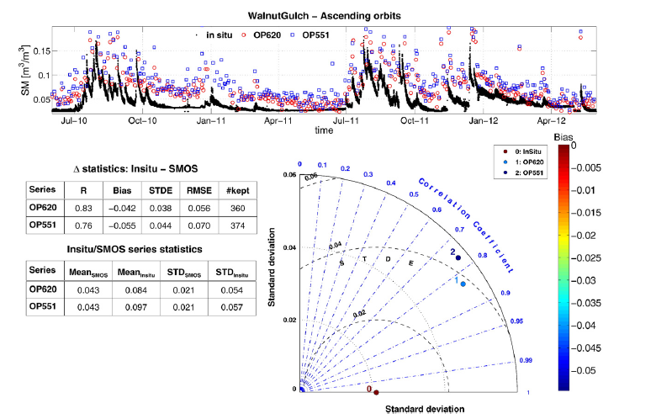

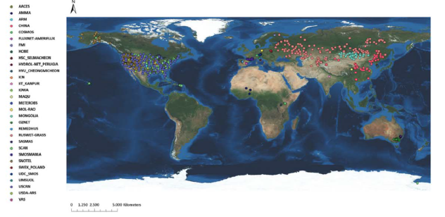
SOIL MOISTURE VALIDATION
In-situ data, campaigns and ISMN
Validation statistics for v620 (updated results being generated) over Walnut Gulch test site. Credits: Cesbio
ICOS Tower in Sodankyla, Finland. Credits: FMI
ISMN stations
From Dorigo et al (2013)
ISMN Database coordinated by TU Vienna
Data available from https://ismn.geo.tuwien.ac.at/ismn/
Currently more than 50 networks providing current and historic data sets
Includes automated QC system based on using ancillary data (soil T, precipitation) and statistical approaches

Slide 8
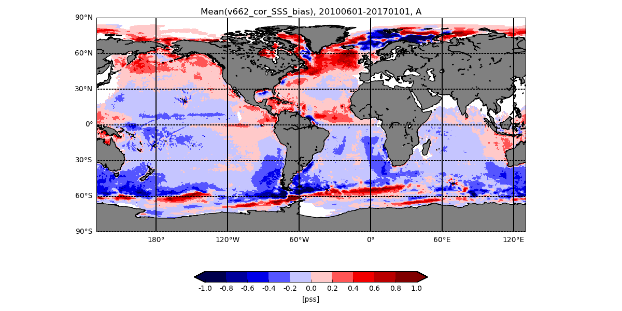
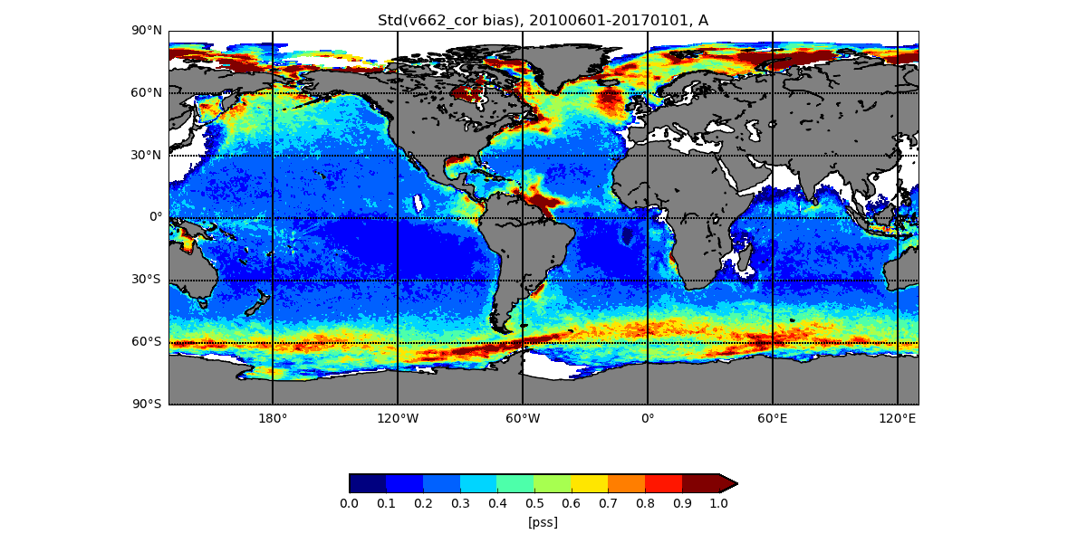
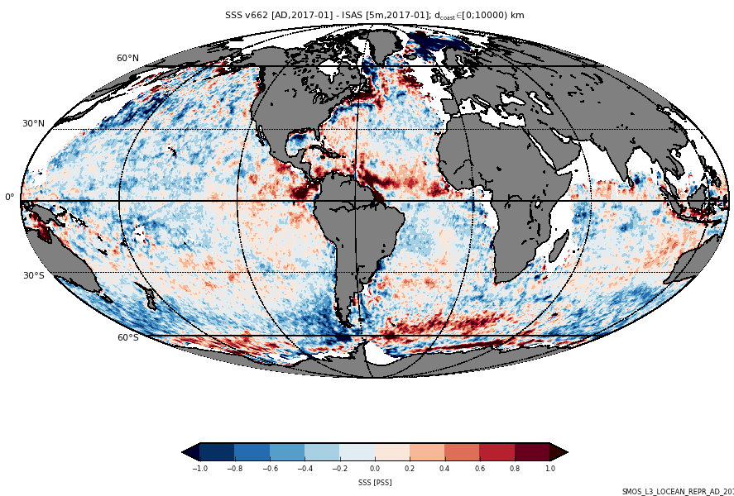
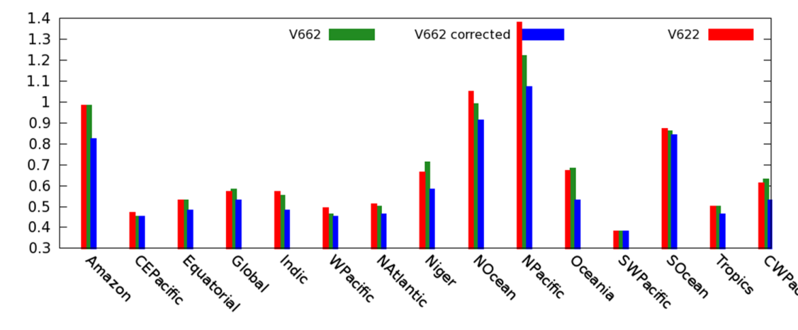
OCEAN SALINITY VALIDATION
SMOS L2 ESL standard Validation protocol
SMOS reference: L2 SSS1, spatio (100km)-temporally (1 month) averaged using a weighting function; filtered for quality flags.
In-situ reference: Argo float (4-10m) and optimally-interpolated fields of SSS (5m) generated using the In-Situ Analysis System (ISAS, Gaillard, 2009).
Colocalization SMOS/In situ: spatial radius of 50km, temporal range of +/-15 days around Argo measurements.
SMOS ESL Validation protocol will be revised and enlarged -> enhanced validation platform (Focus #1)
Mean(SMOS-ISAS) and std(SMOS-ISAS) over the 6 years reprocessing – credits: LOCEAN
Regional RMS processors comparison –Credits BEC
Monthly difference between SMOS (v662) and ISAS SSS – credits: LOCEAN
Notes:
Global validation at 0.29
V6XX
Estimation of the Vertical Total Electron Content (VTEC) through Level 1C Stokes 3 measurements for descending passes and their use in the sea surface salinity retrieval (ascending passes still use the predicted VTEC value from IGS).
Better RFI detection and flagging, including use of cumulative RFI probability to adjust radiometric accuracy.
Improved roughness model 3.
Further investigations during the reporting period focussed on:
Optimal additive/multiplicative OTT (Ocean Target Transformation) or alternative method for residual bias and long-term drift removal.
Better galactic noise scattering model.
Increasing validity of roughness correction models.
Develop and test tools to support the Level 1 and Level 2 ocean salinity data performance metric.
Investigate possible algorithms and methods to correct the SMOS brightness temperature and definition of a possible corrected Level 1 product tailored for oceanographic application.

Slide 9
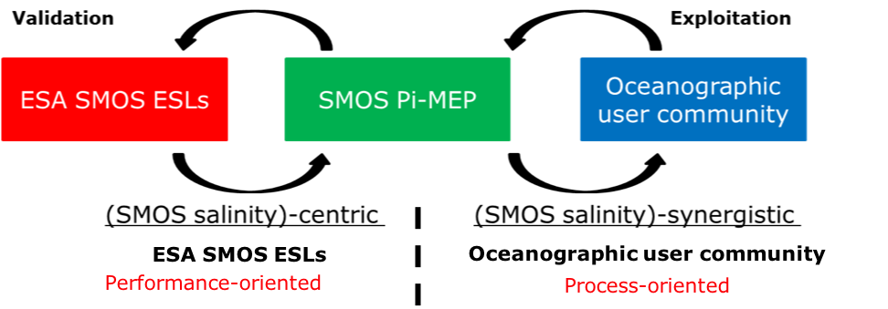

Pi-MEP Salinity – Foci and Stakeholders
The SMOS Pilot Mission Exploitation Platform (Pi-MEP) for Salinity –
ESA initiative to support/widen the uptake of SMOS data over ocean
Focus #1 – To serve as enhanced validation platform [matchup vs in-situ, filtering/QC at various spatial/temporal scales, -> ESL validation testbed and “plug-in”]
Focus #2 – To become a hub to enable and monitor oceanographic process studies [data synergy, statistical and computational tools, on-demand processing]
One-stop-shop for scientific validation, monitoring, assessment and exploitation of the SMOS salinity data
Stakeholders: SMOS Expert Support Laboratories (ESL), CATDS, CP34, space agencies, SISS WG, remote sensing experts, hydrographers, modelers, oceanographers - either using SMOS SSS as research core or as auxiliary data
Requirements baseline
Technical design
Implementation
Pre-ops
Operaztions

Slide 10
SAG panel – membership and involvement
Jacqueline | BOUTIN | LOCEAN
Antonio | TURIEL | ICM
Manuel | ARIAS | ARGANS
Jean-Luc | VERGELY | ACRI-ST
Stéphane | TAROT | Ifremer
Justino | MARTÍNEZ | ICM
Tony | LEE | JPL
Thomas | MEISSNER | RSS
Gilles | REVERDIN | LOCEAN
Nicolas | KOLODZIEJCZYK | Univ. Brest
Benoît | TRANCHANT | CLS
Lisan | YU | WHOI
Julian | SCHANZE | ESR
Johnny | JOHANNESSEN | NERSC
Adrien | MARTIN | NOCS
Marie-Hélène | RIO | ESA
Christophe | MAES | IRD
Lars | KALESCHKE | Univ. Hamburg
Jamie D. | SHUTLER | Univ. of Exeter
Sébastien | CLERC | ACRI-ST
Eric | BAYLER | NOAA
Philippe | RICHAUME | CESBIO
Detlef | STAMMER | Univ. Hamburg
David | LEVINE | NASA
Emmanuel | DINNAT | NASA
Michael | DENSBERGER | REMSS
SAG - Scientific Advisory Group
(~25-people, advisory and pre-ops Platform testing)
SAG Consultation Meeting #1: May 3rd, 2017, ESA-ESTEC
SAG Consultation Meeting #2: May 24th, 2018, ESA-ESRIN
Participated in the discussion at the SAG CM1 driven by specific seed questions (24)
Produced Feedback document, taken into account in the Platform Design
Participated in the discussion at the SAG CM2 driven by specific seed questions (33), assessing a Test Platform towards implementation finalization
Consolidation of feedback, taken into account in the Platform Implementation
Serve as super-users of the platform functionalities before the opening to the wider oceanographic community

Slide 11
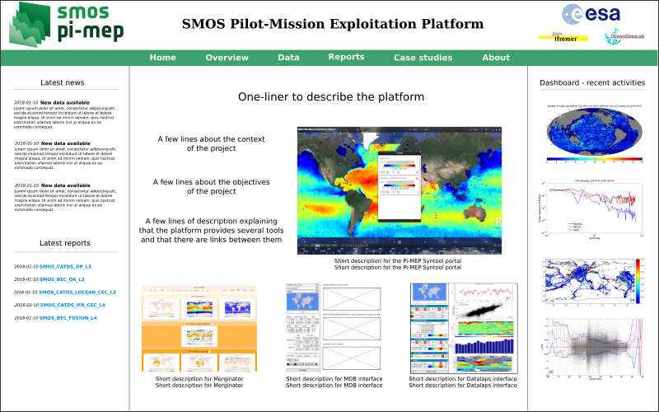
Website mock-up https://pimep-test.oceandatalab.com
Pi-MEP salinity will provide tools for merging/process data at user discretion (typology, scales, filtering, etc); user can interact to an extent decided by the Platform host

Slide 12
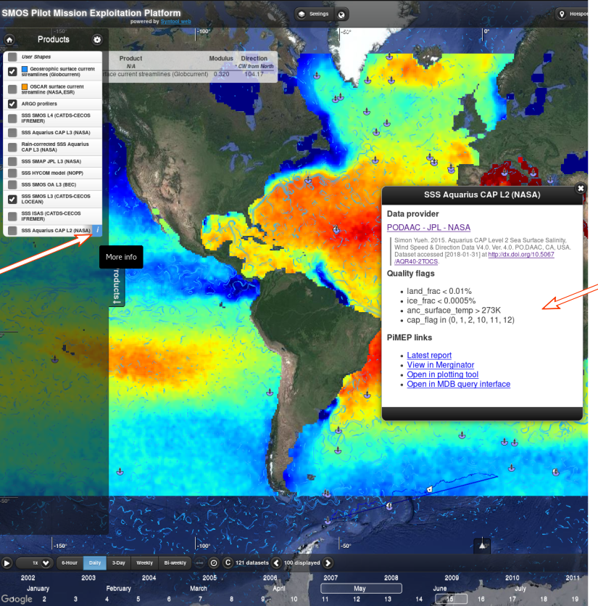
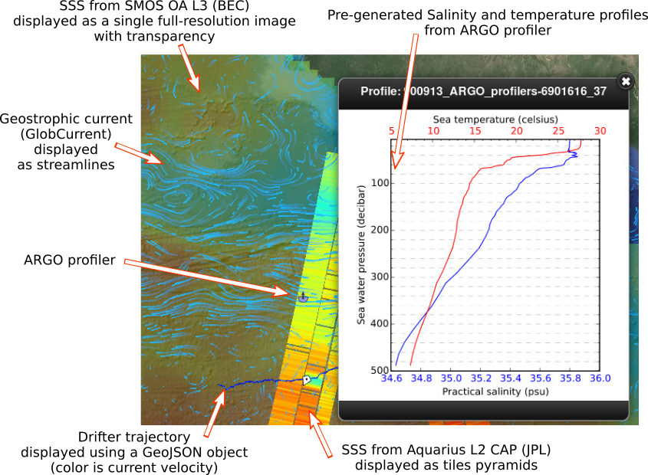
Data visualization –Syntool
Integrated access, visualization and mutlidimensional intercomparison of EO, in-situ and model data.
SynTool

Slide 13
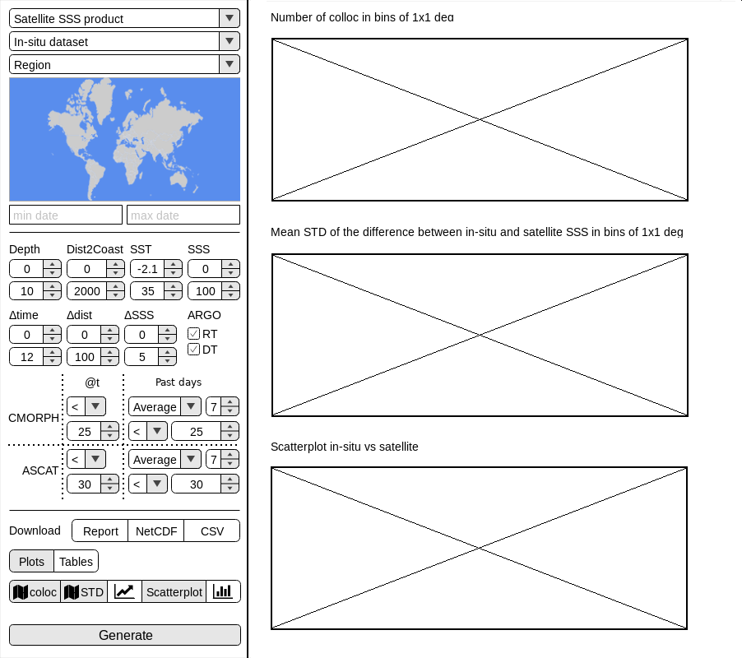
Plot and MDB interfaces
Match-up databases of SMOS/in situ (e.g., Argo, TSG, moorings, drifters) data and inter-comparison reports generated via dedicated tools allowing visualization and/or user-driven extractions.
Datalaps MDB interface
Query and Extract match-ups (CSV, JSON or NetCDF)
Generate plots for match-up metrics
Produce custom PDF reports
Data filtering options
MBD cam be stratified according to several conditions
Datalaps plotting interface
Time series
Scatterplots
Histograms
Hovmöller diagrams
Maps

Slide 14
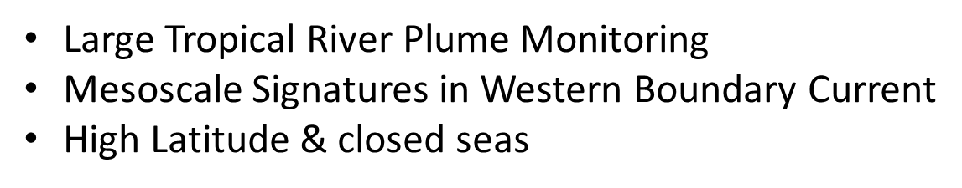
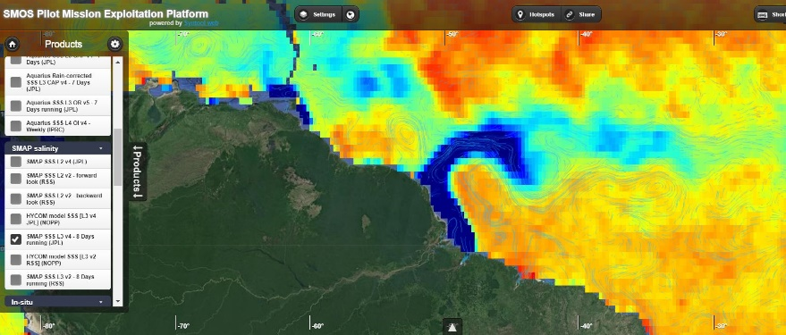
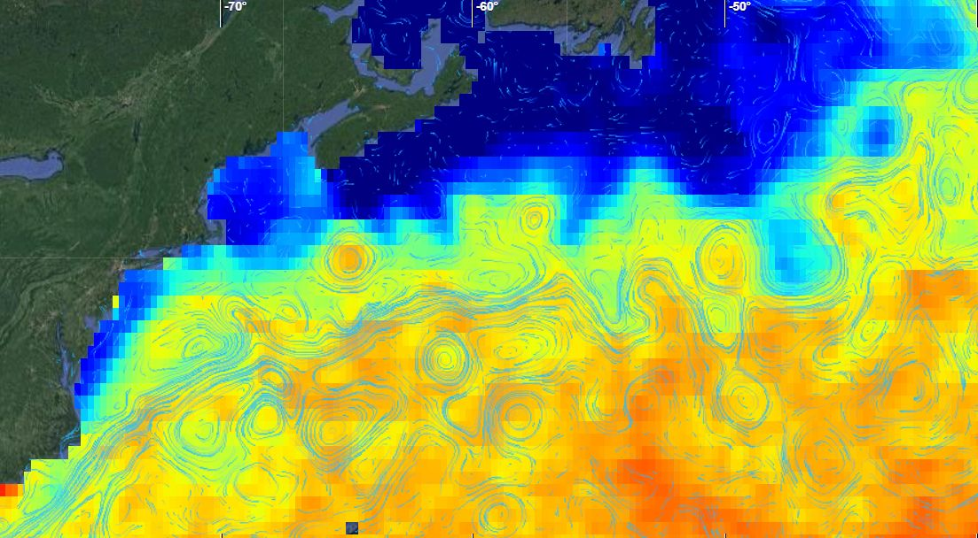
Oceanographic case studies
Consortium Top-down selection of specific oceanographic case studies to be continuously monitored by the Platform (upon SAG feedback)
User Bottom-up capability to exploit SSS data for wider oceanographic applications and process studies
Specific MDB files and validation reports over the specific case study region
Datalaps local Time series & extraction
Multi-data Visualization

Slide 15

ESA/NASA potential Pi-MEP partnership
Ocean Science 2018 ppt – Portland, OR, USA, February 2018 and interaction at SISS WG meeting (E. Lindstrom)
Internal discussion at ESA and notification to NASA (D. Levine, T. Lee, K. Murphy)
Internal discussion within the project consortium
Tentative collaboration proposal to NASA:
Funding manpower that would work on:
Handling additional process studies monitoring (besides those already covered)
Enabling increased user-driven capabilities (beyond the limited extent foreseen so far -> enhance “users to data” paradigm)
Dedicated validation on SPURS-2 site and dedicated case-study
Develop additional Toolboxes (TBC if needed)
Implement triple-collocation analyses framework [T. Lee]
Implement customized collocation s/t radius [T. Lee]
Funding IT capabilities:
Cloud storage/Processing nodes through a standard supplier such as Amazon (TBC)
Verifications and schedule
Clarify communication lines and decision chain <-> ranking collaboration items
Critical Milestones - Nov. 2018 pre-ops, May 2019 ops

Slide 16
Next in line: Pi-MEP Soil Moisture
Capitalizing on the success/expertise of Pi-MEP Salinity
Still focused mainly on SMOS satellite
Core activity on SMOS Soil Moisture validation (exploitation as secondary objective)
Carefully addressing overlap with existing efforts on SM val/exploitation
Mirroring approach of Pi-MEP Salinity as per SAG relevance, Req. collection, Design, Functionalities etc
SoW ready, procurement just started – expected KO June 2019
Towards an (ESA/NASA) SMOS/Aquarius/SMAP MEP?
Salinity
Soil Moisture
Platform design completed Pre-ops starting Nov 2018 Operational May 2019 | Procurement ongoing KO December2018 Operational June 2020
Partnership opportunity identified Coordination/discussion about to start? | ??
ESA
NASA

Slide 17
Summary and perspectives
Level-2 SM and OS retrieval and latest releases
Level-2 SM and OS validation protocols
Overview of the Pi-MEP project objectives -> validation, exploitation
Pi-MEP SAG role -> advisory and early adopters
Pi-MEP Website
Platform tools and functionalities
List of the selected process studies
Exploring ESA/NASA partnership and upcoming Pi-MEP soil Moisture
Validation
Exploitation
Platform
Top Down
Systematic validation reports and monitoring [eg, MDB pdf reports] | Systematic assessment and monitoring selected process studies [eg, case-studies reports]
Inspection, visualization, extraction, computation data/products for validation [eg, MDB metrics extraction] | Inspection, merging, computation data/products for oceanographic applications [eg, Jupyter notebook]
Bottom up
Users

Slide 18

Contacts
Roberto Sabia – roberto.sabia@esa.int

Slide 19
Back-up slides

Slide 20
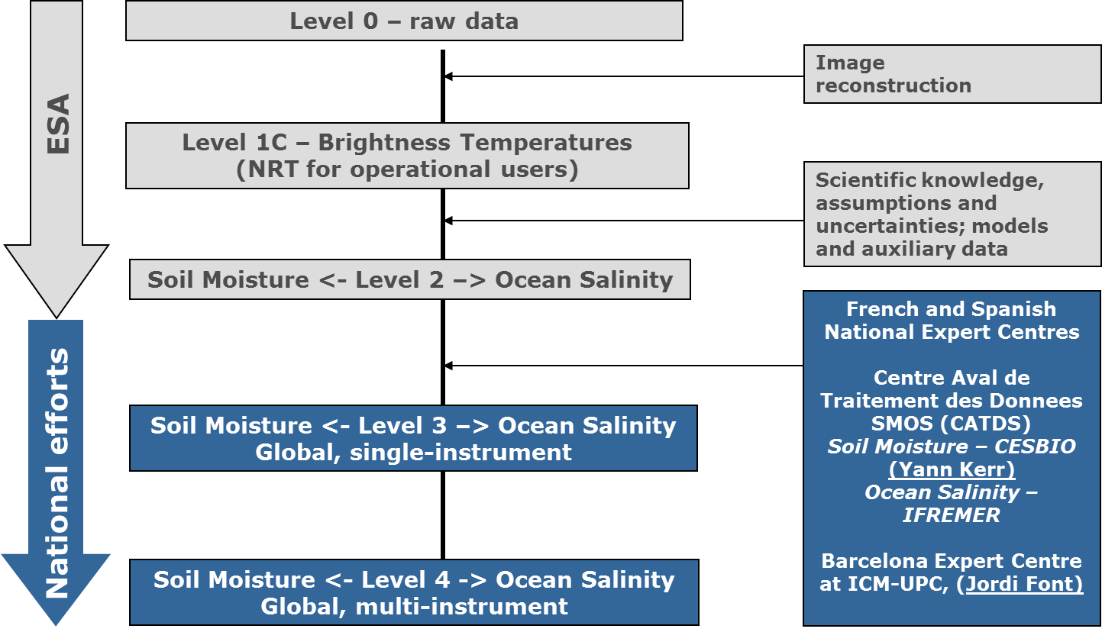
SMOS in a nutshell (i)
SMOS - Background and Motivation
ESA Earth Explorer Opportunity Mission - Living Planet program
Novel Earth Observation techniques demonstration; novel data provision to the science community
Direct response to the current lack of global observations of soil moisture and ocean salinity, needed to further our knowledge of the water cycle, and to contribute to better weather and extreme-event forecasting and seasonal-climate forecasting
Launch: November 2nd, 2009 - SMOS mission operations confirmed by ESA definitively till 2019, while beyond 2019+ pending mid-term-extension-review (end ~2018)
ESA SMOS satellite
SMOS processing chain

Slide 21
ESAC recommendations from 2014 extension
ESAC recommendations triggered Actions | Actions undertaken L2 OS
Improve SSS data quality (#6) | Selection of a reference roughness model (SSS1)
Improve SSS data quality (#6) | Land-Sea-Contamination correction
Improve SSS data validation (#3,#6) | Revised ESL validation protocol (since July 2015)
Improve SSS data validation (#3,#6) | Pi-MEP Salinity: enhanced validation platform (from January 2017)
Synergy with additional data (#4) | Pi-MEP for process studies over ocean; In general, synergy ever increasing (SST, WS, rain rates, currents, Ocean colour, SLA, etc)

Slide 22
SAG CM#1– feedback (i)
Datasets
1. Would you favour the inclusion of SMOS L1 (TB) data in the Platform and, if so, in which frame (antenna/earth), at which level (TOA/BOA) and with which correction included (eg. Atm/Gal/Ionosphere)? -- 24. Any insight to avoid overlapping with future CCI SSS activities, considering that merging spaceborne SSS datasets is already beyond scope of this Platform? | TB merging or inter-comparison with other satellites TBs are beyond primary scope and left to the “Inter-comparison WG” and “CCI SSS”. “Inter-comparison WG” and “CCI SSS” domains: L1 comparison/homogenization fwd models Re-calibration or update of retrieval algorithms Standardization of aux SST, WS and dielectric constant algo parameters Potentially, in the Platform could be considered: L3TB from CATDS List of L1c products (orbits list) used per each specific pixel of the match-up db.
Scientific assessment
14. The Platform intends to “stratify” data according to selected geophysical regimes to favour an enhanced validation (Eg. wrt SST, or WS/SWH, or WS/MLD). Any suggestion for additional regimes to be considered? | High-variability regions vs low-variability regions. High-latitude oceans vs. tropical/subtropical oceans. Strong currents versus weak currents regimes. Instantaneous precipitation. Longhurst or biogeochemical provinces. Density Compensated regimes.

Slide 23
SAG CM#1 – feedback (ii)
On-demand processing
7. Any suggested mechanism for transferring/including campaigns data (eg. SPURS-2) directly into the Platform? -- 19. The platform intends to allow some capability of ingesting user datasets (yet limited in size and format) – Any suggested constraint to the user? | Capability to ingest datasets if fulfilling specific format standard (NetCDF, csv etc.) and size quota. Capability to ingest campaign data (eg. SPURS-2). Database not necessarily ending up in the Platform, yet allowing users to perform studies. Decisions case-by-case; raise conditions/IPRs/disclaimer whenever needed
18. The platform intends to allow some capability of ingesting user codes (yet limited in complexity) – Any suggested constraint to the user? | Capability to ingest codes according to the language and operability burden. Decisions case-by-case; raise conditions/IPRs/disclaimer whenever needed
Process studies
21. Could you rank your most valuable 3 case studies among those selected? | Case studies still being ranked. Currently, highly ranked are: “Mesoscale”, “River plumes” and “High-latitude” Climate Indexes and “Biogeochemistry” most likely monitored in dedicated ESA studies.

Slide 24
SAG CM#2 – feedback (i)
Reports
2. Is there any link or functionality not working properly? 11. Do you find the interface to download the MDB files efficient? 5. Do you find the content of the Pi-MEP in situ database report comprehensive enough? 9. Are the Pi-MEP regions chosen adequately? 13. Do you find the content of the Pi-MEP MDB analyses reports comprehensive? 17. Are the metrics/plots proposed to characterize the database adequate? 18. Would you like to see ∆SSS sorted as function of additional geophysical conditions? | No issues spotted. Pages should appear in “new tab” Minor issues in some browser Comprehensive. Minor issues in some plots. Additional explanatory text needed. introduce distance to coast. Adequate. Define lat,lon boundaries and maybe consider and additional zone <400 km from coast Comprehensive. Minor issues in plots and minor inconsistencies. Additional metrics suggested. Verify how to acknowledge plots taken by the reports. Think of a balance between pre-computed reports and on-the-fly analyses. Sea state, SST classes. “Optimal conditions” class. Some Conditions redundant.
Tools
21/23. Did you experience any issue visualizing in-situ and satellite data, or with the various functionalities of Syntool? 33. Do you find the Datalaps time-series Tool useful and easy to use? | Some issues spotted in visualization of Argo profiles, and drifters data Some issues spoted dysplaying data and animations in Syntool Datalaps tool very useful despite still shaky on this preliminary implementation

Slide 25
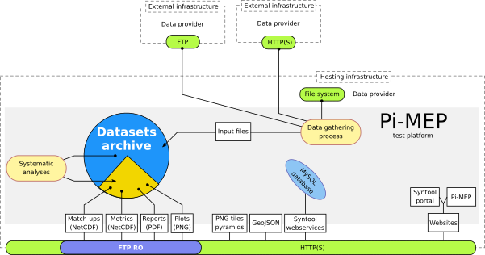
Pi-MEP (Test) platform - Design

Slide 26
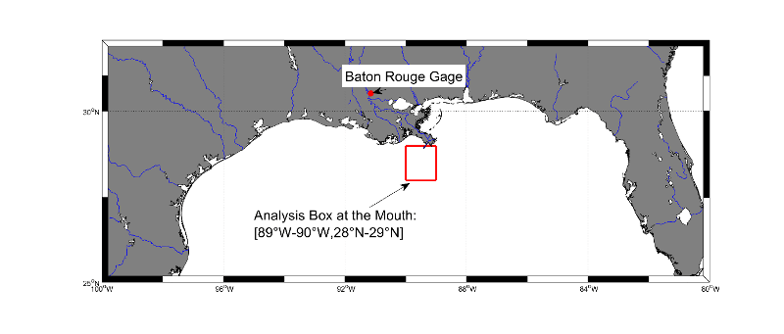
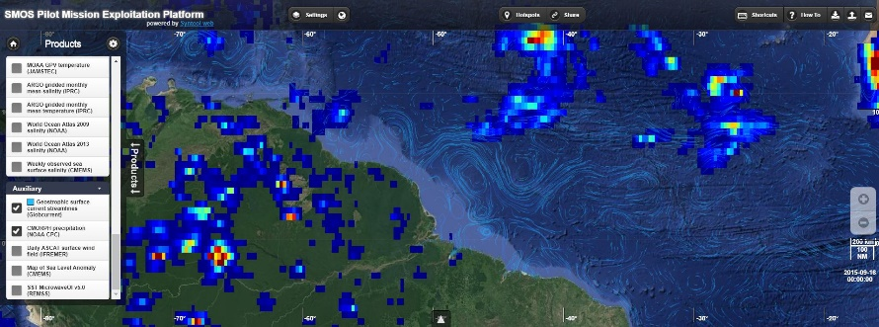
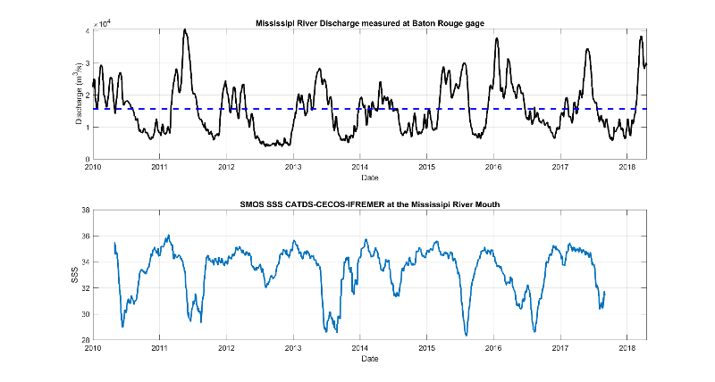
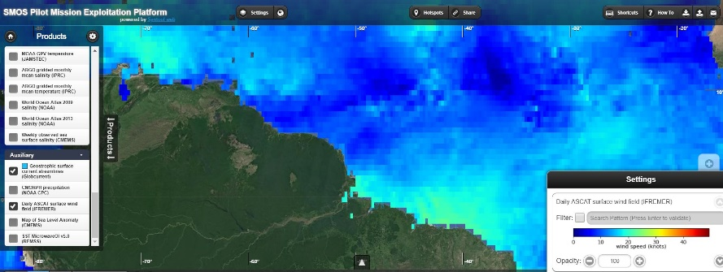
Oceanographic case studies – 1) Large tropical river plumes (ii)
SSS and currents
SSS & color (CDOM, Chla) seasonal cycles
Time series at the river mouths: discharge and SSS evolution
Next steps
SSS and rain
SSS and wind

Slide 27
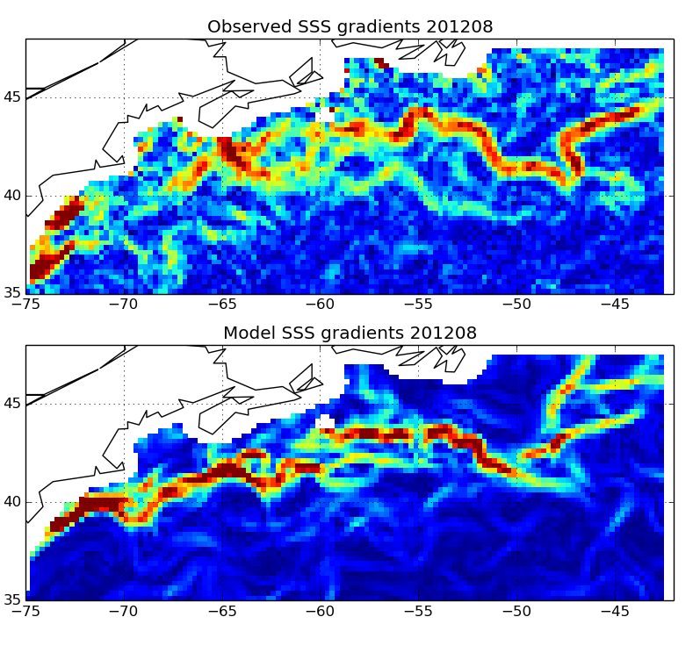
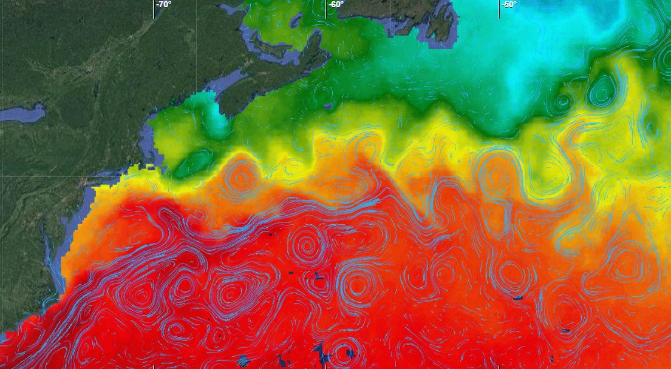
Oceanographic case studies – 2) Mesoscale signatures (ii)
SSS, SST and currents
3) Hovmueller sections
F=SSS’*v ’
SSS
SST
2) Front monitoring:
SSS gradients: satellite and models
4) Salt Eddy Transport (zonal & Meridional)

Slide 28
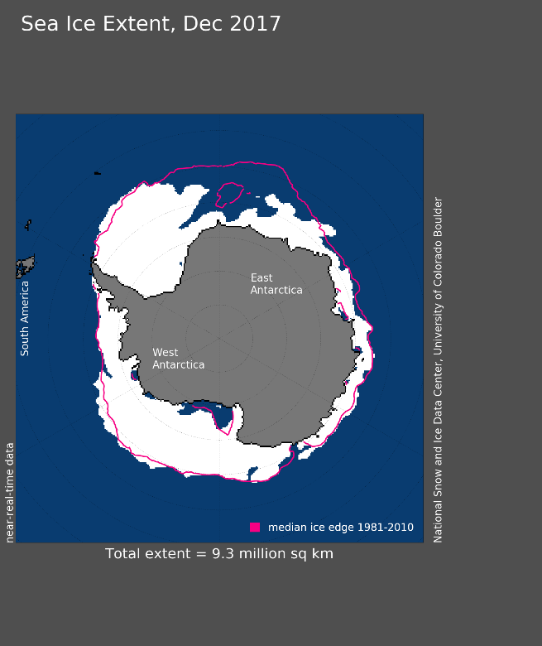
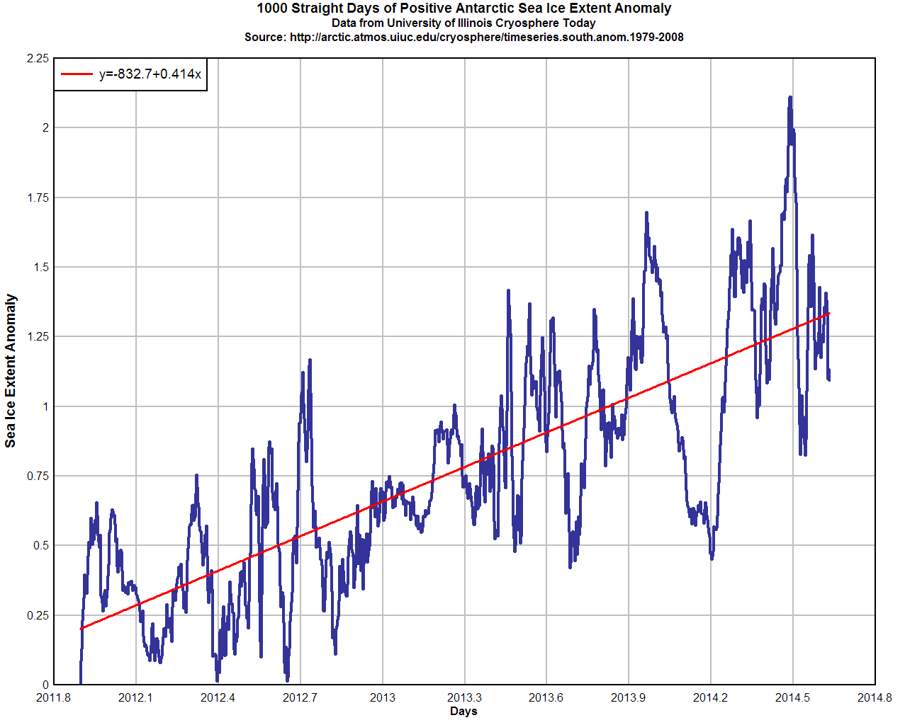
Oceanographic case studies – 3a) High latitudes (ii)
SSS and SST monitoring
3) SSS & Sea Ice
2) Transect monitoring from Tasmania to Antarctica (SSS Hovmoeller)
Correlation SSS & Sea Ice extent

Slide 29
Oceanographic case studies – 3b) Med (ii)
SSS & SST monitoring
3) Transect monitoring (Transmed)
2) SSS correlation with E-P

Slide 30
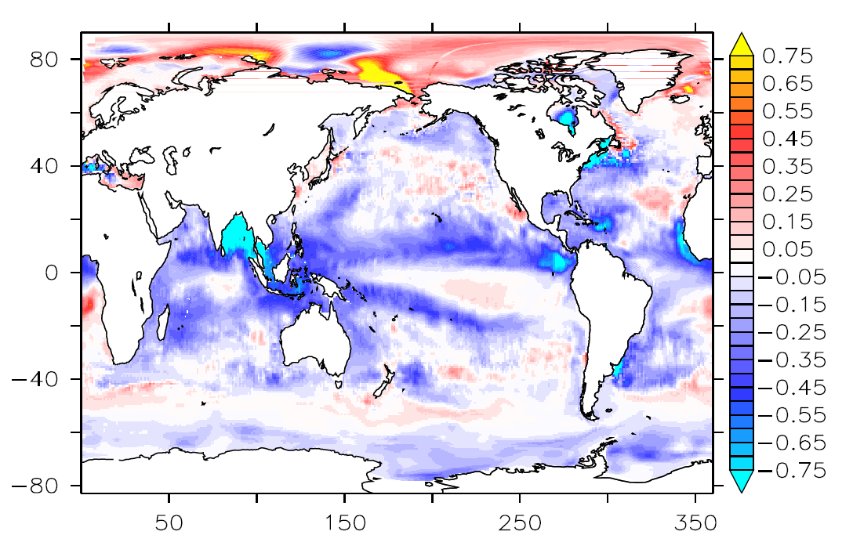
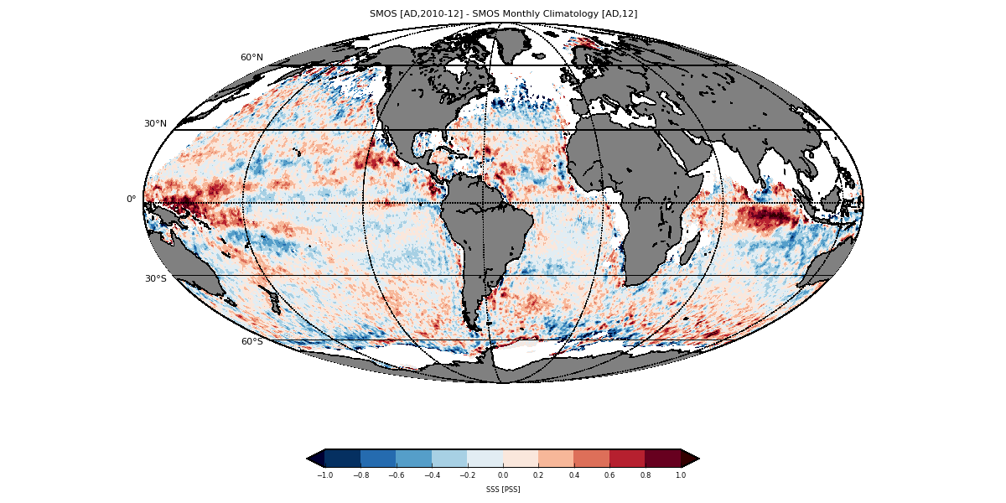
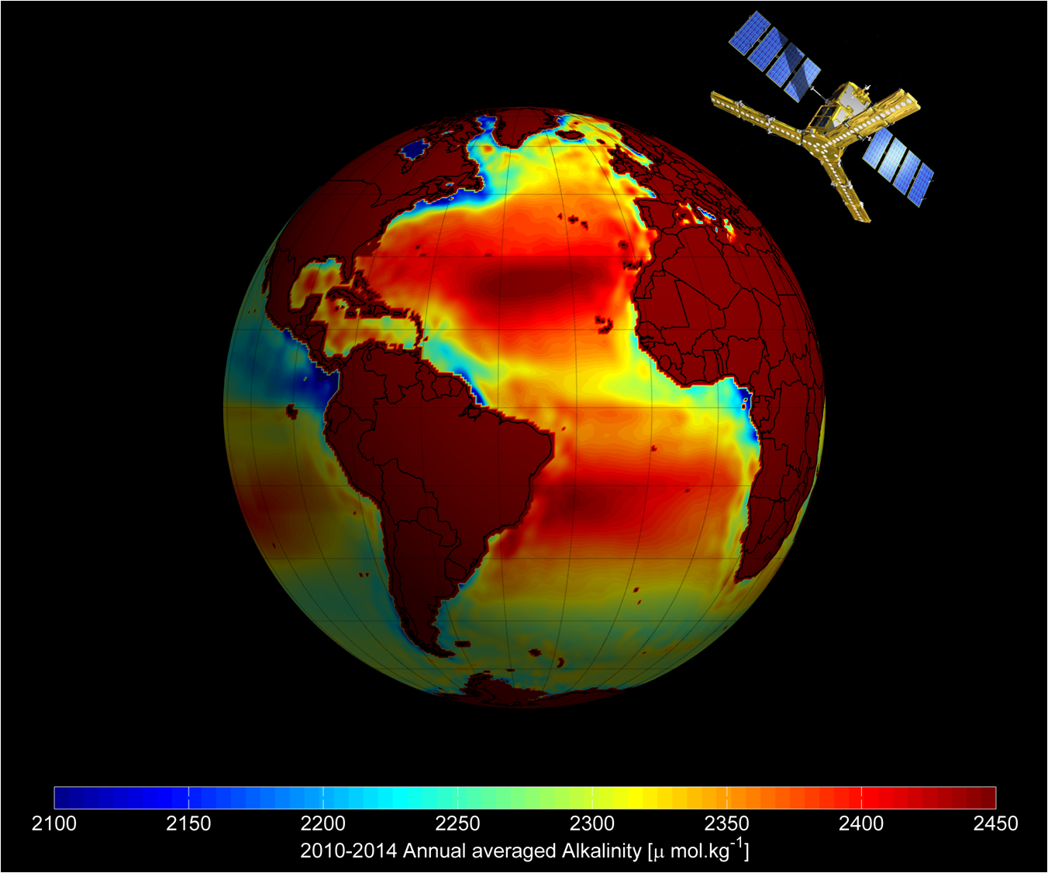
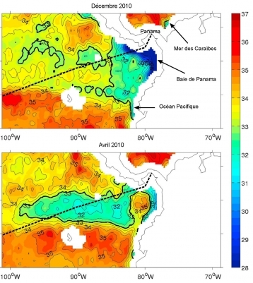
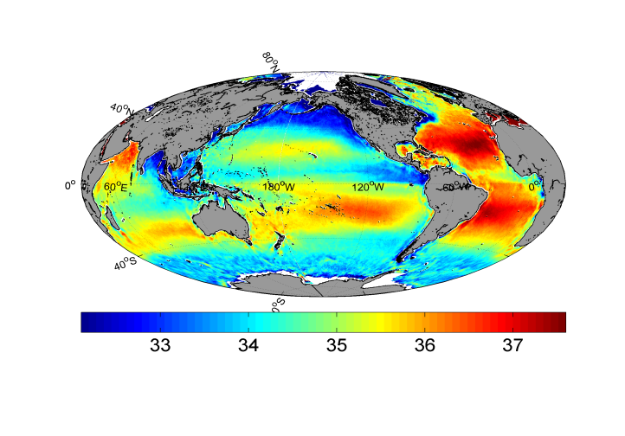
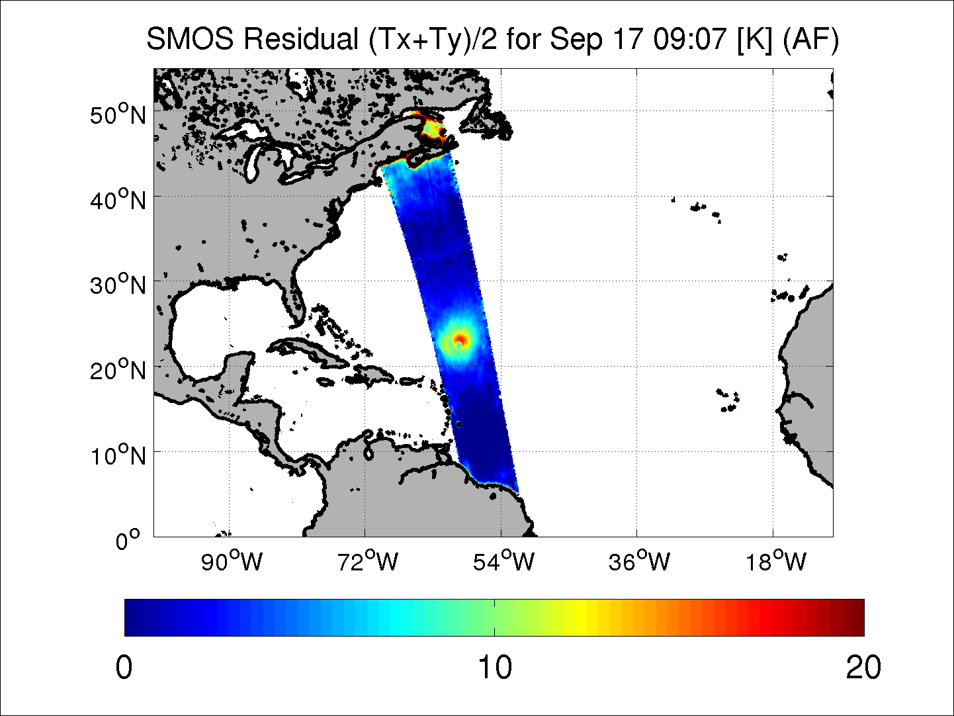
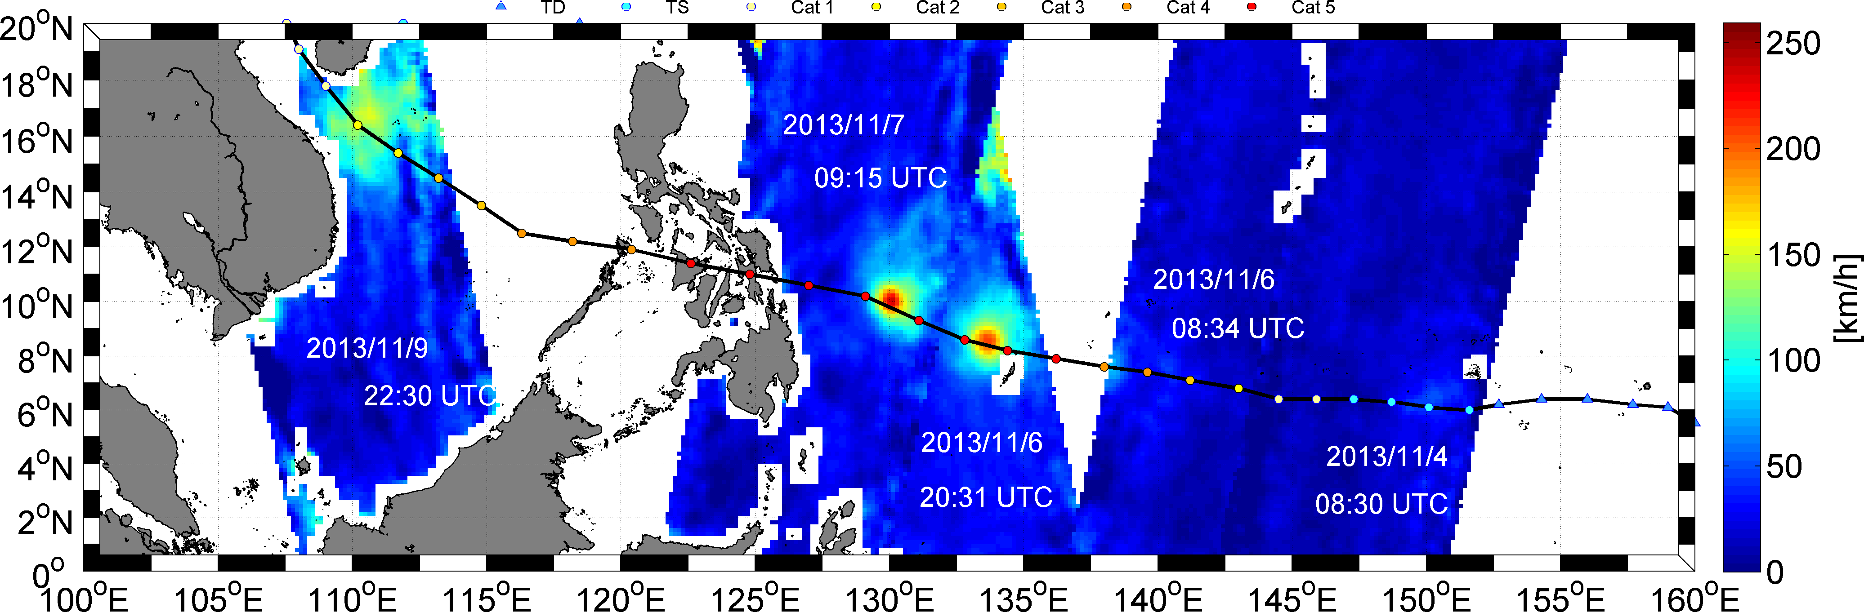
SMOS oceanographic applications
Samples of the wide range of applications stemming in the last few years from the use of SMOS SSS and TB
Ocean Circulation
Modeling
Total Alkalinity (Land et al.)
La Niña detection (Boutin et al.)
Climate indexes
SSS Data Assimilation (Köhl et al.)
Marine Biology & Biogeochemistry
Salinity
TB
Weather Predictions
Air-Sea interactions
Panama
Upwelling
Upwelling detection (Alory et al.)
Hurricane tracking (Reul et al.)

Slide 31
Outlook for the extension phase (2020-2021) -Ocean
Processors and Platforms
  Major upgrade L2 processor (v7 onwards): novel dielectric constant model; novel auxiliary WS source/uncertainty and roughness impact; improved characterization L2/L3 SSS uncertainty; assessment potential novel retrieval scheme
  Pi-MEP salinity: implementation completion, pre-ops and ops release; enhanced validation, synergistic data exploitation; quantification representativeness error; potential collaboration with NASA
  CCI+ SSS: broad L-band (SMOS, Aq, SMAP, AMSR) round-robin intercomparison of retrieval algorithms, errors, models and Aux data
Drivers for mission extension
  Climate: Enlargement of SSS CDR and enhanced monitoring/characterization of SSS along with crucial climate indices/oscillations (ENSO, IOD, MJO) and extreme events
  Ops: Enhanced SSS data assimilation into OCM and operational oceanography; Systematic production of SMOS wind speed / wind radii within TC monitoring/forecasting framework
  Synergy: Sustained and increasing synergy with S1/S2/S3/Cryosat/TPMs for a variety of oceanographic applications with novel sensors or with increased coverage
Further scientific exploitation
  Air/sea interaction (Upwelling, freshwater river plumes; stratification; freshwater lenses)
  Biogeochemistry (carbon cycle and Ocean Acidification)
  High latitudes (Artic) and semi-enclosed sea (Med) regional focus

Slide 32
Outlook for the extension phase (2020-2021) - Land
Processors and Platforms
  Major upgrade L2 processor (v7 onwards): novel dielectric constant model for organic soil; Investigation possible inclusion of 2-stream model in the retrieval scheme; Improved VOD product; refined parameterizations for specific land classes
  Pi-MEP soil moisture: finalization procurement and project start; SAG board involvement for requirements definition and datasets collection; design and implementation; enhanced validation; quantification representativeness error
  CCI+ SM and C3S: Inclusion SMOS to generate climate data records for the SM ECV
Drivers for mission extension
  Climate: Enlargement of SM CDR and enhanced monitoring/characterization of SM and other hydrological variables along with crucial climate indices/oscillations (e.g, ENSO) and extreme events; drought monitoring and warning systems
  Ops: Enhanced SM data assimilation into IFS in the NWP context; Emergency Management (Flood awareness and Forest Fire Information); Water resources mgmt and food security
  Synergy: Sustained and increasing synergy with S1/S2/S3/S5P/Biomass/TPMs for a variety of hydrological applications with novel sensors or with increased coverage
Further scientific exploitation
  Hydrology (RZSM, rainfall estimates, ET, NEE, yield forecast, VOD)
  Cryosphere (freeze/thaw, snow density, SWE, SWLC)
  Hazard management (drought index, fire risk, flood awareness)

Slide 33
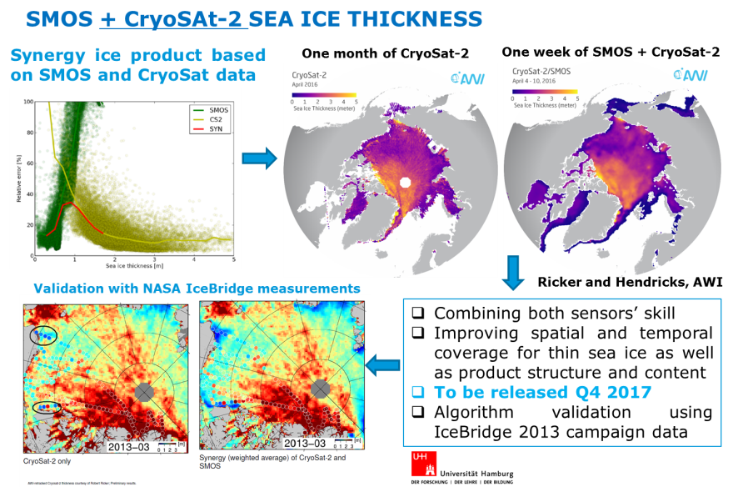
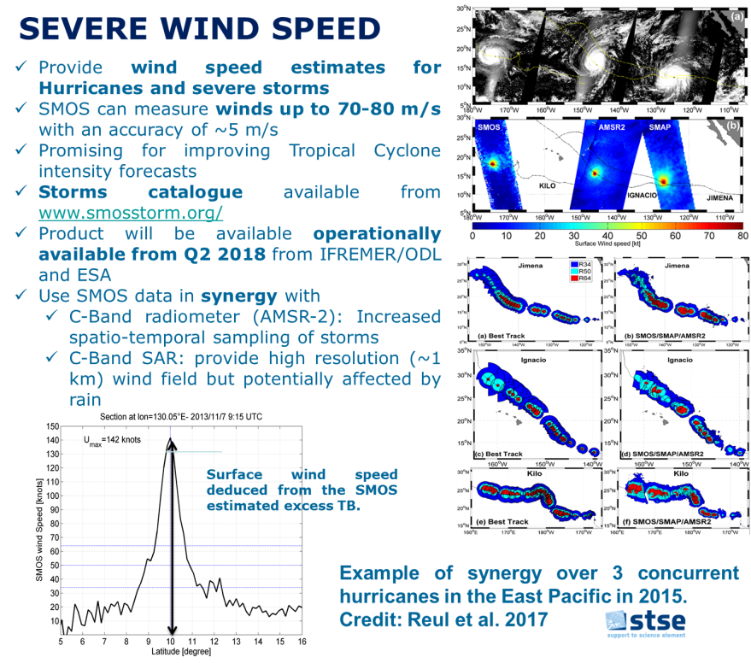
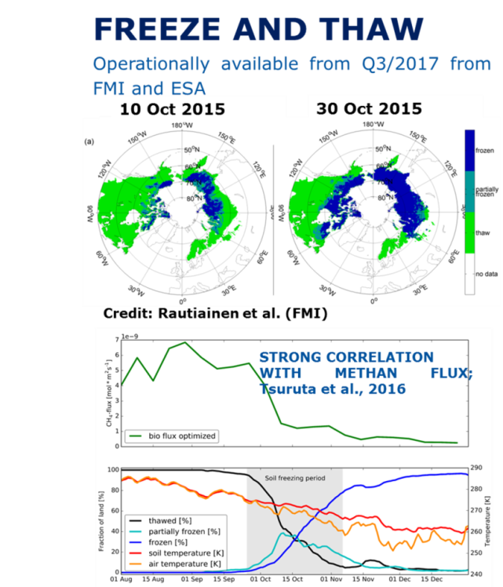
New products to be available to users
Three new (third party) products to be released from individual provider and ESA
Soil Freeze and Thaw – Q4 2017 FMI
SMOS + Cryosat sea ice thickness – Q4 2018, AWI
Severe wind – Q2/2018, ODL/IFREMER

