Slide 1
Assimilation of MW data in
The C3S ERA5 Reanalysis
Bill Bell, Hans Hersbach, Cornel Soci, Paul Berrisford,
Raluca Radu, Joaquin Munoz Sabater, Adrian Simmons, Andras Horanyi, Julien Nicholas, Dinand Schepers
Timo Hanshmann, Viju John & Joerg Schultz (EUMETSAT)

Slide 2
Outline
Passive MW data in the ERA5 reanalysis
Satellite data reprocessing & data rescue
  MHS, MWHS & ATMS
  MSU
Bias correction for NWP & Reanalysis – using
FIDUCEO uncertainty information
Summary

Slide 3
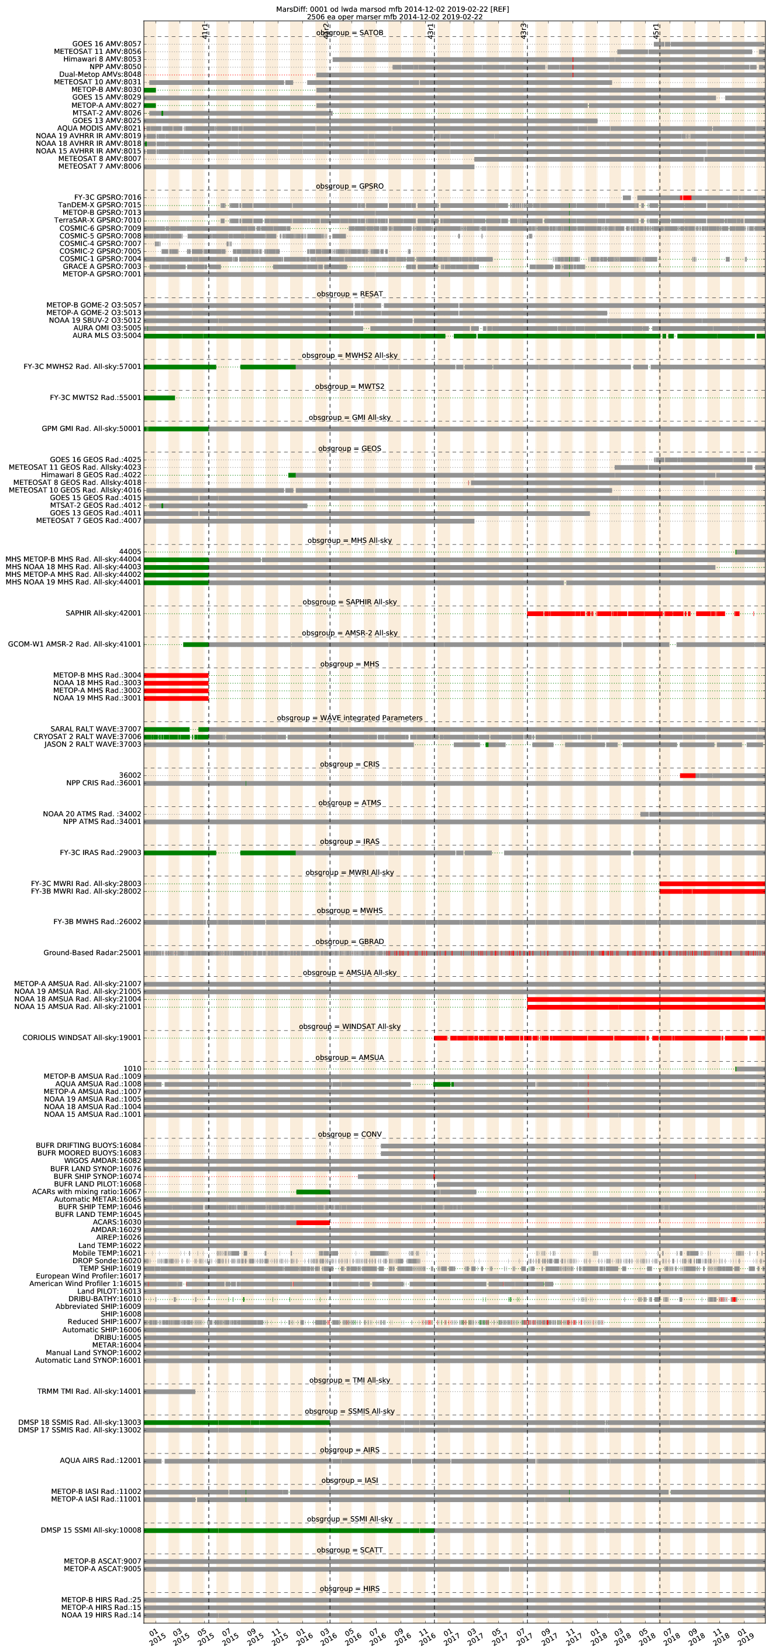
Passive MW data in ERA5
Temperature sounding data:
MSU, AMSU-A and ATMS from all operational NOAA satellites and NASA’s Aqua
AMSU-A from MetOp
Humidity sounding data:
AMSU-B & MHS from NOAA / MetOp
FY3 –B/-C MWHS(-2)
Microwave Imagers:
SSMI, SSMIS, TMI, AMSR-E, -2, GMI

Slide 4
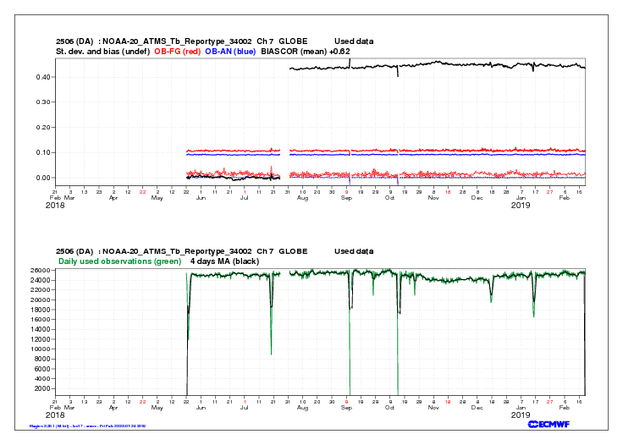
Monitoring satellite data in ERA5
Example: NOAA-20 ATMS
(channel 7)
Processing change in late
July 2018 (well managed!)
Change in bias correction
applied ~0.4K
June 2019: review of all
monitoring of satellite
data for 1979-2019

Slide 5
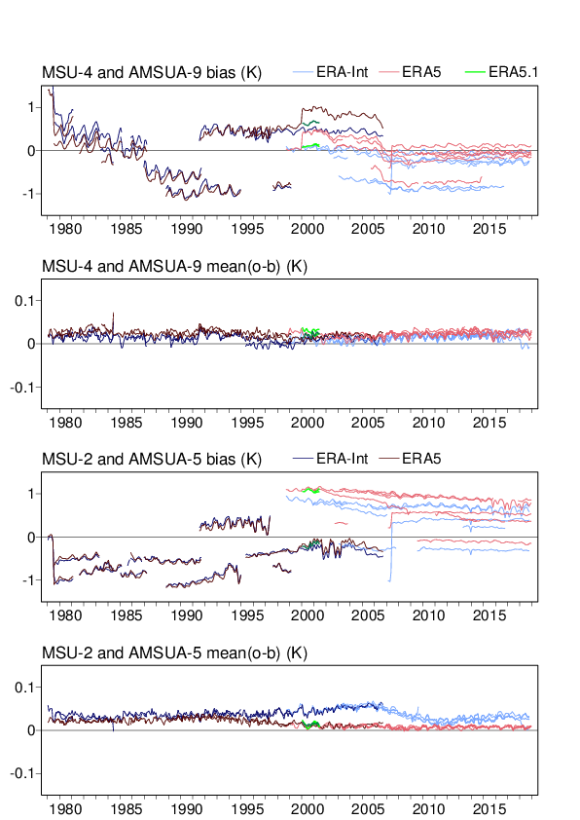
Reanalysis bias corrections for MW sensors
Dynamic bias corrections derived as part of cost function minimisation using Variational Bias Correction (VarBC)
Shown for ERA5, ERA-Interim & ERA5.1
Global mean bias corrections
during MSU-era are ± 1K
During ATOVS era (1998-) corrections are smaller, at ~0.5K typically.

Slide 6
Reprocessing : What is being prepared
sensor | platform | start | end
MHS | METOP A | 21.05.2007 | 31.12.2018
MHS | METOP B | 15.01.2013 | 31.12.2018
MWHS | FY-3A | 01.07.2008 | 04.05.2014
MWHS | FY-3B | 21.12.2010 | 31.12.2018
MWHS | FY-3C | 01.10.2013 | 31.12.2018
ATMS | SNPP | 10.12.2011 | 31.12.2018

Slide 7
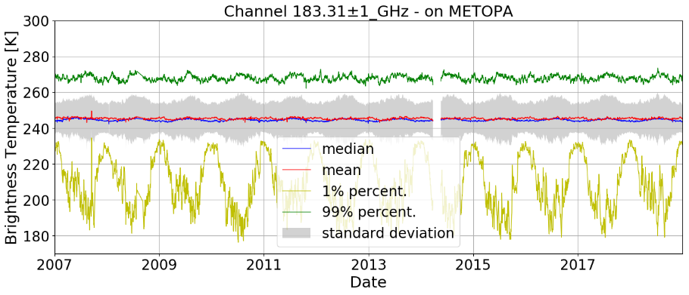
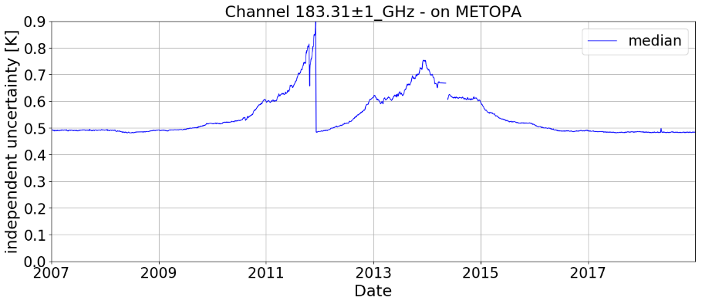
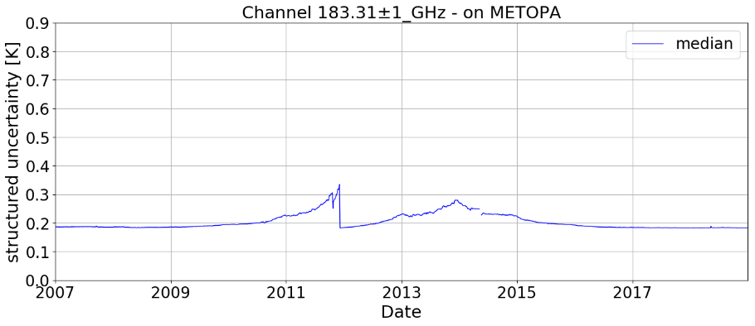
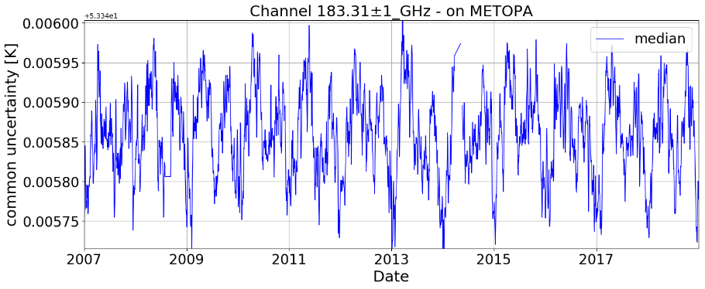
MHS – METOPA Timeseries @ 183±1 GHz
Daily mean BT uncertainty
Independent uncertainty
FIDUCEO independent, structured and common uncertainties (see Rob Roebeling talk , 3i)
How do we use them ????
Structured uncertainty
Common uncertainty

Slide 8
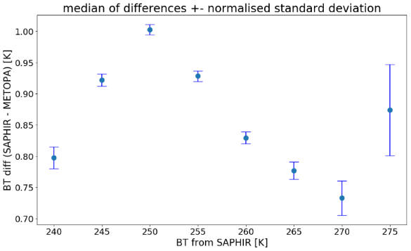
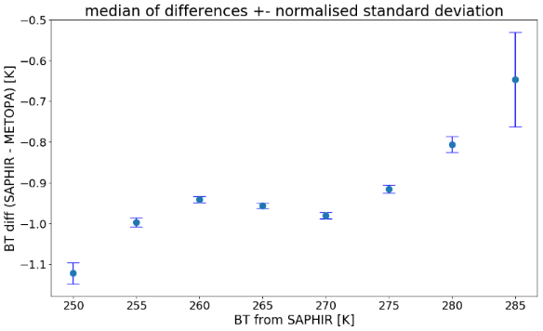
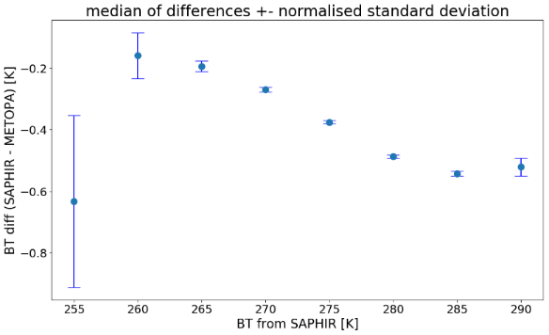
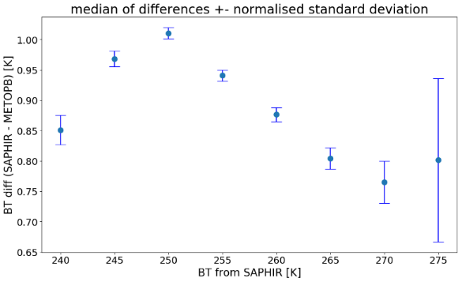
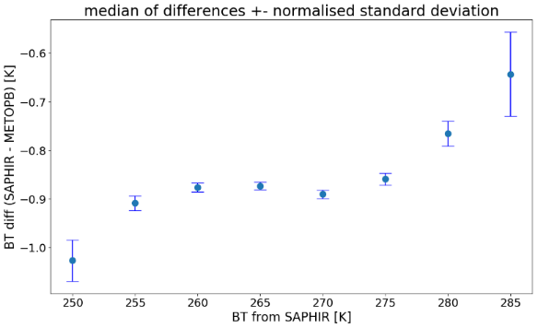
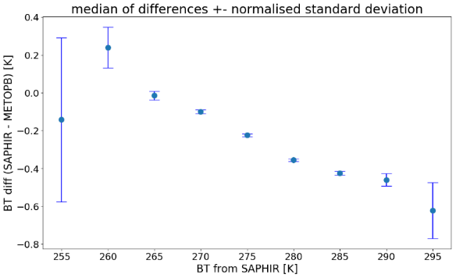
Intercomparisonall against SAPHIR based on 2 years each ~ 50000 SNOs
183 ±1 GHz (1.1 for SAPHIR)
→ expects SAPHIR to be warmer
183 ±3 GHz (2.8 for SAPHIR)
→ expects SAPHIR to be colder
190 GHz (183 ± 6.8 for SAPHIR)
→ expects SAPHIR to be colder

Slide 9
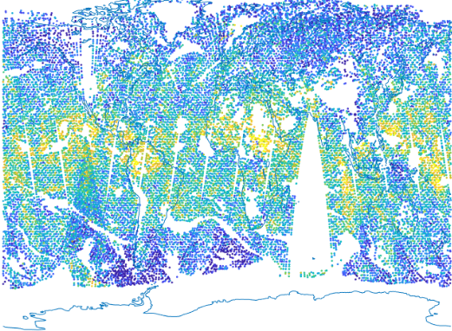
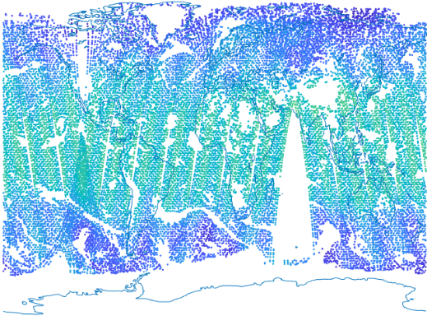
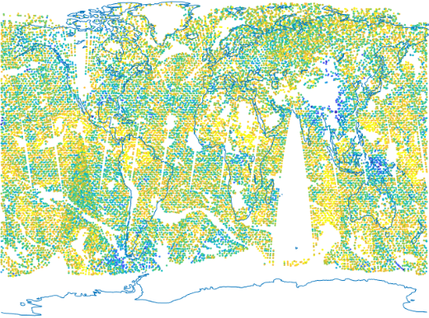
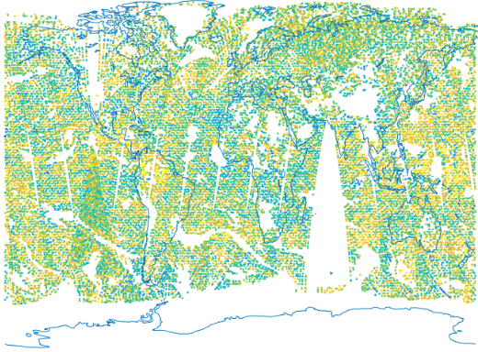
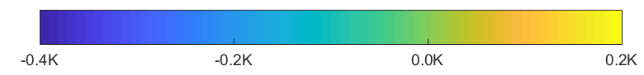
Bias Correction in NWP & Reanalysis
first guess departures
(uncorrected)
bias correction
first guess departures
(corrected)
analysis departures
NOAA-20 ATMS-7
ERA5 departures & bias correction

Slide 10
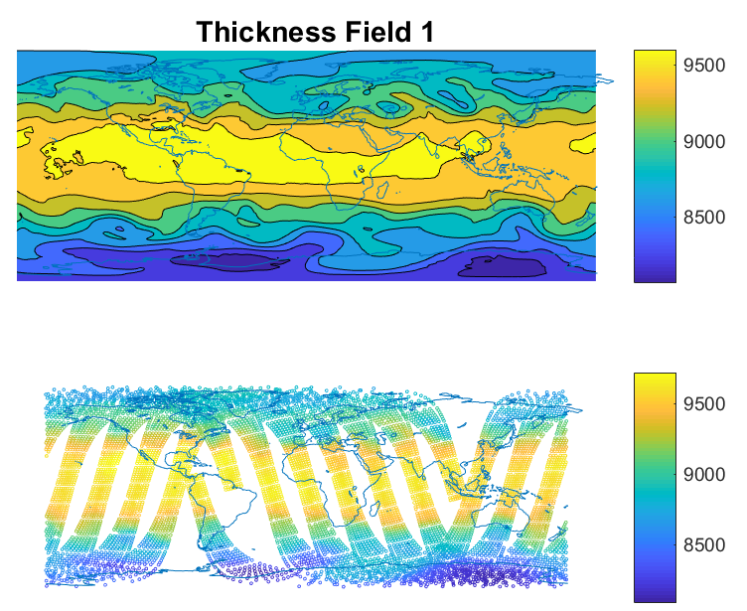
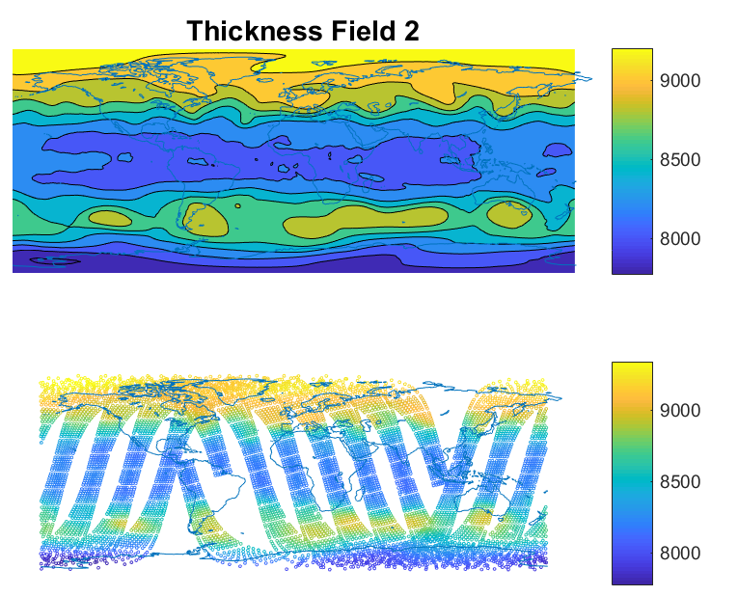
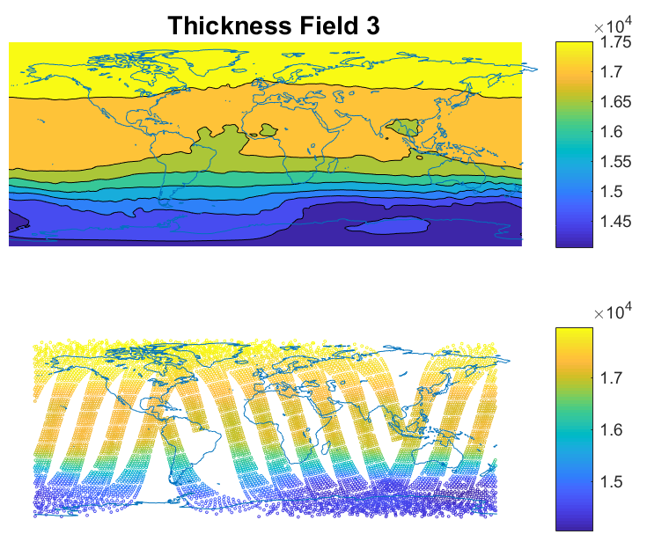
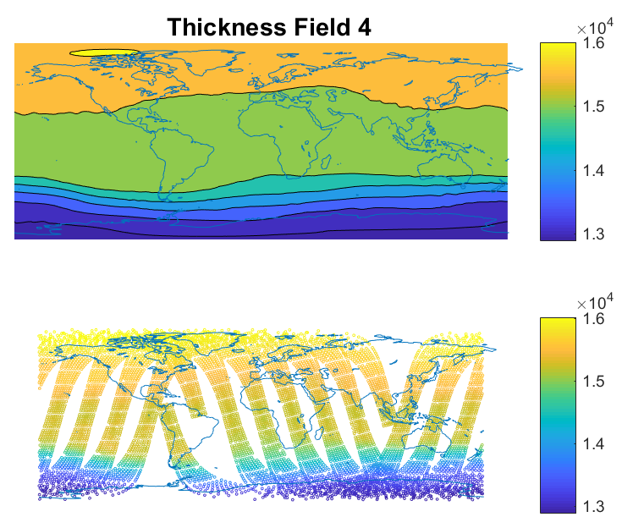
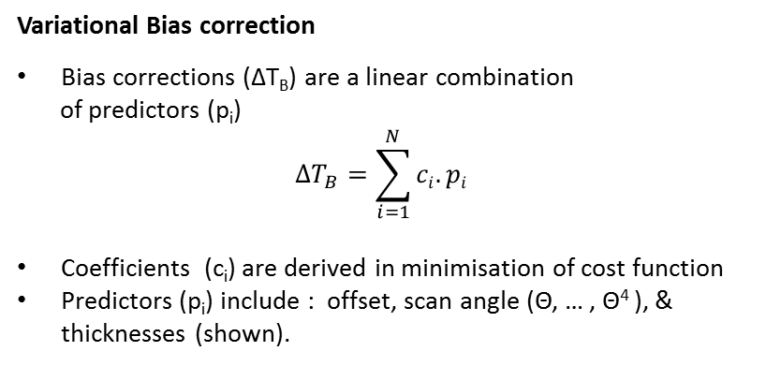
1000-300 hPa
200-50 hPa
10-1 hPa
Variational Bias correction
Bias corrections (ΔT_{B}) are a linear combination
of predictors (p_{i})
$$∆T_{B}=\sum_{i=1}^{N}{ci.pi }$$
Coefficients (c_{i}) are derived in minimisation of cost function
Predictors (p_{i}) include : offset, scan angle (Θ, … , Θ⁴ ), & thicknesses (shown).
50-5 hPa

Slide 11
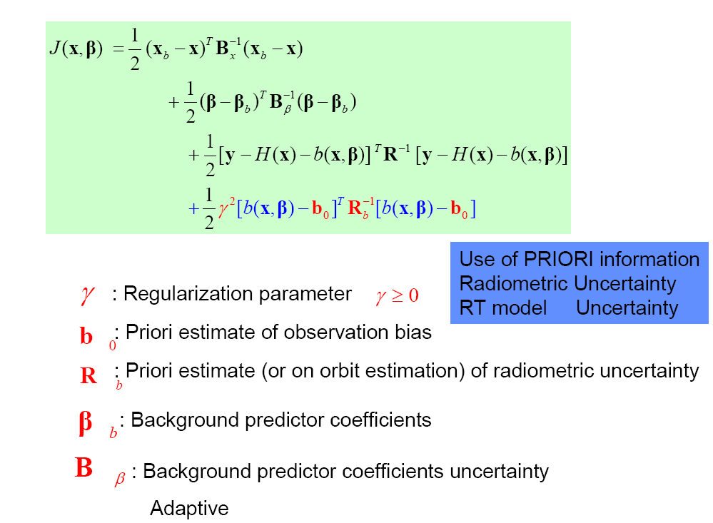
Constrained Variational Bias Correction
Mis-fit to prior information
Mis-fit to prior VarBC coefficients
Mis-fit to observations
Mis-fit to prior bias correction
Wei Han and
Niels Bormann

Slide 12
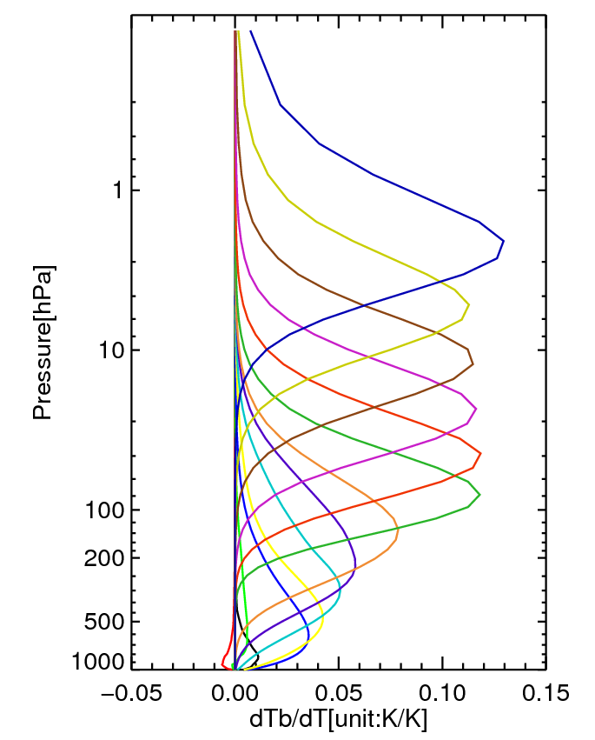
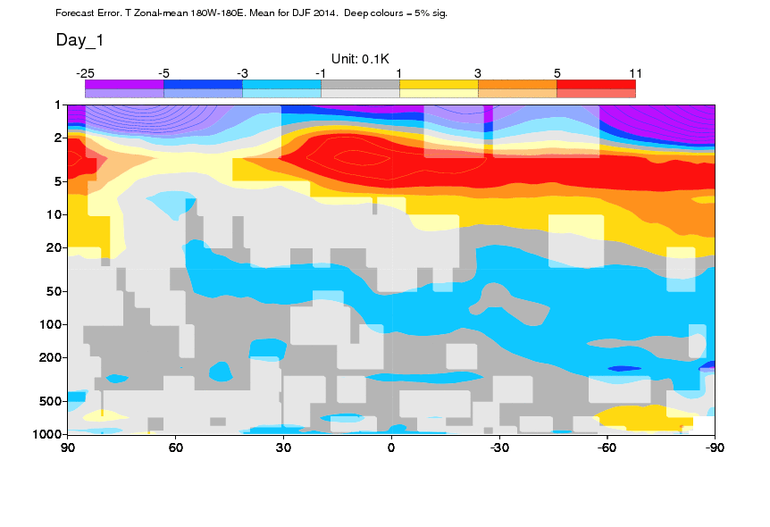
Motivation(1): Model bias in upper stratosphere and mesoshpere

Slide 13
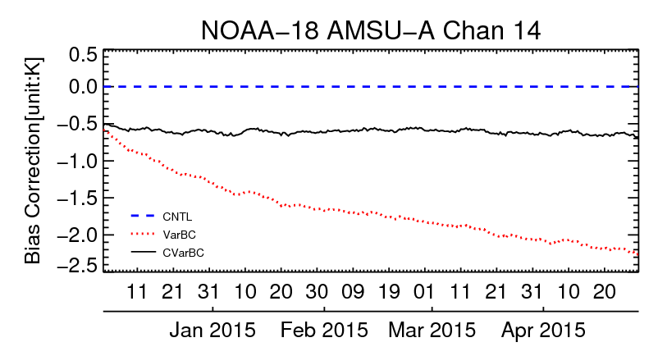
Implementation of Constrained VarBC in IFS
and CY41R2 experiments
AMSU-A | gamma | Bias0 | B(bias0)*
Channel 14 | 0.3 | 0 | 1.4
Channel 13 | 0.0 | 0 | 0.85
Channel 12 | 0.0 | 0 | 0.5
CVarBC
*Same as observation error

Slide 14
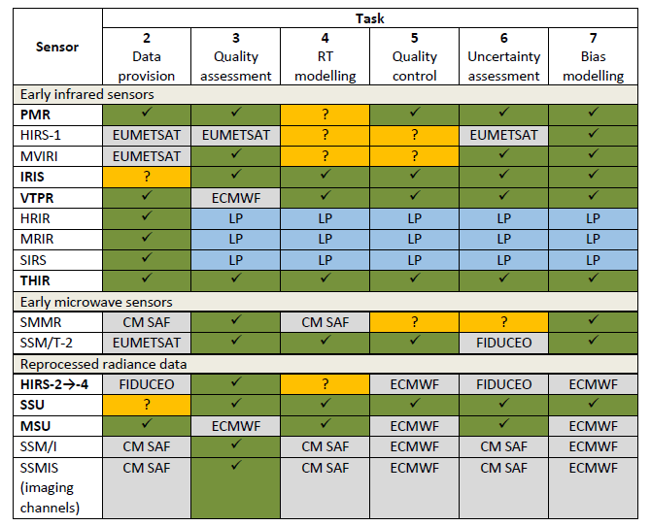

Satellite data rescue for climate reanalysis
Satellite data rescue services will be
delivered by: Spascia, ICARE, CNRM,
Univ. of Reading & Met Office.
(2019 - 2021)
Focus on early datasets
Range of activities: data provision → bias modelling and uncertainty assessment
MW Data
SMMR & SSM/T-2
MSU, SSMI and SSMIS

Slide 15
Summary
ERA5 uses (almost) all available MW sounding and imaging data from US, European, Chinese and Japanese Agencies covering the period 1979 - now. Efforts to rescue (IR) data from 1970-1979 are ongoing.
Bias corrections are applied using VarBC. For temperature sounding channels, these are within ± 1K for early data (MSU: 1979-1998) and within ±0.5K for 1998- present (AMSU-A and ATMS). No attempt is made to check for consistency with uncertainty estimates for these radiometers.
FIDUCEO developments are encouraged and welcomed, but using the uncertainty estimates presents a challenge that requires some R&D by NWP centres/reanalysis groups. CVarBC may be a good start.

