Slide 1
Metop-C AMSU & MHS Radiometric Quality Status Update
Tim Hewison
Slides from Jörg Ackermann
Status for PVRB on 13. Feb. 2019

Slide 2
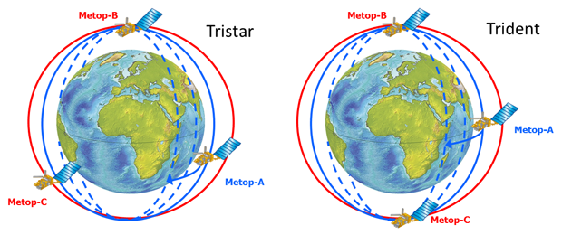
Metop-C AMSU and MHS Status
Metop-C launched 7 Nov 2018
In 9:30 orbit (same as Metop-A & -B), but with different phasing:
SIOV & Commissioning in Tristar configuration
During commissioning, based on early user feedback, decision made to remain in a Tristar phasing configuration or to shift Metop-C 180 degrees opposite Metop-B (original A/B configuration) with Metop-A in-between (“trident” configuration – see Figure 1, right).
Recommend to start Level 1 dissemination as ‘Pre-Operational’

Slide 3
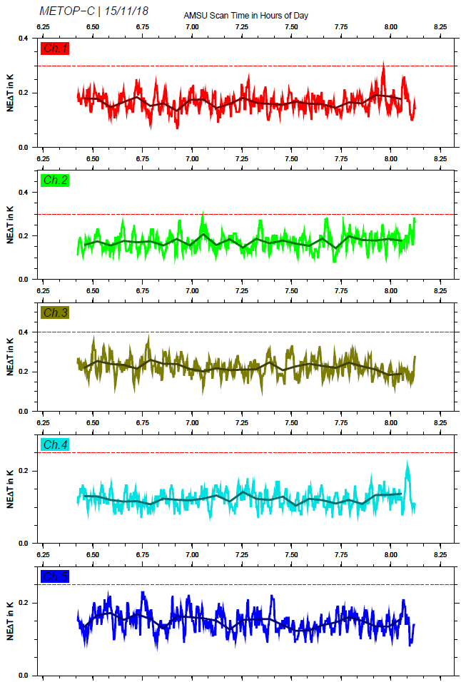
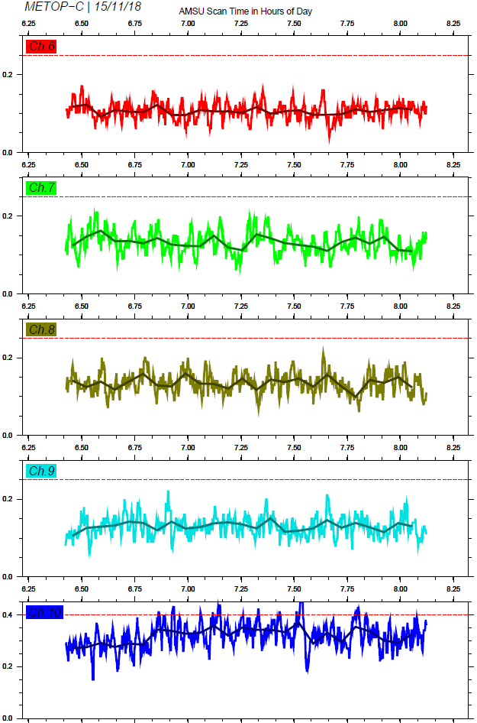
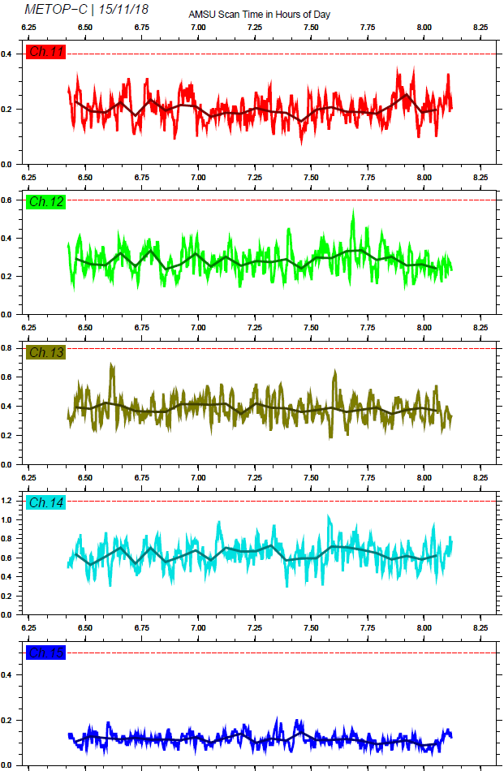
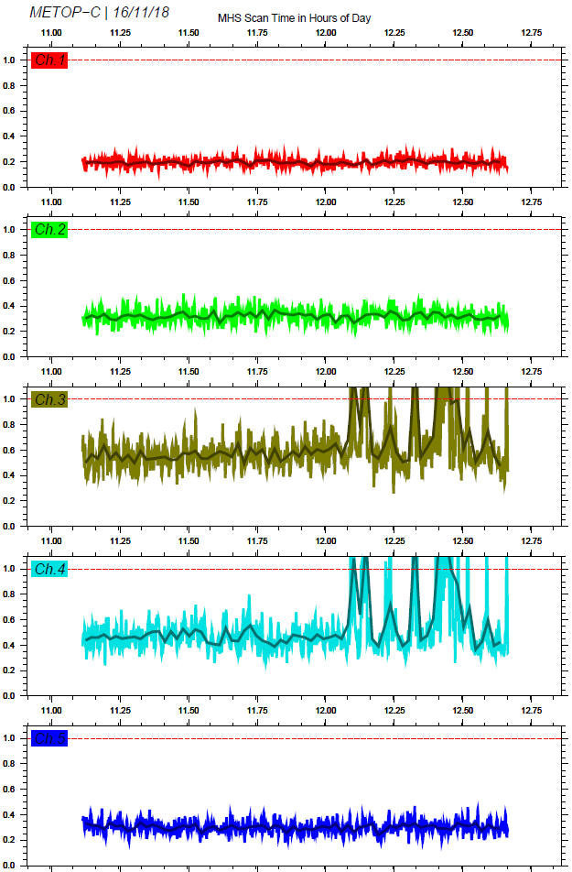
Results: AMSU/MHS Radiometric Performance (NeΔT BOL)
NE∆T < Red line = Requirement

Slide 4
AMSU

Slide 5
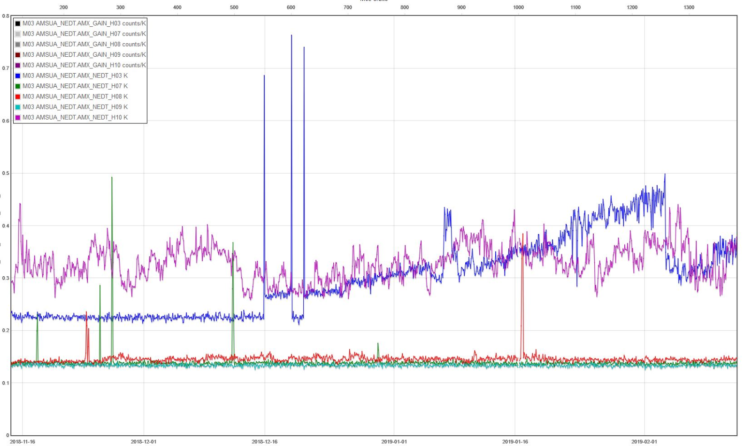
Results: AMSU channels 3, 7, 8, 9, 10 Radiometric Performance Evolution (NeΔT)
Variations related to both, gain changes and NE∆T instabilities.
Cause is still unknown.

Slide 6
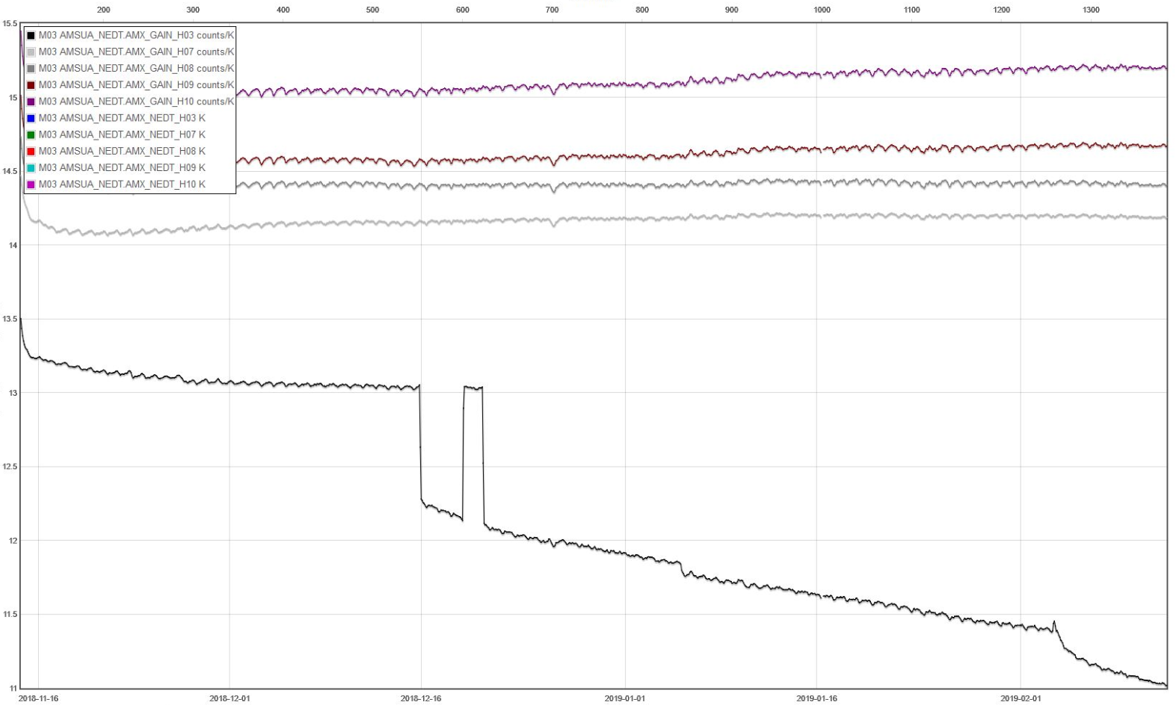
Result: AMSU channels 3, 7, 8, 9, 10 Gain Evolution (Counts/K)

Slide 7
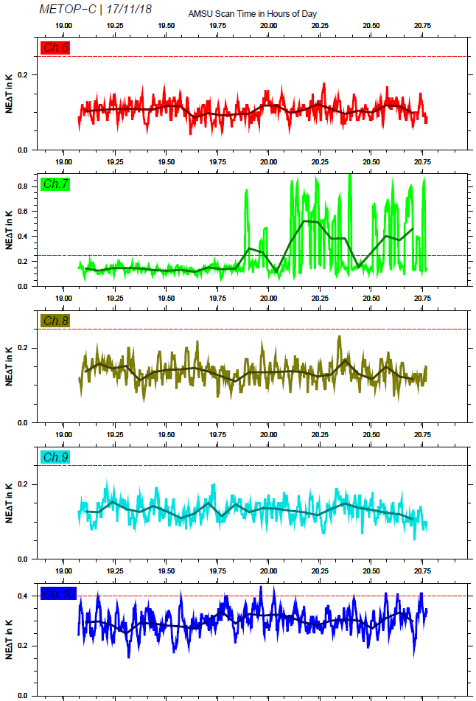
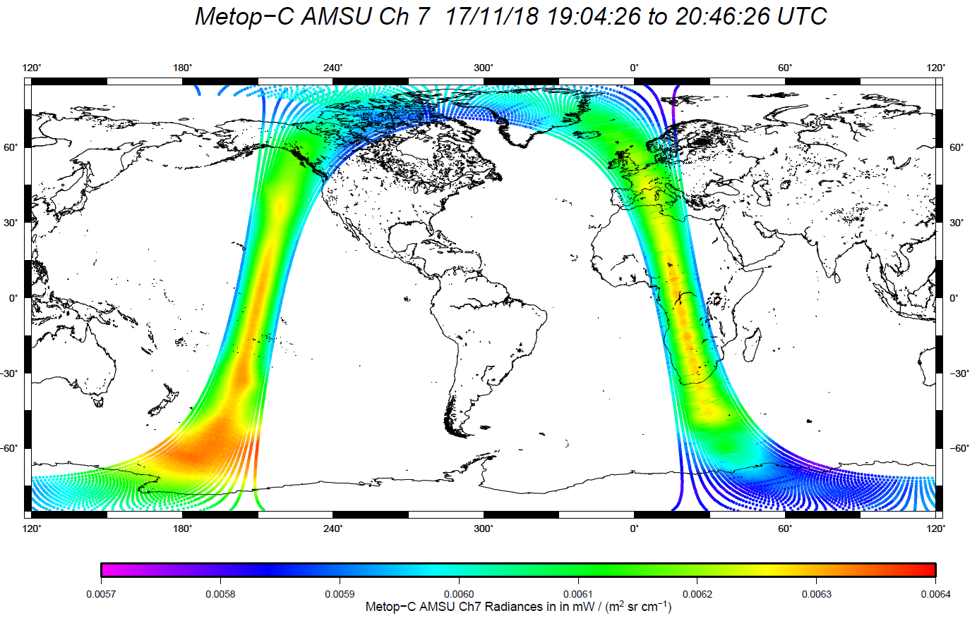
Results: AMSU Ch.7 Instability on 17. Nov. 2018
Higher Noise is visible in the L1B product:

Slide 8
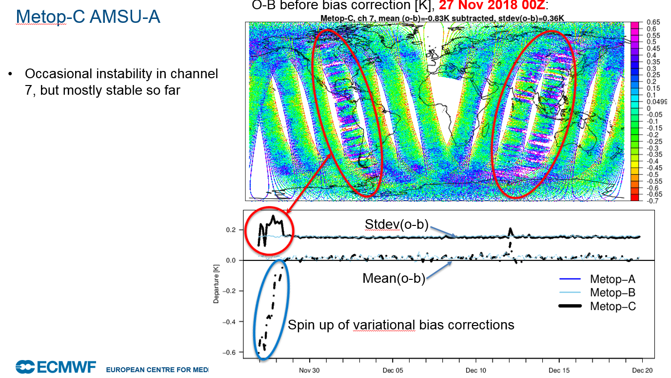
Results: AMSU Ch.7 Monitoring in ECMWF System
Courtesy: Niels Bormann

Slide 9
Results: M03 AMSU Mean Bias (Obs-B)
Courtesy: Niels Bormann

Slide 10
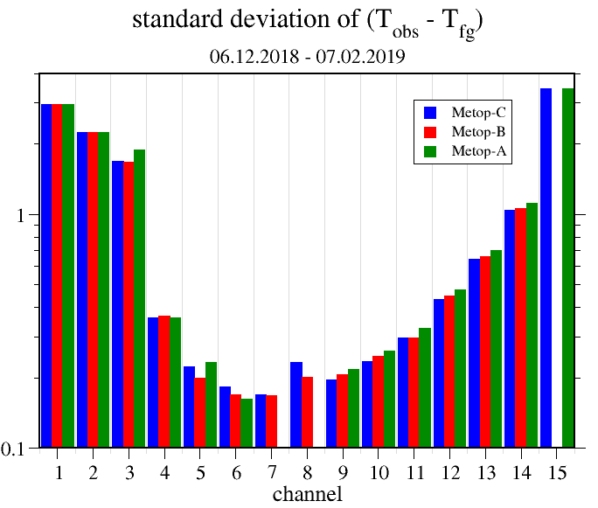
Results: M03 AMSU Stdev (Obs-FG)
Courtesy: Christina Koepken, DWD

Slide 11
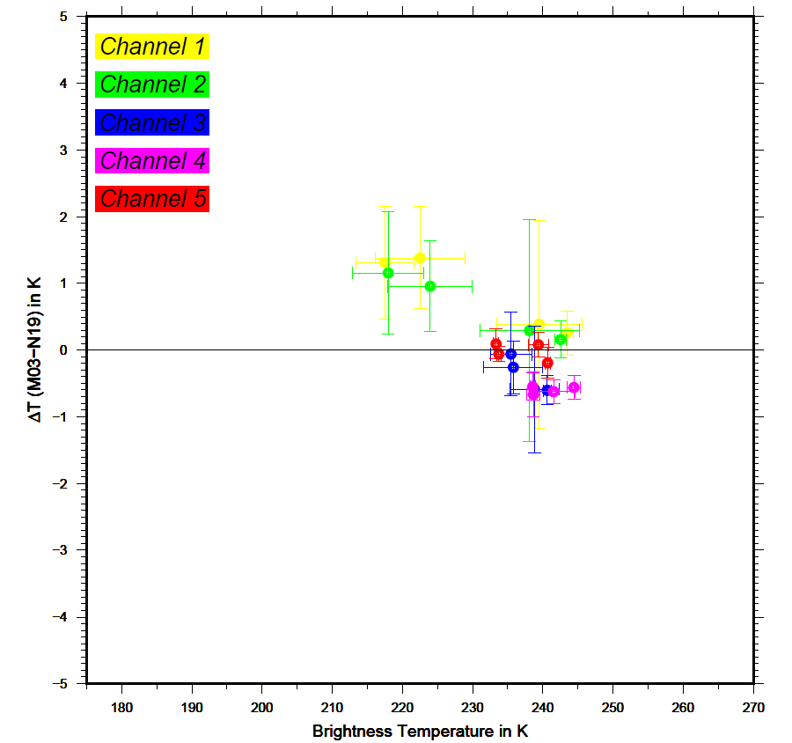
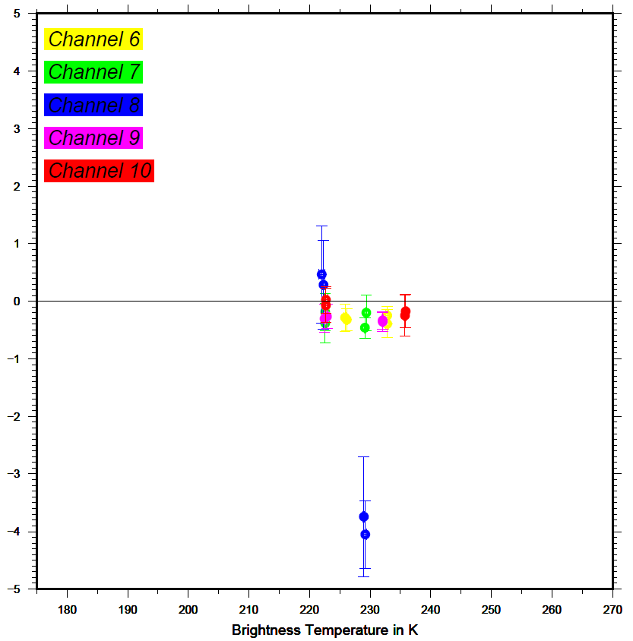
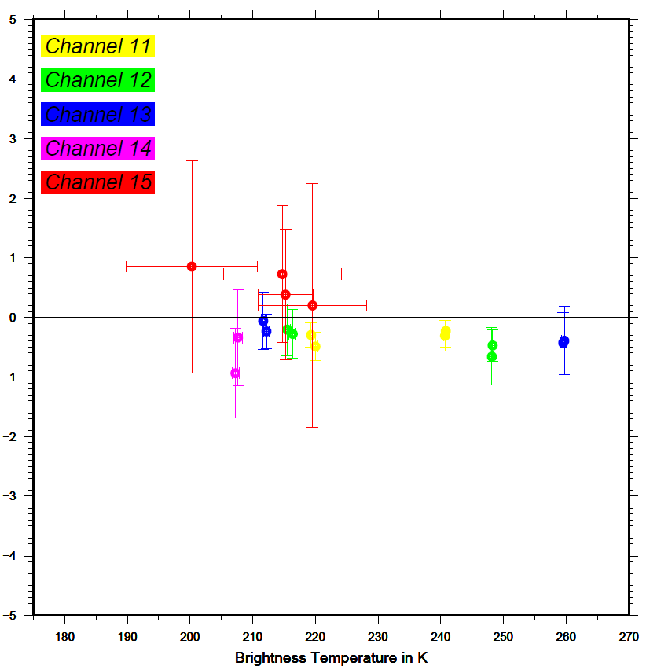
Results: M03 AMSU vs. N-19 AMSU
Results:
AMSU channel 1, 2, and 15 brightness temperatures are about 1 K warmer, when compared with NOAA-19 AMSU (this observation is very similar to an earlier M02 vs. N-19 comparison)
The cause for the channel 8 discrepancy (2 SNO’s over Antarctica) is not understood yet
The remaining channels fit very well within a corridor of 0.8 K

Slide 12
MHS

Slide 13
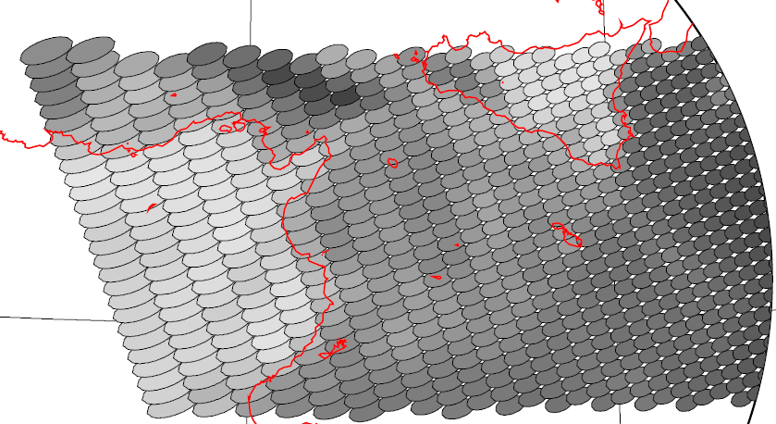
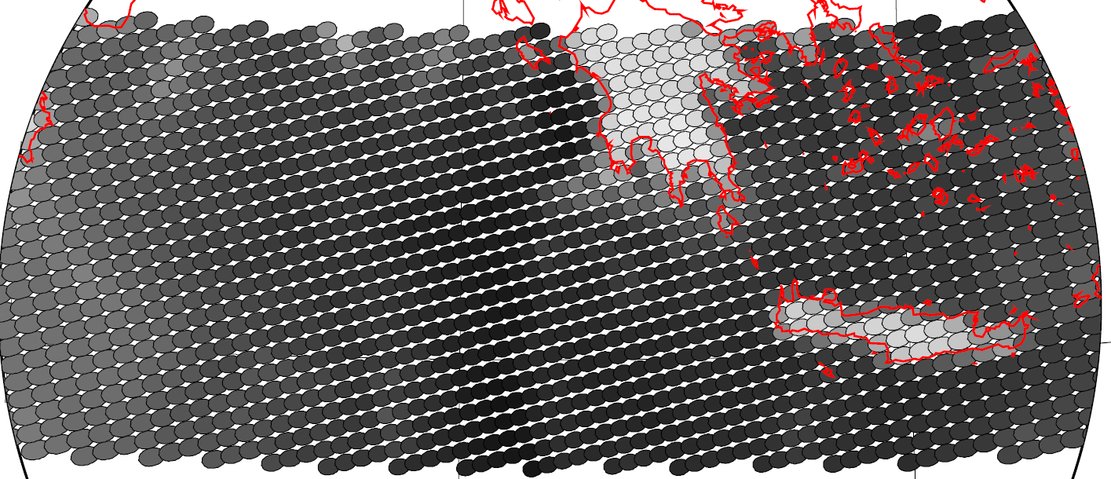
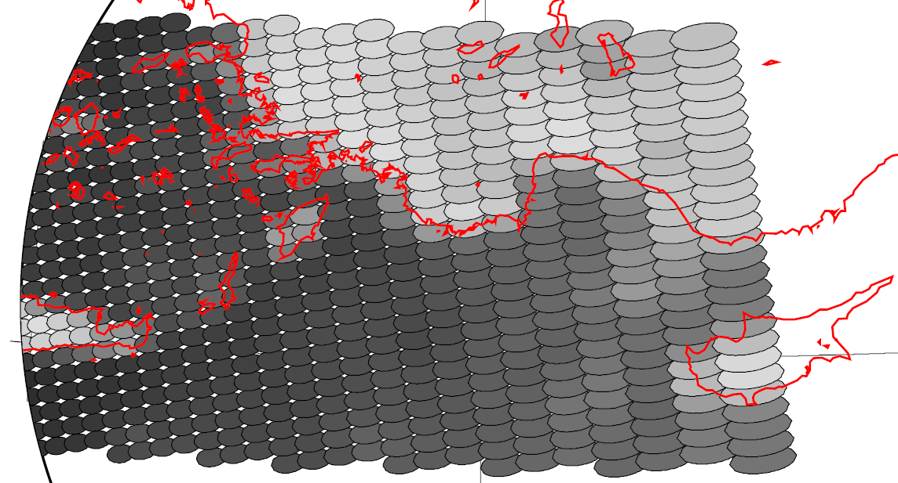
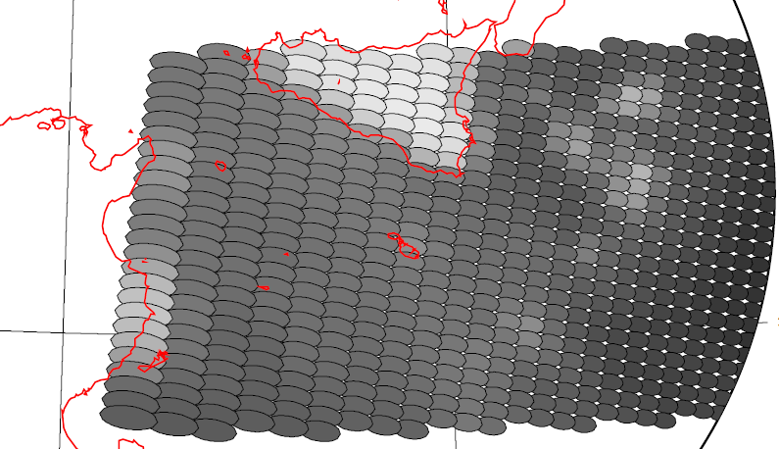
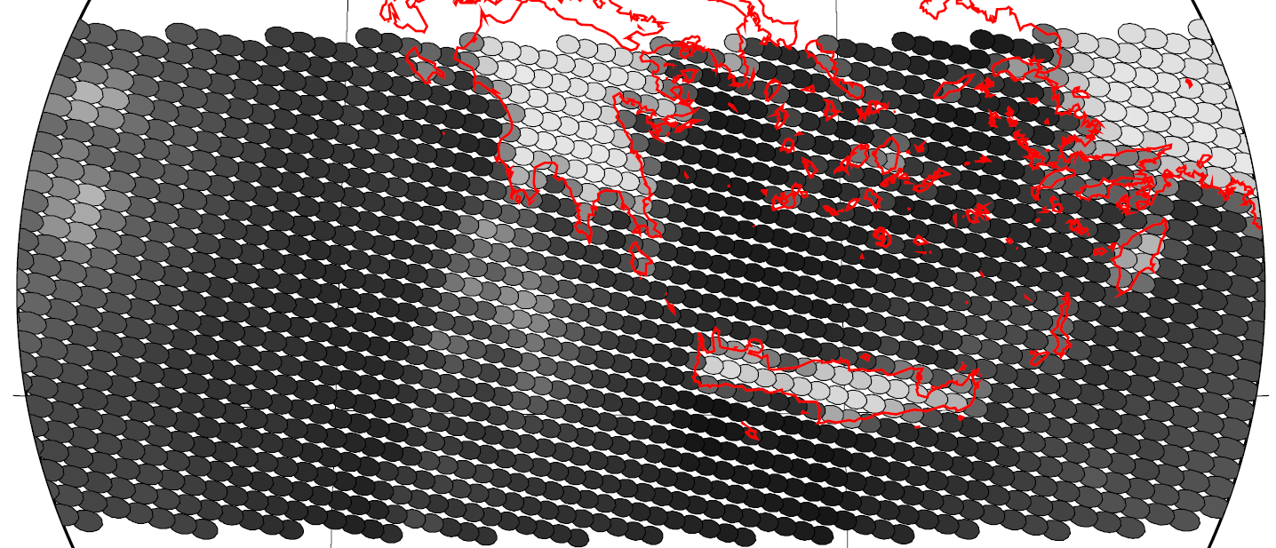
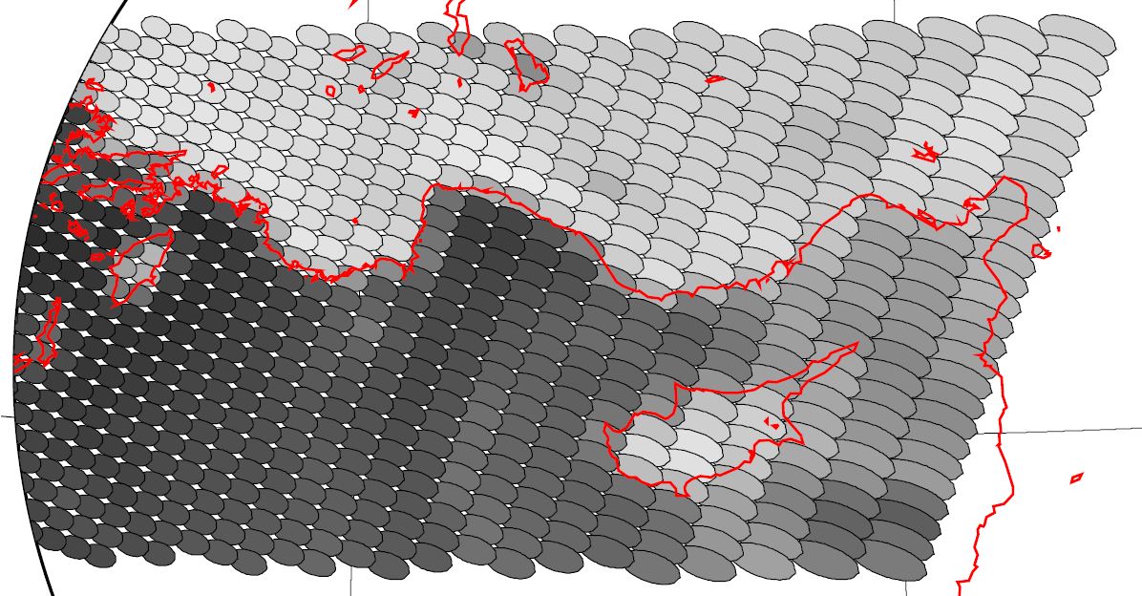
Results: MHS Geolocation Assessment
left
mid
right
Ascending:
Descending:
right
mid
left

Slide 14
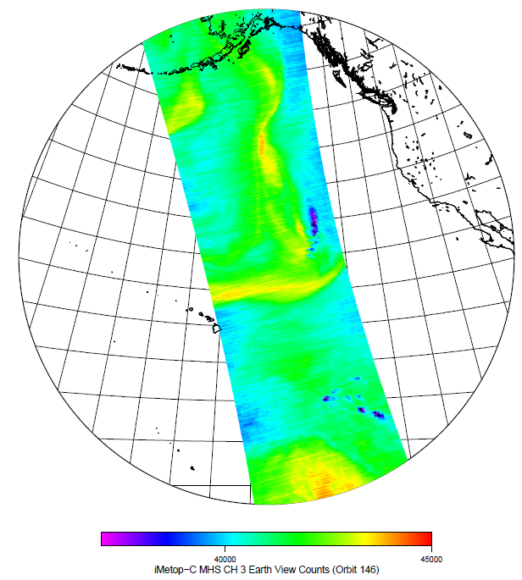
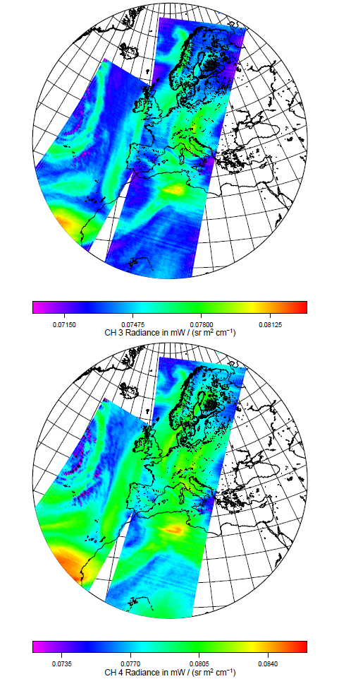
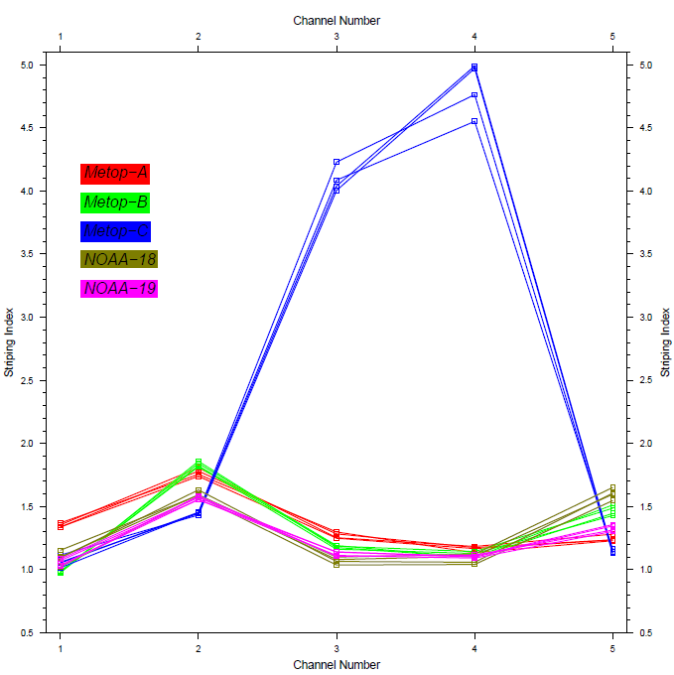
Results: MHS Channels 3 and 4 Striping
First Orbits (L1B):
Early Orbit (L0):
Striping Indices
for all MHS
instruments:
Notes:
It’s always there and nearly independent of NeDT.
Root cause unknown

Slide 15
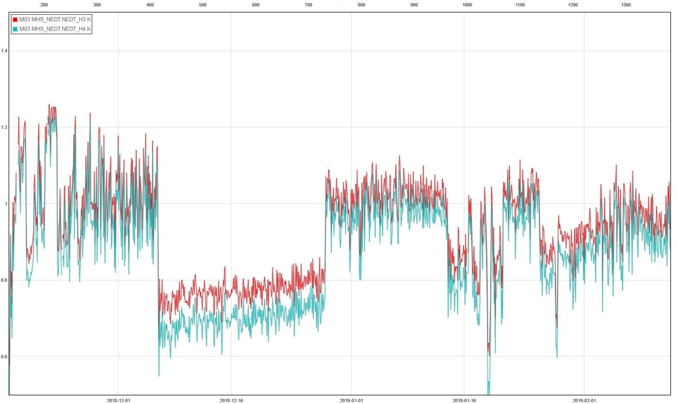
Result: MHS Channels 3 and 4 Radiometric Performance Evolution (NeΔT)

Slide 16
Results: M03 MHS Mean Bias and Stdev (Obs-B)
Courtesy: Niels Bormann
Notes:
noise on MHS-C really higher than MHS-A & -B for channels 3 and 4, it is significantly higher

Slide 17
Results: M03 MHS Stdev (Obs-FG)
Courtesy: Christina Koepken, DWD

Slide 18
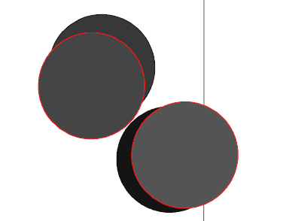
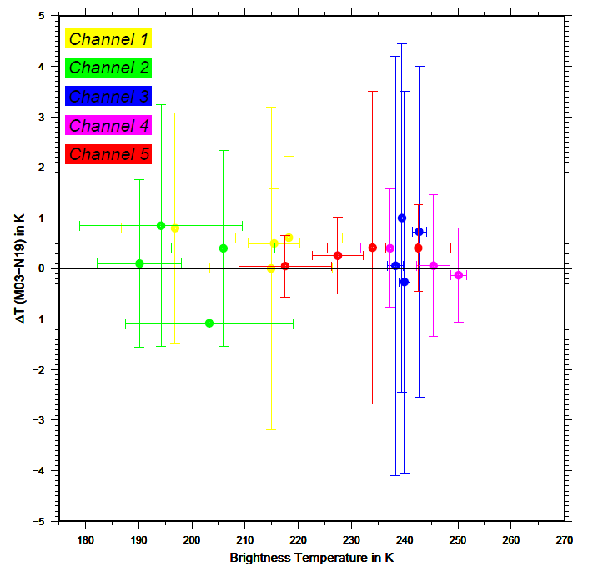
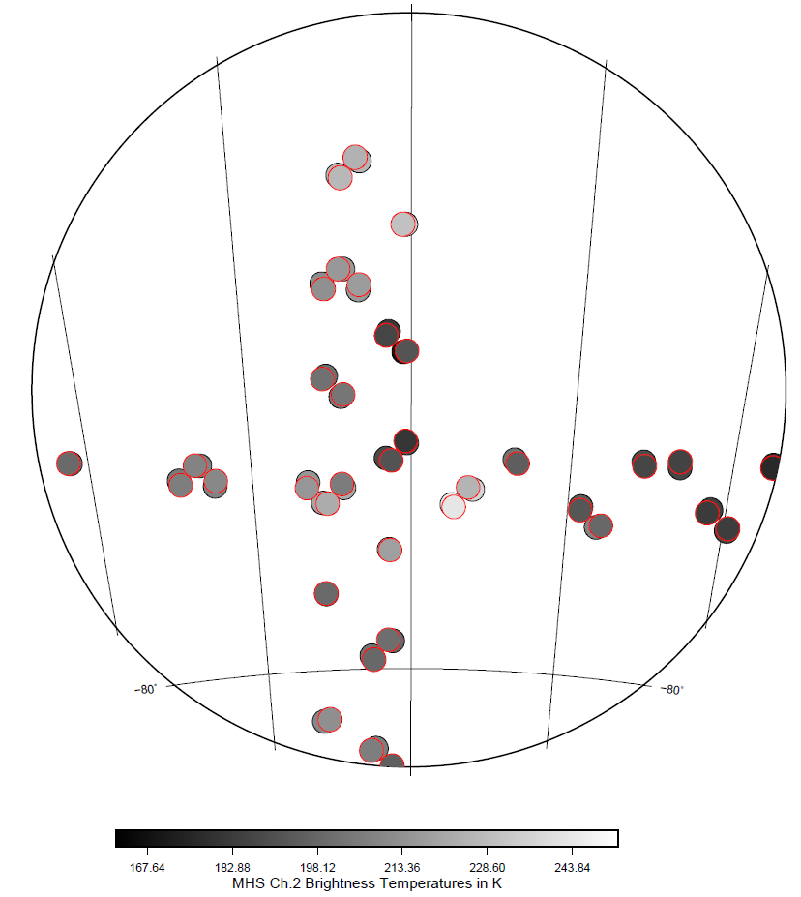
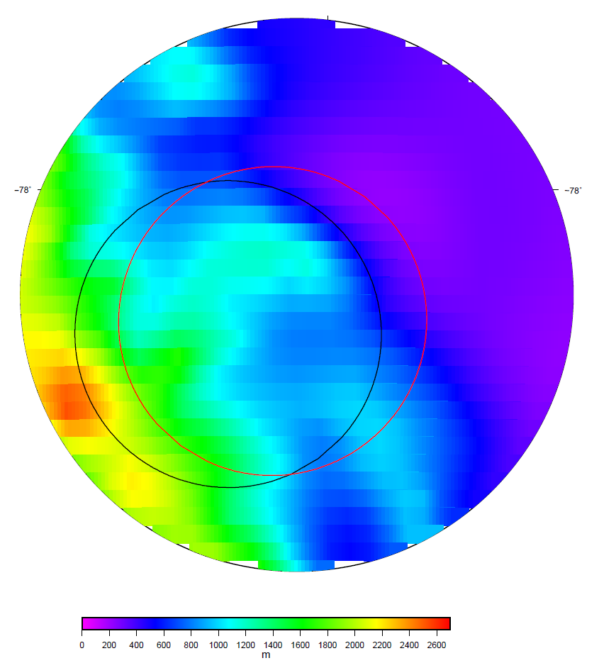
Results: M03 MHS vs. N-19 MHS
Results:
Large scatter of Ch.3 due to high noise (NeDT~ 2.5 K) of NOAA-19 MHS channel 3
Cause for the channel 2 scatter (SNO over Antarctica) is due to a large surface terrain inhomogeneity
Remaining channels fit very well within 1 K

Slide 19
Result: AMSU and MHS Mean Bias (Obs-B)
Courtesy: Brett Candy and Nigel Atkinson

Slide 20
Conclusions
The L0 and L1B products are complete and processed in NRT without gaps
The feedback from the user community (ECMWF, DWD, UKMO) is positive
AMSU channels 7 and 8 exhibit occasionally sudden noise increase that can last for more than one orbit
AMSU channel 3 radiometric instabilities are superimposed by a performance degradation
MHS channels 3 and 4 are unstable (NeΔT between 0.7 K and 1.2 K)
and show a significant striping
Continuous monitoring of product quality is highly demanded
Trial dissemination for Metop-C AVHRR/AMSU, and MHS Level 1 data
will start on 28 Feb via EUMETCast Europe with “pre-operational” status

