Slide 1
NOAA-20 ATMS STATUS
ATMS SDR Team
Mark Liu, Ninghai Sun, Tiger Yang, Lin Lin, Ed Kim, Lisa McCormick, Joseph Lyu, Craig Smith, Vince Leslie, Idahosa Osaretin, Wes Berg, Kent Anderson, James Fuentes
NOAA STAR, NASA/GSFC, MIT/Lincoln Labs,
CIRA/Colorado State Univ, Northrop Grumman
Presented by Ed Kim
6 March 2019

Slide 2
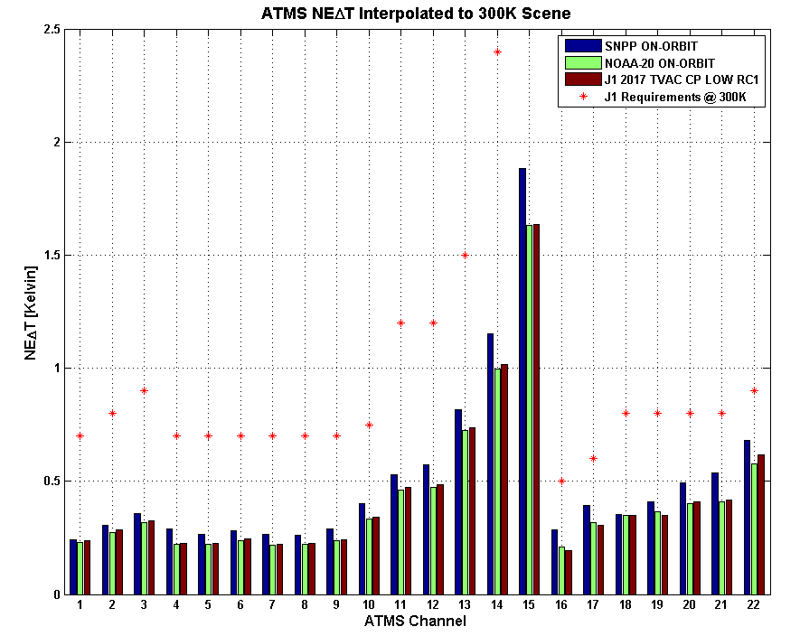
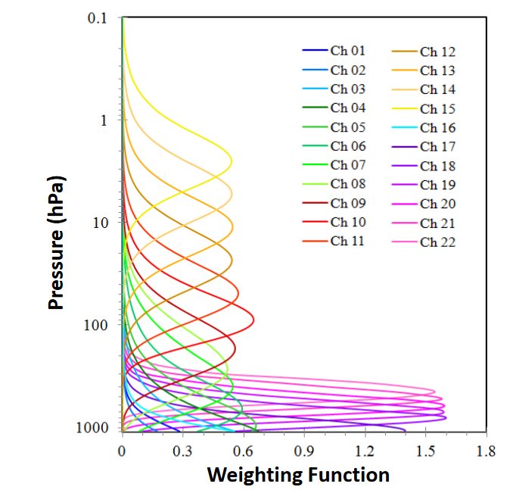
ATMS Sensitivity (NEDT)
Comparison of J1 Pre-Launch, NOAA-20 on-orbit, SNPP on-orbit
V. Leslie & I.Osaretin, MIT LL
S-NPP
N-20
pre & post
launch
spec
N-20 NEDT on-orbit ~ same as pre-launch and better than S-NPP

Slide 3
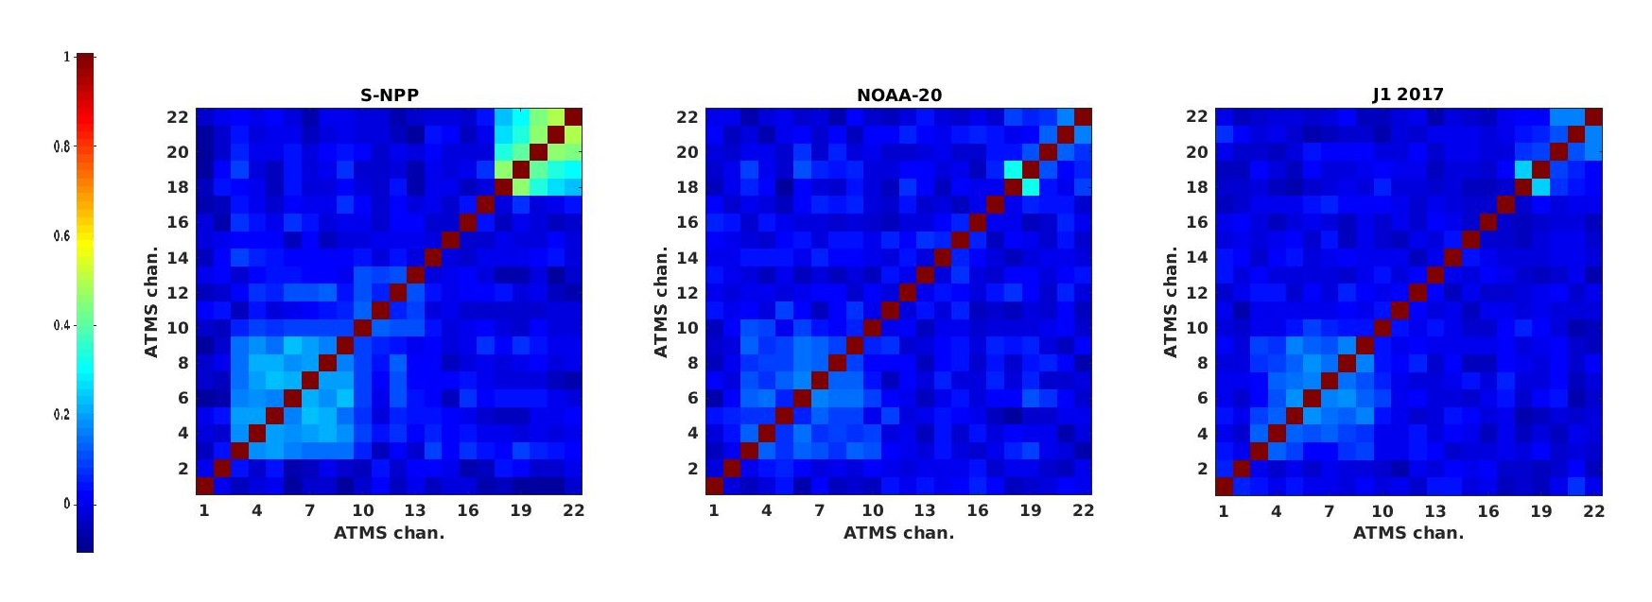
ATMS Inter-Channel Correlation
Comparison of J1 Pre-Launch, NOAA-20 on-orbit, SNPP on-orbit
S-NPP
N-20 on-orbit
N-20 pre-launch
V. Leslie & I.Osaretin, MIT LL
N-20 Noise Correlation Much Better than S-NPP for all Channels

Slide 4
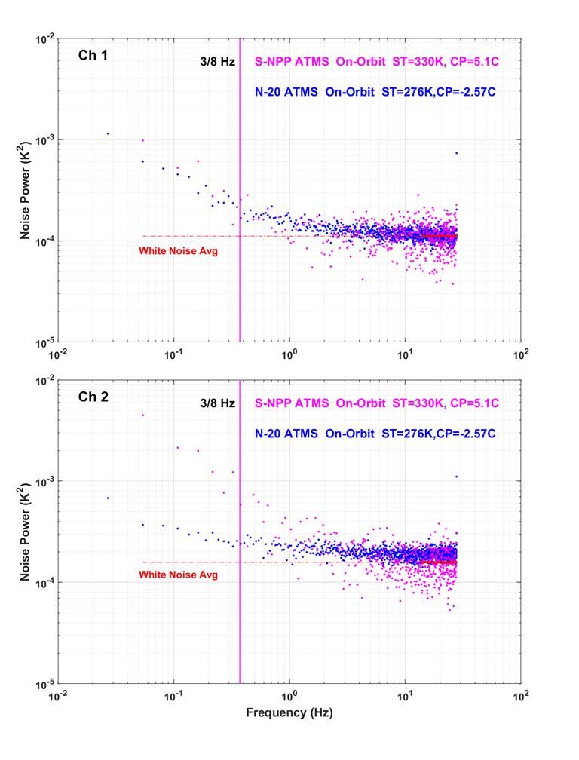
ATMS Noise Power Spectra
S-NPP
N-20
Less
Striping
NOAA STAR
same 1/f noise
On-orbit noise power spectra match well with Instrument TVAC results
Same or better for most channels compared to S-NPP
Channels with < 1/f noise will have less striping
S-NPP
N-20
lower 1/f noise
J.Lyu/ NASA GSFC

Slide 5
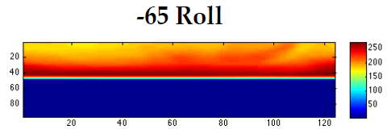
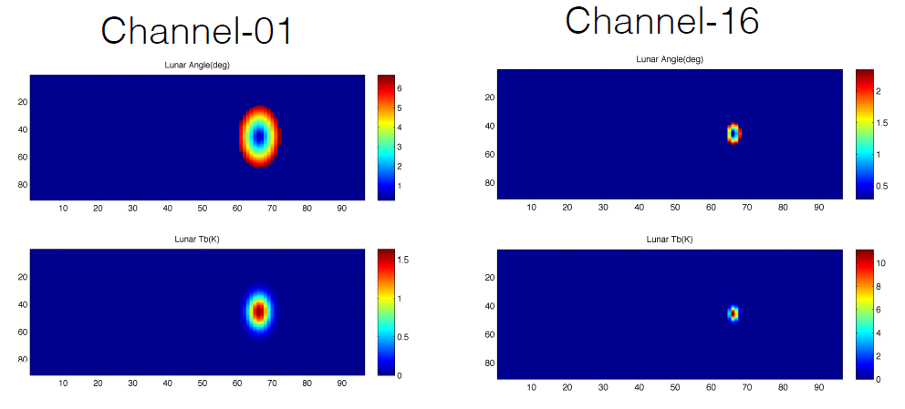
NOAA-20 Maneuvers
Rolls -65deg & +30deg
Antenna pattern/sidelobe check
Backflip Maneuver
Antenna pattern/sidelobe check
Sidelobe contamination characterized
Scan Bias (flat field) determined
Reflector Emissivity much better than SNPP
Minor lunar intrusion; no significant impact
limb
earth
cold space
limb
earth
Hawaii
Backflip
NOAA STAR
cold space
moon
Maneuver results good

Slide 6
Results from Commissioning
Space view profile #1 declared optimal
Channel NE∆Ts stable and lower than S-NPP
Noise power spectra same or better for most channels vs. S-NPP
Image striping slightly less than S-NPP
Inter-channel noise correlation << S-NPP
Channel on-orbit effective field-of-view (EFOV), earth sidelobes effects, and antenna pattern derived maneuvers → nominal
No significant RFI from Ka transmitters so far
Passive lunar intrusion coefficients derived (currently off-line fixed); evaluating alternative active mitigation technique
No heater activation EMI observed
Active geolocation tested for first time; faster determination of pointing accuracy appears achievable

Slide 7
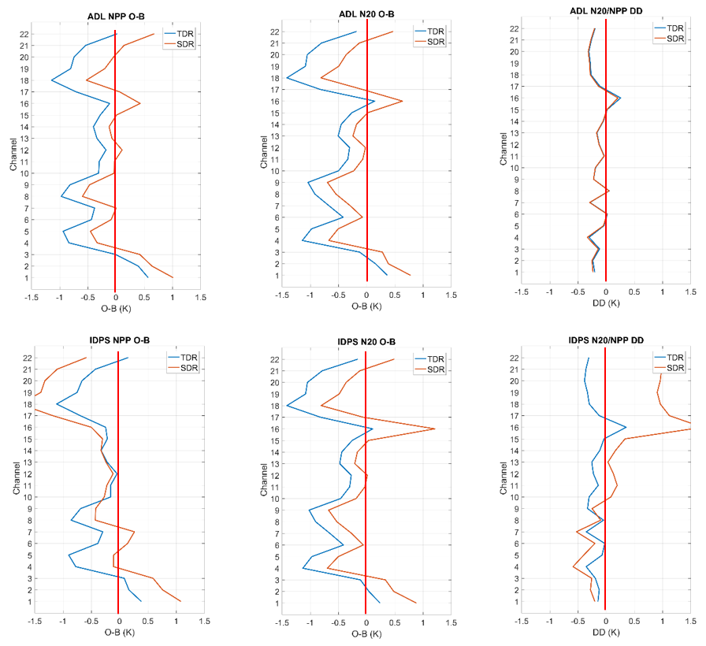
S-NPP/NOAA-20 ATMS TB Inter-comparison
In DD plots, emissivity correction improvement (blue curves closer to zero); mainly ch 11 & 16; overall improvement small (bottom vs top DD plots). SDR improvement big for higher channels, mostly from updated antenna correction coefficients. NPP and N20 ATMS sensors ~same, expect SDR DD curves to be ~similar, and
they are (top DD plot). This is all consistent w/ ECMWF results.
Updated
(emissivity
corr in TDR
& SDR)
DD
OPS
(ant corr in
SDR, no
emissivity
corr in
TDR or SDR)
DD

Slide 8
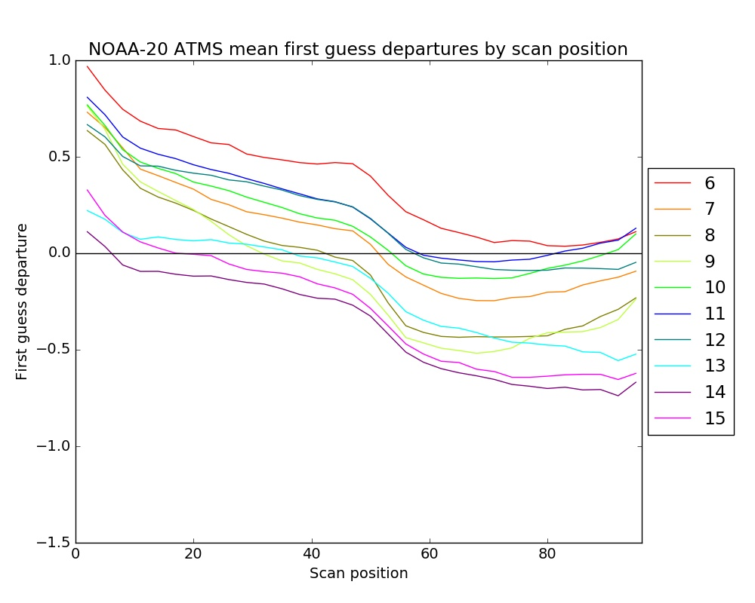
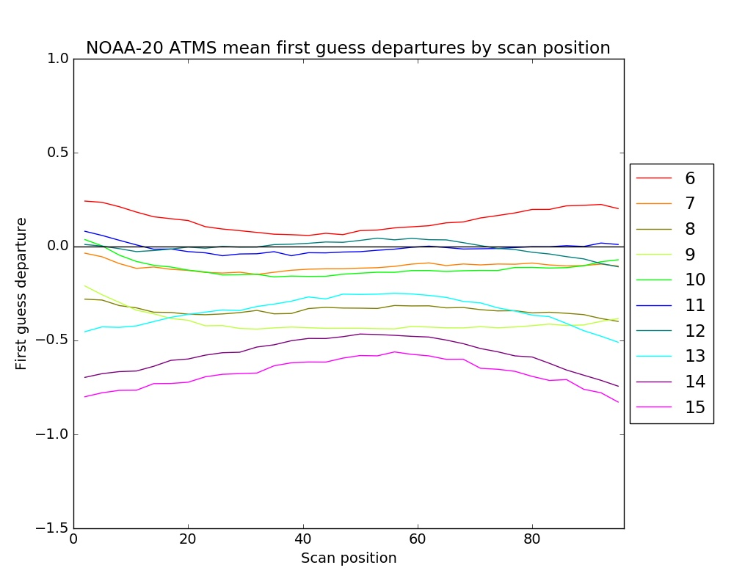
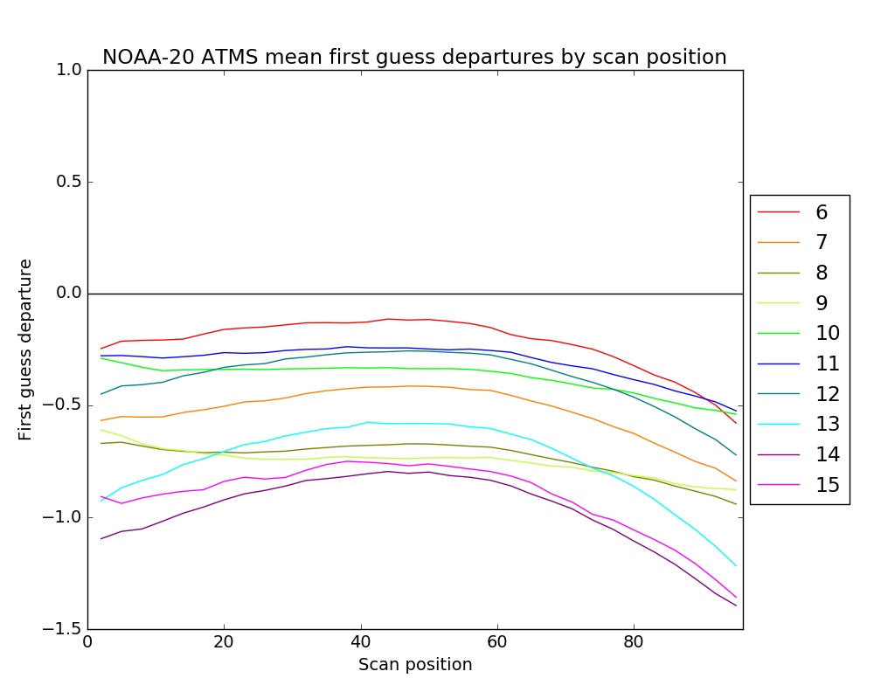
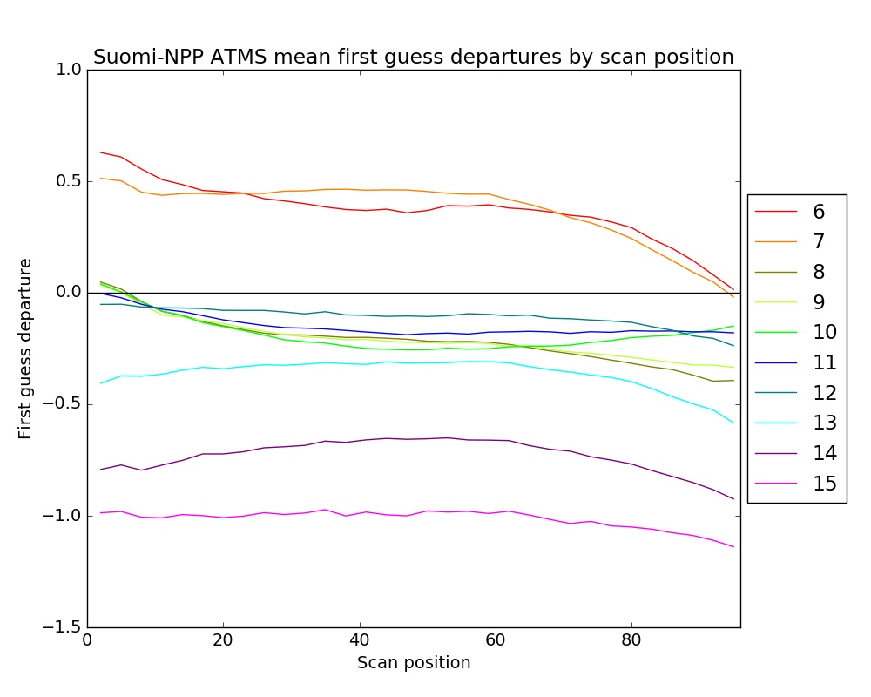
Scan biases (cloud screened data before bias correction)
NOAA-20 original SDRs
NOAA-20 updated SDRs
NOAA-20 updated SDRs have much more symmetric scan biases than NOAA-20 original SDRs
NOAA-20 updated SDRs have more symmetric and smaller magnitude scan biases than NOAA-20 TDRs
NOAA-20 updated SDRs have more symmetric and smaller magnitude scan biases than Suomi-NPP SDRs
NOAA-20 TDRs
Suomi-NPP SDRs
SDR data improved because
1.Improved antenna pattern measurements for J01, especially in W and G bands
2.Improved antenna pattern correction algorithm based on On-orbit environment test data
3.More accurate antenna reflector emission correction model
Peter Weston and Niels Bormann

Slide 9
Selected ATMS Comments from ECMWF
Data quality looks better than Suomi-NPP:
Similar biases
Smaller standard deviation of first guess departures and diagnosed observation errors
Weaker striping signal than Suomi-NPP ATMS
Improved first guess fits to:
Temperature observations (AMSU-A, CrIS, GPSRO)
Humidity observations (MHS, GEO CSRs)
Indicates improved accuracy of short range temperature and humidity forecasts
Neutral to slightly positive forecast scores
Generally positive feedback from ECMWF

Slide 10
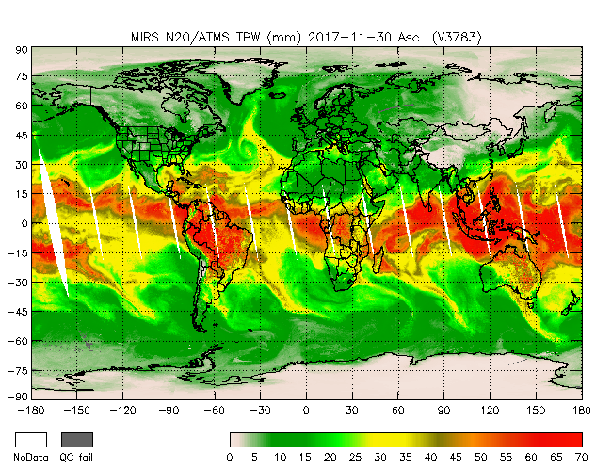
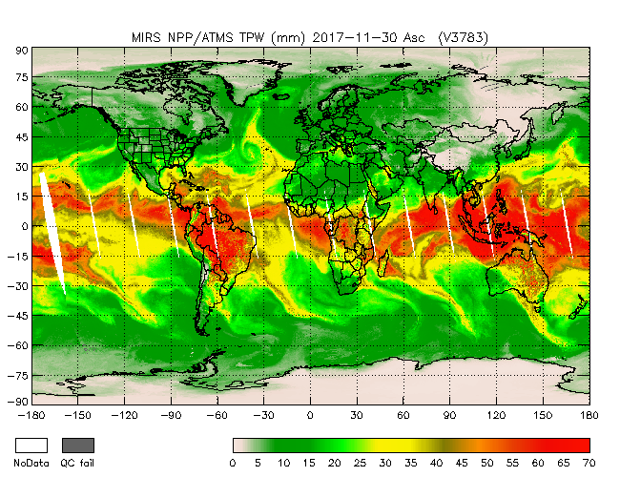
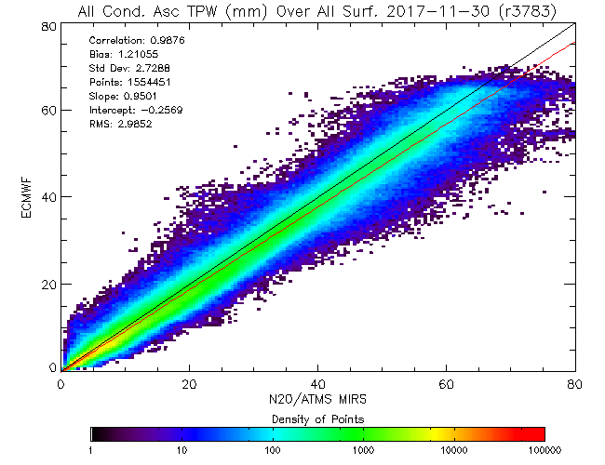
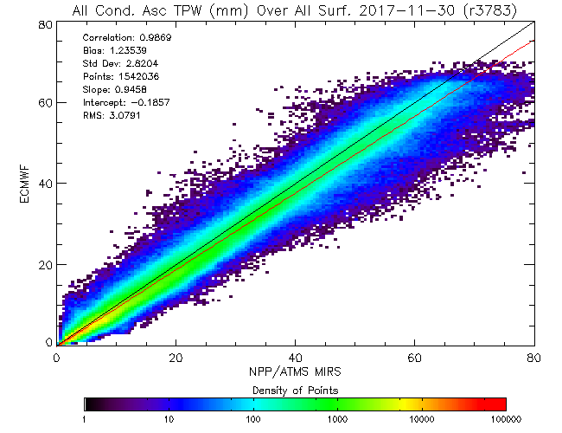
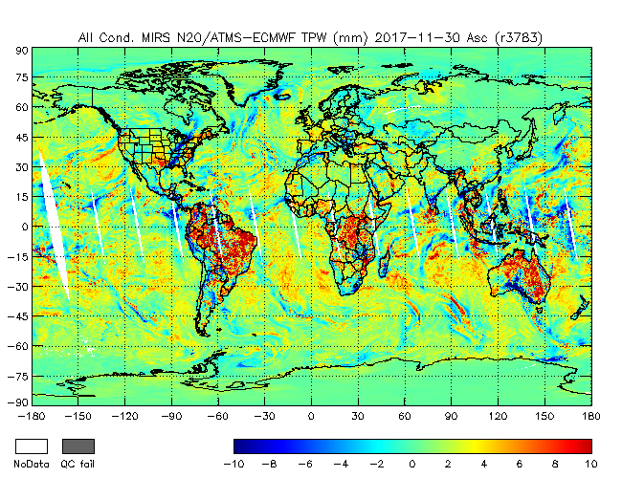
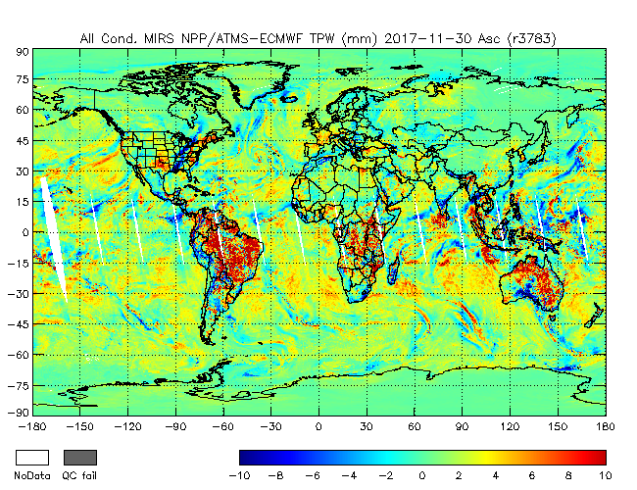
Total Precipitable Water (2017-11-30), beta maturity at day-1
N20
SNPP
Corr: 0.988
Bias: 1.21
StDv: 2.73
Corr: 0.987
Bias: 1.24
StDv: 2.82

Slide 11
Conclusion
NOAA-20 ATMS working well since activation
NOAA-20 ATMS post-launch performance is comparable to pre-launch performance; No Ka-band transmitter RFI and heater induced EMI observed so far
All commissioning successful,
space view profile #1 declared optimal
maneuver-related activities successful
NOAA-20 ATMS TDR/SDR compare well to S-NPP ATMS
NE∆Ts stable since activation and slightly lower than S-NPP
Inter-channel noise correlation much lower than S-NPP
ATMS SDR is significantly improved. MiRS products achieved beta maturity at day-1. TDR/SDR products are operational at major NWP centers. Some centers are working on the ATMS RDR data for climate studies.
Antenna pattern correction is included in SDR
TDR emissivity correction in testing, not quite yet in OPS
NOAA-20 ATMS on-orbit performance compares well with S-NPP ATMS. NOAA-20 ATMS TDR and SDR products look better.

Slide 12
JPSS Radiance Timeline
S-NPP Launch 28-Oct-2011
N-20 Launch 18-Nov-2017
Sensor-Spacecraft | Algorithm | Activation | Beta | Provisional | Validated
ATMS-SNPP | SDR-L1b | 08-Nov-2011 | Jan-2012 (2 m) | Oct-2012 (1 yr) | Dec-2013 (2 yr 2 m)
ATMS-N20 | SDR-L1b | 29-Nov-2017 | 11-Dec-2017 (2 wk) | 23-Jan-2018 (2 m) | June-2018 (8 m)
CrIS-SNPP | SDR-L1b | 14-Dec-2011 | Apr-2012 (5 m) | Oct-2012 (11 m) | Dec-2013 (2 yr)
CrIS-N20 | SDR-L1b | 3-Jan-2018 | 17-Jan-18 (2 m) | 16-Feb-18 (3 m) | Aug-2018 (10 m)
Maturity milestones reached earlier for N20!

Slide 13
JPSS Retrieval Timeline
S-NPP Launch 28-Oct-2011
N-20 Launch 18-Nov-2017
Sensor-Spacecraft | Algorithm | Activation | Beta | Provisional | Validated
MIRS SNPP (ATMS only) | Temperature/Water Vapor | 08-Nov-2011 | Apr-2012 (6 m) | Aug-2014 (2 yr 10 m) | Oct-2016 (5 yr)
MIRS N20 (ATMS only) | Temperature/Water Vapor | 29-Nov-2017 | 21-Mar-2018 (5 m) | Sep-2018 (1 yr) | Sep-2019 (2 yr)
NUCAPS SNPP (ATMS + CrIS) | Temperature/Water Vapor | 14-Dec-2011 | Aug-2012 (9 m) | Jan-2013 (1 yr 1 m) | Sep-2014 (2 yr 10 m)
NUCAPS N20 (ATMS + CrIS) | Temperature/Water Vapor | 3-Jan-2018 | Jun-2018 (6 m) | Sep-2018 (9 m) | Sep-2019 (1 yr 9 m)
Maturity milestones reached earlier for N20!

Slide 14
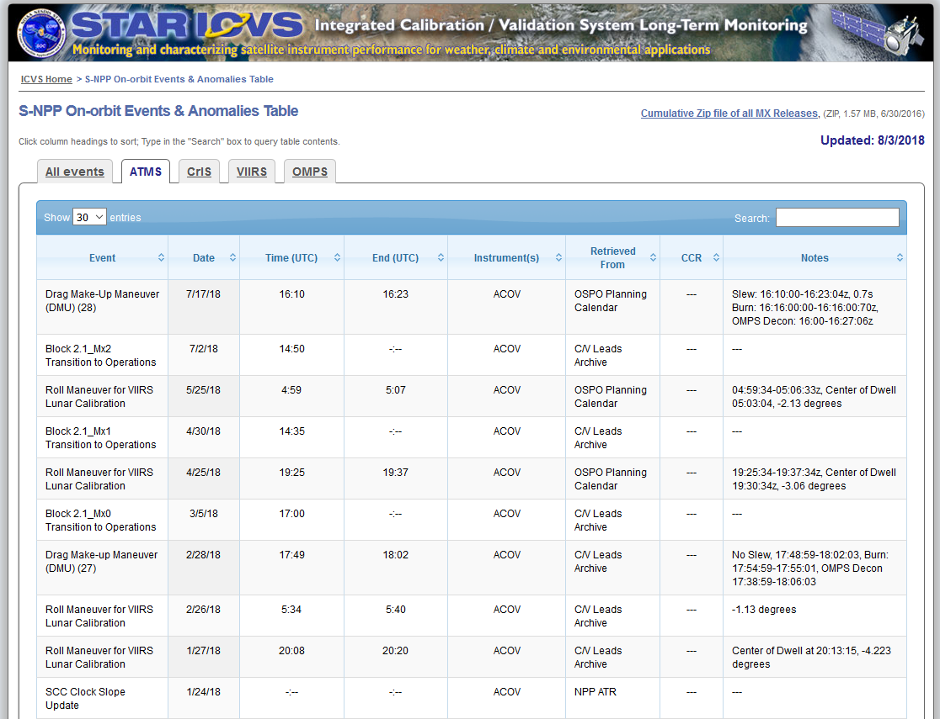
JPSS Anomaly Reporting
https://www.star.nesdis.noaa.gov/icvs/SNPP_Anomalies.php
Easy to find anomalies from STAR ICVS

Slide 15
Future Activities
Keep analyzing post-launch data, such as pitch maneuver, active geolocation, lunar intrusion, and so on, to better characterize NOAA-20 ATMS on orbit performance
Implement key instrument performance and data quality monitoring packages for long term trending (much already available on NOAA/STAR ICVS website)
Further improvements in TDR & SDR algorithms
Switch to active geolocation?
Support data product end users, antenna pattern model for radiance assimilation
Write users manual
JPSS-2 ATMS pre-launch preparation

Slide 16
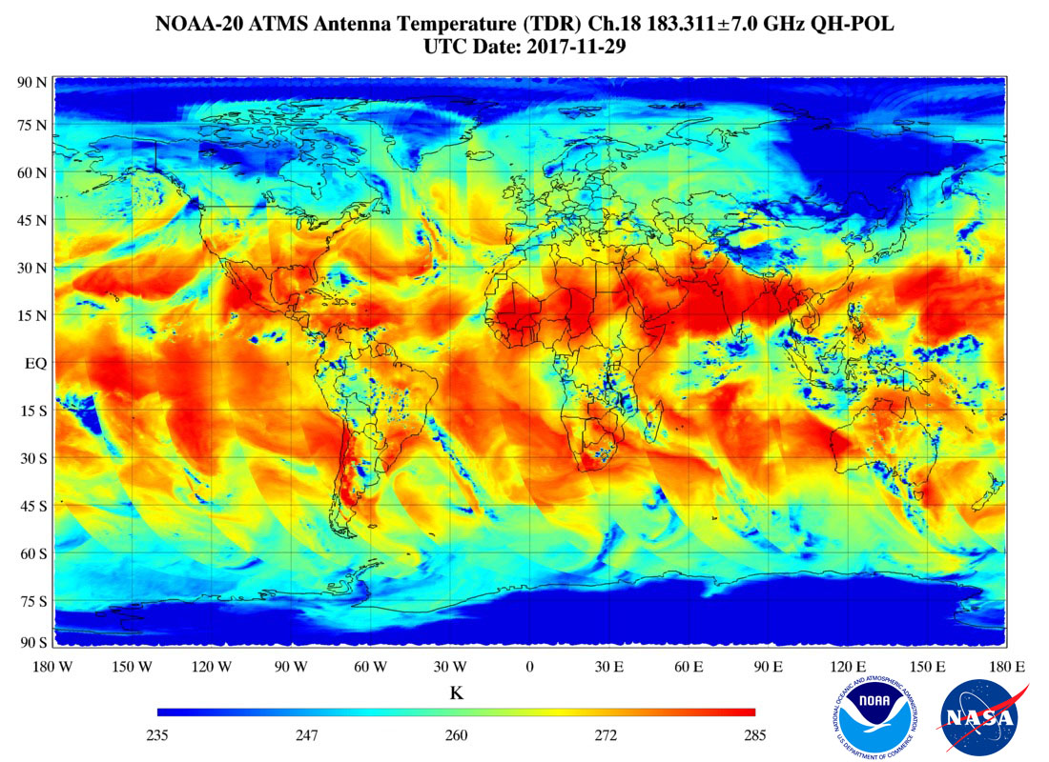
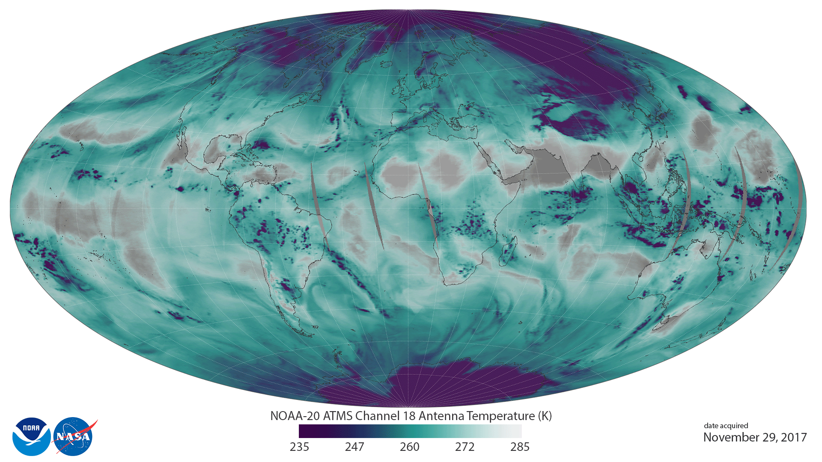
NOAA-20 ATMS First Light Image (First Light Image for the Entire JPSS Series)
Image from
NOAA
STAR

Slide 18
ATMS Cal/Val Team Members
PI | Organization | Team Members | Roles and Responsibilities
Quanhua (Mark) Liu | NOAA/STAR | Ninghai Sun (technical lead), Hu Yang, Xiaolei Zou, Lin Lin | Project management, SDR team coordination and algorithm test in IDPS, ATMS calibration/validation and geolocation science support, ATMS TDR/SDR data quality and monitoring
Edward Kim | NASA | Craig Smith, Joseph Lyu, Lisa McCormick | Liaison NASA flight team and NG Azusa, and independent SDR assessments, manage PLT and data analyze
Vince Leslie | MIT/LL | Idahosa Osaretin, Mark Tolman | ATMS instrument performance and data quality assessments, PLT data evaluation
Wesley Berg | CSU/CIRA |  | ATMS and GPM WG band cross-calibration
Deirdre Bolen | JPSS/JAM |  | ADR/PCR support

Slide 19
ATMS Instrument Specifications
Ch. | Center Freq.(MHz) | POL | Bandwidth Max. (MHz) | Frequency Stability (MHz) | Calibration Accuracy (K) | NEΔT (K) | 3-dB Bandwidth (deg) | Remarks | Characterization at Nadir
1 | 23800 | QV | 270 | 10 | 1.0 | 0.7 | 5.2 | AMSU-A2 | Window-water vapor 100 mm
2 | 31400 | QV | 180 | 10 | 1.0 | 0.8 | 5.2 | AMSU-A2 | Window-water vapor 500 mm
3 | 50300 | QH | 180 | 10 | 0.75 | 0.9 | 2.2 | AMSU-A1-2 | Window-surface emissivity
4 | 51760 | QH | 400 | 5 | 0.75 | 0.7 | 2.2 |  | Window-surface emissivity
5 | 52800 | QH | 400 | 5 | 0.75 | 0.7 | 2.2 | AMSU-A1-2 | Surface air
6 | 53596±115 | QH | 170 | 5 | 0.75 | 0.7 | 2.2 | AMSU-A1-2 | 4 km ~ 700 mb
7 | 54400 | QH | 400 | 5 | 0.75 | 0.7 | 2.2 | AMSU-A1-1 | 9 km ~ 400 mb
8 | 54940 | QH | 400 | 10 | 0.75 | 0.7 | 2.2 | AMSU-A1-1 | 11 km ~ 250 mb
9 | 55500 | QH | 330 | 10 | 0.75 | 0.7 | 2.2 | AMSU-A1-2 | 13 km ~ 180 mb
10 | 57290.344(f_{o}) | QH | 330 | 0.5 | 0.75 | 0.75 | 2.2 | AMSU-A1-1 | 17 km ~ 90 mb
11 | f_{o}± 217 | QH | 78 | 0.5 | 0.75 | 1.2 | 2.2 | AMSU-A1-1 | 19 km ~ 50 mb
12 | f_{o}±322.2±48 | QH | 36 | 1.2 | 0.75 | 1.2 | 2.2 | AMSU-A1-1 | 25 km ~ 25 mb
13 | f_{o}±322.2±22 | QH | 16 | 1.6 | 0.75 | 1.5 | 2.2 | AMSU-A1-1 | 29 km ~ 10 mb
14 | f_{o}±322.2±10 | QH | 8 | 0.5 | 0.75 | 2.4 | 2.2 | AMSU-A1-1 | 32 km ~ 6 mb
15 | f_{o}±322.2±4.5 | QH | 3 | 0.5 | 0.75 | 3.6 | 2.2 | AMSU-A1-1 | 37 km ~ 3 mb
16 | 88200 | QV | 2000 | 200 | 1.0 | 0.5 | 2.2 | 89000 | Window H₂O 150 mm
17 | 165500 | QH | 3000 | 200 | 1.0 | 0.6 | 1.1 | 157000 | H₂O 18 mm
18 | 183310±7000 | QH | 2000 | 30 | 1.0 | 0.8 | 1.1 | AMSU-B | H₂O 8 mm
19 | 183310±4500 | QH | 2000 | 30 | 1.0 | 0.8 | 1.1 |  | H₂O 4.5 mm
20 | 183310±3000 | QH | 1000 | 30 | 1.0 | 0.8 | 1.1 | AMSU-B/MHS | H₂O 2.5 mm
21 | 183310±1800 | QH | 1000 | 30 | 1.0 | 0.8 | 1.1 |  | H₂O 1.2 mm
22 | 183310±1000 | QH | 500 | 30 | 1.0 | 0.9 | 1.1 | AMSU-B/MHS | H₂O 0.5 mm

