Slide 1
SI-Traceable Calibration of
Satellite Microwave Radiometers
Edward Kim NASA/GSFC
Derek Houtz, Dazhen Gu, William Emery
US National Institute of Standards and Technology
University of Colorado, Boulder
WSL (ETH)
Ville Kangas, ESA/ESTEC, Metop-SG
Takaaki Ishikawa, Mitsubishi Electric Corporation
William Bell, ECMWF
Acknowledgements: David Walker, NIST retired

Slide 2
Outline
Background (what)
  SI-traceable Microwave Radiometer calibration
Motivation (why)
  NWP, FCDR
Technology (how)
  NIST blackbody target
Standards
Status & Future Plans
CAVEAT
Ongoing work !!
“The answer” not completely known

Slide 3
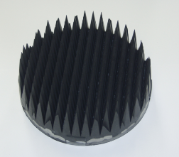
Satellite MW Radiometer Cal Example
Example: ATMS
On-board
Blackbody target
Cosmic MW
Background
GSICS Annual Meeting, Kim et al

Slide 4
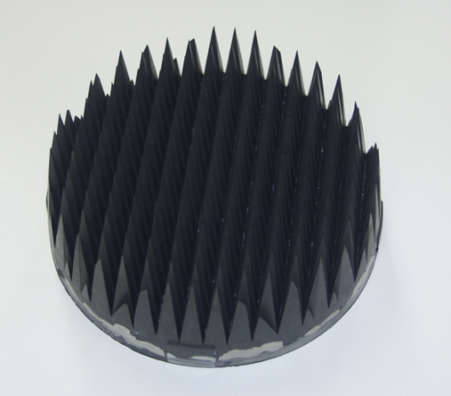
Typical MW Radiometer TB Calibration
(highly simplified version)
Build your radiometer as linear as practical
Point it at 2 calibration targets (1 hot, 1 cold) to determine the cal curve (a line)
Cal targets are typically black bodies with emissivity ~1, so TB = physical temperature
Measured TB
Typical black body used to calibrate satellite MW radiometers: 2D array of pyramids
True TB
GSICS Annual Meeting, Kim et al

Slide 5
What “SI traceable” is not
Traceability implies a rigorous uncertainty assessment—true
Using an SI unit as the standard provides a well-defined reference –true
Your measurement will have unusually good accuracy—not necessarily
In other words, just because you know the size of your error bars very well, doesn’t guarantee that the error bars are small
GSICS Annual Meeting, Kim et al

Slide 6
SI-traceable inter-calibration of
Satellite MW Radiometers
My personal forecast (so not NOAA or NASA policy): future sounder obs will need to combine smallsats + anchor sounders like ATMS, MWS
Example: GPM constellation—”X-cal” effort has harmonized TBs with respect to one member radiometer (GMI)
According to NIST, this is inter-comparison, not inter-calibration because the reference (GMI) isn’t traceable to a standard
Adding traceability to a standard would make it inter-calibration
Traceability to a SI standard would be SI-traceable intercalibration
Traceability to a standard implies absolute calibration
Traceability to which SI unit?
GSICS Annual Meeting, Kim et al

Slide 7
GNSS-RO and Tb Standards
GNSS-RO is SI-traceable through frequency standards.
  Connected to atmospheric Temperature & Humidity via density & refraction modeling
  Relies on 1-2 GHz signals chosen for low sensitivity to atmosphere
  Spatial coverage: best altitude range 8-25 km, 300 km horizontal resolution, ~1 km height resolution
  Creates reliable long-term RO data record
MW Radiometry can be SI-traceable with TB standards.
  More direct connection to atmospheric Temperature & Humidity via radiative transfer
  Relies on 18-183 GHz bands chosen for high sensitivity to atmospheric temperature & humidity
  Finer horizontal resolution, similar vertical resolution, wider altitude range
  Creates reliable long-term Tb data records
Comparable uncertainties achievable: 0.1--1 K (single retrieval)
Strengths & limitations are complementary
GSICS Annual Meeting, Kim et al

Slide 8
Motivation
Inter-calibration for constellation systems
Absolute TB calibration
Benefits to NWP and FCDRs
What is not addressed by SI-traceable TB cal?
GSICS Annual Meeting, Kim et al

Slide 9
Benefit to Constellation Systems
Constellation systems need TB inter-calibration
Example: anchor sounders + smallsat sounders
Pre-launch inter-calibration can reduce burden on post-launch inter-cal
Still want post-launch inter-cal to handle issues like footprint matching, but the portion due to just TB inter-cal would be well-quantified by SI-traceable TB calibration
Post-launch traceable inter-cal also appears possible, which would extend traceability to on-orbit
Pre- or post-launch inter-cal would provide immunity to temporal gaps
TB [K]
True TB
TB [K]
time
GSICS Annual Meeting, Kim et al

Slide 10
Benefit to NWP forecasting
NWP & climate models subtract biases
Bias sources include:
Radiometer sensor
Radiative transfer model (RTM)
Forecast model
Bias corrections are larger than forecast model errors
Bias from RTM & forecast models (#2 & #3) are often artificially assigned to sensor bias (#1) in order not to disturb the models
This is unphysical
Impedes progress in actually fixing the models (thus presumably improving forecasts)
GSICS Annual Meeting, Kim et al

Slide 11
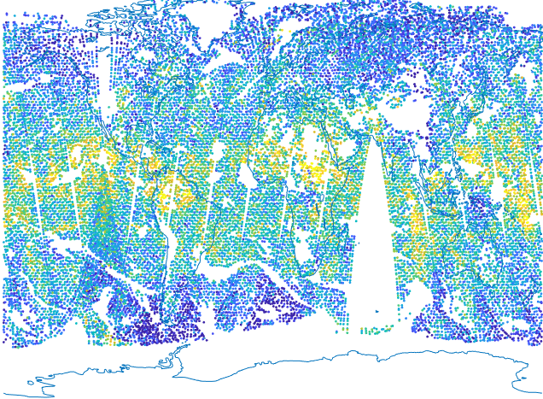
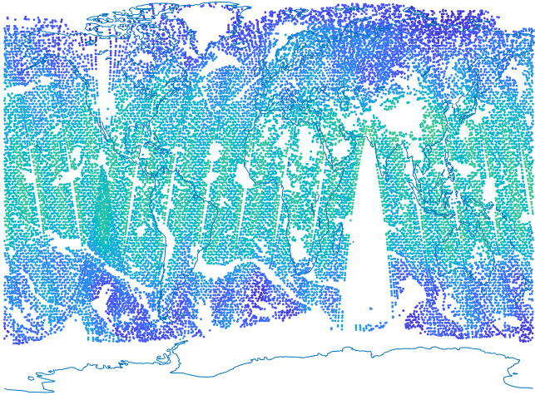
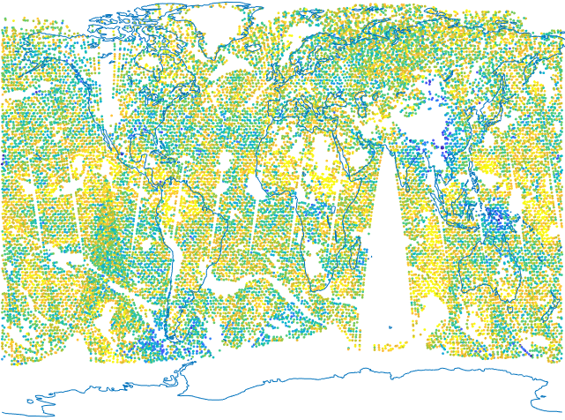
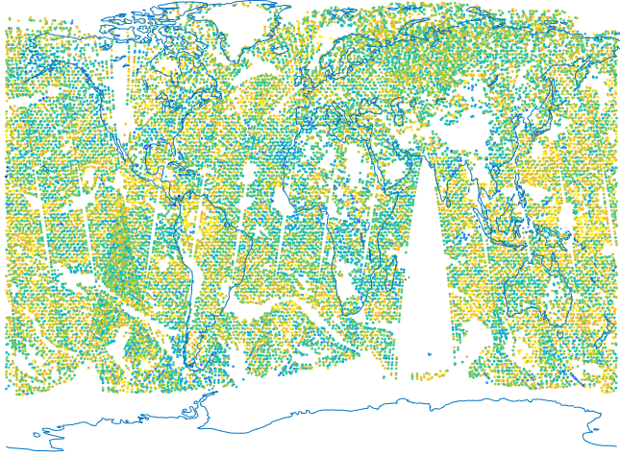
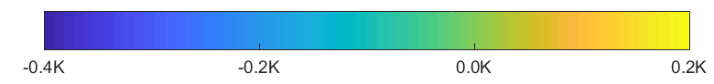
The potential benefits of improved radiometric calibration for NWP and climate reanalysis
first guess departures
(uncorrected)
bias correction
first guess departures
(corrected)
analysis departures
NOAA-20 ATMS-7
ERA5 departures & bias correction
Bill Bell, ECMWF
Forecast model errors are ~0.1K for mid-trop. T- sounding channels
Bias corrections (parametrised, accounting for radiometric & spectral biases, RT & forecast model biases) are larger
Improved, traceable, absolute radiometric calibration would help:
  Partition & bound the contribution due to radiometric uncertainties
  Reduce the magnitude of residual biases being assimilated
  Reduce analysis uncertainties (as RT model and forecast model biases are also, inevitably, reduced in time)
GSICS Annual Meeting, Kim et al

Slide 12
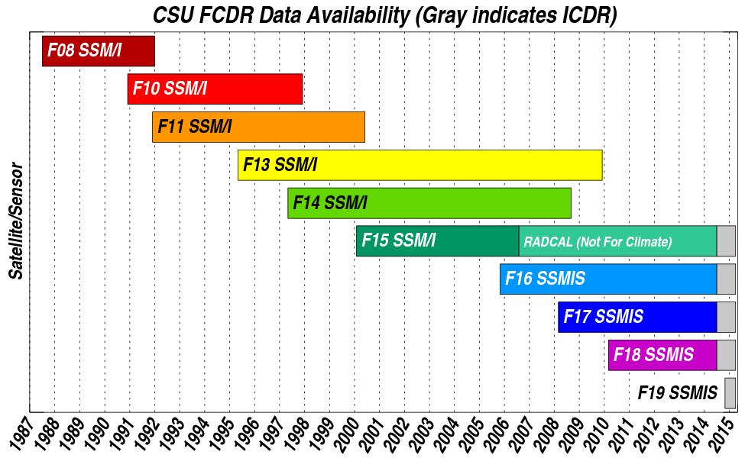
Fundamental Climate Data Records (FCDRs)
Focus on TB FCDR
  decades-long time-series of TB
TB FCDR is foundation for various geophysical retrievals
Used to look for climate trends
Need to remove calibration jumps when transitioning sensors
Or bridging gaps
Should help separate calibration drifts from real climate trends
Pre-launch traceable TB calibration would help attribute uncertainties properly & better quantify them

Slide 13
What SI-traceable TB Cal Does Not Address
Careful! Total TB = f(footprint, scaling, amplitude)
  Traceable TB cal helps quantify the amplitude uncertainty
  Still need other techniques to address the effects of the footprints & scaling
  What is addressed via harmonization or homogenization and what is addressed by SI-traceable TB cal is TBD
GSICS Annual Meeting, Kim et al

Slide 14
The Technology of Traceable TB Calibration
  NIST blackbody target
  Traceable calibration methodology
  Formal standards
  Upcoming satellite mw radiometers
GSICS Annual Meeting, Kim et al

Slide 15
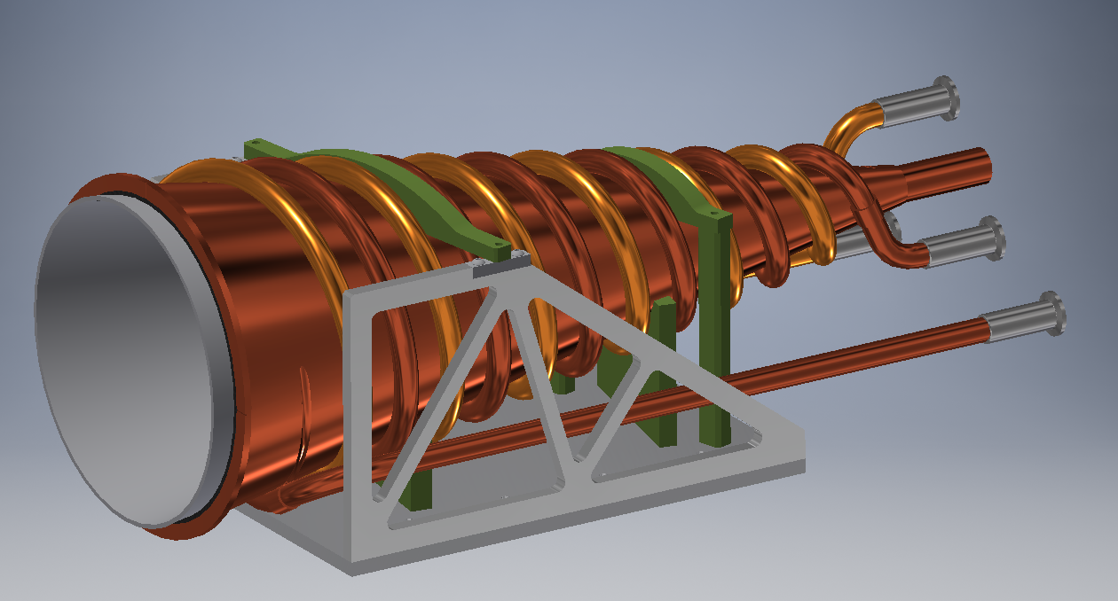
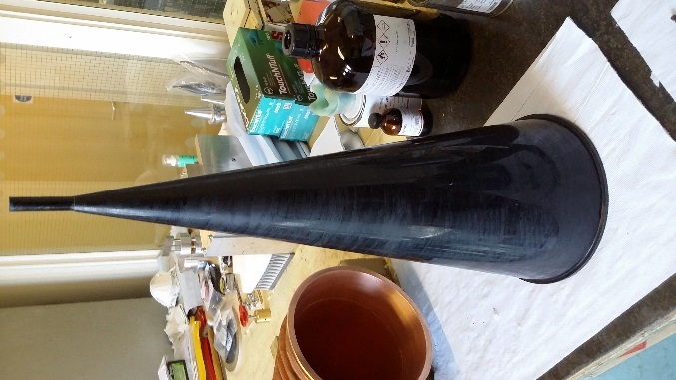
NIST Blackbody Calibration Standard
Broadband passive microwave blackbody
  NIST primary standard; traceable to SI kelvin
  18-220 GHz design frequency range
  Result of Derek Houtz’s PhD thesis
Design requirements:
  Maximize emissivity
  Minimize temperature gradients
  Variable temperature operation
  Minimize IR radiation effects
  Compatible with ATMS (2 targets: 12 & 23 cm dia.)
Hollow
Cone
geometry
GSICS Annual Meeting, Kim et al

Slide 16
Traceable Calibration Methodology
Basic methodology:
Alternately viewing reference target(s) while adjusting new target until radiometer raw response (counts) matches
Results in transfer of cal to new target/system
Status: additional engineering work needed
  Thermal uniformity
  Temperature range
  Temperature sensors
  Vacuum compatibility
  adjust for coupling geometry
Variable temp conical NIST
standard target
Cold BB target
Antenna/main reflector
(rotates)
Hot BB target
GSICS Annual Meeting, Kim et al

Slide 17
Formal Standards for MW Radiometer Calibration
ISO 20930:2018--approved
Space systems — Calibration requirements for satellite-based passive microwave sensors
IEEE Geoscience and Remote Sensing Society (GRSS) has just started to explore whether to create an IEEE standard for calibration of all microwave radiometers (including ground & airborne)
GSICS Annual Meeting, Kim et al

Slide 18
Potential Opportunities to Calibrate Future Satellite MW Radiometers
Metop-SG radiometers (particularly MWI, MWS)
ATMS beginning on JPSS-3 or 4
AMSR x ?
Cubesat radiometers
Other future sounders & imagers
GSICS Annual Meeting, Kim et al

Slide 19
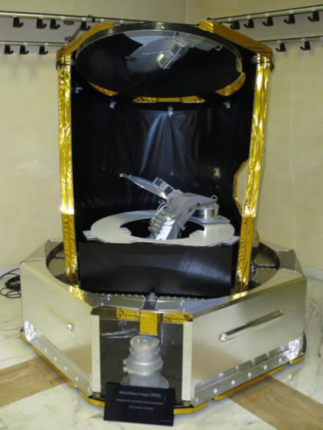
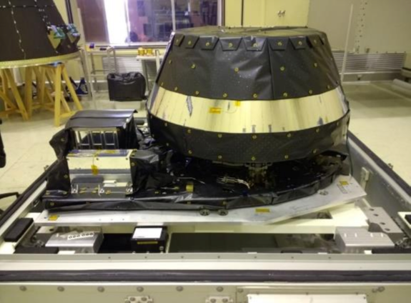
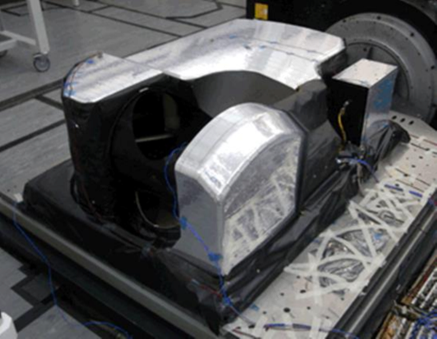
Radiometers under development at ESA
Microwave Sounder (MWS)
Microwave Imager (MWI)
Ice Cloud Imager (ICI)
24 channels, 23 GHz -230 GHz
26
channels
(18.7
to
183
GHz)
13 channels (183 to 664 GHz)
155 kg, 190 W
285 kg (150 kg rotating), 250 W
175 kg (68 kg rotating @45rpm),130 W
1m x 1.5m x 0.6m
2m x 1.4m x 1.4m
1.3m × 1.6m × 0.8m
3 flight models each will be launched between 2022 and 2036,
providing operations at least until mid-2040’s
MWS and MWI could benefit from SI traceability as similar instruments are operational or planned
Ville Kangas, ESA
GSICS Annual Meeting,
Kim et al
ESA Unclassified – For Official Use

Slide 20
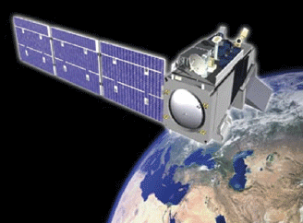
Radiometers under development at NASA
on
JPSS-2/3/4
ATMS
GSICS Annual Meeting, Kim et al

Slide 21
Status and Future Plans
Status:
NIST prototype conical blackbody standard for TB has been designed/fabricated for 18-220 GHz
Enables traceability to SI-kelvin & incorporation of rigorous standards-level quantification of Type A and Type B uncertainties
Physical blackbody standard would enable rigorous pre & post-launch inter-calibration of constellation systems plus long time-series records (e.g., FCDRs) including gaps
Absolute TB calibration would permit more realistic NWP uncertainty allocation (eventually leading to better forecasts) & enhance our ability to generate FCDRs from TB observations
New standard ISO 20930 for satellite MW radiometer calibration
Future Plans:
Additional development and analysis work on conical BB target; demonstrate practical calibration transfer to satellite instrument (ATMS?)
Possible use with future Metop-SG radiometers and/or ATMS on JPSS-3 or 4
IEEE standard being considered for MW radiometer cal (all MW radiometers, not just satellite)
GSICS Annual Meeting, Kim et al

Slide 22
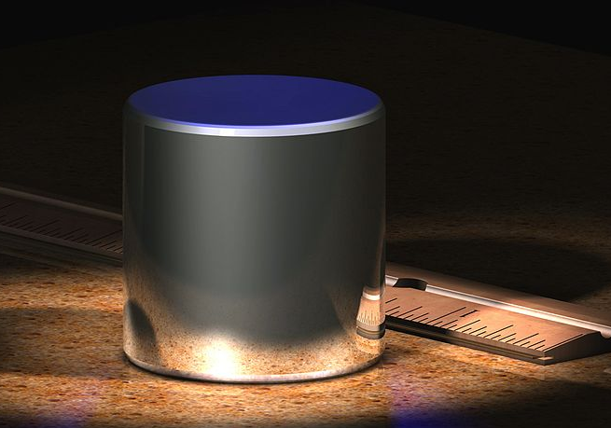
May 20, 2019
World Metrology Day
Basic definitions of fundamental SI units will be updated
  All 7 fundamental SI units will be quantum-based
Example expected outcomes:
  SI kilogram definition will go from a metal block to quantum-based
  SI kelvin definition will become entirely quantum-based
  https://www.bipm.org/en/measurement-units/rev-si/
GSICS Annual Meeting, Kim et al

Slide 23
Thank you!
ed.kim@nasa.gov
+1-301-614-5653
GSICS Annual Meeting, Kim et al

