Slide 1
GSICS Annual Meeting 2019
March 3-8, 2019
ESA-ESRIN, Frascati, Italy
Progress with GRUAN observations in comparisons with
satellite microwave measurements: Preliminary result
Bomin Sun¹ ,Cheng-zhi Zou², Tony Reale², Isaac Moradi³, and Manik Bali³
1 IMSG at NOAA/NESDIS/Center for Applications and Research (STAR),
College Park, Maryland, USA
2 NOAA/NESDIS/STAR, College Park, USA
3 University of Maryland, College Park, USA

Slide 2
Objective
GSICS action
Using GRUAN data to assess the capability of polar satellite microwave observations of monitoring climate.
Polar satellite microwave (MSU/AMSU/ATMS) data temperature data records (TDRs) (Cheng-Zhi Zou et al. from STAR/NESDIS/NOAA)
Using GRUAN data to monitor polar satellite microwave observations and RT models … (RS41, RS92; RIVAL)
Collocation datasets forwarded to Isaac Moradi…
Using satellite to monitor GRUAN … (secondary)

Slide 3
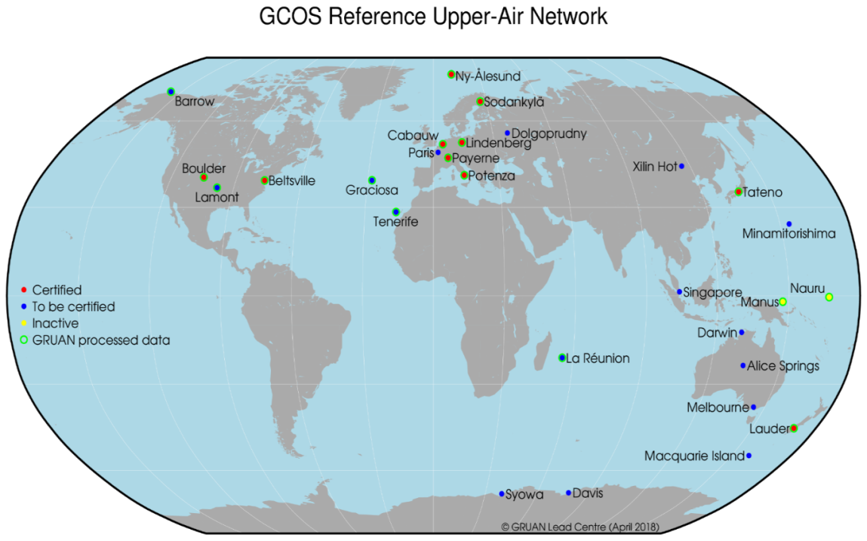
Global Reference Upper Air Network (GRUAN)

Slide 4
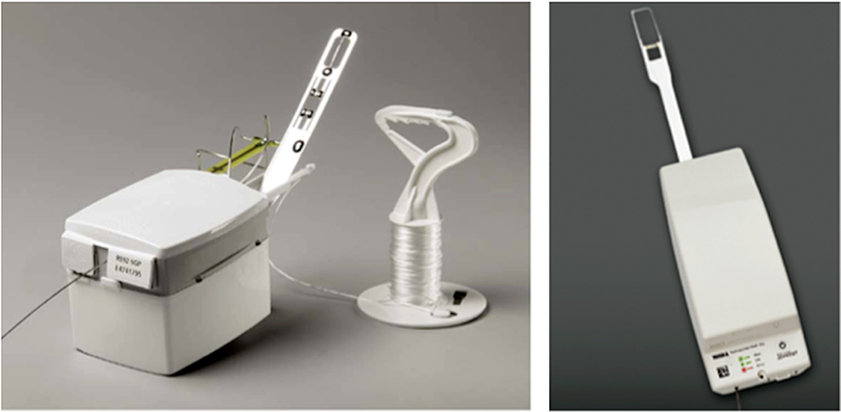
GRUAN
GRUAN Data Processing (GDP): SI-traceable observations with systematic bias removed and fully characterized uncertainty estimate…
Vaisala RS92
(GDP-v2)
RS92-RS41 transition
RS41 not yet GDP processed
RS92
RS41
Courtesy Jensen et al. (2015)
Sun et al. (2019, in press)

Slide 5
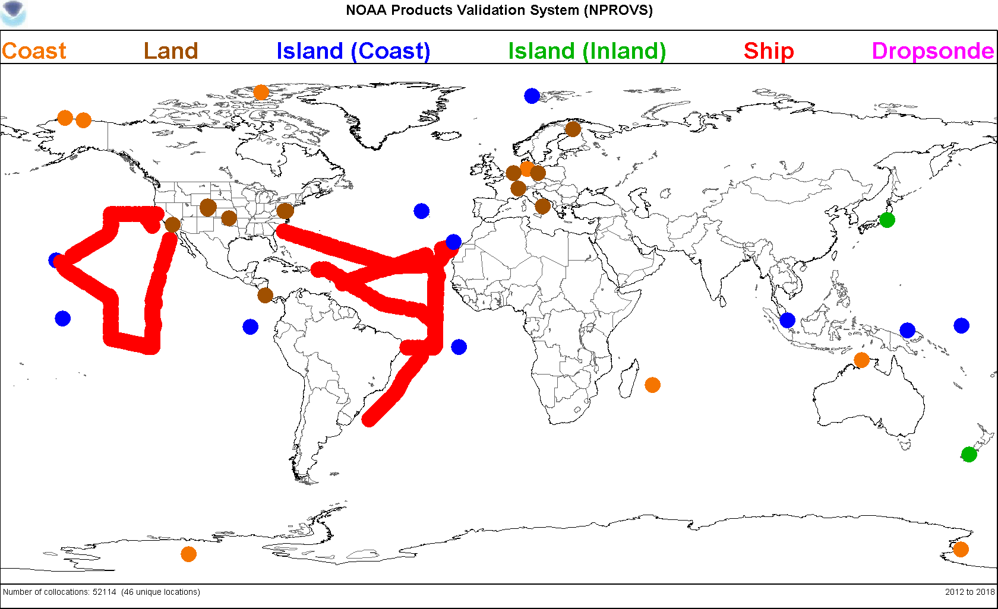
Satellite Synchronized Dedicated Sondes
Ocean field campaigns (AEROSE, ACAPEX, ENRR)
DOE ARM sites (SGP, NSA, ENA)
Radiosonde Intercomparison and VALidation (RIVAL)
Others (Beltsvile, Sterling, …)
Launch configurations:
Single (15 min prior to)
Sequential (30 and 5 min prior to)
RS92-RS41 dual (15 min prior to) …RIVAL
RS92-RS41 dual followed by a single …RIVAL
NOAA-JPSS dedicated sonde database
Acknowledgement:
Lihang Zhou, Mitch Goldberg for JPSS funding
Nick Nalli, Lori Borg, Ryan Smith,…
NOAA Products Validation System (NPROVS, Reale et al. 2012)

Slide 6
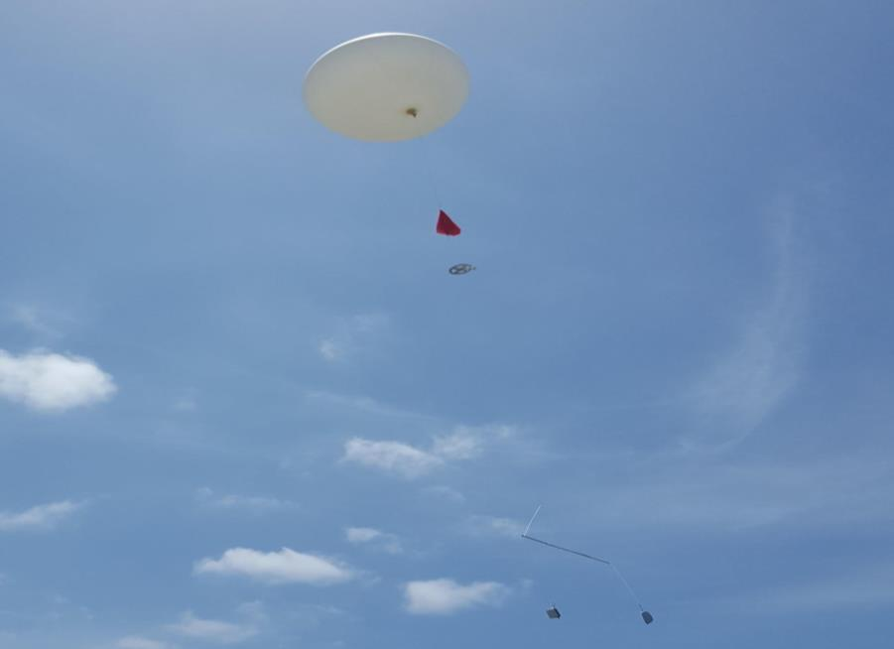
RIVAL dedicated sondes
Using RIVAL dedicated sondes to monitor polar satellite microwave observations and RT models (w/Isaac Moradi at UMD/STAR NESDIS)
RS92-RS41 dual (45-min prior to NOAA20 overpass)
RS41 single (5-min prior to)
Collocations with SDR & TDR
RIVAL dual launch of Vaisala RS92 and RS41 synchronized with NOAA-20 at the DOE-ARM Eastern North Atlantic (ENA) Azores site. (Courtesy Donna Holdridge, Argonne National Laboratory)

Slide 7
Using GRUAN data to assess the capability of polar satellite microwave observations of monitoring climate
METHODOLOGY: Multiply the GRUAN temperature profile by the MSU weighting function to get the microwave equivalent temperature for GRUAN
Chan 2 (mid-troposphere)
Chan 3 (upper-troposphere)
Chan 4 (lower stratosphere)

Slide 8
MSU Weighting Functions (nadir)

Slide 9
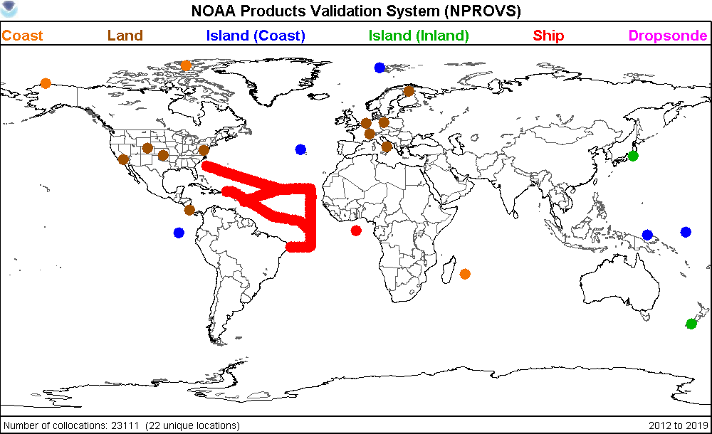
Sites for the initial demonstration
Lindenberg, Germany (52.21N, 14.12N)
GRUAN site
Barrow, Alaska, USA (71.29N, 156.79W)
ARM site with data being GRUAN processed

Slide 10
Lindenberg; ch2 -TMT (middle-troposphere) GRUAN computed using MW weighting function
GRUAN trend: 0.126 (0.04) K/yr
Microwave trend: 0.092(0.04) K/yr
GPSRO trend: 0.102(0.05) K/yr
Microwave
GRUAN 00Z
GRUAN 06Z
GRUAN 12Z
GRUAN 18Z
GPSRO
Correlation:
Microwave vs. GRUAN corr: 0.90
GPSRO vs. GRUAN corr: 0.94
GPSRO data is provided by Johannes Nielsen at EUMETSAT ROM SAF at DMI

Slide 11
Lindenberg; ch3 -TUT (upper-troposphere) GRUAN computed using MW weighting function
Microwave
GRUAN 00Z
GRUAN 06Z
GRUAN 12Z
GRUAN 18Z
GPSRO
Correlation:
Microwave vs. GRUAN corr: 0.77
GPSRO vs. GRUAN corr: 0.52

Slide 12
Lindenberg; ch4 -TLS (lower-stratosphere) GRUAN computed using MW weighting function
Microwave
GRUAN 00Z
GRUAN 06Z
GRUAN 12Z
GRUAN 18Z
GPSRO
Correlation:
Microwave vs. GRUAN corr: 0.07
GPSRO vs. GRUAN corr: 0.56

Slide 13
Lindenberg, Sample of Profiles reaching 19 hPa
GRUAN 00Z
GRUAN 06Z
GRUAN 12Z
GRUAN 18Z
The raob sample exhibit temporal variations due to balloon burst and qc screening etc.

Slide 14
Alternative Method
Use the GRUAN profile temperature only at the levels of the maximum MW weighting function
Chan 2 (575.5 hPa)
Chan 3 (260 hPa)
Chan4 (89.5 hPa)

Slide 15
Lindenberg; ch4 -TLS (lower-stratosphere) GRUAN at 89.5 hPa level
GRUAN trend: 0.013 (0.06) K/yr
Microwave trend: 0.016(0.07) K/yr
GPSRO trend: 0.004(0.07) K/yr
Microwave
GRUAN 00Z
GRUAN 06Z
GRUAN 12Z
GRUAN 18Z
GPSRO
Correlation:
Microwave vs. GRUAN corr: 0.86
GPSRO vs. GRUAN corr: 0.96

Slide 16
Barrow; ch2 -TMT (middle-troposphere) GRUAN at 575.5 hPa level
Microwave
GRUAN 06Z
GRUAN 18Z

Slide 17
Barrow; ch3 -TUT (upper-troposphere) GRUAN at 260 hPa level
Microwave
GRUAN 06Z
GRUAN 18Z

Slide 18
Barrow; ch4 -TLS (lower-stratosphere) GRUAN at 89.5 hPa level
Microwave
GRUAN 06Z
GRUAN 18Z

Slide 19
Summary
The GRUAN radiosonde profile dataset at Lindenberg, Germany and Barrow Alaska are used to assess the NOAA STAR polar satellite microwave TDR in long-term climate monitoring. It is found:
The datasets match well on inter-annual and decadal time scales for the middle and the upper tropospheres and the lower stratosphere.
Datasets available for Microwave Sensor and RT model validations
This work supports the Global Space-based Inter-Calibration System (GSICS) mission to monitor microwave (and also infrared) sensors from space based platforms by introducing ground and space reference observations.
Path forward:
to extend “both” analysis to other GRUAN sites as available, preferably tropical and polar
to integrate measurement uncertainties, version-3 GRUAN etc and redo analysis

