Slide 1
Current and future use of microwave imager radiances in NWP models
Alan Geer
Thanks to: Katrin Lonitz, Niels Bormann

Slide 2
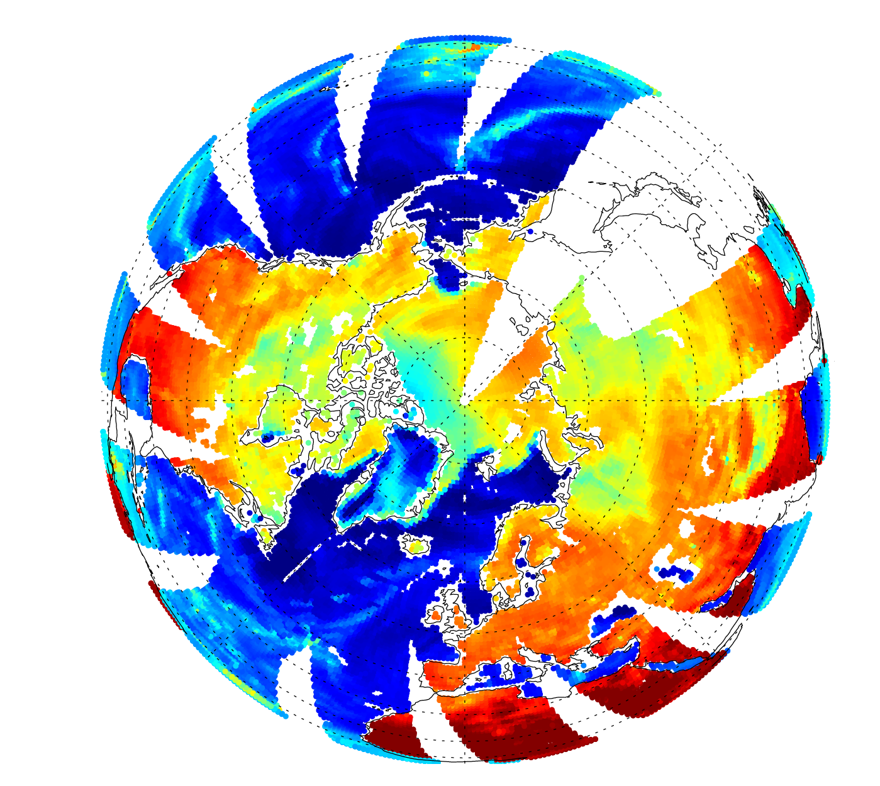
SSMIS F-17 channel 13 (19 GHz, v)
Microwave brightness temperatures
3rd December 2014
Assimilated in atmospheric analysis
Ocean waves, wind, skin temperature
Atmospheric water vapour and temperature
High altitude / snow
Cloud and precipitation
Snow cover
Deep fresh snow
Land surface temperature, biomass, soil/rock, soil moisture
Used via OSTIA
Sea-ice

Slide 3
Definition of “microwave imager” for this talk?
Conical scanning technology
Surface-sensitive channels between 7 GHz and 166 GHz
Here mostly excluding things like:
Very low-frequency and synthetic aperture, e.g. SMOS
Smallsats / cubesats (resolution? No channels < 90GHz?)
Hyperspectral microwave instrumentation developments
Cross-track scanners (e.g. 24 GHz and 31 GHz channels on AMSU-A)
Sounding (e.g. 183 GHz channels on GMI and SSMIS)

Slide 4
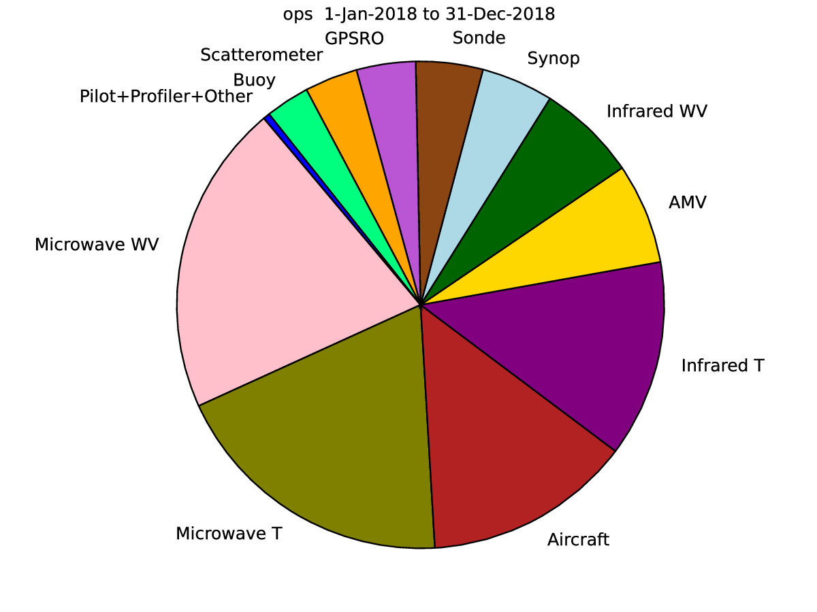
Impact of microwave imagers and humidity sounders (water vapour, cloud and precipitation) at ECMWF: 2018 totals ~ 20%
Relative FSOI = percentage of impact on 36h - 24h forecast improvement

Slide 5
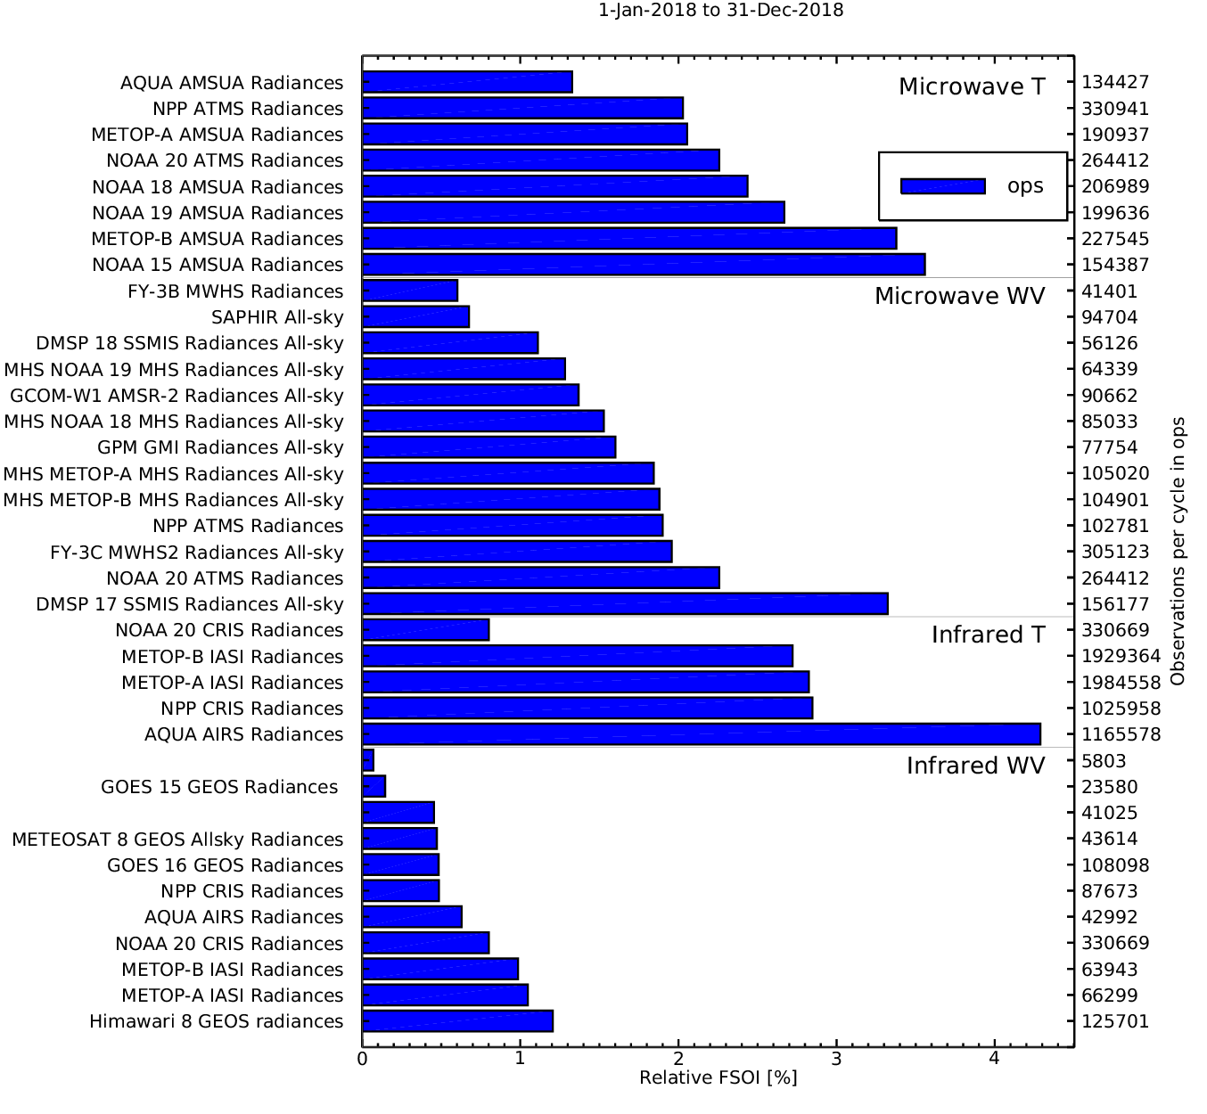
Impact of microwave imagers at ECMWF: 2018 totals
Relative FSOI = percentage of impact on 36h - 24h forecast improvement
Approximately 5% of atmospheric forecast impact comes from all-sky assimilation of the conical scanning imager channels (approximately subtracting the sounding channels, which are included in these totals)

Slide 6
Microwave imager channel usage at ECMWF
Direct all-sky microwave radiance assimilation in atmospheric model:
Radiances at 19v/h, 24v/h, 37v, 92v, 150/166* GHz (or equivalent channels) assimilated
Ocean only, no sea-ice, not poleward of 60 degrees
All states of the atmosphere – clear, cloudy and precipitating
Directly sensitive to humidity, cloud, precipitation, ocean emissivity
Indirectly sensitive to surface wind (via emissivity model) and atmospheric wind (via 4D-Var data assimilation – the generalised tracing effect)
Skin temperature sensitivity exists but is ignored
Also the 183 GHz channels are assimilated where available over ocean, sea-ice, land and snow-covered land with very large benefit to forecasts (not covered here)
Hidden users:
SST and sea-ice analyses ingested from Met Office OSTIA analysis use microwave imager retrievals
IMS land snow cover (not yet assimilated) incorporates some microwave imager data
* In cycle 46r1, this year

Slide 7
August 2017 microwave imager radiance assimilation at some NWP centres: ”All‐sky satellite data assimilation at operational weather forecasting centres”, Geer et al., 2018, QJRMS
 | ECMWF | JMA global | NCEP | Met Office Global | Met Office Local | Meteo-France Global | Meteo-France Local | DWD global | DWD local
SSMIS (F-17) | All-sky | Clear-sky |  | Clear-sky |  | Clear-sky | Clear-sky
SSMIS (F-18) |  | Clear-sky
GMI | All-sky | Clear-sky |  |  |  | Clear-sky | Clear-sky
AMSR2 | All-sky | Clear-sky |  | Clear-sky |  | Clear-sky | Clear-sky
MWRI (FY-3A)
MWRI (FY-3B)
All-sky in development

Slide 8
March 2019: all available imagers
Sensor | Asc. Equator crossing time | Notes
SSMI F-15 | 15:03 | 22 GHz channel affected by RFI
SSMIS F-16 | 15:54 | No longer distributed by FNMOC
SSMIS F-17 | 18:37 | ASSIMILATED AT ECMWF
SSMIS F-18 | 17:33 | WV sounding channels assimilated
GMI | N/A | ASSIMILATED AT ECMWF
AMSR2 | 13:32 | ASSIMILATED AT ECMWF
MWRI FY-3B | 13:38 | Various biases
MWRI FY-3C | 22:15 | Ascending / descending node bias
MWRI FY-3D | 14:00 | Orbital bias appears fixed – await EUMETCAST
Windsat | 18:11 | Stokes channels
AMSU-A | Various | Not an imager, but has 24, 31 and 50 GHz channels
Possible additional or backup microwave imager data

Slide 9
Why not already use more microwave imager data? 1/2
Partly overlapping orbits, so view some instruments as backups?
SSMI/S F-17 (18:37) -> SSMIS F-18 (17:33) -> Windsat (18:11)
AMSR2 (13:32) -> MWRI FY-3D (14:00)
SSMI F-15 (15:03)
GMI (non sun-synchronous)

Slide 10
Why not already use more microwave imager data? 2/2
“We can assimilate a maximum 3 imagers before all-sky assimilation starts degrading the forecast”
An old and probably out-of-date rule of thumb, needs re-evaluation
May have been affected by the “own analysis verification” problem
All-sky microwave imager assimilation apparently “degrades” the early range forecast
Recent developments:
Better screening of areas with model bias (e.g. supercooled liquid water cloud in cold air outbreaks)
Improved relative humidity background error modelling in the DA
Observation error correlation modelling (next cycle 47r1)
Improved identification of land and sea (FOV appropriate LSM)
Plans to test additional microwave imager usage this year:
10 GHz channels, 37h, 92h => additional heavy rain and water cloud information
Additional/backup imagers: MWRI, Windsat, F-18, F-15?

Slide 11
Is there still return in adding more data? Adding GMI or AMSR2, or both, to a system already assimilating SSMIS F-17
Humidity
Temperature
Wind
Below 100% = good = reduction in T+12 forecast error
Results from Lean, Geer and Lonitz, ECMWF Tech. Memo 799

Slide 12
Future use of microwave imagers in NWP – “earth system”
Techniques:
Direct L1B radiance assimilation to replace indirect sources (L2+)
Coupled data assimilation (ocean – sea-ice - atmosphere – land surface)
Improved physical modelling of surface radiative transfer (sea-ice, snow, …)
Some role for continued use of dynamic emissivity retrieval or atlas
Applications for near-future development:
Land surface / snow (7 – 10 GHz)
All-weather SST (7 - 10 GHz)
Sea-ice (all frequencies)
Precipitation and cloud scattering signal over land
Surface wind vector – use the full Stokes component of e.g. Windsat

Slide 13
Conical microwave imagers 2025-2030
Survivors?
F-15 has already done 20 years; TMI survived 17 years
At least 2 of SSMIS DMSP F-17, F-18, GMI, AMSR2, MWRI FY-3D?
Planned:
EUMETSAT EPS-SG MWI – launch ~2023
19 - 183 GHz
Further MWRIs (orbit?)
Possibles:
AMSR3 looking more definite. News presented at IPWG:
10 – 183 GHz instrument combining best of AMSR2 and GMI
JAXA phase-A studies started last year
Launch foreseen on GOSAT/TANSO platform with ECT 1300 ascending node
ESA / Copernicus low-frequency candidate mission CIMR
1 – 36 GHz focused on polar applications e.g. sea-ice, justified by high spatial res.
US DOD weather system follow-on?
COWVR demonstrator follows Windsat polarimetric heritage. 19 – 34 GHz
Pessimistic view: 2

