Slide 1
Current and future use of microwave imager observations in the Met Office NWP system
Fabien Carminati, James Cotton, Stu Newman, Anna Booton, Brett Candy, Heather Lawrence (ECMWF), and Bill Bell (ECMWF)
GSICS 2019 annual meeting

Slide 2
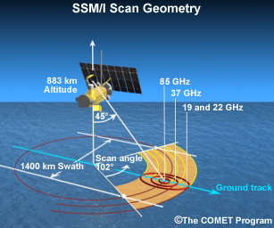
Conical scanning microwave radiometers are widely used for weather and climate applications.
They provide important observations of land and sea surface:
sea surface temperature,
soil moisture,
sea-ice,
snow,
of precipitation and humidity:
total column water vapor (over ocean),
cloud and liquid precipitation​,
cloud ice content (mainly total column)​,
frozen precipitation,
and polarimetric imagers also provide information on sea surface wind direction.

Slide 3
Conical scanning microwave radiometer
Instrument | Platform | 1970 |  |  |  |  | 1980 |  |  |  |  | 1990 |  |  |  |  | 2000 |  |  |  |  | 2010
AMSR-E | Aqua |  |  |  |  |  |  |  |  |  |  |  |  |  |  |  | 6-89 GHz
AMSR-2 | GCOM-W1 |  |  |  |  |  |  |  |  |  |  |  |  |  |  |  |  |  |  |  |  | 6-89 GHz
GMI | GPM |  |  |  |  |  |  |  |  |  |  |  |  |  |  |  |  |  |  |  |  |  |  | 10-183 GHz
MTVZA | Meteor-3M |  |  |  |  |  |  |  |  |  |  |  |  |  |  |  | 18-183 GHz
MTVZA-GY | Meteor-M N1 / 2 |  |  |  |  |  |  |  |  |  |  |  |  |  |  |  |  |  |  |  | 10-183 GHz
MWI | HY-2A / B |  |  |  |  |  |  |  |  |  |  |  |  |  |  |  |  |  |  |  |  | 6-37 GHz
MWRI | FY-3A / B / C / D |  |  |  |  |  |  |  |  |  |  |  |  |  |  |  |  |  |  |  | 10-89 GHz
SHF | Meteor-P1 / 2 / 3 / 6 |  |  | 7-37 GHz
SMMR | Nimbus-7 |  |  |  |  |  | 6-37 GHz
SSMI | DMSP-F08 to 15 |  |  |  |  |  |  |  |  | 19-85 GHz
SSMIS | DMSP-F16 to 19 |  |  |  |  |  |  |  |  |  |  |  |  |  |  |  |  | 19-183 GHz
TMI | TRMM |  |  |  |  |  |  |  |  |  |  |  |  |  |  |  | 10-85 GHz
WindSat | Coriolis |  |  |  |  |  |  |  |  |  |  |  |  |  |  |  |  |  | 3-37 GHz
Some short-lived instruments are not shown, more information available at
https://www.wmo-sat.info/oscar/gapanalyses?mission=7
Notes:
70’-80’: Prototypes >> 90’-00’: Legacy >> 10’: New gen.

Slide 4
Conical scanning microwave radiometer
Instrument | Platform |  | 2020 |  |  |  |  | 2030
AMSR-2 | GCOM-W1 |  | 6-89 GHz
GMI | GPM |  | 10-183 GHz
MWI | HY-2B |  | 6-37 GHz
MWRI | FY-3B / C / D |  | 10-89 GHz
SSMI | DMSP-F15 |  | 19-85 GHz
SSMIS | DMSP-F16 to 18 |  | 19-183 GHz
WindSat | Coriolis |  | 3-37 GHz
ICI | MetOp-SG B1 / 2 / 3 |  |  | 183-664 GHz
MTVZA-GY | Meteor-M N2-2 to 6 | 10-183 GHz
MTVZA-GY-MP | Meteor-MP N1 / N2 |  | 6-183 GHz
MWI | MetOp-SG B1 / 2 / 3 |  |  | 18-183 GHz
MWRI 2 | FY-3F / G |  | 10-118 GHz
MWRI 2RM | FY-3RM-1 / 2 |  | 10-183 GHz
WIGOS recommends at least 3 satellites with microwave imagers on well separated orbits.
Continuing until end of life
WIGOS Implementation Plan for the Evolution of Global Observing Systems (EGOS-IP)
https://www.wmo.int/pages/prog/www/OSY/Publications/EGOS-IP-2025/EGOS-IP-2025-en.pdf

Slide 5
Data usage at the Met Office
SSMI 1999 – 2008 ............... Use of 1DVAR-retrieved total column water vapour, 10m wind speed, and cloud liquid water column
SSMIS 2006 – now .............. Originally assimilating sounder channels (50-60 and 183 GHz) and imager channels (19-37 GHz) since 2016
WindSat 2008 – now ........... Wind speed and direction L2 product from NRL
AMSR-2 2016 – now ............ 19-36 GHz
MTVZA-GY ........................... Assessed but not used
GMI 2018 – now ................... 19-36 and 183 GHz (planned assimilation of 89 GHz V-pol in 2019)
MWRI (FY-3C) ...................... Planned assimilation for 2019
MWRI (FY-3D) ...................... Possible assimilation for 2019/2020
Plans to investigate the use of ICI, MWI (MetOp), MWRI 2, and MWRI 2RM, when data become available.

Slide 6
SSMI 1999 – 2008
Assimilation of 10m wind speeds derived from 1DVAR using F13 from 1999 and F15 from 2001.
1DVAR total column water vapor and cloud liquid water column were used for monitoring and quality control.
First guess total precipitable water (TPW) minus SSMI F13 1DVar-retired TWP (FG-1DVAR) and wind speed FG-1DVAR on July 16th 2007.
English et al., 2002 http://library.ssec.wisc.edu/research_Resources/publications/pdfs/ITSC12/english02_ITSC12_2002.pdf

Slide 7
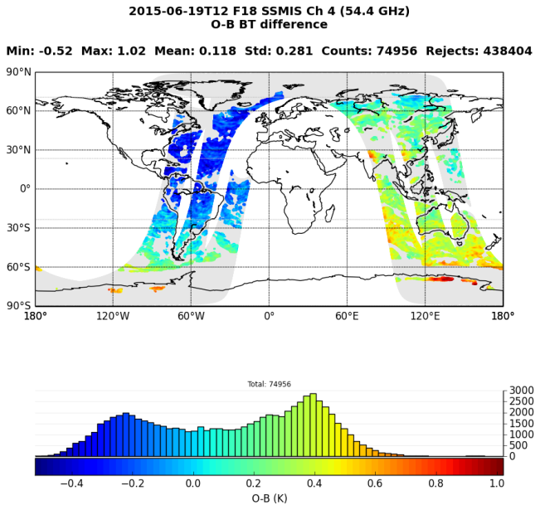
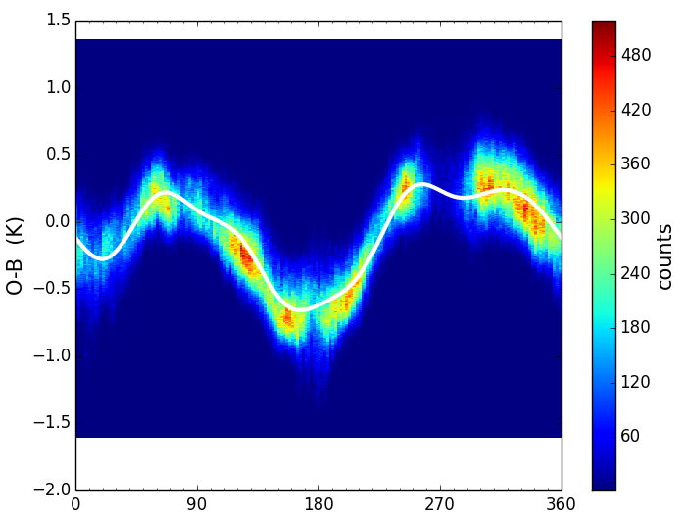
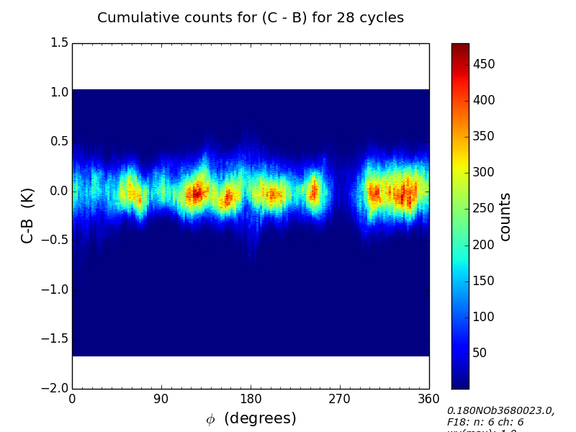
SSMIS 2006 – now
Complex systematic biases that vary with the orbital angle Φ due to uncorrected emission from the main reflector were detected in 2011. A correction scheme using predictors based on Fourier Series coefficients was specially developed.
$$∆T= \frac{1}{2}a_{0}+\sum_{i=1}^{N}{a_{i}\cos\left(i∅\right)+b_{i}\sin{(i∅)}}$$
In this scheme, the temperature channels use N=6 Fourier terms (12 predictors + 1 constant) and the humidity and imager channels use N=2 terms (4 predictors + 1 constant ).
To date, radiances from F17 57-59 (ch. 6-7), 183 (9-11), 19-37 (12-16), and 60 GHz (23-24) are assimilated.
(Left) Background departures (O-B) w.r.t Φ for SSMIS F18 at 57 GHz, June 2015, and Fourier series fit (white line). (Right) Departures after correction (C-B).
Bell et al., 2008 http://ieeexplore.ieee.org/stamp/stamp.jsp?tp=&arnumber=4468717&isnumber=4475697
Booton et al., 2013 https://cimss.ssec.wisc.edu/itwg/itsc/itsc19/program/papers/10_03_booton.pdf
Notes:
F18 temperature sounding channels (Ch 1-7, 23-24) broke on July 28th 2015 while they were tested for assimilation and the instrument was not implemented

Slide 8
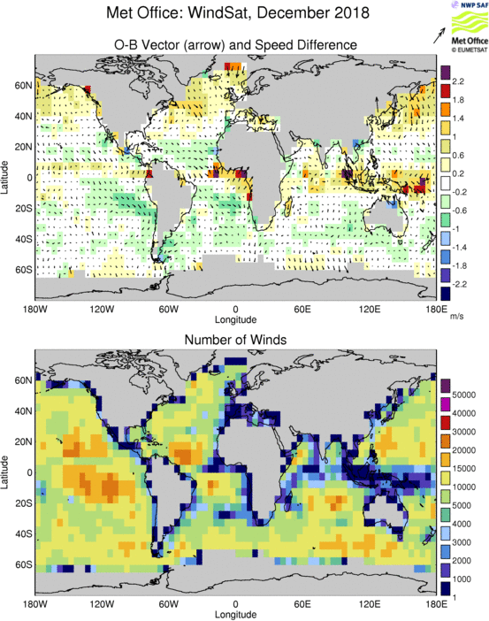
WindSat 2008 – now
Wind speed and direction L2 product from NRL
Ambiguous wind components are assimilated in the same way as a scatterometer.
Wind direction accuracy compared to the model background and scatterometers is worse at low wind speeds (below 6 ms⁻¹).
Data are screened for rain in the field of view using retrieved liquid water path.
Wind speeds are bias corrected prior to assimilation and variational quality control is applied in 4D-Var to remove poor fitting observations.
Candy et al., 2009 http://ieeexplore.ieee.org/stamp/stamp.jsp?tp=&arnumber=4812050&isnumber=4939375
Monitoring https://www.nwpsaf.eu/site/monitoring/winds-quality-evaluation/scatterometer-mon/scatter-nrt-monitoring/windsat/

Slide 9
AMSR-2 2016 – now
In 2015, a comprehensive data quality evaluation was
carried out using Met Office and ECMWF NWP models
as reference comparators. Excluding scenes with high
radiative transfer errors, such as land or sea ice surfaces
and areas of cloud or high winds, the analysis showed:
Consistently higher O-B for ECMWF than Met Office
attributed to the use of different versions of the emissivity
model.
Localised large anomalies in the observations, identified
and attributed to RFI contamination and sun glint.
No sign of bias varying along the orbit as previously seen for SSMIS.
To date, radiances from AMSR-2 channels 7-12 (19-36 GHz) are assimilated over clear sky oceans.
Normalised O-B distributions of AMSR-2 channel 7-12 compared to Met Office (green) and ECMWF (blue) backgrounds, in May 2015.
Newman et al., 2015 http://www.gaia-clim.eu/system/files/workpkg_files/D4.2_Individual%20reports%20on%20validation%20of%20satellites%20v1.pdf
Notes:
This exposed the need for improvement of ocean emissivity models to maximize the use of microwave imager radiances (both in NWP systems and derived products such as ECV or re-analyses).

Slide 10
MTVZA-GY
In 2017, MTVZA-GY was evaluated in a
similar way to AMSR-2.
Findings were:
Large magnitude of bias (±20 K).
Orbital angle dependent biases attributed to solar heating combined with emission from the main reflector.
Latitude dependent biases in the imager channels and the lowest peaking temperature sounding channels.
Striping noise in the temperature sounding channels.
Scan-angle biases for the 10.66 GHz channels.
MTVZA-GY 10.66 GHz V-pol O-B, 2 February 2017, compared to ECMWF (left) and Met Office (right) background fields.
Mean (left) and standard deviation (right) O-B for the imager channels of MTVZA-GY, and AMSR-2 equivalent channels, 31 Jan – 4 Feb 2017.
Lawrence et al., 2017 (pages 4-21) http://www.gaia-clim.eu/system/files/document/d4.6.pdf

Slide 11
GMI 2018 – now
In 2017, GMI was evaluated in a
similar way to AMSR-2 and MTVZA-GY.
Findings were:
Global mean O-B within ±1 K, stable over time, and smaller than for instruments of comparable radiometric capabilities (MWRI and AMSR-2).
Observed biases are principally related to areas that remain poorly simulated by NWP models due to high wind speed, low surface temperature, and cloud residuals.
Absence of an orbital angle dependent bias.
To date, radiances at 19-36 and 183 GHz (and 89 GHz V-pol in May 2019) are assimilated over clear sky oceans.
Mean O-B for Met Office and ECMWF (left), and 1σ standard deviation (right), December 2016 to January 2017.
GMI 36 GHz (V-pol) O-B anomaly.
Carminati et al., 2017 (pages 22-75) http://www.gaia-clim.eu/system/files/document/d4.6.pdf

Slide 12
MWRI (FY-3C)
In 2017, MWRI FY-3C was evaluated in a
similar way to AMSR-2, MTVZA-GY, and
GMI. Findings were:
2 to 3K orbital angle (OA) dependent bias
due to emission from the cold/warm target
reflectors unaccounted for in the calibration.
RFI at 10.65 GHz attributed to interference with a geostationary communications satellite.
4-6 K inter-satellite bias compared to AMSR-2.
Bias drifts over the period Aug-Dec 2016 and increase of OA bias between 2014 and 2016.
MWRI 23 GHz V-pol O-B, 15 September 2016, compared to ECMWF (left) and Met Office (right) background fields.
MWRI (ascending) mean O-B (left) and standard deviation (right) for Met Office (black) and ECMWF (blue) over clear sky ocean, September 2016. AMSR-2 statistics are shown in red.
Lawrence et al., 2017
https://www.ecmwf.int/sites/default/files/elibrary/2017/17206-evaluation-fy-3c-mwri-and-assessment-long-term-quality-fy-3c-mwhs-2-ecmwf-and-met-office.pdf

Slide 13
MWRI 23 GHz V-pol O-B from the Met Office over clear sky ocean w.r.t the orbital angle, May 2017. Fourier series fit (white).
MWRI (FY-3C)
A bias correction scheme similar to that of SSMIS was developed for MWRI FY-3C:
A Fourier series with N=1 component (2 predictors + 1 constant) is used to fit MWRI bias.
After correction O-B differences against the NWP model are similar to those found with existing microwave imagers, such as GMI.
MWRI FY-3C radiances from 18-37 GHz channels will be assimilating from May 2019.
Mean residual bias after correction in a Met Office assimilation trial for MWRI 18.7 and SSMIS 19.35 GHz V-pol channels.
Carminati et al., 2018 https://link.springer.com/article/10.1007/s00376-018-7266-8
Candy et al., 2019 – in prep.

Slide 14
FY-3D MWRI (blue), FY-3C MWRI (green), and GPM GMI (red) O-B mean (solid), mode (dotted), and standard deviation (dashed), June 09, 2018, over clear sky ocean.
MWRI (FY-3D)
A preliminary study has been conducted on 24h of MWRI FY-3D observations. It suggests:
A reduction of global mean O-B and standard deviation compared to the FY-3C version.
Close agreement with GMI at 18, 23, and 89 GHz.
The OA bias reduced to less than 0.2 K on FY-3D.
Those findings are consistent with the bias correction developed by CMA aimed at reducing the noise in the warm target used for the calibration and an emissivity
correction for the warm and cold reflectors.
It is planned to further evaluate MWRI FY-3D for a possible assimilation late 2019.
FY-3D MWRI (left) and FY-3C MWRI (right) O-B from the ascending nodes (blue), descending nodes (green), and their difference (red), June 09, 2018, over clear sky ocean.
Xie et al., 2018 https://ieeexplore.ieee.org/abstract/document/8566165
Carminati et al., 2019 https://www.metoffice.gov.uk/binaries/content/assets/mohippo/pdf/library/weather-science-technical-reports/frtr_634_2019p.pdf

Slide 15
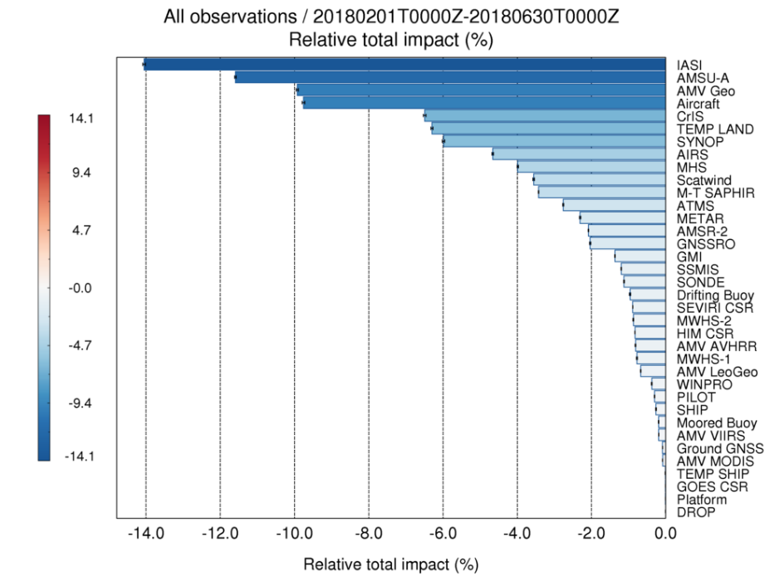
Conclusion
Microwave imagers form an important component of the NWP systems, have useful applications such as the sea-ice monitoring at the poles, and contribute to climate monitoring and re-analyses thanks to time series spanning several decades.
It is therefore important to further stress the need for continuous a working fleet in space. With possibly no planned U.S. and Japanese imager beyond SSMIS and AMSR-2, space borne microwave imager continuity will rely on the EU, Chinese, and Russian programs in the coming years.
Met Office Forecast error Sensitivity to Observations Impact (FSOI) total percentage impact of 24-h forecast error reduction Feb-Jun 2018.

Slide 16
Thank you

