Slide 1

WIGOS: Strawman outline draft of a plan to develop inter calibration products for microwave imagers
Qifeng Lu, Tim Hewison, Shengli Wu, Ralph Ferraro, Manik Bali, Miao Zhang

Slide 2
Outline
Background and requirement
Gap
Goals
Team
Methodology
Progress
Next step

Slide 3
Background and requirements
CGMS actions from discussions in CEOS SIT
  WMO WGIII/ 5.1.1 A45.02 Update the risks assessment and gap analysis of implementation against the CGMS baseline; include the potential risk of gaps in the capability for passive microwave imaging in this update
  H.2 A45.20 CGMS to endorse the gap analysis report and the coordinated action plan in writing prior to CEOS 2017 plenary meeting, to the Joint CEOS-CGMS WG Climate
    CEOS endorsed the ECV gap analysis report and the coordinated action plan
    Will be forwarded now to CGMS 46 for endorsement - expected first week of June
    Important recommendation from GSICS PoV:
    CEOS and CGMS agencies to add the delivery of FCDRs for each individual satellite instrument (linked to relevant precursor instrument series) to their agency remit.
Triggered AGU special session on potential ECV gaps
  (SST, precip, snow, ice, etc.)
Recommendation:
  GSICS Microwave Sub-group to consider strategy to mitigate risk of gaps in microwave imager constellation

Slide 4
Passive Microwave Imagers: Current and Planned

Slide 5
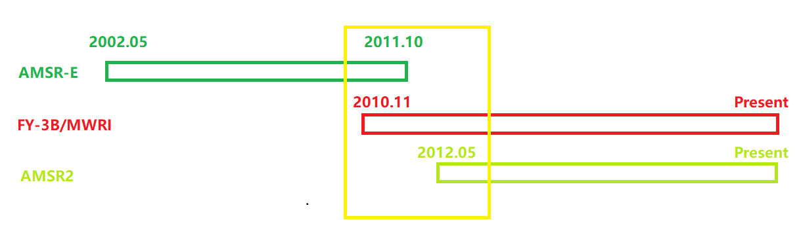
Inter Calibration Between Different Sensor
(Example: AMSR-E/AMSR2 and FY-3B)
There is a 7 month gap between AMSR-E and AMSR2
Double difference (DD) method to do the Inter-Calibration

Slide 6
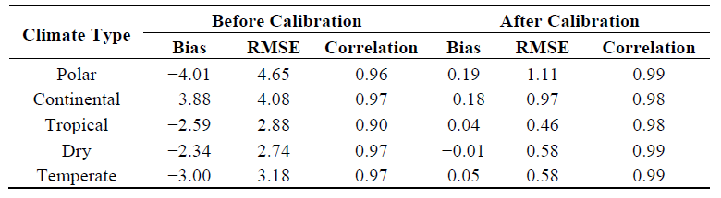
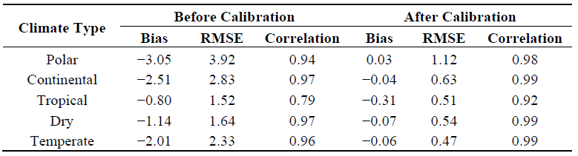
Difference before and after Inter Calibration
Ascending
Descending
Du et al., 2014, Inter-calibration of Satellite Passive Microwave Land Observations from AMSRE and AMSR2 Using Overlapping FY-3B-MWRI Sensor Measurements

Slide 7
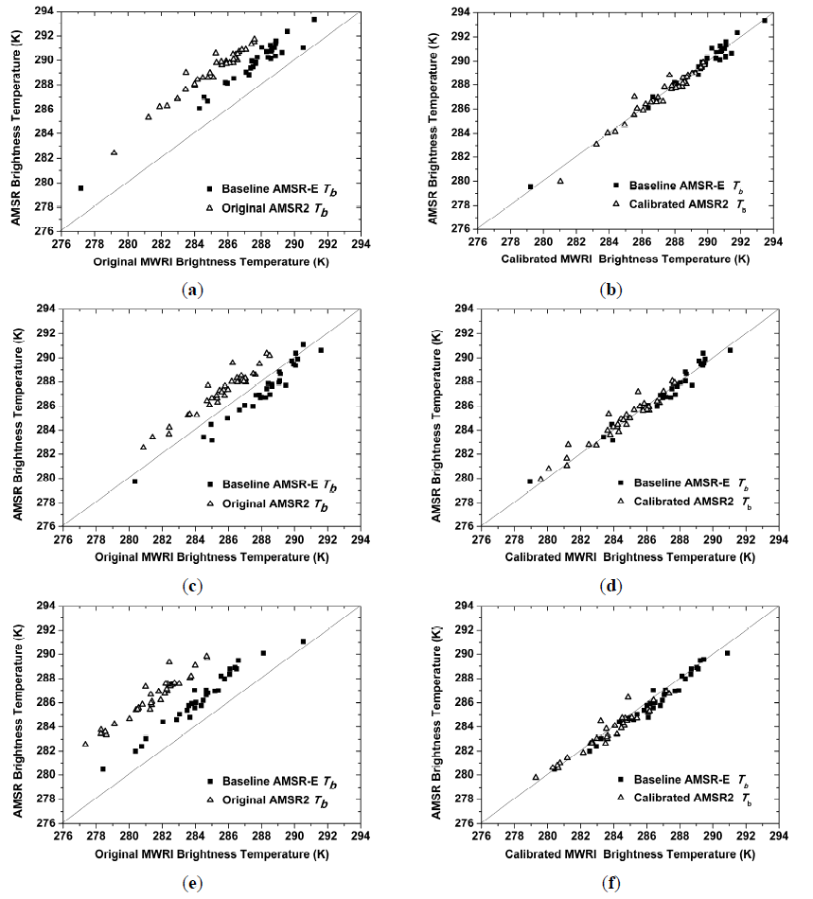
23H
Before
After
18H
10H

Slide 8
At CGMS-46
Draft list of plenary actions resulting from CGMS-46 discussions (11 June 2018): https://www.cgms-info.org/Agendas/WP/CGMS-46-CGMS-WP-29
WGI actions open from previous plenary sessions (at CGMS-46)
Actionee | AGN item | Action # | Description | Action feedback/closing document | Deadline | Status | HLPP ref
GSICS | F | A46.xx | On passive microwave observations: GSICS is requested to organise an expert meeting on the intercalibration of operational PMW sensors to meet the WIGOS 2040 targets for a coordinated effort to share information on current and future PMW instruments and report to CGMS-47 (CGMS-46-EUM-WP-14) |  | CGMS-47 | OPEN
  Joint Meeting between the CEOS/WGCV and GSICS microwave groups:
  CEOS/WGCV develop better instrument design strategy and pre-launch calibration algorithms by learning the knowledge of data quality issues and inter-calibration algorithms from GSICS group.
  GSICS develop better re-calibration and inter-calibration algorithms by learning the instrument design and pre-launch calibration issues from the CEOS/WGCV group

Slide 9
Way forward
How will GSICS apply existing inter-calibration algorithms to range of microwave imagers for NRT applications?
  Who is interested in participating? Coordinating?
Coordinate with XCAL
Coordinate with CEOS-WGCV MWSG
  At MWSG meeting in Darmstadt, August 2018

Slide 10
Case for GSICS to develop NRT products for MWIs
Near Real-Time
  For use in L2 processing chains
  Assumes biases change slowly day-to-day
  Current GSICS NRT products:
    GEO-LEO IR NRT – Typically from t-1d to t-14d
    GEO-LEO VIS NRT – Typically from t-1d to t-30d
Climate applications
  of temperature sounders covered by NOAA (C. Zou)
  of humidity sounders covered by C3S (T. Hanschmann)
  of microwave imagers covered by CMSAF (K. Fennig)
  + numerous other FCDRs being generated at NOAA
NRT applications
  of sounders primarily for DA - include own bias correction
  of microwave imagers critically dependent on inter-calibration
    e.g. L2 products – precipitation, sea ice

Slide 11
Inter-calibration algorithms for Microwave Imagers
XCAL
  Warm vicarious scenes
  Cold vicarious scenes
  SCO-SNO double differencing
  SCO-SCO double differencing
    Using NWP reanalysis, retrievals, GPSRO, …
    n.b. ECMWF ERA5 reanalysis now available in NRT!
CMSAF
  SCO-SCO double differencing?
NWP+RTM “Obs-Calc” double-differencing
Integrated Microwave Inter-Calibration Approach (SNO + Global Mean + RTM)
  Potential application to microwave imagers?
Which algorithms are applicable?
  for which channels?
  of which imagers?
Which algorithms are applicable for NRT?

Slide 12
Progress within GSICS Microwave Sub-group
How will GSICS apply existing inter-calibration algorithms to range of microwave imagers for NRT applications?
  Establish Tiger team to work on this activity
  Define user requirements/expectations
  Review existing algorithms’ applicability to NRT
  Prototype implementation for variety of microwave imagers
Other Issues
  International coordination
  Data availability & timeliness
  Interaction with NWP/RTM experts
    - possible use as transfer reference in future algorithm refinements
Who is interested in participating?
  Qifeng Lu (CMA) – Coordinator + MWRI experience + Vice-chair of GRWG Microwave Sub-Group
  Rachael Kroodsma (NASA) – XCAL contact + GMI experience
  Misako Kachi (JAXA) – AMSR experience
  Jun Park (KMA) – AMSR inter-calibration experience
  Shengli WU (NSMC/CMA) and Miao Zhang (NSMC/CMA) – MWRI experience
  Kevin J. Garrett, Paul S Chang, Banghua Yan (NOAA)
  Tim Hewison (EUMETSAT) – Experience with NRT GSICS products

Slide 13
Strawman Plan to develop NRT GSICS products for microwave imagers
First step is QC monitoring
  Counts, temperatures, gains, NEdT, etc
  Use this to flag dodgy data
  Flags can be updated in NRT
Second step is to do calibration monitoring
  Based on Obs-Calc Double-Differencing
  + Vicarious Hot/Cold algorithms
Third step is to analyse these differences
  To understand relative biases
  And liaise with operators to fix them in L1 processing/reprocessing
Future steps could be to develop inter-calibration corrections
  If biases are stable/predictable
  These could be static or dynamic
  e.g. through GSICS
  Need to define NRT
    but a day or 3 lag could be OK for slowly changing biases

Slide 14
Products For Hydrology and cryosphere
Using Passive Microwave Radiation Imager
Soil Moisture
Snow Depth/SWE
Precipitation
Land Surface Temperature
Total Precipitation Water
Cloud Liquid Water
Snow Depth/SWE
Sea Ice concerntration
Frozen Soil

Slide 15
CMA team for the MWI products
Product/Target | Research scientist
Coordinator | Qifeng Lu
Sea Wind Speed | Dawei An
Total Precipitation Water | Qiong Wu
Cloud Liquid Water | Fangli Dou
Soil Moisture | Ruijing Sun
Land Surface Temperature | Ronghan Xu
Precipitation (Rain Rate) | Xiaoqing Li
Sea Surface Temperature | Miao Zhang
Snow Depth/SWE | Shengli Wu
Sea Ice Concentration | Shengli Wu

Slide 16
Product Review: Soil Moisture
Sensor/Algorithm | Accuracy | Temporal Coverage | Spatial Coverage | Reference | Agency | Bands requirement
AMSR-E/Njoku | 0.06 | 2002.6.19-2011.10.3 | Global | [1] Njoku, 2003 | NASA | 6/10
AMSR-E/LPRM | 0.09 | 2012.6.19-2011.10.3 | Global | [1]Owe, 2008 | NASA/GSFC | 6/10/36
FY-3/NSMC | 0.06 | 2011.7.12-2019 | Global | [1] Shi, 2006 [2] Sun, 2016 | NSMC/CMA | 10/36
AMSR2/JAXA | 0.06 | 2013.5.17-2019 | Global | ATBD,, 2013 | JAXA | 10/36
AMSR2/LPRM | 0.09 | 2012.7.2-2019 | Global | [1] Rajat 2018 | NASA/GSFC | 6/7/10/36
TMI/LPRM | 0.09 | 1997.12.7-2015.4.8 | 40N-40S | [1]Owe, 2008 | NASA/GSFC | 10/37

Slide 17
Product Review: Snow Depth/SWE
Sensor/Algorithm | Accuracy(cm)(China) | Temporal Coverage | Spatial Coverage | Reference | Agency | Bands requirement
AMSR-E,AMSR2/Kelly | 16 | 2002-2012 | Global | Kelly, 2003,2009 | NASA/JAXA | 18/36/89
FY-3/Wu&Jiang | 7 | 2010-2019 | Global | Liu, Jiang and Wu 2014,2018 | NSMC/CMA | 10/18/36/89
SSMIS/Che | 7 | 1978-2019 | China | Che,2008 | CAS | 18/36
SSMIS/Chang | 19 | 1978-2019 | Global | Hall,2002 | DOD | 18/36
SSMIS/Foster | 21 | 1978-2019 | Global | Foster,1997 | DOD | 18/36

Slide 18
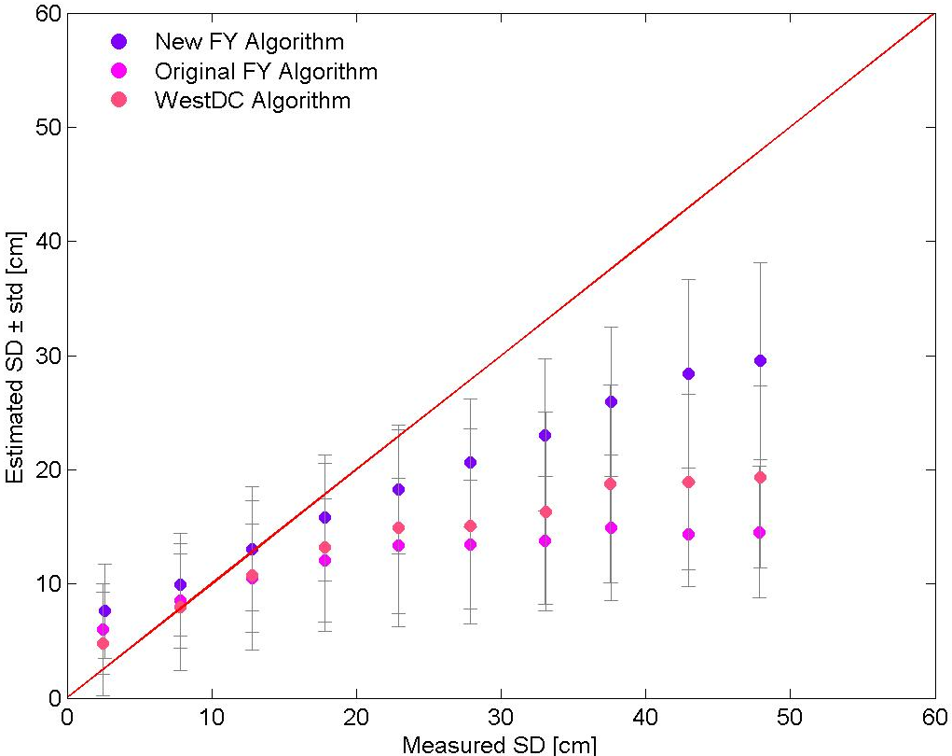
Improvement of FY-3D

Slide 19
Product Review: Precipitation(MRR)
Sensor/Algorithm | Accuracy | Temporal Coverage | Spatial Coverage | Reference | Agency | Bands requirement
FY-3 MWRI/Li | <10% (bias) （2018.04~05，global, Ku2A） | 20150206~ | Global | Li | NSMC/CMA | 10/10
AMSR2/ Kazumasa Aonashi | <10% (bias) （2018.04~05，global, Ku2A） | 20120703~ | Global | Misako Kachi，2014 | JAXA
GMI/GPROF-V5 | 20% (bias) （2016.6.14~7.16, USA Ground radar MRMS） | 20140305~ | [60oS 60oN] | Walt Petersen, 2017 | JAXA
GMI/GPROF-V03 | 0.82-1.21mm/h (RMSE) 0.50-0.76mm/h ( Mean Absolute Error ) (2014.03-06, Europe radar) | 20140305~ | [60oS 60oN] | Silvia Puca, 2014, | JAXA
AMSR-E | <17% (bias) （2013.06，KWAJ & MELB） | 20020601~20111004 | Global | Wolff & Fisher, 2009 | NASA/JAXA | 10/10
SSMI | <35% (bias) （2013.06，F13~F15, KWAJ & MELB） | 19870709~ | Global | Wolff & Fisher, 2009 | NASA | 10/10

Slide 20
Product Review: Total Precipitation Water
Sensor/Algorithm | Accuracy | Temporal Coverage | Spatial Coverage | Reference | Agency | Bands requirement
SSMI/S/Frank J.Wentz | 1.2mm | 1987-present | Global | Wentz,1997 | NASA | 19/22/37
TMI | 2.5mm | 1997-2015 | 35N-35S |  | NASA, JAXA | 19/21/37
AMSR-E/Frank J.Wentz | 1.0mm | 2002-2011 | Global | Wentz | NASA | 19/23/37
AMSR2 | 2.0mm | 2012-present | Global |  | JAXA | 19/23/37
GMI |  | 2014-present | 65N-65S |  | NASA,JAXA | 19/23/37
FY-3C/Qiong Wu | 2.5mm | 2014-present | Global |  | NSMC/CMA | 18/23/37
FY-3D/Qiong Wu | 2.5mm | 2019-present | Global |  | NSMC/CMA | 18/23/37

Slide 21
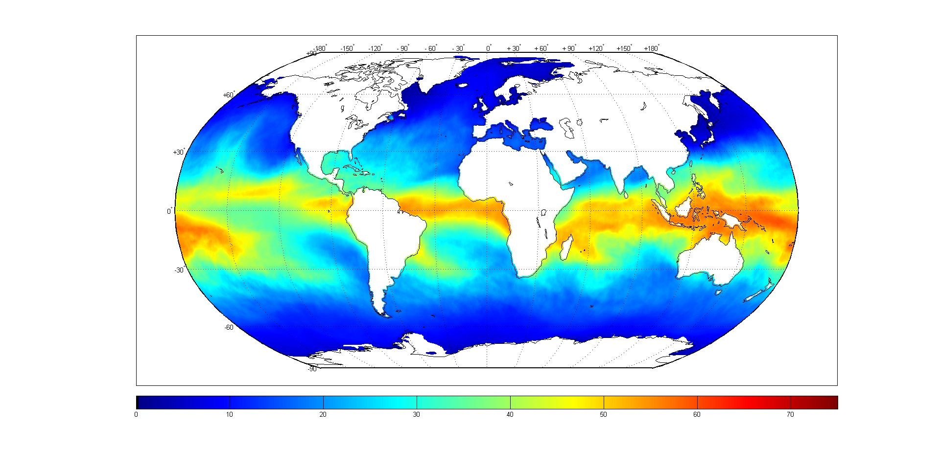
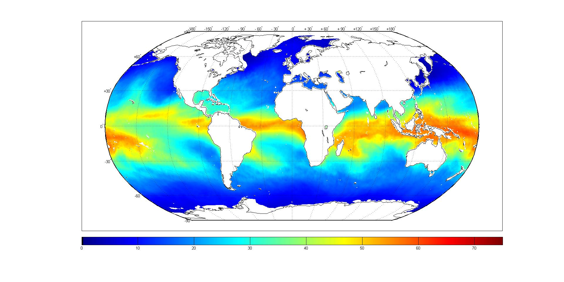
MWRI
SSMIS

Slide 22
Product Review: Cloud Liquid Water
Sensor/Algorithm | Accuracy | Temporal Coverage | Spatial Coverage | Reference | Agency | Bands requirement
SSM/I/Wentz | 0.025mm | 2003-present | Global | Wentz,1997 | RSS | 19,23,37
AMSR-E/Wentz | 0.025mm | 2002-2011 | Global | Wentz,2007 | RSS | 19,23,37
GMI/Wentz |  | 2014- | Global |  | RSS
TMI/Wentz |  | 1997-2004 | Global |  | RSS
AMSR2/Wentz | 0.025mm | 2012-present | Global | Wentz,2000 | RSS | 19,23,37
AMSR/Wentz | 0.025mm | 2003 | Global | Wentz,2000 | RSS | 19,23,37
FY-3 MWRI/CLW Semi-physical algorithm | 0.025mm | 2018.08- | Global | Dou F L, 2019 | NSMC/CMA | 23,37
AMSU-A/Weng | 0.05mm | 1998- | Global | Weng F , 2003 | NOAA | 23,31

Slide 23
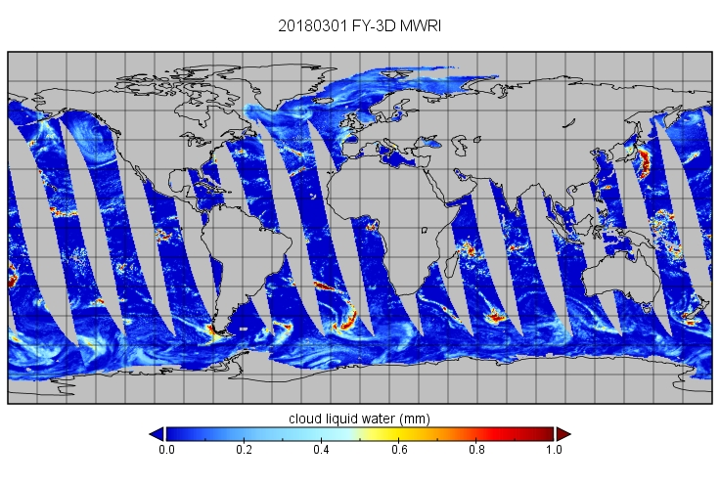
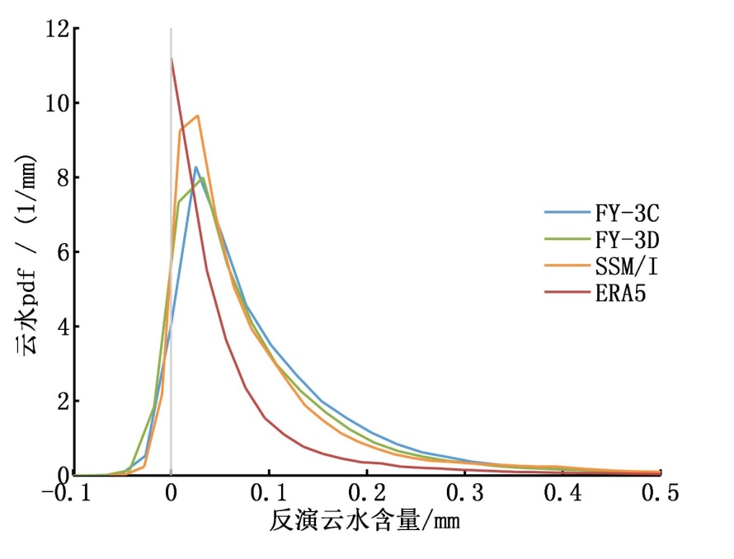
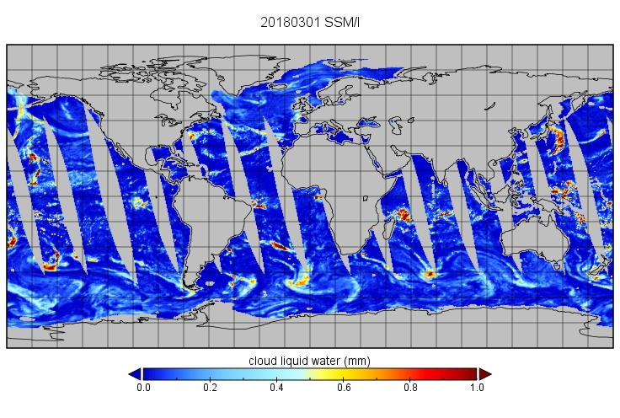
Cloud Liquid Water

Slide 24
Product Review: Sea Ice
Sensor/Algorithm | Accuracy | Temporal Coverage | Spatial Coverage | Reference | Agency | Bands requirement
SSMIS/BS | 3%-5% | 1987-present | Global | Comiso,1986 | DOD | 18/36/89
SSMIS/NT | 3%-5% | 1987-present | Global | Cavalieri,1984 | DOD | 18/36/89
AMSR2 | 3%-5% | 2012-present | Global |  | JAXA | 18/36/89
MWRI | 3%-5% | 2010-present | Global | Thorsten,2000,Wu,2018 | NSMC/CMA | 18/36/89

Slide 25
Next Step
Organize a joint research group(MWI-Tiger Team) to optimize the calibration and products to reduce MWI gap impact through the following:
Inter Calibration of different sensor, based on GMI or other standard sensor/target;
Improvement on algorithm of different products;
Inter calibration between different datasets of same product;
Climate data record of different products of Hydrology and cryosphere ( Time series and grid resample).
Monitor the instrumental performance by the difference of the intersatellites and the OMB from NWP fields (test)
Normalize the output from GSICS MW-subgroup as an important component of WIGOS

