Slide 1
New Russian Cal/Val portal on meteorological satellite instruments and products State Research Center “PLANETA”, ROSHYDROMET, Russia
2019 GSICS Data and Research Working Groups Annual Meeting
Presenter: Alexander Uspensky, Principal Scientist
Frascati, Italy, 06 March 2019

Slide 2
CAL/VAL System Performance for Satellite Data and Products
Standard measurements
Cal/Val examples
Roshydromet’ observation sites
Russian meteorological satellites of ELECTRO-L and METEOR-M series data
Data inter-calibration for channel
10.2-11.2 μm over sea surface
Data calibration
Data inter-calibration
Test sites
1
2
3
4
Thematic processing
- METEOSAT-10/SEVIRI data
- ELECTRO-L/MSU-GS data
- ELECTRO-L/MSU-GS data
(after intercalibration)
5
1. Zotino
2. Peterhof
3. Valday
4. Gelendjik
5. Polyarny
Validation
Sea surface temperature validation
vs ship measurements
Satellite products
Foreign satellite data
Numerical weather prediction
dТ=ТПО-Тсуд
SST derived from
METEOR-M/MSU-MR
Bias = -0,01° К
RMSE = 0,9° К
NOAA/AVHRR METEOSAT/SEVIRI TERRA/MODIS
© SRC Planeta

Slide 3
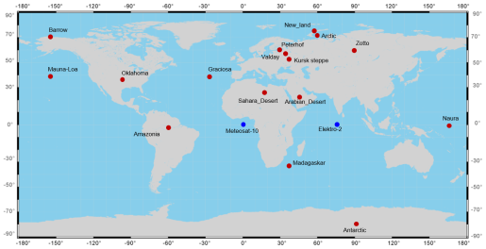
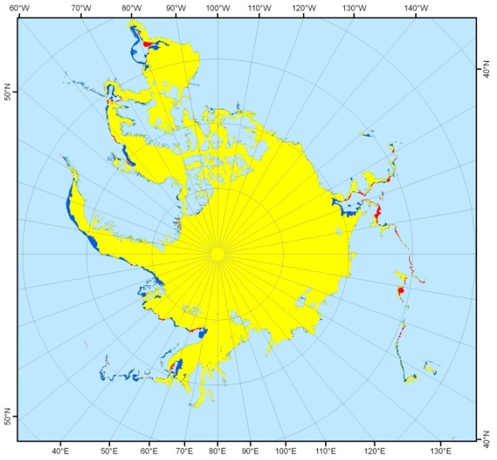
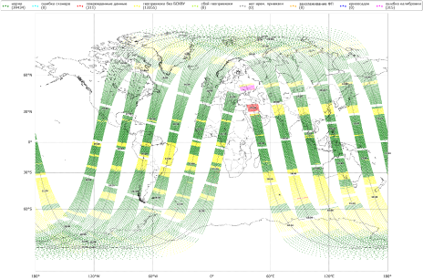
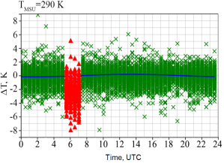
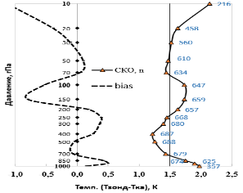
Cal/Val portal for SRC Planeta GSICS Processing
and Research Center (GPRC)
The portal is focused on the Cal/Val data for the Russian on meteorological satellite instruments and products (from polar-orbiting METEOR-M series and geostationary ELECTRO-L series). It is divided into three sections: Calibration, Validation, and Archive.
Calibration (Inter-calibration) | Validation | Archive
Post-launch calibration (inter-calibration) products for basic instruments of METEOR-M and ELECTRO-L satellites.
Validation results for the products derived from METEOR-M and ELECTRO-L data.
METEOR-M and ELECTRO-L basic instrument measurements data for pre-selected test sites.
LEO-GEO: MSU-MR vs SEVIRI
LEO-GEO: IKFS-2 vs SEVIRI
SST Validation
10.8 mkm
12.0 mkm
5 July 2018, Bias = -0.5 K, RMSE = 0.9 K
LEO-LEO: MSU-MR vs AVHRR
LEO-LEO: IKFS-2 vs IASI
Bias Monitoring
Sea ice extent validation
HDF5 files of Level-1C IKFS-2. The data can be utilized for inter-calibration of IR-channels (imaging instruments).
overlap area of SRC Planeta and NIC data
area of NIC data over SRC Planeta data
area of SRC Planeta over NIC data
GEO-GEO: MSU-GS vs SEVIRI
GEO-LEO: MSU-GS vs IKFS-2
Error statistics for temperature profile retrievals
RMSE
09/08/2018
Global IKFS-2 / METEOR-M N2 data coverage
T_{zond} – T_{ret}, K
July 2018
http://planet.rssi.ru/calval/
© SRC Planeta

Slide 4
Navigating through the website
http://planet.rssi.ru/calval/
Home | GSICS | Validation | Data | Info
 | Calibration |  | Archive | Satellites
 |  |  | IKFS-2 data | Calibration Landing Page
 |  |  |  | Data outages
 |  |  |  | Publications
 |  |  |  | Abbreviations
 |  |  |  | Contacts
 |  |  |  | Documents
For pages in red – only authorized access
© SRC Planeta

Slide 5
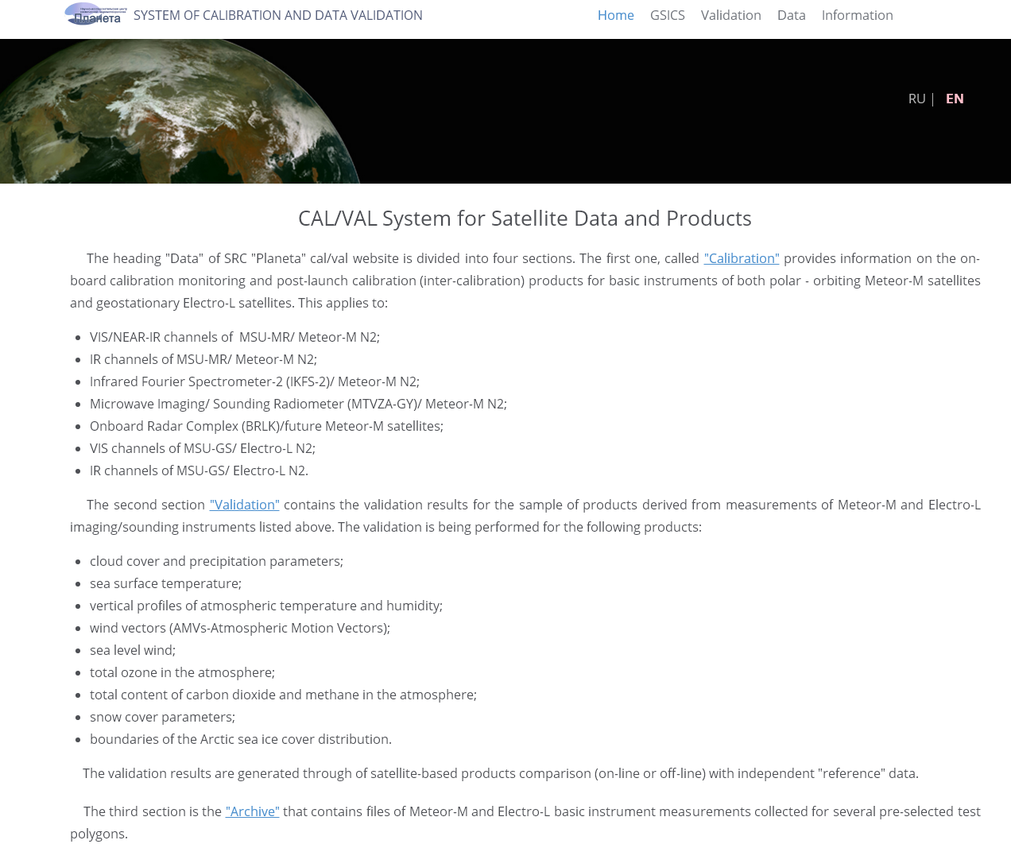
Home page
© SRC Planeta

Slide 6
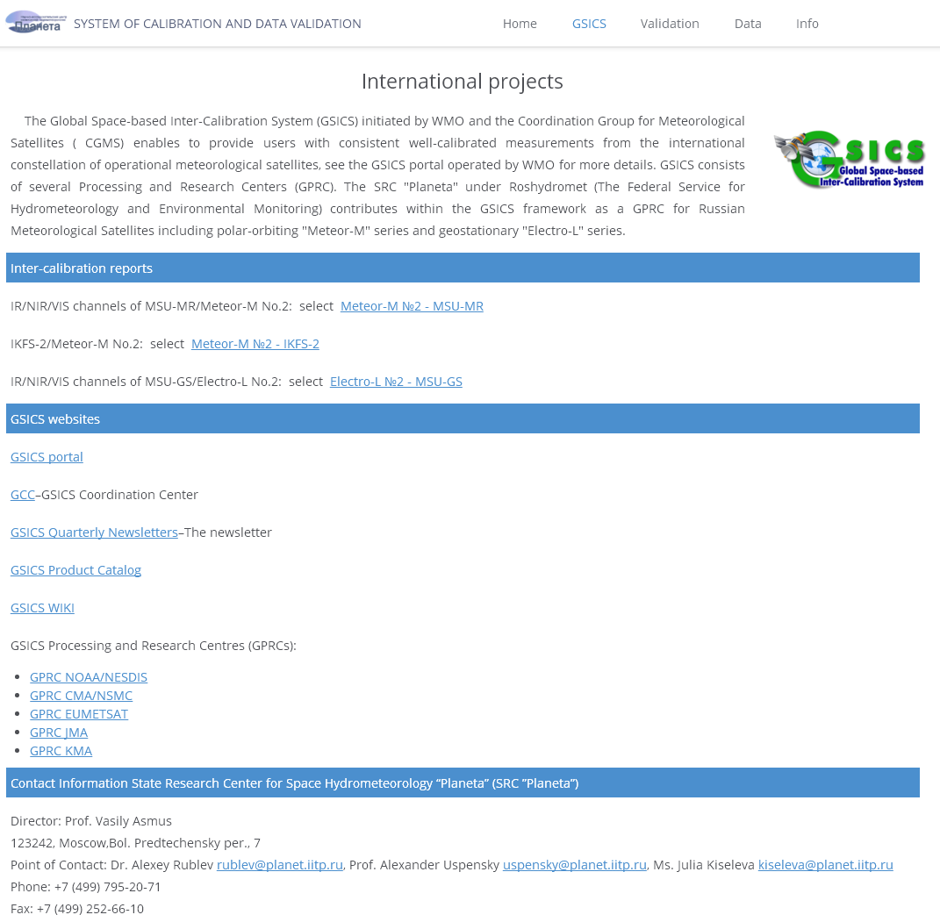
GSICS page
© SRC Planeta

Slide 7
GSICS/Calibration-inter-calibration
Post-launch calibration monitoring and correction (inter-calibration)
Baseline algorithms | Monitored instrument | Reference instrument
GEO-GEO | MSU-GS (IR)/Electro-L No.2 | SEVIRI/Meteosat-11
GEO-LEO | MSU-GS (VIS, NIR)/Electro-L No.2 | VIIRS/SNPP
GEO-LEO | MSU-GS (IR)/Electro-L No.2 | IKFS-2/Meteor-M No.2
LEO-LEO | MSU-MR (VIS)/Meteor-M No.2 | AVHRR/Metop, NOAA
LEO-GEO | MSU-MR (IR)/Meteor-M No.2 | SEVIRI/Meteosat-11
LEO-GEO | IKFS-2/Meteor-M No.2 | SEVIRI/Meteosat-11
LEO-simulator | MTVZA-GY/Meteor-M No.2 | Modeling (LBLRTM, FRTM-RTTOV,…)
GSICS Correction. Regression coefficients between reference and monitored observations enable to perform the GSICS Correction. Linear regression coefficients (C₀ and C₁) are estimated to derive relationship between radiances measured by monitored (Mon) and reference (Ref) instruments:
Radiance (Mon) = C₀ + C₁ × SBAF × Radiance (Ref), where SBAF - Spectral Band Adjustment Factor
Corrected satellite radiances are calculated using the relationship :
Corrected radiance (Mon) = {Radiance (Mon) − C₀ }/ (C₁ × SBAF )
© SRC Planeta

Slide 8
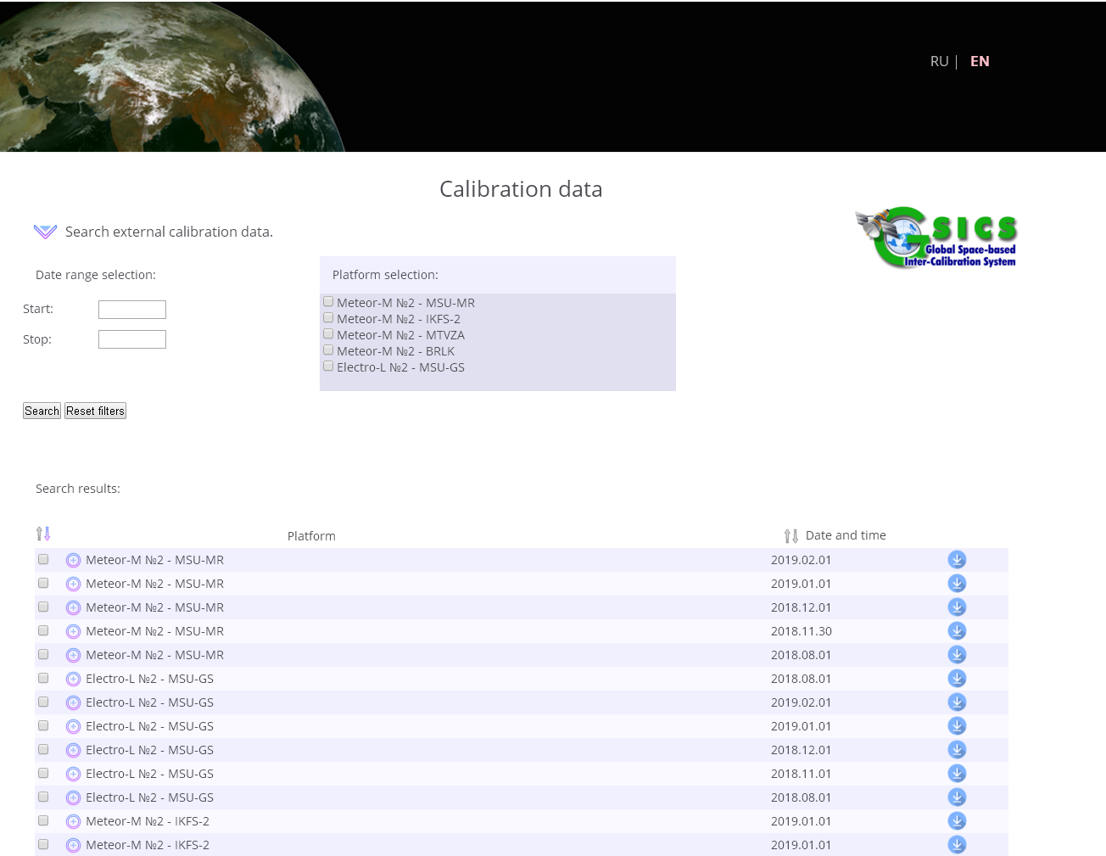
GSICS/Calibration-inter-calibration page
© SRC Planeta

Slide 9
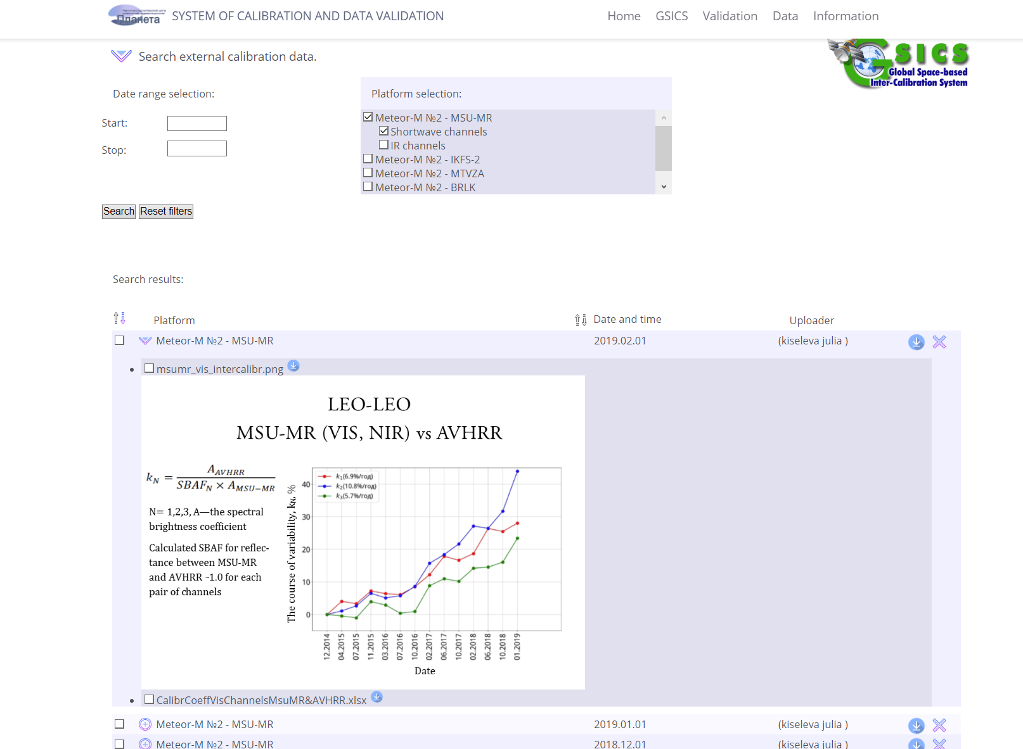
GSICS/MSU-MR inter-calibration (VIS, NIR, IR)
© SRC Planeta

Slide 10
Inter- calibration GEO-LEO
MSU-GS (Ch 1-3) vs VIIRS/Suomi NPP
Comparison above
deep convective clouds
over the Indian Ocean
Calculated SBAF between MSU-GS
and VIIRS ~1.0 for each pair of channels
± 20° North/South and East/West of Electro-L No. 2
sub-satellite point (76 °E)
© SRC Planeta

Slide 11
Inter-Calibration GEO-GEO
MSU-GS (IR ch9- 10.7 µm) vs SEVIRI/Meteosat-11
© SRC Planeta

Slide 12
Inter-calibration GEO-LEO
MSU-GS (ch6-8) vs IKFS-2/Meteor-M N2
© SRC Planeta

Slide 13
GSICS Bias Monitoring and Correction
(Meteor-M №2/IKFS-2 vs Meteosat-10,-11/SEVIRI)
© SRC Planeta

Slide 14
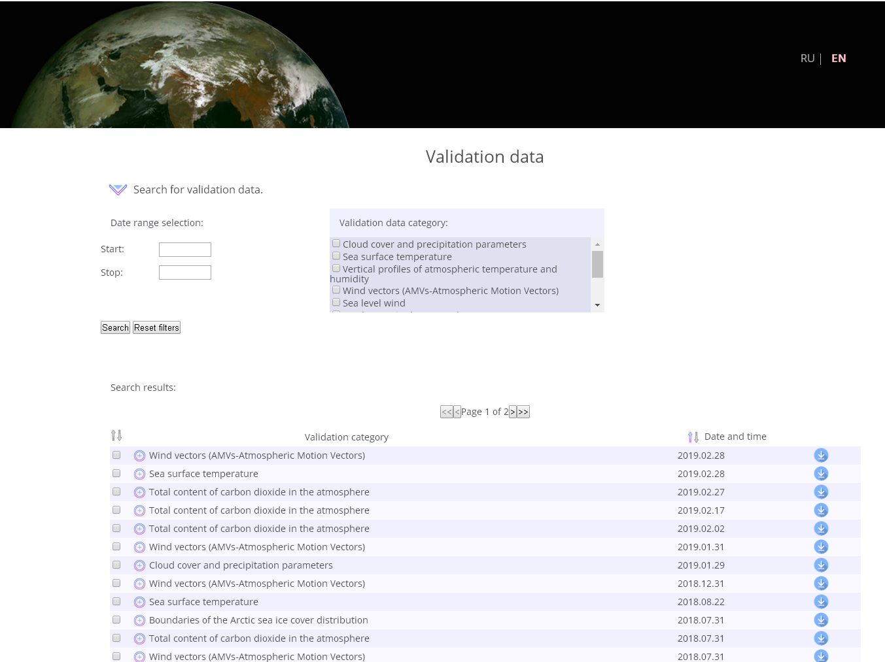
Validation page
© SRC Planeta

Slide 15
SST Validation
SST (MSU-MR) vs ship’s measurements
© SRC Planeta

Slide 16
Temperature and Humidity profiles Validation
IKFS-2 based profiles vs radiosondes
Far-Eastern Region

Slide 17
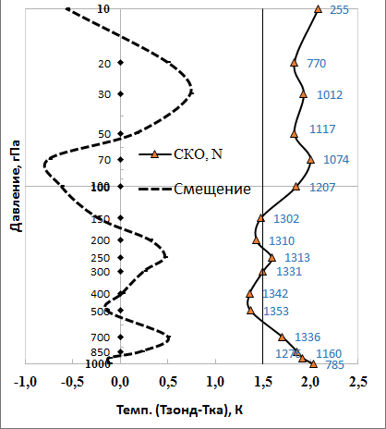
Temperature profiles Validation
IKFS-2 based profiles vs radiosondes
RMSE, N
BIAS
Global coverage
Error statistics for 12.2018-02.2019. Sample size 255÷1353 for various levels
© SRC Planeta

Slide 18
Wind vectors (Cloud motion winds)
© SRC Planeta

Slide 19
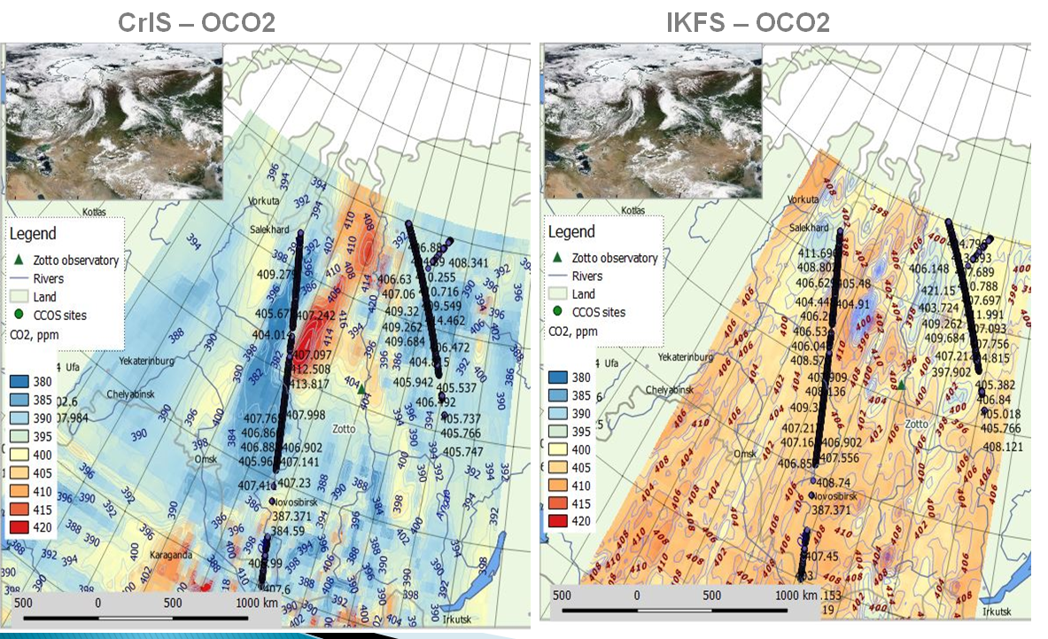
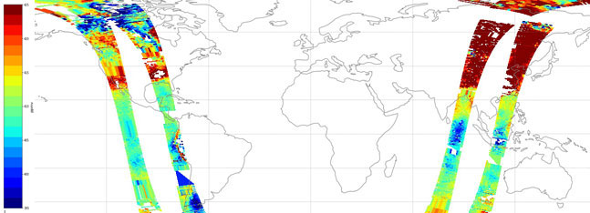
CO₂ column amount validation
IKFS-2 vs CrIS, ZOTTO (OCO)
July 2019
17.02.2019

Slide 20
Data page
Archive
IKFS-2 data
Available Data MSU-MR, IKFS-2, MTVZA-GY
for 17 test sites from 2015 year (BIN files)
Publicly available data
from March 2015 up to now (HDF-5 files)
© SRC Planeta

Slide 21
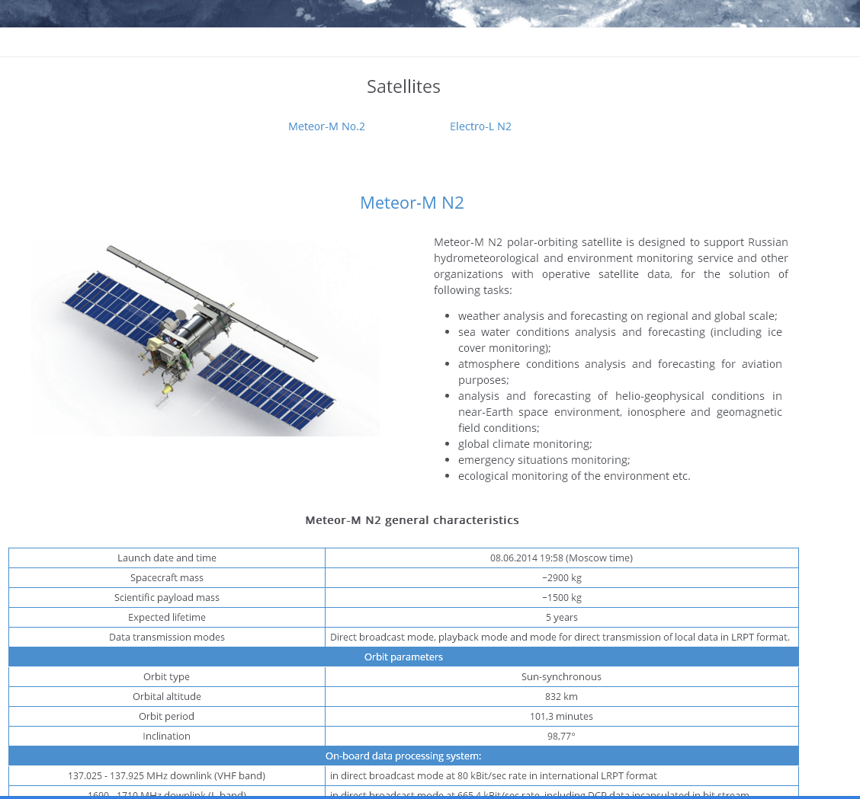
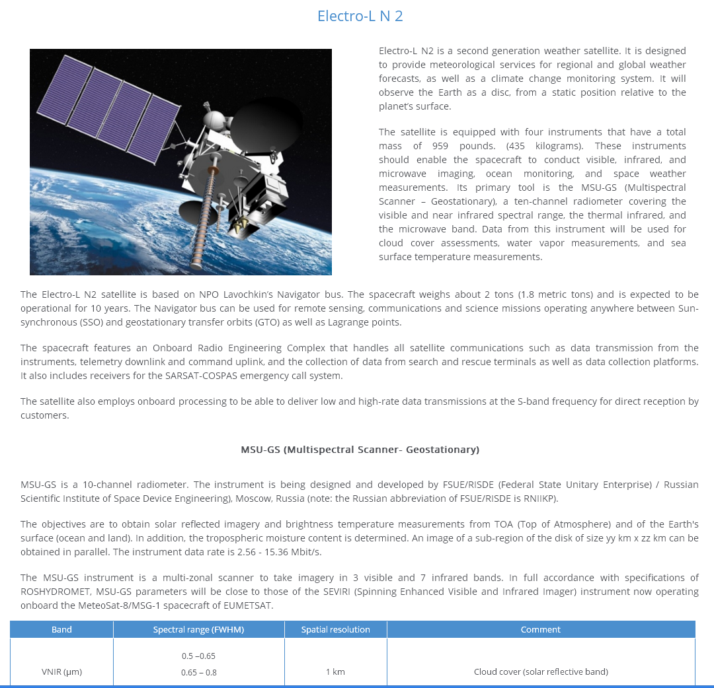
Info page/Satellites
© SRC Planeta

Slide 22
Info page/Calibration Landing Page
© SRC Planeta

Slide 23
Info page/Data outages
© SRC Planeta

Slide 24
Info page/Publications
© SRC Planeta

Slide 25
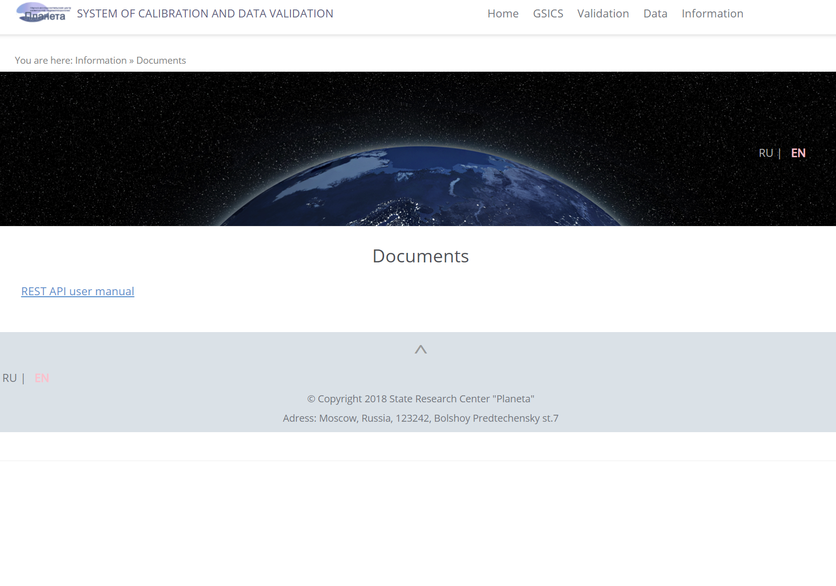
Info page/Documents
REST API functions:
Get list of test regions and their basic descriptive information;
Get list of remote sensing platforms. Remote sensing platform is a combination of satellite platform and sensing instrument on it;
Search instrument measurements archives by specified criteria;
Download files from instrument measurements archives.
© SRC Planeta

Slide 26
2019 GSICS Data and Research Working Groups Annual Meeting
Thank you!
Frascati, Italy, 06 March 2019

