Slide 1

Working Group on Information Systems and Services (WGISS)
Committee on Earth Observation Satellites
Mirko Albani, ESA, WGISS Chair
GSICS Meeting
ESA/ESRIN, Frascati
6 March 2019

Slide 2
Introduction to CEOS
Viewing Earth, serving society
The Committee on Earth Observation Satellites (CEOS) ensures international coordination of civil space-based Earth observation programmes
Established in 1984
62 members and associate members
160 missions currently operating
177 missions under development

Slide 3
Introduction to CEOS
Three primary objectives:
Optimise benefits of EO through cooperation between CEOS Agencies in mission planning and the development of compatible mission outputs
Provide a focal point for international coordination of space-based Earth observation
Serve as a forum for exchange for technical and policy information to encourage complementarity and compatibility among space-based Earth Observation systems

Slide 4
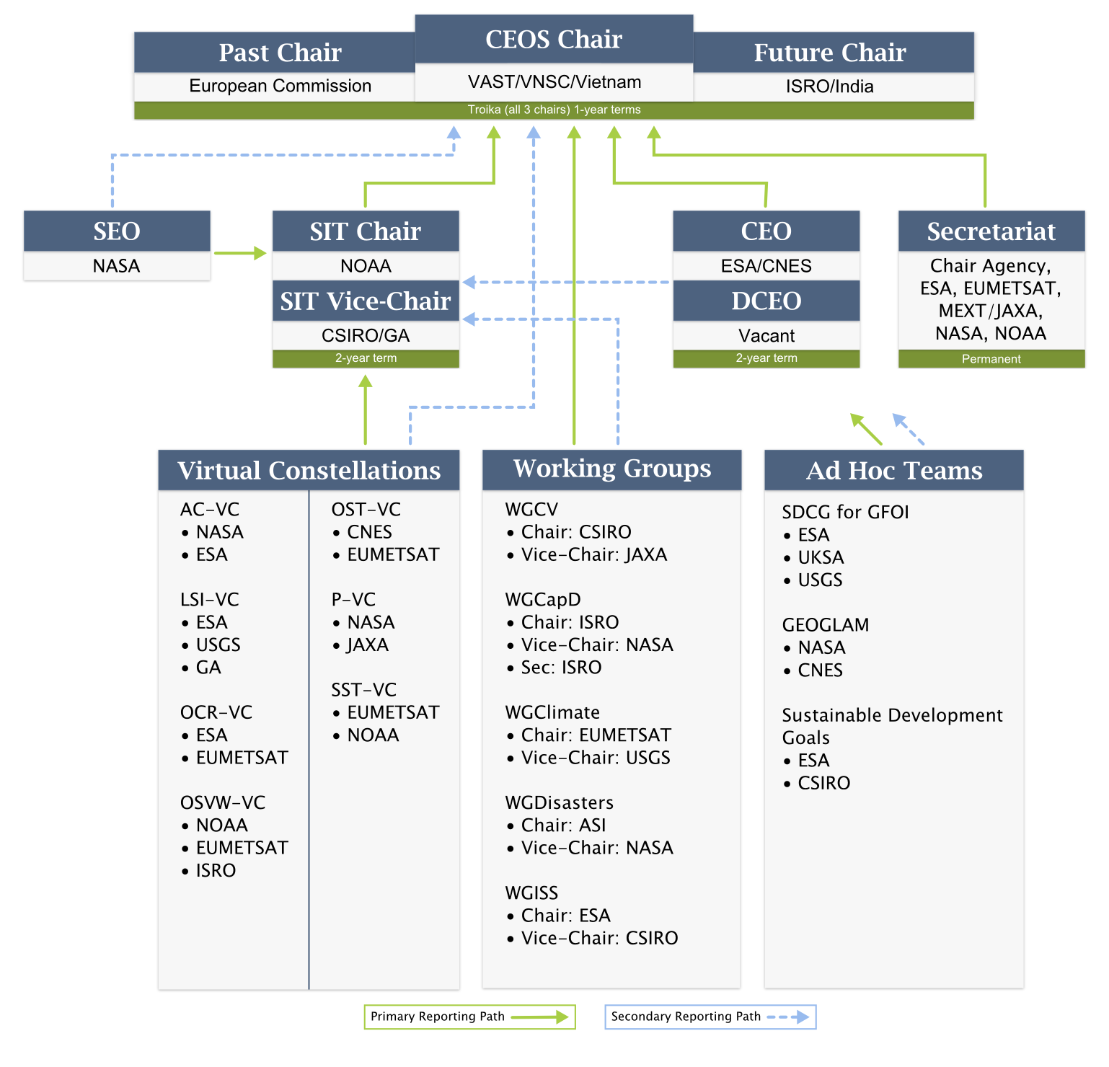
Organisational structure
CEOS Leadership
Support roles
Working Groups
Virtual Constellations
Ad-hoc Teams
Notes:
The CEOS Chair is a senior space agency official that serves a one-year term as the primary interface for all external coordination. The Chair reports to CEOS Agency Principals at the annual CEOS Plenary session and ensures that their guidance and direction are appropriately reflected in CEOS activities and priorities.
The SIT Chair serves a two-year term and formally reports to the CEOS Chair. The objectives of the SIT Chair focus on strategic guidance with regard to governance, stakeholders, and the accomplishment of Virtual Constellation and Working Group deliverables. In addition, the SIT Chair coordinates the technical implementation of CEOS contributions to the Group on Earth Observations (GEO) Work Plan.
The SEC coordinates internal and external CEOS activities between Plenary sessions and assists the CEOS Chair and SIT Chair in the formulation of CEOS position statements, the coordination of external meeting attendance, and the review of major meeting agendas, actions, and minutes.
The CEO/DCEO report to the CEOS Chair or SIT Chair (as determined by the CEOS Chair) and work closely with the SEC, Working Groups, Virtual Constellations, and CEOS Agencies to:
Develop the CEOS Work Plan
Discuss CEOS Contributions to the GEO Work Plan with GEO
Advise CEOS leadership on continued/increased internal and external cooperation
Track progress on the CEOS Work Plan Objectives/Deliverables
The SEO provides systems engineering leadership to the Virtual Constellations, Working Groups, and other ad hoc CEOS activities. The SEO facilitates the use of systems engineering methodologies and tools to strengthen plans and improve CEOS collaboration.
The CEOS Virtual Constellations are the other permanent working-level mechanism for coordinating CEOS Agency assets. Virtual Constellations report primarily to the SIT Chair and are typically made up of space-based, ground-based, and/or data delivery systems that are coordinated to meet a common set of requirements within a specific domain.

Slide 5
WGISS - Working Group for Information Systems and Services
Committee on Earth Observation Satellites

Slide 6
WGISS Scope
WGISS is a subsidiary body supporting CEOS
  Promotes collaboration in the development of systems and services that manage and supply Earth Observation data;
  Creates and demonstrates prototypes supporting CEOS and Group on Earth Observation (GEO) requirements;
  Addresses the internal management of EO data, the creation of information systems and the delivery of interoperable services.
The activities and expertise of WGISS span the full range of the information life cycle from the requirements and metadata definition for the initial ingestion of satellite data into archives through to the incorporation of derived information into end-user applications.
Notes:
Recent advances in technology open the floor for new and innovative approaches for data exploitation and use and require an adaptation and evolution of the approaches, infrastructures and services provided by CEOS agencies. WGISS contribution and role in providing a forum for technical exchange and sharing, and for the definition and prototyping of common and interoperable approaches and architectures for data management and exploitation will become more and more central for CEOS agencies and for CEOS as a whole in support to the achievement of its objectives

Slide 7
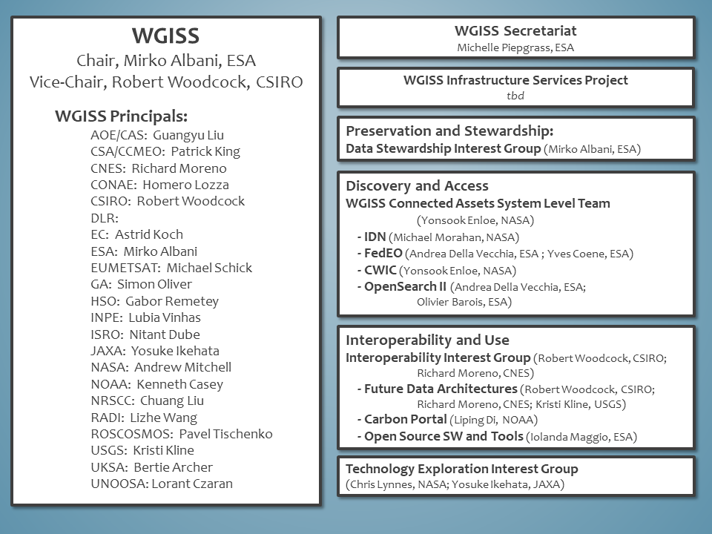
WGISS Structure

Slide 8


Data Preservation and Stewardship
WGISS accomplishes its Data Preservation and Curation efforts through the Data Stewardship Interest Group (DSIG)

Slide 9
Data Stewardship Best Practices
Document Tree
EO Data Stewardship
Cooperative Framework
Policy Documents
CEOS Agencies EO Space Data Sets
Applied to
Data Purge Alert Procedure & White Paper
Recommended / Reference
Individual organizations'
policies (stewardship, access, ...)
Recommended for
application
Recommended /
Reference
Technical Documents
Reference Model for Data Stewardship
Glossary of Acronyms and Terms
General guidelines and best practices
Support
Preservation Workflow
EO Data Preservation Guidelines
Preserved Data
Set Content
Associated Knowledge Preservation
WGISS Maturity Matrix
Persistent Identifiers Best Practice
Guidelines and best practices on specific topics
Technical implementation procedures
EO Data Set
Consolidation Process
…
Image Source: http://eastenders.wikia.com/wiki/File:Under-construction.png

Slide 10
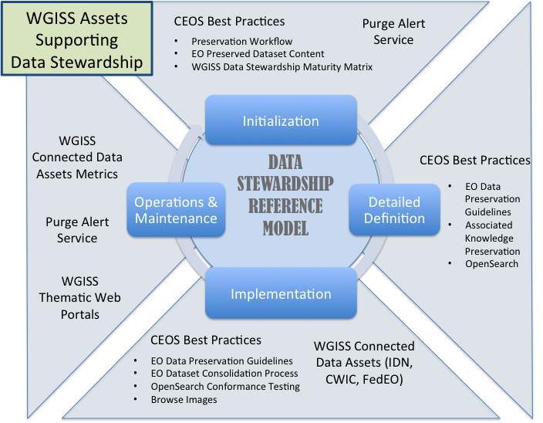
Reference Model for Data Stewardship

Slide 11
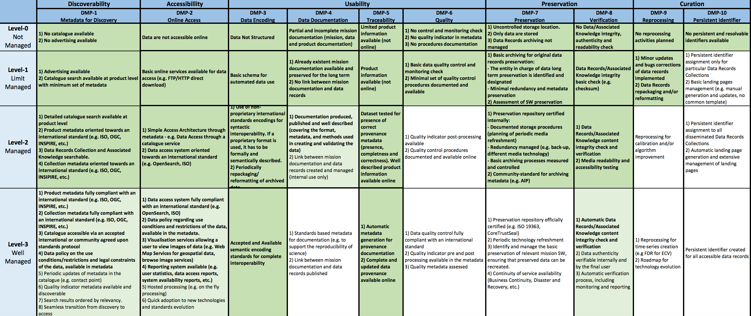
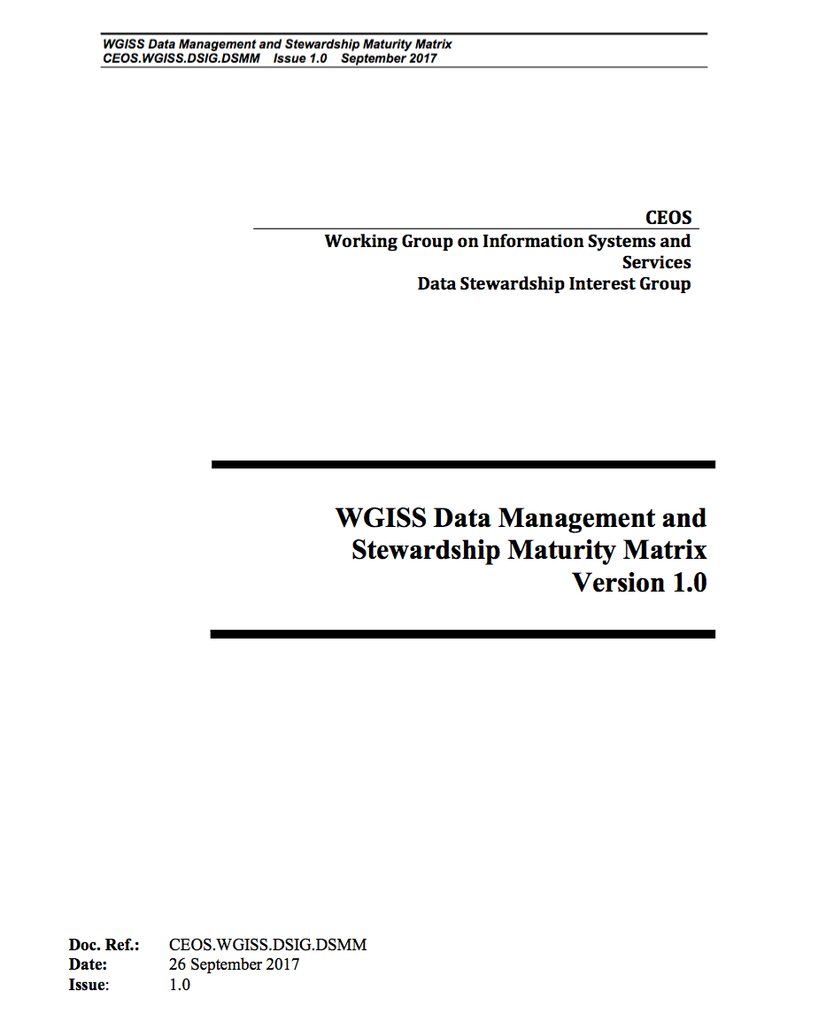
WGISS EO Data Stewardship Maturity Matrix

Slide 12


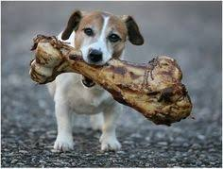
Discovery & Access
WGISS accomplishes its Data Discovery and Access efforts through the WGISS Connected Data Assets System Level Team (SLT)

Slide 13
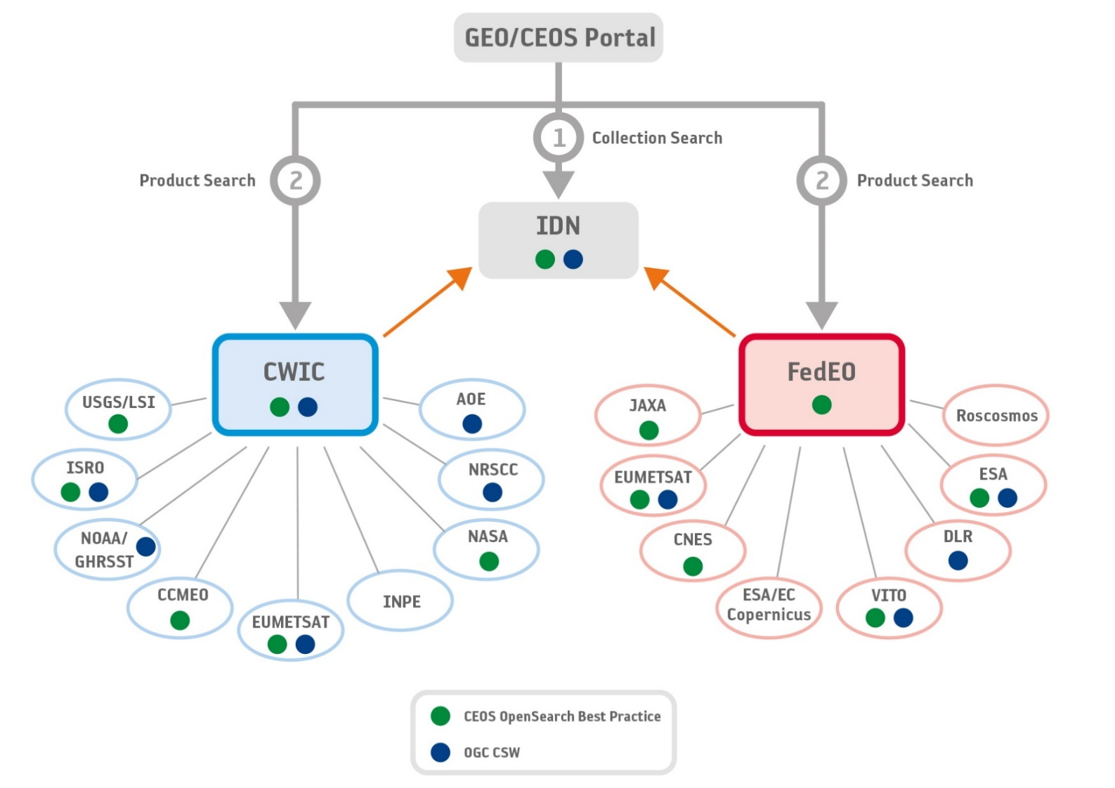
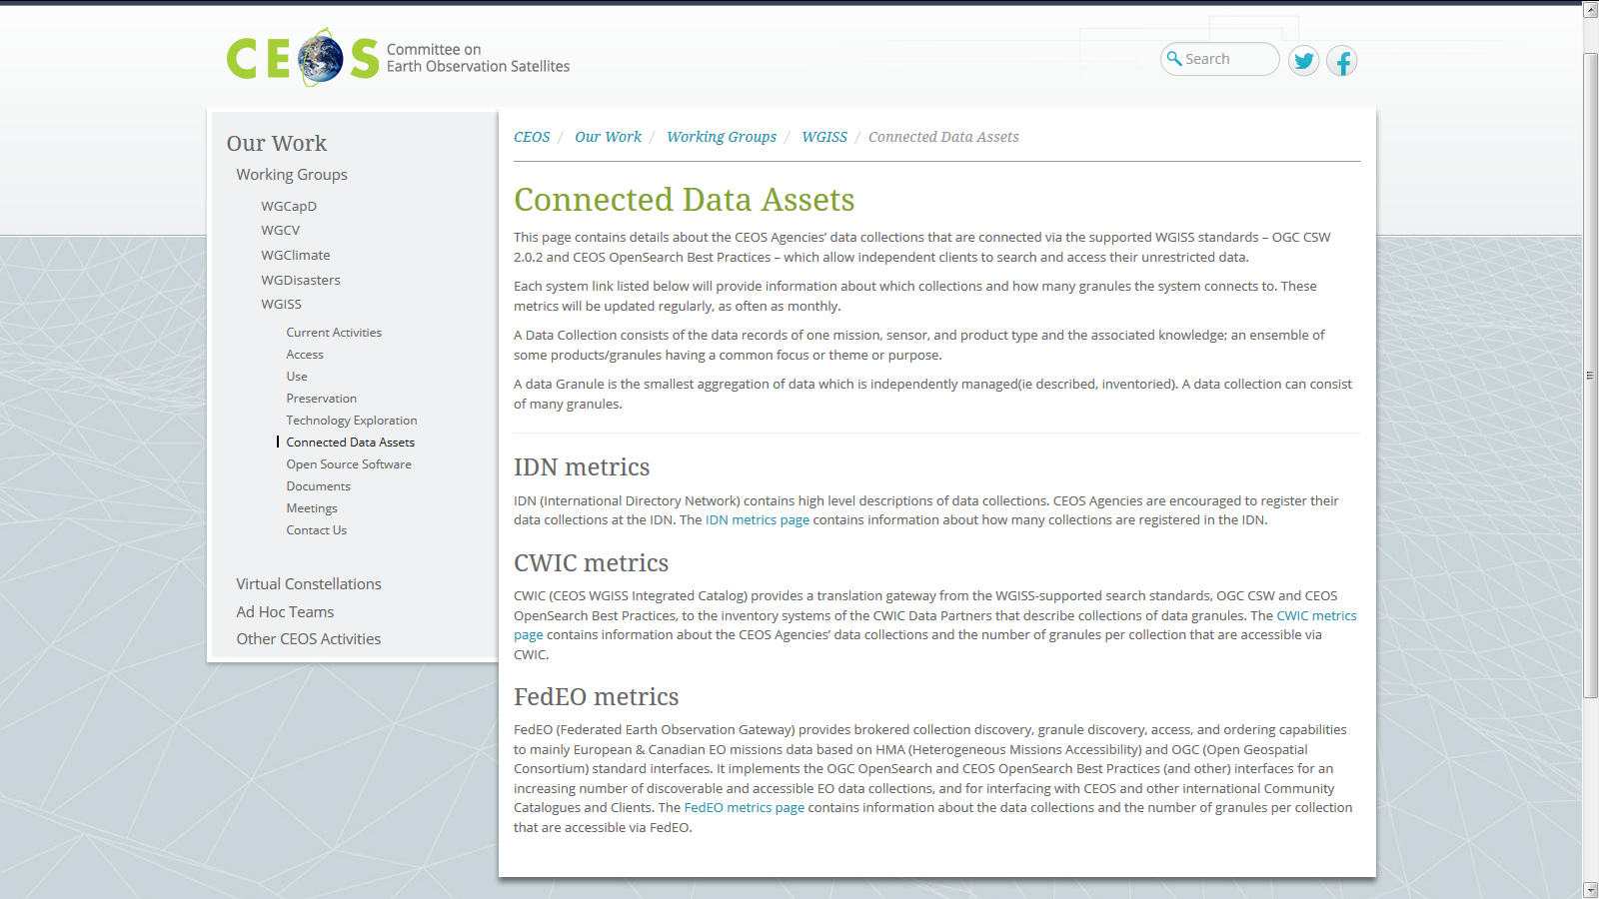
WGISS Connected Data Assets (CDA)
Relying on IDN/CWIC/FedEO components, provides a single entry point for external clients to discover and access CEOS agencies data
Search over 32,000 collections in the IDN
Access over 5000 collections with associated over 300+ million granules (granule search)

Slide 14
WGISS Connected Data Assets (CDA)
System Level Team (SLT) coordinates maintenance and operations.
Client Portals:
  GEOSS Platform (GEO Portal)
  AMERIGEOSS Portal
  ESA EOPortal
  CEOS COVE Tool
  CEOS Carbon Portal
Being enlarged with new partners and continuously populated with additional data collections, for example:
  ECVs/CDRs in coordination with WGClimate, COVERAGE Team, CEOS Carbon Team
  ESA Heritage and Earth Explorer Missions (11 million granules)
  NOAA One Stop (over 100 million granules)
  National Remote Sensing Center of China (NRSCC) now active participant in WGISS CDA (35 millions granules)
(2017-2018)
Sent Provider DIF-9 to DIF-10 QA/Triage Reports.
May 1, 2018
Start migrating existing non-NASA EOSDIS DIF-9 records to DIF-10.
2019 (First quarter)
Plan to have all metadata records transition.
Example IDN: DIF-9 to DIF-10 Transition Schedule
Notes:
WGISS Connected Data Assets Operational Systems (IDN, CWIC, FedEO):
Is maintained and operated in coordination among different agencies (System Level Team) and implements the OpenSearch Interoperability Best Practice defined in WGISS.
Provides a single entry point for GEO (GEOPortal) to discover and access CEOS agencies data.
Is being enlarged with new partners and continuously populated with additional Collections (e.g. ECVs/CDRs inventories from WGClimate).

Slide 15
ECVs/CDRs Discovery and Access through WGISS Systems
913 ECV/CDRs from ECV Inventory V2.0
CURRENT
FUTURE
417
496
204 not in IDN
Notes:
Objective: facilitate discoverability and accessibility of ECV Products and space-born CDRs relevant for the CEOS Carbon Action via WGISS Interoperability Systems & Standards (FedEO/CWIC/IDN, OpenSearch).
Approach: start from results of WGClimate Questionnaire for ECV Inventory population; tailoring for Carbon Action and gaps identification wrt data records already discoverable/accessible through WGISS systems.
Additional Resources: support from WGClimate and experts for priorities setting; activities at data providers’ side to be carried out by relevant entities.
496 out of 913 considered (417 out of 913 not considered because future collections).
288 out of 496 registered in IDN with granule/product accessible via CWIC infrastructure
4 out of 496 registered in IDN with IDN granule/product accessible via CNES infrastructure
204 out of 496 not registered in IDN

Slide 16
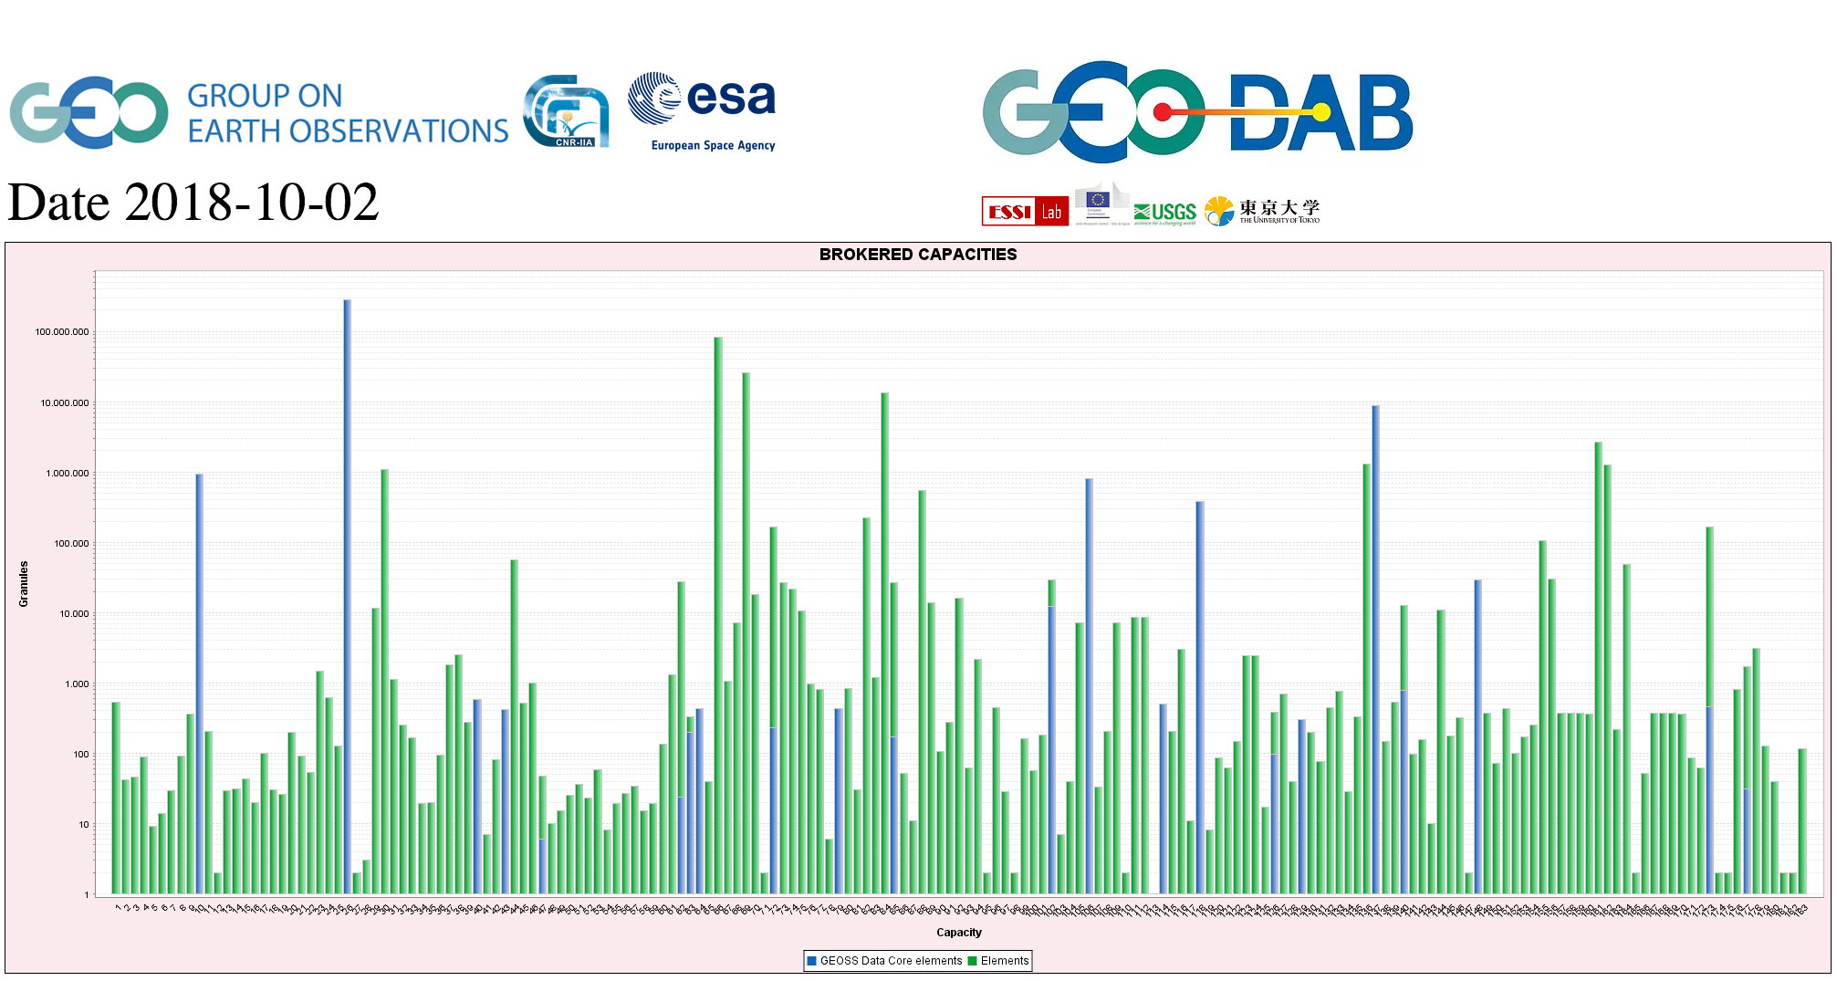
CEOS data in GEOSS
GEOSS PLATFORM DISCOVERABLE DATA PRODUCTS
CWIC
FedEO

Slide 17
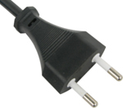

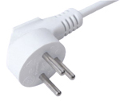
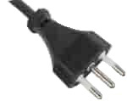

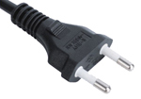
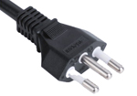




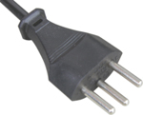
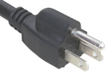



Interoperability and Use
(including Future Data Architectures)
WGISS accomplishes its interoperability and data use efforts through the Interoperability Interest Group.

Slide 18
Interoperability and Use
FDA Themes supported via WGISS
CEOS Analysis Ready Data (ARD)
  Develop and provision CARD4L-compliant optical and/or SAR products
  Examine ARD for ocean and atmosphere domains
Interoperable Free and Open Tools
  Continue supporting the CEOS Data Cube (CDC) initiative
  Demonstrate new technologies through ongoing support of ‘pilot projects’ and consideration of alternate candidate architectures
Data, Processing, and Architecture Interface Standards
  Develop standards for pixel-level data discovery, access, and common analytical processing requests (e.g., cloud free mosaics of ARD) exploiting EO satellite data among various CEOS exploitation platforms
Analytical Processing Capabilities
  Prototype portable web-based analytical processing APIs/Web Services that work across CEOS exploitation platforms in full computing environments for time series and other analysis
User Metrics
  Develop a data use metrics framework through which agencies can contribute to how EO data is being used, rather than just downloaded data quantities
Block A: Analysis Ready Data, CARD4L and interoperable products
Block B: Agency roles in stimulating EO “use-environments”
BLOCK B
BLOCK C
Block C: Earth Observation Resources Analysis and User Metrics
Notes:
CEOS agencies looking into Future Data Architectures and new technologies to maximize uptake and use of EO data.

Slide 19
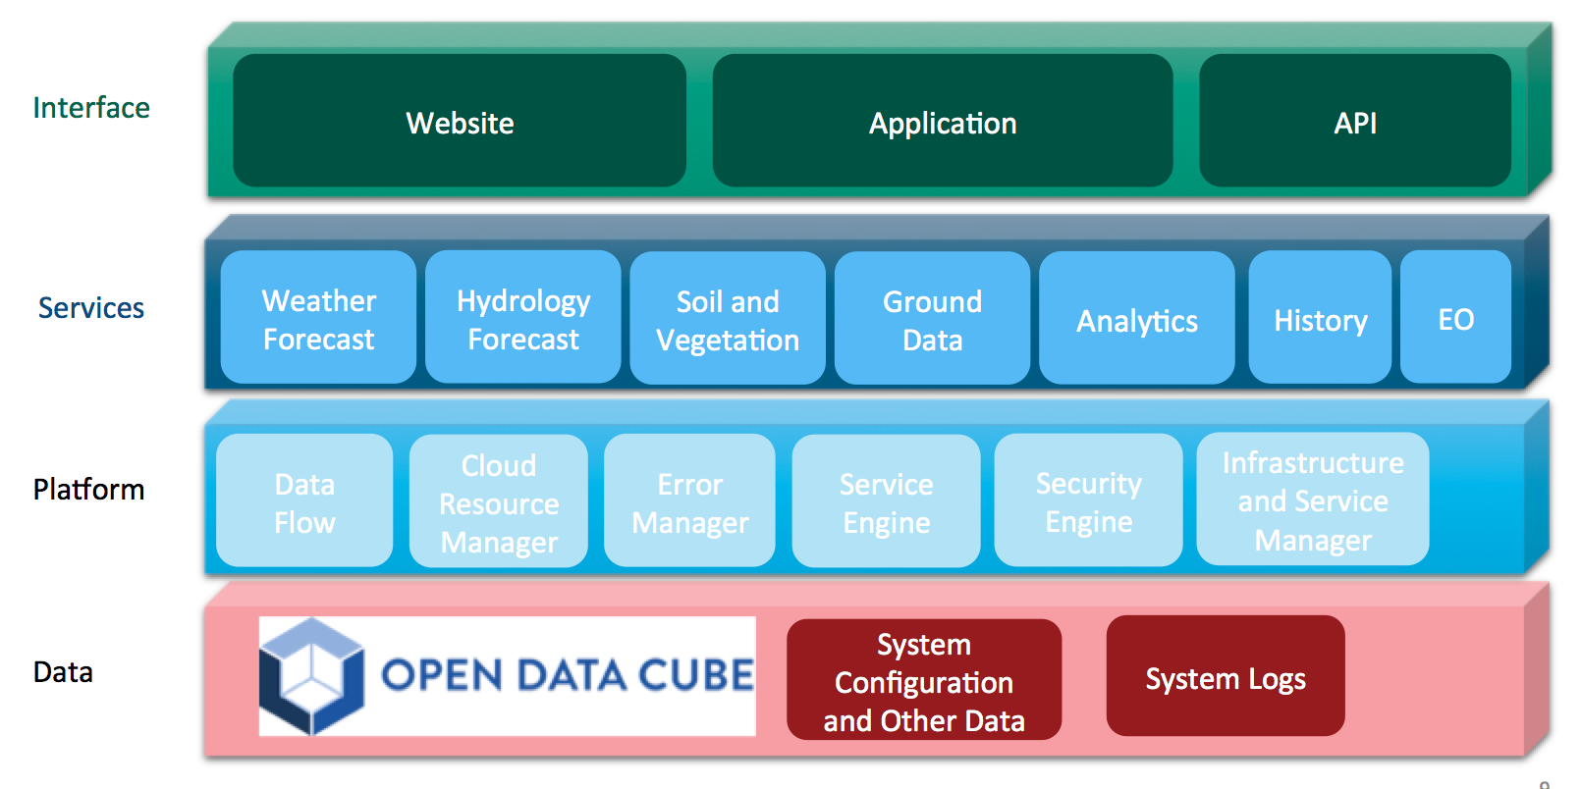
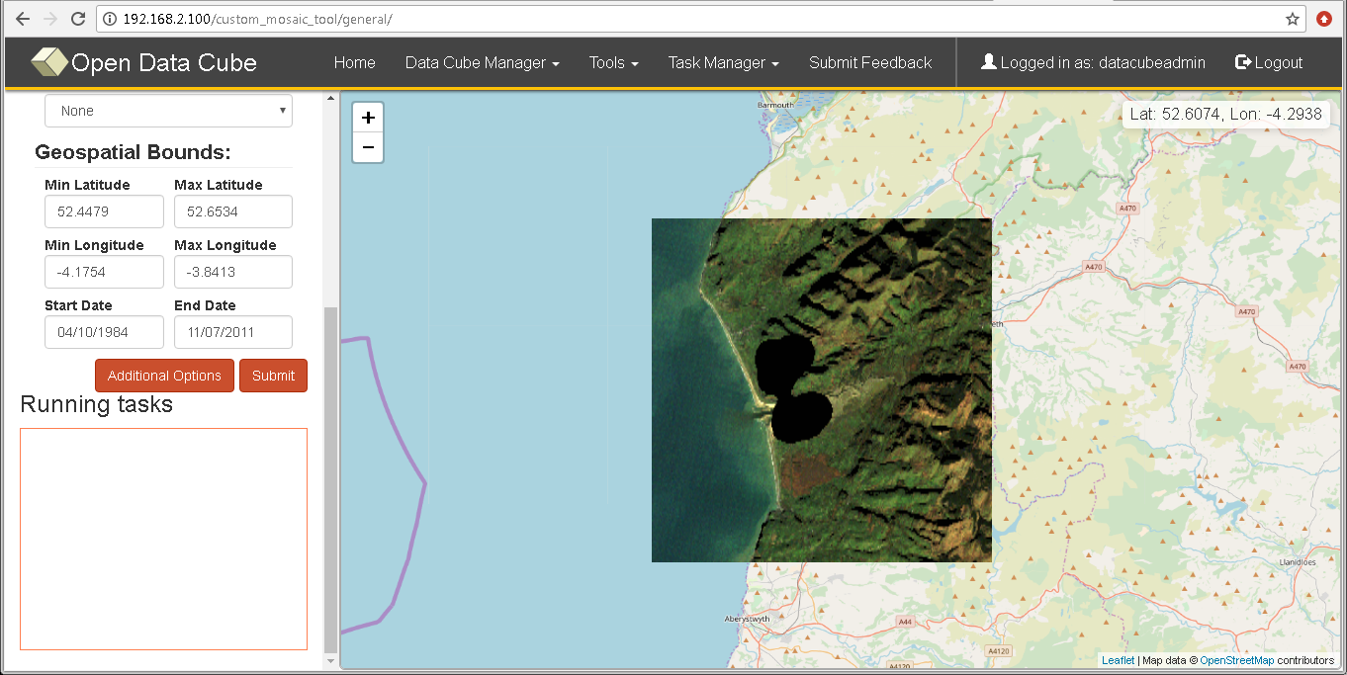


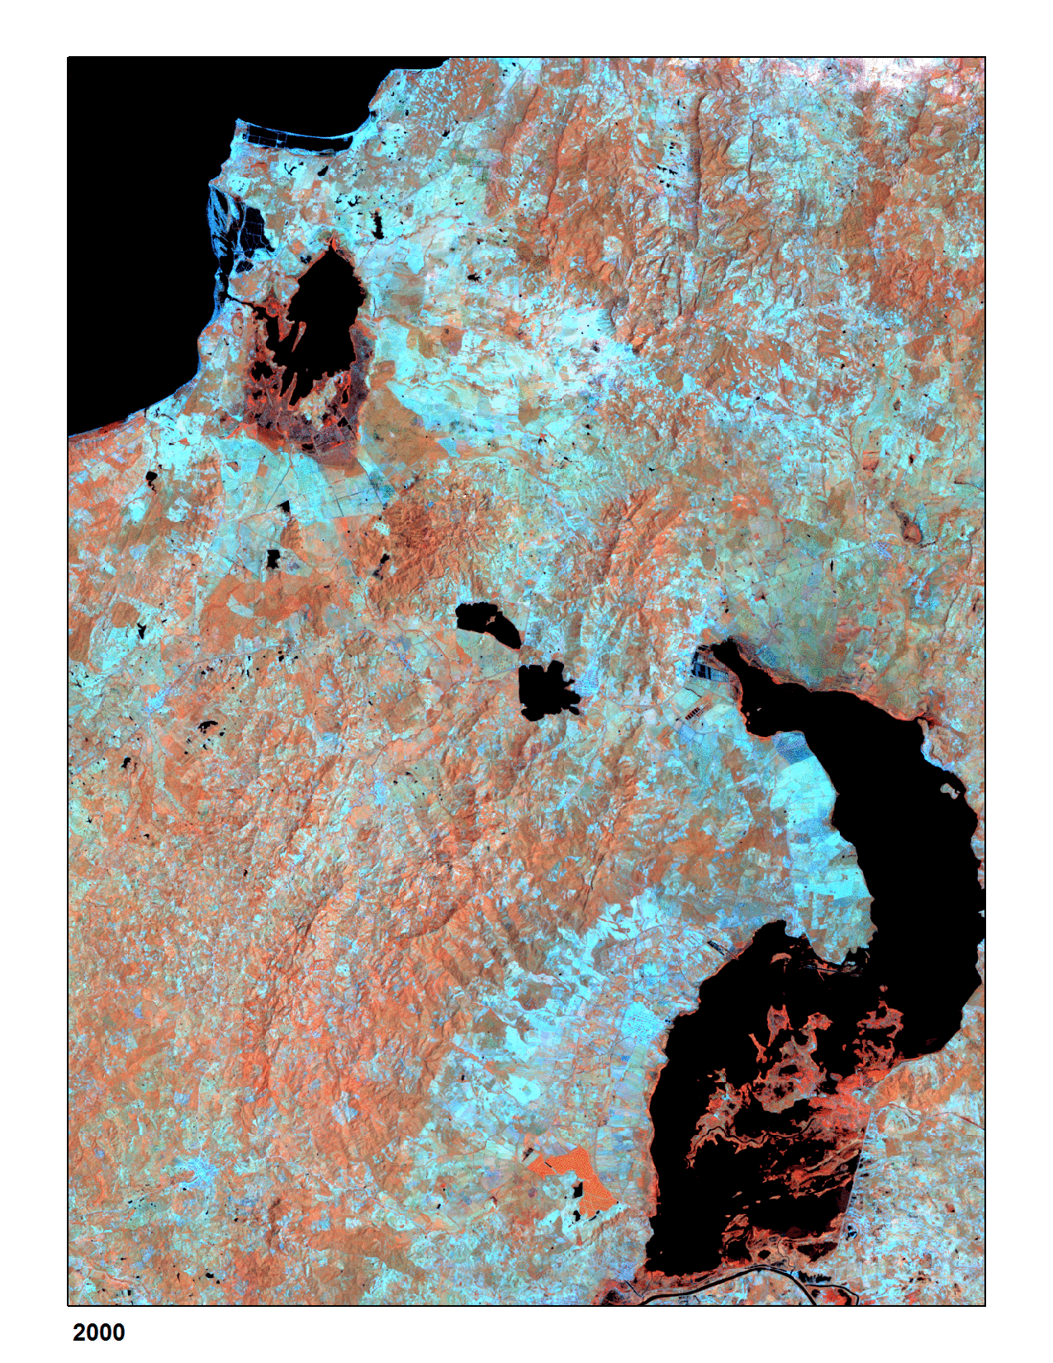
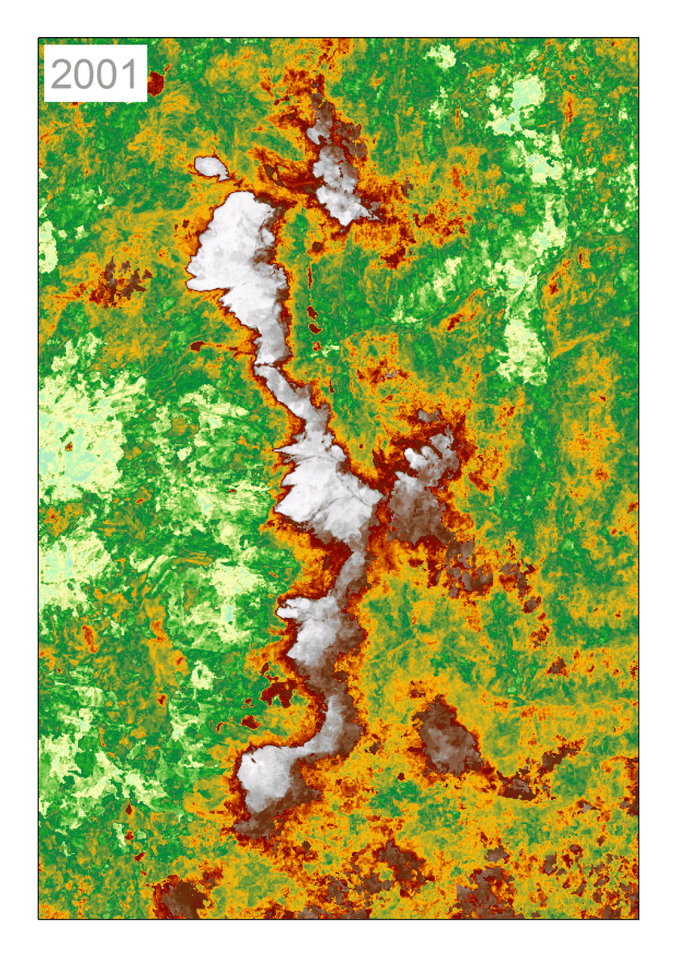
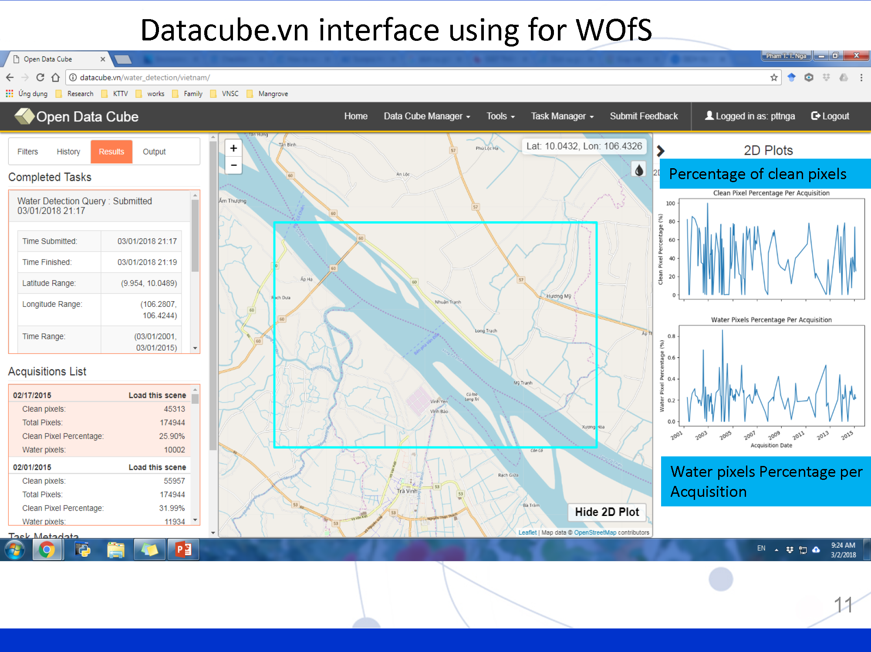

Data Cubes
WALES
UGANDA
VIETNAM

Slide 20













DIAS based functional chart
End user: customer to third-party services
FIVE DIAS PROVIDERS
Funded by
third-parties
Front
office service
Front
office service
Front
office service
Front
office service
Front
office service
Front
office service
Front
office service
Anne Chanié
anne.chanie@airbus.com
Front
office service
Front
office service
Front
office service
Alek Cesarz
alek.cesarz@creotech.pl
Front
office service
Copernicus DIAS interfaces
DIAS
funded
Guido Vingione
guido.vingione@serco.com
Contact for EUMETSAT DIAS
will be published once
commercial provider is selected
Copernicus Data & Information
Other EO and non-EO data
User data integrated into DIAS
Jean-Baptiste Lavedrine
jean-baptiste.lavedrine@atos.net

Slide 21
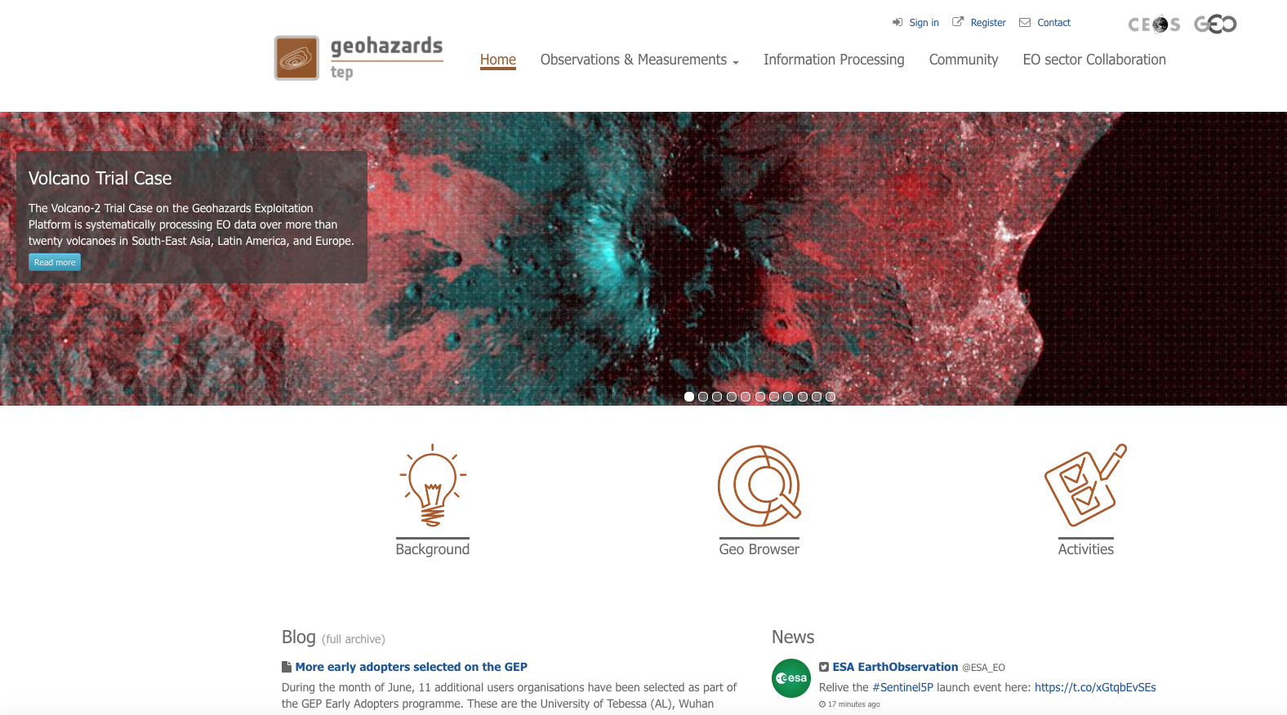
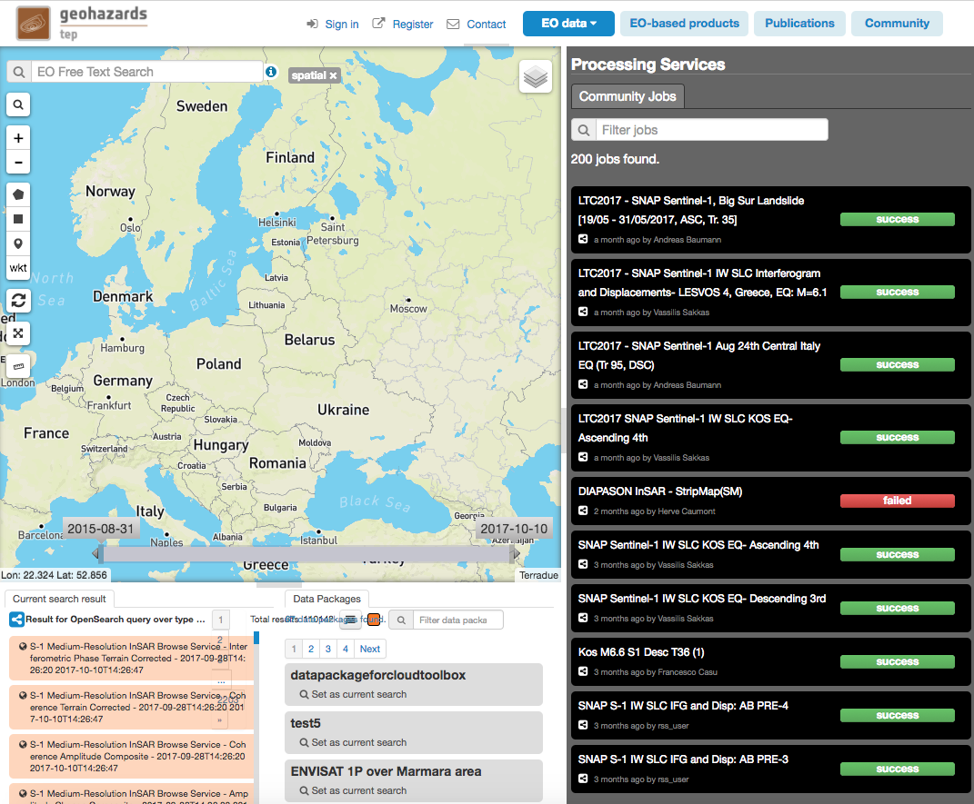
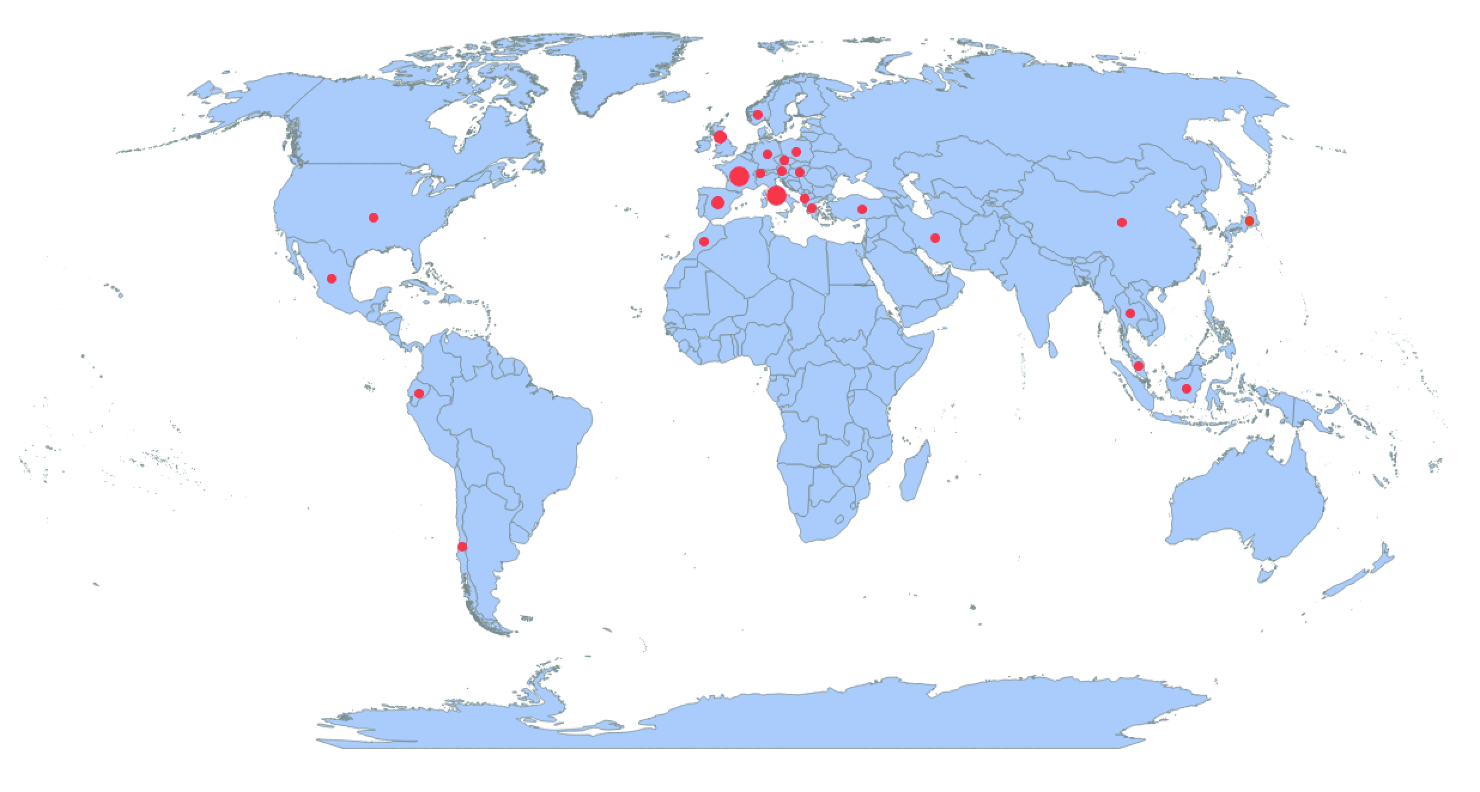
Thematic Exploitation Platforms:
Example Geohazards
Country | Number of User organisations
FR | 13
IT | 11
ES | 10
UK | 7
GR | 4
DE | 3
CH | 2
TR | 2
US | 2
AT | 1
CL | 1
CN | 1
CZ | 1
DK | 1
DZ | 1
EC | 1
HU | 1
JP | 1
ID | 1
IR | 1
MA | 1
ML | 1
MX | 1
NO | 1
PL | 1
TH | 1
Total | 71
820 registered users

Slide 22
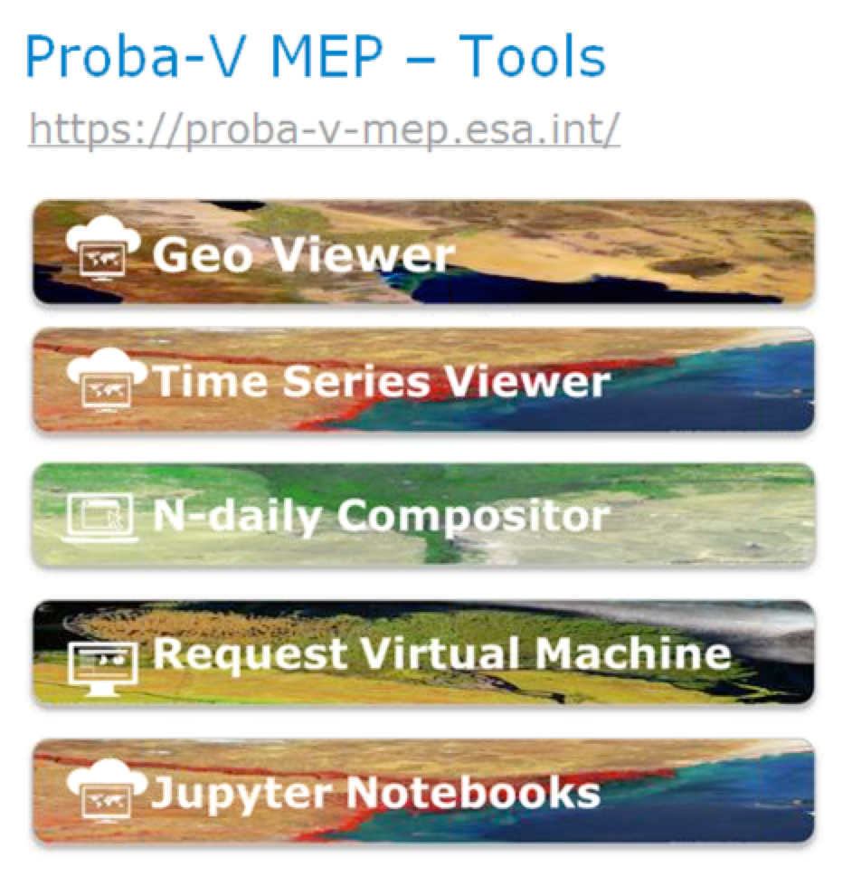






Mission Application Platforms
ESA-NASA multi-Mission Analysis Platform for improving global aboveground terrestrial carbon dynamics
ESA NASA MEP
NASA Mission
Data
NASA Mission
Tools&Visu
ESA-NASA
Missions
Community
ESA Mission
Data
ESA Mission
Tools&Visu
NASA Mission
Processing
resources
ESA Mission
Processing
resources

Slide 23
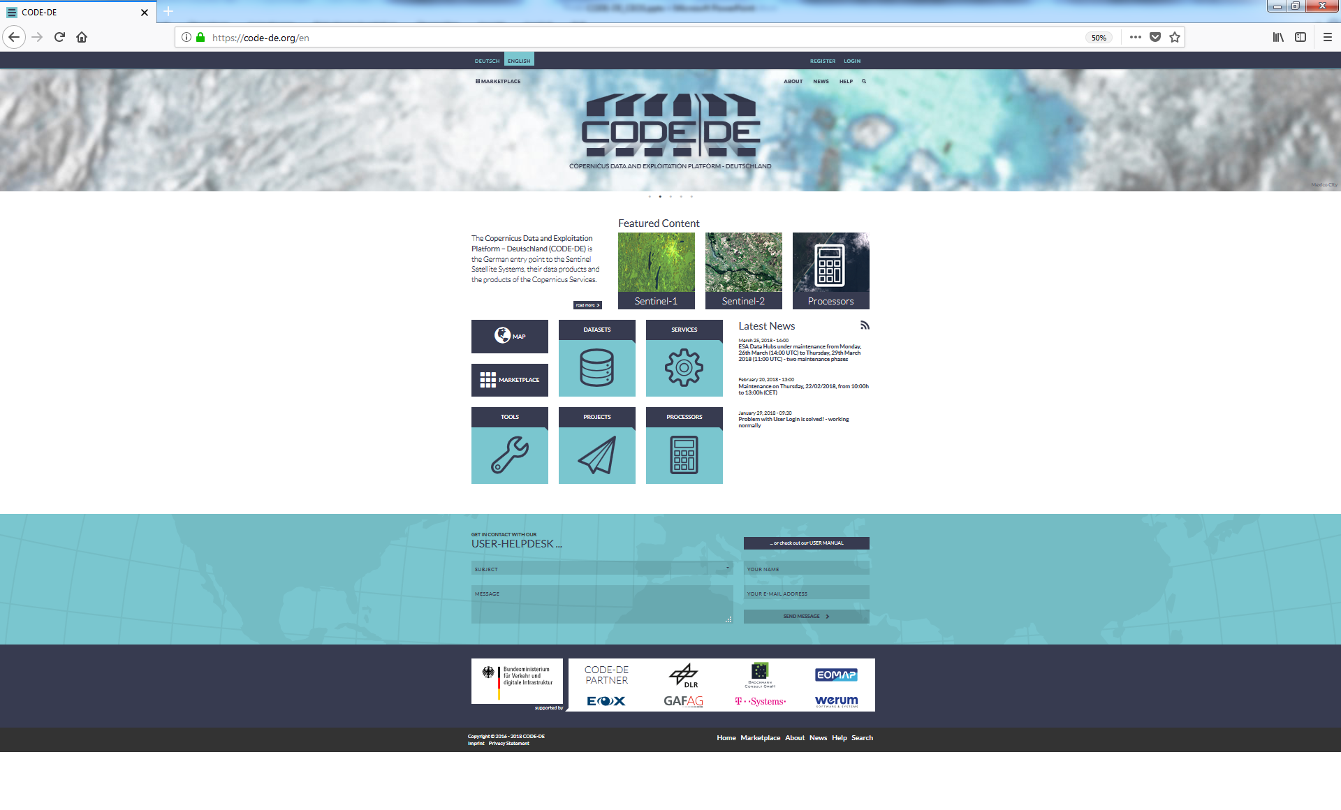
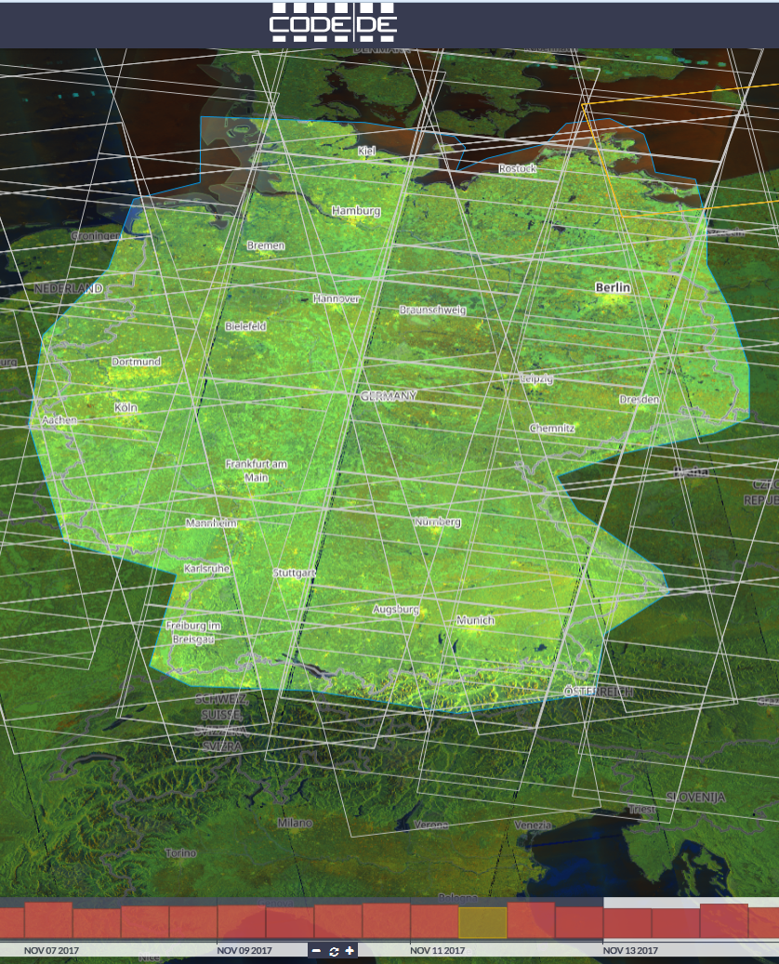
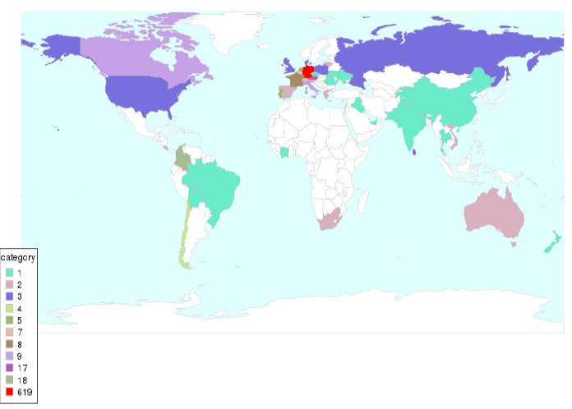
Copernicus Data and Exploitation Platform - Deutschland
code-de.org
830 users

Slide 24

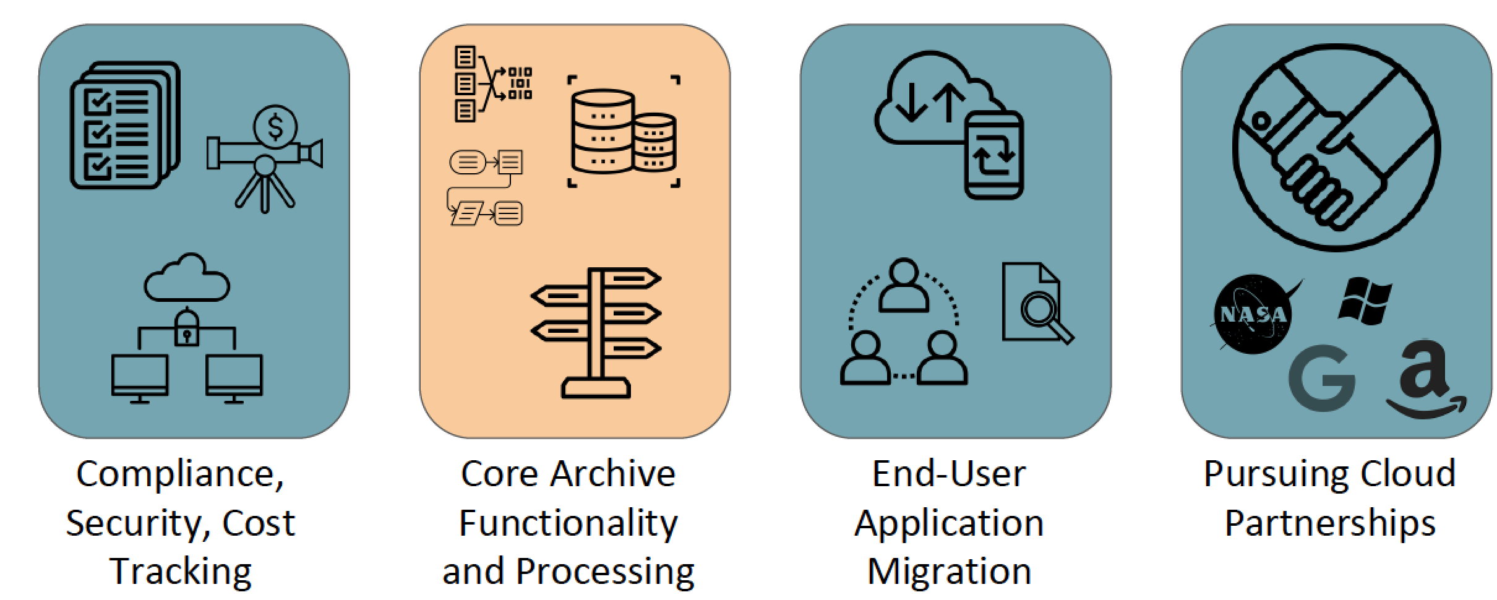

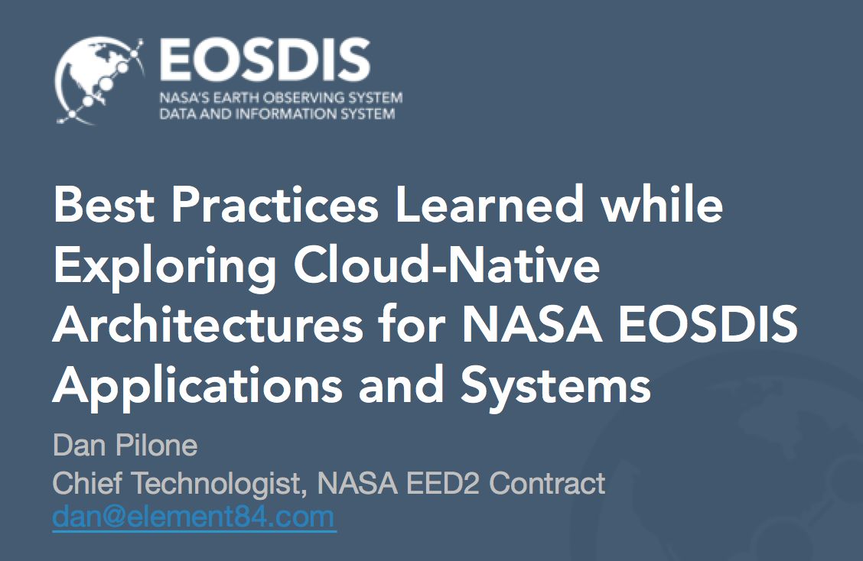

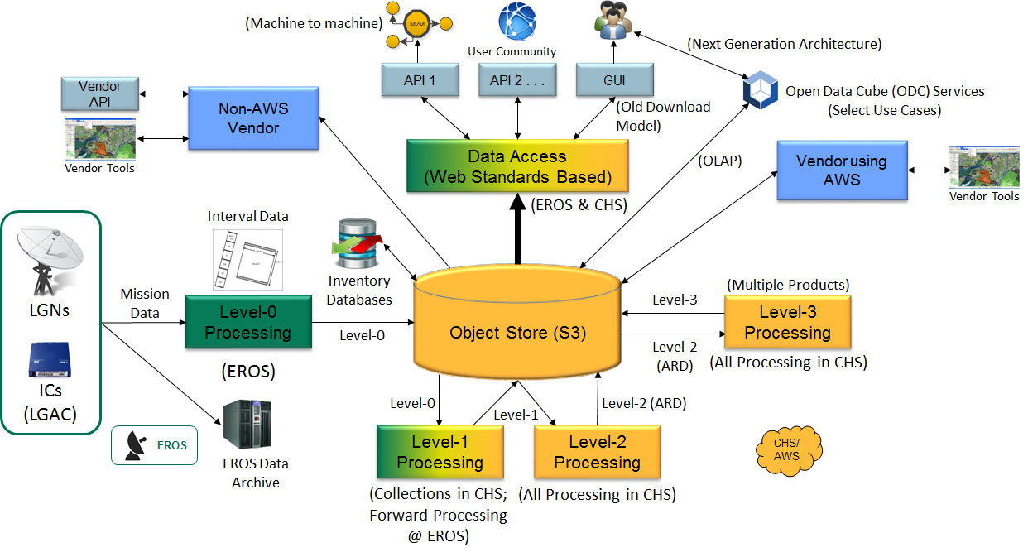
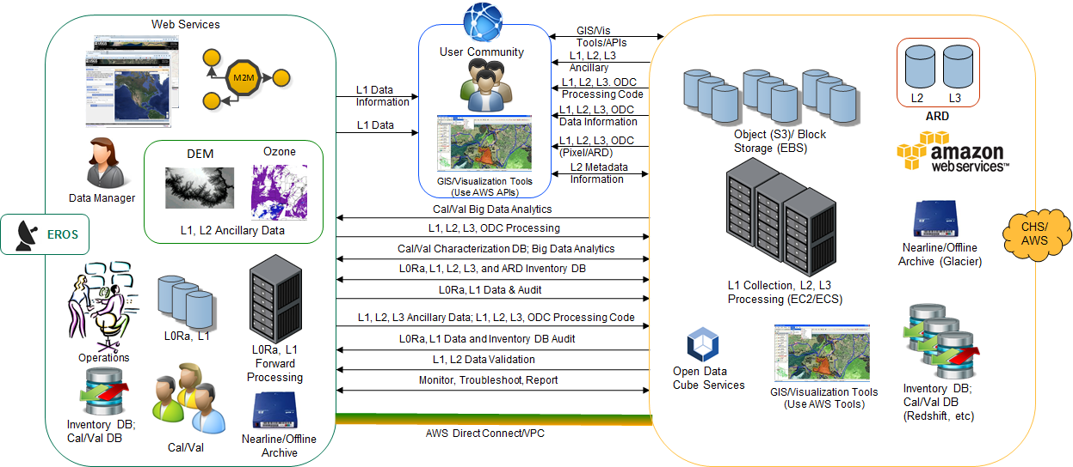

Moving to Cloud: some experiences

Slide 25
WGISS FDA Activities
More and more agencies are experimenting with FDAs
This experimentation brings clear evidence of significant potential benefits
Varying implementations can induce huge variations in functionalities and costs
Consensus that a common architectural model and terminology will:
  facilitate interagency dialog
  enable identification of interfaces
  enable work on standardisation once interfaces identified
WGISS to:
Establish a common description of Future Data Architecture functional blocks and identify interfaces and interoperability approaches;
Inventory and characterise existing “EO use environments” and FDA elements;
Develop a User Metrics Best Practice

Slide 26
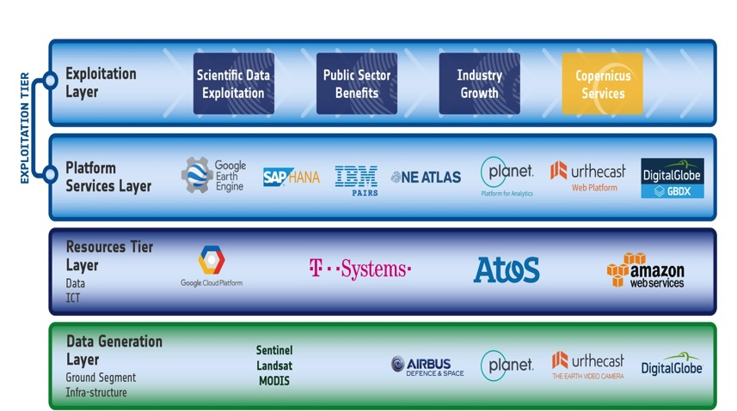
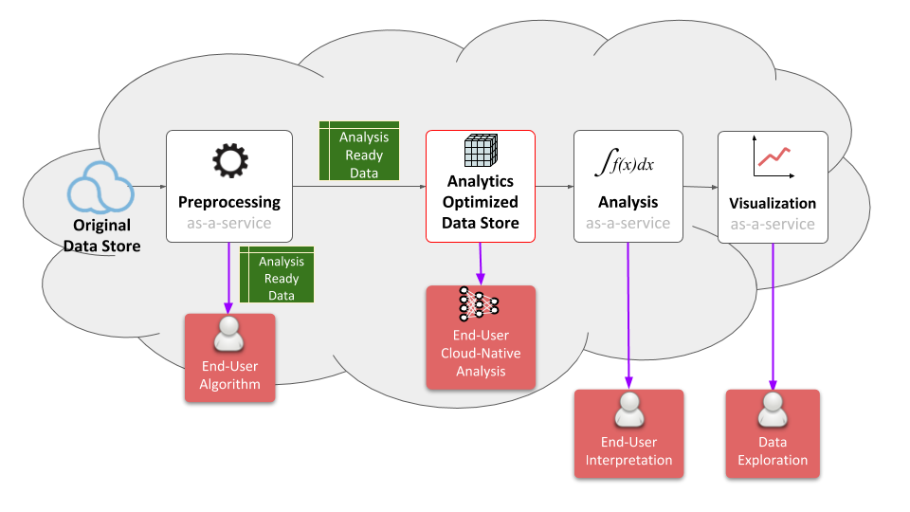
FDA Common Description
White Paper
  Establish a common description of Future Data Architecture functional blocks and identify interfaces and interoperability approaches (WGISS supporting FDA AHT)
Multiple viewpoints into the evolving FDA landscape:
  Enterprise, Information, Computation, Engineering, Technology
Building on WGISS Discovery and Access Infrastructure with a system wide view
Emphasis on what is changing: Analysis, Cloud, consumer EO
Notes:
WGISS is supporting the FDA ad-hoc team in the drafting of a white paper on to establish a common description of Future Data Architecture functional blocks and interfaces
There is large consensus that a common architectural model and terminology will:
facilitate interagency dialog
enable identification of interfaces
enable work on standardisation once interfaces identified
So we are working on a unified pretty diagram based on 5 viewpoints to convey all the necessary knowledge.
Building on WGISS Discovery and Access Infrastructure with a system wide view
Emphasis on what is changing: Analysis, Cloud, consumer EO
Technology and Engineering viewpoints link directly to the open source software and FDA inventory activities.

Slide 27
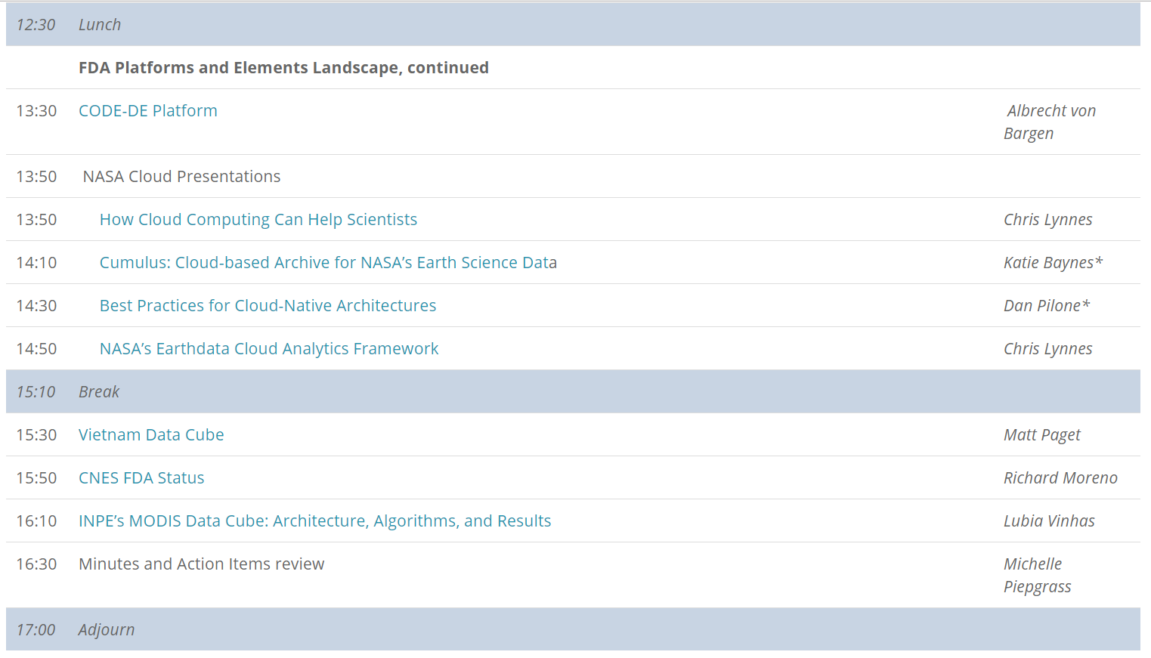
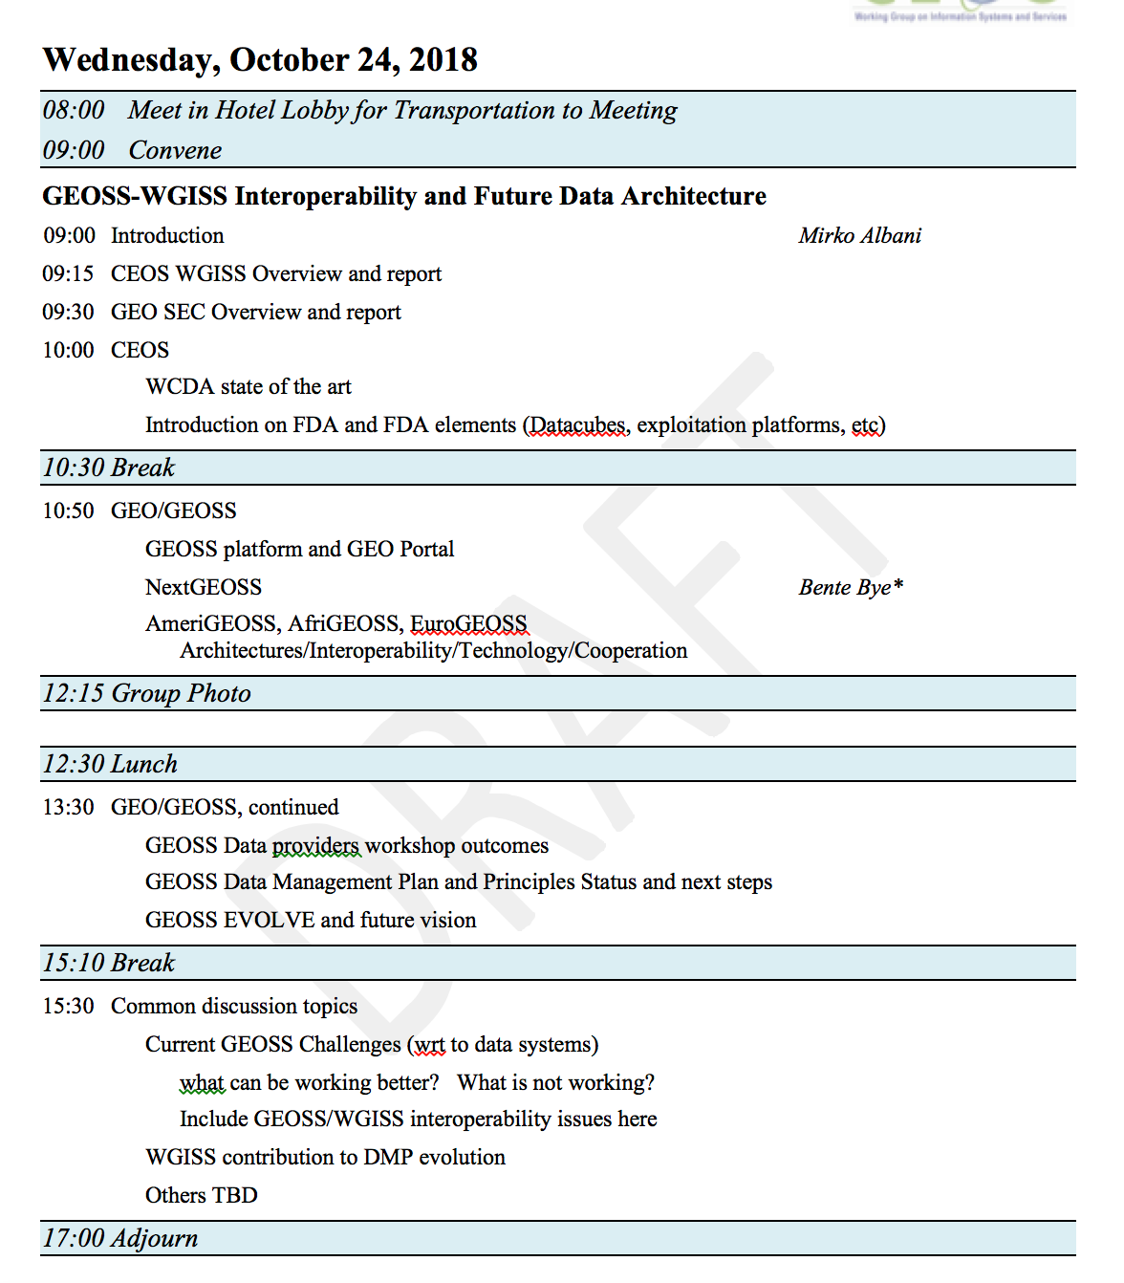
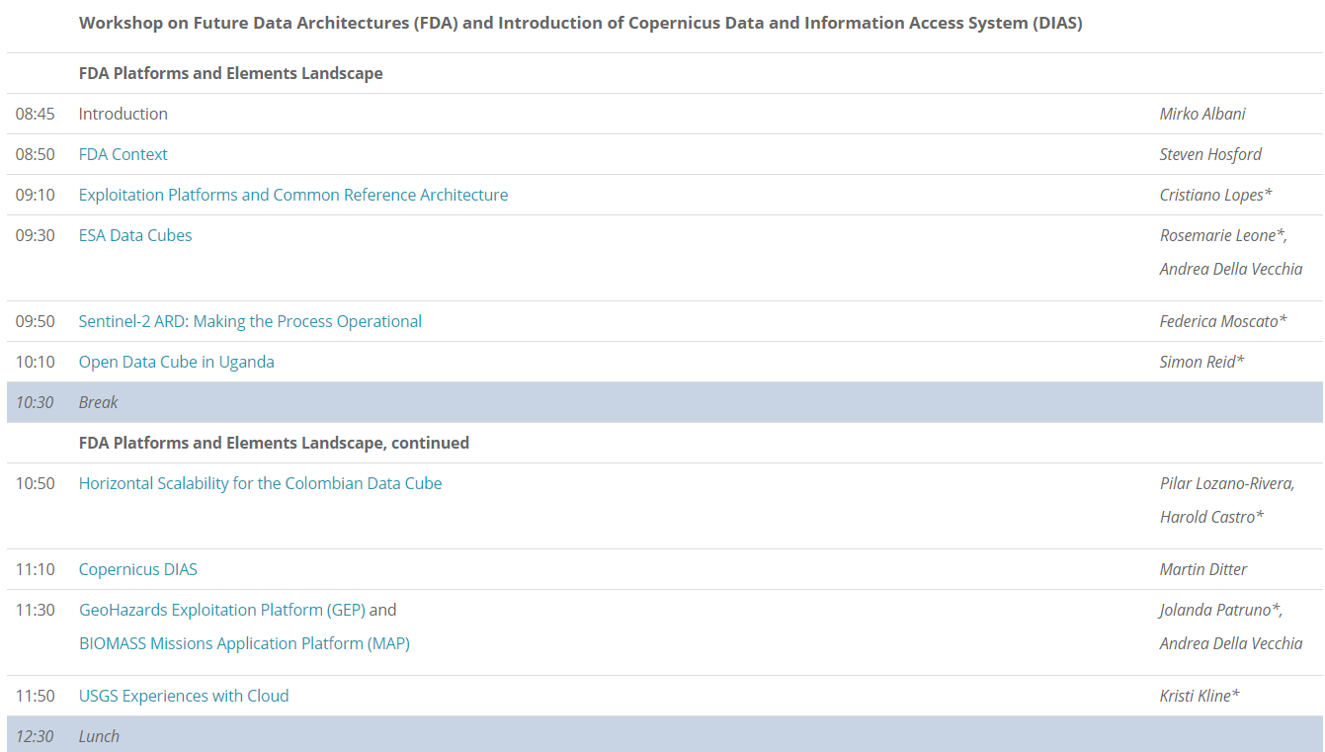


FDA Workshops
http://ceos.org/meetings/wgiss-45/

Slide 28
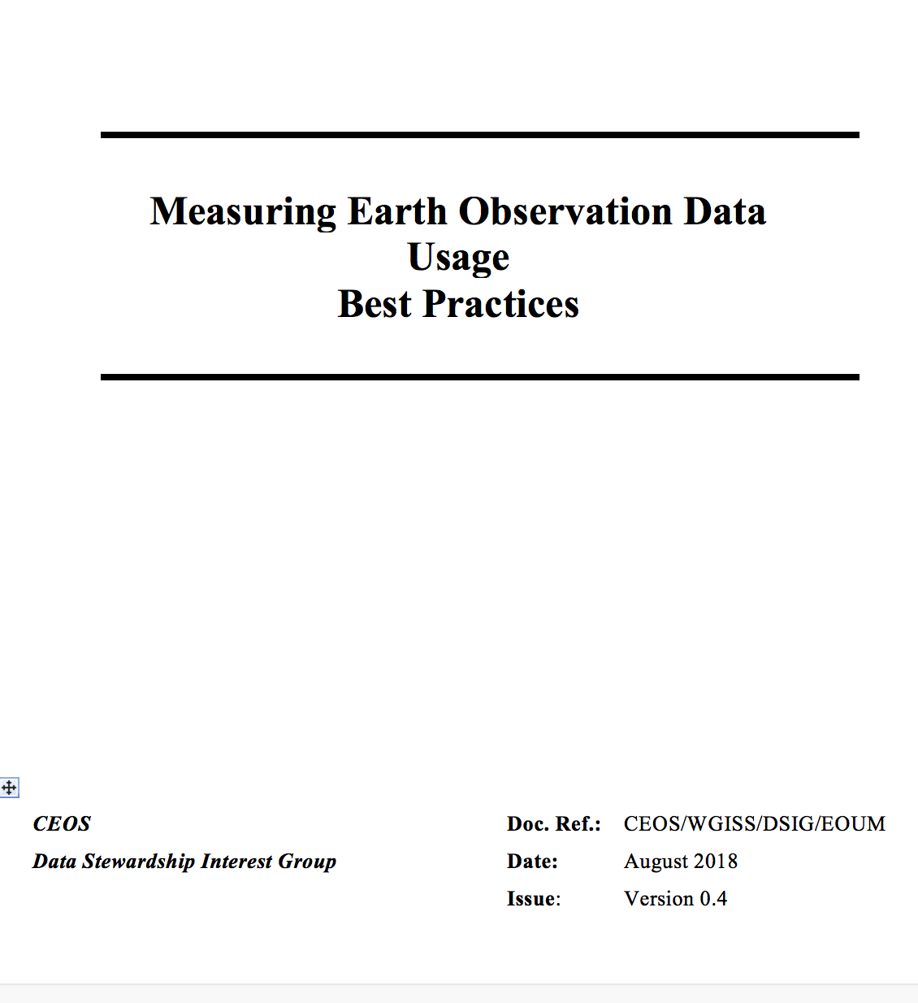

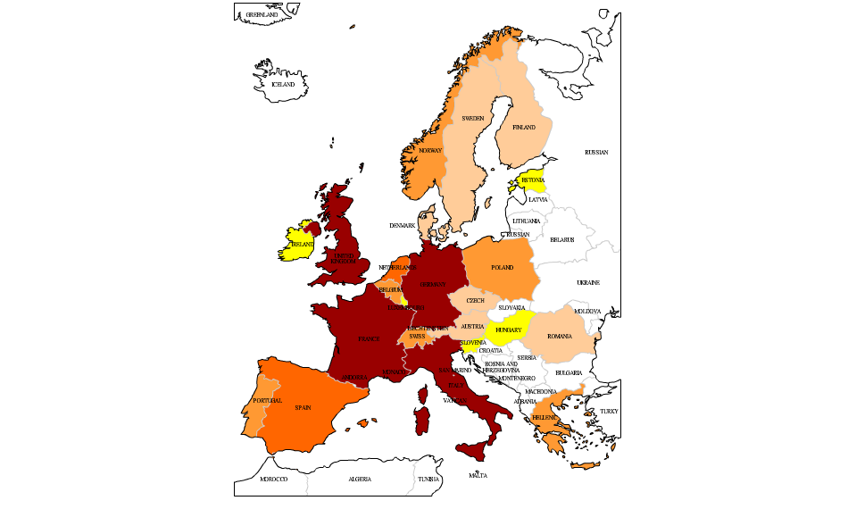
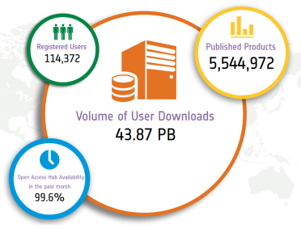
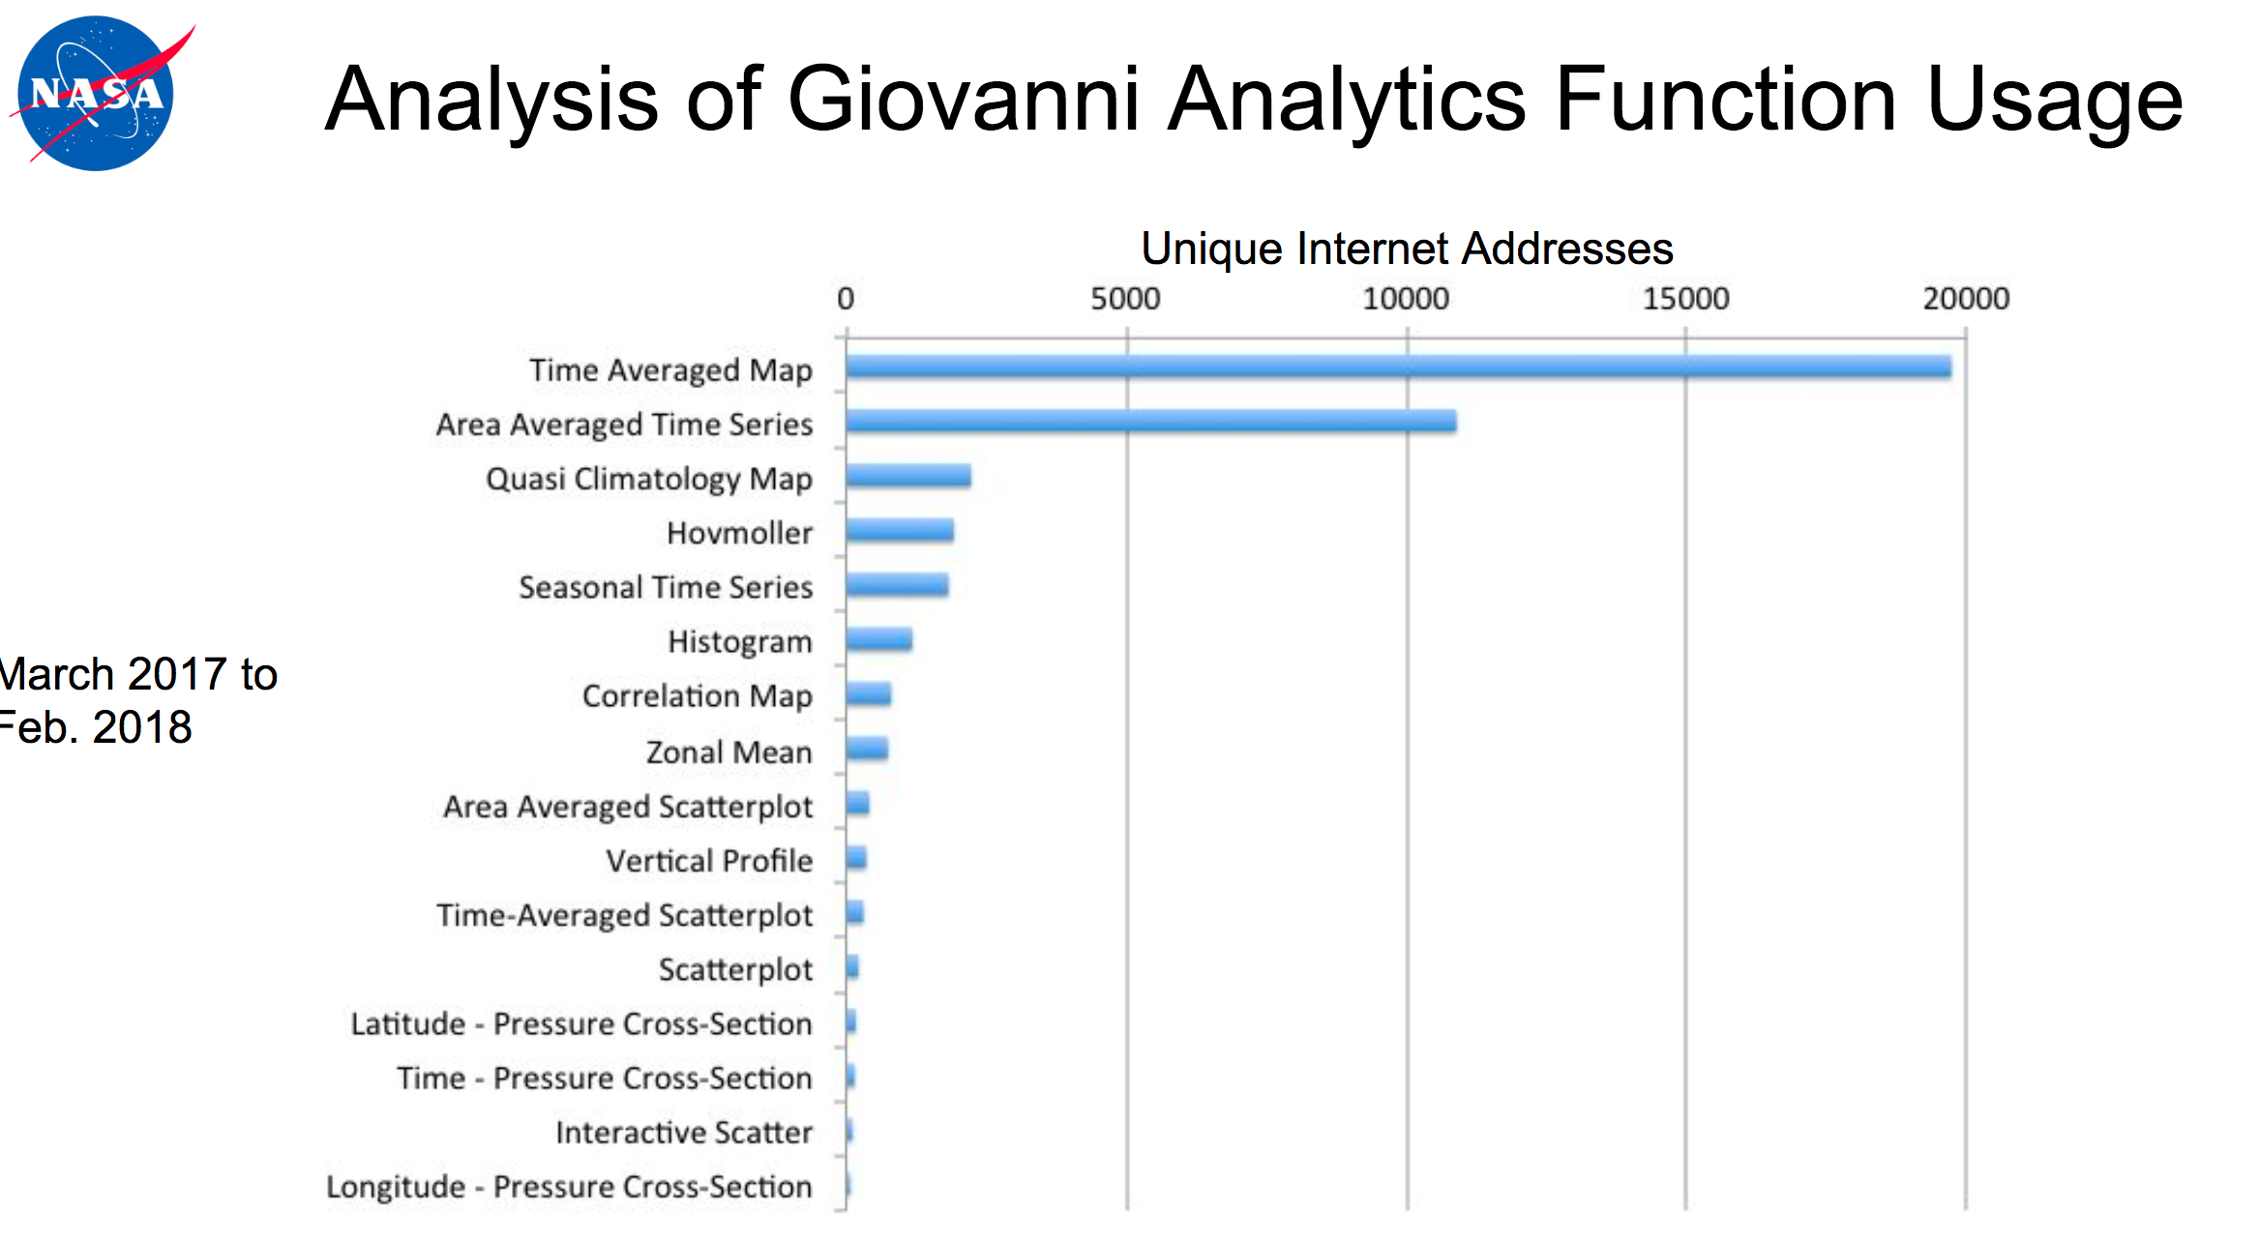
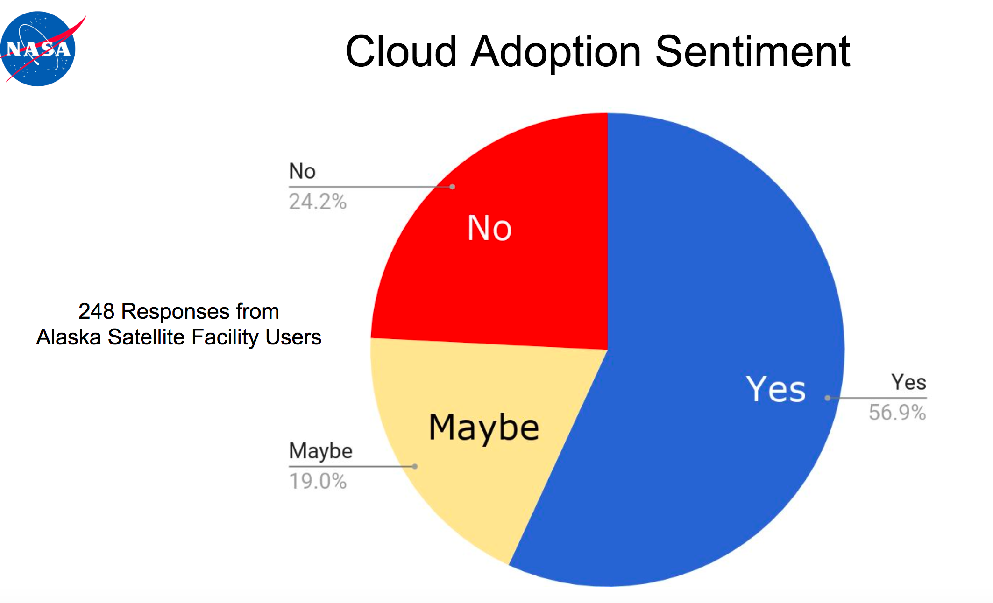
EO Data Usage Best Practice
EO Data Offer Metrics
Web/Platform Metrics
User Engagement and Satisfaction Metrics
1-100
100-199
200-399
400-799
>800
Number of user projects
Notes:
USER METRICS CONCEPT OVERVIEW
Objectives and needs – Why
Data Usage Metrics Categories – Which
Data Usage Metrics Collection – When and How
USER METRICS DEFINITION
Assumptions
User Metrics Description
User Metrics Formatting
Earth Observation Data Offering Metrics
Web and Platform Metrics
User Engagement and Satisfaction Metrics
USER METRICS FROM THIRD PARTIES
ANNEX A – Examples of statistics and INDICATORS
ANNEX B - List of Software for Statistics and User Metrics generation

Slide 29
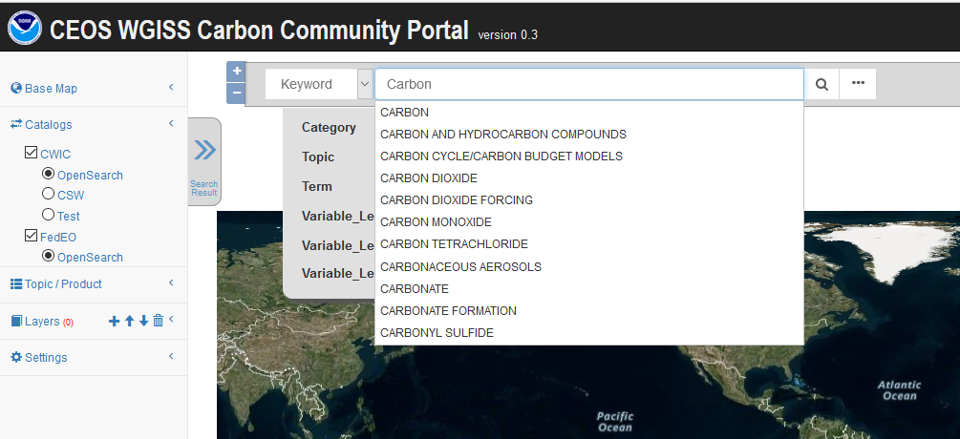
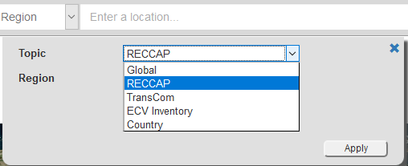
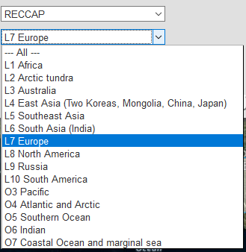
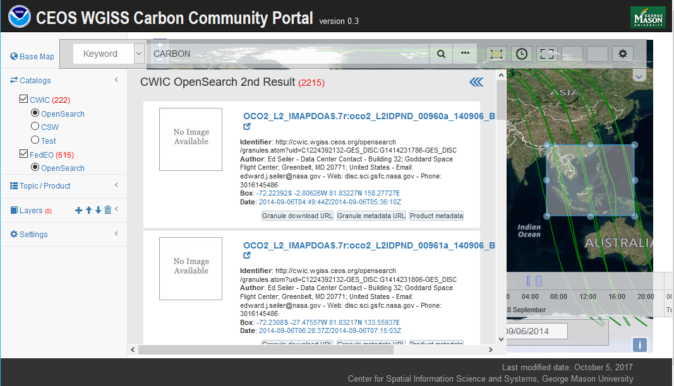
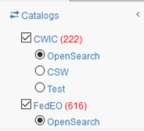
WGISS Carbon Community Portal
Special regions: Global, RECCAP, TransCom, Country Names, ECV Inventory)
Temporal Searches: support for time range and specific date
Pre-defined Carbon topics/datasets: (Atmospheric, Ecosystem, Ocean, Mixed-Theme)
Keywords (auto-completion with IDN Science Keywords)
Return records from both CWIC and FedEO
Notes:
Objective: Implement a prototype carbon data portal to facilitate the discoverability and accessibility of ECV products and space-borne CDRs. The portal will seamlessly access data both in CWIC and FedEO to provide necessary data and services to the carbon science community of both CEOS and GEOSS.
Approach: prototype developed by WGISS in coordination with CEOS Carbon Team and WGClimate Carbon (requirements and use cases provision/validation).
Status: Several iterations held between WGISS and Carbon teams. Carbon Portal latest version (August 2018) with Carbon Team for review/feedback.
Next steps: 1) Improve discoverability of ECV/CDR key datasets for Carbon Community and functionalities based on received feedback; 2) Open-up portal to wider user community to gather additional feedback (target end October 2018).

Slide 30



Technology Exploration
The Technology Exploration interest group serves as a forum for exchange of technical information and lessons-learned experience about current and trending technologies, services and other WWW / Internet related software technologies.

Slide 31

Technology Webinars
Relevancy Ranking of Data Search Results
  14th of March 2017
    Stefano Nativi (GEOSS EVOLVE)
    Chris Lynnes and James Norton (NASA)
Data Cubes for Large Scale Data Analytics
  19th of June 2017
    Rob Woodcock (CSIRO)
    Brian Killough (CEOS SEO)
Burgeoning Role of Python for Earth Observation Data Analysis
  22nd of August 2017
    Syed Rizvi (Open Data Cube)
    Rich Signell (USGS)
    Alber Sanchez (INPE)
The OGC Coverage Standards Suite: Introduction and Overview
  19th of January 2018
    Dr Peter Baumann (Rasdaman)
Scrum and scale agile methods
  31st July 2018
Joint webinars and advertising with:
  WGCapD
  NextGEOSS
  GEOSS Evolve
  Federation of Earth Science Information Partners (ESIP)
http://ceos.org/ourwork/workinggroups/wgiss/technology-exploration/
Future Webinars being organised in cooperation with WGCapD: more end user oriented

Slide 32


WGISS Cooperation

Slide 33
Cooperation with WGCV
Ongoing around four different topics:
Data Formats and Interoperability in the framework of FDA
Quality Indicators in Discovery Metadata
CEOS Data Cubes and CEOS Test Sites Data Access in support of WGCV Activities
Standardization and Best Practices

Slide 34
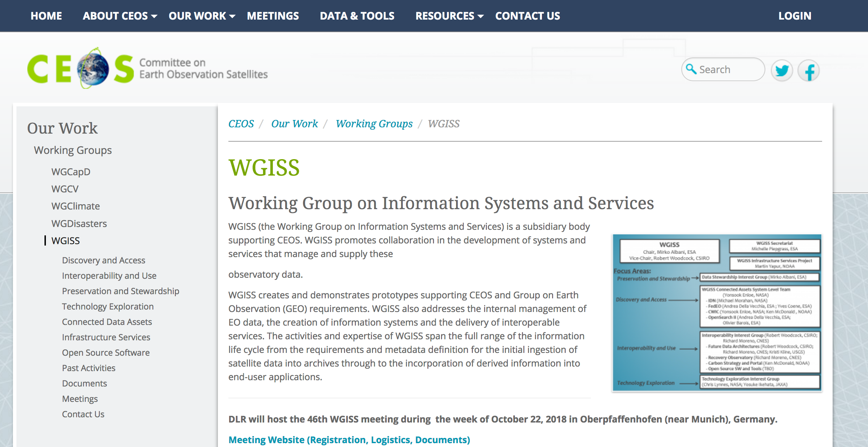
WGISS Information
http://ceos.org/ourwork/workinggroups/wgiss/

Slide 35


Upcoming Meeting
WGISS#47 hosted by NOAA- Silver Spring, USA (29 April- 2 May 2019)
FDA & Interoperability Workshop

Slide 36


Slide 37

Contact:
Mirko.Albani@esa.int

