Slide 1
Instrument Specifications and Calibration Information GDWG, March 2019
Rob Roebeling, Masaya Takahashi , Peter Miu

Slide 2
Agenda Topics
Status on landing pages, and agree on way forward
Proposal for update to WMO OSCAR, and agree on way forward
Discuss how to proceed with the next step proposed for calibration event logging, i.e., moving towards implementing common data and naming conventions (as proposed in the CGMS white paper). If we aim for this, this work needs to be picked up new group, i.e., a group that with members that have deep knowledge of the event logging systems/databases operated by within their space agency.

Slide 3
Landing pages

Slide 4
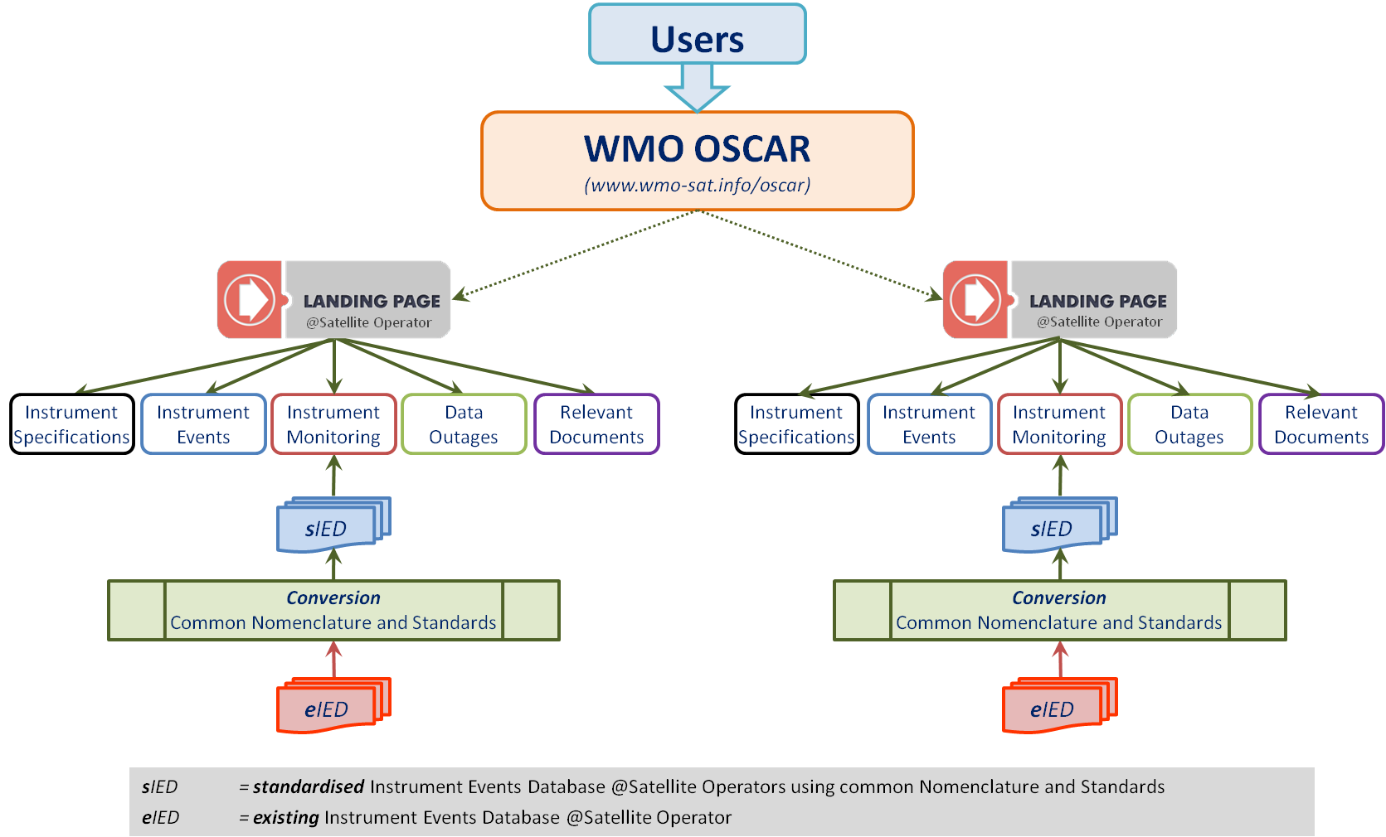
Concept of standardization Calibration Event Logging Infrastructure
Notes:
The Task Team and GSICS recommend the WMO-OSCAR web-portal for linking to Satellite/Instrument Calibration Landing Pages @CGMS Satellite Operators;
The WMO-OSCAR web-portal has been updated to allow linking to Satellite/Instrument Calibration Landing Pages @CGMS Satellite Operators
The Task Team recommends that the Satellite/Instrument Calibration Landing Pages include the following five topics:
Instrument Specification (documents on instruments baseline physical basis)
Instrument Events (database or documents of calibration related events)
Instrument Monitoring (database or documents following state of the instrument)
Data Outages (database or documents with instrument outage dates)
Relevant Documents (documents on data usage and data calibration and validation).

Slide 5
Status landing pages
Most space agencies now prepared landing pages following CGMS recommended format (CGMS White Paper: CGMS-45-EUM-WP-33);
EUMETSAT gathers updates to landing pages from the space agencies each year and send these to WMO.
Space Agency | Representative | Landing Page | Links
CMA | Dr. Li, Yuan | CGMS concept implemented | Updated for 2018
EUMETSAT | Peter Miu Mr. Miu, Peter | CGMS concept implemented | Updated for 2018
ESA | Dr. Philippe Goryl | CGMS concept not implemented | No links provided yet
IMD | Dr. A.K. Mitra | CGMS concept not implemented | No links provided yet
JMA | Mr. Takahashi, Masaya | CGMS concept implemented | Updated for 2018
KMA | Ms. Woo, Jin | CGMS concept implemented | Last updated for 2017
NASA | Mr. Dell, Gregory T. | CGMS concept not implemented | No links provided yet
NOAA | Mr. Bali, Manik | CGMS concept not implemented | Last updated for 2014
ROS | Dr. Zoya Andreeva, | CGMS concept implemented | Updated for 2018

Slide 6
Standardised Landing Pages concept From CGMS White Paper: CGMS-45-EUM-WP-33
Landing Page Categories
Instrument Specifications
Instrument Events
Instrument Monitoring
Data
Outages
Relevant
Documents
Instrument Specifications
General information on the platform, instruments, and sensors operated in the mission that is relevant to all users of the satellite data (see OSCAR website).
Instrument Events
Database (and graphical interface) of events at satellite and processing level that are not occurring systematically and that impact the radiometric or geometric quality of the observations due to instruments calibrations, manoeuvres or miscellaneous.
Instrument Monitoring
Database (and graphical interface) of quasi continues information on the present state of the instruments and sensors operated on the platform.
Data Outages
Events that triggered the temporary or definitive end of the data collection.
Relevant Documents
Other documents relevant for calibration and event logging that the satellite operator wants to share.

Slide 7
WMO OSCAR webpage

Slide 8
Proposal WMO OSCAR update of interface to landing pages
Current Proposal for new setup
Satellite Payload
All known Instrument flying on Himawar-7 (MTSAT-2)
Acronym | Full name | Calibration and Status
DCS
IMAGER | MTSAT-2 Imager | <landing page>

Slide 9
Towards adopting
Common Nomenclature and Common Standards
Based on CGMS White Paper: CGMS-45-EUM-WP-33

Slide 10
Proposed Actions to GSICS From CGMS White Paper: CGMS-45-EUM-WP-33
The Task Team recommends CGMS Satellite Operators to create and maintain Satellites/Instruments Landing Pages that can be linked to from the WMO-OSCAR web-portal.
There is no formal responsible entity for providing WMO-OSCAR with annual updates to the list of landing pages from the space agencies. Which entity could be responsibility for this?
Some space agencies did not prepare landing pages following CGMS recommendation. What is the status and what are the plans from these agencies to prepare CGMS landing pages?
CGMS plenary endorsed the guidelines for reporting on instrument calibration events across the CGMS Satellite Operators.
The Task Team recommends establishing a Technical Team on Event Logging under the umbrella of GSCIS, with representatives from all CGMS Satellite Operators, that coordinates further implementation of an Event Logging System. Can the GDWG follow up on this task, and discuss what can be done through GSICS, through CGMS, or through ..?

Slide 11
Thank You

