Slide 1
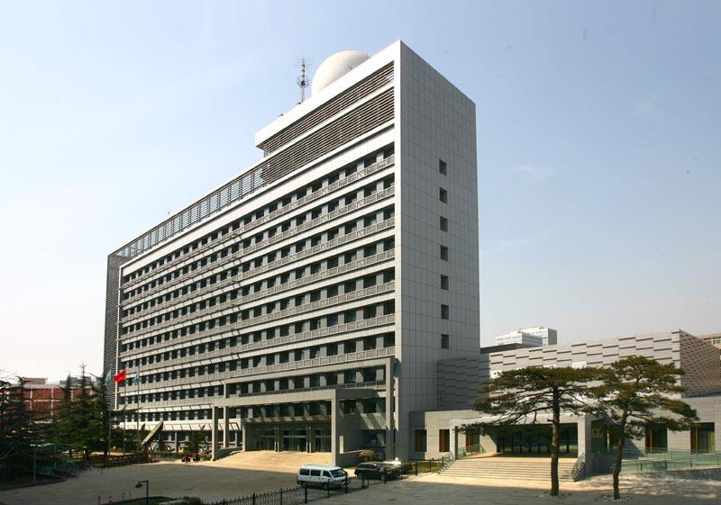
FY-3D/HIRAS
On-orbit performance and validation
Chengli Qi, Chunqiang Wu, Xiuqing Hu, Hanlie Xu, Lu Li, Fang Zhou
National Satellite Meteorological Center(NSMC), CMA
Mingjian Gu, Chunyuan Shao
Shanghai Institude of Technical Physics(SITP), CAS
GSICS Annual Meeting, 04-08 Mar 2019

Slide 2
Outline
HIRAS on-orbit Performance
L1 Products overview and Status
Spectral accuracy validation
Radiometric Calibration validation
Summary

Slide 3
1. HIRAS on-orbit status
Mar ,2018
- HIRAS infrared detectors powered on
- Telemetry parameters check
- Checks of 1st IGM, Raw Spectra, Calibrated spectra
- Initial alignment of Interferometer fixed-mirror
Apr, 2018
- Temperature changing of detector from 85Deg to 82Deg
- Fine alignment of Interferometer fixed-mirror
- Temperature cooling down of ICT
- Cold space observations
- ILS parameters tuning
- NL coefficients generation
Mar ~ Jun commission test , 17 items
- NEdT evaluation
- Spectral channel frequencies validation
- Radiance validation
- Inter-pixel comparison
Aug, 2018
- commission finished

Slide 4
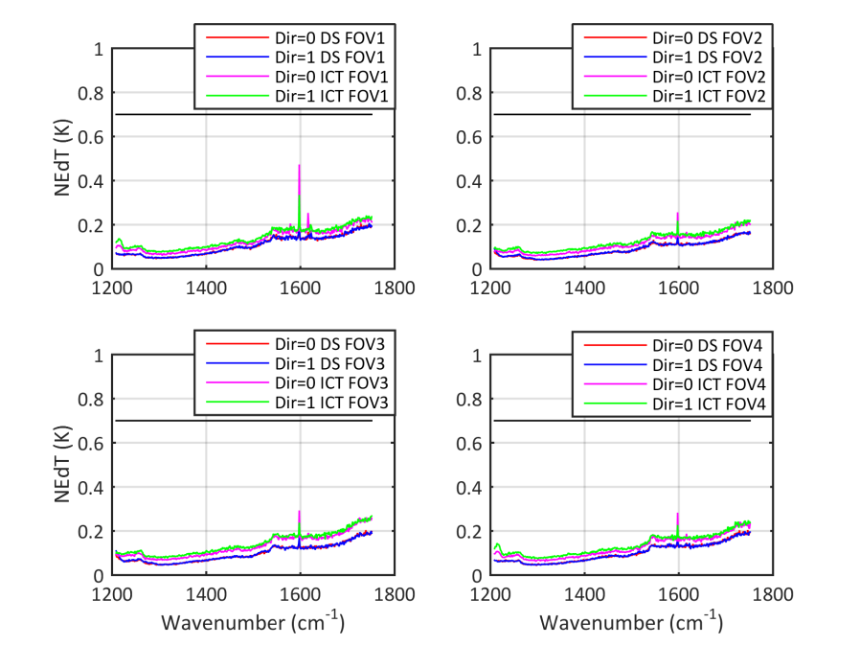
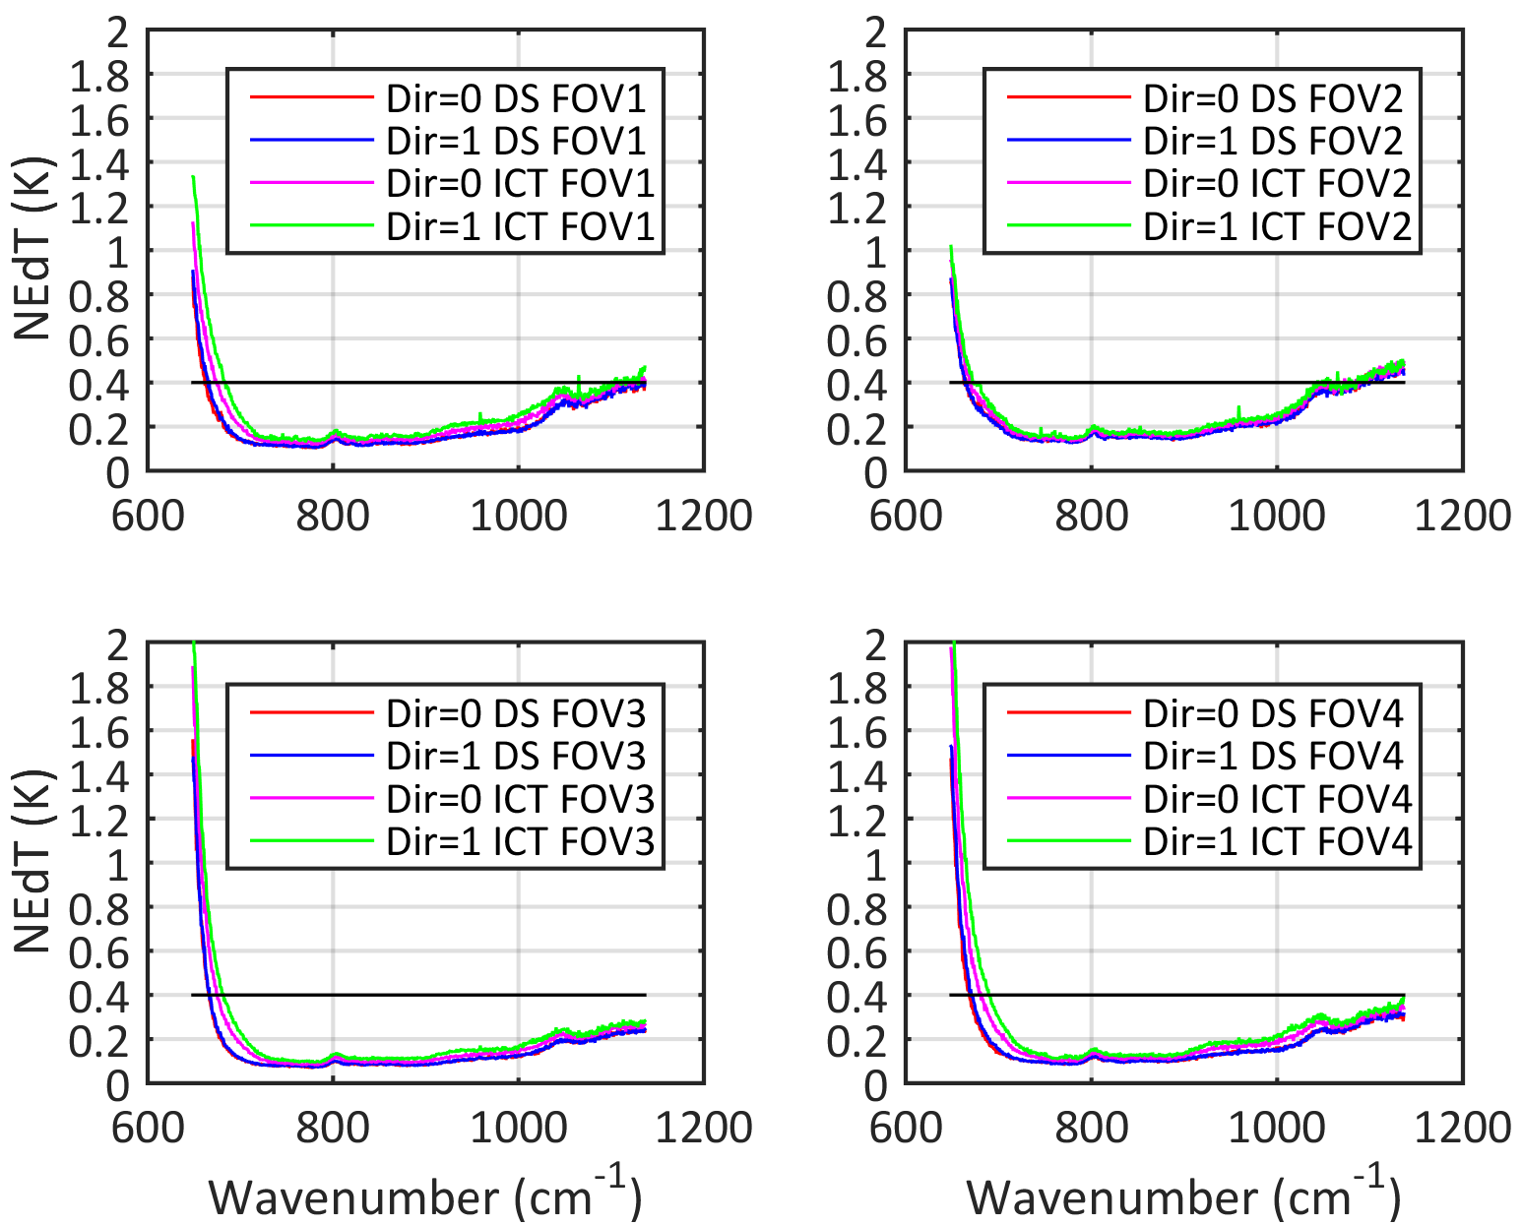
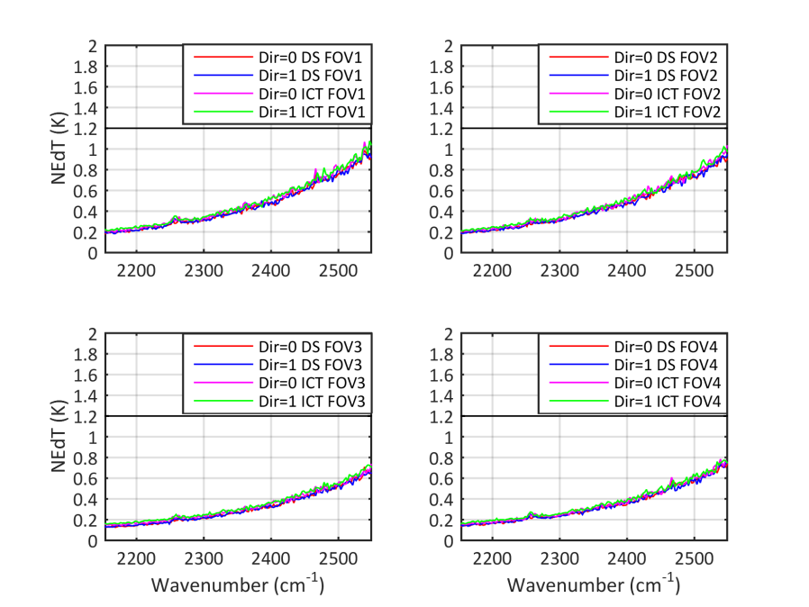
HIRAS performance: NEdT
LW @ 0.625cm-1 Res
MW @ 1.25cm-1 Res
SW @ 2.5cm-1 Res
Noise performance: derived from DS and ICT measurements
NEdTs derived from DS and ICT are consistent.
NEdTs in forward and reverse sweep direction are consistent.
Meet requirements.

Slide 5
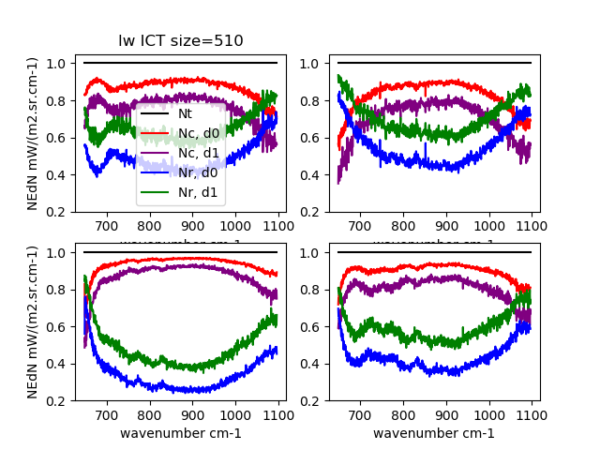
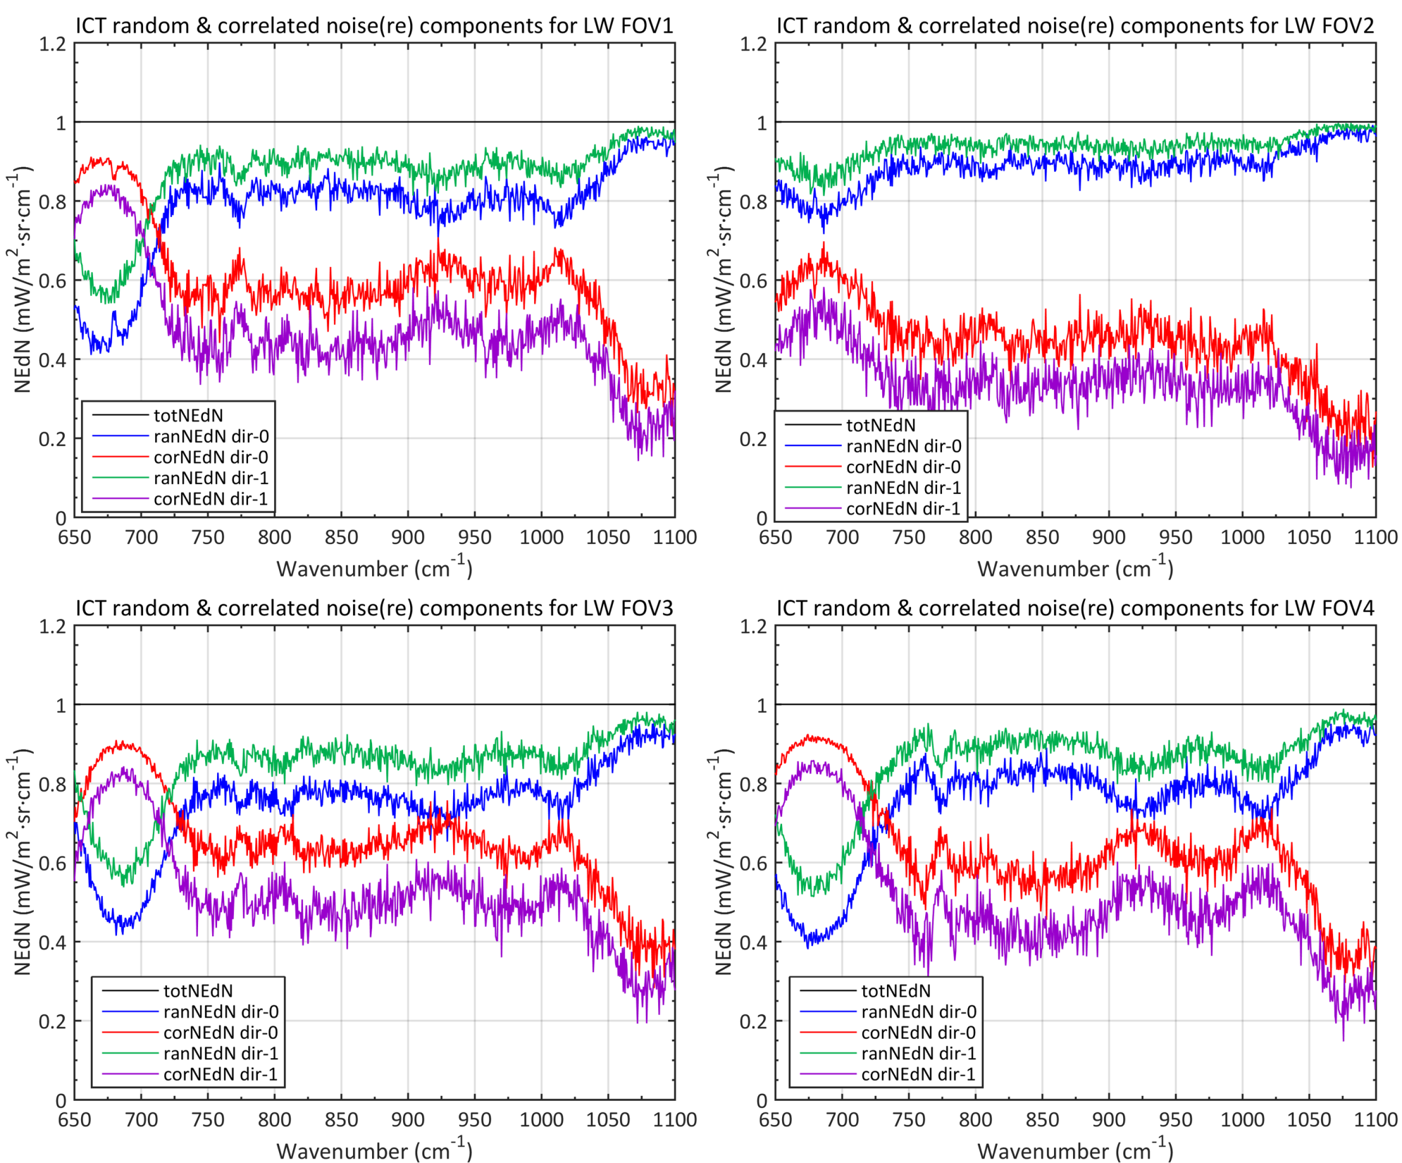
After preliminary assignment：2018-03-11，noise dominated by correlated noise
Correlated noise
Random noise
FOV3
FOV4
After fine assignment：2018-04-30，noise dominated by random noise
Total NEdN
Correlated NEdN random NEdN
Nt² = Nc² + Nr²

Slide 6
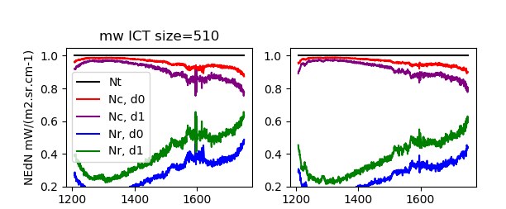
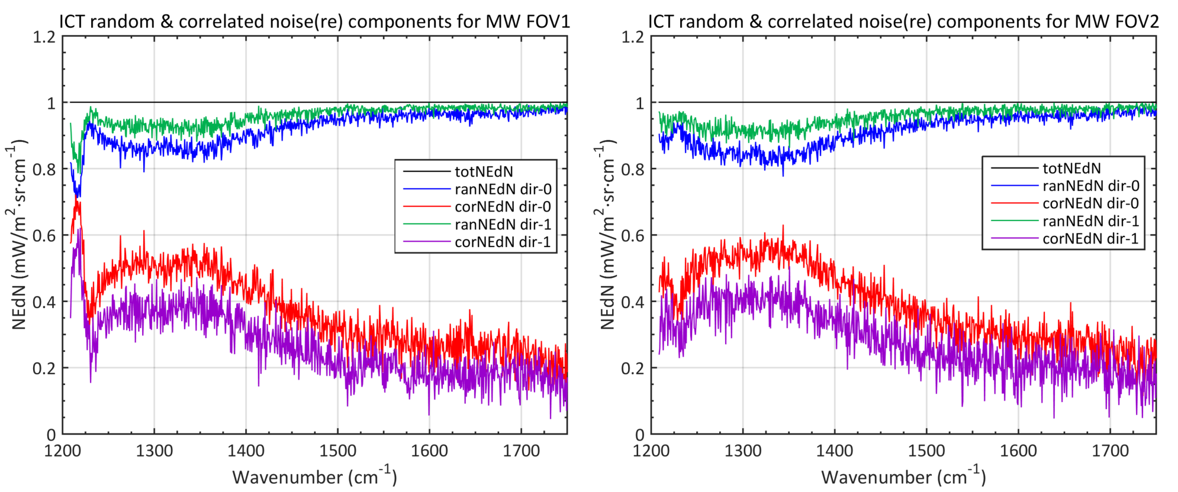
After preliminary assignment ：2018-03-11， more than 90% dominated by correlated noise
After fine assignment ：2018-04-30，more than 90% dominated by random, proportion of correlated noise reduced.
MW

Slide 7
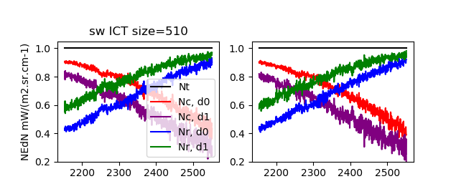
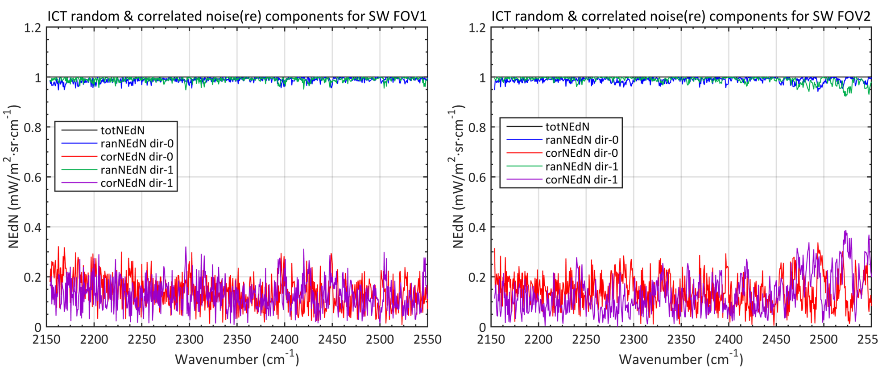
After fine assignment ：SW random noise proportion reached 95%. Correlated noise proportion reduced and without obvious wavelength dependence .
MW2

Slide 8
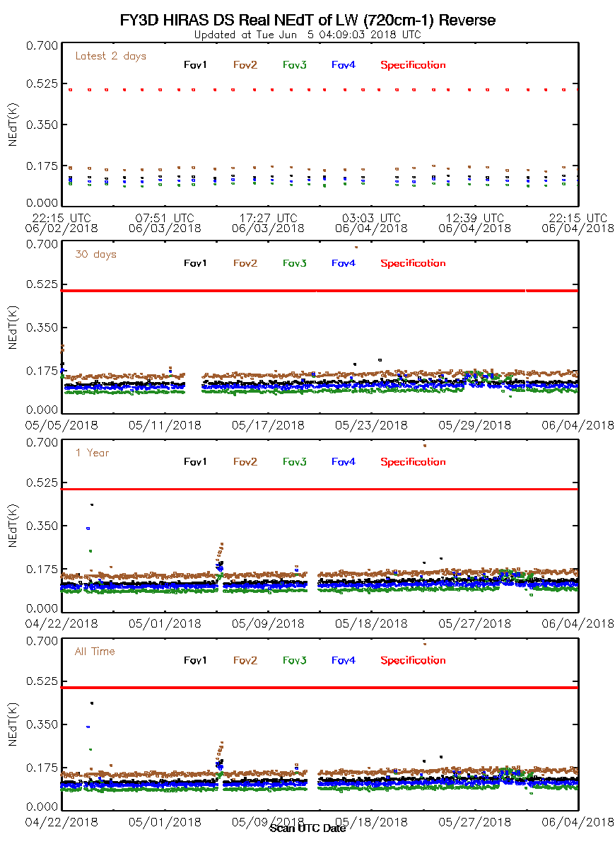
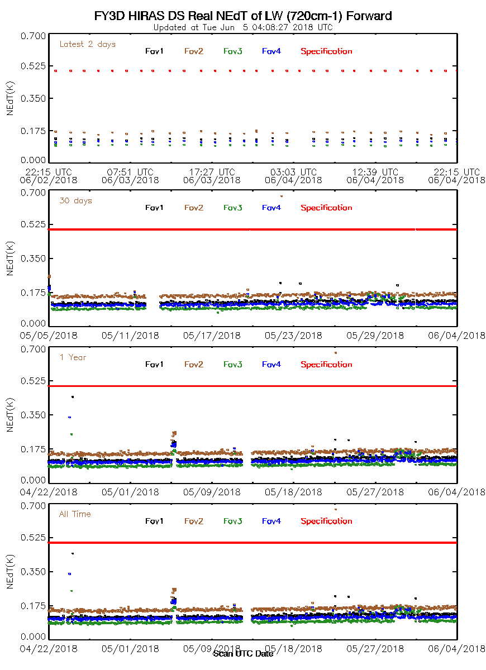
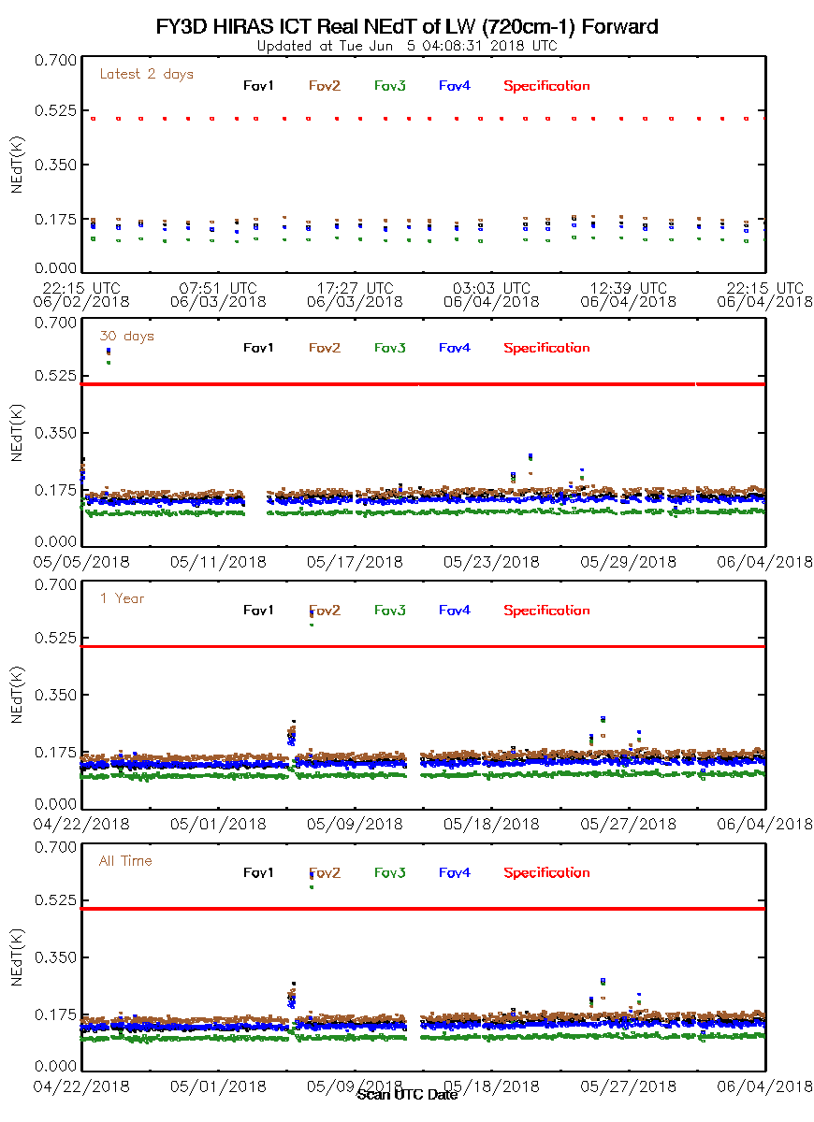
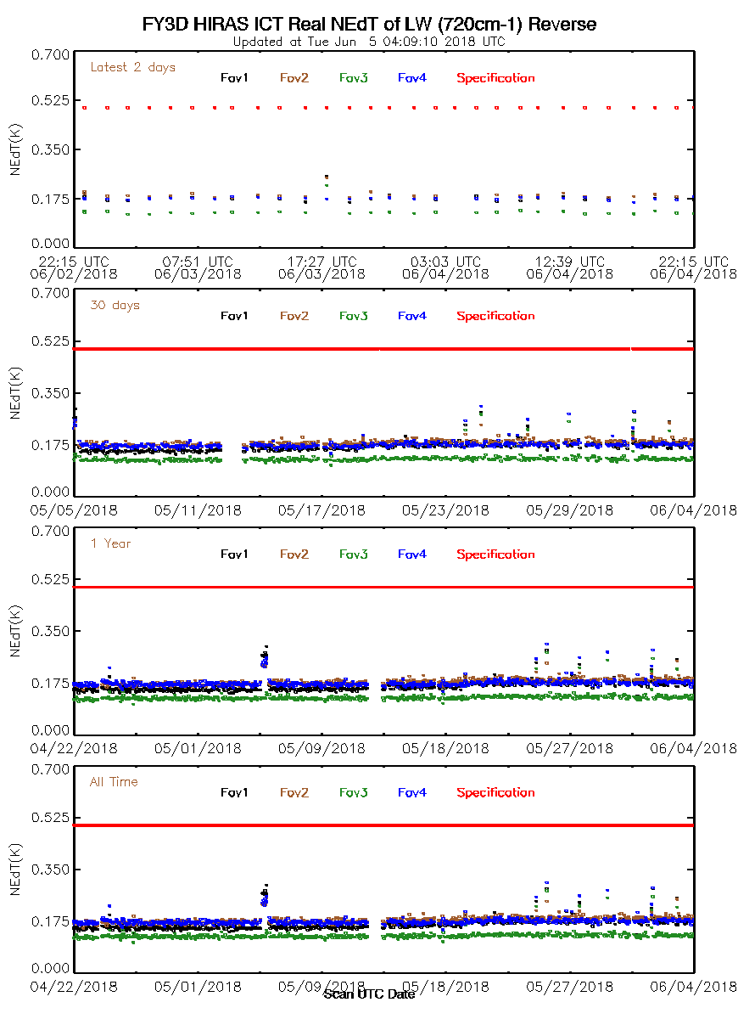
NEdT monitoring for some channels in 3 bands, Performs stable；

Slide 9
2. L1 Products overview and Status
Band | Spectral Range （cm⁻¹） | Spectral Resolution（cm⁻¹） |  | MPD（cm） |  | Ch No
 |  | FR | DR | FR | DR | FR | DR
LW | 650~1135 | 0.625 | 0.625 | 0.8 | 0.8 | 777 | 777
MW | 1210~1750 | 0.625 | 1.25 | 0.8 | 0.4 | 869 | 433
SW | 2155~2550 | 0.625 | 2.5 | 0.8 | 0.2 | 637 | 159
FY3D_HIRAS_GBAL_L1_20180501_1310_L1AXX_MS.HDF
FY3D_HIRAS_GBAL_L1_20180501_1310_016KM_MS.HDF
FY3D_HIRAS_GBAL_L1_20180501_1310_OBCXX_MS.HDF
FY3D_HIRAS_GBAL_L1_20180501_1310_L1AXX_DR.HDF
FY3D_HIRAS_GBAL_L1_20180501_1310_016KM_DR.HDF
FY3D_HIRAS_GBAL_L1_20180501_1310_OBCXX_DR.HDF
FY-3D/HIRAS L1 data valid from 2018.04.20, data with Quality control flag valid from 2018.08.22

Slide 10
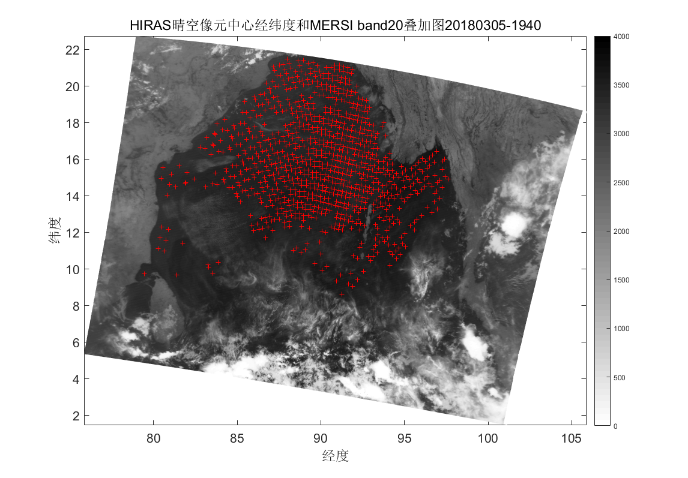
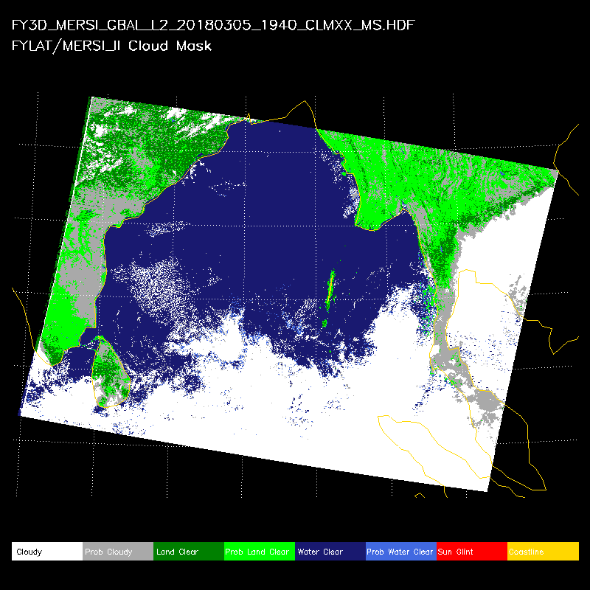
3. Spectral accuracy validation
HIRAS OBS compared with LBLRTM simulation in clear ocean condition.
Clear pixels filtering: Using MERSI cloud mask production.
MERSI-II Cloudmask
Clear pixels determined from MERSI cloud mask

Slide 11
Spectral bias vs LBLRTM – first optical assignment
Spc bias mean（ppm） | FOV1 | FOV2 | FOV3 | FOV4
LW | 38.299 | 32.145 | 24.97 | 29.822
MW | -15.18 | -4.6811 | -10.813 | -3.4975
Spc bias std（ppm） | FOV1 | FOV2 | FOV3 | FOV4
LW | 0.996 | 0.774 | 0.751 | 1.085
MW | 1.185 | 2.143 | 2.592 | 1.834

Slide 12
Spectral bias vs LBLRTM after fine optical assignment
Spc Bias mean（ppm） | FOV1 | FOV2 | FOV3 | FOV4
LW | -3.06 | -0.67 | 1.05 | 1.58
MW | -3.76 | -1.02 | -1.17 | -2.60
SW | -1.38 | 1.05 | 1.61 | 2.39
Spc Bias std（ppm） | FOV1 | FOV2 | FOV3 | FOV4
LW | 1.18 | 1.11 | 0.81 | 1.39
MW | 1.35 | 1.34 | 1.65 | 1.68
SW | 4.52 | 5.22 | 3.09 | 3.32

Slide 13
Instrument responsivity function (ISRF) used to monitor the signal variation
HIRAS suffered signal attenuation due to silica gel gas contamination, in LW band most serious region of 800cm-1 attenuation rate is about 9% per month

Slide 14
In MW and SW bands, attenuation rate is about 2.7% and 3.7% per month

Slide 15
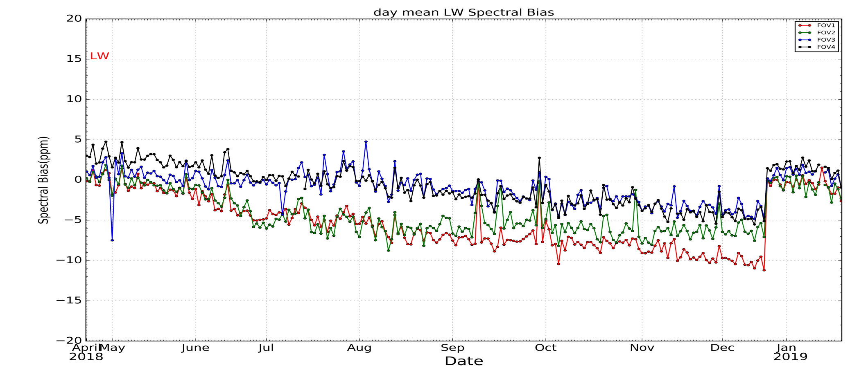
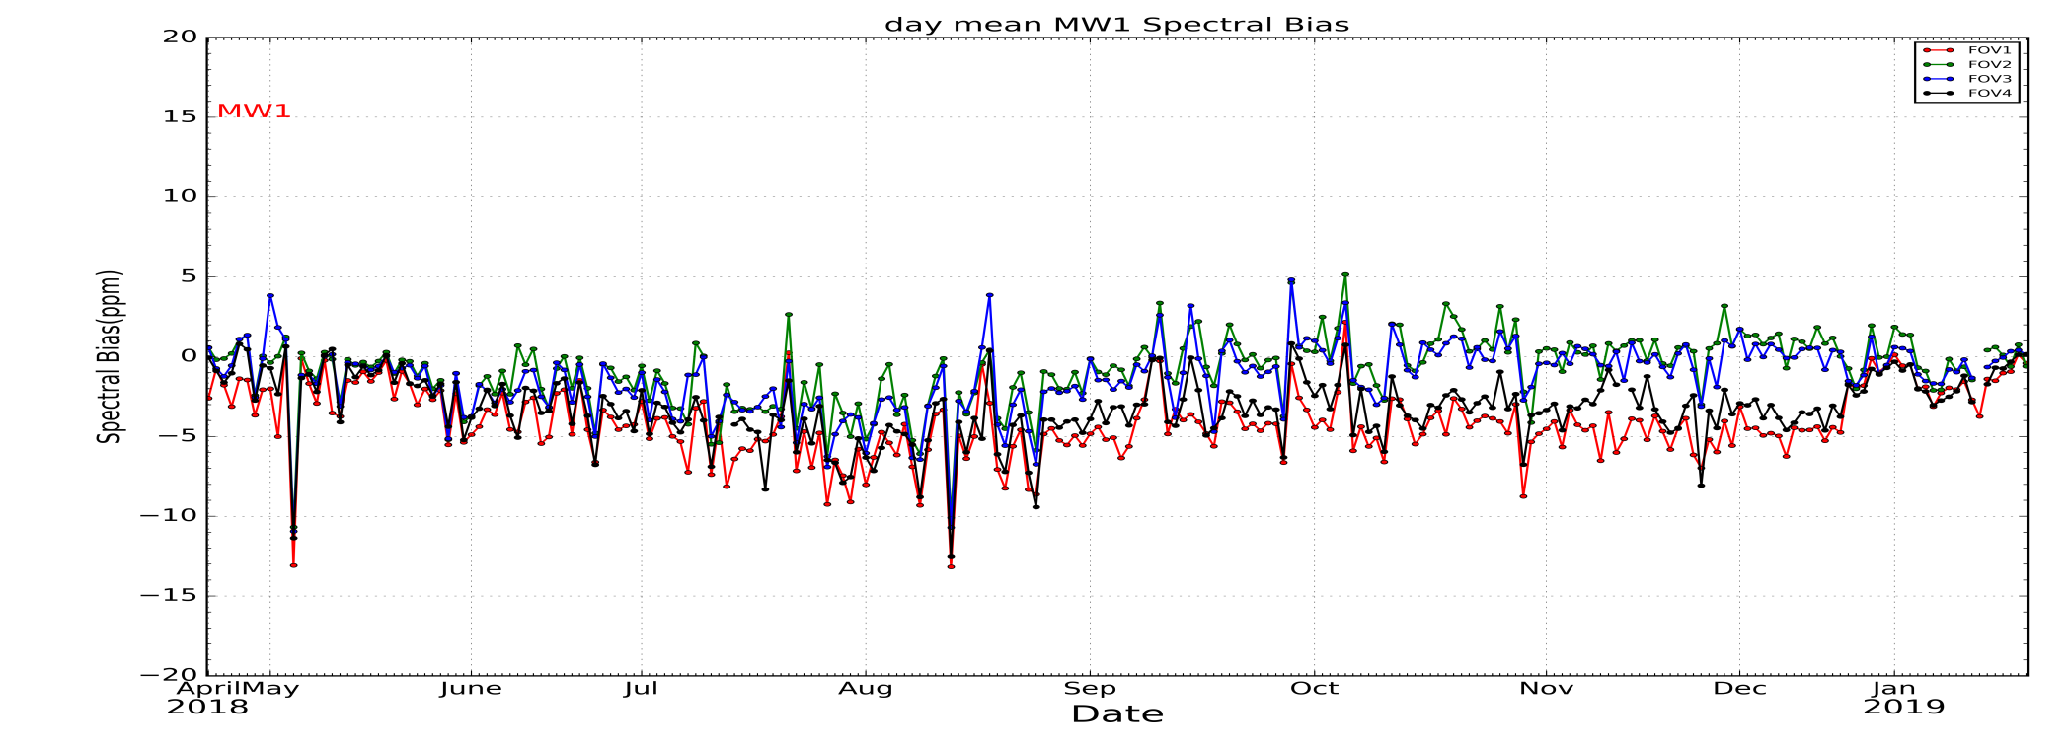
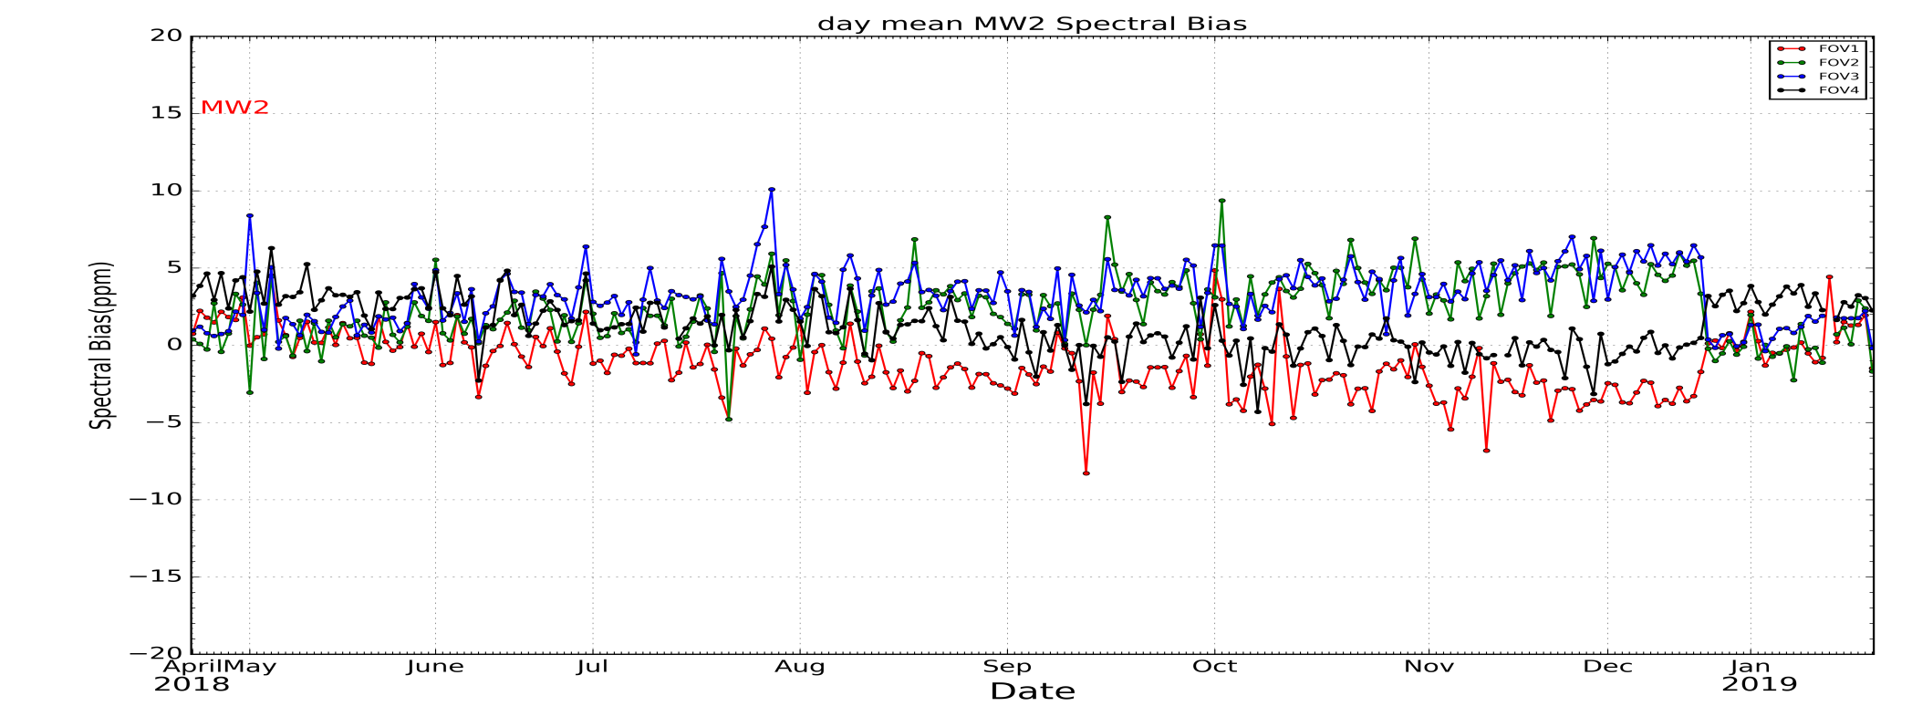
LW band
decontamitation
MW band
Spectral bias monitoring in 9 months, spectral bias is in range of 5ppm for MW and SW in 9 months. There is 5~10 ppm trend in LW, after on-orbit heating it recovered.
SW band

Slide 16
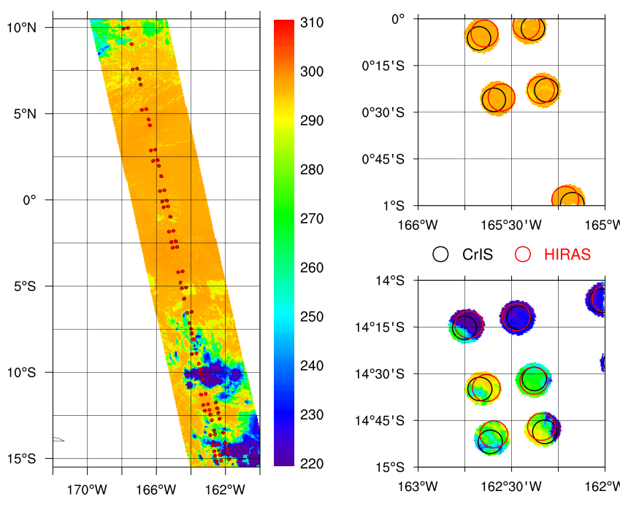
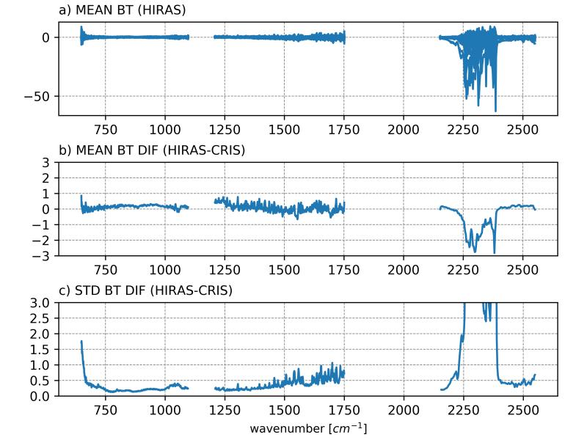
4. Radiometric Calibration validation
SNO Pairing Method
Time Constrains: 10 minutes
Air Path Constrains
FOR 14-17 for CrIS
FOR 14-16 for HIRAS.
Distance constrains: 5 km
Scene uniformity
VIIRS and MERSI: std < 0.2K
Method: Wang et al 2016
Data:2018.04.25-2018.05.15 20 days
LW bias better than 0.5K，MW less than 0.7K；
LW bias std better than 0.3K，MW std 0.2~1K；

Slide 17
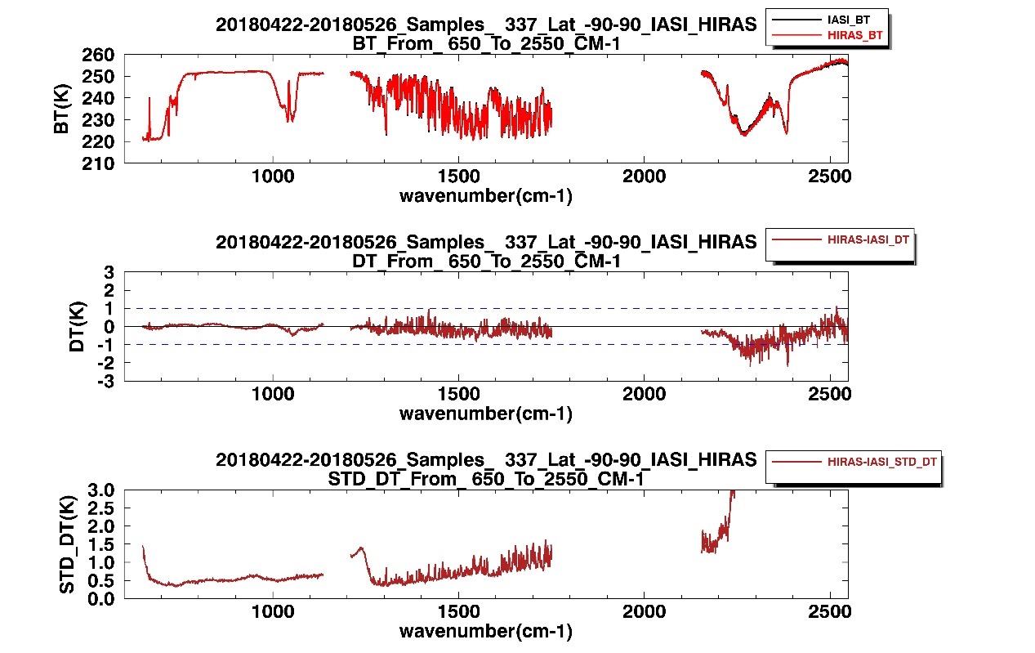
Data:2018.04.22-2018.05.26 17 days
LW bt bias better than 0.5K，MW bt bias less than 0.7K；
LW bias std lett than 0.5K， MW bias std in 0.5~1K， SW window and weak absorption region meet 0.5K ；

Slide 18
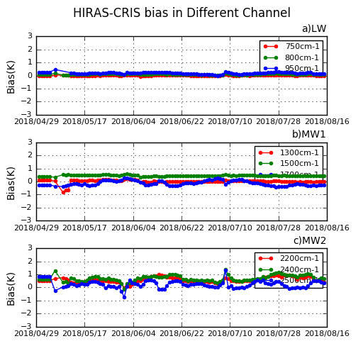
4 months of HIRAS-CrIS bias monitoring shows stable error characteristics.

Slide 19
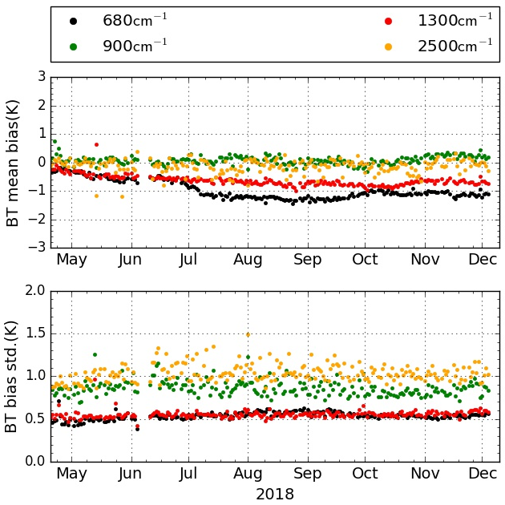
O-B monitoring shows stable error characteristics.

Slide 20
Comparison between HIRAS and MERSI
advanced MEdium Resolution Spectral Imager (MERSI II)
FY-3D/MERSI-II Spectral Characteritics
Channel | Wavelenth (μm) | Bandwidth (nm) | Nadir spatial resolution (m)
20 | 3.8 | 180 | 1000
21 | 4.05 | 155 | 1000
22 | 7.2 | 500 | 1000
23 | 8.55 | 300 | 1000
24 | 10.8 | 1000 | 250
25 | 12.0 | 1000 | 250

Slide 21
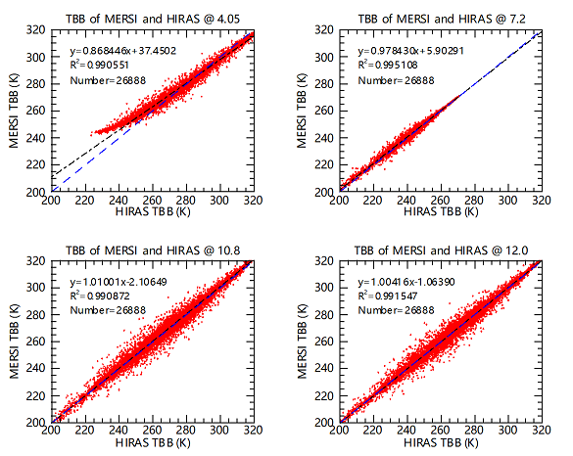
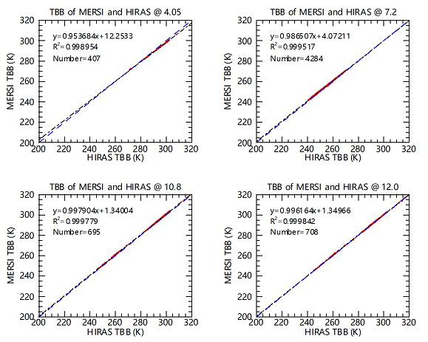
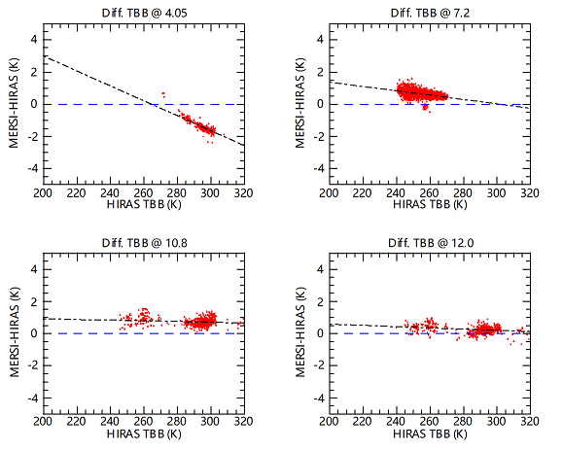
After scene uniformity check
MERSI-HIRAS bias changed with scene brightness temperature
MERSI Ch | 4.05 | 7.2 | 10.8 | 12.0
Scene_bt(K) | 284 | 251 | 286 | 285
Mean bias(K) | -0.90 | 0.68 | 0.74 | 0.26

Slide 22
HIRAS RTTOV simulation and measurement
Mean bias
Bias std
Mean bias are within 1K in LW and MW bands, FOV3 exhibits inconsistency with
Other 3 FOVs due to a little field sheltering.

Slide 23
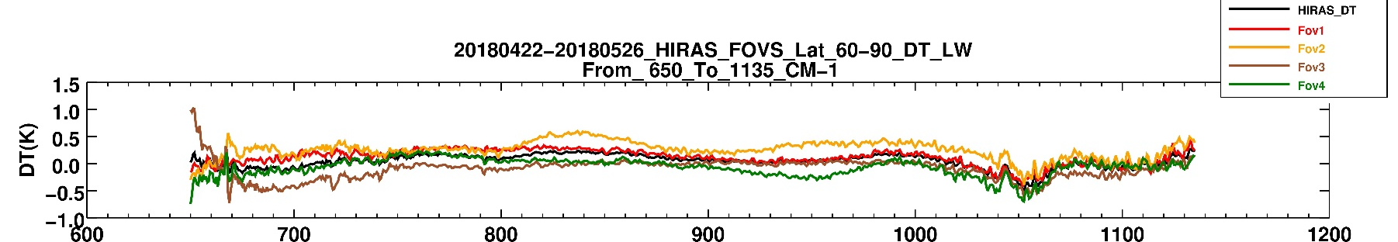
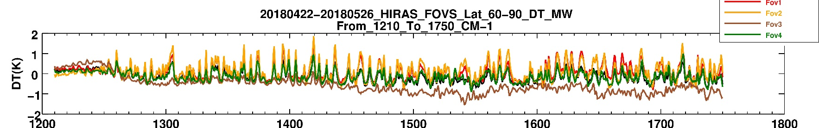
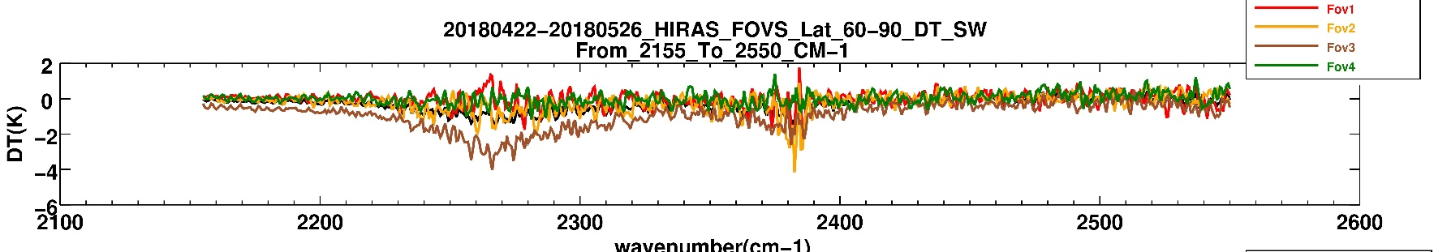
LW
MW
SW
HIRAS-CrIS bias for each FOV, FOV3 exhibits 0.3~0.5K of inconsistency with other
FOVs.

Slide 24
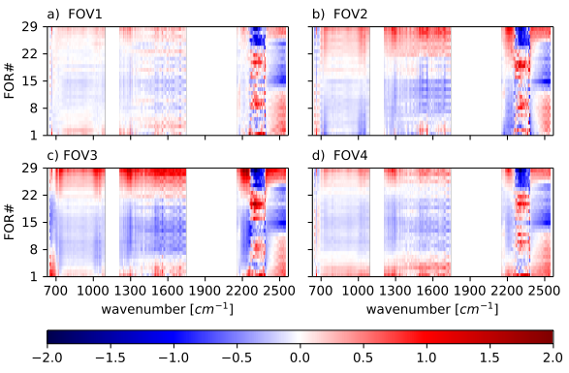
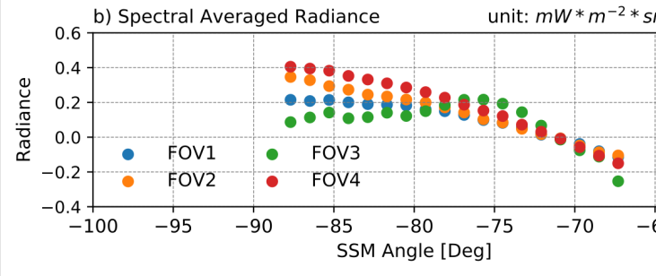
Future Work
To improve data quality in SW band
To improve the FOV uniformity
To decrease scene temperature and scan angle dependent BIAS
Move to FY-3E, Early Morning Orbit
scan angle dependent BIAS
Irregular response

Slide 25
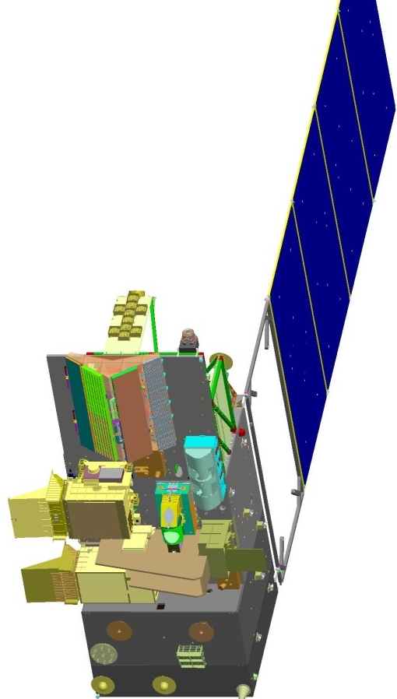
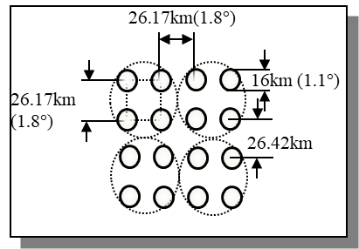
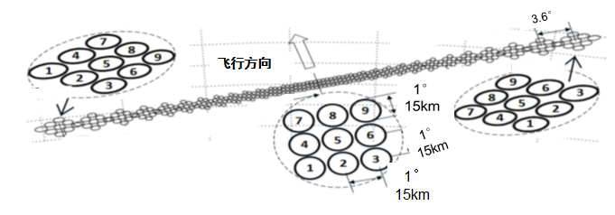
HIRAS Improvement from FY-3D
to FY-3E Early Morning orbit
FY-3D
FY-3E
Band | Spectral Range (cm⁻¹) | Spectral Resolution (cm⁻¹) | Sensitivity (NEΔT@280K) |  |  | Num of Channels
 |  |  | FY-3D | FY-3E
LWIR | 650～1136 （15.38μm～8.8 μm） | 0.625 | 0.15(Expectation) 0.4K(Requirement) | 650 ～667 cm⁻¹ | 0.8K | 778
 |  |  |  | 667～689 cm⁻¹ | 0.4K
 |  |  |  | 689～1000 cm⁻¹ | 0.2K
 |  |  |  | 1000～1136 cm⁻¹ | 0.4K
MWIR1 | 1210～1750 （8.26μm～5.71 μm） | 1.25 | 0.1(Expectation) 0.7K(Requirement) | 1210～1538 cm⁻¹ | 0.2K | 433
 |  |  |  | 1538～1750 cm⁻¹ | 0.3K
MWIR2 | 2155～2550 （4.64μm～3.92 μm） | 2.5 | 0.3(Expectation) 1.2K(Requirement) | 2155～2300 cm⁻¹ | 0.3 | 159
 |  |  |  | 2300～2550 cm⁻¹ | 0.5

Slide 26
SUMMARY
FY-3D/HIRAS Commission test which contain 17 test items finished and results are promising.
Ground processing system is running smoothly and is generating L1 data in real time.
The accuracy of HIRAS radiometric and spectral calibration and its stability are assessed using SNO samples and Simulation Data.
Overall, radiometric biases (O-S) are small and stable over time, FOV-2-FOV differences are less than ~0.2 K for LW and MW bands.
The spectral accuracy is better than 3ppm for LW and 5 ppm for MW/SW band.
HIRAS is a great improvement to Chinese satellite infrared atmospheric sounding system

