Slide 1
The First Geostationary Infrared Hyper-spectral Measurements: In-orbit Validation Method for Radiometric Accuracy and its Preliminary Results
2019 GSICS Data & Research Working Groups Annual Meeting
Qiang Guo, Xin Wang, and Rui Wen
guoqiang@cma.gov.cn
National Satellite Meteorological Center, CMA
7 March 2019, Frascati, Italy

Slide 2
Outline
Background
GEO-LEO/Sounder Intercalibration
In-orbit Radiometric Accuracy of GIIRS
Conclusion

Slide 3
Main Specifications of GIIRS
Spectral Parameters (Normal mode) | Range Resolution Channels LWIR: 700-1130 cm⁻¹ 0.625⁻¹ 689 S/MIR:1650-2250 cm⁻¹ 0.625⁻¹ 961 VIS : 0.55- 0.75 μm
Spatial Resolution | LWIR/MWIR : 16 Km SSP VIS : 2 Km SSP
Operational Mode | China area 5000 × 5000 Km² Mesoscale area 1000 × 1000 Km²
Temporal Resolution | China area <1 hr Mesoscale area <½ hr
Sensitivity (mW/m²srcm²) | LWIR: 0.5-1.1 S/MIR: 0.1-0.14 VIS: S/N>200(ρ=100% )
Calibration accuracy | 1.5 K (3σ) radiation
Calibration accuracy | 10 ppm (3σ) spectrum
Quantization Bits | 13 bits

Slide 4
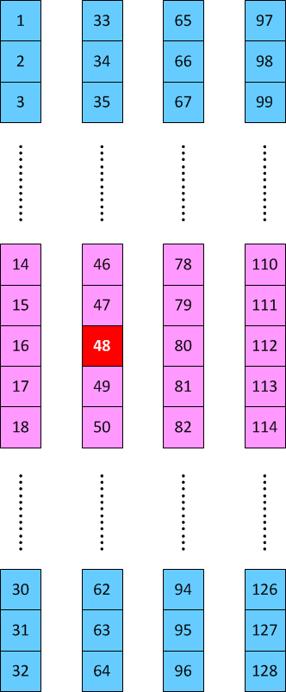
FY-4A: 32×4@16km
FY-4B: 16×8@12km

Slide 5
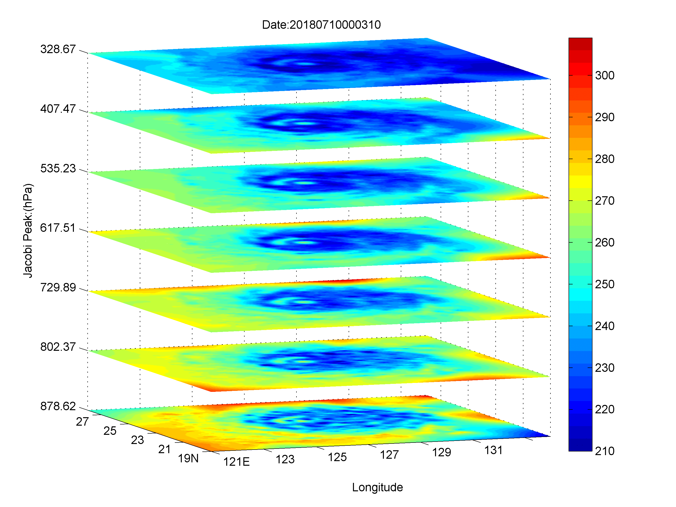
Brightness Temperature Animation of FY-4A/GIIRS within MW Spectral Region

Slide 6
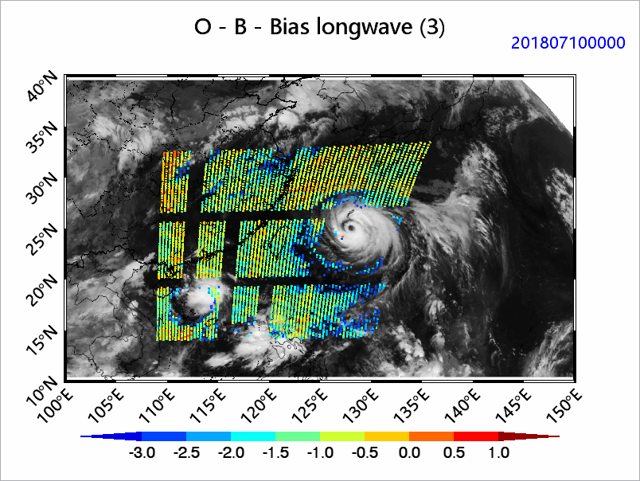
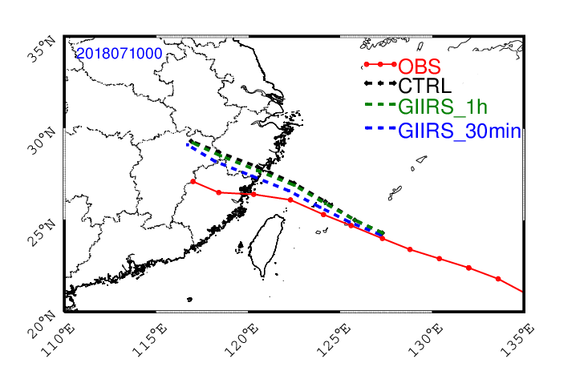
GIIRS NWP Application in GRAPES

Slide 7
Outline
Background
GEO-LEO/Sounder Intercalibration
In-orbit Radiometric Accuracy of GIIRS
Conclusion

Slide 8
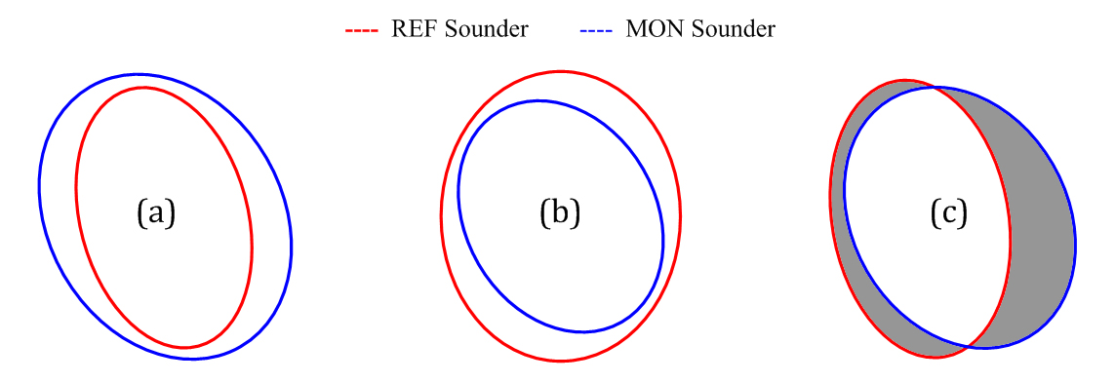
Spatial Collocation: quasi-full-overlap (QFO) criterion
GEO-LEO/imager
GSICS: recommended overlap pattern (UW)
GeoCAVS: Overlap pattern far away from nadir (VW)
GEO-LEO/sounder
Different overlap relationships of footprints between GEO and LEO sounders

Slide 9
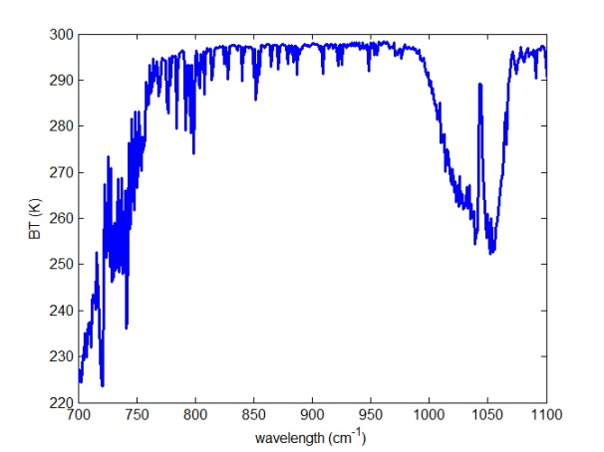
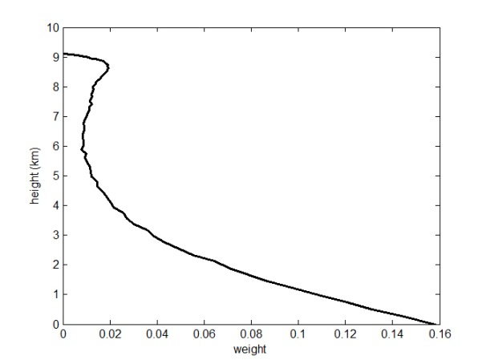
Clear Sky Detection: quasi-full-overlap (QFO) criterion
(a)
(b)
Atmospheric radiation characteristic of the stable weak ozone absorption peak (around 1043 cm⁻¹) for the U.S. Standard Atmosphere profile. (a) Clear-sky spectral radiance (presented as BT); (b) weight function of channel 550 of GIIRS (its central wavelength: 1043.125 cm⁻¹).
$\left\{\begin{matrix}\left|\max_{λ∈Φ}{{BT}_{MON}\left(λ\right)}−\max_{λ∈Φ}{{BT}_{REF}\left(λ\right)}\right|≤{Th}_{∆BT} \\ \max_{λ∈Φ}{{BT}_{REF}\left(λ\right)}≥{Th}_{BT}\end{matrix}\right.$, $Φ∈\left[1042.5{cm}^{−1},1044.5{cm}^{−1}\right]$

Slide 10
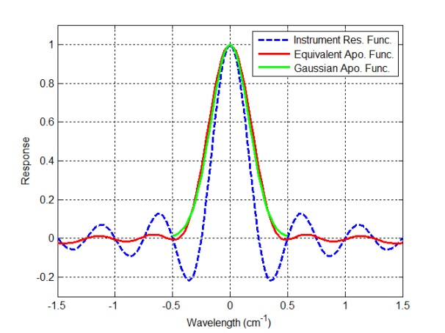
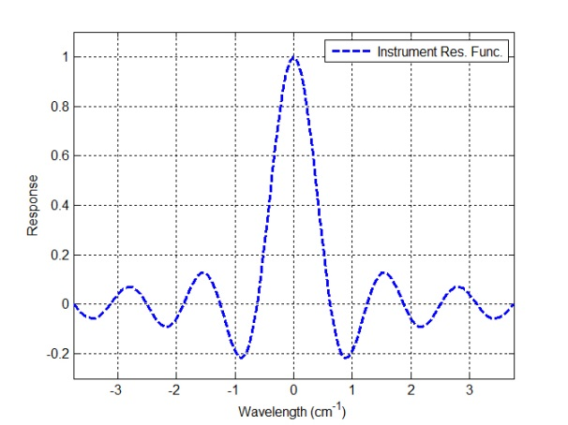
Spectrum Transformation: between two Fourier Transform Spectrometers
Flowchart of spectra transformation between two FTSs
IASI
GIIRS

Slide 11
Outline
Background
GEO-LEO/Sounder Intercalibration
In-orbit Radiometric Accuracy of GIIRS
Conclusion

Slide 12
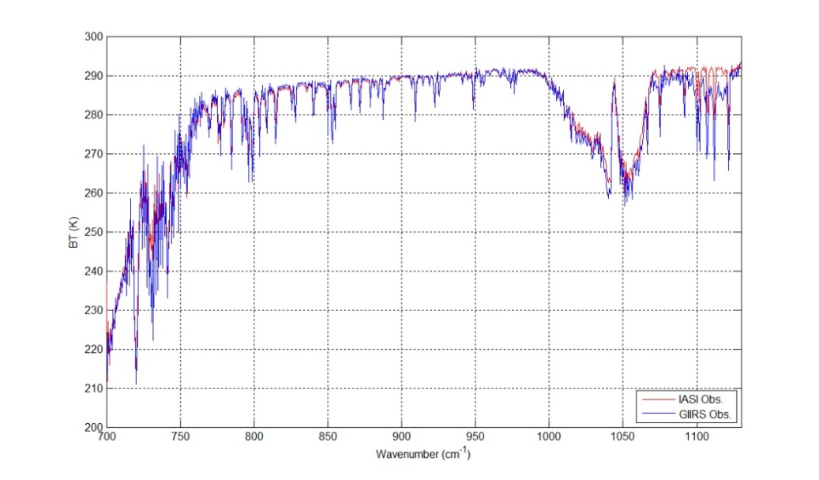
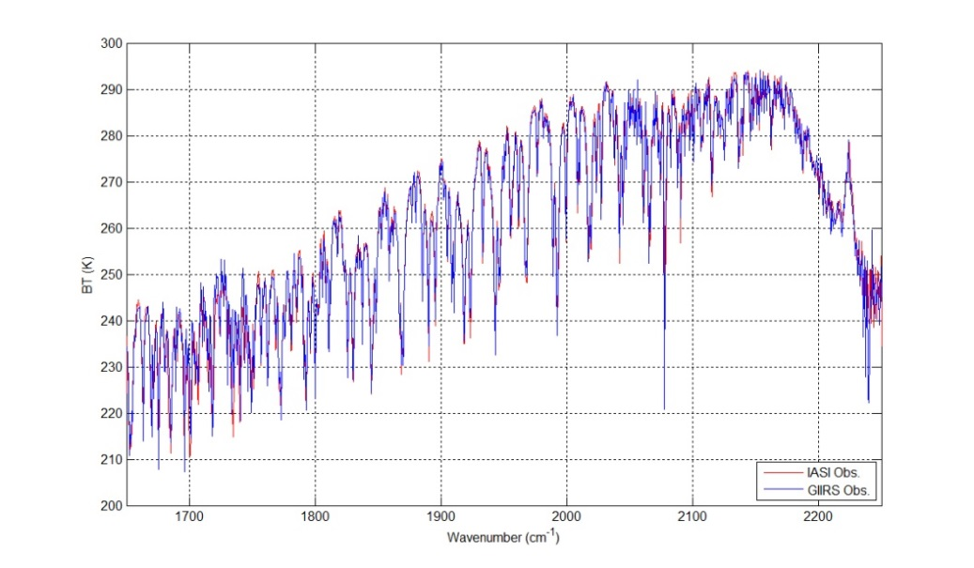
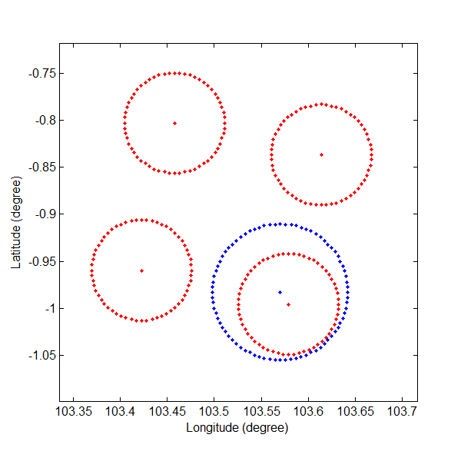
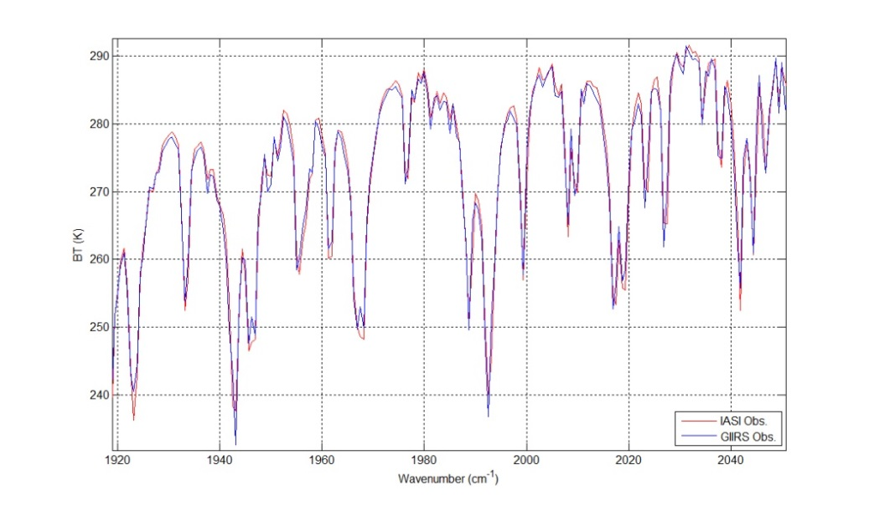
Examples of paired spectra between GIIRS and IASI at UTC 0230, 30 January, 2018
(Notes: red line for IASI, blue line for GIIRS)

Slide 13
For a period between August 2017 and March 2018, the averaged absolute monthly biases of GIIRS are assessed to be 0.25K and 0.42K for the two uncontaminated spectral coverages (i.e. 760-1050 cm⁻¹ and 1800-2188 cm⁻¹) respectively
LW
MW

Slide 14
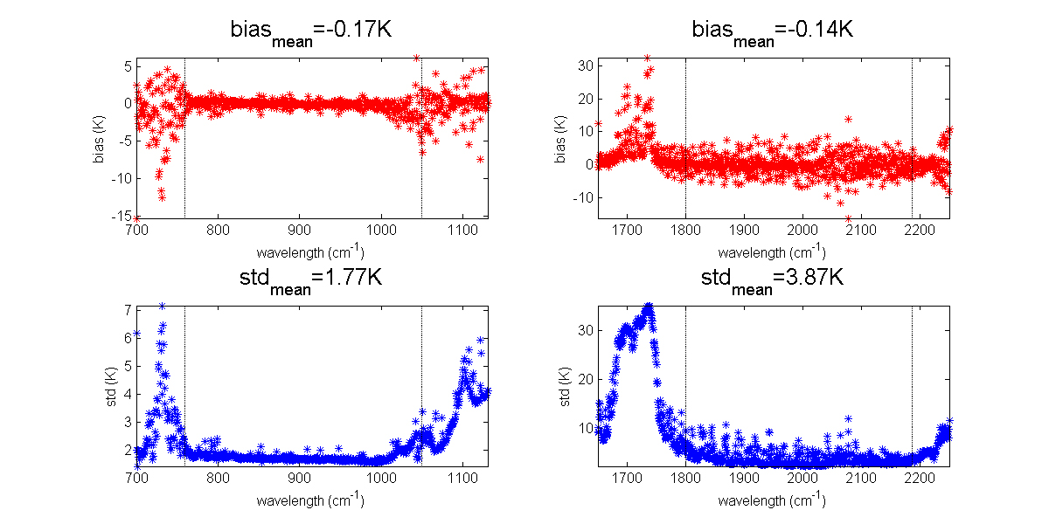
Long-term RA results of all the uncontaminated channels for GIIRS against IASI from August 2017 to March 2018

Slide 15
Outline
Background
GEO-LEO/Sounder Intercalibration
In-orbit Radiometric Accuracy of GIIRS
Conclusion

Slide 16
For a period between August 2017 and March 2018, the averaged absolute monthly biases of GIIRS are assessed to be 0.25K and 0.42K for the two uncontaminated spectral coverages (i.e. 760-1050 cm⁻¹ and 1800-2188 cm⁻¹) respectively, while the annual variation feature of monthly biases appears clearly.
RA results for individual detectors of GIIRS indicate that the mean biases of column 3 is the best, columns 4 and 2 take the second place, and column 1 is the worst.
The preliminary RA outcomes also validate that the spectral calibration as well as the harmonization among different detectors of GIIRS still have more space for enhancement.
The proposed method is widely suitable for two FTSs intercalibration with not only GEO-LEO but also LEO-LEO modes, and is believed to be benefit to GSICS community for the future applications.
It has been submitted to TGRS (TGRS-2018-01812) and is undergoing review

Slide 17
Thanks for your attention
Question?

