Slide 1
Spectral Gap-filling and Convolution Error Correction in Satellite Sensor Inter Calibrations
Xu Liu, W. Wu, Q. Yang, S. Kizer, and CLARREO Science Team
NASA Langley Research Center
X. Xiong, R. Li, and A. Wu
NASA Goddard
L. Wang and C. Cao
NOAA STAR

Slide 2
Outline
Definition of convolution errors when inter-calibrate a broad band sensor and a hyperspectral sensor
Error characterizations using realistic radiative transfer model simulations
Method for correcting the convolution errors
Applying the method to MODIS/AIRS MODIS/CrIS, and MODIS/IASI inter-cal
Summary and conclusions

Slide 3
Definition of Convolution Errors
Convolution Errors
Errors due to spectral gap
Errors due to finite spectral resolution and spectral overlapping of the sensor spectral response function
Errors due to uncertainties in instrument characteristics
Radiometric calibration
Uncertainties due to broadband SRF
Our goal is to minimize the convolution error so we can characterize the radiometric uncertainties and sensor SRF uncertainty better.

Slide 4
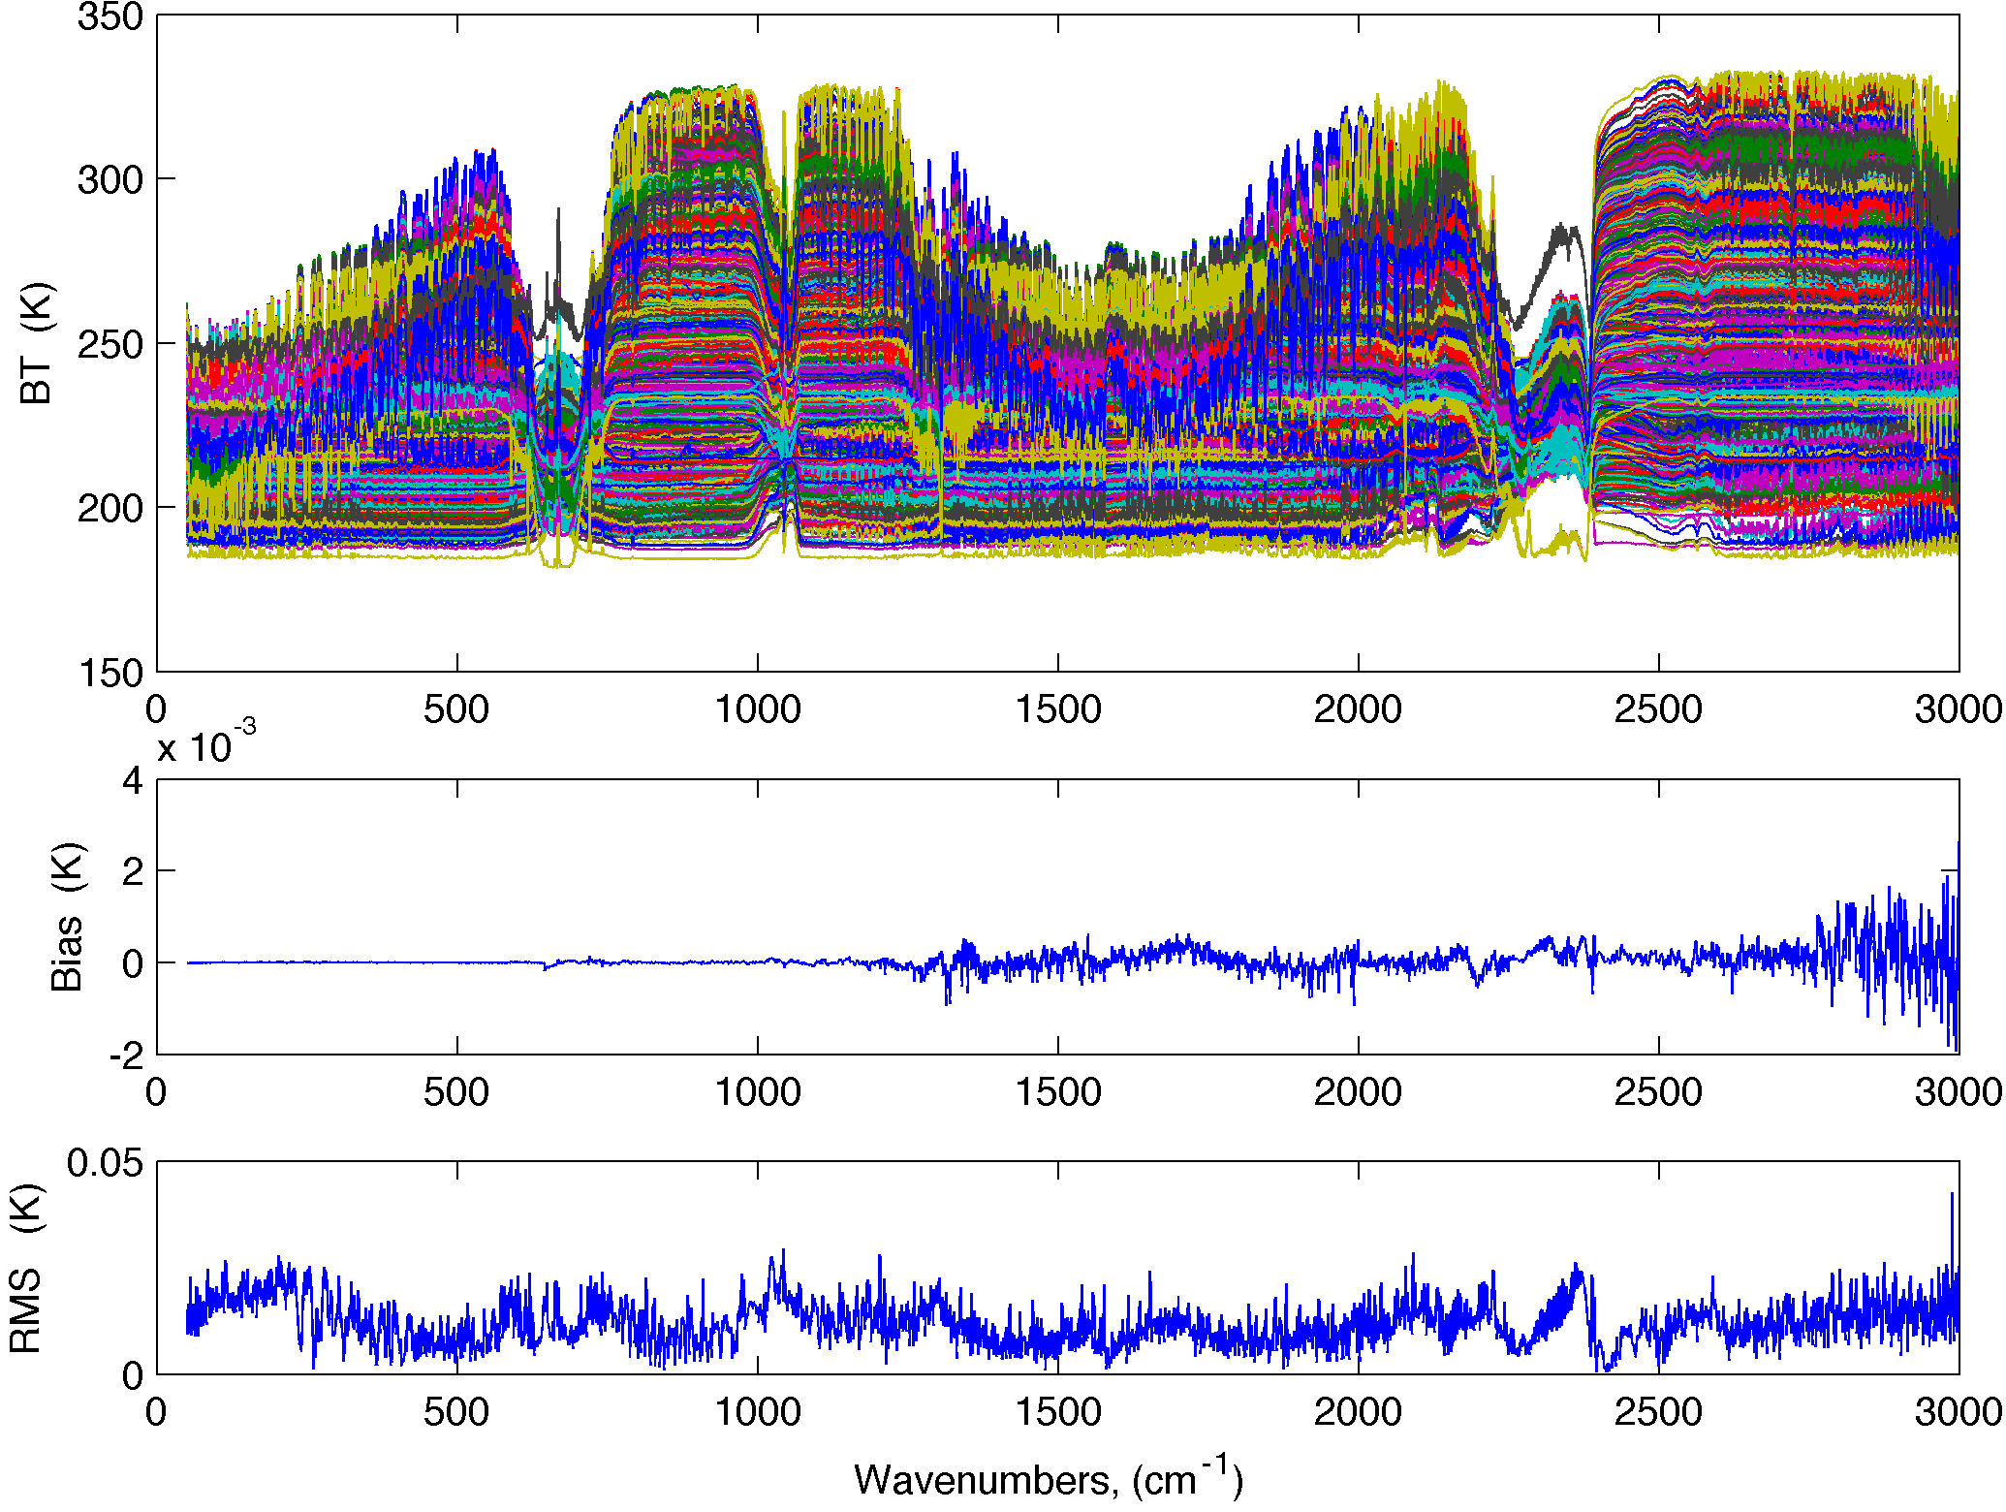
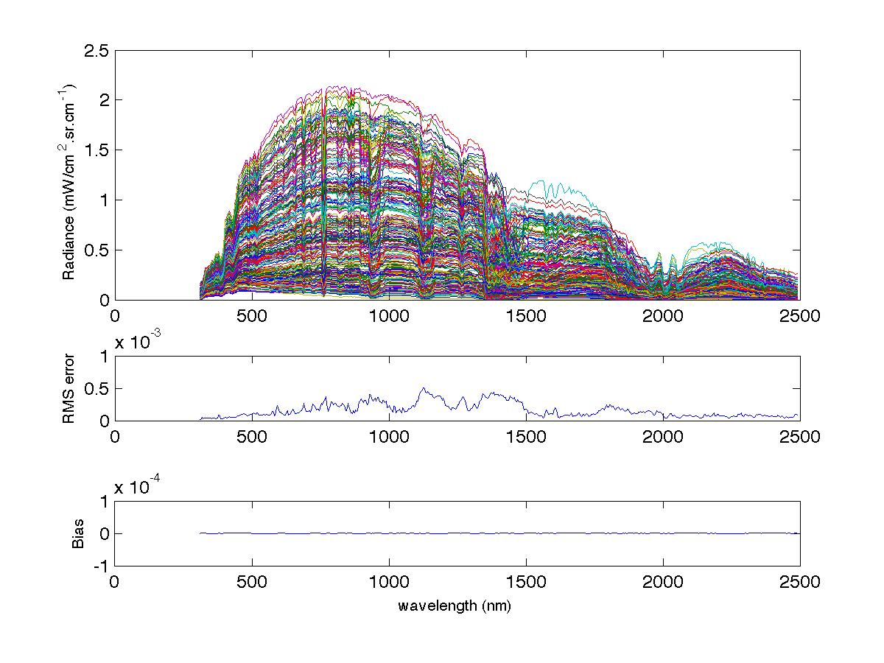
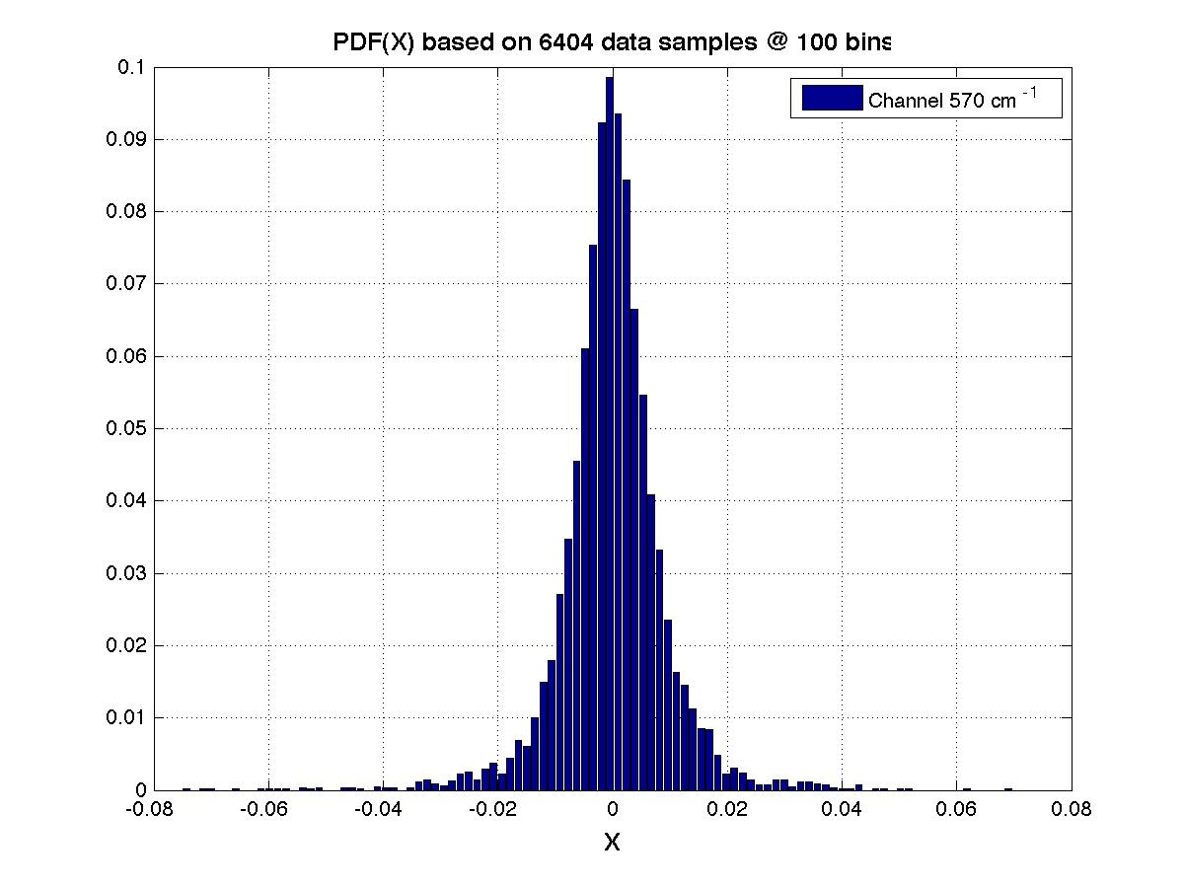
Accuracy of PCRTM is very good relative to reference RT models
Bias error relative to LBL is typically less than 0.002 K
The PDF of errors at different frequencies are Gaussian distribution
RMS error < 0.03K for IR and < 5x10⁻⁴ mW/cm²/sr/cm⁻¹ for solar (< ~0.02%)

Slide 5
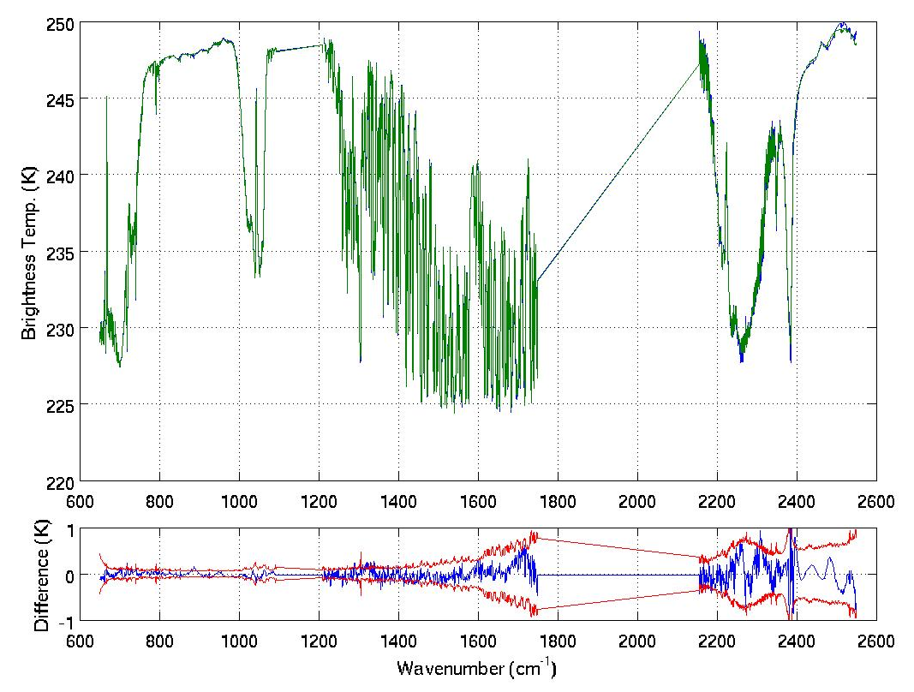
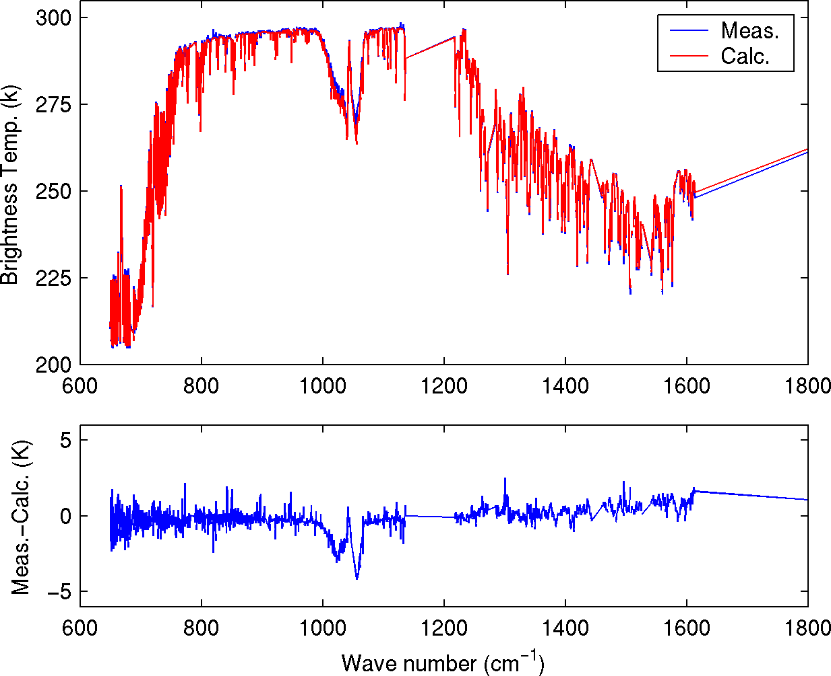
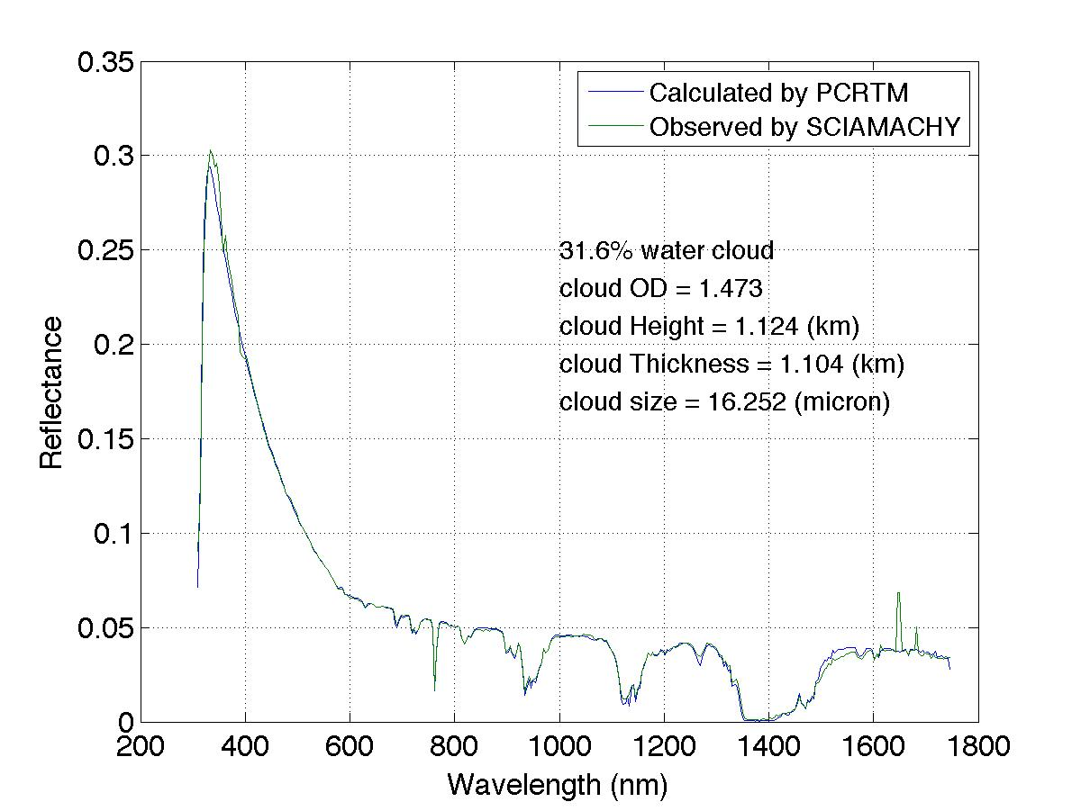
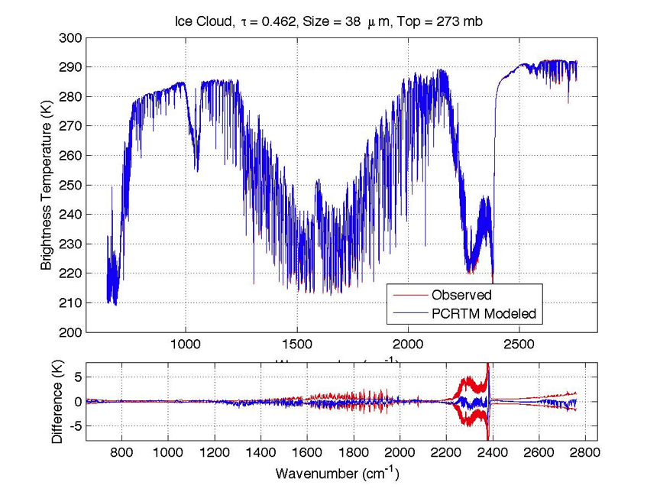
PCRTM has been validated using CrIS, IASI, AIRS, NAST-I, and SCIAMACHY real data

Slide 6
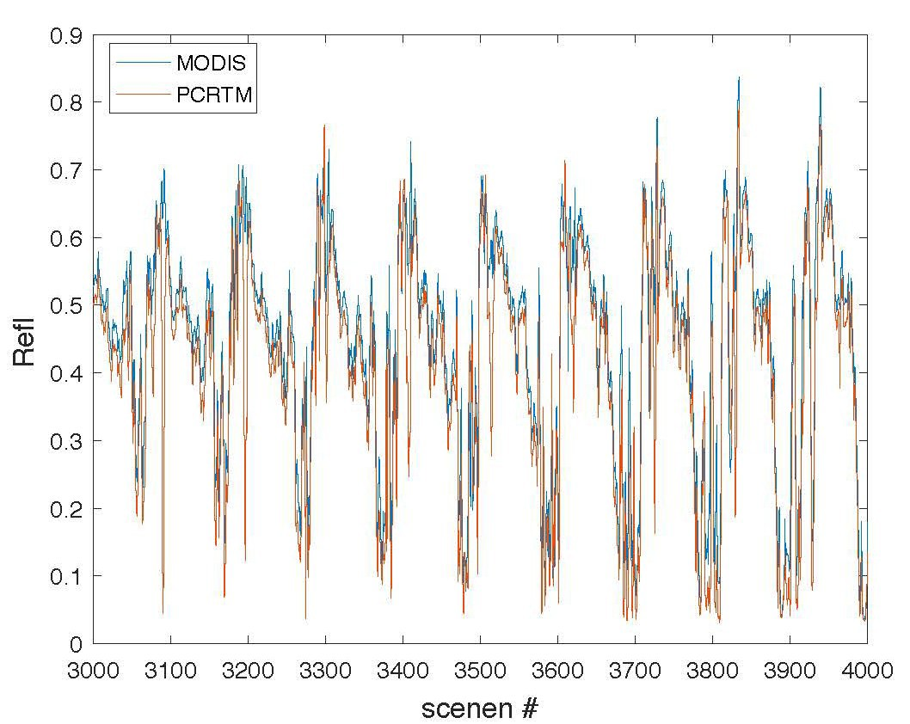
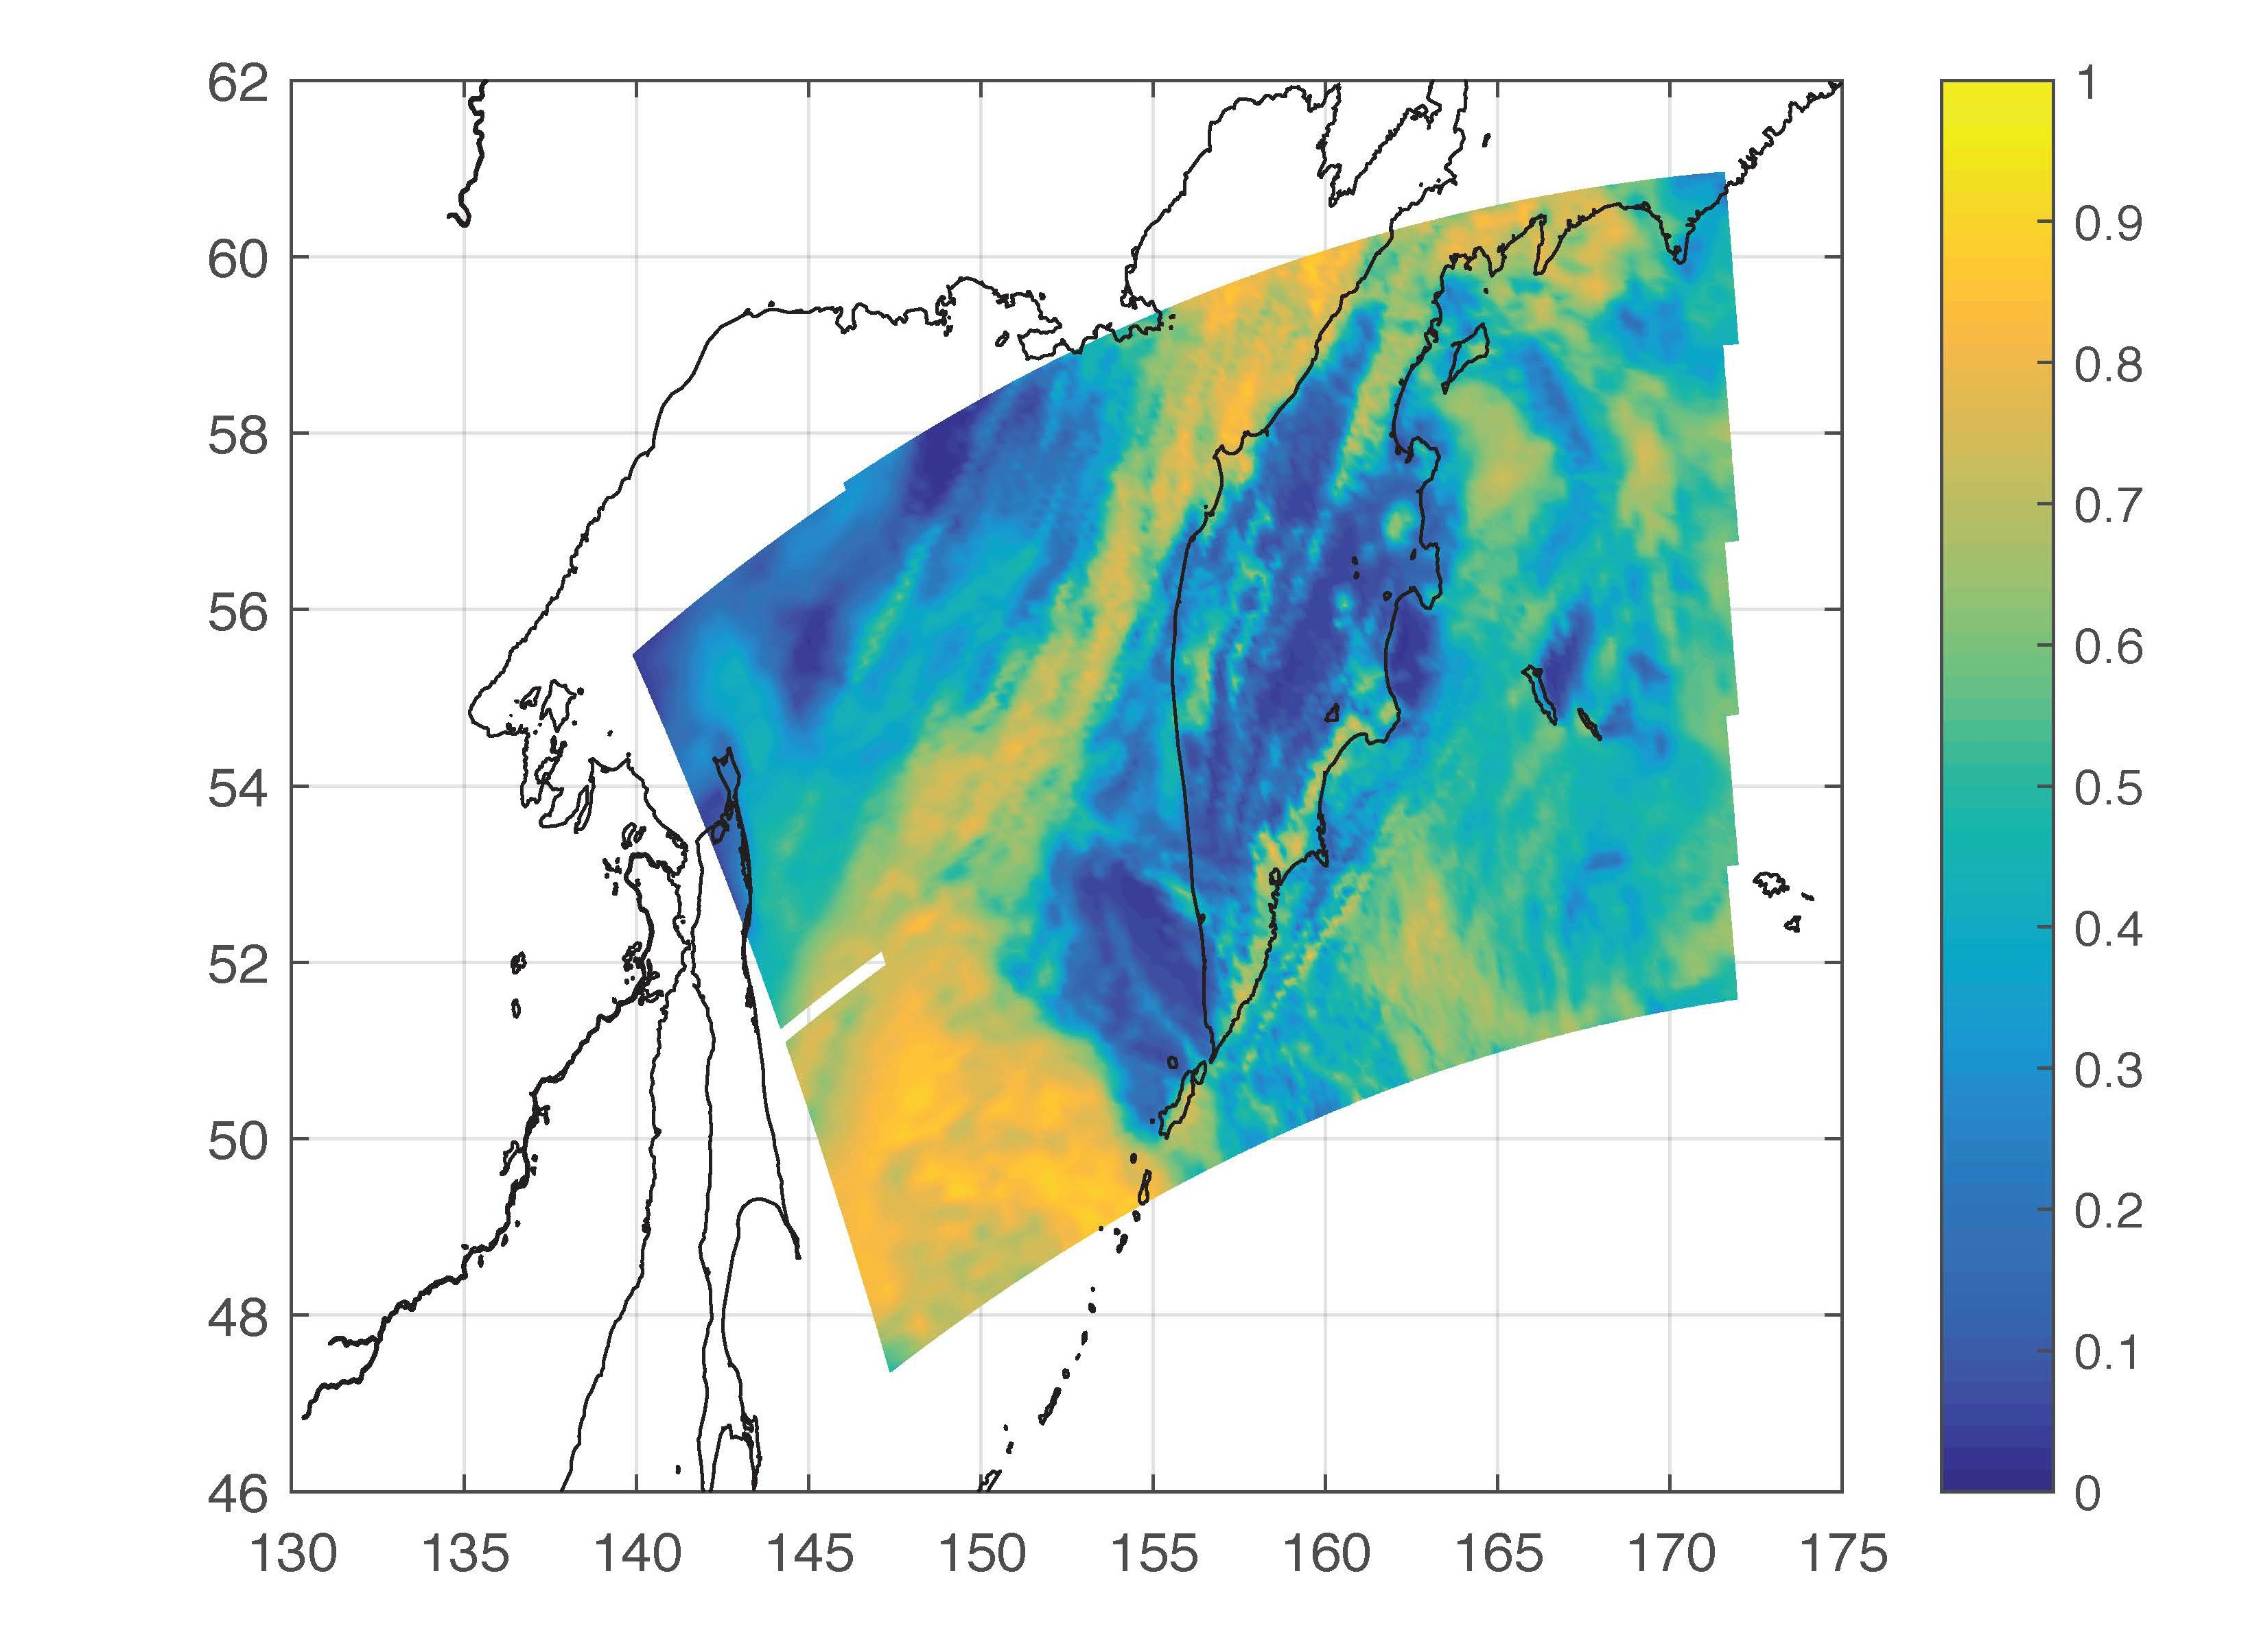
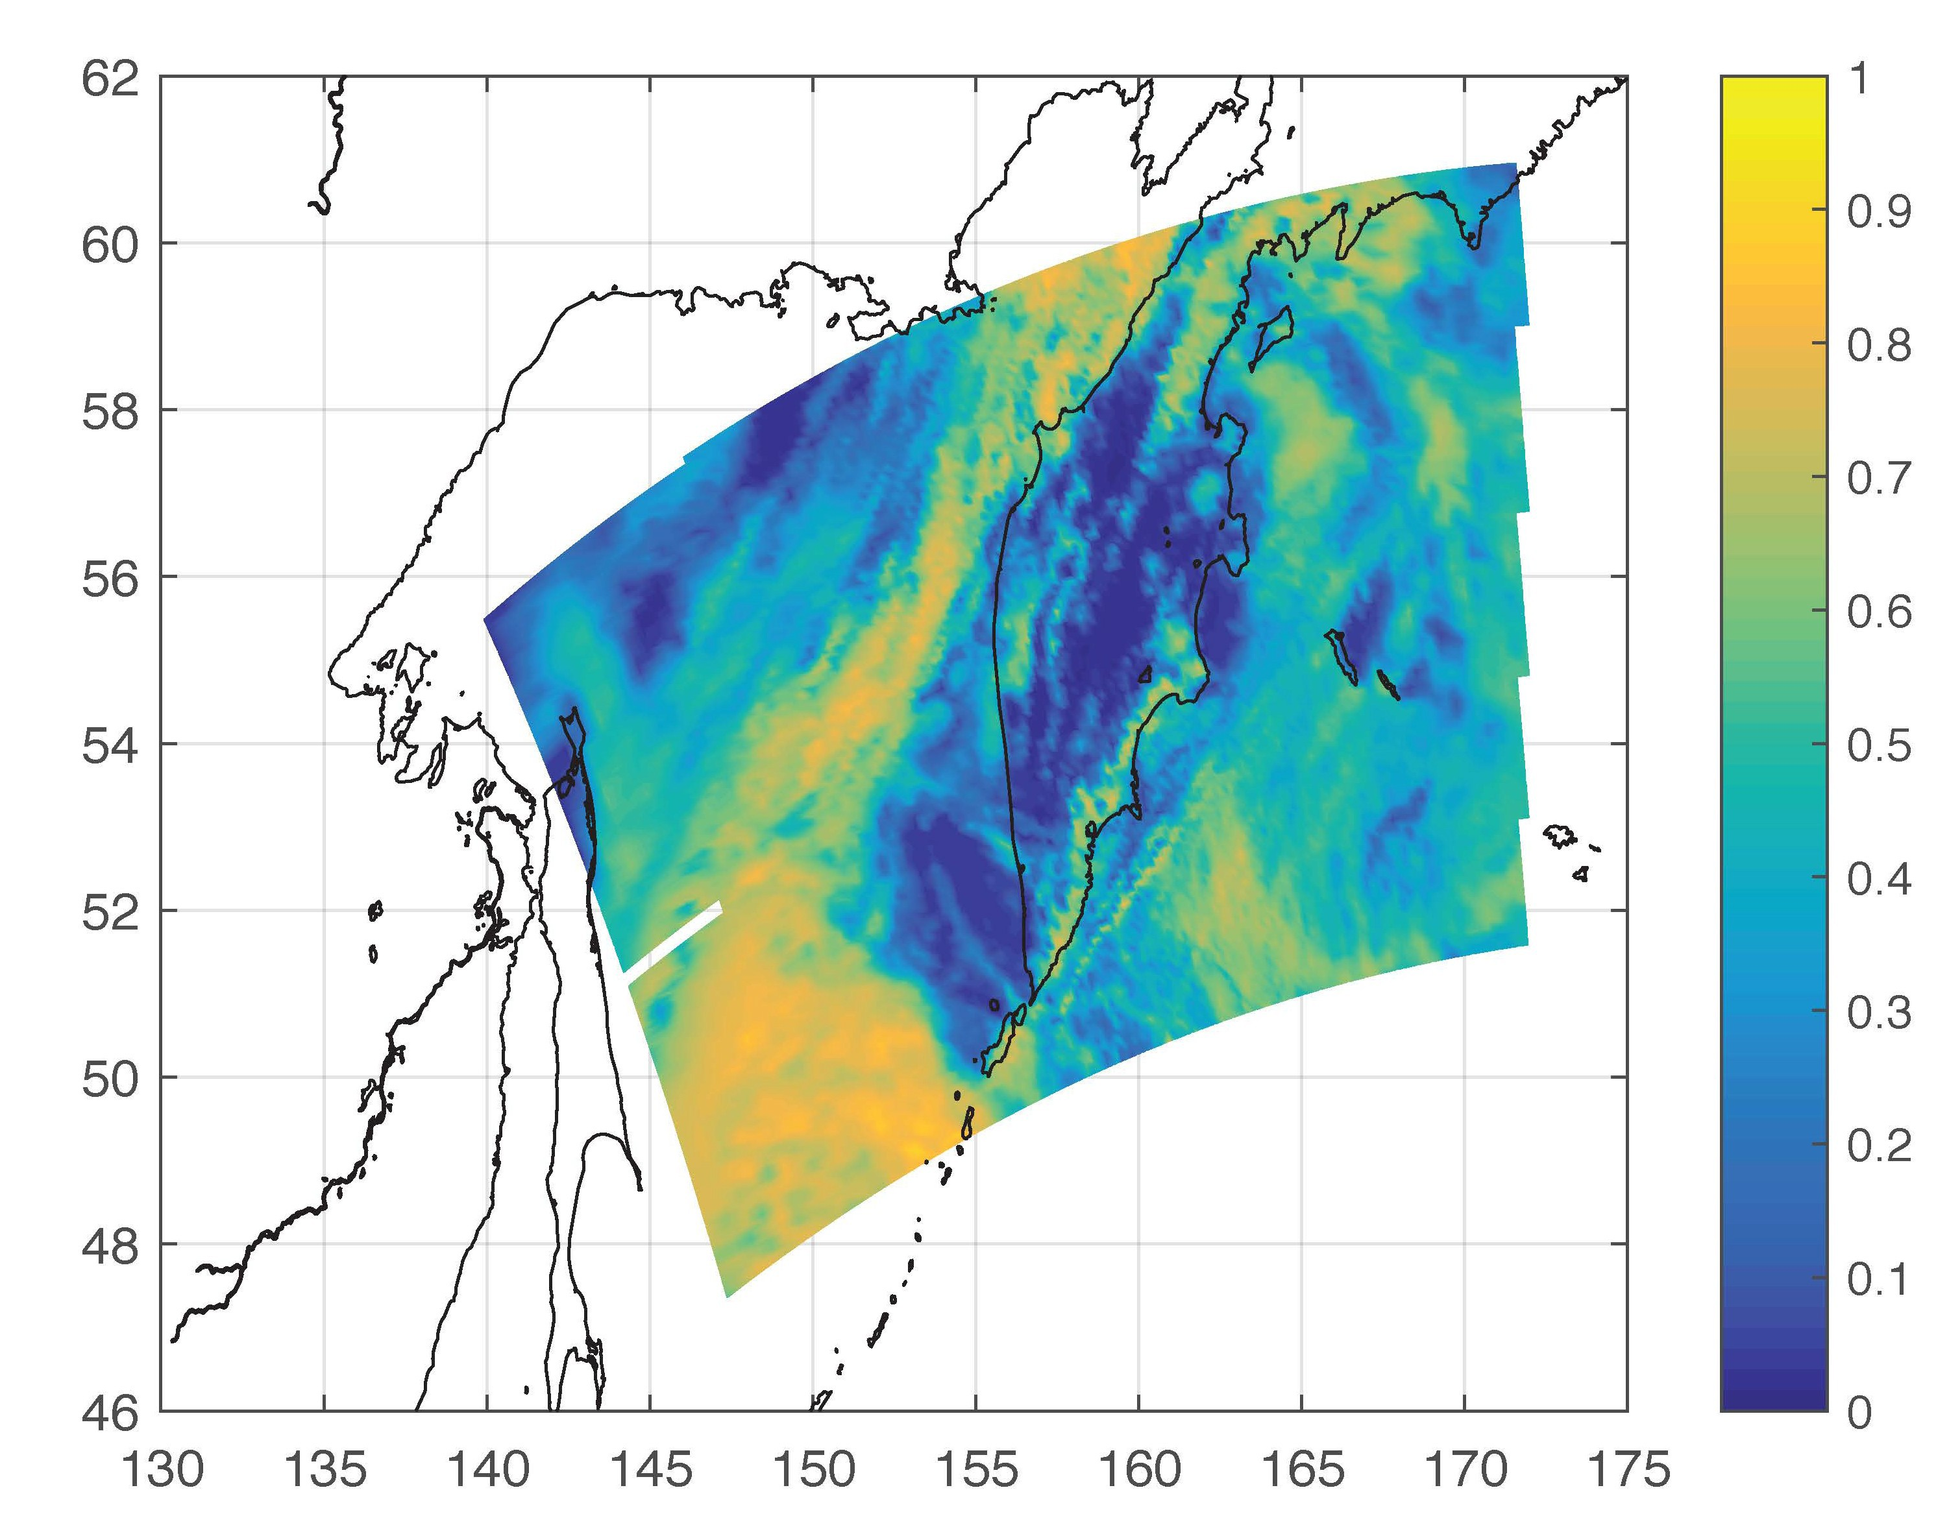
A granule with both land and ocean surface
The spatial pattern agrees well between the PCRTM simulated and MODIS observed
The data can be used for satellite inter- cal and for geophysical parameter retrievals
Plan to use the simulator for climate benchmarking studies.
CALRREO Science Team Meeting, Hampton, November 14, 2017 (Xu.Liu-1@nasa.gov )
26

Slide 7
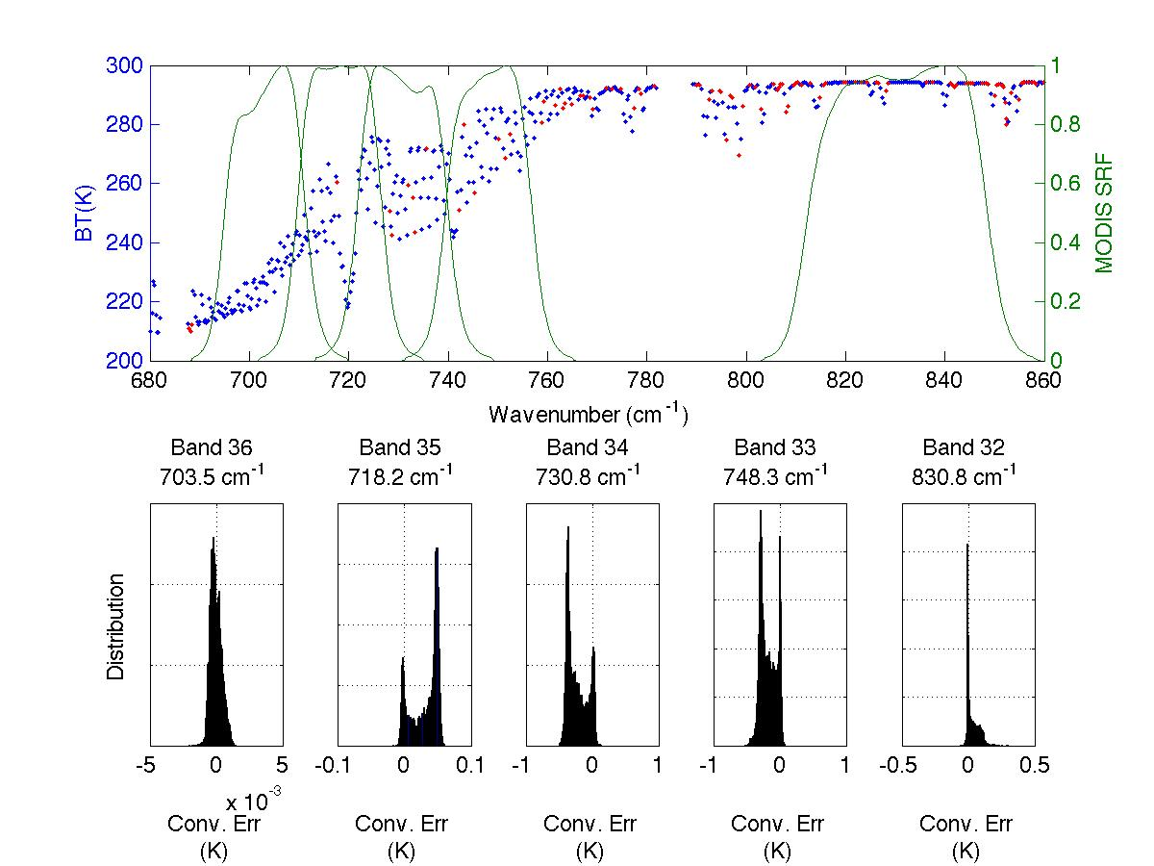
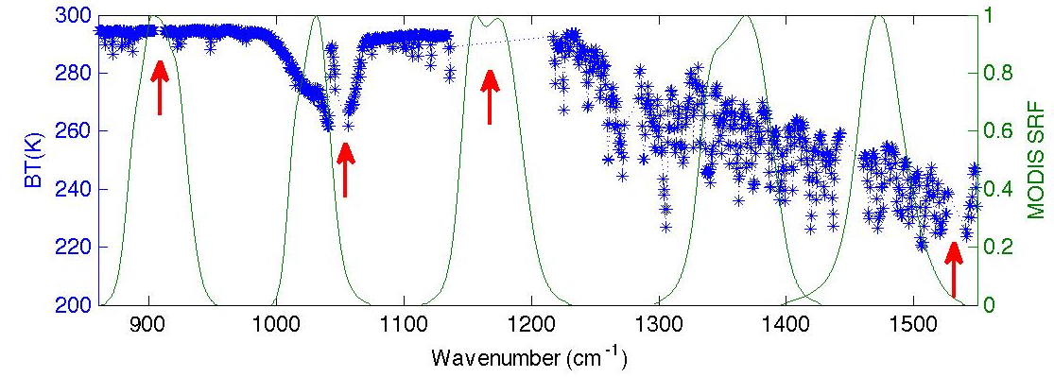
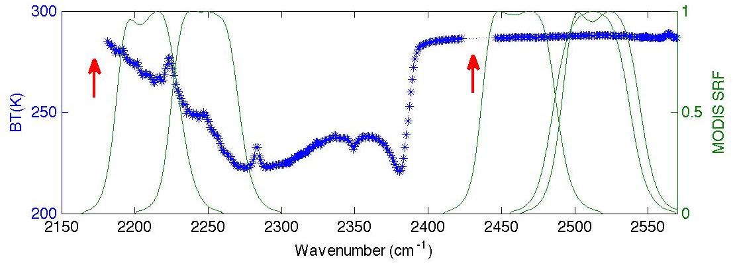
MODIS-AIRS convolution errors
(simulation)

Slide 8
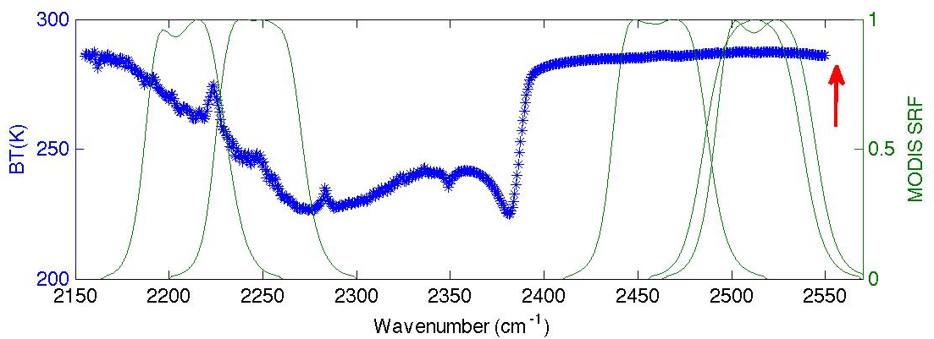
MODIS-CrIS convolution errors
(simulation)

Slide 9
MODIS calibrated by IASI, CrIS, and AIRS
MODIS
IASI
IASI
CrIS
AIRS
Simulated from thousands of training samples.
CrIS
AIRS

Slide 10
PCRTM based convolution correction algorithm

Slide 11
MODIS-AIRS convolution correction

Slide 12
Convolution Correction for 09/17/2007
AIRS/MODIS SNO data

Slide 13
Convolution Correction after SRF shift

Slide 14
Correction for MODIS-CrIS convolution errors

Slide 15
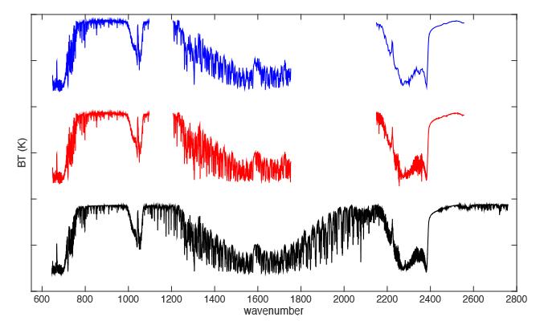
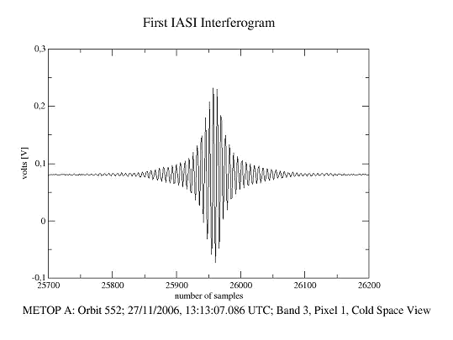
CrIS-MODIS convolution errors evaluated using real IASI observations as the proxy
Convolution Errors
Based on PCRTM simulation of training samples
IASI
SWIR
MWIR
CrIS
LWIR
Convolution Errors
Based on real IASI data (2013)

Slide 16
Correction for MODIS-CrIS (Blackman, Band 22)
Convolution Errors produced from IASI data

Slide 17
Correction for MODIS-CrIS (Blackman, Band 34)
Convolution Errors produced from IASI data

Slide 19
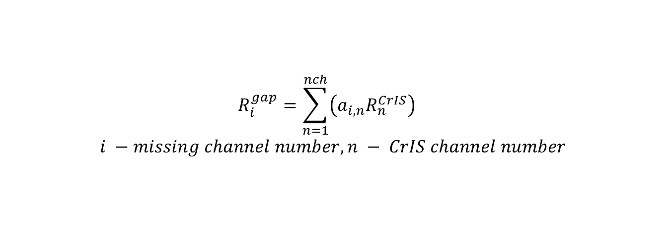
Spectral gap filling for MODIS band 29 region
$$R_{i}^{gap}=\sum_{n=1}^{nch}{\left(a_{i,n}R_{n}^{CrIS}\right)}$$
$$i −missing channel number, n − CrIS channel number$$
CrIS and AIRS barely cover MODIS band 29
Spectral information within band 29 can be accurately predicted using spectral information out of that band
IASI real data is used as the proxy data to test the spectral gap filling

Slide 20
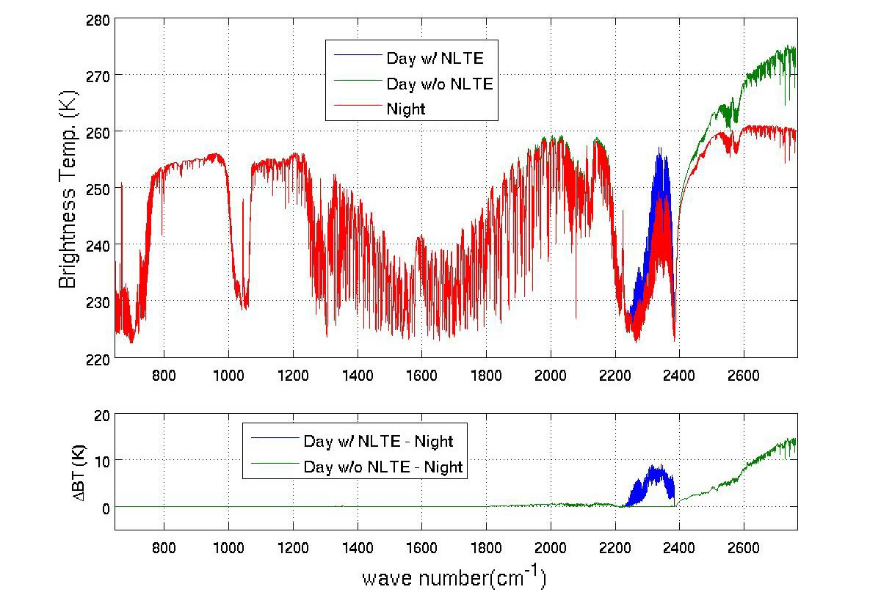
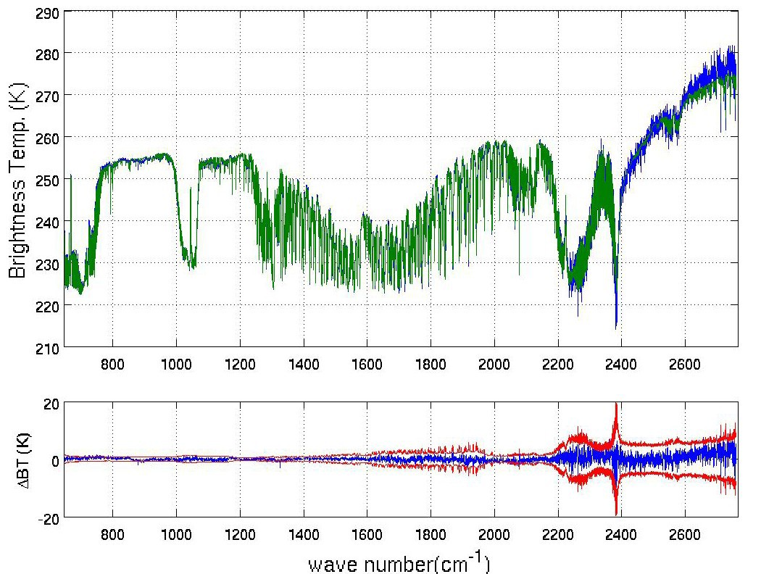
PCRTM handle NLTE and solar scattering properly
Figure 1 shows the calculated hyper spectra for night time, day time without NLTE and daytime with NLTE
Figure 2 shows PCRTM calculated and observed day-time IASI spectra during SNPP-2 field campaign
Fig. 1
Fig. 2
(Xu.Liu-1@nasa.gov )

Slide 21
Recent Results on Simulating AIRS spectra in the using ECMWF cloud fields (Aunman et al, 2018 JGR)
PCRTM was able to match with ARIS observation well during day time
bt2616 (AIRS observed –calculated) | day PDF correlation | day bias ± std [K] 1437 cases | night PDF correlation | night bias ± std [K] 1377 cases | day-night [K]
SARTA_pM1 | 0.8744 | +5.00±14.79 | 0.9738 | -3.06±18.40 | 8.0
SARTA_p999 | 0.8779 | +7.05±15.57 | 0.9746 | -0.37±19.45 | 7.4
PCRTM_ERO | 0.9855 | +1.55±15.90 | 0.9371 | -0.29±19.23 | 1.84
PCRTM_MRO | 0.9846 | +0.73±15.84 | 0.9334 | -1.88± 18.84 | 2.61
PCRTM_ERO2 | 0.9804 | +2.52±16.79 | 0.9543 | +0.58± 20.56 | 1.94
PCRTM_MRO4 | 0.9766 | +0.91±16.22 | 0.9446 | -1.25±19.47 | 2.1
HT_CMO | 0.6669 | +15.04±20.11 | 0.9075 | -2.53±20.49 | 17.5
HT_CRO | 0.6492 | +15.97±19.76 | 0.9809 | -1.43±20.12 | 17.4
HT_CMRO | 0.6653 | +15.13±20.10 | 0.9074 | -2.46±20.47 | 17.5
HT_SMO | 0.9215 | +3.69±15.86 | 0.9791 | -2.11±20.59 | 5.7
HT_SRO | 0.9628 | +3.87±15.83 | 0.9736 | -0.83±20.14 | 4.7
HT_SMRO | 0.9245 | +3.65±15.88 | 0.9799 | -2.02±20.56 | 5.7
RTTOV_MRO | 0.8948 | +4.81±15.86 | 0.9574 | -6.48±19.85 | 11.3
RTTOV_CMSS | 0.8803 | +8.07±15.26 | 0.9605 | -2.38±19.02 | 10.5
σ-IASI_as | 0.4809 | +20.94±18.94* | 0.8739 | +5.37±19.50 | 15.6
CRTM2_tcc | 0.3991 | +20.55±17.60 | 0.6623 | +6.38±20.52 | 14.1
CRTM_mro | 0.6680 | +13.90±18.74 | 0.9604 | -2.16±19.58 | 16.1
CRTM_2col | 0.6410 | +15.33±18.59 | 0.9486 | -1.04±19.63 | 16.4
(Xu.Liu-1@nasa.gov )

Slide 22
Summary and Conclusions
Convolution errors are due to the spectral gaps and finite spectral resolution of the hyperspectral instrument
These errors can be corrected using a simple method
  PCRTM and associated LBL radiance database are used to train the correction coefficients
  The PCRTM has realistic multi-layer clouds, multiple scattering calculations, realistic surface emissivity variabilities, non-LTE effect, and anisotropic solar cloud scattering
The method has been applied to real AIRS/MODIS and IASI/MODIS data
  The radiance differences between broadband instrument (MODIS) and the hyperspectral instruments (IASI and AIRS) are more consistent after convolution corrections
We have demonstrated the spectral gap filling capability using real MODIS/IASI/CrIS data
  Accurate experiment design and assumptions with good results
  The method can be used to extend spectral range beyond IASI spectral coverage (e.g far-IR and solar-spectral region)

