Slide 1


Mutual Evaluation between the imager and hyperspectral sounder at the same platform FY-3D and FY-4A
Hanlie XU, Na XU, Xiuqing HU, Chengli QI, Chunqiang WU
NSMC CMA
2019-3-7

Slide 2
Outline
Background
Methodology
Consistency check between MERSI and HIRAS
Geolocation
Radiometric calibration
Application on inter-calibration
4. Summary

Slide 3
Background
IASI
CrIS
High spatial resolution
High geolocation accuracy
Wide application
Imager
FY3D/MERSI
Imager
FY4A/AGRI
Imager
High spectral resolution
High calibration accuracy
Reference instrument
Sounder
FY3D/HIRAS
Hyperspectral Sounder
FY4A/GIIRS
Hyperspectral Sounder
Joint application of Imager and hyperspectral sounder on the same platform:
Taking advantage of both spectral and spatial capabilities can benefit atmospheric and surface geophysical parameter retrievals and data utilization for NWP;
Consistency is the premise of data joint application;
Inter-calibration is a useful tool to check their consistency , i.e. geolocation, radiometric calibration.

Slide 4
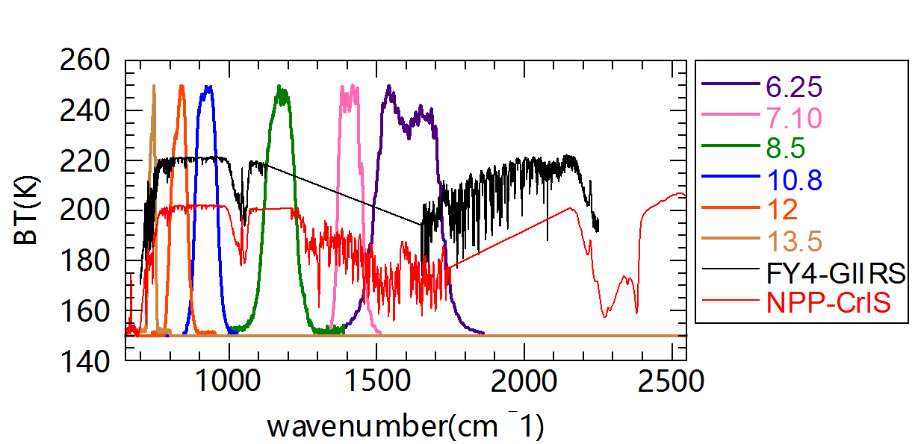
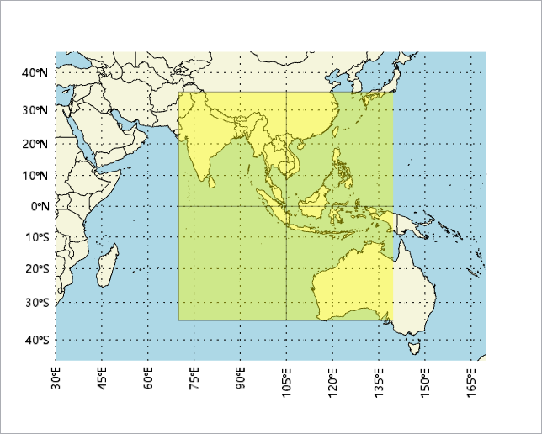
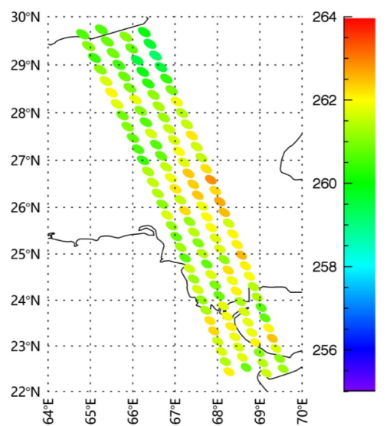
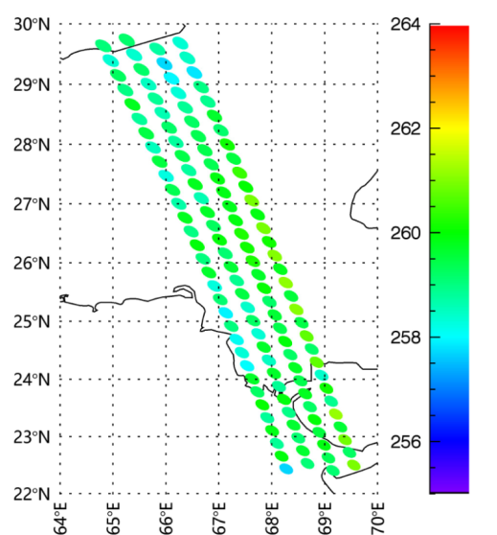
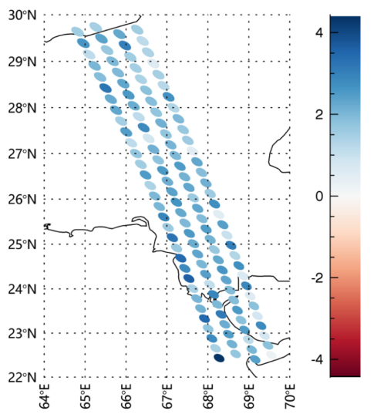
Previous job: AGRI and GIIRS consistency check (2017)
Collocation area
FY4A/AGRI
IR band SRF
Collocation area: GEO nadir ±35º area;
Time difference: 180s
Target area: 5*5 AGRI pixels
Environment area: 15*15 AGRI pixels
Only uniform areas are chosen.
GIIRS Simulated 13.5
AGRI 13.5
GIIRS-AGRI

Slide 5
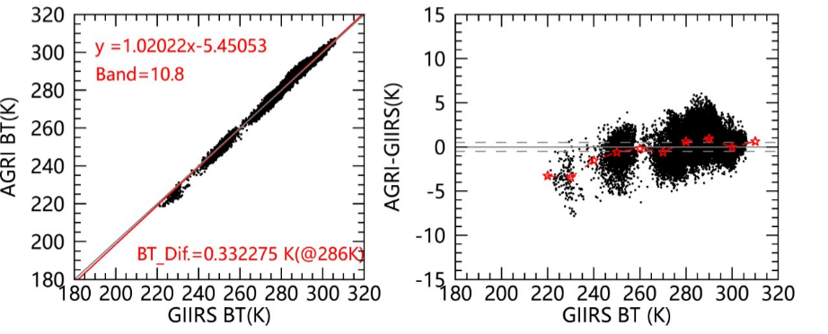

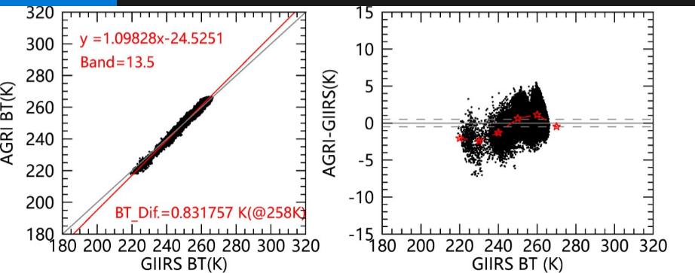
AGRI and GIIRS radiometric consistency check
A case: 20180105
Band | 10.8 | 12 | 13.5
Scene (K) | 286 | 285 | 258
AGRI-GIIRS | 0.33 | 0.19 | 0.83
GIIRS and AGRI have a good consistency, at the standard sense temperature, GIIRS is a little lower than AGRI;
In this case, for window bands, the bias is less than 0.5 K, for absorption band, bias is less than 1 K;
Bias has BT dependence, in low temperature area, the bias is larger;

Slide 6
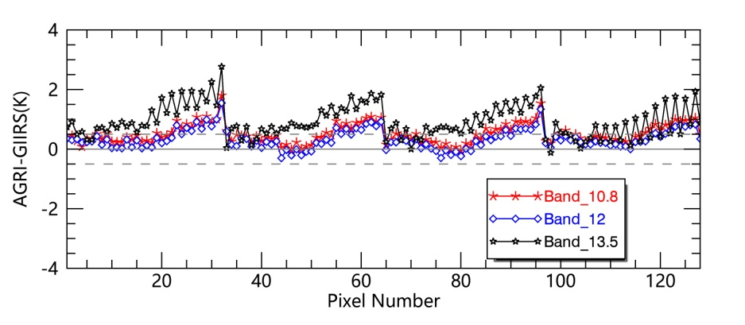
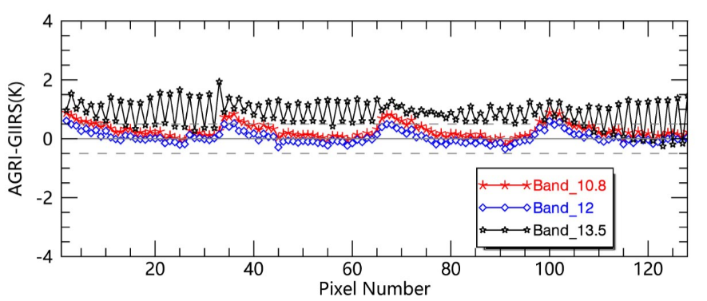
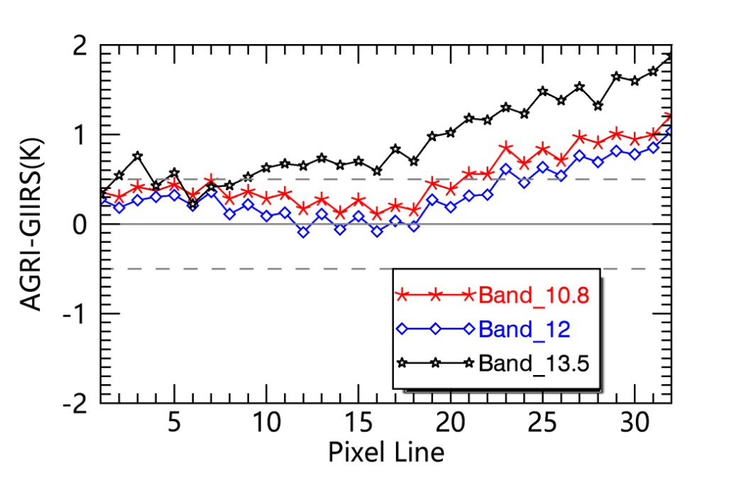
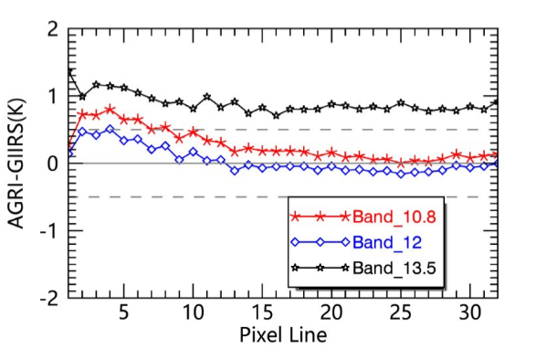
Bias of FOV dependent
201708
201801(After operation update)
Finding significant FOV dependence

Slide 7
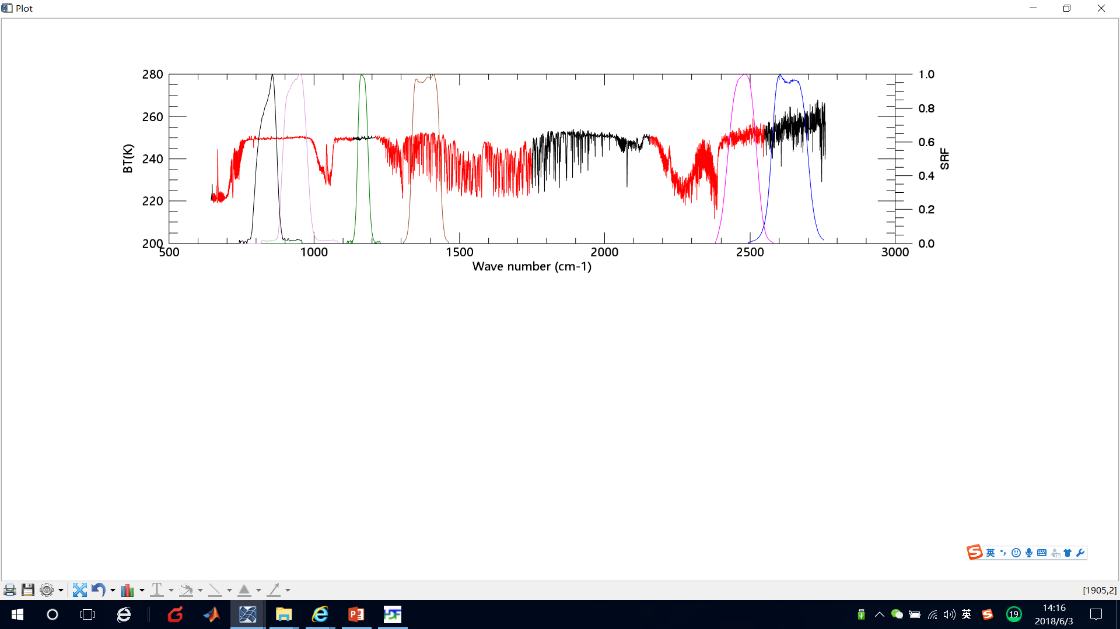
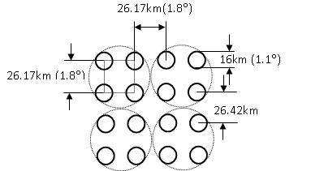
FY-3D/MERSI and HIRAS spectral specification
HIRAS
4 bands are covered by HIRAS, 2 LW 1 MW, 1 SW;
2 bands in spectral gap;
CH25
CH24
CH23
CH22
CH21
CH20
IR Band | MERSI |  |  | HIRAS(cm-1)
 | (cm-1) | (μm) | Nadir IFOV(m)
CH25 | 833.33 | 12.0 | 250 | 650-1135 (LW)
CH24 | 925.926 | 10.8 | 250
CH23 | 1169.591 | 8.55 | 1000
CH22 | 1388.889 | 7.2 | 1000 | 1210-1750 (MW)
CH21 | 2469.136 | 4.05 | 1000 | 2155-2550 (SW)
CH20 | 2631.579 | 3.8 | 1000
Notes:
加阴影

Slide 8
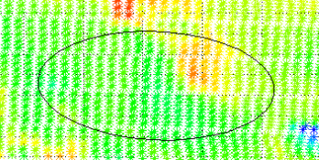
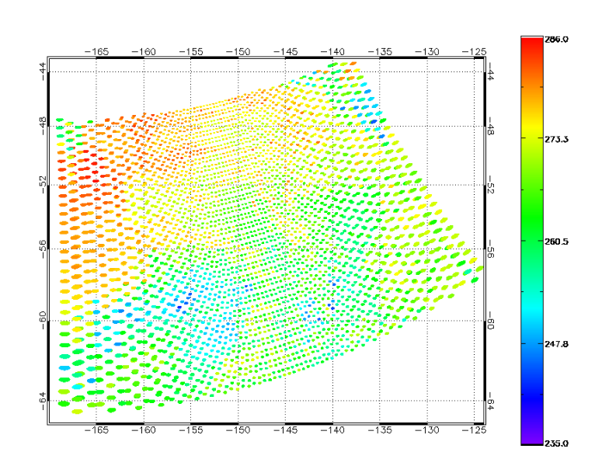
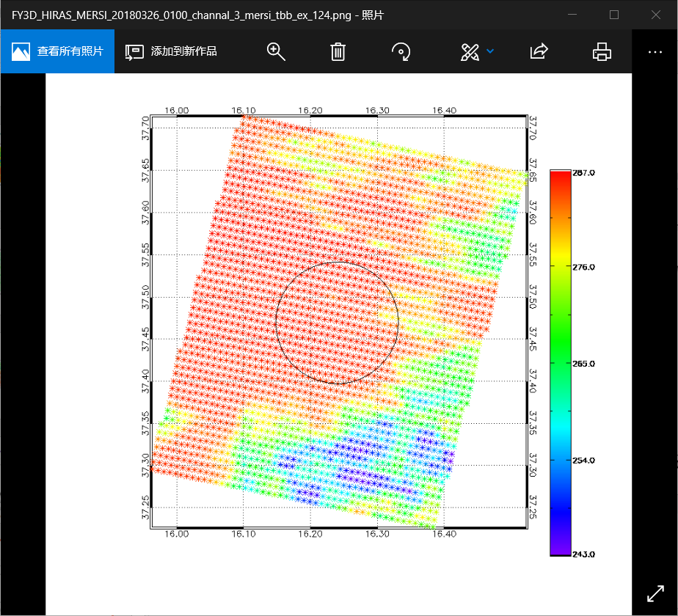
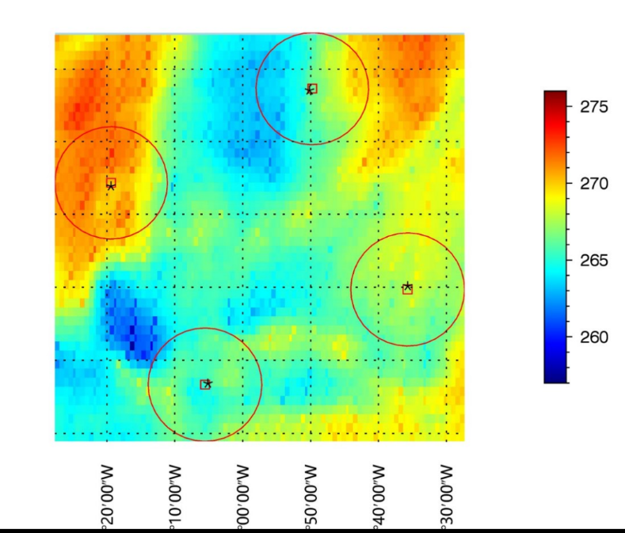
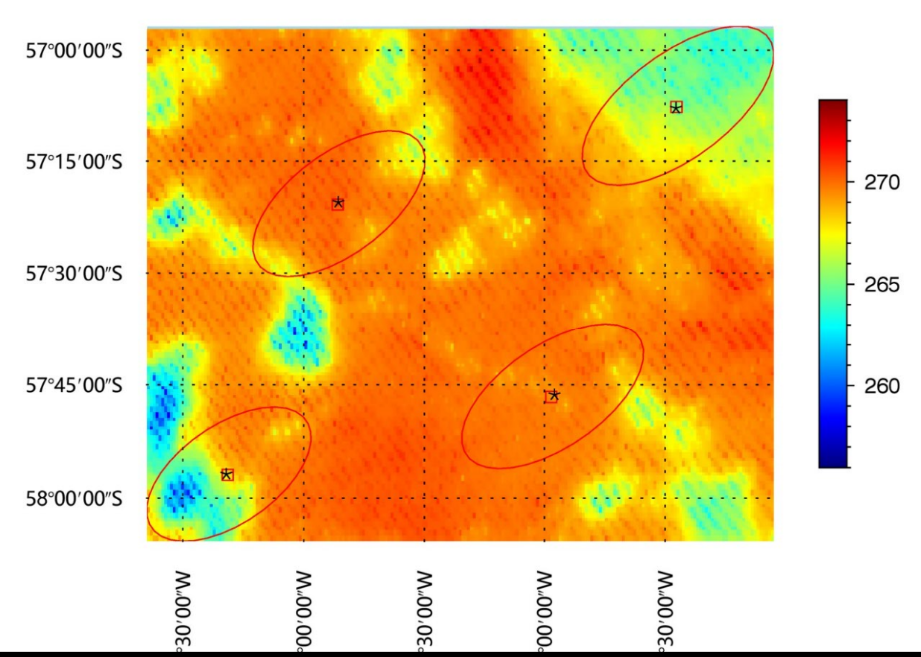
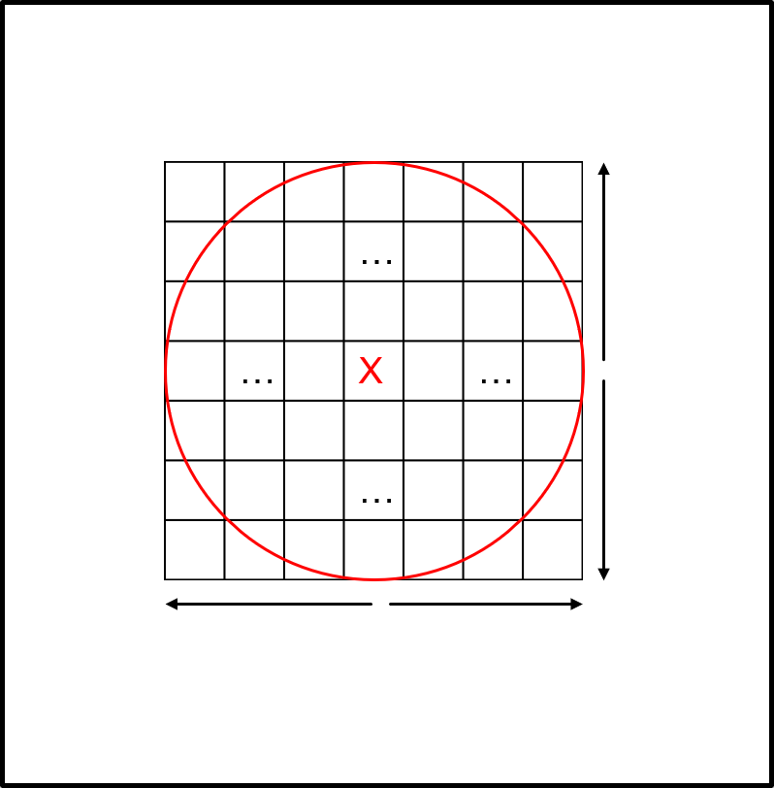
HIRAS FOV
29 km
HIRAS
55km
16km
Diameter:
Nadir: 16 km ;
Edge: more than 55 km (long axis) and 30 km (short axis)
Shape： From circle to ellipse;
HIRAS
TARGET
AREA
ENV
AREA
Nadir FOR
Off-nadir FOR

Slide 9
Accurate collocation Method
An accurate collocation method from GSICS is used for inter-calibration on the same platform. (Wang et al., 2013,2016).
Accurate collocation is based on line-of-sight pointing vectors, but not the spatial location.
Satellite
P
Computing the two sensor’s pointing vector;
Comparing the angle between pointing vectors with HIRAS’s FOV size angle;
Finding exactly which MERSI pixels are in HIRAS’s FOV.
According to Wang et al.,(2016)

Slide 10
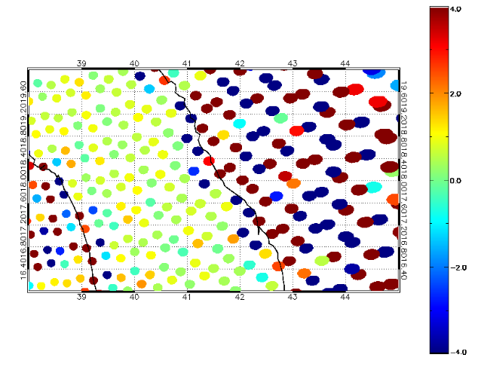
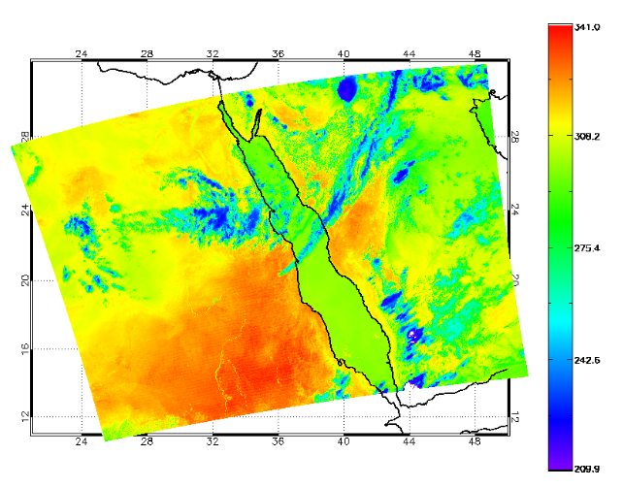
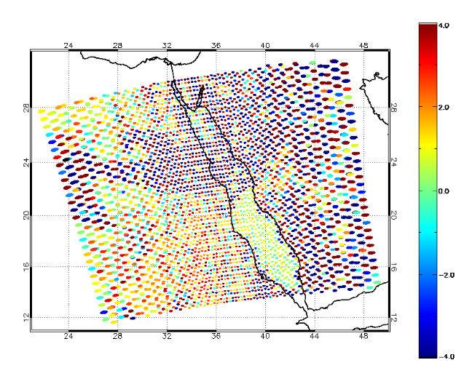
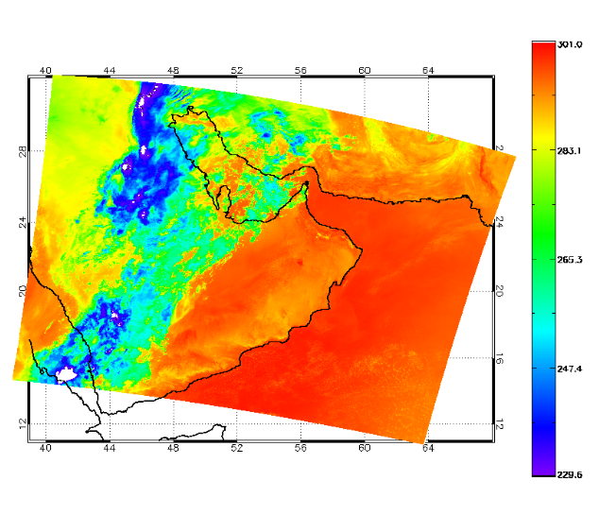
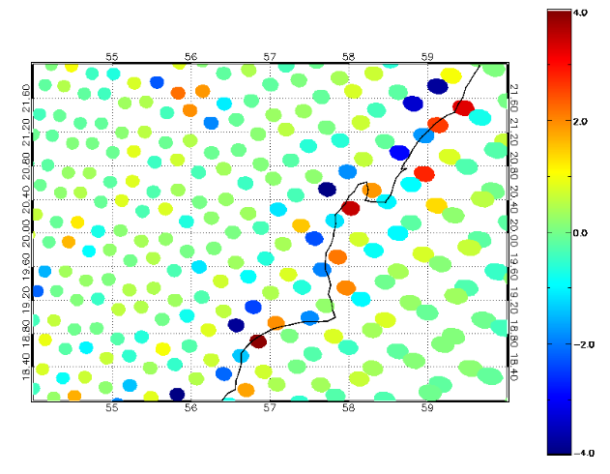
Results: Geolocation consistency
Geolocation inconsistency was found at the beginning of commissioning.
MERSI
MERSI-HIRAS
Local Zoom-in
Radiation of the two instruments shows a significant difference in the inhomogeneous targets, especially at coastline;
Bias has no systematic error along the coastline;
Notes:
1、偏差，并且在海陆边界比较大——很可能是定位引起
2、偏差在海陆边界并没有一边大一边小，系统性特征，这与传统的定位差异又有所不同

Slide 11
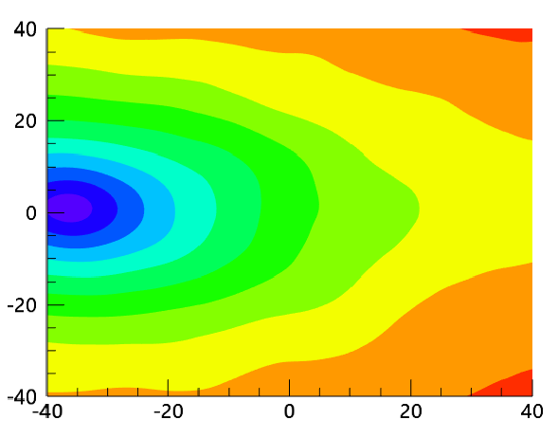
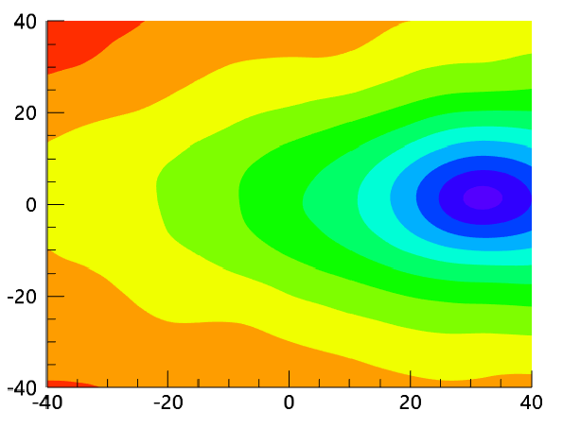
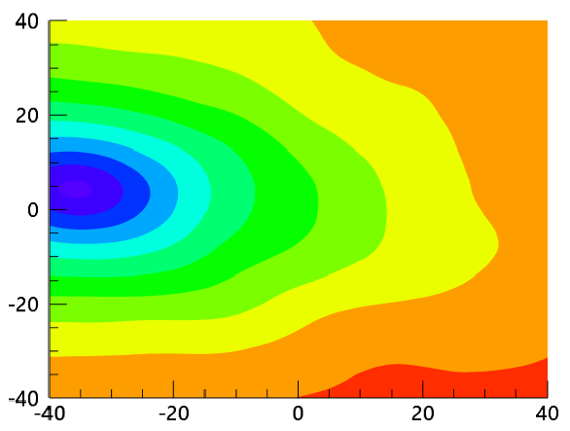
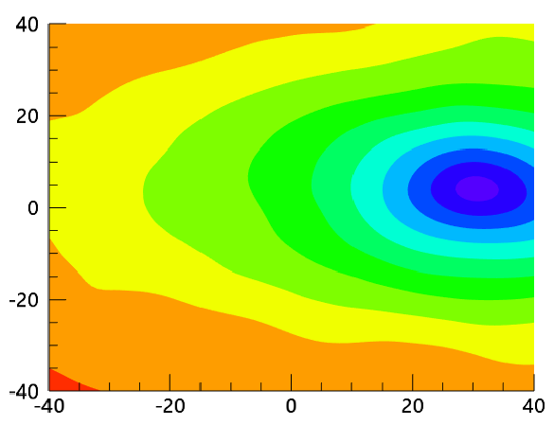
Finding HIRAS Geolocation v1 bug
FOV1
FOV2
Checking each FOV’s image with MERSI in order to examine FOVs geolocation consistency.
Orbit Direction
FOV4
FOV3
 | X | Y
FOV1 | -37 | 3
FOV2 | 32 | 0
FOV3 | 31 | 2
FOV4 | -32 | 3
Scan Direction
Low latitude, nonuniformity samples
FOR 13-17，near nadir samples
The FOVs maybe reverse left and right!
Notes:
为了分析这个问题，我们分别查看了每个HIRAS 的FOV图像与MERSI 图像的相关性特征，以检查HIRAS的各像元的定位不一致性。

Slide 12
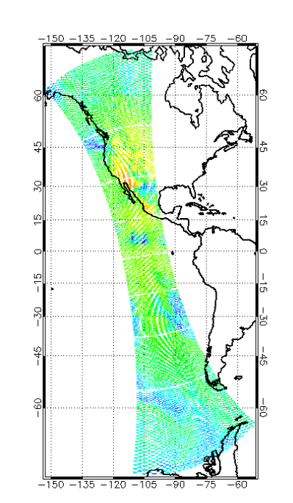
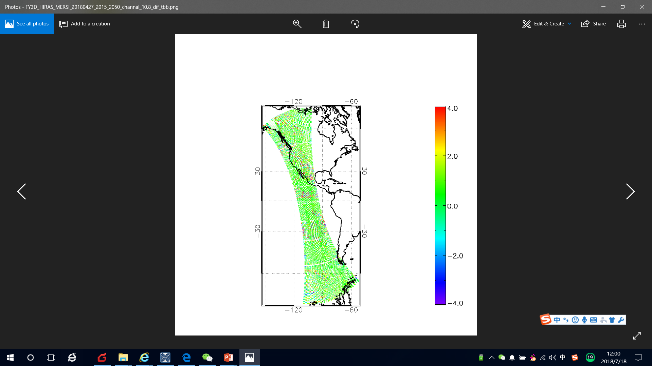
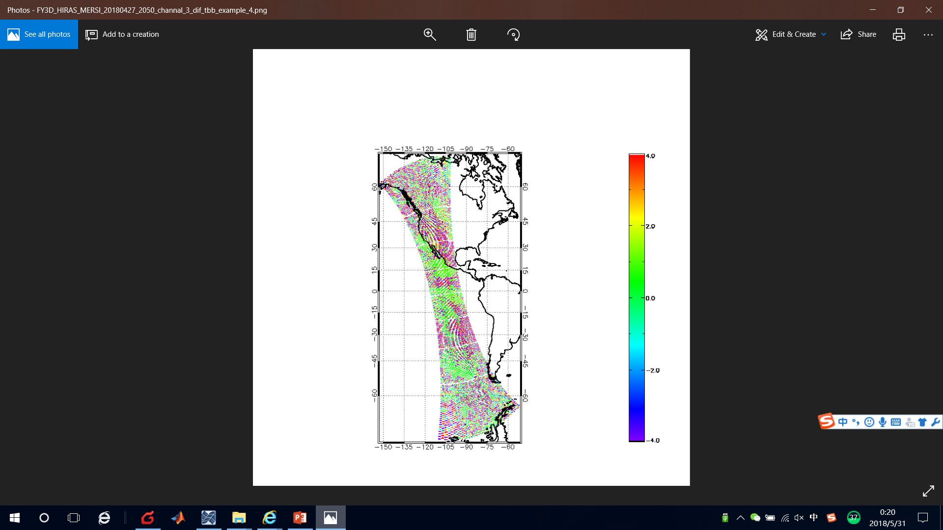
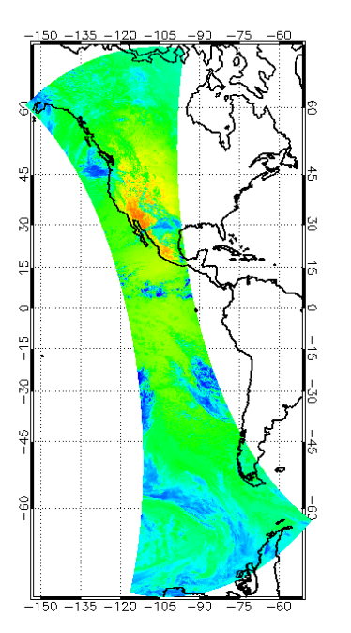
Results after geolocation correction
MERSI-HIRAS
Version 1
Version 2
HIRAS
MERSI

Slide 13
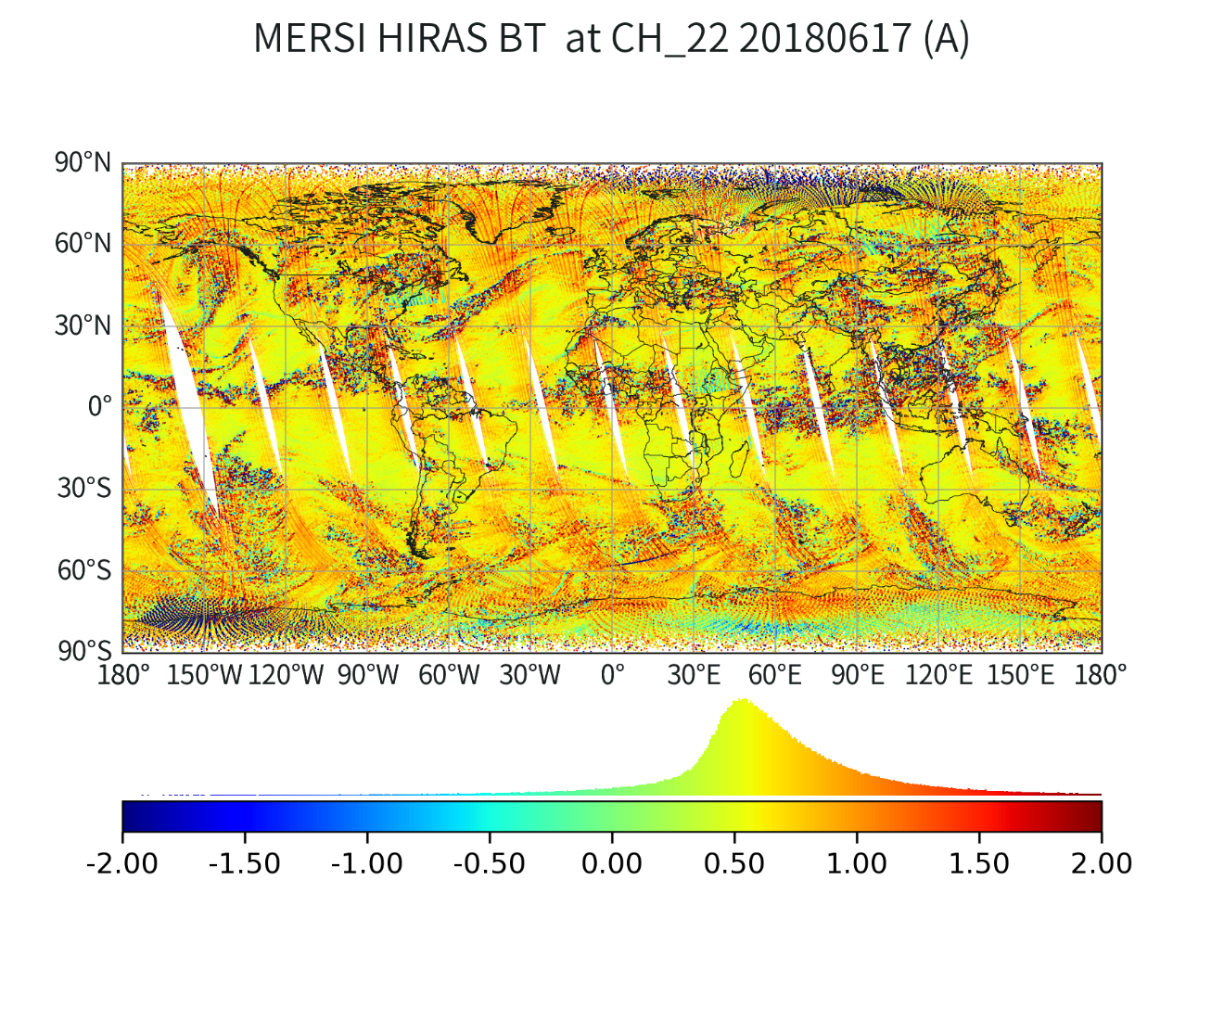
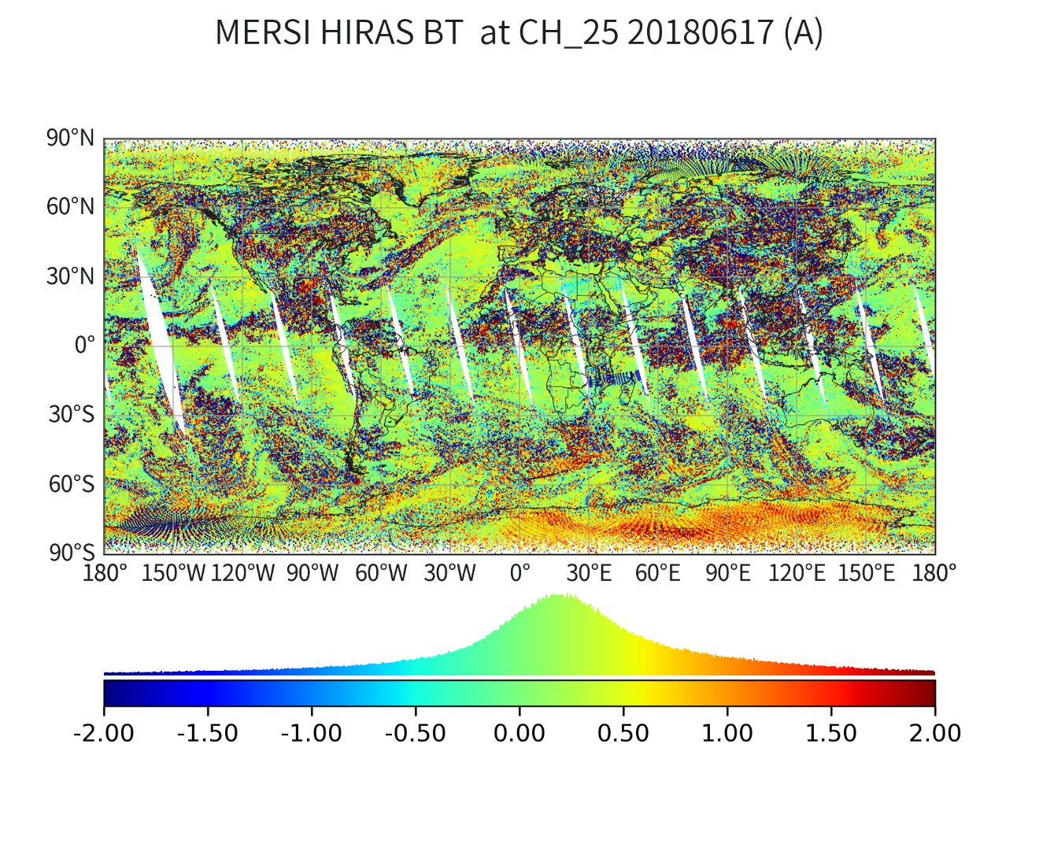
Radiometric consistency between MERSI and HIRAS
a) Spatial distribution
Stripe
CH22: 7.2μm
CH25: 12μm
Angle dependent bias
Stripe distribution at 7.2μm band but not at other bands;
Bias at edge is larger than that in nadir;

Slide 14
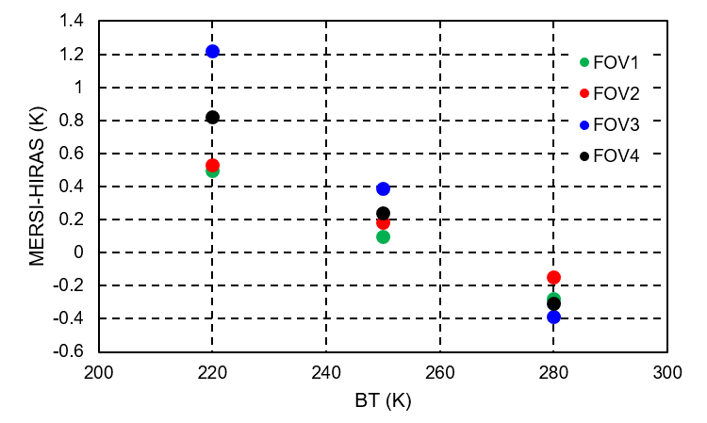
Results: radiometric consistency
Bias analysis: stripe
FOV3
 | CH21 (SW) | CH22 (MW) | CH24 (LW) | CH25 (LW)
FOV1 | -0.160±0.170 | 0.096±0.177 | -0.402±0.253 | -0.252±0.192
FOV2 | -0.165±0.177 | 0.182±0.186 | -0.399±0.149 | -0.346±0.170
FOV3 | -0.186±0.319 | 0.389±0.312 | -0.420±0.279 | -0.258±0.236
FOV4 | -0.167±0.169 | 0.242±0.251 | -0.422±0.327 | -0.256±0.247
7.2μm bias at different BT
In MW, the FOV3’s bias is much higher than the others, the difference between FOV3 and the minimum bias is nearly to 0.3 K;
In SW and LW, the biases between MERSI and HIRAS in 4 FOVs are similar to each other;
Non-linear feature of 4 FOVs are difference;
FOV3’s non-linearity seems more significant than others;

Slide 15
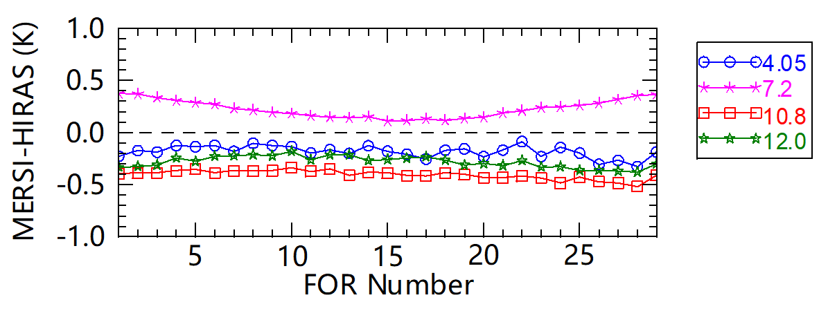
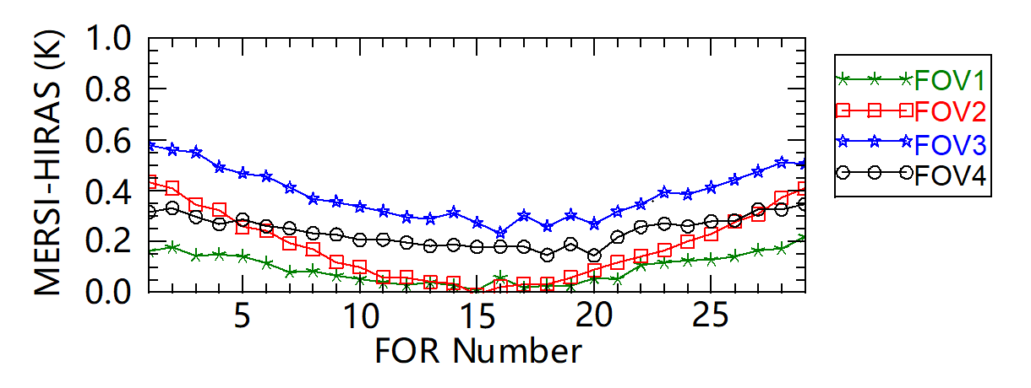
Results: radiometric consistency
Bias analysis: angle dependent bias
The bias at 7.2μm is increase with scan angle;
Bias at nadir is minimum, and the maximum appears at edge of scan;
All FOVs’ bias increase with scan angle;
FOV 1/3 are larger than others;
Bias mechanism is not sure and finding.
7.2 μm

Slide 16
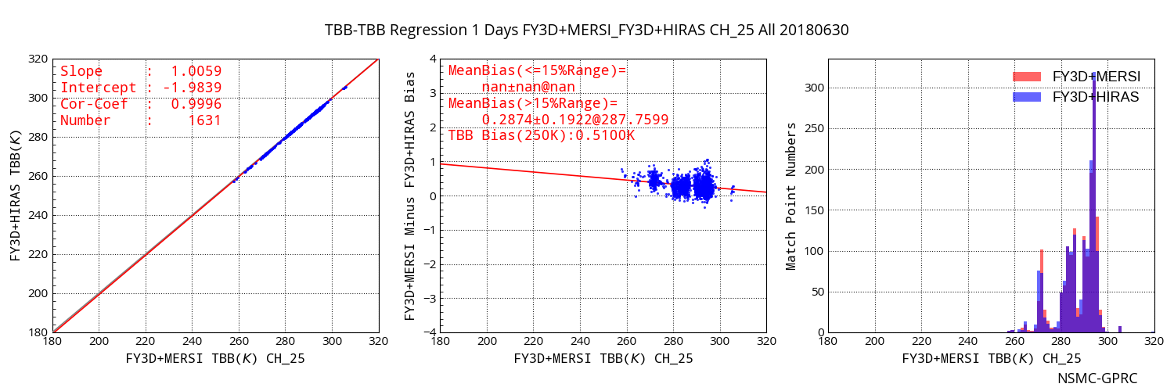
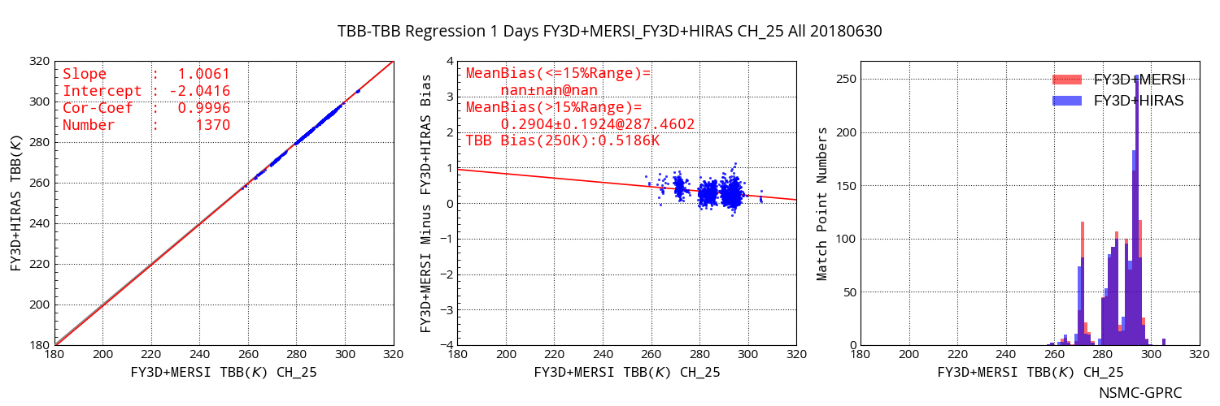
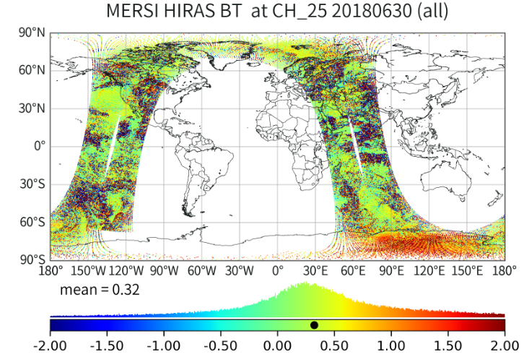
Difference: with and without accurate collocation
CV< 0.005
Accurate
Without accurate
HIRAS
TARGET
AREA
ENV AREA
Accurate
Bias=0.287@287K
MERSI in HIRAS:
Std/ave<0.005
Target area: Std/ave<0.005
Env. Area: Std/ave<0.005
Without
Bias=0.290@287K
 |  | Std/ava<0.1 | Std/ava<0.05 | Std/ava<0.01 | Std/ava<0.005
bias | Accu. | 0.3998 | 0.4160 | 0.2995 | 0.2874
 | without | 0.4417 | 0.4547 | 0.3558 | 0.2904
std | Accu. | 0.9960 | 0.7308 | 0.2168 | 0.1922
 | without | 1.4860 | 0.7548 | 0.3267 | 0.1924
Samples | Accu. | 22675 | 18372 | 5052 | 1631
 | without | 23864 | 19039 | 3064 | 1370
Our result can prove the Likun’s saying:
With enough uniform scene samples, actually, even the collocation is not good enough, we still can achieve the similar accuracy and precision for radiometric assessment.

Slide 17
Summary
Inter-calibration is a useful tool to check the geolocation and radiometric consistency between two sensors on the same platform;
An accurate collocation method is used for FY3D MERSI and HIRAS inter-calibration to check the observation consistency; It has revealed:
HIRAS’s FOV left and right reversing;
FOV3’s non-linear feature;
Angle dependent bias;
these all help us to improve the data quality;
For inter-calibration, if enough uniform samples are choosed, the biases are nearly the same between with and without accurate collocation.

Slide 18
Thanks for your attention!

