Slide 1
Inter-calibration result of COMS/MI using before and after reprocessed CrIS data
March 2019
Minju Gu and Dohyeong Kim

Slide 2
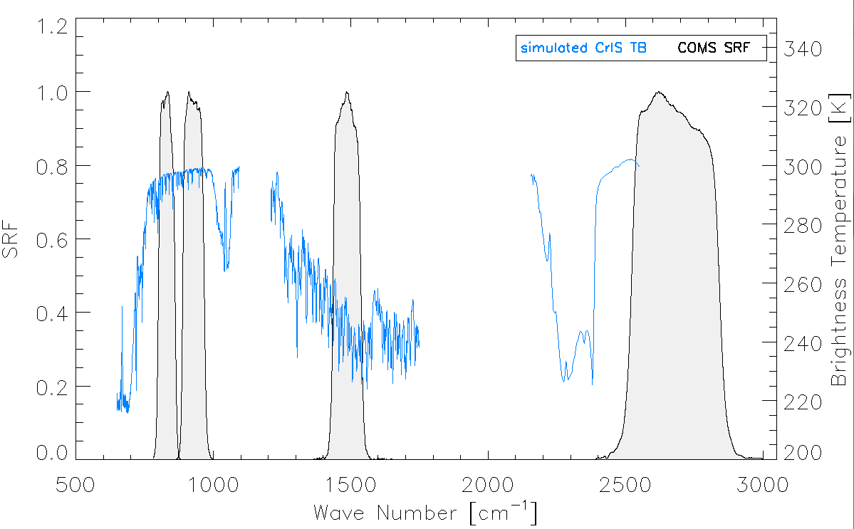
COMS/MI using SNPP/CrIS
Inter-calibration of COMS/MI using NSR(Normal Spectral Resolution) CrIS radiance data in NOAA CLASS archive system from Jan. 2014
Access to Suomi-NPP/CrIS SDR reprocessing data for one year from Jan. to Dec. 2015 (http://jlrdata.umd.edu/opendap/thredds)
COMS SWIR
GSICS-EP action | Description
A.KMA.20180601.2 | KMA to provide the inter-calibration comparison results of COMS/MI using before and after reprocessed CrIS data

Slide 3
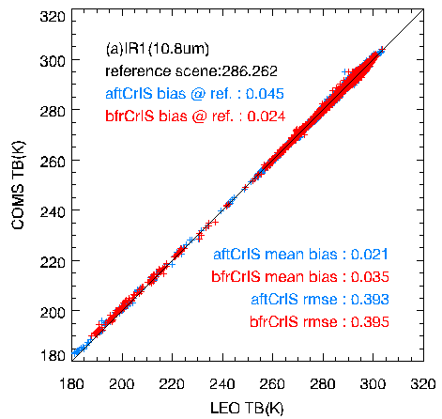
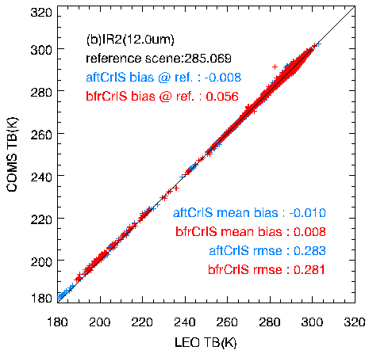
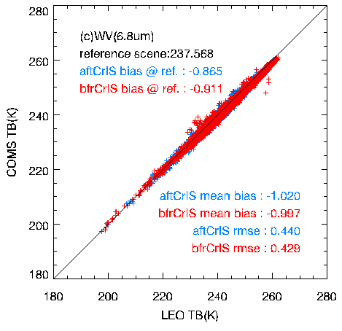
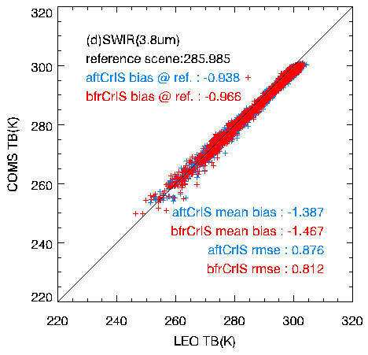
COMS/MI vs (before and after reprocessed) CrIS
Period of CrIS_{after} and CrIS_{before} : Jan/01/2015-Dec/31/2015 (normal spectral resolution)
CH. |  | After CrIS | Before CrIS
IR1 | mean bias(K) | 0.021 | 0.035
 | bias(K) @st | 0.045 | 0.024
 | rmse | 0.393 | 0.395
IR2 | mean bias(K) | -0.010 | 0.008
 | bias(K) @st | -0.008 | 0.056
 | rmse | 0.283 | 0.281
WV | mean bias(K) | -1.020 | -0.997
 | bias(K) @st | -0.865 | -0.911
 | rmse | 0.440 | 0.429
SWIR | mean bias(K) | -1.387 | -1.467
 | bias(K) @st | -0.938 | -0.966
 | rmse | 0.876 | 0.812

Slide 4
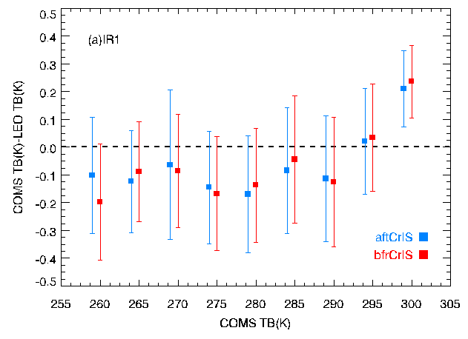
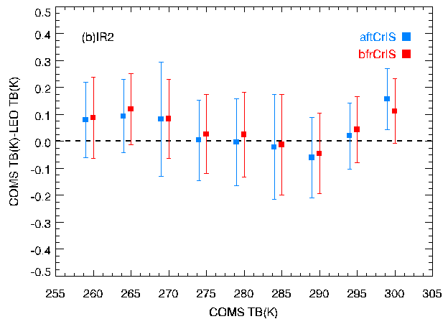
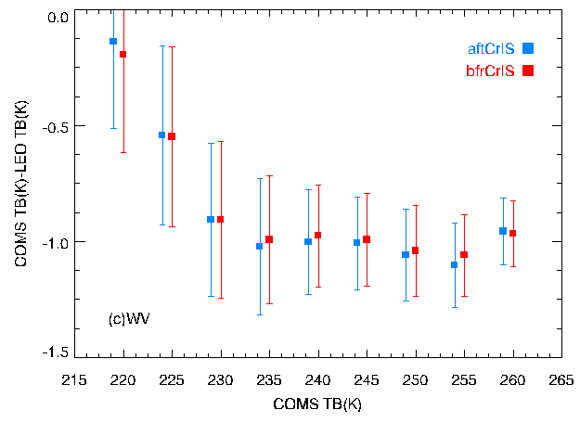
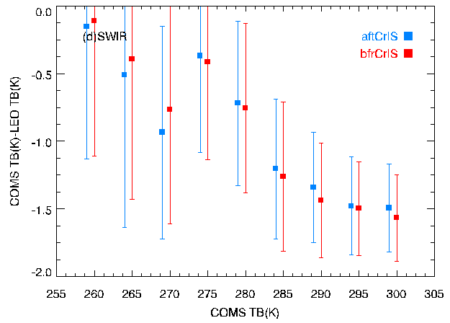
Trend of TB bias
Box plot : (COMS – CrIS_{after}) and (COMS - CrIS_{before}) mean for 5K bin
Large biases/uncertainties
due to limited spectral coverage of COMS SWIR broadband
Large biases (~-1K) are due to SRF shift issue before December 2017
Notes:
due to systematic uncertainty, as the broadband area of MI and the broadband area of CrIS coincide very little

Slide 5
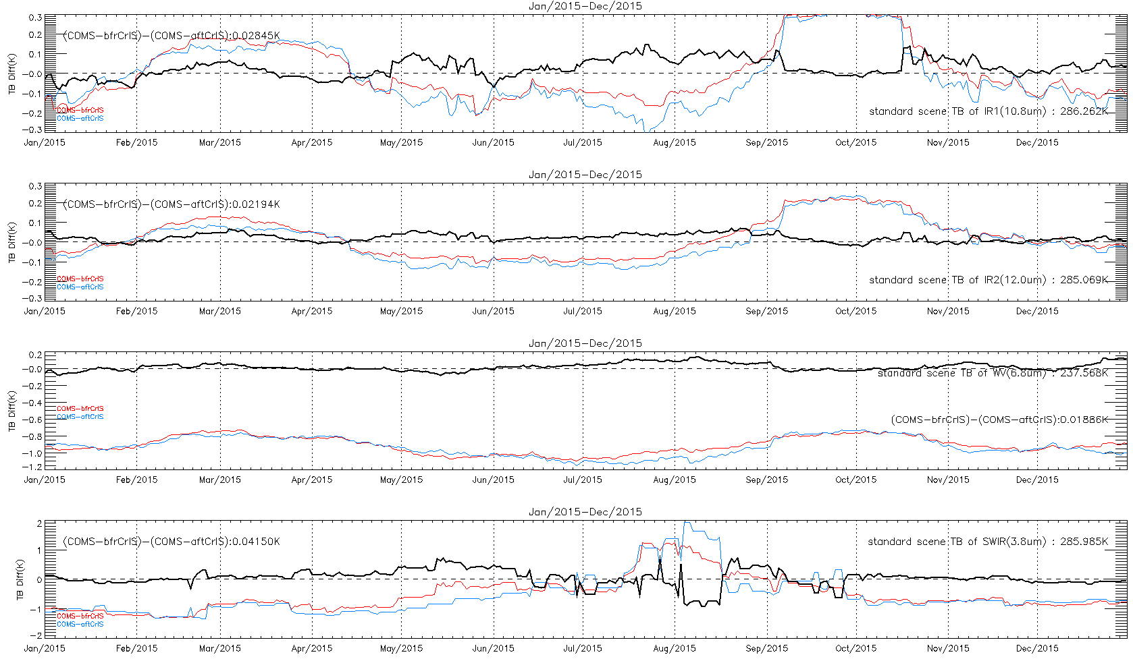
Time series of double difference
Timesereise of COMS – CrIS_{after}, COMS - CrIS_{before} and (COMS- CrIS_{before})-(COMS- CrIS_{after}) for RAC data @ standard scene

Slide 6
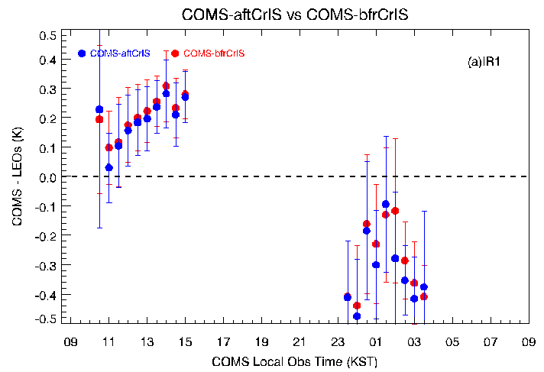
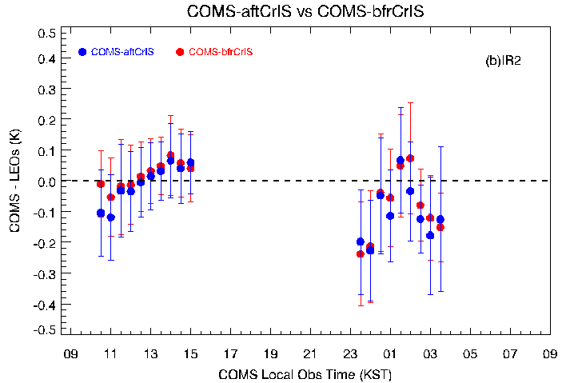
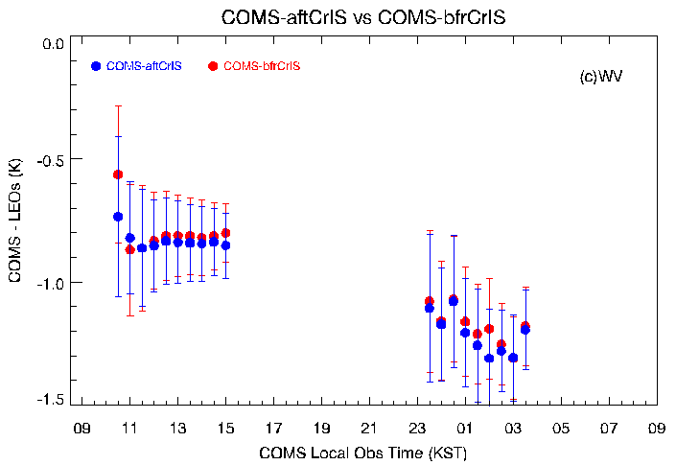
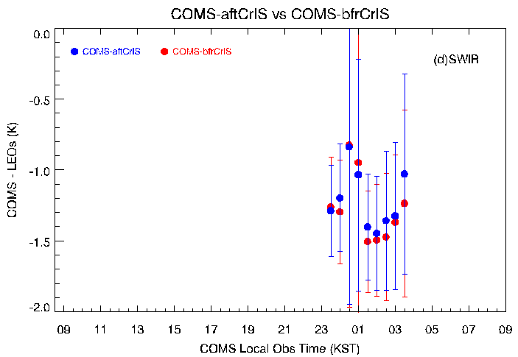
Diurnal variation for GEO-LEOs
Diurnal variation for TB bias with CrIS_{after} and CrIS_{before}

Slide 7
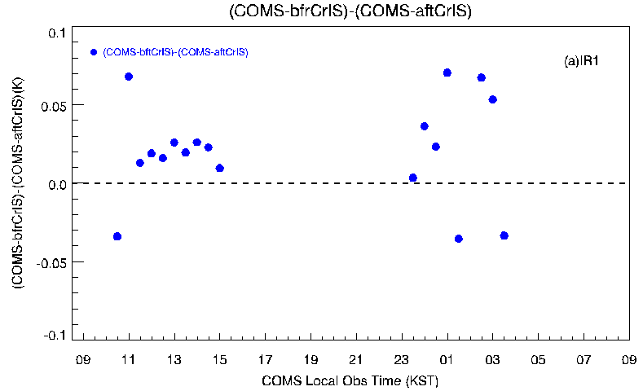
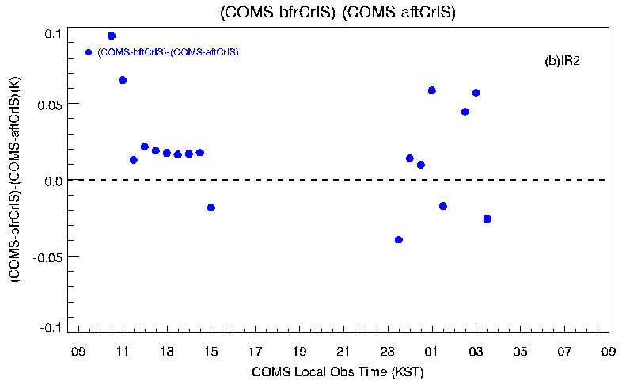
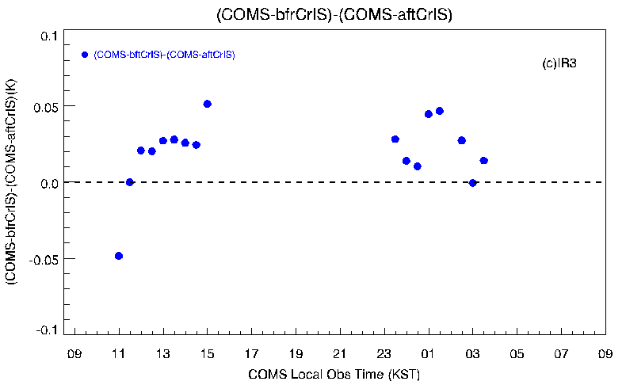
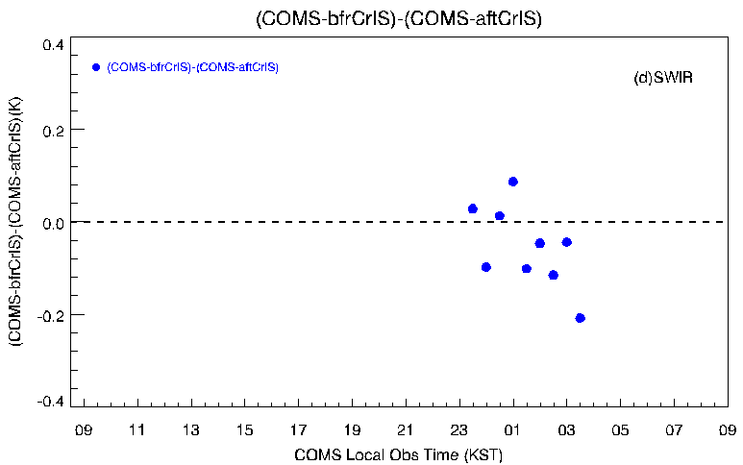
Diurnal variation for double difference
Diurnal variation for TB mean bias of (COMS - CrIS_{before}) - (COMS – CrIS_{after})

Slide 8
Summary
Small mean TB biases of COMS/MI-CrIS_{before} and COMS/MI-CrIS_{after}
< 0.04K for IR1, 0.01K for IR2, and -1K for WV
The same seasonal variation for TB bias for CrIS_{before} and CrIS_{after}
Double Difference between (COMS/MI-CrIS_{after}) and (COMS/MI- CrIS_{before}) for RAC data during 2015
0.028K for IR1, 0.022K for IR2, 0.019K for WV, and 0.041K for SWIR
Double difference for diurnal variation shows a large variation in the night time than in the day time

Slide 9
Thank you!

