Slide 1
Multispectral IR Sub-session
Tim Hewison
Special Issue of the IEEE TGRS on “Inter-Calibration of Satellite Instruments”:
Special Issue of the IEEE TGRS on “Inter-Calibration of Satellite Instruments”:

Slide 2
Multispectral IR
Propose structuring IR Sub-group discussions:
  Hyperspectral IR:
    target hyperspectral sounder calibration (~1000s of channels)
    GEO and LEO
  Multispectral IR:
    target calibration of instruments with few (1-20) channels
    Could include older GEO and LEO sounders (HIRS, GOES, …)
    May use hyperspectral references for inter-calibration
  Research
    Applicable to both hyperspectral and multispectral sensors

Slide 3
Minute Taking for IR Session
Likun Wang to take minutes for the Multispectral IR Session using the following Zoho Docs:
https://writer.zoho.com/writer/open/cnj528ad2577d166644409217de74cf6a4f3e
Please check your actions in this as they are taken!

Slide 4
Update on GSICS products for IR channels of GEO imagers
Tim Hewison
Yusuke Yogo
Special Issue of the IEEE TGRS on “Inter-Calibration of Satellite Instruments”:
Special Issue of the IEEE TGRS on “Inter-Calibration of Satellite Instruments”:

Slide 5
GSICS GEO-LEO IR Product Status 2019-03
GPRC | Monitored Instrument | Reference Instrument | GSICS NRT Correction | GSICS Re-Analysis Correction | GSICS Bias Monitoring
EUMETSAT | Meteosat-8-11/SEVIRI | Metop-A/IASI Metop-B/IASI Prime | Operational Operational - | Operational Operational Demo | RAC Plotting Tool ProductCatalogImages
JMA | MTSAT-2 Imager Himawari-8/AHI (Himawari-9/AHI) | IASI-A+B+AIRS (+CrIS) | Demo (Ready for GPPA) | Demo | RAC Plotting Tool JMA Web ProductCatalogImages
NOAA | GOES-11-12 Imager GOES-15 Imager GOES-16-17/ABI | IASI-A+B+ CrIS-SNPP+N20 | - - - | Demo Pre-Op - | NOAA GOESCAL
CMA | FY2C,D,E,F,G/VISSR FY4A/AGRI FY4A/GIIRS (Plan) | IASI-A+B + AIRS+CrIS+HIRAS | Development | Development | CMA Web CMA Web Cloud (Plan)
KMA | COMS KOMPSAT-2A? | IASI-A+B + AIRS+CrIS? | Demo | Demo | KMA Web ProductCatalogImages
ISRO | INSAT-3D/Imager INSAT-3D/Sounder INSAT-3R | IASI-A | Demo | Demo | ISRO Web
Full GSICS Product Catalog available at http://www.star.nesdis.noaa.gov/smcd/GCC/ProductCatalog.php

Slide 6
GEO-LEO IR Update – Round Table
Review current status of GSICS GEO-LEO IR Products
Progress GSICS Procedure for Product Acceptance (GPPA)
Near-Real-Time Corrections
Re-Analysis Corrections
FCDR Support
Monitoring
Plans to establish traceability to Anchor Reference
  E.g. Prime Correction, monitoring double-difference
Impact assessment
Switching Reference IASI-A to IASI-B

Slide 7
GEO-LEO IR Update - JMA
NRTC & RAC generated for AHI on Himawari-8, -9
  IASI-A,B and AIRS products in Demo-Phase since Dec. 2017
  CrIS products will also be submitted to GPPA
Re-calibration of IR/WV for GMS to MTSAT-2
  Using HIRS/2, AIRS, IASI-A as references
  Mr. Tasuku Tabata’s work in collaboration w/ EUM under SCOPE-CM/IOGEO
Plans
  AHI Type-B Uncertainty analysis for Pre-Operational Phase
  Use of S-NPP/CrIS Full Spectral Resolution SDR and NOAA-20/CrIS
  Implementation of Prime GSICS Correction to AHI

Slide 8
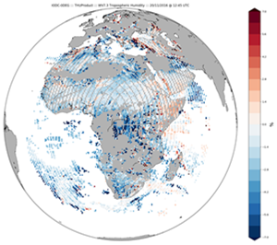
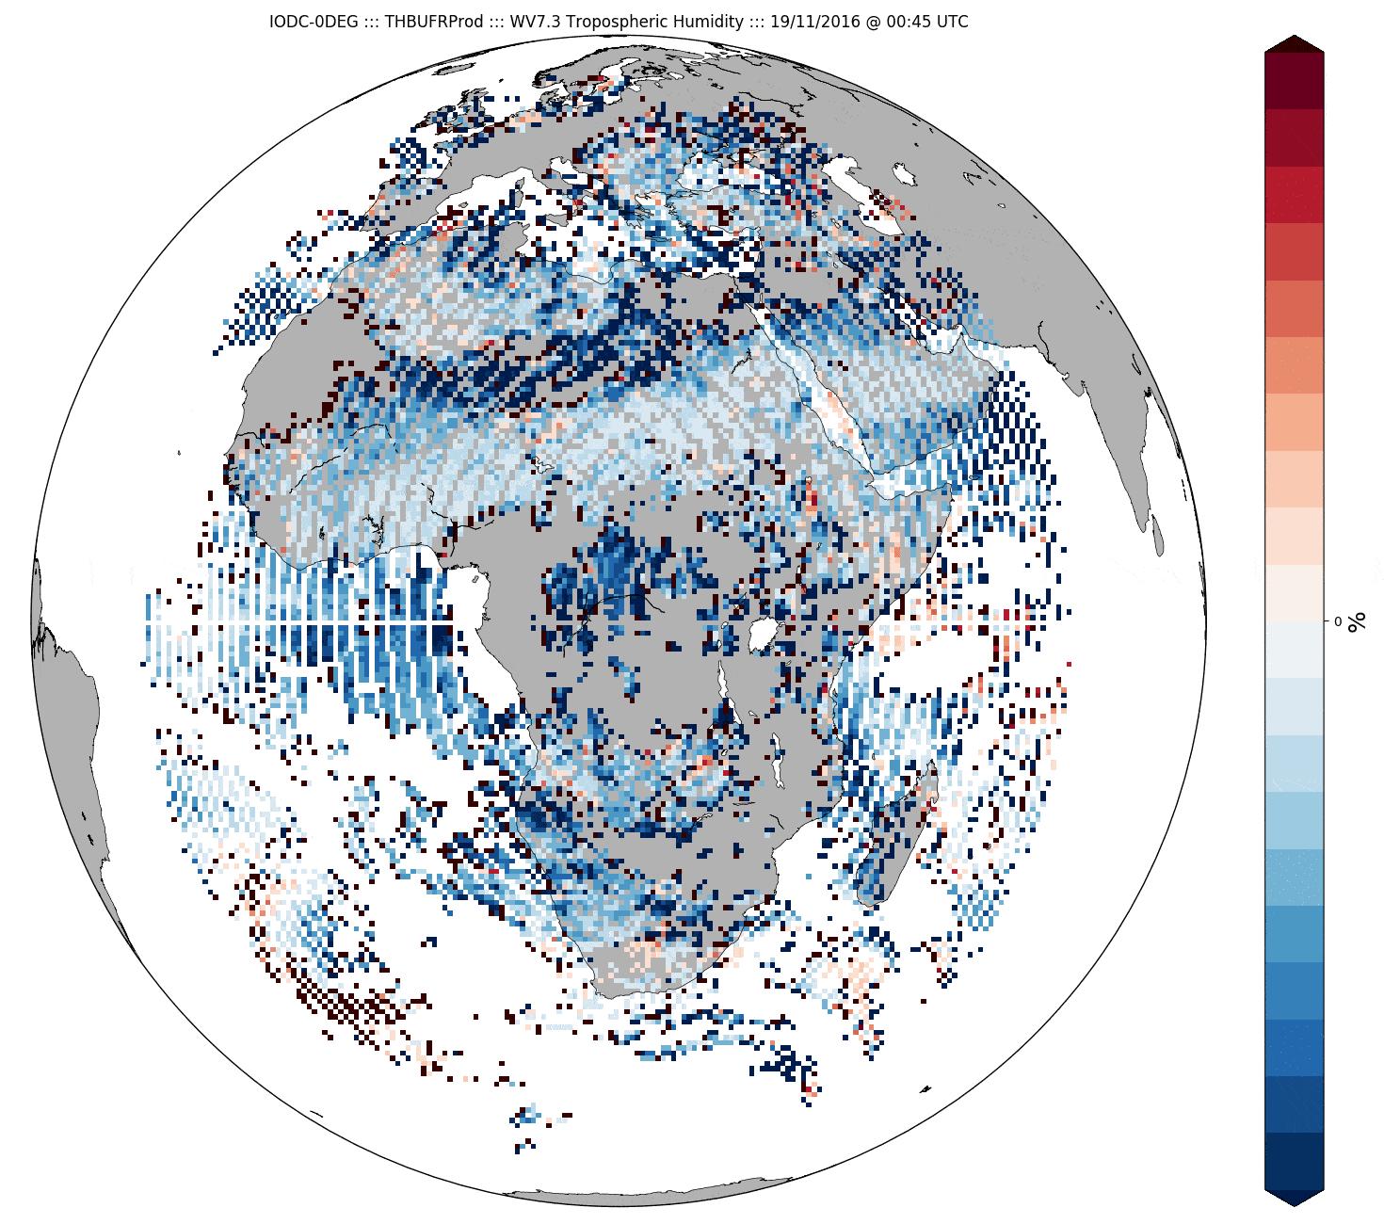
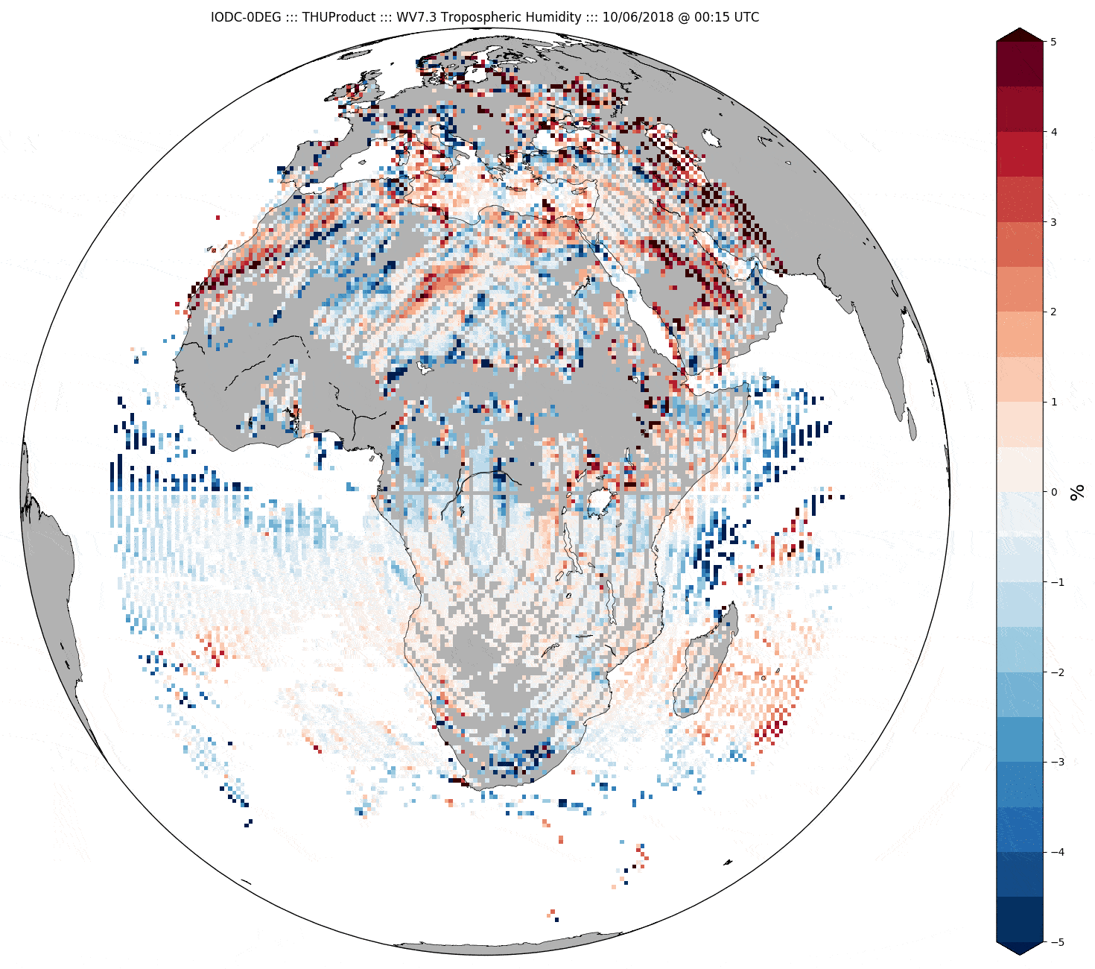
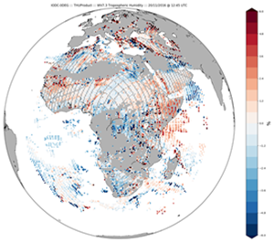
GEO-LEO IR Update - EUMETSAT
NRTC & RAC generated operationally for all SEVIRIs
  on Meteosat-8, -9, -10 and -11
Using IASI on Metop-A, -B
  Will extend to include Metop-C/IASI after commissioning
  Plan to introduce CrIS in 2021 (for MTG commissioning)
All considered operational GSICS Products
Met-11 now operational prime
Met-8 now at 41.5°E
Generated test datasets for IOGEO GEO-ring (#3j)
Tested impact of GSICS Corrections on Level-2 products
  Reported at EUMETSAT Conference 2018 (PPT)
  Small impact – but reduced inter- Meteosat differences
Difference of THU WV7.3 from Met8-Met10
20 Nov 2016 12:45 UTC
before GSICS Correction (above)
After GSICS Correction (below)
Difference of THU WV7.3 from Met8-Met10
19-21 Nov 2016 animation
before GSICS Correction (above)
After GSICS Correction (below)
8

Slide 9
GEO-LEO IR Update - NOAA
GOES-15
  Now on 128W
GOES-16 ABI
  GS operational update of ABI ICT PRT LUT on 06/19/2018. Reduced the mean Tb bias to CrIS and IASI within 0.1-0.15K
  SNPP/CrIS, NOAA-20/CrIS, Metop-A/IASI and Metop-B/IASI are used for IR inter-calibration. Biases are monitored at the NOAA GOESCal website
GOES-17 ABI
  Declared as the operational GOES-West satellite at 137.2W on 12 February 2019.
  SNPP/CrIS, NOAA-20/CrIS, Metop-A/IASI and Metop-B/IASI are used for IR inter-calibration. Biases are monitored at the NOAA GOESCal website

Slide 10
GEO-LEO IR Update - CMA
Baseline methodology update:
  Accuate collocation from Wang LK, and
  spectral gapfilling from Xu Z are
  all integrated in CMA IR inter-calibration;
IR Products Progress:
  New products are developed, i.e. FY4 AGRI vs IASI/CrIS/HIRAS, FY-2 vs HIRAS , in Demo status;
  FY-2 NRTC/RAC products are available;
Data & server
  CMA GPRC Website has been integrated into NSMC Web Portal,
  GISCS Plotting Tool is ready.

Slide 11
GEO-LEO IR Update – CMA cont
• FY4/AGRI：FY4/AGRI vs IASI(CrIS/HIRAS) IR products are ready;
• FY4/GIIRS: GIIRS is compared with IASI/CrIS/HIRAS, the standardized products are under developing;
• Demo status: the following products are in demo status,
FY4 AGRI vs IASI/CrIS/HIRAS, FY-2 VISSR vs HIRAS ;
FY2 VISSR vs IASI/CrIS towards pre-op;
• GSICS Data and Products Server: operation
• NRTC/RAC product availability: available on http://gsics.nsmc.org.cn/portal/en/fycv/index.html
• GISCS Plotting Tool compatability: available for RAC product

Slide 12
GEO-LEO IR Update - KMA
  COMS/MI
    IASI (MetOp-A,-B), CrIS (SNPP) and AIRS (AQUA) are used for bias monitoring at KMA website
    To add CrIS (NOAA-20), and Full Spectral Resolution SDR data (SNPP, NOAA-20)
  To update KMA’s processing algorithm (NRTC/RAC products) based on ATBD (Masaya’s comments) by modifying calculation formula of variables in the program
  GEO-LEO IR products for GK-2A
    To inter-calibrate and generate NRTC/RAC product using IASI (MetOp-A,-B), CrIS (SNPP, NOAA-20) and AIRS (AQUA)
  Collaboration with NOAA on diurnal variation of IR calibration

Slide 13
GEO-LEO IR Update - ISRO
INSAT-3D/Imager – NRTC Demo
INSAT-3D/Sounder- NRTC Demo
Web plots?
RAC?
GSICS coefficients are not currently available on MOSDAC site.
  Do they need to be made available online?
Residuals after applying GSICS Correction
  discuss the potential root causes
  Nonlinear GSICS Correction?

Slide 14

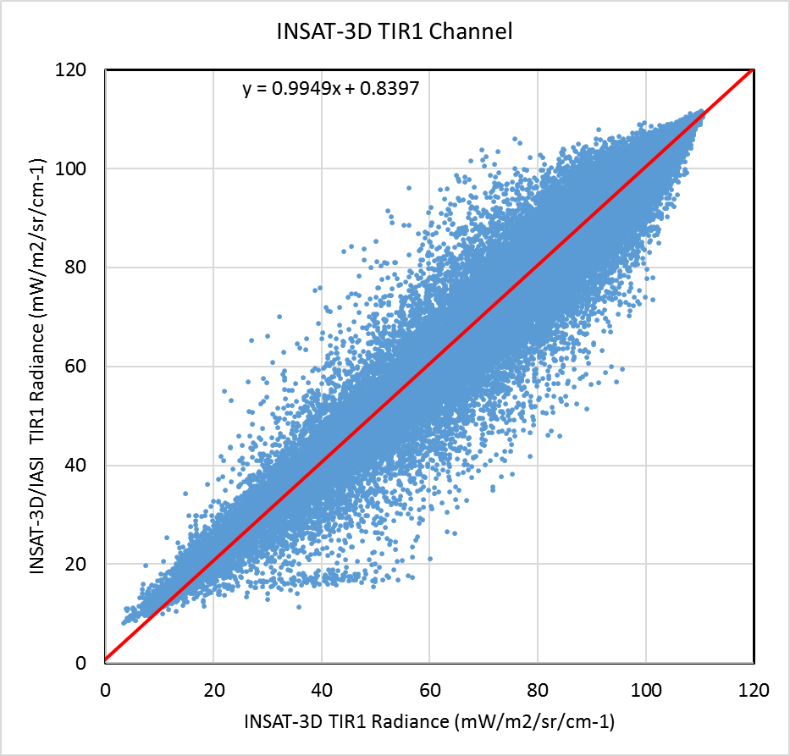
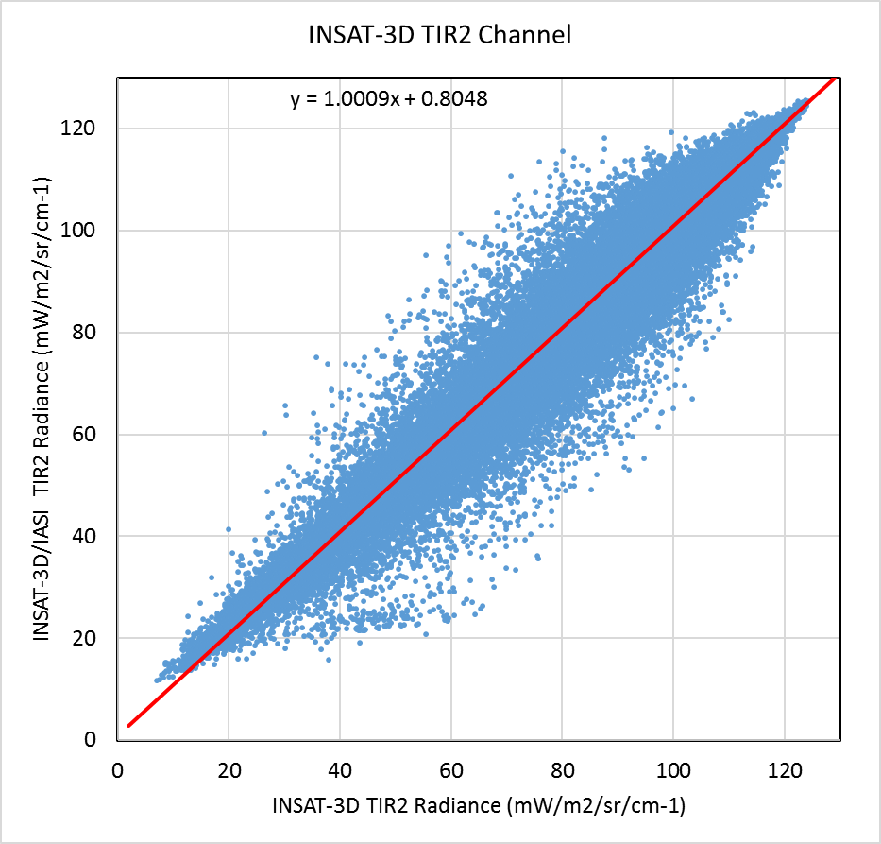
Issues: Retention of residual biases after GSICS correction

Slide 15
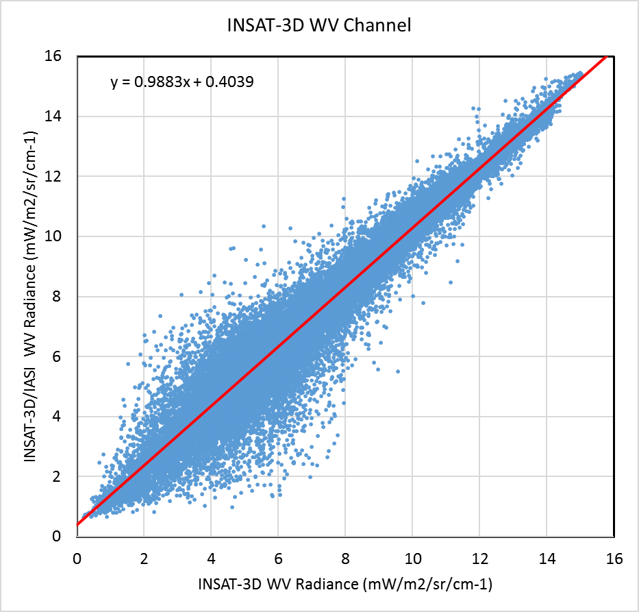
Retention of residual biases after GSICS correction
  Currently diagnosing the problem
  Exploring effect of conversion in radiance unit
    Radiance unit in INSAT-3D: mW/cm²/sr/µm
    Radiance unit in IASI:
    mW/m²/sr/cm⁻¹
  Non-linearity in the GSICS correction – exploring various possibility to incorporate the non-linear correction

Slide 16
Switching Reference IASI-A to IASI-B
IASI-B onboard processing change 2017
  Impact on calibration & nonlinearity
  Treat period before/after change as separate references
Check consistency
  After change with IASI-A
  And IASI-C – when – by end 2019?
Expected degradation of IASI-A as reference?
  Due to orbital degradation
When to switch to IASI-B?
  Or switch directly to IASI-C & minimise switches?

Slide 17
Thank You for your contributions!

