Slide 1
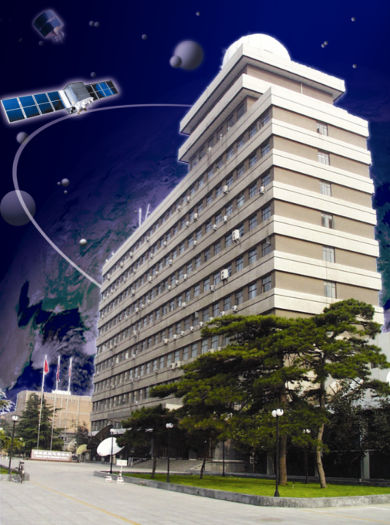
Multispectral IR inter-calibration update in CMA including GEO-LEO and LEO-LEO
Na XU, Hanlie XU, Xiuqing HU
National Satellite Meteorological Center(NSMC), CMA
2019 GSICS Annual Meeting, Frascati, Italy,
04-08, March, 2019

Slide 2
OUTLINE
Overview of CMA IR products status
Baseline GSICS IR methodology update
Progresses on CMA GEO-LEO inter-calibration
Progresses on CMA LEO-LEO inter-calibration
Summary

Slide 3
Overview of CMA IR products status
Achievements after 2018 Annual Meeting:
Developed new GSICS products for new multispectral instruments: FY-3D/MERSI, FY-4/AGRI
Supplemented HIRAS as reference for CMA scientific researches.
Type | Monitored Instrument | Reference Instrument | GSICS NRT/RAC Correction Products | GSICS Bias Monitoring
Operational Products for GEO Multispectral instruments | FY2C~G/VISSR | IASI-A+B(+ AIRS+CrIS) | Pre-Demo (planning to submit the GSICS Product Acceptance Form for official approvement) | CMA Web
 | FY2G/VISSR | HIRAS | Pre-Demo | Not released
 | FY2H/VISSR | IASI-A+B(+CrIS+HIRAS) | Developing | Developing
 | FY4A/AGRI | IASI-A+B(+CrIS+HIRAS) | Pre-Demo (planning to submit the GSICS Product Acceptance Form for official approvement) | Not released
Scientific Products (for LEO Multispectral instruments and LEO/GEO sounders) | FY3A~C VIRR/MERSI/IRAS | IASI-A+B(+CrIS) |  | CMA Web(only FY3C)
 | FY3D MERSI | IASI-A+B(+CrIS+HIRAS) |  | Not released
 | FY3D/HIRAS | IASI-A+B(+CrIS) |  | Developing
 | FY4A/GIIRS | IASI-A+B(+CrIS+HIRAS) |  | Developing
Notes:
standard specification previous

Slide 4
Baseline methodology update
Accurate collocation(Wang L et al., 2013,2016) and spectral gap filling(Xu H, 2018) are applied in CMA IR inter-calibration.
Wang L K, et al., 2016
Xu H, et al., 2018
Figure 1: Diagram of generic data flow for inter-calibration of monitored (MON) instrument with respect to reference (REF) instrument

Slide 5
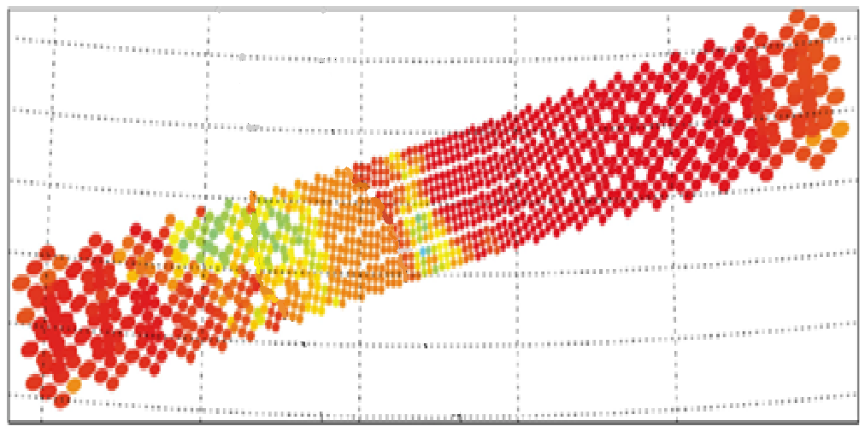
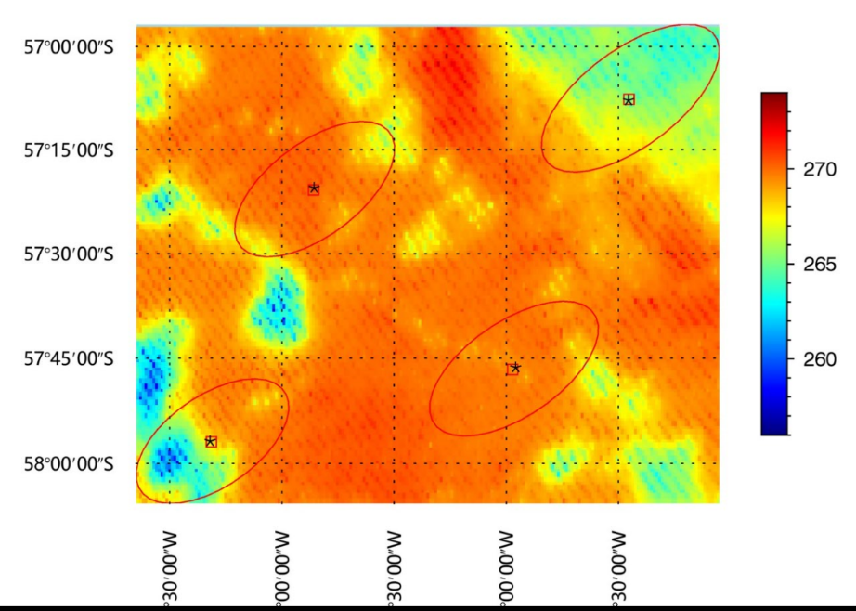
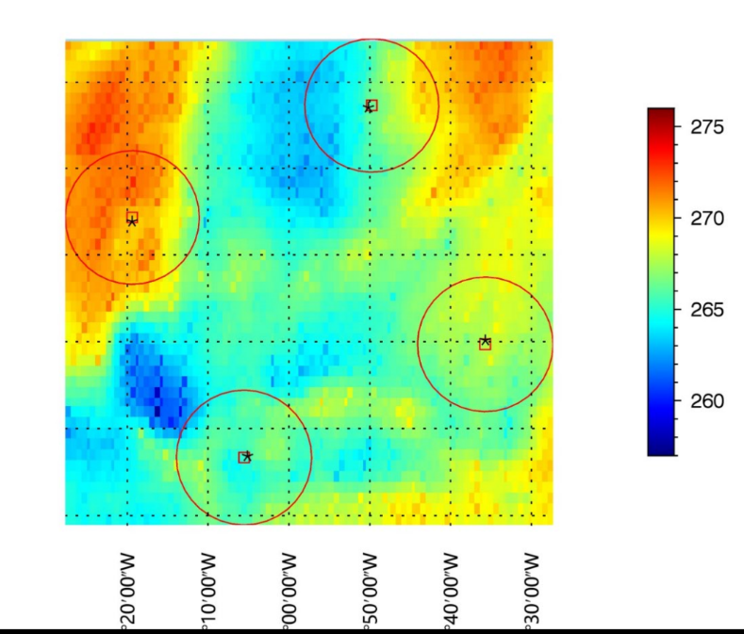
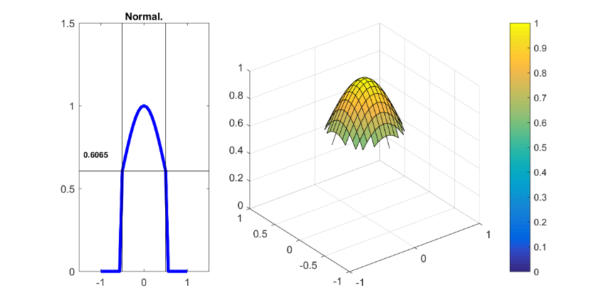
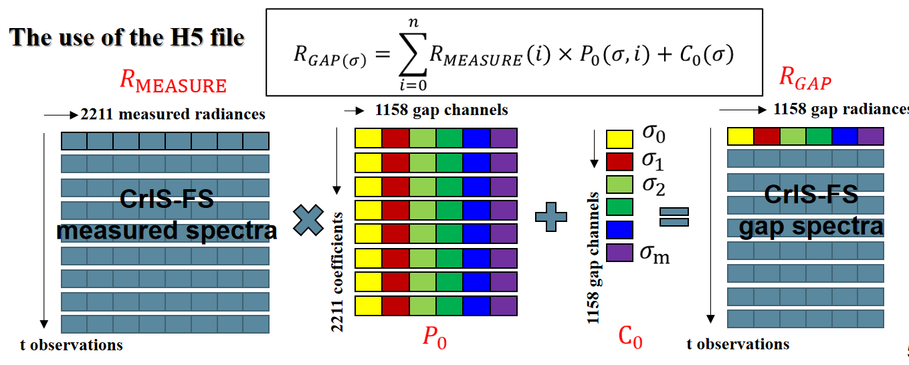
Method and Consideration
Requirements:wide angle and spatial intercalibration (polarization,contamination,navigation...
Spatial
Accurate collocation
(Wang L K, 2016)
Solution
+
Spatial Accurate Collocation and Matching
Spatial Point Spread Functions
55km
16km
29 km
16 km
Point2：Spatial Non-uniformity
Point1：space deformation, different IFOV
Requirements:large spectral gap channels intercalibration
Spectral
Gapfilling(Xu H,2018)
Solution
Point1：Resolution and coverage mismatch
Point2：Low spectral resolution
Notes:
technique applicative

Slide 6
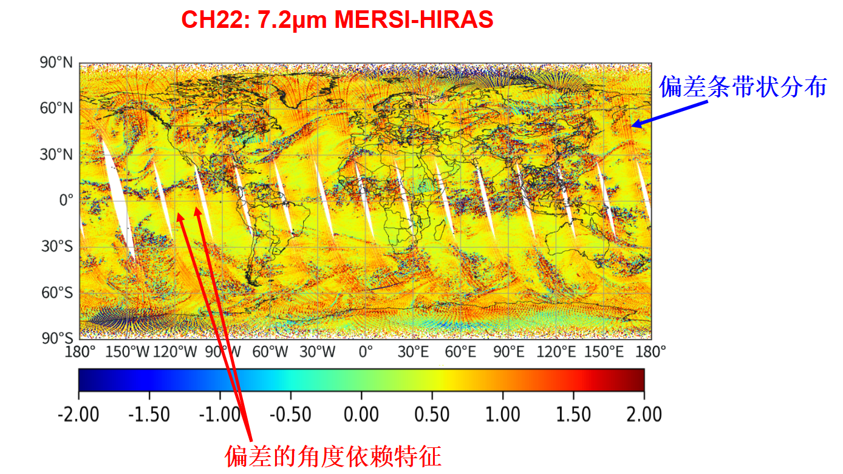
Application and assessment: Accurate collocation
Satellite
A pretty good tool to reveal veiled biases due to unexpected instrument anomaly observation.
P
wang et al.,2016
NPP VIIRS&CrIS using CMA code
Stripe Bias
(HIRAS)
Angle dependence Cloud Margin Bias
(MERSI?HIRAS?) (Geolocation&PSF)
Notes:
margin s

Slide 7
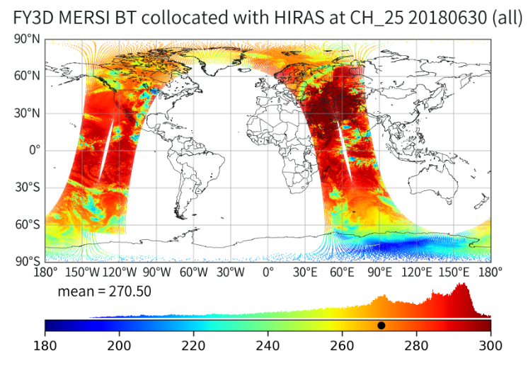
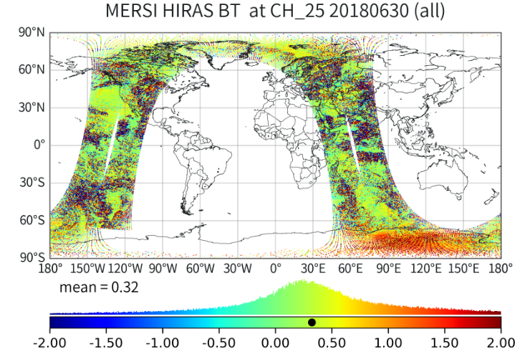
Application and assessment: Accurate collocation vs General option
Comparison of FY-3 MERSI&HIRAS intercalibration results based on accurate collocation and General option under the same filtering criteria.
Inter-calibration results based on different collocation methods are almost indentical using strict uniform filter.
Same Platform intercalibration
FY-3D MERSI&HIRAS
Std/ave<0.005
Accurate
Bias=0.2874K@287K
Traditional
Bias=0.2904K@287K
 |  | Std/ava<0.1 | Std/ava<0.05 | Std/ava<0.01 | Std/ava<0.005
bias | Accu. | 0.3998 | 0.4160 | 0.2995 | 0.2874
 | Trad. | 0.4417 | 0.4547 | 0.3258 | 0.2904
std | Accu. | 0.9960 | 0.7308 | 0.2168 | 0.1922
 | Trad. | 1.4860 | 0.7548 | 0.3267 | 0.1924
Sample number | Accu. | 22675 | 18372 | 5052 | 1631
 | Trad. | 23864 | 19039 | 3064 | 1370
Notes:
strict

Slide 8
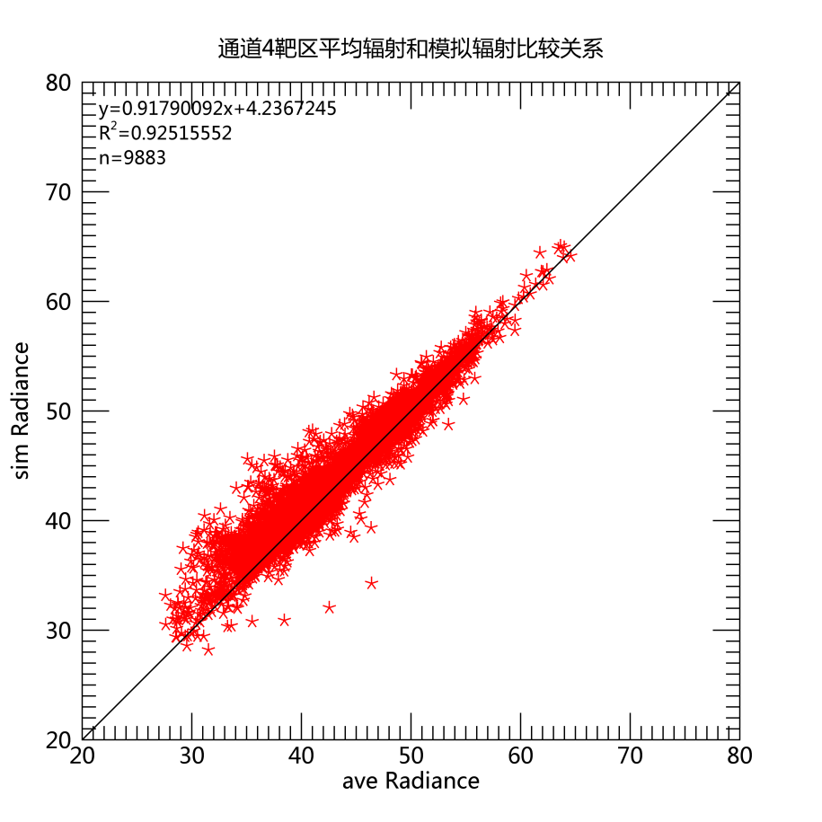
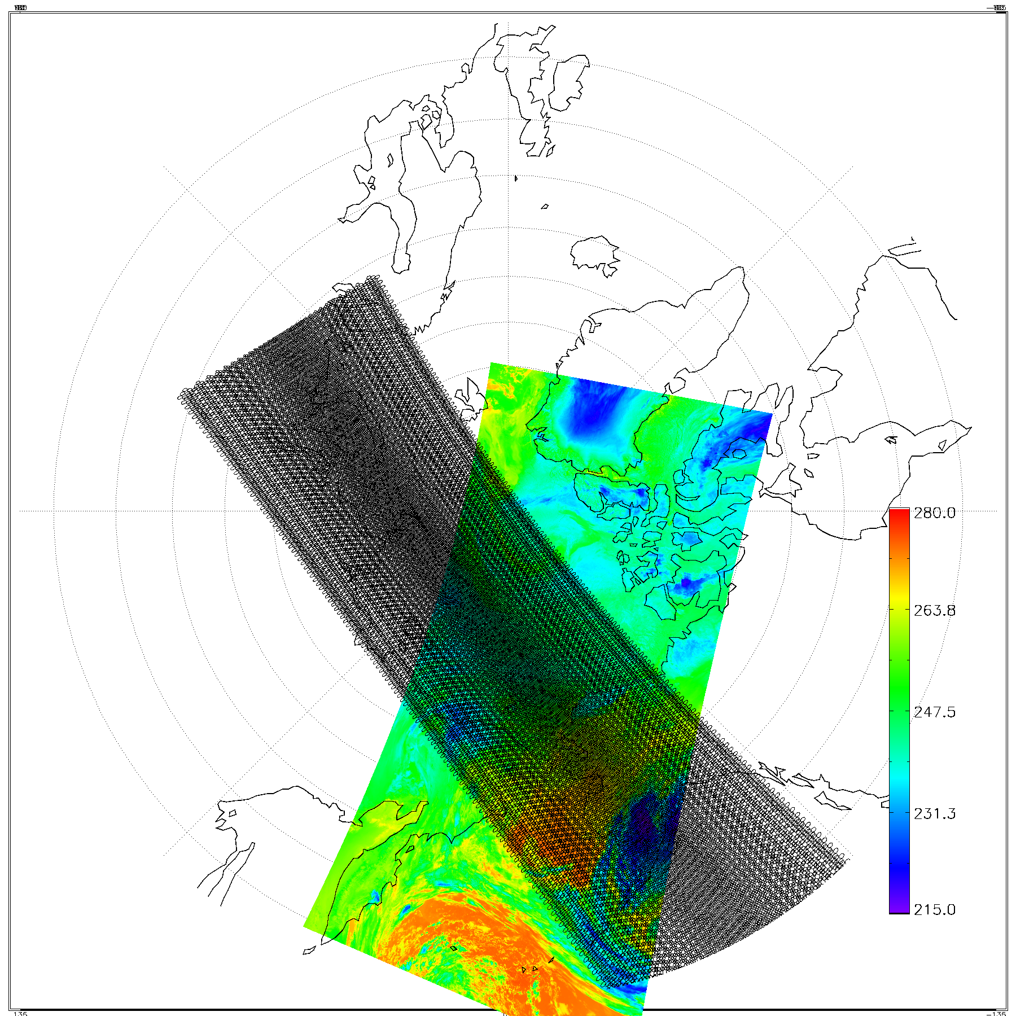
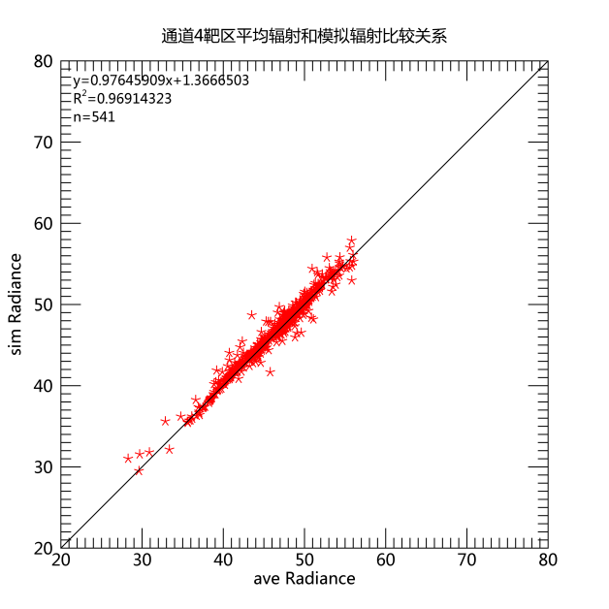
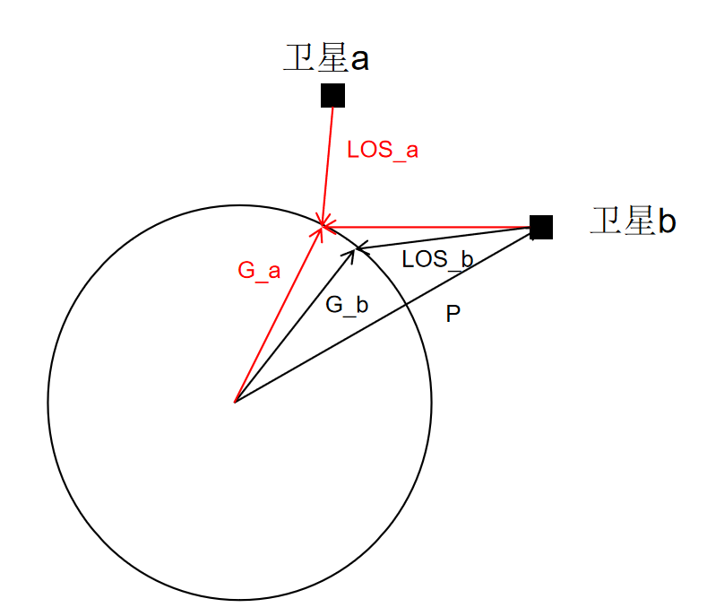
Application and assessment: Accurate collocation vs General option
Comparison of FY-3 VIRR&S-NPP CrIS intercalibration results based on accurate collocation and General collocation
under the same filtering criteria.
Different Platform intercalibration
FY-3 VIRR&S-NPP CrIS
0.1145K@250K
Inter-calibration results among different platform based on different collocation methods almost the identical using quite uniform scene samples.
If the uniform scene filter is not considered, even under accurate collocation, the intercalibration results show great uncertainty.
Accurate results
without uniform filter
0.2829K@250K
0.2867K@250K
Accurate
Traditional
under the same filtering criteria
wang et al.,2016

Slide 9
Instruments Spectral Coverage
Application and assessment: Spectral gapfilling
MERSI SRF & IASI、HIRAS(CrIS) spectral coverage
CH25
CH24
CH23
CH22
Spectral Gap of HIRAS
CH21
CH20
FY-3D/MERSI |  | FY-3D/HIRAS | NPP/CrIS | METOP/IASI
Band number | Wavelength Center | Spectral channel coverage (cm⁻¹)
CH25 | 12μm (833cm⁻¹) | 650-1135 | 650-1095 | 645-1210
CH24 | 10.8μm (926cm⁻¹)
CH23 | 8.55μm (1169cm⁻¹) | Gap | Gap
CH22 | 7.2μm (1389cm⁻¹) | 1210-1750 | 1210-1750 | 1210-2000
CH21 | 4.05μm (2469cm⁻¹) | 2155-2550 (A little bit gap) | 2155-2550 (A little bit gap) | 2000-2760 (A little bit gap)
CH20 | 3.8μm (2631cm⁻¹) | Gap | Gap

Slide 10
CrIS and HIRAS Gap filling coefficients are applied in CMA multispectral instrument inter-calibration
Application and assessment: Spectral gap filling
20180601-0820
Blue：Original Spectra
Red ：Gapfilling Spectra
Warm Scene
Cold Scene
HIRAS BT Spectra after gapfilling

Slide 11
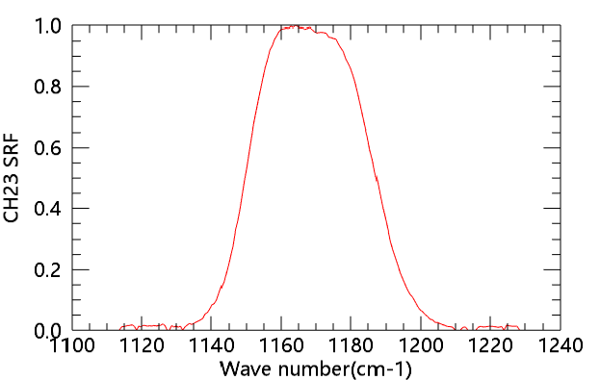
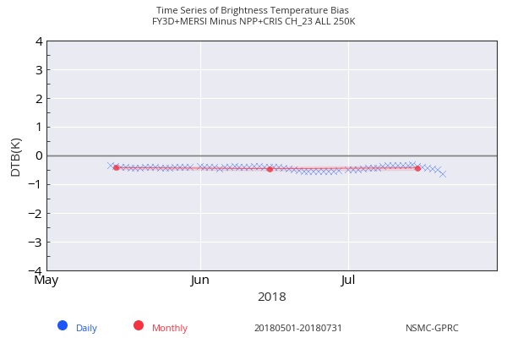
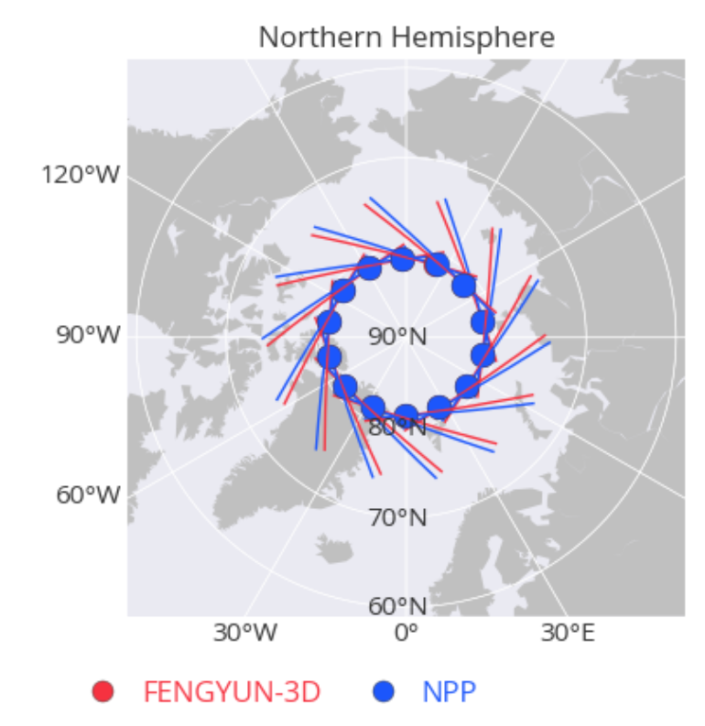
SNO Intercalibration Regression based on IASI and CRIS for MERSI Band 8.55μm
MERSI SRF
Spectral Gap
MERSI-CrIS
Before filling
Radiance Bias
TBB Bias
Time series of TB bias after gapfilling
SNO track selection
60°N~80°N
After filling
Hanlie Xu, [7t]
Bias@250K=-0.39K
Bias@250K=-0.54K

Slide 12
Progresses on GEO-LEO inter-calibration
New Activities
Implementation of GSICS inter-calibration methods to FY-2H VISSR and FY-4 AGRI;
Diurnal investigation using IASI and CrIS SNO samples
hyperspectral inter-calibration of FY-4 GIIRS w.r.t IASI ,CrIS and HIRAS;
New achievements
New IR GSICS Correction products are developed, i.e. FY4 AGRI w.r.t. IASI/CrIS/HIRAS, FY-2 w.r.t. HIRAS ;
FY-2H NRTC/RAC products are on-going;

Slide 13
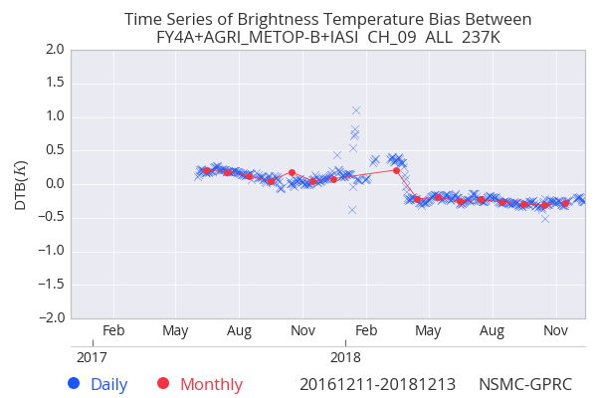
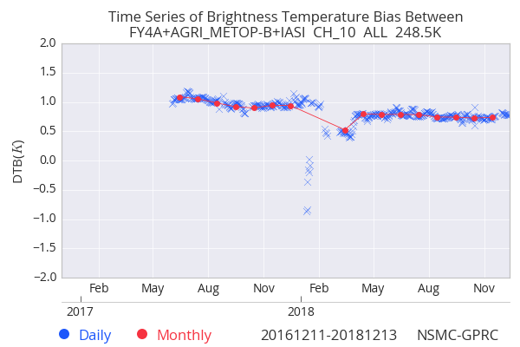
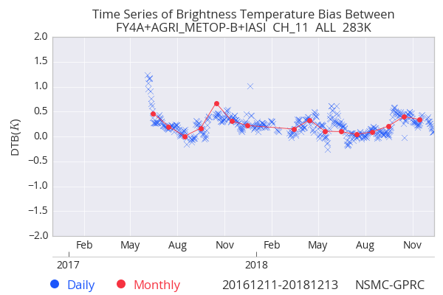
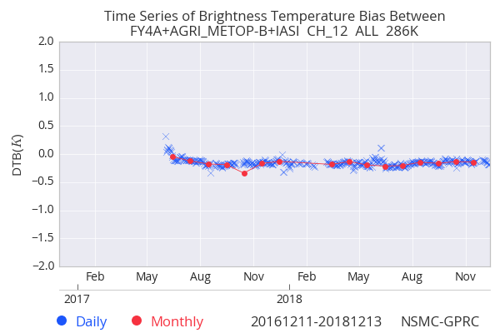
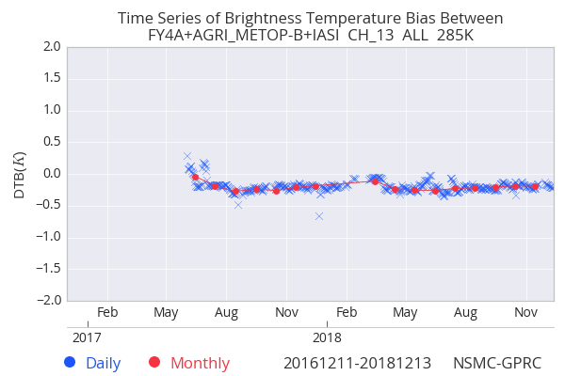
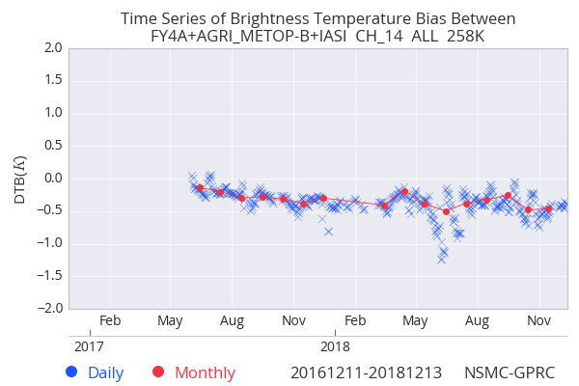
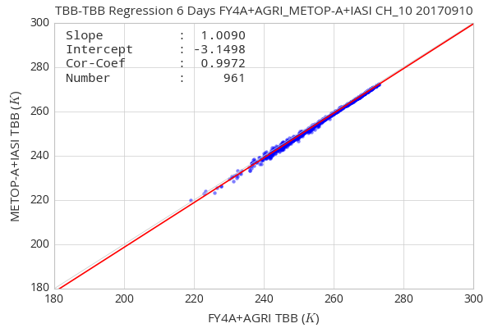
Updates of GEO-LEO intercalibration to multispectral instrument
FY4/AGRI VS METOP-B/IASI
AGRI IR Biases are less than 0.5K for B9/11~14, and about 0.8K for B10；
Bias time sequence of B11 and B14 are less stable than others.
SRF Update
SRF Update
B9(6.3μm)：~-0.3K
B10(7.1μm)：~0.8K
B11(8.5μm)：0.2K~0.5K
B12(10.8μm)：~-0.2K
B13(12μm)：~-0.2K
B14(13μm)：-0.2~-0.4K
Time sequence of FY-4 AGRI TB Biases at standard BT
Notes:
结果已经业务运行，结果可以共享

Slide 14
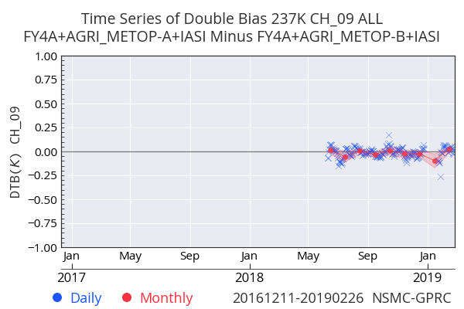
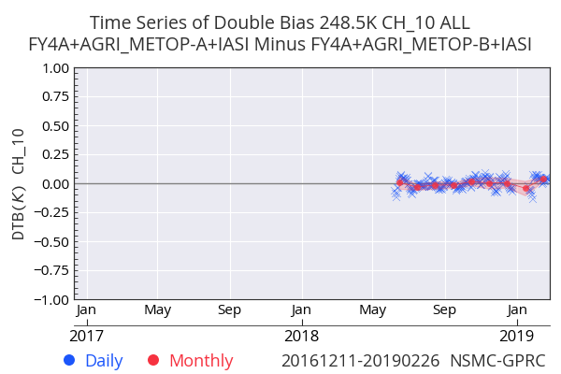
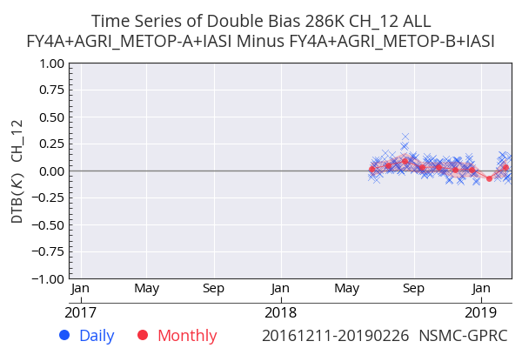
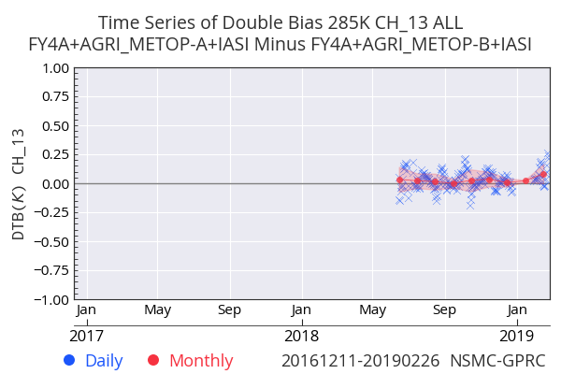
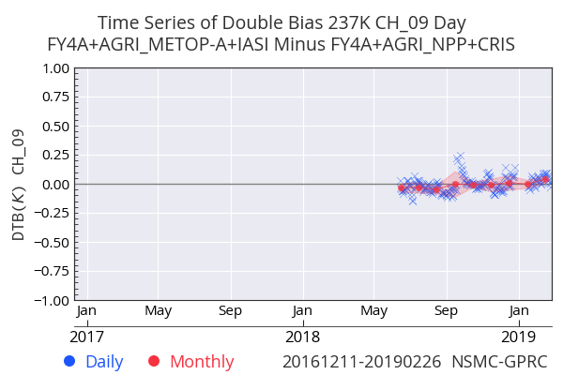
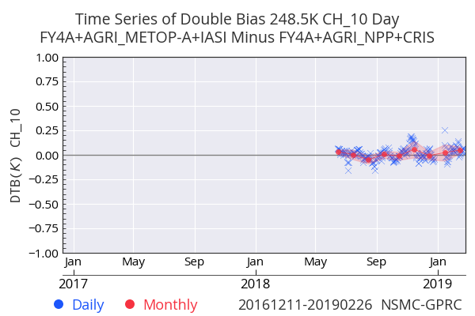
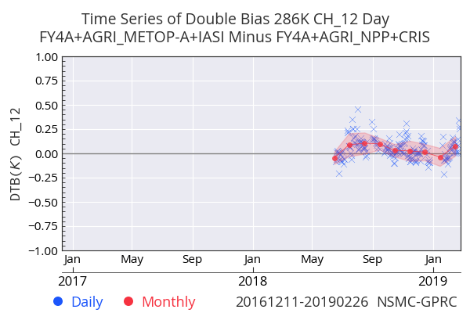
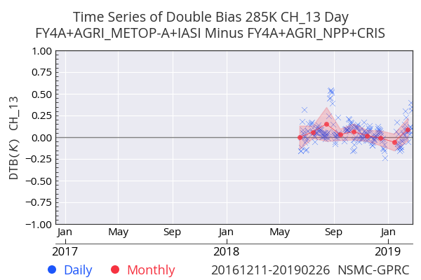
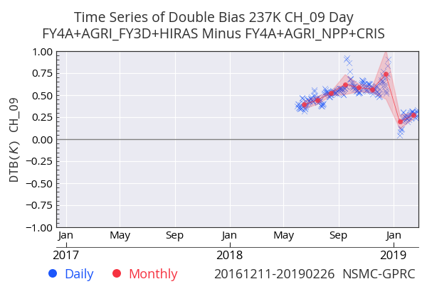
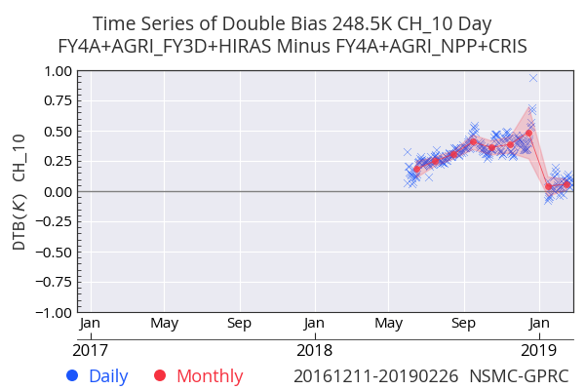
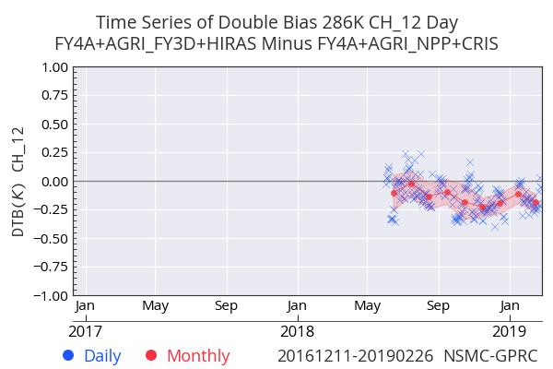
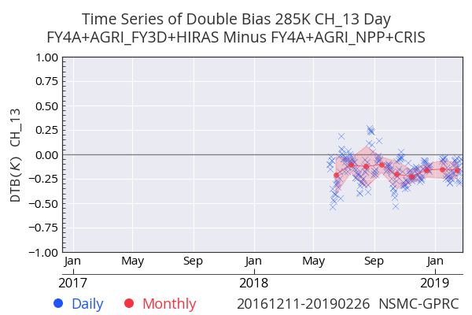
Reference sounders comparison: double difference
METOP-B/IASI VS METOP-A/IASI
<<0.1K
6.3μm
7.1μm
10.8μm
12μm
S-NPP/CrIS VS METOP-A/IASI
<<0.1K(B9/10)
<0.1K(B12/13)
S-NPP/CrIS VS FY3D/HIRAS
<0.25K(after Decontamination )
Decontamination
Decontamination

Slide 15
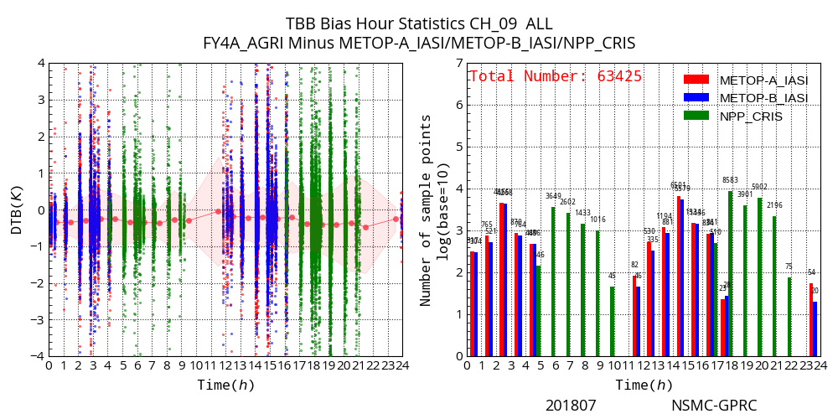
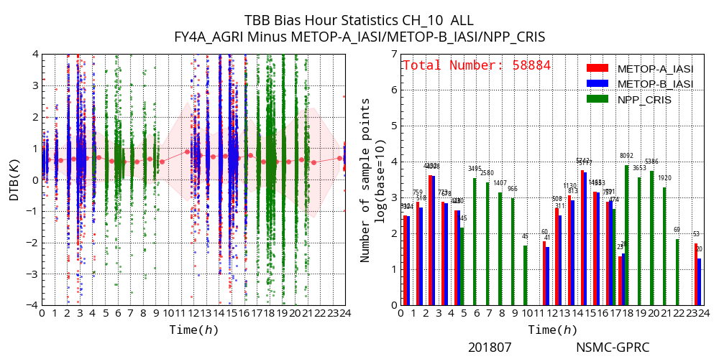
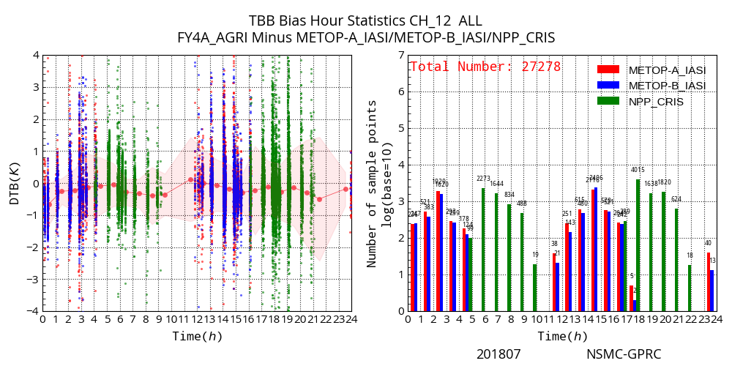
Diurnal Variation
6.3μm
7.1μm
There is no significant diurnal variation seen in FY-4A AGRI
The biases of clear sky radiance (TB10.8>270k) are shown.
Data period is July 2018.
Reference sensors are:
Metop-A/IASI
Metop-B/IASI
S-NPP/CrIS
Midnight
10.8μm
12μm
Ref transfer
Notes:
如果是CRis与IASI间差异导致，IASI应该比Cris小， 实际两者的交叉比对结果也显示相同趋势

Slide 16
Progresses on LEO-LEO inter-calibration
New Activities & Achievements
Implementation of GSICS inter-calibration methods to FY-3D MERSI II w.r.t. IASI/CrIS/HIRAS ;
Inter-platform and Intra-platform comparison between FY-3D MERSI II and CrIS, FY-3D MERSI II and HIRAS;
Hyperspectral inter-calibration of FY-3D HIRAS w.r.t IASI and CrIS;

Slide 17
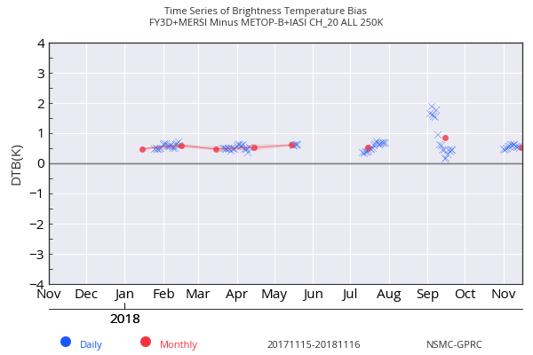
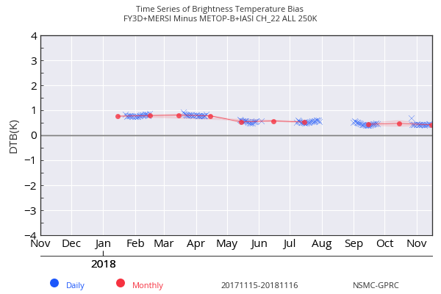
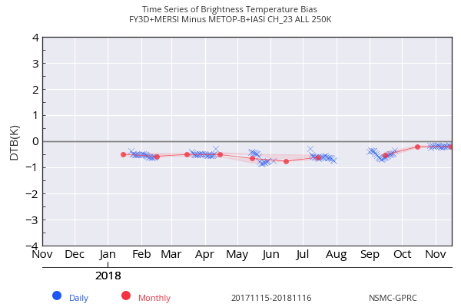
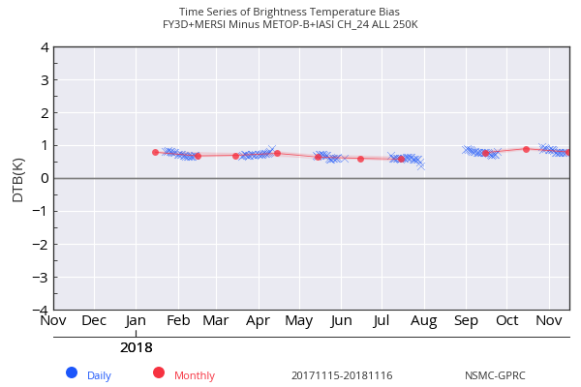
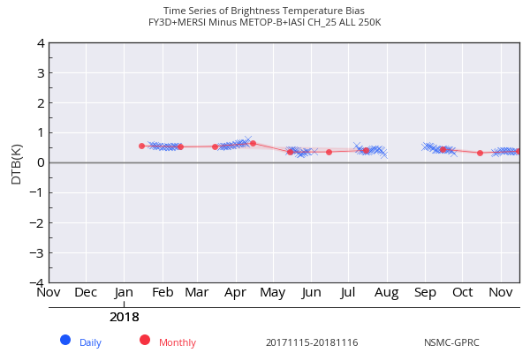
Updates of LEO-LEO intercalibration to multispectral instrument
FY3D/MERSI II VS METOP-B/IASI
MERSI II IR Biases are less than 0.5K for B20/22/23/25, and about 0.8K for B24；
The time sequence of TB biases is stable.
B20(3.8μm)
B22(7.2μm)
B23(8.5μm)
B24(10.8μm)
B25(12μm)
Time sequence of FY-3D MERSI II TB Biases at standard BT
Notes:
focal plane

Slide 18
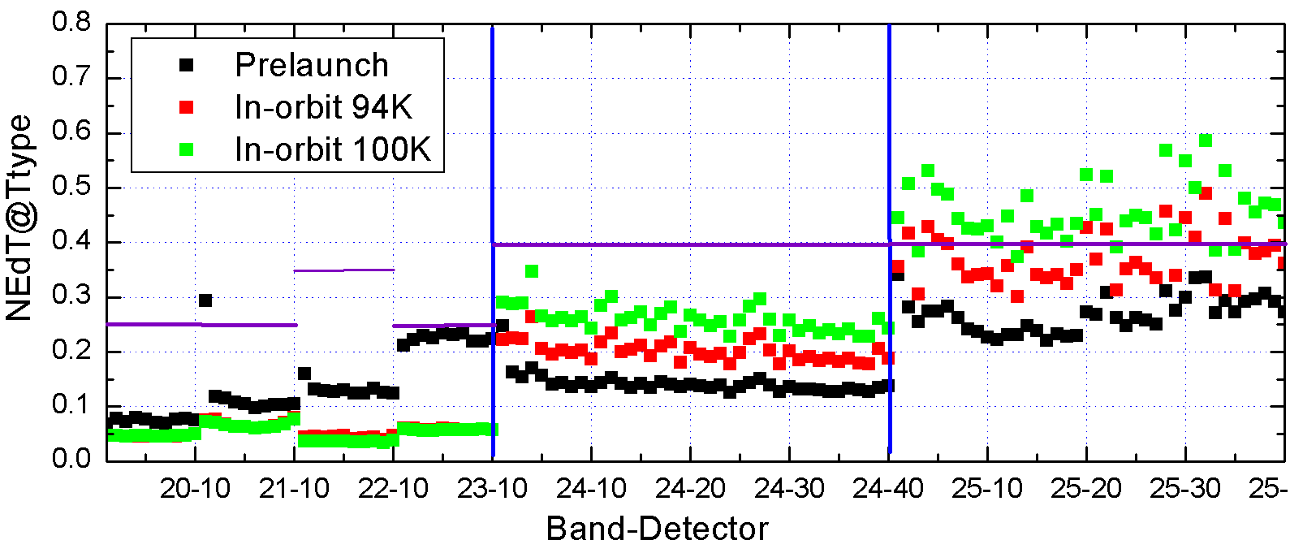
FPA cooling down
The performances are improved especially for the photoconductive (PC) HgCdTe bands
FPA Temperature
10.8μm
12μm
3.8μm
4.05μm
7.2μm
8.55μm
Notes:
reduced

Slide 19
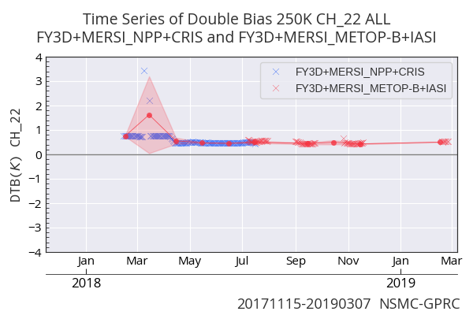
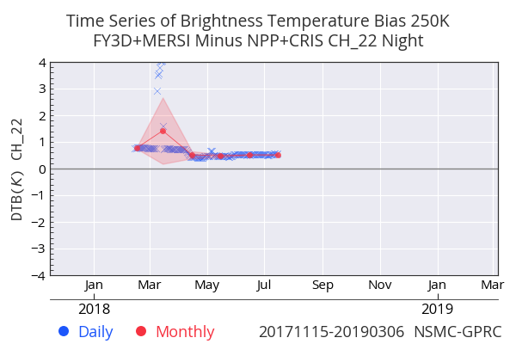
FY3D/MERSI II VS NPP/CrIS
Cross tracks are periodically occurring;
similar results with that of IASI
consecutive SNO tracks help to reveal the TB bias variation more timely
Valid Period Feb.2018 ~Aug.2018(within 15min)
BB WUCD
FPA cooling down (100K → 94K)
BB WUCD
①
②
③
①
②
③
Notes:
Cross tracks sometimes appear continuously, sometimes not

Slide 20
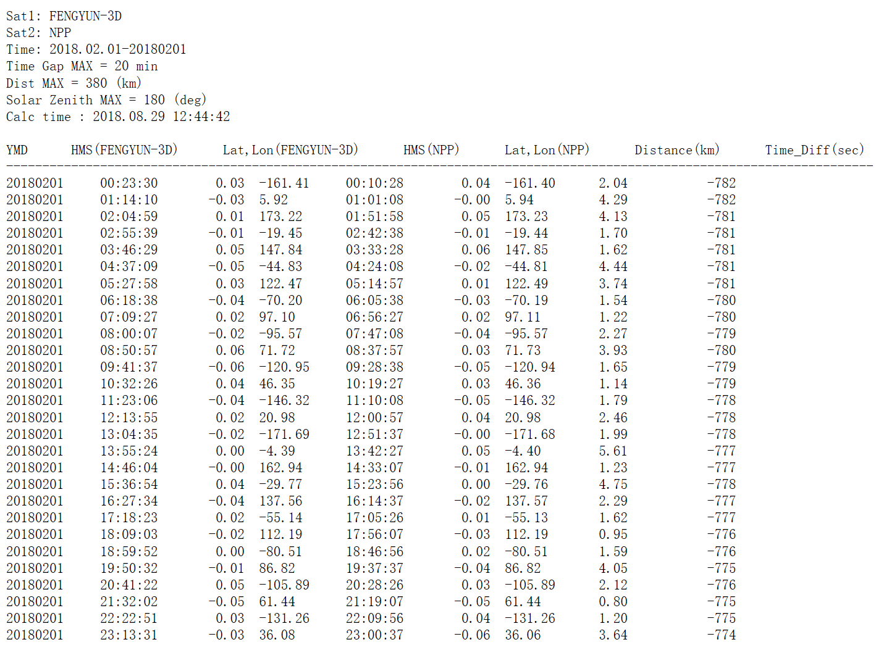
Coincident Orbit (SNOx) comparison with CrIS
Coincident observation orbit of FY-3D and S-NPP occurs periodically.

Slide 21
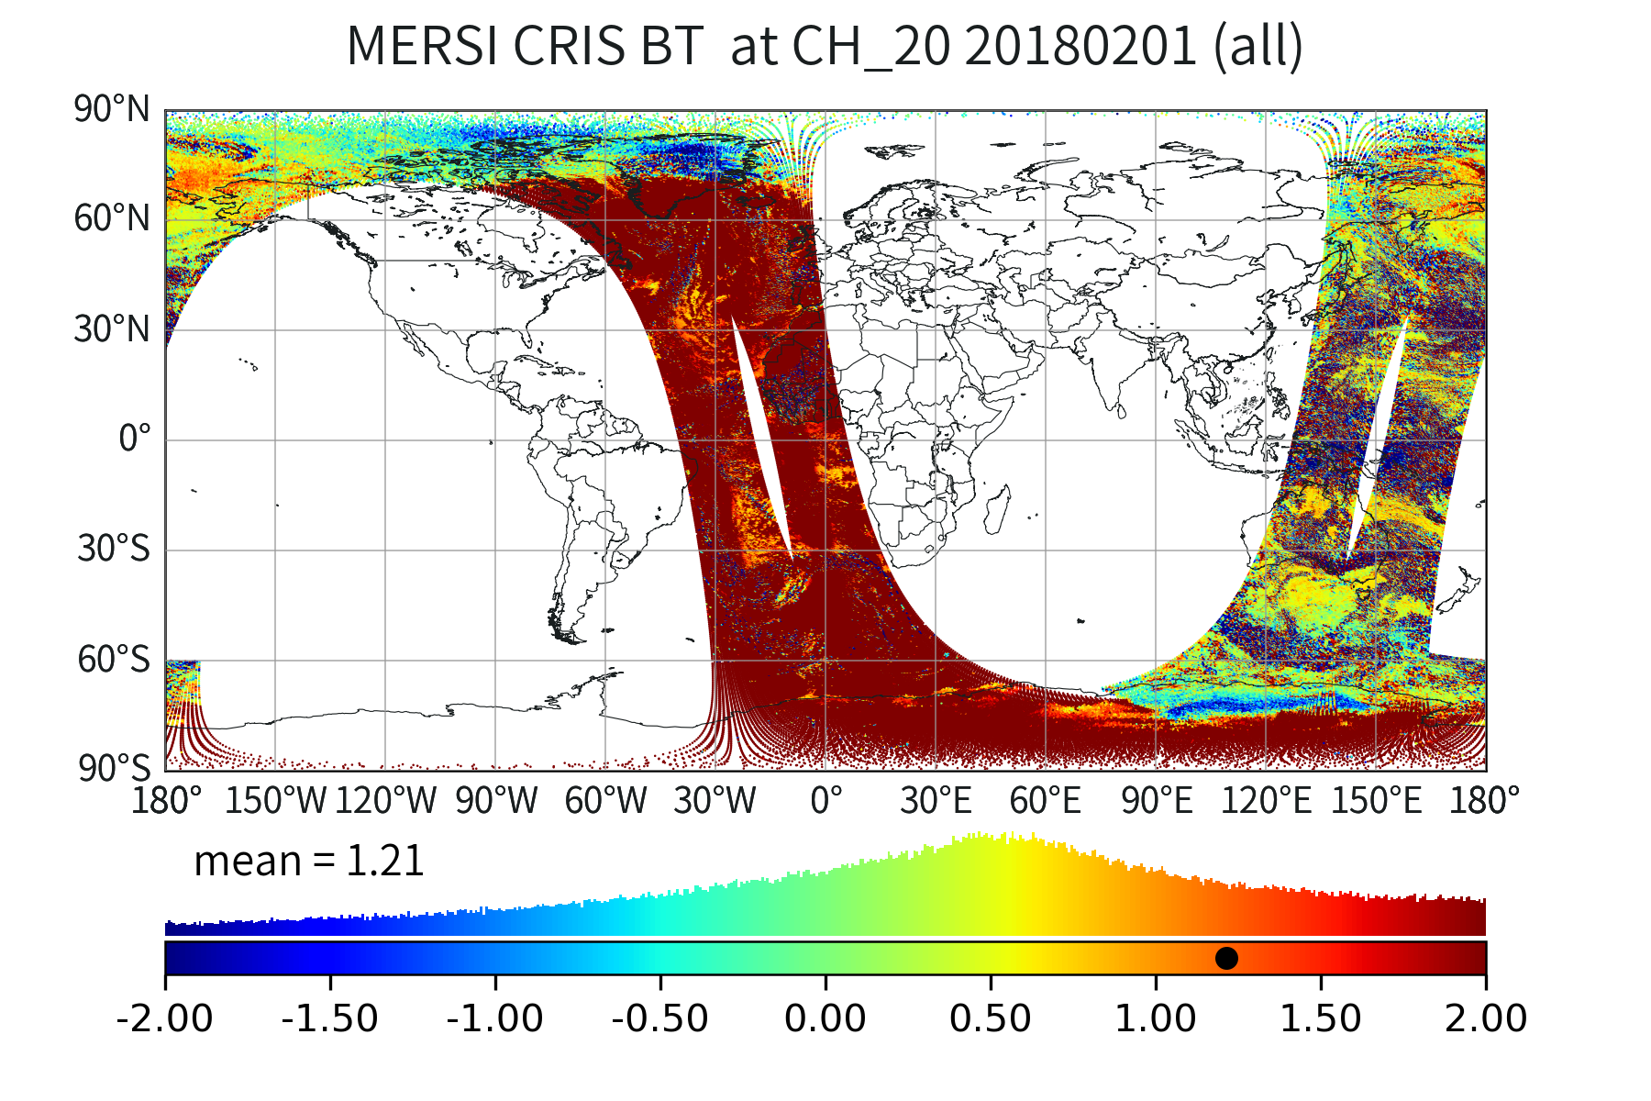
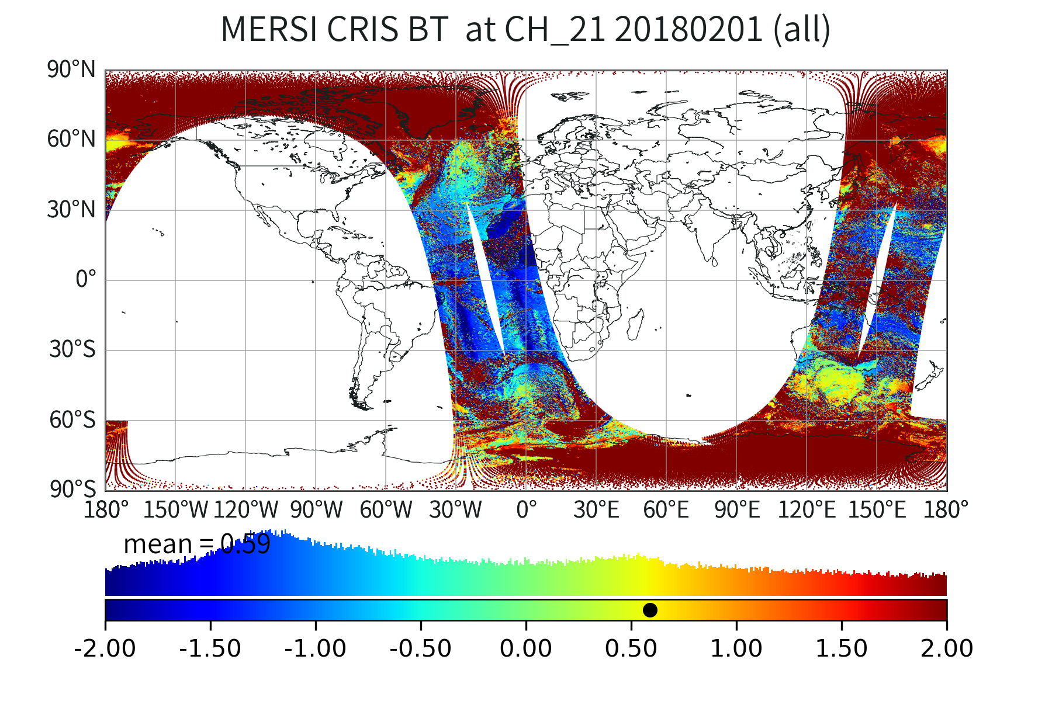
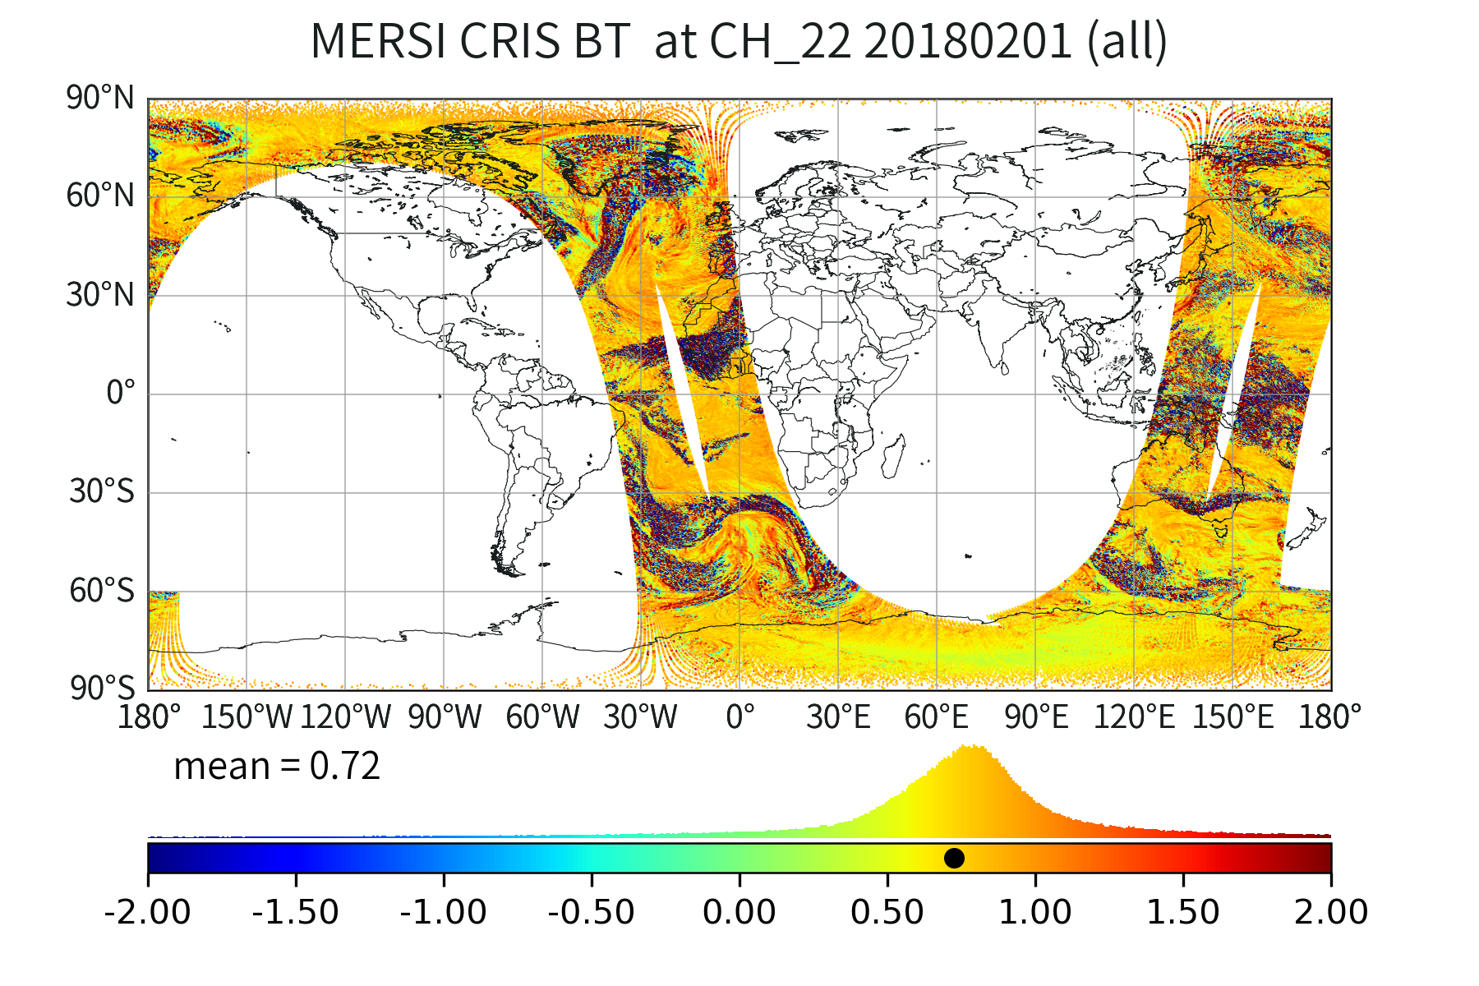
global observation comparison beween MERSI II and CrIS on coincident orbit

Slide 22
Summary
Under the GSICS framework, the baseline IR intercalibration methodology was updated by applying Likun Wang's accurate collocation and Hui Xu's spectral gapfilling methods .
GSICS IR inter-calibration method have been implemented to FENGYUN new multispectral instruments, e.g., MERSI II, FY-4, FY-2H(on-going), using IASI, CrIS, HIRAS as references.
Discussion:
The investigation results show that accurate collocation is a good tool for large spacial scale comparison, but not a necessary process for SNO inter-calibration focusing on uniform scenes.
Uniformity filter is the most important factor, helping us to reduce the uncertanty of navigation error, IFOV differences, geometric matching and other factors.
" With enough uniform scene samples, actually, even the collocation is not good enough, we still can achieve the similar accuracy and precision for radiometric assessment."
Notes:
prettily

Slide 23
Thank you for your attention!

