Slide 1
Inter-calibration results of COMS/MI using with and without MBCC
March 2019
Minju Gu and Dohyeong Kim

Slide 2
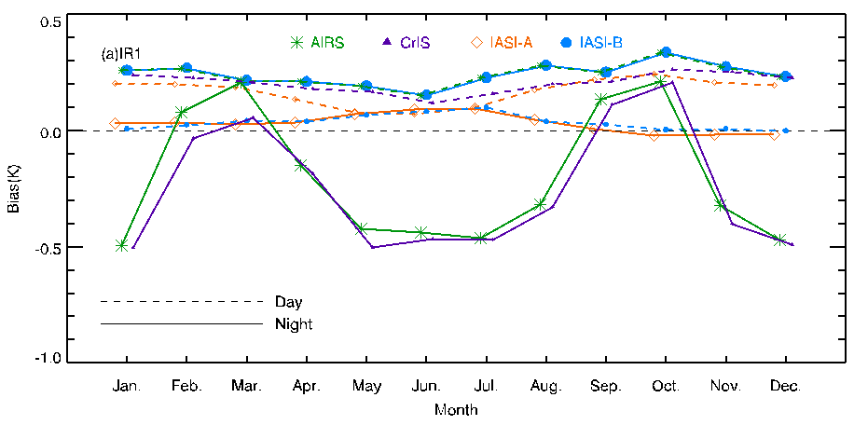
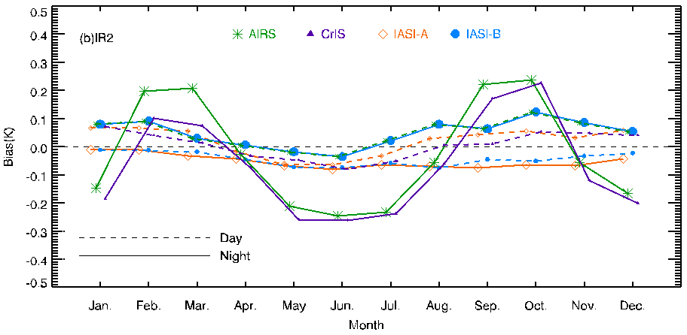
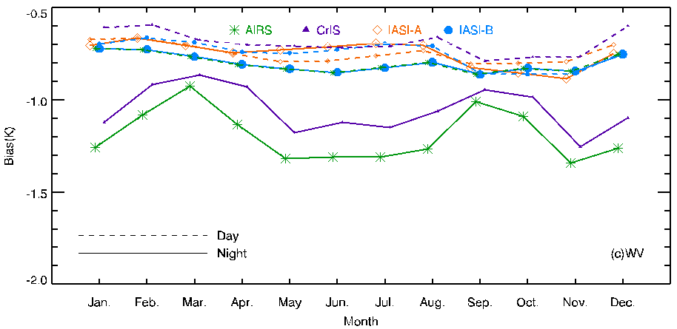
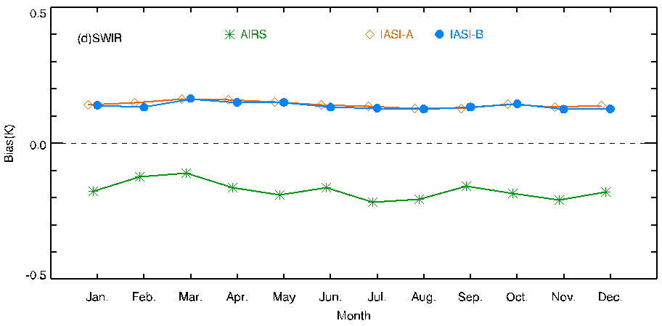
Seasonal Variation of Bias(COMS-LEO)
bias patterns of COMS-AIRS/CrIS(include midnight), and COMS-IASI A/IASI B between daytime(dotted line) and nighttime(solid line)
COMS-AIRS/CrIS has two peaks around March and Sep-Oct
IR1(10.8μm)
IR2(12.0μm)
WV(6.8μm)
SWIR(3.8μm)

Slide 3
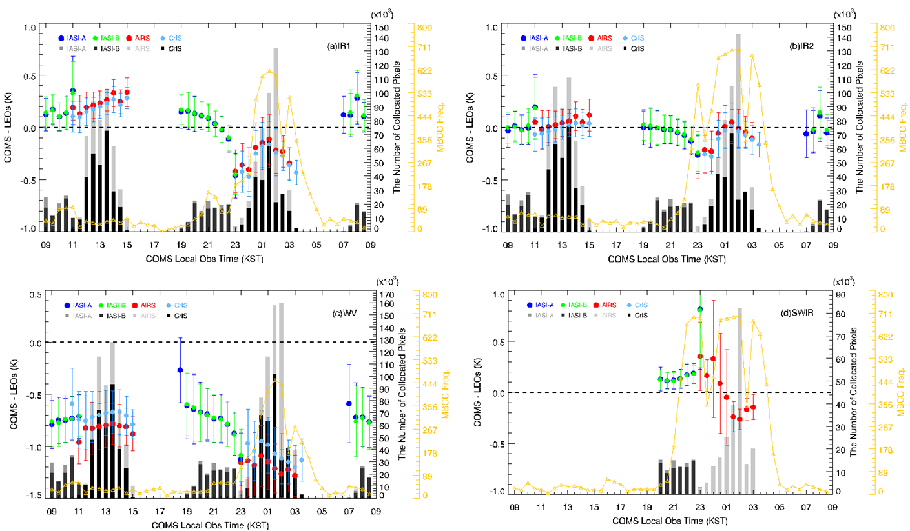
Diurnal Variation of Bias(COMS-LEO)
Diurnal variation for TB bias of IASI-A, -B, AIRS and CrIS, and for Frequency of MBCC application
Midnight Blackbody Calibration Correction (MBCC)
IR1(10.8μm)
IR2(12.0μm)
WV(6.8μm)
SWIR(3.8μm)
calibration correction is applied by estimated slope(with MBCC) instead of original slope(without MBCC) at local midnight
Original Slope : $m_{org}=\frac{r_{BB}−q×({{\overline{X}}_{BB}}^{2}−{{\overline{X}}_{SP−BB}}^{2})}{{\overline{X}}_{BB}−{\overline{X}}_{SP−BB}}$ (Nominal IR calibration equation : $R=q×X^{2}+m×X+b$ , where $X$ : digital number, $R$ : radiance)
Estimated Slope : $m_{est}=C_{0}+C_{1}×T_{optics}+C_{2}×{T_{optics}}^{2}$ , where $T_{optics}$ : Optical temperature

Slide 4
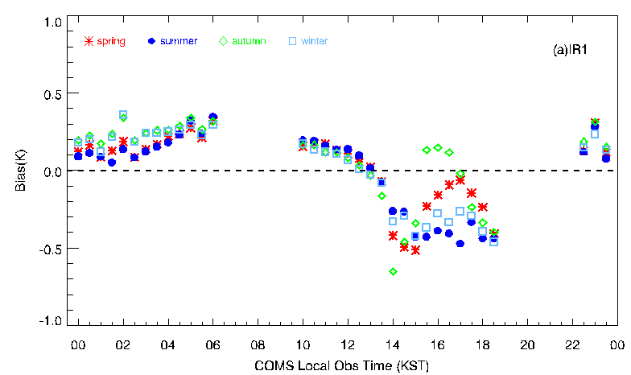
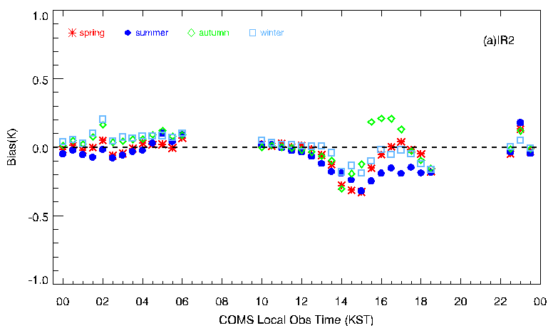
Diurnal variation of mean bias for LEOs
Diurnal variation of mean bias for IASI-A, and –B or AIRS, and CrIS according to season( spring, summer, autumn and winter)
COMS Obs Time(UTC)
COMS Obs Time(UTC)
The large variation in the local midnight of spring and autumn

Slide 5
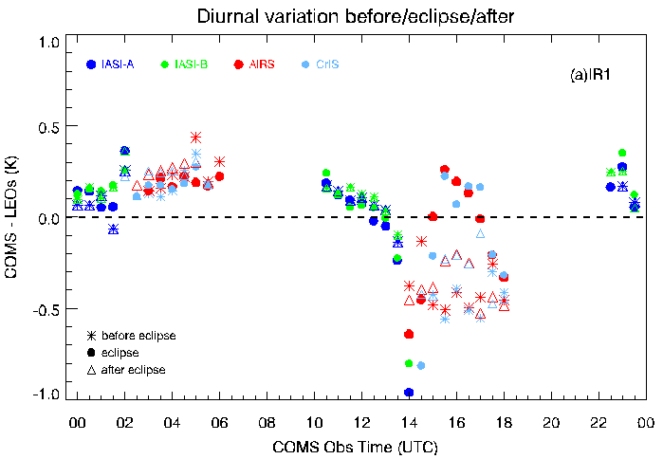
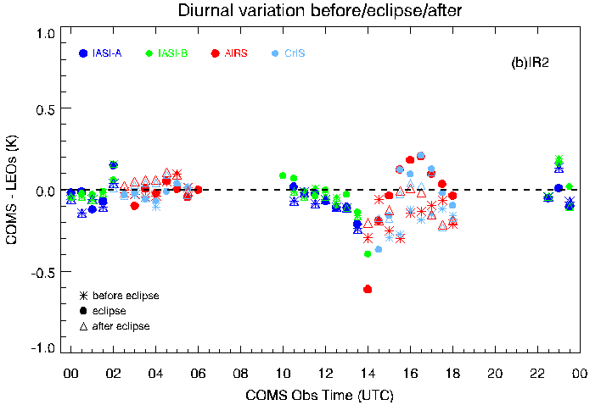
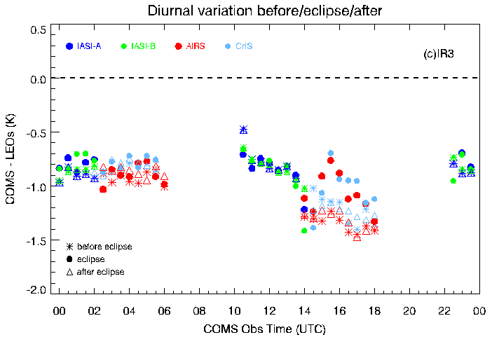
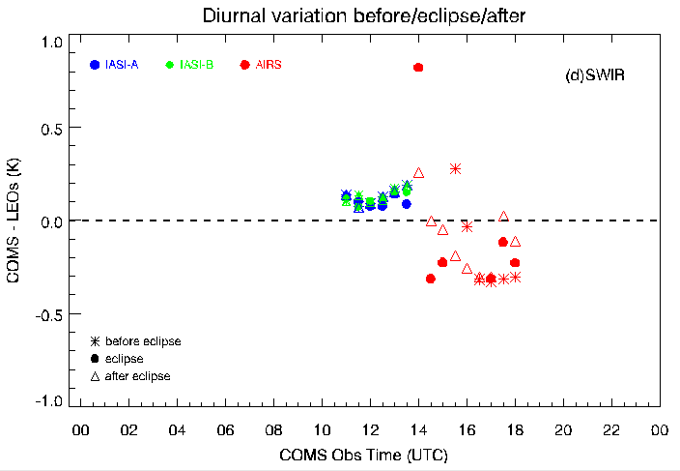
Diurnal Variation for Eclipse
Diurnal variation for TB bias of IASI-A, -B, AIRS and CrIS
For period of before(Aug.) , after(Oct.), and eclipse(Sep.)

Slide 6
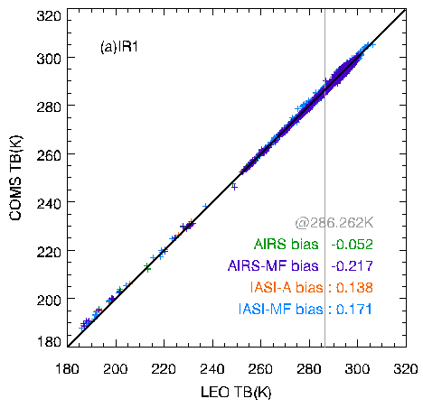
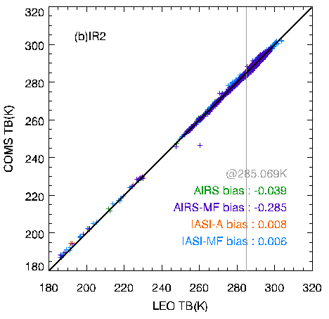
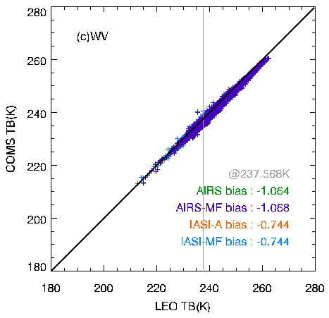
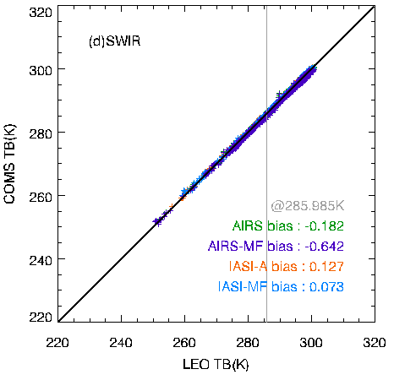
Inter-calibration using COMS with MBCC and without MBCC
Test operation on the process system without MBCC (from March 2016 to August 2017)
GEO(COMS with MBCC, and without MBCC ) data and LEO(IASI-A, and AIRS) data for each 10 days in March, June, September, and December 2016
 |  | IASI-A (with MBCC) | IASI-A (MBCC OFF) | AIRS (with MBCC) | AIRS (MBCC OFF)
IR1 | Bias mean | 0.082 | 0.101 | 0.015 | -0.154
 | RMSE | 0.351 | 0.368 | 0.410 | 0.486
 | Bias @ST | 0.138 | 0.171 | -0.052 | -0.217
IR2 | Bias mean | -0.034 | -0.034 | -0.024 | -0.245
 | RMSE | 0.327 | 0.337 | 0.330 | 0.422
 | Bias @ST | 0.008 | 0.006 | -0.039 | -0.285
IR3 (WV) | Bias mean | -0.833 | -0.840 | -1.090 | -1.124
 | RMSE | 0.409 | 0.414 | 0.460 | 0.481
 | Bias @ST | -0.744 | -0.744 | -1.064 | -1.068
IR4 (SWIR) | Bias mean | 0.175 | 0.123 | -0.132 | -0.546
 | RMSE | 0.191 | 0.203 | 0.226 | 0.325
 | Bias @ST | 0.127 | 0.073 | -0.182 | -0.642
Notes:
Test operation to conduct preprocess system without MBCC (from March 2016 to 2017)
KMA’s operation system generated L1b data not applied to MBCC

Slide 7
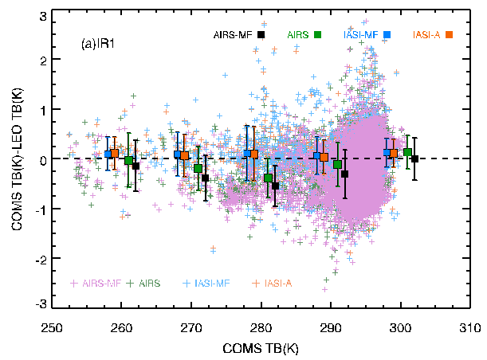
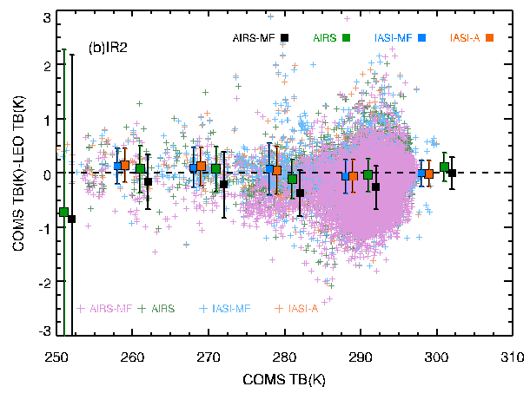
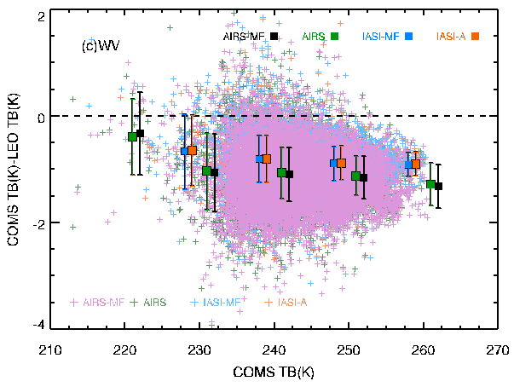
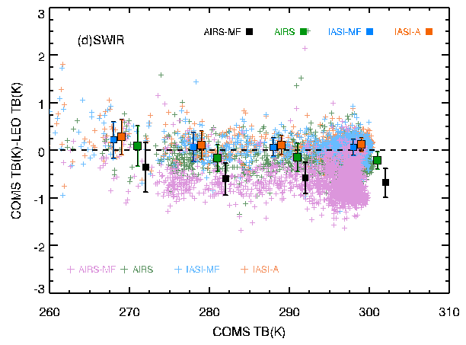
Trend of TB bias
The TB difference between COMS(with MBCC, without MBCC) and LEOs(IASI-A, AIRS) as a function of the MI TB
Box plot : COMS wt_{MBCC}-IASI, COMS wo_{MBCC}-IASI, COMS wt_{MBCC}-AIRS, and COMS wo_{MBCC}-AIRS mean for 5K bin

Slide 8
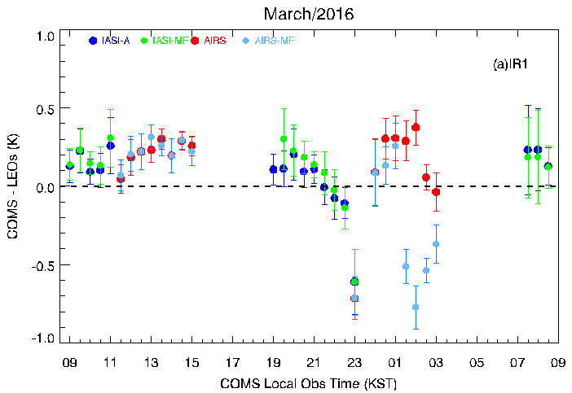
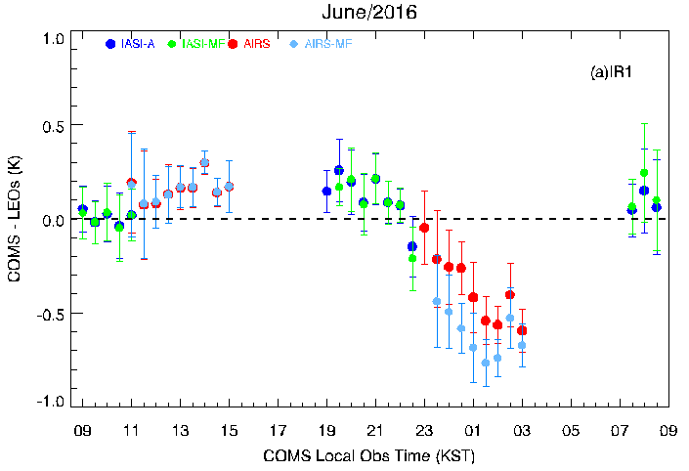
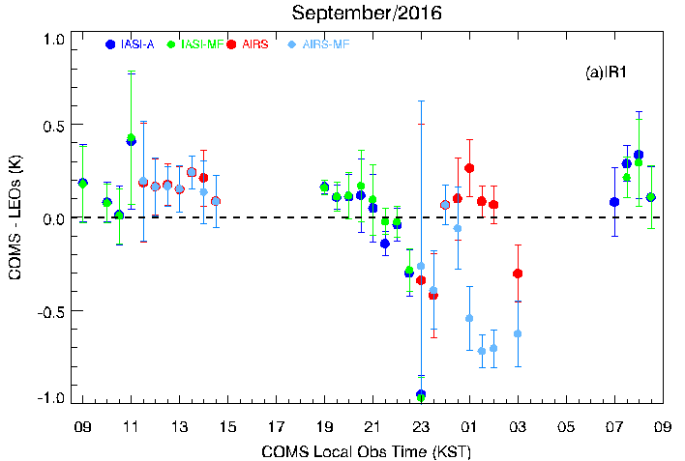
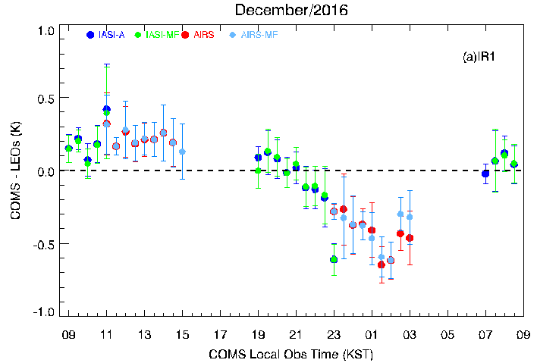
Diurnal Variation of TB bias for IR1
Diurnal variation for TB bias of COMS wt_{MBCC}-IASI, COMS wo_{MBCC}-IASI, COMS wt_{MBCC}-AIRS and COMS wo_{MBCC}-AIRS according to season
spring
summer
autumn
winter

Slide 9
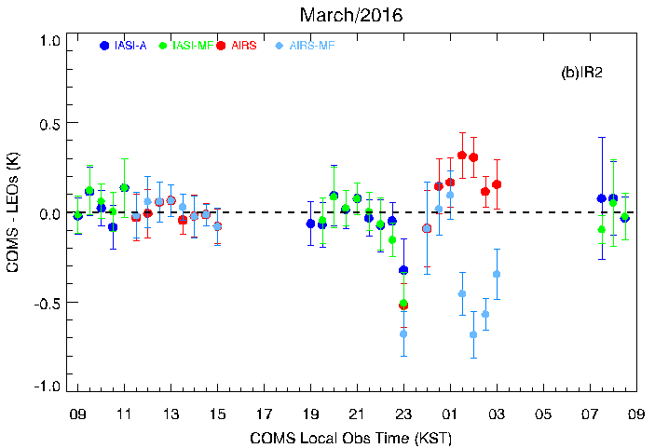
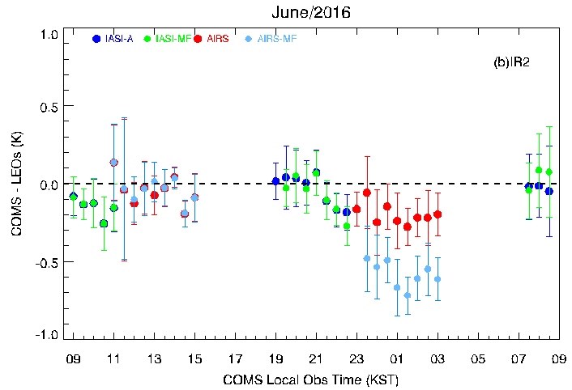
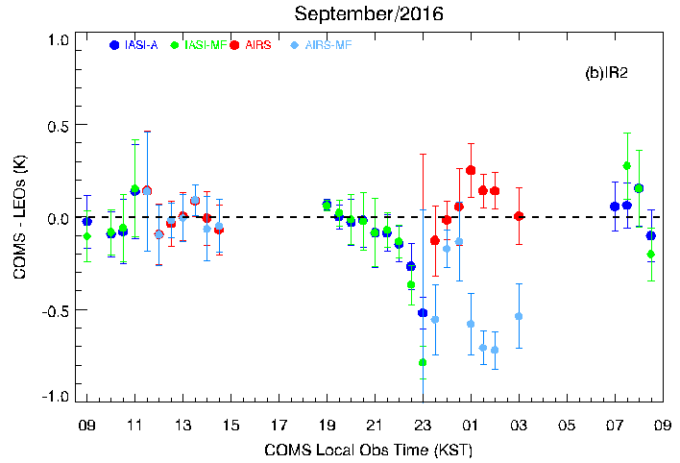
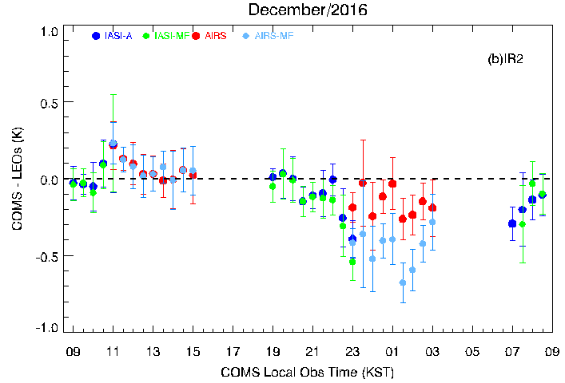
Diurnal Variation of TB bias for IR2
Diurnal variation for TB bias of COMS wt_{MBCC}-IASI, COMS wo_{MBCC}-IASI, COMS wt_{MBCC}-AIRS and COMS wo_{MBCC}-AIRS according to season
spring
summer
autumn
winter

Slide 10
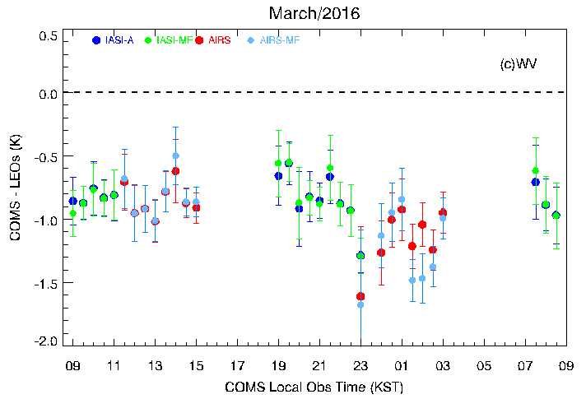
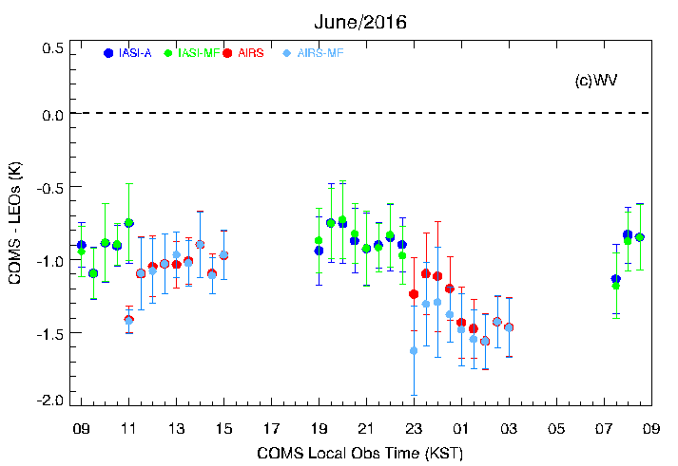
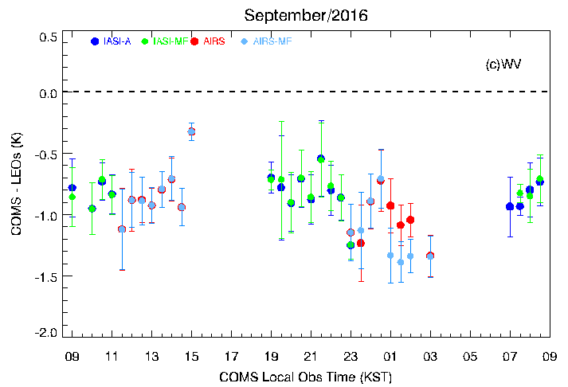
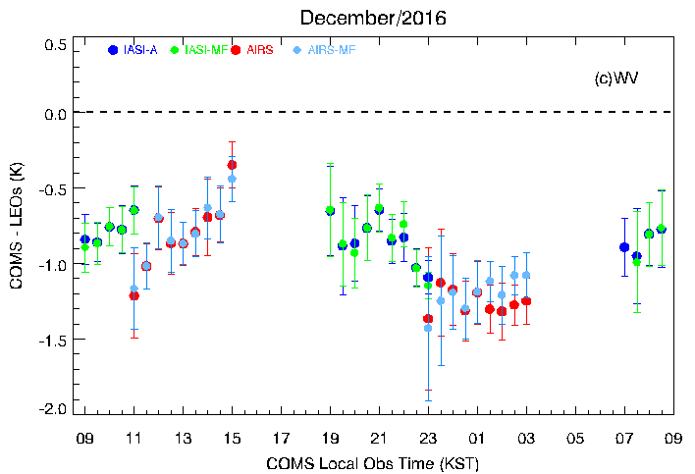
Diurnal Variation of TB bias for WV
Diurnal variation for TB bias of COMS wt_{MBCC}-IASI, COMS wo_{MBCC}-IASI, COMS wt_{MBCC}-AIRS and COMS wo_{MBCC}-AIRS according to season
spring
summer
autumn
winter

Slide 11
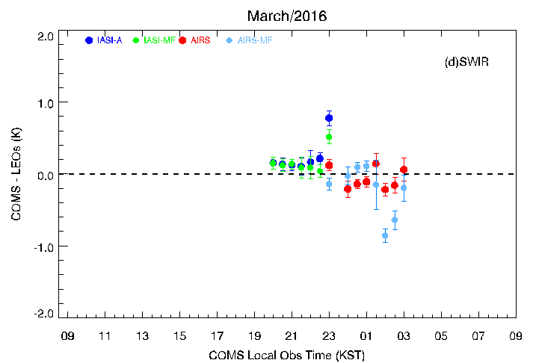
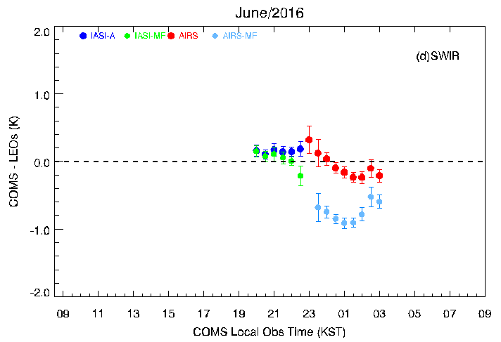
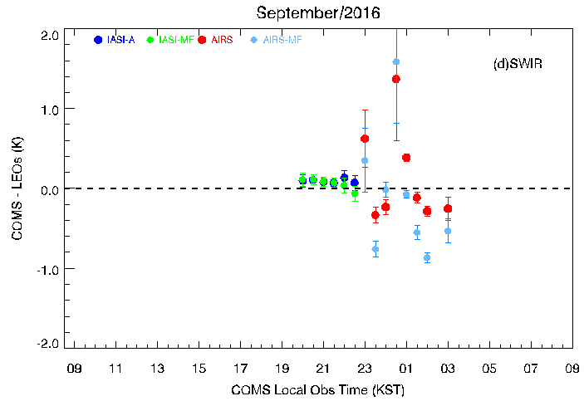
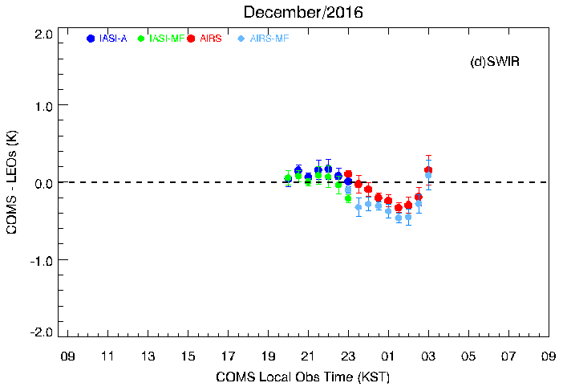
Diurnal Variation of TB bias for SWIR
Diurnal variation for TB bias of COMS wt_{MBCC}-IASI, COMS wo_{MBCC}-IASI, COMS wt_{MBCC}-AIRS and COMS wo_{MBCC}-AIRS according to season
spring
summer
autumn
winter

Slide 12
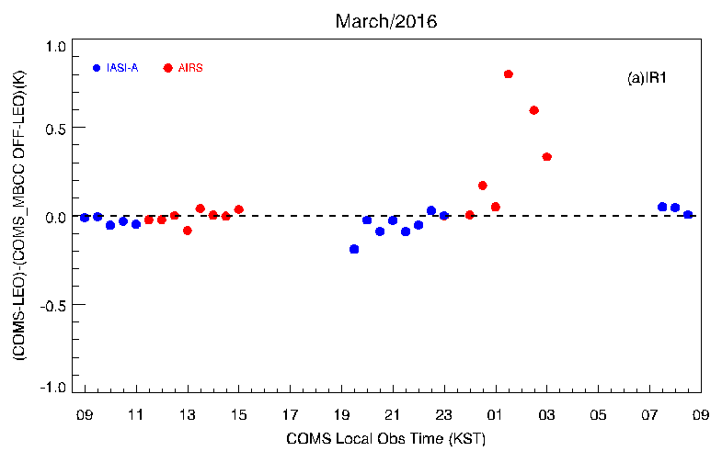
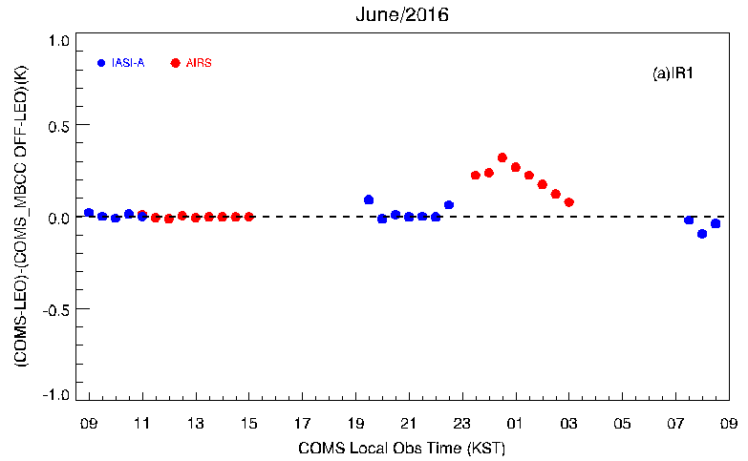
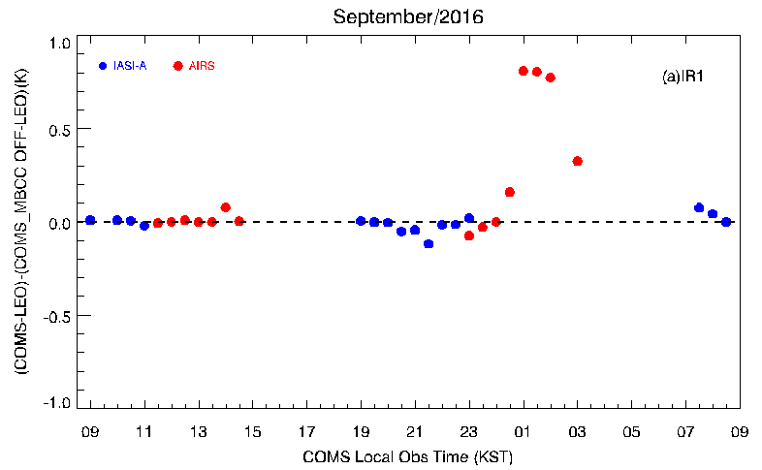
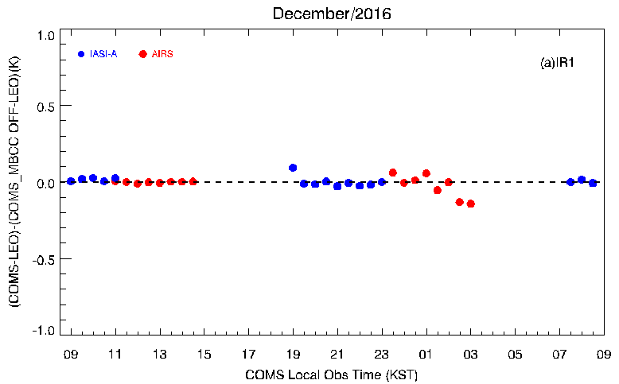
Diurnal variation of Double Difference for IR1
Diurnal variation of (COMS wt_{MBCC} – IASI/A)-(COMS wo_{MBCC}-IASI/A) and (COMS wt_{MBCC} – AIRS)-(COMS wo_{MBCC}-AIRS)
spring
summer
autumn
winter

Slide 13
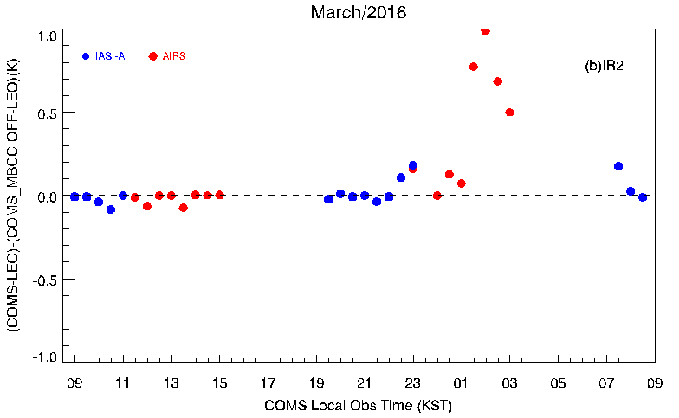
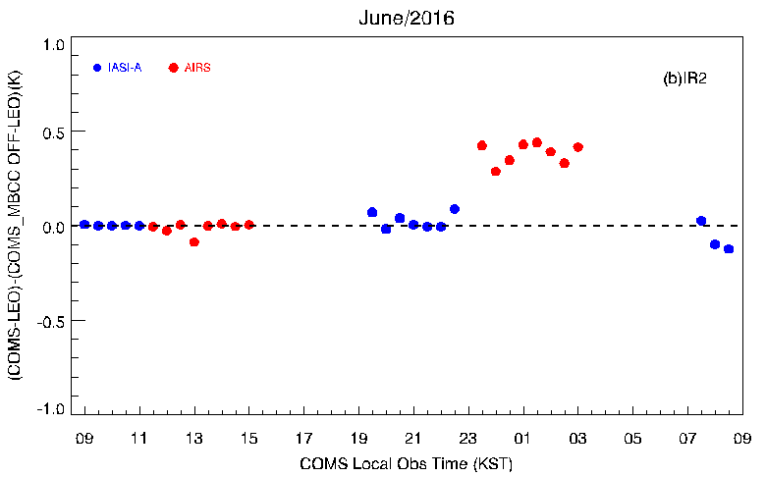
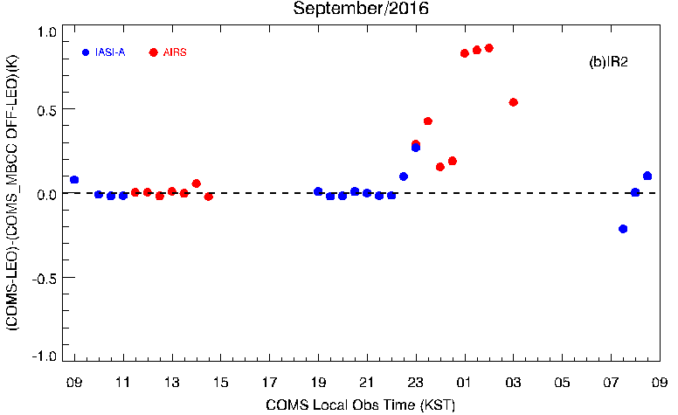
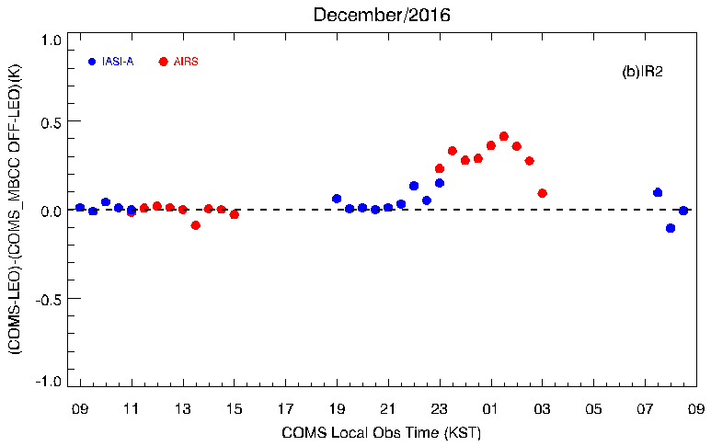
Diurnal variation of Double Difference for IR2
Diurnal variation of (COMS wt_{MBCC} – IASI/A)-(COMS wo_{MBCC}-IASI/A) and (COMS wt_{MBCC} – AIRS)-(COMS wo_{MBCC}-AIRS)
spring
summer
autumn
winter

Slide 14
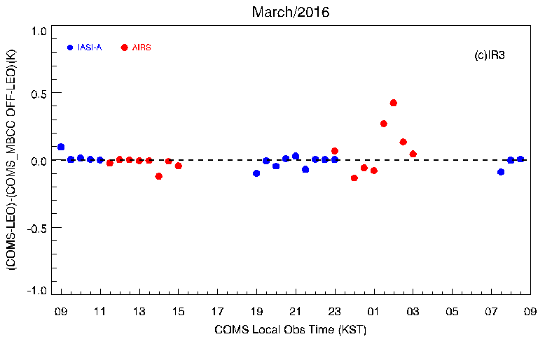
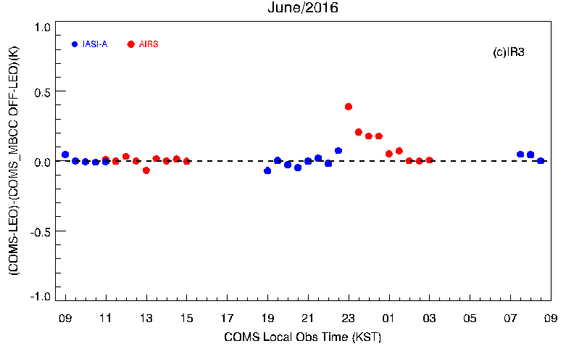
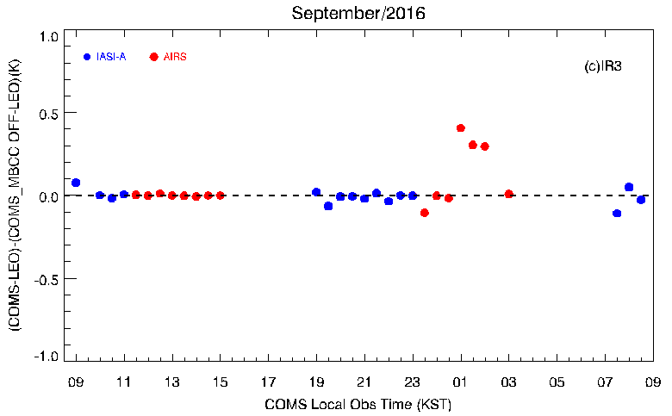
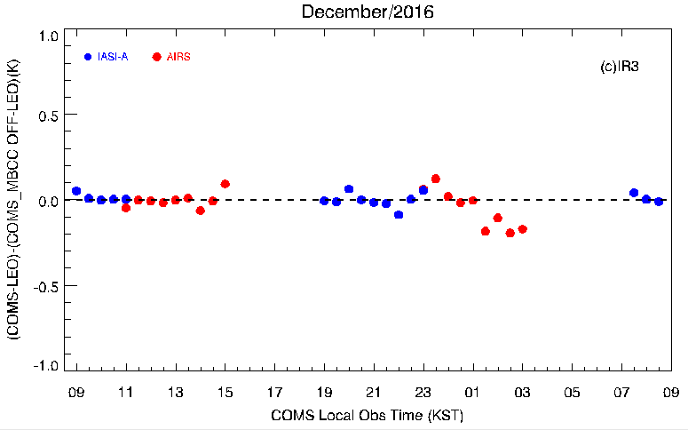
Diurnal variation of Double Difference for WV
Diurnal variation of (COMS wt_{MBCC} – IASI/A)-(COMS wo_{MBCC}-IASI/A) and (COMS wt_{MBCC} – AIRS)-(COMS wo_{MBCC}-AIRS)
spring
summer
autumn
winter

Slide 15
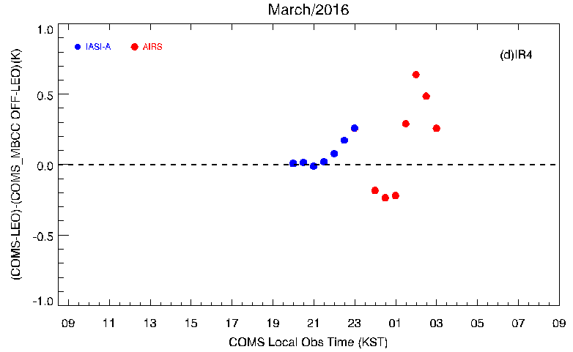
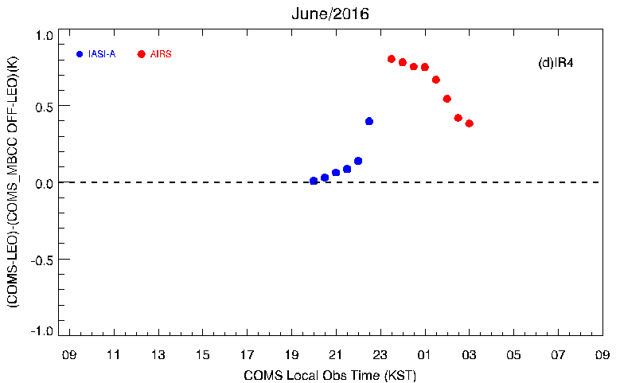
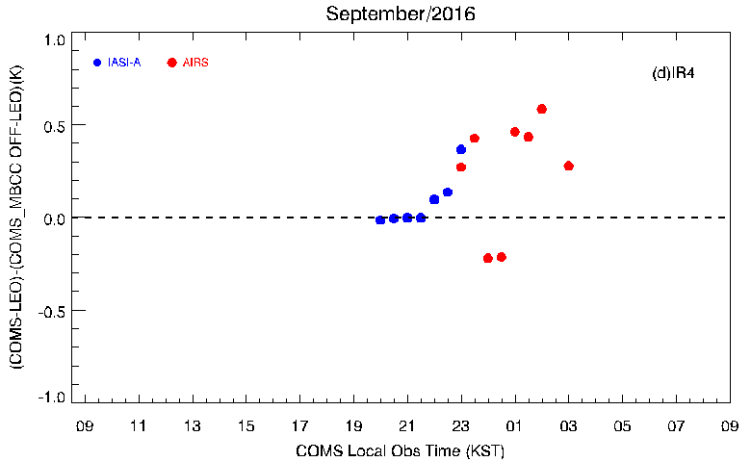
Diurnal variation of Double Difference for SWIR
Diurnal variation of (COMS wt_{MBCC} – IASI/A)-(COMS wo_{MBCC}-IASI/A) and (COMS wt_{MBCC} – AIRS)-(COMS wo_{MBCC}-AIRS)
spring
summer
autumn
winter

Slide 16
Diurnal variation of Erroneous slope
Diurnal variation of Erroneous Slope (= Original slope-Estimated Slope/with MBCC) according to season
spring
summer
autumn
winter

Slide 17
Summary
The IR channels inter-comparison (TB biases) between COMS and LEOs show seasonal variation and diurnal variation
COMS-AIRS/CrIS whose ECT is 01:30 shows large variation before/after midnight, especially in Spring/Autumn and eclipse season, in spite of application of Midnight Blackbody Calibration Correction (MBCC)
Analysis using L1B with and without application of MBCC(March 2016~August 2017)
Large discrepancy in biases between with/without MBCC application around midnight in Spring and Autumn, as the erroneous slope increases during the time of the seasons
The performance of MBCC in Spring/Autumn is better than Summer/Winter
The current MBCC performance could be affected to generate products
Need to analyze the behavior of the MBCC performance/abnormal pattern based on season, eclipse, and so on
Notes:
(COMS with MBCC and without MBCC from IASI-A show similar
Bias of COMS without MBCC from AIRS shows a larger negative value than it with MBCC

Slide 18
Thank you!

