Slide 1
G16 vs. G17 IR Inter-comparison: Some Experiences and Lessons from validation toward GEO-GEO Inter-calibration
Fangfang Yu, Xiangqian Wu, Hyelim Yoo and Zhipeng Wang
NOAA/NESDIS/STAR

Slide 2
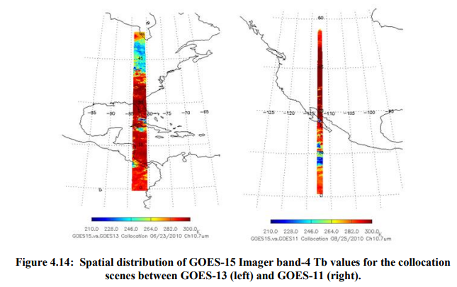
Background
GEO-GEO inter-comparison can provide continuous comparison results between two satellites in a day
NOAA has a long-term experience in using the GEO-GEO inter-comparison to monitor the relative calibration accuracy variation between two satellite instruments (e.g. Imagers and Sounders at GOES-East and GOES-West), especially during the PLT/PLPT periods
  Diurnal calibration variation validation
  Straylight impacts
  Instrument performance anomaly detections
  Assistance to anomaly investigation
  Validation of operational algorithm update
  …
GSICS community is also interested in the GEO-GEO IR inter-calibration
  Complementary to GEO-LEO inter-calibration
  To cover the 24-hour in a day for the GSICS IR correction products

Slide 3
GOES-16/17 ABI IR Data
G16 ABI IR data are well calibrated with the ICT temperature and focal plane module (FPM) temperature well under control
  No significant scene radiance dependent radiance/Tb bias to the collocated hyperspectral measurements
  No detectable diurnal variation
  No detectable incident dependent response at both NS and EW directions within the full-disk scan region
  After the most recent operational update on 06/19/2018, the mean Tb bias to all the four reference hyperspectral radiometers (CrIS/IASI) is within 0.15K.
G16 data can serve as the reference to validate and monitor the relative calibration variation of G17 IR measurements
  G17 ABI performance was reported by Wu et al. (Monday, #1f)

Slide 4
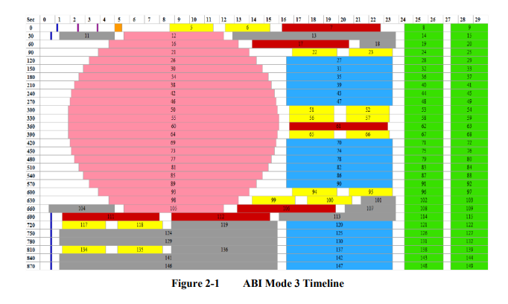
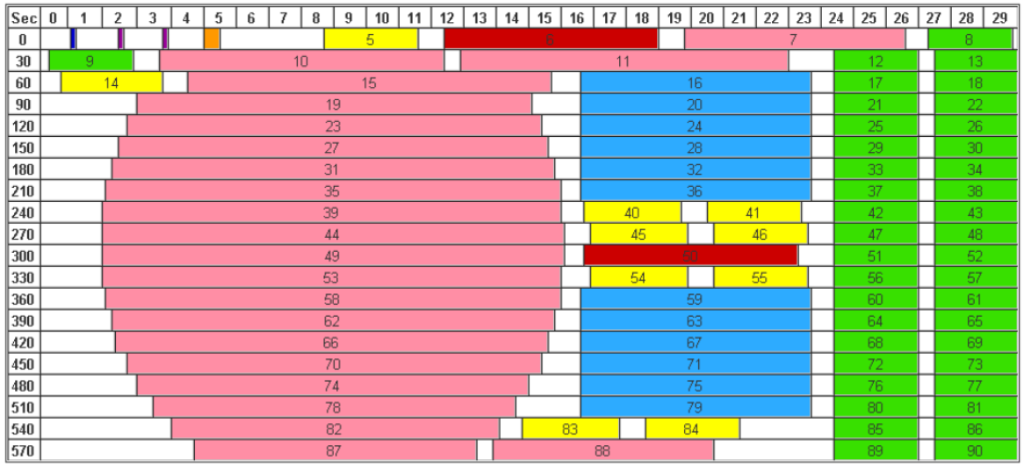
G17 vs G16 IR Inter-Comparison
The GEO-GEO inter-comparison is conducted at different scan frames based on the ABI timelines
  Calibration-to-calibration
  CONUS-to-CONUS
  Swath-to-swath
GOES-17 Mode 3/6 timelines have the same numbers of MESO, CONUS and FD scans. The main difference is that GOES-17 conducts the ICT calibration at every 5 minutes.
NOAA is going to operate different versions of Mode 6 timeline for both GOES-16 and GOES-17.
Default Mode 6 timeline used at GOES-16
Default Mode 3 timeline used at GOES-16

Slide 5
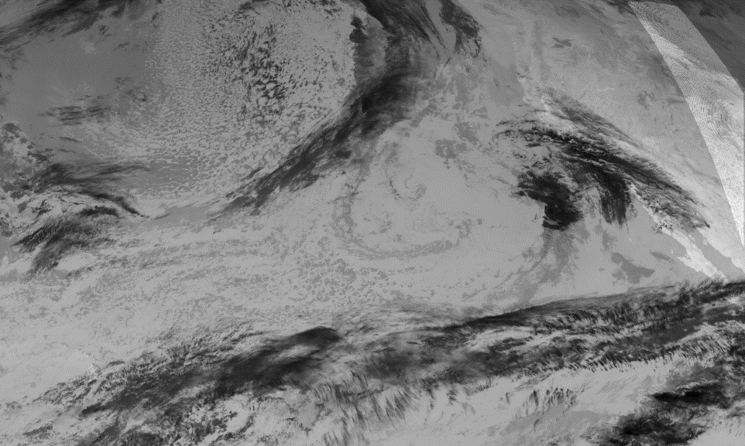
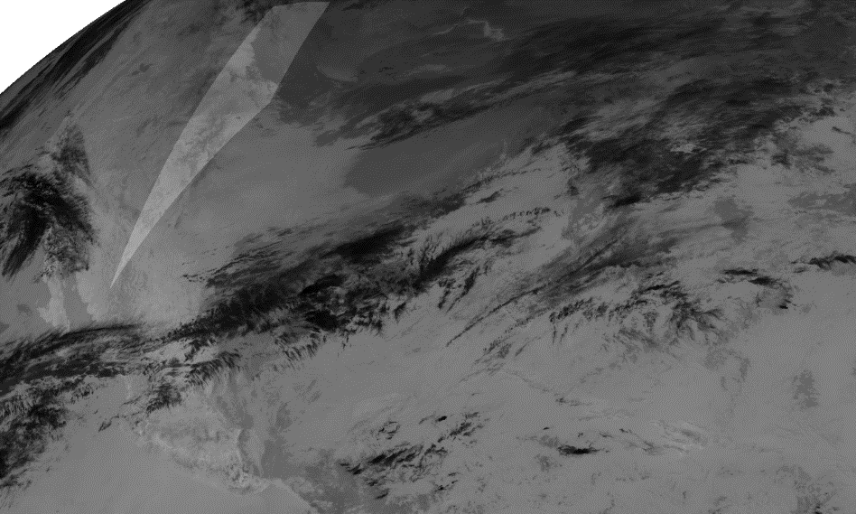
Pixel-matched GEO-GEO Inter-Comparison
Example: CONUS-to-CONUS
GOES-17
GOES-16
Matching criteria:
Same geo-location
Similar viewing zenith angle difference
Almost same time (time difference < 60 seconds)

Slide 6
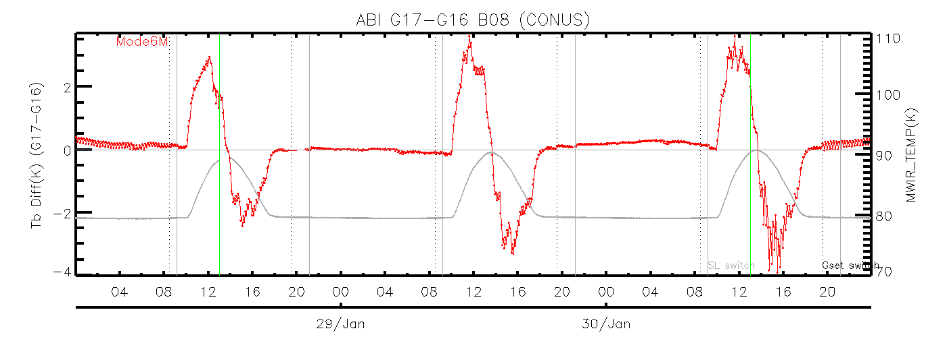
GEO-GEO Inter-comparison: B08 as an Example
Mode 3
Mode 6
Mode 3
GOES-17 IR radiance is generally stable when the FPM temperature is under control.

Slide 7
GEO-GEO Inter-comparison : B08 as an Example
Warmer than G16 before FPM reaches the peak temperature.
Colder than G16 before FPM reaches the peak temperature.
The variation of the G17 IR radiance is due to the quick change of detector responsivity as FPM temperature changes. This impact will be mitigated with the predictive calibration algorithm (Wu et al., #1f).

Slide 8
Validation of Timeline Update: B08 as an Example
Cal-to-cal variation
Cal-to-cal variation
Mode 3
Mode 6
Mode 3
Mode 6 reduces the calibration-to-calibration variation

Slide 9
Validation of Timeline Update: B08 as an Example
Gainset switch time
Gainset switch time
Cal-to-cal variation
Cal-to-cal variation
Mode 3
Mode 6
Mode 3
Gainset switch can change the magnitude of cal-to-cal variation for the Mode 3 timeline data

Slide 10
Anomaly Detections: B08 as an Example
Space-look location switch time
Slight residual of the EW scan mirror uniformity correction may exist at this channel.

Slide 11
Lessons and experiences for the GEO-GEO IR Inter-calibration

Slide 12
Experiences and Lessons from G16/17 ABI IR Inter-comparison -1
Ideally, the two inter-comparison instruments should view the same target simultaneously with the same viewing geometry.
Yet, difference in the viewing azimuth always exists with the GEO-GEO inter-comparison
  Always viewing from almost opposite directions
Therefore, to derive the accurate instrument performance information, it is critical to reduce the uncertainties associated with the different viewing geometry

Slide 13
Experiences and Lessons from G16/17 ABI IR Inter-comparison -2
Uncertainty associated with the different viewing azimuth angles over the same geo-location
  Parallax: e.g. cloud pixel displacement
  Directional surface temperature
  Different atmospheric components
  Others …

Slide 14
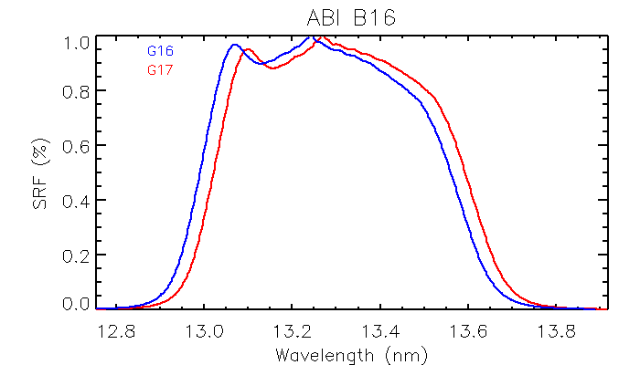
Experiences and Lessons from G16/17 ABI IR Inter-Intercalibration -3
Uncertainty associated with the different viewing azimuth angles over the same geo-location
  Parallax: e.g. cloud pixel displacement
  Directional surface temperature
  Different atmospheric components
  Others …
Determine the “best” area for the GEO-GEO inter-calibration
Impact of SRF difference may be followed after the site selection
On the top of these impacts is the SRF difference, if the GEO-GEO inter-calibration is what we are seeking for

Slide 15
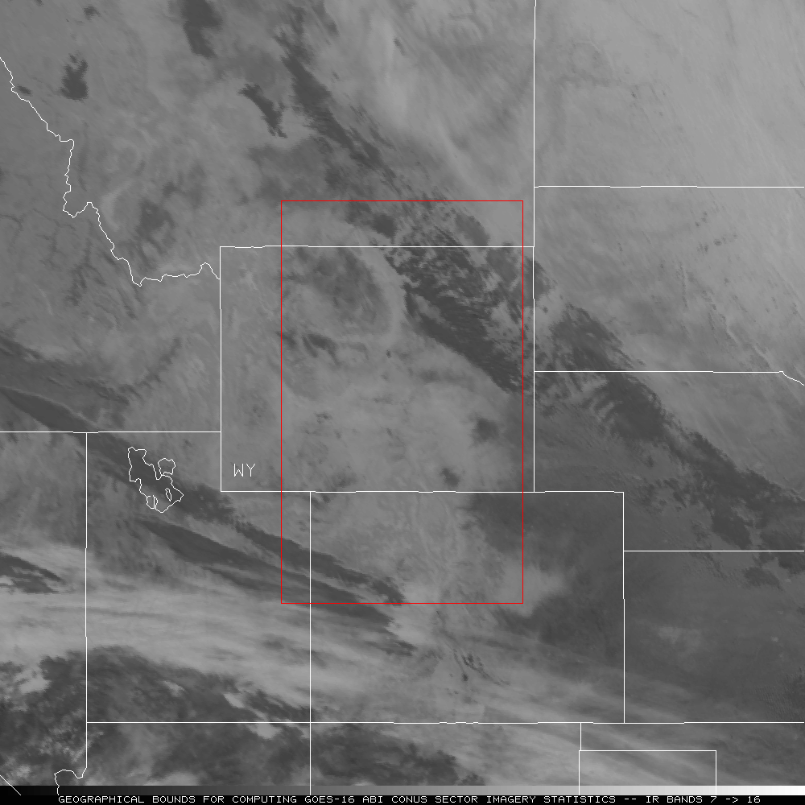
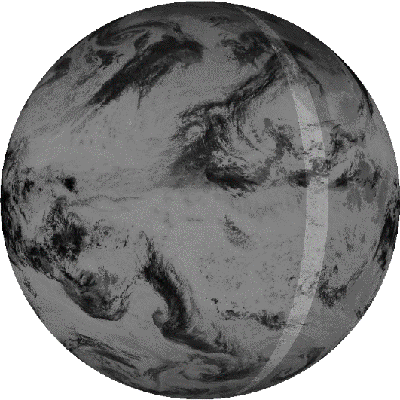
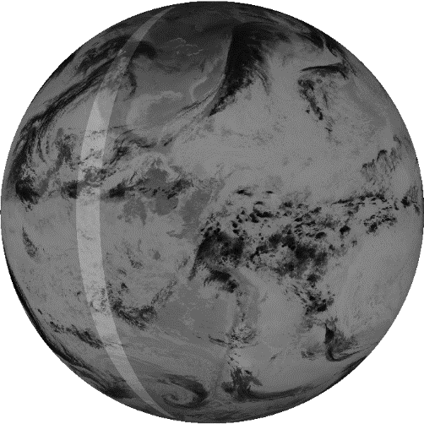
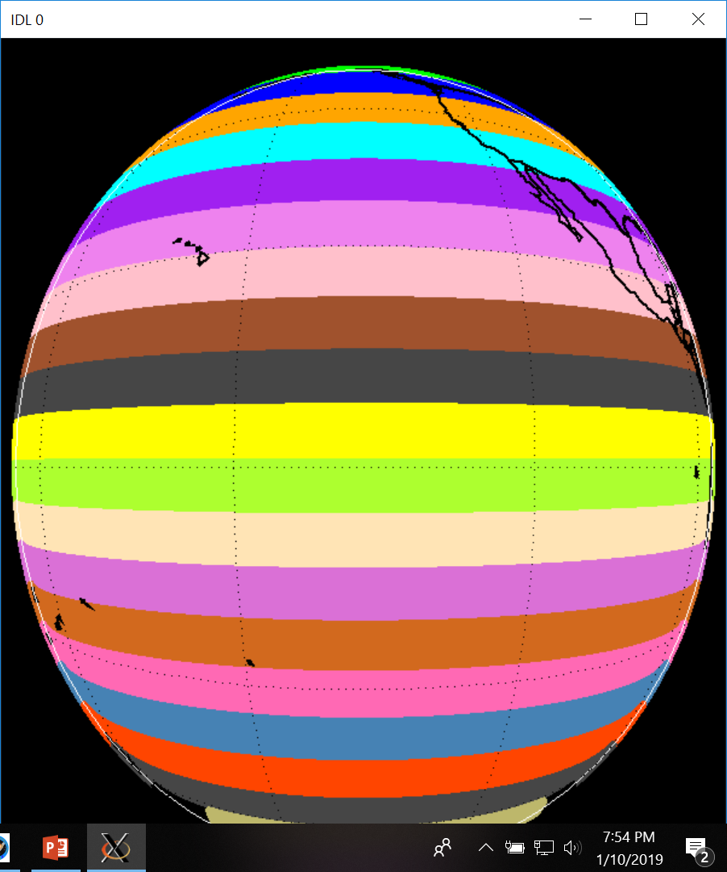
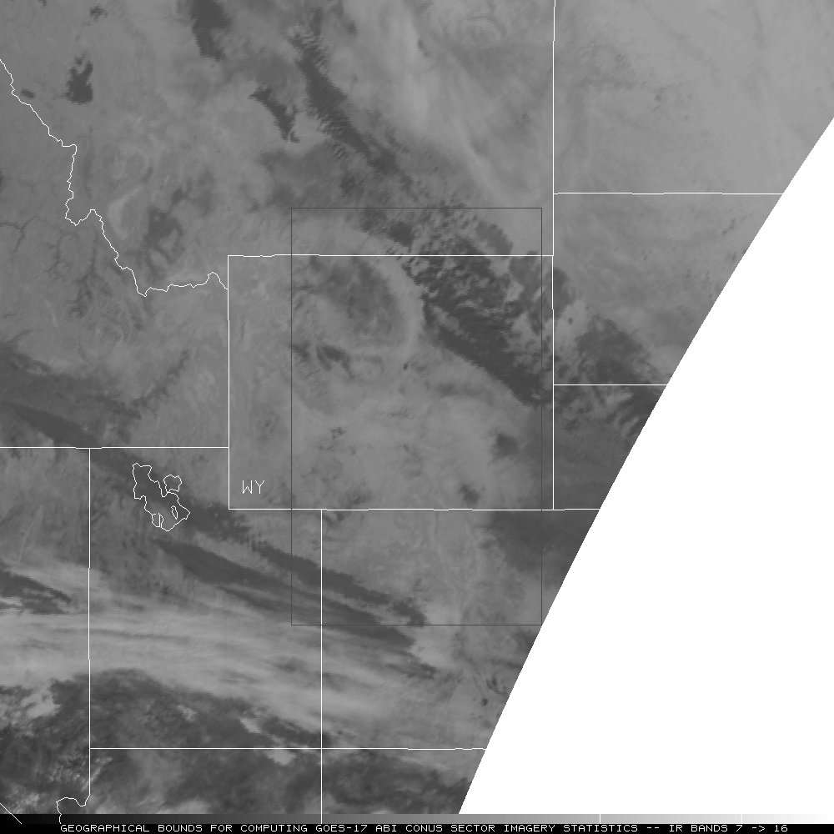
Different Collocation methods
UW/CIMSS method:
- Collocated area
NOAA CWG’s method:
pixel-to-pixel collocations with similar viewing zenith angle from full-disk Swath #11
Viewing zenith angle difference <2%
Number of collocated pixels: ~13,500
G16
G17
Comparison Area
- Centered at 42.5N, 107W
- 501x301 Pixels
- Both GOES-16 and GOES-17 CONUS get remapped into the Mercator projection to offset the different viewing geometries
Courtesy of T. Schmit & M. Gunshor

Slide 16
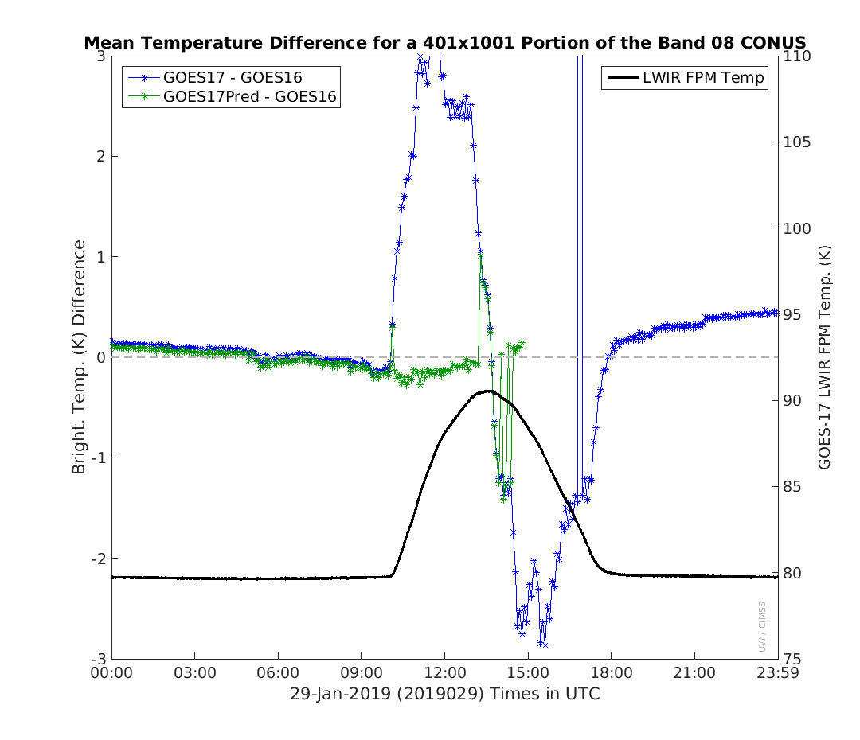
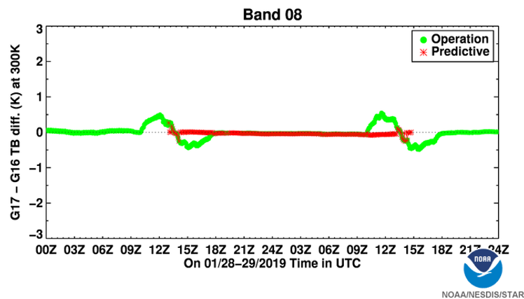
Area-based GEO-GEO
Pixel-based GEO-GEO
Different min/max values
Different variations
Courtesy of T. Schmit & M. Gunshor
What may be the causes to the difference?
Location of the collocations – e.g. difference in the atmospheric components?
Can uniformity sanity check reduce the variation?
…..

Slide 17
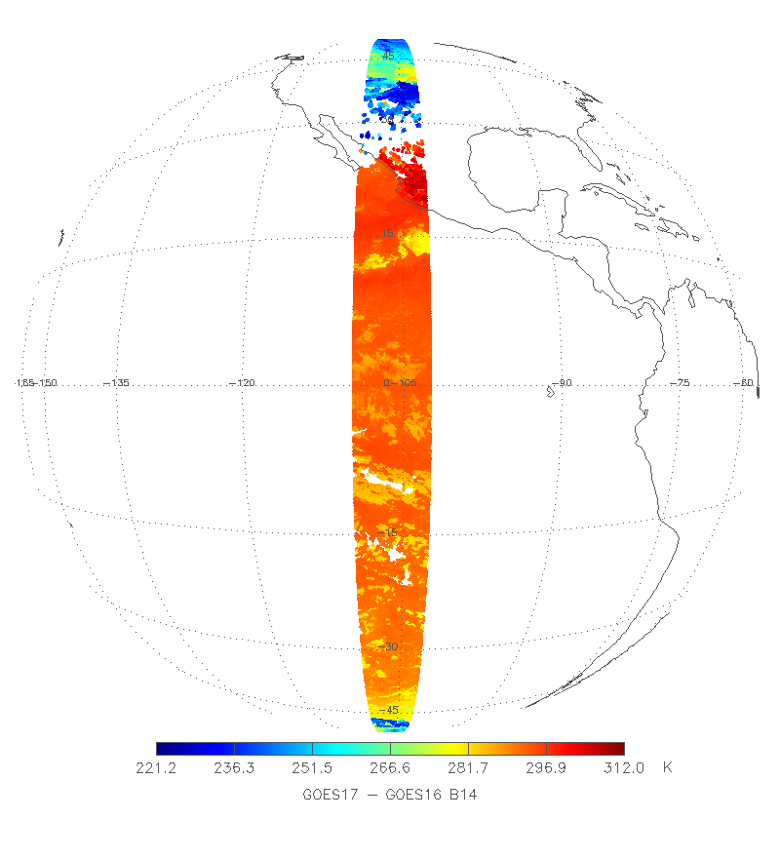
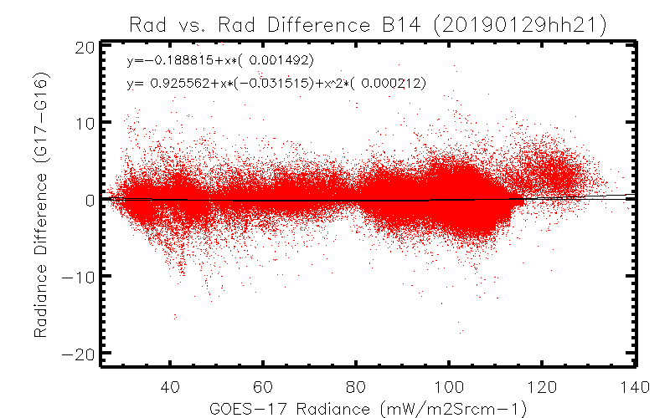
Selection of Collocation Location
Pixel-to-pixel collocation method
Uniformity criteria is applied (CoV < 5%)
Positive bias can be observed at warm scenes at all the window channels
Unlikely due to the calibration anomaly at this swath, based on our knowledge on ABI performance

Slide 18
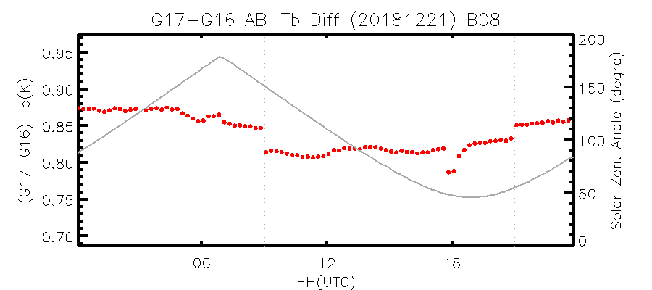
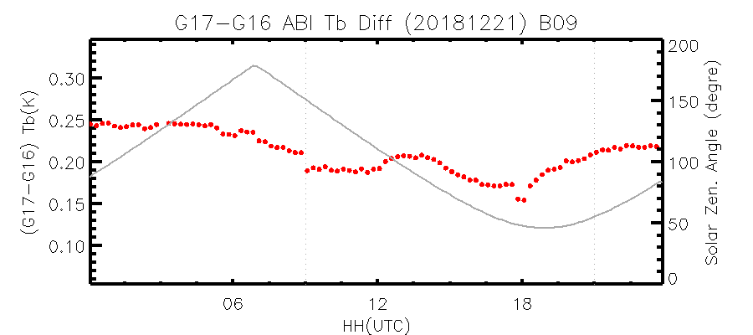
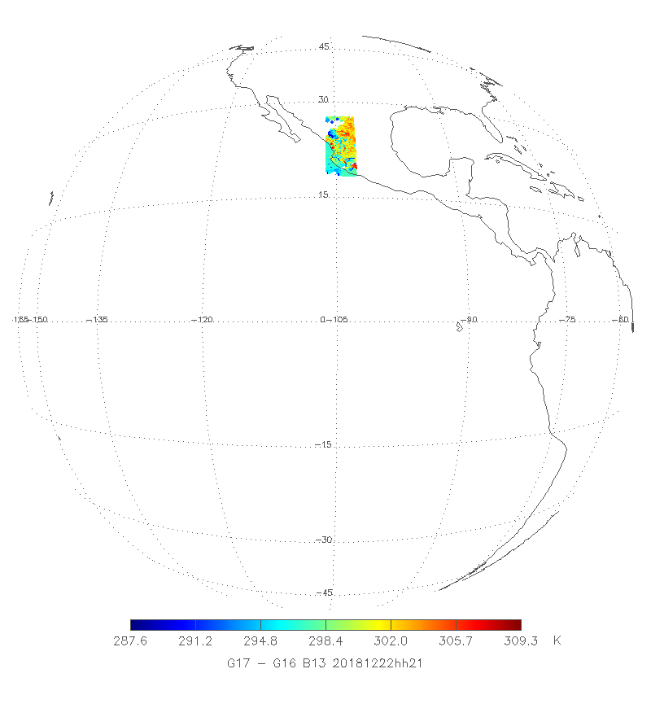
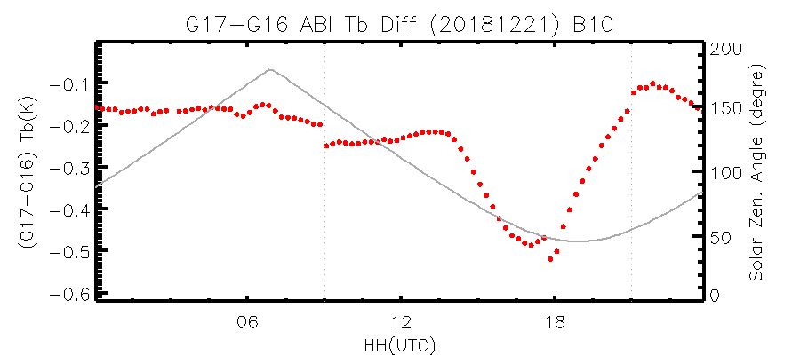
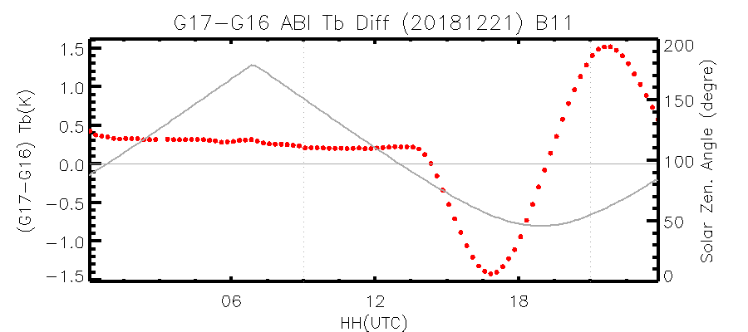
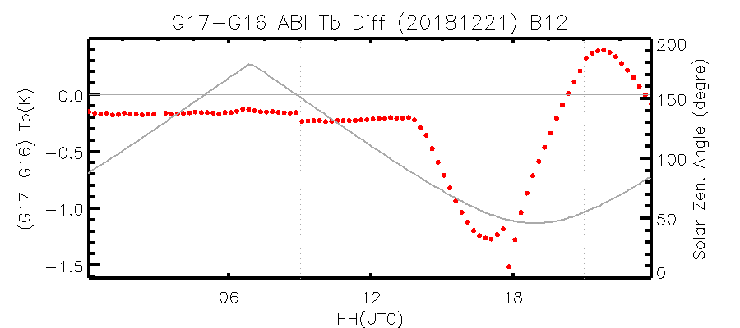
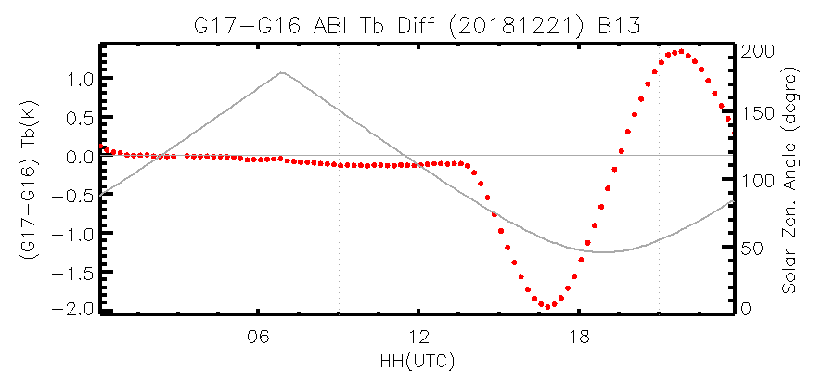
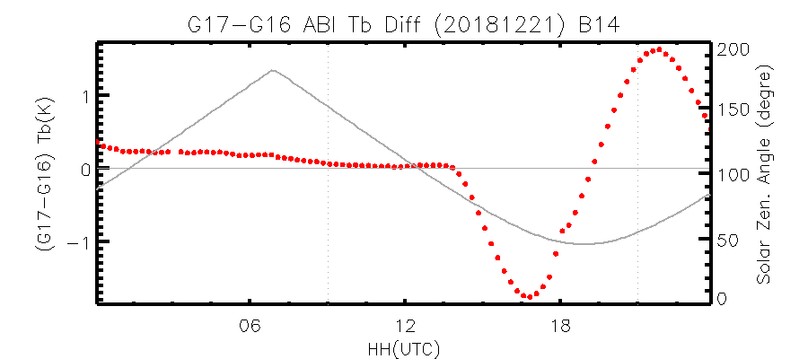
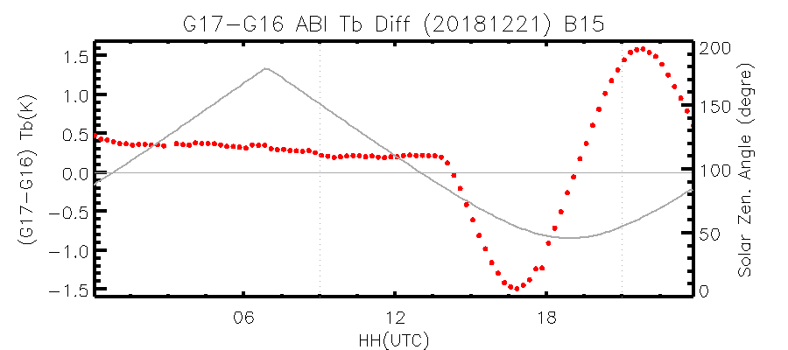
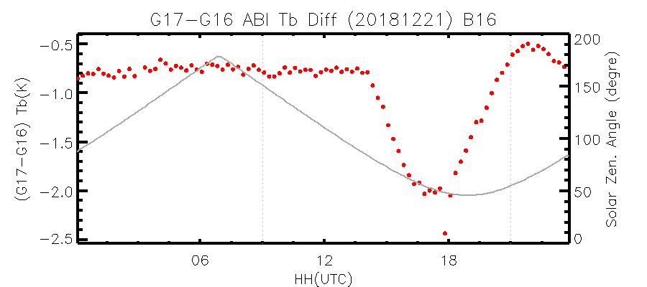
106W-102W, 18N-27N
? Need to check
Tb difference only exists during day-time, for all the window channels + Band 16
Window channels: directional heating phase at the mountain area
How about the daily time variation at B16?

Slide 19
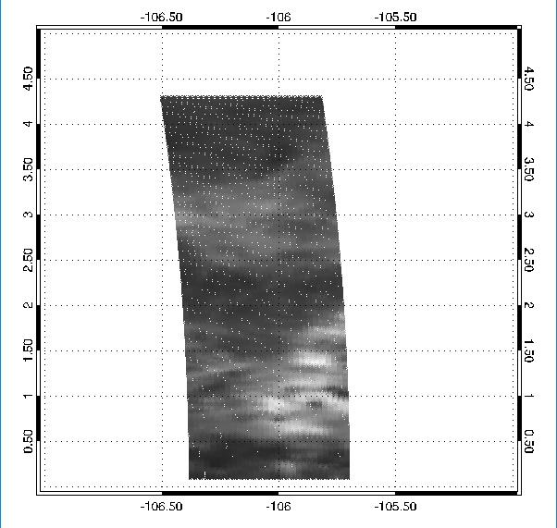
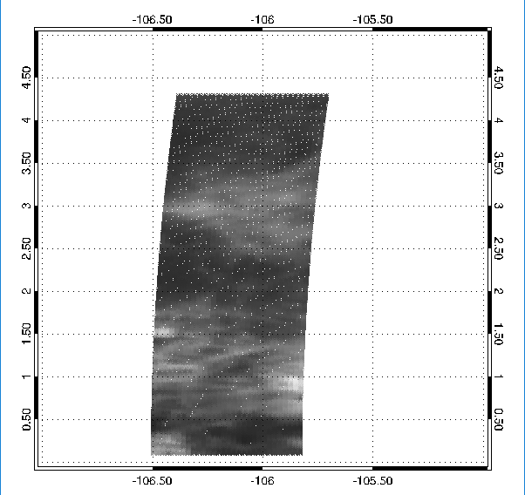
Impact of Parallax - pixel displacement
G16 at 21:00
G17 at 21:00
Clean ocean may be preferred to reduce the parallax impact
Impact may be reduced with uniformity check and statistically sufficient collocated pixels

Slide 20
G16 vs. G17 Inter-Comparison Target
Pixels at the FD swath #11 and/or #12 (near the Equator) will most likely be the candidate collocation target for the G16 vs. G17 inter-comparison
  In the middle of the two satellite sub-satellite points
  Ocean, most time cloud-free. Meanwhile cold scene is also needed to cover as much temperature range as possible
  Sensitivity analysis is still under going

Slide 21
Summary
GEO-GEO inter-comparison is a powerful tool to validate and monitor the instrument performances
Experiences/lessons for the GEO-GEO IR inter-calibration:
Pixel-to-pixel matching method is recommended
Identify the “best” collocation area(s)
  Ocean target may be preferred
  Large dynamic temperature range is needed
  The ocean in the middle of the two satellites will most likely be selected for GOES-16/17.
  Assessment is still undergoing
Assess the impacts of SRF difference on the radiance/Tb bias after the site selections

