Slide 1
Monitoring SLSTR calibration using IASI: status and way forward
A. Burini I. Tomazic T. Hewison

Slide 2
Introduction
Aim
To verify if SLSTR IR is meeting the performance requirements:
The absolute radiometric accuracy for data acquired by the IR channels shall be smaller than 0.2K, traceable to ITS-90.
As a minimum, this requirement shall be met in the blackbody temperature range (~250K - ~300K)
Objectives
To intercompare SLSTR with a stable and characterized reference sensor:
IASI is the GSICS reference sensor due to its stability and characterisation
To follow GSICS methodology (Hewison, 2013)
Based on EUMETSAT study by University of Leicester: Radiometric Intercomparison of AATSR and IASI, 2013, C. Whyte, D. Moore and J. Remedios
Collaboration with FIDUCEO project (H2020), Merchant et al.

Slide 3
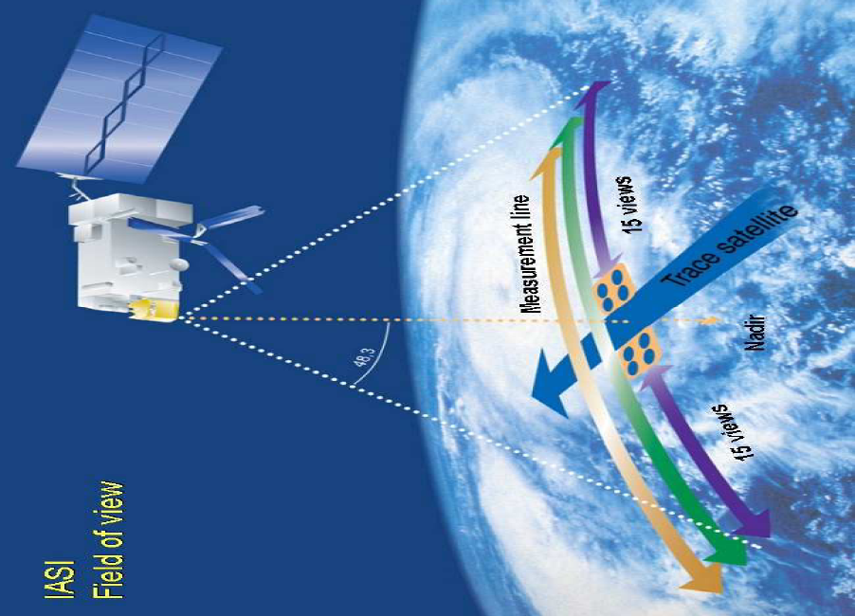
Input Dataset
SLSTR: @Se3-A and Sen3-B: SL_1_RBT___
IASI: @MetopA/B and C
Level 1C
SNOs time range
For atmospheric sounding
Spectral range: 645 to 2760 cm⁻¹ (3.62 to 15.5 microns)
Maximum Optical Path Difference (OPD) : +/- 2 cm
Spatial resolution : pixel diameter of 12 km
Spectral resolution : 0.5 cm⁻¹
Radiometric resolution : 0.2 to 0.4 K
Number of channels: 8700

Slide 4
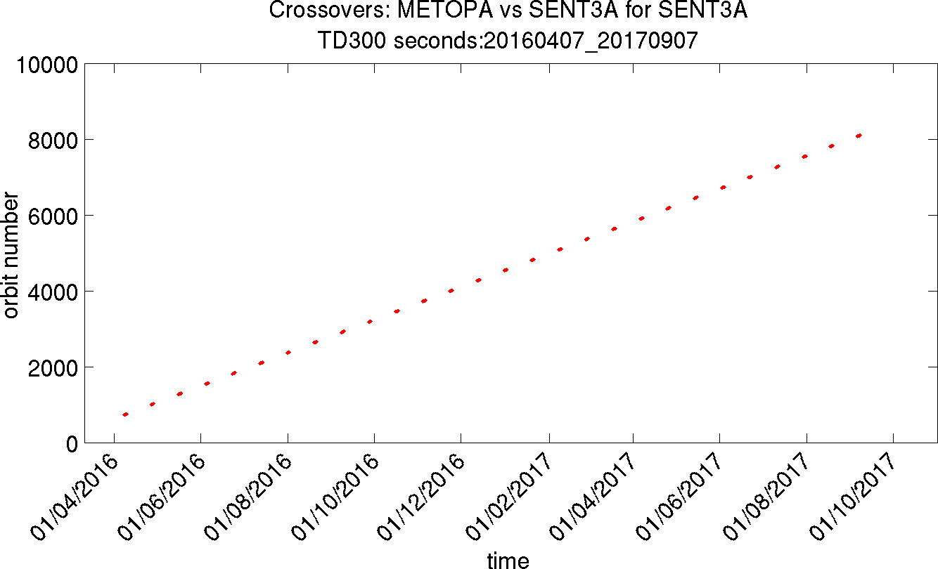
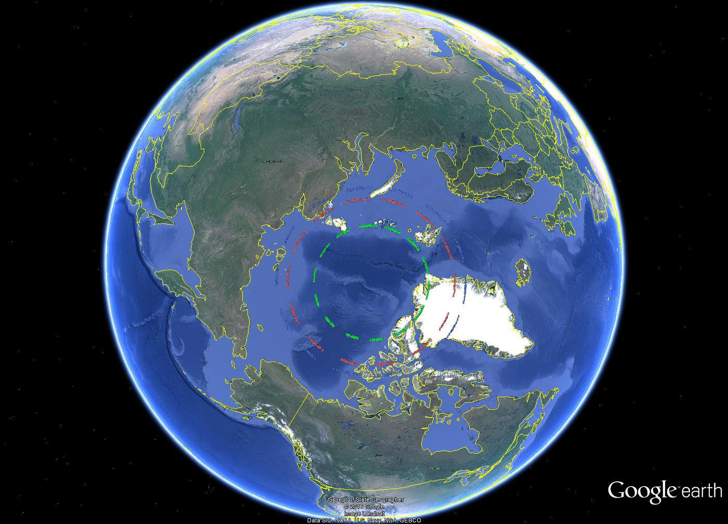
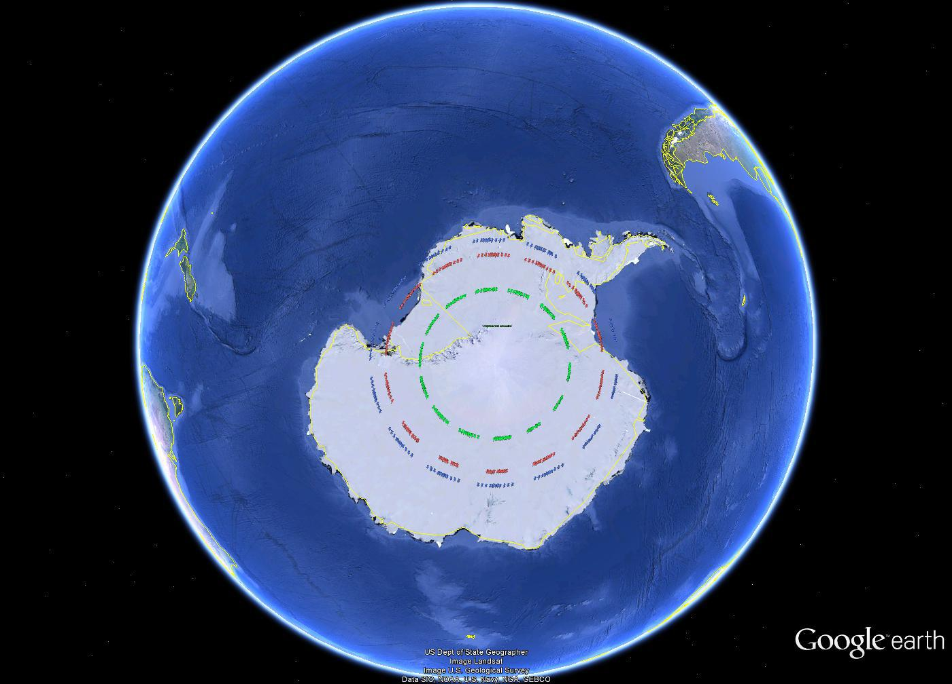
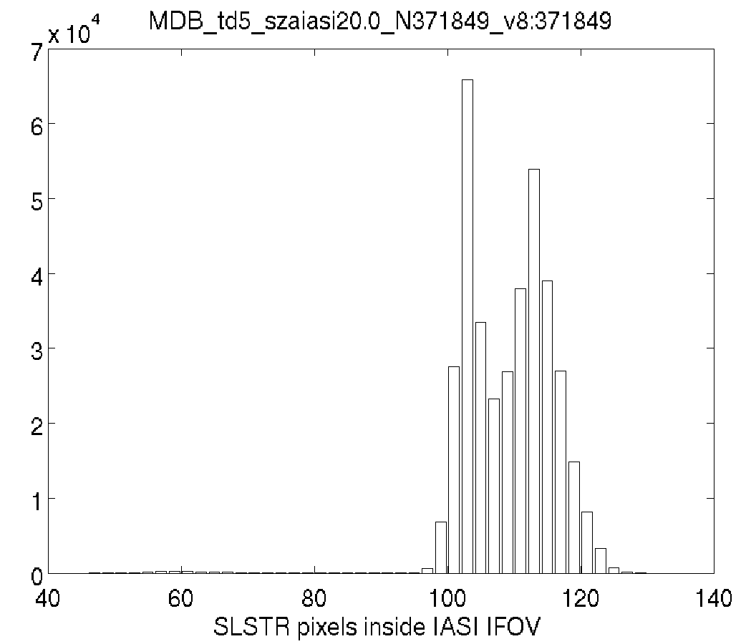
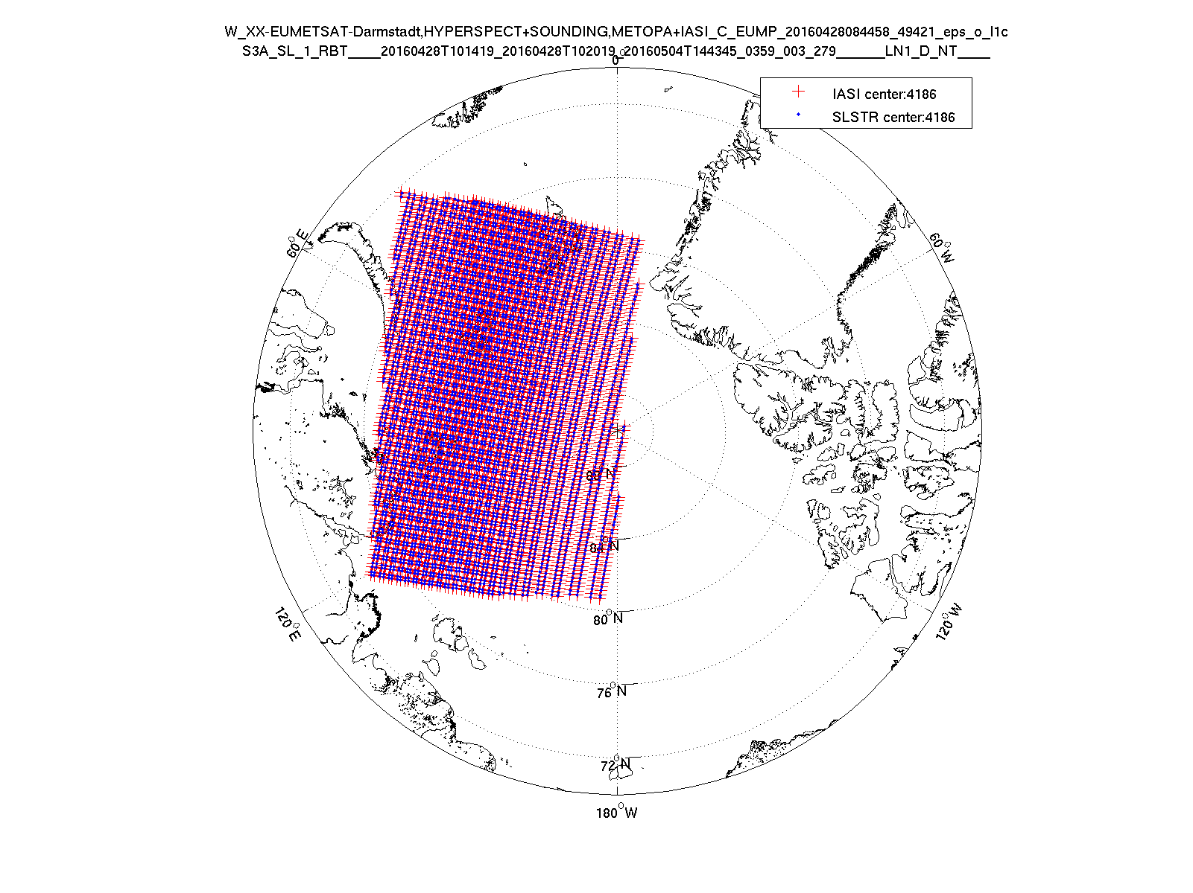
Methodology
Crossovers (SNO)
SNO = simultaneous nadir overpasses
based on orbital model prediction
Each event last ~2 days with ~50 crossovers per SNO
Collocations (matchups)
spatio/temporal/geometry
Time: 5 min pixel time difference
Spatial: within pixel
Viewing angle: |Δsec(ϑ)/sec(ϑ)|<1% or |IASI SZA| < 20°
IASI IFOV estimated as ellipse
Spectral convolution
Convolve IASI radiance spectra with SLSTR SRF
SLSTR SRF v2014
S7 (3.7 µm) requires gap filling approach – incomplete IASI spectral coverage
Aggregate (average)
SLSTR pixels in IASI FoV
Green – true collocation; blue – time of collocation + 3 min; red – time of collocation – 3 min
Limited to pole regions → temperature range ~200 K - 280 K

Slide 5
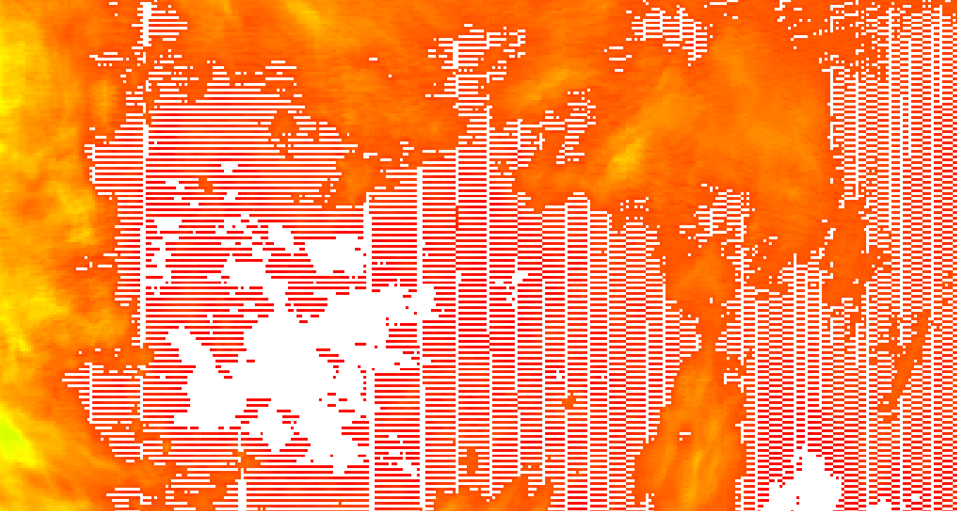
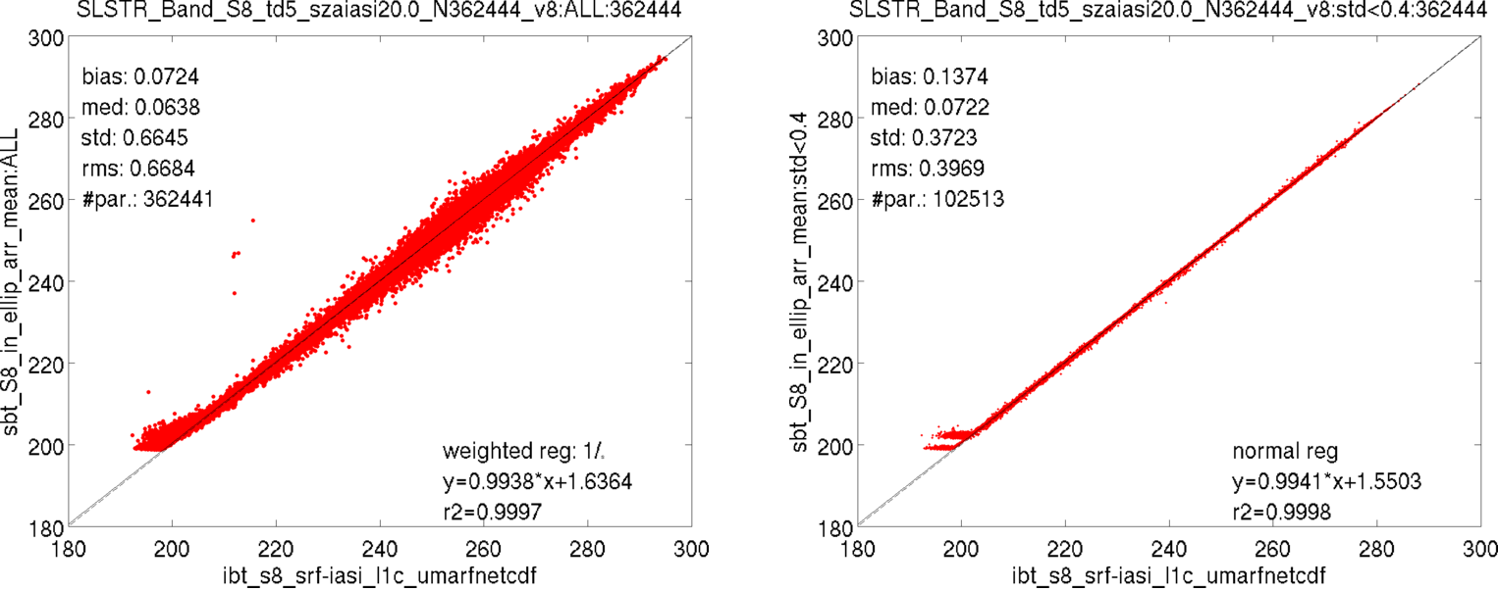
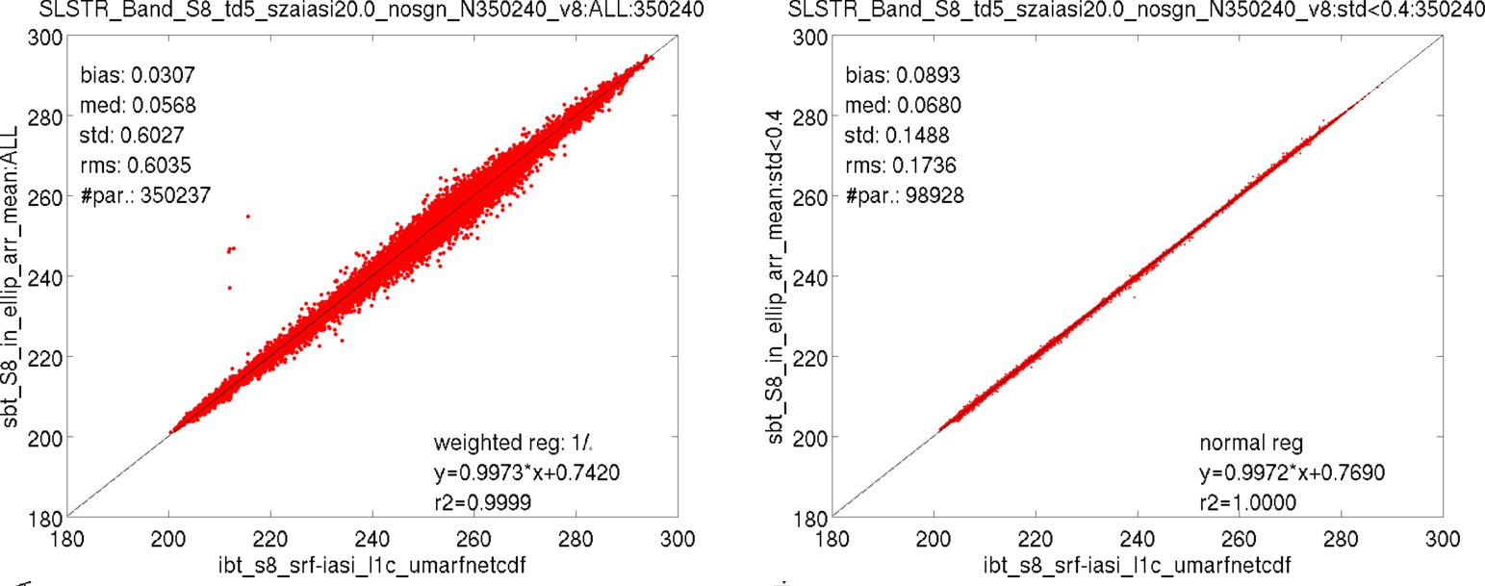
S8 nadir: td5 min; |IASI sza|<20deg:no_signal filtered
Checkerboard pattern around ~200 K related to different response of det0 and det1
Removed all collocations containing SLSTR pixels flagged with no_signal → no tail
ALL
Homogenous: (std<0.4 K within IASI IFOV)

Slide 6
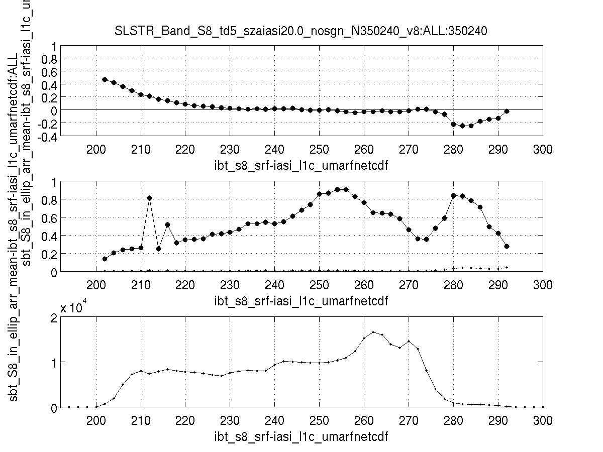
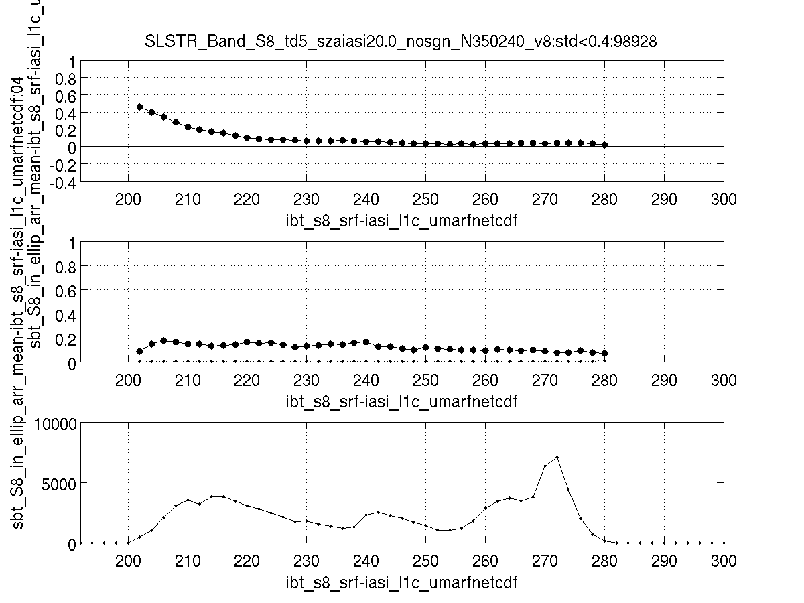
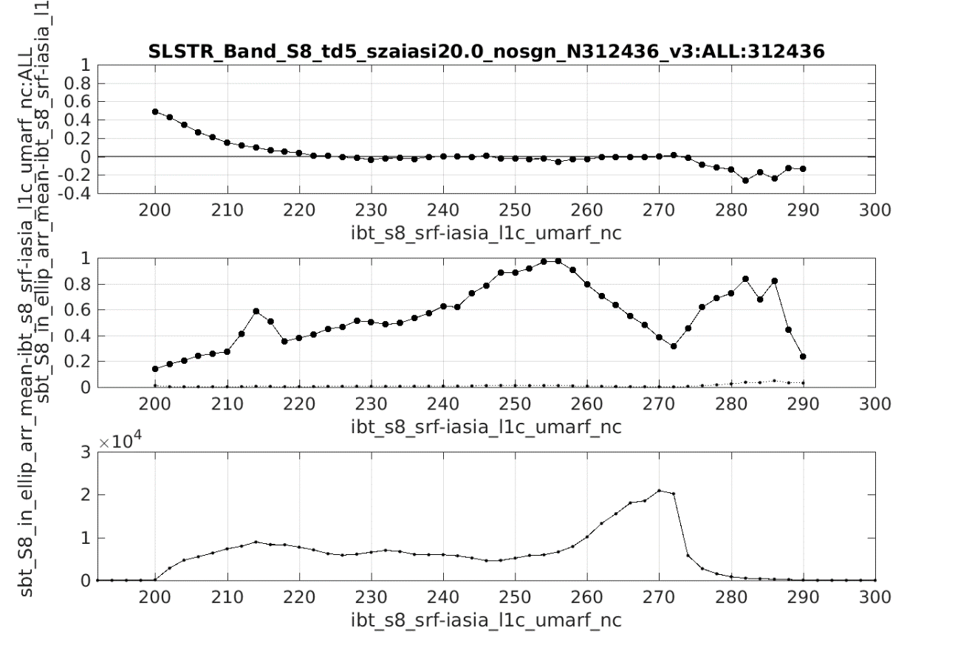
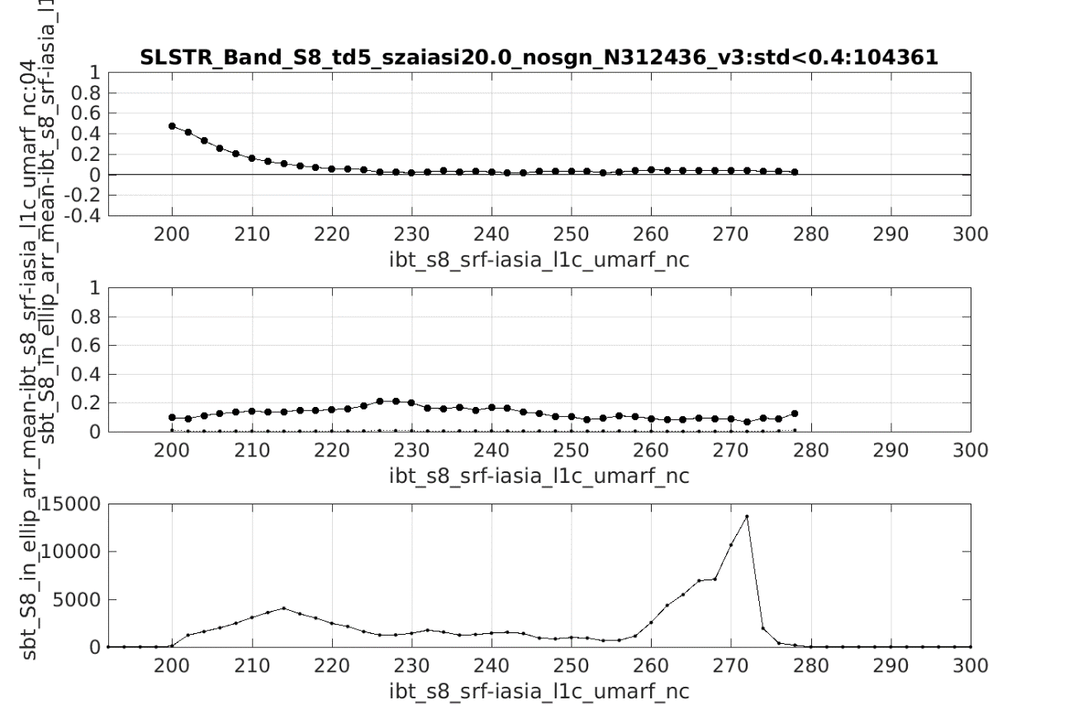
S8 nadir: td5 min; |IASI sza|<20deg:binned: ALL/homo: no_signal filtered
ALL
Homo

Slide 7
S8: td5 min; |IASI sza|<20deg:binned: homo: no_signal filtered: detector0/1
S8: detector 0/1
S9: detector 0/1
Good agreement between detectors, but not the same!
Difference slightly more pronounced for S9
SLSTR - two IR radiometers

Slide 8
Re-engineering of the Prototype Processor
Objective:
To solve the collocation problem in a general and fast way
To create an infrastructure for the operational monitoring of IR sensor with IASI
To extend the collocation criteria outside the polar region
To ready for future missions
To identify and test a “gap filling” method for S7 (outside IASI range)

Slide 9
Processing Schema
Crossover
Based on Orbit Prediction
Identify matched only when there is an orbit intersection
Collocation
Space/temporal/angular based on STAMP (EUM)
Spectral Convolution
Aggregation of SLSTR Pixels in IASI FOV
Generation of potential candidates couple for the analysis
Aggregation
Convolution of IASI radiance spectra with SLSTR SRF
Data Access Interface
Based on database and catalogues
Collocation
Minimization of distortions (raster and/or vector based)
Based on Proj4 + GIS libraries (well tested)
Spectral Convolution
To use the GSICS format for SRF
Identification of matched data outside the polar regions (partial swath overlap, customized time window)
Stand Alone Service
Aggregation
IASI FOV modelling – Generic Modelling of FOV projected on Earth surface
Connection to Database for storing results

Slide 10
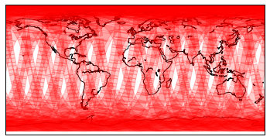
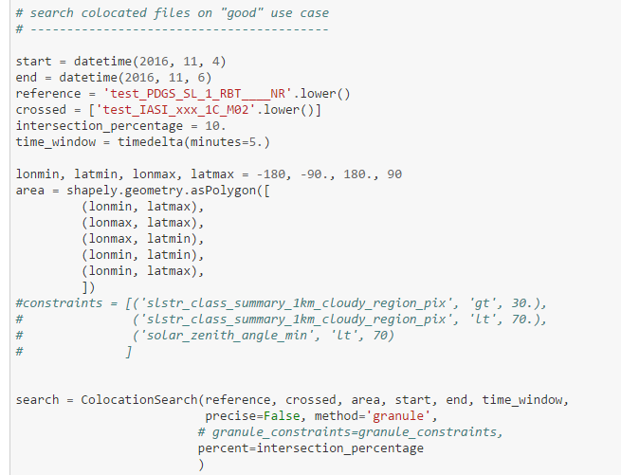
Data Access as a service
Cataloguing of data (testing of ElasticSearch or classical DB solutions)
Daemon tool to perform cross query:
Identification of Potential Candidates
Overlap Criteria can be customized (percentage of overlapping polygons)
Tool Completely de-coupled from the processing:
To speed up the pre-collocation process
It can be re-used for other processes
Cataloguing of the operational data stream is in place as python API.

Slide 11
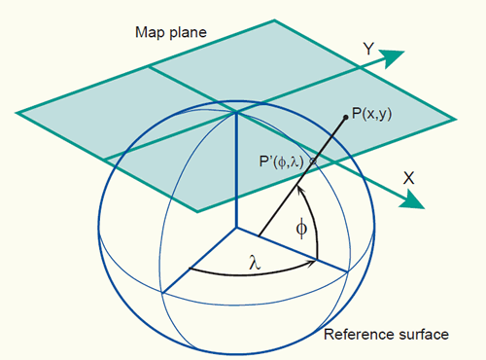
A Generic Collocation Approach
Orthographic projection
To make re-use of well tested and broadly accepted libraries for geographic projection, aiming to minimize the distortion of data
Collocation between sounding sensors and Imaging sensor is then automatically achieved (same reference system) = DATA CUBE
The collocation is done at “granule” level (or at scenario level ) in order to be easily parallelized over several nodes. (it can still be applied in the GEO disk)
Projection in a common reference grid.
Oblique Mercator
Transversal Mercator

Slide 12
Summary
Prototype for monitoring SLSTR calibration with IASI as reference has been developed. Thanks to it the following considerations can be made:
Stable calibration within requirements (220-280 K)
Near zero nadir view bias (<0.1 K) in S8 and S9 (220 K – 280 K)
Oblique view looks ok – to be confirmed with QSNO
Cold temperature bias (~>0.2 K)
Nonlinearity? - BB 250-300 (also observed with the “Tandem” analysis)
S8 cold temp. calibration issue ~200 K (dynamic range, “no_signal”)
Small difference in dynamic range for two detectors (will be lowered to ~183 K)
Different detectors response:
S8 – OK, S9 small offset between detectors (~0.08 K)
SLSTR IR → 2 radiometers
Preparation for a more generic software suite and generic functions has started. Planned to be concluded in few months.

