Slide 1
S3 SLSTR TIR Calibration
Dave Smith – SLSTR Calibration Scientist
Ed Polehampton, Mireya Etxaluze
RAL Space, Science and Technologies Facilities Council, United Kingdom

Slide 2
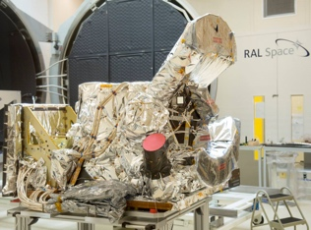
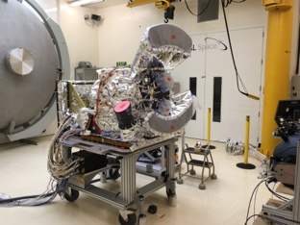
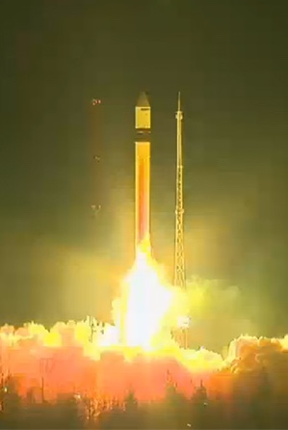
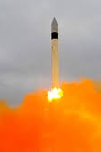
Sea and Land Surface Temperature Radiometer (SLSTR)
2016 – Sentinel 3A
2018 – Sentinel 3B
2021 – Sentinel 3C
  Spectral Calibration in progress
  Instrument Calibration Spring 2019
2023 – Sentinel-3D
…
Launched 16-Feb-2016 ☺
Launched 25-Apr-2018 ☺

Slide 3
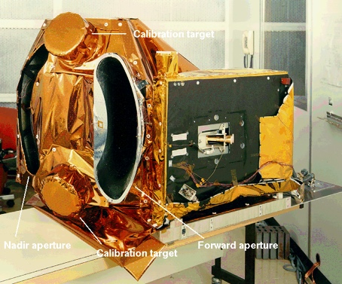
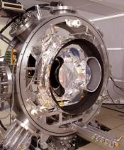
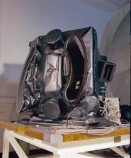
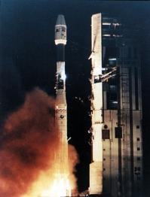
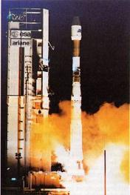
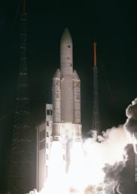
ATSR Series
1991-2000 ATSR-1
1995-2008 ATSR-2
2002-2012- AATSR

Slide 4

SLSTR instrument
Nadir swath >74° (1400km swath)
Dual view swath 49° (750 km)
Two telescopes Φ110 mm / 800mm focal length
Spectral bands TIR : 3.74µm, 10.85µm, 12µm
SWIR : 1.38µm, 1.61µm, 2.25 µm
VIS: 555nm, 659nm, 859nm
Spatial Resolution 1km at nadir for TIR, 0.5km for VIS/SWIR
Radiometric quality NEΔT 30 mK (LWIR) – 50mK (MWIR)
SNR 20 for VIS - SWIR
Radiometric accuracy 0.2K for IR channels
2% for Solar channels relative to Sun

Slide 5
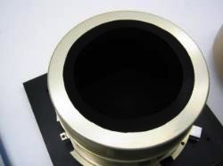
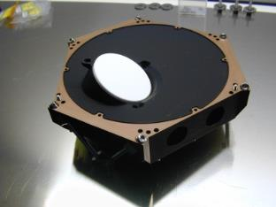
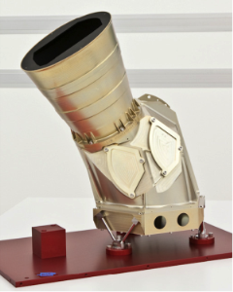
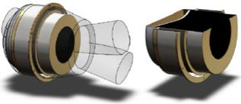
On-Board Calibration systems
Thermal InfraRed
Blackbodies
VIS-SWIR Channels
VISCAL
Effective e >0.998
T non-uniformity < 0.02 K
T Abs. Accuracy 0.07 K
T stability < 0.3 mK/s
8 PRT sensors + 32 Thermistors
Zenith diffuser + relay mirrors
Uncertainty <2%

Slide 6

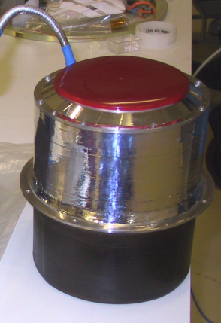
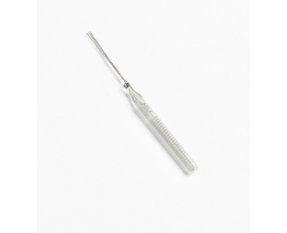
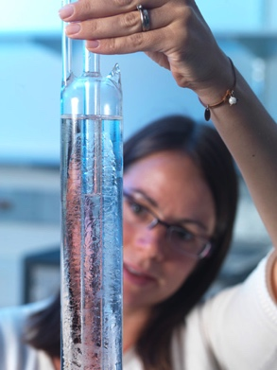
The Goal
To ensure the interoperability of satellite datasets it is a requirement for their measurements to be calibrated against standards that are traceable to SI units
For temperature this is the International Temperature Scale of 1990
For IR instruments such as SLSTR the traceability is achieved via internal BB sources
Instrument
Blackbody Source
S-PRT
Fixed Point Cells

Slide 7
SLSTR L1 Processing
Processing specification defined by
  ATBD -> DPM
  L0 and L1 Product Specifications
Each spectral band (5 thermal bands) and detector element (2x2) for each for each earth view (separate for nadir and oblique) has unique set of calibration calibration coefficients
  = 40 for IR channels alone
Contained in Satellite Characterisation and Calibration Database Document (S-CCDB)
  Configuration controlled by MPC

Slide 8
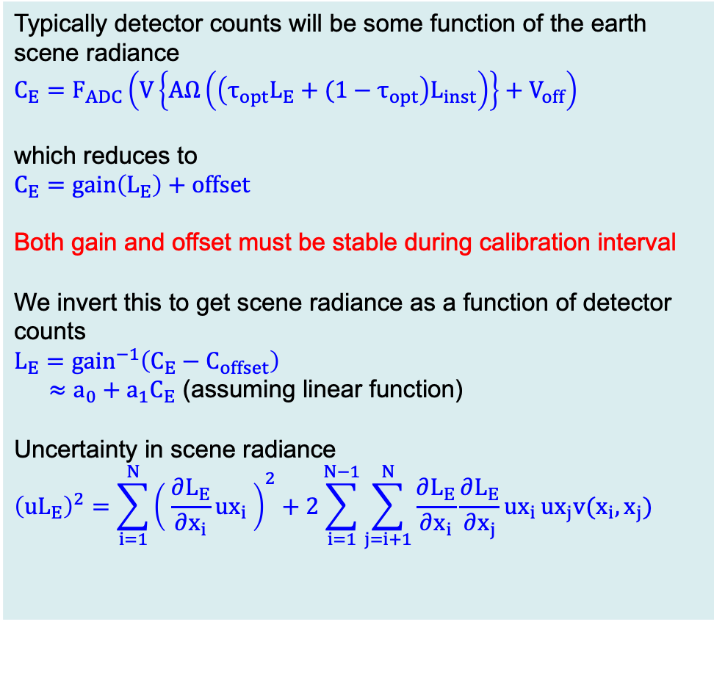
Calibration Model
Typically detector counts will be some function of the earth scene radiance
$$C_{E}=F_{ADC}\left(V\left\{AΩ\left(\left(τ_{opt}L_{E}+(1−τ_{opt}\right)L_{inst}\right)\right\}+V_{off}\right)$$
which reduces to
$C_{E}=gain\left(L_{E}\right)+offset$
Both gain and offset must be stable during calibration interval
We invert this to get scene radiance as a function of detector counts
$$L_{E}={gain}^{−1}\left(C_{E}−C_{offset}\right)$$
$≈a_{0}+a_{1}C_{E}$ (assuming linear function)
Uncertainty in scene radiance
$${\left(uL_{E}\right)}^{2}=\sum_{i=1}^{N}{{\left( \frac{∂L_{E}}{∂x_{i}}ux_{i} \right)}^{2}}+2\sum_{i=1}^{N−1}{\sum_{j=i+1}^{N}{\frac{∂L_{E}}{∂x_{i}}\frac{∂L_{E}}{∂x_{j}}ux_{i}}}ux_{j}v(x_{i},x_{j})$$
We obtain calibration coefficients via reference to known calibration sources

Slide 9
SLSTR TIR Calibration Effects Tree

Slide 10
Primary Sources of Uncertainty in TIR calibration
Black-Body Temperatures
  PRT calibration at subsystem level – traced to SPRT (ITS-90) – NPL/NIST
  Blackbody gradients, thermal analysis - RAL
Black-Body Cavity Emissivity
  Spectral Reflectance of Black Coating – NIST/NPL
  Cavity Model – STEEP323 or SMART3D (ABSL model)
Spectral Response
  FPA measurements – RAL reports [S3-RP-RAL-SL-102 (S3A), S3-RP-RAL-SL-114 (S3B)]
Non-Linearity
  Instrument level calibration tests – RAL reports
Detector Noise
  Instrument level calibration tests, on-board BB sources

Slide 11
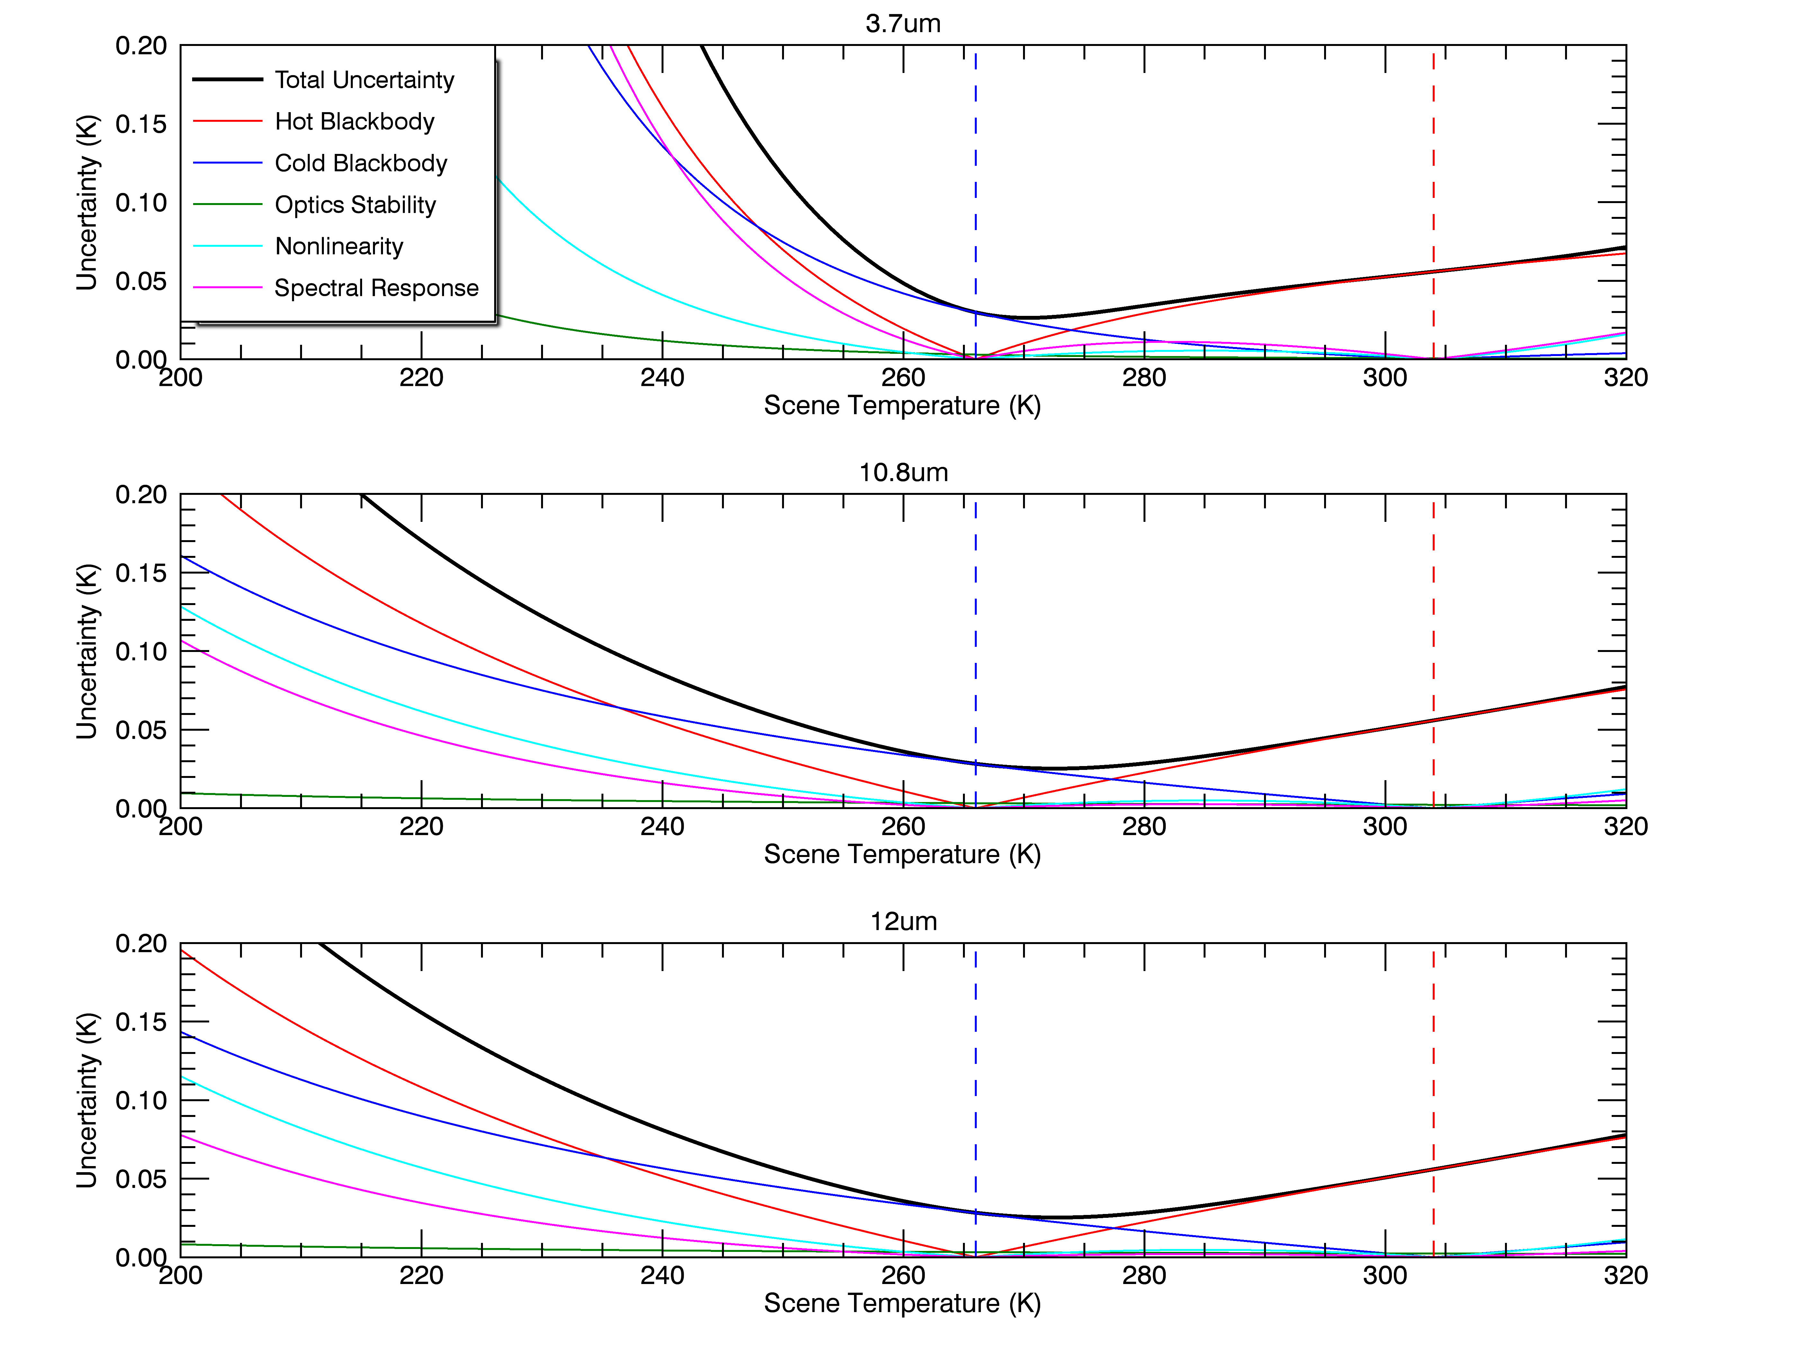
S3B TIR Uncertainty Budget – Jun-2018
Uncertainties vs. Temperature from pre-launch are included in L1 products

Slide 12
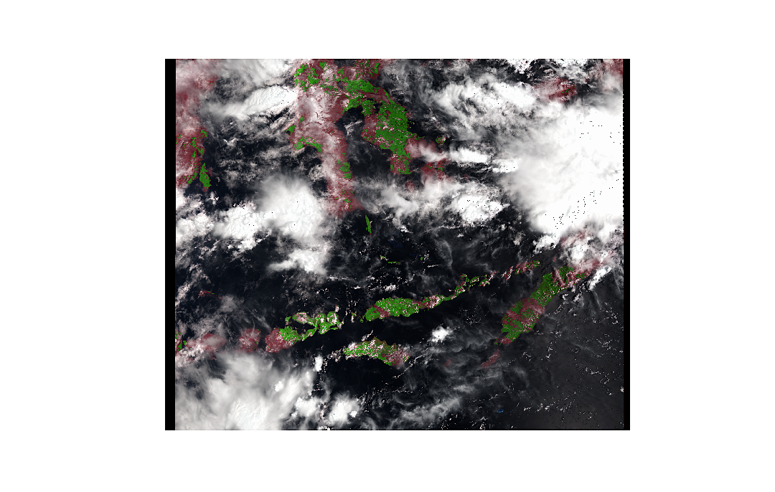
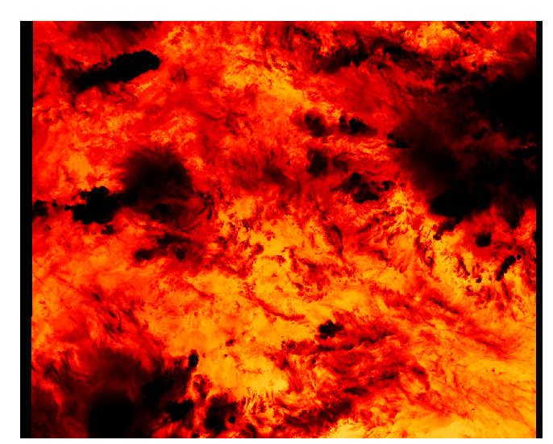
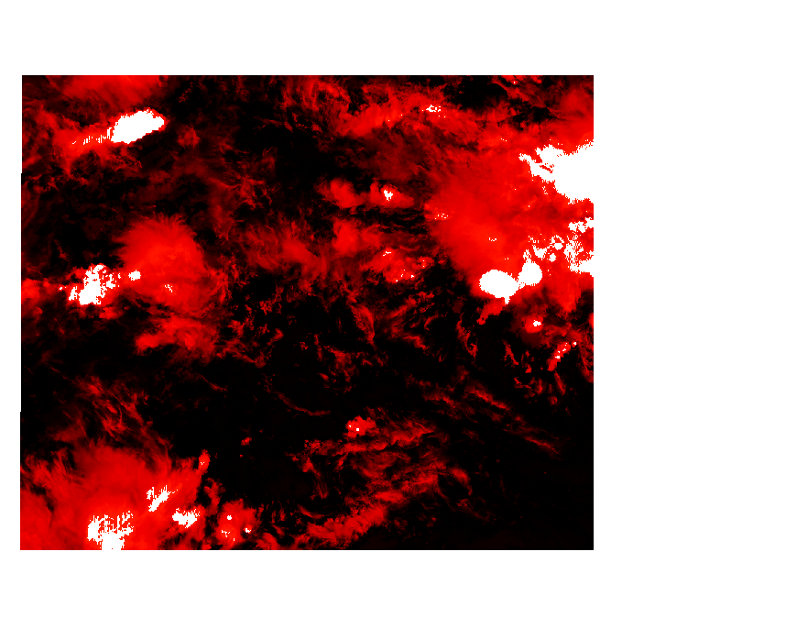
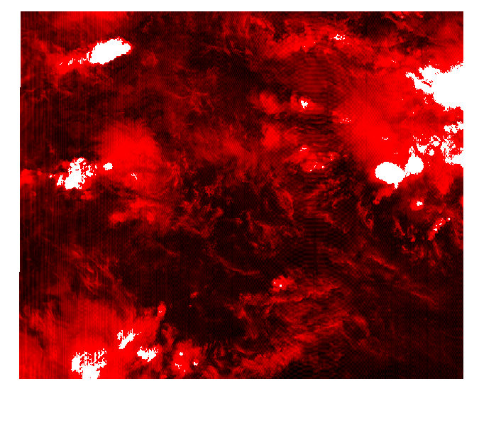
Uncertainties in L1 products
RGB False Colour
S8 BT
L1 Products contain information to generate per pixel uncertainty estimates
Noise estimates (random) from on-board sources
Uncertainty in calibrated (correlated) is derived from pre-launch calibration
User tool under development by RAL to generate uncertainty ‘images’
S8 NEDT
(Random Effects)
S8 Calibration Uncertainty (Correlated Effects)
S3A_SL_1_RBT____20171129T014030_20171129T014330_20171129T032538_0179_025_074_3059_SVL_O_NR_002.SEN3

Slide 13
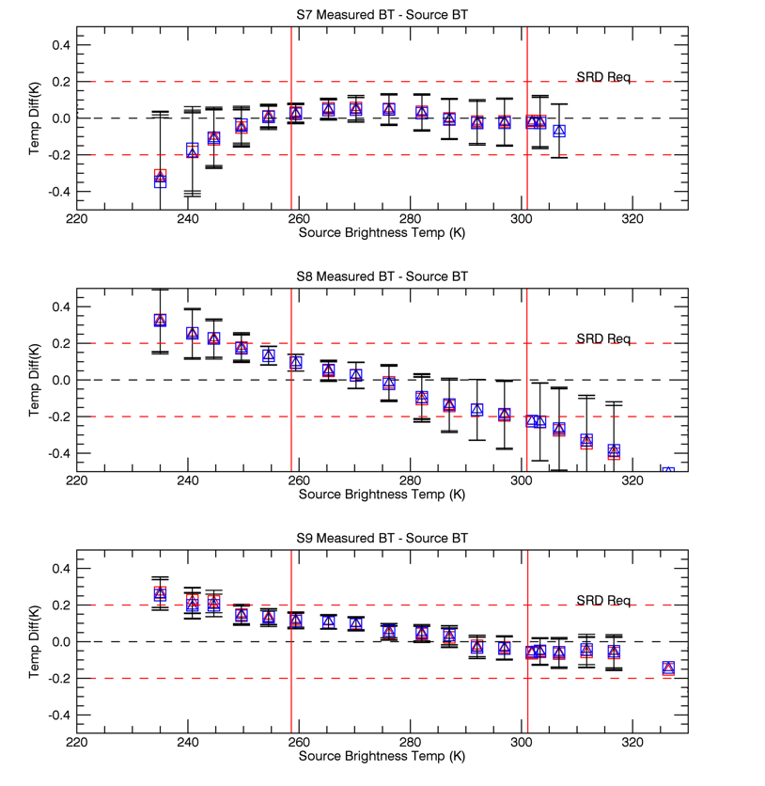
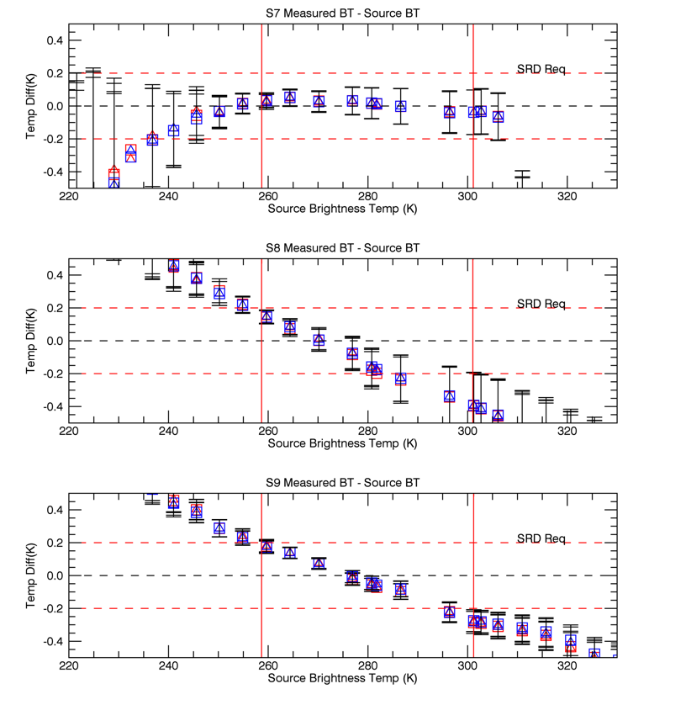
Pre-Launch Calibration - SLSTR-A
Nadir View
Oblique View
Plots show the differences between the BT measured by SLSTR and the BT derived from the BB thermometry
Uncertainties are combined uncertainty estimates – k=1
Only S7-S9 shown for clarity

Slide 14
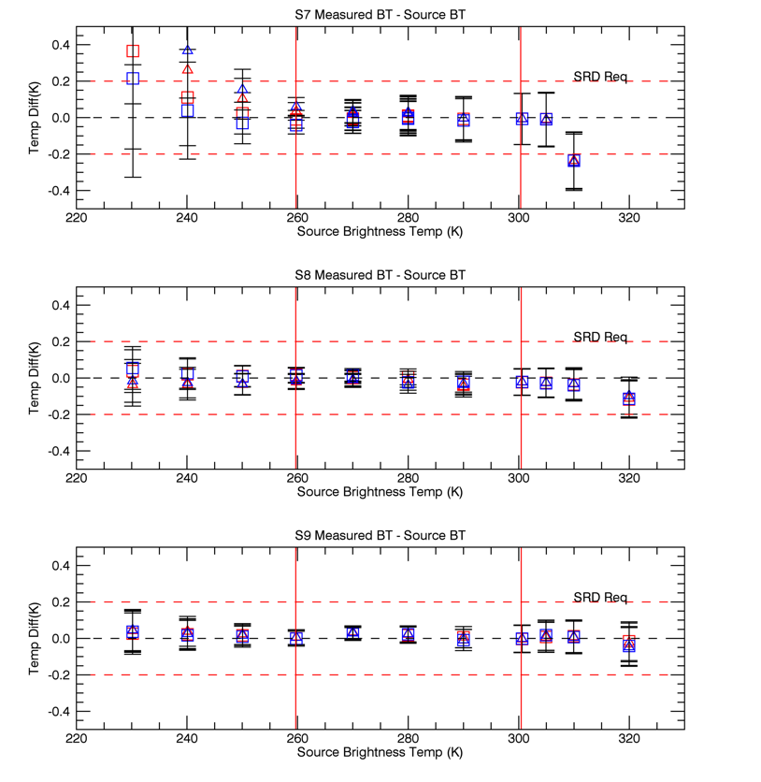
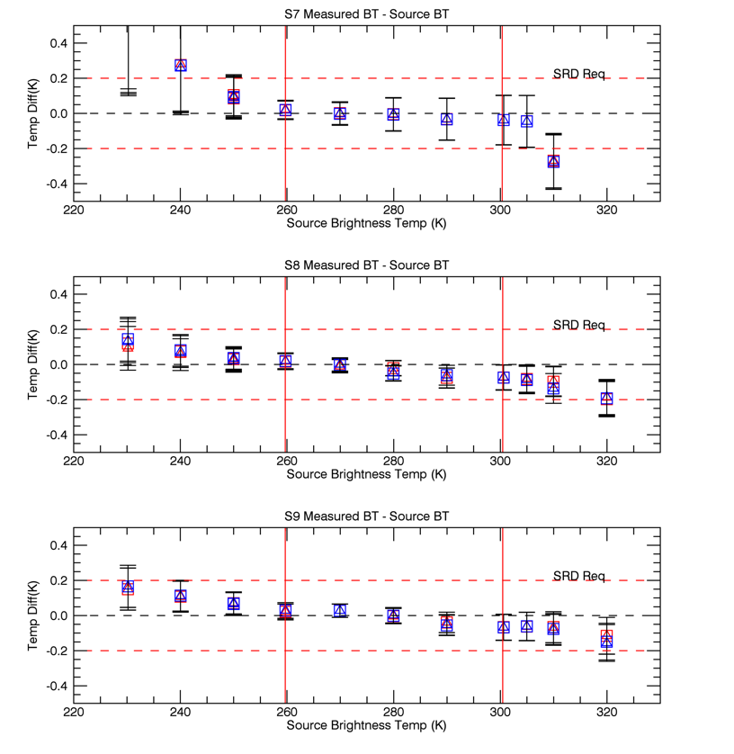
Pre-Launch Calibration - SLSTR-B
Plots show the differences between the BT measured by SLSTR and the BT derived from the BB thermometry
Uncertainties are combined uncertainty estimates – k=1
Only S7-S9 shown for clarity
Nadir View
Oblique View

Slide 15
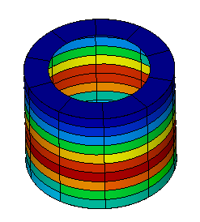
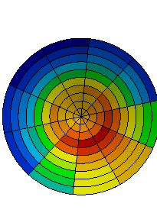
Why the differences?
Non-Blackness of optical stops (i.e. ɛ < 0.9) causing non-uniform thermal background
Measurements by PTB confirm issue with black coatings
Hence modification to stop coatings
Temperature gradients in flight BBs
Thermal modelling shows asymmetry of baseplate temperatures
Analysis using monte-carlo model (STEEP-323) suggests that non-uniformity does not affect BB radiances

Slide 16
Post Launch Calibration – The Challenge
Field radiometers validate the L2 product (SST, LST)
  Dominated by uncertainties in atmospheric correction, surface emissivity, temporal effects, retrieval algorithm
There are no stable reference sites!
  TIR radiances are influenced by temperature which does vary over short time scales
  Atmosphere contributes to the measured radiances – strong spectral sensitivity – even in window bands
Post Launch Calibration is therefore limited to:
  Monitoring of instrument temperatures – in particular detectors, optics,
    BB-sources since these contribute to the uncertainty budget.
  Comparisons with other sensors – i.e. IASI
    Limited to SNOs
  Tandem phase analysis

Slide 17
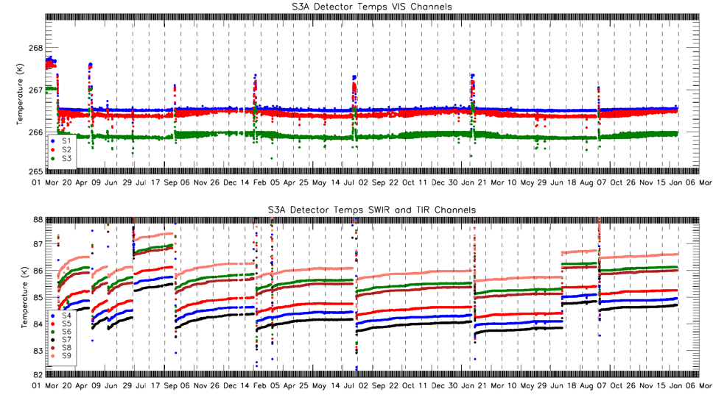
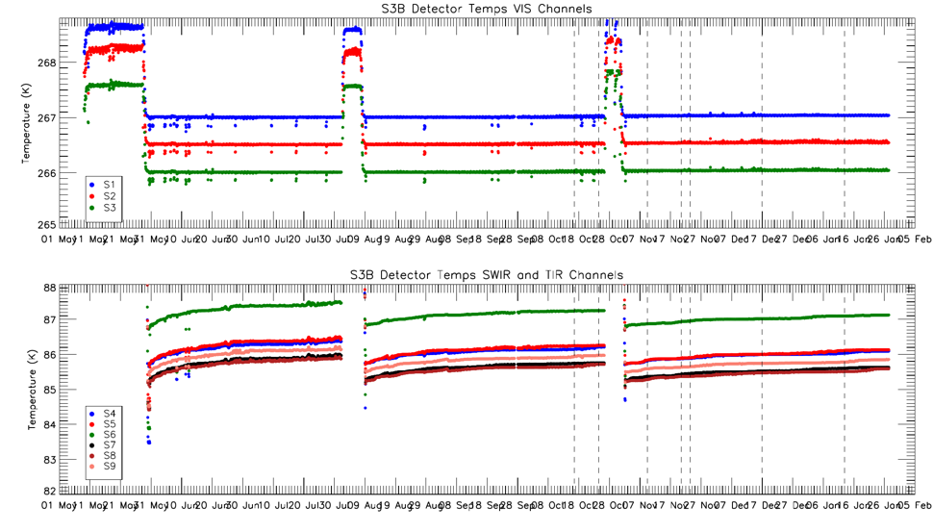
Detector Temperatures
SLSTR-A
VIS Detectors
IR detector temperatures maintained between 84 K and 87 K
Periodic de-contamination is needed to remove water ice from cold surfaces
SLSTR-A FPA Cooler set-point increased by 1K in July to increase running time between decontaminations
IR Detectors
SLSTR-B
VIS Detectors
IR Detectors

Slide 18
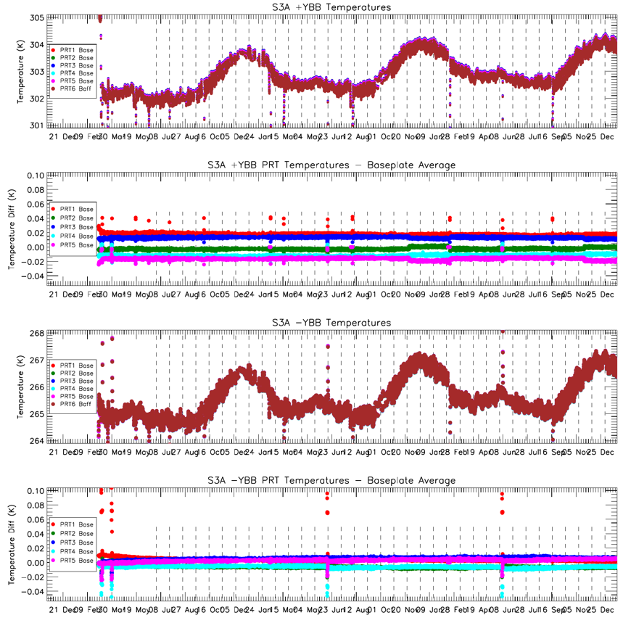
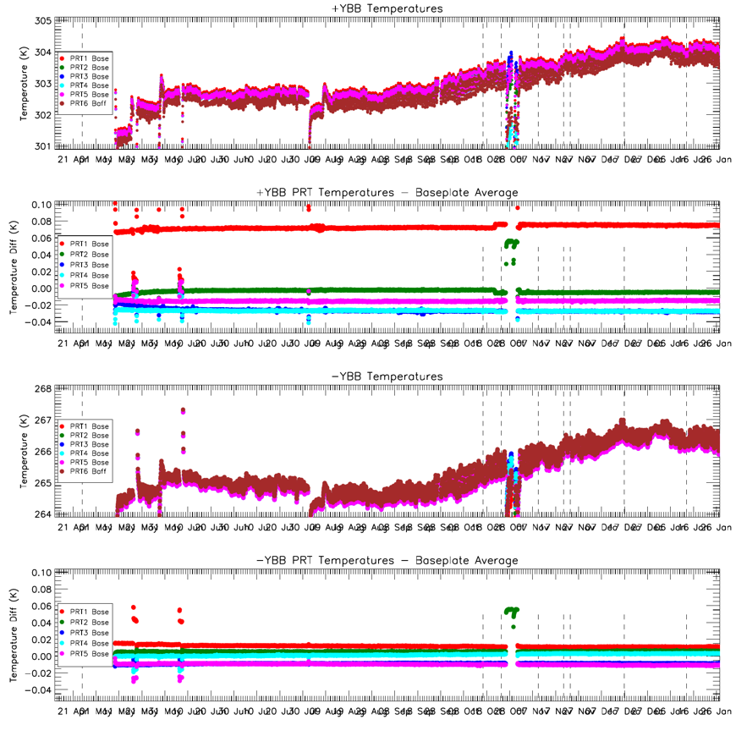
Black-Body Performance
SLSTR-A
SLSTR-B
+YBB
-YBB
Blackbody temperatures have a seasonal cycle on top of the daily/orbital temperature cycles. Heated BB remains below 305K limit necessary for S7 calibration.
Temperature gradients consistent with pre-launch values for SLSTR-A and B
Note higher gradient in heated BB for SLSTR-A

Slide 19
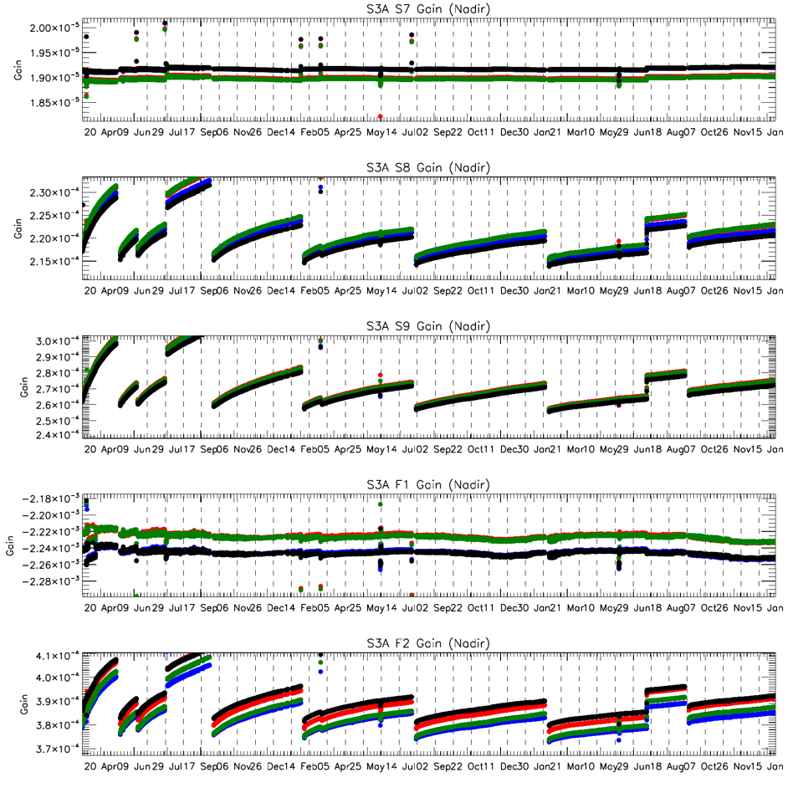
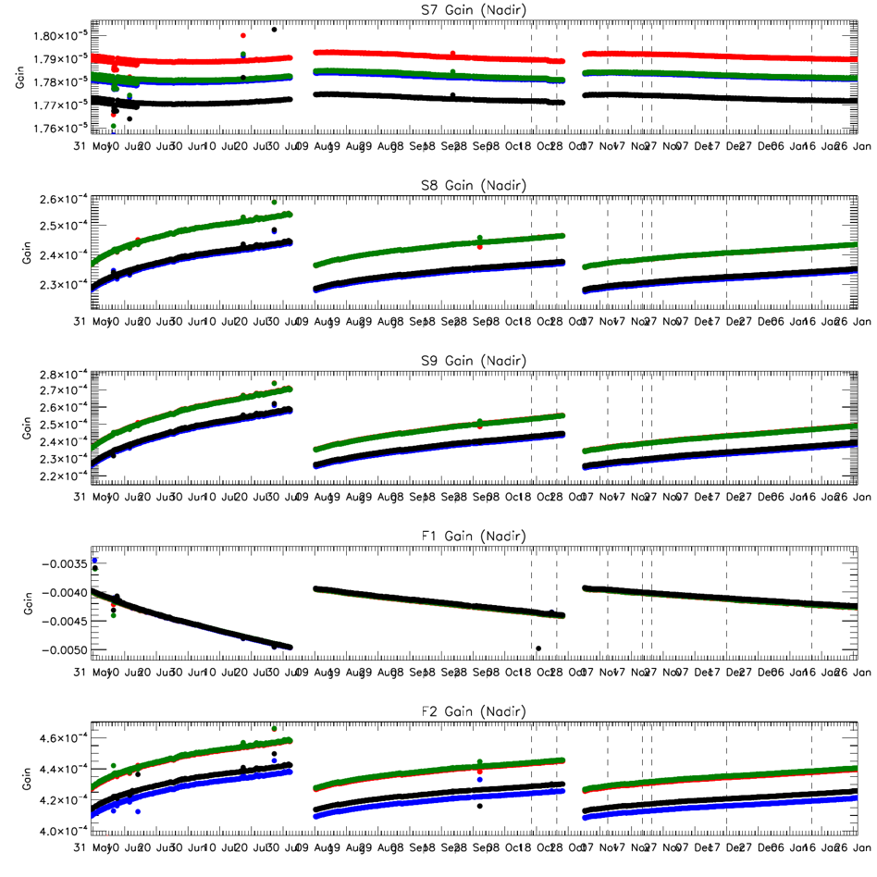
IR Channels Gains
SLSTR-A
SLSTR-B
S7
S8
S9
F1
F2
All detectors are performing as at launch within expected ranges
Gains and offsets show slow drift with detector temperature as expected.

Slide 20
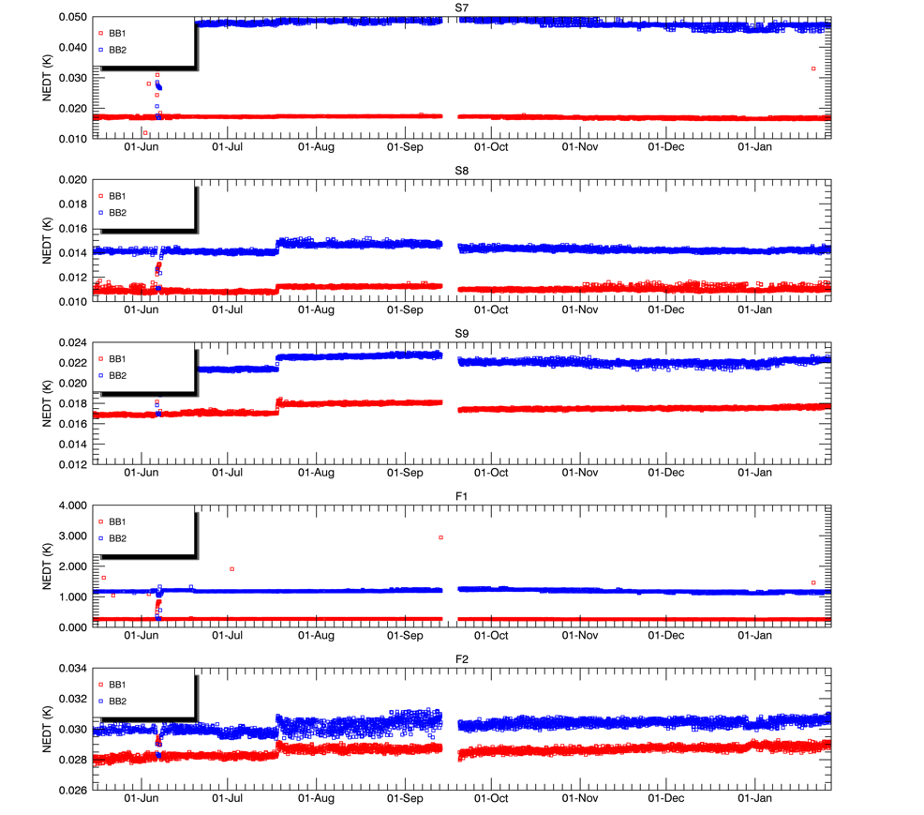
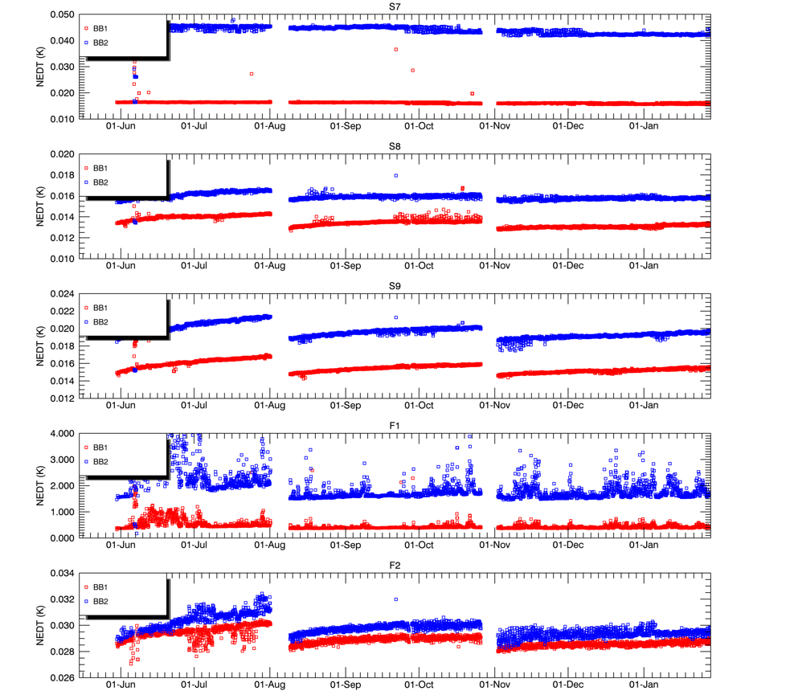
IR Channels Noise
SLSTR-A
SLSTR-B
S7
S8
S9
F1
F2
Radiometric noise levels for the TIR channels have remained stable throughout at pre-launch values.
NEDT for the S8 and S9 channels are below 20mK with no indication of degradation.
S3B F1 shows periodic increases in noise – possibly due to motional chopping

Slide 21
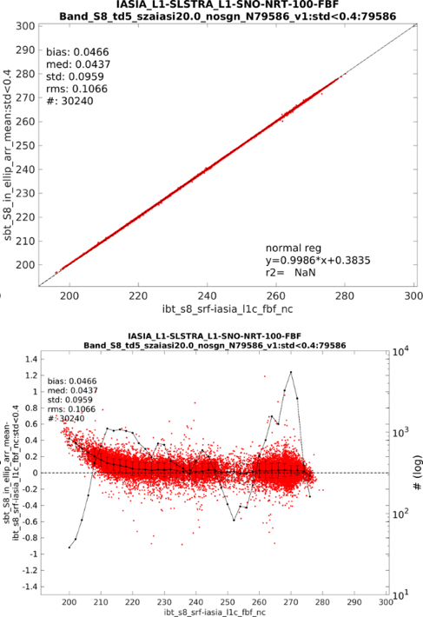
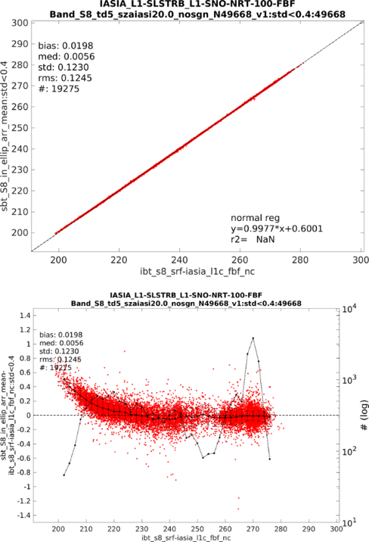
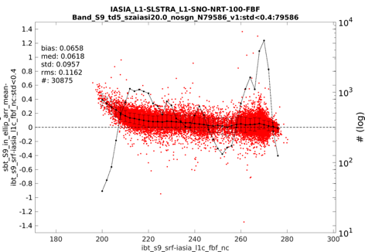
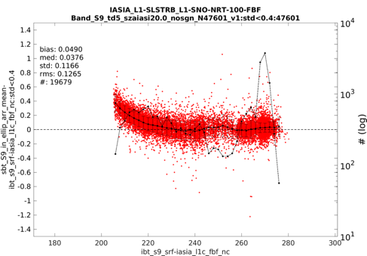
IASI-SLSTR Co-Locations from Eumetsat
SLSTR-A/B vs IASI-A
Simultaneous Nadir Observations (SNO) performed by Eumetsat following GSICS methodology based on the approach developed for AATSR/IASI comparisons.
  IASI data are spectrally averaged over SLSTR bands
  SLSTR data are spatially aggregated over IASI footprint
Results shown for SNO event (20-22.06.2018) during the S3 tandem phase
Analysis for both S3A and S3B are performed separately for the two detectors of the two nadir view channels S8 and S9
Comparisons are shown for homogenous scenes (∆T <0.1K)
SLSTR-A vs IASI-A
SLSTR-B vs IASI-A
ALL SNO events
SLSTR-A vs IASI-A
Nadir: 10.8 µm (S8)
SLSTR-B vs IASI-A
Nadir: 10.8 µm (S8)
SLSTR-A vs IASI-A
Nadir: 12 µm (S9)
SLSTR-B vs IASI-A
Nadir: 12 µm (S9)
Courtesy I.Tomazic (Eumetsat)

Slide 22
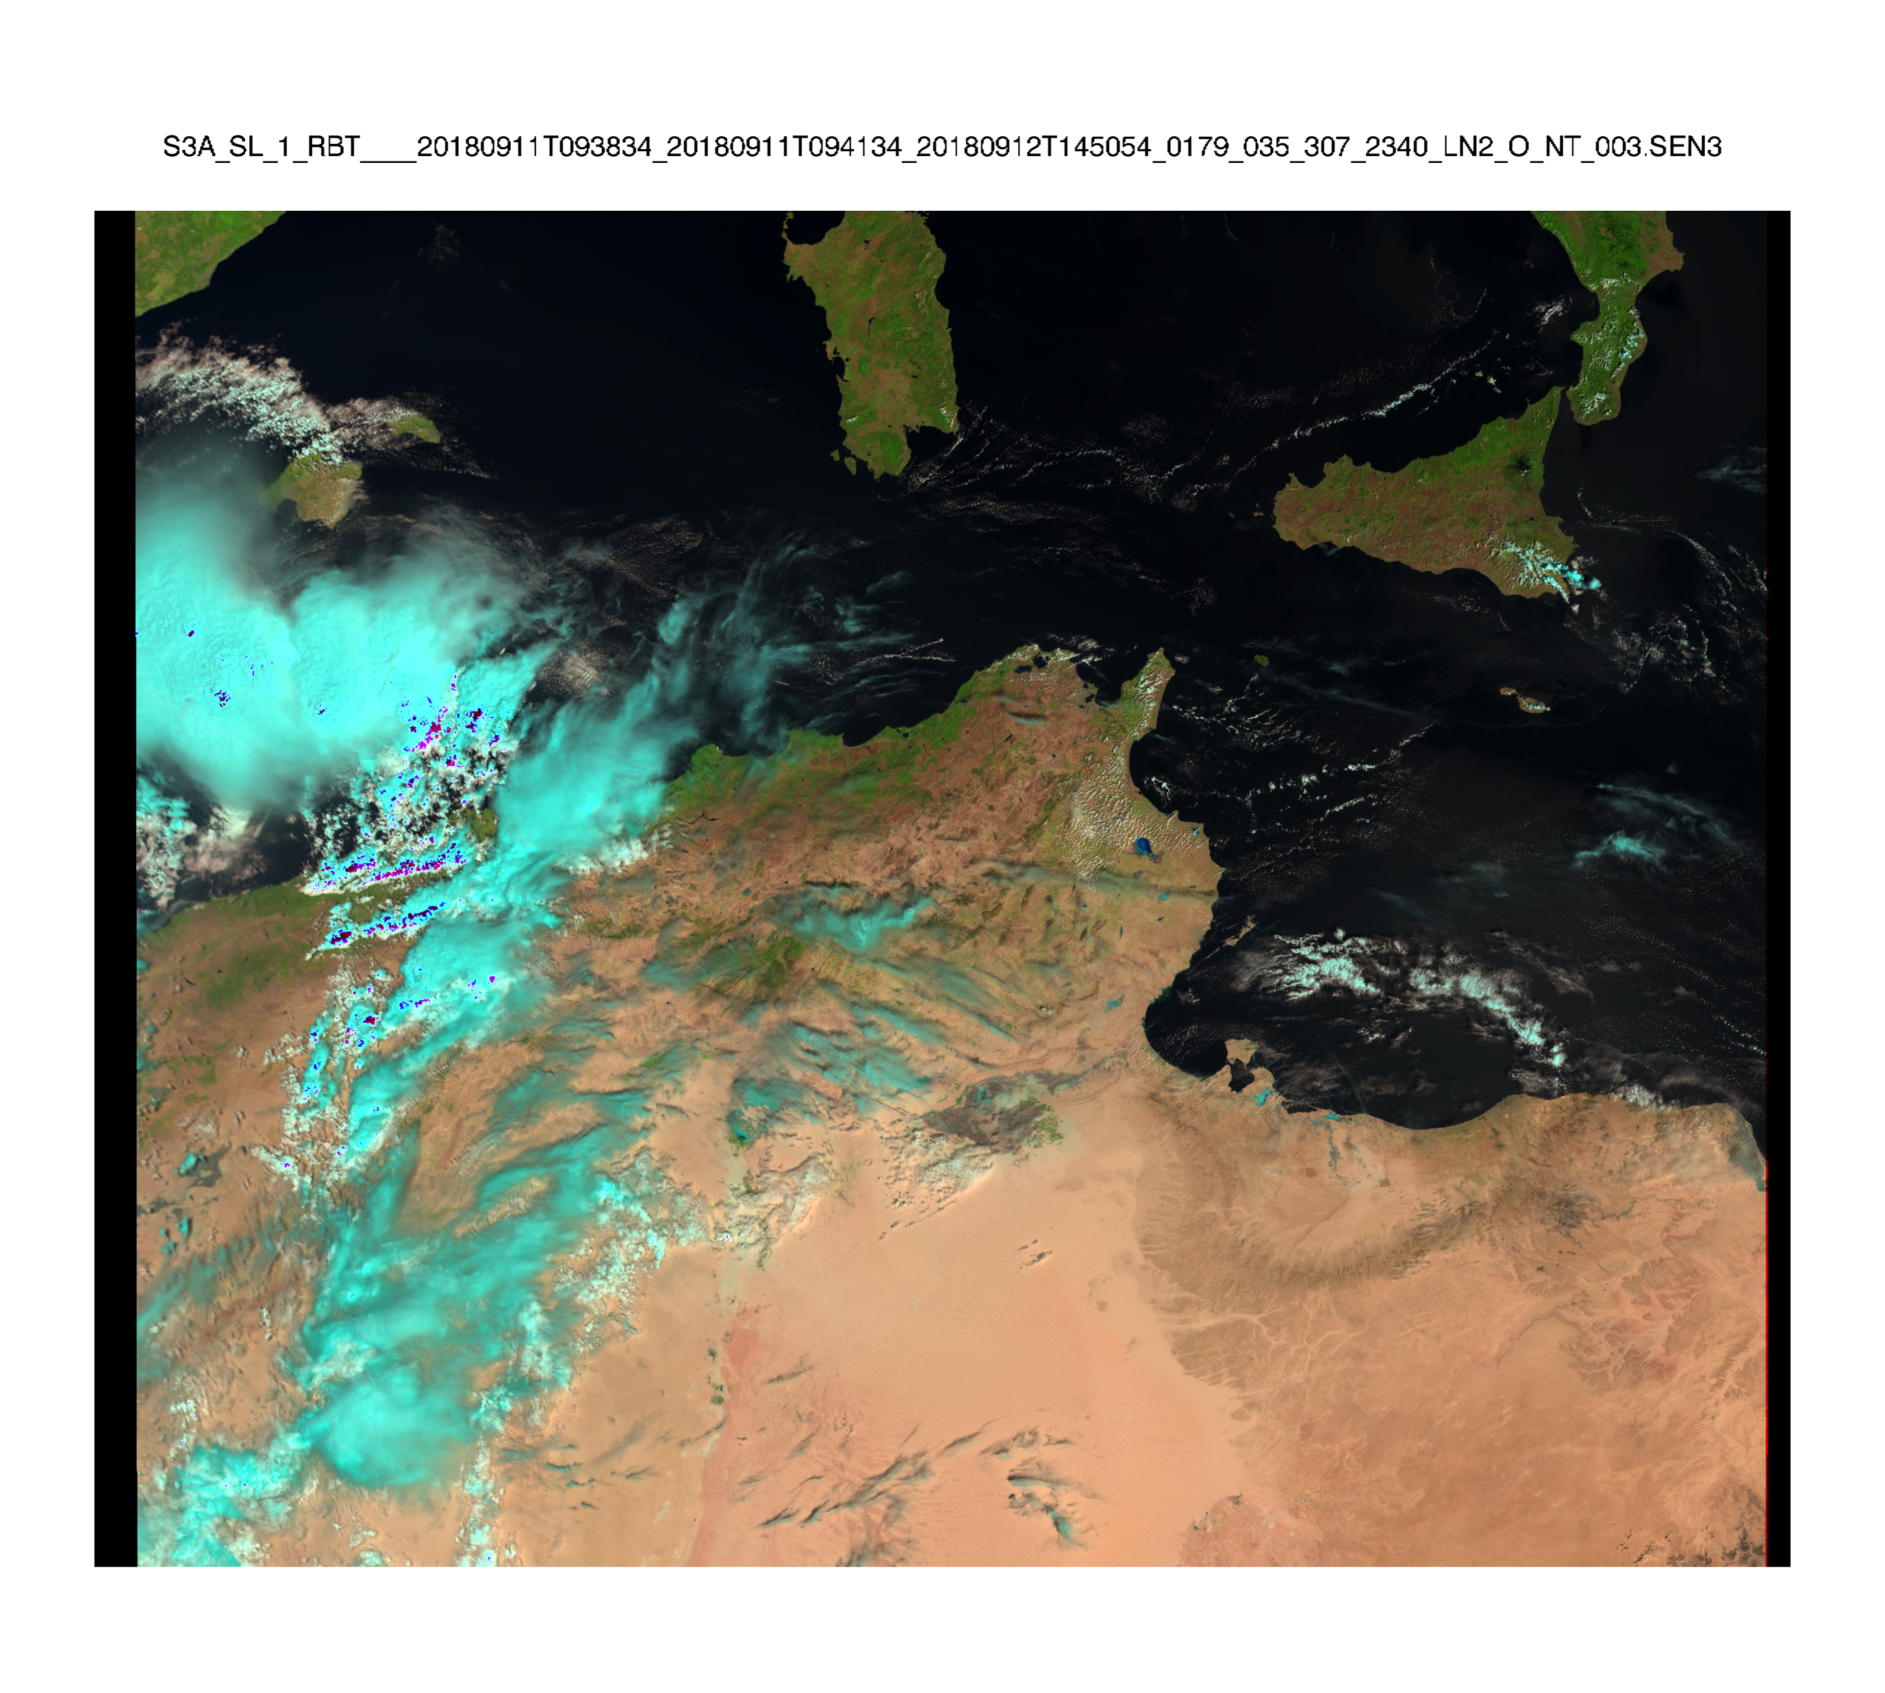
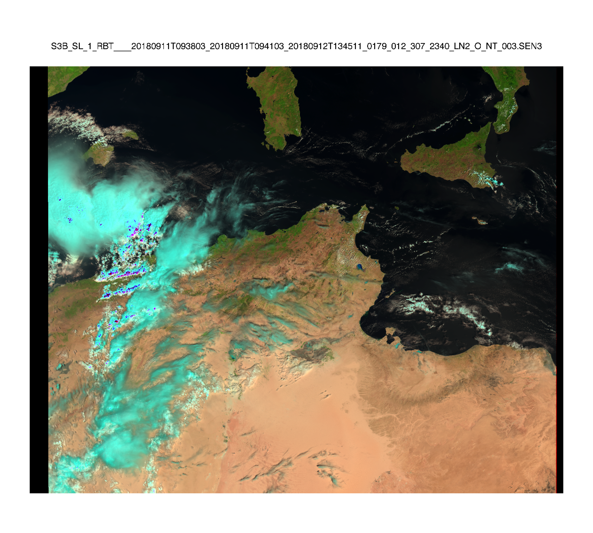
Tandem Phase Analysis
Sentinel-3A
Sentinel-3B
Sentinel-3A flying on Same Track 30s behind Sentinel-3B

Slide 23
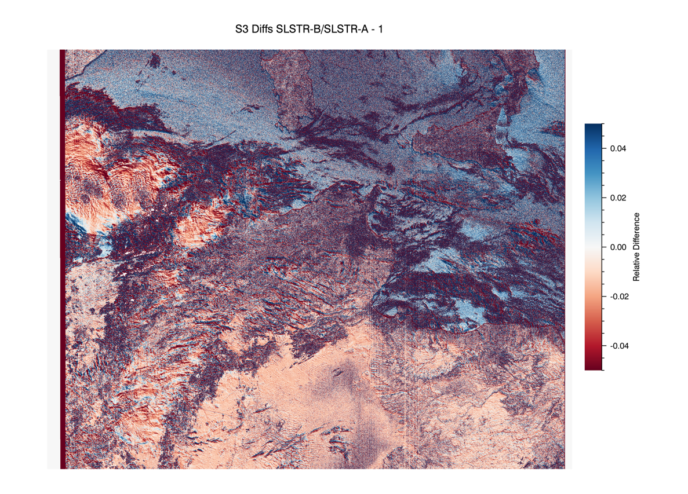
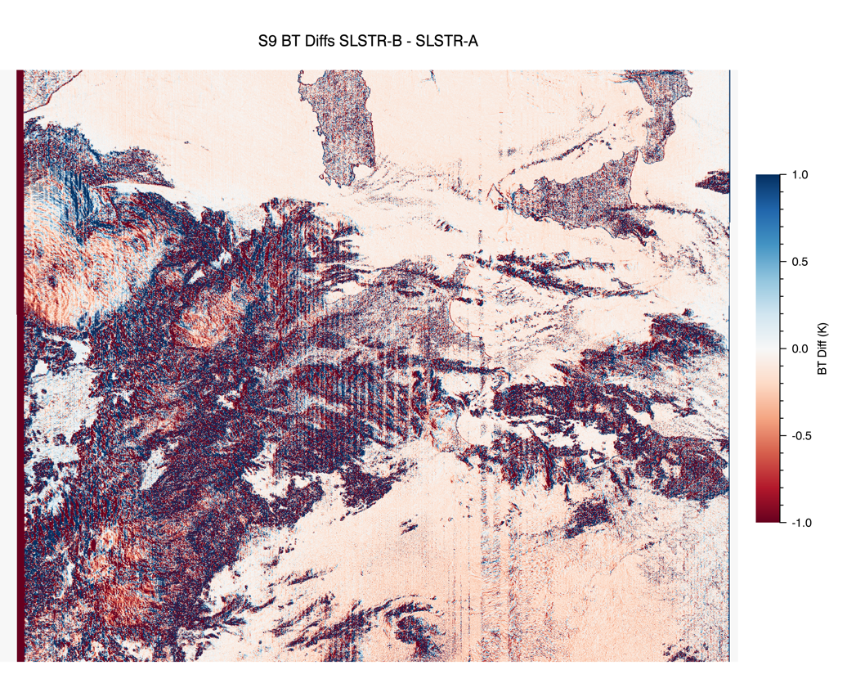
Tandem Phase Analysis
S3 (870nm) Differences
S9 (12um) Differences
Note comparisons are affected by spatial variations – e.g. clouds, surface features

Slide 24
TIR Channel Radiometric Comparisons
Comparisons of S3B vs S3A have been performed for selected days during tandem phase using L1 products remapped to 0.05degree cells.
  Comparisons are for corresponding 0.05degree cells
Averages are filtered to use spatially uniform cells with standard deviations <0.1K and BTs within valid range.
  Invalid BTs are not included in averages
Summary plots have been averaged over 5K intervals

Slide 25
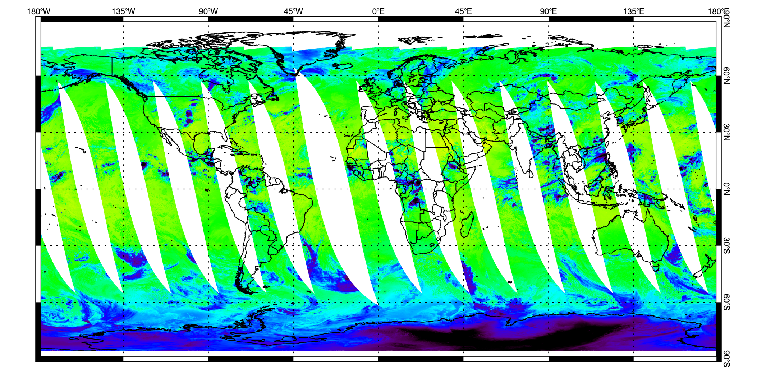
SLSTR-A S8 – Night Time - Nadir
Data for 26-August-2018
Notes:
L1 data are averaged in 0.05degree cells as for VIS/SWIR channels

Slide 26

SLSTR-B S8 – Night Time - Nadir
Data for 26-August-2018
Notes:
L1 data are averaged in 0.05degree cells as for VIS/SWIR channels

Slide 27
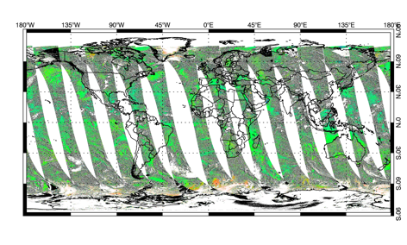
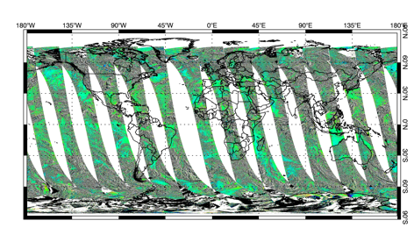
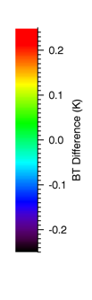
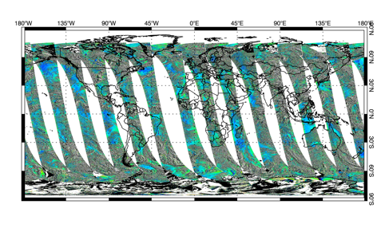
S3B-S3A Tandem Comparisons
S7
S8
Level-3 data for 26th August 2018
BT Differences S3B - S3A
S9

Slide 28






S3B-S3A Comparisons – Nadir View
Unfiltered
±10% Outliers removed
Low temperature differences possibly due to residual non-linearity

Slide 29






S3B-S3A Comparisons – Oblique View
Unfiltered
±10% Outliers removed
Error bars are standard deviation of match-ups
Notes:
Add comment on stray light

Slide 30

Stray Light Correction
The radiometric calibration model depends on the thermal background being constant around the scan
What if the thermal background is different between the earth view and the hot and cold blackbody sources?
Recalling the calibration model
      $$L_{E}=XL_{hbb}+\left(1−X\right)L_{cbb}$$
      where
      $$X=(C_{E}−C_{cbb})/(C_{hbb}−C_{cbb})$$
We make use of the +0 term in the BB radiance model to get
      $${∆L}_{E}=X∆L_{hbb}+\left(1−X\right){∆L}_{cbb}$$

Slide 31




Potential Impact of Correction on S3B-S3A Comparisons
As measured
With Correction
The model shows that the differences between SLSTR-A and B are consistent with the pre-launch calibration errors and can be corrected with a reduced version of the stray-light model developed for the IPF-P.
Notes:
Add comment on stray light

Slide 32
Conclusions
Sentinel-3A/B Tandem phase has provided a unique opportunity to cross-compare twin instruments in near ideal conditions
Preliminary analysis shows:
  Good agreement between S3B and S3A in nadir view
  Differences in oblque view consistent with pre-launch calibration
  Both nadir and oblique show residual non-linearity error for T_{E} below 220K (note design range 220K – 330K)
SNO comparisons are so-far limited to match-ups with IASI-A
  Limited to high latitude observations – T_{E} < 280K
  Cross calibration with other sensors would be useful – VIIRS, AIRS…
Study with NPL is in progress to document and publish current status of the traceability of SLSTR TIR channels

Slide 33
Spares

Slide 34

IR Calibration Model – Noise Estimates
Noise estimates (solid red line) were predicted using instrument noise model and the expected performance of FM Detector + EM Electronics + margins for EOL performance.
Measured values (points) are from pre-launch calibration representative of ‘cold’ start of mission

Slide 35

Modelling Calibration Error
A small team was set up to investigate possible causes of the discrepancies in the calibration results
  I.e. what are the additional terms in the calibration model.
An analysis suggested a non-uniform background radiance which varied around the scan.
  BB radiance errors
  Non-Black coating on optical baffles
The effects were modelled and a correction was tested with the data.
  Model is has several free parameters and is an approximation
Early inter-comparsions with IASI performed by EUMETSAT suggest that on-orbit stray-light error correction is not necessary.
Nadir View

Slide 36
Detector Temperatures
SLSTR-A
VIS Detectors
IR detector temperatures maintained between 84 K and 87 K
Periodic de-contamination is needed to remove water ice from cold surfaces
SLSTR-A FPA Cooler set-point increased by 1K in July to increase running time between decontaminations
IR Detectors
SLSTR-B
VIS Detectors
IR Detectors

Slide 37
Black-Body Performance
SLSTR-A
SLSTR-B
+YBB
-YBB
Blackbody temperatures have a seasonal cycle on top of the daily/orbital temperature cycles. Heated BB remains below 305K limit necessary for S7 calibration.
Temperature gradients consistent with pre-launch values for SLSTR-A and B
Note higher gradient in heated BB for SLSTR-A

Slide 38
IR Channels Gains
SLSTR-A
SLSTR-B
S7
S8
S9
F1
F2
All detectors are performing as at launch within expected ranges
Gains and offsets show slow drift with detector temperature as expected.

Slide 39
IR Channels Noise
SLSTR-A
SLSTR-B
S7
S8
S9
F1
F2
Radiometric noise levels for the TIR channels have remained stable throughout at pre-launch values.
NEDT for the S8 and S9 channels are below 20mK with no indication of degradation.
S3B F1 shows periodic increases in noise – possibly due to motional chopping

Slide 40

SLSTR-A S8 – Night Time - Oblique
Data for 26-August-2018
Notes:
L1 data are averaged in 0.05degree cells as for VIS/SWIR channels

Slide 41

SLSTR-B S8 – Night Time - Oblique
Data for 26-August-2018
Notes:
L1 data are averaged in 0.05degree cells as for VIS/SWIR channels

Slide 42



S3B-S3A Tandem Comparisons
Oblique
S7
S8
Level-3 data for 26th August 2018
BT Differences S3B - S3A
S9

