Slide 1
Discussion Way Forward for Multispectral IR
Tim Hewson and Likun Wang

Slide 2
Collect
L1 data
Collocate
Match up observations
Convert
Spectral Convolution
Gap-filling, SBAF
from Monitored and Reference Instruments
Compare
Correct
Regression
Is a correction necessary? Dynamic/static? form?
Define correction function

Slide 3
Collocation
Can we define a common framework for collocation?
For GEO-LEO IR, LEO-LEO IR
Although it didn’t seem to have a big impact on the GEO-LEO IR results,
it could for the LEO-LEO case, where there are far fewer collocations, so their quality matters more
Multispectral as well as hyperspectral
Could it be extended to the ray-matching case for the VIS/NIR?

Slide 4
Spectral Gap Filling
Can we apply the NOAA’s new CrIS spectral gap filling in the inter-comparisons, to forward and improve this step by step?
CrIS and GOES-ABI / HIMAWARI-AHI / Meteosat-SEVIRI / FY-4 AGRI …
Can anyone could collaborate with Hui Xu/UMD on the IASI SW beyond extension? He has already had some preliminary results on this.
PCRTM training spectra from Liu Xu (NASA)?
Any other lblrtm modeled training dataset that could fully cover IASI and extend it to at least 3300 cm-1?

Slide 5
Regression Refinements
Brightness Temperatures instead of Radiances?
Binning?
Uncertainty propagation?

Slide 6
GEO-GEO IR
Slides from Alexey Rublev (ROSHYDROMET)

Slide 7
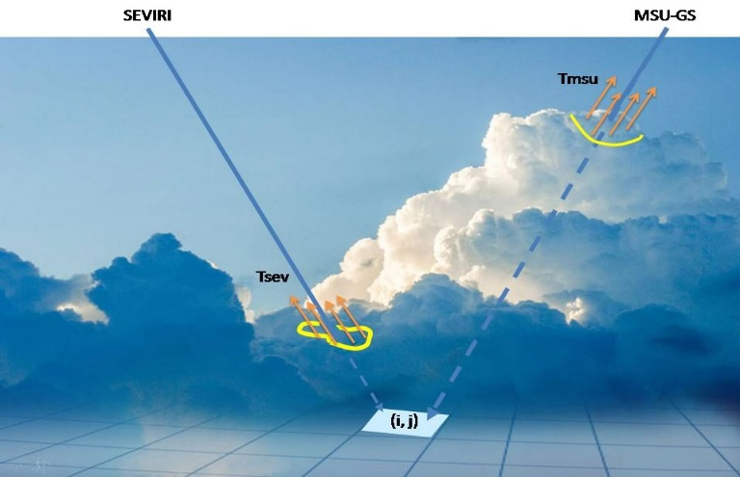
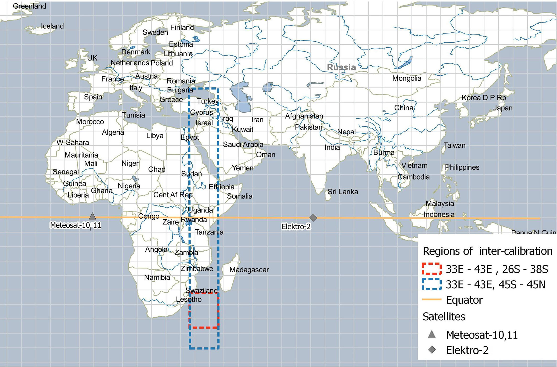
GEO-GEO inter-calibration
of IR channels of Russian MSU-GS/Elektro-L#2 imager using SEVIRI /Meteosat-10, 11
When it is required:
to calibrate IR imager channels at a frequency to identify daily calibration course;
to inspect the amplitude functions of channels in the wide dynamic range of measured brightness temperatures
Problems:
at pixel-to-pixel comparison, low temperatures (~ 200K) measured, for example, by MSU-GS from the tops of deep convection clouds are much less then BTs measured by SEVIRI for the same pixels that are cloudless for SEVIRI or shadowed from it by low clouds;
the calibration errors due to the unequal daily course of land surface temperature observed from both satellites in opposite directions;
geolocation errors.
Key points of GEO-GEO inter-calibration:
the determination of the two inter-calibration fields of regard for hot and cold BTs in the middle between sub-satellites points;
establishment of a one-to-one correspondence between subsets of uniform image fragments from both satellites;
correction of geolocation errors;
obtaining regression relationships for inter-calibration in a wide range of BTs.

Slide 8
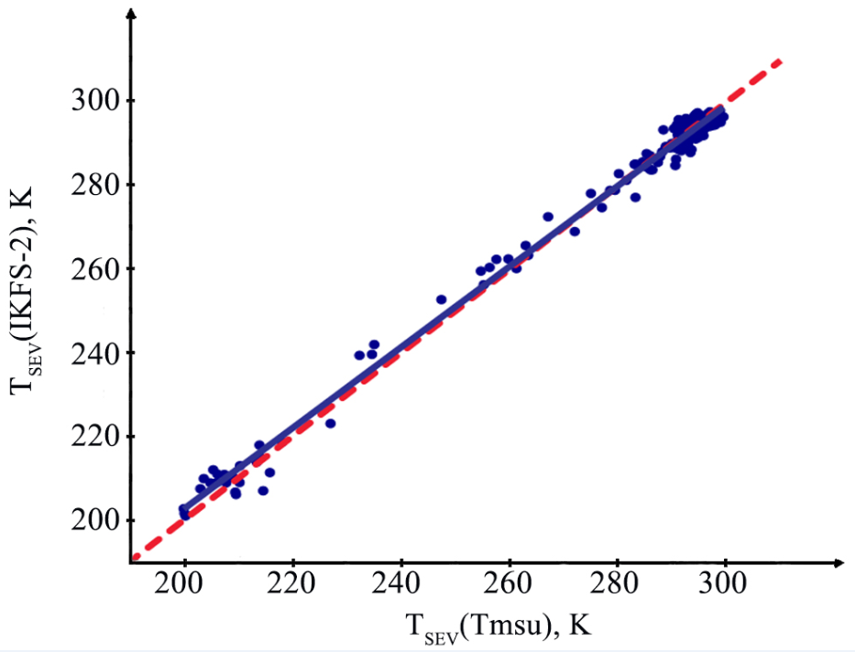
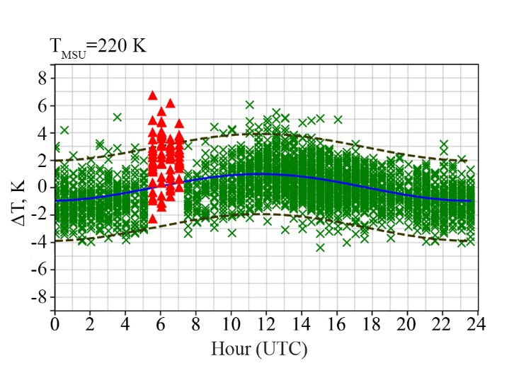
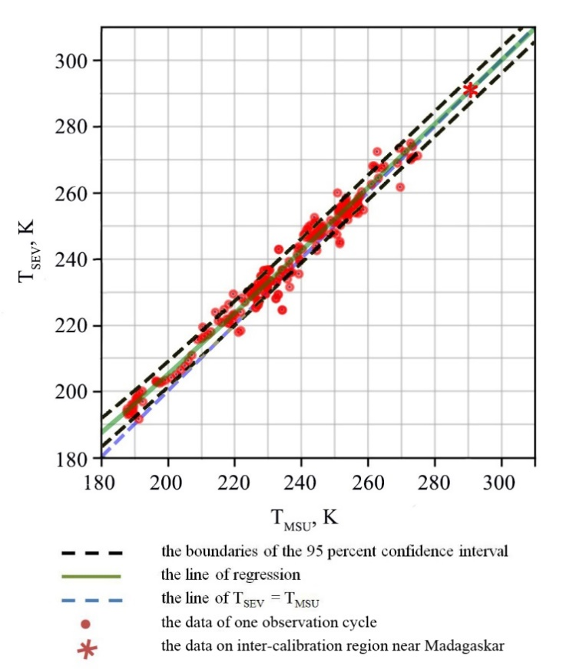
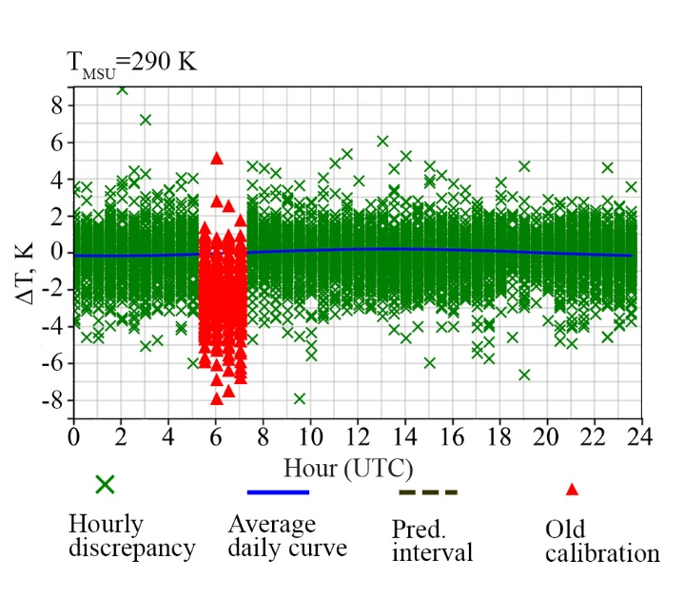
Results of inter-calibration
for MSU-GS channel #9 (10.7 μkm )
Amplitude of the daily calibration course less 0.2° for BTs ~ 300K and gradually increases to 1° for BT~200K
Validation of GEO-GEO inter-calibration using GEO-LEO
Example of regression T_{SEV} (T_{MSU}), May 7, 2018, 14:30 UTC
Comparison of Madagaskar region images (10.7μkm) after inter-calibration
SEVIRI MSU-GS

Slide 9
GEO-GEO IR
Q: Can we recommend GEO-GEO IR algorithm?
For monitoring?
GEO-ring / FCDR?
Blending GEO-LEO + GEO-GEO comparisons?
Collocation conditions
Dynamic range
Geolocation requirements
Parallax - homogeneity filtering?
Definition of SBAFs
Diurnal / seasonal variations
Monitoring
Anomaly detection

Slide 10
LEO-LEO IR
Q: Can we recommend LEO-LEO IR algorithm?
For monitoring?
Blending GEO-LEO + LEO-LEO comparisons?
Collocation Criteria
Relaxing time threshold to extend dynamic range (global SNOs)
Trade-off homogeneity / dynamic range?
Definition of SBAFs
Diurnal / seasonal variations
Monitoring
Anomaly detection

Slide 11
 | GEO-LEO IR | GEO-GEO IR | LEO-LEO IR
Hyperspectral Reference | Diurnal Var Gap-Filling | Diurnal Var Gap-Filling | Gap-Filling
Multispectral Reference | SBAF | SBAF | SBAF
All | Collocation Regression Standard Scene Reference Migration/Blending

Slide 12
Switching Reference IASI-A to IASI-B
•IASI-B onboard processing change 2017
–Impact on calibration & nonlinearity
–Treat period before/after change as separate references
•Check consistency
–After change with IASI-A
–And IASI-C – when – by end 2019?
•Expected degradation of IASI-A as reference?
–Due to orbital degradation
•When to switch to IASI-B?
–Or switch directly to IASI-C & minimise switches?

