Slide 1


Sensitivity Test and Further Validation of Cross-track Infrared Sounder Spectral Gap Filling in Inter-comparisons
Hui Xu, Likun Wang, Yong Chen, Fangfang Yu, Fred Wu and Mitchell D. Goldberg
GSICS Annual Meeting 2019
03/07/2019
Notes:
1

Slide 2
Outline
The performance of CrIS spectral gap filling in inter-comparisons
Updates on IASI SW extension
Conclusions and future works
Training dataset analysis
Scene and scan angle dependency analysis
Stability analysis
Accuracy analysis
Notes:
2

Slide 3
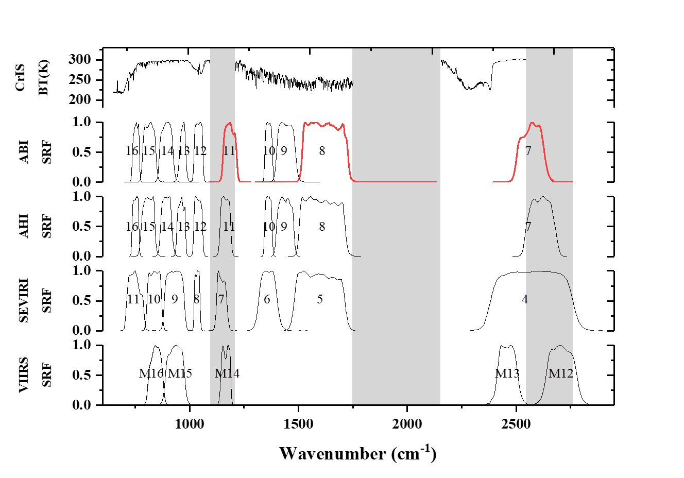
Background
Previously, a Principle Component Regression (PCR) based spectral gap filling method was successfully developed to solve the channel missing issue in the satellite inter-comparisons between CrIS and other broadband instruments.
The detailed information of the gap filling method can be found at :
H. Xu, Y. Chen and L. K. Wang, 2019, Cross-Track Infrared Sounder Spectral Gap Filling Toward Improving Intercalibration Uncertainties, IEEE Transactions on Geoscience and Remote Sensing, 57(1), pp. 509-519.
GSICS annual meeting 2018: http://gsics.atmos.umd.edu/pub/Development/20180319/4d_2018_GSICS_HUIXU.pptx
GSICS annual meeting 2018 suggestion and action
Respond: A comprehensive sensitive test and validation were made on this issue, by using the GOES-16 Advanced Baseline Imager (ABI)’s three gap channels (11, 8 and 7) as examples. This was achieved through a set of CrIS and ABI proxy datasets that directly simulated from the MetOp-A/B IASI measurements.
Suggestions from Mitchel & A.GIR.2018.4d.3:
Evaluate the NOAA proposed gap filling method with IASI data. “To pretend IASI has gaps and fill them with this method and check it with real IASI data. That would be the best validation.”

Slide 4
The performance of CrIS spectral gap filling in inter-comparisons
Flow chart of the CrIS gap filling method evaluation using IASI proxy data
FullCrIS Spectra
(0.625 cm-1, 650~2755 cm-1, continuously)
GOES-ABI SRF
CrIS-ABI(truth)
(Regarded as truth)
Channel 11
(LW)
Step1. Conversion to
CrIS(gapfilled) Spectra
IASI Spectra
(Globally, All FORs and FOVs)
Step2. Convolve with GOES-ABI
Advantages of Proxy data
(Global Scale, no collocation, spatial average ... uncertainties)
Proxy Collocation data
CrIS measured channels
(0.625 cm-1, 650~1095, 1210~1750, 2155~2550 cm-1)
Channel 8
(MW)
Gap Filling
CrIS gap channels
(0.625 cm-1, 1095~1210, 1750~2155, 2550~2755 cm-1)
Channel 7
(SW)
CrIS-ABI(gapfilled)
CrIS spectral band coverage for GOES-16 ABI.
The difference between CrIS-ABI(gapfilled) and CrIS-ABI(truth) can be regarded as the uncertainty of gap filling which is mainly caused by the following two parts:
fitting error of the gap filling method
the original IASI instrument noise.
In the following analysis, their difference refer to CrIS-ABI(gapfilled) minus CrIS-ABI(truth).

Slide 5

The performance of CrIS spectral gap filling in inter-comparisons
A. Training dataset analysis
Training dataset matters
Training datasets randomly selected from different months and seasons in the years between 2014 and 2018 are investigated.
The testing data (10 April 2015) are not included in the training datasets.
Training datasets are selected from the same year
Similar statistical results are observed for different training datasets.
The training data sample increasing does not bring significant improvement in the gap filling result.
The gap filling results still keep negligible change even we increase the scan interval from two to fifteen in the training dataset selection
2016, 4 days
(scan interval: 2)
2016, 4 days
(scan interval: 5)
2016, 6 days
(scan interval: 2)
2016, 4 days
(scan interval: 10)
2016,12 days
(scan interval: 2)
2016, 4 days
(scan interval: 15)
Column bar is the mean bias between CrIS-ABI_{(gapfilled)} and CrIS-ABI_{(truth),} Y-error bar is their standard deviation.

Slide 6
The performance of CrIS spectral gap filling in inter-comparisons
A. Training dataset analysis
Training dataset matters
Training datasets are selected from DIFFERENT year
Tiny differences are observed in the gap filling results with different year derived coefficients.
Particularly, the result calculated with the multi-year (Black) training data derived coefficients is quite like those from the yearly (Blue) derived coefficients both in mean and standard deviation.
All these suggest that the four-day training dataset selected from different seasons within a year that used in our previous study, are enough to have a general representative of the earth’s different atmospheric and surface conditions. Further validations will be conducted in the future, to see if extending of the training dataset could reduce the uncertainties in extreme cases.
2014, 4 days
(scan interval: 2)
2017, 4 days
(scan interval: 2)
2015, 4 days
(scan interval: 2)
2018, 4 days
(scan interval: 2)
2016, 4 days
(scan interval: 2)
2014~2018, 18 days
(scan interval: 2)

Slide 7
The performance of CrIS spectral gap filling in inter-comparisons
B. Scene and scan angle dependency analysis
10 April 2015
Is there any scene / scan angle dependency
SE of slope = 3.444e-6 K
Long-wave
（Window channel）
K
K
BT BTD
GOES-ABI Channel 11
The scene and scan angle dependencies can be hardly found in the LW window gap channel.
For the majority scenes, such as the ocean areas, their BTD values caused by the spectral gap filling are generally within the range of -0.1 and 0.1 K.
However, relatively larger BTD values are observed over the middle-latitude arid and semi-arid areas, such as the Sahara Desert.

Slide 8
The performance of CrIS spectral gap filling in inter-comparisons
B. Scene and scan angle dependency analysis
10 April 2015
Is there any scene / scan angle dependency
SE of slope = 2.154e-8 K
Middle-wave
（Water vapor channel）
K
K
BT BTD
GOES-ABI Channel 8
As expected, the scene and scan angle dependences are still not found in this MW channel.
The gap filling method performs well for most of the global scenes from the Polar to the Tropical areas except for several cloudy regions as marked.
These anomaly areas are mostly distributed in the tropical region and possibly the deep convective clouds (DCC).

Slide 9
The performance of CrIS spectral gap filling in inter-comparisons
B. Scene and scan angle dependency analysis
10 April 2015
Is there any scene / scan angle dependency
SE of slope = 1.204e-5 K
Short-wave
（Window channel）
K
K
BT BTD
GOES-ABI Channel 8
Similarly, there is no obvious scene as well as scan angle dependency in this SW channel too.
Different from the other two channels, large BT differences between them are mainly observed in the very cold scenes (e.g., the cloudy and the high-latitude Polar regions, highlighted by the black rectangles).

Slide 10
The performance of CrIS spectral gap filling in inter-comparisons
C. Stability analysis
Long-term performance
The long-term stability of the CrIS spectral gap filling method is analyzed from 2014 to 2018.
Mean biases fluctuate around the zero-line during 2014 to 2018.
Standard deviations also vary in a very small dynamical range respectively.
Trend is not found either, indicating that the spectral gap filling method in general is quite stable.
However, there is a tiny seasonal pattern detected in the SW channel 7.
More cold scenes are observed in the winter than in summer.

Slide 11
The performance of CrIS spectral gap filling in inter-comparisons
D. Accuracy analysis
Convolution Uncertainty
CrIS and GOES-16 ABI potential collocation area (from 125°W to 25°W and 50°S to 50°N).
MetOp-A IASI was used in the CrIS-ABI proxy data simulation.
Randomly selected from each months of year 2016
LW channel 11, the channel 11 gap filling accuracy is in a mean of 6.740 mK and standard deviation of 0.059 K.
MW channel 8, the gap filling mean bias and standard deviation are around -0.005 mK and 1.543e-4 K respectively.
SW channel 7, same normal distribution pattern is also observed with a mean bias of -1.018 mK and standard deviation of 0.105 K.
The errors transferred from the spectral gap filling are negligible in CrIS and ABI inter-comparison studies, as they will be cancelled out during the scene average.

Slide 12
The performance of CrIS spectral gap filling in inter-comparisons
Convolution Uncertainty
CrIS spectral gap filling accuracy for broadband instruments
Similar spectral gap filling accuracies are observed when these instruments are compared with the CrIS measurement over the LW, MW and SW spectral regions.
However, as they were deployed at different locations as well as orbits, and the channel spectral responses are also not identical, the accuracy of the spectral gap filling varies from instrument to instrument and channel to channel.

Slide 13
Updates on IASI SW extension
There are still several short-wave broadband channels that are not fully covered by IASI (limit is 2760 cm-1), such as the AVHRR channel 3B, SEVIRI channel 4, …
Can we use modelled radiance spectra?
Representative radiance spectra to train gap-filling
  Need to cover full range of atmospheric conditions
    Temperature profiles
    Surface types/temperatures
    Water vapour burdens
    Cloud amounts (low, mid-level, high, …)
    CH4, CO2, …
  Need to cover full spectrum of monitored channel
    IASI doesn’t help here!
  At sufficient spectral resolution
    Whatever that means…
  Over full range of viewing angles
Suggestions from Tim Hewison
  GSICS IR web meeting 2018: http://gsics.atmos.umd.edu/pub/Development/20180605/SLSTR%203.7%c2%b5m%20channel%20-%20IASI.pptx
GIR.20180605.3: Hui Xu (UMD) to work with Liu Xu (NASA, using the PCRTM training spectra ) on IASI shortwave extended gaps and generate first version coefficients for night time observations if possible.
Updates on this issue (initial step)
IASI SW gap channel prediction coefficients derivation
ECMWF (different days) + Typical profiles (TIGR,… )
Monochromatic radiance (0.01 cm-1, from 600 to 3300 cm-1)
Convert to IASI specification (as well as CrIS)
Use the measured channels as predictors, filling up the SW beyond channels with the PC gap filling method (Xu et al., 2019).
Typical surface emissivity (IGBP, …)
LBLRTM
Geometry (from nadir to limb)
Nighttime + Clear sky + Ocean only

Slide 14
Updates on IASI SW extension
Apply to real Metop-B IASI
The RT model derived IASI SW channel prediction coefficients are then applied to the real Metop-B IASI spectra.
9 Jan 2019
Large noises are observed in IASI’s SW channels over the cold scene (with many of the values are negative).
In general, the predicted gap channels (Blue) matched well with the IASI measured channels (Red).

Slide 15
Updates on IASI SW extension
Metop-B AVHRR(CH3B) v.s IASI
The inter-comparison results between IASI and AVHRR channel 3B are investigated before and after the gap filling.
9 Jan 2019
Before
Central wavenumber: 2661.541 cm-1
After
Spectra with negative values in SW channels are removed.
Both the mean and standard deviation are greatly reduced after the gap was filled. In addition, the scene dependency is also obviously decreased.

Slide 16
Updates on IASI SW extension
Metop-B AVHRR(CH3B) and IASI
5 Dec 2018
Before
After
10 Feb 2019
Before
After
We may well solve this issue with modelled radiance spectra if they could have a general representative of different atmosphere and surface conditions. (We believe that the training spectra from the PCRTM from Xu Liu-NASA could make a great improvement on this.)

Slide 17
Conclusions and future works
Conclusions
To address the channel missing issue in the satellite inter-comparisons between CrIS and other broadband channel instruments, a principle component regression based spectral gap filling method was developed.
Sensitive test shows that the selected training dataset are enough to have a general representative of different atmospheric and surface conditions.
Neither the scene nor the scan angle dependency is observed in the gap filling results, implying that the gap filling coefficients can be applied to both the cold and warm scenes at all scan views.
The gap filling result varies only in a very small range from year to year, illustrating that the gap filling method is stable and can be confidently applied to the long-term inter-comparison studies as well.
Future works
We do hope our community could use and test the newly developed CrIS spectral gap filling method in the inter-comparisons, to forward and improve this issue step by step.
We will continually collaborate with other colleagues on the IASI SW beyond extension.

Slide 18
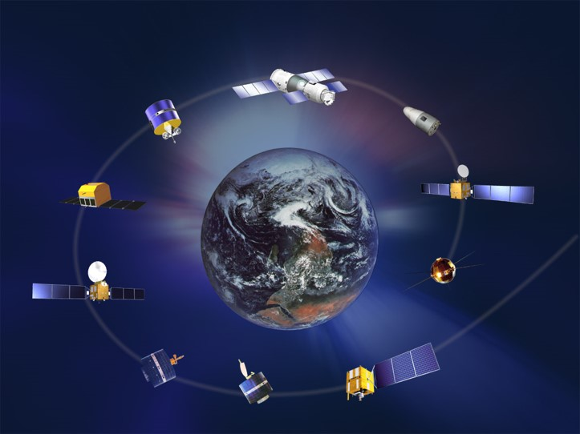
Thanks
(Thank all the IR group colleagues for providing valuable suggestions on this topic)
CrIS gap filling coefficients can be found at:
https://github.com/HuiXu-RS/Satellite-Infrared-Sounder-Spectral-Gap-Filling
Hui Xu
(CICS/ESSIC/Univ. of Maryland, College Park, MD)
Email: huixu@umd.edu

