Slide 1
GSICS Annual Meeting 2019
March 4-8, 2019
ESA-ESRIN, Frascati, Italy
Progress with GRUAN observations in comparisons with
satellite infrared measurements: Preliminary result
Bomin Sun¹, Xavier Calbet², Tony Reale³, and Manik Bali⁴
1 IMSG at NOAA/NESDIS/Center for Applications and Research (STAR),
College Park, Maryland, USA
2 AEMET, Madrid, Spain
3 NOAA/NESDIS/STAR, College Park, USA
4 University of Maryland, College Park, USA

Slide 2
Objective
GSICS action
Feasibility to use GRUAN data to monitor polar satellite IR observations and RT models …
Using Sensor to monitor GRUAN (ie, RS92 to RS41 transition)…

Slide 3
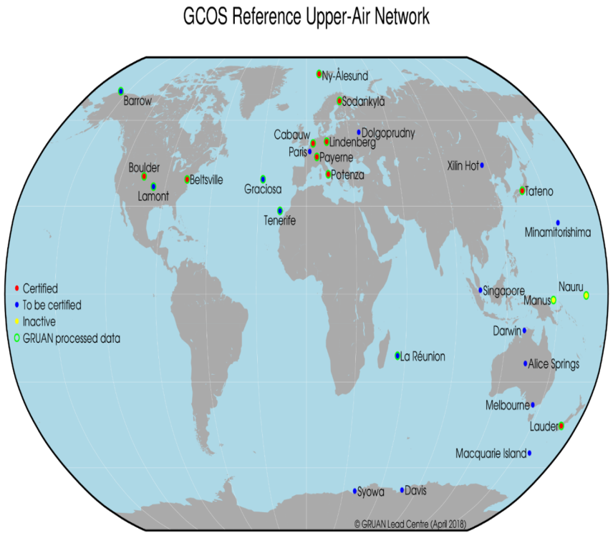
Global Reference Upper Air Network (GRUAN)

Slide 4
GRUAN vs Non-GRUAN
Raw measurements (temperature, humidity, wind, pressure) +ancillary data
Vender-provided processing software -> conventional observations
GRUAN data processing software (GDP) -> GRUAN data: SI-traceable observations with fully characterized uncertainty estimate (version-2)
“Reference quality upper-air measurements: GRUAN data processing for the Vaisala RS92 radiosonde” by Dirksen et al. (2014), Atmos.Meas.Tech.

Slide 5
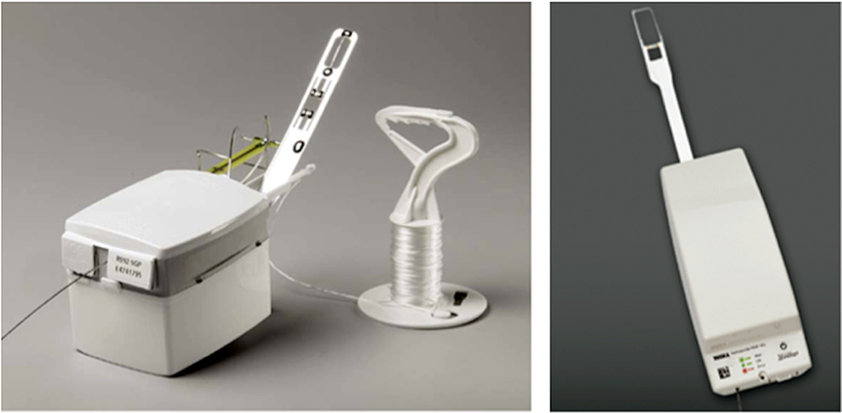
Sonde instrument transition
Vaisala RS92
GDP v2
RS92-RS41 transition
RS41 not yet GDP processed
RS92
RS41
Courtesy Jensen et al. (2015)

Slide 6
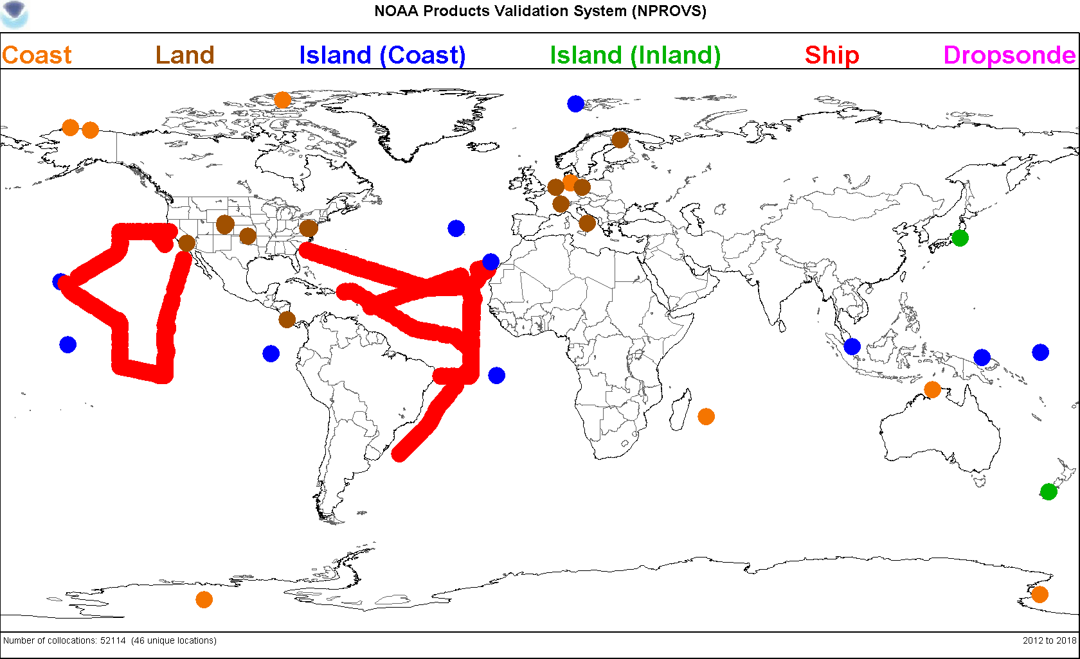
Satellite synchronized dedicated radiosondes
Ocean field campaigns (AEROSE, ACAPEX, ENRR)
DOE ARM sites (SGP, NSA, ENA)
Radiosonde Intercomparison and VALidation (RIVAL)
Others (Beltsvile, Sterling, …)
Launch configurations:
Single (15 min prior to)
Sequential (30 and 5 min prior to)
RS92-RS41 dual (15 min prior to) …RIVAL
RS92-RS41 dual followed by a single …RIVAL
GRUAN & NOAA-JPSS dedicated
sonde database
Acknowledgement:
Lihang Zhou, Mitch Goldberg for JPSS funding
Nick Nalli, Lori Borg, Ryan Smith for launch
NPROVS (Reale et al. 2012)

Slide 7
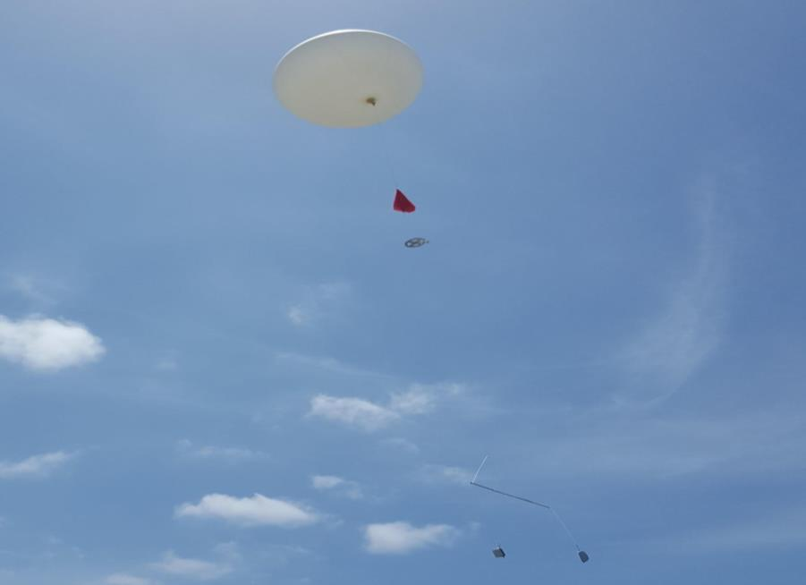
RIVAL dedicated sondes
Using RIVAL dedicated sondes to monitor polar satellite infrared/microwave observations and RT models
RS92-RS41 dual (45-min prior to NOAA20 overpass)
RS41 single (5-min prior to)
RIVALdual launch of Vaisala RS92 and RS41 synchronized with NOAA-20 at the DOE-ARM Eastern North Atlantic (ENA) Azores site. (Courtesy Donna Holdridge)

Slide 8
Background and Goal
“Consistency between GRUAN sondes, LBLRTM and IASI” by Calbet et al. (2017)
GRUAN observations (RS92) are consistent with IASI measurements via LBLRTM in the upper tropospheric water vapor absorption spectrum
GRUAN RS92 data still have a dry bias
Based on one site (Manus) and RS92 sondes
Extend Calbet et al.(2017) to understand the accuracy status of current GRUAN observations
RS41 has replaced RS92
A lot of sites/campaign data and satellite/NWP collocations are available

Slide 9
Method
Find radiosondes that are closely matched with IASI pixels that are “cloud-free”
Compute radiance for the radiosonde profiles using LBLRTM
Compare the radiosonde-computed radiance with IASI measurements (in the context of measurement noise and collocation error).

Slide 10
GRUAN & dedicated sondes
Payerne
Lindenberg
AEROSE2017
Lauder

Slide 11
Courtesy EUMETSAT

Slide 12
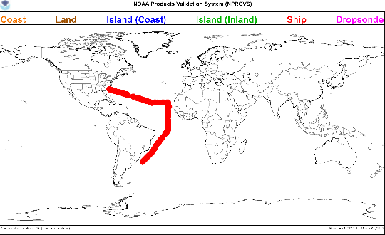
AEROSE 2017, Tropical-subtropical Atlantic, RS41, based on 22 single launches
RS41-minus-iasi
RS41 appears to be slightly drier relative to IASI

Slide 13
Lauder, New Zealand, RS92 vs RS41 based on 19 pairs of dual launches
RS92-minus-RS41 RH (%)
GRUAN RS92-minus-iasi
RS41-minus-iasi
Both sondes appear to be drier relative to IASI but RS41 is less drier than RS92

Slide 14
Payerne, Switzerland, RS92 vs RS41 based on 23 pairs of dual launches
GRUAN RS92-minus-iasi
RS41-minus-iasi
Both sondes appear to be drier relative to IASI but RS41 is slightly less drier than RS92

Slide 15
Lindenberg, Germany, RS92 vs RS41 based on 33 pairs of dual launches
RS92-minus-RS41 RH (%)
GRUAN RS92-minus-iasi
RS41-minus-iasi
Both sondes appear to be drier relative to IASI but RS41 is less drier than RS92

Slide 16
Preliminary Result
RS41 shows improvement over GRUAN RS92: less drier in the upper tropospheric water vapor absorption spectrum.
RS41 temperature profiles are comparable to RS92 but less sensitive to solar radiation in the lower stratosphere (Sun et al. 2019).
Need to refine the work, for example, accounting for collocation error, measurement uncertainties, differences per site, etc. (Will be visiting Xavier Calbet …)

Slide 17
Path forwarding
Expand to NOAA-20 CrIS
Sondes now targeting NOAA-20 (JPSS dedicated, RIVAL)
Pending EUMETSAT plans to target MetOp (NOAA EUMETSAT coordination underway at NESDIS)
v3 GRUAN processing for RS41 and RS92

