Slide 1
GSICS Collaboration Servers 2019
Peter Miu
CMA, CNES, ESA EUMETSAT, ISRO, IMD, JAXA, JMA, KMA, NASA, NIST, NOAA, ROSHYDROMET, USGS, WMO

Slide 2
Presentation Overview
Collaboration Server; Recap for new members
Current Status:
Servers
data sets; source, intermediate, products
tools
GPPA
Future
Questions

Slide 3
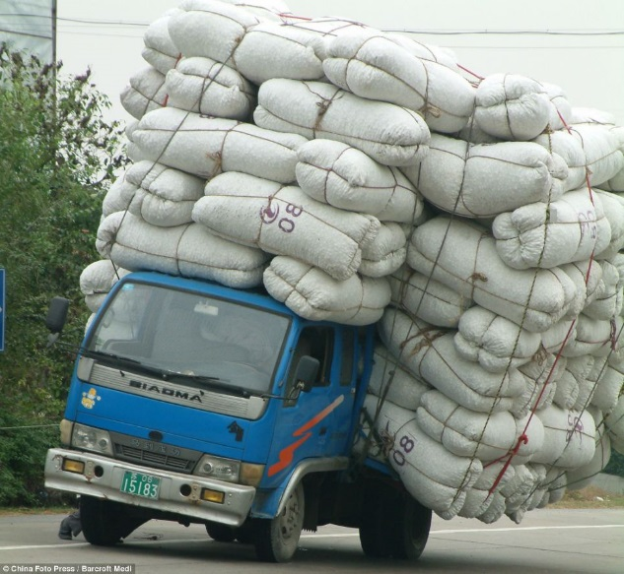
Collaboration Servers
A Vehicle for Receiving and Distribution GSICS source Data Sets and Products
4 Collaboration Servers
CMA
EUMETSAT
ISRO
NOAA
GPRC upload their comparable source Data Sets to these Servers
Scientist develop GSICS Products, upload these and supporting data sets back to the servers.
Users download these products for calibrating data needed for the work / research.

Slide 4
GSICS Collaboration Server Design

Slide 5
GSICS Servers
CMA;?
EUMETSAT; source data sets, JMA intermediate Data Sets, GSICS products
ISRO; ?
NOAA; ?

Slide 6
GSICS Data Sets
Source Data Sets
Intermediate Data Sets
GSICS Products in various GPPA states
Demo
Pre-op
Oper

Slide 7
GSICS Data Sets
Source Data Sets; MSG HighRateSeviri, IASI L1c, GOME L1B
Intermediate Data Sets; HIMAWARI8 AHI with AQUA AIRS, AQUA MODIS, IASI, …
GSICS Products in GPPA states; RAC & NRTC
EUMETSAT: GEOLEOIR, LEOLEOIR,
ISRO: GEOLEOIR
JMA: GEOLEOIR
KMA: GEOLEOIR
NOAA: GEOLEOIR

Slide 8
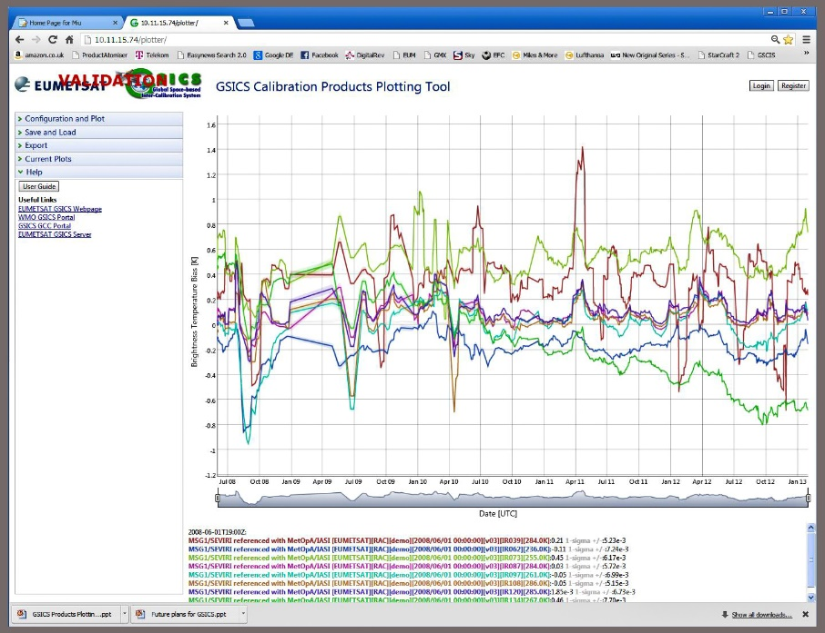
GSICS Product Plotting Tool
EUMETSAT has implemented a tool
ISRO has implement a tool
Purpose its to provide users with a view of the content of the calibration products
The tool can be used to assist evaluating new products during the GPPA

Slide 9
GPPA
GSICS Procedure for Product Acceptance
Validating GSICS products for operational use
GPAT: GSICS Product Acceptance Team
Demo, Pre-op and Oper

Slide 10
Future
Use of the netCDF Enhanced Data Model
New Types of GSICS products require for new instruments
GSICS guidelines, conventions and standard updates.
New data access mechanisms

Slide 11
Thank you for your attention

