Slide 1
Updates on Collaboration Server Mirroring of GSICS Products at NOAA
GSICS Annual Meeting 2019
Frascati, Italy
Manik Bali, NOAA

Slide 2
Introduction
Action: NOAA to investigate the mirroring of EUMETSAT products on the NOAA server

Slide 3
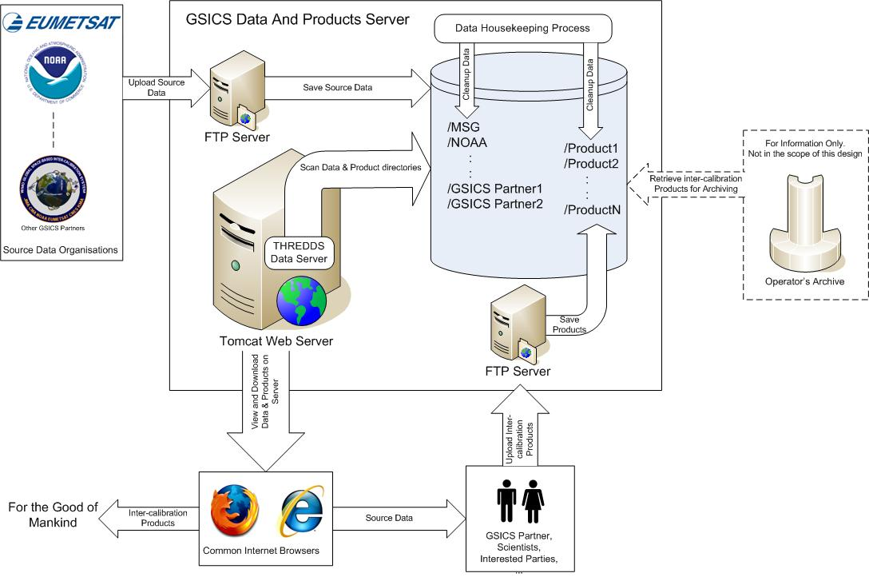
Collaboration Network
Breaking news…GSICS THREDDS server back online GOES-13/15 products visible in product catalog. Rest of the products would be online shortly

Slide 4
Collaboration Network

Slide 5
FTP Server
NOAA has a robust FTP Server.
Directory structure was created on a disk mounted on FTP Server.
GSICS Products are downloaded via wget onto this directory structure once each month.
Currently NOAA has approved enough disk area to copy entire time length of GSICS data files and update them monthly.
Access to mirror (New Location Would be provided soon)
Currently GSICS Products are copied to a NOAA/STAR server

Slide 6
FTP Server
http://gsics.atmos.umd.edu/bin/view/Development/DownloadGSICSProducts

Slide 7
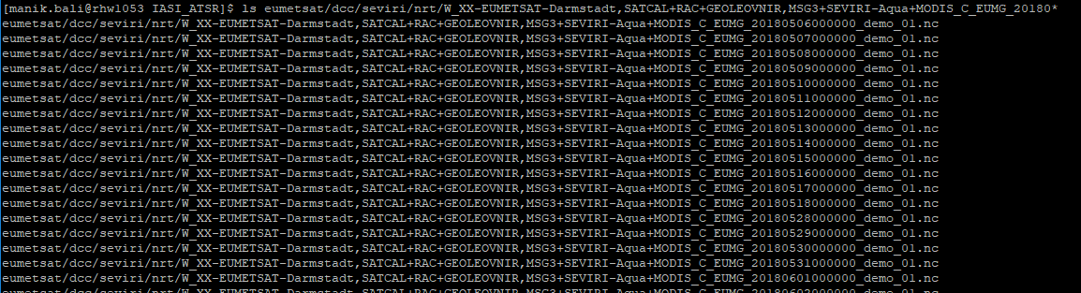
Snap Shot of Data downloaded from THREDDS
EUMETSAT
JMA
Next step is to copy this data on the FTP server routinely that would act as a mirror and redundancy site

Slide 8
Summary
NOAA- THREDDS is back online
NOAA develops capability to backup GSICS RAC and NRT products
Next step is to make the mirror and disseminate products via ftp.

Slide 9
THANK YOU

