Slide 1

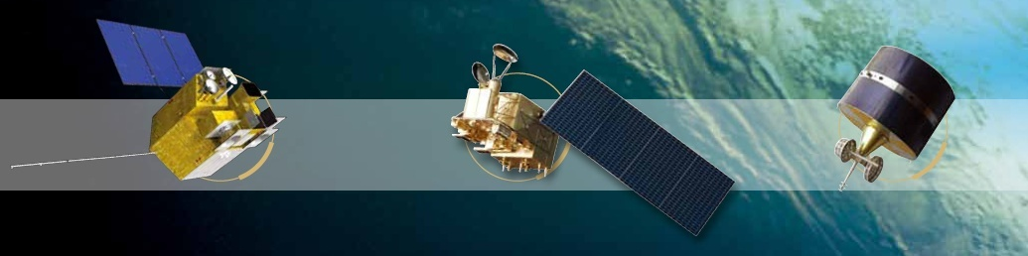




PICS/SNO data extraction function and data dissemination
Lin Chen, Xiuqing Hu，Zhe Xu, Na Xu, Ling Wang, Peng Wang, Peng Zhang
National Satellite Meteorological Center(NSMC), CMA
chenlin@cma.gov.cn
March 7, 2019
2019 GSICS Annual Meeting ,Frascati,Italy, March 4-8, 2019

Slide 2
Background
Response to the action GDWG.8b.1: Zhe Xu to provide their Data needs to GDWG chair for presenting to EP chair to present to CGMS to see if agencies can provision of support to this data exchange request.
Traditional way of GSICS L1 data acquirement for reference instrument is from public website order and downloading in general when these reference data is not provided by theirselves. This is time-consuming and heavy time delay for operational use.
Everytime the L1B data reprocessed(e.g. NASA MODIS V7, NOAA VIIRS V3),which can be yearly, the whole dataset will be downloaded, which may take years and resources.
Three THREDDS severs in CMA, EUMETSAT and NOAA were setting down and provide the opportunity to share more data for GSICS operation, especially these data of their own reference instruments and target sensors for other GPRCs.
Current status of isolated data acquirement way in all GPRCs under GSICS community reveals weak organization, little collaboration, large unbalance between all GPRCs. This is disadvantageous to strengthen our voice and authority in EOS.
EUMETSAT GDWG have done a good demonstration in L1 sharing for CMA GSICS operation in L1 IASI.nc (for FY-2-IASI) requirement and is testing the provision of GOME-2 for FY-2 VIS inter-calibration.

Slide 3
Scope of GSICS L1 Data sharing
Reduce the time delay of GSICS operational processing based on L1 public website order procedure (2~3 days→1day) between different agencies and also reduce data volume transfer(by crop).Keep operation stability of GEO-LEO and LEO-LEO GSICS processing in all GPRCs, especially NRTC products
Benefit the reprocessing of historical data. VIS/NIR Inter-calibration and reference transfer based on global PICS sites (desert, snow and barren ocean)
Support other GSICS researches such as SBAF, BRDF research
User may feedback their analysis results to the instrument operator

Slide 4
Two kinds of data extraction
PICS data--Satellite observed PICS(Pseudo Invariant Calibration Site) ROI data extraction from granule L1, including the reference and target instruments
  Reference-MODIS, VIIRS, GOME-2, SCIAMACHY, Hyperion
  Each agency payloads, such as FY3/MERSI, MERIS
SNO data--SNO Reference instruments granule L1 data based on the SNO cross-point forcasting
  Hyper-spectral : IASI, CrIS, GOME-2, HIRAS(FY-3D)
  Imager: MODIS, VIIRS
  MW Sounder : ATMS, AMSR-E, GMI, HIRS
Notes:
This presentation illustrte the two kinds of data extration

Slide 5
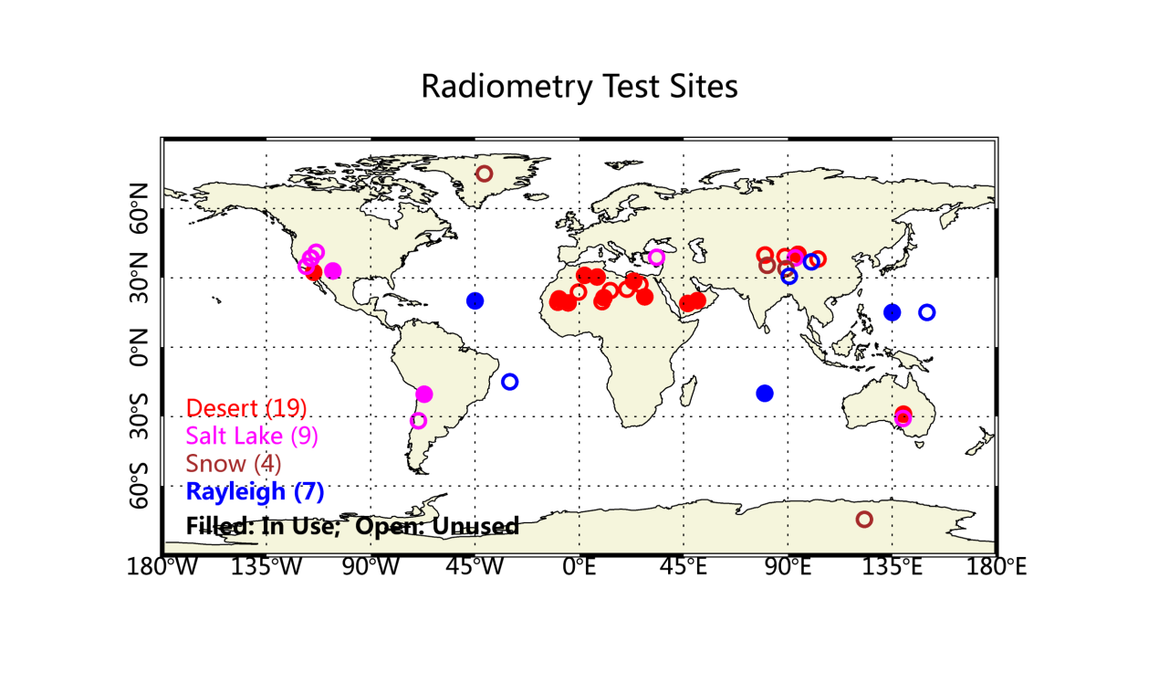
How to do the data extraction?
PICS(Pseudo Invariant Calibration Site) data extraction from granule L1
  Reference-MODIS, VIIRS, GOME-2, SCIAMACHY, Hyperion
  Each agency payloads, such as FY3/MERSI, MERIS
39 PICS targets are selected based on the CEOS and SADE recomended and results of the paper evaluation

Slide 6
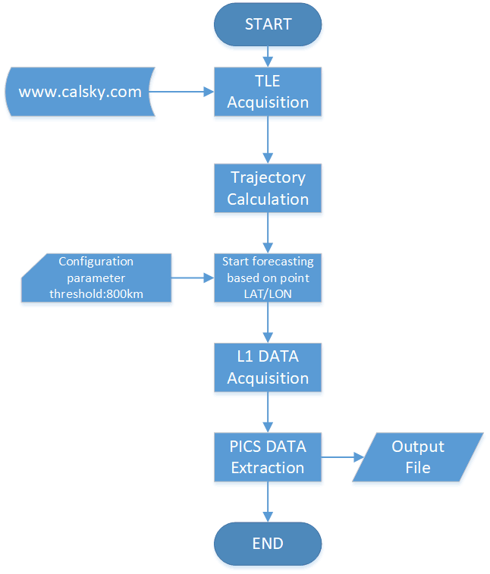
Flowchart of the PICS data extraction
1. Two Line Elements(TLEs) file of each satellite acquisiton;
2. Satellite trajectory calculation;
3. Start Forcasting based on the satellite trajectory.
Criteria: If the PICS sites' locations are no more than 800km from the forcasted sub-satellite track, then output the time of the satellite passby the nearest point of the PICS site.
4. Find the L1 data filename and download
5. Extration the ROI(255*255pixels of the centre) of the PICS data from the L1 data
Notes:
no = the SGP type “mean” mean motion at epoch
eo = the “mean” eccentricity at epoch
io = the “mean” inclination at epoch
Mo = the “mean” mean anomaly at epoch
ωo = the “mean” argument of perigee at epoch
Ωo = the “mean” longitude of ascending node at epoch
n˙ o = the time rate of change of “mean” mean motion at epoch
n¨o = the second time rate of change of “mean” mean motion at epoch
B∗ = the SGP4 type drag coefficient
ke = √
GM where G is Newton’s universal gravitational constant and M is the mass
of the Earth
aE = the equatorial radius of the Earth
J2 = the second gravitational zonal harmonic of the Earth
J3 = the third gravitational zonal harmonic of the Earth
J4 = the fourth gravitational zonal harmonic of the Earth
(t − to) = time since epoch

Slide 7
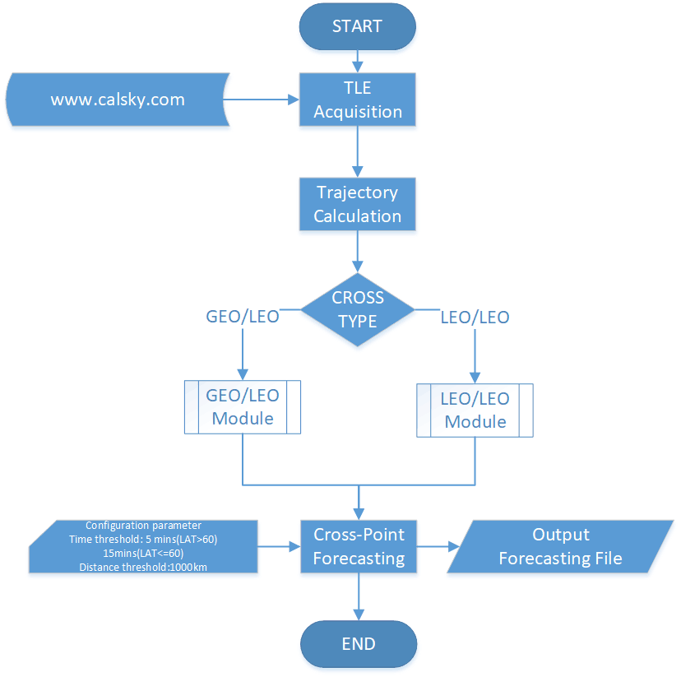
Flowchart of the SNO data extraction
1. Two Line Element(TLE) file of each satellite acquisiton;
2. Satellite trajectiory calculation;
3. Cross type judgment;
4. Cross-Point Forecastiing
Criteria:
Time threshold: 5mins(Lat>60),15mins(Lat<=60)
Distance threhold: <1000km
4. Output the L1 data filename

Slide 8
Data Catelog, Designation, Format
Data Catelog
  Common Data
  Source data
  CROSS
    Support data
    Result data
    ...
  PICS
    Support data
    Result data
    ...
CMA_GSICS
CommonData
SourceData
CROSS
PICS
title
orbit
sno
snox
FENGYUN-3D
METOP-A
SupportData
Results
InterfaceFile
Log
SupportData
Results
InterfaceFile
Log
NPP
AQUA
......

Slide 9
File Designation
SATName+SensorName_YYYYMMDD_HHMM_PICSName_lon+XXX.XXX_lat+XXX.XXX.HDF
FY3D+MERSI_20190201_0746_Algeria3_lon+030.320_lat+007.660.HDF

Slide 10
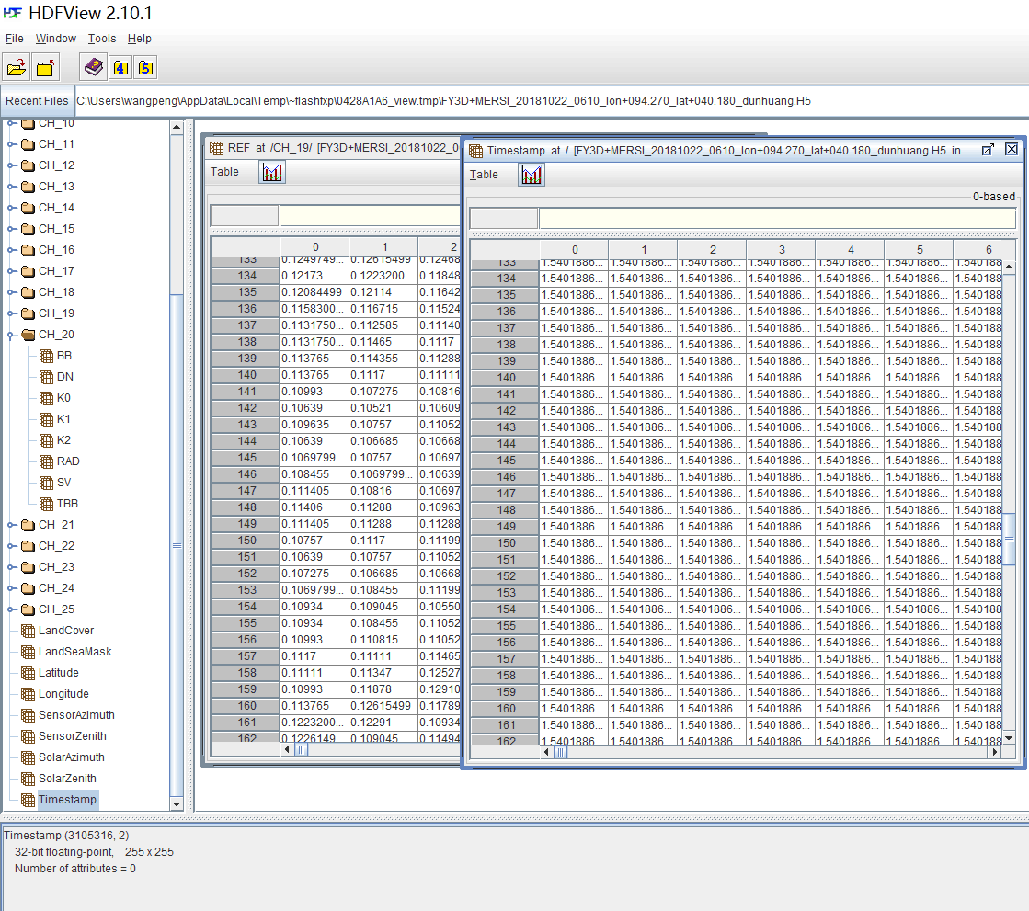
Data Format and structure
Format:HDF5
Structure:ROI(255*255pixel of the centre) of the L1 data which contains the PICS
Band: DN,REF,SV,BB,Cal_eff
Latitude:
Longitude:
Angle:
TimeStamp: (Coordinated Universal Time，UTC)

Slide 11
Outputs or tools can be shared in GSICS
Outputs:
  SNO Prediction Timetable
  PICS Prediction Timetable
  PICS extraction data
Tool : Cross Forecasting Module tool
  Module
  CMA GSICS THREDDS severs
  Website

Slide 12
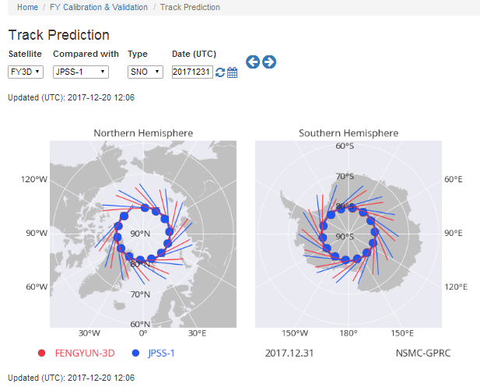
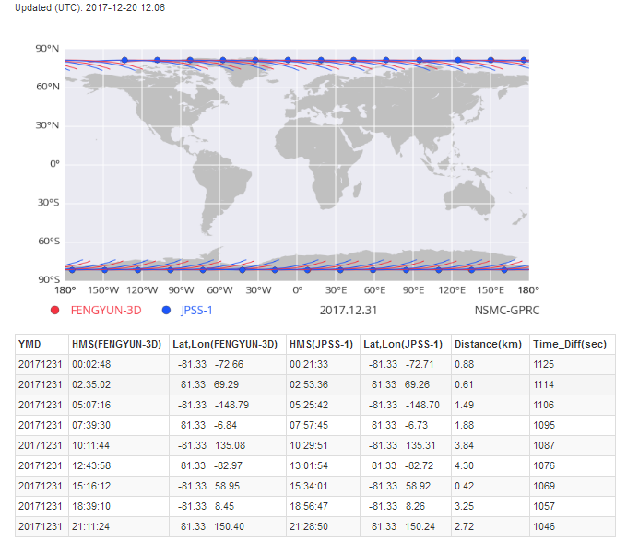
SNO Prediction Timetable

Slide 13
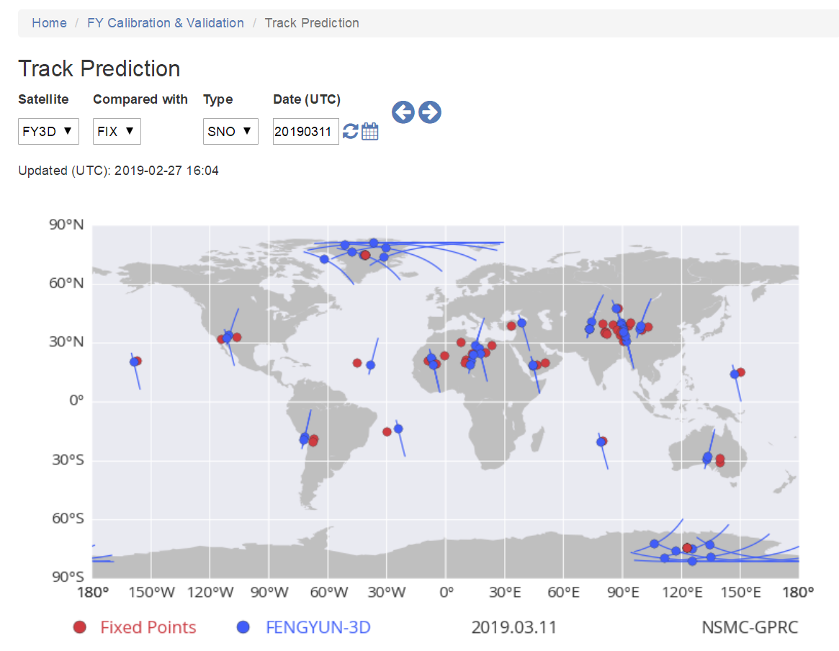
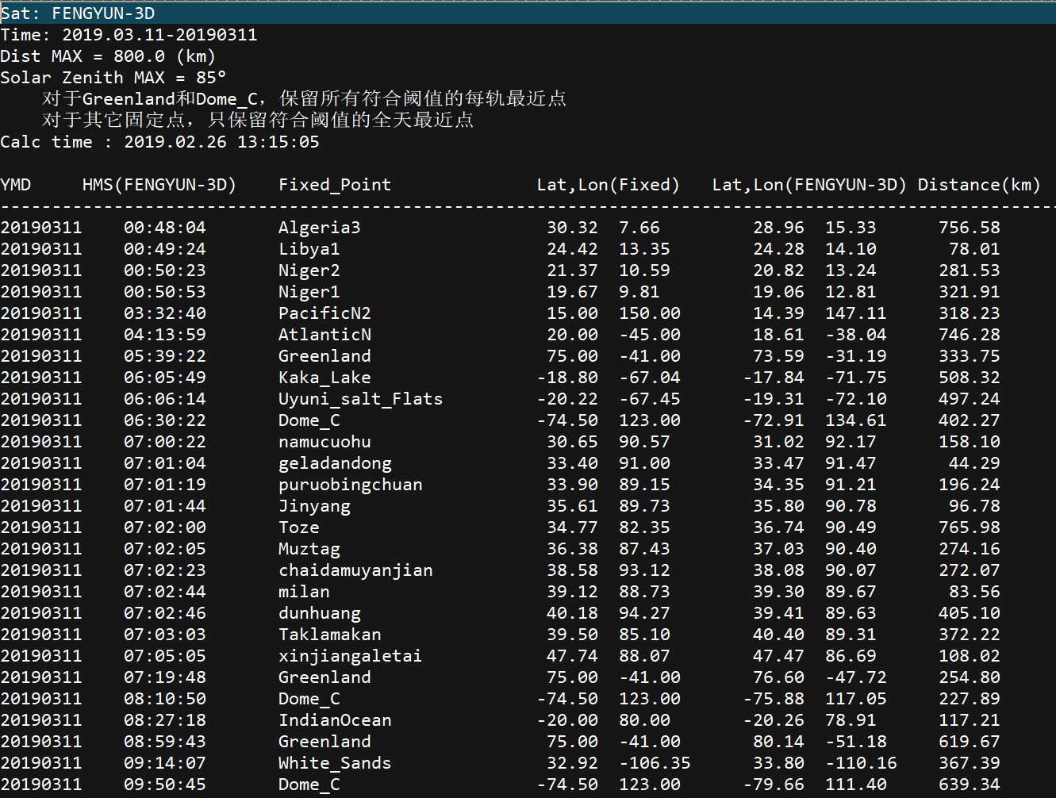
PICS Prediction Timetable

Slide 14
CFM tool
Program Language: python2
Module Name: Cross Forecasting Module (CFM.py)
Run env: windows/linux
Run example: python CMF.py cmf.cfg
Output: %(ROOT)s/SupportData/cross
arguments: cmf.cfg
﻿#### cfm.cfg 配置文件 #### [PATH] ROOT = /home/gsics/DISK2/CMA_GSICS TITLE = %(ROOT)s/SupportData/title ORBIT = %(ROOT)s/SupportData/orbit CROSS = %(ROOT)s/SupportData/cross SNOX = %(ROOT)s/SupportData/snox LOG = %(ROOT)s/Log [SAT_TYPE] GEO = FENGYUN-2C, FENGYUN-2D, FENGYUN-2E, FENGYUN-2F, FENGYUN-2G, FENGYUN-4A, HIMAWARI-8 [TITLE] #报文获取地址 URL = http://www.calsky.com/observer//tle.cgi?satid=%s&tdt=%f # 报文更新期限或允许延时（即报文3天没有更新也可保存为当天时间的报文，超过则不下载） DELAY = 3 [ORBIT] ORBIT_DAYS = 14 #轨迹计算的天数，业务上是14, windows的轨迹计算程序有问题 不回自动向前找报文，所以只能预报当天 ORBIT_EXE = orbit_calculate.exe #根据部署系统类型自动到项目目录exe/windows或是linux下查找此程序 [CROND] # 不跟参数执行时，滚动天数 rolldays = 1, 2, 3, 4, 5, 10, 15 [SAT_ID] #卫星报文标识ID清单 FENGYUN-3A = 08026A [[FENGYUN-3A]] area_list = , # ALL, 或者是区域名字 fix_list = group1, # 只能写组的名字 fix_dist = 800 # unit KM sat_list = AQUA, TERRA, METOP-A, METOP-B, NPP # 目标卫星 sat_dist = 1000 # unit KM sat_time_high = 5, 5, 5, 5, 22 # unit mins sat_time_low = 15, 15, 15, 15, 22 # unit mins [[FENGYUN-3D]] area_list = , # ALL, 或者是区域名字 fix_list = group1, # 只能写组的名字 fix_dist = 800 # unit KM sat_list = AQUA, METOP-B, NPP, TERRA, METOP-A, OCO-2, TANSAT, Tiangong-2, JPSS-1 # 目标卫星 sat_dist = 1000 # unit KM sat_time_high = 5, 25, 20, 5, 25, 5, 5, 5, 20 # unit mins sat_time_low = 15, 15, 20, 15, 15, 15, 15, 15, 20 # unit mins [[NPP]] fix_list = group1, # 目标固定点 只能写组的名字 fix_dist = 800 # unit KM [FIX_LIST] #站点名称，经度，维度 [[group1]] xinjiangaletai = 88.0710, 47.7415 #新疆阿勒泰 qinghaihu = 100.15, 36.88 #青海湖 wuwei = 102.97, 38.1 #武威 dunhuang = 94.27, 40.18 #敦煌 milan = 88.73, 39.12 #米兰 Toze = 82.35, 34.77

Slide 15
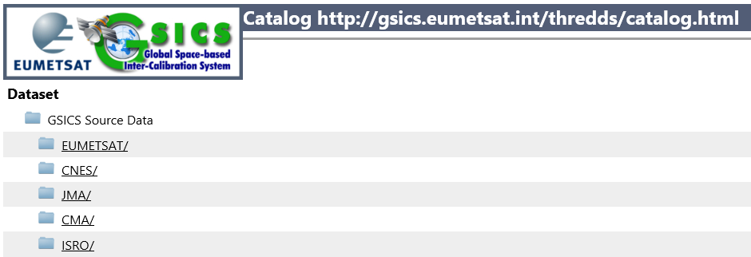
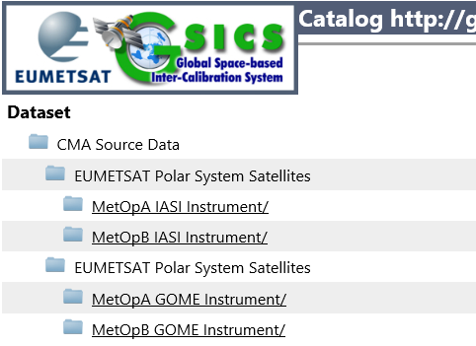
Data Dissemination
Cropped data can be shared by using agency’s Thredds server
  Directory: GSCIS Souce Data——Agency (User)
  Example: EUMETSAT Prepared EUM LEO data (IASA and GOME) for CMA
    Cropped region fit CMA’s GEO satellite

Slide 16
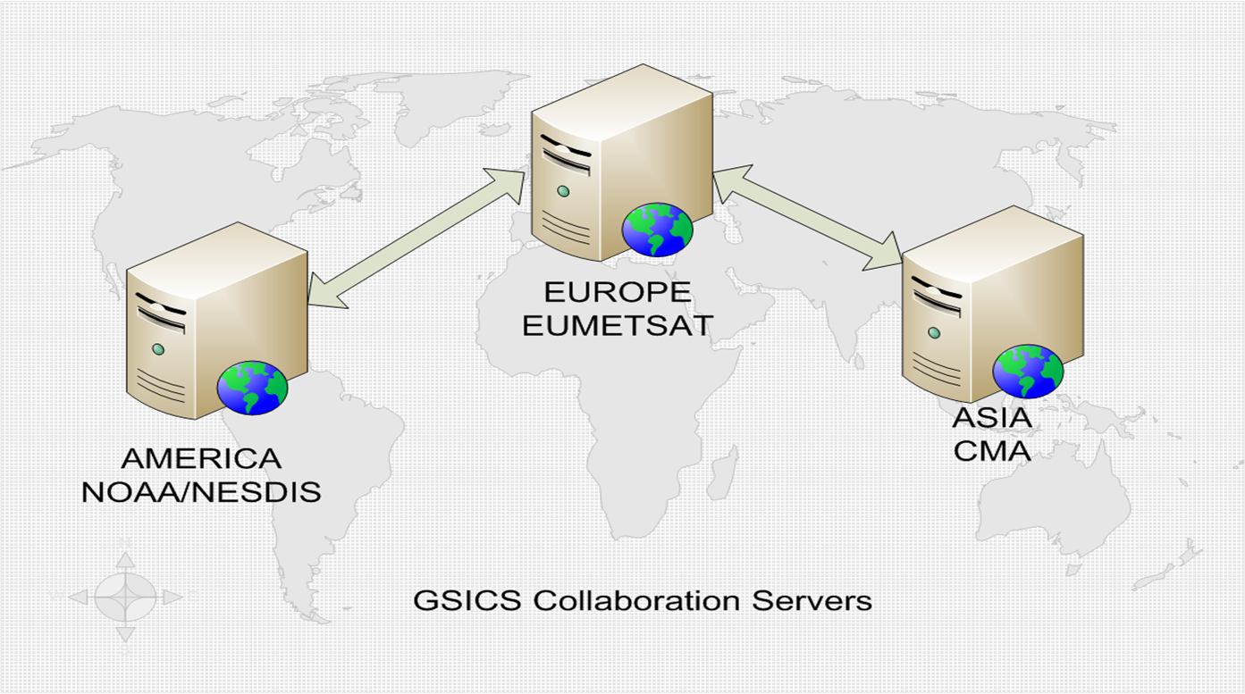
Current Status of GSICS THREDDS severs
3 Collaboration Servers available
GSICS Collaboration Server | Server URL
EUMETSAT GSICS Server (Europe) | http://gsics.eumetsat.int/thredds/catalog.html
NOAA GSICS Server (Americas) | http://gsics.nesdis.noaa.gov/thredds/catalog.html
CMA GSICS Server (Asia) | http://gsics.nsmc.cma.gov.cn/thredds/catalog.html

Slide 17
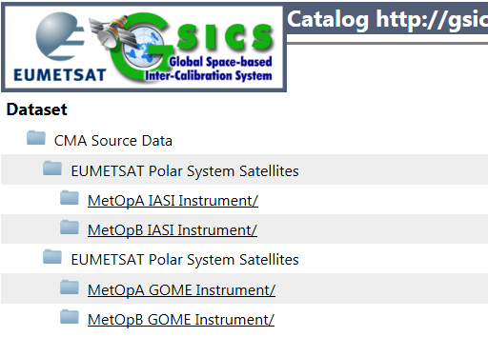
EUMETSAT L1 Source Data For CMA
Satellite: MetopA MetopB
Instrument: IASA GOME
Server: EUMETSAT GSICS Thredds
Timeline: Near real time
Spatial: Cropped for FY-2
Format:
  IASA: NetCDF
  GOME: HDF 5.0
    GOME NC demo data is being investigated by CMA now
We hope IASI and GOME-2 is also provided for FY-3 SNO collocation in the next step instead of our order from CLASS.

Slide 18
Summary
Requirement of L1 data sharing in collaboration servers for GSICS operation is necessary.
CMA developped PICS/SNO data extraction scheme and gave a demostration of PICS/SNO extracted data.
Outputs and tools can be shared in GSICS.
We should incorporate L1 data sharing into the future Working Plan of GDWG.

Slide 19
Suggestion to GSICS/GDWG
Building the public platform for predicting SNO cross-pionts or PICS targets is necessary. The public platform will be avaliable not only for GSICS members but also for public research user.
  CMA could provide prediction tool or help to build the platform.
  Some demos, including the PICS/SNO Prediction Timetable, L1 filename and PICS extraction data, will be avaliable on CMA GSICS THREDDS sever.
PICS extraction data exchange on GSICS THREDDS or sharing greatly reduce data volume and transfer time.
  ~8000MB(before PICS extraction) VS ~200MB(after PICS extraction) per day

Slide 20
Thanks

