Slide 1
Visualization of GSICS Products on GSICS Plotting Tool - Current Status and User Requirements
Masaya Takahashi
Japan Meteorological Agency

Slide 2
Overview and Purpose
Purpose of this talk
To introduce GSICS Plotting Tool
To introduce GRWG requirements and recent GDWG activities
To discuss what GDWG can do in future

Slide 3
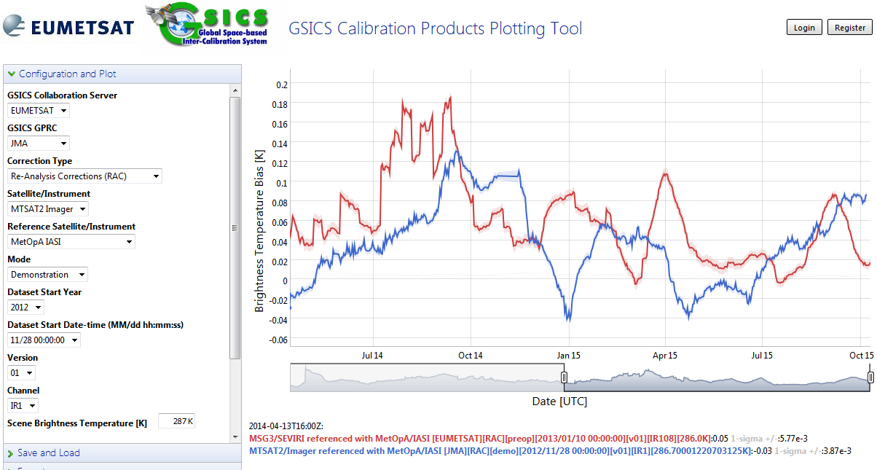
GSICS Plotting Tool
http://gsics.tools.eumetsat.int/plotter/
GPRCs have their own product monitoring/plotting websites
GSICS Plotting Tool: developed at EUMETSAT based on the requirements document (EUM/OPS/TEN/11/3804)
Primary user of the plotting tool: product users, NOT developers
Common look and feel (easy comparison among multiple products)
Dynamical plotting (no need to prepare lots of figures)
At present, GEO-LEO-IR is only supported

Slide 4
Recent Progress on Plotting Tool
GRWG: Preparation of the requirements document
Lead by Sebastien Wagner (EUMETSAT)
Document was circulated to gsics-dev in Dec. 2017 and updated
Implementation will be done under EUMETSAT’s MICMICS (Mission Integrated Calibration Monitoring Inter-Calibration System)
The codes would be shared on GDWG GitHub repository (R.GRWG.2018.5g.1)
GDWG: Updates of the tool by member agencies
ISRO has supported NRTC files
RAC (Re-Analysis Correction): 1 file contains whole time series of data
NRTC (Near Real-Time Correction): 1 file contains info at one target time

Slide 5
Discussion
Future collaborations among agencies
To be discussed at 9p
Need for re-considering the use of neteCDF’s Enhance Data Model – if GRWG requires?

Slide 6
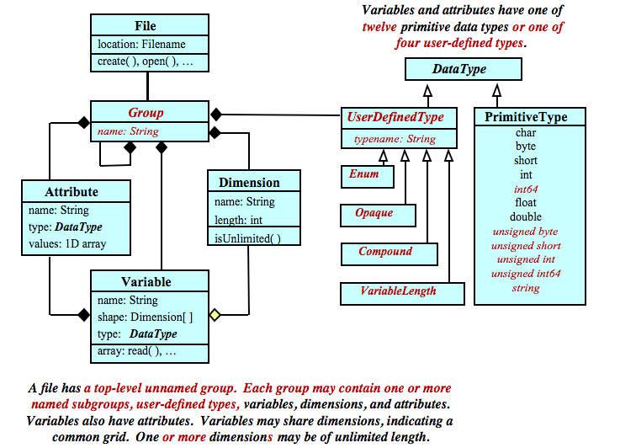
NetCDF-4 Data Model
New features: Groups and User-Defined Types
http://www.unidata.ucar.edu/software/netcdf/workshops/2011/datamodels/Nc4-uml.html
Notes:
For more information, see:
https://www.unidata.ucar.edu/presentations/Rew/rew-egu.pdf

Slide 7
Use of netCDF-4 “grouping” function (Enhanced Data Model)
SEVIRI vs. Aqua/MODIS VISNIR product
This is NOT the GDWG recommendation because:
It breaks backward compatibility
Unknown whether it could be supported by existing GSICS Tools (e.g. THREDDS server, Plotting Tool)
GDWG.2016.6g.2: JMA to investigate the impact of enhancement data model, use of grouping
Delayed due to limited resources
Combined result (DCC+Moon+…)
Global attributes, Dimensions, Variables
Method1 (Deep Convective Cloud)
Global attributes, Dimensions, Variables
Method2 (Moon)
Global attributes, Dimensions, Variables
Method3 (Desert)
Global attributes, Dimensions, Variables

Slide 8
When to Use the Enhanced Data Model – from 2011 Unidata NetCDF Workshop
http://www.unidata.ucar.edu/software/netcdf/workshops/2011/datamodels/Nc4-WhyUse.html
Enhanced data model: offers rich features for structuring data, but breaks backward compatibility
Classic model: simple, well-understood, and had been around for a long time
a
Reasons to use the classic model:
Data using the classic model can be read by all existing netCDF software
Writing programs for classic model data is easier
Most or all existing netCDF conventions are targeted at the classic model
Many great features, like compression, parallel I/O, large data sizes, etc., are available within the classic model
Reasons to use the enhanced model:
Complex data structures can be represented very easily in the data, leading to easier programming
Notes:
Description in the 2011 Unidata NetCDF Workshop website...
If existing HDF5 applications produce or use these data, and depend on user-defined types, unsigned types, strings, or groups, then the enhanced model is required.
In performance-critical applications, the enhanced model may provide significant benefits.

Slide 9
Backup Slides

Slide 10
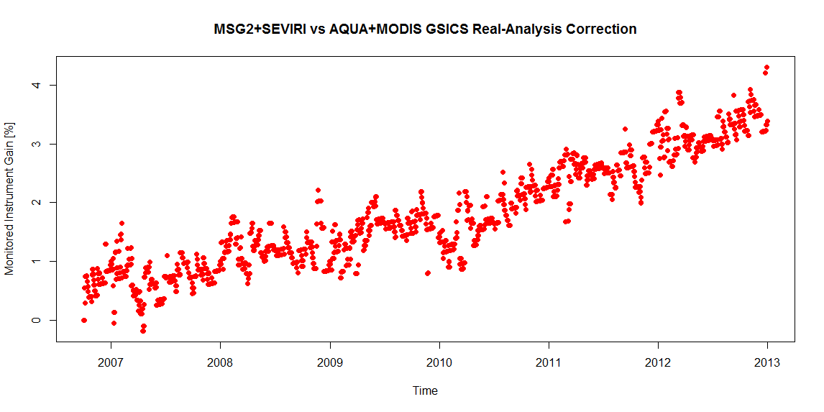
Sample image of DCC inter-calibration results on the Plotting Tool
Time series of MSG-2/SEVIRI vs. Aqua/MODIS DCC RAC product by EUMETSAT (S. Wagner)
Monitored Instrument Gain [%]
0 1 2 3 4
Inter-calibration gain, scaled at the first result [%]

Slide 11
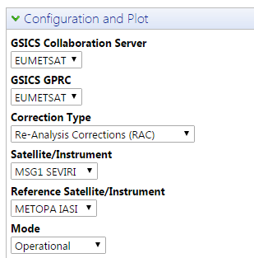
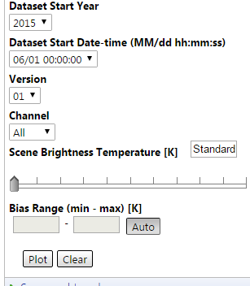
Plotting elements - IR/VNIR products
This part could be the same in IR/VNIR products
Different element is required for VNIR products
Need multiple classes to handle different product types
Need different interface
IR: Brightness temperature [K]
VNIR: Instrument trend [%]

