Slide 1
Introduction to EVDC (ESA Atmospheric Validation Data Centre)
Paolo Castracane¹, Angelika Dehn²
1)-RHEA SYSTEM S.p.A.; 2)-ESA/ESRIN
4-8 Mar 2019 GSICS Data and Research WG annual Meeting, ESA/ESRIN Frascati

Slide 2
Table of Contents:
Overview of EVDC
Satellite Element
Cal/Val Data
GEOMS format
EVDC tools:
Search Satellite Form
Sub-setting tool
Orbit Predictor and Overpass tool
Systematic Service
Data Viewer
GEOMS file generator
Conclusion

Slide 3
EVDC Overview
The ESA atmospheric Validation Data Centre (EVDC) serves as a central, long-term repository for archiving and exchange of correlative data for validation of atmospheric composition products from satellite platforms. EVDC web Portal: https://evdc.esa.int/
The objective of the EVDC is to provide an online information system that supports users in managing and exploiting campaign datasets for Earth Observation missions and applications.
EVDC provides tools for
Cal/Val data conversion, upload, archival, as well as, query and download
Satellite orbit prediction and Product query, download subsetting
EVDC includes relevant documentation (GEOMS, DCIO, Newsletters, etc.)
access of the Sentinel-5P MPC for routine validation
Current focus on Sentinel-5P and AEOLUS

Slide 4
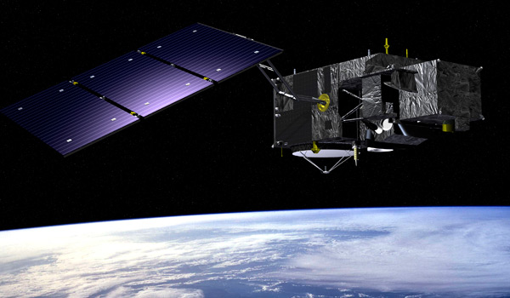
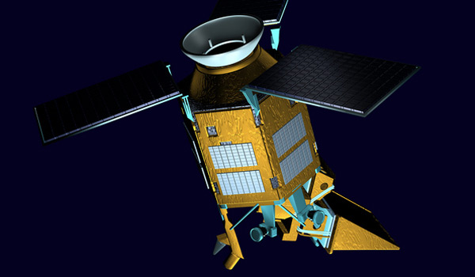
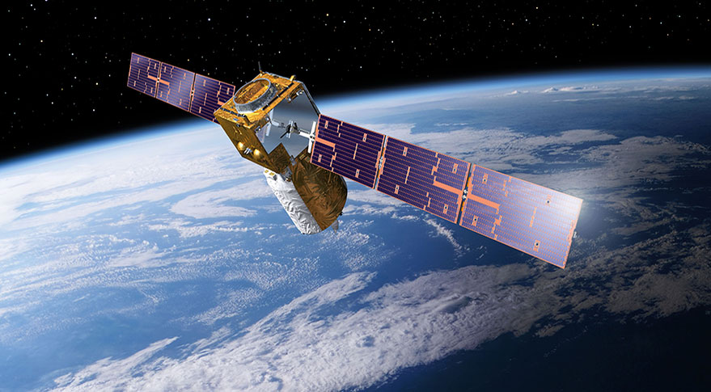
The satellite Element
Beyond the CalVal data, the EVDC provides access to satellite data subset for specific missions over user defined areas.
Having satellite data subsets will greatly increase the possibility of validating missions over long time series and understanding the behaviour of sensors during the entire mission.
Current focus on Sentinel-5P Products and AEOLUS data

Slide 5
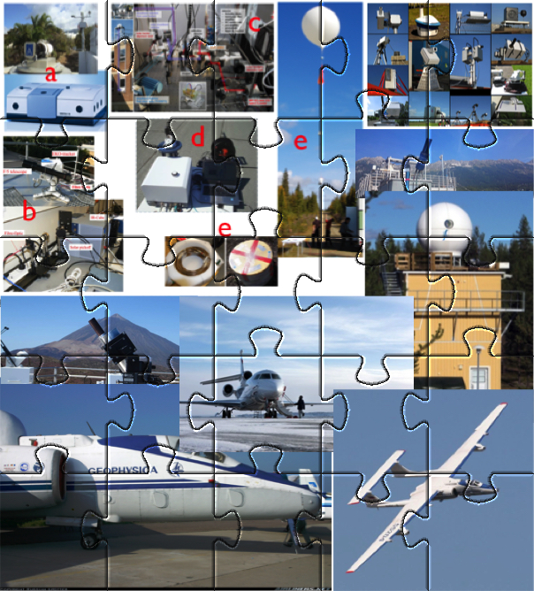
Atmospheric Cal/Val Data
EVDC Contains a large variety of data and tools used for validation of satellite atmospheric composition products:
Aircraft data; Assimilation data; Ground based and balloon data from a wide range of stations and measurement principles; Datasets mirrored from existing Cal/Val networks e.g. NDACC; ECMWF data provision and tool
In particular it includes Fiducial Reference Measurement (FRM) from several ESA projects/campaigns
Users have to sign a protocol for exchange data (upload and download) with the EVDC
Access to the EVDC data hosted at NILU is granted only after having signed this protocol.

Slide 6
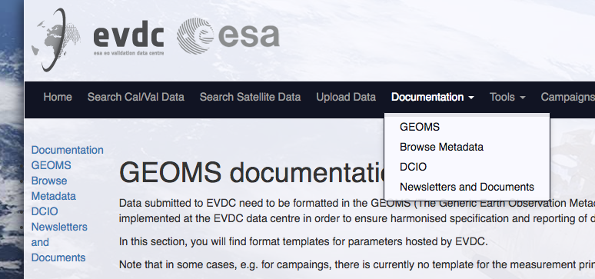
GEOMS metadata format:
The Generic Earth Observation Metadata Standard (GEOMS) is implemented at the EVDC data centre in order to ensure harmonised specification and reporting of data and metadata.
Most of the EVDC data are submitted according the GEOMS standard, to enhance the usability of correlative data in Cal/Val and ensure an extensive quality control.
GEOMS is developed in collaboration between ESA, NASA and NDACC.
EVDC hosts documentation and
GEOMS conversion routines

Slide 7
EVDC embedded tools
The EVDC portal includes a number of tools to support validation activities.
Some of these are already available, others are undergoing testing:
Search Satellite Form
Sub-Setting Tool
Orbit Predictor and Overpass tool -> Search Satellite data
Systematic Service
Search Cal/Val data
Data Viewer
Online GEOMS file generator

Slide 8
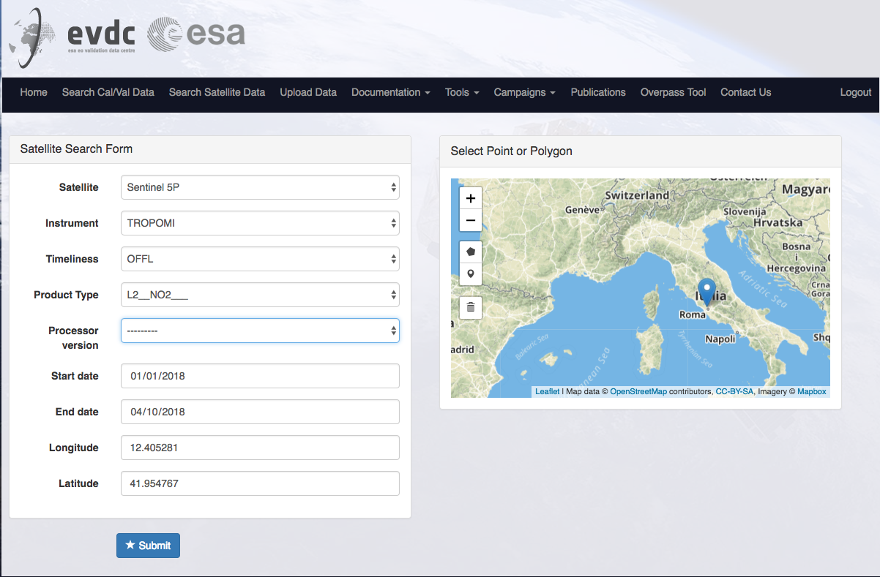
Search Satellite Form
Satellite/Instrument customization
Product info
Date/time window
Spatial coordinates

Slide 9
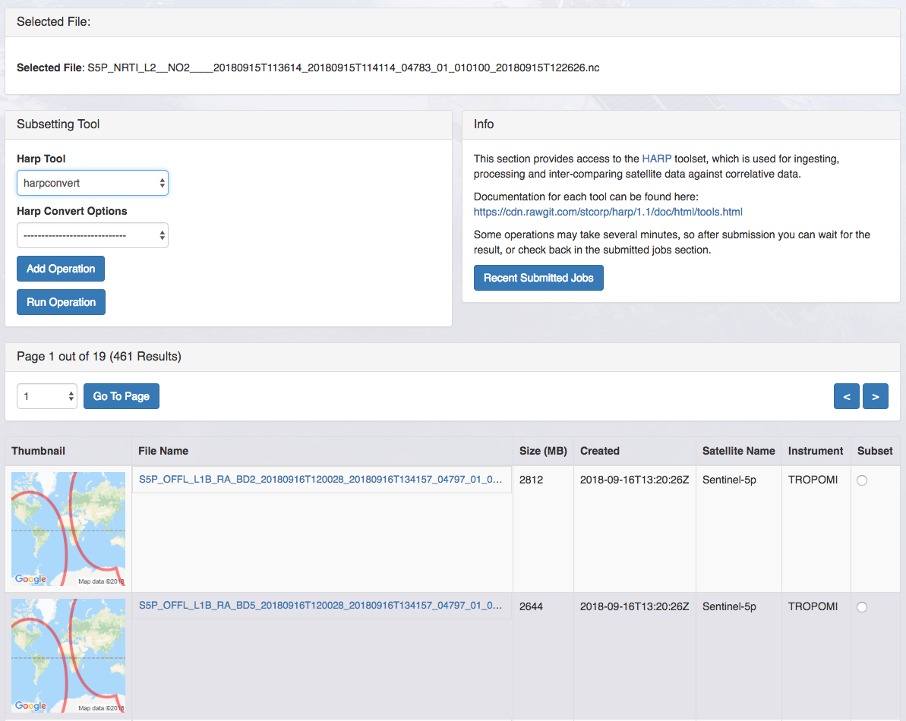
Satellite data extraction:
Sub-Setting Tool
The Sub-setting tool uses the
HARP toolkit [1] as its backbone residing on the EVDC cloud deployed server platform.
It removes the need for users
to install the toolkit,
to bear with large files,
to have huge computational load
[1] HARP documentation: https://cdn.rawgit.com/stcorp/harp/master/doc/html/index.html

Slide 10
Sub-Setting Tool -example

Slide 11
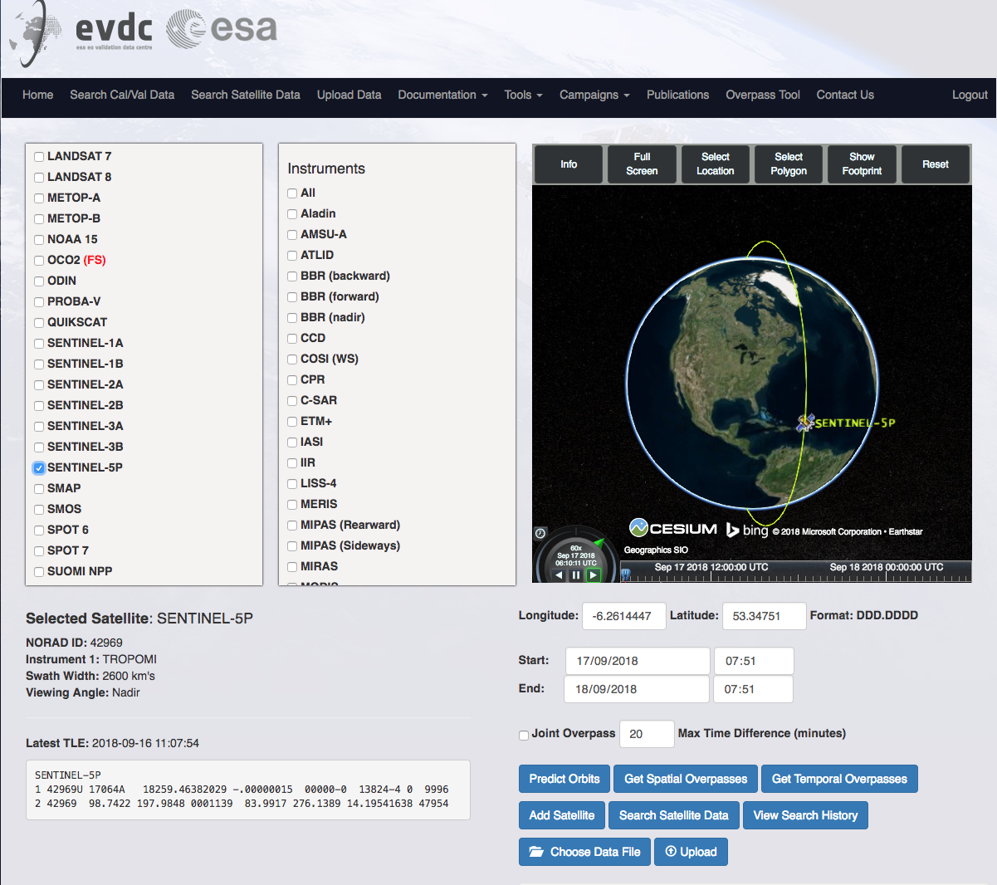
Orbit Predictor and Overpass Tool
Continuos and automatic TLEs update.
New Satellites/Instruments can be easily included.
New features added:
Search Satellite Data
Selection from Overpass
Download of Overpass as
KML file
Data Viewer

Slide 12
Searching Satellite data by OPOT Example

Slide 13
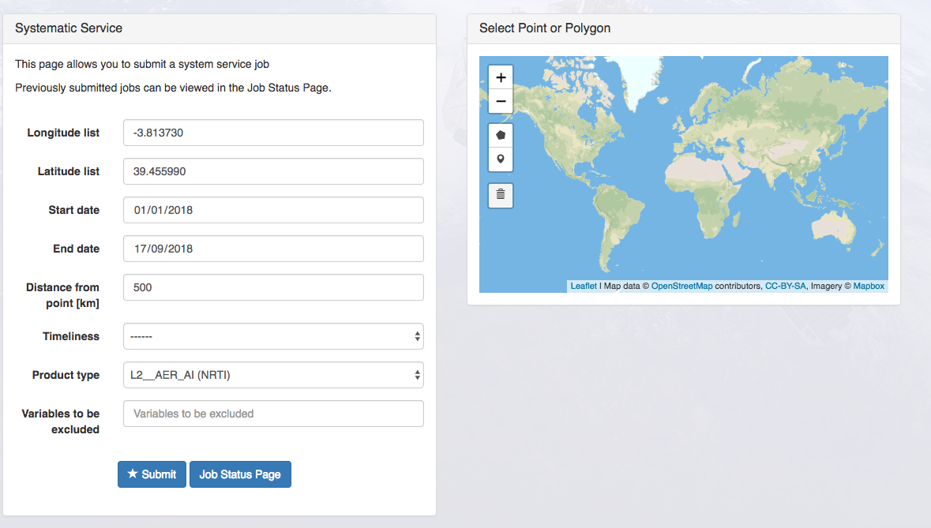
Systematic Service for Satellite Sub-setting
The systematic service allows to specify sub-setting jobs to run on a number of files at once, rather than individually.
User can specify a location/polygon, date range, and product type, and the system automatically sub-sets all files which match that query.
User can, then, check the Job Status Page, to download the results files individually, or in bulk.

Slide 14
Systematic Service for Satellite example

Slide 15
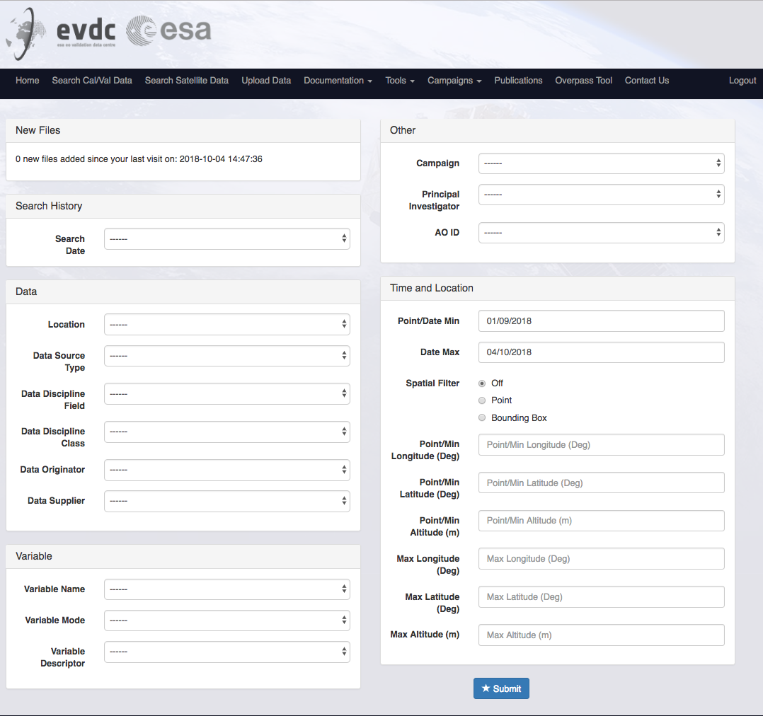
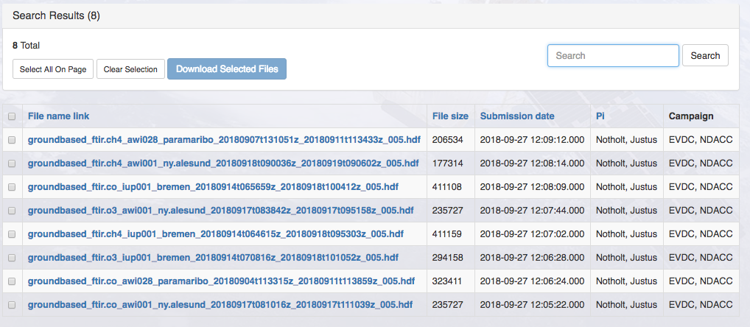
Query the Cal/Val Data
The Cal/Val data access in terms of query, upload and download has been strongly improved
Interface with Data Viewer

Slide 16
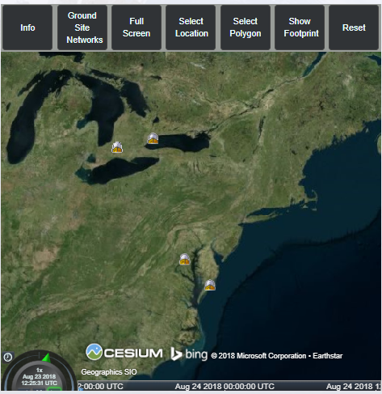
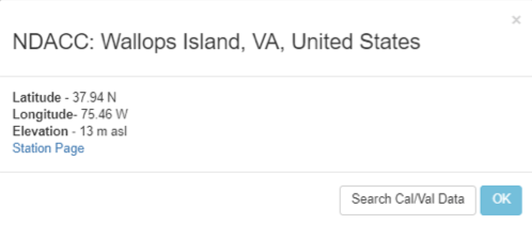
Data Viewer
The EVDC Data Viewer is built on top of the Orbital Predictor and Overpass Tool (OPOT). The EVDC Data Viewer’s main feature will be the display of ground site networks, which will give more info when clicked upon, and allow a search to be performed on the Cal/Val database. In addition, support for the KML format for overpass details will be provided.

Slide 17
Online GEOMS file generator
The tool provides 2 services:
Register a new metadata template: This would be a one-off requirement to define a particular site, instrument and dataset version. The PI completes a set of prompts and, based on these, a metadata template is created that will subsequently be used, together with the data upload, to create the GEOMS file(s).
GEOMS file creation: The data provider uploads a single ASCII data file, or a compressed zip or tar file containing multiple data files, which the on-line tool converts to GEOMS compliant file(s). (HDF4, HDF5 or netCDF)

Slide 18
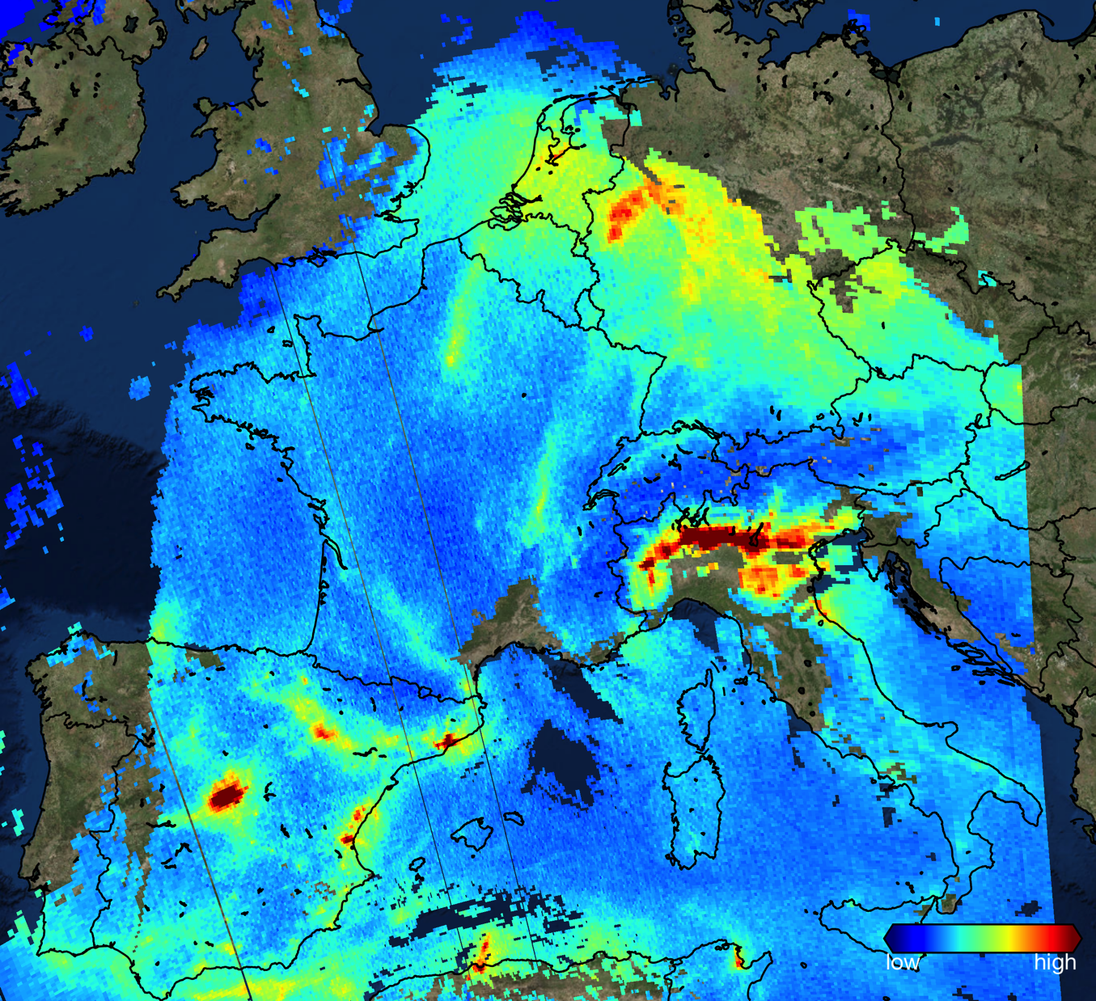
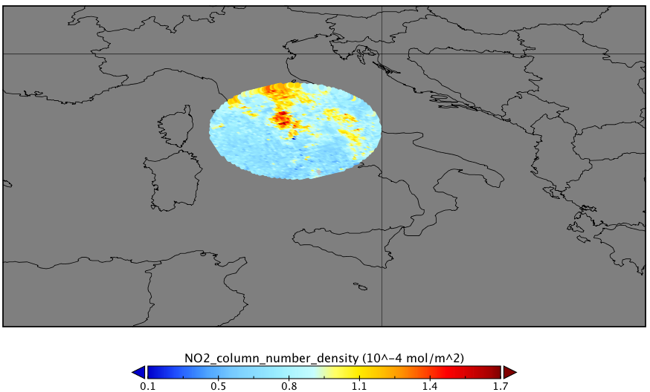
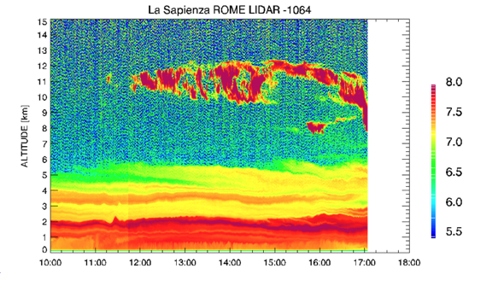
Examples of Validation
Access of Sentinel-5P MPC for routine validation
See Poster:”The Boundary layer Air Quality-analysis Using Network of Instruments (BAQUNIN)” A. Iannarelli, S. Casadio
Utilization of the EVDC Overpass predictor
Cal/Val data measured in the supersite -> GEOMS formatted and provided to EVDC
NO₂ over Europe by Sentinel-5P

Slide 19
Conclusion
Sentinel-5P data available via EVDC – undergoing test
Features to support Sentinel-5P validation:
Search Cal/Vl data – improved
Overpass tool with added functionalities
Satellite Search Form - updated
Subsetting Tool
Systematic Service
Data Viewer,
online GEOMS generator
Next Steps:
Finalization of the undergoing test

Slide 20
Thank you!

