Slide 1
Impact of Global Space-based Inter-Calibration System (GSICS) Corrections on Meteosat/SEVIRI Level-2 Products
Tim Hewison, Sauli Joro, Colin Duff, Jagjeet Nain, Phil Watts, Hans-Joachim Lutz
2018 EUMETSAT Conference

Slide 2
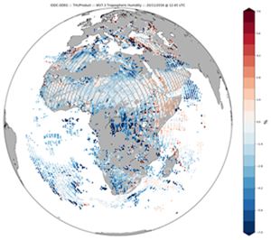
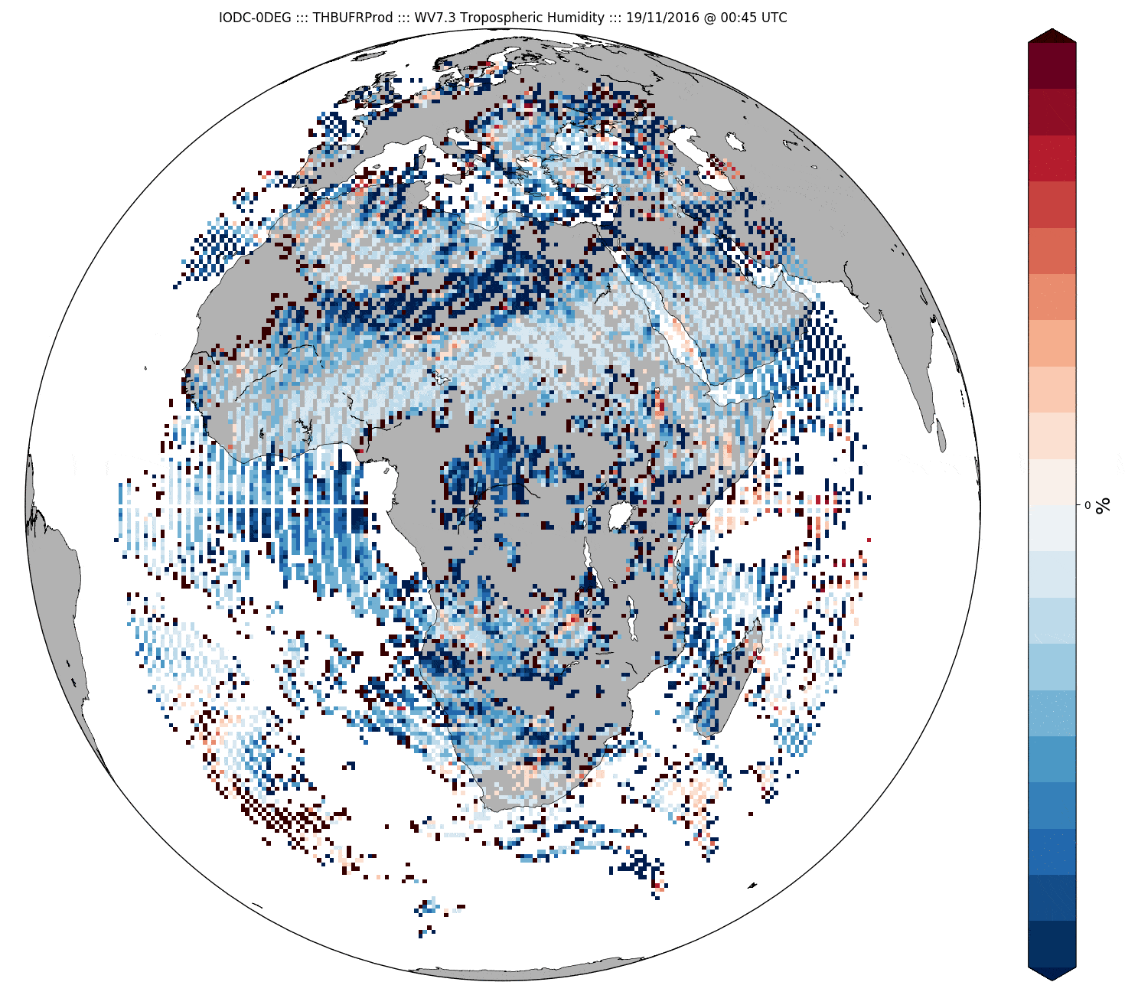
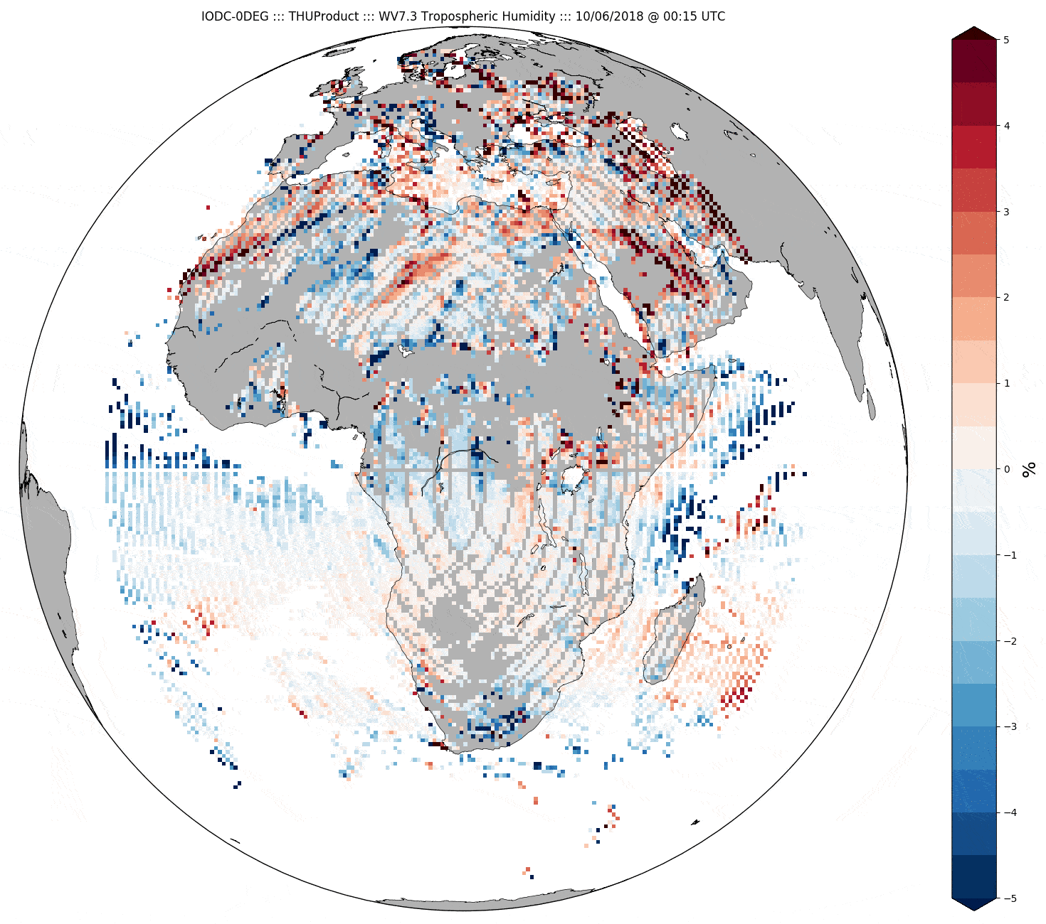
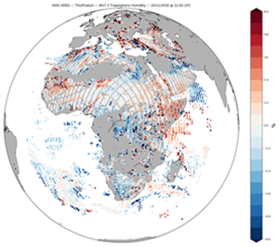
Trigger for Meteosat-8 Calibration Check
Meteosat-8 moved to 41.5°E in 2016
Validated MPEF products with Met-10
In overlap region
Tropospheric Humidity from WV7.3
1.8% lower in Meteosat-8
Applying GSICS Correction
Reduced difference to -0.1%
But that was just one case
Extended time series show diurnal variation
Similar patterns in O-B @ ECMWF (See Chris Burrows, Monday)
Rotating bias pattern
Difference of THU WV7.3 from Met8-Met10
20 Nov 2016 12:45 UTC before GSICS Correction (above)
After GSICS Correction (below)
Difference of THU WV7.3 from Met8-Met10
19-21 Nov 2016 animation before GSICS Correction (above)
After GSICS Correction (below)

Slide 3
Global Space-based Inter-Calibration System
What is GSICS?
Global Space-based Inter-Calibration System
Initiative of CGMS and WMO
Effort to produce consistent, well-calibrated data from the international constellation of Earth Observing satellites
What are the basic strategies of GSICS?
Improve on-orbit calibration by developing an integrated inter-comparison system
Initially for GEO-LEO Inter-satellite calibration
Being extended to LEO-LEO
Using external references as necessary
Best practices for calibration & characterisation
This will allow us to:
Improve consistency between instruments
Reduce bias in Level 1 and 2 products
Provide traceability of measurements
Retrospectively re-calibrate archive data
Better specify future instruments
EUMETSAT | CNES | JMA
NOAA | CMA | KMA
ISRO | NASA | WMO
USGS | NIST | JAXA
ROSHYDROMET | IMD | ESA
Notes:
3
Well, what is GSICS?
The Global Space-based Inter-Calibration System (GSICS) is an initiative of CGMS and WMO, which aims to ensure consistent calibration and inter-calibration of operational meteorological satellite instruments.
One of the basic strategies of GSICS is to develop an integrated on-orbit cal/val system - initially by LEO-GEO Inter-satellite/inter-sensor calibration.
This will then allow us to provide corrections to improve the consistency between instruments, produce less biased level 1, and therefore, level 2 data, and ultimately, retrospectively re-calibrate archive data, which is of great interest in the climate monitoring community

Slide 4
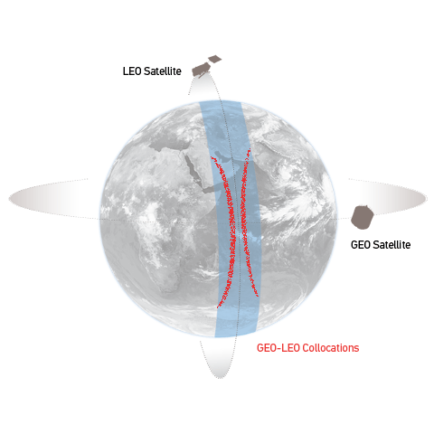
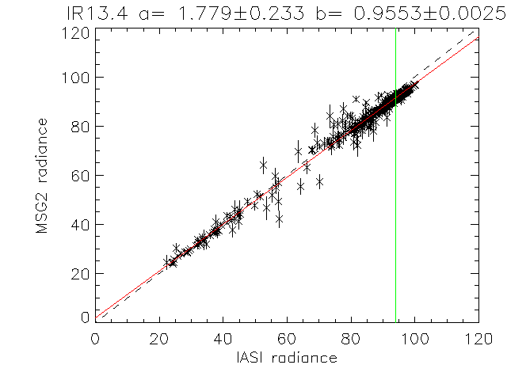
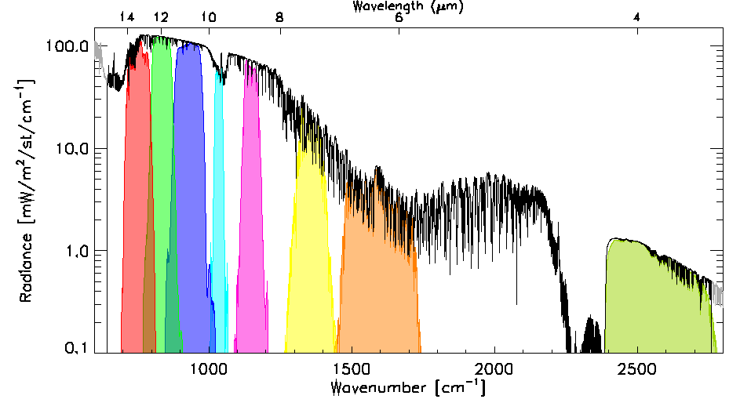
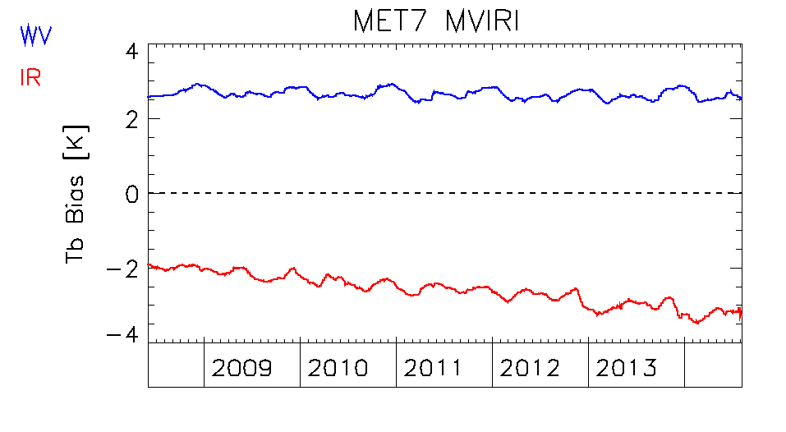
GSICS Corrections for GEO imagers’ IR channels
Collocate in Space, Time, Angle
“Simultaneous Nadir Overpasses” (SNOs)
Tie to contemporaneous reference
With very small uncertainty
Hyperspectral Reference (IASI)
Spectral Convolution
Can diagnose SRF errors
Compare
Regression of collocated radiances
Generate GSICS Correction
Updated daily
EUMETSAT GSICS Server
Evaluate & Monitor Bias

Slide 5
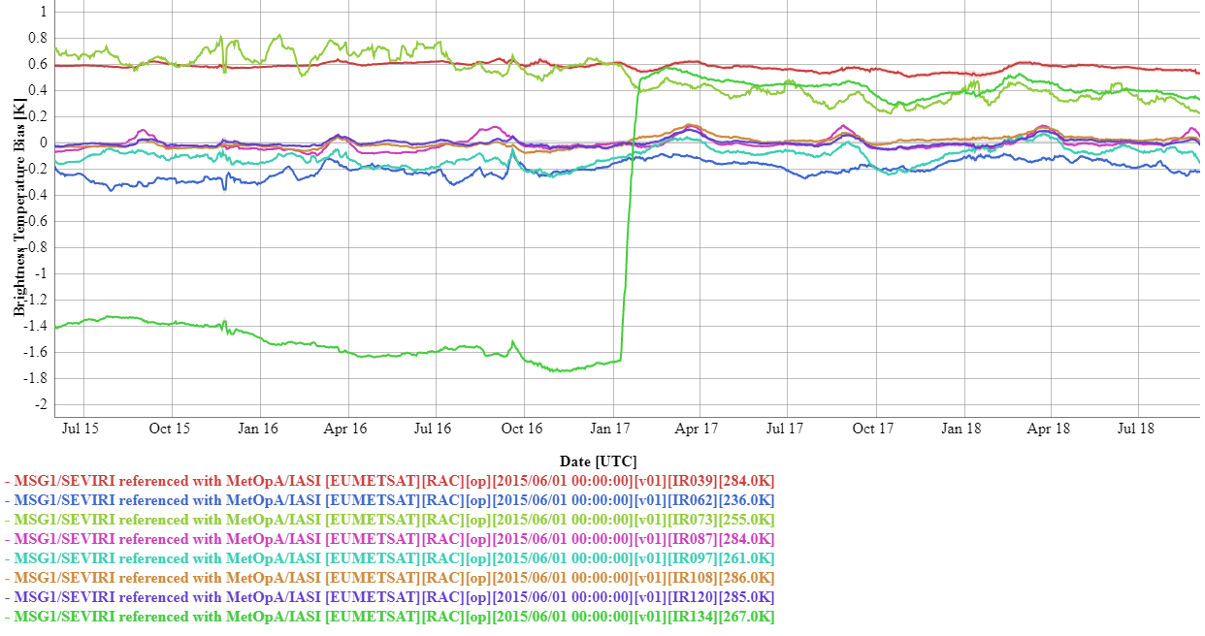
Bias in Meteosat-8/SEVIRI IR Channels wrt IASI-A
Biases ~stable over last 3 years
<±0.2K in most channels
~+0.6K in IR3.9 & WV7.3 ±0.1K p-p
Summer 2016: Met-8 moved to IODC
Jan 2017: Decontamination
IR13.4 jumped +2.2K, WV7.3 -0.2K
http://gsics.tools.eumetsat.int/plotter/

Slide 6
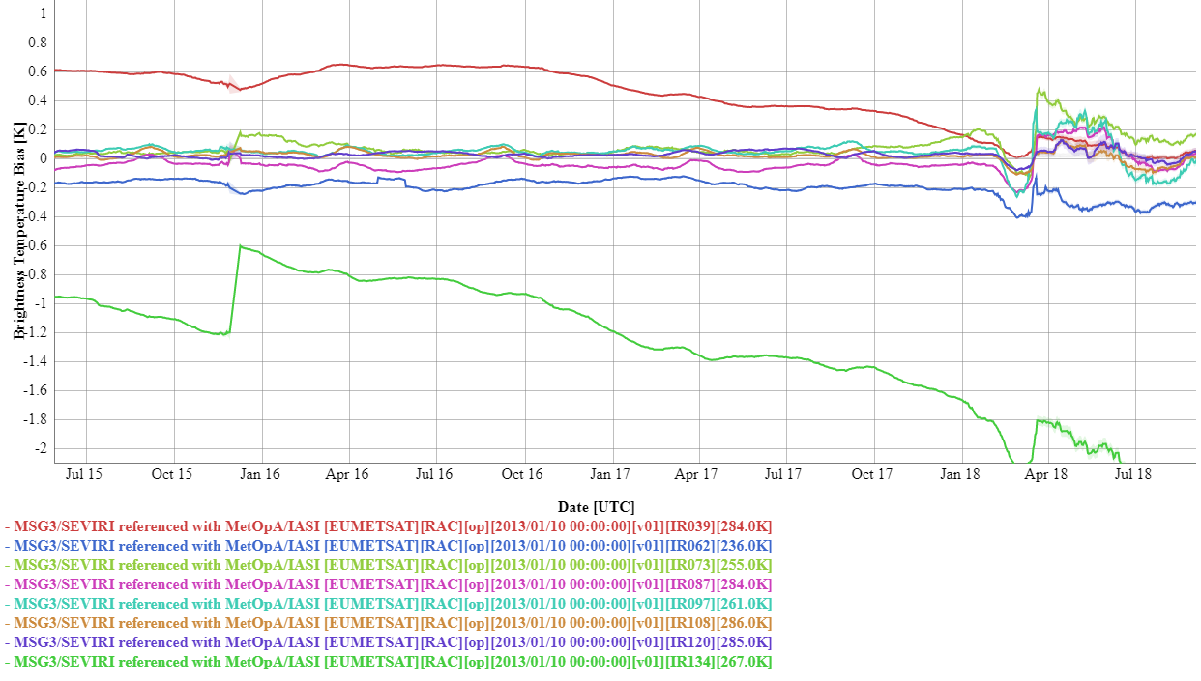
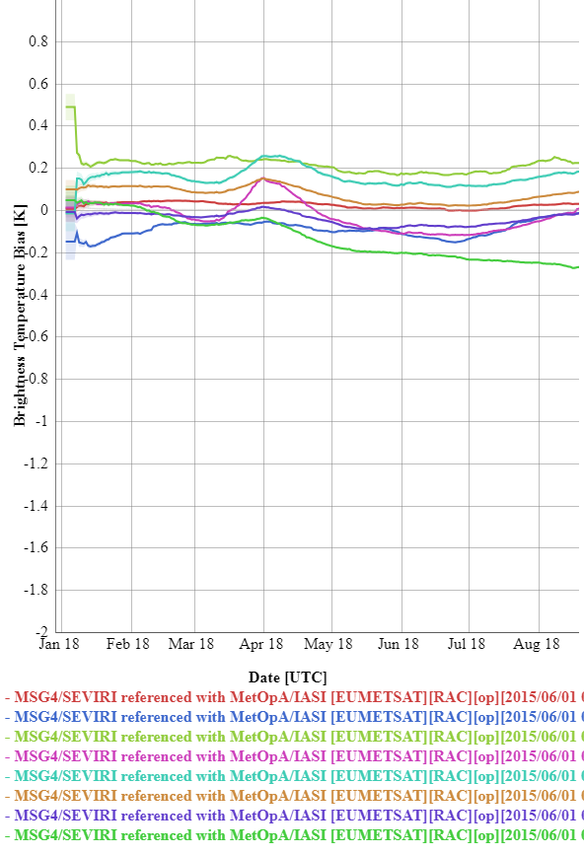
Bias in Meteosat-10/SEVIRI IR Channels wrt IASI-A
Summer 2016:
IR3.9 bias ~+0.6K
IR13.4 bias ~-0.8K
Small Biases in other channels <±0.2K
Biases very stable during 2018
Small Biases in all channels <±0.2K
http://gsics.tools.eumetsat.int/plotter/

Slide 7
Bias in Meteosat-11/SEVIRI IR Channels wrt IASI-A
Biases very stable during 2018
Small Biases in all channels <±~0.2K
http://gsics.tools.eumetsat.int/plotter/

Slide 8
GSICS NRT Corrections impact on MPEF L2 Products
GSICS NRT Corrections available in L1.5 header
As GSICSCalCoeff and GSICSOffsetCount
Easy to switch for operational calibration coefficients
Parallel runs of MPEF L2 product suite
With and without GSICS Correction
Over 2-week period 2018-06-01/15
For SEVIRI on Meteosat-8 and Meteosat-11
Evaluated impact of GSICS Correction on:
Cloud Mask (CLM)
Global Instability Index (GII):
K-index, Lifted-index, Water Vapour in 3 layers and Total
Tropospheric Humidity (THU):
From WV6.2 and WV7.3 channels
Total Ozone (TOZ)
Cloud Optical Thickness (COT) and Cloud Top Pressure (CTP)
Hope to see GSICS Corrections reduce THU differences Met8-11

Slide 9
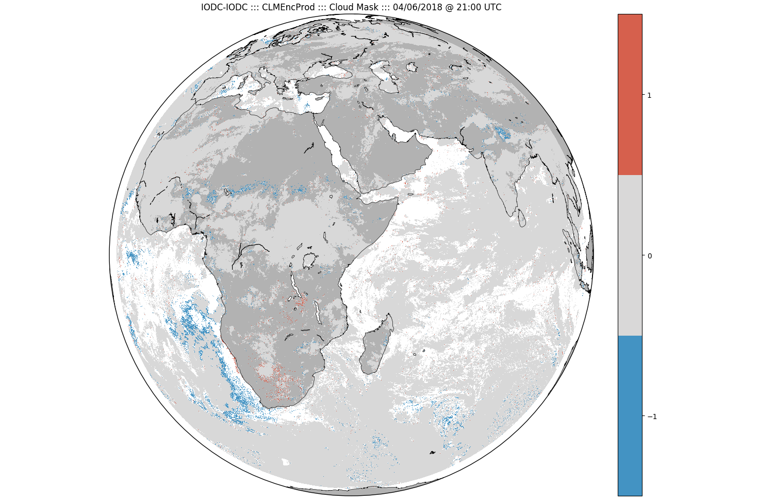
Impact on Cloud Mask (CLM)
Cloud Mask (CLM)
derived using set of threshold tests
uses almost all SEVIRI channels
For Meteosat-8 CLM:
Cloud masks increases cover up to 4% after applying GSICS Correction
esp where VIS channels less important (twilight and night)
Some channel combination thresholds change ±5%
Generally GSICS correction increases fraction of cloudy pixels
Subjective improvement (visually)
e.g. Meteosat-8 @ 2018-06-04 18:00z:
5.1% more low-level cloud (IR10.8-3.8)
0.2% more mid-level cloud
0.8% less high-level cloud
2.5% more total cloud
Difference of cloud mask (CLM) product before/after GSICS Correction 4 June 2018, 21:00 UTC for Meteosat-08 Blue means GSICS cloudy vs. OPE not-cloudy
Time (UTC) | No Change [%] | Cloudy before GSICS, Clear after GSICS [%] | Clear before GSICS, Cloudy after GSICS [%]
00 | 95.9 | 1.2 | 2.9
03 | 96.1 | 1.1 | 2.8
06 | 98.0 | 0.8 | 1.2
09 | 99.2 | 0.6 | 0.2
12 | 99.0 | 0.6 | 0.4
15 | 98.2 | 0.6 | 1.2
18 | 96.5 | 0.5 | 3.0
21 | 96.6 | 0.7 | 2.7
24 | 96.5 | 0.8 | 2.6

Slide 10
Impact on Humidity, Ozone and Cloud Products
Tropospheric Humidity (THU)
Derived from WV6.2 and WV7.3
Difference between Meteosat-10 & -8 original trigger for investigation
GSICS Correction reduces THU7.3 difference
Total Ozone (TOZ)
Derived mostly from IR9.7
Small calibration changes - Significant TOZ changes
Cloud Top Pressure (CTP)
Sensitive to IR13.4 calibration
GSICS Correction has significant impact – esp Met-08
 | GSICS - OPERATION
Meteosat-08 | THU62 | THU73 | TOZ | COT | CTP
 | % | % | DU |  | hPa
Mean Diff | -0.2 | 0.8 | -0.29 | -0.06 | 8.1
Std Error | 0.1 | 0.1 | 0.05 | 0.02 | 0.2
Diff #Pixels (%) | 0.1 | -0.7 | -0.8 | 0.8 | 0.7
Meteosat-11 | THU62 | THU73 | TOZ | COT | CTP
 | % | % | DU |  | hPa
Mean Diff | -0.2 | 0.4 | 0.33 | -0.28 | -2.2
Std Error | 0.1 | 0.1 | 0.05 | 0.01 | 0.2
Diff #Pixels (%) | 0.0 | 0.3 | -0.4 | -0.18 | -0.2
But not only cause of THU differences between Meteosat-10 & -8 !

Slide 11
Impact on Global Instability Index Products
Global Instability Index (GII) products include
Integrated Precipitable Water in 3 layers
Total Precipitable Water
K-index
Lifted Index
Only significant impact of GSICS Correction for:
Meteosat-8
Mid-level humidity (IPW2)
K-index – small increase in max on 1 day (below)
 | GSICS - OPERATION
Meteosat-08 | GII lPW1 | GII lPW2 | GII lPW3 | GII TPW | GII KI | GII LI
 | mm | mm | mm | mm
Mean Diff | -0.003 | 0.041 | 0.00 | 0.04 | 0.08 | -0.02
Std Error | 0.002 | -0.004 | 0.02 | 0.03 | 0.03 | 0.01
Diff #Pixels (%) | -1.0 | -1.0 | -1.0 | -1.0 | -1.0 | -1.0
Meteosat-11 | GII lPW1 | GII lPW2 | GII lPW3 | GII TPW | GII KI | GII LI
 | mm | mm | mm | mm
Mean Diff | 0.000 | 0.002 | 0.01 | 0.01 | 0.01 | -0.02
Std Error | 0.002 | 0.014 | 0.02 | 0.03 | 0.03 | 0.01
Diff #Pixels (%) | 0.3 | 0.3 | 0.3 | 0.3 | 0.3 | 0.3

Slide 12
GSICS Correction reduces Met11-Met8 differences
Showed some MPEF products sensitive to calibration changes covered by GSICS Correction
Cloud, Instability
Humidity, Ozone
But does GSICS Correction reduce differences?
Yes!
Statistically significant, if not physically
Precipitable Water by 0.04 /~10mm
Tropospheric Humidity by 0.4%
Cloud Optical Thickness by 0.22 /~10
Cloud Top Pressure by 10 /~500 hPa
But
Total Ozone by +0.62 / 300 DU
 | Mean Diff | Std Error
GII lPW1 | 0.002 | 0.003 | mm
GII lPW2 | -0.04 | 0.01 | mm
GII lPW3 | 0.01 | 0.02 | mm
GII TPW | -0.02 | 0.04 | mm
GII KI | -0.08 | 0.05
GII LI | 0.00 | 0.02
THU62 | 0.0 | 0.1 | %
THU73 | -0.4 | 0.2 | %
TOZ | 0.62 | 0.07 | DU
COT | -0.22 | 0.02
CTP | -10.3 | 0.3 | hPa
Mean Change in Difference of MPEF products (Meteosat-11) – (Meteosat-8) after applying GSICS Correction 1-15 June 2018

Slide 13
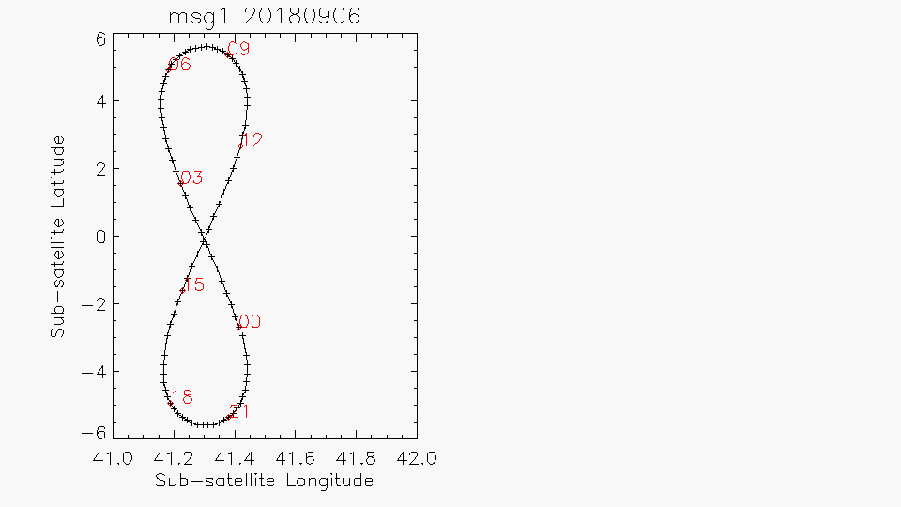
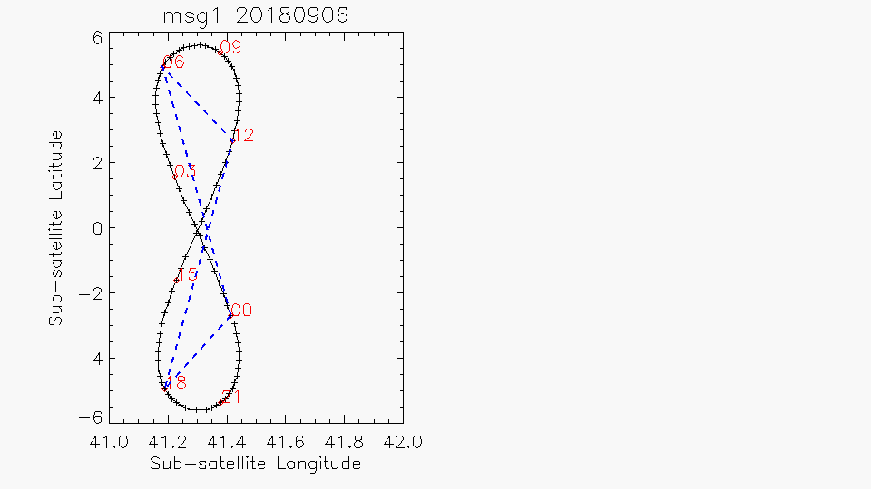
Meteosat-8 High Inclination Geostationary Orbit
Meteosat-8 high inclination orbit:
Now ±5.6°N/S, ±0.2°E/W
Inclination continues to grow…
Significant impact on radiances
Especially in non-window channels
Need to account for actual sub-satellite position in L2 processing
Chebyshev polynomials in L1.5 HDR
e.g. for ±4.3°N/S changes in 2016
WV7.3 CSR up to +3.5/-4.7K
~±1K at mid-latitudes
THU product interpolates auxiliary data between ECMWF runs
Including Sub-satellite position
Introduces errors up to ~2° @09z
~±0.3K change in WV7.3 CSR mid-lat
~ calibration variations
Explains diurnal variations in difference of THU from Met-8 /-10

Slide 14
Conclusions & Way Forward
SEVIRI Calibration remains (mostly) very good
GSICS Corrections
Allow users to correct calibration of Meteosat/SEVIRI
To be consistent with GSICS Reference (IASI-A)
Available in L1.5 header
Impact of GSICS Corrections on MPEF products:
Small impact on Cloud & Humidity products
Reduces difference between Meteosat-8 & Meteosat-11 (both low bias)
➔ Plan to apply GSICS corrections to L2 processing in MPEF
Accurate use of actual Satellite Position
Particularly important for Meteosat-8 – High Inclination
Avoid interpolation
Can introduce errors ≥ calibration biases
Diurnal variations in difference of THU from Met-8 & Met-11
Due to inaccurate interpolation of sub-satellite position in aux data
Plan to remove linear interpolation & run RTM every repeat cycle
Plan to use more frequent forecast runs (3-hourly ECMWF fields)
Will bring other improvements – Surface Temperature, Ozone, …

Slide 15
The End
Thank You for Your Attention!
Any Questions?

Slide 16
Other Analysis – to be written up
The results for the initial test case were encouraging, showing a reduction in the difference of the THU products from MSG1 and MSG3 in their overlap areas. However, more extended analysis showed this difference is still quite variable in time.
A longer trial is planned to test the impact of the GSCIS Correction on multiple MPEF products by implementing it as part of an MPEF deployment on VER.
Changes of the Spectral Response Function of the WV7.3 channel on MSG1 could explain the small calibration changes observed during its move to 41.5°E in 2016.
For example this difference corresponds to the SRF difference in this channel between MSG1 and MSG2. SRF changes due to ice contamination induce apparent calibration changes in this channel of a similar magnitude (~0.1K) – albeit on a much longer timescale. INRC will investigate this together with a visiting scientist later in 2018.

Slide 17
From the analysis below, the following conclusions can be drawn:
The IR7.3 channel of Met-8/SEVIRI had relatively large bias over the period 2008-2016.
The cause of this bias is unknown, but suspected to be due to an SRF error.
Since Meteosat-8 moved to 41.5°E during 2016, the bias on this channel started to reduce.
The cause of this change is unknown – investigations are ongoing.
It is possible to empirically correct the SEVIRI calibration using GSICS products.
A test is planned following the deployment of MPEF 2.6 in late 2017.

Slide 18
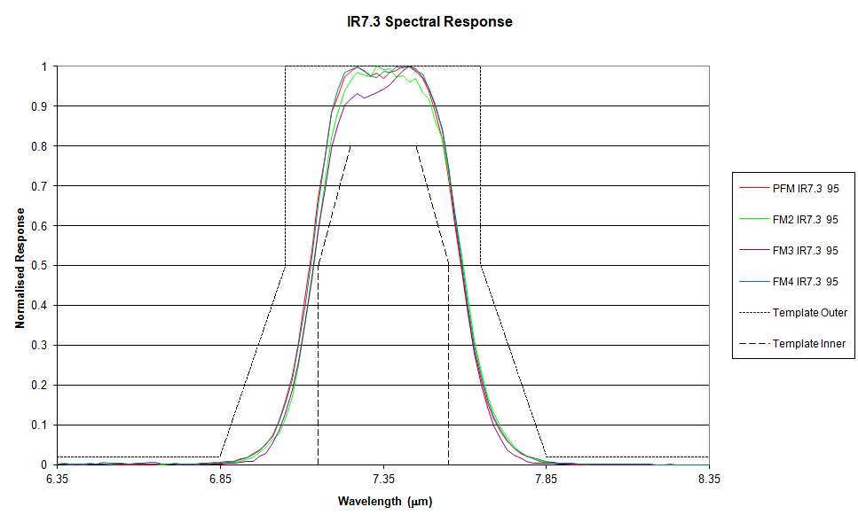
Possible Spectral Response Function Errors
The large residual bias in this channel suggests its Spectral Response Function on Meteosat-8 may have long been in error. However, Figure 3 shows that this channel is not out-of-family, compared to its counterpart on other SEVIRI instruments in the series.
Figure 3 – Official Spectral Response Functions for IR7.3 channel of Meteosat-8 (PFM), -9 (FM2), -10 (FM3) and -11 (FM4) (for 95K)
Although it would be possible to investigate the sensitivity of the apparent bias in this channel to errors in its SRF by substituting different SRFs before the spectral convolution with IASI data, this would not explain the observed bias trends without introducing a mechanism to modify its spectral response.
The variations in Figure 1 do not resemble interference effects from thin films of ice contamination previously proposed for the IR3.9 channel [Hewison et al. 2013], which are believed to have negligible influence in the WV band.

Slide 19
Non-Linearity Errors
One suggested explanation is that recent changes in Meteosat-8’s operating environment could result in a change of the IR7.3 channel’s non-linearity – although this channel is the most linear channel of all those on SEVIRI. However, a multi-variate analysis of the observed bias patterns during the relatively stable 6 month period from 3 Jan to 3 July 2016 showed no significant non-linear component to the biases.
This analysis was repeated with collocations from the period 19 March to 19 October 2017, which again showed no significant non-linear component to the biases.

Slide 20
Conclusions
GSICS Corrections
Allow users to correct calibration of Meteosat/SEVIRI
To be consistent with GSICS Reference (IASI-A)
Available in L1.5 header
Impact of GSICS Corrections on MPEF products:
For Meteosat-8 & Meteosat-11 (both low bias)
Small impact on Cloud Mask
Small impact on Tropospheric Humidity
Difference in THU between Met-10 & -8 in 2016
Reduced by decontamination of Met-8
WV7.3 bias reduced 0.2K
Reduced by switching from Met-10 to Met-11
WV7.3 calibration more stable & Closer to Met-8
Diurnal variations in relative difference
Due to inaccurate interpolation of sub-satellite position in aux data
Important to accurately account for high inclination orbit of Met-8!

Slide 21
Way Forward
1. Apply GSICS corrections to L2 processing
Will be proposed to SWG
2. Run RTM every repeat cycle
Could be activated in next release – 2019q2
3. Use more frequent forecast runs
Prototyping with 3-hourly ECMWF fields
Will bring other improvements – Tsurf, O3
Could be included in 2019q4

