Slide 1
GSICS annual meeting 2024 Logistics & mini conf introduction
Mounir Lekouara

Slide 2
Logistics information
Rooms: Council (whole week) + STG/AFG (parallel sessions)
Use of the microphones: switch on + speak closely
Lunches: from 13 to 14 CET in the canteen
Ice breaker on 11.03 at 18:00 in the canteen
Dinner on 13.03 at 19:00 at “Roeders”, please register and choose your menu today by the event organisers.
Group photo on 14.03 at 12:45
Thursday PM: visit of the control room at 14:30 and/or guided tours of Darmstadt/Heidelberg.
The remote connection links are provided in the GSICS online agenda
If you have any further questions or require additional assistance, please do not hesitate to contact us: events@eumetsat.int
Questions?

Slide 3
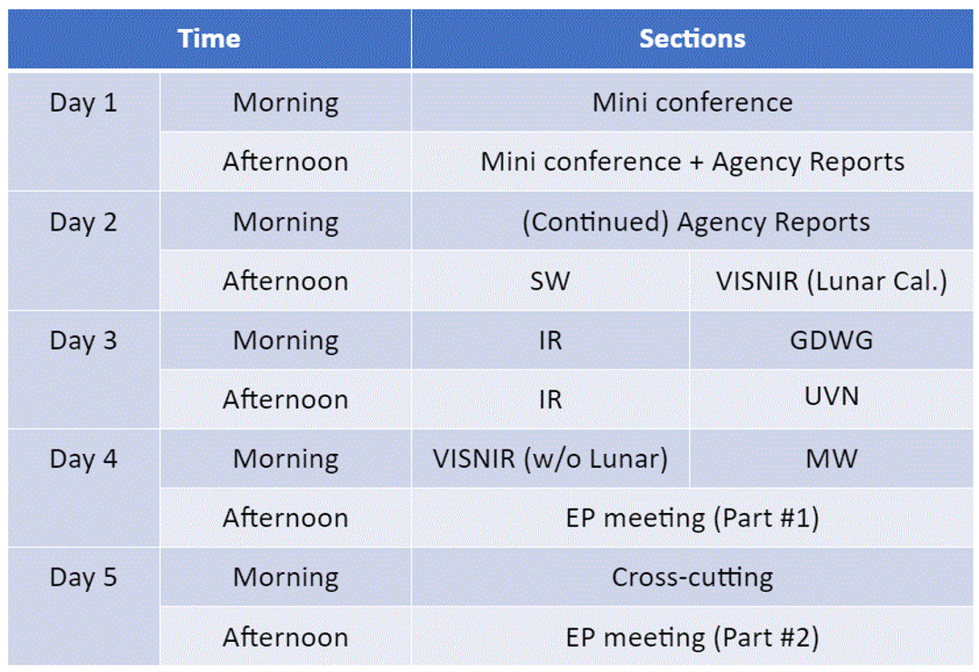
Week Agenda

Slide 4
Mini-conf Agenda
Mini Conference
9:35 | Mini Conference introduction | Mounir Lekouara (EUMETSAT) | 1c
9:45 | MTG missions status | Jochen Grandell (EUMETSAT) | 1d
10:15 | EPS-SG mission status and MW missions | Thierry Marbach and Christophe Accadia (EUMETSAT) | 1e
10:45 | Break
11:20 | Sentinel-3 calibration at EUMETSAT … from L1 to L2 and back | Ali Mousivand (EUMETSAT) | 1f
11:40 | Intercalibration of polarimeters | Bertrand Fougnie (EUMETSAT) | 1g
12:00 | overview of FY-3G Rainfall Satellite | Jian Shang (CMA) | 1h
12:20 | Indian OC-3 mission | Pradeep Thapliyal (ISRO) | 1i
12:40 | Intro to Himawari-10 and inter-calibration approach | Masaya Takahashi (JMA) | 1j
13:00 | Lunch
14:00 | Advances in lunar calibration (WS outcomes) | Tom Stone/Sebastien Wagner | 1k
14:20 | Using commercial data in an operational environment - e.g. RO | Bojan Bojkov (EUMETSAT) | 1l
14:40 | Towards a constellation of thermal infrared sensors for wildfire detection: On the inter-calibration of Forest-2/SAFIRE-2 TIR data | Fatima Kahil (Ororatech) | 1m
15:00 | Disussion / Spare Mini Conference slot |  | 1n
15:20 | Break

Slide 5
Let’s roll!
Questions are welcome.

