Slide 1
EPS-SG Mission Status & MW missions
Thierry Marbach Christophe Accadia Rosemary Munro
Project Scientist for Cal/Val Passive MW & RO Team Leader EPS-SG Programme Scientist
GISCS Annual Meeting 2024, 11-15 March 2024, EUMETSAT

Slide 2
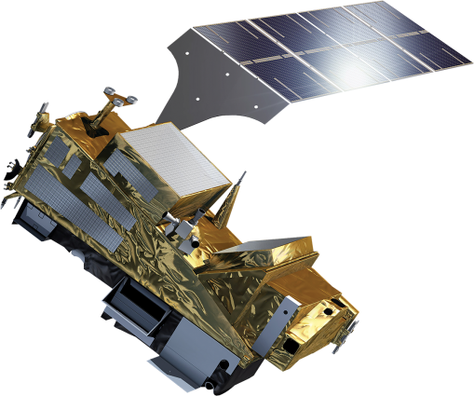
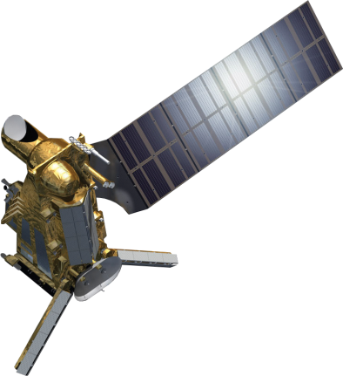
Programme Status - Overview
Two-satellite configuration Metop-SG-A and –B
on the same orbit, separated by 90°
Metop-like orbit: → Sun synchronous → low earth orbit at 835 km mean altitude → 09:30 local time of the descending node
Metop-SG A
Sounding & Imagery
Nominal launches:
Metop-SG A1 Q4-2025 Metop-SG B1 Q3-2026
Metop-SG A2 2032 Metop-SG B2 2033
Metop-SG A3 2039 Metop-SG B3 2040
https://www.eumetsat.int/planned-launches
Metop-SG B
Microwave Imagery

Slide 3
Metop & Metop-SG Orbit Phasing Proposal (Flight Direction is CCW)
2022
2025/2026
2026
2027/28
Metop-B
Metop-B
SG-A1
SG-A1
SG-B1
Metop-B
SG-B1
Metop-C
SG-A1
Metop-C
Metop-C
Metop-C
Situation to 2022 – this would be the last OOP Manoeuvre for Metop-B.
~180 degree Phasing is maintained
(Metop-A already de-orbited)
Tandem Flight with Metop-C – flying behind as safe modes cause them to separate (Metop-B cannot be used because LTAN is drifting irrespective of decision on Phasing v GT)
SG-A1 and Metop-C to become primary pair. SG-A1 to be repositioned to 12 o’clock over ~2 weeks while Metop-B is drifted to 3 o’clock over ~3 months (using 2kg of fuel). Both move clockwise to avoid X-Band interferences.
Goal is to minimize time where neither Metop-B nor SG-A1 is opposite Metop-C.
Metop-B LTAN drift is under way (remaining fuel reserved for de-orbiting)
SG-B1 needs no tandem flight, so goes directly to 9 o’clock position.
PDAP constraints mean the Metop-SG-B satellites should lead the respective Metop-SG-A satellites by ~1/4 orbit (to avoid data overload of processing chain)
Metop-B will be de-orbited end 2027 or end 2028.
Metop-C phase is maintained, until the slot needs to be freed up for Metop-SG-A2
Courtesy: FLO/RDY

Slide 4
EPS-SG Data Missions: Global Mission
NRT delivery of processed products generated from data sensed during up to one full orbit stored on board before being dumped via SMD link to Stored Data Acquisition (SDA) stations on ground.
Global Mission timeliness:
Threshold Timeliness: 110min (50%) – 120min (90%)
Breakthrough Timeliness: 60min (50%) – 70min (95%)
(Note: Orbit duration ~ 102 minutes)
Global Data volume is about 20 times bigger than EPS

Slide 5
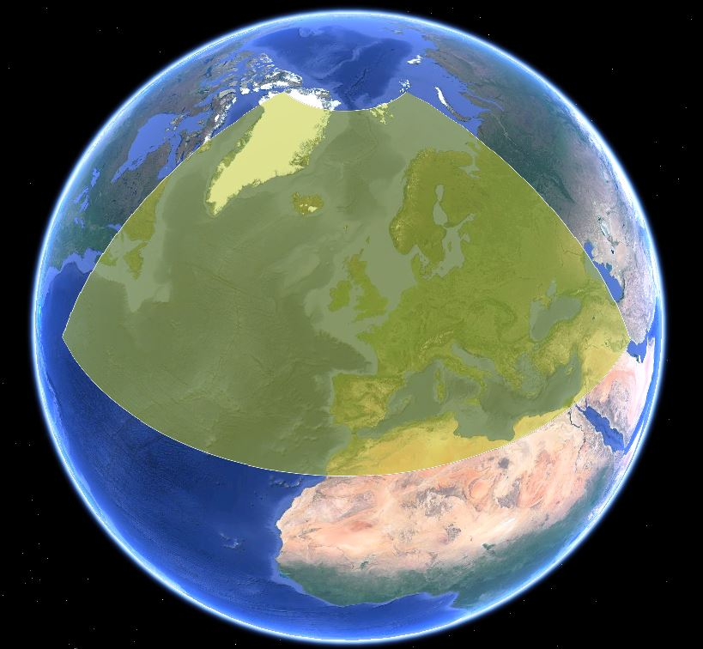
EPS-SG Data Missions: Regional Mission
Delivering processed products in near real time from all instruments to end users
with improved end-to-end timeliness from observation.
This Mission is supported via Direct Data Broadcast (DDB) link.
Improved end-to-end timeliness over Europe and North Atlantic area within 65°W, 30°N and 50°E, 80°N)
Threshold timeliness:
30min (50%) – 110min (90%)
Breakthrough timeliness:
20min (50%) – 30min (95%)

Slide 6
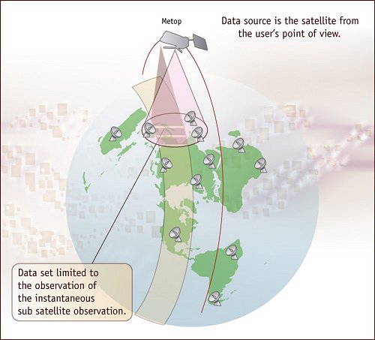
EPS-SG Data Missions: Local Mission
Delivering real time observational data and administrative messages via DDB link, during satellite overpasses, over a geographical area in the field-of-view of a EPS-SG satellite to the corresponding ground stations, called Local User Stations.
Provided by direct broadcast from the
Space –segment
Local mission supported by making
processing software and Aux data
available.

Slide 7
EPS-SG Programme Objectives
Primary mission: further improve observational inputs to Numerical Weather Prediction models.
Continuation and enhancement of service from mid morning polar orbit in 2025 – 2046.
Significant contributions to other real time applications:
Nowcasting at high latitudes
Marine meteorology and operational oceanography
Operational hydrology
Air quality monitoring
Climate monitoring: expand by 20+ years the climate data records initiated in 2006 with EPS (first generation).

Slide 8
EPS-SG A Sounding and Imagery Mission
3MI: No onboard calibration device,
Relying on vicarious calibration only
4
IASI-NG Infrared Atmospheric Sounding
MWS Microwave Sounding
METImage Visible-Infrared Imaging
RO Radio Occultation
3MI Multi-viewing, -channel, -polarisation Imaging
Copernicus Sentinel-5 UN/VIS/NIR/SWIR Sounding
5
2
Degradation
Monitoring
e.g. solar diffuser
1
6
4
3
Radiometric
Geometrical
X-Calib
New challenge:
In-flight Polarisation Calibration
(see talk from Bertrand Fougnie)
Spectral
X-Calib

Slide 9
Key Meteorological Information from EPS-SG Mission
Vertical profiles of temperature and humidity, even in cloudy cases
Wind vectors of the troposphere in polar regions
Optical and physical properties of clouds and aerosols including volcanic ash
Vertical profiles of many atmospheric gases
Sea surface temperature, ocean surface wind vectors and sea-ice
Precipitation, soil moisture and snow cover
Land surface parameters, fire
Ionospheric electron content

Slide 10
EPS-SG Sounding missions: Enhancements and Innovations
Main Payload | Enhanced Capabilities | Innovative Capabilities | Applications Benefitting
High-Resolution Infrared Sounding (IASI-NG) Metop Heritage: IASI | +75% information in temperature profiles +30% in water-vapour profiles | More trace gases and their vertical profiles | NWP, NWC, AC, CM
Microwave Sounding (MWS) Metop Heritage: AMSU, MHS | Enhanced spatial over-sampling, five more spectral channels | Ice-cloud info in support of humidity profiling | NWP, NWC, CM
Radio Occultation Sounding (RO) Metop Heritage: GRAS | Large increase of number of radio-occultations, implementation on A- and B-satellites | Tracking of Galileo and Compass/Beidou signals | NWP, CM
Nadir viewing UV/VIS/NIR/SWIR Sounding (Sentinel-5) Metop Heritage: GOME-2 | Drastic increase of spatial resolution, extension into UV and short-wave infra-red | Additional trace gas measurements; CO₂ being studied | Air Quality, CM, AC

Slide 11
EPS-SG Imaging Missions: Enhancements and Innovations
Main Payload | Enhanced Capabilities | Innovative Capabilities | Applications Benefitting
VIS/IR Imaging (METimage) Metop Heritage: AVHRR | Better radiometric and spatial resolution | Far more variables measured with higher accuracy | NWC, NWP, Operational Oceanography, Hydrology, CM
Scatterometry (SCA) Metop Heritage: ASCAT | Higher spatial resolution and coverage | Cross polarisation for higher wind speeds | NWP, NWC, Operational Oceanography, Hydrology, CM
Multi-viewing, -channel, -polarisation Imaging (3MI) | New mission | Aerosol parameters | Air Quality, CM, NWC
Microwave Imaging (MWI) | New mission | Precipitation observations | NWP, NWC, Hydrology, Operational Oceanography, CM
Ice Cloud Imaging (ICI) | New mission | Cloud microphysics parameters | NWP, NWC, Hydrology, Operational Oceanography, CM

Slide 12
EPS-SG A Sounding and Imagery Mission
4
IASI-NG Infrared Atmospheric Sounding
MWS Microwave Sounding
METImage Visible-Infrared Imaging
RO Radio Occultation
3MI Multi-viewing, -channel, -polarisation Imaging
Copernicus Sentinel-5 UN/VIS/NIR/SWIR Sounding
5
2
1
6
4
3

Slide 13
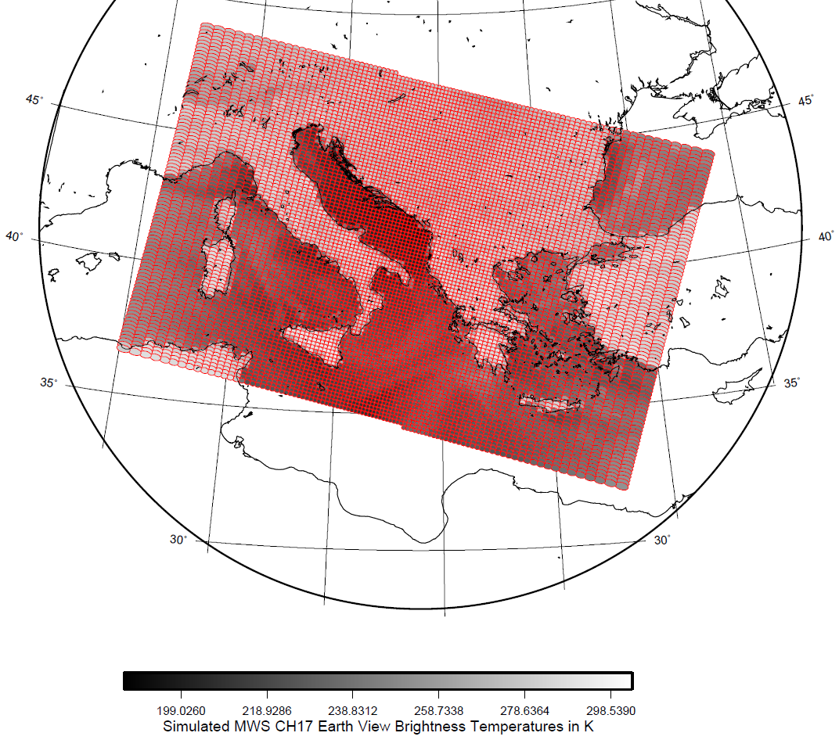
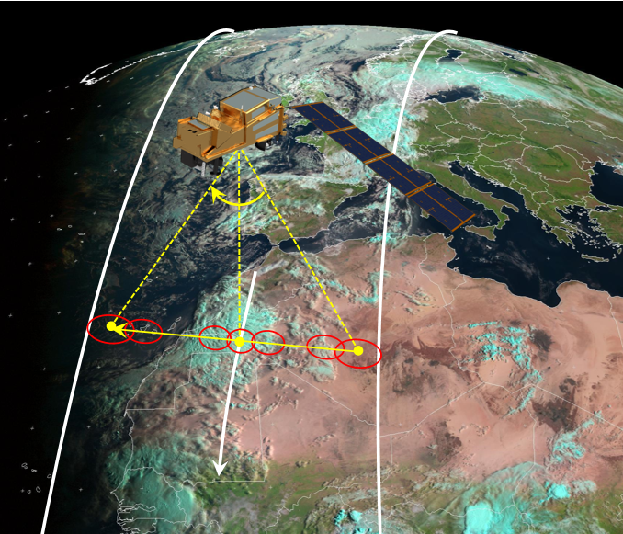
MWS Scanning Characteristics
Cross-track scanner
95 pixels per scan line for each channel
2.25 seconds scan duration
49.85° maximum scanning angle
~2250 km swath width
MWS Channel 17 scan pattern and brightness temperature simulations.

Slide 14
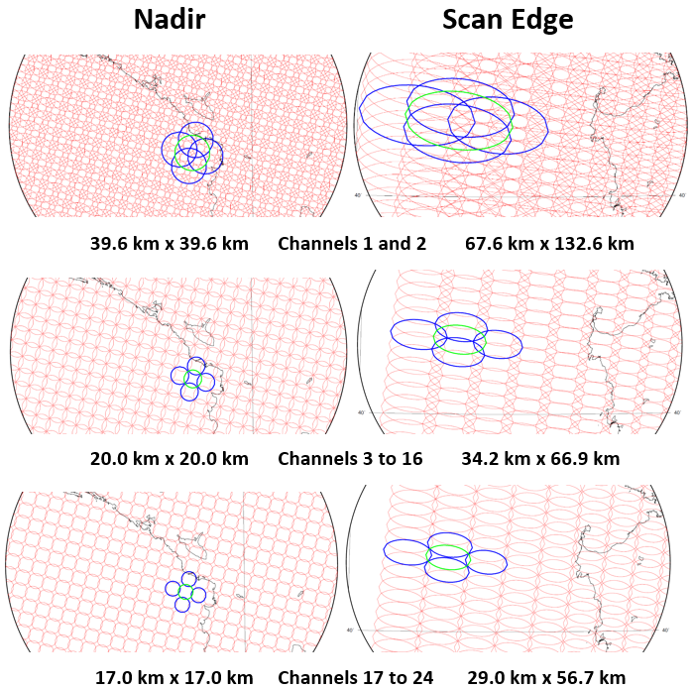
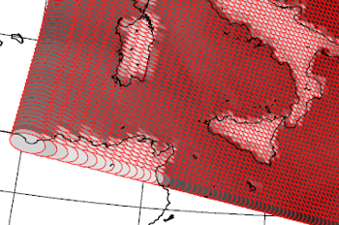
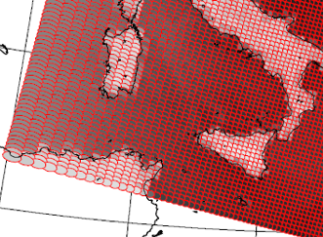
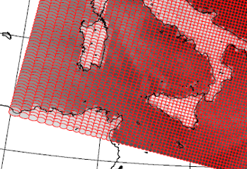
MWS: Range of Footprint Sizes
Note: Pixel representations are displayed as Instantaneous Field of Views (3dB level)

Slide 15
MWS: Channel Performance Requirements
Channel | Frequency (GHz) | Bandwidth per passband (MHz) | Utilisation | NEΔT Threshold (K) | Footprint (IFOV) Size at 3dB (km) | Centre frequency stability (B/T) (MHz) | Lower End of Dynamic Range (K) | Upper End of Dynamic Range (K)
MWS-1 | 23.8 | 270 | Water-vapour column | 0.25 | 40 | ±5.0/±10.0 | 80 | 335
MWS -2 | 31.4 | 180 | Window, water-vapour column | 0.35 | 40 | -/±10.0 | 80 | 335
MWS -3 | 50.3 | 180 | Quasi-window, surface emissivity | 0.5 | 20 | ±5.0/±10.0 | 100 | 320
MWS -4 | 52.8 | 400 | Temperature profile | 0.35 | 20 | ± 3.0/±5.0 | 100 | 320
MWS-5 | 53.246 ± 0.08 | 2x140 | Temperature profile | 0.4 | 20 | ±5.0/±10.0 | 100 | 320
MWS -6 | 53.596±0.115 | 2x170 | Temperature profile | 0.4 | 20 | ±2.0/± 5.0 | 100 | 320
MWS-7 | 53.948 ± 0.081 | 2x142 | Temperature profile | 0.4 | 20 | ±1.0/±2.0 | 100 | 320
MWS -8 | 54.40 | 400 | Temperature profile | 0.35 | 20 | ±2.0/±5.0 | 100 | 320
MWS -9 | 54.94 | 400 | Temperature profile | 0.35 | 20 | ±2.0/±5.0 | 100 | 320
MWS -10 | 55.50 | 330 | Temperature profile | 0.4 | 20 | ±2.0/±5.0 | 100 | 320
MWS -11 | 57.290344 | 330 | Temperature profile | 0.4 | 20 | -/±0.5 | 100 | 320
MWS-12 | 57.290344±0.217 | 2x78 | Temperature profile | 0.55 | 20 | -/±0.5 | 100 | 320
MWS-13 | 57.290344 ±0.3222±0.048 | 4x36 | Temperature profile | 0.6 | 20 | -/±1.2 | 100 | 320
MWS-14 | 57.290344±0.3222±0.022 | 4x16 | Temperature profile | 0.9 | 20 | ±1.2/±1.6 | 100 | 320
MWS-15 | 57.290344±0.3222±0.010 | 4x8 | Temperature profile | 1.2 | 20 | -/±0.5 | 100 | 320
MWS-16 | 57.290344±0.3222±0.0045 | 4x3 | Temperature profile | 2.0 | 20 | ±0.2/±0.5 | 100 | 320
MWS-17 | 89.0 | 4000 | Window | 0.25 | 17 | ±130/±210 | 80 | 335
MWS-18 | 164-167 | 3000 | Quasi-window, water-vapour profile | 0.5 | 17 | ±40/±80 | 80 | 335
MWS-19 | 183.311±7.0 | 2x2000 | Water-vapour profile, precipitation | 0.4 | 17 | ±30/±70 | 80 | 320
MWS-20 | 183.311±4.5 | 2x2000 | Water-vapour profile | 0.4 | 17 | ±10/±30 | 80 | 320
MWS-21 | 183.311±3.0 | 2x1000 | Water-vapour profile | 0.6 | 17 | ± 30.0/±70 | 80 | 320
MWS-22 | 183.311±1.8 | 2x1000 | Water-vapour profile | 0.6 | 17 | ±10/± 30.0 | 80 | 320
MWS-23 | 183.311±1.0 | 2x500 | Water-vapour profile | 0.75 | 17 | ±30.0/±50 | 80 | 320
MWS-24 | 229 | 2000 | Quasi-window, water-vapour profile | 0.70 | 17 | ±100.0/±350.0 | 100 | 310
Several types of requirements:
Acquisition requirements
Spectral requirements
Level 1 radiometric requirements
Level 1 geometric requirements
In addition, timeliness requirements shall be met.

Slide 16
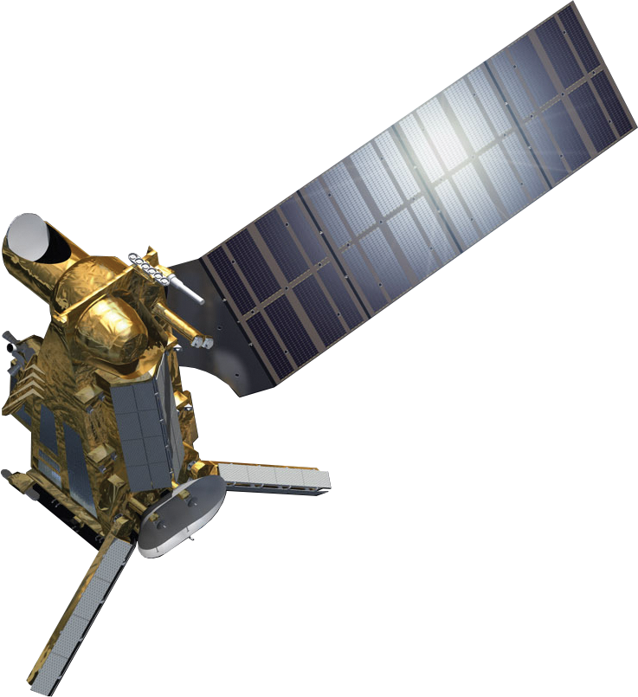
EPS-SG B Microwave Imagery Missions
SCA Scatterometer
RO Radio Occultation
MWI Microwave Imaging for Precipitation
ICI Ice Cloud Imager
ARGOS-4 Advanced Data Collection System
3
2
5
4
1
1
2
1

Slide 17
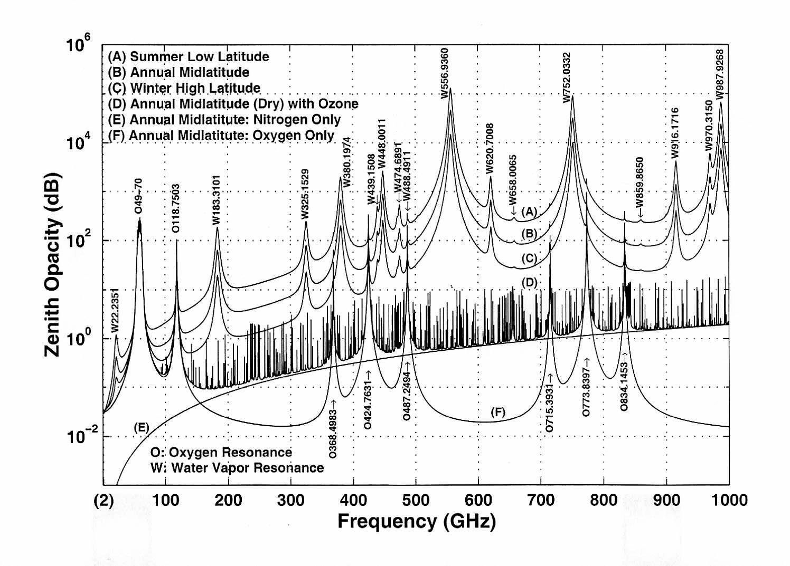
Main channels of EPS-SG MWI and ICI in spectrum
MWI Imaging channels
in the “windows” (18.7, 31.4, 89.0, 165.5 GHz) and low water vapour absorption (23.8 GHz)
MWI Temperature sounding in the O₂ 50/60 complex - 118 GHz line
Humidity sounding in the 183 GHz line (some of bands in common)
..and beyond: ICI channels in “quasi-windows” (243, 664 GHz) and WV bands (325, 448 GHz)
Channel | Frequency (GHz) | Pol.
MWI-1 | 18.7 | V, H
MWI-2 | 23.8 | V, H
MWI-3 | 31.4 | V, H
MWI-4 | 50.3 | V, H
MWI-5 | 52.61 | V, H
MWI-6 | 53.24 | V, H
MWI-7 | 53.75 | V, H
MWI-8 | 89.0 | V, H
MWI-9 | 118.7503±3.2 | V
MWI-10 | 118.7503±2.1 | V
MWI-11 | 118.7503±1.4 | V
MWI-12 | 118.7503±1.2 | V
MWI-13 | 165.5±0.75 | V
MWI-14 | 183.31±7.0 | V
MWI-15 | 183.31±6.1 | V
MWI-16 | 183.31±4.9 | V
MWI-17 | 183.31±3.4 | V
MWI-18 | 183.31±2.0 | V
Atmospheric spectrum in the MW/Sub-mm range (Klein and Gasiewski, 2000)
Channel | Frequency (GHz) | Pol.
ICI-1 | 183.31±7.0 | V
ICI-2 | 183.31±3.4 | V
ICI-3 | 183.31±2.0 | V
ICI-4 | 243.2±2.5 | V, H
ICI-5 | 325.15±9.5 | V
ICI-6 | 325.15±3.5 | V
ICI-7 | 325.15±1.5 | V
ICI-8 | 448±7.2 | V
ICI-9 | 448±3.0 | V
ICI-10 | 448±1.4 | V
ICI-11 | 664±4.2 | V, H

Slide 18
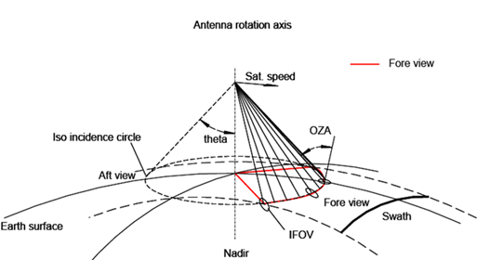
MWI and ICI scanning characteristics
Conically scanning at 45 rpm (about 1.3333 seconds). Incidence angles within 53°±2°. Observations acquired ± 65° in azimuth in the fore view (about 1700 km swath).
ICI: conically scanning counterclockwise, MWI: conically scanning clockwise (as seen from zenith) and are not synchronized.
MWI
ICI

Slide 19
EPS-SG microwave missions
Will :
Support Numerical Weather Prediction at regional and global scales
Support the retrieval of cloud and precipitation products
Support Nowcasting and very short-range forecasting at regional scales
Support observations of sea ice parameters and snow cover, snow water equivalent, sea surface wind
Continuity of measurements of key microwave channels in support of long-term climate records

Slide 20
EPS Sterna: Complementary to EPS-SG
Small microwave sounding satellites complementing the reference EUMETSAT Polar System (EPS-SG) /Microwave Sounder (MWS) is a potential additional EUMETSAT contribution to the realisation of the WIGOS Vision 2040 and is in line with objective four of the EUMETSAT strategy “Destination 2030”
EPS-Sterna will be a constellation of small microwave sounding satellites which will complement observations from other core missions such as EPS-SG, the NOAA JPSS satellites and the Chinese FY satellites.
EPS-Sterna space segment will capitalise on the experience from the ESA mission “Arctic Weather Satellite (AWS)” which is a technology demonstrator to be flown this year in the June-July timeframe.
A successful outcome of the AWS in-orbit demonstration in 2024-2025 would represent an opportunity for EUMETSAT to expand the products’ envelope of the EPS-SG mission for its users, by implementing the EUMETSAT Polar System Sterna.
EPS-Sterna overall operational mission duration will be 13 years with the initial constellation expected in 2029.

Slide 21
Objectives of the mission
To expand and complement the microwave sounding observations from the Metop-SG, the NOAA JPSS and the CMA FY polar-orbiting, meteorological satellites.
To improve accuracy of global numerical weather prediction models by increasing the number of microwave sounding observations by providing atmospheric water-vapour and temperature profiles in clear and cloudy air;
To contribute to nowcasting applications at high latitudes through an increase in the frequency of microwave observations;
To contribute to climate monitoring by adding to the existing record data with increased time/space sampling.

Slide 22
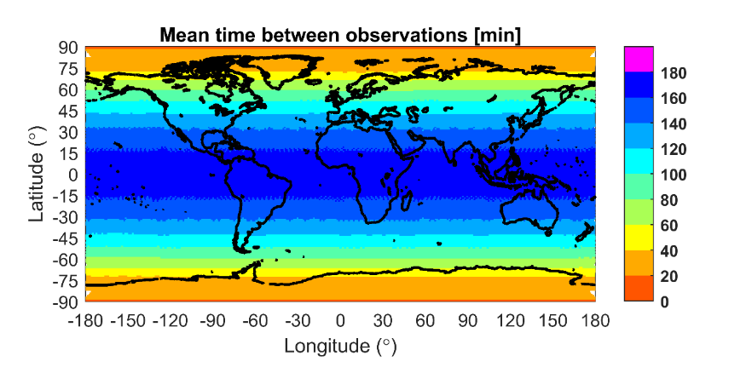
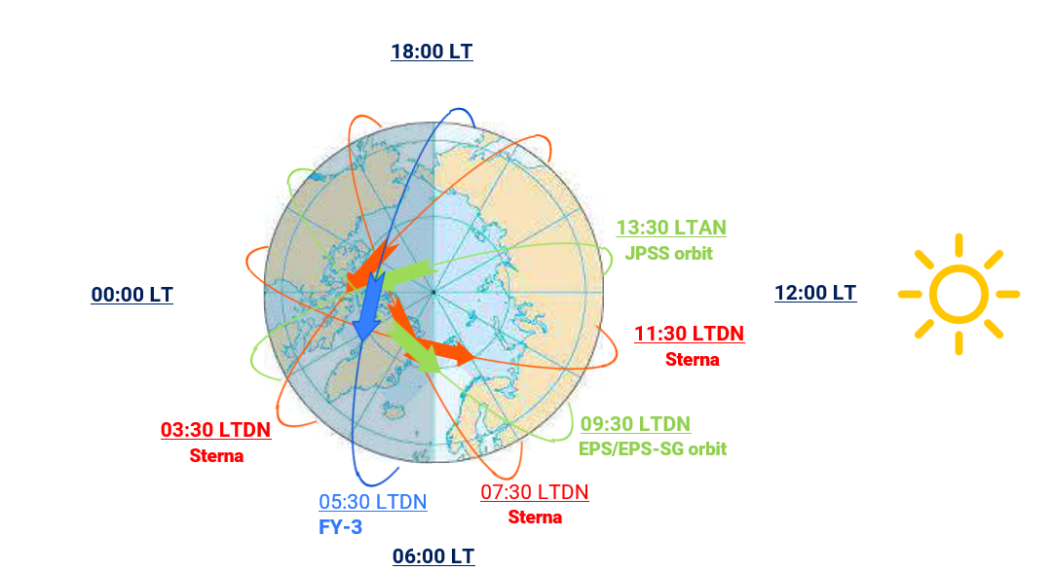
Constellation architecture
A constellation of 6 small satellites distributed in 3 orbital planes in sun synchronous Low Earth Orbit (LEO) at 595km at equatorial crossing time 03:30, 07:30, 11:30
Every 3.1 hours we can cover 90% of the globe!
Complementary to EPS-SG and JPSS

Slide 23
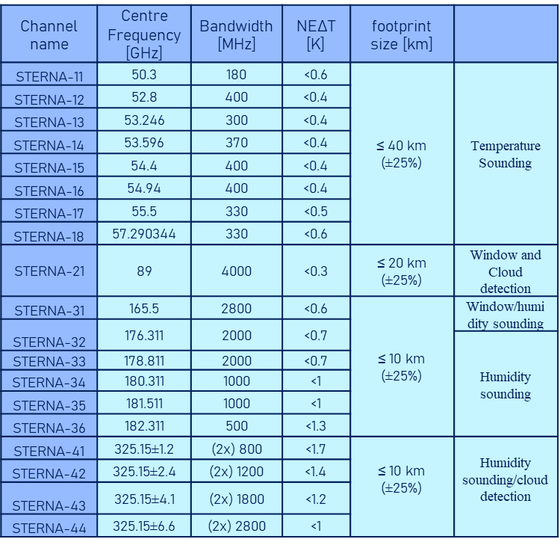
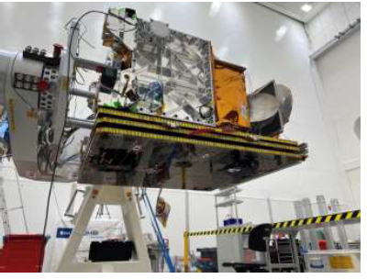
Overall system overview - space segment
AWS
courtesy of ESA/OHB
Spacecraft- three axis stabilised with electric propulsion:
Mass: ca. 135 kg;
Volume: 1.1x 0.7 x 0.8m;
Power (nominal): ca. 143 W;
Science data : L band (1.707 GHz);
Command and Control: S band (2.230/2.053 GHz).
Payload data rate: 60 kbps
Payload scan rate: 45 RPM

Slide 24
EPS-SG Current Status

Slide 25
Programme Status – SAF Network
The SAFs Segment Test Result Review (STRR) is organised in two steps;
Part 1 after the SAF processing chains have been tested in standalone mode → successfully completed for all SAFs, for Metop-SG A and Metop-SG B processing, by September 2023, with the exception of the AC SAF for which the SIRR and STRR Part 1 will be combined and be completed by end Q1 2024;
Part 2 when the SAFs will be part of a joint end-to-end test with the Payload Data Acquisition Processor (PDAP) via EUMETCast, aiming to circulate Level-1 and Level-2/3 products from EUMETSAT headquarters to the SAFs and back → postponed to Q3 2024 due to delay of PDAP v3.
At the end of this two-step milestone, the SAFs segment will be successfully integrated within the EPS-SG System and the relevant EPS-SG System requirements will be verified.

Slide 26
Programme Status – Local Processors
The L0 Local Processor contract running as planned; acceptance review colocation of the V2 was successfully completed
The L1B local processors contract executed as planned:
KO for SAT-A Local Processors (MWS and VII) held in June 2022
MWS L1: Acceptance Review collocation planned for January 2024 – TRB successfully held on 29 November​
VII L1: Acceptance Review TRR planned for January 2024​
KO for SAT-B Local Processors (MWI, ICI and SCA) was held in November 2022
Acceptance Review planned for March 2024
IASI-NG L1c local processor developed under CNES responsibility, progressing with delays
Based on re-usage of the IASI-NG L1c global processor
KO for IASI-NG L1c Local Processor with CNES was held in January 2022 (later with Industry)
Preliminary Design Review was held in April 2023
Acceptance Review originally planned for May 2024, moved now to Q3 2024

Slide 27
Programme Status – Cal/Val Planning
Further consolidation of the Metop-SG A Cal/Val-Plans completed by December 2023
Preparation and procurement of Cal/Val tools and definition of Cal/Val data needs are ongoing
Development of an overall Cal/Val schedule in progress
Readiness for Cal/Val will be assessed in a combined Sat-A and Sat-B Cal/Val Check Point planned for June 2024

Slide 28
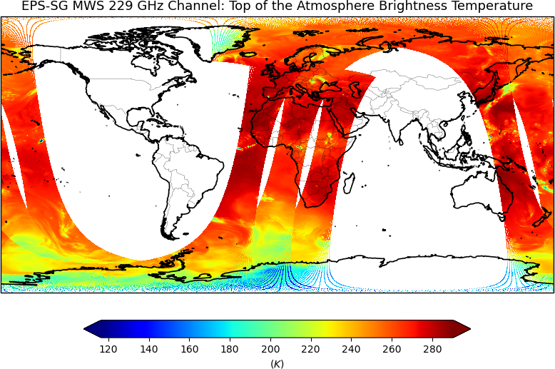
Test Data for user familiarisation
Pre-launch test data provide information on content, format and size, primarily for format familiarisation, system testing and science investigations
Following EPS-SG test data has been released
Three consecutive orbits, netCDF format, in-line with latest processing specifications
EPS-SG Test Data
MWS L1-L2
RO L1
METimage L1 + L2 + CM
3MI L1b + L1c + L2 MAP
S5 L1 + L2
IASI-NG L1C+L1D + L2
MWI – ICI L1 + L2
SCA L1B
A set of EPS-SG BUFR test data was also released in March 2023
MWS L1B
MWI L1B
ICI L1B
IASI-NG L1C, L1D and L2
SCA 1B
METimage L2
https://user.eumetsat.int/resources/user-guides/metop-sg-test-data
Notes:
Format familiarisation
for software and tool development, and development of higher level products
System testing for infrastructure
upgrading data acquisition systems, and scaling up storage infrastructure
Scientific investigation
Not all test data are mature for scientific studies

Slide 29
Summary

Slide 30
Summary on EPS-SG Mission (1/2)
EPS-SG will continue to be a key provider of information to improve Numerical Weather Prediction (NWP) in Europe and worldwide
Enhanced infra-red, micro-wave, and radio-occultation soundings of temperature and humidity
Polar atmospheric motion vectors extracted from optical imagery
Novel precipitation and cloud measurements of imagers in the optical, sub-millimetre and microwave spectra
High-resolution ocean surface wind-vector and soil moisture measurements extracted from scatterometer observations
EPS-SG supports Nowcasting applications at high latitudes by imaging and scatterometery missions

Slide 31
Summary on EPS-SG Mission (2/2)
EPS-SG also supports operational oceanography by providing ocean surface wind vectors, sea surface temperatures, and sea ice cover
Atmospheric composition applications particularly monitoring and forecasting of air quality, ozone, aerosols and volcanic ash, and surface ultra-violet radiation, will be served with high spectral and spatial resolution
All EPS-SG observation missions will support climate monitoring, based on the production of relevant Climate Data Records involving also heritage observations from the EPS Programme.

Slide 32
Thank You

