Slide 1
Sentinel-3 calibration at EUMETSAT
from L1 to L2 and back
Ali Mousivand, Anne O’Carroll, Ewa Kwiatkowska and Julien Chimot
GSICS annual meeting
11th March 2024, Darmstadt

Slide 2
Sentinel-3 Level-1 radiometric calibration monitoring
Ali Mousivand, Sebastien Wagner, Vincent Debaecker, Rakshith Shanbhag, Tim Hewison, Mounir Lekouara and Bertrand Fougnie
GSICS plenary 2024
11th March 2024

Slide 3
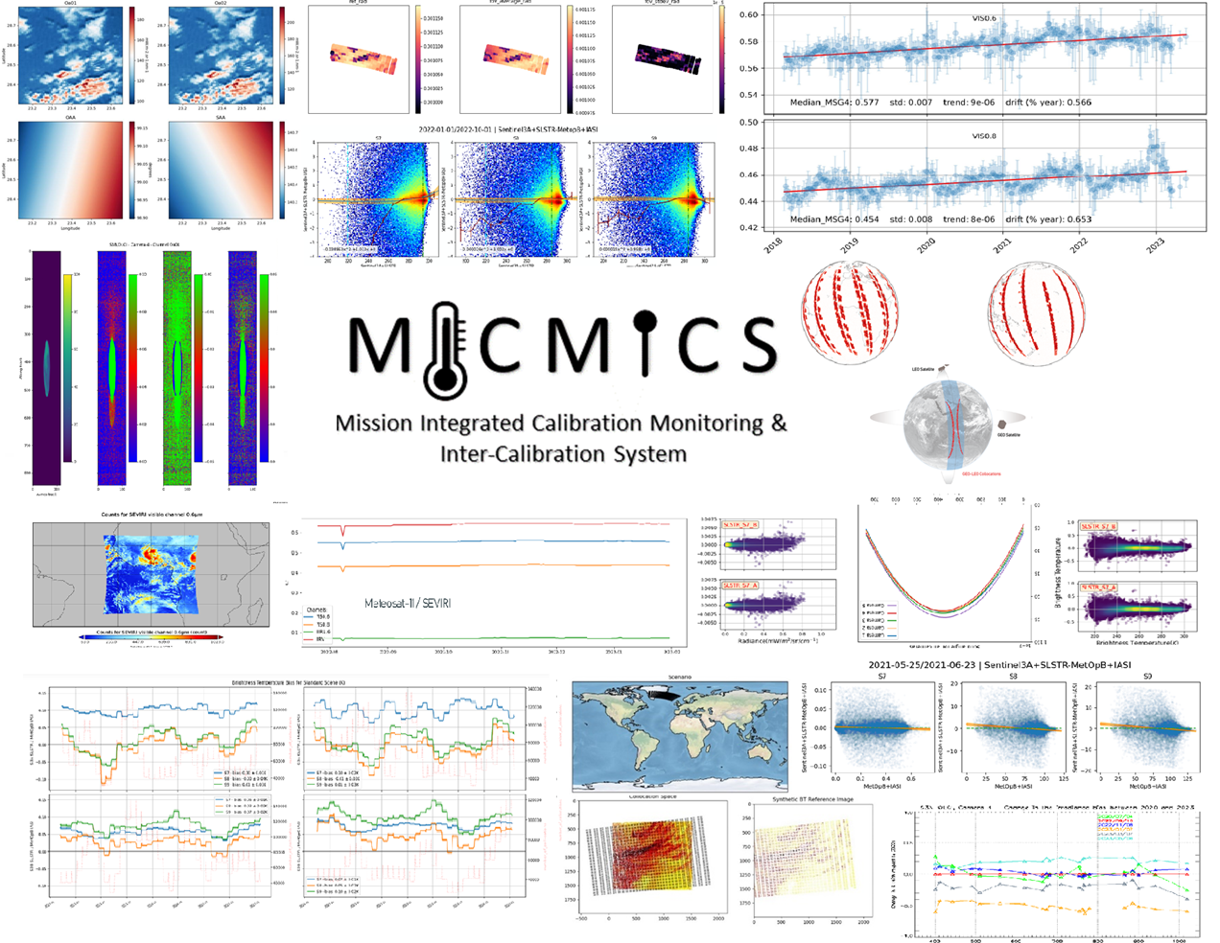
MICMICS (Mission Integrated Calibration Monitoring and Inter-Calibration System)
MICMICS = agile system dedicated to the near-real time monitoring of radiometric performances and inter-calibration
Main assets:
  Easy integration of new missions;
  Easy integration of new calibration methods;
  Inter-operability of the processing modules;
  Rationalisation of resources + efforts (including maintenance);
  Support the operational generation of GSICS products (and intermediate products such as collocations);
  Support generation of Fundamental Climate Data Records;
Status:
  The prototype has been extensively tested and validated;
  Already supporting the EUMETSAT diagnostics on SEVIRI, AVHRR, OLCI & SLSTR;
  Currently used for the FCI and LI commissioning;
  Developments are on-going for EPS-SG and CO2M.
  Will become the EUM GSICS engine and replace MPSTAR in 2024;

Slide 4









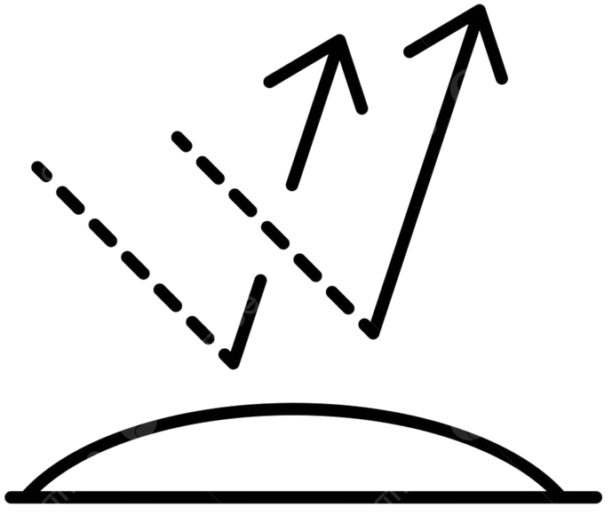

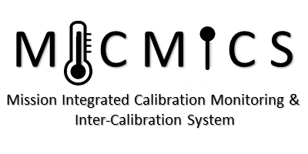


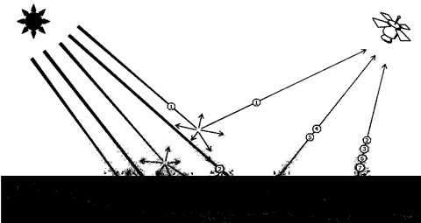
MICMICS workflows
Desert Inter-Calibration
Desert Calibration
Desert Inter-Calibration
Desert Calibration
DCC Inter-Calibration
DCC Inter-Calibration
Lunar Calibration
Lunar Calibration
DCC Calibration
DCC Calibration
Lunar Inter-Calibration
Lunar Inter-Calibration
Imager-Hyperspectral
Inter-Calibration
Imager-Hyperspectral
Inter-Calibration
Rayleigh Calibration
Rayleigh Calibration
LI
FCI
LI
FCI
SLSTR
Imager-Imager
Inter-Calibration
SLSTR
Imager-Imager
Inter-Calibration
Rayleigh Inter-Calibration
SEVIRI
Rayleigh Inter-Calibration
SEVIRI
OLCI
OLCI
SLSTR
SLSTR
METimage
METimage
Ray-Matching
Inter-Calibration
NWP Calibration
Ray-Matching
Inter-Calibration
NWP Calibration
FCI
FCI
AVHRR
SEVIRI
AVHRR
NWP Inter-Calibration
SEVIRI
NWP Inter-Calibration
Inter-Calibration Blender
Inter-Calibration Blender
3MI
3MI
METimage
METimage
CLIM
DCC Extraction Module
CLIM
DCC Extraction Module
Sun Glint Inter-Calibration
MAP
Sun Glint Inter-Calibration
UVN
MAP
UVNS
UVN
UVNS
Snow and Ice Inter-Calibration
Lunar Extraction Module
Snow and Ice Inter-Calibration
Lunar Extraction Module
Radiative Transfer Module
Subsetter Tool
Radiative Transfer Module
Subsetter Tool
#9ba9ea
Data-Fusion Tool
#9ba9ea
Data-Fusion Tool
Colocation Tool
Colocation Tool
Pre-Colocation Tool
Pre-Colocation Tool

Slide 5
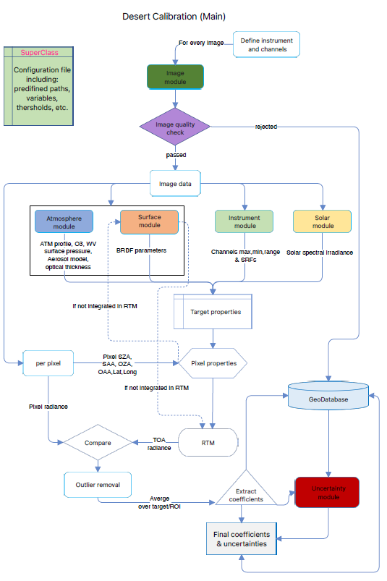
DESert Calibration System (DESCS)
Uses desert Pseudo Invariant Calibration Sites (PICS) to transfer the calibration from a reference Radiative Transfer Model (RTM) to the monitored instrument.
TOA radiance simulation
  RTM: a customised version of the polarized 6SV2.1, DISORT, Monte-Carlo;
  Surface: 4-parameter BRDF RPV model using spectrally resolved BRDF parameters;
  Atmosphere:
    Customized Desert Aerosol model over the Sahara and Arabian Peninsula;
    US standard atmosphere, scaled with H2O and O3 column;
    O3, WV, surface pressure from ECMWF, and AOT550 from CAMS;
Evaluate & Monitor bias:
  Estimate the absolute calibrations by comparing simulated radiance against actual measurements
  Desert vicarious calibration offers an accuracy of approximately 2-3%.

Slide 6
DESert Inter-Calibration System (DESICS)
Uses desert Pseudo Invariant Calibration Sites (PICS) to transfer the calibration from a reference instrument to the monitored instrument.
BOA reflectance retrieval
  Atmospheric correction: Customised version of the polarized 6SV2.1,
  Atmosphere:
    same as those of Desert Calibration system;
TOA reflectance simulation
  RTM: customised version of the polarized 6SV2.1
  Surface: simulated spectral surface reflectance for monitored instrument
  Atmosphere: same as those of BOA reflectance retrieval
Filtering: Apply geometry criteria
Evaluate & Monitor bias:
  Estimate the relative calibrations by comparing TOA simulated reflectance against actual measurements
Reference instrument
Monitored instrument
Update Meteo data
Update Meteo data
Outlier removal
Filtering observations by geometry criteria
(∆SZA, ∆VZA, ∆RAA)
Forward RT simulation
Atmospheric correction
Spectrally interpolate BOA reflectance
Simulated BOA reflectance for monitored instrument
Reference BOA reflectance
High resolution spectrum
Simulated TOA reflectance for monitored instrument
Calibration coefficients
Measured TOA reflectance

Slide 7
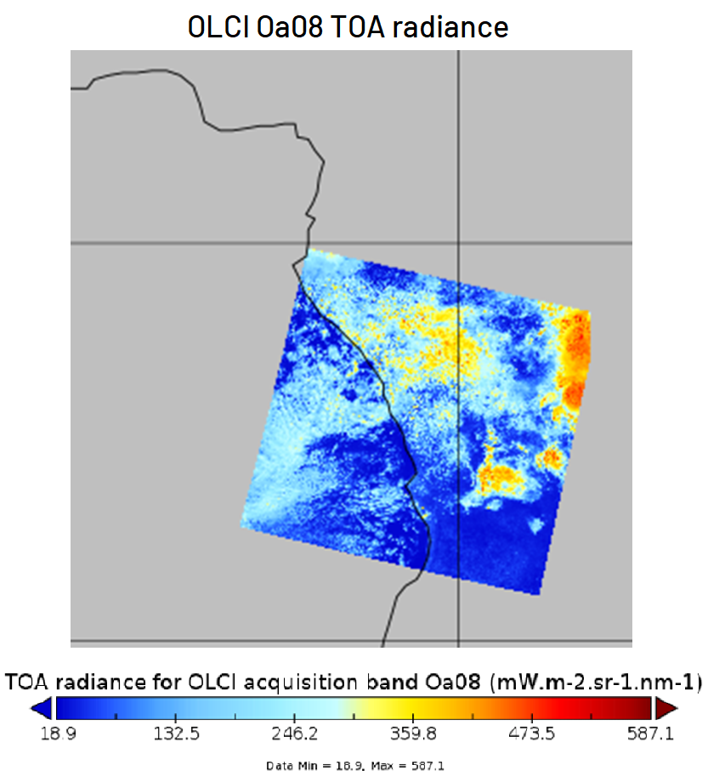
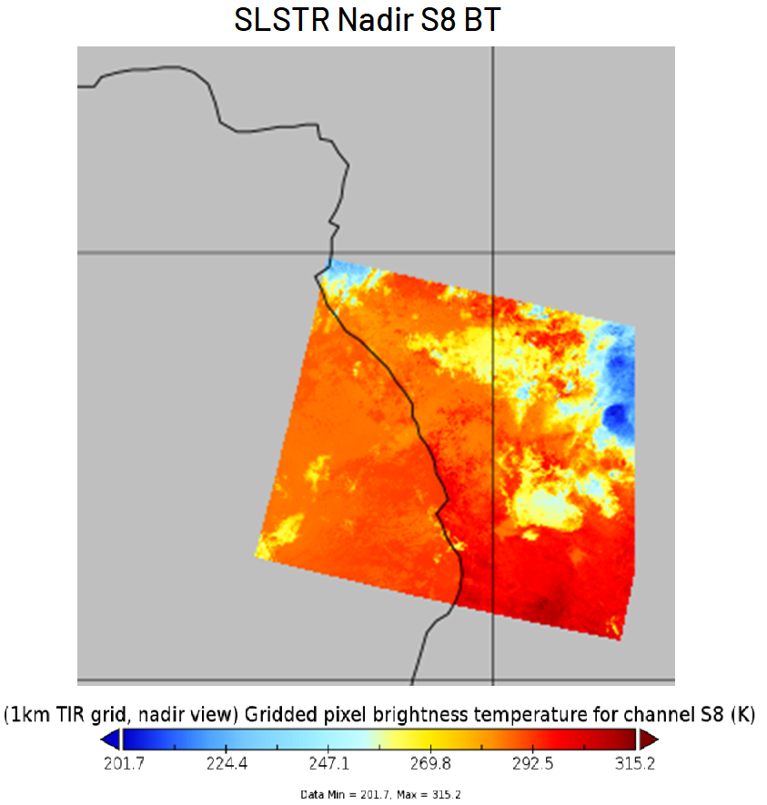
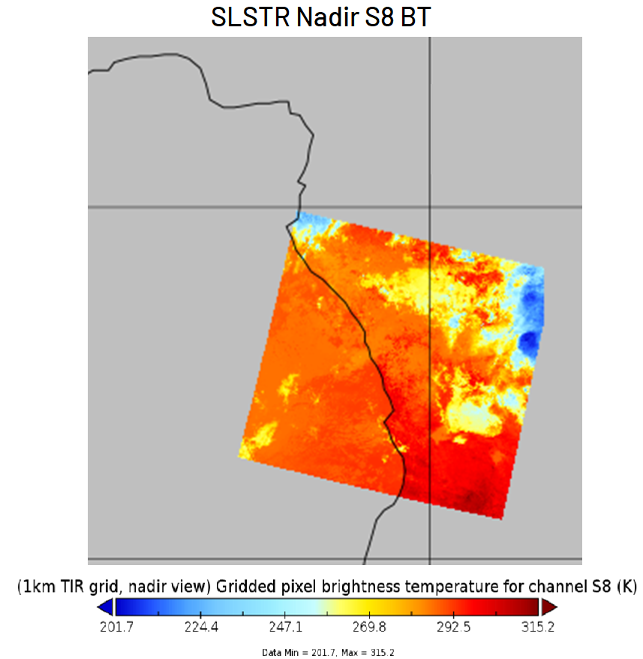
Deep Convective Clouds Inter-Calibration System (DCCICS)
Uses Deep Convective Clouds (DCC) to transfer the calibration from a reference instrument (NOAA-20 VIIRS as provided by NASA) to the monitored instrument;
DCC extraction:
  Subsets of L1C products over ROI;
  Remapping of SLSTR 11μm band (data fusion module) to OLCI grid and extract DCC
Statistical approach:
  DCC observations accumulated over about 30 days (sliding windows), extract PDFs;
  PDF parameter defining the typical observed DCC signal = MODE (Mean + Median also tested);
  The metric to define the measurements to be taken from the target instrument is still under evaluation;
Spectral band adjustment factors provided by NASA (SBAF)
  To account for the SRF difference between the reference and target instruments;
  If no corresponding channel available on the reference instrument, we make assumptions and use the closest channel.

Slide 8
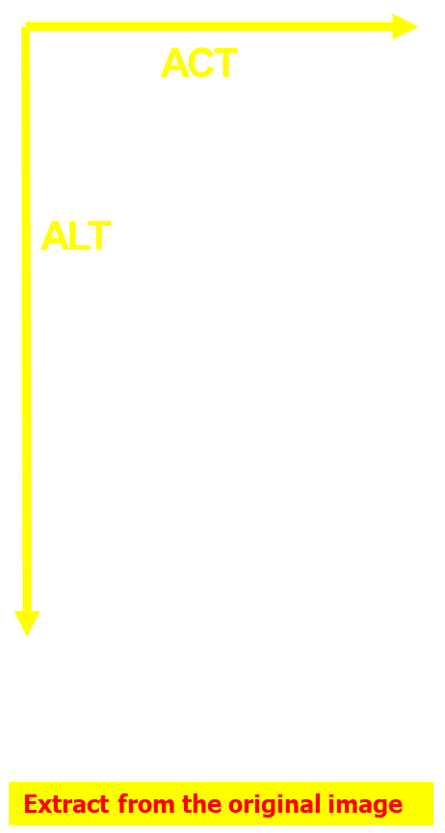
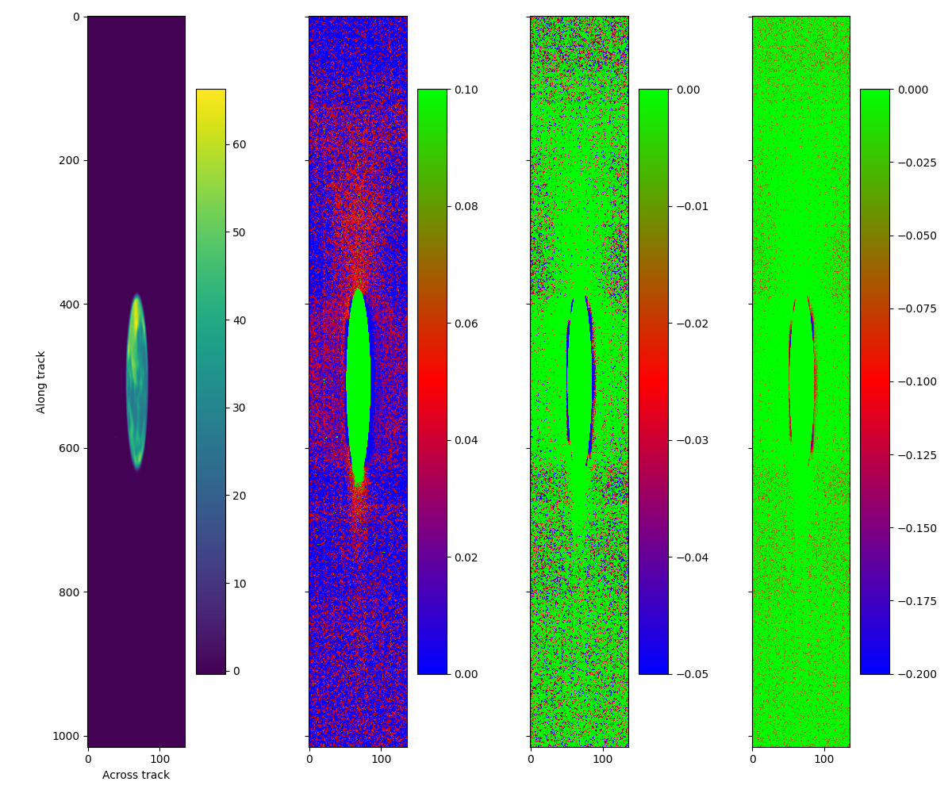
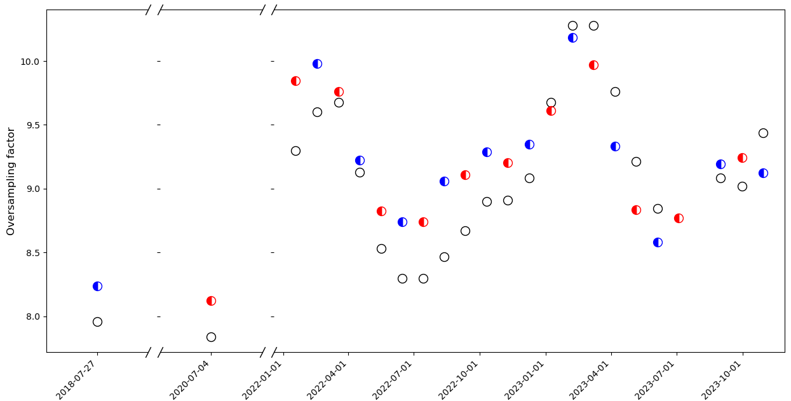
Lunar calibration system (LCS)
Use the Moon to transfer the calibration from a reference Lunar irradiance model to the monitored instrument;
Dataset
  Camera#4 OLCI-B in 2018 (commissioning)
  Camera#4 OLCI-A in 2020 (during operations)
  One acquisition per camera with OLCI-A + OLCI-B in 2022
  Routine monthly observations for Camera#4 with OLCI-A and B, since September 2022
  Phase is ~ 6.5 deg +/- 2 deg (but first observations with negative phase)
Data processing
  From Level 0 to Level 1 breakpoints ➔ IPF offline
  Lunar data extraction + radiometric assessment using EUMETSAT MICMICS prototype
Two lunar irradiance models in MICMICS
  GSICS Implementation of the ROLO model (GIRO), based on ROLO telescope set in Flagstaff Arizona + RELAB (Apollo samples);
  Lunar Extended Satellite Simulation Solar Reflectance (LESSSR), based on SCIAMACHY + RELAB;
Two parameters to be estimated as accurately as possible
  The oversampling factor OSF (which may vary in time)
  The pixel solid angle Ωi (which can vary from pixel to pixel)

Slide 9
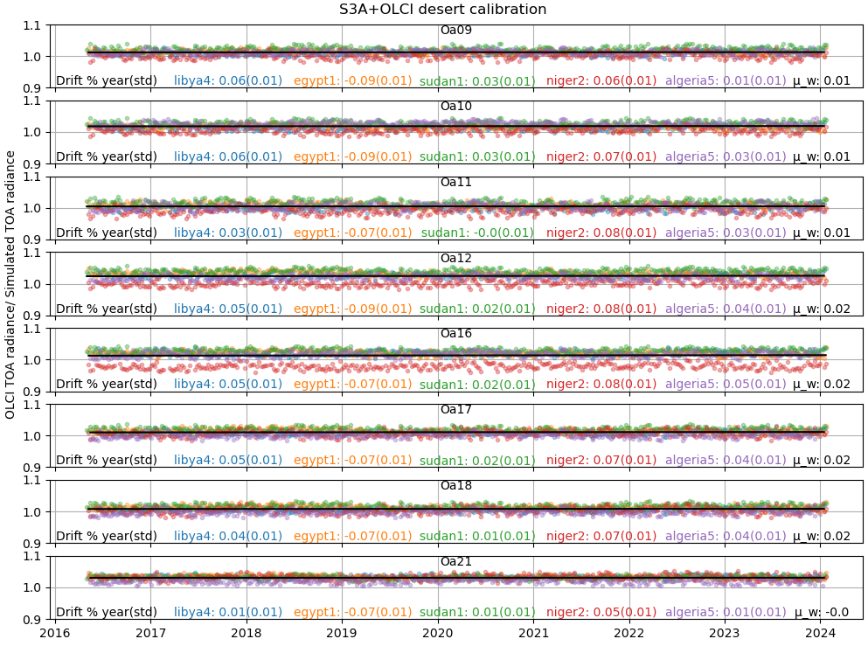
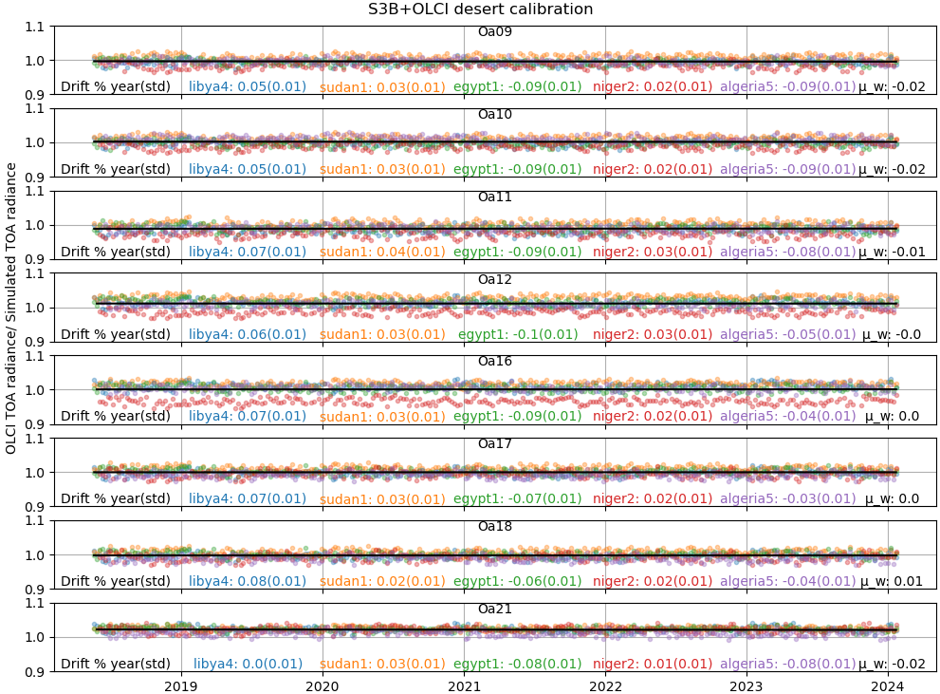
OLCI desert calibration
DESCS

Slide 10
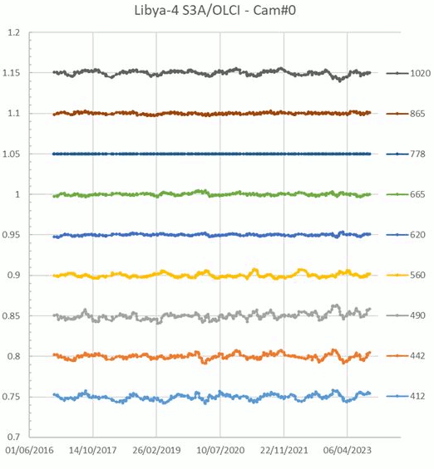
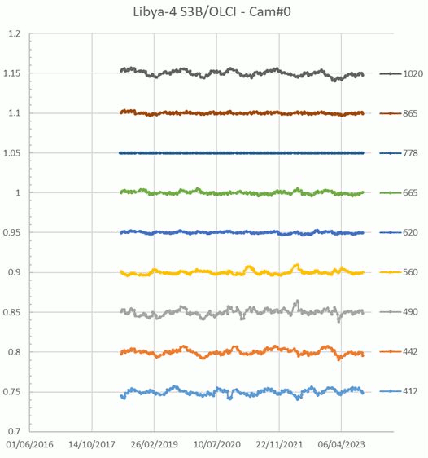
OLCI desert inter-band calibration

Slide 11
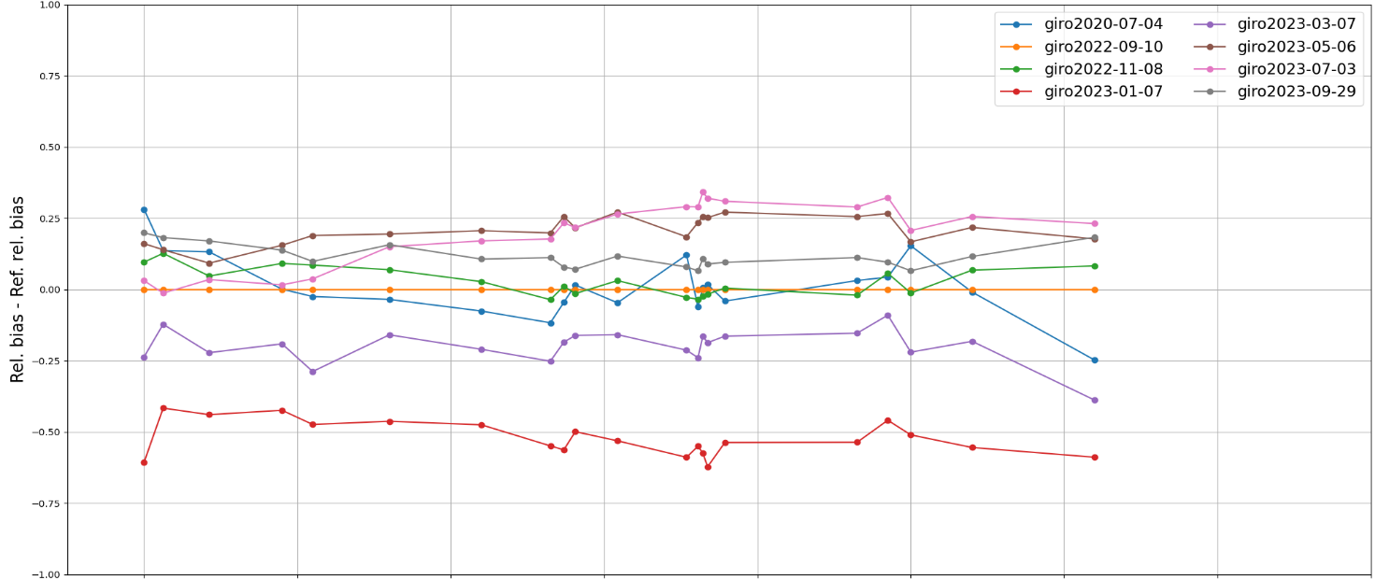
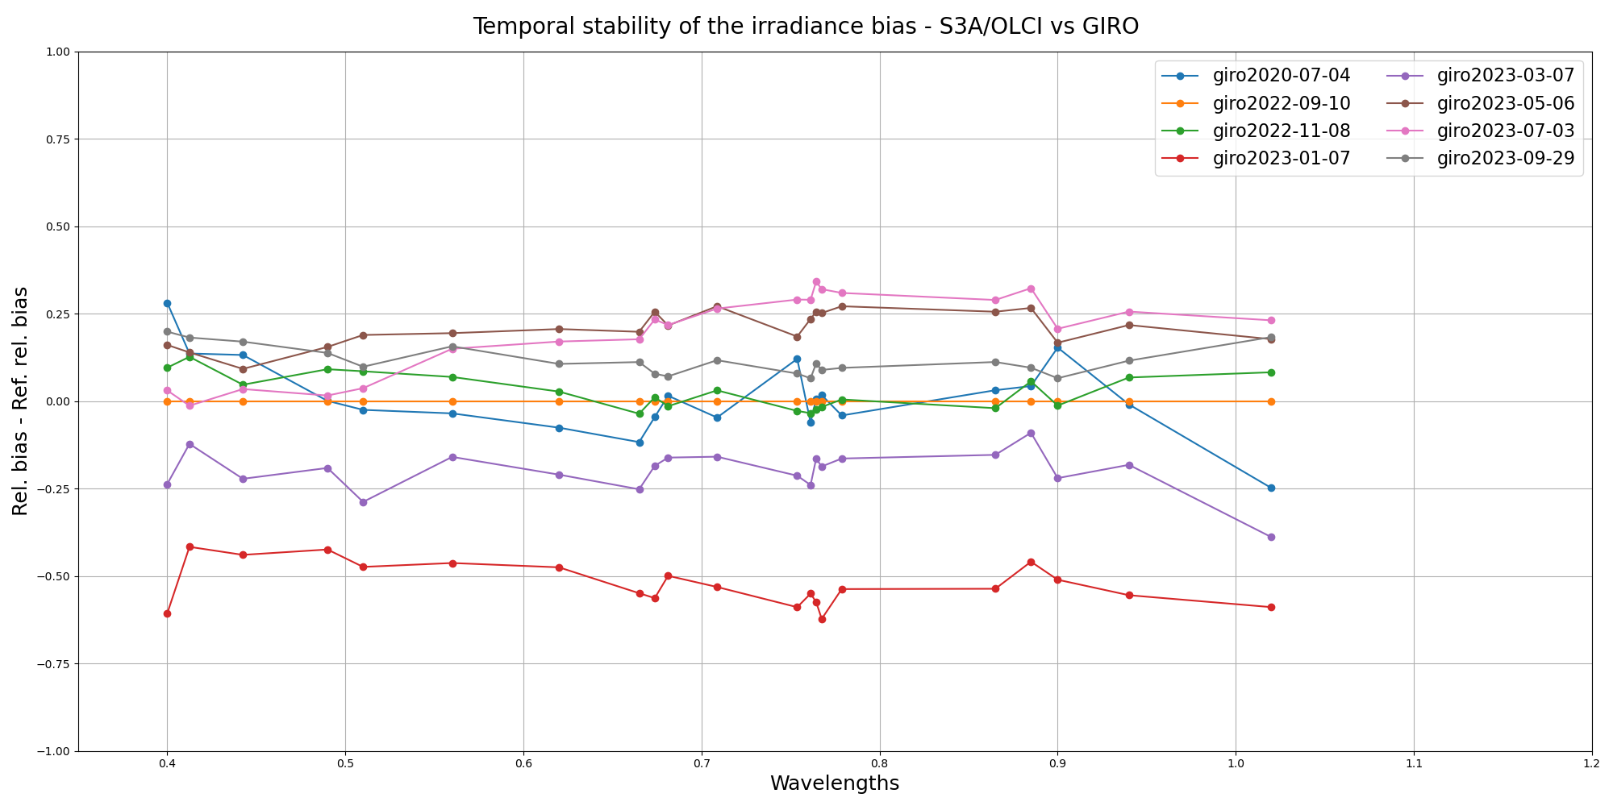
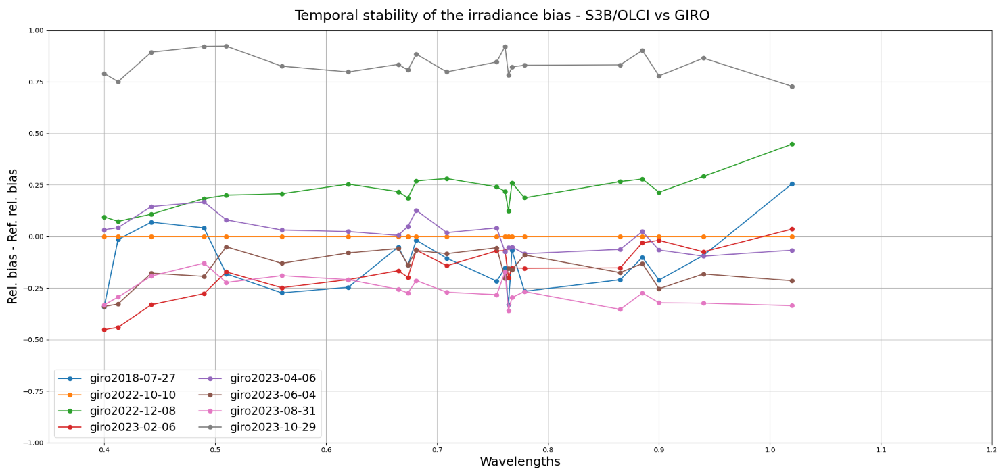
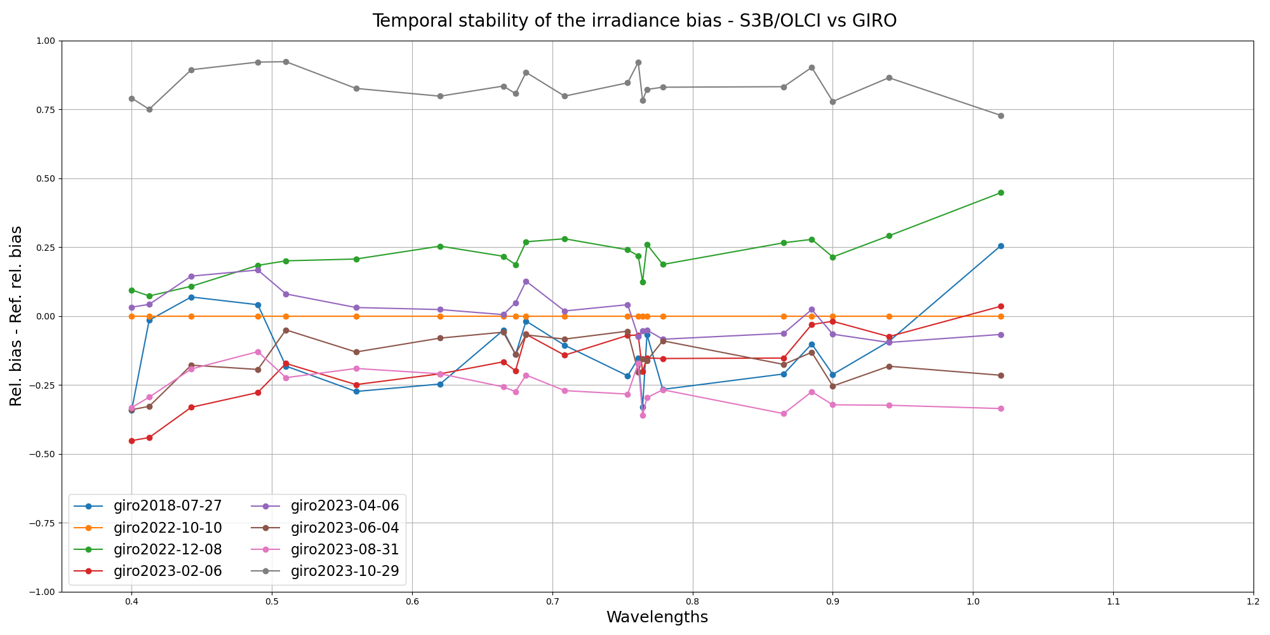
Lunar temporal stability monitoring
Only Camera#4 results with positive and negative lunar phase are considered (routine monitoring)
➔ Reference measurement = first measurement with Camera#4 and positive phase (09/2022 for OLCI-A and 10/2022 for OLCI-B)
Results:
Between -0.5 and +0.5% variability in time for S3A
Even better for OLCI-B, except an out-of-family event with the observation from October 2023 ➔ Requires further investigation.
Note: Lunar is only used for temporal monitoring due to the current limitations of lunar irradiance models.
LCS

Slide 12
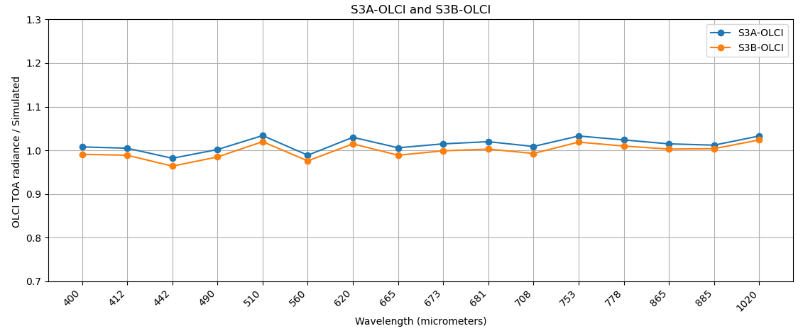
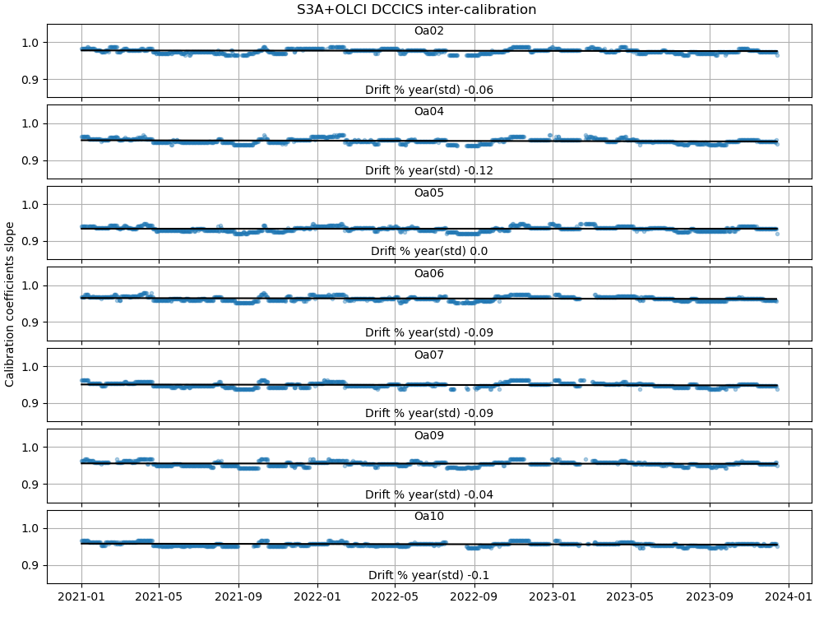
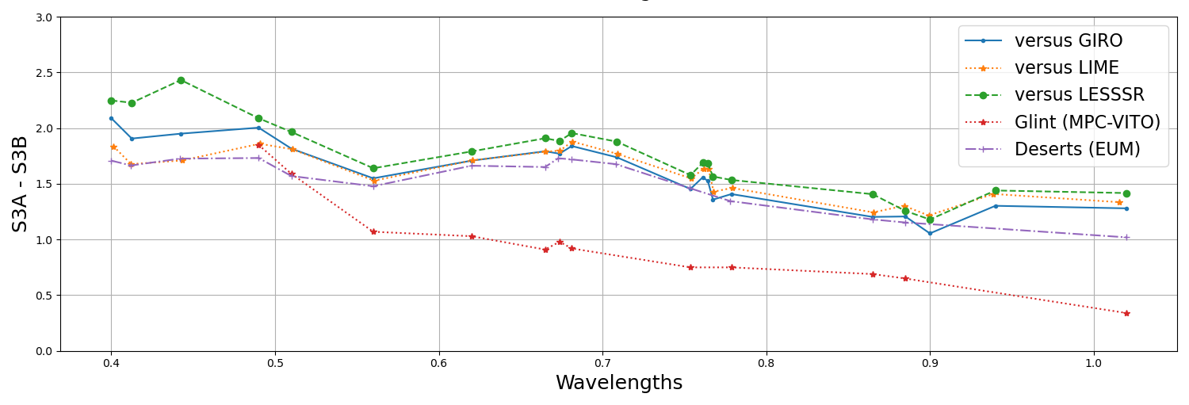
OLCI radiometric performance monitoring summary
OLCI radiometric performance is in line with expectations (considering uncertainty of methods)
Both OLCI-A and OLCI-B show good temporal stability and inter-band accuracy across multiple calibration and inter-calibration methods
OLCI-A is about 2% brighter than OLCI-B (1% for longer wavelengths).
DCCICS

Slide 13
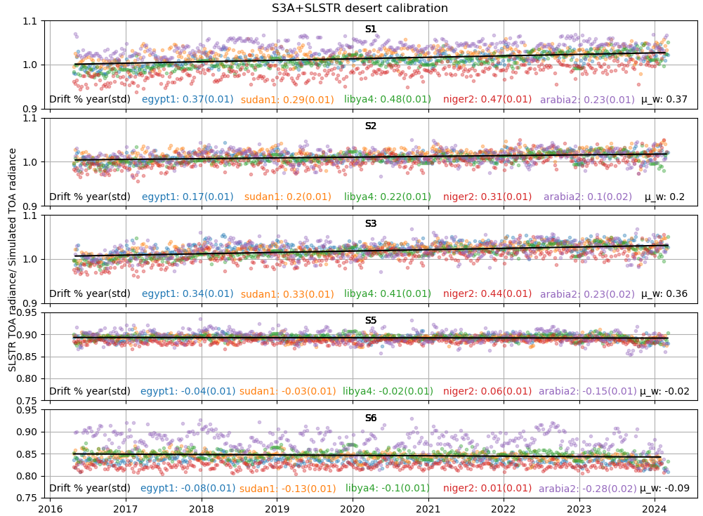
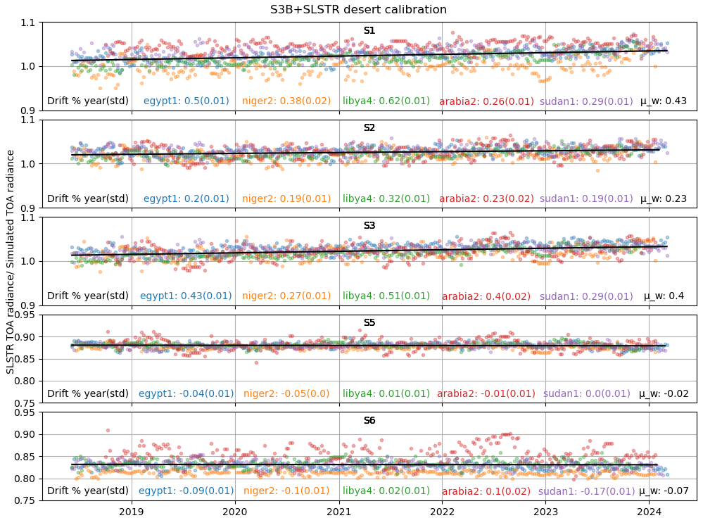
SLSTR desert calibration
DESCS

Slide 14
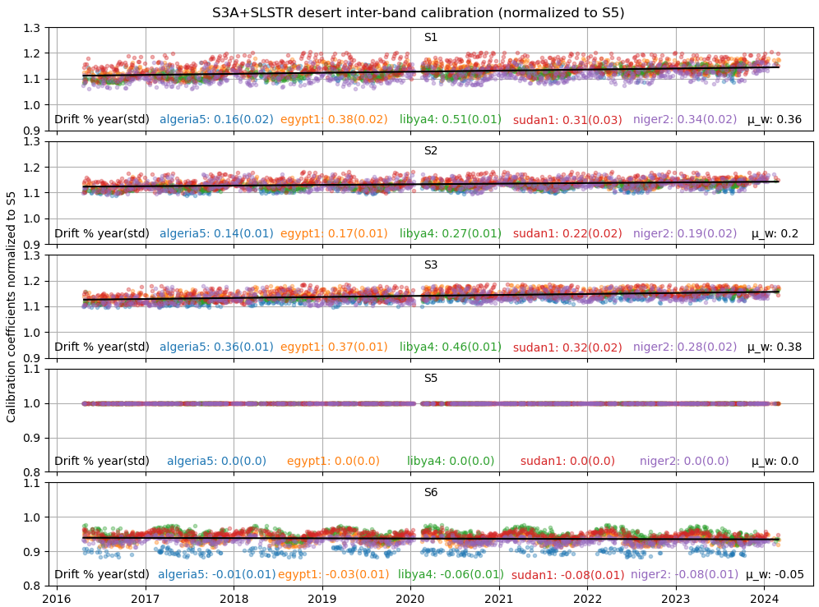
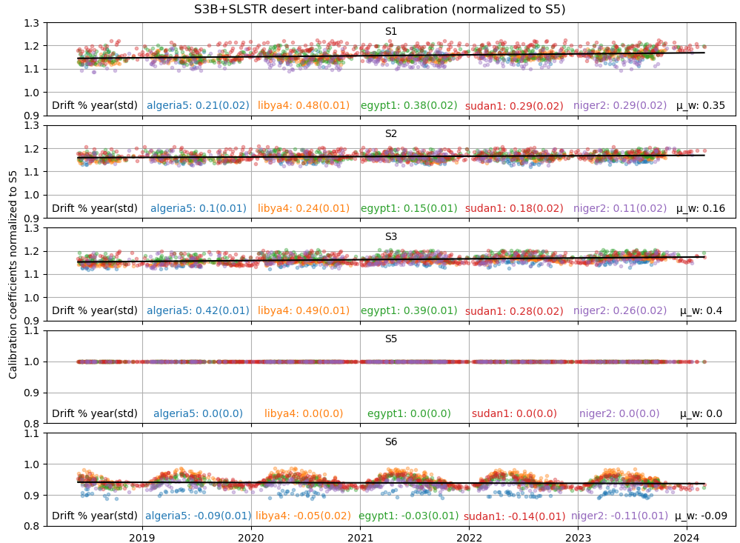
SLSTR Inter-Band calibration over desert (normalized to S5)

Slide 15
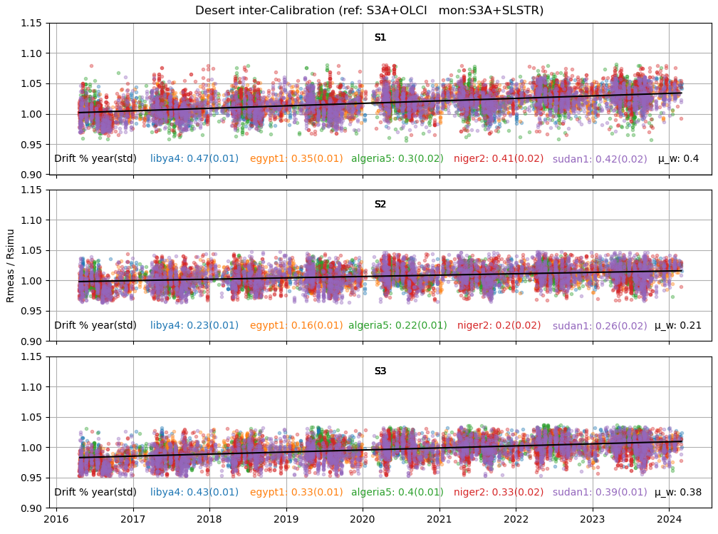
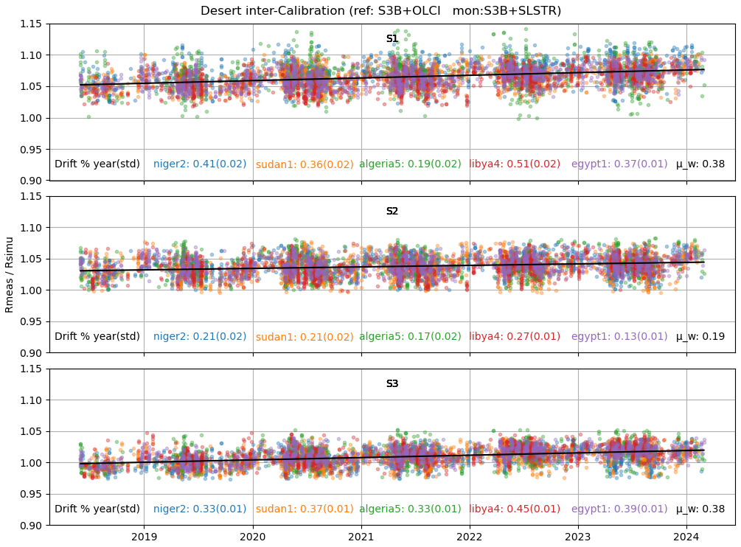
SLSTR Desert Inter-calibration (Ref: OLCI-A & OLCI-B)
DESICS

Slide 16
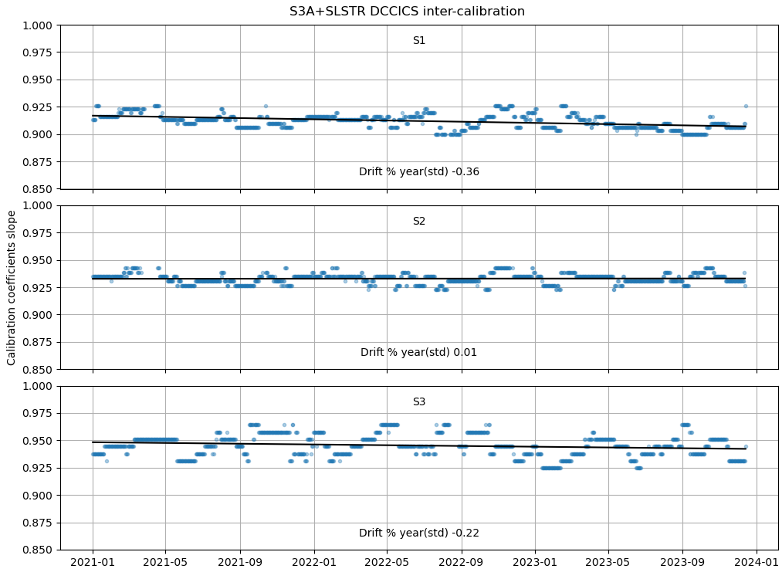
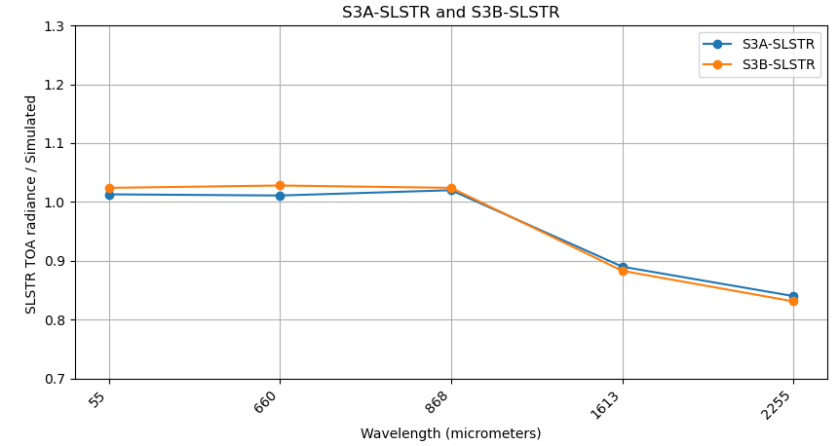
SLSTR radiometric performance monitoring summary
Temporal drift observed in SLSTR VIS/SWIR channels (except S5), with larger drift in S1 and S3 channels
Large negative bias in S5 and S6 (already known)
Results further confirm relevance of VIS/SWIR correction factors recommended to users
DCCICS

Slide 17
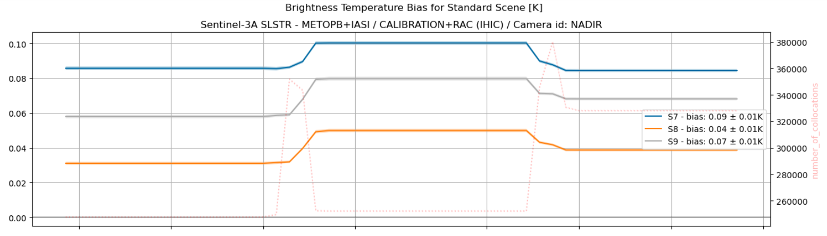
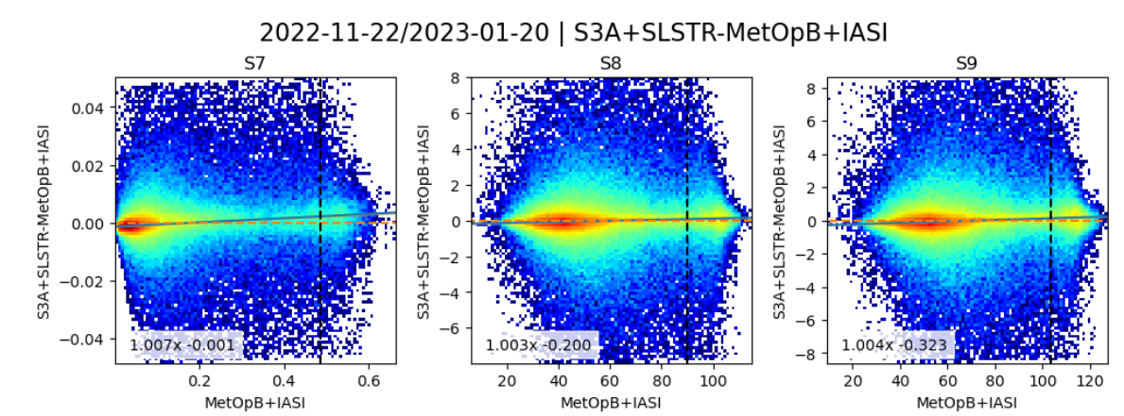
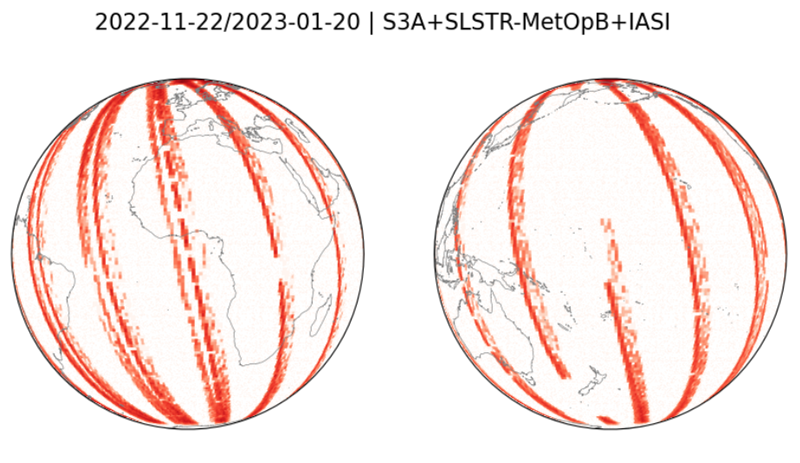
IR Channels calibration monitoring LEO-LEO IR
Collect Simultaneous Nadir Overpasses (SNOs)
Tie to contemporary reference instrument with very small uncertainty
Based on GSICS GEO-LEO IR
Matching view zenith angle and time
Apply weighted regression to collocated radiances
Evaluate uncertainties
Collocate in Space, Time, Angle
Convolve reference
Hyperspectral
(IASI & CrIS)
Compare
Evaluate & Monitor Bias
Convolve IASI spectrum with Spectral Response Function (SRF) of SLSTR
Gap-filling to extend IASI to fully cover SLSTR-S7
Can diagnose SRF errors
Check long-term stability & Decontamination

Slide 18
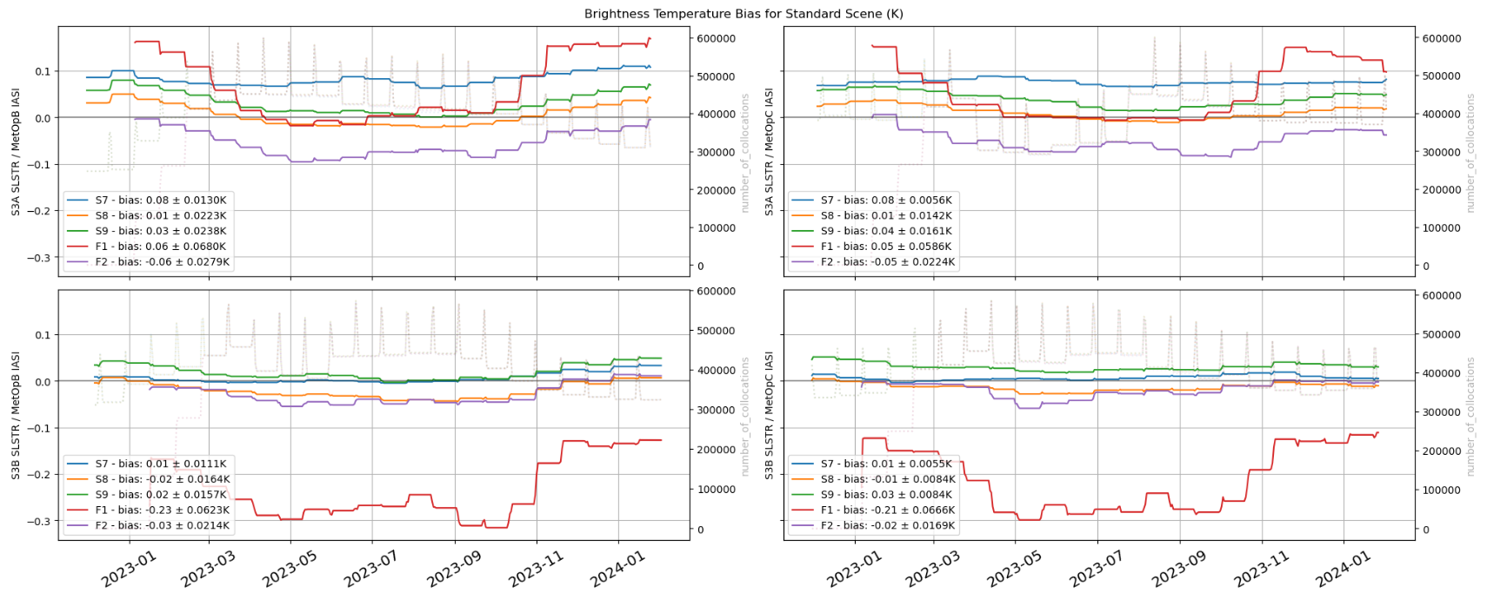
Bias for Standard Scenes (SLSTR vs IASI)
Nadir:
  S3A: Small bias in all channels <~0.08K vs IASI-B & IASI-C (upper row)
  S3B: Small bias in all channels (but F1) <~0.04K vs IASI-B & IASI-C (lower row)
  Stable for S7, S8 and S9 channels
  ReAnalysis Correction (RAC) 60 days time frame, standard scenes Tb ~285K

Slide 19
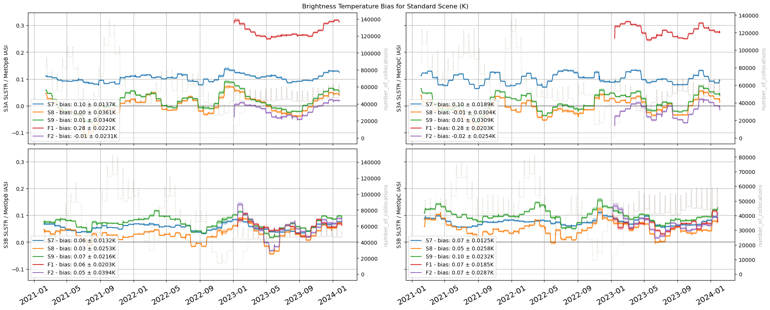
Bias for Standard Scenes (SLSTR vs IASI)
Oblique:
  S3A: Small bias in all channels (but F1) <~0.1K vs IASI-B & IASI-C (upper row)
  S3B: Small bias in all channels <~0.1K vs IASI-B & IASI-C (lower row)
  Stable for all channels
  ReAnalysis Correction (RAC) 60 days time frame, standard scenes Tb ~285K

Slide 20
Thank you!
Questions are welcome.

Slide 21
Sentinel-3 SLSTR Level-2 SST/ IST products and L1 to L2 Cal/Val
Anne O’Carroll, Gary Corlett, Igor Tomazic
GSICS plenary 2024
11th March 2024

Slide 22
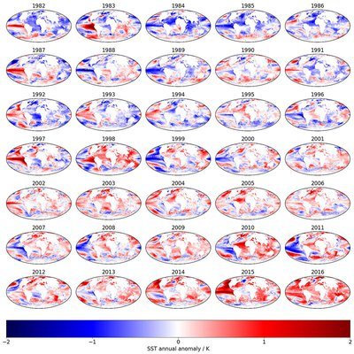
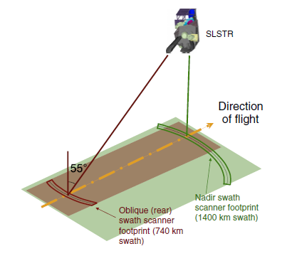
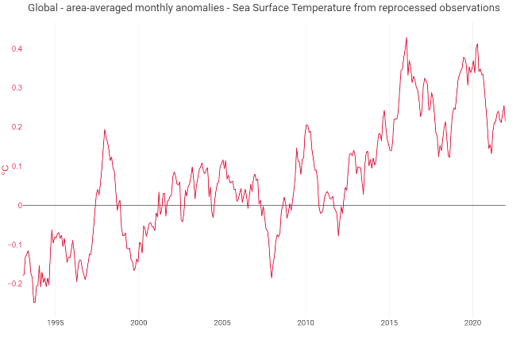

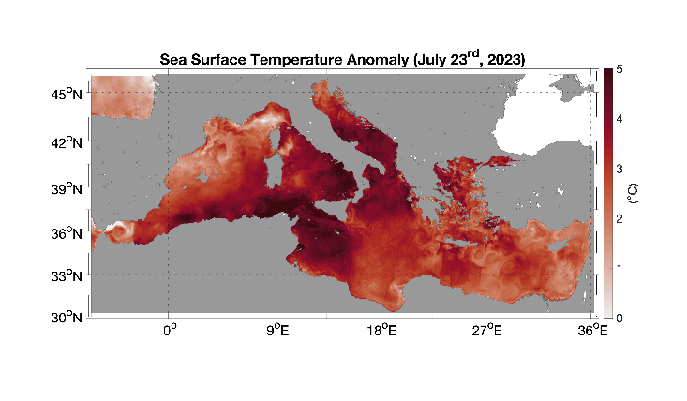
Sentinel-3 Sea and Land Surface Temperature Radiometer - reference SST
Sentinel-3 SLSTR provides Reference satellite Sea-Surface and Sea-ice Surface Temperature for the marine domain
https://figshare.com/articles/figure/Annual_sea_surface_temperature_anomalies_1982_-_2016/10303718/1

Slide 23
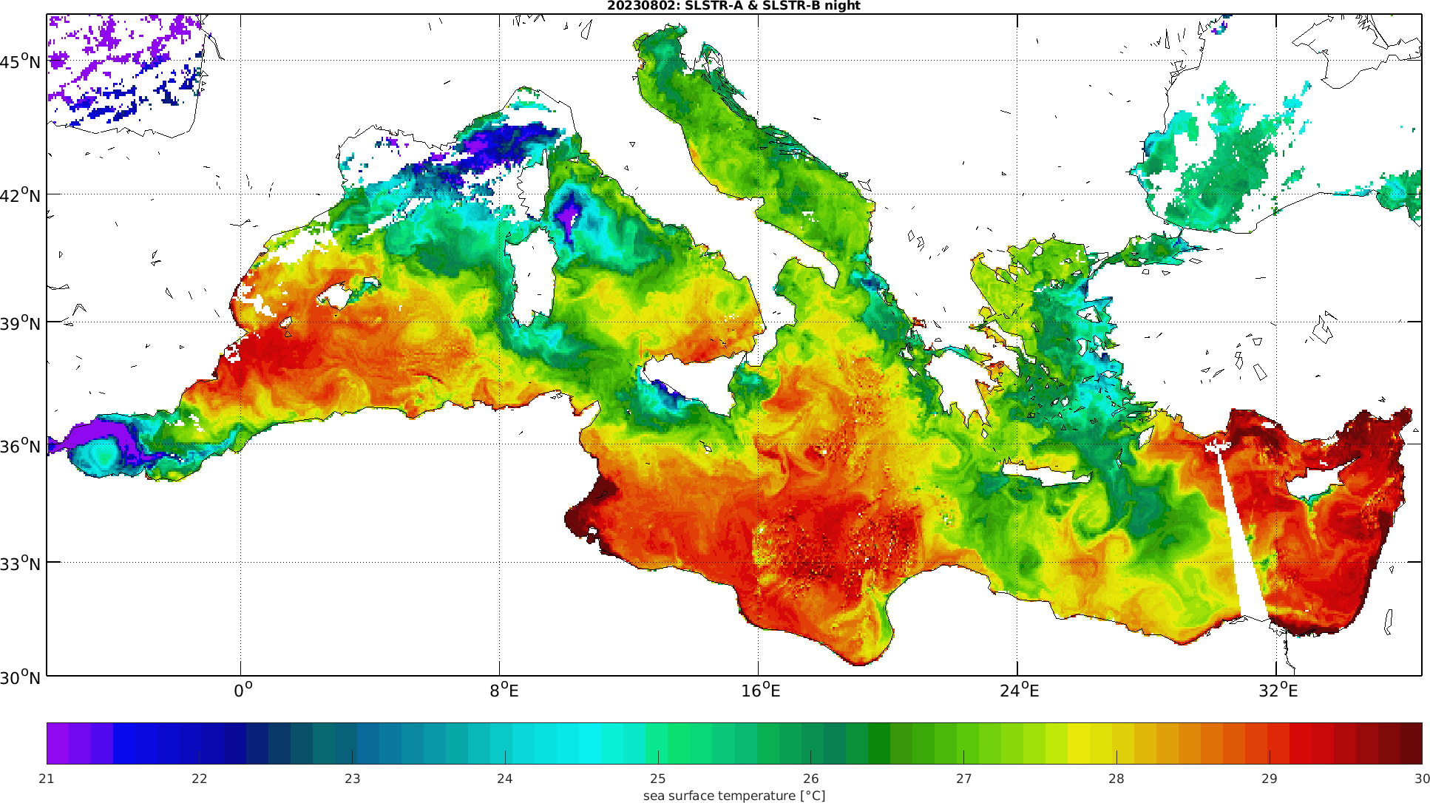
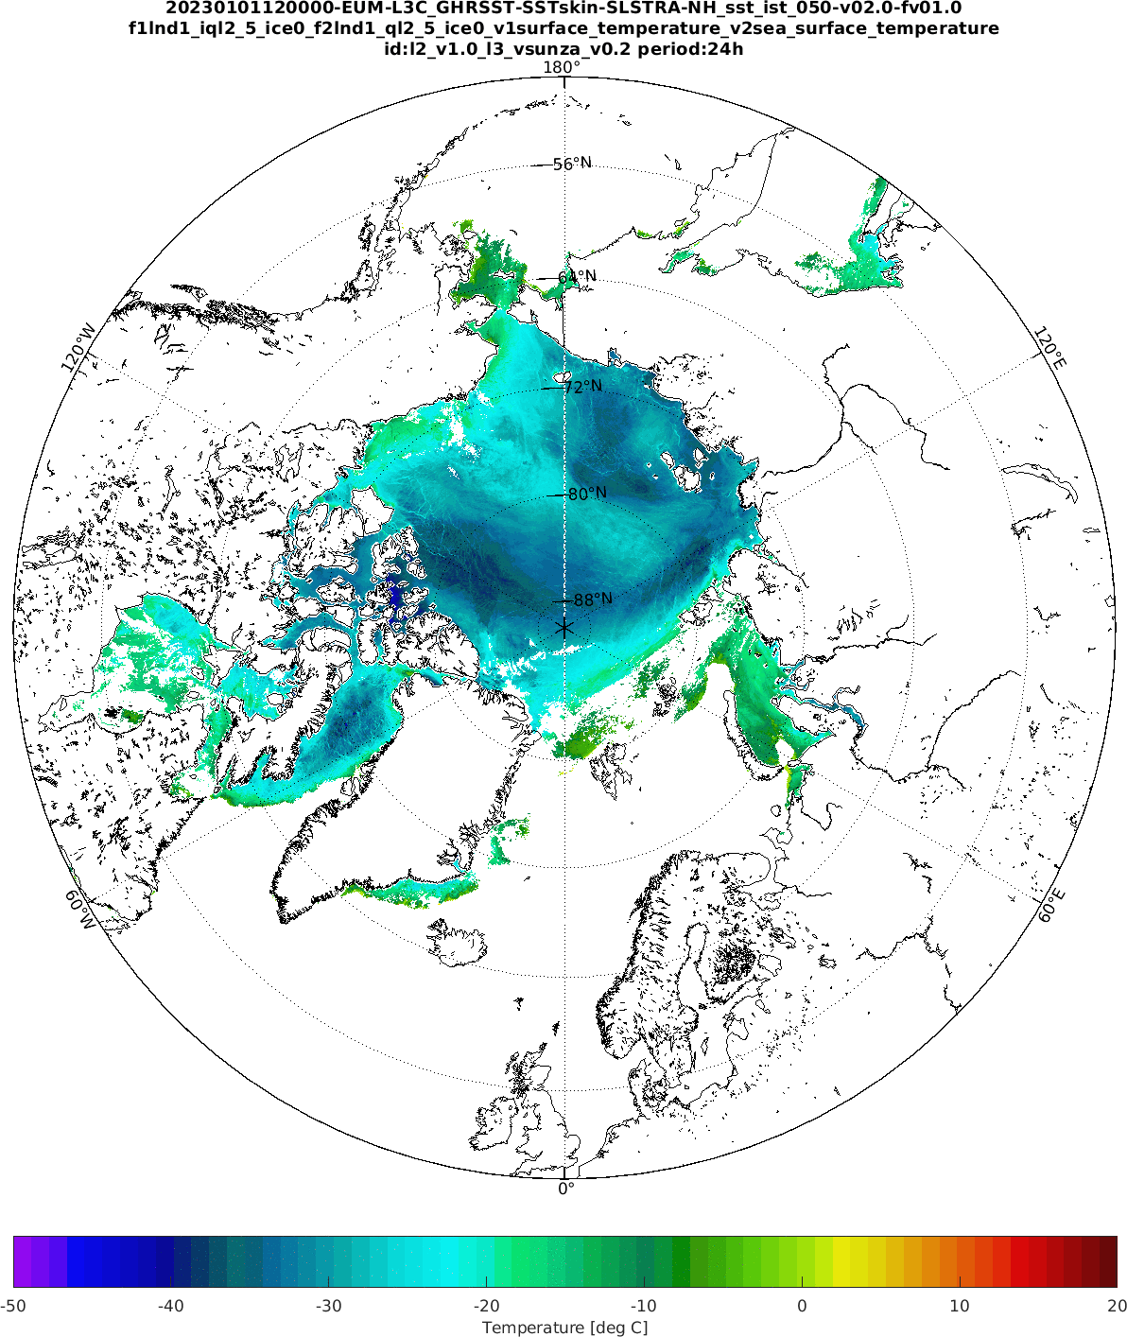
Sea Surface Temperature and sea-Ice Surface Temperature
Sentinel-3A/B providing operational SST since 2017/2019. IST pre-operational products available on WEkEO by Spring 2024 and operational 2025 TBC.

Slide 24
Recent scientific and Cal/Val developments
SLSTR coefficient generation tool and operational retrieval algorithms
Coastal Bayesian Cloud detection
Consistency of SST products and steps towards harmonisation
IST and cloud-mask validation
Evolution of SST Cal/Val tools and MMDB
2021
2022
2023
2024
L0->L1->L2 Cal/Val framework needed to ensure quality of Sentinel-3 (and multi-mission) operational / reprocessed products

Slide 25
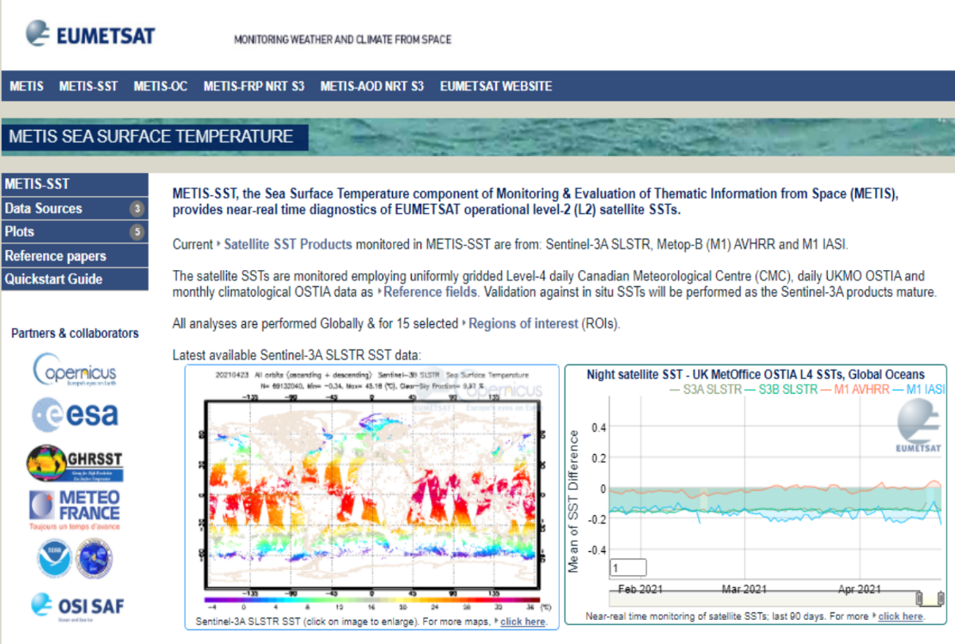
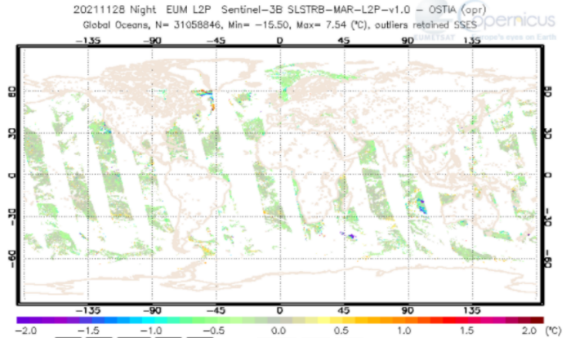
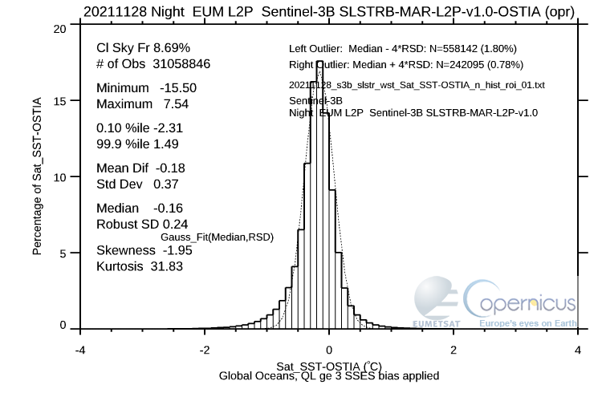
Level-2 SST monitoring and validation framework (METIS)
Monitoring and Evaluation of Thematic Information from Space METIS: metis.eumetsat.int
Routine SLSTR L2P SST inter-satellite comparisons with L4 OSTIA and CMC gap-free, daily SST analyses of night-time foundation SST
Validates L2 Copernicus Marine Data Stream polar orbiting SST
  SLSTR, OSI SAF AVHRR, IASI
Future to include SLSTR-C/D/NG, MetImage, CIMR and consider GEOs plus sea-ice surface temperature
  Tool evolution in progress as part of Sci4MaST project (www.eumetsat.int/sci4mast)
SLSTR used as a reference sensor in OSTIA since December 2020
SLSTR integrated in CMEMS SST-TAC in 2020 and used as a reference

Slide 26
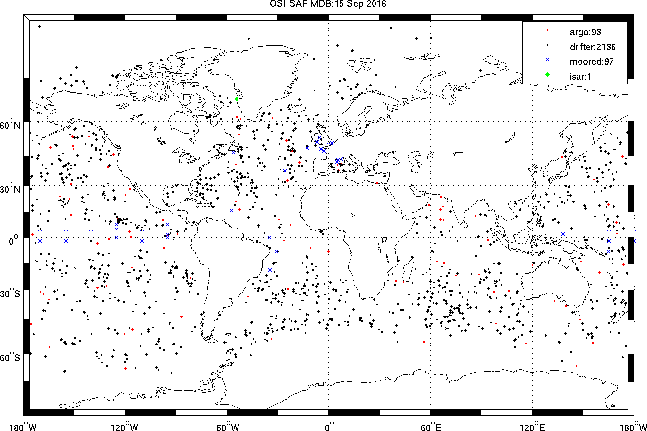
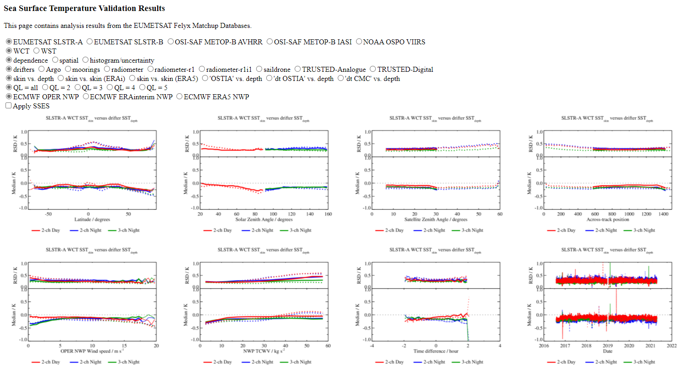
SST validation methodologies (Level-2 SST)
Multi-Matchup Dataset (MMDB) based on Felyx
Evolutions in 2022/2023 prepared for expansion of multi-matchup framework
Sea Surface Temperature Validation Results (SSTVAL)
Based on available in situ data
drifting buoys, Argo, Fiducial Reference Measurements (TRUSTED and ship-borne radiometers)

Slide 27
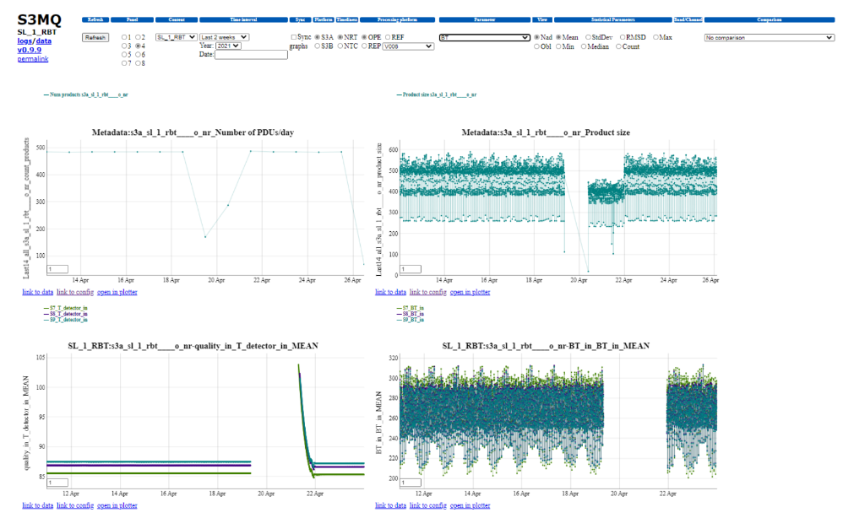
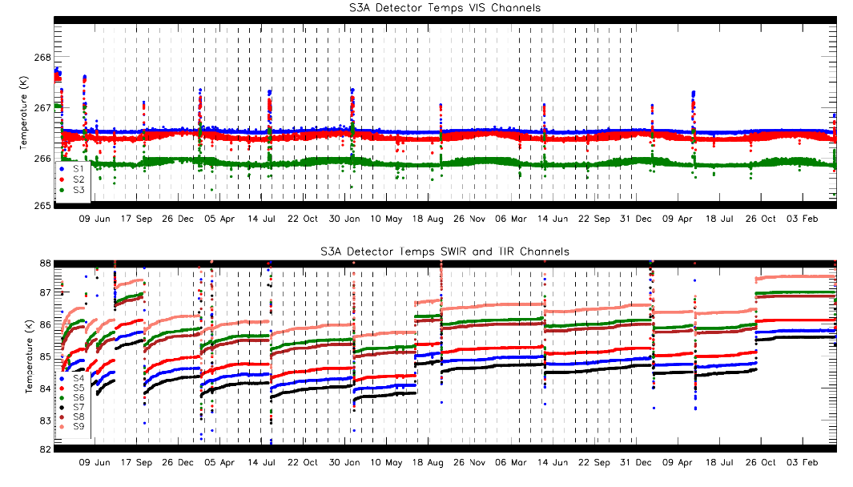
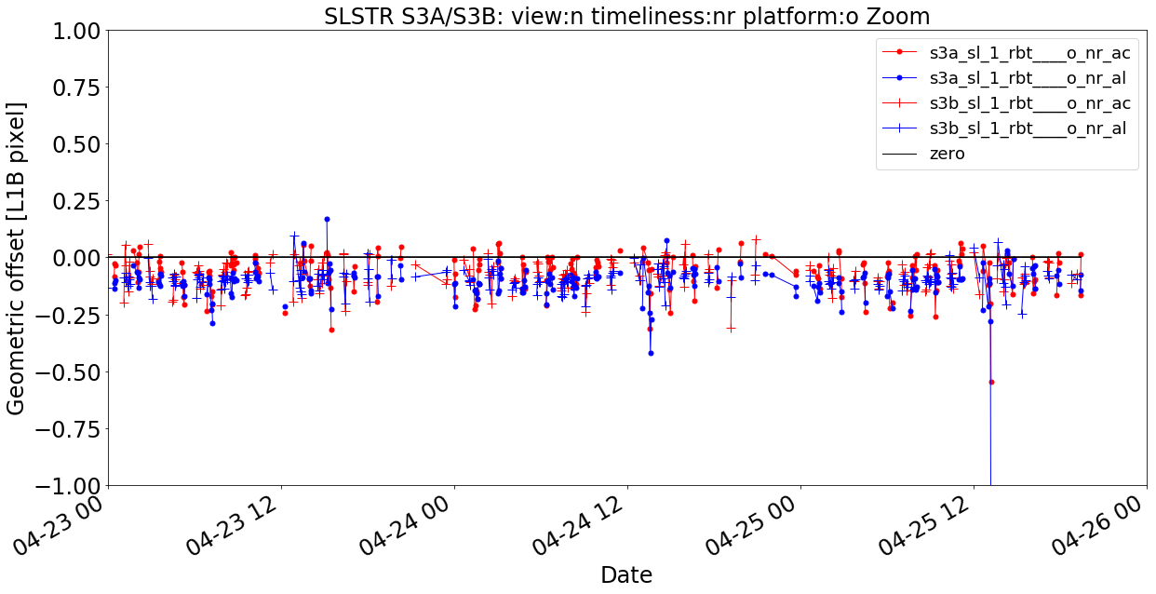
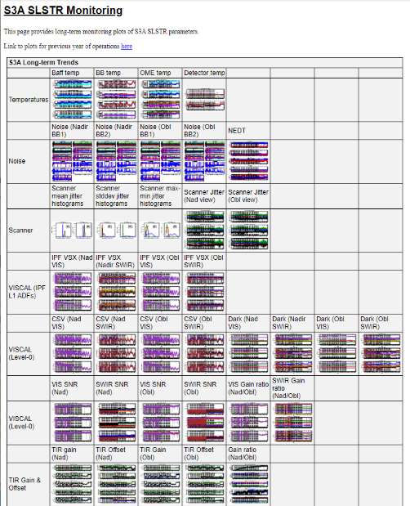
SST validation methodologies (Level-0/1)
L0, L1, L2 metadata monitoring (S3MQ)
L0/L1 monitoring (based on work from RAL)
Geolocation monitoring (GEOCAL)

Slide 28





Validation of uncertainties
GHRSST L2P specification provide SSES bias and standard deviation
Provision of theoretical uncertainty encouraged and increasing
Uncertainties also need validating
Method developed in ESA SST CCI project
Plot courtesy Owen Embury

Slide 29

Summary
SLSTR continues to provide high-quality dual-view SSTs as a reference sensor
Validation activities continue for Sentinel-3 from L3, L2, and L1/0
Developments continue for further existing and future EUMETSAT / Copernicus marine Surface Temperatures

Slide 30
Thank you!
Questions are welcome.
Anne.OCarroll@eumetsat.int

Slide 31
Sentinel-3 OLCI Level-2 Ocean Colour products and L1 to L2 Cal/Val
Ewa Kwiatkowska, Juan Ignacio Gossn, David Dessailly, Francesco D’Amico
GSICS plenary 2024
11th March 2024

Slide 32


Satellite Ocean Colour: observing the living aquatic ecosystems
March 2023
Ocean Colour data from the European Commission Copernicus Programme Sentinel-3 OLCI instruments
Water Quality
Aquatic resources
Carbon/Climate
Drinking and bathing water quality
Harmful Algal Blooms
Tourism and coastal communities
Eutrophication
Ecosystem status and services
Legislation, e.g. EU Water Framework Directive
Fisheries
Aquaculture
Coastal management / ports
Coastal sedimentation / erosion
Biodiversity, ecosystem modelling
Legislation, e.g. EU Marine Strategy Framework Directive, Biodiversity
Aquatic phytoplankton are the Biological Carbon Pump
Important Carbon sink
Absorption of 20 – 30% of anthropogenic CO₂ emissions
Earth’s Primary Production ~50%
Legislation: European Green Deal

Slide 33


Ocean Colour requires the lowest possible uncertainties in satellite instrument calibration
Satellite measurement, L_{TOA} [mW/m²/sr/nm]
Water-leaving radiance, L_{w} ~ 10% (in blue/green)
Atmosphere and water surface ~ 90%
Clear water chl-a = 0.05 mg/m³, clear sky, tropical marine atmosphere
Water-leaving radiance ~ 10% in the blue and green spectral range
/absorbed
Dierssen and Randolph, 2012, Earth System Monitoring
Mobley 2021, Ocean Optics Web Book
Water appears black from space
Water-leaving radiance is a small fraction of the total radiance measured by the satellite
Satellite instrument uncertainties are magnified 10-fold for water-leaving radiance
Water-leaving radiance product requirement uL_{w} 5%

Slide 34











System Vicarious Calibration is a requirement for all Ocean Colour missions
Ocean Colour relies on the quality of satellite instrument calibration, characterisation, temporal stability, inter-band, spectral, geometric ← uρ_{TOA} calibration typically within 2%
Ocean Colour requires uρ_{TOA} « 0.5% to meet the 5% uL_{w} product uncertainty requirements
Ocean Colour System Vicarious Calibration (OC-SVC) is a bias adjustment
OC-SVC is the Fiducial Reference Measurement (FRM) Gold Standard in Ocean Colour
OC–SVC relies on in situ water-leaving radiance measurements with SI traceability and the lowest achievable uncertainties of the complete OC-SVC ‘system’
Sentinel-3 OLCI-A and OLCI-B OC-SVC accomplished courtesy NOAA’s Marine Optical Buoy (MOBY)
OC-SVC ‘system’
Sentinel-3 OLCI-A: No and With OC-SVC
$$L_{TOA}$$
$$L_{atm}$$
$$L_{w}$$
$$L_{sur}$$
Sentinel-3 Cal/Val Plan
OLCI-L2WLR-CV-200

Slide 35






Importance of the Ocean Colour System Vicarious Calibration
Sentinel-3 OLCI-A and OLCI-B: With OC-SVC (OLCI Collection-3 reprocessed and operational data)
With OC-SVC: OLCI-A 490 nm vs AERONET-OC
Blue/green bands within Mission Requirements or just above (complex waters, case-2) < 8%
With OC-SVC: OLCI-A and OLCI-B water reflectance at 442.5 nm time series, oligotrophic waters
CMEMS: Merged OLCI-A and OLCI-B Ocean Colour 300 m products are distributed from May 2021 (Collection-3) thanks to the excellent consistency between OLCI-A and -B, because of the OC-SVC
With OC-SVC: Merged OLCI-A and OLCI-B chlorophyll concentrations, 28 March 2021
With OC-SVC: OLCI-A and OLCI-B chlorophyll concentration time series, mesotrophic waters
With OC-SVC: OLCI-B 490 nm vs AERONET-OC
Blue/green bands within Mission Requirements or just above (complex waters, case-2) < 8%
OLCI-A
OLCI-B
OLCI-A
https://metis.eumetsat.int/oc
Robust OC-SVC process: OC-SVC gains were derived independently for both sensors (OC-SVC tool)
Good agreement with third party missions, e.g. MODIS-Aqua courtesy of NASA
Sentinel-3 OLCI Collection-3 Report here
AERONET-OC data courtesy of AERONET-OC PIs, JRC and NASA

Slide 36



Activities towards Copernicus OC-SVC infrastructure
Within the Copernicus framework, EUMETSAT manages OC-SVC infrastructure development activities for the Copernicus Programme on behalf of the European Commission
Goal is to achieve the best OC-SVC infrastructure for the upcoming 20+ years of the Copernicus Programme and in support of international missions
~2028
Immediate target is to secure the Copernicus OC-SVC expertise and autonomy for Sentinel-3 OLCI and the corresponding Next Generation sensors
Accompanying goal is to support other current and planned Copernicus Sentinels and Expansion missions such as Sentinel-2, CHIME and other European and international missions with ocean colour goals or possibilities
  https://www.eumetsat.int/OC-SVC

Slide 37





Activities towards Ocean Colour FRM for validation – FRM4SOC2
Fiducial Reference Measurements for Satellite Ocean Colour validation
  Phase 1 coordinated by ESA, https://frm4soc.org
  Phase 2 funded by the EC Copernicus Programme and coordinated by EUMETSAT, https://frm4soc2.eumetsat.int
  Supporting operational implementation of the FRM principles by the Ocean Colour Community, starting with in situ hyperspectral radiometry
Goal is to provide to the Community easy procedures, guidelines and tools for collecting FRM-quality radiometric measurements
https://frm4soc2.eumetsat.int

Slide 38
Thank you!
Questions are welcome.
Ewa.Kwiatkowska@eumetsat.int

Slide 39
Sentinel-3 Near Real Time (NRT) Atmosphere
On the critical importance of high L1 CalVal performance
Julien Chimot, Edouard Martins, Andrea Meraner, Jaap Onderwaater, Thierry Marbach, Loredana Spezzi, Alessio Bozzo, Bertrand Fougnie
GSICS plenary 2024
11th March 2024

Slide 40







EUMETSAT Sentinel-3 NRT Atmosphere portfolio: Entrusted by Copernicus & Member States
Connecting all the European operational Near real Time (NRT) multi-missions
Existing Operational: SLSTR: NRT Aerosols
NRT Fires
New NRT on WekEo: OLCI TCWV (COWA)
SLSTR Wind (AMV)
Near Future NRT:
Synergy Cloud mask
OLCI Cloud Top pressure (CTP)
SLSTR TCWV (AirWave)
OLCI Aerosol Layer Height
(ALH)
For all: NRT + Multi-year processing validation
(as per user requests)
MetOp
Sentinel-3
MTG
FCI, Sentinel-4
EPS-SG
Sentinel-5, 3MI
CO2M
MAP, CLIM
PMAp CDR, Metop-A/B, daily AOD in 2007-2019
Courtesy: S. Jafariserajehlou + B. Fougnie (RSP)
+ all USC colleagues (M. Doutriaux)

Slide 41








Establishing the European NRT Aerosols / Fires satellite constellation
Summer 2023 observed by NRT Sentinel-3 – Dust, Smoke, hot-spots
NRT Aerosols
NRT Fires
EPS-SG
NRT AOD: 3MI + SYNergy (MAP)
MetOp
NRT AOD SYNergy
MTG FCI
EUMETSAT partnership with
NRT User communities
Continuous support to CAMS for reanalaysis campaigns & assimilation preparation (in addition to: NRT SYNergy PMAP, FCI, 3MI, NRT SYNergy MAP)
Collaboration with NASA + NOAA for smoke prediction and transition from MODIS Terra to NRT Sentinel-3.
1st testing of NRT FRP with CEMS, NILU (vegetation fires, industrial gaz flare).

Slide 42







Individual 1 km hot spot and imagery
A zoom over Canada single hot-spots (2023 summer)
Toward Collection 3* of NRT Sentinel-3 Fires:
Highly improved detection accuracy of each 1-km thermal hot-spots during day-time
Geo – LEO fire CalVal – Credit A. Meraner (EUM)
1-km Fire Radiative Power [MW]
RGB Composite from SLSTR Solar Channels (R=2.2μm, G=1.6μm, B=0.6μm)

Slide 43



NRT Aerosol Optical Depth – Multi-Year Analysis
North-America
Further validation support from Copernicus Fiducial Reference Measurement (FRM) for Aerosols
Led by:
Thierry Marbach (EUMETSAT)
Carlos Toledano (Universidad Valladolid)
NRT Sentinel-3
MODIS Terra / Aqua
VIIRS SNPP Deep Blue (NASA)
VIIRS NOAA-20 Deep Blue (NASA)
S3 A vs. AERONET
South-America

Slide 44



On the critical importance of high performance of OPErational L1 CalVal
Sentinel-3 SLSTR - significant VIS-NIR-SWIR dual-view calibration issues - not (yet) corrected in the L1 products.
Not affecting the primary SLSTR application (SST).
To mitigate impacts on the L2 NRT Atmosphere, a vicarious calibration expert group has been established:
  Copernicus Sentinel-3 Mission Performance Centre (MPC) led by ESA
  EUMETSAT Calibration & MICMICS expert system (multi-mission).
  => Provision of absolute + temporal drift correction gains
The correction gains are operationally implemented in the L2 NRT processing chains since 2020.
L1 and L2 teams work hands in hands => highly beneficial for the L2 NRT Aerosol products
Vicarious calibration correction
On-board L1 Calibration
L2 NRT Atmosphere

Slide 45


On the critical importance of high performance of OPErational L1 CalVal
Example with latest knowledge (2024) on the drift correction SLSTR VIS-NIR-SWIR radiances in L1 as computed by EUMETSAT MICMICS, and tested in the evolved L2 NRT AOD(550 nm) chain:
No VIS-NIR drift Correction
With VIS-NIR drift Correction
S3 A Ocean vs. AERONET
Small but noticeable benefits!

Slide 46
Thank you!
Questions are welcome.
Julien.Chimot@eumetsat.int
Bertrand.Fougnie@eumetsat.int

