Slide 1
Polarisation – Specific Needs in Calibration & In-orbit Activities
Bertrand Fougnie, Margarita Vazquez-Navarro, Pepe Phillips,
Ali Mousivand, Bernd Husemann
for the Remote Sensing & Products division
11/03/2024

Slide 2
Summary
Introduction
Why polarisation ?
Polarimeters
From radiometry to polarisation
Specific needs for the performance
Polarisation model
Measurement of the polarisation
In-flight calibration
PICS, Rayleigh, Sunglint, Clouds, Moon, Statistics, Cross-comparison
Summary and Way forward

Slide 3
Why instrument characterisation for polarisation?
Needed for:
Polarimeters: when the goal is to measure the polarisation from Earth-Atmosphere
e.g. EPS-SG/3MI, CO2M/MAP, EPS/GOME-2
Many other instruments: to quantify and/or correct when it becomes a perturbing effect
e.g. S3/SLSTR, MTG/FCI, EPS-SG/VII…
A proper on-ground characterisation remains critical
Contribution and support industry for the definition and analysis of ground campaigns (e.g. 3MI)
Derivation of a polarisation model for the instrument: support the understanding and monitoring
Implementation of in-flight methodology
Need: In-orbit verification & assessment, and monitoring
Implementation in operational systems: e.g. MICMICS (EUM), MUSCLE (CNES)…

Slide 4
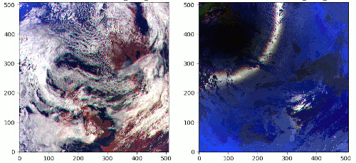
Polarisation – A different vision of the Earth-Atmosphere
Level 1 TOA reflectance (RGB)
Natural light
Polarized light
3MI simulated observation
R=865nm
G=670nm
B=443nm
Qualitatively:
where MM is the Mueller Matrix = the instrumental sensitivity to the polarisation
MM to be maximised/optimised for a polarimeter
MM to be minimised for a non-polarimeter instrument
Measure = Natural light + MM * Polarized Light

Slide 5
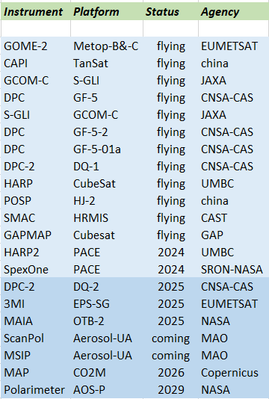
Polarimeters
Increasing suite of flying instruments
Long-term provision of polarimetric measurements coming
In this context, need for evaluation and monitoring of the performance
Maybe also harmonisation
Polarimetry = performance differs from more classical imagers
Specific needs & methodologies
Non-exhaustive list (Dubovik et al, 2019; WMO-OSCAR database)

Slide 6
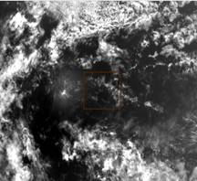
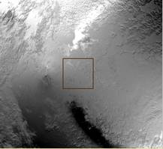
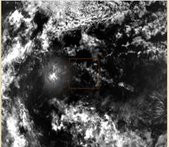
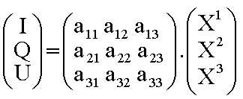
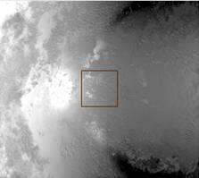
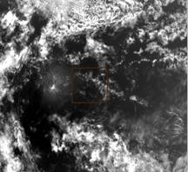
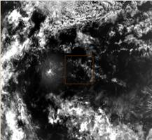
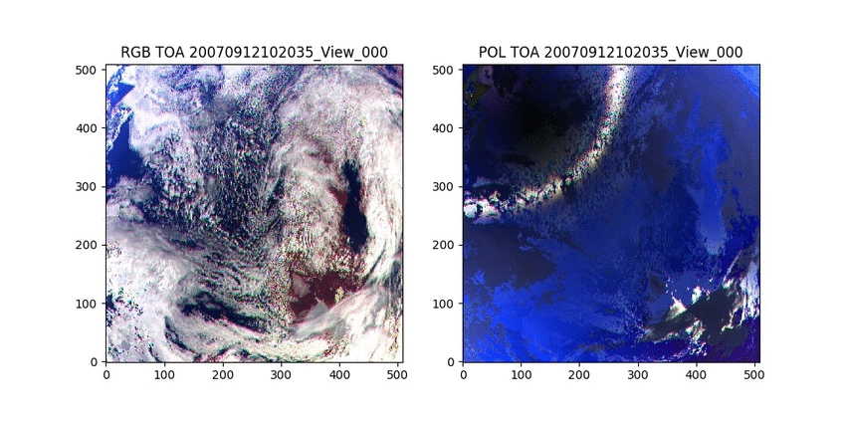
From radiometry to polarisation…
General concept: from N measurements through polarisers → I/Q/U Stokes vector
From (Σ X_{n}) to I/Q/U: the Mueller matrix describes the instrumental response
Qualitatively (perfect system -60°/0°/60°):
I = (X₁ + X₂ + X₃)/3 → average
Ip ~ √( (X₁-X₂)² + (X₁-X₃)² + (X₃-X₂)² ) → quadratic sum of differences
U
X1
from [X₁X₂X₃] to [IQU]
X2
Q
X3
Ip =
√(Q²+U²)
I
I

Slide 7
Performance – specific needs for polarisation
Qualitatively (perfect system -60°/0°/60°):
I = (X₁ + X₂ + X₃)/3 → average
Ip ~ √( (X₁-X₂)² + (X₁-X₃)² + (X₃-X₂)² ) → quadratic sum of differences
The needs for polarisation are:
1/ I requires the usual effort for characterisation, including absolute
2/ Q, U, and Ip require additional efforts (but not that much absolute) ➔ system performance
Harmonisation of X_{n} components in term of radiometry:
Impacted by the radiometric artefacts correction (Non-Linearity, Flat-Field, DarkCurrent, StrayLight…) +
inter-calibration of X_{n} components + geometrical co-registration
Note: when no incoming polarisation → no differences should be observed between X_{n} components
Accurate knowledge of the polarimetric answer of the system
= Mueller matrix or the components of the polarimetric model
3/ Polarisation is useful when associated with multi-directionality
High need of harmonisation of the “Views”
Impacted by the radiometric artefacts correction (NL, FF, DC, SL…), inter-calibration of views + geometrical co-registration, LineOfSight (LoS)

Slide 8
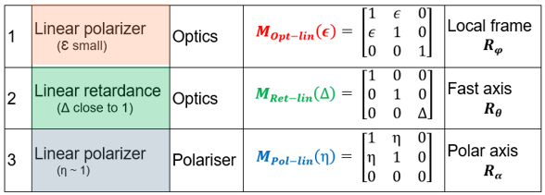
Polarisation Model
Example with 3MI – Why a model?
Model based on the knowledge we have of the instrumental behaviour and its sub-systems
Small deviation from the model MM and the measured MM
Provide an understanding of the features observed in MM
4/ combination retardance, optics & polariser
P1
P2
P3
$${ m}_{12}$$
2/ optics
1/ polariser
3/ combination retardance
& polariser
P1
P2
P3
$$X\sim { m}_{11}.I+ m_{12}.Q+ m_{13}.U$$
$${ m}_{13}$$

Slide 9
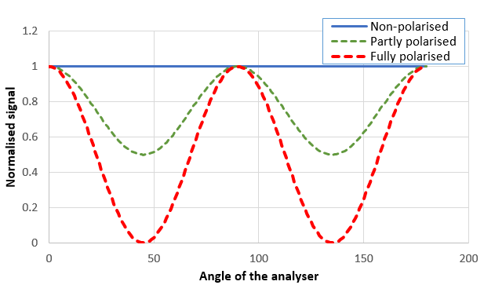
Measure the polarisation sensitivity
On-ground or In-flight, the principle remains:
Put a reference in front of instrument (pixel) – called “analyser”
Analyse the behaviour of the signal
Amplitude of polarisation sensitivity
Angle of polarisation sensitivity
On-ground: a polarised source serves as analyser
In-flight: observed targets are polarised sources and can serve as analyser
1/ Amplitude of
polarisation
1
2
2/ Angle of
polarisation

Slide 10
In-flight Calibration of Polarisation
A proper ground characterisation is always a pre-requisite
On-board (polarised) systems: useful when available
In-flight calibration based on natural targets
Extension of the Vicarious Calibration methods which have already demonstrated their ability to provide a reliable performance, usually able to complement on-board systems (S3, MODIS…)
The approach is statistical (minimum bias obtained only after collection of a large amount of data)
Useful Targets:
Low polarisation (τ<5%): clouds/DCC + Neutral points (POLDER-2, PARASOL)
Moderate polarisation (τ<15%): Moon
Highly polarised (τ>60%): sunglint, Rayleigh (POLDER-1, MODIS)
PICS (desert) in general, as long as there are characterised in polarisation
➔ Combination of methods provides a higher performance and confidence (+ assessment of the accuracy)
Strong heritage from POLDERs/PARASOL, GOME-2, SCIAMACHY, MODIS, VIIRS, S-GLI…
Non-exhaustive list of methodologies and examples in the next slides

Slide 11
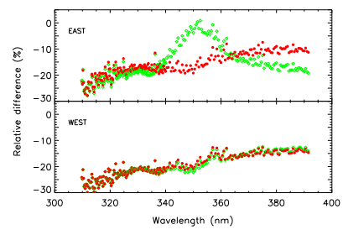
Vicarious Technics - PICS
PICS-Desert: well known but PICS have their own polarisation properties
Type: moderated (depending on bands)
A TOA-BPDF model or reference is needed
Mostly coming from atmosphere
Don’t need a high spatial resolution – coarse is needed (would be needed for more heterogeneous sites)
Don’t need a high angular resolution – smooth, avoiding specific features
Spectral coverage – TBD but no obvious need for super-spectral
Some bands are needed to anchor
The interband approach can be used to extend to the whole spectrum
3MI (and similar sensors) = good candidate to provide such references
To be tested
Early morning orbit, but the fitted model could allow extrapolation
Could be combined with other polarimeters
Sciamachy
Tilstra et al. 2003

Slide 12
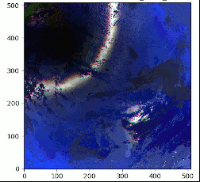
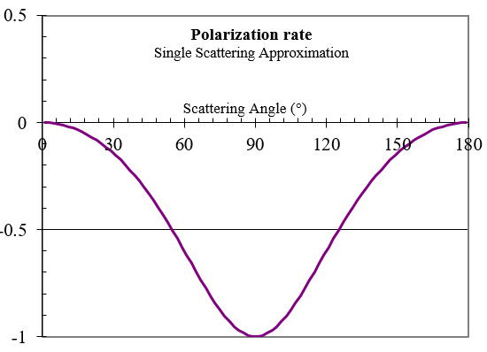
Vicarious Technics – Rayleigh Scattering
Rayleigh Scattering
Obvious potential – can be mostly fully polarised
Type: strongly polarised (>60%)
Accurate RTM calculation needed
Effects of secondary terms are reduced (oceanic surface, aerosol)
Examples :
Adjustment of the MODIS correction
GOME-2
Jafariserajehlou et al., 2020
see also Tilstra et al., 2014
MODIS
GOME-2
Meister et al. 2014

Slide 13
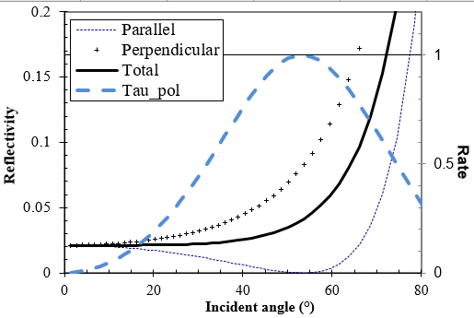
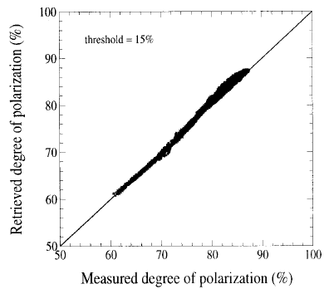
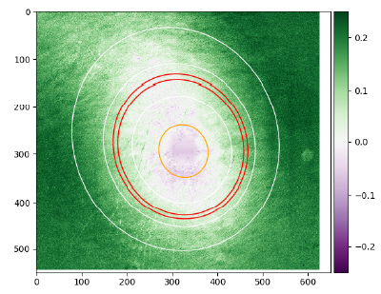
Vicarious Technics - Sunglint
Sunglint
Obvious potential – can be mostly fully polarised
Type: strongly polarised (> 60%)
Accurate RTM calculation needed
Effects of secondary terms are reduced (oceanic surface, aerosol)
Reduced sensitivity to the knowledge of the wind speed
Interband in polarisation for the reflective domain
Absolute polarisation also accessible
Examples :
POLDER-1
PARASOL
Toubbé et al., 1999
Djellali et al., 2021
POLDER-1
PARASOL

Slide 14
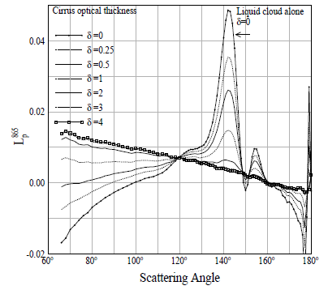
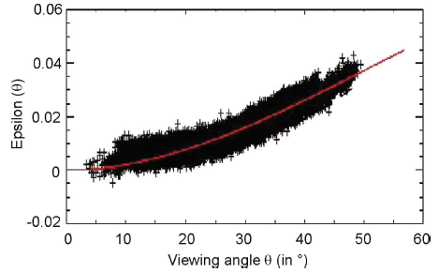
Vicarious Technics - Clouds
Ice Clouds
Obvious potential – can be mostly fully polarised
Type: very low (< 5%) in backscattering
Selection of Ice clouds in backscattering domain
Modelling can be used to extend the geometrical domain
Checking the polarisation
Examples :
PARASOL
Riedi et al. 2010
PARASOL
Fougnie et al., 2007

Slide 15
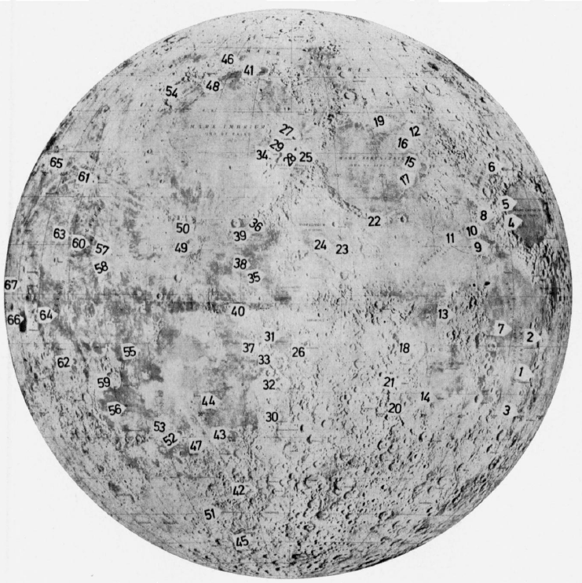
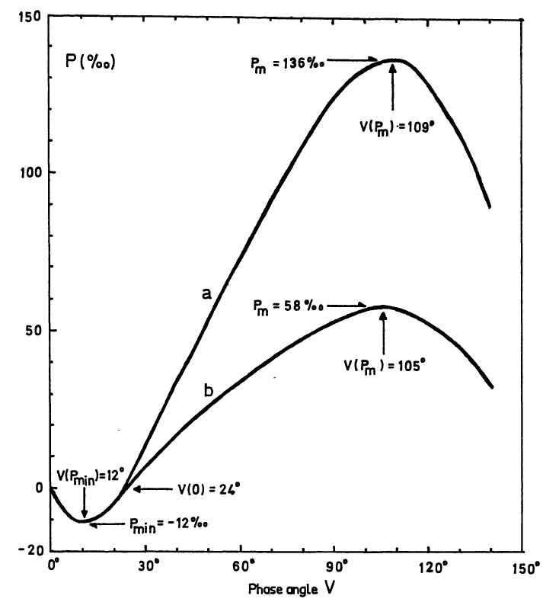
Vicarious Technics – Lunar calibration
Moon and Lunar surface
Well known calibration target
Type: Moderated (0-15%)
Integrated disk or ROIs
Historical measurements
Potential for polarisation with the advantage of lunar
Moon acquisitions are already a baseline
Extension to polarisation would be a minimum cost
The interband approach can be used to extend to the whole spectrum
Example:
S-GLI acquisitions
Dolphus, 1971

Slide 16
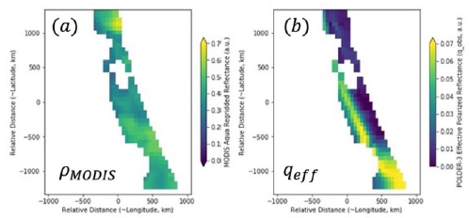
Vicarious Technics – Simultaneous Observations
Simultaneous acquisitions (including SNO, but not only)
Type: Various / All
Example of polarisation sensitivity in-flight assessment:
MODIS-Aqua (imager) using PARASOL (polarimeter) over marine stratocumulus clouds
Limitation (and needed modelling) because of the difference in acquisition time and so geometry
EPS-SG/VII (imager) using 3MI (polarimeter)
Quasi-similar geometry with massive bins of matchups (same platform)
multiple type of source, level of polarisation and orientation of polarisation (characterised by 3MI)
Similar to a Lab measurements
VIIRS/CLARREO
VII
Phillips & Fougnie, 2024
MODIS
McBride et al., 2023

Slide 17
Vicarious Technics – Statistical
Behaviour of the polarisation: identify bias and quantify performance
Type: Various / All
Distribution of the polarisation angle
Expected to be distributed around 90°
Distribution of the polarisation around scattering plane
Expected to be U distributed around 0
U component
Polarisation Angle
Goldin et al., 2023
PARASOL
POLDER-1
Schutgens et al., 2004

Slide 18
Summary and way forward
Very High demand involving all GSICS agencies
EUMETSAT Workshop with targeted experts
Exhaustive brainstorming on in-flight approaches & their performances
3 needs:
Evaluation of performance (commissioning)
Monitoring
Inter-calibration assessment
Outcomes: recommendation for implementation and developments
GSICS: structure the interaction within a VISNIR sub-group?
Discuss a set of common references or methodologies
RTM, PICS reference BPDF, lunar polarisation model….
Moving toward inter-calibration of the polarisation
Special role for polariser equipped with on-board polarisation calibration systems
Later: identify if some approaches can be implemented as GSICS references for operational missions

Slide 19
References
Djellali, M. S., J. Riedi, S. Marcq, B. Fougnie, S. Hioki, and J.M. Nicolas, “Development of calibration methods using specular reflection over the ocean for the Multiviewing, Multichannel, Multipolarization Imager (3MI) of the EUMETSAT Polar System - Second Generation (EPS-SG),” SPIE Optical Engineering, January, 2019.
Toubbé, B., T. Bailleul, J. L. Deuzé, P. Goloub, O. Hagolle, and M. Herman, “In-flight calibration of the POLDER polarized channels using the sun’s glitter,” IEEE Trans. Geosci. Remote Sens. 37, 513–525, 1999.
Fougnie, B., G. Bracco, B. Lafrance, C. Ruffel, O. Hagolle, and C. Tinel, “PARASOL In-flight Calibration and Performance”, Applied Optics, vol. 46, n° 22, pp. 5435-5451, 2007.
Jafariserajehlou, S., B. Fougnie, “EPS/GOME-2 PMD Radiometric Adjustment over Rayleigh Scattering”, GSICS Annual Meeting, Virtual, 2021.
Tilstra, L. G., R. Lang, R. Munro, I. Aben, P. Stammes, “Contiguous polarisation spectra of the Earth from 300 to 850 nm measured by GOME-2 on-board MetOp-A”, Atmos. Meas. Tech., 7, 2047–2059, 2014.
Dolphus, A., E; Bowell, “Polarimetric Properties of the Lunar Surface and its Interpretation”, Astron. & Astrophys., 10, 29-53, 1971.
Phillips, P., and B. Fougnie, “In-orbit monitoring of the EUMETSAT Polar System - Second Generation (EPS-SG) Visible/Infrared Imager (METimage) Polarisation Sensitivity using the Multi-View, Multi-Channel, Multi-Polarisation Imager (3MI)”, SPIE Europe, Edinburg, 2024.
Schutgens, N. A. J., L. G. Tilstra, P. Stamnes, and F. M. Bréon, “On the relationship between Stokes parameters Q and U of atmospheric ultravioletvisiblenear-infrared radiation,” J. Geophys. Res. 109, 2004.
Meister, G., R. E. Eplee and B. A. Franz, "Corrections to MODIS Terra calibration and polarization trending derived from ocean color products", Proc. Earth Observing Syst. XIX, vol. 9218, Oct. 2014.
Goldin, D., B. Rajendra, S. Yolanda, “Evaluation of systematic errors on polarization parameters from POLDER instrument data for use in CLARREO Pathfinder-VIIRS intercalibration”, J. Applied Remote Sensing, Vol. 17, 2023.
Riedi, J., B. Marchant, S. Platnick, B. A. Baum, F. Thieuleux, C. Oudard, F. Parol, J.-M. Nicolas, and P. Dubuisson, “Cloud thermodynamic phase inferred from merged POLDER and MODIS data”, Atmos. Chem. Phys., vol. 10, 11851–11865, 2010
Tilstra, L., J. Acarreta, J.M. Krijger, P. Stammes, “Verification of SCIAMACHY‘s Polarisation Correction Over the Sahara Desert”, ENVISAT Validation Workshop (ESA SP-531). 9-13 December, Frascati, Italy, 2003
McBride, B. A., X. Xiong, A. Wu, “Assessment of polarization sensitivity of Aqua MODIS using co-incident POLDER-3 polarized measurements over marine stratocumulus clouds”, Earth Observing Systems XXVII, vol. 12232, 2022

