Slide 1
Introduction to Himawari-10 and its inter-calibration approach
TAKAHASHI Masaya, KODERA Kazuki, and EIKI Misaki
Meteorological Satellite Center of Japan Meteorological Agency

Slide 2
Contents
Introduction
History of Japanese Geostationary Meteorological Satellites
Himawari-10 Program
Program Overview
VIS/IR Imager (GHMI)
IR sounder (GHMS)
Inter-calibration approach for GHMI and GHMS
Summary

Slide 3
History of Japanese Geostationary Meteorological Satellites
Over 40-y history of GEO satellites operation at around 140 E°
Himawari-8
Advanced Himawari Imager (AHI): 16-band VIS/IR imager
Identical specification to AHI on Himawari-9
Operation: 7 July 2015 to 13 December 2022
Currently in-orbit standby operation (backup of Himawari-9)
Himawari-9
Switchover of operation from Himawari-8 on 13 December 2022, after ~2 months parallel observation with Himawari-8
To be operated until JFY2029
Satellite | Operation Period
GMS | 1978 – 1981
GMS-2 | 1981 – 1984
GMS-3 | 1984 – 1989
GMS-4 | 1989 – 1995
GMS-5 | 1995 – 2003
GOES-9* | 2003 – 2005
MTSAT-1R | 2005 – 2010
MTSAT-2 | 2010 – 2015
Himawari-8 | 2015 – 2022
Himawari-9 | 2022 – 2029
* Back-up operation of GMS-5 w/ GOES-9 by NOAA/NESDIS

Slide 4
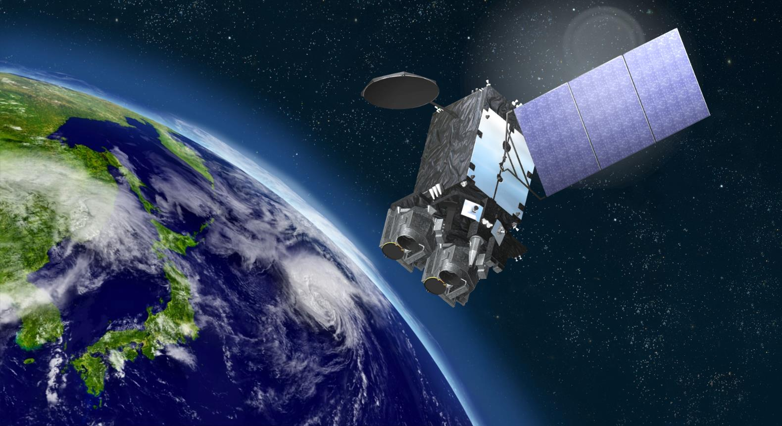
Future Mission: Himawari-10
Himawari-10 Perspective Image
© Mitsubishi Electric

Slide 5
Himawari-10 Program
JFY2018: JMA started consideration of next GEO satellite program, by taking into account:
Demand for improving JMA’s weather forecasts/warnings​ caused by high-impact weather events (e.g., stationary linear mesoscale convective systems and typhoons); and,
Contribution to seamless GEO satellite system and Geo-Ring observations by considering CGMS baseline and WMO Vision for WIGOS in 2040
JFY2022: RFI, RFP and start of manufacturing of Himawari-10
Launch
JFY2028: launch
JFY2029: operation start (to be operated to JFY2038 timeframe)

Slide 6
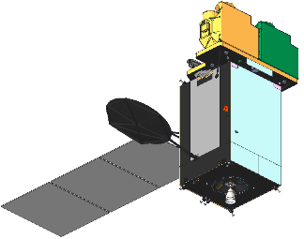
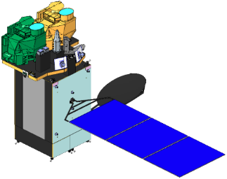
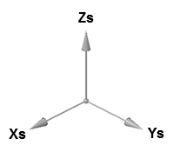
Himawari-10 Overview
JMA contracted manufacturing of Himawari-10 in March 2023, with initiation of operation scheduled for JFY 2029.
Design lifetime
10-y observation + 5-y on-orbit storage
Geostationary position
At around 140.7 deg. E
Missions
Geostationary HiMawari Imager (GHMI)
Geostationary HiMawari Sounder (GHMS)
Data Collection System
Space Environment Suite
Proton & electron flux observation, as a government furnished equipment by NICT
Satellite Outline
GHMS
GHMI
Space Environment Suite
Satellite Design
Spacecraft | MELCO standard DS2000 bus
Mass (approx.) | 2.4 t (dry), 6.1 t (with propellant)
Size (approx.) | 4 m x 3 m x 6 m (folded), 11 m (deployed)
Design life | ≥ 15 years (mission period ≥ 10 years)
Communications | Ka-band: Mission data downlink Ku-band: TT/C uplink & downlink UHF-band: DCP uplink

Slide 7
Geostationary HiMawari Imager (GHMI)
GHMI Spectral Band Characteristics
L3Harris’s new 18-band VIS/IR imager based on the same concept with its GeoXO Imager (GXI) selected by NASA
Observing sequence & band configuration changed for Himawari-10
Values in the tables show JMA requirements
 | Center Wavelength [µm] | Bandwidth [µm] | Spatial Resolution at Nadir [km]
VIS | 0.46 - 0.48 | ≤ 0.07 | ≤ 1
 | 0.54 - 0.56 | ≤ 0.05 | ≤ 1
 | 0.63 - 0.65 | ≤ 0.12 | ≤ 0.5
NIR | 0.85 - 0.87 | ≤ 0.06 | ≤ 1
 | 1.375 - 1.385 | ≤ 0.04 | ≤ 2
 | 1.60 - 1.62 | ≤ 0.08 | ≤ 2
 | 2.24 - 2.27 | ≤ 0.06 | ≤ 2
IR | 3.75 - 3.95 | ≤ 0.50 | ≤ 1
 | 5.10 - 5.20 | ≤ 0.20 | ≤ 1
 | 6.05 - 6.45 | ≤ 1.20 | ≤ 2
 | 6.90 - 7.00 | ≤ 0.50 | ≤ 2
 | 7.27 - 7.43 | ≤ 0.60 | ≤ 2
 | 8.44 - 8.76 | ≤ 0.50 | ≤ 2
 | 9.55 - 9.70 | ≤ 0.50 | ≤ 2
 | 10.3 - 10.5 | ≤ 0.90 | ≤ 2
 | 11.1 - 11.3 | ≤ 1.00 | ≤ 2
 | 12.25 - 12.55 | ≤ 1.20 | ≤ 2
 | 13.2 - 13.4 | ≤ 0.70 | ≤ 2
GHMI Observing Area & Interval
Observing Area | Minimum Coverage | Interval
Full Disk |  | 10 min
Japan | EW 2500 km x NS 2000 km | 2.5 min
Target Area1 | EW 1000 km x NS 1000 km | 2.5 min
Target Area2 |  | 2.5 min
Target Area3 |  | 2.5 min
Target Area4 |  | 2.5 min
Target Area5 (*) | EW 1000 km x NS 500 km | 30 sec
*Mainly used for CAL/VAL activities

Slide 8
Geostationary HiMawari Sounder (GHMS)
L3Harris’s new infrared FTS
Values in the tables show JMA requirements
GHMS Observing Area & Interval
GHMS Spatial & Spectral Characteristics
Observing Area (minimum coverage) | Interval
Sounding Disk (LZA ≤ 60 deg) | 60 min
Japan (EW 2500 km x NS 2000 km) | 15 min*
Target Area (EW 1000 km x NS 1000 km) | 15 min
Spatial (horizontal) Resolution |  | ≤ 4.2 km
Spectral Coverage | LWIR | 680 - 1095 cm⁻¹ (14.7 - 9.13 µm)
 | MWIR | 1689 - 2250 cm⁻¹ (5.92 - 4.44 µm)
Spectral Resolution (FWHM) |  | ≤ 0.754 cm⁻¹
Spectral Sampling Distance |  | ≤ 0.625 cm⁻¹
* Sounding Disk observation over Japan area is regarded as one of the "Japan" observations in the 60-min repeat cycle (i.e., three "Japan" observations to be conducted in 60 minutes).

Slide 9
Inter-calibration approach for Himawari-10 Imager (GHMI)
JMA just started consideration of inter-calibration in Himawari-10 era (2030s).
Direct observation comparison w/ SI-traceable instruments is expected, but is it enough?
# of collocation samples, continuity of SI-traceable missions, …
Use of existing methods would also be important, but is everything needed?
Lunar: monitoring instrument’s response change (relative cal) + absolute cal?
Ray-matching w/ broadband imager: most stable/reliable for operational monitoring?
Vicarious cal: important for field campaign (particularly during commissioning)?
DCC: advantages in lower resources? long time-series validation?
Blending multiple methods?
GEO-GEO?

Slide 10
Inter-calibration approach for Himawari-10 Sounder (GHMS)
We would learn from existing (GIIRS) and coming (IRS) approaches for our monitoring system (and generation of future GEO sounder’s GSICS products, if required).
Needs for new GSICS ATBD for GEO sounder inter-calibration?
Would (future) GEO-LEO-IR v2 algorithm also be applicable to GEO sounder?
GEO-GEO?
Compared w/ imager, overwrap area and # of collocations would be narrower and smaller due to observation mode (and satellites’ positions).
Would indirect GEO-GEO (e.g., double difference of GEO-LEO) be useful for some applications?

Slide 11
Summary
JMA has been operating GEO satellites at around 140 E° over 40 years
Current Himawari-9 will be operated until JFY 2029 (Himawari-8 is in-orbit backup).
JMA contracted manufacturing of Himawari-10 in March 2023, with initiation of operation scheduled for JFY 2029.
Himawari-10 is scheduled to carry a VIS/IR imager (GHMI), an IR sounder (GHMS) and a space environmental suite.
GHMI: 18-band imager, same concept w/ GeoXO/GXI
GHMS: FTS, similar observation capability w/ MTG-S/IRS and GeoXO/GXS
Consideration of inter-calibration approach for GHMI and GHMS was just started at JMA.
GSICS member agencies’ ongoing cal/val activities and discussions on future GSICS inter-calibration algorithms would be definitely helpful for us.

Slide 12
Thanks for your attention!

Slide 13
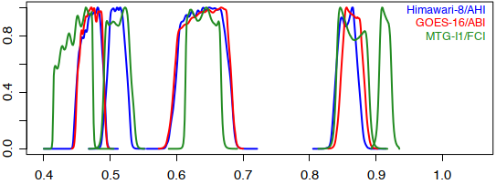
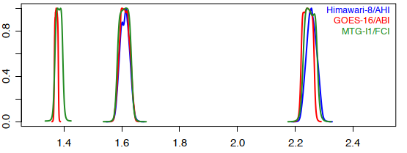
Himawari-8/-9 AHI
16 spectral bands (5 similar spectral range in VNIR among AHI/ABI/FCI)
Observation by 2 independent (EW and NS) scan mirrors
Onboard calibration
Solar diffuser (SD) and blackbody for VNIR and IR bands
SD obs: twice / month, but nominal calibration slope (gain) is not updated
Himawari-8: calibration trend is estimated on annual basis and included in HSD (L1b equiv. data) as the trend correction info
 | B01 | B02 | B03 | B04 | B05 | B06 | B07 | B08 | B09 | B10 | B11 | B12 | B13 | B14 | B15 | B16
Central wavelength [μm] | 0.47 | 0.51 | 0.64 | 0.86 | 1.6 | 2.3 | 3.9 | 6.2 | 6.9 | 7.3 | 8.6 | 9.6 | 10.4 | 11.2 | 12.4 | 13.3
Spatial resolution at SSP [km] | 1 | 1 | 0.5 | 1 | 2 | 2 | 2 | 2 | 2 | 2 | 2 | 2 | 2 | 2 | 2 | 2
# of detectors for N-S direction | 676 | 676 | 1460 | 676 | 372 | 372 | 332 | 332 | 332 | 332 | 332 | 332 | 408 | 408 | 408 | 408
Wavelength [μm]
Wavelength [μm]

Slide 14
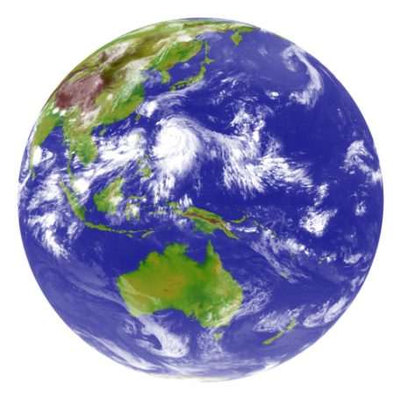
AHI Observation Repeat Cycle
Region 5 (1000 x 500 km every 30 sec) is used for lunar observation.
Pre-defined area
Flexible observation area
Full Disk Observation
every 10 min. (23 swaths)
Region 1
2000 x 1000km
(NE Japan)
Every 2.5 min.
Region 2
2000 x 1000km
(SW Japan)
Every 2.5 min.
Region 3
1000 x 1000 km
(Target Area)
Every 2.5 min.
Region 4
1000 x 500 km
(Landmark Area)
Every 30 sec.
Region 5
1000 x 500 km
(Landmark Area)
Every 30 sec.

