Slide 1
Outcome of the Lunar Calibration Workshop from a EUMETSAT perspective
S. Wagner (EUMETSAT), T. Stone (USGS)
4th Joint GSICS/IVOS Lunar Calibration Workshop

Slide 2
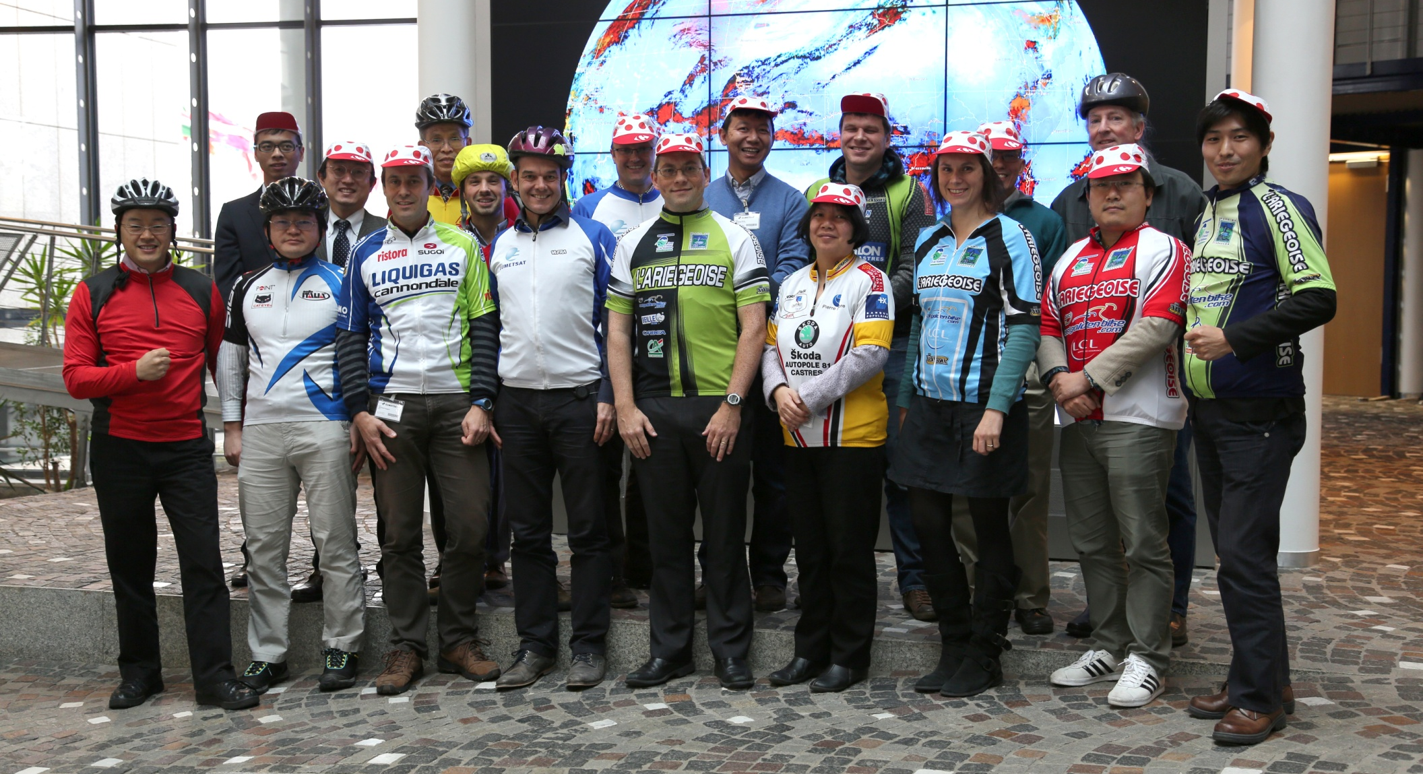
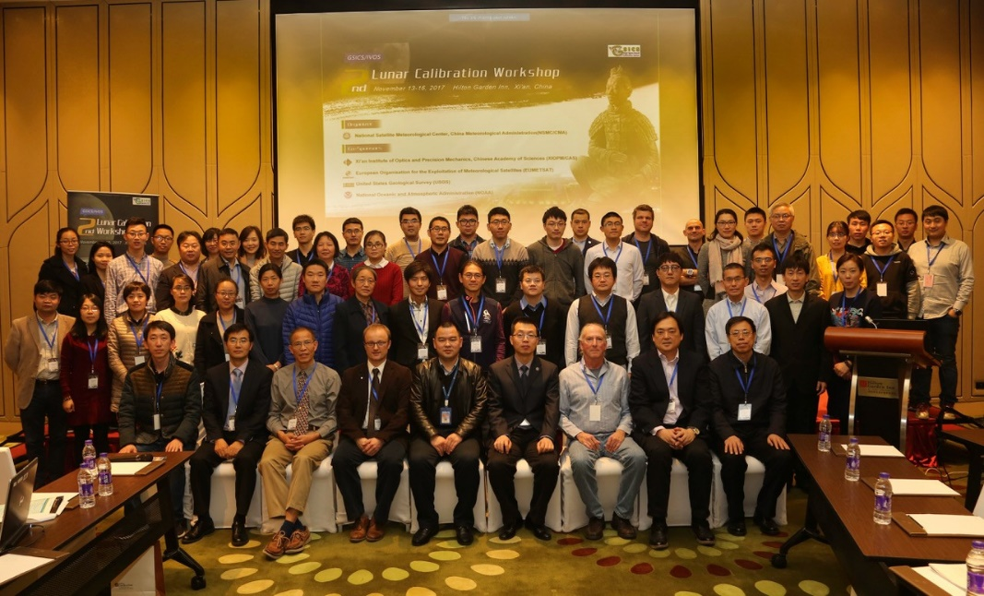
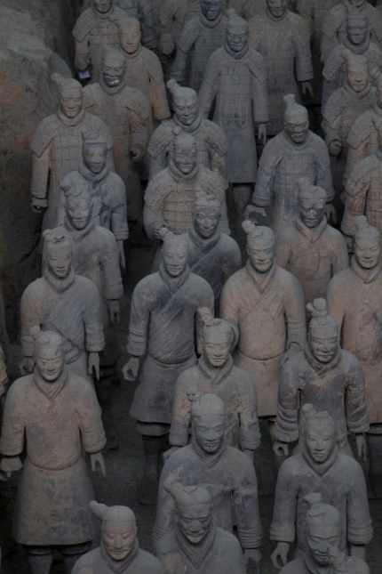
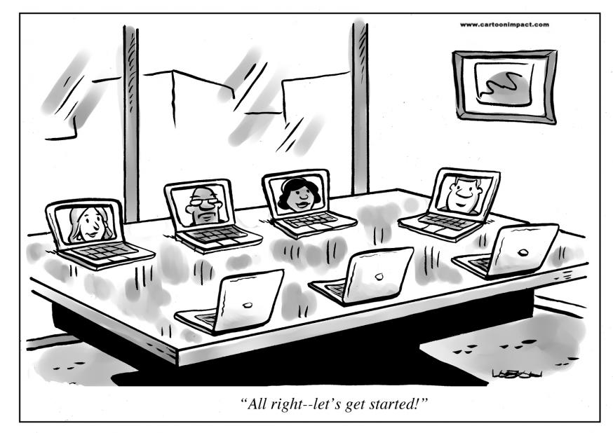
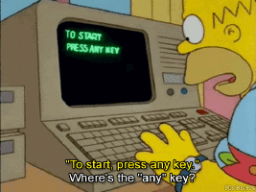
Previous Workshops
2014 : Darmstadt – Germany
14 agencies + departments
26 people (including remote attendees)
2017 : Xi’an – China
22 agencies + departments
More than 60 scientists (including remote attendees)
2020 : online reduced event due to COVID restrictions
Almost 30 agencies / departments / institutes / universities
Between 70 and 80 participants from Asia / Europe / US

Slide 3
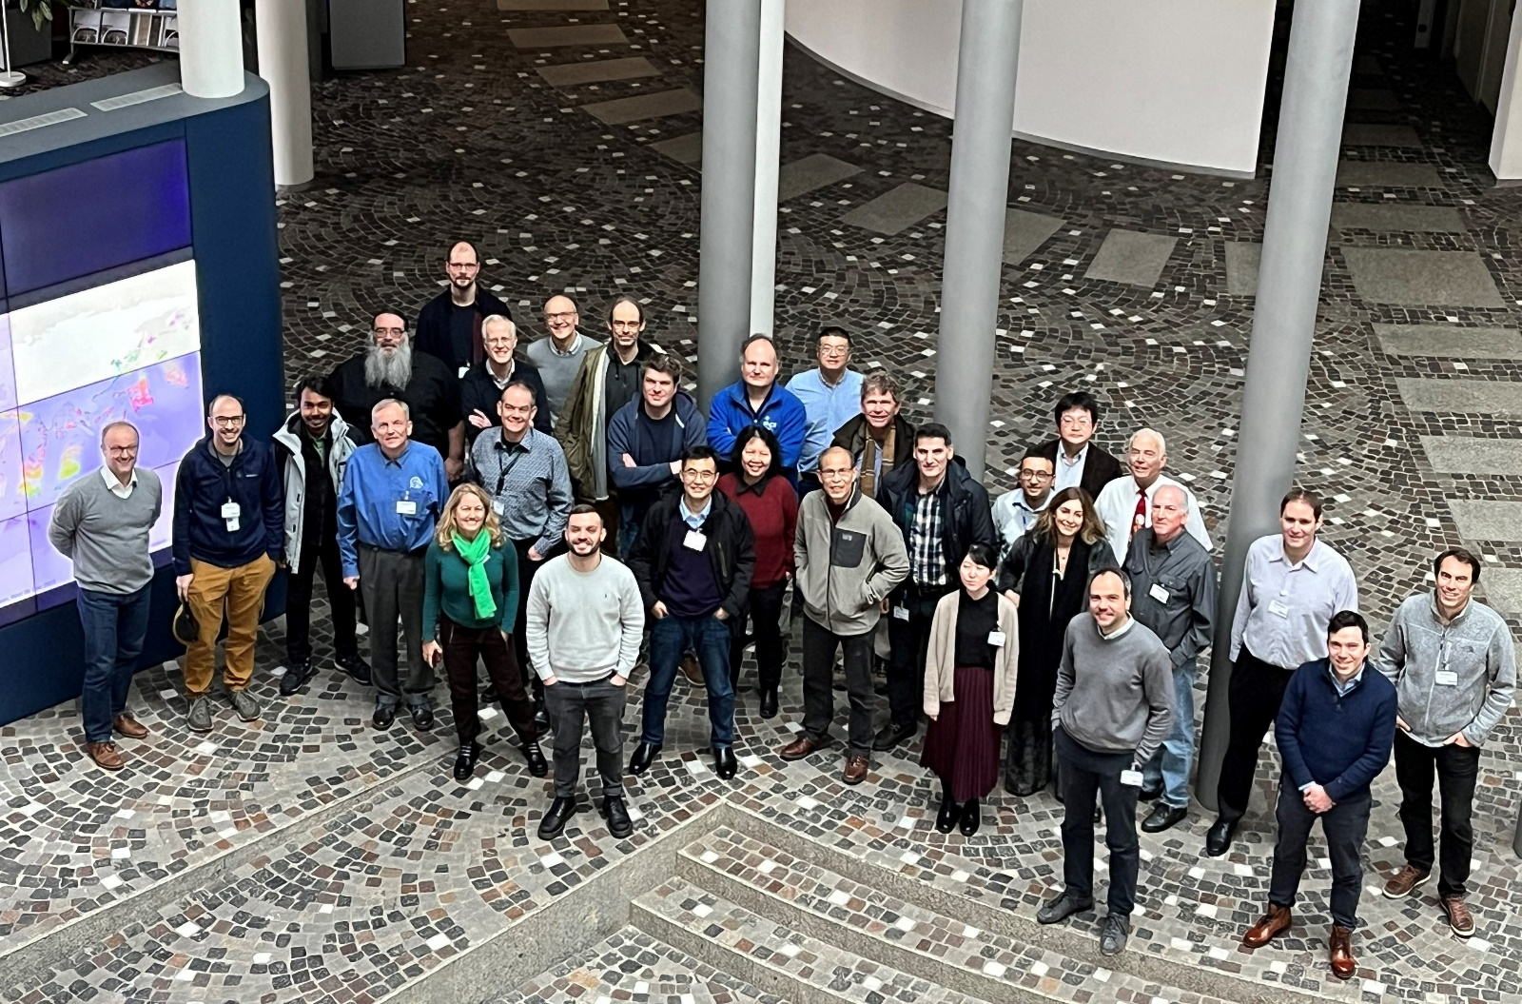
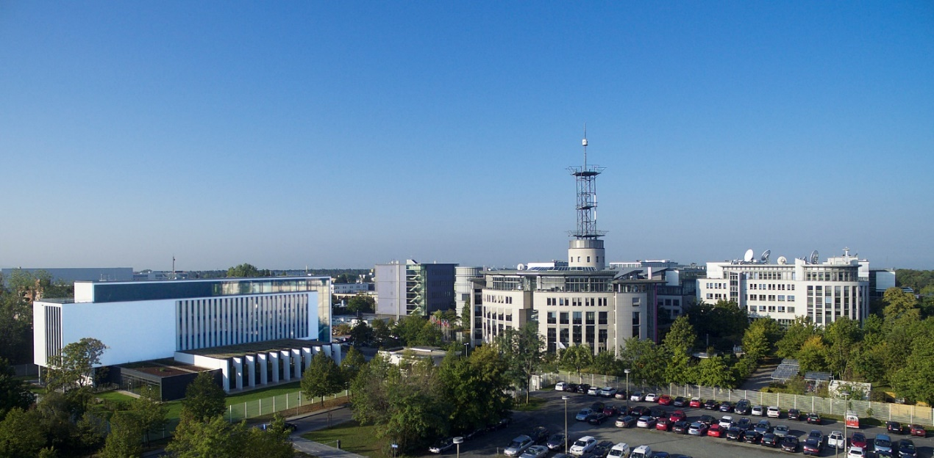
4th GSICS / IVOS Lunar Calibration Workshop
5-day meeting from 4th Dec till 8th Dec 2023 in EUMETSAT HQ
Attendees: ~35 participants on site + 40 participants online
More than 30 agencies / institutes / companies

Slide 4
Workshop highlights
Sessions on:
Lunar measurements (for model derivation)
Lunar models and their development
Instrument monitoring
Thermal infrared and microwave
Alternative usages of lunar imagery
Continuation of the topics addressed in previous editions of the LCWS

Slide 5
Workshop highlights - Lunar measurements (for model derivation)
Status on series of measurement campaigns / measurements datasets:
Airborne (Air-LUSI),
Ground-based (Mauna-Loa LUSI, Lijiang, LIME, PMOD and Precision Filter Radiometer),
Satellites (SCIAMACHY, JiLin-1, FY-3G, ARCSTONE, CLARREO Pathfinder)
Some measurements to be released early 2024 (SCIA, Air-LUSI) or later (access to Chinese datasets in ~1 year, after QA/QC)
Concerns on the funding of some activities (Air-LUSI)
ARCSTONE + CLARREO PF are proceeding (timeframe = 2025-2026)
LIME to extend spectral range coverage with some hyperspectral measurements + new bands in SWIR + Release of the LIME Toolbox in 2024 (available from CEOS IVOS)
PMOD PFR = measurements in excellent agreement with ROLO* (experimental correction to ROLO for aerosol retrievals – 4 to 8% correction)
Question on the need to have polarisation measurements of the Moon

Slide 6
Workshop highlights - Lunar models and their development
Vision = reference model(s) to predict irradiance for “reference” measurements
GIRO to be replaced by LSICS (Lunar Spectral Irradiance Calibration System)
LSICS = framework encompassing the core disk reflectance model ➔ expected in Q3 2024 + no license
Model developers encouraged to build LSICS core modules to allow integration in LSICS e.g. for benchmarking purposes ➔ traceability process to be ensured!
LSICS is NOT meant to support the generation / inference of models!
Absolute need to document in detail the models: ATBD / ASD to be reviewed by the GSICS lunar community (separate from peer-review publication)
Model comparison:
Uncertainties need to be provided to really compare the models!
Influence of the solar spectrum ➔ what about comparing in reflectance?
Question about performing the assessment as a function of time

Slide 7
Workshop highlights - Instrument monitoring
Presentations on:
SP model and how it is applied to GOSAT-2/CAI-2 ➔ usable for multiple purposes (radiometric monitoring, MTF, spectral modelling to support hyperspectral missions)
LEO and GEO sensors, including high resolution (Jilin-1) and new sensors (MTG/FCI and LI)
Massive amount of acquisitions by Himawari 8 and 9 (resp. 30000 and 4000 obs within usual phase interval)
Presentations on the OCO-2 and 3 lunar acquisitions ➔ new in the context of the Lunar Calibration Workshop
“Usual suspects” = accurate determination of the oversampling, pixel solid angles, straylight, etc.
Need for the group to work on defining best practises
Models:
More models can be used for monitoring purposes (GIRO, LIME Toolbox [Q1 2024], SP, LESSSR)
Results to be analysed in view of the results of the inter-comparison exercise
Need to realign the solar irradiance spectra to TSIS HSRS (GSICS + IVOS new reference)
Need to develop a lunar polarisation model
Interesting discussion on the NOAA-20 VIIRS solar diffuser “recovery” ➔ suspected to be linked to space weather

Slide 8
Workshop highlights -Thermal infrared and microwave
Numerous applications:
Inter-calibration transfer target (requires model or similar obs conditions)
Inter-band calibration (but requires spectral model)
Long-term calibration monitoring, including detector monitoring (e.g. VIIRS)
FOV/antenna pattern mapping (may require manoeuvres) ➔ accurate pointing
Targets such as Venus or Mercury = alternatives to the Moon
Models ➔ major achievements wrt to past LCWS editions!
Thermo-Physical Models available for the Moon ➔ radiance map of the Moon in the IR
Could be extended to the MW
Can also provide disk integrated irradiances
Question of the uncertainties wrt the needs (absolute / relative)
Question of the emissivity model, libration influence, etc. and how to validate the models
How to handle saturation?

Slide 9
Workshop highlights -Alternative usages of lunar imagery
Presentations on MTF + Straylight corrections + Skynet Network
MTF:
Review of several algorithms ➔ choice of the fitting functions for the ESF is important for the assessment.
Exercise will continue
Definition of best practises still under discussion
Straylight:
How to account for straylight when assessment radiometric performance (e.g. ABI RSV)?
Skynet Network
Aerosol retrieval at night using the lunar irradiance as exo-atmospheric source
Large network that could be used in the context of model development
How can capitalise on such dataset?
How can we collect the various sources of information in general ➔ Recommendation on GDWG

Slide 10
Workshop highlights
Proposed creation of a GSICS subgroup on Lunar calibration covering:
Measurements
Lunar models
Instrument monitoring
IR + MW
Alternative usage of lunar imagery
EUMETSAT played a key role in fostering exchanges
2024 GSICS annual meeting = announcement
Starting from 2024 = increased visibility on the activities
Regular meeting online (2-3 / year)
One physical meeting every 1-2 years ?

Slide 11
Workshop highlights
Web infrastructure to provide visibility to the sub-group
GSICS Coordination Centre?
Way forward to be discussed after agreement on the creation of the sub-group
Start to work on Lunar Calibration Best Practices Recipes
Group effort encompassing all aspects of lunar calibration
Living document with multiple contributors
Process for review in the lunar community still to be agreed

Slide 12
Not discussed at the LCWS
Not discussed at the LCWS but of high relevance
➔ Inter-calibration:
Completion of the inter-calibration algorithm proposed to GSICS
Reference = NOAA-20 VIIRS
Blending: how to combine DCC and lunar products?

Slide 13
Decisions
In total, 7 decisions
Main decisions:
D.LCWS.2023.5a.1: The Lunar Calibration Community proposes the formation of a sub-group on lunar calibration within the GSICS Research Working Group - cross-cutting spectral bands, and will ask the GSICS Executive Panel for endorsement at the next EP meeting (March 2024). Proposal of chairs to follow EP endorsement
D.LCWS.2023.2i.1: GSICS LSICS model will be developed as a GSICS deliverable tool.
D.LCWS.2023.2i.3: future version of GSICS LSICS model output will include uncertainties.

Slide 14
Actions
In total, 15 actions (also on GDWG)
Main actions:
A.LCWS.2023.1q.1: Model developers shall provide a detailed description of how their model is derived and a detailed functional description of their model.
A.LCWS.2023.2b.1: T. Stone to coordinate with the group involved in the first lunar model inter-comparison to define a way forward for the next iteration on the model inter-comparison.
A.LCWS.2023.2f.1: Teams involved in software development to liaise with LSICS development group on what are the typical disclaimers for distributing software.
A.LCWS.2023.2i.1: T. Stone (USGS) to report the scope of LSICS to EP in the 2024 annual meeting.
A.LCWS.2023.2i.5: GDWG to provide guidance on the method to implement for flagging that LSICS products came from official LSICS run.

Slide 15
Actions
Main actions:
A.LCWS.2023.5a.1: Hugh Kieffer to propose section titles for Best Practice Guideline on lunar calibration by 2024-03-01
A.LCWS.2023.5a.2: Seb Wagner (EUMETSAT) to propose way forward with GSICS Lunar Observation Dataset (GLOD) by 2024-03-01

Slide 16
Recommendations
In total, 22 recommendations
Main recommendations:
R.LCWS.2023.1f.1: Lunar Calibration Community to investigate in coordination with the GSICS Research Working Group how to raise visibility of the lunar (measurement) activities, and how to show the usefulness of those activities for climate monitoring.
R.LCWS.2023.1j.1: Agencies acquiring lunar observations to share data with documentation and uncertainties as far as possible.
R.LCWS.2023.1j.2: GSICS to define a mechanism to share observations (jointly with IVOS) - e.g. assigning a DOI, linked to a URL. Share recommendation with WGCV (actionee: Jack Xiong - NASA)
R.LCWS.2023.5b.1: EP to promote acquisition of SI-traceable observations of the Moon to support further operation of Mauna Loa-LUSI, and to include the aerosol retrieval application to raise visibility of lunar calibration by tying it to a key climate data record

Slide 17
Recommendations
R.LCWS.2023.5b.2: GSICS Exec Panel to support acquisitions of more polarisation-diverse observations of the Moon.
R.LCWS.2023.5b.3: GSICS recognises the additional value in disk-resolved lunar observations to support the further development and validation of lunar radiance models.

Slide 18
Conclusions and way forward
LCWS#4 = great success with a lot of new developments, in particular in the IR + WV
Review of minutes + summary + Decisions/Actions/Recommendations to be finalised (will be circulated asap)
Formation of a dedicated GSICS sub-group + nomination of a chair
Future meetings (web meetings + in-presence meeting) TBD (idea = in-presence meeting every year or 2 years)
Wish from the Lunar Calibration Community to establish Best Practice Guideline on lunar calibration

Slide 19
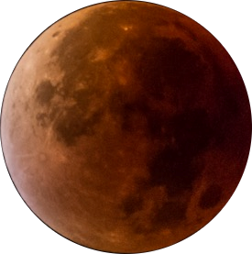
Thank you!
Questions are welcome

