Slide 1
GRWG Report
Fangfang Yu, GRWG Chair
03/11/2024

Slide 2
Outlines
Activities and Achievements
New Products and Deliverables
Updates for Chairpersons
Highlights from the GRWG Subgroups
Challenges and Opportunities
Summary

Slide 3
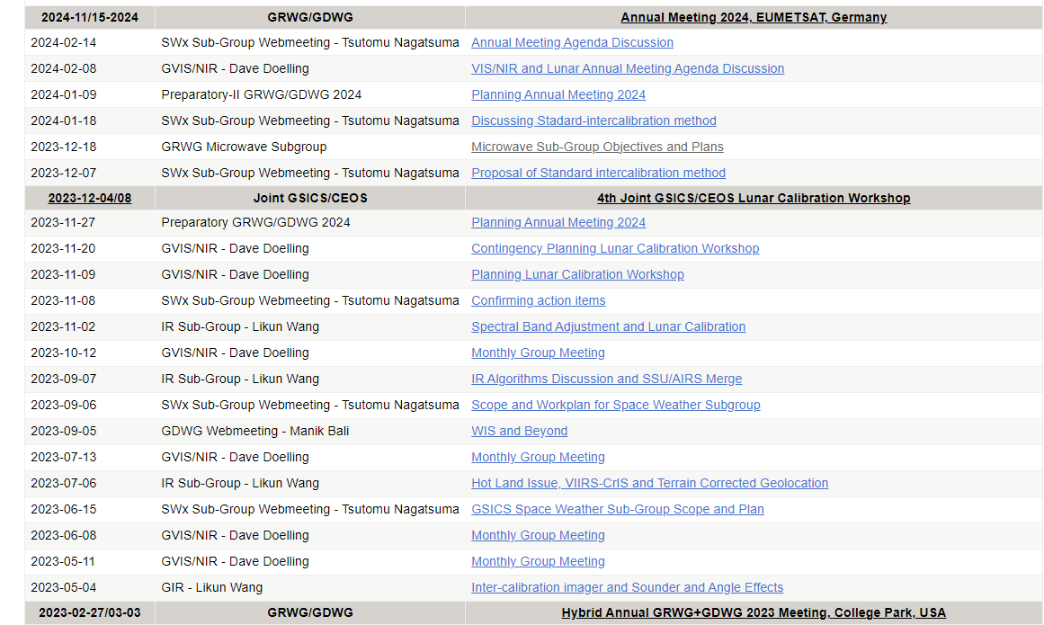
Meetings Organized/Supported in 2023
Organize the 2024 Annual and EP joint meeting
11-15 March 2024, Darmstadt, Germany
http://gsics.atmos.umd.edu/bin/view/Development/AnnualMeeting2024
Organized 24 Web-meetings
VNIR (7), SW (6), IR (4), GRWG (3),WM (1)
Supported the 2023 EP meeting
29-30 June 2023, Tokyo, Japan
Attended CEOS WGCV IVOS 35 meeting (virtually)
25 – 29 Sept, 2023

Slide 4
Workshops Jointly Organized with CEOS/WGCV
Fourth joint GSICS/IVOS lunar calibration workshop(LCWS4), hosted by EUMETSAT
4 - 8 December, Darmstadt, Germany
http://gsics.atmos.umd.edu/bin/view/Development/LunarCalibrationWS2023
Pre-flight calibration and characterization of optical satellite instruments for Earth observation
19 – 22 November 2024, Norrdwijk, Netherlands
https://atpi.eventsair.com/pre-flight-calibration-workshop/

Slide 5
Significant Outcomes of LCWS4
Formation of a New Subgroup for Lunar Calibration
Proposal initiated by the EP Chair (B. Bojkov) in the welcome address
Consensus reached within the lunar calibration community by the end of workshop
GRWG chair (F. Yu) communicated the proposal to the EPs post-workshop in December 2023
Tom Stone was appointed as the Interim chair for the new subgroup, focusing on lunar calibration across a broad spectral range from UV to MW
Development of a New Module-Based Reference System
Lunar Spectral Irradiance Calibration System (LSICS) for generating lunar irradiance
Discussions and Reports in this meeting
Detailed report by T. Stone and S. Wagner in the mini-conference this morning
Talks in the upcoming VNIR breakout sessions on 12, March

Slide 6
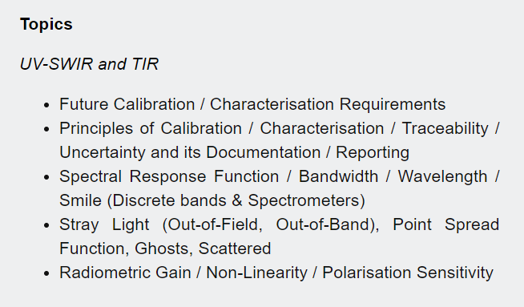
Pre-flight Workshop
Being organized by CEOS WGCV and CGMS GSICS
19 – 22 November 2024, Norrdwijk, Netherlands
https://atpi.eventsair.com/pre-flight-calibration-workshop/
Scope:
Passive optical sensors (200 nm - 50 um) with emphasis on solar reflective domain (<~2500 nm).
All aspects of pre-flight and related on-board calibration and characterization
Preparation for next generation or future applications
Detailed status report in this annual meeting
11:25 am, Friday morning, 15 March by Philippe Gory and Jack Xiong
https://atpi.eventsair.com/pre-flight-calibration-workshop/

Slide 7
Reports Delivered
2023 GSICS State of Observing System (G-SOS) report
New template will be discussed in the coming annual meeting
2023 Agency reports from member agencies

Slide 8
New Products and Product Promotions
Four new GEO-LEO IR products generated by KMA GPRC in the Demo phase
GK2 AMI vs. SNPP/N20 CrIS and Metop-B/C IASI
Passed GCC GPPA review and approved by GCC director into the monitoring catalog
Four SEVIRI/IASI-B products generated by EUMETSAT GPRC being promoted to operational phase
Passed the GCC GPPA review as a “family instrument”

Slide 9
Development of New Chair Election Procedure
Establishment of a New Election Procedure
Forged and implemented during the 2023 MW subgroup chair election with the support from EP, GCC, key members in GRPC
Developed in accordance with the guideline from the “Selection of Working Groups & Sub-Group Chairs and Vice Chairs” section of the “Terms of Reference."
Approval and Application
Procedure received approval at the 2023 EP meeting
Successfully used for electing MW subgroup co-chairs
Documentation and Encouragement
Thoroughly documented by S. Iacovazzi (2023)
Designed for scenario with multiple candidates, which is beneficial to the GSICS community

Slide 10
Developing New G-SOS Template
Development of a new G-SOS report template
Moving from PowerPoint to document format
Including of key monitoring parameters with summary
Incorporating new content
More discussions in this meeting (by T. Hewison)
Monday afternoon, plenary session
Wednesday in the IR and GDWG breakout sessions
Thursday morning in the VNIR breakout session

Slide 11
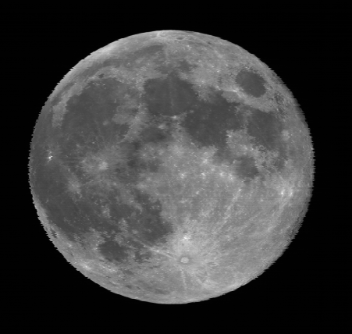
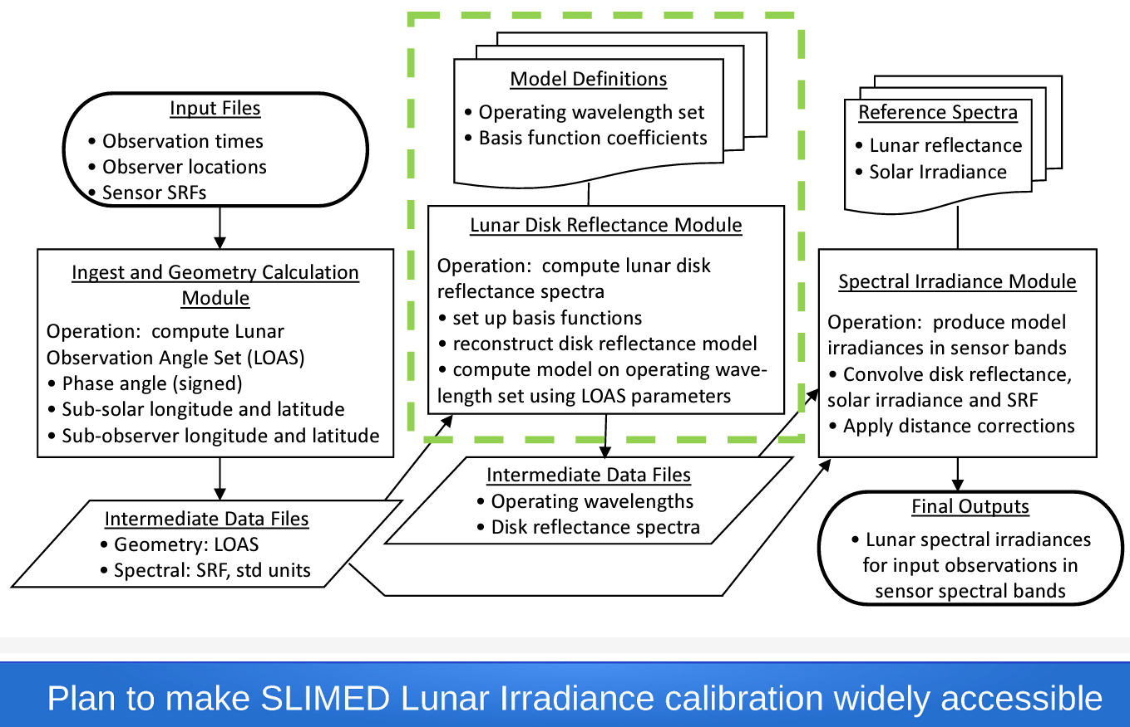
A New GSICS Deliverable is Forthcoming - LSICS
Lunar Spectral Irradiance Calibration System (LSICS)
Operational system to generate reference irradiance for lunar measurements.
Features of LSICS
LSICS will utilize a module-based framework with open source code (Python)
SLIM, expected to the first LSICS lunar irradiance model implemented, aims to succeed GIRO
Community and Support
Proposed by T. Stone (USGS) in the 2023 annual meeting and received community endorsement
Implementation receives support from NOAA, with significant contributions from EUMETSAT, ESS, NIST and USGS etc.
Chaired by T. Stone (USGS) and F. Yu (UMD@NOAA)
Discussions and report in this annual meeting:
T. Stone and S. Wagner in the mini-conference this morning
VNIR subgroup talks on Tuesday afternoon, chaired by T. Stone
GOES-16 ABI Moon
T. Stone (2023)

Slide 12
Update of Chairpersons
GRWG Chairs
Mounir Lekouara (EUMETSAT): 2024 –
Fangfang Yu (UMD@NOAA) will step down from the sitting chair position after the 2024 annual/EP joint meeting
Space-Weather (SWx) Subgroup
Tsutomu Nagatsuma (NICT): the first SW subgroup chair, after his interim term in 2022
Microwave (MW) subgroup
New elected co-chairs: Flavio Iturbide (NOAA) and Shengli Wu (CMA), 2023 -
Quanhua “Mark” Liu (NOAA) and Qifeng Lu (CMA): stepped down in 2023
Infrared (IR) subgroup
Chengli Qi (CMA): candidate for the incoming IR subgroup chair

Slide 13
A New GRWG Subgroup Is Coming
GSICS Exec Panel
GSICS Coordination Centre
GSICS Research Working Group
Chair: Fangfang Yu (UMD@NOAA)
Incoming Chia: Mounir Lekouara(EUM)
GSICS Data Working Group
Space Weather Sub-Group
Chair: Tsutomu Nagatsuma (NICT)
UVN Spectrometer Sub-Group
Chair: Lawrence Flynn (NOAA)
VIS/NIR Sub-Group
Chair: David Doelling (NASA)
IR Sub-Group
Chair: Likun Wang (NOAA)
MW Sub-Group
Co-chairs: Shengli Wu(CMA)
Flavio Iturbide (NOAA)
Lunar Calibration
Sub-Group
Interim Chair: Tom Stone (USGS)
A new subgroup is being developed using the Moon and extra-terrestrial targets as the reference

Slide 14
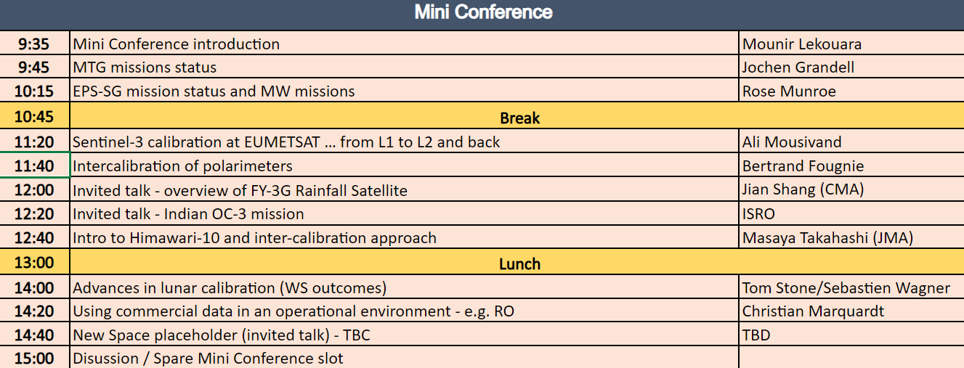
New Satellite Programs

Slide 15
Outreaching and Collaborations
CEOS/WGCV
Tom Stone (USGS) and Sebastien Wagner (EUM): “Advances in lunar calibration”, Monday, 11 March
Jack Xiong (NASA) and P. Gory (ESA): “Pre-flight workshop”, Friday, 15 March
SITSat
Nigel Fox (NPL) and Yolanda Shea (NASA): “SI Traceable Satellite (SITSat) Group Overview,” Friday, 15 March
Raj Bhatt (NASA): “CLARREO CPF Mission Overview and Intercalibration Capabilities,” Tuesday, 12 March
Thomas August: “TRUTHS Update”, Thursday, 14 March
L2+ community
Invited talks in the LCWS4 workshop
Ali Mousivand (EUM): “Sentinel – 3 calibration at EUMETSAT, from L1 to L2 and back”, Monday, 11 March
New Space community
Participated LCWS4
Orora Tech, by Fatima Kahil, Monday, 11 March

Slide 16
GRWG Subgroup Report — Lunar
Activities
NEW Subgroup: proposed GRWG subgroup on Lunar Calibration
4th GSICS/CEOS-IVOS Lunar Calibration Workshop (presentation by Seb W.)
Results from the GSICS lunar model comparison exercise
LSICS (Lunar Spectral Irradiance Calibration System), currently in development
replacement for GIRO, the current GSICS lunar reference
by Tom Stone

Slide 17
GRWG Subgroup Report - VNIR
DCC sparse sampling and SWIR BRDF methodology improvements
Need more GSICS VIS/NIR calibration products outside of DCC and Lunar
Need volunteers to lead these efforts
Current VIS/NIR reference sensor is NOAA20-VIIRS
Prior to 2018, Aqua-MODIS C6.1 was the reference instrument
NASA and NOAA teams N20 VIIRS RSB calibration differences within 0.2%
Lyapustin et al 2023 paper multiple retrieval and calibration groups inter-calibrated NPP-VIIRS, N20-VIIRS and Aqua-MODIS, the RSB band calibration within 2%
Current solar spectra reference is TSIS-1 HSRS
Future NASA VIIRS L1B products to use TSIS-1 HSRS
by Dave Doelling

Slide 18
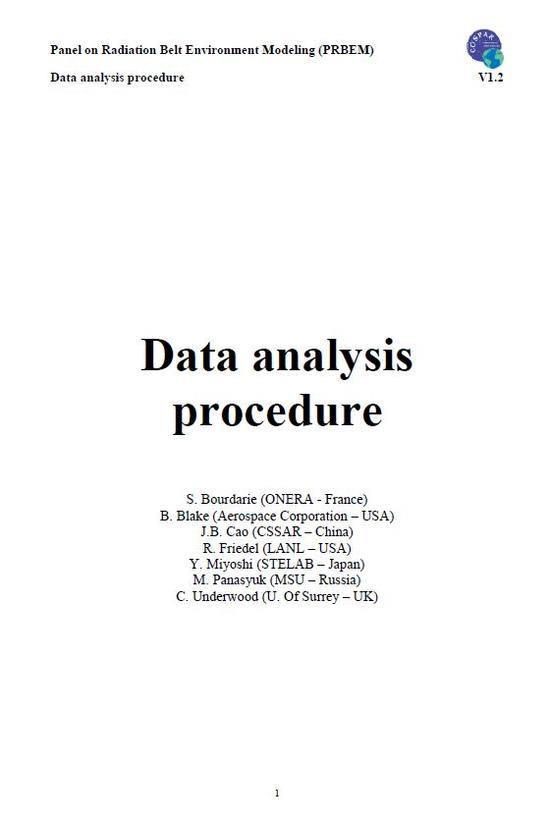
GRWG Subgroup Report - SW
Activities/Achievements
Scope and Work Plan of SW subgroup was confirmed.
(on-going) Reviewing COSPAR PRBEM document on Standard Data Analysis Procedure to consider a standard cross-calibration of high energy particle data
(on-going) Collecting definition of data levels in each organization for harmonization
(on-going) Defining a GSICS product into specific outputs
Issues, challenges and/or recommendations
Establishing standard cross-calibration procedure
What is the current reference instrument(s)/model(s), if available?
It is still an open question in our subgroup.
by Tsutomu Nagatsuma

Slide 19
GRWG Subgroup Report - UVN-S
Activities
Participating in quarterly OCO/GOSAT/TropoMI calibration meetings
Presentation on Deep Convective Clouds to assess long-term stability of OMPS Nadir Mapper.
Applications of TSIS HSRS to compare solar measurements from different instruments.
Comparisons to new geostationary instruments (GEMS and TEMPO).
Issues, challenges and/or recommendations
Develop intercomparisons using underflights of GEMS, TEMPO and EPIC.
Consider using OMI and S-NPP OMPS as stable transfer references.
What is the current reference instrument(s)/model(s), if available?
We will be discussing the stability of instruments in orbit in the session.
by Lary Flynn

Slide 20
GRWG Subgroup Report - IR
IR group hosted 4 web meeting last year.
05/04: Inter-calibration imager and Sounder and Angle Effects
07/06: Hot Land Issue, VIIRS-CrIS and Terrain Corrected Geolocation
09/07: IR Algorithms Discussion and SSU/AIRS Merge
11/02: Spectral Band Adjustment and Lunar Calibration
The IR group is focused on the inter-calibration algorithms improvements for current GEO-LEO inter-calibration. Some issues are identified for further investigation.
Regression
Hot Land Bias issue
High viewing angles
Interpolation between GEO images
With its high temporal resolution and precision, the GEO-GEO inter-comparison is a powerful tool to detect potential calibration change between the matched sensors
The IR group explore an innovative way to use Moon as a potential stable target to inter-calibrate IR sensors when the Moon was within their FOVs.
From Tim Hewison

Slide 21
Challenges and Opportunities
Innovative instrumentation
New instruments featuring expanded spectral ranges and novel characterization techniques operated by multiple agencies
Development of new inter-calibration algorithms and products to match these advancement
Embracing the AI Era
Integrate the Artificial Intelligence (AI) technique for satellite calibration and inter-calibration
Potential inclusion of IA as a component of best practice exercise in the futuree
Support for New Space Initiatives
Unique opportunities to support the burgeoning new space/small satellite programs
Explores applications that benefit the agility and innovation of small satellite platform
Continue the implementation of product uncertainty analysis
Uncertainty analysis following CEOS/QA4EO guidelines for the products
Commitment to establishing SI traceability and algorithmic improvements

Slide 22
Summary
It is a productive year marked by full resumption of activities, facilitating discussion and collaborations
Continue enhancing GSICS products and deliverables through inter-calibration/cross-calibration/inter-comparison activities
Launched four new Demo products by KMA, promoted four EUM products to operational status, and developing a new delivery by the LSICS community
Continue the ongoing active collaborations with CEOS/WGCV and other key communities
Continue growing in size and influence with the establishment of new Space Weather subgroup and the upcoming lunar calibration subgroup

