Slide 1
GSICS Coordination Centre (GCC) Report for 2023-2024
Larry Flynn & Manik Bali
March 11, 2024
2024 GSICS Annual Meeting/GSICS Executive Panel Meeting

Slide 2
Disclaimer
"The contents of this presentation are those of the authors and do not necessarily reflect any position of the US Government or the National Oceanic and Atmospheric Administration."

Slide 3
Outline
Introduction
GCC Activities
Global participation in GSICS activities
GSICS Quarterly Newsletter
Meeting Support
GSICS Product Status
New products accepted in past year
GSICS Action Tracker
GSICS Notebooks
GSICS Product Status System
Guidance from Executive Panel
Near Term Goals
Summary

Slide 4
GCC Activities – Participation in GSICS Activities
Interest in GSICS activities continues to grow

Slide 5
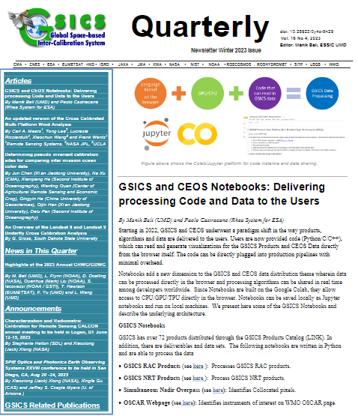
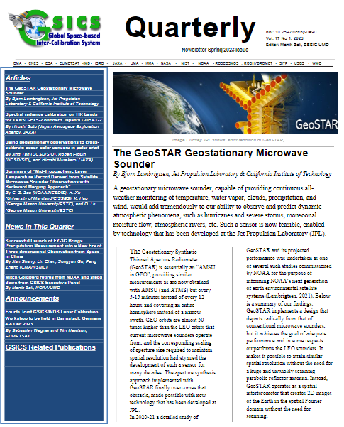
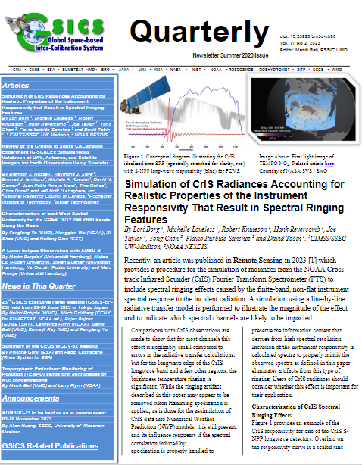
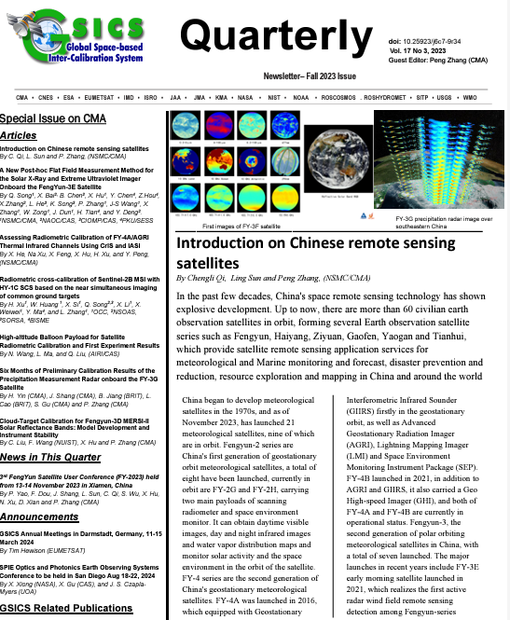
GSICS Activities-GSICS Newsletter
Each year we publish four Issues of the GSICS Newsletter. For the last year, the issues contained:
21 Research Articles and Eight Topics of News to which
Approximately 120 Scientists contributed as Authors & Co-Authors.
Special Issue on Chinese remote sensing satellites
Upcoming issues: Ideas welcome [ Special issues, Lunar, SW, UV]
https://www.star.nesdis.noaa.gov/smcd/GCC/newsletters.php
GSICS Newsletter Editorial Board
Manik Bali, Editor
Lawrence E. Flynn, Reviewer
Lori K. Brown, Tech Support
Fangfang Yu, US Correspondent.
Tim Hewison, European Correspondent
Yuan Li, Asian Correspondent
Reviewers in the past year
Lawrence E. Flynn, NOAA
Tim Hewison, EUMETSAT
Sri Harshara Madhavan, SSAI/NASA
Cheng-Zi Zou, NOAA
Articles written with the help of GenAI tools would be reviewed

Slide 6
2023 Meeting Support
GSICS Coordination Center supported the GSICS Annual Meeting 2023.
Meeting was hosted by NOAA at NCWCP.
Meeting Minutes /Agenda can be accessed from GSICS Wiki
http://gsics.atmos.umd.edu/bin/view/Development/Gsicsannualmeeting2023
Meeting Actions can be viewed at https://www.star.nesdis.noaa.gov/smcd/GCC/MeetingActions.php

Slide 7
2024-02-08 | GVIS/NIR - Dave Doelling | VIS/NIR and Lunar Annual Meeting Agenda Discussion
2024-01-09 | Preparatory-II GRWG/GDWG 2024 | Planning Annual Meeting 2024
2024-01-18 | SWx Sub-Group Webmeeting - Tsutomu Nagatsuma
2023-12-18 | GRWG Microwave Subgroup | Microwave Sub-Group Objectives and Plans
2023-12-07 | SWx Sub-Group Webmeeting - Tsutomu Nagatsuma | Proposal of Standard intercalibration method
2023-12-04/08 | Joint GSICS/CEOS | 4th Joint GSICS/CEOS Lunar Calibration Workshop
2023-11-27 | Preparatory GRWG/GDWG 2024 | Planning Annual Meeting 2024
2023-11-20 | GVIS/NIR - Dave Doelling | Contingency Planning Lunar Calibration Workshop
2023-11-09 | GVIS/NIR - Dave Doelling | Planning Lunar Calibration Workshop
2023-11-08 | SWx Sub-Group Webmeeting - Tsutomu Nagatsuma | Confirming action items
2023-11-02 | IR Sub-Group - Likun Wang | Spectral Band Adjustment and Lunar Calibration
2023-10-12 | GVIS/NIR - Dave Doelling | Monthly Group Meeting
2023-09-07 | IR Sub-Group - Likun Wang | IR Algorithms Discussion and SSU/AIRS Merge
2023-09-06 | SWx Sub-Group Webmeeting - Tsutomu Nagatsuma | Scope and Workplan for Space Weather Subgroup
2023-09-05 | GDWG Webmeeting - Manik Bali | WIS and Beyond
2023-07-13 | GVIS/NIR - Dave Doelling | Monthly Group Meeting
2023-07-06 | IR Sub-Group - Likun Wang | Hot Land Issue, VIIRS-CrIS and Terrain Corrected Geolocation
2023-06-15 | SWx Sub-Group Webmeeting - Tsutomu Nagatsuma | GSICS Space Weather Sub-Group Scope and Plan
2023-06-08 | GVIS/NIR - Dave Doelling | Monthly Group Meeting
2023-05-11 | GVIS/NIR - Dave Doelling | Monthly Group Meeting
2023-05-04 | GIR - Likun Wang | Inter-calibration imager and Sounder and Angle Effects
Supported over 20 meetings
In the past 12 months.
New Space Weather Subgroup
New Lunar Subgroup
Member of SITSAT Team
Chaired GDWG Meeting on
WIS System
Supported over 20 meetings
In the past 12 months.
New Space Weather Subgroup
New Lunar Subgroup
Member of SITSAT Team
Chaired GDWG Meeting on
WIS System

Slide 8
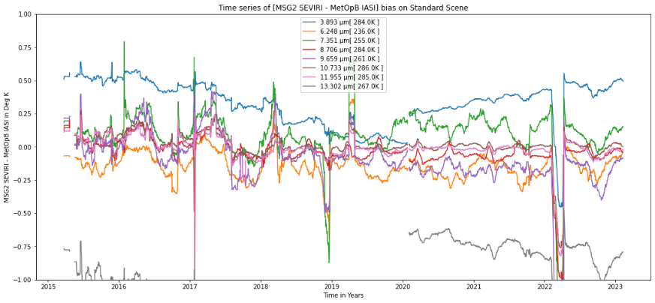
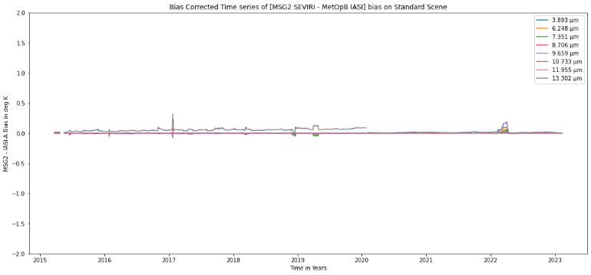
GSICS Products Status
A total of 80 (+8 from last year) Products presently delivered via the GSICS Product Catalog
Operational 16 (+4 from last year) product [16 EUMETSAT]
Preoperational 10 products [10 NOAA]
Demonstration 48 products [12 EUMETSAT, 13 NOAA, 16 JMA, 5 KMA, 2 ISRO]
Prototype 2 products [ 2 EUMETSAT]
Four new Himawari-9 Monitoring products from JMA included in the product catalog in the past year
Four new GK2A Monitoring products from KMA included in the product catalog in the past year
Example of GSICS Correction
Notes:
Four demonstration products (NOAA) have ended production.
There are two prototype products.

Slide 9
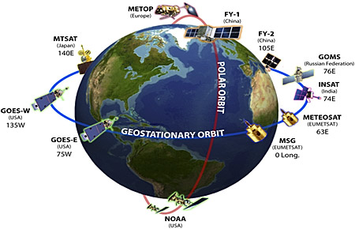
State of Observing System (SOS)
A Colab Platform has been developed that can extract biases of Geo instruments over the past year from GSICS product comparisons to create the SOS.
The GSICS Executive Panel presents the SOS report to CGMS.

Slide 10
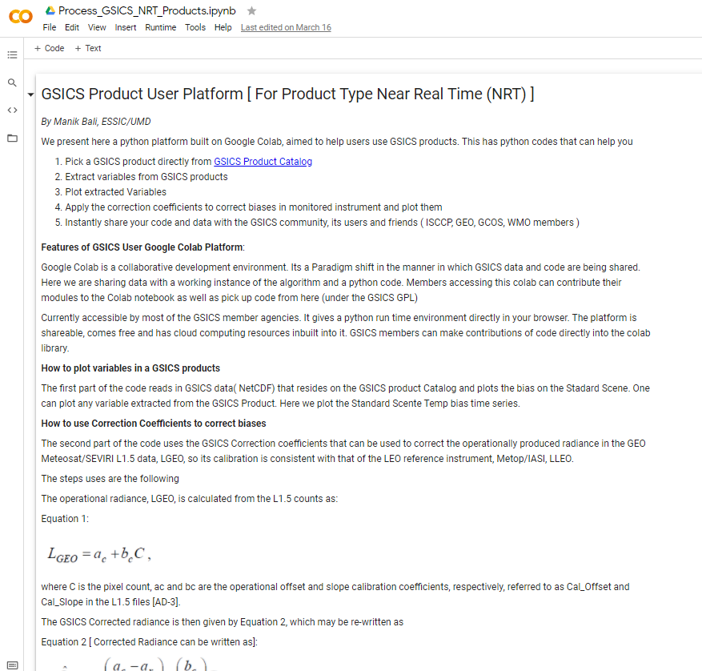
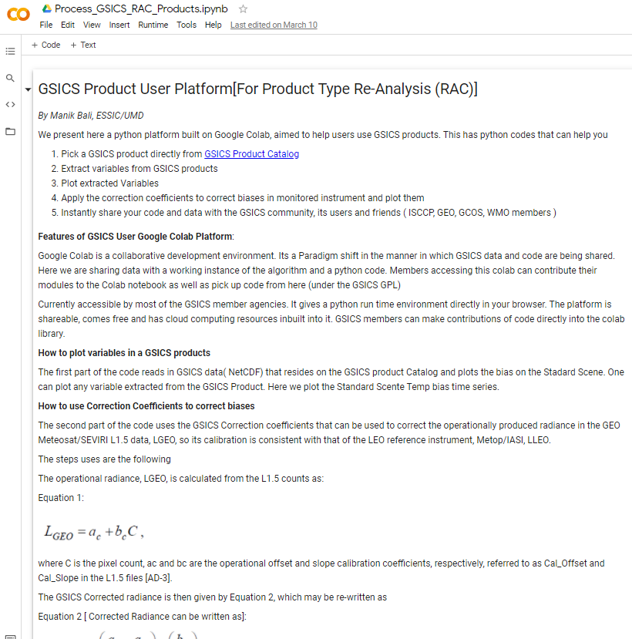
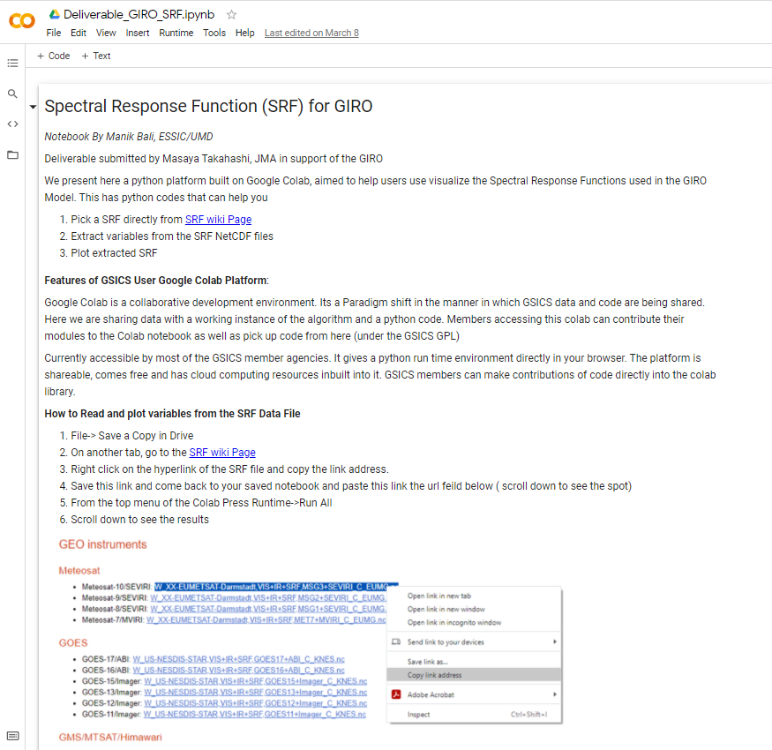
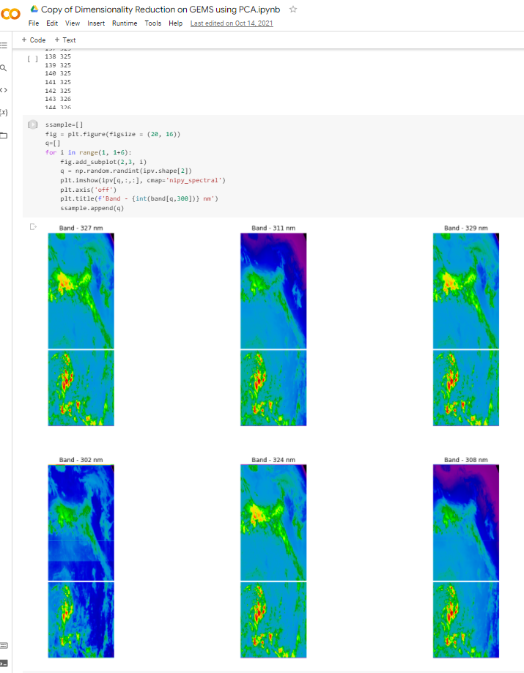
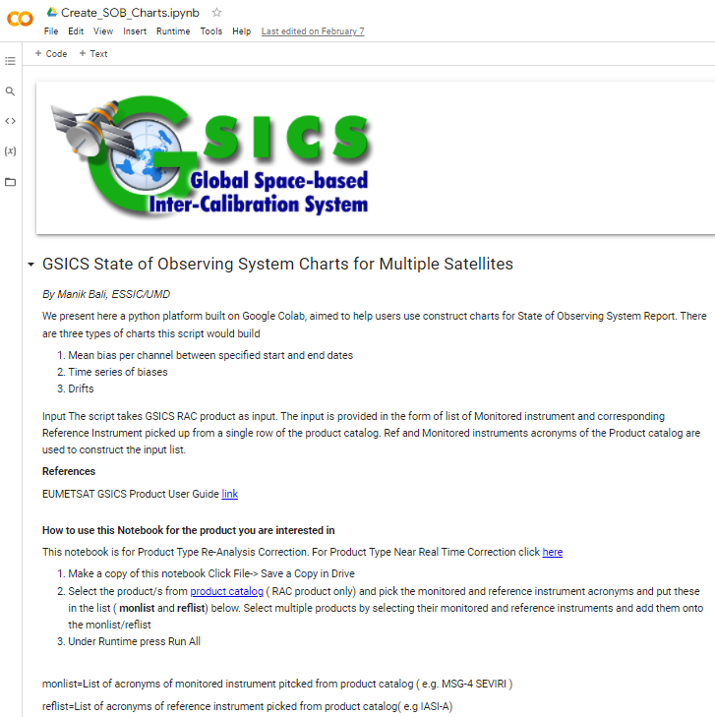
New GSICS Google Colab Notebook
New Colab files were created and previous ones maintained and supported.
The Python Script can read and use GSICS Products/Deliverables. It can be run directly from the browser.
Connects Users directly with product producers which helps in collaborative development.
Can be shared instantly. Click on hyperlinks below and start using GSICS Products/Deliverables
GSICS RAC Product
GSICS NRT Product
GSICS Deliverables SRF/Cal Tables
GEMS Data Processing
Generate State of Observing System Charts

Slide 11
GSICS Notebooks
Google Notebooks for Deliverables
Spectral Response Function (SRF) netCDF: SRFs used in GIRO in NetCDF format (Author: Masaya Takahashi, JMA) Note
GEO-LEO-IR Collocation netCDF: Intermediate Collocation data Himaware, METSAT 1R/2 Vs AIRS/IASI/MODIS (Author: Masaya Takahashi, JMA) [ Above Notebook can be tuned ]
LEO L1 netCDF: IASI Reference Radiances (Author: Masaya Takahashi, JMA) [Above Notebook can be tuned]
Level 1C inter calibration tables: Inter-Cal tables for Microwave Radiometers, e.g., SSMI series TRMM Constellation and GPM Radiometers (Author: Wes Berg, CSU)

Slide 12
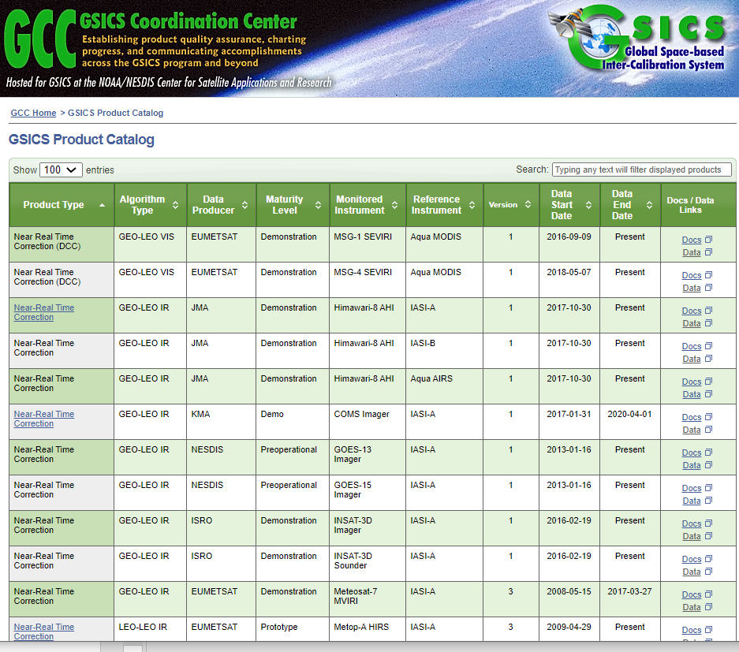
GSICS Product Status System: Background
The Global Space Based Inter-Calibration System ( GSICS ) maintains 80 inter-calibration products. These products are produced each day and disseminated via the THREDDS server or via the ftp servers on the https://www.star.nesdis.noaa.gov/smcd/GCC/ProductCatalog.php
The Product Status System continues to provide status of GSICS product generation to subscribers
For a Demo Click here
Relays the following information to the subscriber:
When was the last time the product upload took place on the THREDDS server
Whether or not the URL is active.
**System was updated to allow multiple users to access emails.

Slide 13
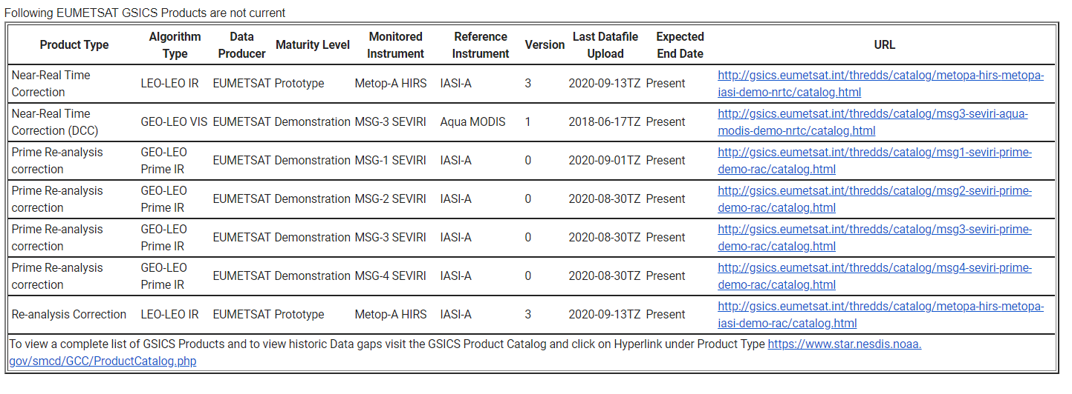
Sample Status Emails

Slide 14
Actions Status
Annual Meeting Actions
A.GWG.20230228.1 | Manik Bali to engage with Copernicus climate archive experts (via Betsy Weatherhead) and NIST data librarians on strategies to provide users with guidance to access best GSICS products for their application | Manik Bali | Initial meeting held with Betsy and follow-ups planned | Ongoing
A.GWG.20230227.2 | Manik Bali (NOAA) to consider the development of tool to interface GSICS Correction coefficients from GSICS Server with Satpy as external calibration coefficients. | Manik Bali | Satpy installed on GSICS Wiki linux instance | Ongoing
A.GDWG.20230301.1 | Manik Bali (NOAA) to add option in tracking tool to label actions as no longer relevant, and ensure a lead is clearly identified for each action | Manik | Implemented | Closed
A.GSW.20230615.1 | Larry Flynn/Manik Bali will assemble background documentation on the GSICS processes and products (Wiki, introductory presentation, GSICS products catalogue etc.) |  | Provided to SW | Closed
A.GDWG.20230904.1 | GDWG to contact the product producers to learn about their views on making their products discoverable in the WIS system on a test basis |  |  | Ongoing
A.GDWG.20230904.2 | GDWG so share lessons learnt with GRWG, Simon and the WIS team. |  |  | Ongoing
Executive Panel Actions
A.GEP.20230630.11 | GCC to organize trimestral status teleconference between EP Chair, WG Chairs and GCC. | GCC | Bojan visited NCWCP | Ongoing
A.GEP.20230630.5 | Prepare proposal for the new space involvement in GSICS. | GCC | Ongoing | Open
A.GEP.20230630.8 | Evaluate ISCCP-NG user feedback, and other user feedback, prioritize and address open issues as actions to subgroups. | GCC/Manik Bali |  | Ongoing

Slide 15
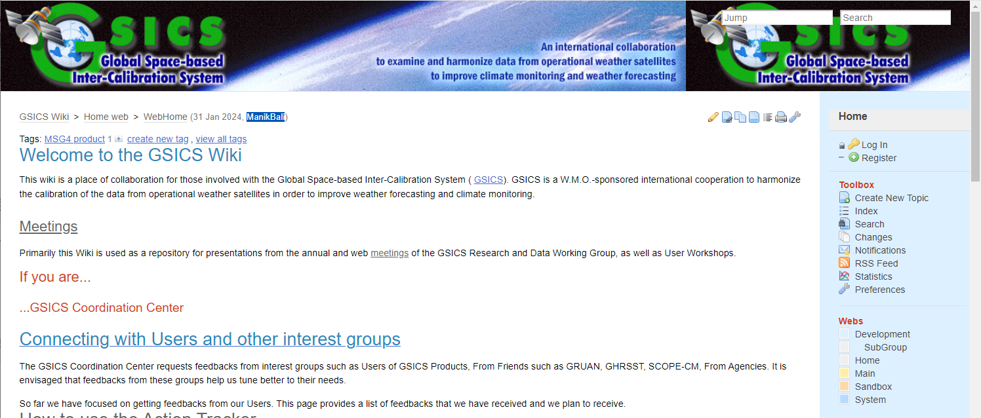
Actions Webpage and GSICS Wiki
The Action tracker was maintained
GSICS Wiki Server was maintained.
http://gsics.atmos.umd.edu/wiki/Home
https://www.star.nesdis.noaa.gov/smcd/GCC/MeetingActions.php
http://gsics.atmos.umd.edu/wiki/Home

Slide 16
Near-term 2024-2025 Goals
Coordination
Continue to work with the GPRCs, GRWG and GDWG to expand and formalize the content in the Annual Instrument Reports.
Continue to coordinate efforts to establish the GSICS baseline algorithms, especially those for the GEO solar reflective channels, and increase the number of GSICS products for visible sensor measurements,
Continue to provide communication between the research group and users
GSICS Quarterly
Continue to compile, edit and distribute this important link to the GSICS community.
Support the inclusion of new products in the GPPA, and conduct reviews of GSICS Products, Deliverables and Resources
Meeting Support (additional proposed meetings in the Note Pages)
GSICS Annual Meeting for 2024
Continue collaborative development of the Action Tracker.
[ added sharepoint for updating actions]
Develop tools to help users
Develop User Guide and Google Notebook
Develop Product Status system
Improve outreach to potential Users of GSICS Products
Notes:
2020-01GDWGProgress Meeting
2019-??GVNIR - D.DoellingSolar Spectra
2019-??GVNIR - S.WagnerPICS data extraction and sharing
2019-??GVNIR - D.DoellingExtension of DCC method to NIR
2019-??GVNIR - D.DoellingSolicit inputs from all GPRCs on preferred sites to be characterized by CLARREO Pathfinder
2019-??GVNIR - D.DoellingPlan journal paper on DCC method
2019-??GVNIR - B.FougnieRayleigh scattering calibration
2019-??GUV - R.MunroUltraviolet Sub-Group web meeting
2019-??GIR - T.HewisonReview different GEO-LEO IR inter-calibration algorithm evolutions
2019-??GRWG - R.Roebeling/T.HewisonReprocessing/recalibration Workshop planning
2019-??GRWG - X.WuMTF characterization on the moon2019-??GDWGTHREDDS + Plotting Tool
2020-06-18GRWGECMWF Workshop on Error treatment

Slide 17
Seeking Guidance from the Executive Panel
It is a constant endeavor of GCC to meet the expectations of the members
To this end we seek guidance on the following:
When, where, and how should we plan the next GSICS Users Workshop? How can we include Users at the next Annual Meeting?
Venue of GSICS Annual Meeting 2025.
Evaluate use of GenAI for GSICS activities [need supportive actions]
GPRCs to have Machine readable content [need supportive actions ]
How should we increase the participation of New Space in GSICS?

Slide 18
Summary
The GSICS Coordination Center continues to support and coordinate exchanges of ideas within GSICS.
GCC continues to play its role in reaching out to potential future members
GCC continues to publish the Newsletter.
GCC continues to support the collaboration and planning of GSICS research and other activities with complementary groups such as GRUAN, GNSS and WIGOS.
Established capability to generate SOS report at NOAA.
Suggestions, Feedback are welcome

Slide 19
Thank You

Slide 20
Backup

Slide 21
GCC Action Status [2022]
Status of Actions in Past Year
A.GCC.20220318.1 | GCC to edit an article on Notebooks, wiki and pages GSICS Tools |  | Closed
A.GDWG.20220316.3 | GDWG members to inform GCC about the latest membership |  | Concurrent
A.GVNIR.20220318.6 | GRWG (Dave) to work with GCC lead a recommendation to EP of recommending TSIS-1 HSRS as a reference Solar spectrum | TSIS-1 recommended as reference solar spectrum | Closed
New Actions in 2023
A.GDWG.20230301.1 | Manik Bali (NOAA) to add option in tracking tool to label actions as no longer relevant, and ensure a lead is clearly identified for each action | Closed
A.GSW.20230615.1 | Larry Flynn/Manik Bali will assemble background documentation on the GSICS processes and products (Wiki, introductory presentation, GSICS products catalogue etc.) | Closed [documents shared by Larry]
A.GWG.20230227.2 | Manik Bali (NOAA) to consider the development of tool to interface GSICS Correction coefficients from GSICS Server with Satpy as external calibration coefficients. | Ongoing[ Implemented at UMD, converting to container]
A.GWG.20230228.1 | Manik Bali to engage with Copernicus climate archive experts (via Betsy Weatherhead) and NIST data librarians on strategies to provide users with guidance to access best GSICS products for their application | Ongoing [Met with Betsy, Lunar shared algorithm]
R.GDWG.20230301.5 | Manik Work closely to develop to utilize OSCAR API for retrieving information of interest | Ongoing[Met with Heikki Shared experience]

