Slide 1
GSICS State of Observing System (SOS) Reports 2024
Tim Hewison (EUMETSAT) Manik Bali (UMD@NOAA)
Fangfang Yu (UMD@NOAA)

Slide 2
State of Observing System Report
Instrument/activity status report
Operational periods
Major events (changes/outages)
Instruments/activities include
GSICS references
Instruments monitored with the GSICS references
Period = Calendar Year
Or ~year between annual meetings?
Calendar Year allows time to generate report + more useful for users?
Publication
Historical reports?

Slide 3
State of Observing System Report
Provide the accuracy with respect to GSICS references:
Mean Bias
Variance (Standard Deviation)
Uncertainty (typical value/median)
Provide the drift rate, if it exists
If multiple references are used, also provide the difference between references with double difference method
Optional?

Slide 4
Generation of G-SOS Reports
Standardise & Automate where possible!
Encourage GPRCs to generate GSICS products for all instruments to be monitored
Even if they do not need to apply corrections (insignificant biases)
Encourage to use the GCC-derived colab tool to generate the charts
Tool available at: http://gsics.atmos.umd.edu/bin/view/Development/Annualmeeting2022
Question? Please contact Manik Bali (manik.bali@noaa.gov)
Also provide time series bias over time and any other relevant plots

Slide 5
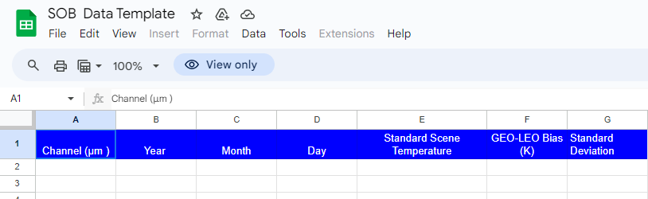
Input Format for GCC SOS Report
Action2: . : Agencies to share biases using agreed-upon metadata and in machine readable format to help colab read biases and generate SOS.
Agencies wishing to provide data to be included in the SOS heatmaps
need to provide satellite data in this format
For each instrument they can generate a data file with the headings provided here
Data required is for the period ( 20230101-20231231) – full calendar year
Simple Spreadsheet in Google Document
Accessibility issues? – Just email data to Manik Bali
Automatic population from GSICS Server?

Slide 6
Examples
Action1. Agencies to support the use of the colab which can generate instant reports can we discuss an action
Using GCC Colab tool
(Click link for walk-through)
Reads data from links in GSICS Product Catalog

Slide 7
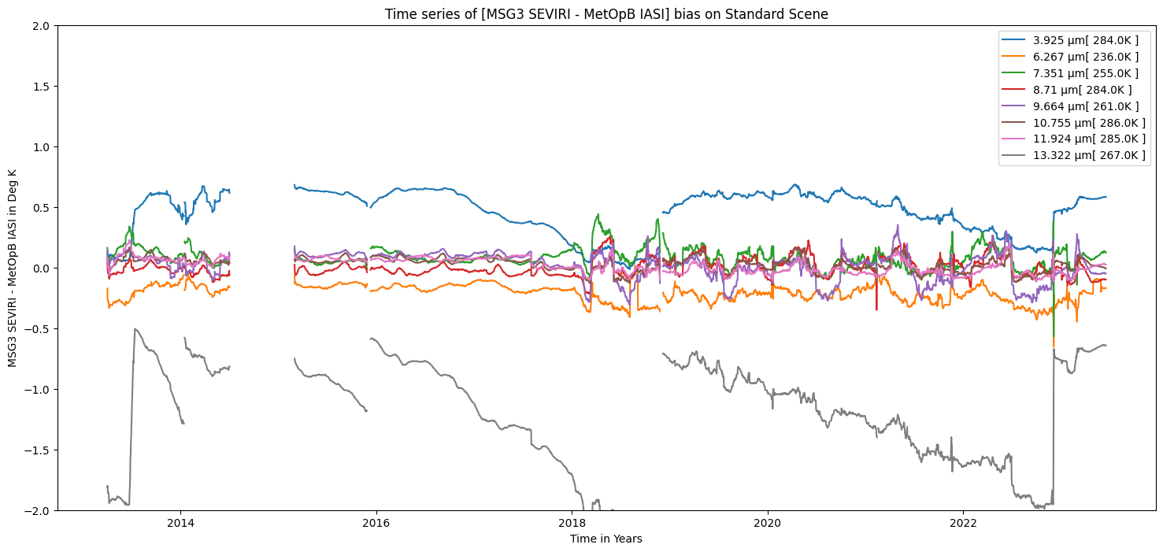
Example – Meteosat-10 over 10 years

Slide 8
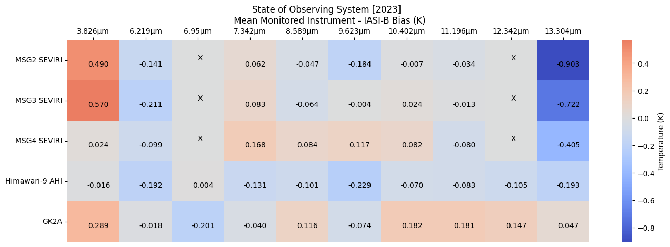
New! Heat Maps for common channels of multiple instruments
➔ Feedback and Technical Discussion in IR Sub-Group

Slide 9
GSICS SOS Report Publication
Where/how to publish?
EP chair recommends transfering G-SOS report to document format (open action)
Publish on WMO website? GCC? GSICS Wiki?
Link from Instrument Landing Pages? WMO OSCAR?
When to publish?
The G-SOS report is scheduled on Friday, 15 March 2023 – feasible?
Fangfang: I think we should report the discussion results in the annual meeting with a proposed submission date in this EP report.
Historical reports?
Retrospectively generate?
In new format?
past reports missing summary

Slide 10
Discussion
How can agencies provide input?
Commit to generating GSICS products for instruments to be included?
Which content is useful?
Summary Statistics
Mean Bias – for Standard Scene
Variance (Standard Deviation)
Uncertainty (typical value/median) – needed?
Drift rate (Linear trend) – for Standard Scene – still needed, if we have Std Dev?
Time Series Plots
Over instrument lifetime
Heat Maps
Provide quick look at status of all instruments in a class
Bias / Stability / Drift ?

