Slide 1
GSICS Agency Report
2024
Chengli Qi，Xingwei He, Lin Tian,
Lee Lu, Yuan Li, Qian Wang, Xiuqing(Scott) Hu
CMA

Slide 2
Presentation Overview
GSICS Activities, Actions, and Achievements
Support to GDWG Activities
Support to GRWG Activities
Instruments Updates & Planned launches that are relevant to GSICS
Calibration Major Updates

Slide 3
Activities and Achievements
FY-3G Rainfall satellite launched on 16 Apr, 2023, carried precipitation measurement radar(PMR), High Accuracy On-board Calibrator (HAOC), short-wave infrared Polarized Multi-Angle Imager (PMAI), MERSI-RM, MWRI-RM, GNOS, in pre-operational status. FY-3G performance see Jian Shang’s talk in mini conference.
FY-3F AM mission launched on 3 Aug, 2023, carried 2 new payloads: Ozone Monitoring Suite(OMS-Nadir&OMS-Limb), the post-launch test is ongoing, Qian Wang will give intruduction in UVN subgroup.
Instrument performance and product quality of CMA’s operational and new launched satellite instruments are monitored in near real time .
Edited 4th GSICS quarterly of 2023 .

Slide 4
Actions
Action Id | Summary | Lead | Due | Completed | Notes | Status
A.GIR.20230301.2 | investigate 1) diurnal variations | Chengli Qi | 3/1/2024 | 3/1/2024 | See Xingwei’s talk in IRWG meeting | To be closed
 | 2) GEO and LEO hyperspectral sounder comparison | Chengli Qi | 3/1/2024 |  |  | Ongoing
 | 3) GSICS correction | Chengli Qi | 3/1/2024 |  |  | Open

Slide 5
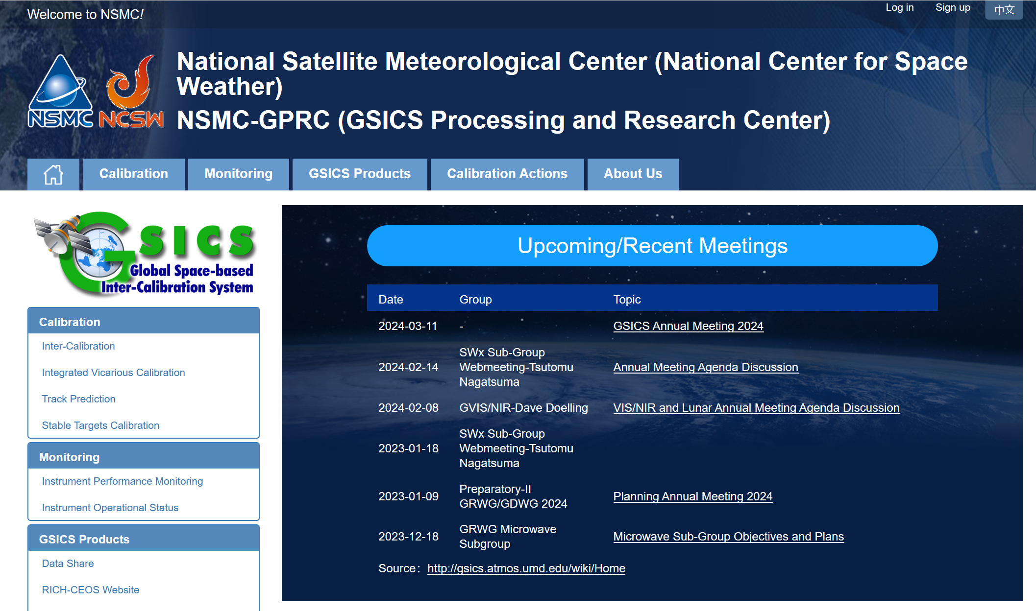
Agency’s support to GDWG Activites
Keep CMA GPRC Website Content updating:
  Add GSICS releated meeting info.
  Update FY-4A&4B AGRI calibration monitoring results.
  Add FY Satellites Instrument Operation Status, software update, instrument status long-term monitoring results.
Data support:
  Share Fengyun satellite reprocessing dataset for GSICS
  Recover IASI data acquisition from EUMETSAT THREAD website
http://gsics.nsmc.org.cn/portal/en/fycv/index.html

Slide 6
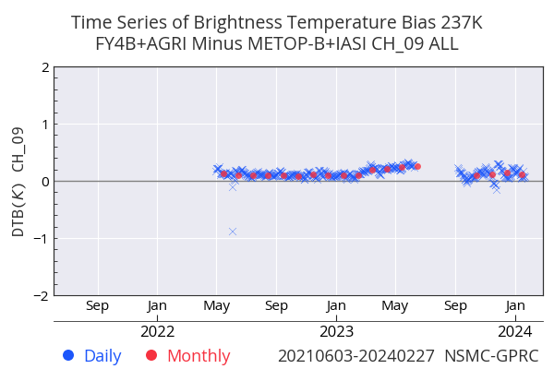
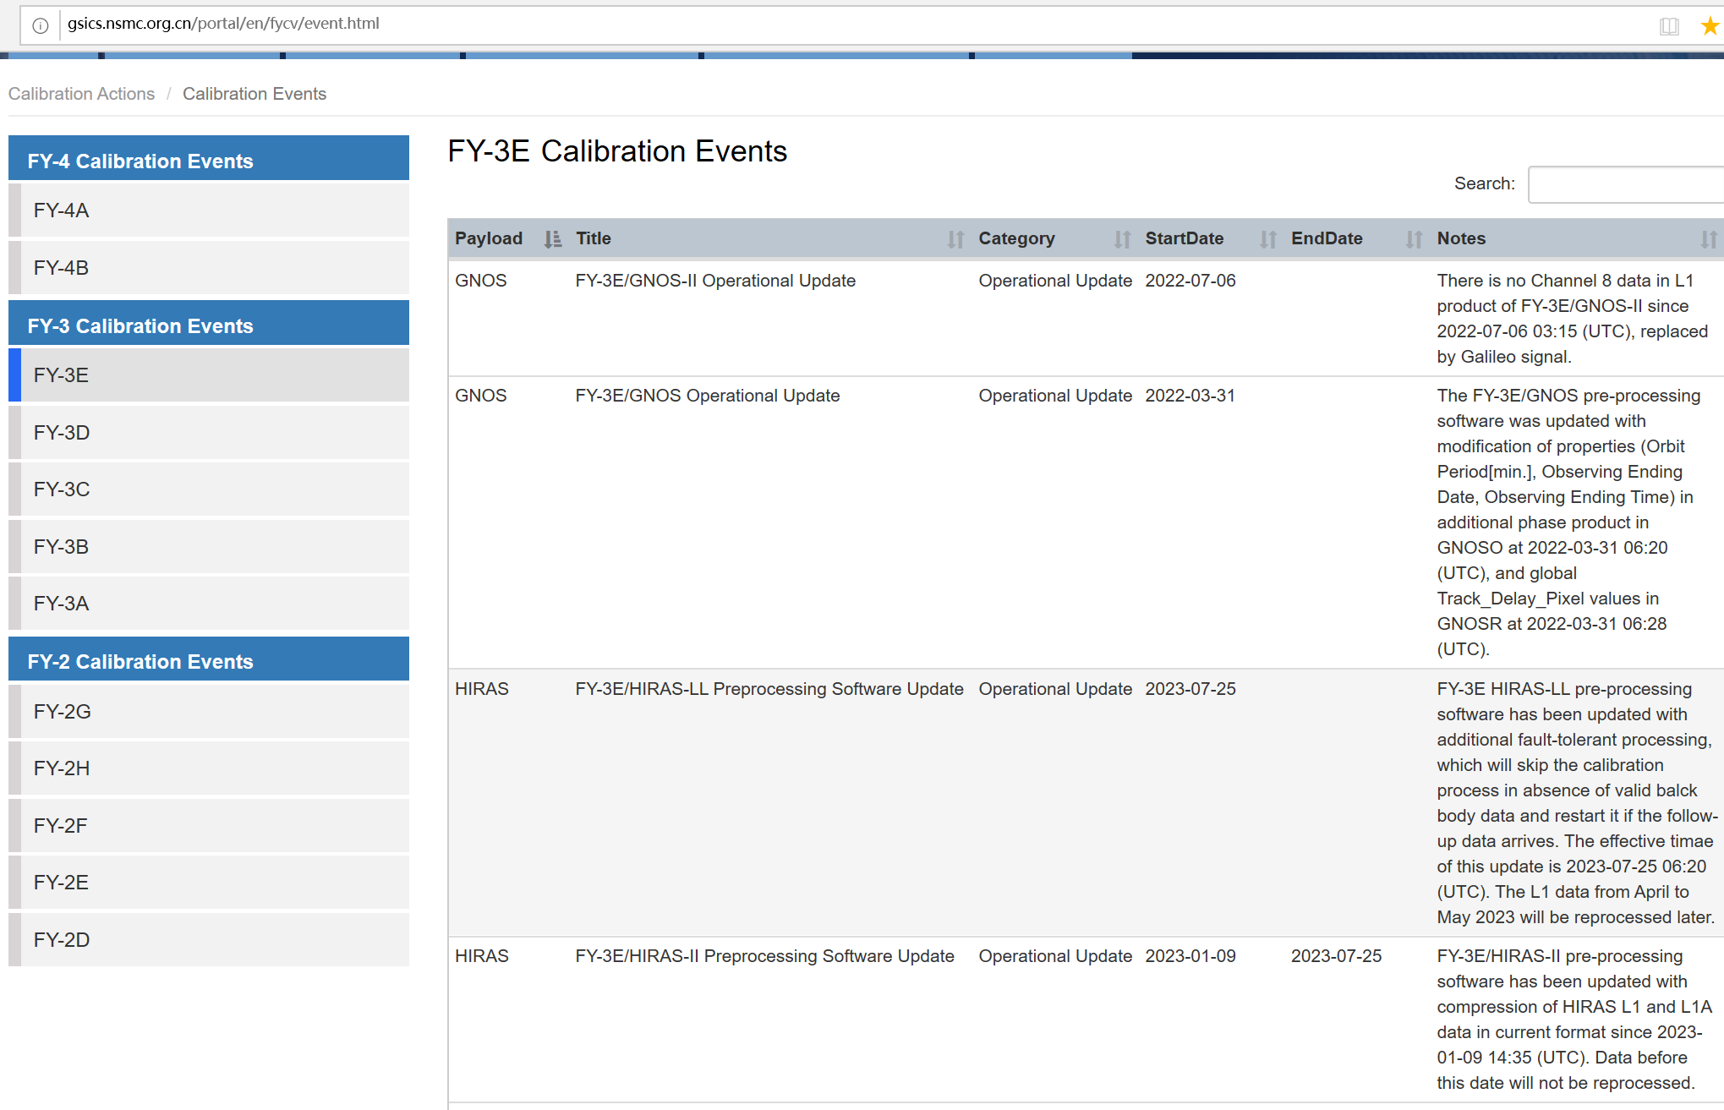
Website Content updating
FY-4A&4B AGRI calibration monitoring results
Calibration Events

Slide 7
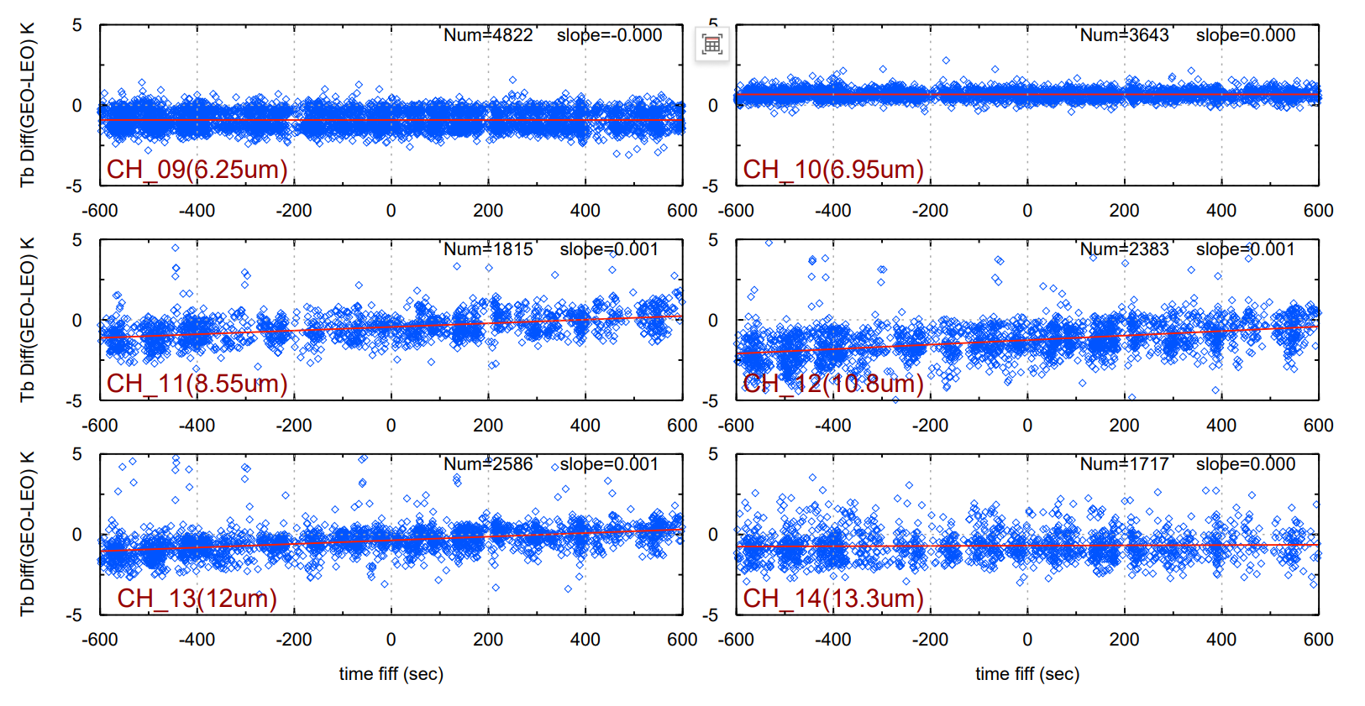
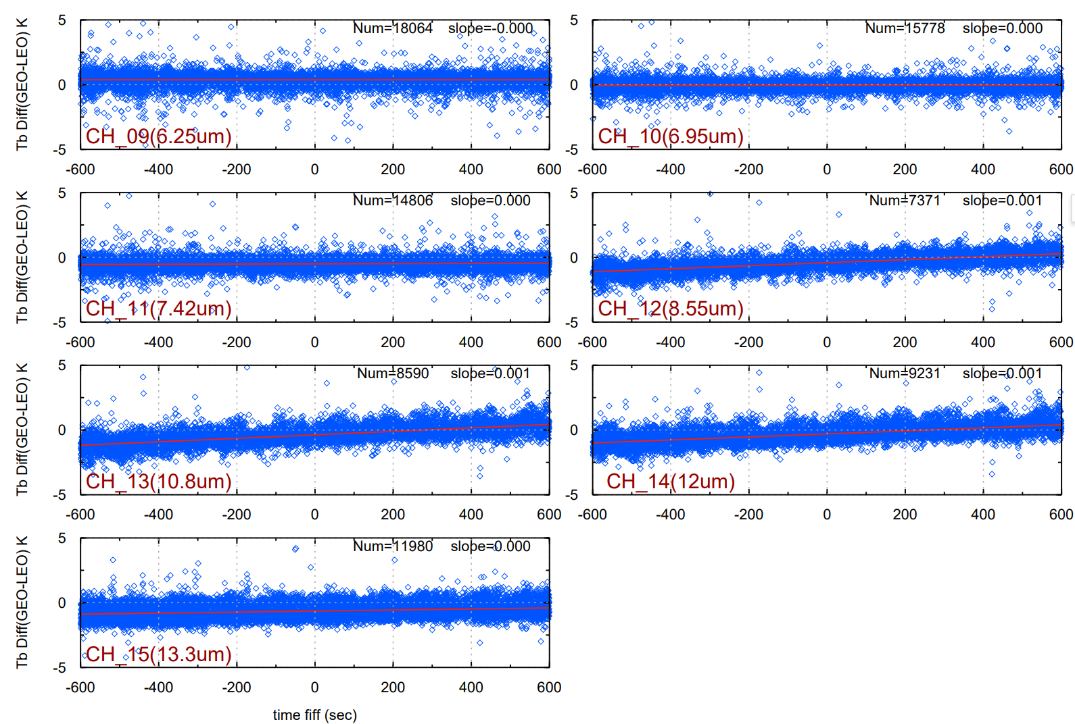
Bias(AGRI minus IASI) analysis of hot land
Agency’s support to GRWG Activites
FY-4B/AGIR
FY-4A/AGRI
8.55um
10.8um
8.55um
12um
10.8um
12um
  Bt bias not symmetrically distributed with time difference over hot land for channels of 8.55,10.8 and 12μm on both AGRIs.
Notes:
First , is the hot land bias analysis. We checked bias of IR channel over hot land and found....., in next, we can discuss how to do the more strict quality control or develop algorithm to correct this error caused by time dif for some special objects.

Slide 8
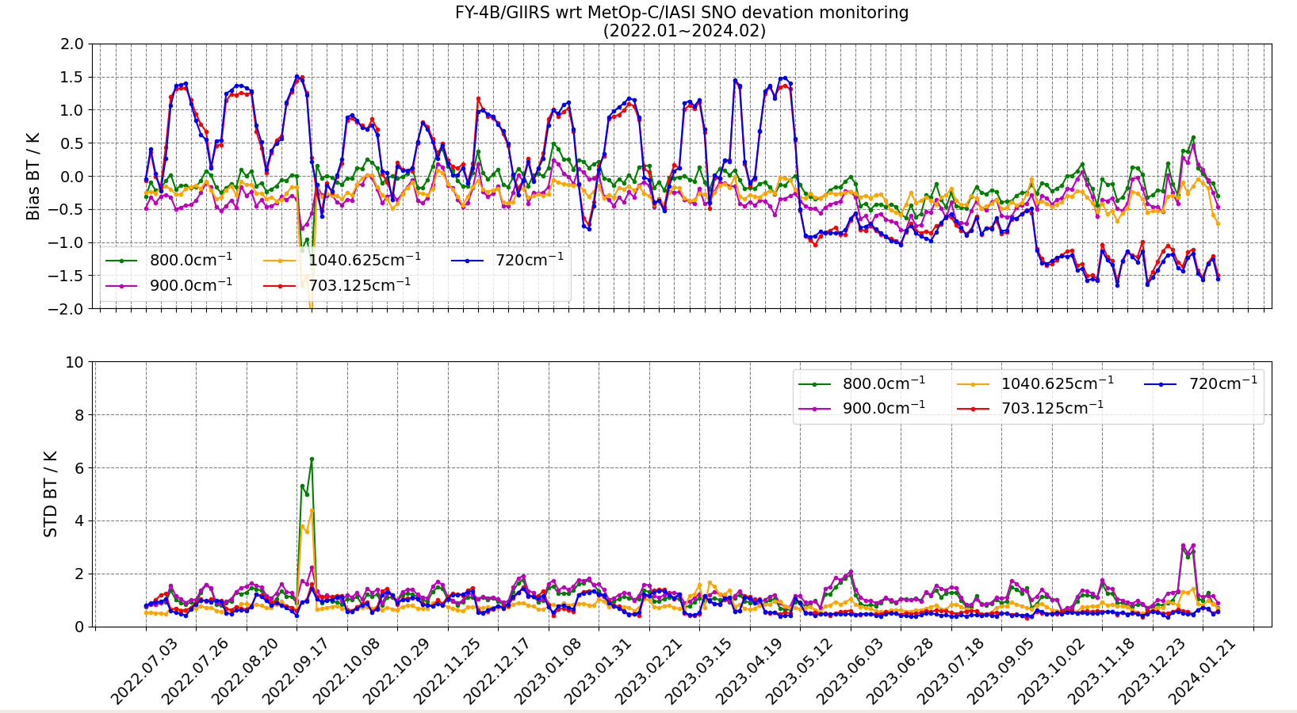
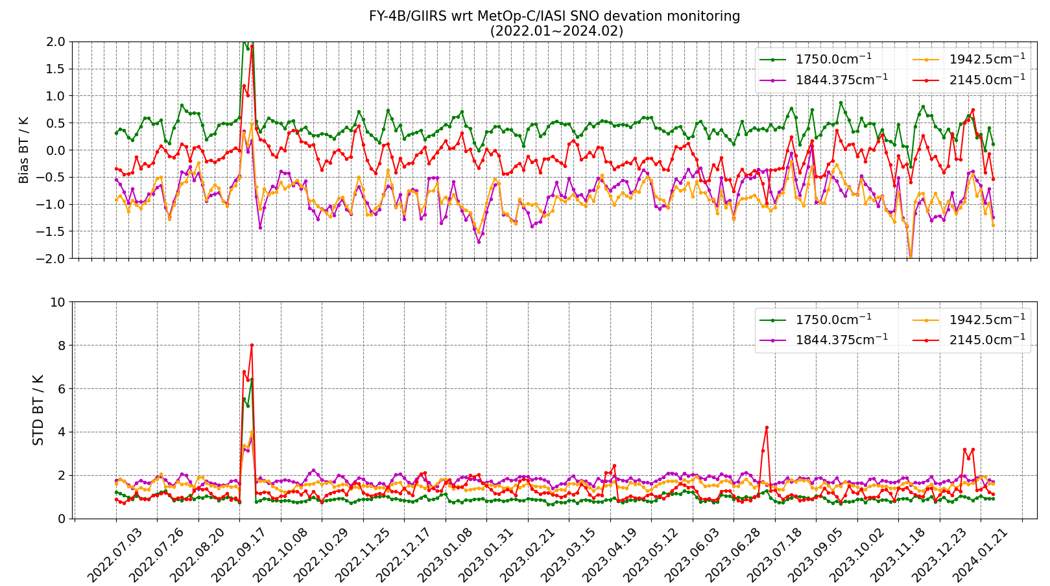
FY-4B/GIIRS updates
FY-4B/GIIRS v.s. Metop-C/IASI
DS view adjusted on 2023.05.27
Satellite yaw flip maneuver on 2023.09.25
From 2024.02.01 to 02.27, FY-4B drifted from 133° E to 105° E
LW
MW
DS view adjusted on 2023.05.27, GIIRS stability of radiometric calibration is improved.
Bias also be affect by the yaw flip maneuver on Sep.
Work on instrument stability monitoring and the influence of the internal temperature on radiometric calibration is ongoing.
From February 1 to February 27, 2024, FY-4B drifted from 133° E to 105° E, during which time observations were interrupted, data service recoved on 5 Mar, 2024.

Slide 9
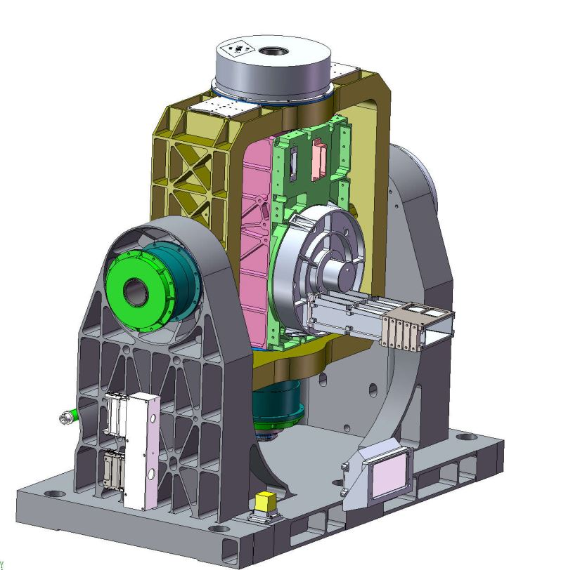
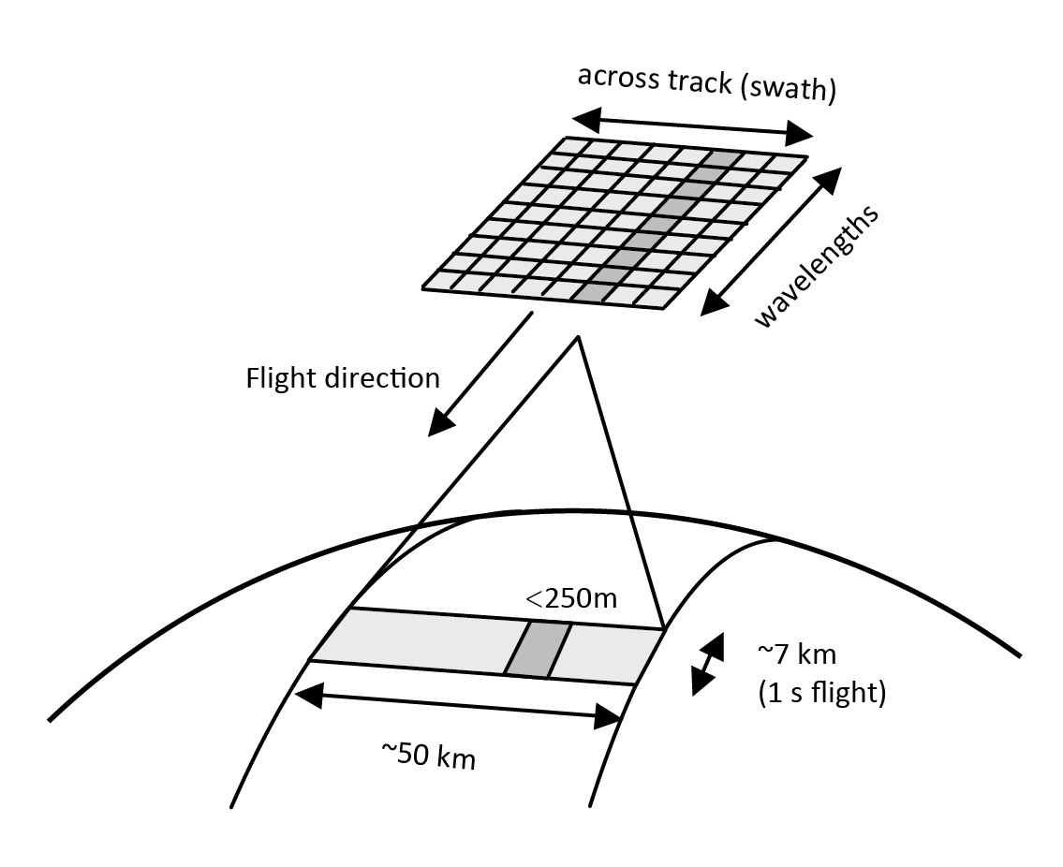
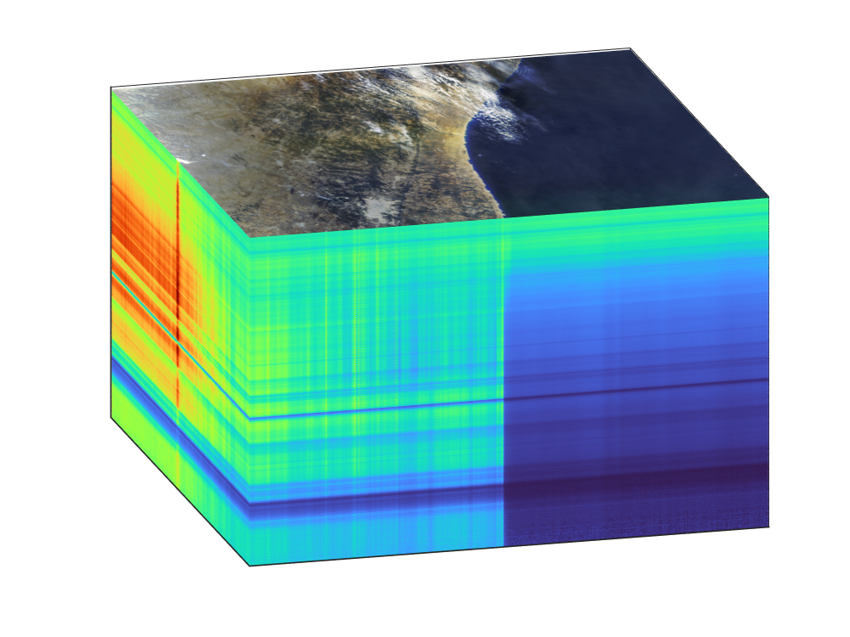
FY-3G/HAOC
Attenuator Wheel
Parameter | Value
Spatial resolution | 250 m
Spectral sampling | 4 nm
Spectral range | 400 nm~1060 nm
Swath width | 50 km
Radiometric calibration accuracy | 2%
Spectral calibration accuracy | 2 nm
Field of regard | 7° s.s.p.
The High Accuracy On-board Calibrator (HAOC) onboard FY-3G satellite is a demonstration/pathfinder of Earth–Moon imaging spectrometer in the Chinese space-based radiometric benchmark LIBRA project, which is aimed to demonstrate its ability to (a) make high-accuracy reflectance measurements at 2% uncertainty through its on-orbit calibration and (b) transfer that calibration uncertainty to other sensors by inter-calibrating with MERSI instruments.
Notes:
The following, there are several new instruments on fengyun satillites and the Cal/Val activities.

Slide 10
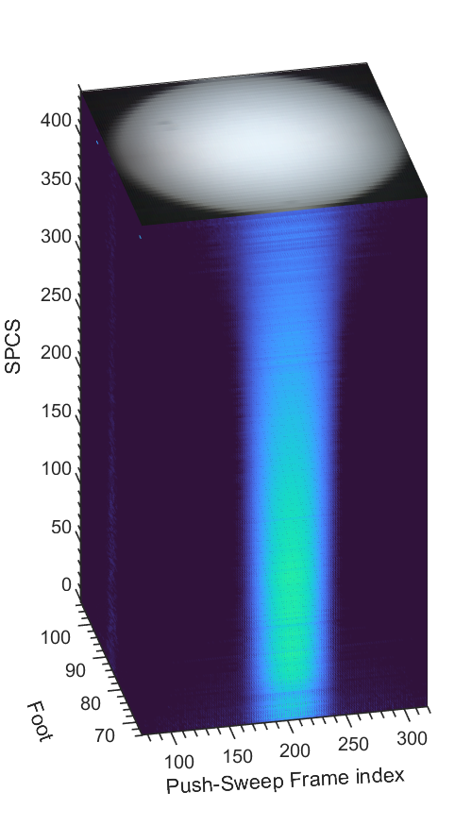
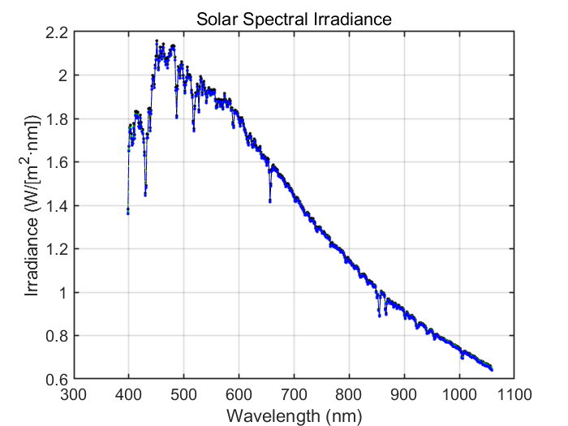
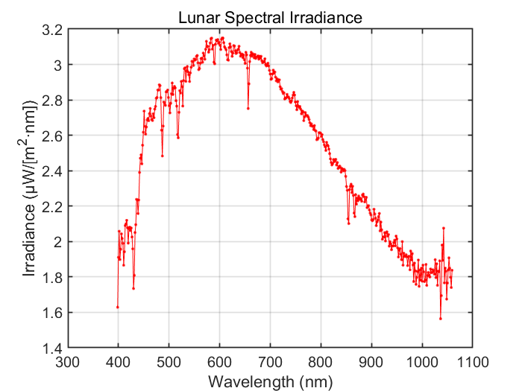
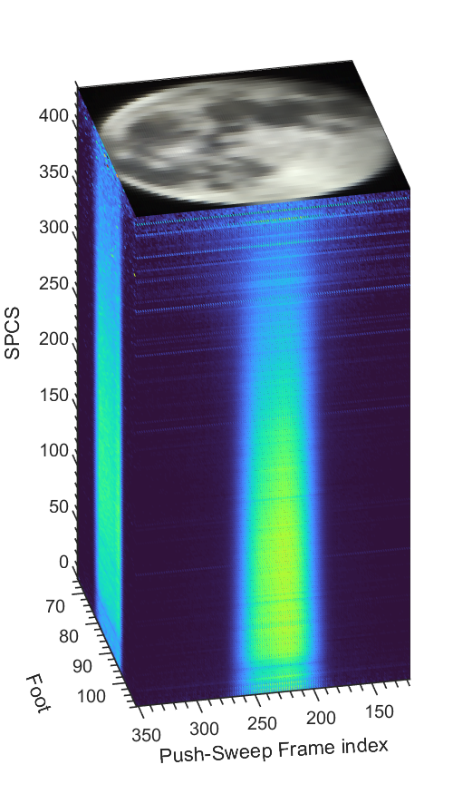
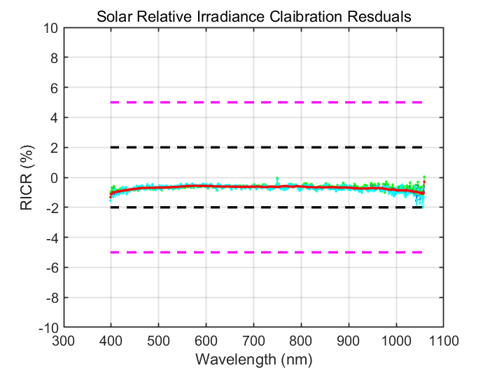
+5
+2
-2
FY-3G/HAOC conducts solar and lunar observations according to schedule.
Solar irrdiance and lunar radiance cube
-5
Notes:
HAOC conducts solar and lunar observations

Slide 11
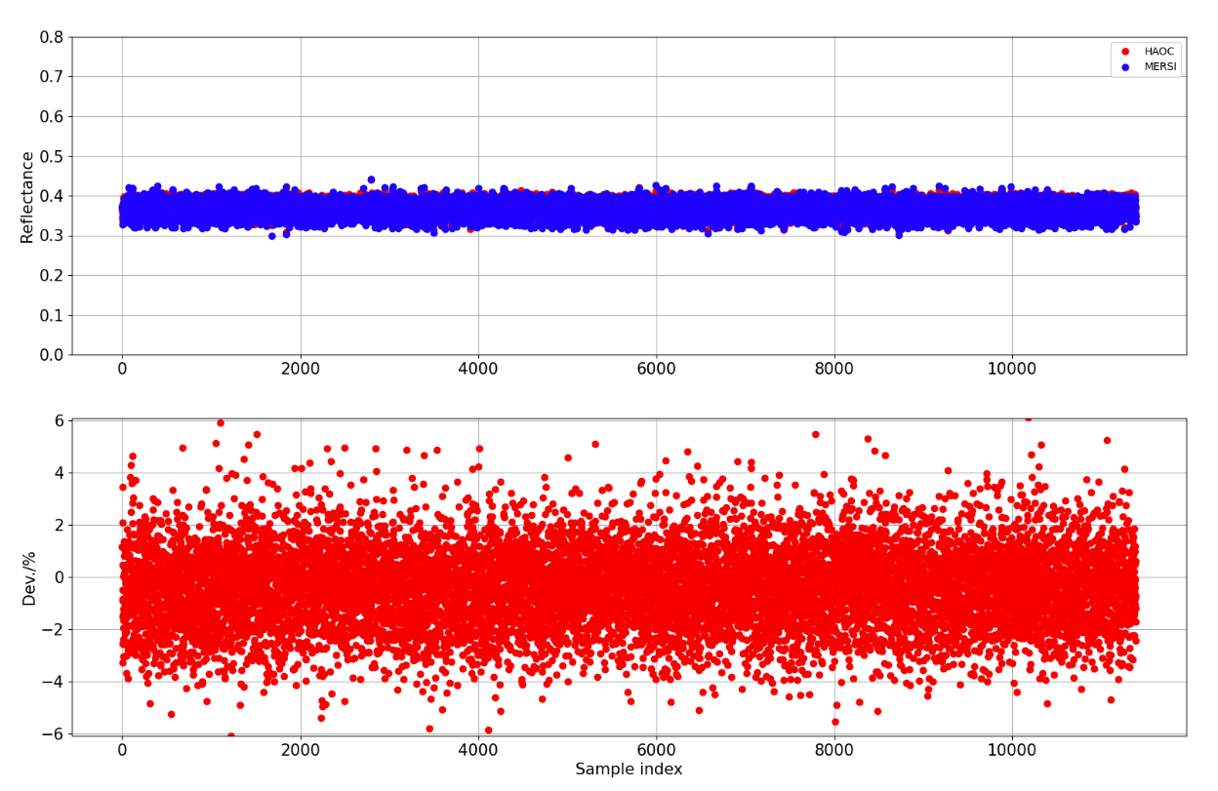
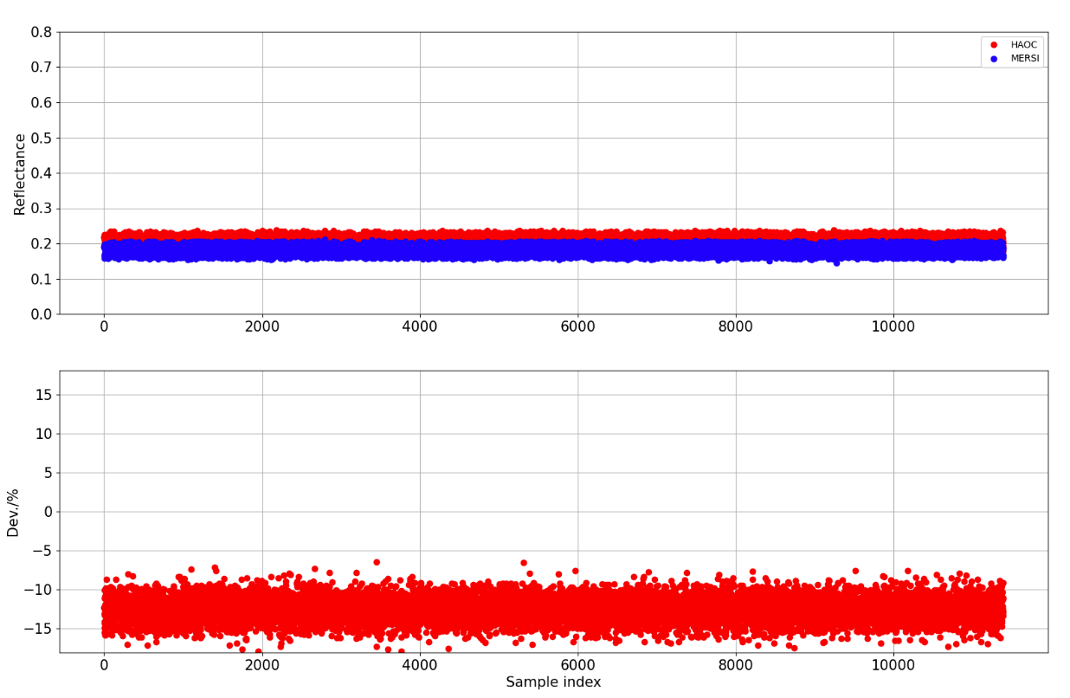
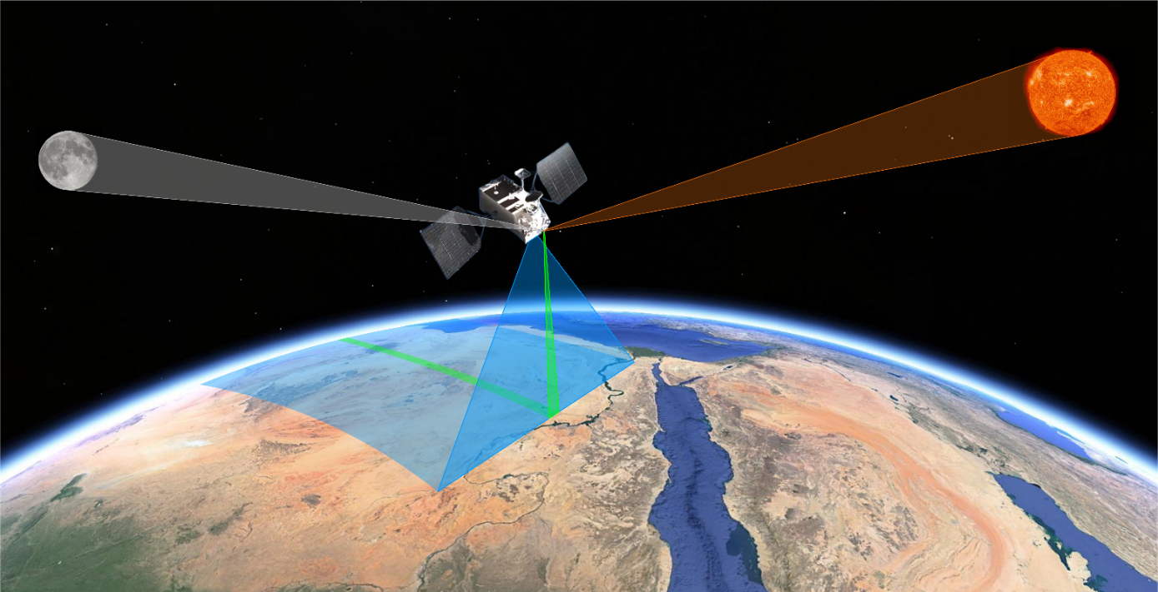
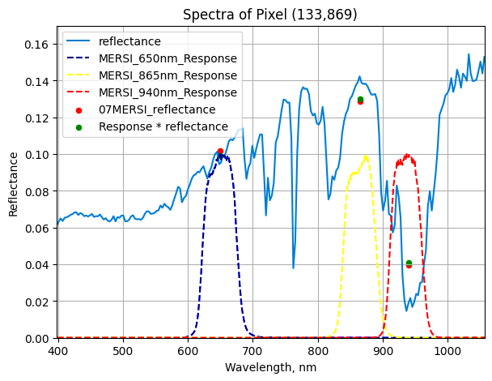
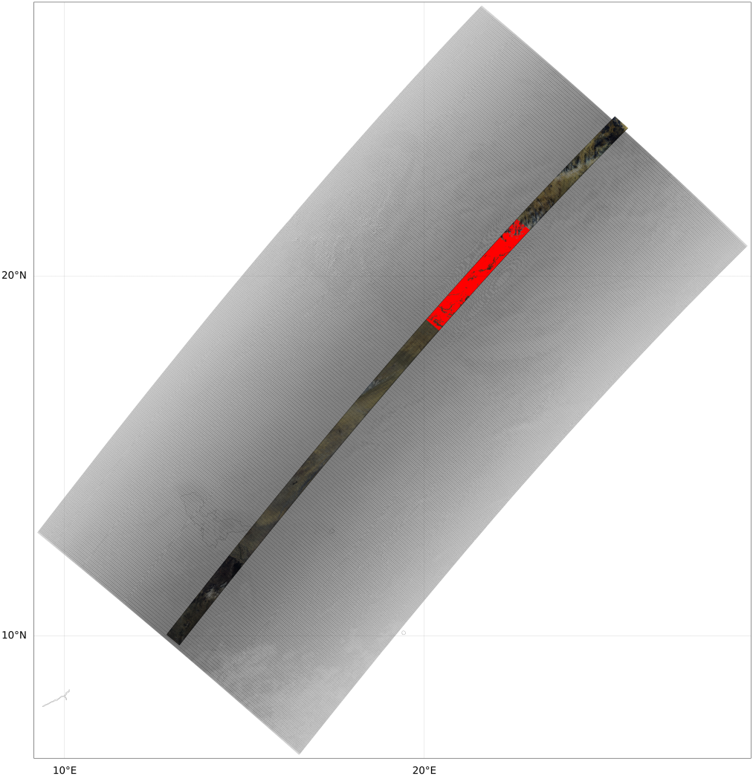
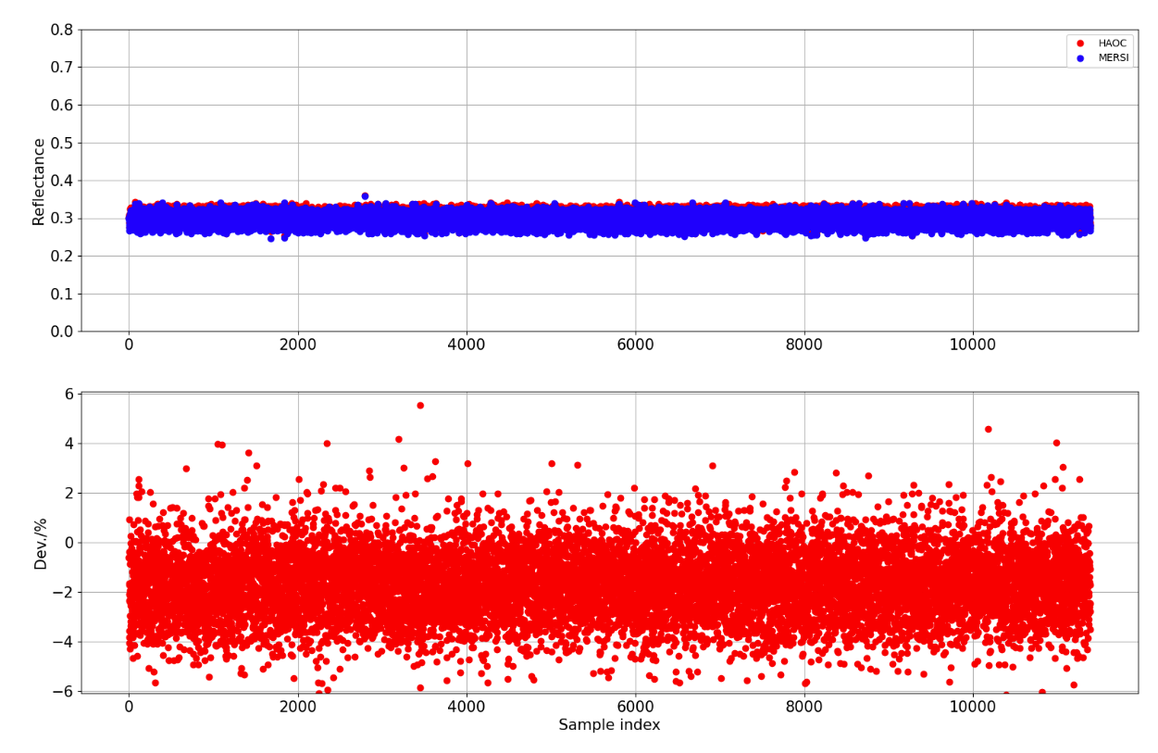
865 nm
940 nm
+2%
-2%
-10%
650 nm
The preliminary results of FY-3G/HAOC and MERSI SNOx.
+2%
-2%

Slide 12
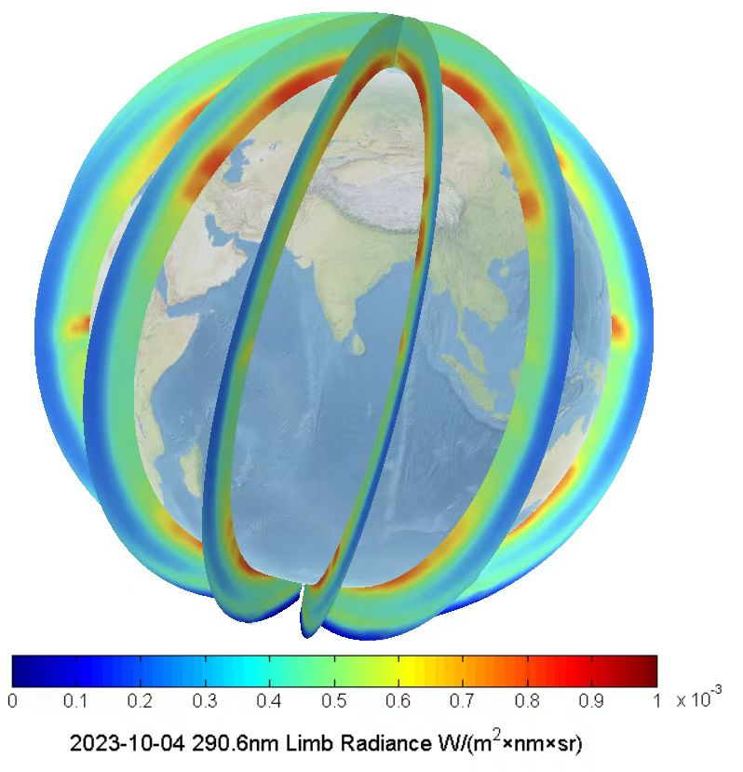
FY-3F/OMS-L Instrument Introduction
The Ozone Monitoring Suite - limb scanning unit. OMS-L is a UV/VIS spectrometer flying on FY-3F Satellite. It uses continuous ultraviolet spectroscopy for observation and is equipped with a stable onboard calibration source, enabling high-precision monitoring and correction of radiation and spectral performance.
OMS-L started observing on September 5, 2023 and is currently undergoing in orbit testing.
OMS-L specification
No. | Test items | Technical requirement
1 | Spectral range / nm | 290-500
2 | Spectral resolution / nm | 0.6
3 | Spectral sampling interval | Continuous sampling pixel by pixel
4 | Wavelength calibration accuracy / nm | 0.01
5 | Spatial resolution / km | 3 (vertical)
6 | Instantaneous field of view / ° | 2.3 (horizontal) × 0.045 (vertical)
7 | Dynamic range | 10⁵
8 | Relative radiometric calibration accuracy | Better than 2%
9 | Calibration accuracy of diffuse reflector | Better than 3%
10 | Absolute radiometric calibration accuracy | Better than 3%
11 | Signal to noise ratio | > 300@0.1mw /cm² × sr × nm (radiance)

Slide 13
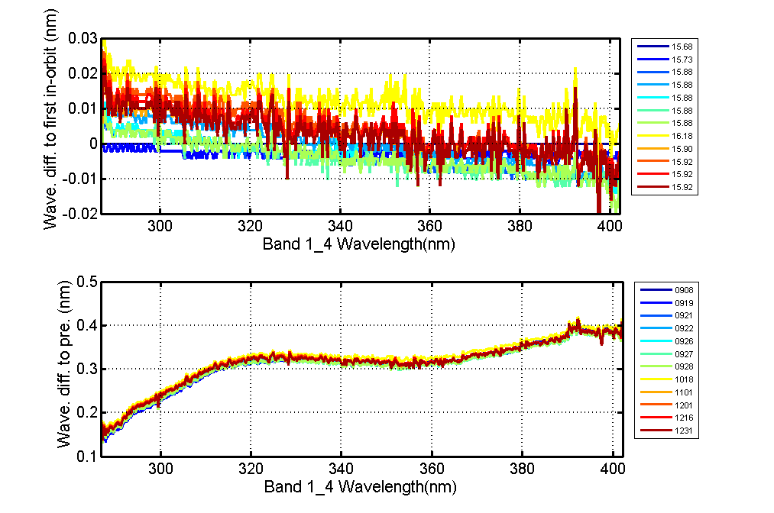
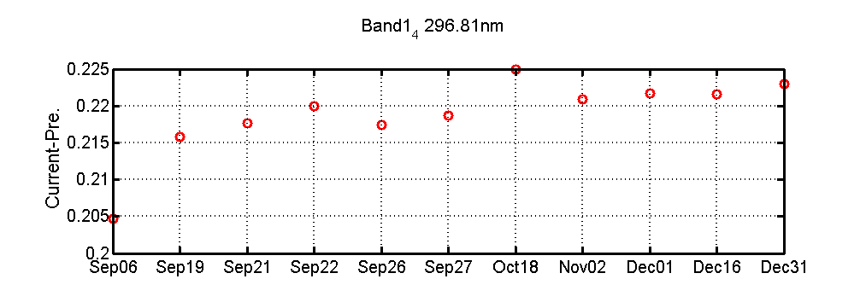
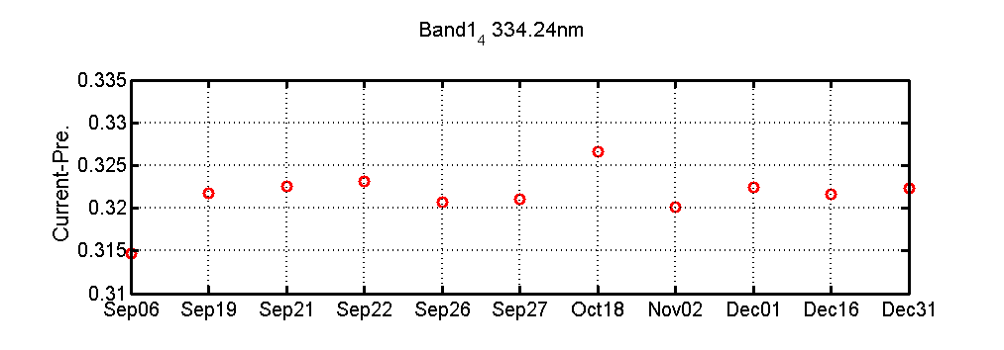
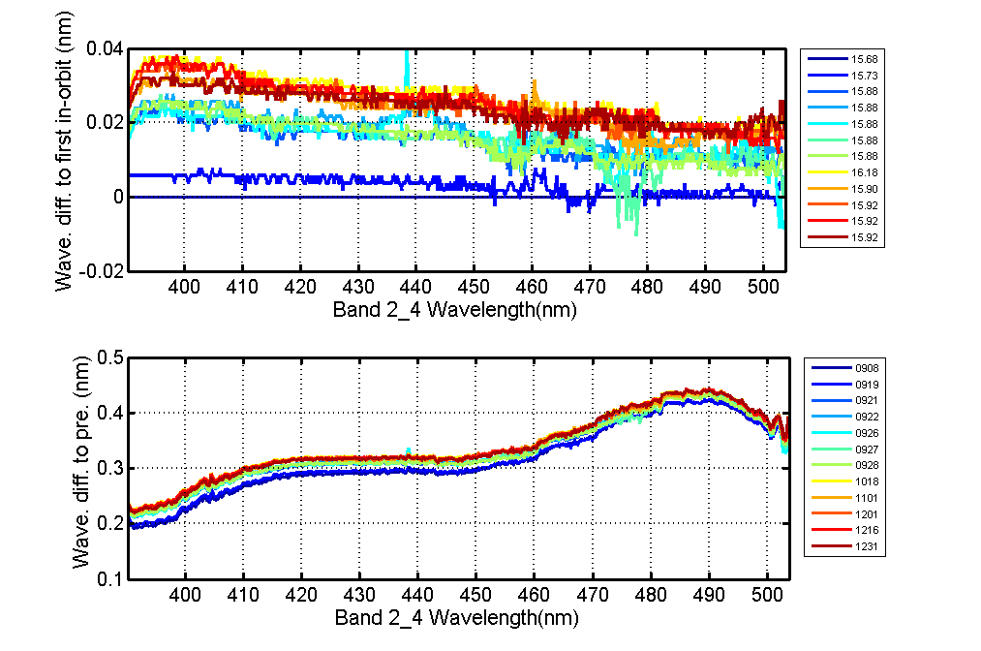
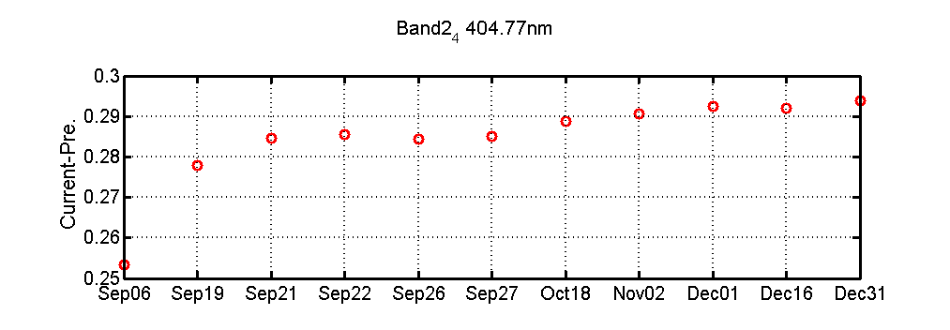
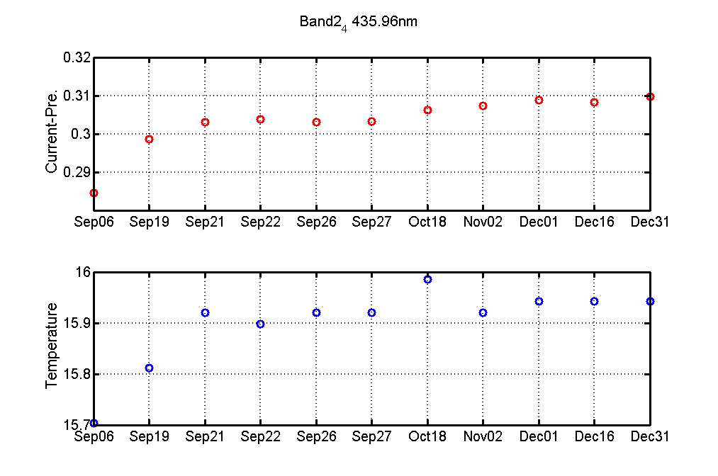
On orbit variation of OMS-L spectrum
OMS-L has mercury lamp calibration mode and solar calibration (main/backup) mode for in orbit spectral calibration.
  On orbit spectral correction using solar calibration mode combined with TSIS solar reference spectrum;
  Use mercury lamp calibration mode to monitor spectral changes at characteristic wavelengths of mercury and verify the accuracy of solar on orbit spectral correction .
After 21 Sep, (Stable state), the wavelength change is less than 0.01nm
296.8nm(mercury lamp)
334.2nm (mercury lamp)
band 1 center wavelength in orbit changes from -0.01 to 0.03nm (Sun)
Time variation compare to prelaunch in Band 1
404.8nm(mercury lamp)
436.0nm(mercury lamp)
Band 2 center wavelength in orbit changes from 0 to 0.04nm (Sun)
Time variation compare to prelaunch in Band 2

Slide 14
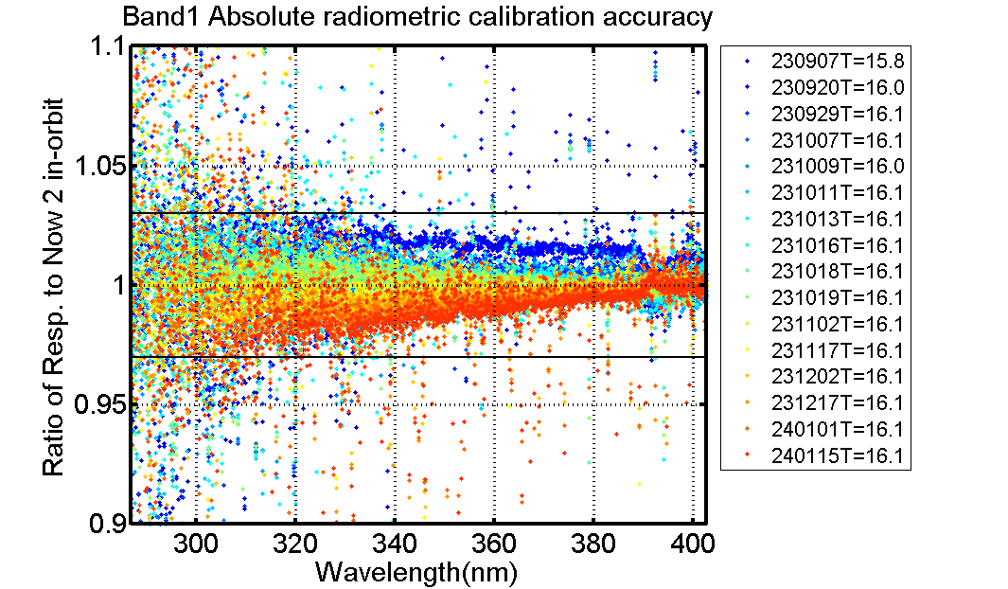
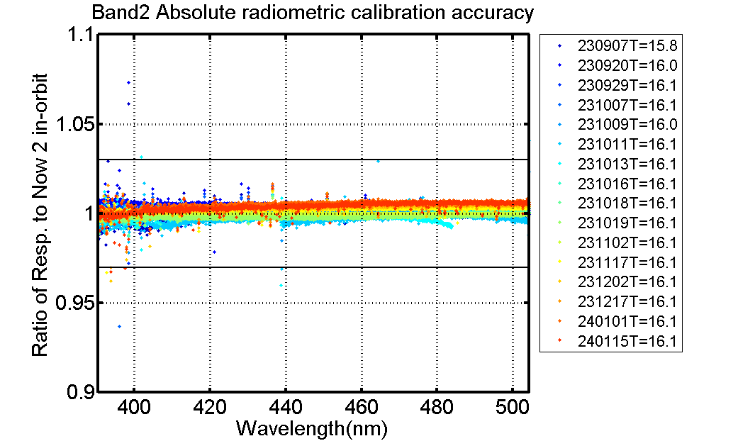
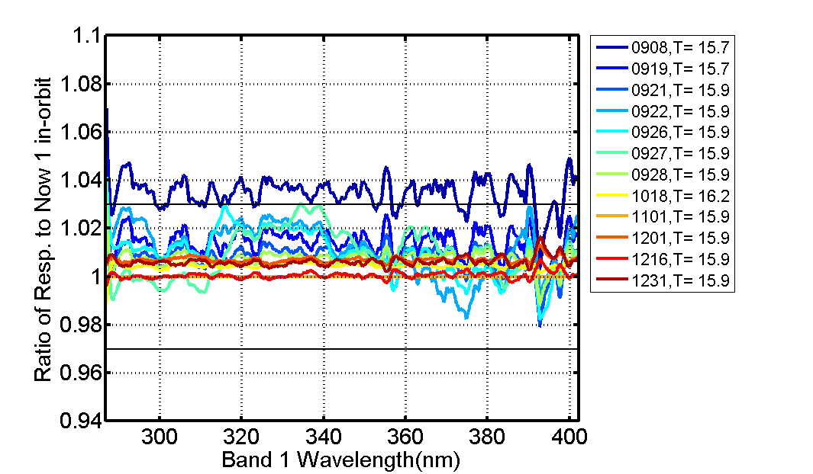
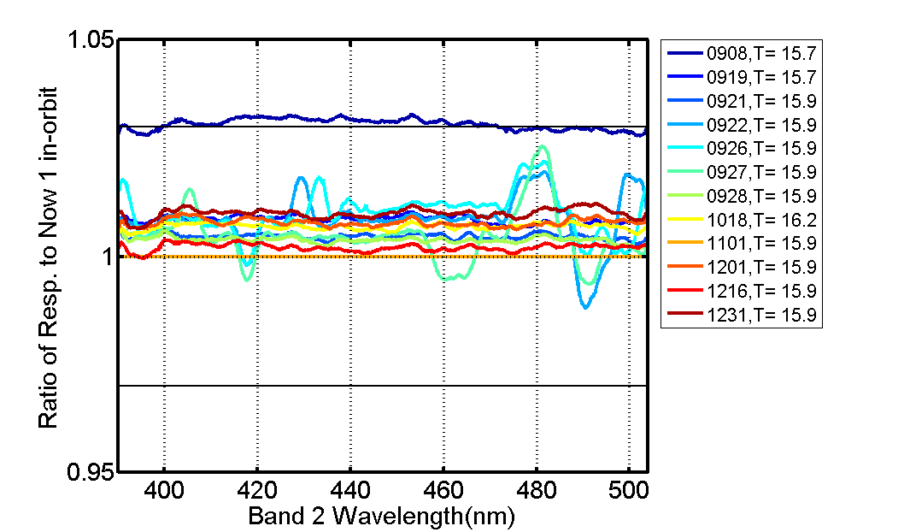
On orbit variation of OMS-L radiation responsivity
The difference between the observed data and the reference value is less than 3%.
Using the solar calibration results on November 1st as a reference, compare the instrument response time variation based on tungsten lamp and solar observation data.
  The observation data before the 320nm of tungsten lamps were noisy due to weak signals;
  The significant deviation in the first solar observation was caused by the reference board pitch angle approaching its maximum value, and the BRDF correction error being too large.
Band1
Band2
The difference between the tungsten data and the reference value Band1
Band1
Band2
The difference between the Solar data and the reference value Band1

Slide 15
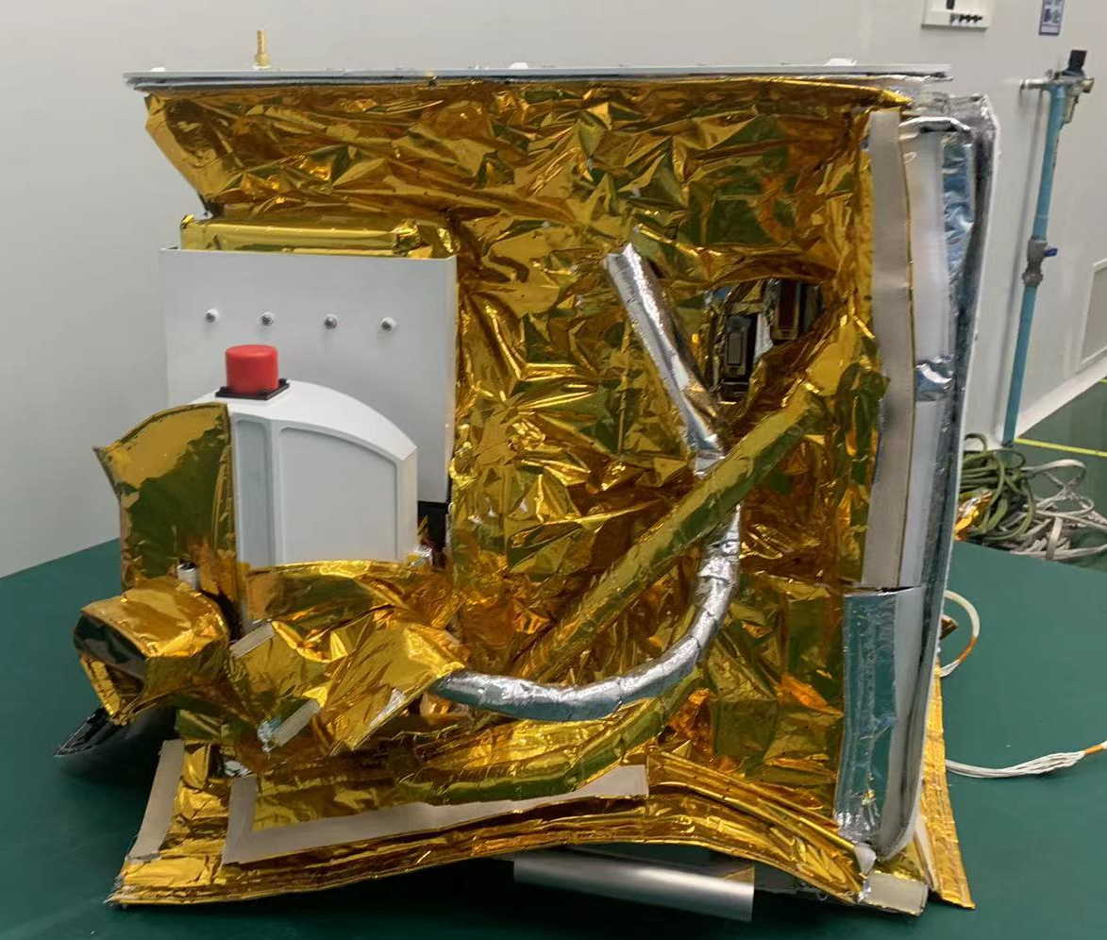
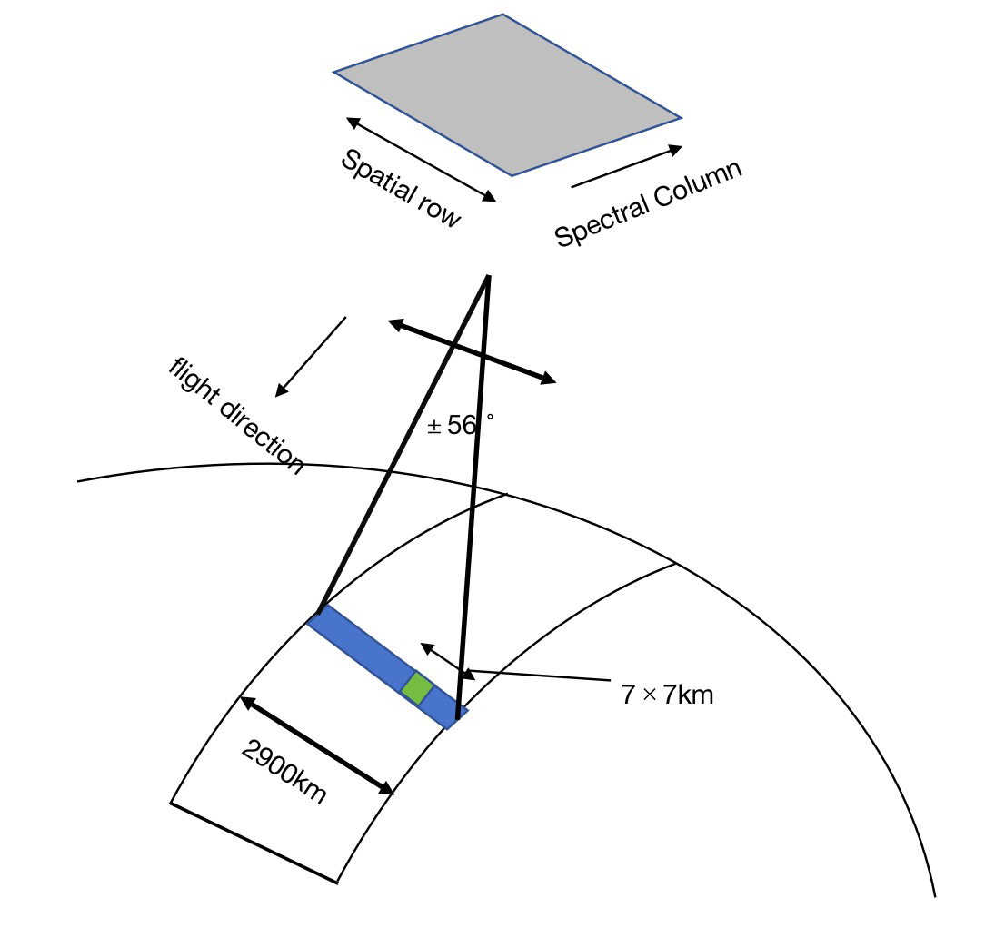
FY-3F/OMS-N
Configuration
  Push-broom 112 deg
  No scanning mirrors cross track
  Two grating spectrometers
    UV covers 250 nm to 320 nm
    VIS covers 310nm to 493 nm
  CCD optical detector for each grating spectrometer
Ozone Monitoring Suite -Nadir (OMS-N)
Mission | Trace gases measurements
Band | UV1 250-300nm UV2 300-320nm VIS 310-493nm
SPC Res. | ~0.4~0.56 nm at UV ~0.45~0.5 nm at VIS
Swath | 2900km(daily global coverage)
Spatial Res. at Nadir | 21 (A.T. ) ×28(C.T.) at UV1 7 (A.T.) × 7(C.T.) at UV2&VIS
Local Time | Descending node of 10:00 a.m.
Height | 836km
The OMS-nadir Instrument and Observation schematic view

Slide 16
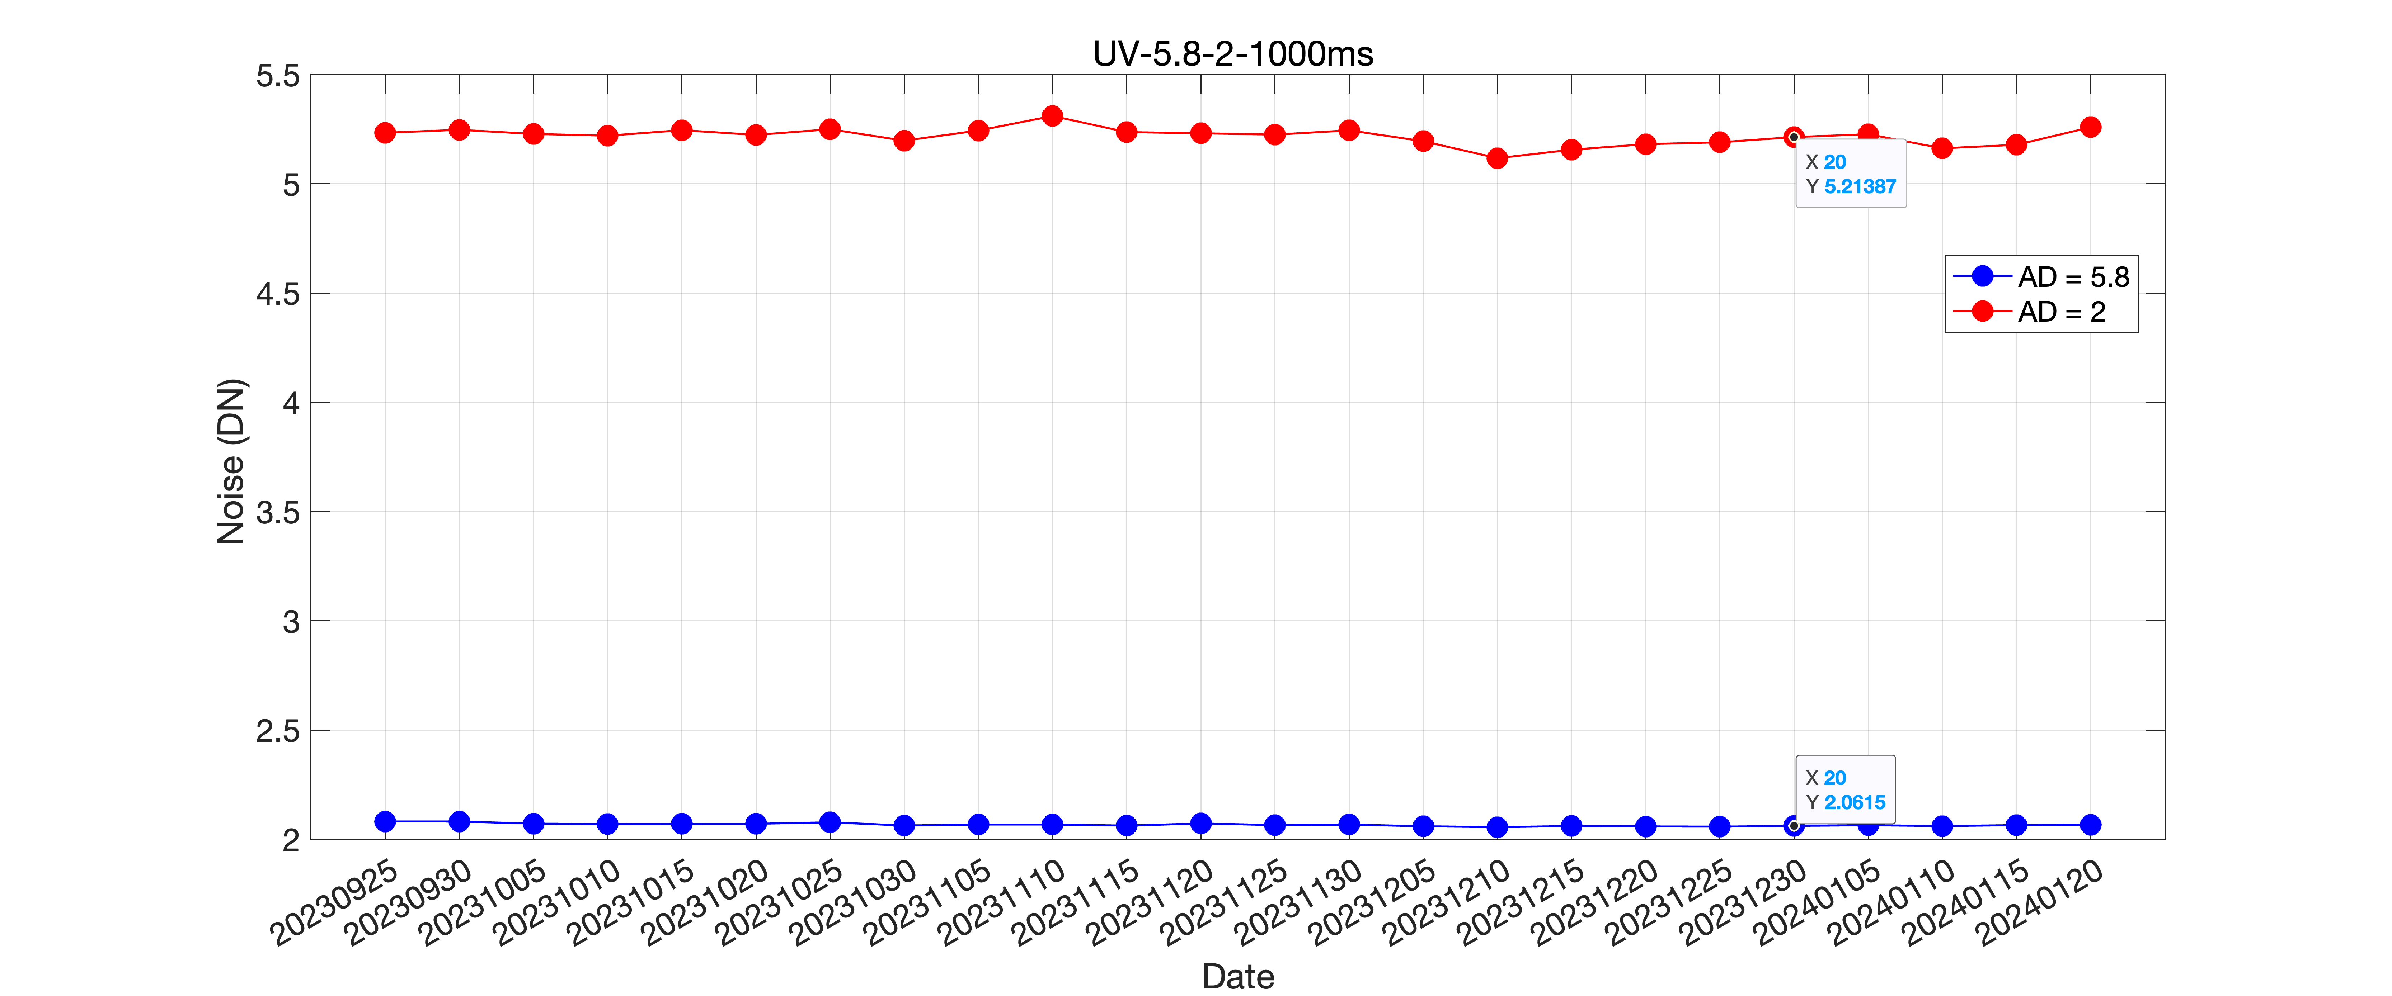
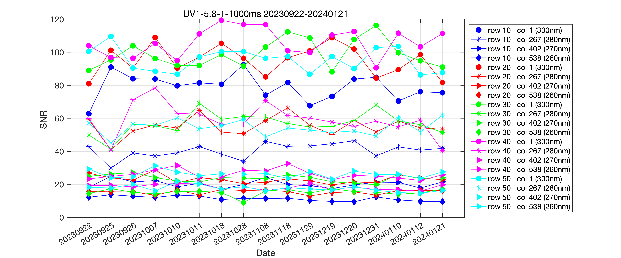
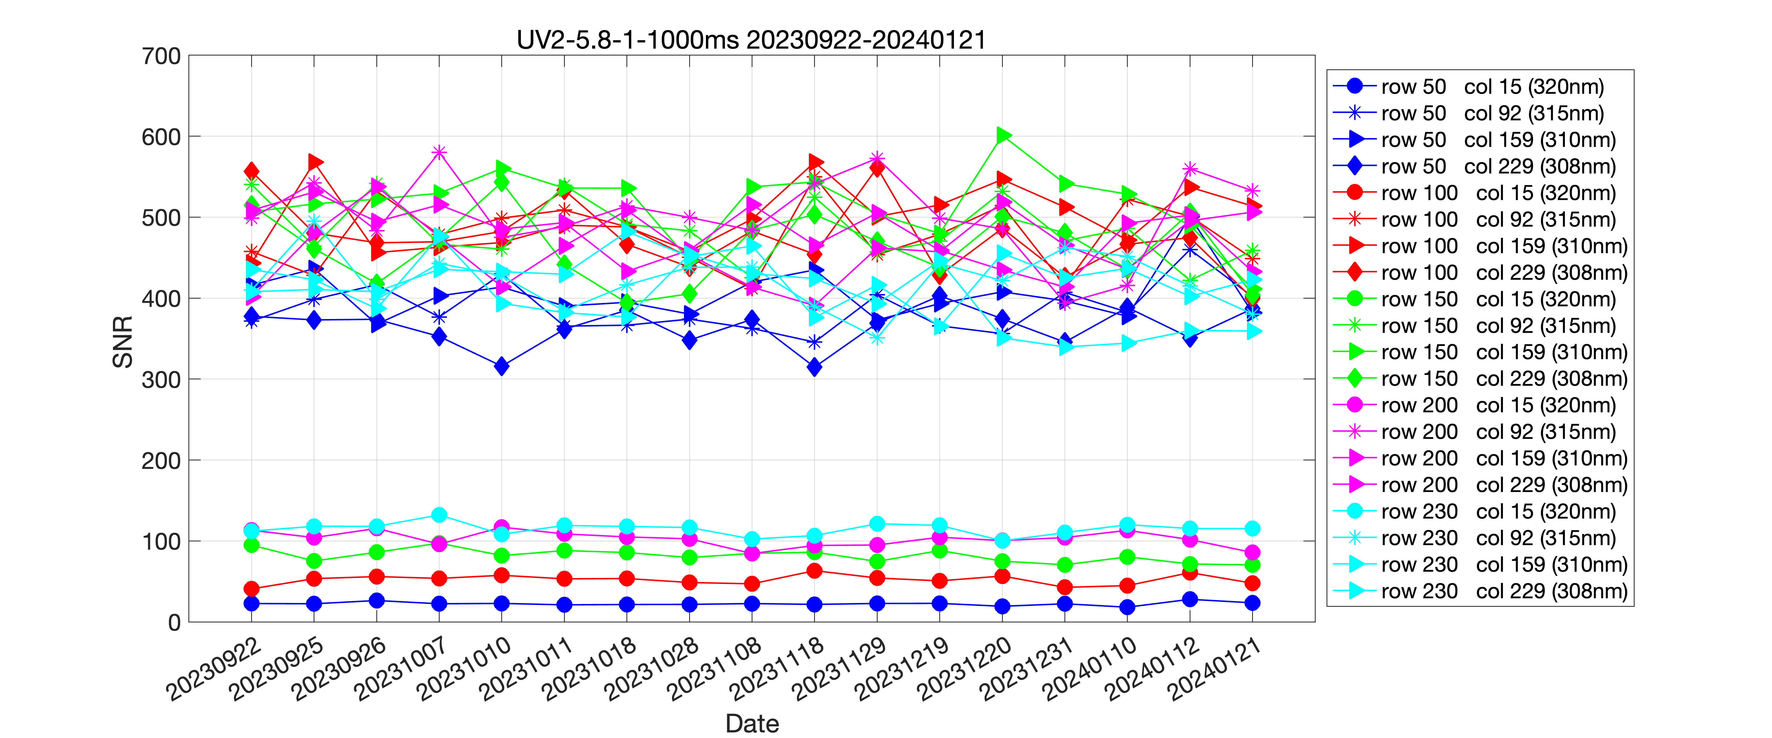
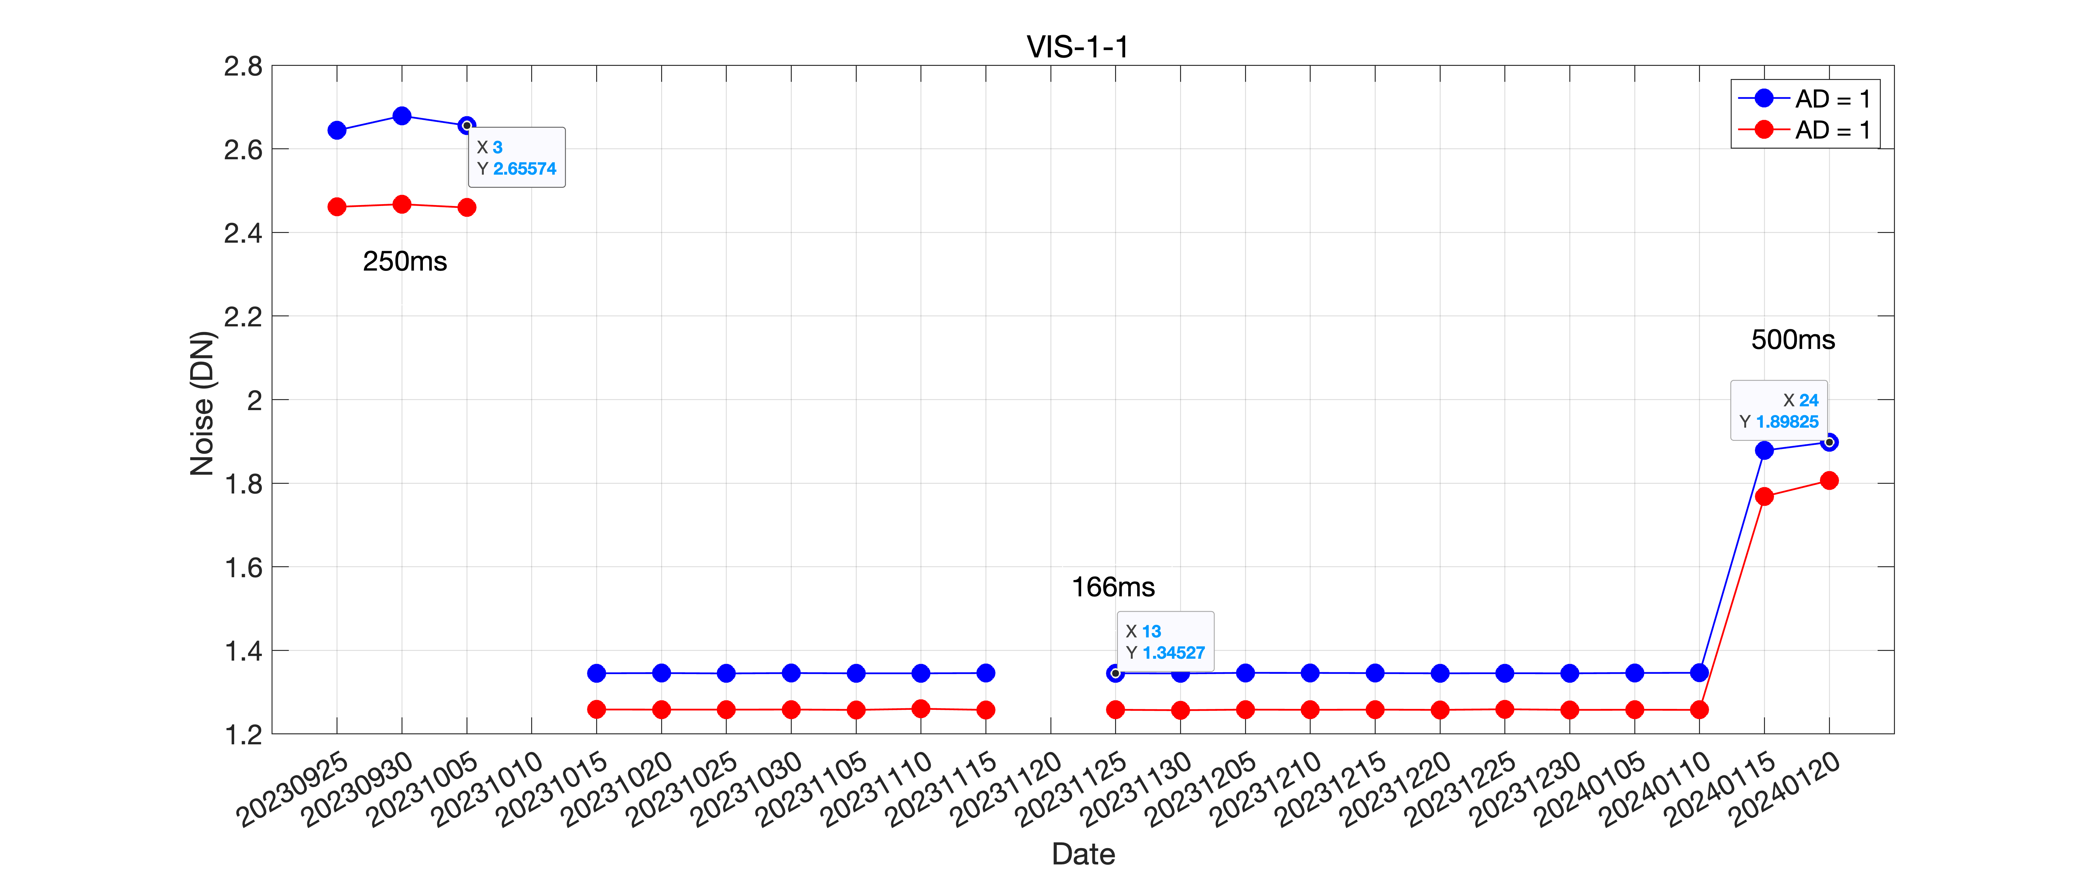
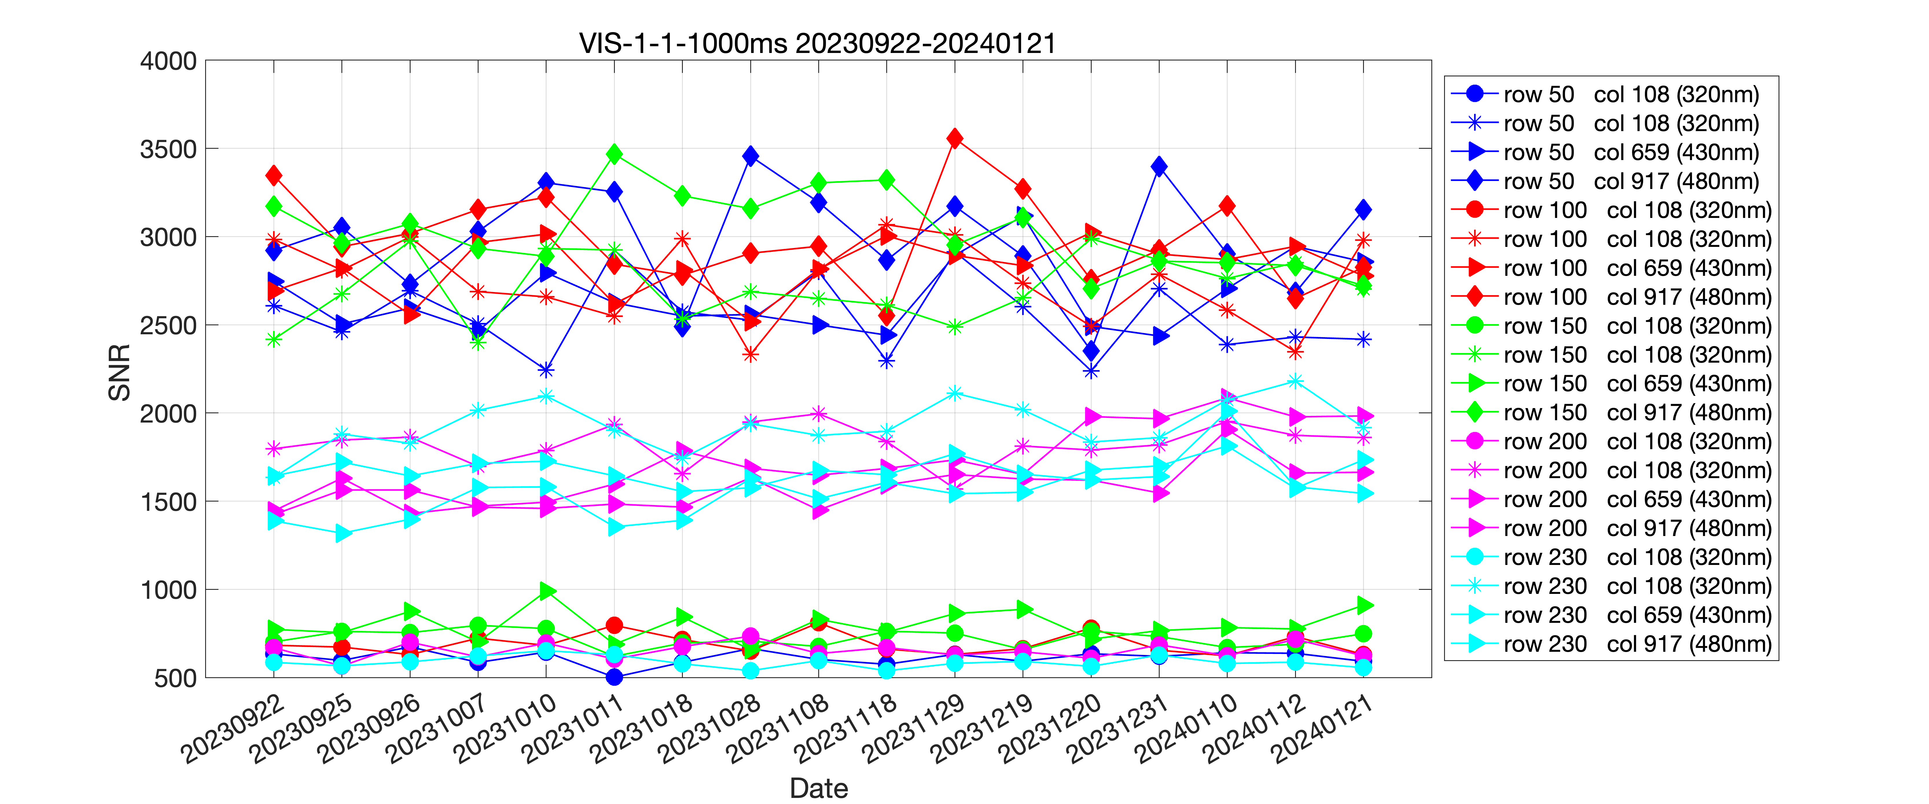
Preliminary performance —stability (20230925-20240121)
Dark noise time-series tendency
SNR time-series tendency
UV1
UV
UV2
VIS
Since 25 Sep. 2023, there is no obvious time trend in SNR and dark noise,indicating OMS-N is in stable.
VIS

Slide 17
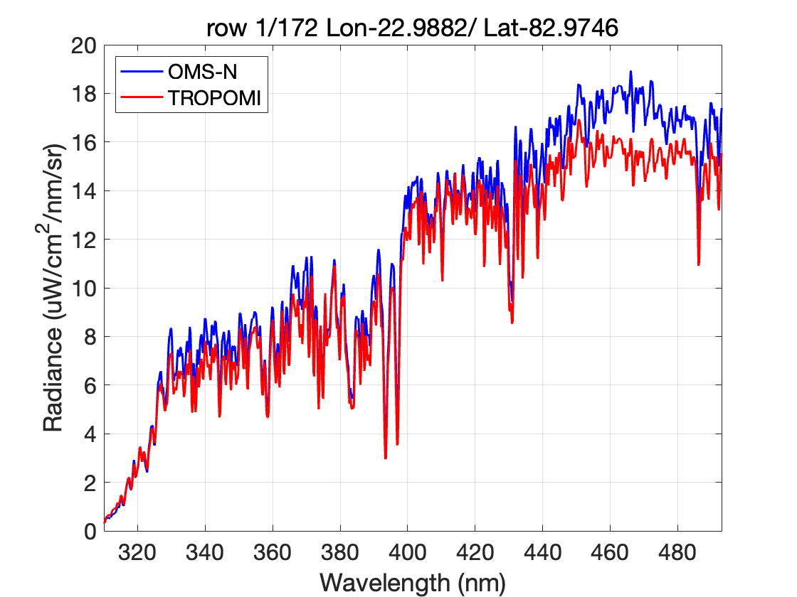
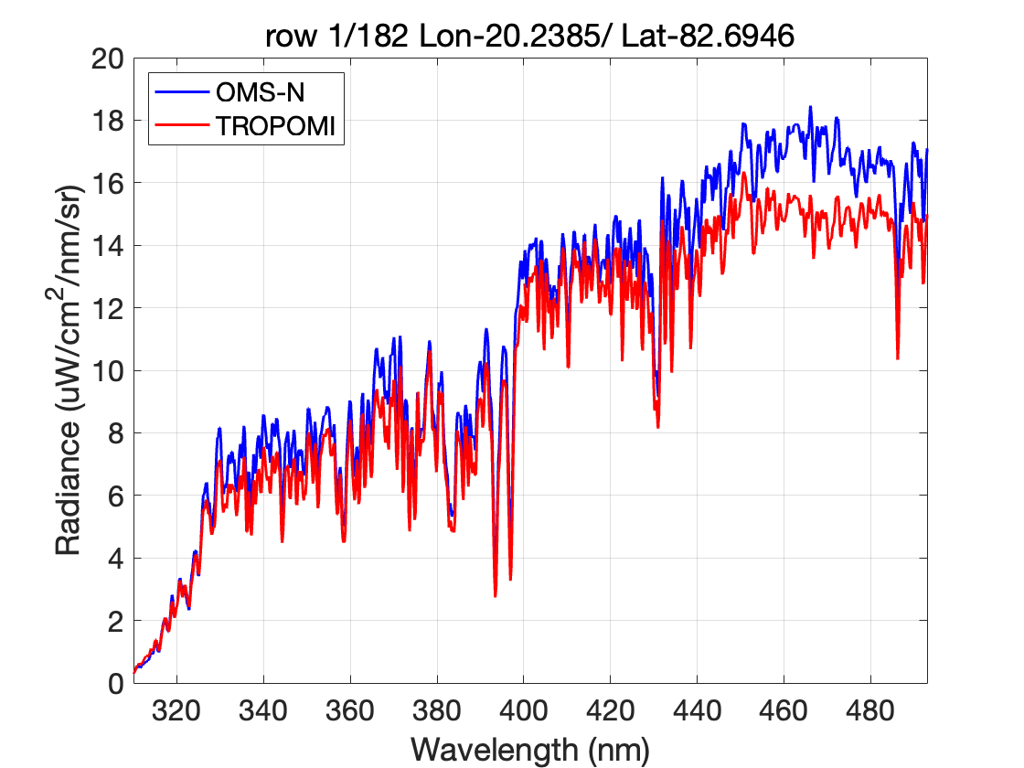
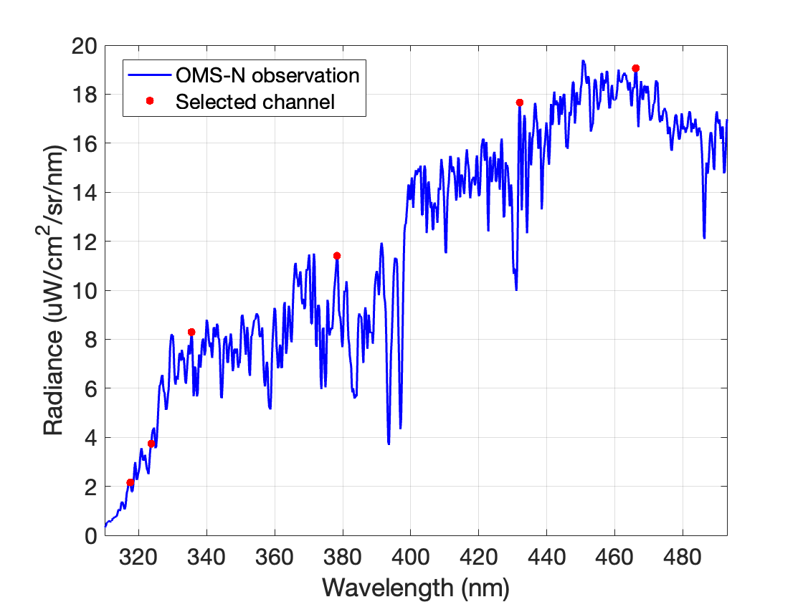
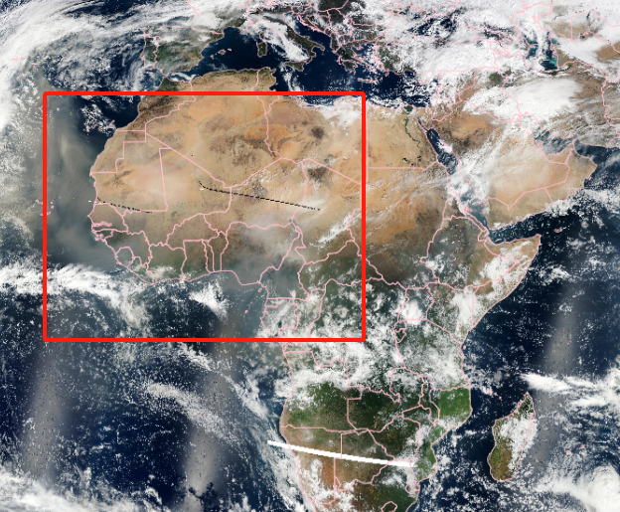
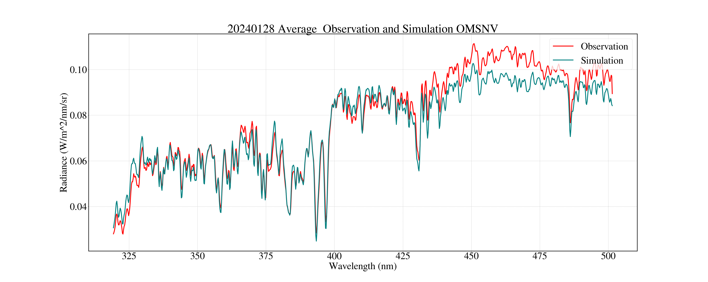
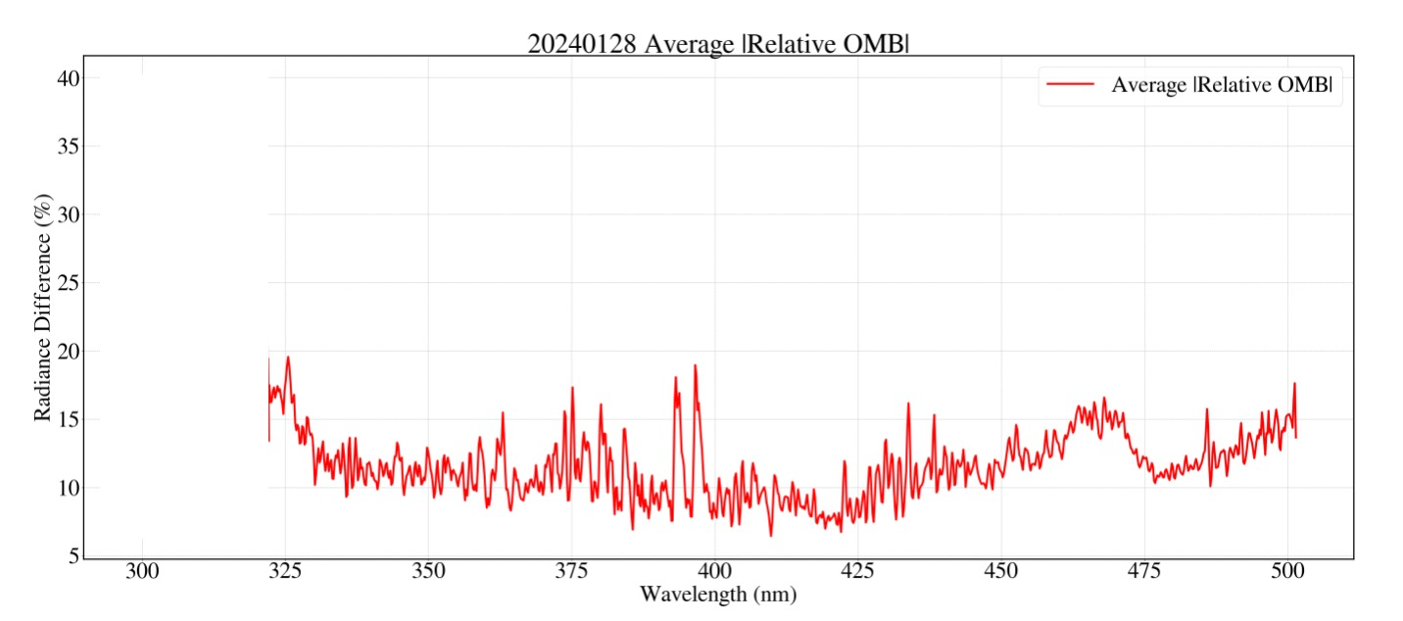
OMS-N L1 radiance product comparison
OMS-N vs. TROPOMI （Antarctica 20240211）
OMS-N earth radiance is higher at most of the VIS band, especially at longwave side and bright targets.
Correction development for improvement in radiance is still work in progress.
OMS-N vs. RTM （Sahara desert 20240128）
Sample size 220

Slide 18
Instruments Updates & Planned launches that are relevant to GSICS
Current FY satellite and instruments status on orbit
Satellite |  | Launch | EO instruments
FY-3D | (Op) | 2017-11-15 | MERSI | HIRAS | MWTS | MWHS | MWRI | IPM
 |  |  | GAS | WAI | SEM | GNOS
FY-3E | (Op) | 2021-07-05 | MERSI-LL | HIRAS-II | SIM-II | SSIM | MWTS-III | MWHS-II
 |  |  | WindRAD | GNOS-II | Tri-IPM | SEM-II | X-EUVI
FY-3G | (Pre) | 2023-04-16 | MERSI-RM | MWRI-RM | PMR | GNOS-II
FY-3F | (Test) | 2023.08.03 | MERSI-III | HIRAS-II | SIM-II | ERM-II | MWTS-III | MWHS-II
 |  |  | MWRI-II | GNOS-II | OMS-N | OMS-L
Satellite Status
Op = Operational
Pre = Pre-operational
B = Back-up, secondary
L = Limited availability
Instrument Status
 | Operational(or capable of)
 | Operational with limitations(or Standby)
 | Operational with Degraded Performance
 | Not Operational
 | Functional, Turned Off
Satellite (status) |  | Location | Launch | EO instruments
FY-2G | (Op) | 99.2° E | 2014-12-31 | S-VISSR
FY-2H | (Op) | 79° E | 2018-06-05 | S-VISSR
FY-4A | (B) | 86.5° E | 2016-12-11 | AGRI | GIIRS | LMI | SEP
FY-4B | (Op) | 105° E | 2021-06-03 | AGRI | GIIRS | GHI
http://www.nsmc.org.cn/nsmc/en/operation/status.html

Slide 19
Instruments Updates & Planned launches that are relevant to GSICS
2023 launches:
FY-3G Rainfall & FY-3F AM mission launched on Apr and Aug 2023 respectively.
Future Plan:
FY-3H PM plan to be launched in 2025.
FY-4C plan to be launched in 2025.
Satellite status updates:
FY-3C maintained degraded performance status.
According to the service adjustment scheme, FY-4B carried out operational service at 105°E, FY-4A drifted to 86.5°E and suspended service from 5 Mar, 2024.
.

Slide 20
Calibration Major Updates
FY-3D
FY-4B
 | Date | Updates
1 | 2023.02.12 | GNOS-R added Galileo channel
2 | 2023.03.25 | FY-3D/HIRAS decontamination
3 | 2023.03.14 | MERSI reflective band calibration update
 | Date | Updates
1 | 2023.04.12 | The on-orbit data processing software of data transmisstion Ch X on GIIRS was updated, data of Ch X and Ch Ka were the same after the update
2 | 2023.05.23 | The cold space stray light avoidance mode of GIIRS is adjusted, and the radiance bias diurnal variation reduced
3 | 2023.08.03 | GIIRS L1B data implemented compression storage
4 | 2023.05.22 | The calibration coefficients of AGRI reflective bands are updated, accuracy of reflective bands less than 5%
FY-3E
 | Date | Updates
1 | 2023.03.07 | MERSI-LL add infrared channel detector normalization correction
2 | 2023.05.04 | WindRAD calibration software update
4 | 2023.12.04 | X-EUVI self-cleaning maintenance

Slide 21
Personnel Supporting GSICS
EP
Xiuqing (Scott) Hu
GRWG
MW: Shengli Wu(Co-chair), Yang Guo, Juyang Hu, Jian Shang
IR: Chengli Qi , Hanlie Xu, Xingwei He
VIS/NIR: Ling Wang
UVN: Yuan Li
Space Weather: Cong Huang
GDWG
Lin Tian
POC for Operational Matters
Chengli Qi

Slide 22
Thank you for your attention
CMA/NSMC Calibration portal
http://gsics.nsmc.org.cn/portal/en/fycv/index.html

Slide 23
Additional Slides Not Presented
Agency’s GSICS related research activities.
  Present the technical details in the break-out sessions
Agency’s Reprocessing Activities, if any
Introduce/Confirm the Agency’s Personnel Supporting GSICS
  Focal Points of EP members and GCC PoCs
  GRWG members/GDWG members/GPRC PoCs
  Other Key Agency Personal
Agency’s GSICS activities to be discussed in this joint meeting
  Agenda items that are especially of interest to your agency
  Agency’s activities that may be of interest to the GSICS community

