Slide 1
GSICS Agency Report 2024
Mounir Lekouara and EUMETSAT team (see last slide)
EUMETSAT

Slide 2
EUMETSAT operational GSICS products
Near-Real Time and Re-Analysis Correction products for SEVIRI Meteosat-9, -10 and -11 (MSG-2, -3, -4) , based on GEO-LEO IR inter-calibration with Metop-C/IASI (in addition to those already generated with Metop-B/IASI) - now officially operational GSICS products
11 OPERATIONAL PRODUCTS + 2 retired

Slide 3
Support to GRWG Activities (i)
Led or contributed to discussions at Web Meetings on:
Lunar Calibration R&D and workshop preparation
VNIR DCC (product definition + ATBD evolutions + applications to LEOs)
IR: hot-land issue + uncertainty analysis

Slide 4
Support to GRWG Activities (ii)
Ongoing Developments:
MTG-I FCI and LI are now routinely monitored
VNIR:
Organisation of the 4th Joint GSICS/IVOS Lunar Calibration WS (4-8/12/2023)
Involved in the discussions on LSICS framework + SLIM model as a new lunar calibration community model
Enhancement of the LESSSR model (lunar model based on SCIAMACHY + RELAB) via external study (on-going)
DCCs, using NOAA-20 VIIRS as a reference
Desert Calibration + Inter-Calibration : two new algorithms for MICMICS
IR:
Development of improved IR inter-calibration algorithm ​
MICMICS now facilitates IR inter-calibration, leveraging references from both IASI and CrIS
EUMETSAT-ECMWF collaboration in preparing for MTG-IRS in NWP using GIIRS (-A/-B) observations
MW:
Supported development of work plan for Microwave Sub-Group​
UV:
Extraction + processing of all GOME-2 lunar measurements to support inter-calibration between SCIAMACHY and GOME-2 using the Moon as a transfer target
Ongoing development and integration of radiometric calibration systems for UVN, UVNS & CO2-I in MICMICS
See 1k
See 3b
See 3s
See 1f
See 3u
See 5m/n/p
See 5f
See 8i

Slide 5
Support to GDWG Activities
Introduction to WMO WIS 2.0 System​
Supported revision of GSICS SOS Reports​
See 2d

Slide 6
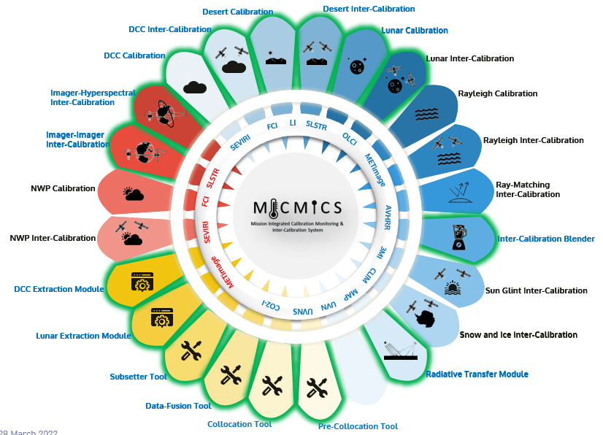
EUMETSAT Other GSICS Activities
MICMICS
Prototype Development & procurement of Operational System
To replace current GSICS processors
New capabilities:
Improved GEO-LEO IR algorithm
Switch to NOAA-20 VIIRS in the GSICS DCC algorithm as new GSICS reference + implementation of a DCC calibration (reference = RTM)
On-going development of new GSICS DCC products for VNIR (LEO/LEO)
New Desert Calibration
New Desert Inter-Calibration
Process more instruments/channels: SEVIRI, FCI, LI, AVHRR, SLSTR, OLCI, …
The tool has reached a critical mass of methods and sensors to support new accurate diagnostics

Slide 7
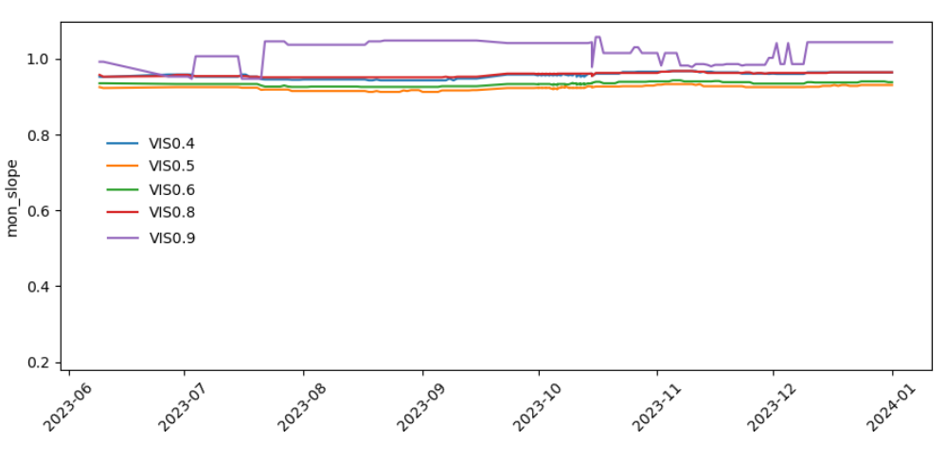
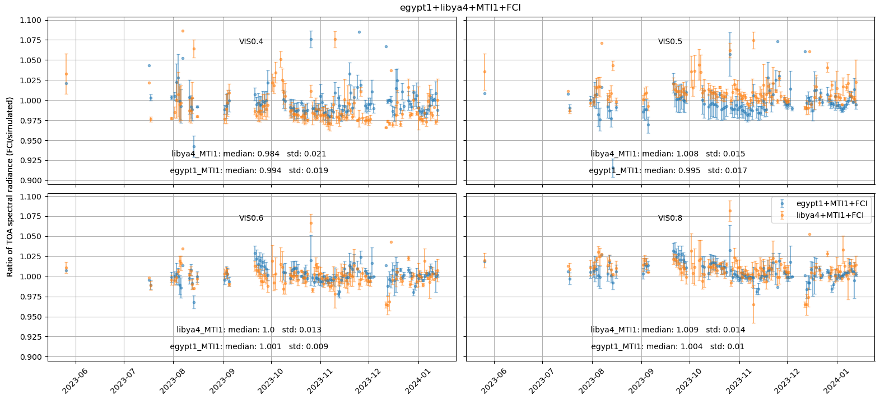
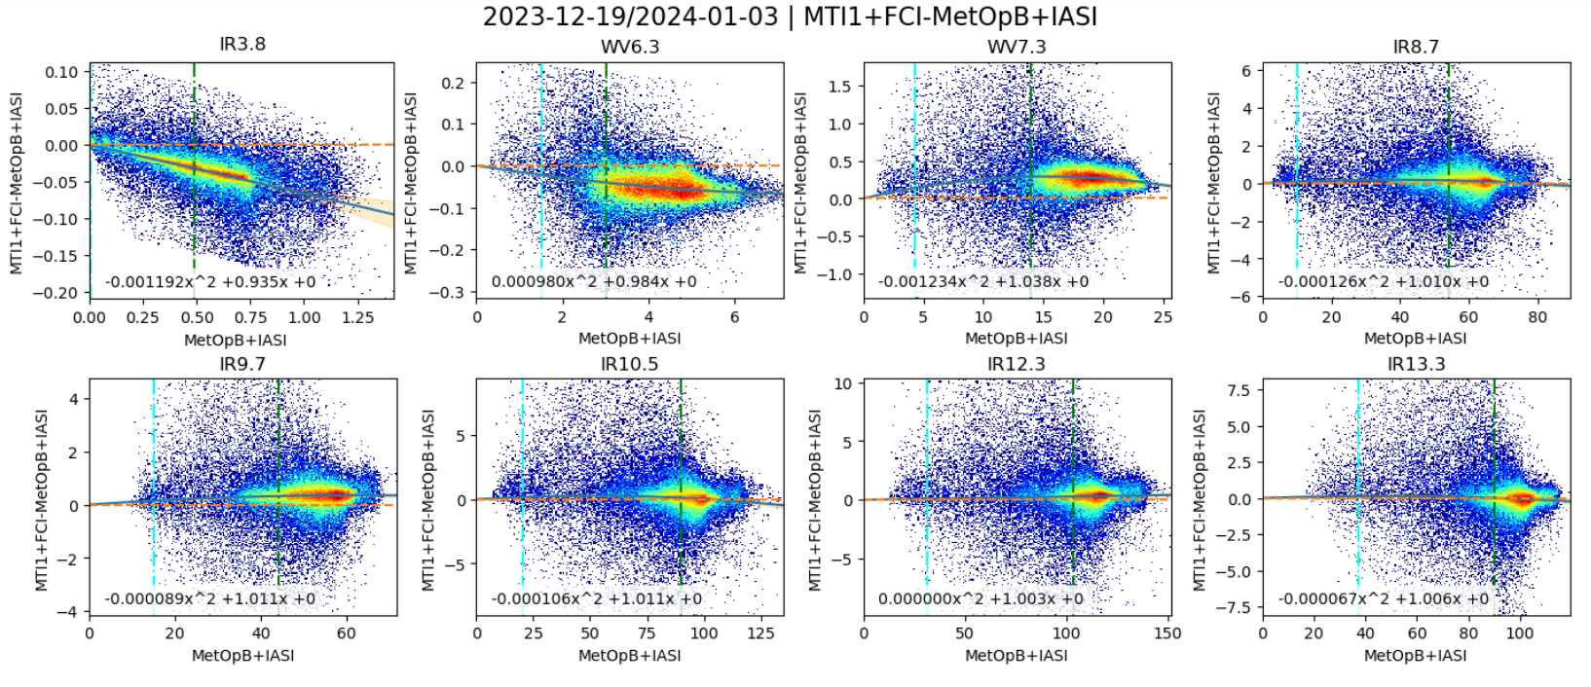
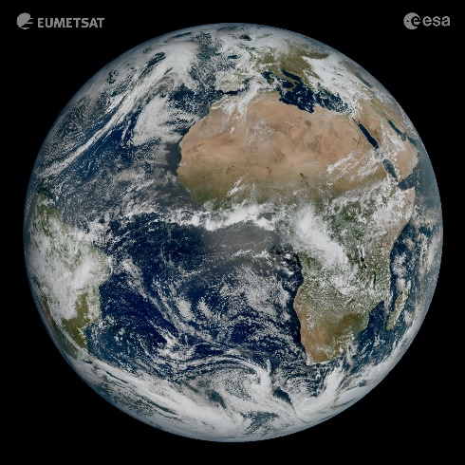
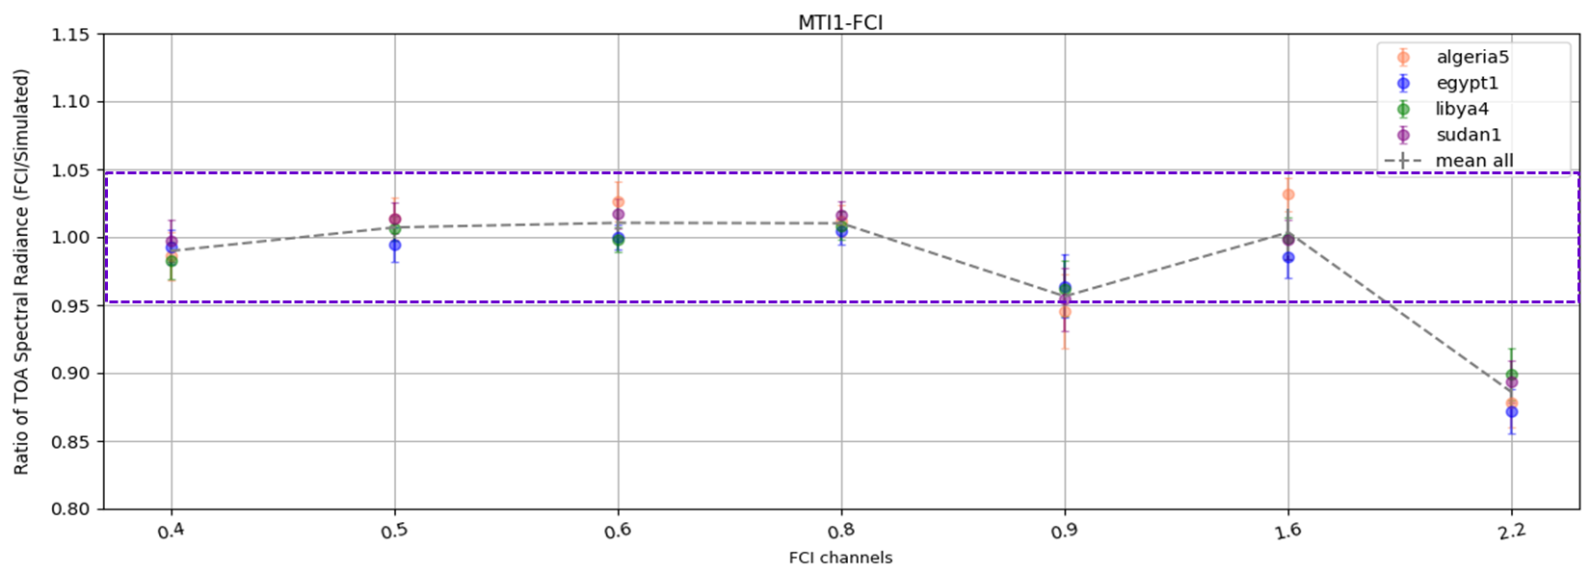
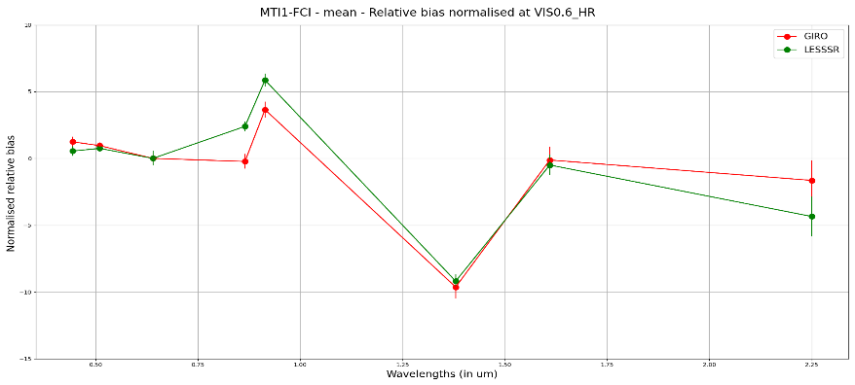
MICMICS analyses for MTG-I FCI
Preliminary analyses on not fully calibrated Level-1c products
DCCICS
VNIR Drift monitoring
DESCS
IHIC
DESCS
Monitoring IR channels
VNIR absolute calibration and Drift monitoring
DESICS
VNIR Drift monitoring
LCS
VNIR Drift monitoring

Slide 8
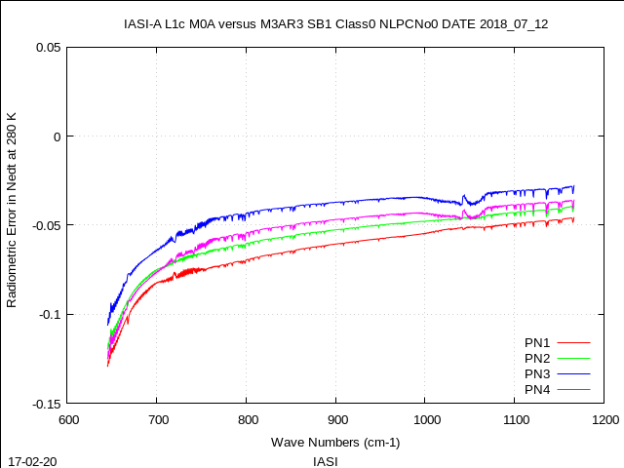
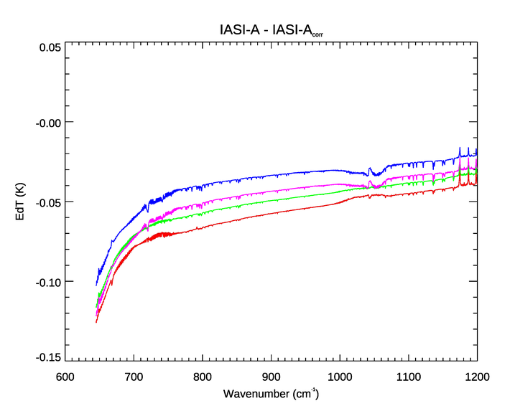
New IASI L1c products ➔ Correction of the non-linearity
Motivation:
The on-board non-linearity (NL) correction has been improved for both IASI-A (in 2019) and IASI-B (in 2017) → But no reprocessing possible;
EUMETSAT has developed a NL post-processing to be applied on the IASI L1c products → To restore the time consistency of the IASI radiance archive in the CO₂ band at 15 mm, as well as the consistency between the instruments.
Residual NL error computed from the raw interferograms
Difference IASI-A vs IASI-A_{reprocessed} averaged over Jun-Sep. 2019

Slide 9
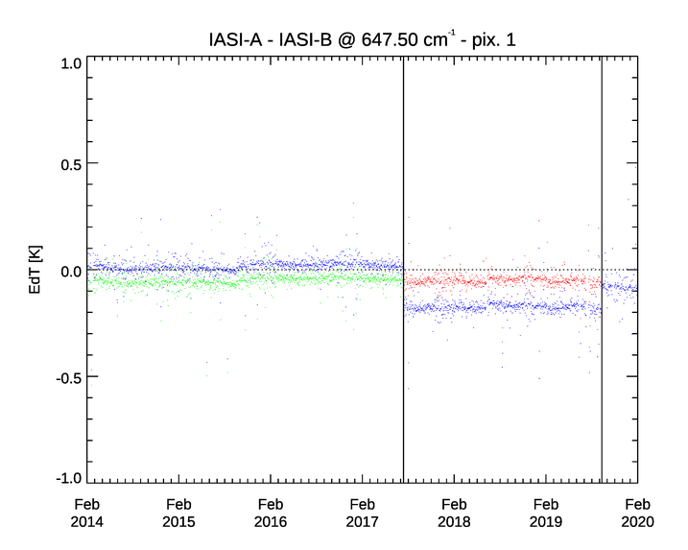
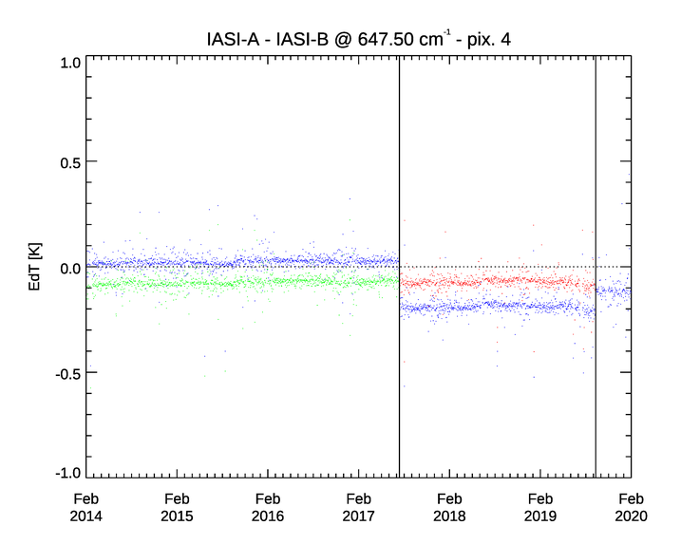
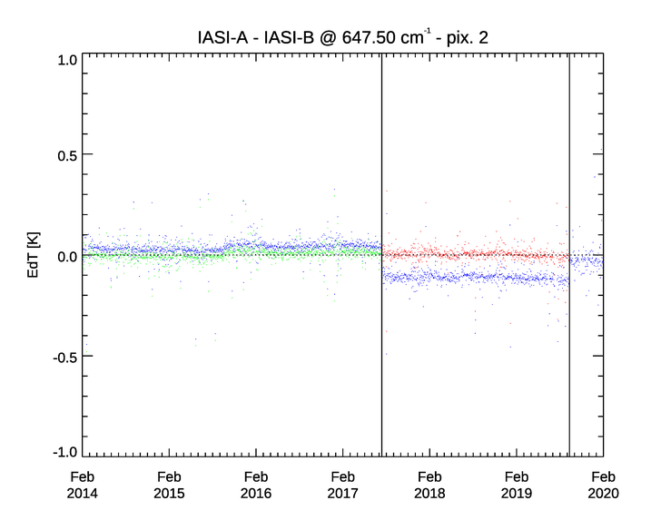
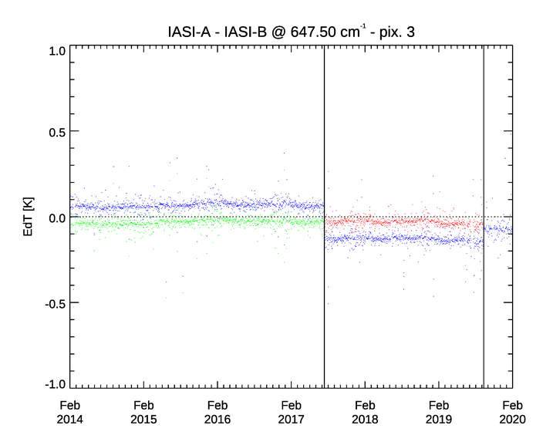
New IASI-A/-B L1c products - Q2/2024
Original
(IASI-A – IASI-B)
(IASIA_{repro} – IASIB) between 2017 and 2019
(IASIA_{repro} – IASIB_{repro})
Before 2017
IASI-B
NL on-board update
IASI-A
NL on-board update
IASI-B
NL on-board update
IASI-A
NL on-board update

Slide 10
Update on GSICS Actions on EUMETSAT
A.LCWS.2023.2i.3: EUMETSAT & NOAA to continue to develop spec & circulate, then iterate with group. Seb Wagner needs to check with EUMETSAT. (Actionee: S. Wagner – F. Yu / by 2024-03) – to be closed
A.LCWS.2023.5a.2: Propose way forward with GSICS Lunar Observation Dataset (GLOD) (Actionee: S. Wagner by 2024-03) ➔ related to data sharing + infrastructure (discussion still open)
A.GEP.20230630.9: Transfer GSICS report on the State of the Observing System in document format and set working environment for that (Actionee: T. Hewison – M. Bali / no date) - ongoing
A.GIR.20230301.7: EUMETSAT to revise uncertainty analysis for GEO-LEO IR v2 algorithm (Actionee: T. Hewison / by 2024-03) – open – but delayed due to FCI
A.GMW.20230302.3: Brief MWSG on experience in developing GSICS products for IR channels of GEO imagers – and uncertainty analysis (Actionees: T. Hewison / by 2024-03) – open
A.GVNIR.2020.16f.1: re-align GIRO and ROLO (Actionees: S. Wagner – T. Stone / 2021.03.01 - late)
A.GVNIR.2020.16f.4: distribution list for the Lunar Cal Community - On-going
A.GVNIR.2020.19g.2: LCWS actions/recom follow-on – Closed - in preparation of LCWS

Slide 11
Update on old GSICS Actions involving EUMETSAT
A.GDWG.2022031.8 GDWG to contact GRWG/Tim Hewison to get information on Combined products
A.GRWG.20201020.4 GRWG to provide inputs to GDWG as to what convention changes needed for new/revised products
Closed
R.GIR.20210113.4 Tim Hewison is recommended to lead the study in the IR sub group to optimize the current GSICS inter-calibration algorithms for very cold scenes.
Closed - covered in GEO-LEO IR v2 algorithm
A.GWG.2020.1a.2 All agencies to compile reports on calibration of instruments monitored by GSICS, following the template - to include IASI double-differences. Reports due by the end of April. A web meeting will be organized and held in early May to review the submitted reports. Assigned to all agencies.
Closed – now part of SOS
A.GIR.20181114.3 Manik Bali and Tim Hewison to draft a section of the IRRefUTable Report on the process of selecting a reference instrument.
Abandoned
A.GRWG.2016.2d.1 Tim & Dohyeong to review outstanding actions on Tim Hewison and decide which to transfer to GRWG Chair.
Closed

Slide 12
Reprocessing activities
HIRS FDR Release 2 have been generated and delivered to C3S2 for assimilating into ERA6 for three generations of instruments covering 1978 – 2022 using of Cao et al., 2007 calibration algorithm (available from ops@eumetsat.int);
MVIRI FCDR Release 2 has been released covering 1981 – 2017 – new image reprocessing, inclusion of anomaly images, and better recalibration using HIRS FDR (available from 10.15770/EUM_SEC_CLM_0057);
SEVIRI Rapid Scan Service FCDR Release 1 have generated for Meteosat-8 to -10 covering 2008 – 2022 (available from ops@eumetsat.int)
Special sensor microwave temperature sounder (SSM/T) FDR Release 1 have been generated and delivered to C3S2 for assimilating into ERA6 for satellites F-10 to F-15 covering 1991 – 2004 (available from ops@eumetsat.int);

Slide 13
EUMETSAT instruments status
MTG-I and MTG-S
EPS-SG A and B
CO2M
The development phase is on-going and the EUM scientific teams are in place to follow-up instrument development and on-ground calibrations
The Cal/Val plan will be significantly updated by EUMETSAT for the CDR in first half of 2024 and dedicated Cal/Val infrastructure for GHG is in prep.
The instrument and calibration experts will engage in the existing GSICS sub-groups UVN spectrometer (CO2I) and VIS-NIR (MAP and CLIM) to support the definition and assessment of the inter-calibration strategies
As a multi-instrument system, a strong inter-instrument calibration is foreseen to ensure an excellent relative calibration of the CO2M system
See 1d
See 1e
See 7d

Slide 14
EUMETSAT instruments update: many new sensors to calibrate
mission | launch | instruments | GSICS sub-groups
MTG-I1 | 2022 | FCI | VIS-NIR and IR
 |  | LI | VIS-NIR
MTG-S1 | 2025 | IRS | IR
 |  | UVN | UVN spectrometers
EPS-SG A1 | 2025 | METimage | VIS-NIR and IR
 |  | 3MI | VIS-NIR
 |  | IASI-NG | IR
 |  | UVNS | UVN spectrometers
 |  | MWS | MW
EPS-SG B1 | 2026 | MWI | MW
 |  | ICI | MW
CO2M | 2026 | CO2I | UVN spectrometers
 |  | MAP | VIS-NIR
 |  | CLIM | VIS-NIR

Slide 15
EUMETSAT GSICS team
Executive Panel
Bojan Bojkov | EUMETSAT representative
Data Working Group
Simon Elliott | Formats Expert
Research Working Group
Mounir Lekouara | incoming vice-chair of GRWG
Tim Hewison | Vice-chair IR sub-group + MW Sub-Group PoC
Sébastien Wagner | VIS/NIR + Lunar calibration PoC
Rob Roebeling | Event logging
Rasmus Lindstrot | UVN spectrometers expert
Dorothée Coppens | Hyperspectral IR expert
Christophe Accadia Vinia Mattioli | Microwave experts
Rüdiger Lang | UVN spectrometers and VIS-NIR for CO2M
Viju John | FCDR, IR, MW
Ali Mousivand | MICMICS + Radiative Transfer Modelling + Desert Calibration
Bertrand Fougnie | VIS/NIR polarimetry
Point of Contact for Operational Matters
Harald Rothfuss

